Slide 1
Why Not Bayes
John D. Norton
Department of History and Philosophy of Science
University of Pittsburgh
Based on
Ch. 10. Why Not Bayes
Ch. 11. Circularity in the Scoring Rule Vindication of Probabilities
in
The Material Theory of Induction

Slide 2
Overview

Slide 3
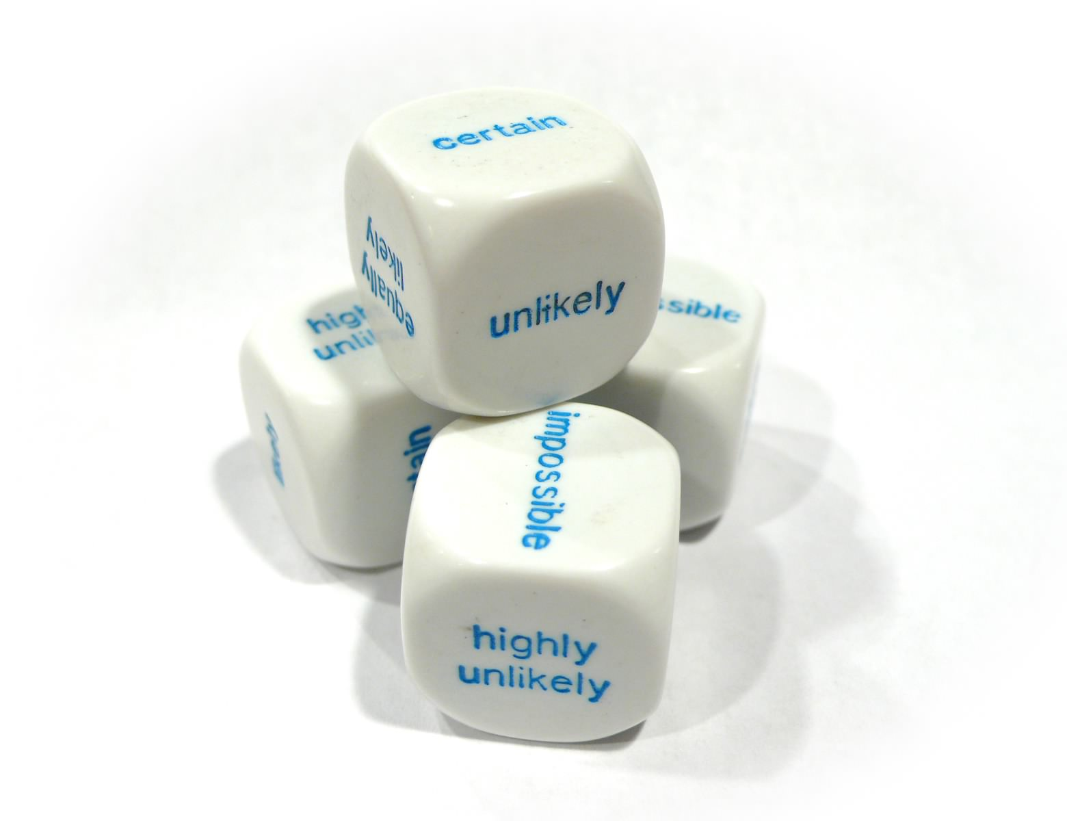
Target
It’s all probabilities.
Any form of objective inductive support or subjective uncertainty is probabilistic.

Slide 4
No universal logic of induction.
Any logic of induction must restrict what happens in ways that go beyond logical consistency.
Hence a logic of induction is applicable in some domain if the facts of that domain match the factual restrictions of the logic of induction.
Since there is no universally applicable factual restriction, in general, different domains require different inductive logics.

Slide 5
Circularity of Proofs
A proof of necessity of probabilities is a deductive argument whose premises must be at least as strong logically as the conclusion.
Therefore, the assumptions of the proof must already presuppose the necessity of probabilities or something logically stronger.
Hence by dominance we are better off simply presupposing the necessity of probabilities at the outset and forgoing the proof.

Slide 6
No Universal Logic of Induction

Slide 7
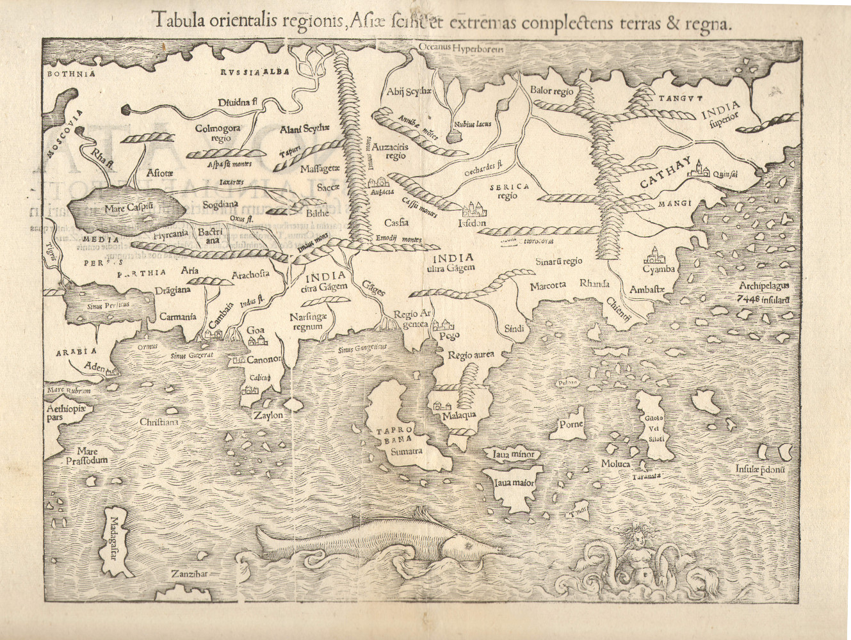
Something else here
Probabilistic inference here
Something else here
Something else here
Something else here
What determines which logic goes where?
Background facts.

Slide 8
Probabilistic inference here
Probabilities are not the automatic default.
Probabilists must show their applicability in each instance.
Where it applies, it can do a wonderful job.

Slide 9
The Argument

Slide 10
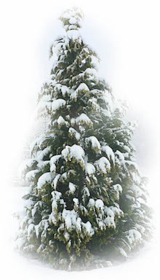


Induction
Winters past
have been snowy.
warrant outside the premises
Winters past
have been snowy.
AND
Winters future will be snowy.
FACT: our world is hospitable to this inductive inference.
Conclusion asserts
more than premises.
Hospitable:
World without climate change.
Inhospitable:
World with warming climate change.
vs
Cascade
of warrants
Whether a schema applies in some domain depends on the facts prevailing in the domain.

Slide 11

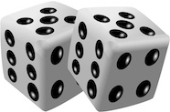
Probabilistic Success
Present climate and related terrestrial processes.
warrant outside the premises
P( )
warming climate
is high.
FACT: our world is hospitable to this inductive inference.
Conclusion asserts
more than premises.
Warranting facts in the detailed climate models.
Includes warrant for probabilities.
e.g. chaotic processes are pseudo-random.

Slide 12

Doomsday Argument
Creation
Time = 0
Now
Time = t
Doom
Time = T
Our t is equally likely in any unit time interval from 0 to T.
P(T₁ | t)
P(t | T₁) . P(T₁)
1/ T₁
=
=
P(T₂ | t)
P(t | T₂) . P(T₂)
1/ T₂
P(t | T) = 1/T
Doom soon
at T
Doom
later
at 10T
Prior indifference over T.
ten times more probable than
P(T₁) = P(T₂)

Slide 13
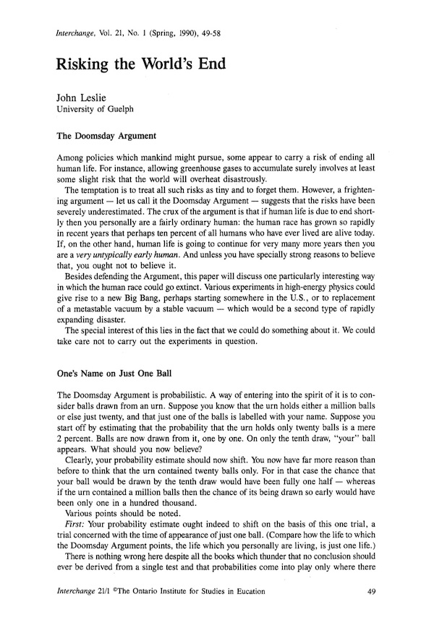
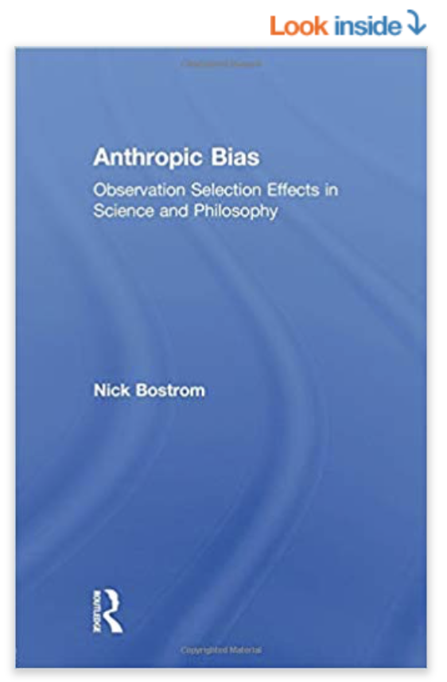
Probabilistic Failure
Our world has survived t years.
“Doomsday argument”
NO warrant outside the premises
P( )
greater for smaller T>t.
doom at time T
Failed warrant:
“Self-sampling assumption”
“One should reason as if one were a random sample from the set of all observers in one’s reference class.”
Nick Bostrom, Anthropic Bias. Routledge, 2002. p.57.
Conclusion asserts
more than premises.

Slide 14
If not probabilities, then what?
Invariances determine:
Completely neutral support.
Infinite lottery logic.

Slide 15
Completely Neutral Support

Slide 16
Cosmic parameter h over which we are completely ignorant (completely neutral support)
I
I
I
I
I
h
0
1
2
3
4
5
I. Invariance under redescription
(= principle of indifference reasoning)
Ignorance over h: equal intervals have equal support
=
Ignorance over h’ = f(h): equal intervals have equal support
=
II. Invariance under negation
e.g. A = “h lies in [0,1].”
Support for proposition A concerning h
Support for proposition not-A concerning h
I
Invariance under
h’ = f(h) = 1/h
II

Slide 17
Invariance under h’=1/h
I
I
I
I
I
h
0
1
2
3
4
5
Assume smaller interval cannot have greater support.
relabel h to 1/h
I
I
h
0
1
2
3
4
5
Additivity fails
support in
h in [1,2]
support in
h in [1,2] OR
h in [2, ∞]
=

Slide 18
Completely Neutral Support
[A|B] = support
A accrues from B
[ |B] = I
“indifference”
“ignorance”
any contingent proposition
I
I
I
I
I
h
0
1
2
3
4
5
I
I
I

Slide 19
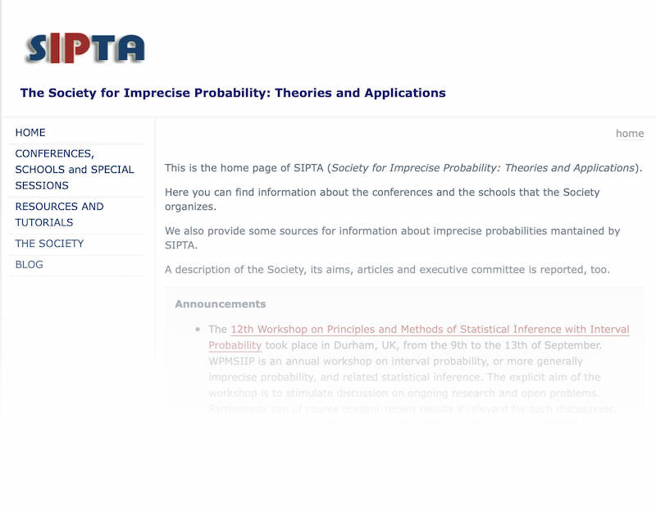


Imprecise
Probabilities?
Main argument applies.
Inferences using imprecise probabilities
Evidence
Results
Results assert more than the conclusion.
Requires an hospitable context.
Problem context calls for
A new logic
Simulate it within the old logic?
NO
Mistaken approach
Recognize the new logic?
YES

Slide 20
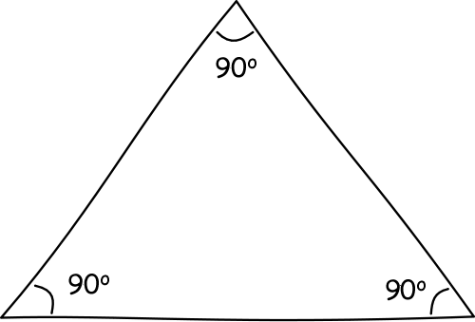
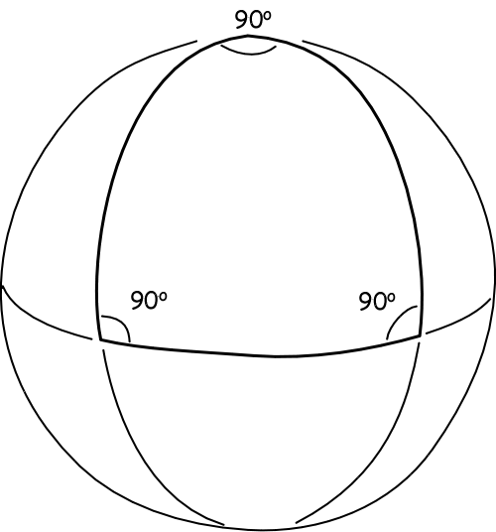
“Surface Logic” Analogy in Geometry
We can simulate virtually any non-Euclidean geometry …
…by embedding the surface in a higher dimensioned Euclidean space.
That does not make Euclidean geometry the One True geometry.

Slide 21
The Infinite Lottery

Slide 22
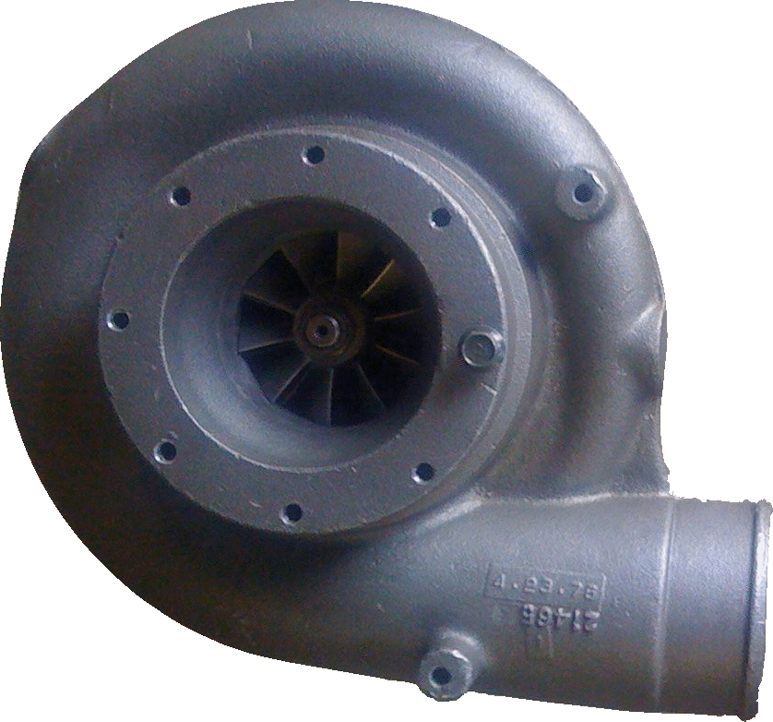
A fair lottery machine
27
Selection made among infinitely many balls 1, 2, 3, … without favor.
Chances of each ball or each set is invariant under relabeling of the balls.
=
1
3
2

Slide 23
Odd and even
1
2
3
4
5
6
7
8
9
…
2
1
4
3
6
5
8
7
9
…
Chance [Even] = Chance [Odd]

Slide 24
Co-infinite Infinite Sets
1
2
3
4
5
6
7
8
9
…
1
2
3
4
…
10¹
10²
10³
10⁴
10⁵
All Co-infinite infinite sets have the same chance.
Additivity fails.

Slide 25
Equivalent sets have equal chances.
Ch(finite_{n}) = V_{n}
n = 1, 2, 3, …
Ch(infinite_{co-infinite}) = V∞
Ch(infinite_{co-finite-n}) = V_{-n}
n= 1, 2, 3, …
“unlikely”
Ch(empty-set) = V₀
“certainly not”
Ch(all-outcomes) = V₋₀
“certain”
“as likely
as not”
“likely”
V₂
V∞
V∞
V₋₂
Ch( ) < Ch( ) = Ch( ) < Ch( )
10, 100,
1000,
10000, …
3, 4, 5, 6
7, 8, 9, …
1, 2
odd
for a generic lottery machine.

Slide 26
Chance Properties of Infinite Lottery Inhospitable to Probabilites
even = {2, 4, 6, ..}
hundredth = {100, 200, 300, …}
Map even set to hundredth set by relabeling.
P(even) = 1/2
With high probability, roughly 1 in 2 are even in many draws.
P(hundredth) = 1/100
With high probability, roughly 1 in 100 are hundredth in many draws.
Chance (0 even in N draws) = Chance (0 hundredth in N draws)
Chance (1 even in N draws) = Chance (1 hundredth in N draws)
Chance (2 even in N draws) = Chance (2 hundredth in N draws)
…
Chance (N/2 even in N draws) = Chance (N/2 hundredth in N draws)
…
Chance (N-1 even in N draws) = Chance (N-1 hundredth in N draws)
Chance (N even in N draws) = Chance (N hundredth in N draws)
Relative frequencies of even cannot stabilize to probabilistic values in many repeated draws.

Slide 27
Circularity of Proofs of the Necessity of Probabilites
Dutch books,
Representation theorems,
Accuracy/scoring rules

Slide 28
Proof structure
Premises
… and logically at least as strong as the conclusion.
contingent…
deduction
Dominance:
Least risk lies in positing the conclusion directly.
Conclusion of the necessity of probabilities
contingent

Slide 29
A Dutch Book
ONE = {1, 4, 7, 10, …}
TWO = {2, 5, 8, 11, ...}
THREE = {3, 6, 9, 12, ...}
Ch(ONE) =
Ch(not-ONE)
Ch(TWO) =
Ch(not-TWO)
Ch(THREE) =
Ch(not-THREE)
ONE
TWO
THREE
TWO
THREE
ONE
THREE
ONE
TWO
Accept even odds bets on outcomes of equal chance.
On ONE
On TWO
On THREE
Net
ONE
gain $1
lose $1
lose $1
lose $1
TWO
lose $1
gain $1
lose $1
lose $1
THREE
lose $1
lose $1
gain $1
lose $1

Slide 30
A Dutch Book Theorem
IF
Therefore…
Your credences match the non-probabilistic, infinite lottery chances.
…Non-probabilistic credences are incoherent.
and
You accept even odds bets on (exclusive, exhaustive) outcomes with equal credences.
… If you hold non-probabilistic credences, this betting behavior is incoherent.
THEN
The Dutch book scenario is not benign. It covertly favors probabilistic credences by supposition.
A sure-loss Dutch book can be made against you.

Slide 31

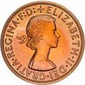
Accuracy/Scoring Rules
x₁ = credence in outcome 1
Brier scores INaccuracy of credence:
If outcome 1 obtains,
L₁ = (1-x₁)² + x₂²
If outcome 2 obtains,
L₂ = x₁² + (1-x₂)²
x₂ = credence in outcome 2
Contours of constant L₁
Contours of constant L₂
Probabilistic credences lie on the diagonal
x₁ + x₂ = 1

Slide 32
Accuracy/Scoring Rules
Outcome 1 obtains
Outcome 2 obtains
Improve accuracy by replacing a non-probabilistic credence by a probabilistic credence.
Improve accuracy by replacing a non-probabilistic credence by a probabilistic credence.

Slide 33
Accuracy/Scoring Rules
Choose accuracy dominating credences under Brier score/ strictly proper score.
Use of these scoring rules encodes probabilities.
Most scoring rules gives different calculi.
deduction
Credences must be probabilities

Slide 34
Alternative Scoring Rules
For credences x₁, …, x_{r}, on r outcomes, when the i-th outcome obtains:
Brier score: L_{i} = x₁² + … + (1-x_{i})² + … + x_{r}²
n-power score: L_{i} = x₁^{n} + … + (1-x_{i})^{n} + … + x_{r}^{n}
superadditive
additive
subadditive
sum of r dominating credences for equal credence outcomes
n

Slide 35
Regress of Reasons
…
Premises
Premises
Premises
Premises
Premises
Premises
Contingent, therefore more reasons needed.
Premises
Contingent, therefore more reasons needed.
deduction
Conclusion of the necessity of probabilities

Slide 36
Conclusion
What we have.
What we do not have.

Slide 37
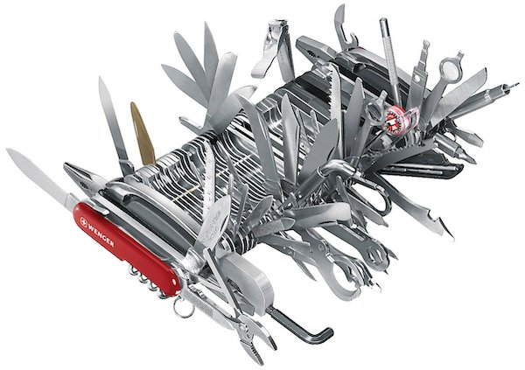
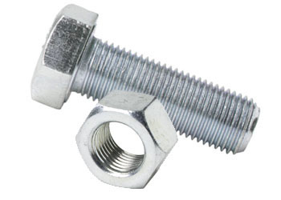
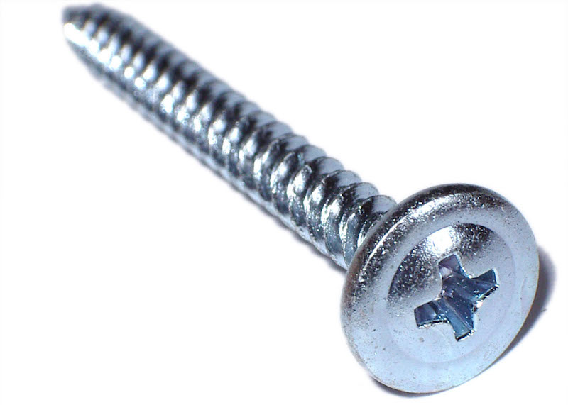
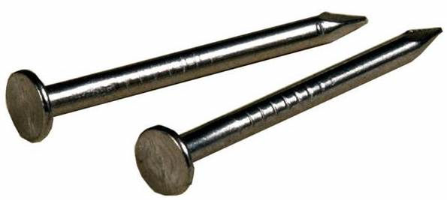
Bayes does not …
…provide a universal framework for the analysis of problems in philosophy of science.
It is not the automatic default.

Slide 38

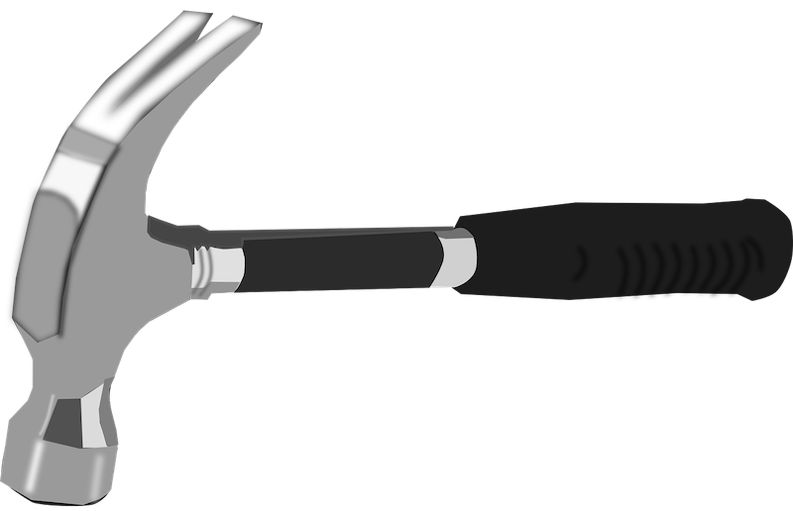
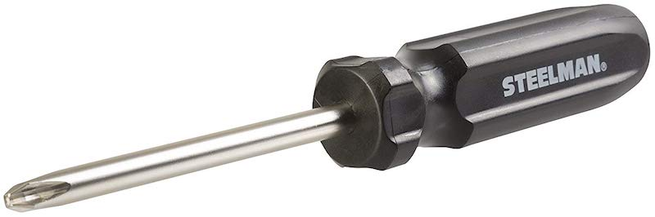
Bayes does …
… provide a useful tool for some applications.
For each application, analysts have a positive obligation to show that it is the right tool.

Slide 39
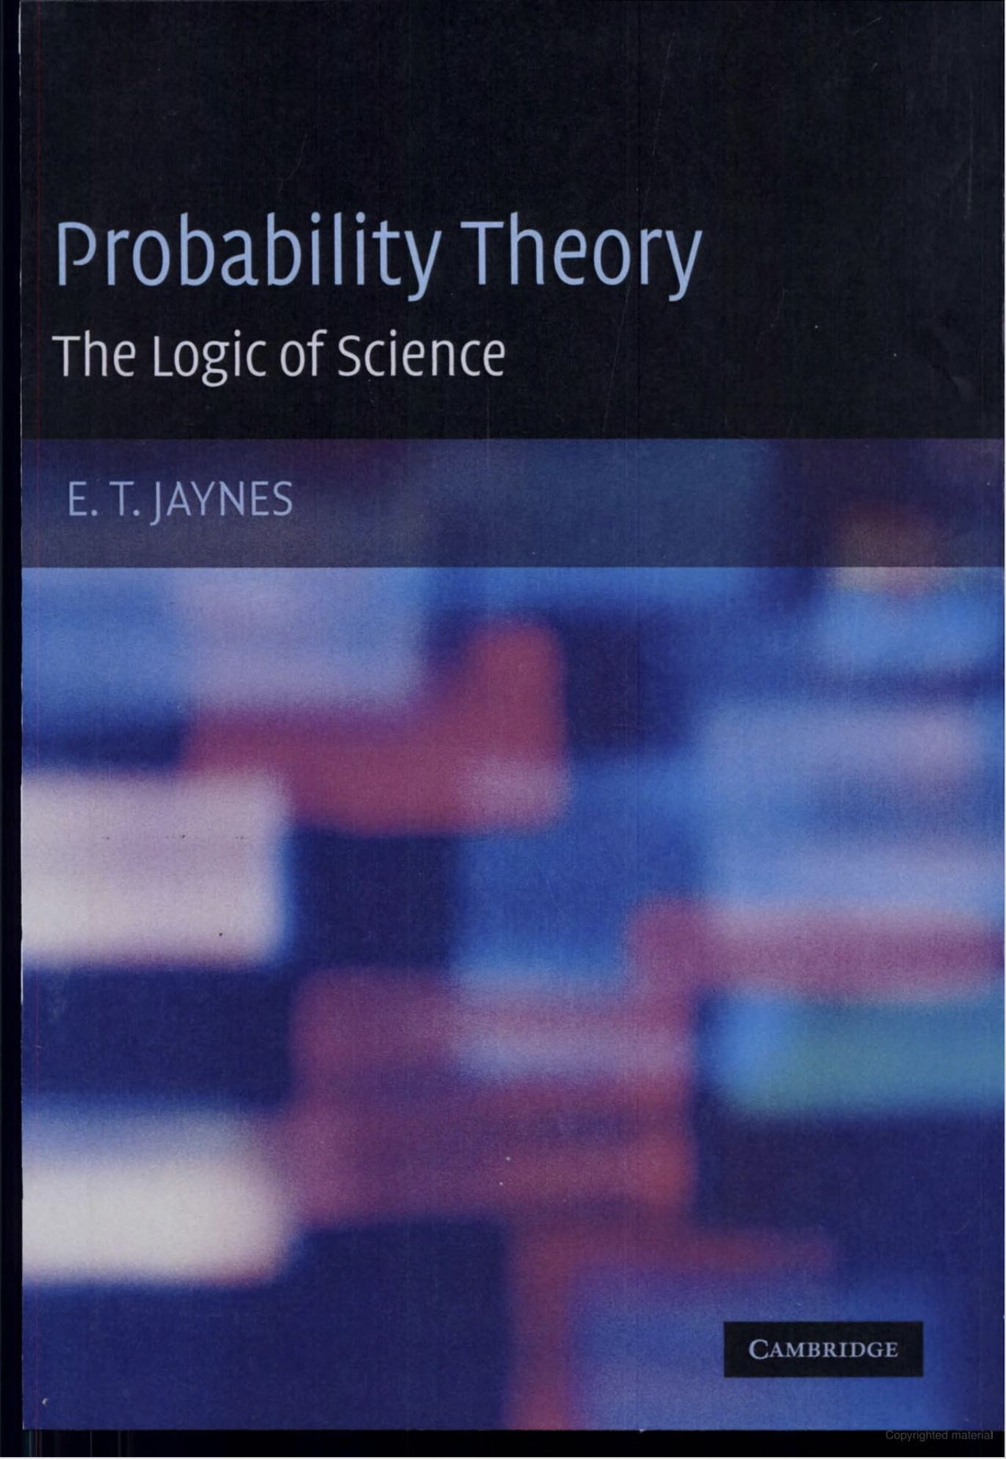


Slide 40
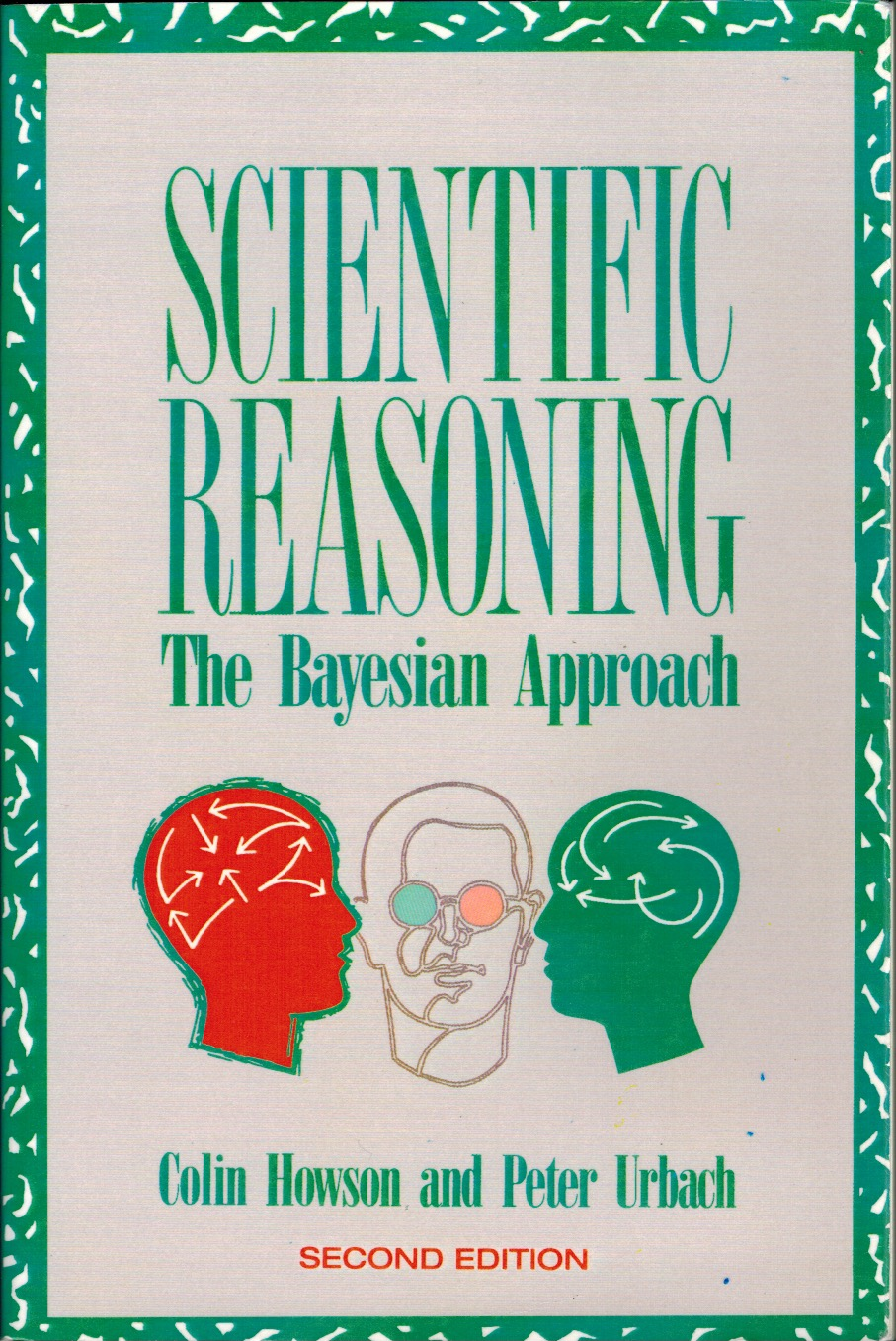

Slide 41
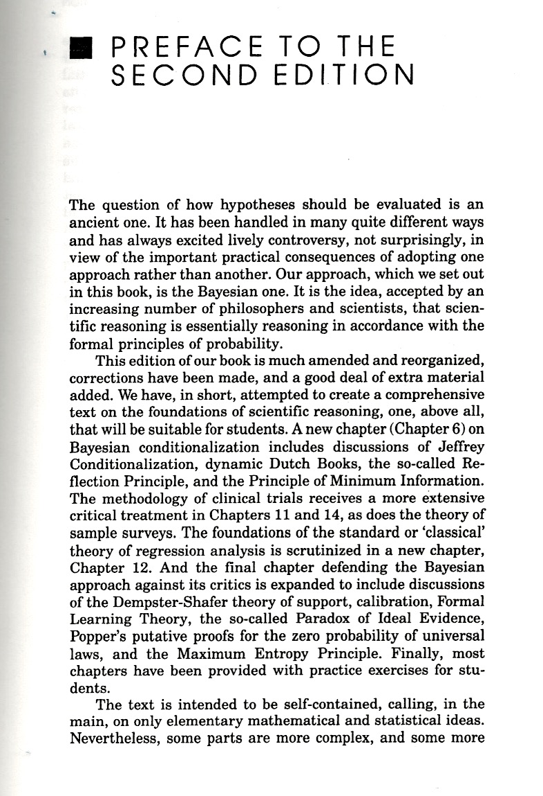
Our approach, which we set out in this book is the Bayesian one. It is the idea, accepted by an increasing number of philosophers and scientists, that scientific reasoning is essentially reasoning in accordance with the formal principles of probability.

Slide 42
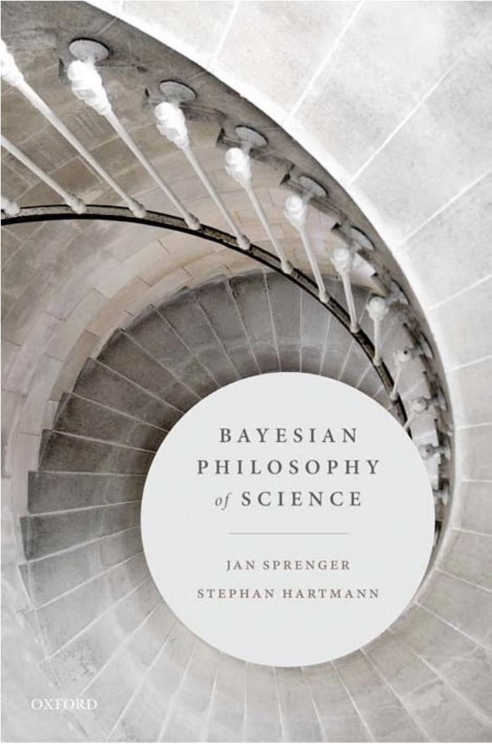
Topics covered
1. Confirmation and Induction.
2. The No Alternatives Argument
3. Scientific Realism and the No Miracles Argument
4. Learning Conditional Evidence
5. The Problem of Old Evidence
6. Causal Strength
7. Explanatory Power
8. Intertheoretic Reduction
9. Hypothesis Test and Corroboration
10. Simplicity and Model Selection
11. Scientific Objectivity
12. Models, Idealization and Objective Chance.

Slide 43
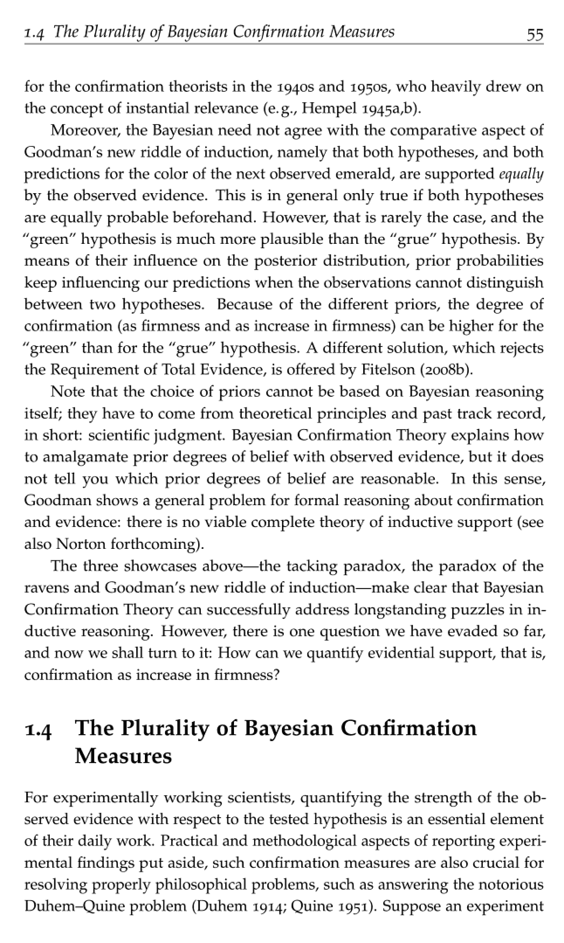
Note that the choice of priors cannot be based on Bayesian reasoning itself: they have to come from theoretical principles and past track record, in short: scientific judgment.
Bayesian Confirmation Theory explains how to amalgamate prior degrees of belief with observed evidence but it does not tell you which prior degrees of belief are reasonable.
In this sense, Goodman shows a general problem for formal reasoning about confirmation and evidence: there is no viable complete theory of inductive support (see also Norton forthcoming).
“A Demonstration of the Incompleteness of Calculi of Inductive Inference,”Brit. J. Phil. Sci. 70 (2019), 1119–1144.

Slide 44
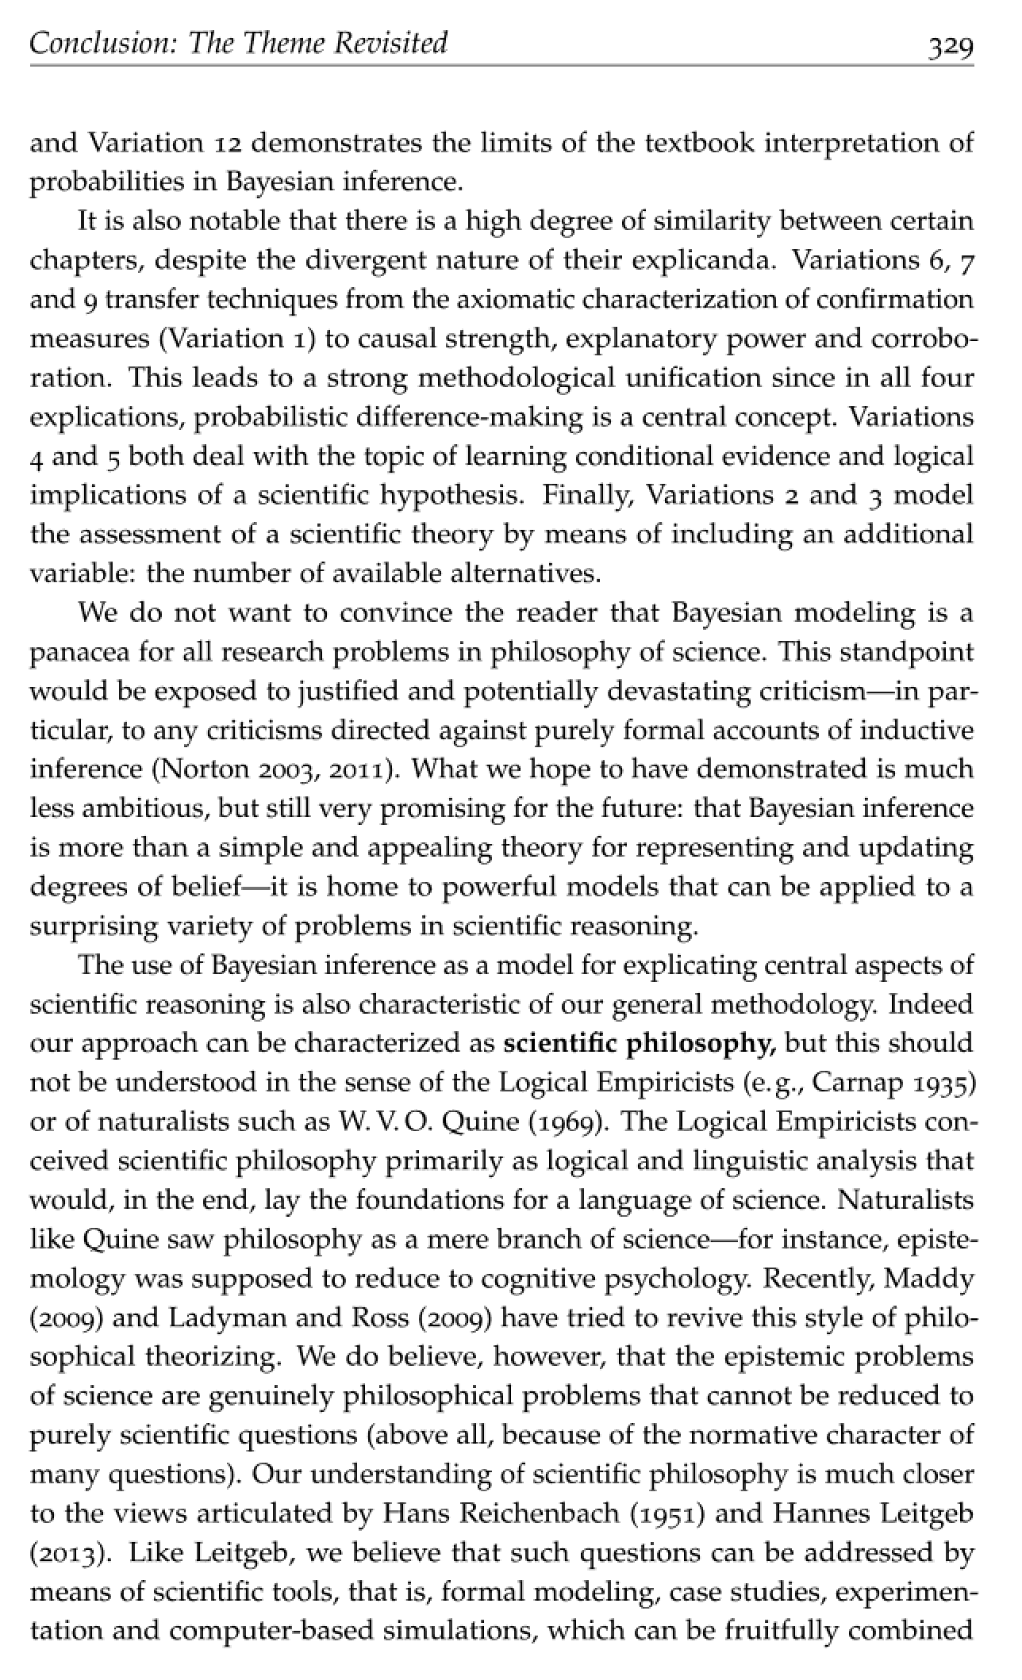
We do not want to convince the reader that Bayesian modeling is a panacea for all research problems in philosophy of science. This standpoint would be exposed to justified and potentially devastating criticism--in particular, to any criticisms directed against purely formal accounts of inductive inference (Norton 2003, 2011).
What we hope to have demonstrated is much less ambitious, but still very promising for the future: that Bayesian inference is more than a simple and appealing theory for representing and updating degrees of belief--it is home to powerful models that can be applied to a surprising variety of problems in scientific reasoning.
“A Material Theory of Induction” Philosophy of Science, 70(2003), pp. 647-70.
“Challenges to Bayesian Confirmation Theory,” pp. 391-439 in Philosophy of Statistic, Vol. 7: Handbook of the Philosophy of Science. Prasanta S. Bandyopadhyay and Malcolm R. Forster (eds.) Elsevier, 2011.

Slide 45


Slide 46
Appendices

Slide 47
Incompleteness of All Calculi of Inductive Inference

Slide 48
The Bayesian Lacuna
P(H)
We want “informationless,” “vacuous” priors.
But priors always add inductive content.
No computation is inductively self-contained.
“incompleteness”
…
conditionalize on E_{n-2}
Is there another, generalized, modified calculus that is complete?
P(H|E_{n-2}…)
conditionalize on E_{n-1}
P(H|E_{n-1}&E_{n-2}…)
NO
conditionalize on E_{n}
P(H|E_{n}&E_{n-1}&E_{n-2}…)

Slide 49
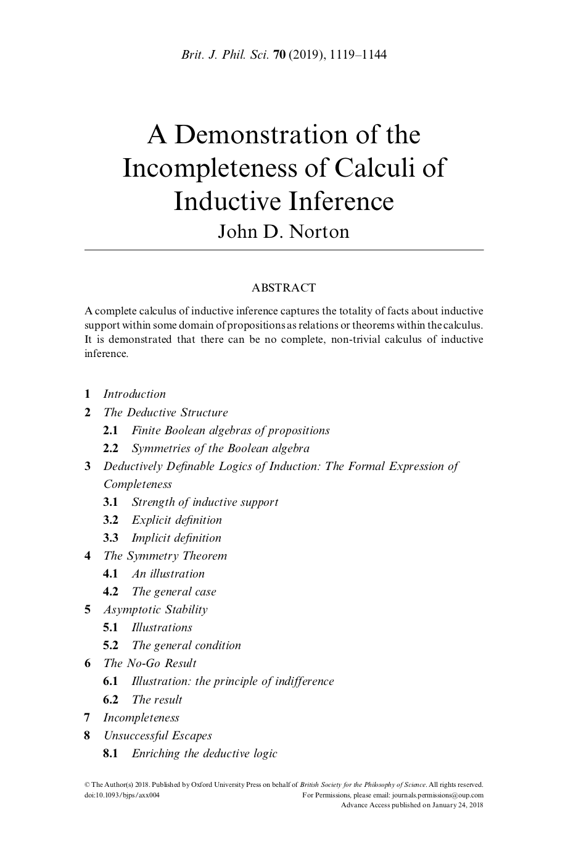

Slide 50
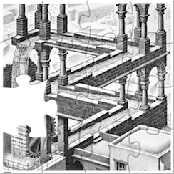
Incompleteness sketched
Deductive Definability
Inductive strength [A|B] defined implicitly or explicit by deductive relations among propositions of a Boolean algebra.
Symmetry of Boolean algebras.
Triviality
All strengths have the same value.
Asymptotic Stability
Principle of indifference reasoning in the extreme.
Inductive strength [A|B] for some fixed propositions eventually stabilize to unique values as the propositions are embedded in larger algebras of propositions.

