Slide 1

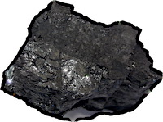
A Little Survey of Induction
There are just three general principles guiding all formal accounts of inductive inference.
There are too many competing accounts of inductive inference.
Can I go “doctor shopping” for the result I want in a case that interests me?
The material theory of induction decides which inductive logic applies locally in each case.

