Slide 1
Part 1: “Evidence Enriched”
Nora Mills Boyd
Siena College

Slide 2
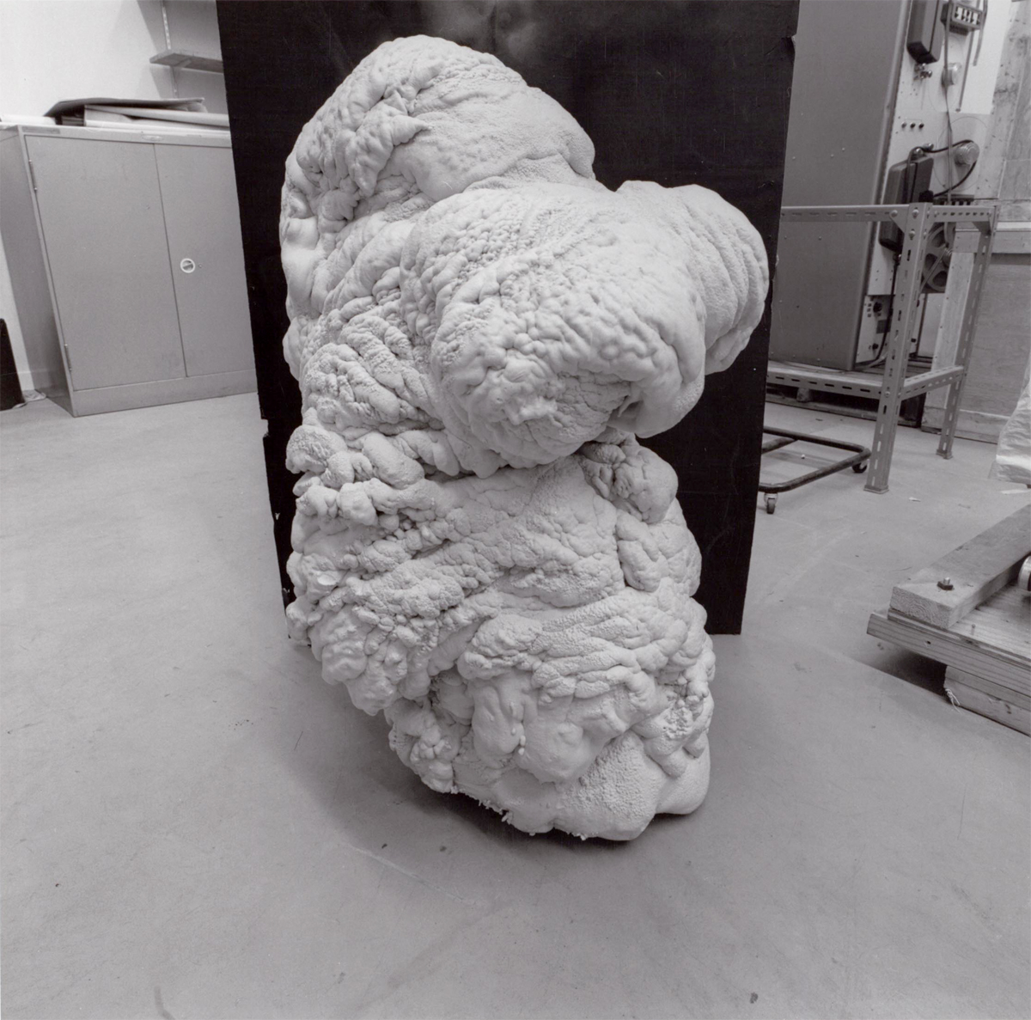
Sultan and Mandel (1977)
Notes:
This is a photograph from the exhibit titled “Evidence” by Larry Sultan and Mike Mandel, first shown in 1977 at the San Francisco Museum of Modern Art. All but one of the pieces in the exhibit were photographs that Sultan and Mandel had gleaned from files at institutions like the Jet Propulsion Laboratories, the General Atomic Company, and the Stanford Linear Accelerator Center. The photographs were displayed without identifying text, stripped from their context of production, stripped from the details of their provenance as a quote “poetic exploration upon the restructuring of imagery” (Phillips 2003). What does this photograph depict? Why was it made? The viewer is left to speculate, conjuring possible narratives for this uncanny artifact. Sultan and Mandel had bet the museum’s Curator of Photography a good bottle of whiskey that he would not be able to pick out an inauthentic photograph they had planted in the show, guessing that without further information, even a keen eye could not discern the imposter.
Sultan and Mandel’s “Evidence” exhibit vividly shows that a record detached from its context is useless as evidence. Without sufficient background information, such records can only serve as (perhaps marvelous) sources of “poetic exploration”.
Today, I'll sketch an account of empirical evidence that applies to science in practice--data production, processing, analysis, and all, which nevertheless retains an epistemically significant distinction between the empirical and the non-empirical. I'll argue that an empiricist who embraces this view of evidence can both account for how we learn about the natural world through scientific investigation and for the myriad sophisticated methodologies that empirical scientists actually employ in their work that have little to do with perception.

Slide 3

HEART OF EMPIRICISM
Necessity of experience:
To learn about the natural world, we must submit our conceptions to the ‘tribunal of experience’
Mansūr ibn Ilyās
Notes:
As you know, there are a variety of empiricisms in the history of philosophy and in contemporary scholarship. Yet there is a common thread. The heart of empiricism is the necessity of experience for learning about the world. To learn about the natural world, we must submit our conceptions to the ‘tribunal of experience.’
https://www.nlm.nih.gov/exhibition/historicalanatomies/mansur_home.html
Mansūr ibn Ilyās: Tashrīh-i badan-i insān

Slide 4
HEART OF EMPIRICISM
Opposition to rationalism:
We do not gain knowledge about nature via contemplation in absence of experience
Resists ‘epistemic shifts’ towards theory choice by non-empirical virtues like parsimony, elegance, explanatory power
Mansūr ibn Ilyās
Notes:
Empiricism in this sense stands in opposition to rationalism. We do not gain knowledge about nature via contemplation in absence of experience. This is not empty posturing. Every so often, even today, scientists raise the possibility of doing science proper in the absence of experience. Such possibilities are particularly tempting it seems, in contexts where scientists are investigating parts or aspects of nature where it is becoming difficult to collect more data—where scientists are coming up against limitations in the empirical access they have to what they would like to study. In such contexts, scientists sometimes reach for other resources in the hopes of keeping scientific inquiry moving forward. If we are running out of empirical evidence in some domain, if there is no more data to collect, or we don’t see a way to collect the data that we want, scientists begin to wonder if perhaps we might adjudicate theories based on other virtues alone, like parsimony, elegance, or explanatory power, in the absence of empirical evidence…The occasional flirtation with this possibility within the scientific community is, I think, a manifestation of the empiricist/rationalist debate. Empiricists of course should oppose such an epistemic shift every time it arises, and insist on a continued critical role for empirical evidence in the adjudication of scientific theories.

Slide 5
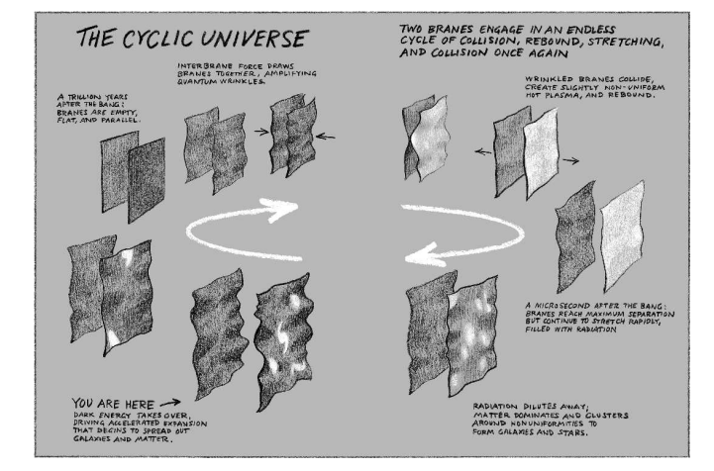
EXAMPLE: SHIFT
“[T]he cyclic model leads naturally to the prediction of quintessence and cosmic acceleration, explaining them as essential elements of an eternally repeating universe. (Steinhardt and Turok 2002, 1439)
Notes:
Let me just give you one quick example of this sort of moment, where the rationalist possibility has recently been raised by scientists themselves. In investigating the very early universe, cosmologists do seem to run out of data they would like to have. The electromagnetic spectrum can take us back only so far into the very early history of the universe, perhaps neutrinos, and primordial gravitational radiation can take us a bit further. But it seems that there will be some causal horizon, beyond which we will not be able to access more information.
One fairly clear case of cosmologists instantiating a shift towards non-empirical methods is the defense of the eternal cyclic universe cosmology offered by proponents Paul Steinhardt and Neil Turok. According to that theory our universe lives on a surface in a higher-dimensional space (a “brane") and very close by in this space there is another such brane that periodically collides with our own, thereby causing successive “big bangs" on the order of every trillion years. The basic scenario is as follows. The branes collide as a result of a
spring-like force between them (Steinhardt and Turok, 2002, 1437). The potential energy associated with this force is positive when the branes are far apart after a rebound, which causes the expansion of the branes to accelerate. Because of the nature of the spring-like force, eventually the branes to collide again and this cycle repeats eternally.
Note that an eternal cyclic model is indistinguishable in principle from a finite cyclic model. The claim that cycles are similar, periodic, and occur eternally cannot be favored over a non-eternal cosmology by observational or experimental evidence even in principle. Instead of appealing to empirical evidence, Steinhardt and Turok offer non-empirical support for their theory by claiming that the eternal cyclic model has significant explanatory power, namely that it explains why there is a dark energy component in the energy density of the universe. In particular, they suggest that the eternal cyclic model “naturally" provides dark energy a key role in cosmic history (ibid., 1439).
The best reconstruction that I can muster of the explanation Steinhardt and Turok offer is a teleological explanation whose telos is the eternal
nature of the universe. Consider the following quote in which these cosmologists invoke their eternal cyclic scenario to explain the presence of dark energy:
“[T]he cyclic model leads naturally to the prediction of quintessence and cosmic acceleration, explaining them as essential elements of an eternally repeating universe. (Steinhardt and Turok 2002, 1439)
In other words: if we are to have the eternal cyclic solution (which is conceptually desirable for other reasons) then our theory must have some component that blocks inhomogeneities from accumulating across successive cycles because if the theory predicts that they do accumulate then it is falsified by the apparent homogeneity of our observable universe on large scales. In other words, if dark energy is present then a cyclic universe is possible. The power of this teleological explanation is apparently supposed to provide support for the eternal
cyclic model.
Now, I think that a teleological explanation, that assumes an a priori preference for eternity, cannot help us to discern which cosmological theories are viable candidates for ways the world could be, and cannot serve as a replacement for empirical evidence we wish we had in order to keep science moving along.
[image is from Steinhardt and Turok’s 2007 book]

Slide 6
What is the ‘tribunal of experience’?
Notes:
So, I’ve said that the heart of empiricism is its commitment to the necessity of experience. We must submit our conceptions, our theorizing about nature, to the tribunal of experience in order to learn about nature.
But what is the ‘tribunal of experience’? What is our theorizing accountable to? With respect to what exactly should our theories be empirically adequate?
6:30

Slide 7
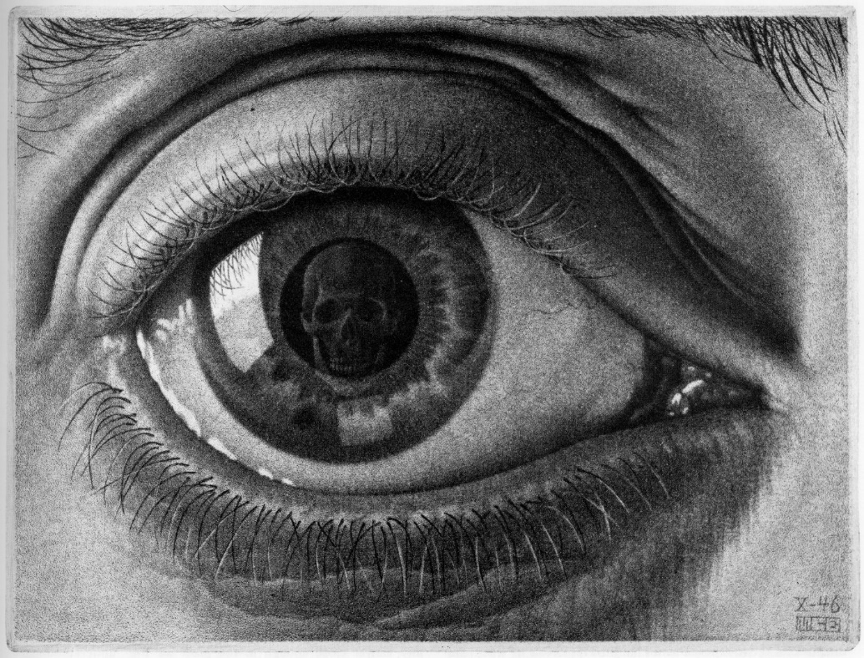


Notes:
Empiricism has traditionally emphasized the primacy of human perceptual experience in the project of learning about Nature. The traditional empiricist worldview is something like this:
there is the natural world on one hand,
and human theorizing about nature on the other, and the way that we get our theorizing into alignment with the way nature actually is—is by adjusting our theoretical understanding in response to our observations, that is, to our perceptual experiences, paradigmatically,
what we see. This traditional idea, that our knowledge of nature bottoms out in observation does not accord well with science in practice. Much of our best science has disastrously little to do with observation by the human eye-ball.

Slide 8
Observation vs. theory
“observation is perception, and perception is something possible for us, if at all, without instruments” (van Fraassen 2008)
Notes:
So, we have van Fraasseen (even in 2008) explicating observation as perception, and perception as “something possible for us, if at all, without instruments”.
P. 93

Slide 9
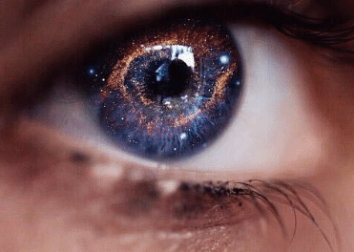
Notes:
On this sort of view, what science is accountable to--what our theories must be empirically adequate with respect to--is what is perceivable to creatures like us. For example, in the space sciences this would include observations of the Sun and Moon, some stars and planets, comets, the Magellanic clouds, etc. which are visible to naked eye astronomers, and any other astronomical objects or phenomena that are (or would be) perceivable by unaided human senses in space missions—such as Pluto would presumably be if anyone bothered to make the trip out. But, as many others have noted, the emphasis that empiricism has traditionally placed on observation (understood in the narrow sense of unaided perception) does not accord well with science in practice. Much of our best science has precious little to do with human perception.

Slide 10
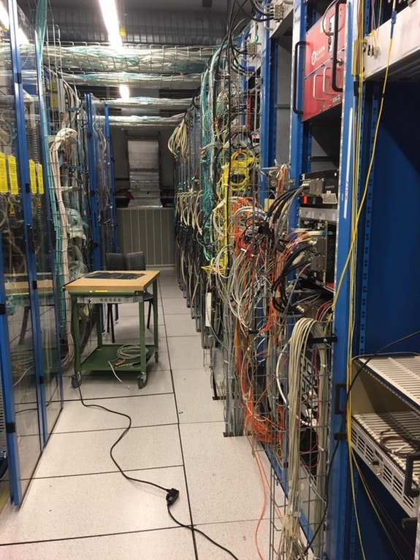
Notes:
When we look at actual scientific practice, we see instead complicated instruments, techniques, and processing—and what, at the end of the day, our scientific theories are constrained by are often results that come out of sophisticated data analysis pipelines. The process of making naked eye observations, like gazing at the moon, just isn’t a good model for

Slide 11
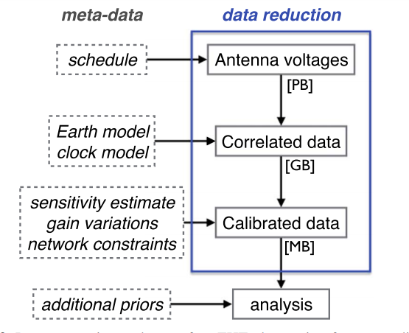
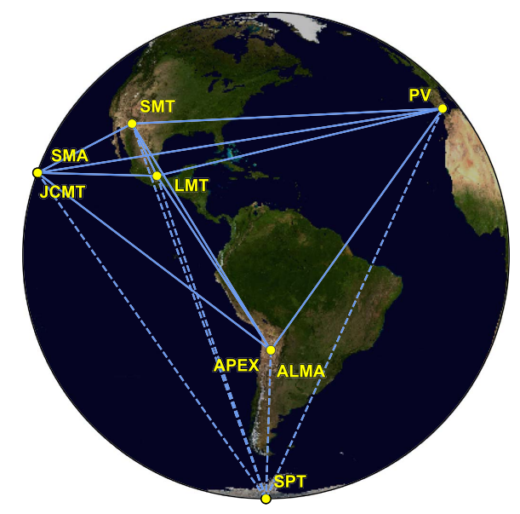

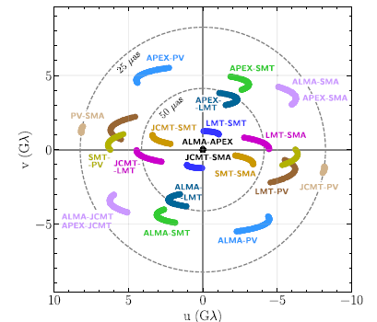
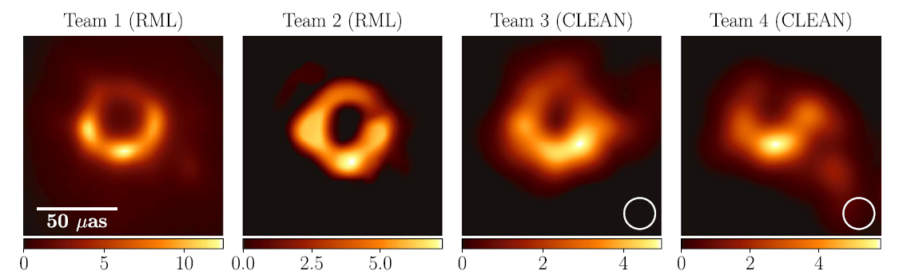
EHT Collaboration
Notes:
imaging a black hole accretion disk with the Event Horizon Telescope. The details of this image’s provenance are quite complicated and particular. To get this beautiful image of M87*’s accretion disk, the collaboration starts with radio data amalgamated from several stations around the globe
This data is then processed using a suite of presuppositions, including the distance to M87, a Geometric Earth Model to precisely locate the stations with respect to one another, a Clock Model to synchronize the data across stations, corrections accounting for the Earth’s atmosphere, and so on.
The system of telescopes yields patchy data, and the full image has to be reverse-engineered.
The collaboration tried different plausible options for reconstructing the image, which yielded different results. In the end, they developed a few different imaging pipelines optimized based on their success in reconstructing known synthetic images. The empirical data was run through each of these various pipelines, blurred to a common angular resolution, and then averaged together to produce the final image of M87*’s accretion disk.
Even from this brief discussion, I hope it is clear that the resulting image produced by this long chain of processing
[even shorter!]

Slide 12
EHT Collaboration
Notes:
has itself accreted an extensive halo of assumptions and presuppositions that contribute to making it what it is. Even further: to get from this image to an estimate of the mass of the black hole presumed to be at its center, the collaboration had to make further assumptions—in particular, they had to invoke models that already take on board theoretical assumptions from general relativity and magnetohydrodynamics. To check the consistency of this empirical result with general-relativistic accounts of black holes, the researchers have to invoke a lot of assumptions that leave their imprint on the result, and in part constitute how it turns out. Moreover, this sort of story is ubiquitous in science in practice. It’s not just the Event Horizon Telescope—it’s everywhere. What kind of empiricist epistemology of science can account for this?

Slide 13
Empirical adequacy is adjudicated with respect to enriched lines of evidence
Notes:
In my 2018 paper, I argued that empirical adequacy is adjudicated with respect to what I have called “enriched lines of evidence.”

Slide 14
DATA PRODUCTION
DATA PROCESSING
DATA RECORD
EMPIRICAL RESULT
PROCESSED DATA
Notes:
The idea is that generically there is some process of data collection that produces data records, then typically data processing that transforms those records into a result that can actually be used to constrain some theory. For instance, the process of reducing a set of images from a digital telescope might involve correcting each exposure by performing bias subtraction, flat field correction, and bad pixel masking, then calibrating each exposure astrometrically and photometrically, modeling the point spread function in each exposure, remapping each exposure to a common coordinate system, co-adding exposures, and so forth.

Slide 15
DATA PRODUCTION
DATA PROCESSING
DATA RECORD
EMPIRICAL RESULT
PROCESSED DATA
PROVENANCE METADATA
WORKFLOW METADATA
ENRICHED LINE OF EVIDENCE
Notes:
There will be metadata associated with the data collection, which I’ve called “provenance metadata”, and metadata associated with data processing, which I’ve called “workflow metadata”. Metadata are auxiliary information about how the empirical results produced in data collection and processing are generated. For example, in volcanology, provenance metadata might include geographical information about where particular rock samples were collected, and workflow metadata might include information about corrections for atmospheric contamination of certain isotopes that would otherwise confound potassium-argon dating of the rock sample. Again, note that, in order to generate an empirical result that is appropriately formulated to constrain some theory, for example, to calculate the empirical value of a particular parameter or to produce a proposition, much more processing than just preliminary data reduction will typically be required.

Slide 16
LINE OF EVIDENCE:
sequence of empirical results
AUXILIARY INFORMATION:
provenance and workflow metadata
LINE OF EVIDENCE + AUXILIARY INFORMATION = ENRICHED LINE OF EVIDENCE
Notes:
So, my view is that the empirical adequacy of scientific theorizing is adjudicated with respect to lines of evidence enriched by auxiliary information about how those lines were generated.
By “line of evidence” I mean a sequence of empirical results including the records of data collection and all subsequent products of data processing generated on the way to some final empirical constraint. By “auxiliary information” I mean the metadata regarding the provenance of the data records and the processing workflow that transforms them. Together, a line of evidence and its associated metadata compose what I am calling an “enriched line of evidence.” The evidential corpus is then to be made up of many such enriched lines of evidence.
Why does it have to be this complicated? Why can’t for instance final empirical results serve as the evidence with respect to which our theories need to be consistent?

Slide 17
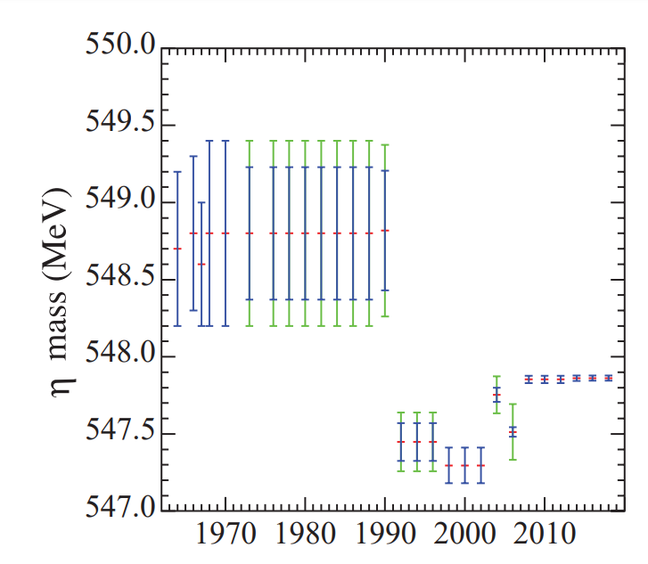
Particle Data Group (2020)
Notes:
Bare empirical results, considered apart from their metadata, are not good candidates for explicating the ‘tribunal of experience’—that with respect to which our theories ought to be consistent—because the evidential corpus composed of empirical results is internally inconsistent and it would be a fool’s errand to require our theories to be consistent with something that itself lacks consistency. Time and time again it looks like science produces result R and then promptly not-R. Here is a plot from the Particle Data Group showing measurements of the mass of the eta meson from the 1960s through the present. Some of these measurements fall outside of each other’s error bars, and so taken by themselves, appear inconsistent. However, the collection of empirical results considered together with auxiliary information about how they were generated is not internally inconsistent, just as there is no contradiction between “If x then p” and “If y then not-p”, even though there is one between “p” and “not-p”. So we really need to consider not just bare empirical results, but empirical results considered together with their associated metadata.
I should say however, that although all of the presuppositions that contribute to the generation of an empirical constraint are implicated in the epistemic utility of that constraint, in practice the entire enriched line of evidence need not be hauled out for appraisal every time a result gets used as a constraint. For instance, researchers may have good reasons to believe that the instrument used to collect data was well calibrated without checking all of the available information relevant to that calibration explicitly. However, new reason for them to be suspicious of the instrument’s calibration could always arise later on, and revisiting the information available about the calibration could become epistemically imperative.

Slide 18
How can evidence accumulate across theory change?
How can evidence produced by different experiments be combined?
How can the same evidence be used to constrain competing theories?
Notes:
In my 2018 article, I argued that viewing empirical evidence as enriched in this way, helps us to answer otherwise puzzling questions.
Questions like: How can evidence accumulate across theory change? How can evidence produced in different experiments be combined and used jointly? And how can the same evidence be used to constrain competing scientific theories?
Indeed, I argued that it is not despite the assumption-riddled character of empirical results that these feats are accomplished, but in virtue of it, that they are possible at all.

Slide 19
To serve as a constraint on theorizing, an empirical result must be well adapted to the context of constraint.
A result is well adapted when either:
  all presuppositions incorporated throughout data collection and processing are formally compatible with the theory to be constrained, or
  their incorporation does not make a relevant difference to the constraint.
Notes:
To see why, it helps to note that to serve as a constraint on scientific theorizing, an empirical result must be well adapted to the context of constraint. In other words, the result has to be presented in a form amenable to the theory to be constrained. Given the myriad assumptions that get baked into an empirical result throughout the course of data production and processing, and the fact that empirical results need to be couched in conceptual or formal trappings that are recognizable to the theory to be constrained—the issue of whether a particular result is well-adapted to serve as a constraint in some context is no idle matter.

Slide 20
To serve as a constraint on theorizing, an empirical result must be well adapted to the context of constraint.
A result is well adapted when either:
  all presuppositions incorporated throughout data collection and processing are formally compatible with the theory to be constrained, or
  their incorporation does not make a relevant difference to the constraint.
Notes:
We will say that a result is “well adapted” when either all presuppositions incorporated throughout data collection and processing are formally compatible with the theory to be constrained, or their incorporation does not make a relevant difference to the constraint. To take a quick example: my calculation of the dark matter contribution to the total energy density of the universe based on empirical data from galaxy surveys cannot straightforwardly serve as a constraint on your new theory of cosmology if dark matter is not among the ingredients of your theory.

Slide 21
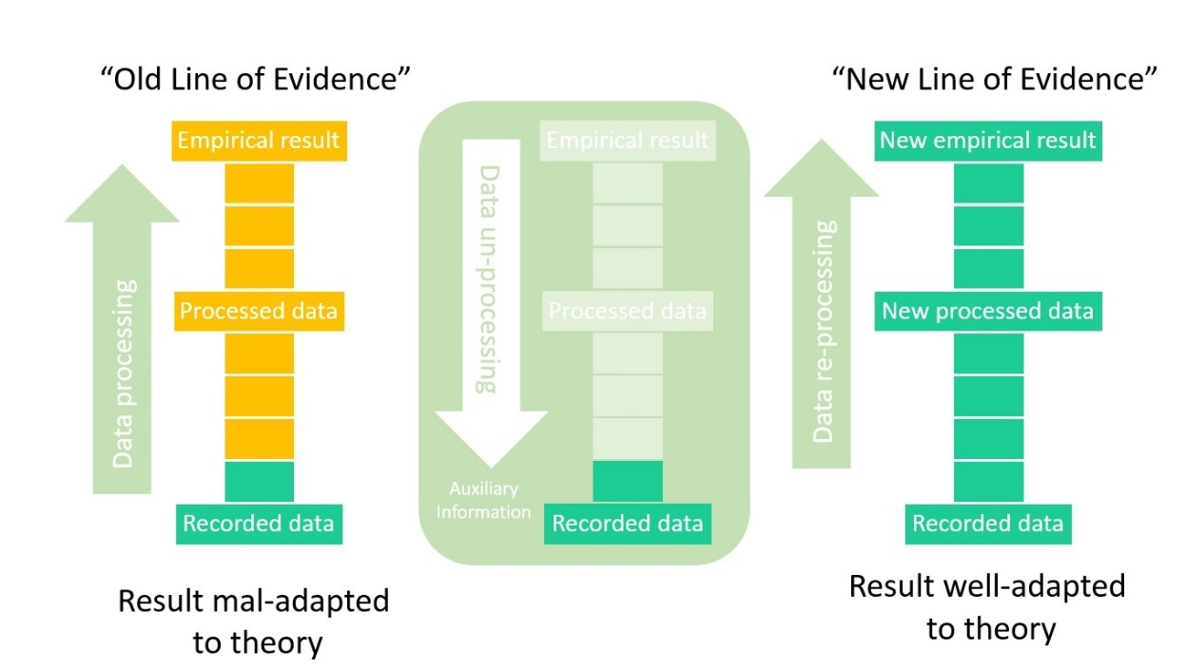
Notes:
But this means that when researchers have access to enough background information, that is, enough metadata, empirical results need not be ossified in their original form. It can be possible to “unwind” the processing that results have undergone and re-process them to render them newly well-adapted to a different epistemic context. In this way, the epistemic utility of empirical evidence can transcend radically diverse contexts.
[redo figures?]
[re-emphasize Kuhn?]

Slide 22


Notes:
For instance, ancient Babylonian eclipse records inscribed on cuneiform tablets have been used to generate constrains on contemporary geophysical theorizing about the causes of the lengthening of the day on Earth. This is surprising since the ancient observations were originally recorded for the purpose of making astrological prognostications. Nevertheless, with enough background information, the records as inscribed can be translated, the layers of assumptions baked into their presentation peeled back, and the results repurposed using resources of the contemporary epistemic context, the likes of which the Babylonians could have hardly dreamed.
So while it is true that the epistemic utility of empirical results depends on the details of their provenance and those details are often extensive and particular, this doesn’t necessarily render evidence “tragically local”—rather, with sufficient metadata, the epistemic utility of empirical results can be revived in new contexts.

Slide 23
Observation per se is irrelevant to the empirical nature of evidence.
Empirical results are imbued with theoretical assumptions.
It is in virtue of those assumptions that the fruits of empirical investigations can be ‘put in touch’ with theorizing at all.
Notes:
On this view, observation per se is irrelevant to the empirical nature of evidence. The fact that the output of scientific instrumentation eventually needs to make a transcranial journey in order to be of any real epistemic interest ought not mislead us into think that the empirical is best understood as ‘observable’ or ‘sensible’. The interesting questions are not about observability but about empirical access, and observation is neither necessary nor sufficient for that access.
Empirical data and empirical results are imbued with theoretical assumptions—but these assumptions are an important part of what makes theory appraisal possible.
The enriched view of evidence supports the idea that it is not despite the intertwining of the theoretical and empirical that scientists
accomplish key epistemic aims, but often in virtue of it. Furthermore, being imbued with assumptions does not prevent us from repurposing empirical results and putting them to epistemic use in new contexts.
In addition, this view makes the epistemic value of the metadata encoding the various assumptions that have been made throughout the course of data collection and processing explicit. The desirability of explicitly furnishing empirical data and results with auxiliary information that allow them to travel across epistemic contexts can be appreciated in light of the ‘objectivity’ norm, construed as accessibility to interpersonal scrutiny. When data are repurposed in new contexts, they are not only shared between subjects, but can in some cases be shared across radically different paradigms, even those with incompatible theoretical commitments.

Slide 24
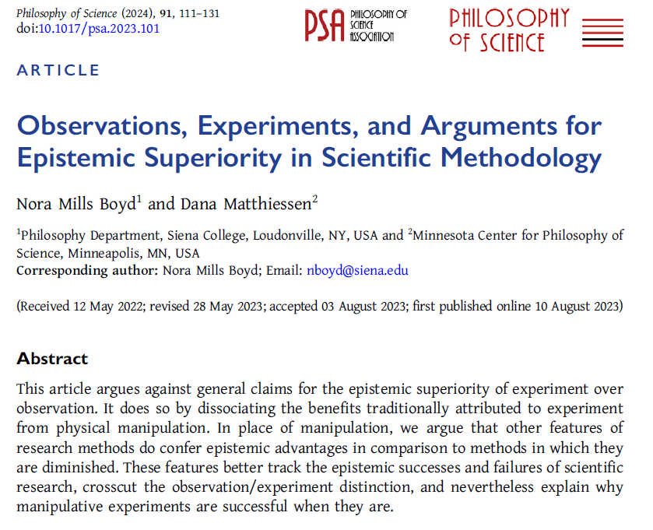
https://philsci-archive.pitt.edu/22359/

Slide 25
What makes data empirical?
Notes:
But what makes data empirical in the first place? An empiricist position ought to be able to distinguish the empirical from, for instance, the virtual if it is to remain faithful to the heart of empiricism. The tribunal of experience ought to originate from the world lest empiricism lose what makes it distinctive from rationalism.

Slide 26
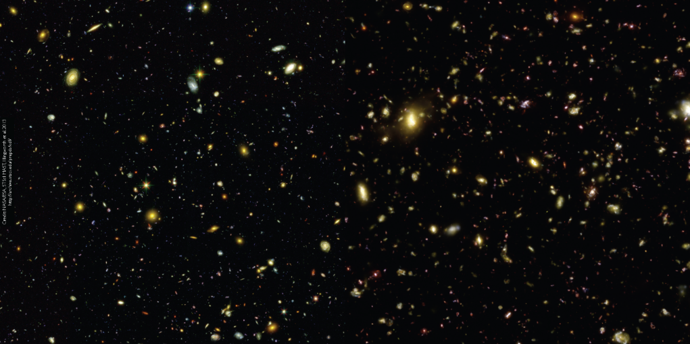
What makes data empirical?
Data are empirical with respect to some target when there is an interpretation of the provenance of those data using the resources of an epistemic context such that the data are products of causal interaction with that target.
Illustris Collaboration
Notes:
I argue that data, including astrophysical data, are empirical with respect to some target when there is an interpretation of the provenance of those data using the resources of an epistemic context, such that the data are products of causal interaction with that target. By ‘epistemic context’ I mean the collection of conceptual, theoretical and representational resources from the perspective of which the data is to be interpreted. It is important to note that data are empirical relative to a target. Without specifying a target it is impossible to say whether some particular dataset is empirical or not. Data are also empirical relative to an epistemic context and the epistemic context supplies the resources with which the data are interpreted. These resources are drawn upon to identify the target in the first pace, as well as to furnish a causal story connecting the target to the data production process.
Consider this image from the Illustris Collaboration. The left half of this image is empirical, it’s the image of the Hubble eXtreme Deep Field, the data for which was produced by light from these very distant galaxies impinging on the Hubble instrument. The right half of the image is output from the Illustris simulation, the results of elaborate calculations transforming the elements of a model of cosmic structure. The rhetorical force of the juxtaposition is clear: the Illustris folks want you to marvel at how similar the empirical results and their simulated ones are. But the epistemic significance of each half of this image is very different. The empirical half participates in the tribunal of experience in virtue of having been produced by the right sort of connection to those galaxies. The simulated images cannot play that role, they have not been produced by the right sort of connection. Indeed, in scientific practice, the results of simulations are not typically used as though they were empirical results. Rather, they often serve the role of the theoretical prediction to which the empirical results (considered together with information about how those results were produced) are compared—the simulation results are subjected to the ‘tribunal of experience’ as a way of checking the empirical adequacy of the theoretical frameworks that engendered them. But the empirical half of this image is not empirical in virtue of us being able to perceive IT with our unaided senses! That would give it none of the epistemic credentials it needs in order to participate in the tribunal of experience.
https://www.illustris-project.org/static/illustris/media/illustris_hudf_real_vs_simulated.png
Caption: “Hubble eXtreme Deep Field observations (2.8 arcmin on a side) in B, Z, H bands convolved with Gaussian point-spread functions of sigma = 0.04, 0.08, and 0.16 arcsec, respectively. Divided down the middle: real observation (left side) and mock observation from Illustris (right side).”

Slide 27
CAUSAL CHAINS
Under an interpretation, the provenance of empirical data involves causal interaction with the target.
Epistemic contexts supply the resources for identifying and interpreting casual interactions.
Notes:
An important feature of the view of empirical data that I am defending is the causal production of data. As I said, to be properly empirical, data should have been produced by causal processes that connect the worldly target of research to the process of data collection and recording from the perspective of the epistemic context in which the data are to be interpreted. There is no perspective outside of an epistemic context from which the causal processes can be identified and traced. Indeed, there is no perspective outside of an epistemic context from which a worldly target can be identified in the first place. Yet, using the resources of an epistemic context, it can be possible to answer the question: were these data produced by causal interaction with the target?
This view of what makes data empirical obviously relies on the notion of a casual interaction (which for philosophers is a notoriously fraught notion). I am not committed to a special theory of causal interaction. In fact, I believe that this view of what makes data empirical is probably compatible with a variety of ways of explicating the notion of causal interaction and I think it is best that the precise explication of what counts as a causal interaction be spelled out from within a particular epistemic context, using the resources of the background theory in play.

Slide 28

Contrast with ‘empirical’ by ostension
“My basic intuition here is that scientific data rest on raw material that can be presented, or reproduced, upon request. It is essential that this level is kept as simple as possible, e.g., ‘this rock here,’ or ‘these spots on the screen there,’ or – in social science – ‘these filled in questionnaires,’ etc.”
Kaiser 1991
Image credit: João Pacheco
Notes:
To see why causal production matters, let us consider a different characterization of what makes data empirical that eschews causal production and relies instead on ostension. Matthias Kaiser has developed an abstract characterization of the epistemological structure that carries scientific reasoning from what he calls “observable reality (data)“ to “empirical phenomena" (1991, 121). The basic elements the structure are what he calls an ‘anchor-point’ (the bit of the world that source the data) and ‘inference tickets’ that transform the data by redescription and other operations licensed by background knowledge (ibid., 122-123). Kaiser’s view relies importantly on what he calls “the simple act of presentation”. He writes:

Slide 29
Contrast with ‘empirical’ by ostension
“My basic intuition here is that scientific data rest on raw material that can be presented, or reproduced, upon request. It is essential that this level is kept as simple as possible, e.g., ‘this rock here,’ or ‘these spots on the screen there,’ or – in social science – ‘these filled in questionnaires,’ etc.”
Kaiser 1991
Image credit: João Pacheco
Notes:
“My basic intuition is here that scientific data rest on raw material that can be presented, or reproduced, upon request. It is essential that this level is kept as simple as possible, e.g., ‘this rock here’, or ‘these spots on the screen there’, or – in social science – ‘these filled-in questionnaires’, etc.”
Thus, on Kaiser's view, what makes data empirical are these original (and reproducible) acts of ostension, like “this rock here". Unfortunately, Kaisers view is ill-suited to far away targets in virtue of this feature of his account. When the material specimen is not present at hand, the scientist cannot anchor the data to it via acts of ostension and is forced to anchor the data, not to the worldly target of interest, but to some intermediary as in “these spots on the screen there".
Image credit: João Pacheco

Slide 30
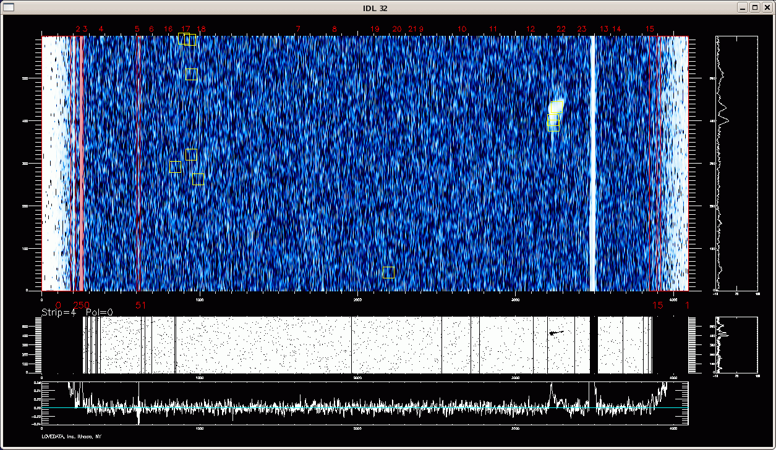
RIP Arecibo
Notes:
Let us consider an example of this sort. Here is a visualization of data from the Arecibo telescope, displaying “spots" that can be interpreted as radio signals from distant galaxies. On Kaiser's account, what makes the data visualized here empirical is that they can be picked out by ostension, by some scientist gesturing to the image—”these spots on the screen there". This approach locates the empirical at the site where some bit of the world is present to perception of a human inquirer. In this case, the spots in the image are what is present to the inquirer. But approach seems to miss the point. The data displayed here are empirical data with respect to galaxies--they are data encoding the radio frequency emissions of galaxies over time--in virtue of being produced by the interaction of electromagnetic radiation emitted by those galaxies traveling through space and interacting with the receiver of the Arecibo observatory telescope (RIP) and subsequently the rest of the readout apparatus of that telescope.

Slide 31
Data are empirical with respect to some target when there is an interpretation of the provenance of those data using the resources of an epistemic context such that the data are products of causal interaction with that target.
Notes:
In determining whether some data is empirical or not, we should ask two questions: what is the worldly target that the research seeks to investigate? And what is the data the result of causal interaction with? If the data has been produced by a causal interaction that we can trace from the worldly target using the theoretical resources of the relevant epistemic context, then I think we can call this data empirical. (It could still be poor data.) However, if, construed from the perspective of the epistemic context in which researchers are working, the production of data is not derived from a causal interaction anchored in the worldly target (as construed by that epistemic context), then the data cannot be empirical with respect to that target. Empirical data may have been procured via observation, or more generally “detection”, or intervention, but not (for instance) by modeling or computation alone.

Slide 32

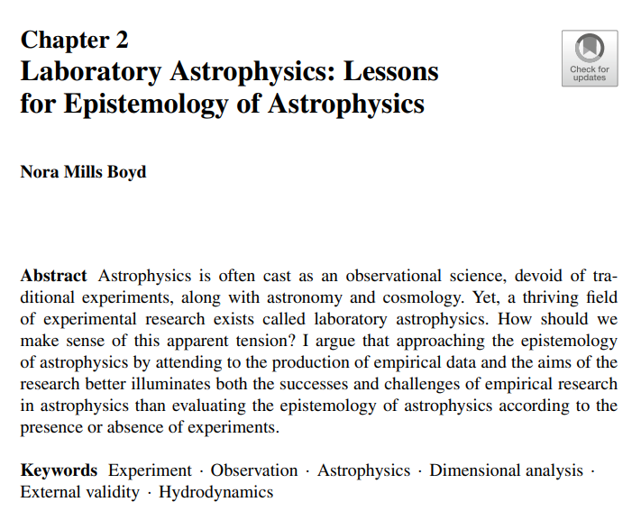
https://link.springer.com/book/10.1007/978-3-031-26618-8

Slide 33
What is the ‘tribunal of experience’?
Enriched evidence!
Notes:
So far I have argued that a empiricist philosophy of science that wants to accommodate much of science in practice need to make sense of the abundance of sophisticated, instrument-aided data collection and processing. I suggest this can be accomplished by adopting an enriched view of evidence, according to which the ‘tribunal of experience’ is understood to be the growing evidential corpus composed of lines of evidence considered together with the details of their provenance. Unlike bare empirical results, enriched evidence is cumulative across theory change, and by appealing to metadata, empirical results can be repurposed in new epistemic contexts. In other words, this view of evidence helps show how it can be that empirical results are both theory-laden and also escape ossification in the original contexts of their production.

Slide 34
Identify an example of evidence in a scientific theory you know that illustrates one of:
How can (or cannot) evidence accumulate across theory change?
How can (or cannot) evidence be combined and used jointly?
How can (or cannot) the same evidence be used to constrain competing theories?

Slide 35
Identify an example of evidence in a scientific theory you know that illustrates one of:
How can (or cannot) evidence accumulate across theory change?
How can (or cannot) evidence be combined and used jointly?
How can (or cannot) the same evidence be used to constrain competing theories?
How do these examples reflect on the viability of enriched evidence as a philosophical account of scientific evidence? Still too pessimistic?

Slide 36
What makes data empirical?
See pg. 404 of “Evidence Enriched”

Slide 37
Do you think empiricism that does not require observation is worthy of the name?

Slide 38
Can causation be made safe for empiricists?

Slide 39
Can we have a story about what makes data empirical that is both applicable to science in practice and does not appeal to causation?

Slide 40
Are hybrid results empirical?

Slide 41
Part 2: “Is There an Epistemology of Experimental Physics”

Slide 42
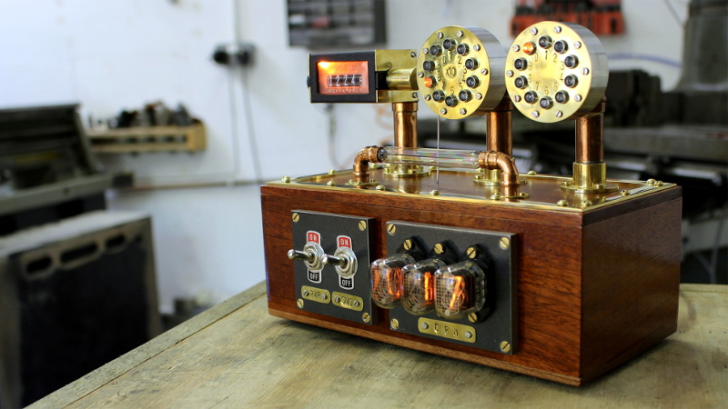
Image credit: Chris Crocker-White
Notes:
Imagine that I built this detector. It’s a brand new kind of detector that is supposed to detect a brand new kind of particle called the ‘mystery particle’. Until now, no one has ever detected a mystery particle. I want you to use the detector to try and detect mystery particles, to see if they really exist. Imagine that you turn the detector on and after a while, it beeps, which is what the detector is supposed to do when it has successfully detected a mystery particle. What would you think? Would you conclude that you have successfully detected a mystery particle using this detector?
While it would be very exciting to have made the first ever mystery particle detection, there are some considerations that might make you cautious about declaring your success. What if the detector picked up some noise, rather than a mystery particle, and it was the noise that made it beep? What if there was some subtle malfunction inside the mystery particle detector that caused it to accidentally beep?
https://www.balena.io/blog/show-tell-a-steampunk-desktop-background-radiation-monitor/

Slide 43
‘Experimenters’ regress’
To successfully detect a mystery particle, you need a functioning mystery particle detector.
The way to tell that you have a functioning mystery particle detector is to check to see if it successfully detects mystery particles.
But in order to tell that your detector successfully detects mystery particles, you need to be assured that you have a functioning mystery particle detector…
Notes:
It seems like in order to successfully detect a mystery particle ,you need a functioning mystery particle detector, but that the way to tell that you indeed have a functioning mystery particle detector is to check to see if it successfully detects mystery particles. But, in order to tell that your detector successfully detects mystery particles, you need to already be assured that you have a functioning mystery particle detector. So how are you supposed to make any progress with the mystery particle detector? This puzzle is what sociologist Harry Collins has famously called the ‘experimenters’ regress’.

Slide 44
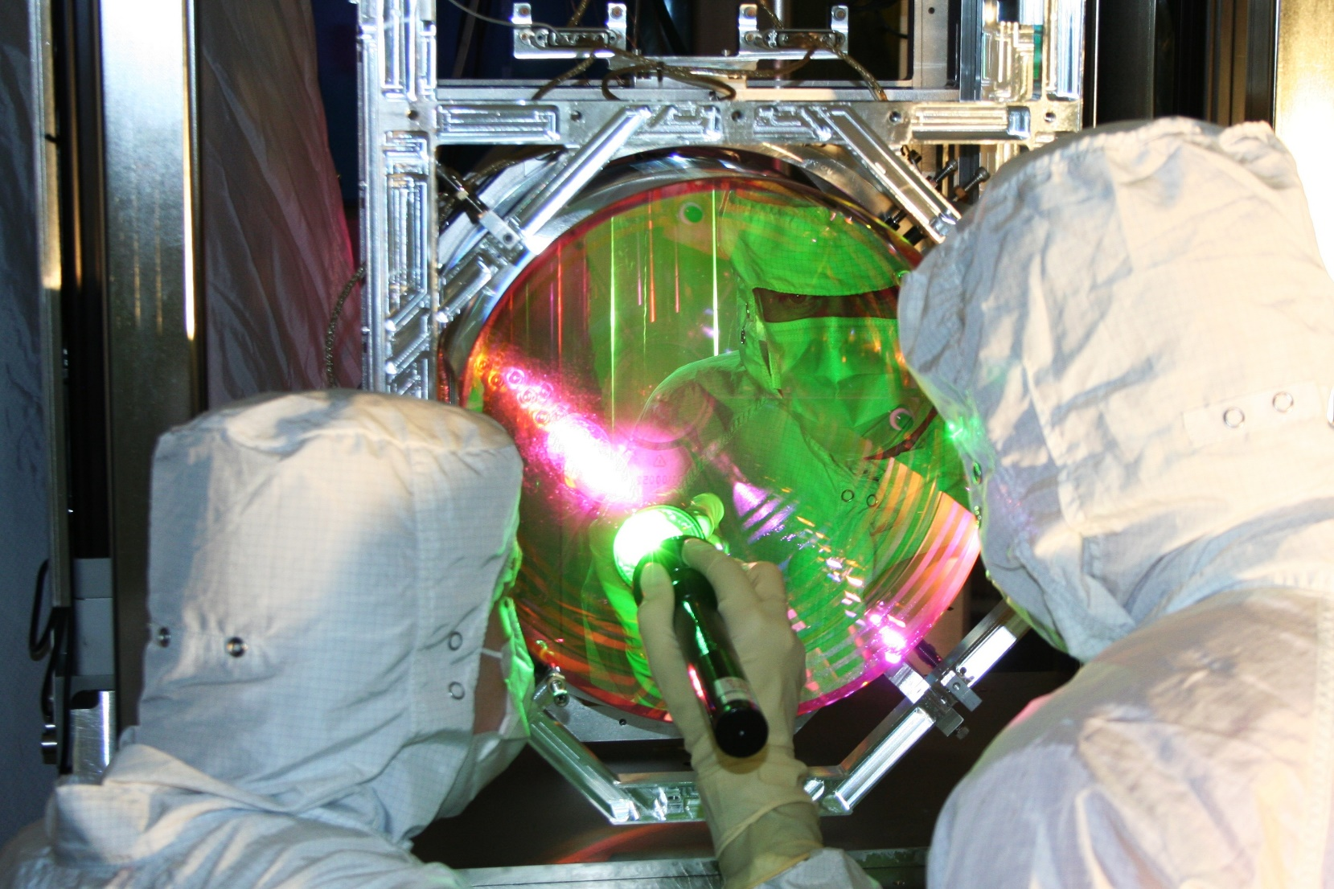
Image credit: Caltech/MIT/LIGO Lab
“In a modern, complex experiment, distinguishing new science from an instrument artifact or a routine occurrence may be far from obvious ” (Kanner and Weinstein 2016)
Notes:
And if instead of thinking about an imaginary mystery particle detector, we think about a real scientific apparatus, it looks like the puzzle only gets worse. As two gravitational wave scientists put it: “In a modern, complex experiment, distinguishing new science from an instrument artifact or a routine occurrence may be far from obvious.”
https://www.ligo.caltech.edu/system/media_files/binaries/6/original/041212_full_2.jpg?1415638716
https://nautil.us/issue/42/fakes/the-cosmologists-who-faked-it

Slide 45
functioning detector?
successful detection?
Notes:
So how is it that scientists decide when the results of their experiments should be taken seriously? When are they convinced that they have functioning detectors?
Suppose that, when you suggest that my new mystery particle detector may have beeped in response to noise or due to some internal malfunction, I get super offended and say: “How dare you question my expertise as a detector maker—I’m one of the world’s finest?!” What if there is a Nobel Prize at stake?

Slide 46
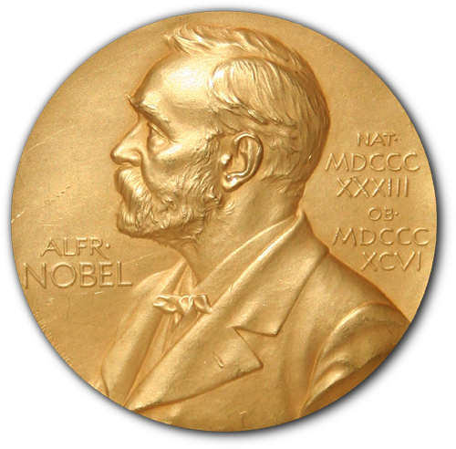
“Science wars”
Sociological factors: power, prestige etc.
vs.
Epistemic justification: good, non-sociological reasons
Notes:
In the so-called “sciences wars’—a period of vigorous debate between sociologists of science and philosophers of science—some sociologists argued that non-epistemic factors like deference to power and desire for prestige determine scientists decisions, including their decisions about when to take the results from a new scientific instrument seriously. Philosophers of science saw this view from the sociologists as an attack on the epistemology of science, the justification of scientific knowledge, and the special and distinctive status of science in comparison to other human activities as a knowledge-producing enterprise. If the decisions that scientists make about when to take results seriously are epistemically justified, then they would not be determined by factors like power and prestige. But is it actually the case that these crucial decisions scientists make, like when to take results seriously, are made with the support of good epistemic reasons?

Slide 47
Are decisions to take results seriously epistemically justified?
Notes:
That is: are decisions to take scientific results seriously in fact epistemically justified? Or at least generally justified, or justified in most cases?
After all, it seems clear that sometimes scientists make unjustified decisions under the strong influence of sociological factors. Scientists sometimes let their hopes, fears, and egos get the best of them.

Slide 48
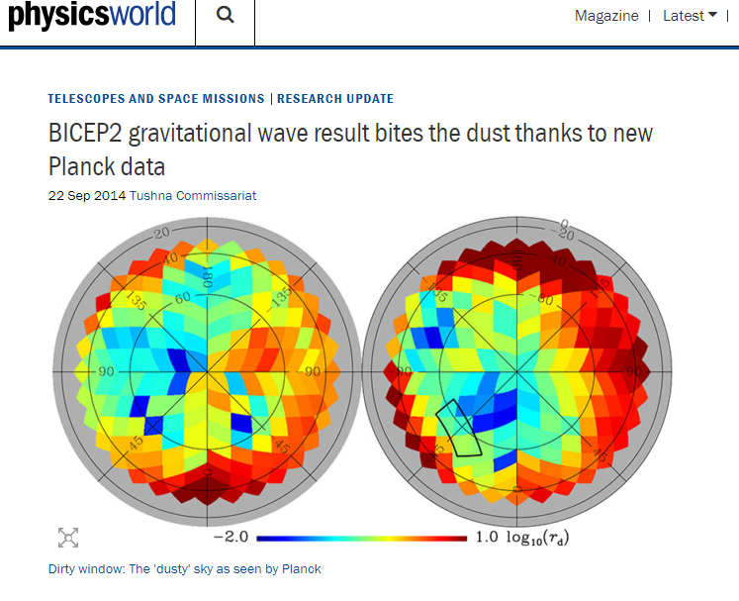
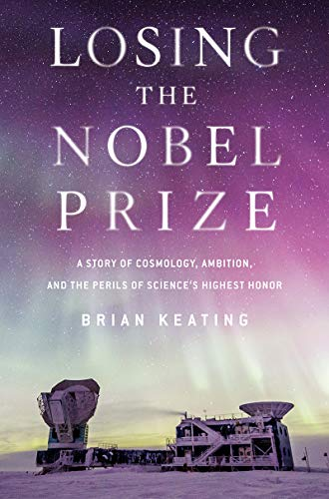
“As with the lunar landing and the South Pole, there’s no Nobel Prize for second place. The goal is to be the scientist who makes the first discovery, the one for the ages, the one who wins.
Winning the Nobel Prize confers the ultimate capital” (Keating 2018, 177)
Notes:
One striking, relatively recent example is the BICEP2 debacle. BICEP2 was an experiment looking for the tell-tale signs of cosmic inflation in the polarization pattern of our universe’s primordial light, the cosmic microwave background. The BICEP2 team published results claiming the discovery of the “smoking gun” signature of cosmic inflation, which by some accounts would imply the existence of the multiverse, but later had retract its claim.
In a memoir describing the episode from within the collaboration, cosmologist Brian Keating explains how he (at least) was strongly motivated by the possibility of winning a Nobel Prize if the research was successful. He writes, “As with the lunar landing and the South Pole, there’s no Nobel Prize for second place. The goal is to be the scientist who makes the first discovery, the one for the ages, the one who wins. // Winning the Nobel Prize confers the ultimate capital” (177) Indeed, Keating claims that competition for the prize let fear and greed cloud the judgement of the BICEP2 researchers (247). The key misstep happened when the BICEP2 researchers rushed a step in data analysis in the hope of beating their competition, the Planck Collaboration, to the results. The problem for the BICEP2 collaboration was that their competitors were the only ones who held some key data that BICEP2 needed in order to complete its analysis. Keating claims that despite efforts on the part of the BICEP2 team to get the Planck folks to share the key data, the Planck collaboration would not cooperate. Then the BICEP2 team found that one member of the Planck team posted a talk that contained a preliminary map of the key data online.
https://physicsworld.com/a/bicep2-gravitational-wave-result-bites-the-dust-thanks-to-new-planck-data/

Slide 49
“It was a treasure map, with polarized “X”s marking the spot of Nobel gold.
As soon as we discovered it, one of our team members digitized Bernard’s slide, revealing by extrapolation the formerly forbidden Planck data. We knew it was an unorthodox approach. In fact, it didn’t sit well with many of us. We took unpublished data, a single qualitative image, and digitized it, turning it into quantitative information” (Keating 2018, 195)
Notes:
In Keating’s memoir, he describes what the members of the BICEP2 collaboration felt when they found that slide. He writes: ““It was a treasure map, with polarized “X”s marking the spot of Nobel gold. // As soon as we discovered it, one of our team members digitized Bernard’s slide, revealing by extrapolation the formerly forbidden Planck data. We knew it was an unorthodox approach. In fact, it didn’t sit well with many of us. We took unpublished data, a single qualitative image, and digitized it, turning it into quantitative information” (Keating 2018, 195)
Unfortunately for the BICEP2 team, the map on the slide had not yet been appropriately processed by the Planck collaboration for the use that the BICPE2 team put it to. So after their premature announcements and public celebration, racing for the prize, the BICEP2 team was ultimately humiliated and had to retract their claim to have discovered the signature of cosmic inflation and evidence supporting the existence of the multiverse.
This seems like a clear case where the decision to take the results of the experiment seriously were not epistemically justified and were driven primarily by sociological factors, at least on the side of the BICEP2 collaboration. Are all (or even many?) scientific decisions like this? Or was this more like a fluke, a striking, but relatively unusual mistake in judgement?

Slide 50

Experimenters’ regress and calibration
Coherentist epistemology of measurement?
Notes:
In the section of my Element that you read for today, I take up this question about whether the decisions that scientists make about when to take the results of scientific research seriously are indeed epistemically justified. To remind you of the details, I’ll spend a little bit more time talking about Harry Collins’ ‘experimenters’ regress’ and the threat it poses to the epistemology of science. I’ll then introduce Allan Franklin’s response to Collins, in which Franklin argues that the mundane process of ‘calibration’ neutralizes the threat posed by the regress, thereby restoring the integrity of the epistemology of science and the special status of science among other human pursuits. Next I’ll raise another, more recent, challenge to the epistemology of science, this time stemming from Eran Tal’s work on calibration in the epistemology of measurement. While I certainly won’t resolve all of the issues that Tal’s epistemology of measurement raises for the justification of scientific knowledge, I will point out where I think the promising directions and really difficult problems lie. Given the focus of the seminar, I’ll set aside the issue of commissioning, which I discuss at the end of the section you read. However, I’d be happy to talk more about that with any of you if you are interested.

Slide 51
‘Epistemology of experimental physics’
An ‘epistemology’: helps us make sense of how some form of knowledge is gained; articulates the structures and moves appropriate for certain epistemic activities
‘Experimental’: broadly construed, i.e. inclusive of observation and detection – empirical research
Notes:
To start, let me make a couple remarks on terminology. In the way that I will use the term here, an ‘epistemology’ helps us to make sense of how some form of knowledge is gained—it articulates the structures and moves appropriate for certain epistemic activities. In using the term this way, I am following Allan Franklin’s example in the way that he speaks about his “epistemology of experiment”. When I refer to experiments here, or to ‘experimental’ physics, I mean a very permissive understanding of ‘experiment’ that includes activities like observation and detection. In fact, the more general phrase ‘empirical research’ would probably be more apt, but sometimes I will say ‘experiment’ to mean this broad category of research activities.

Slide 52
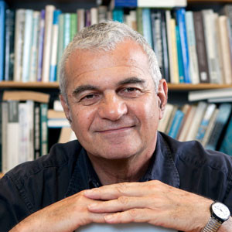
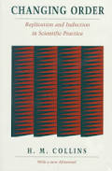
Experimenters’ regress
“we won’t know if we have built a good detector until we have tried it and obtained the correct outcome! But we don’t know what the correct outcome is until . . . and so on ad infinitum” (Collins 1992/1985, 84)
Notes:
It seems to me that one of the biggest threats to the epistemology of experiment is encapsulated in what Harry Collins has called the “experimenters’ regress”, which I have already mentioned. In his 1985 book Changing Order, Collins’ expresses the crux of the regress by saying: “we won’t know if we have built a good detector until we have tried it an obtained the correct outcome! But we don’t know what the correct outcome is until … and so on ad infinitum” (Collins 1992/1985, 84).

Slide 53
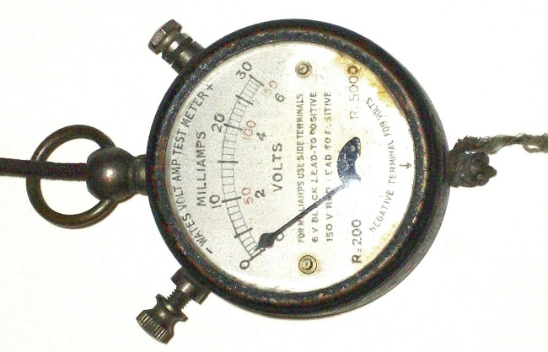
?
? V
Notes:
So, again, to take a very simple example: suppose we come across a battery of unknown voltage. We have voltmeter, but we don’t know whether the scale on the voltmeter is accurate or not. We could try to measure the voltage of the battery using this voltmeter, but the reading might as well be arbitrary. To take the reading that the voltmeter supplies seriously, we’d want to be assured that it delivers the right voltage for the battery. But the whole problem is that we don’t yet know what the voltage of the battery is, that’s why we were trying to measure it with the voltmeter in the first place.
Given this simple example, you probably already see have some ideas about how to get around this apparent problem.

Slide 54

Notes:
For example, if we have access to another battery the voltage of which is already known, then we could check to see if the scale on the voltmeter is accurate. If the voltmeter reads “9 volts” for a battery that we already know is a 9 volt battery, then we can confidently use the voltmeter to determine the voltage of the battery of unknown voltage.

Slide 55


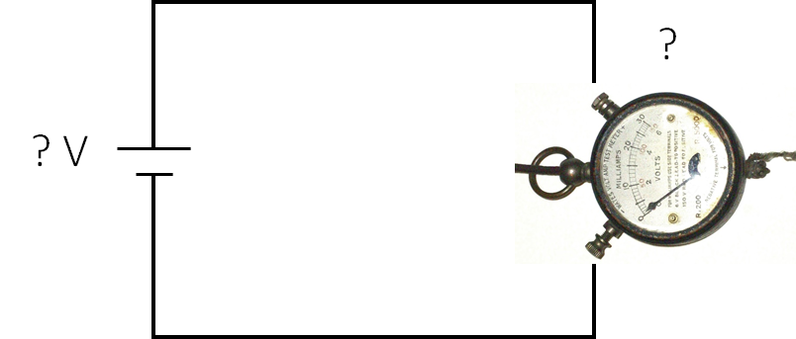

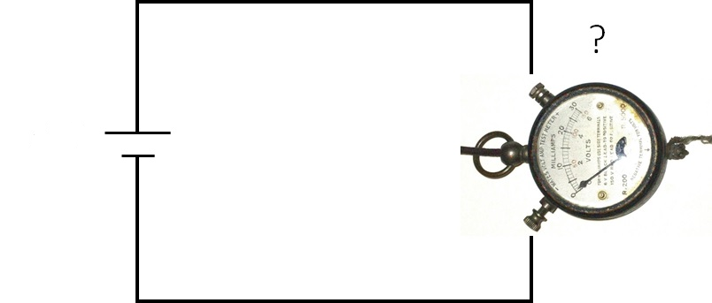
Calibration
“the use of a surrogate signal to standardize an instrument” (Franklin 1997, 31)
1)
2)
3)
Notes:
And this is how Allan Franklin suggests scientists evade the experimenters’ regress: via calibrating their instruments. Franklin defines ‘calibration’ as “the use of a surrogate signal to standardize an instrument”. So, if we want to successfully use a voltmeter to determine the unknown voltage of a battery, we should first be sure that the voltmeter is well-calibrated—that it reads the appropriate voltage when applied to a surrogate battery of known voltage. Once the instrument is properly calibrated, we have good epistemic reason to take the result it delivers seriously when applied to the battery of unknown voltage.
In other words, Franklin argues that in practice, Collins’ regress is truncated by calibration and that therefore calibration plays an important role in the epistemology of experiment.

Slide 56
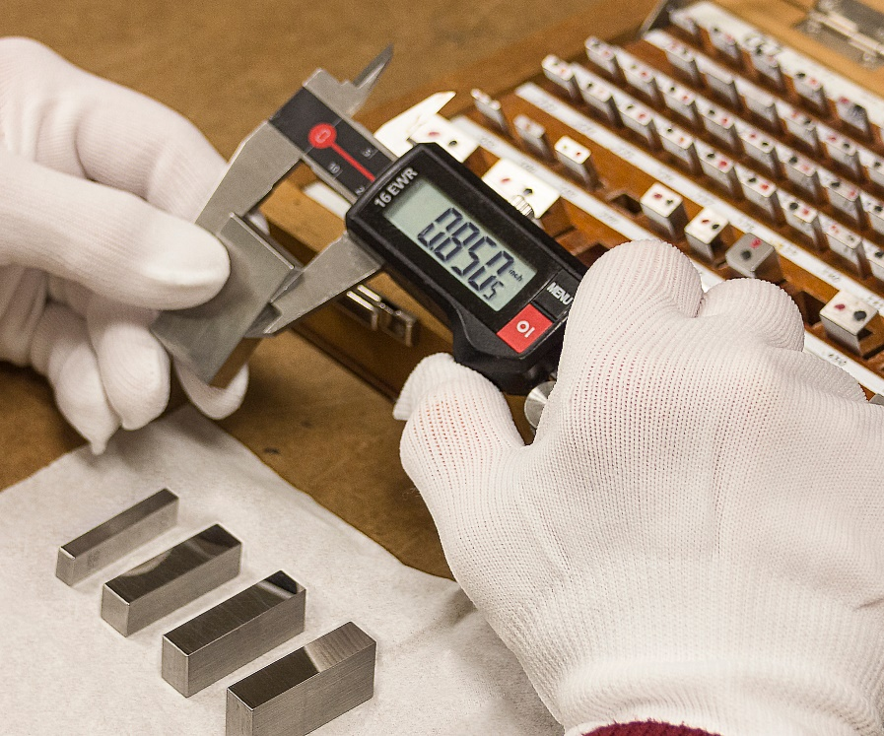
Image credit: Modern Machine Shop
Notes:
Indeed, calibration is a routine and ubiquitous aspect of scientific practice. Relatively simply measuring instruments like thermometers and scales must be calibrated. This picture comes from a machine shop guide, showing how to calibrate a digital caliper using gauge blocks, which were specially manufactured to have a standard length. Here, the gauge block serve as the surrogates according to which the instrument is standardized through the process of calibration.
https://www.mmsonline.com/articles/how-to-calibrate-your-calipers

Slide 57
As yet unmeasured signals
“The assumption built into this procedure is that the unknown voltage acts upon the meter in the same way as the standard voltages which were applied to calibrate it. This is so slight an assumption as hardly to be worthy of the name. After all, a voltage is a voltage is a voltage! Nevertheless, it would be correct to say that during the calibration of a voltmeter, standardized voltages are used as a surrogate for as yet unmeasured signals. In more controversial science the assumptions underlying the process of calibration are of greater moment” (Collins 1992/1985, 101)
Notes:
But Harry Collins emphasizes that thinking about mundane cases like measuring battery voltages with a voltmeter or lengths with calipers are misleadingly simple. The full force of the challenge that the experimenters’ regress poses arises in cases where scientists hope to measure signals that have not yet been measured at all. He writes: “The assumption built into this procedure is that the unknown voltage acts upon the meter in the same way as the standard voltages which were applied to calibrate it. This is so slight an assumption as hardly to be worthy of the name. After all, a voltage is a voltage is a voltage! Nevertheless, it would be correct to say that during the calibration of a voltmeter, standardized voltages are used as a surrogate for as yet unmeasured signals. In more controversial science the assumptions underlying the process of calibration are of greater moment” (Collins 1992/1985, 101) In other words, even in the case of measuring voltage, we have to make the assumption that the standard voltages used to calibrate the instrument are good surrogates for the unknown voltages that we want to measure. And perhaps this assumption seems justified in the case of voltages. But, what if we consider efforts to calibrate instruments designed to detect or measure genuinely new signals for which there aren’t ‘standard surrogate signals’?

Slide 58
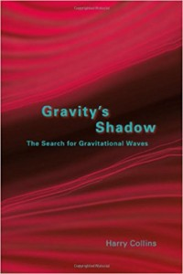
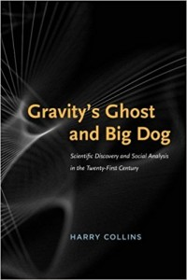
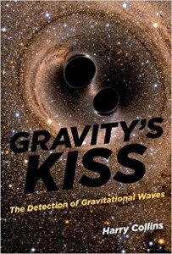
Problem: new types of signal
Notes:
Genuinely new signals thus seem to give the challenge that the experimenters’ regress poses to the epistemology of experiment some force that can’t be easily dismissed by appealing to routine calibration. Indeed, Collins has extensively studied the way that scientists reason in a particular context in which they faced a new type of signal: the search for gravitational waves. He’s written multiple books on this topic. Before anyone had ever detected a gravitational wave, how could scientists justify thinking that they had functioning gravitational wave detectors? You can’t just take a surrogate gravitational wave out of the supply cabinet in the way that you can a 9 volt battery.

Slide 59
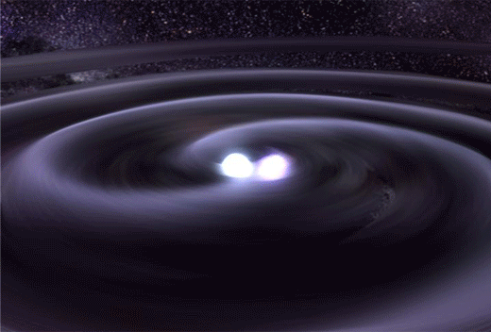
Gravitational waves
GW from merging astrophysical objects (like black holes and neutron stars) passing through our neighborhood would manifest as subtle, characteristic, changes in distances
Image credit: Carnegie Science
Notes:
In order to see what makes the case of gravitational wave research so interesting for the epistemology of science, let me just give you a little bit of context. Gravitational waves were predicted by Einstein, following his general theory of relativity. Gravitational waves dissipate energy from certain physical systems and travel through spacetime. Gravitational waves from merging astrophysical objects of extraordinary mass (such as black holes and neutron stars) could travel through spacetime and pass through detectors on Earth. These passing waves would manifest as subtle, but characteristic, changes in distances.
https://epl.carnegiescience.edu/file/neutron-merger-animationsmallshortgif

Slide 60
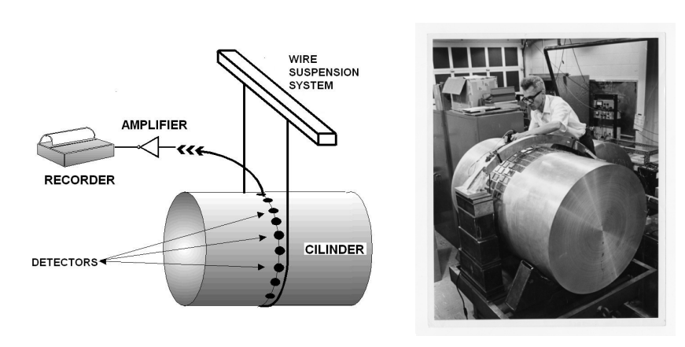
‘Weber bars’
Cervantes-Cota, Galindo-Uribarri and Smoot 2016, Figure 4
Notes:
Joseph Weber was an early pioneer in efforts to construct detectors on Earth that would be sensitive to gravitational waves. Weber designed a detector that consisted of a large aluminum cylinder outfitted with a belt of vibration sensitive detectors. Weber’s idea was that a passing gravitational wave would induce mechanical vibrations in the cylinder, which would then be picked up by the detectors and converted to an electrical signal. In 1969, Weber published an article claiming that he had detected gravitational waves, and claimed to have detected many waves in subsequent years. However, by about 1972 or so, there were serious doubts in the broader scientific community about the credibility of his results. And by the late-70s, once other scientists had built several other gravitational wave detectors around the world and systematically failed to detect gravitational waves themselves, as Cervantes-Cota and colleagues put it, quote: “everyone except Weber himself agreed that his proclaimed detections were spurious” (12).
How could this dispute between Weber and the other gravitational wave researchers be settled on epistemic grounds? Weber claimed he had a functioning gravitational wave detector and indeed that he had successfully detected gravitational waves many times over. The other researches thought he was mistaken and that his instrument wasn’t doing what Weber claimed it was. But neither Weber nor the other researchers could reach for standard surrogate signals in order to settle the dispute about these instruments.
Any empiricist epistemology of science (as opposed to a rationalist one) bestows a key role on empirical results. In order to argue that the results of one’s experiment are to be taken seriously, one has to argue that the experimental apparatus is working properly, but to argue that the apparatus is working properly – so says the regress – one demonstrates that the apparatus has produced the expected “correct” results (Collins 1992/1985, 84). Collins argues that it is in virtue of this looping in experimental reasoning that social factors like power, prestige, and personality get traction in decisions about how the results of experiments are interpreted and received by researchers and the scientific community at large.
://www.science.org/content/article/remembering-joseph-weber-controversial-pioneer-gravitational-waves
https://www.mdpi.com/2218-1997/2/3/22/htm
https://arxiv.org/ftp/arxiv/papers/1609/1609.09400.pdf

Slide 61
Problem: looks like sociological factors truncate the regress
Notes:
If Collins is right about the existence of this sort of regress, then the epistemology of experiment faces a serious problem. The experimenters’ regress cannot be abolished by good research ethics alone. All fraud could cease, but social factors would still be required to truncate the regress. If social factors were to play the decisive role in the deliverances of science, then there is not much to recommend a special epistemic status for the enterprise in comparison to other human pursuits like art, politics, and myth-making.

Slide 62
The regress as applied to Weber
“The so-called ‘epistemological criteria’ are necessary for establishing the existence of a new phenomenon (as Allan says) but they are not a sufficient criterion where dispute runs deep” (Collins and Franklin 2016, 100)
Notes:
Although at times in the past they have vehemently disagreed with one another, a few years ago Harry Collins and Allan Franklin actually jointly wrote a paper in which they attempted to clarify shared common ground and points of remaining disagreement. Even in this relatively conciliatory piece however, Collins maintains that ‘epistemological criteria’ are not sufficient for establishing the existence of a new phenomenon (like gravitational waves were in Weber’s day). That is, Collins still maintains that sociological factors play significant roles in such deliberations.

Slide 63
Franklin’s rejoinder
“Scientists injected pulses of acoustic energy into the antenna and determined whether their apparatus could detect such pulses. Weber’s apparatus failed to detect the pulses, whereas each of the six experiments performed by his critics detected them with high efficiency” (Franklin 1997, 44)
Notes:
Franklin has responded extensively to Collins’s discussion of Joseph Weber’s attempts to detect gravitational waves, arguing that Weber’s apparatus failed the relevant calibration tests (1997, 46). That is, before even worrying about the inferential gap involved in interpreting purported detections of novel phenomena, Weber’s instrument had an opportunity to show that it was suitable for the task ahead, and failed. Without handy gravitational wave standards, the detectors in these experiments were subjected to surrogate signals. As Franklin explains, “Scientists injected pulses of acoustic energy into the antenna and determined whether their apparatus could detect such pulses. Weber’s apparatus failed to detect the pulses, whereas each of the six experiments performed by his critics detected them with high efficiency” (44). According to Franklin, the crucial difference between Weber’s experiment and his competitors’ was the algorithm he used to search for signals in his data. Weber’s algorithm was nonlinear while the competitors’ was linear. Weber was evidently concerned that a linear algorithm would miss the gravitational wave signals. Addressing this worry, the competitors also checked to see if using the nonlinear algorithm on their own data would yield the detection that Weber claimed – it did not (45).
Franklin concludes that in light of Weber’s failure to properly calibrate his instrument using plausible surrogate signals considered together with several other problems with Weber’s analysis, the physics community rightfully rejected his detection claims based on epistemological criteria (49).

Slide 64
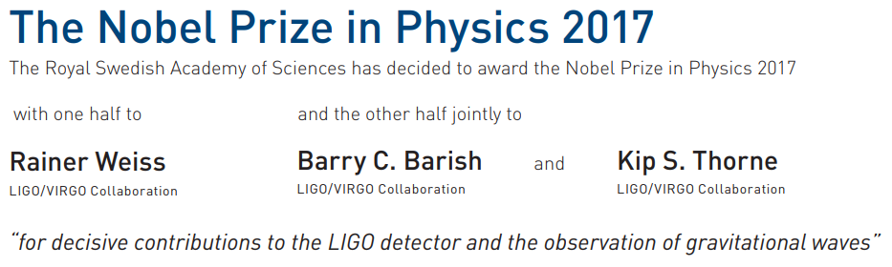
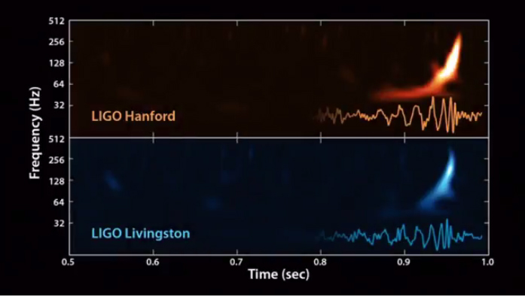
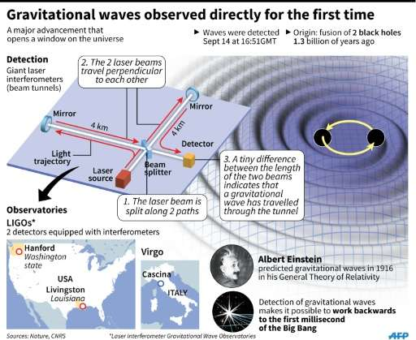
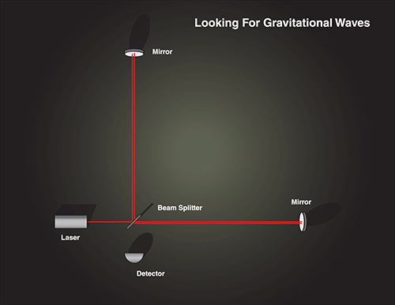
Gravitational wave detection
Image credit: National Science Foundation
Image credit: NASA
Notes:
As you may know, the 2017 Nobel Prize in physics was awarded for the observation of gravitational waves. Not to Weber, but rather to three other physicists for their contributions to the LIGO detector—the Laser Interferometer Gravitational Wave Observatory. The first detection came in 2015. Given problems that we have just seen with Weber’s efforts to detect gravitational waves, you might wonder: what makes the LIGO researchers so sure they have succeeded? Is that confidence well-justified by the right sort of epistemic reasons, or did sociological factors (the lure of the Nobel Prize perhaps?) play a decisive role?
https://www.space.com/31900-gravitational-waves-discovery-ligo.html
https://spaceplace.nasa.gov/gravitational-waves/en/
https://phys.org/news/2016-02-gravitational-unveiled-china.html
https://www.nobelprize.org/uploads/2018/06/press-40.pdf

Slide 65
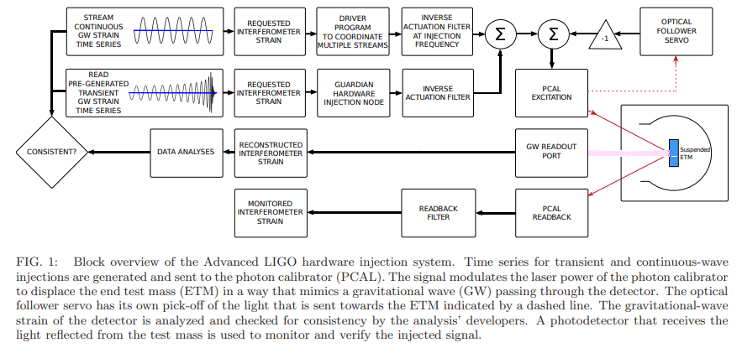
Surrogates: ‘hardware injections’
Biwer et al. 2017
Notes:
It seems to me that there are good epistemic reasons to take the LIGO results seriously, which in fact do have a lot to do with the role of surrogate signals in the preparation of the apparatus. I’ll try to explain this briefly. Remember that Collins’ emphasis on the novelty of gravitational wave signals was supposed to cast doubt on the availability of appropriate surrogate signals to use in calibrating the gravitational wave detector. But the LIGO team did have surrogate signals, that they argued were appropriate for testing the functioning of their instrument. The collaboration used something called ‘hardware injections’ to mimic gravitational waves passing through the detector. LIGO is an interferometer, it works by carefully monitoring the lengths of two long ‘arms’. Because a passing gravitational wave would subtly change the lengths of these arms, the surrogate signal is induced by purposefully altering their length in a characteristic way by displacing the end test mass in the apparatus. In a truly fascinating episode, the LIGO collaboration designated a small number of its own researchers as the so-called ‘blind injector group’ who were allowed to secretly inject these surrogate signals into the detector during normal data taking. The rest of the collaboration would have to react to the signal not knowing whether it was real or faked and decide whether they were confident enough in the result to submit it for publication in a journal before the blind injection team revealed whether they had injected that signal.
The scientists themselves were evidently worried about the possibility that the high-stakes nature of their research could influence their reasoning in an unhelpful way. As two LIGO researchers put it: “Our collaboration made the decision that the moment of potential discovery—when emotions are running high and reputations are at stake—is not the time to define a procedure for confirming a potential major scientific discovery” (Kanner and Weinstein). If a promising looking result came in, but the collaboration knew that it might be faked, they hoped that possibility would make them as careful and reasonable as possible in their analyses and in interpreting their results.
In fact, in 2010, LIGO detected a strong signal that looked like that expected from gravitational waves emitted by a pair of merging black-holes. The collaboration named the signal ‘the Big Dog’ because they had inferred that it originated in the constellation Canis Major. For six months they “labored over the data and ran through a suite of hardware checks”, they “developed new analysis tools and tried to figure out if the event was due to the instrument or other terrestrial noise” and drafted “a discovery paper” for which they “agonized over” whether to call the result a ‘detection’, ‘observation‘, ‘discovery’, ‘evidence’…finally at a collaboration meeting in which they reviewed all they evidence, the paper draft, and voted to submit the paper to a journal…the signal was revealed to be a surrogate. It had been intentionally injected in secret as a test by the blind injector group.
https://arxiv.org/pdf/1612.07864.pdf

Slide 66
‘Big dog’
“So when Jay Marx opened his envelope in Arcadia in 2011 and told us all that the Big Dog was a Big Fake, and that we had just completed the first successful discovery fire drill in gravitational wave observation history, we still treated it as a moment of celebration. We raised glasses of champagne, and toasted our fake success. It was a strange, hollow feeling. But clearly, Big Dog had motivated a flurry of work, including big steps forward in our ability to measure the masses of the source objects (the neutron star or black hole) using only the gravitational wave signal. Most significantly, our collaboration had agreed for the first time what standards we’d use, and how we’d minimize our biases. For the first time, we had decided that we had enough evidence for a detection” (Kanner and Weinstein 2016)
Notes:
Researchers Kanner and Weintsein describe how they felt after learning that the signal had been intentionally injected as follows: “when Jay Marx opened his envelope in Arcadia in 2011 and told us all that the Big Dog was a Big Fake, and that we had just completed the first successful discovery fire drill in gravitational wave observation history, we still treated it as a moment of celebration. We raised glasses of champagne, and toasted our fake success. It was a strange, hollow feeling. But clearly, Big Dog had motivated a flurry of work, including big steps forward in our ability to measure the masses of the source objects (the neutron star or black hole) using only the gravitational wave signal. Most significantly, our collaboration had agreed for the first time what standards we’d use, and how we’d minimize our biases. For the first time, we had decided that we had enough evidence for a detection.”
https://nautil.us/issue/42/fakes/the-cosmologists-who-faked-it

Slide 67
Summary so far…
Experimenters’ regress – a challenge to the epistemology of science
  Problem: looks like sociological factors truncate the regress
Calibration – truncates the regress via surrogate signals
  Problem: new types of signals, e.g. GW
  Solution: fake surrogates, e.g. hardware injections for GW research
Notes:
Before I move on to discuss the epistemology of measurement, let me first summarize where we’ve gotten so far. I began by introducing Harry Collins’ experimenters’ regress as a challenge to the epistemology of science. How can scientists tell whether they have successfully detected something without first knowing that they have a functioning detector? But how can they know that they have a functioning detector without showing that the detectors successfully detects whatever they were trying to detect in the first place? I then described Allan Franklin’s approach to neutralizing the regress. Franklin argues that calibrating an instrument with surrogate signals gives scientists good reasons to trust the results the instrument yields when applied to new cases. Indeed, even in cases where the signal to be detected is of a new type, as was the case for gravitational wave researchers until very recently, we saw how researchers design appropriate surrogate signals, as in the hardware injections for gravitational wave research.
My own impression of this scholarly exchange between Collins and Franklin is that Franklin is largely correct. Scientists are often in a position to justify taking the results their instruments yield seriously in virtue of prior work that has been done to properly calibrate those instruments using surrogate signals. At least for many cases, sociological factors like desire for power and prestige don’t play the decisive role in determining when scientists take results seriously. Scientists take care to ensure that their instruments are functioning appropriately and often enough that is sufficient for taking the results those instruments produce seriously. So, I don’t think that the challenge that experimenters’ regress poses to the epistemology of science ultimately succeeds.
With that said, I now want to discuss some recent scholarship on the epistemology of measurement in connection with calibration that I think raises a different sort of challenge for the epistemology of experiment.

Slide 68
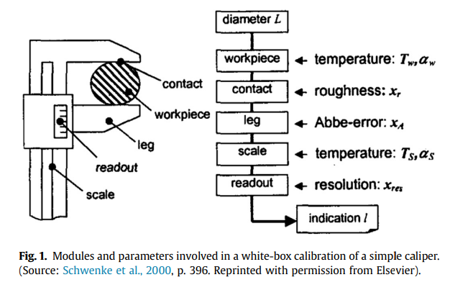
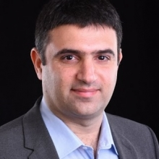
Epistemology of measurement
Tal 2017a
Notes:
Philosopher of science Eran Tal’s sophisticated account of calibration complicates the interpretations presented thus far. Tal argues that we are mistaken to think of calibration primarily as adjusting the readout of one instrument to reflect that of a standard, concluding that “comparison with a standard is neither necessary nor sufficient for successful calibration” (2017a, 246). If Tal’s argument is correct, then it seems that we will have to revisit the responses to the threat of the experimenters’ regress in order see if compelling arguments against it can nevertheless be made even with an understanding of calibration modified by Tal’s insights. In order to do this, we had better understand Tal’s critique of other accounts of calibration and the nature and implications of his own view.
Adopting terminology from metrology, the science of measurement, Eran Tal helpfully distinguishes between “instrument indications” and “measurement outcomes.” An instrument indication is the final state of a measuring apparatus such as the position of a pointer on a dial or the display of some readout. By itself, an instrument indication is of little use for gaining information about the measurand. In order
to yield such information, an instrument indication must be interpreted in light of other information about the measuring context, notably, a calibration function. On Tal’s account, a measurement outcome refers to “a claim that is inferred from one or more indications along with relevant background knowledge” (Tal 2017a, 235). To make a claim about the measurand, one must make an informed inference from the relevant instrument indications, drawing on auxiliary information.
The calibration of a caliper provides an illustrative example. Calipers facilitate the precise measurement of the diameter of workpieces by way of adjustable jaws that can be snugly fit around the piece whose diameter one wants to measure. You might think (as indeed I suggested earlier in this talk) that calibrating a caliper is straightforward; the scale on the caliper simply needs to be tuned so as to measure the appropriate diameter when applied to standard gauge blocks – that is, objects whose diameter has already been precisely determined (242). However, as Tal explains, a more accurate calibration of a caliper can be accomplished by “white-box calibration,” which explicitly models factors that contribute to the caliper readout, “e.g. the roughness of the contact [between the caliper and the workpiece], the resolution of the readout, the temperature of the workpiece, and so on” (243). The more complicated calibration function that takes these aspects of the measurement into account will improve measurement accuracy.
Tal rightfully emphasizes that a widespread view of measurement fails to account for the epistemic significance of the work required to get a claim about a target from the state of a measuring instrument. Tal characterizes the traditional definition of calibration as “the activity of establishing a correlation between the indications of a measuring instrument and quantity values associated with a measurement standard,” like establishing a correlation between the value displayed on the caliper readout and the previously established diameter of gauge blocks (243). The vertigo-inducing problem with this view is that people trying to make measurements do not have access to the true values of the measurand to use as standards for calibration. How is the diameter of the gauge block itself established? This is starting to sound like the experimeters’ regress again.
Tal 2017, 37

Slide 69

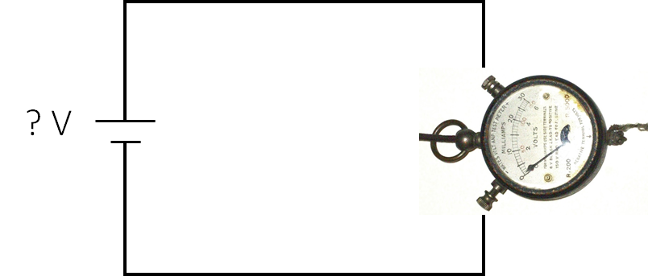
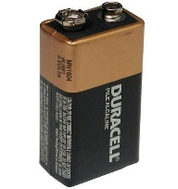
Circle & Regress
See Feest 2016
…
Notes:
At this point, following Feest (2016), it is actually helpful to distinguish between two regresses, or better yet, a circle and a regress (35). First, there is a loop internal to an experiment, which is what Collins has called the experimenters’ regress: the apparatus is judged to be working correctly when it returns the appropriate result and that the result returned by the apparatus is appropriate is judged on the basis that the apparatus is working correctly. In its most striking form: one judges that the phenomenon of interest has been successfully detected only when the detector is working properly, but one only has reason to believe that the detector is working properly when it successfully detects the phenomenon of interest. As we have already seen, this circle can be severed by calibration: the apparatus is judged to be working correctly by returning the appropriate result when applied to independently well-characterized surrogates.
However, there is a second, or perhaps proper regress, which Tal’s epistemology illuminates. On what basis have the surrogates been well characterized? The surrogates used in calibration are well characterized via other applications of apparatuses that have themselves been calibrated on other well-characterized surrogates, which have been well-characterized via other applications of apparatuses, and so on. This regress extends beyond the context of using a single instrument. It traces the justification for taking results that instrument yields all the way back.
https://commons.wikimedia.org/wiki/File:1920s_multimeter_3738-6b.jpg

Slide 70
Problem: no access to true values
Notes:
The epistemic problem here—the challenge to the epistemology of science—is that of course we don’t have access to the true values of anything we are trying to measure in order to calibrate the ‘first’ instrument that can seed the chain of justification up through various surrogates and instruments to get the assurance that the instrument we want to use to measure an unknown value will produce results that we can justifiably take seriously.

Slide 71
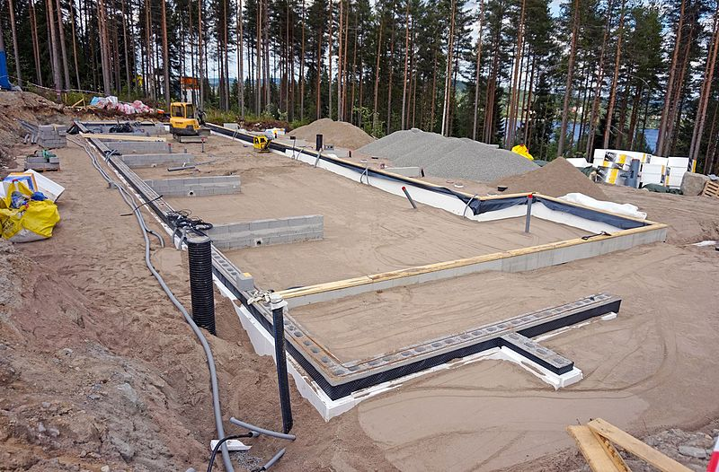
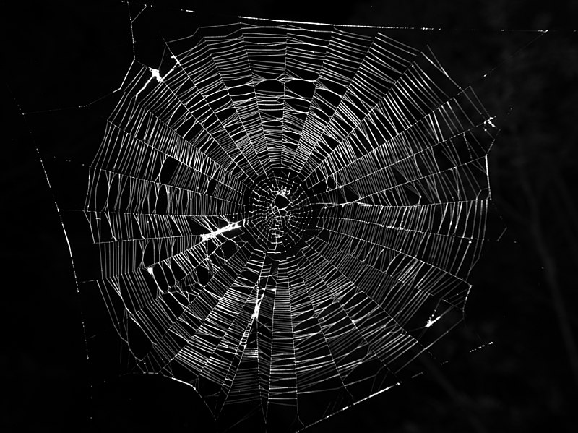
Foundationalism vs. coherentism
‘built from the ground up ‘hangs together in a on a solid foundation’ self-supporting web’
Notes:
Here it is helpful to distinguish between two philosophical views that one could have about the epistemology of measurement. One could adopt foundationalism with the hope that the regress bottoms out somewhere on secure epistemic foundations. Or one could adopt a coherentist view according to which measurements get their epistemic support by cohering with other measurements in the right sort of way.
As I have just suggested, foundationalism does not look promising in this context. Since we don’t have access to the true values of measurands, it seems that we don’t have a secure foundation on which to build.
Thinking about the calibration regress that extends beyond the context of a focal measurement, a coherentist account of epistemic justification appears more promising that a foundationalist one.
https://commons.wikimedia.org/wiki/File:Building_foundation.jpg

Slide 72
Coherent models
“Instead of comparing outcomes to true values, practicing scientists are faced with the challenge of evaluating accuracy and error by comparing measurement outcomes to each other. Such comparisons by their very nature cannot determine the extent of error associated with any single outcome but only overall mutual compatibility among outcomes” (Tal 2017a, 239)
Notes:
And indeed, Tal argues for a coherentist view of measurement.
On Tal’s account, measurement in general is a modeling activity. To get to a measurement outcome, one has to construct a model of the measuring process such that the instrument indication relates to a representation of the measurand. Modeling measurements in this way is, according to Tal, what facilitates comparison of measurements across different specific contexts. Such comparison is essential to calibration. For Tal, “different measurement processes provide objective knowledge about the values of a quantity only once they have been idealized in a mutually coherent and consistent manner in terms of that quantity” (241). A measurement, then, is a prediction of the value of the measurand by way of the idealized model of the measuring process (243).
Measurements are validated insofar as they mutually cohere with predictions of the purportedly same measurand made with different models of measuring processes – that is, properly informed measurement outcomes. By invoking these intermediary models of measurement processes, Tal claims to avoid the
kind of operationalization that would isolate epistemologies of measurement to individual measurements (240). Calibration functions are therefore tools for predicting the value of the measurand from instrument indications (243).
If calibration is, as Tal argues, a web of mutually coherent measurement outcomes, can it effectively sever the experimenters’ regress?
Tal argues against traditional foundationalist views of measurement that confer special epistemic status to measurement outcomes in virtue of their closeness to observation by human senses. Instead, Tal argues (drawing on the work of Kent Staley) that insofar as measurement outcomes serve a special role in generating scientific evidence, it is because of their “security” (5). Measurement outcomes are more “secure” in this sense the less an epistemic agent expects them to require revision in the future. If an agent has reason to suspect that an outcome is bound to be revised in the future, that outcome is not very secure. This is certainly no foundationalism!
However, for those who would take up this line of inquiry, I offer a word of caution: a coherent web disconnected from causal contact with worldly targets will not do empirical science epistemic justice. Let me briefly say why I suspect this worry applies to Tal’s epistemology of measurement, and how the view of measurement that Hasok Chang defends might be recruited to avoid it.
I suggest that Tal’s emphasis on idealized models is misleading and that his blurring of the boundary between prediction and measurement ultimately unhelpful.
On his view, scientists predict the value of a measurand from an instrument indication via a model of the measuring process. Tal construes this as a benefit of his view and a topic worthy of further investigation:

Slide 73
Measurement and prediction
“Another advantage of the model-based view is that it exposes the close relationship between measurement and prediction, which has thus far remained implicit in philosophical writings about measurement. Measurement and prediction are traditionally viewed as two distinct kinds of epistemic activity, the former concerning the observation of actual states of affairs while the latter concerns the derivation of consequences from hypothetical assumptions. If the analysis presented here is correct, the boundaries between measurement and prediction are more permeable than previously supposed. Measurement outcomes are predictors that have been “objectified” through coherence, and measurement accuracy is a special case of predictive accuracy. These relationships between measurement and prediction suggest interesting new directions in the study of scientific evidence, as well as unexplored parallels between measurement in the natural and behavioural sciences” (Tal 2017b, 44–45)
Notes:
He writes, “Another advantage of the model-based view is that it exposes the close relationship between measurement and prediction, which has thus far remained implicit in philosophical writings about measurement. Measurement and prediction are traditionally viewed as two distinct kinds of epistemic activity, the former concerning the observation of actual states of affairs while the latter concerns the derivation of consequences from hypothetical assumptions. If the analysis presented here is correct, the boundaries between measurement and prediction are more permeable than previously supposed. Measurement outcomes are predictors that have been “objectified” through coherence, and measurement accuracy is a special case of predictive accuracy. These relationships between measurement and prediction suggest interesting new directions in the study of scientific evidence, as well as unexplored parallels between measurement in the natural and behavioural sciences” (Tal 2017b, 44–45)

Slide 74
Measurement and prediction
“The epistemic credentials of measurement are not different in kind from those of other modes of quantitative estimation, such as theoretical prediction and computer simulation” (Tal 2106, 5)
Notes:
Indeed, he claims that “The epistemic credentials of measurement are not different in kind from those of other modes of quantitative estimation, such as theoretical prediction and computer simulation” (Tal 2106, 5)
If measurements were to have the same epistemic function as predictions, the experimenters’ regress would pose a very serious problem. In fact, the consequences of that unity would be epistemically catastrophic well beyond the scope of the regress. Calibration was supposed to disrupt the regress because an instrument could be judged to be working correctly in virtue of something other than success at its principal aim. Support for the judgment that the gravitational wave detector is working correctly is supplied by noting its appropriate response to surrogate acoustic signals. In other words, the instrument is tested out on an input that has already been well characterized. In a measurement context, the caliper is judged to be working correctly, not merely when it yields some instrument indication in a new application, but when the caliper has been carefully calibrated using gauge blocks whose diameter has been measured by other procedures. That the calibration procedure, even for common instruments like calipers, is better achieved by modular modeling than by a linear fit between inputs and indications does not disrupt the important fact that the gauge blocks are needed to accomplish the procedure. Suppose measurements are just predictions. It would then be possible to construe successful calibration (as in, the new caliper readout returns the appropriate value when applied to independently measured gauge blocks) along the lines of Tal’s view in the following way: the predicted value of the measurand using the new model is coherent with the predicted value of the measurand using other models. This phrasing is jarring because we typically understand predictions in the manner Tal indicates in the extended quote cited earlier: as deriving from theory or hypothesis. Coherence between predictions cannot truncate the experimenters’ regress because coherence between predictions can be achieved regardless of the state of the world.

Slide 75
Problem: doesn’t let the world ‘push back’
Notes:
Without a distinction between theoretical predictions and empirical results, the evidential corpus floats free of the world of which it is supposed to inform us, stranding us with nothing but the products of our own imaginations. It doesn’t make sense of how the world ‘pushes back’ on our theorizing, how nature can tell us when our predictions are wrong.
Let me suggest that the enriched view of evidence allows us to avoid this problem.

Slide 76
DATA PRODUCTION
DATA PROCESSING
DATA RECORD
EMPIRICAL RESULT
PROCESSED DATA
PROVENANCE METADATA
WORKFLOW METADATA
ENRICHED LINE OF EVIDENCE
See Boyd 2018
Notes:
I suggest that we subsume the epistemology of measurement under my view of enriched evidence. As we discussed already, on that view, the epistemic utility of the result of the measurement depends on the assumptions baked into it. Those assumptions will inform the ways in which the result of the measurement may be responsibility deployed. Furthermore, the enriched view of evidence displays how measurement results can be revised when initial assumptions come under further scrutiny. Suppose assumptions made about
the roughness of surfaces in the application of a caliper end up being revised. By keeping track of what assumptions were made in generating a measurement result, one can then judge whether the subsequent revision of those assumptions affects the epistemic utility of the result for one’s purposes.
If we understand measurement outcomes as empirical results in the manner I have just described, then we are not tempted to construe the comparison of measurement outcomes with theoretical predictions as a comparison of one prediction to another prediction. Rather, we can understand measurement outcomes as empirical results generated by cleverly processing data, in this case, records of instrument indications. The data are empirical in virtue of having been produced by a causal interaction involving the worldly target. The data produced by that initial interaction are not epistemically useful themselves. They need to be cajoled into a form that is relevant to the desired information. This cajoling is achieved by processing them, often by invoking models. To put the results of such processing to epistemic use, one must consider them together with their enriching information. Theoretical and modeling assumptions are typically made in the course of data processing and interpreting empirical results, but this does not render those results predictions. Similarly, predictions can be empirically informed, but they are not themselves empirical results. Countenancing measurement outcomes as empirical results yields a picture of successful calibration that retains the essential role of the empirical. Consider an apparatus that is new or of questionable functioning. Using background knowledge about the functioning of the apparatus, the processing used to generate results from it is adjusted so as to deliver appropriate results when applied to well-characterized surrogates. The results are deemed appropriate when they are consistent with the results delivered by prior applications of other properly functioning apparatuses. Should new information bring the proper functioning of those prior apparatuses or other aspects of the background knowledge employed into question, the calibration should be adjusted accordingly.
While I think that conceiving of measurement outcomes as empirical results helps us keep clear on the distinctive epistemic roles that predictions and empirical results play, and the way in which the natural world ‘pushes back’ on our theorizing about it via empirical results, this approach does not obviously resolve the issue of the experiments’ regress. So does that mean that Tal is right after all?

Slide 77

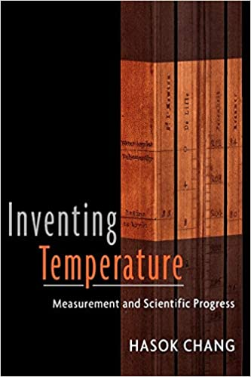
Chang’s ‘progressive coherentism’
“In the framework of coherentism, inquiry must proceed on the bass of an affirmation of some existing system of knowledge […] The initial affirmation of an existing system of knowledge may be made uncritically, but it can also be made while entertaining a reasonable suspicion that the affirmed system of knowledge is imperfect” (Chang 2004, 224-5).
Notes:
Historian and philosopher of science Hasok Chang’s (2004) masterful study of the evolution of temperature measurements might seem at first glance to corroborate collapsing the distinction between theoretical predictions and empirical results. In particular, Chang’s cases show that what is assumed, predicted, and measured can swap places as inquiry evolves. On the surface, this might look like looping with the attending threat of free-floating coherentism. But Chang argues that there is genuine epistemic progress here – rather than circles, these loops are spirals (2007, 14). Chang’s view of “progressive coherentism” relies on the engine of epistemic iteration. Starting from a system of knowledge that is affirmed without foundationalist justification, by iterative refinements a type of progress is possible. Chang writes: “In the framework of coherentism, inquiry must proceed on the bass of an affirmation of some existing system of knowledge […] The initial affirmation of an existing system of knowledge may be made uncritically, but it can also be made while entertaining a reasonable suspicion that the affirmed system of knowledge is imperfect” (Chang 2004, 224-5).
In other words: scientists have to start somewhere and it doesn’t have to be perfect in order to make progress. In the case of temperature this start was affirming the reliability of human sensation for qualitative appraisal of hot and cold. Thermoscopes, later affirmed in part because they largely agreed with the pronouncements of sensation, could then be used to show the limitations of sensation. Thus, on Chang’s view, the starting point of inquiry is not retained unchanged. It is corrected and refined as the spiral emerges.
Moreover, despite the swapping and spiraling, there is still a meaningful distinction to be made between theoretical predictions and empirical results within Chang’s progressive coherentism. Pick out a point on the spiral and one can discern the predictions from the results. The role that empirical results play in this progression could not be performed by theoretical predictions instead. In stating that computation can usefully be cast as a kind of measurement (2016a, 6), Tal risks losing sight of the channels through which nature constrains our theorizing. It may be useful for identifying predictions and empirical results to distinguish them by the functional roles they play in the epistemology of science at a given point in the spiral. However, it is not just anything that can play the role of an empirical result – it needs to be possible to tell a story about how the empirical result is causally downstream of the worldly target.

Slide 78
Suppose we adopt progressive coherentism. If scientists have to start somewhere, is that starting point arbitrary?
Are there roles for non-empirical virtues in an empiricist epistemology of science?
If so, must we accept strong pluralism?
Would any of this be a problem for empiricism?
See pg. 52 of “Is There an Epistemology of Experimental Physics?”

Slide 79
Are there any other (non-foundationalist) alternatives that would be more appealing to empiricists?

Slide 80
Are there meaningful epistemic differences between predictions and results?
See pg. 48 of “Is There an Epistemology of Experimental Physics?”

