Slide 1

There is No Complete
Calculus of Inductive Inference
John D. Norton
Department of History and Philosophy of Science
University of Pittsburgh
Based on
Ch. 12. “No Place to Stand: The Incompleteness of All Calculi of Inductive Inference”
in
The Material Theory of Induction
and
“A Demonstration of the Incompleteness of Calculi of Inductive Inference,” British Journal for the Philosophy of Science, 70 (2019), pp. 1119–1144.

Slide 2
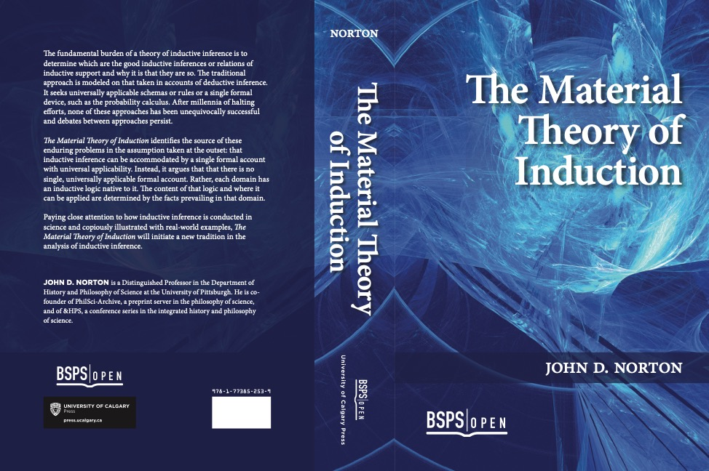
Material Theory of Induction

Slide 3
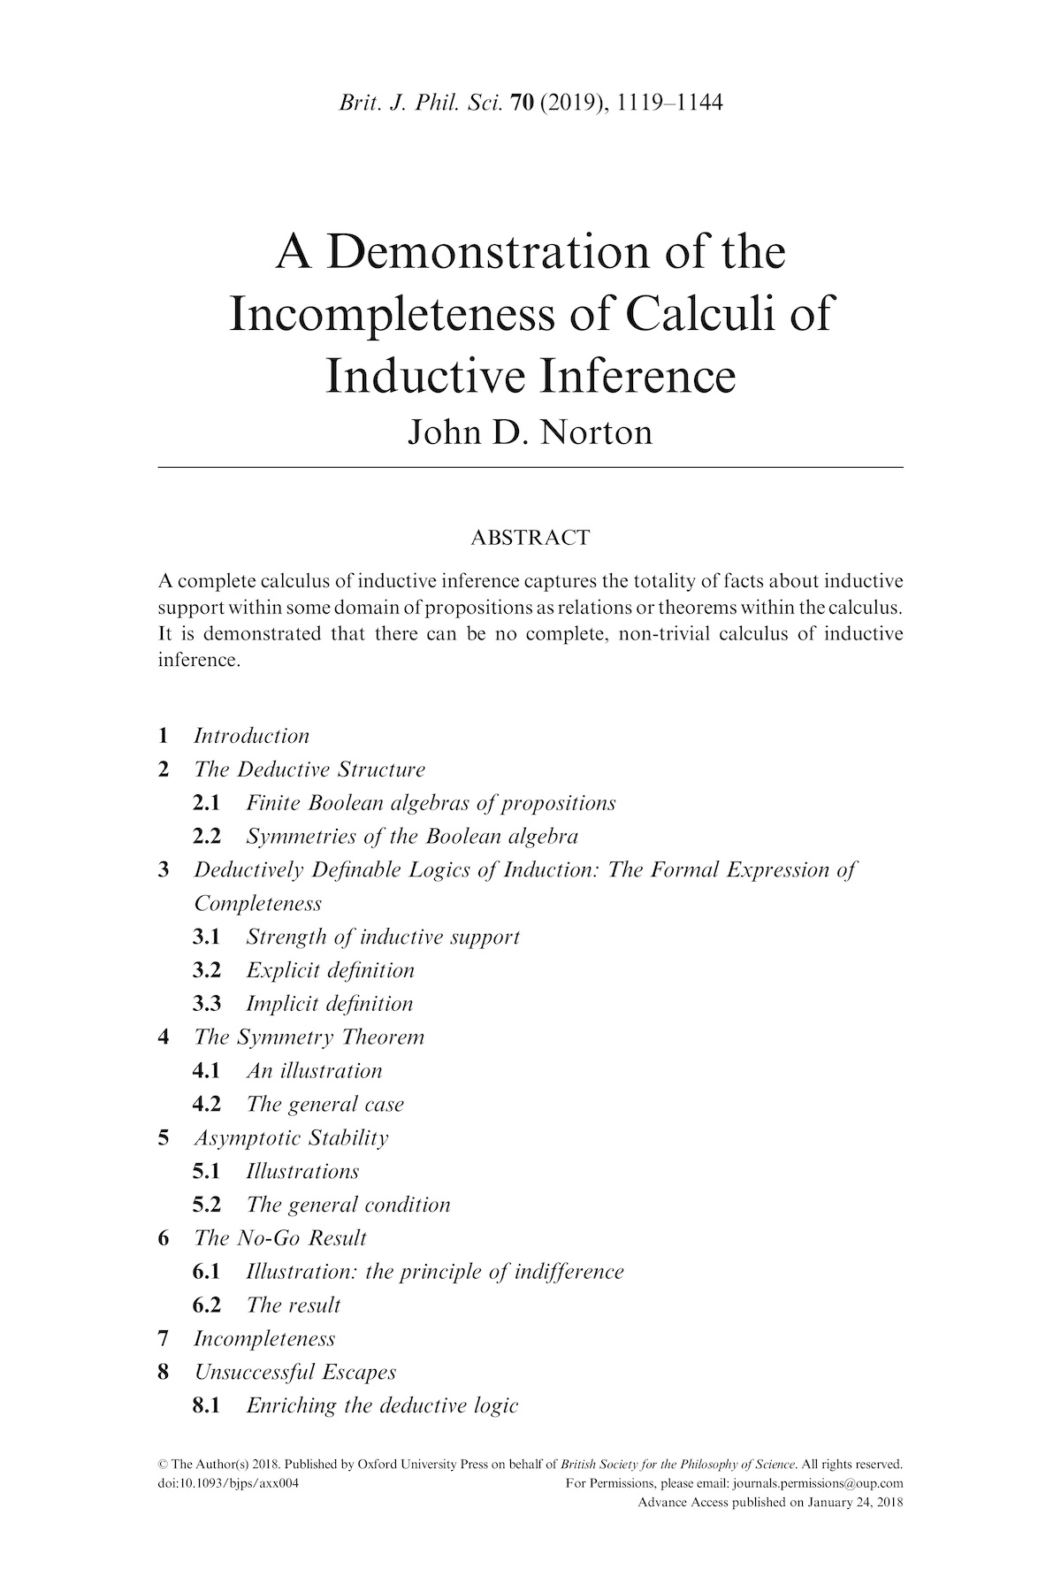

Slide 4
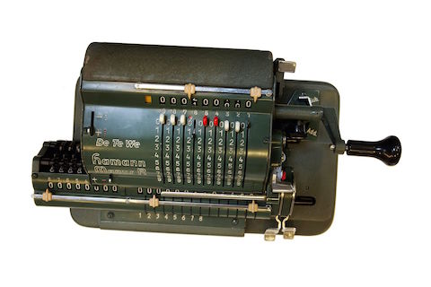




This Talk
There is no non-trivial,
complete calculus of inductive inference.
What is completeness and why would we want it?
Why can’t we have it?
Really? Isn’t there some way out?

Slide 5
The Path to Completeness

Slide 6
What IS inductive inference?
?
?
?
Good
inductive inference
Inference that conforms with the probability calculus
An appealing possibility
=
or some other calculus
Woes of
inductive inference
Mechanical calculation
Particular facts of inductive support
Computation of a particular conditional probability
strength of support
General properties of inductive inference
Demonstration of a theorem in the probability calculus
other calculus

Slide 7
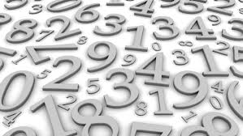

Particular Facts
Is 7,919 the thousand’s prime number?
Compute mechanically by the sieve or Eratosthenes
2
3
4
5
6
7
8
9
10
11
12
13
…
1st
2nd
3rd
4th
5th
6th
Is evolution well supported by the fossil record?
Compute mechanically
P( evolution | fossils ) = 0.99865
or
[ evolution | fossils ] = big

Slide 8
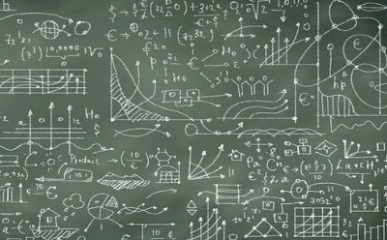
General Properties
Are there infinitely many prime numbers?
Yes. Euclid proves constructively that for any prime number, there is always a greater one.
If a simple hypothesis simp and complicated one comp both entail the evidence, should we prefer the simpler one?
Prove as a theorem that
P( simp | evid ) > P( comp | evid )
or
[ simp | evid ] > [ comp | evid ]

Slide 9
External Inductive Content
(illustrated)

Slide 10
Simple versus Complicated
posteriors
likelihoods
priors
P( simp | evid )
P( evid | simp )
P(simp)
=
x
P( comp | evid )
P( evid | comp )
P(comp)
1
Both simp and comp entail evid.
1

Slide 11
Simple versus Complicated
posteriors
priors
P( simp | evid )
P(simp)
=
P( comp | evid )
P(comp)
There are few simple hypotheses.
{ simp } = {simp₁, simp₂, …}
There are many complicated hypotheses.
{ comp } = {comp₁, comp₂, comp₃, …}
Stipulate
P( {simp } ) = P( {comp } )
P(simp)
many
=
>>1
P(comp)
few
P( simp | evid ) >> P( comp | evid )

Slide 12
Simple versus Complicated
posteriors
priors
P( simp | evid )
P(simp)
=
P( comp | evid )
P(comp)
There are few simple hypotheses.
{ simp } = {simp₁, simp₂, …}
There are many complicated hypotheses.
{ comp } = {comp₁, comp₂, comp₃, …}
Stipulate
P( simp₁ ) = P(simp₂ ) =…
… = P( comp₁ ) = P( comp₂ ) = …
P(simp) = P(comp)
P( simp | evid ) = P( comp | evid )

Slide 13

External Inductive Content
=
The determination of inductive strengths of support by considerations external to calculations within the calculus.
Stipulate
P( {simp } ) = P( {comp } )
Stipulate
P( simp₁ ) = P(simp₂ ) =…
… = P( comp₁ ) = P( comp₂ ) = …
The optimists’ hope.
Eliminate the influence of external inductive content
by
expanding the scope of the analysis to include the external factors.

Slide 14
Completeness

Slide 15
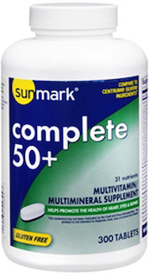
Completeness in a domain
propositions within the domain.
inductive content
is fixed by the calculus from
All
Complete list of what supports what with what strength.
No inductive content introduced from outside.
IN
OUT
All background facts of science
universal calculus
Proper warrant for all hypotheses of science

Slide 16


THERE IS
NO
NON-TRIVIAL
COMPLETE CALCULUS
OF INDUCTIVE
INFERENCE.
THERE IS
NO
NON-TRIVIAL
COMPLETE CALCULUS
OF INDUCTIVE
INFERENCE.

Slide 17
Demonstrating the Incompleteness

Slide 18
Overall…
A standard way of defining a logic of induction that expresses completeness.
IF
(a) The inductive logic is deductively definable;
(b) asymptotically stable; and
(c) continuous,
Well-behaved under redescription of the propositions.
Proof method: principle of indifference thinking runs amok.
THEN
all inductive strengths of support are the same.
(the trivial inductive logic).

Slide 19
Deductive Definability

Slide 20
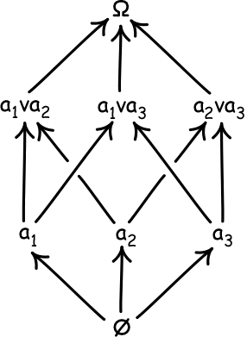


Deductive Structure: Finite Boolean Algebras
Goal: Lay bare the deductive structure of ordinary sentential logic, free of the distracting duplications: A = (AvA) = (A&A) = (Av (A&A)) = ….
All finite sets of sentences belong to one of a
one, two, three, four, … atom Boolean algebra:
Three-atom algebra.
Atoms a₁, a₂, a₃ are the logically strongest propositions that are not
Finitely many propositions closed under v (or), & (and), ~ (negation).
universally true
contradiction

Slide 21
Inductive strengths of support
[A|B] = Strength of inductive support that proposition B affords to A
Calculus = strengths can by computed by explicit or implicit rules
Deductive definability
Deductive Structure
Inductive strengths of support.
fixes

Slide 22
Deductively Definable Logic of Induction
Explicit definition of [A_{i}| A_{k}]
for i, k = 1, ..., m
[A_{i}|A_{k}] = formula that mentions only
• the deductive relations among
{A₁, A₂, ..., A_{m}}
• their deductive relations to the atoms of the algebra Ω.
Implicit definition of [A_{i}| A_{k}]
for i, k = 1, ..., m
Sentences that mention only
• the strengths [A_{i}|A_{k}]
• the deductive relations among
A₁, A₂, ..., A_{m}
• their deductive relations to the atoms of the algebra Ω.
The sentences uniquely fix the strengths.
E.g. classical probability
[A|B] = P(A|B) = #A&B/#B
E.g. Kolmogorov axioms plus equiprobability of atoms.
#formula = number of atoms in formula

Slide 23
There are many, interesting, deductively definable logics of induction

Slide 24
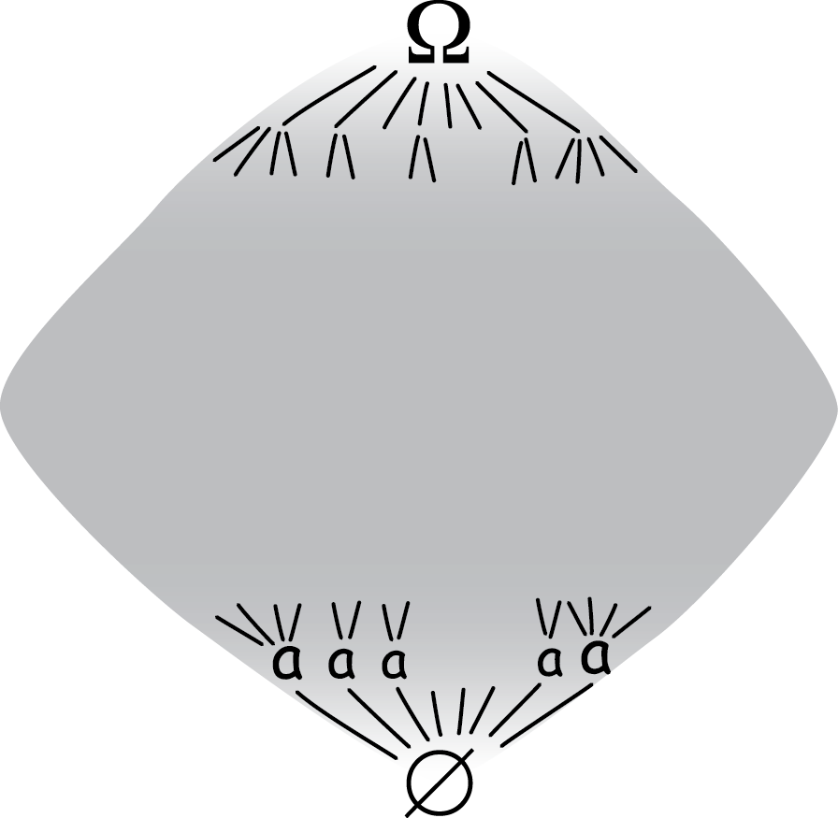
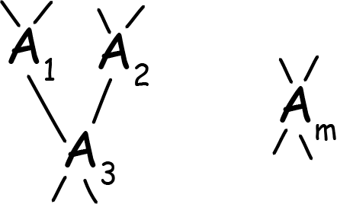
Completeness
In a very big Boolean algebra…
…for some very large set of propositions
{A₁, A₂, …, A_{m}} …
… strengths [A₁|A₂],
[A₁|A₃], …, [A_{m-1}|A_{m}]…
… must be fixed by resources fully within the algebra.
External inductive content
Deductive relations among A₁ , …, A_{m} and the atoms.
External inductive content

Slide 25
Symmetry Theorem

Slide 26
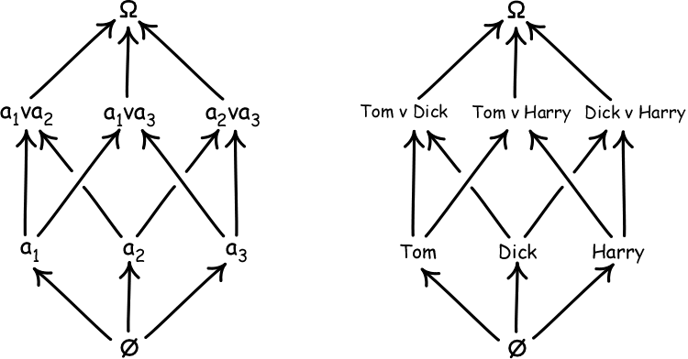
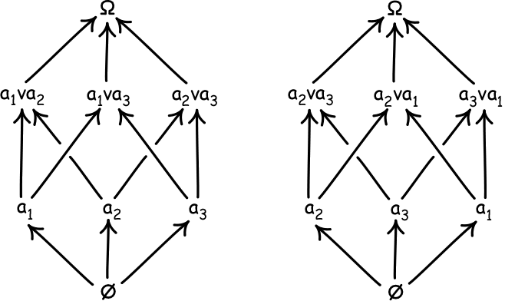
Symmetries of a Boolean algebra
Same deductive structure if we…
… relabel the atoms arbitrarily.
… permute the atomic labels arbitrarily.

Slide 27
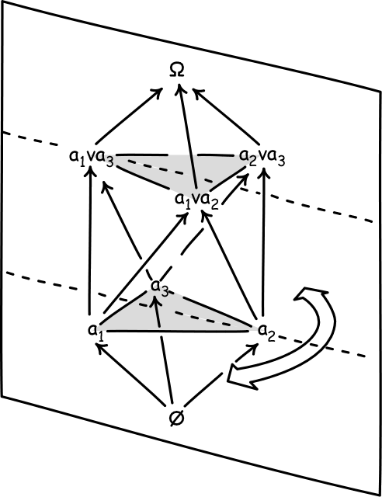
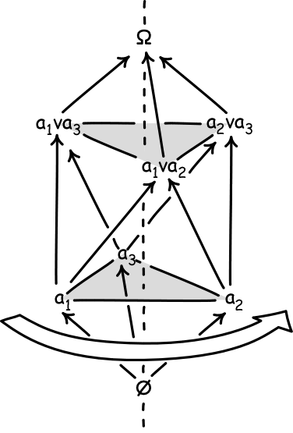
Richness of Symmetries of a Boolean algebra
Cyclic permutation of atoms a₁, a₂, a₃
Exchange of atoms a₁ and a₃

Slide 28
In a deductively definable logic of induction…
• the deductive relations among
{A₁, A₂, ..., A_{m}}
• their deductive relations to the atoms of the algebra Ω.
FIX
FIX
strengths
[A_{i}|A_{k}]
Symmetry here
Symmetry here
a₁ entails a₁ v a₂
[a₁ | a₁ v a₂ ]
same deductive relations as
= [a₂ | a₁ v a₂ ]
a₂ entails a₂ v a₁

Slide 29
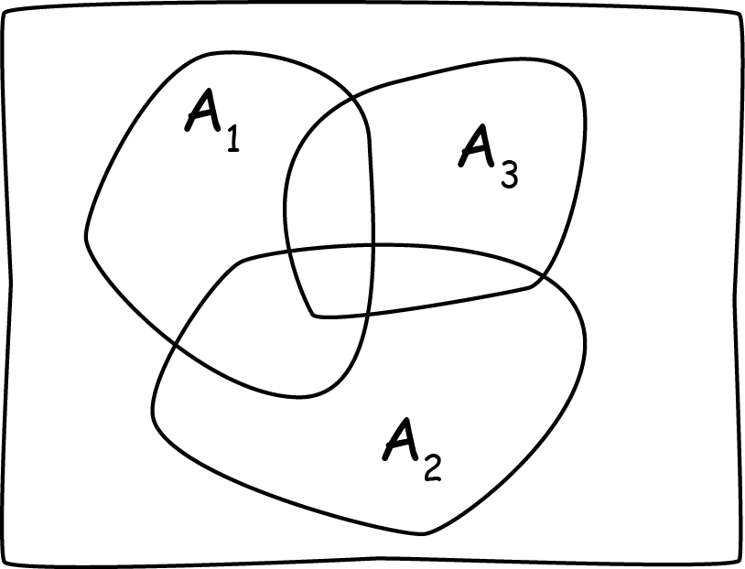




Deductive structure
fixed by number of atoms in the logically strongest propositions:
#~A₁&~A₂&~A₃
#A₁&~A₂&~A₃
#A₁&A₂&~A₃
…
#A₁&A₂&A₃

Slide 30
Symmetry Theorem
Very many f’s
Very many inductive logics
For propositions A₁ and A₂ in the set {A₁, A₂, ..., A_{m}}
[A₁|A₂] = f(#A₁&A₂&…&A_{m},
#~A₁&A₂&…&A_{m},
#A₁&~A₂&…&A_{m},
…
#~A₁&~A₂&…&~A_{m})
list of 2^{m} logically strongest conjunctions

Slide 31
Asymptotic Stability

Slide 32
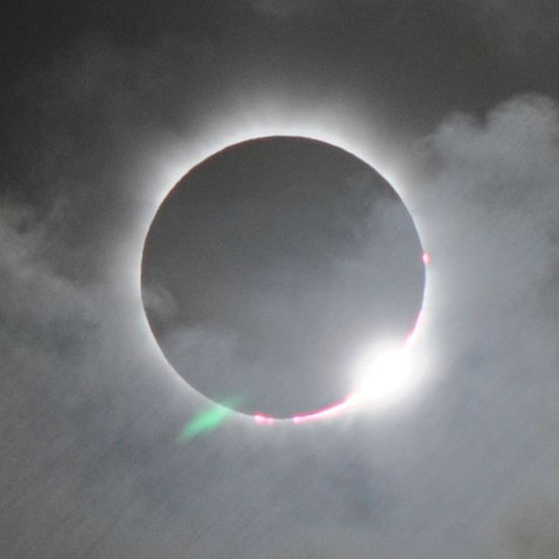
How to make a Boolean Algebra Bigger
a₁ There is a solar eclipse on June 1.
a₁, a₂, a₃
disjunctive refinement
a₁ expanded to b₁v b₂
b₁ There is a solar eclipse in the morning of June 1.
b₂ There is a solar eclipse in the afternoon of June 1.
b₁, b₂, a₂, a₃

Slide 33


Refine for more expressive power
a
a
two atoms
P(inside|Ω) = 1/2
a
a
a
a
a
a
a
a
a
a
a
ten atoms
P(inside|Ω) = 8/10
a
a
a
a
a
a
a
a
a
a
a
a
100 atoms
P(inside|Ω) = 79/100
a
a
a
a
a
a
a
a
a
a
a
a
a
a
a
a
a
a
a
a
a
a
a
P(inside|Ω) = π/4 = 0.785398...
Asymptotic stability
[A|B]
stabilizes towards a unique limiting value under arbitrary disjunctive refinement of A and B and the other propositions.

Slide 34


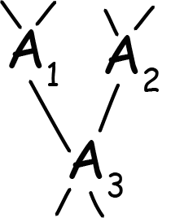

Asymptotic Stability
As disjunctive refinement continues:
[A₁| A₃], [A₂| A₃]
stabilize.
Else no definite values for
[A₁| A₃], [A₂| A₃]
unless refinement halted by inductive content from outside.
Eventually just inductive hair-splitting.

Slide 35
Triviality Deduced

Slide 36

The Rough Idea
A deductively definable logic has no way to tell when further disjunctive refinement becomes inductively inert.
From earlier
[a₁| a₁v a₂] = [a₂| a₁v a₂]
“[1atom|2atoms]”
“[1atom|2atoms]”
Confuse by malicious disjunctive refinement.
refine
a₁ to b₁v…vb₉₉
refine
a₂ to c₁v…vc₉₉
[b₁v…vb₉₉ | b₁v…vb₉₉ v a₂]
vs
[a₂| b₁v…vb₉₉ v a₂]
[a₁| a₁v c₁v…vc₉₉]
vs
[c₁v…vc₉₉ | a₁v c₁v…vc₉₉]
“[99atoms|100atoms] > [1atom|100atoms]”
“[1atom|100atoms] < [99atoms|100atoms]”

Slide 37
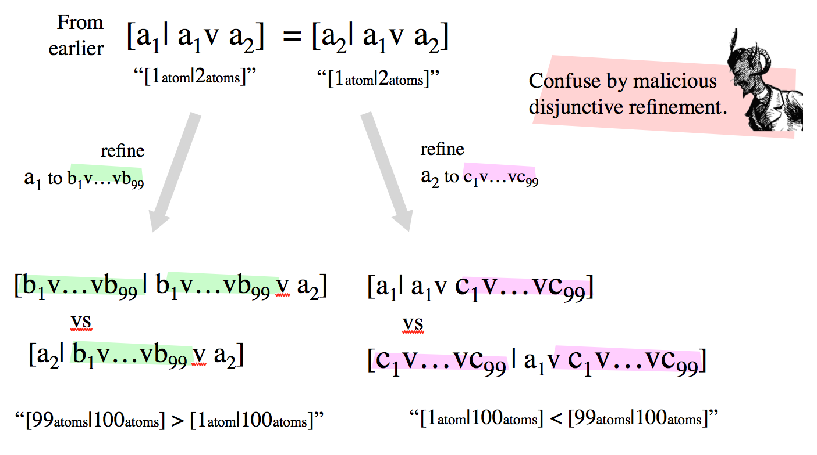
The Rough Idea
A deductively definable logic has no way to tell when further disjunctive refinement becomes inductively inert.
Instability…
!
[A|B] [C|D] [E|F] [G|H] …
!
!
!
!
!
Unless all strengths converge to the same limit under repeated disjunctive refinement.
same limit

Slide 39
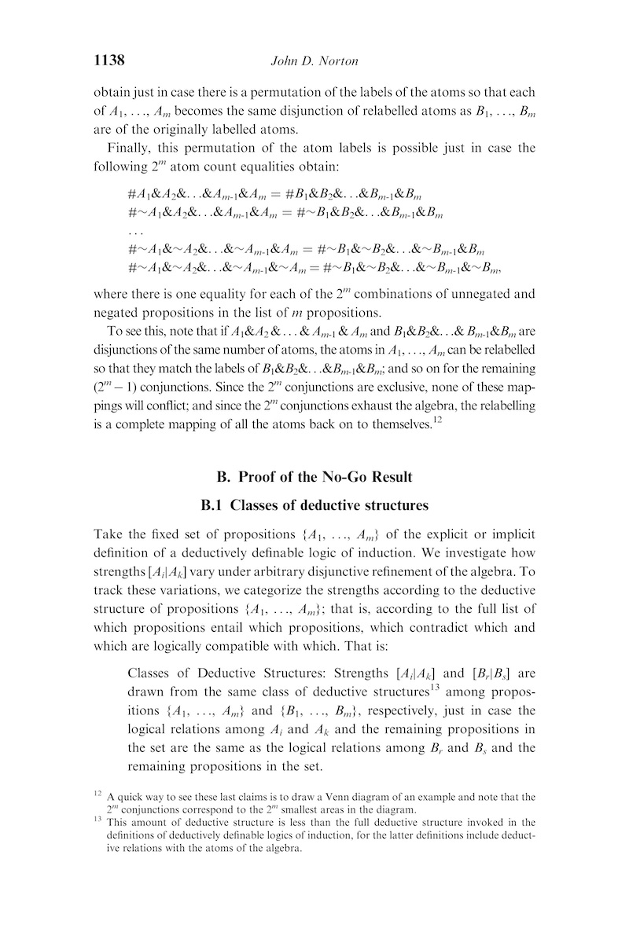
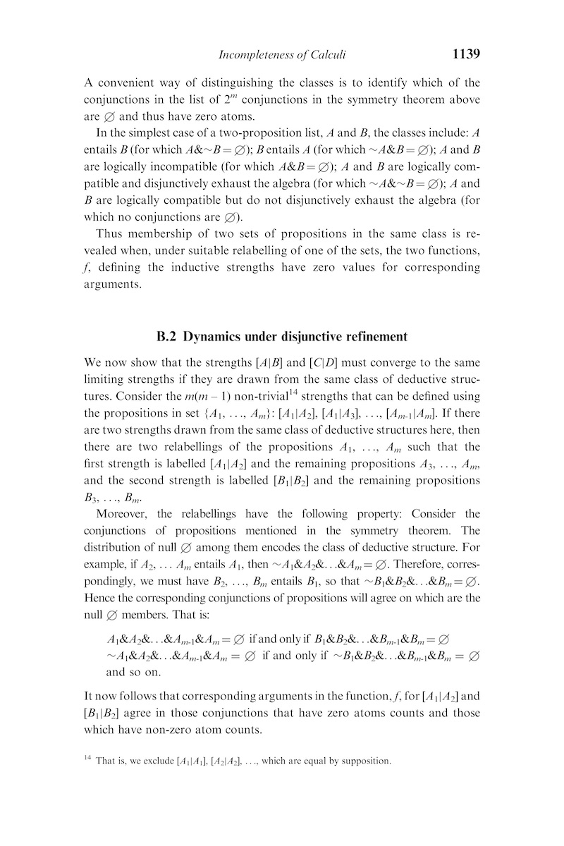
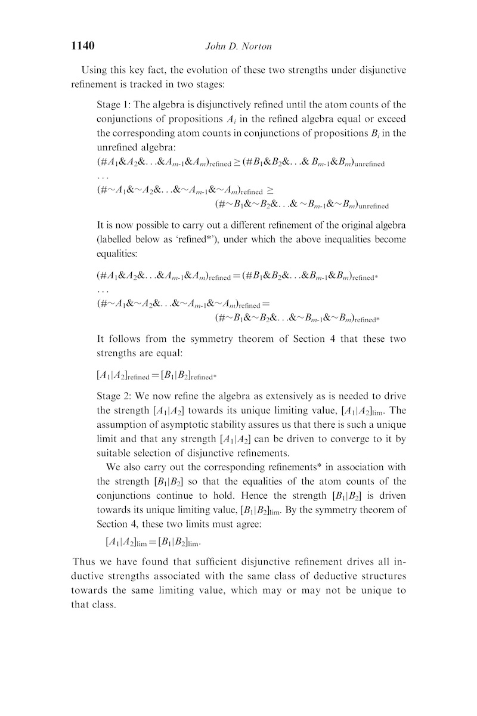
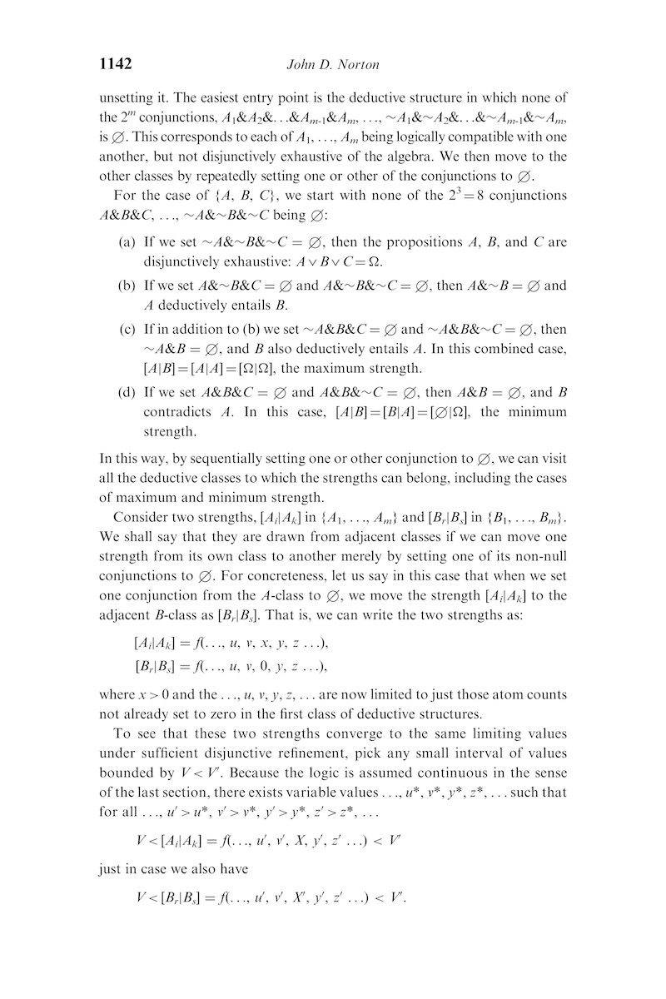
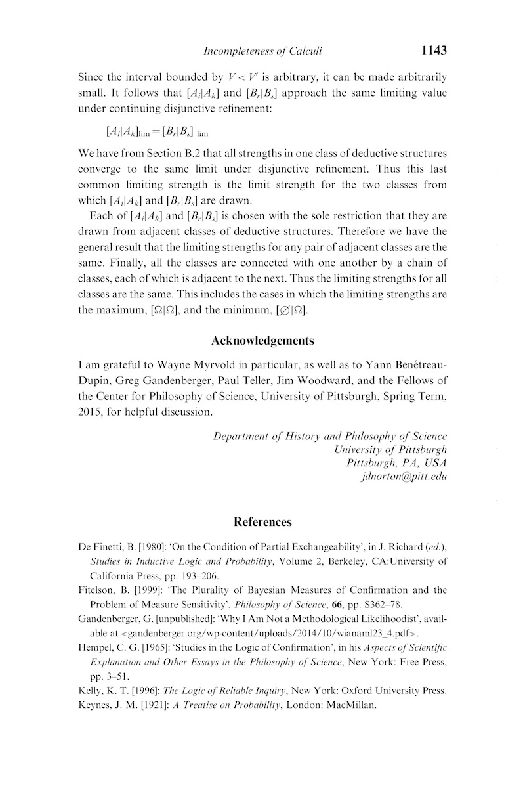

Slide 40
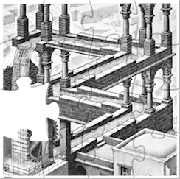
In sum…
For a set of propositions {A₁, …, A_{m}} defined on finite Boolean algebras
and for an inductive logic that is:
  (a) deductively definable,
  (b) asymptotically stable and
  (c) continuous,
all the well-defined inductive strengths [A_{i}| A_{k}] converge under disjunctive refinement to a single strength.
This includes the maximum strength [Ω|Ω] and the minimum strength [Ø|Ω].
Avoid triviality
Incompleteness
Introduce external inductive content
e.g. stipulate
priors, preferred partitions, …

Slide 41

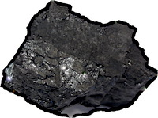
Gems and coals
So that’s why all my efforts to find a complete calculus of inductive inference failed!
We are freed from the idea of a “Bayesian philosophy of science.”
Formal epistemologists just keep going as if everything is fine.

Slide 42
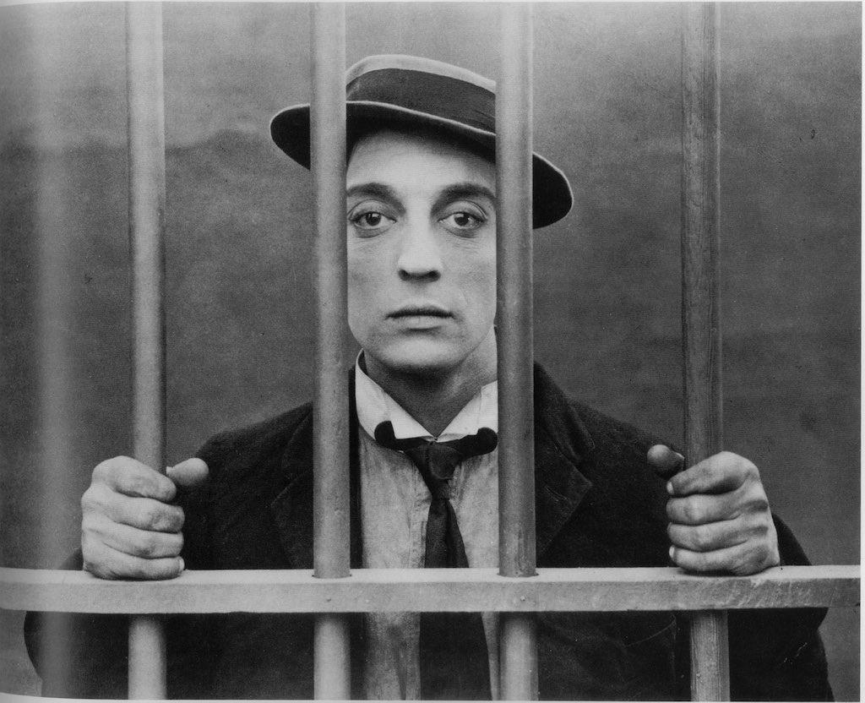
Escape?

Slide 43

Enhanced Logics?
Enhanced inductive logic?
[A|B,C] = support for A from B with background C
[A,B|C,D] = relative support for A vs B from C with background D
…
Enhanced deductive logic?
• infinite Boolean algebra
• predicate logic
…
Deductive structure remains highly symmetric.
Slight adjustment to proof yields analogous no go result.
No protection from malicious refinements.

Slide 44
Subjective Bayesianism
Prior probabilities introduced as
arbitrary opinion.
Symmetry of symmetry theorem broken.
Malicious disjunctive refinement blocked.
BUT
P(hypothesis | evidence)
= arbitrary opinion
+ evidential warrant
“washing out of the priors”??
Escape:
Tempered Bayesianism
Use only sensible priors
Bayes’ theorem
external
inductive content
…incomplete
for any nominated favoring of H₁ over H₂
for fixed evidence E
there is a ratio of priors that delivers it

Slide 45
Subjective Bayesian
Confirmation Measures
e. g. Distance measure
d(H,E,B) = P(H|E&B) – P(H|B)
Either
the confirmation measure
is dependent on an arbitrary prior
Fails to provide an objective measure of inductive support.
or
Is subject to the triviality result
or its use is incomplete.
is NOT dependent on an arbitrary prior.

Slide 46
Conclusion

Slide 47

What is inductive inference?
It is merely inference that conforms with such-and-such a calculus.
There will always be
a bit missing
in formal accounts of inductive inference.
Priors must be set “sensibly.”
Preferred partitions chosen.
…
External inductive content is always
needed to escape triviality

Slide 48


Slide 49
The End
The End

Slide 50
Appendices

Slide 51
The condition
Asymptotic Stability Under
Disjunctive Refinement
For some fixed set of propositions {A₁, ..., A_{m}} of the explicit or implicit definition of a deductively definable logic of induction,
for each strength [A_{i}| A_{k}], i, k = 1, ..., m,
there exists a limiting value, possibly unique to that strength, [A_{i}| A_{k}]_{lim}
to which the strength converges
under all possible disjunctive refinements of the algebra.

Slide 52


Continuity illustrated
Absolute differences in atom counts do not matter in the limit.
15 atoms
150 atoms
15000 atoms
15 atoms
15000 atoms
150 atoms
0
atoms
10 atoms
10
atoms
100 atoms
10000 atoms
10 atoms
100 atoms
10000 atoms
A
B
C
D
[A|B]
[C|D]
converge
same limit

