Slide 1
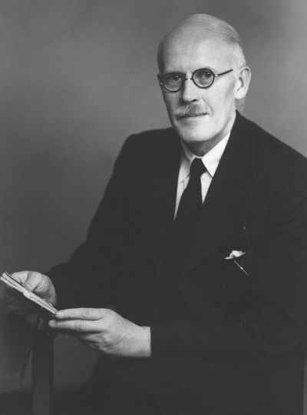
Harold
Jeffreys, Scientific Inference
John D. Norton
Department of History and
Philosophy of Science
University of Pittsburgh

Slide 2

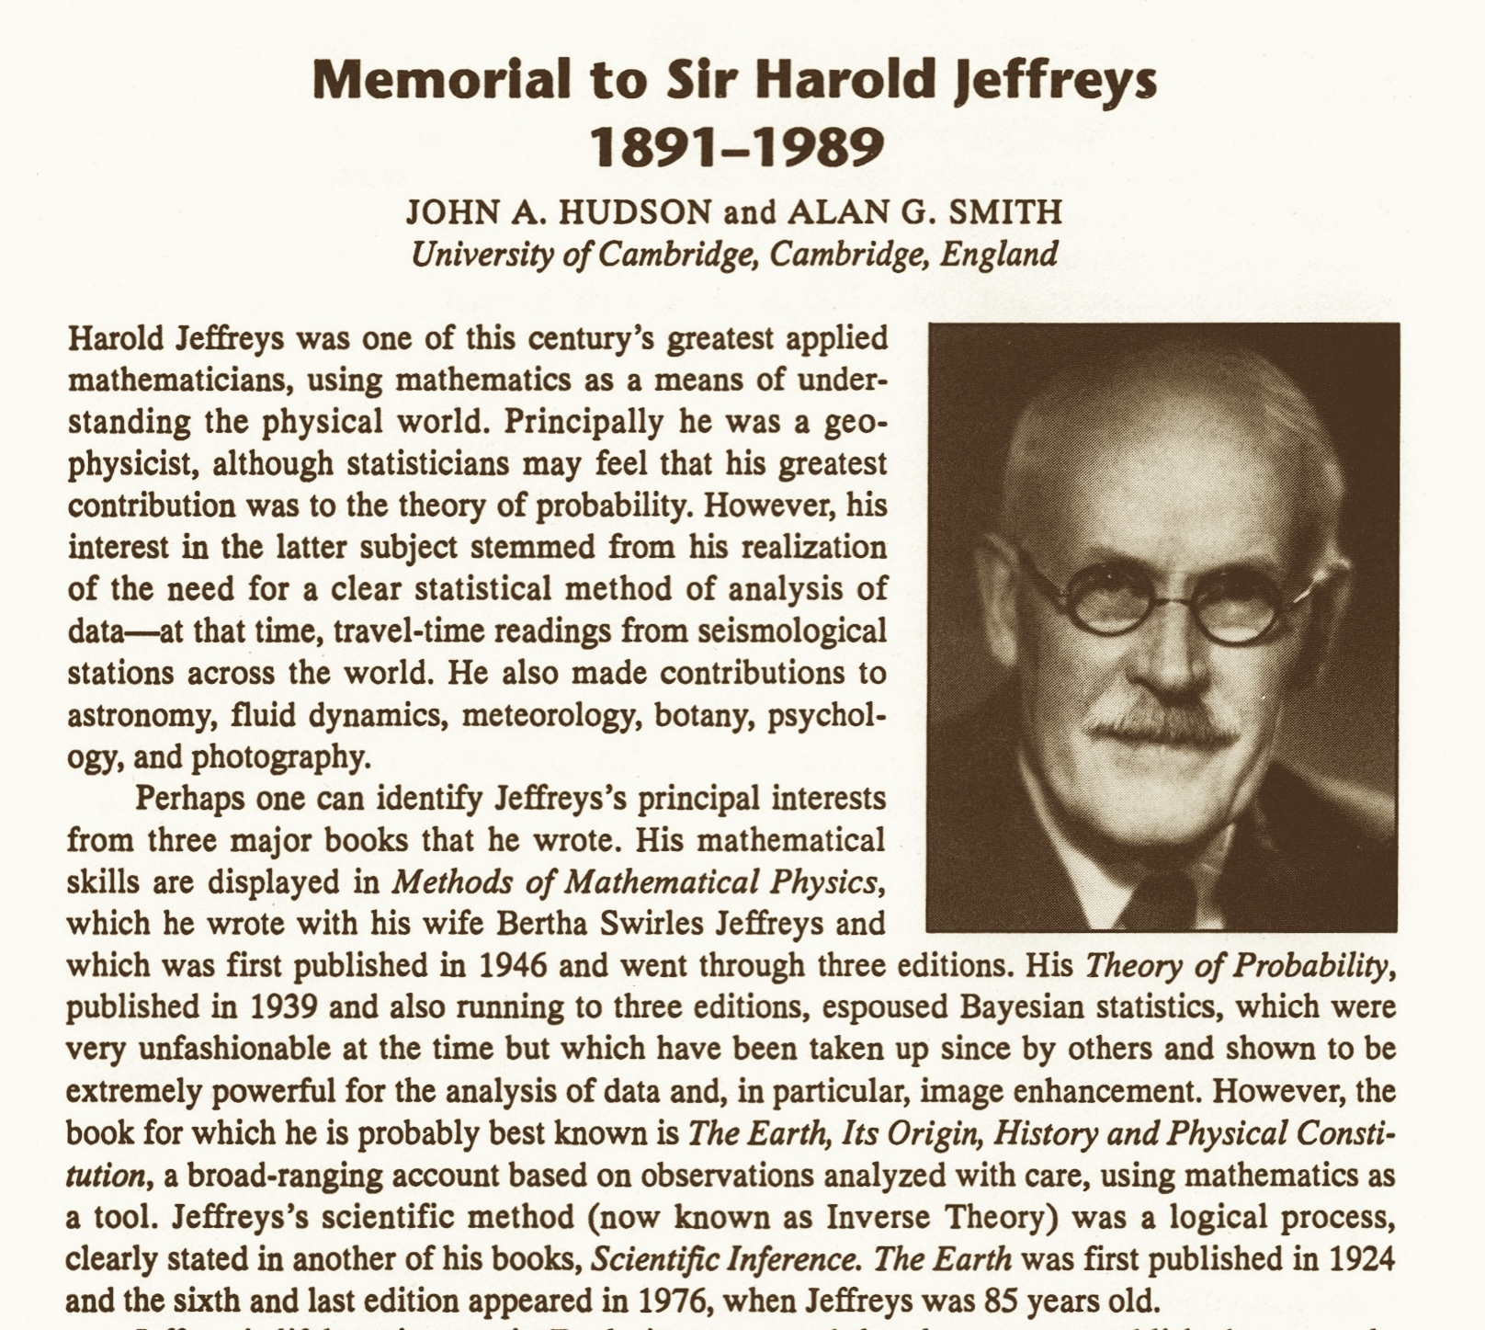

Slide 3
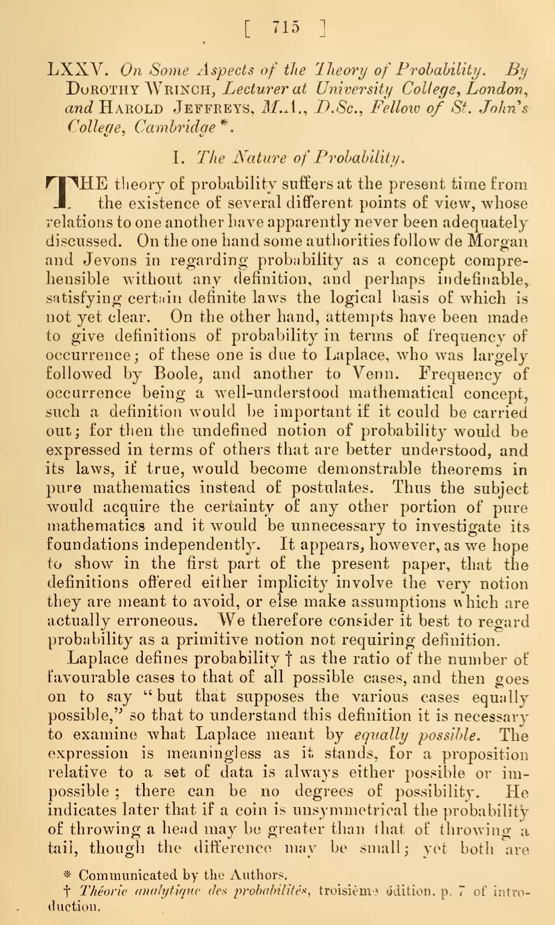
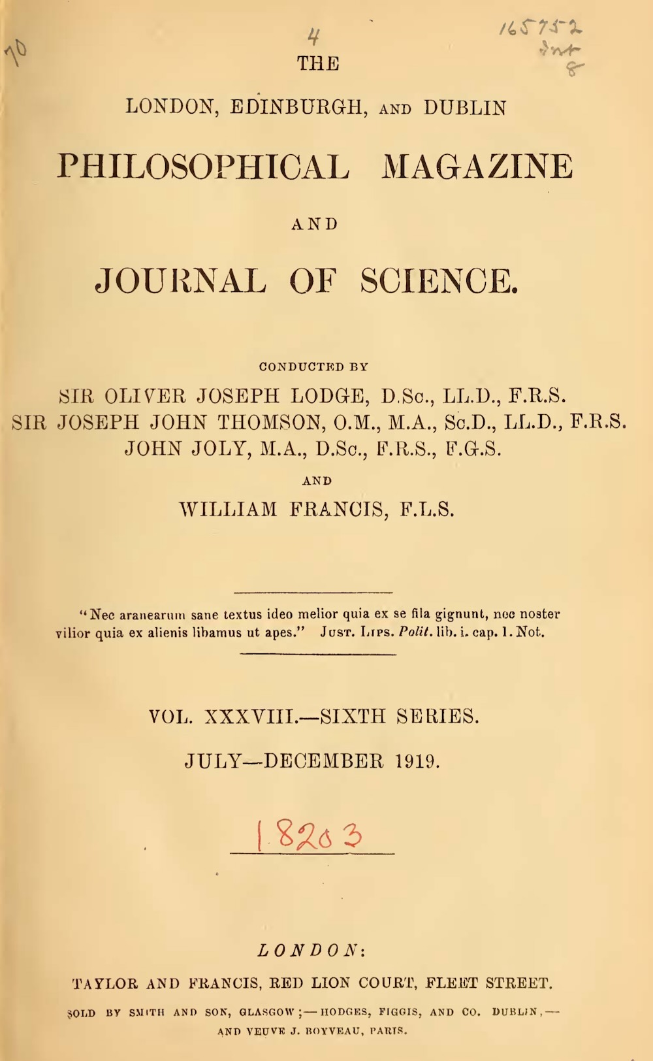
Rejects Boole’s and Venn’s frequency interpretation of probability, Laplace’s classical definition as ratio of cases.
Accepts de Morgan and Jevons “in regarding probability as a concept comprehensible without any definition, and perhaps indefinable,…”
“We therefore consider it best to regard probability as a primitive notion not requiring definition.”

Slide 4
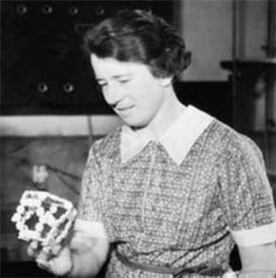
Dorothy Maud Wrinch was an Argentinian-English-American mathematician and biochemist famous for her use of mathematical techniques to deduce protein structure.
(From MacTutor)

Slide 5
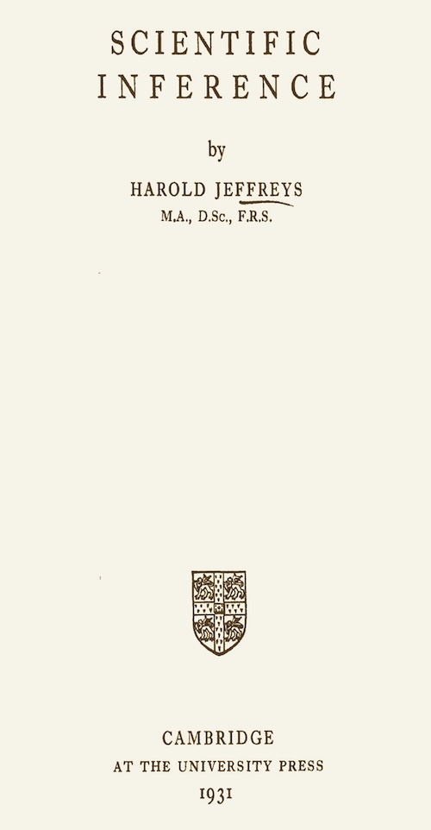
First edition.
Later editions much expanded.

Slide 6
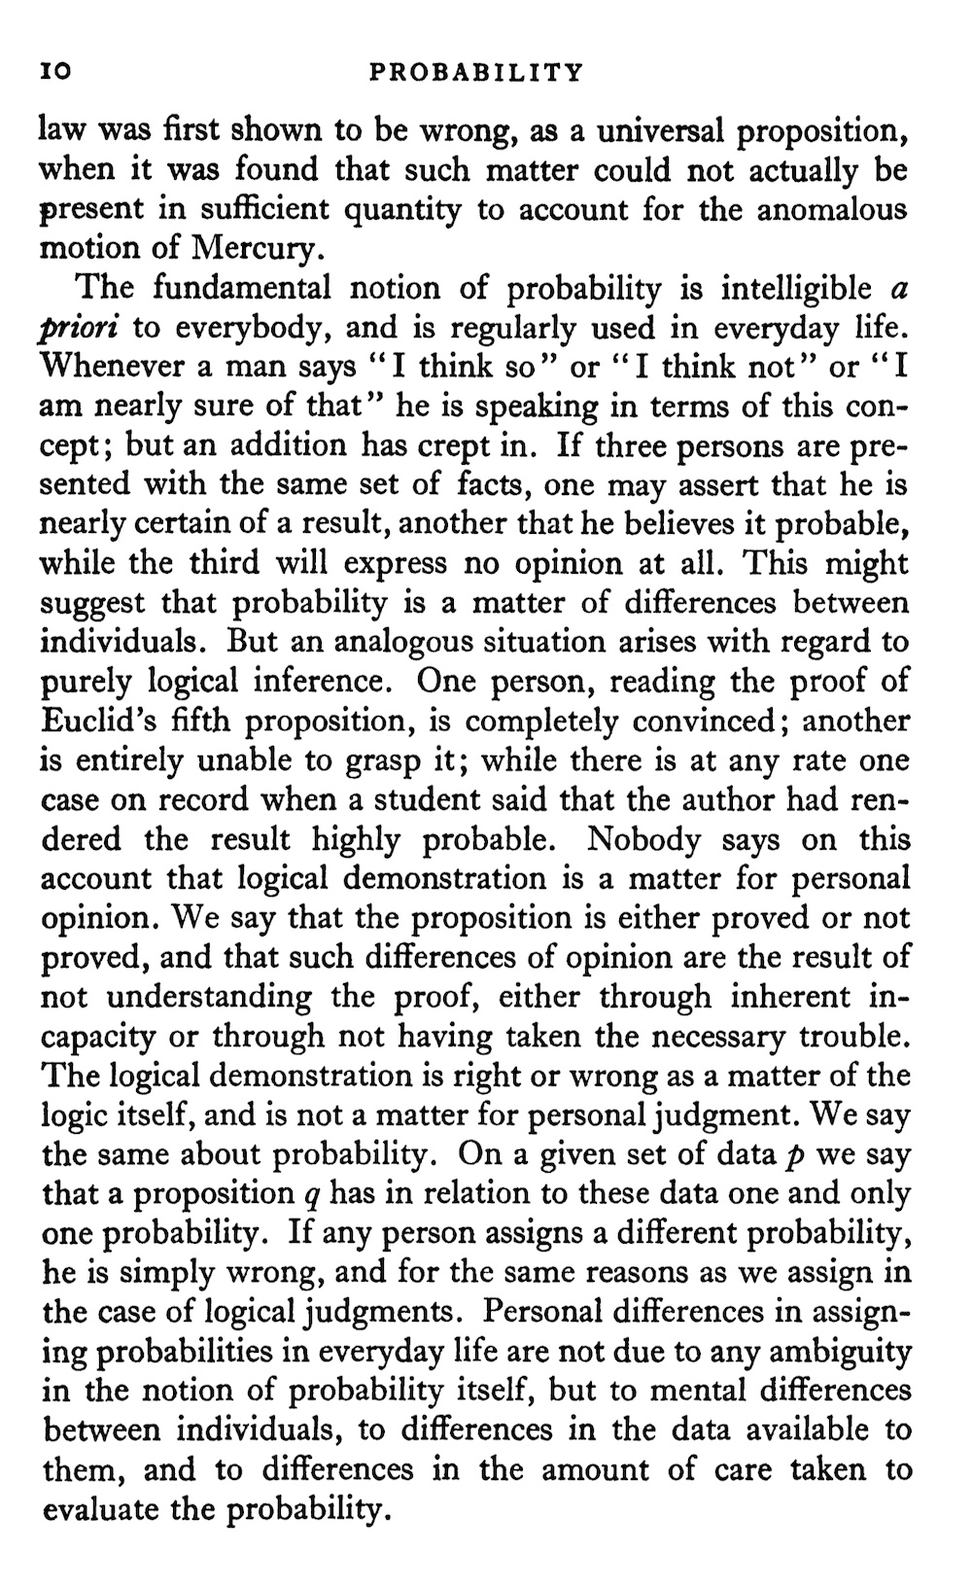
Objective interpretation of probability
“On a given set of data p we say that a proposition q has in relation to these data one and only one probability. …”
“… If any person assigns a different probability, he is simply wrong, and for the same reasons as we assign in the case of logical judgments. …”
“ … Personal differences in assigning probabilities in everyday life are not due to any ambiguity in the notion of probability itself, but to mental differences between individuals, to differences in the data available to them, and to differences in the amount of care taken to evaluate the probability. … ”

Slide 7
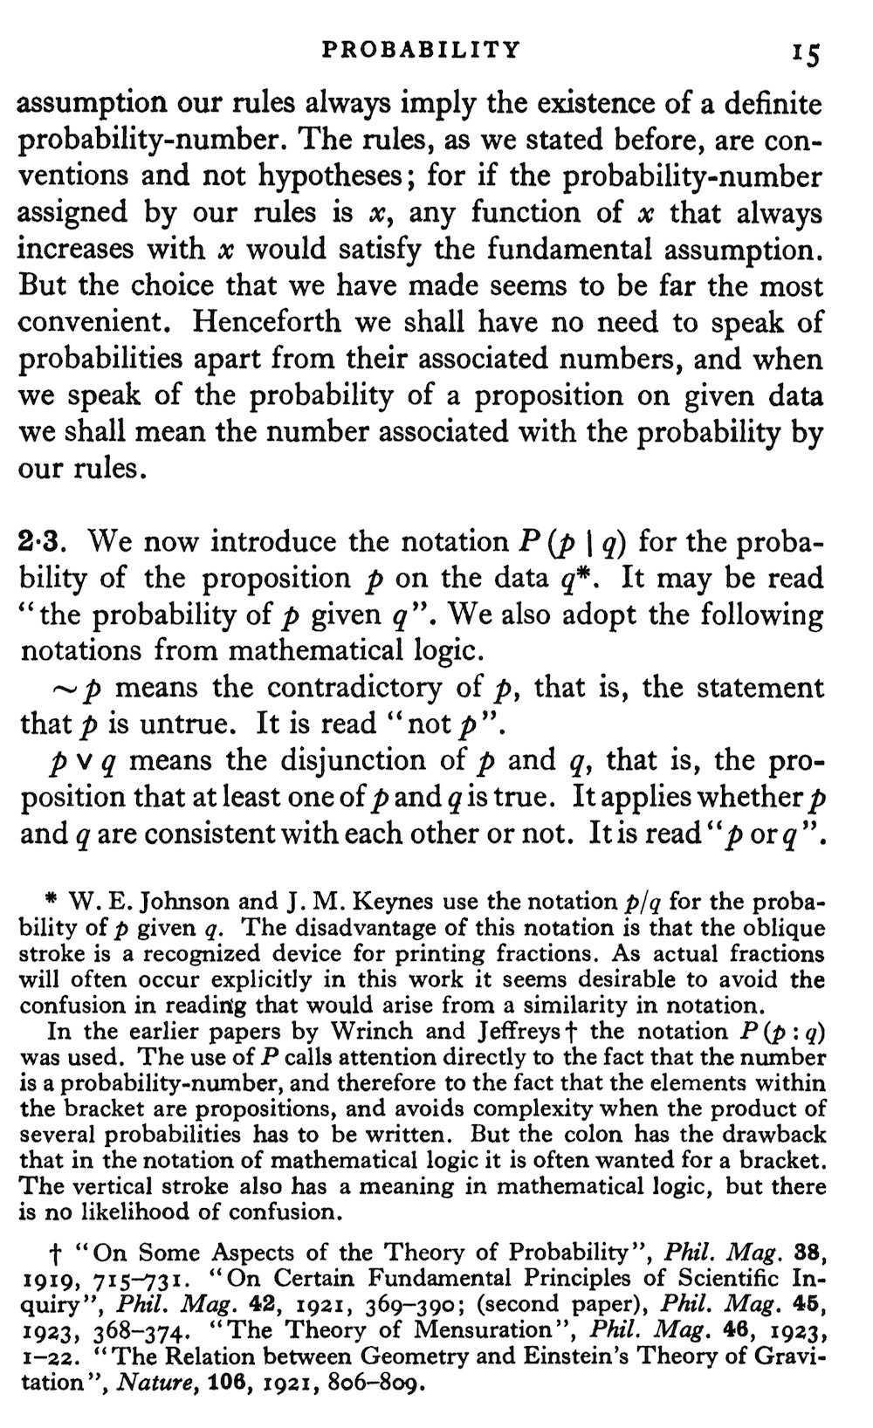

P(p|q)
“We now introduce the notation P(p|q) …”
Replaces earlier “p/q”
(Johnson and Keynes)
and “P(p:q)”
(Wrinch and Jeffreys).

Slide 8
The modern Bayes’ theorem
Vindication of hypothetico-deductive confirmation

Slide 9
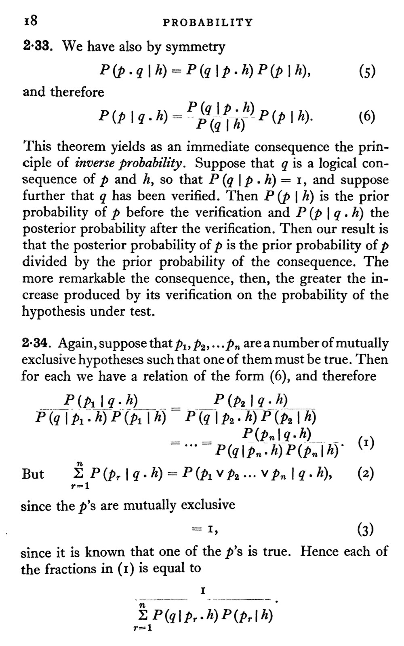
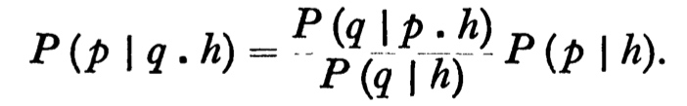
“the principle of inverse probability”
h = background
q = evidence
p = hypothesis
q is a logical consequence of p and h.
P(q|p.h)=1
“The more remarkable the consequence [q], then the greater the increase [in posterior probability] produced by its verification …”

Slide 10
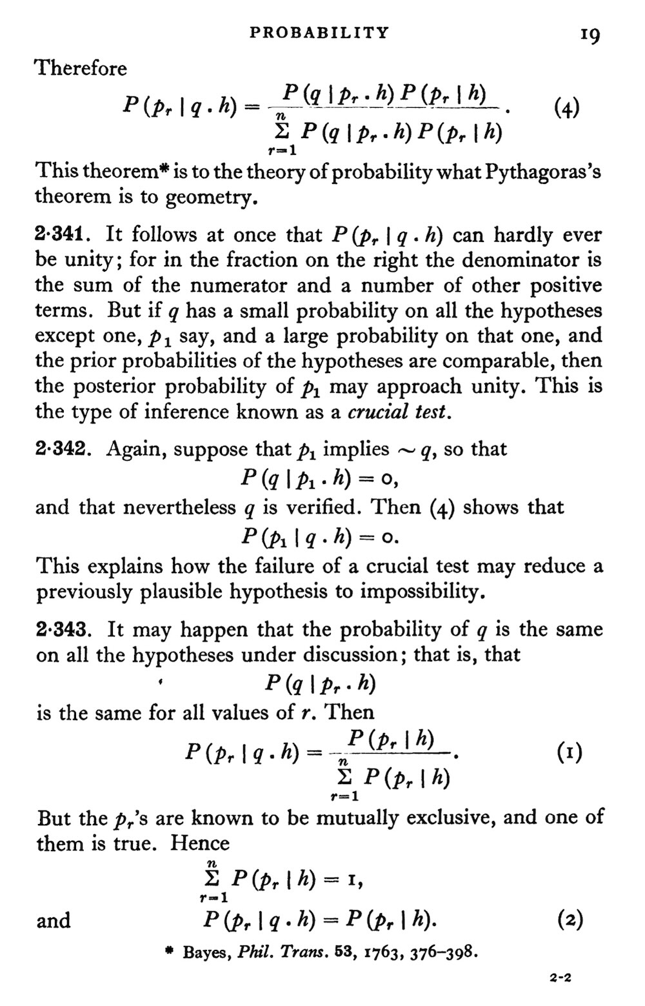
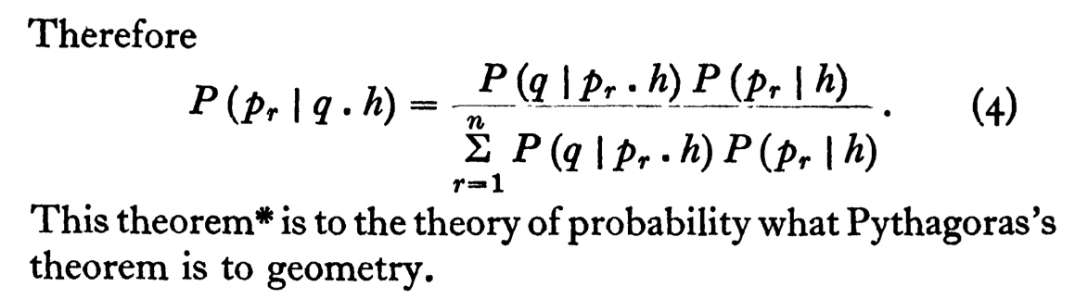

Slide 11
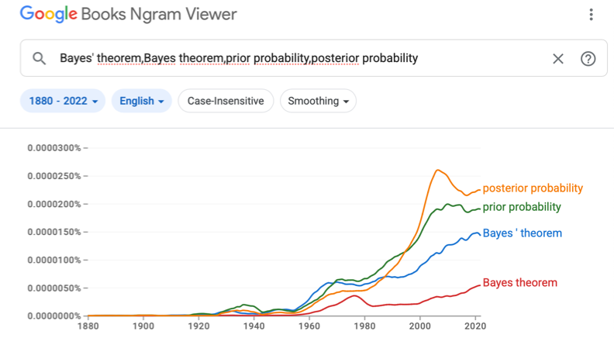
Some sporadic use of “Bayes’ theorem” prior to 1930. e.g. Todhunter’s history, 1865, and more.

Slide 12
Simplicity in the confirmation of laws

Slide 13
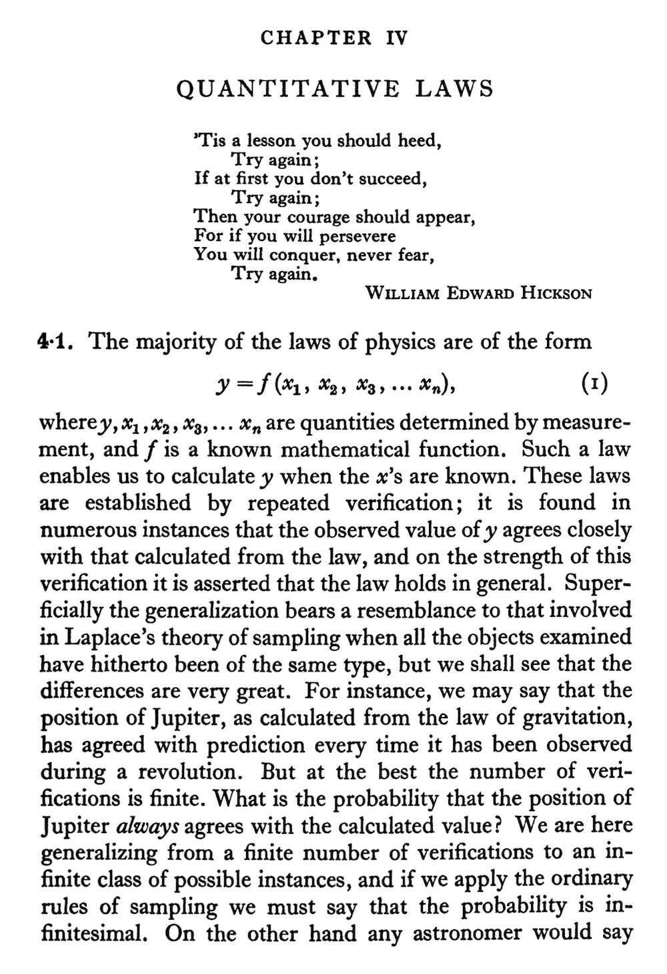
Confirm a law of physics by observed instances.

Slide 14
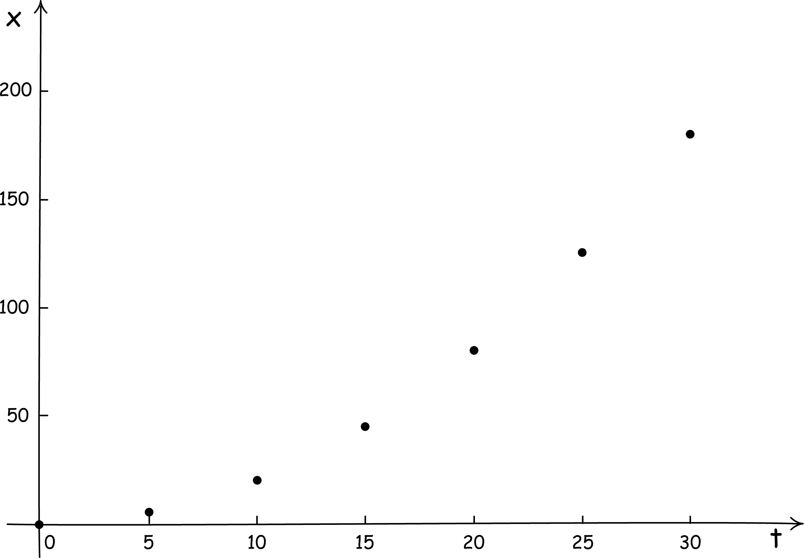
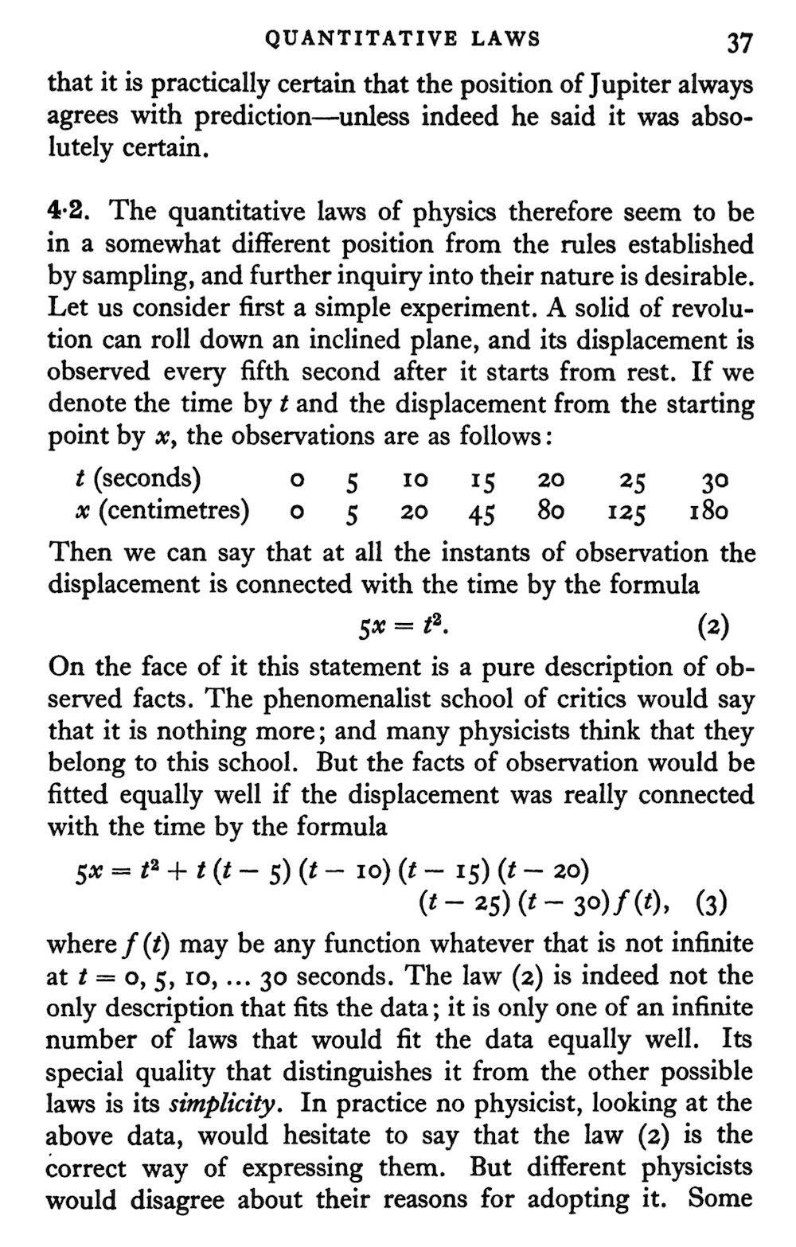
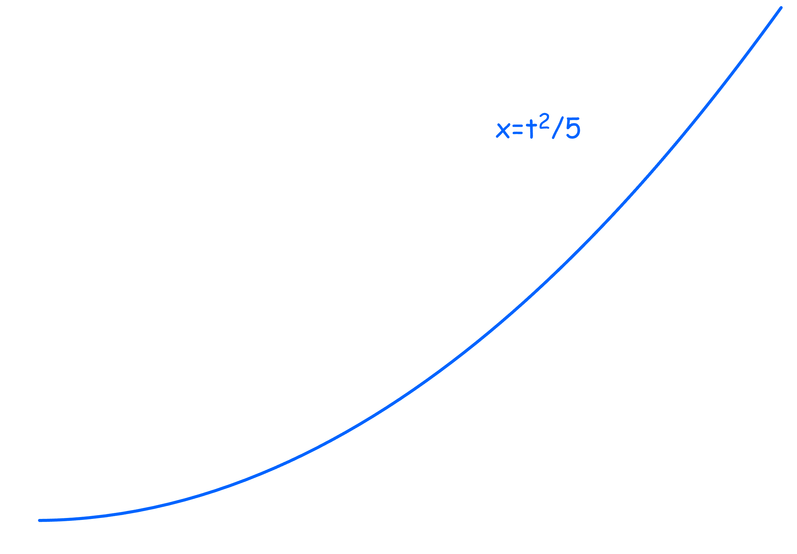
These data
fitted by curve
5x=t²

Slide 16
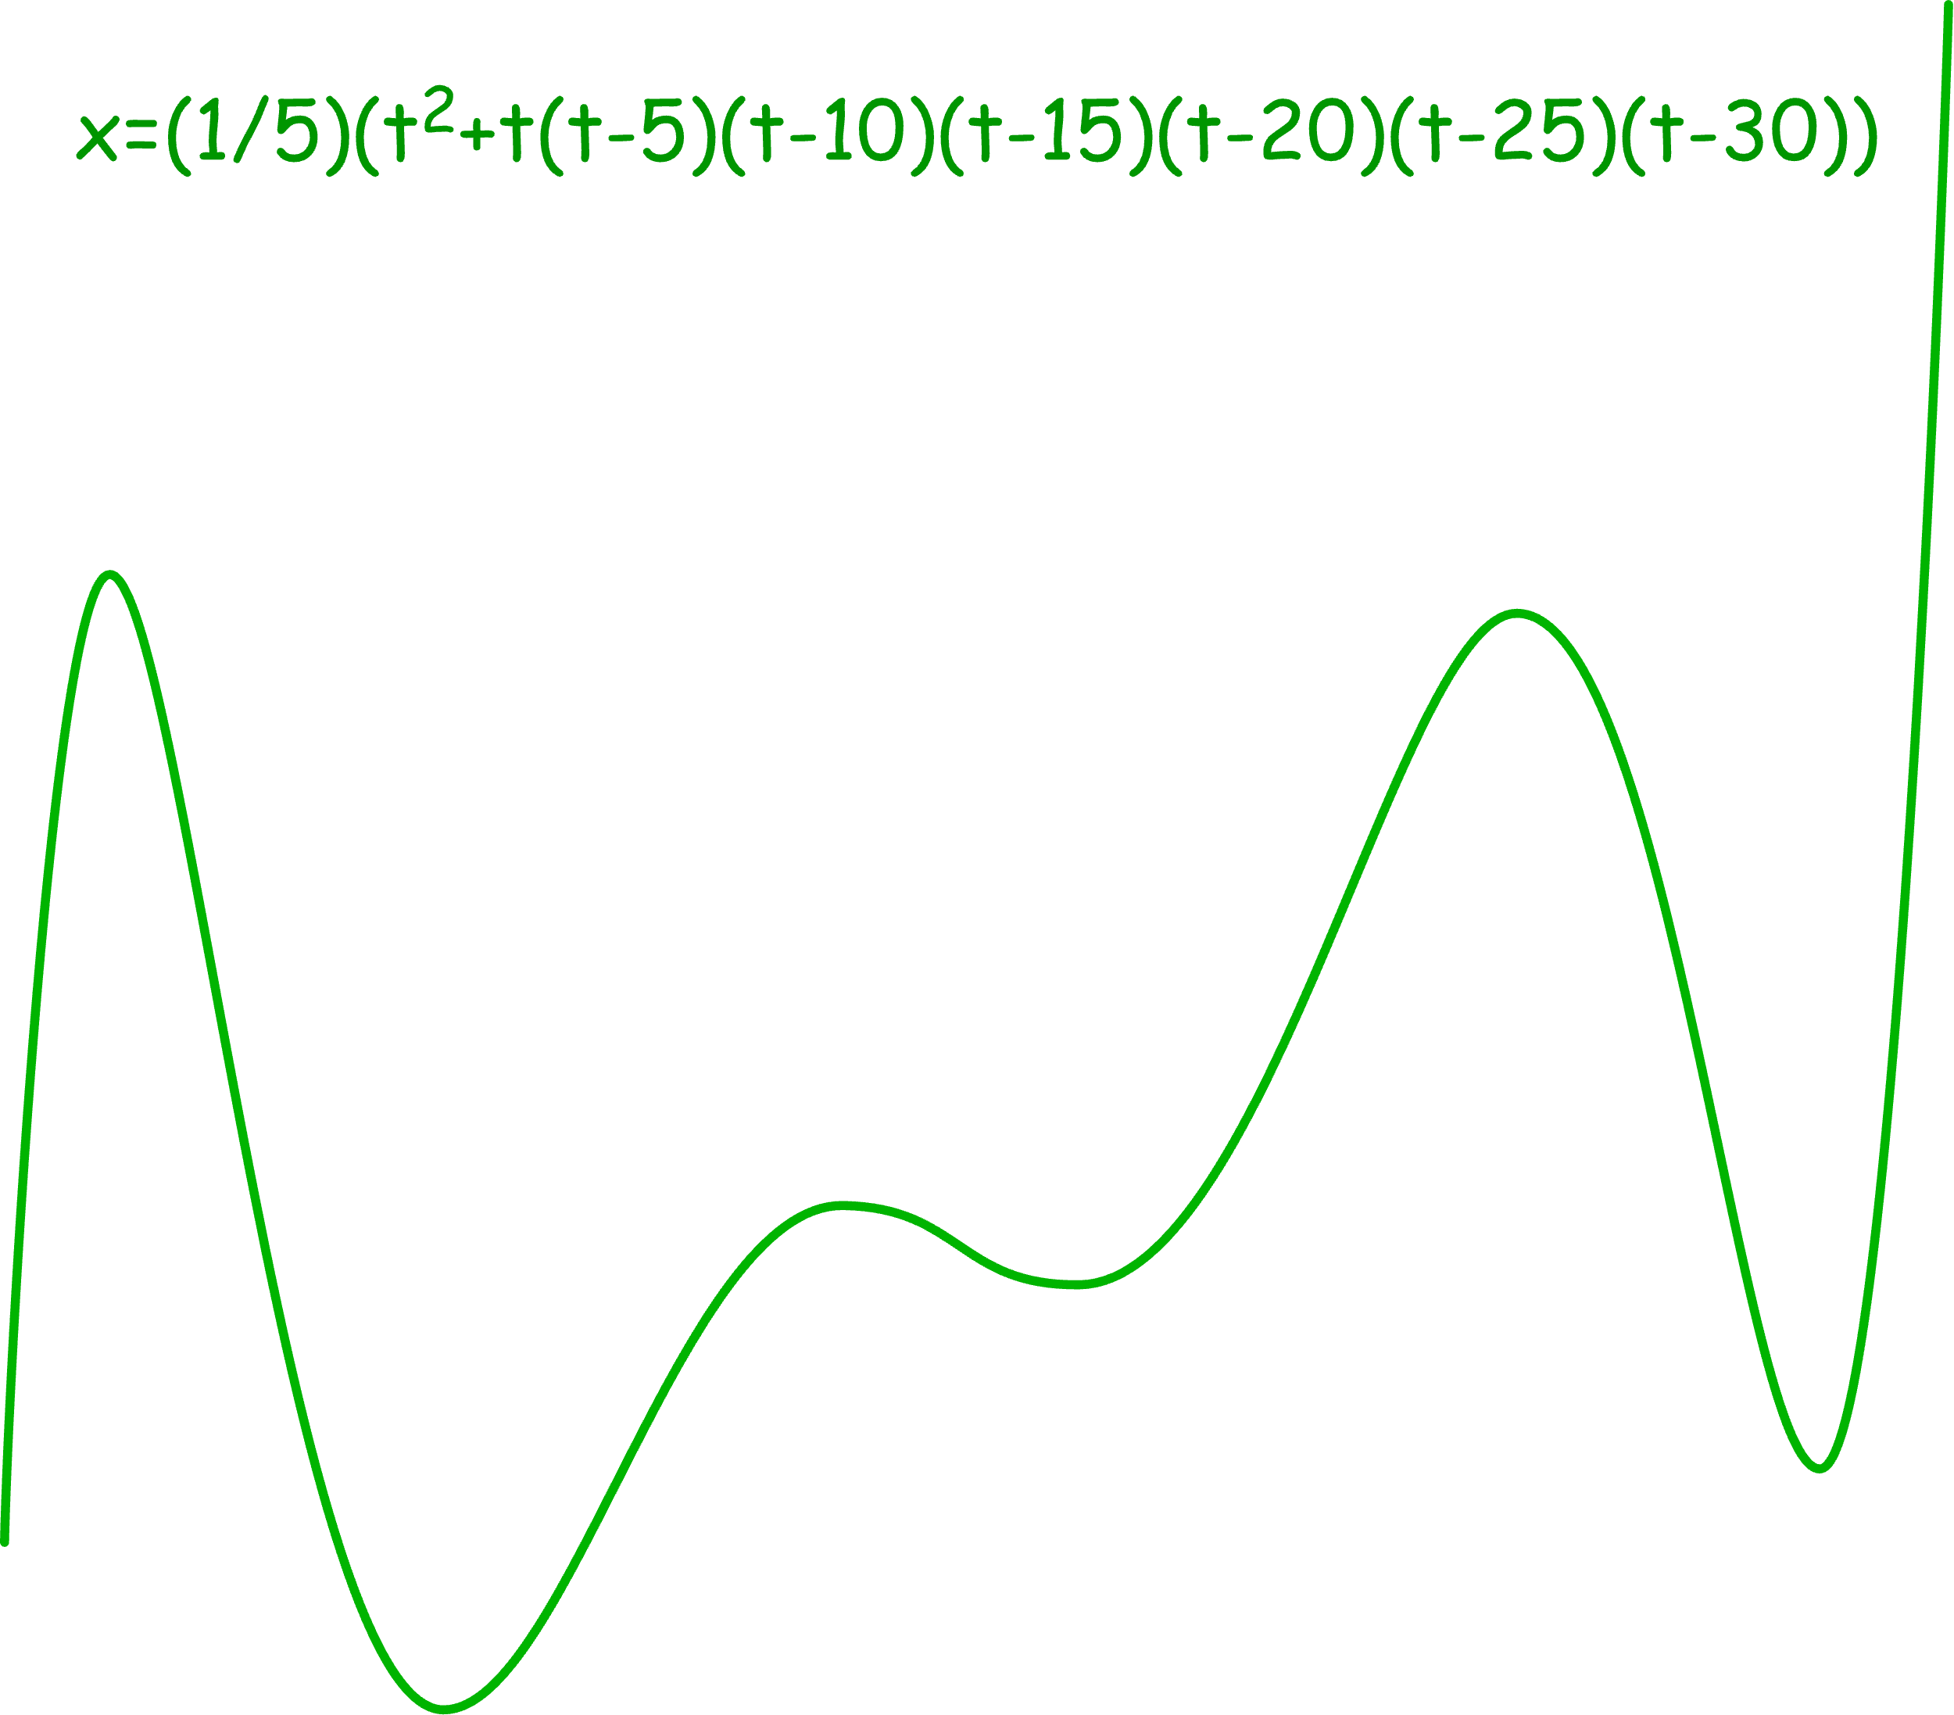
fitted by curve
5x=t²+…
These data

Slide 17
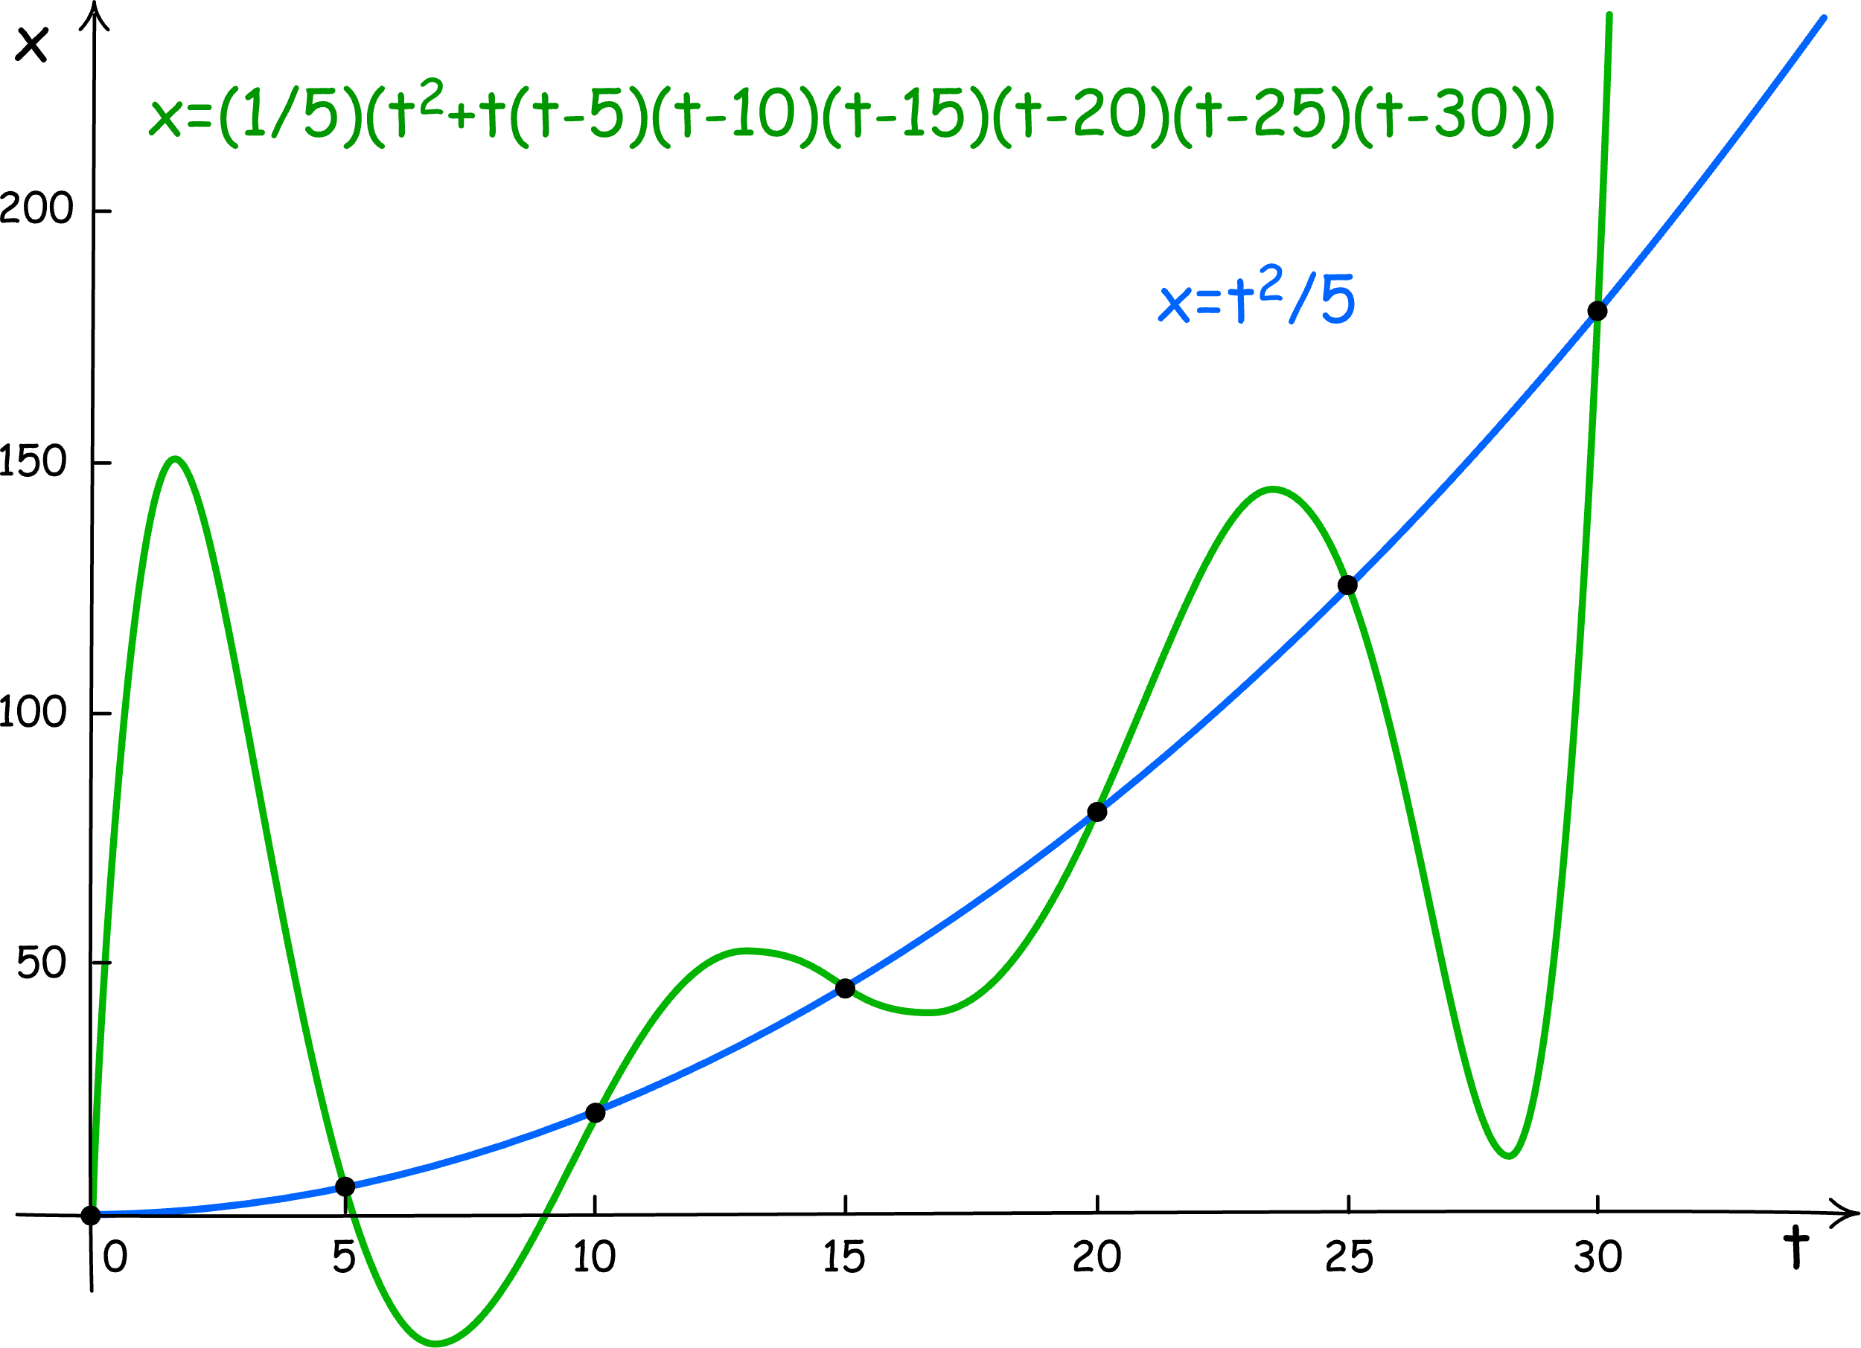

Slide 18
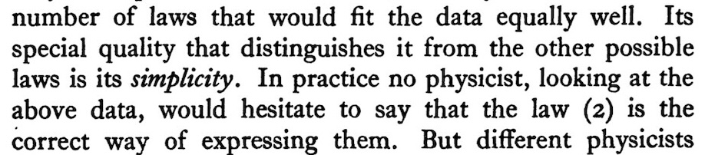
What privileges
5x = t²?

Slide 19
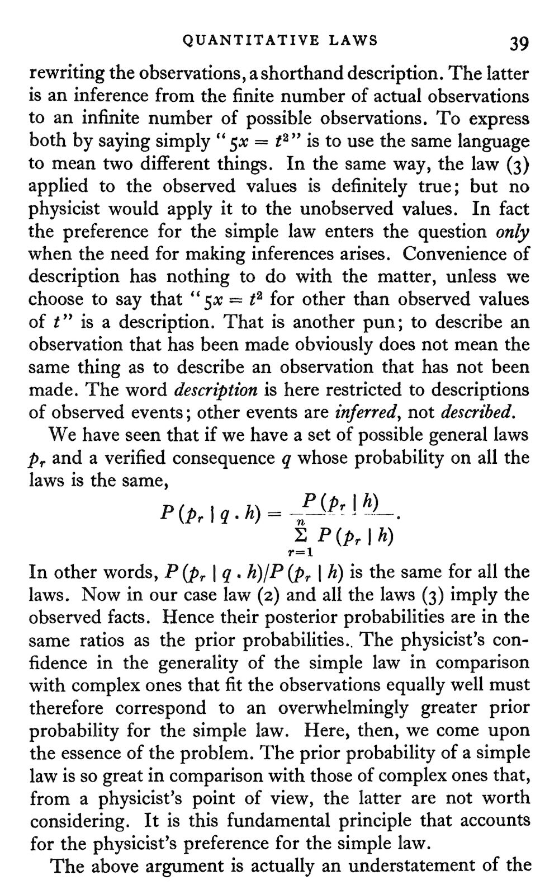
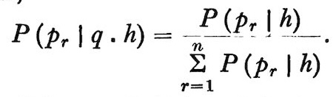
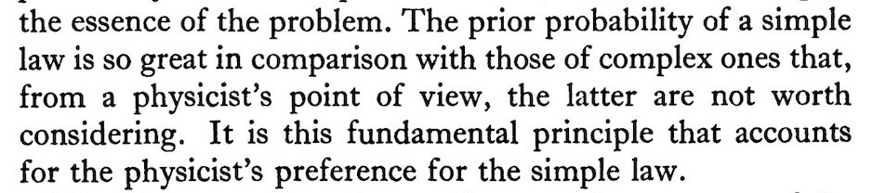
P( )>>P( )
simple law
complex law

Slide 20
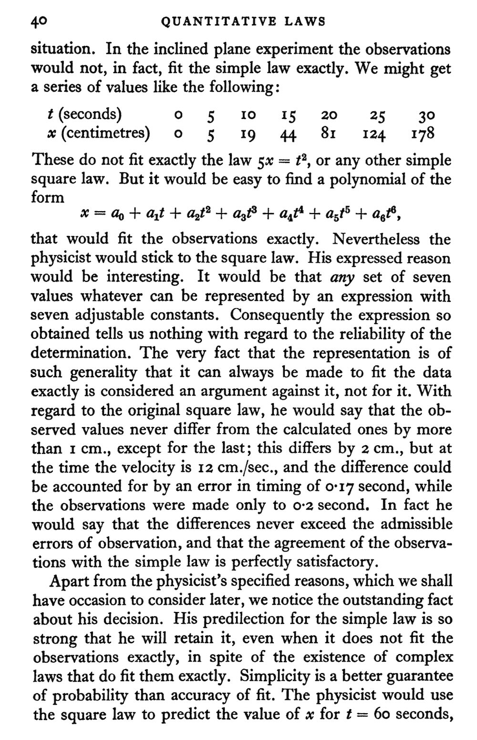
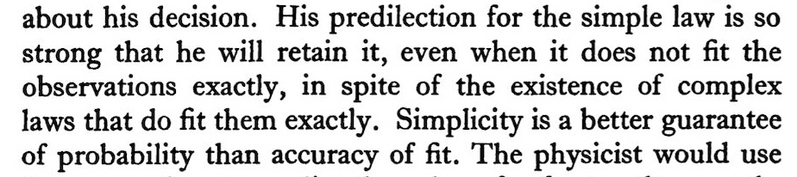
New case:
Data does not exactly fit the simple 5x = t².

Slide 21
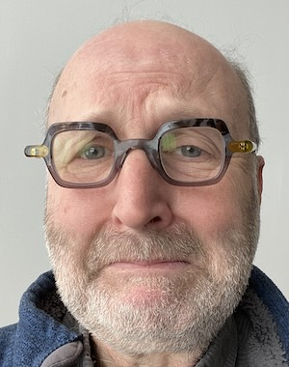
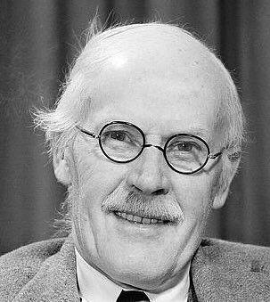
Ummmm….
Isn’t Bayes wonderful?!
1.
Many, many, many laws fit the data near enough.
2.
Pick the one we like best because we judge it simplest.
We didn’t need Bayes to get this result.
Supplied externally by adjusting prior probabilities by hand.

Slide 22
Jeffreys’ projection theorem

Slide 23
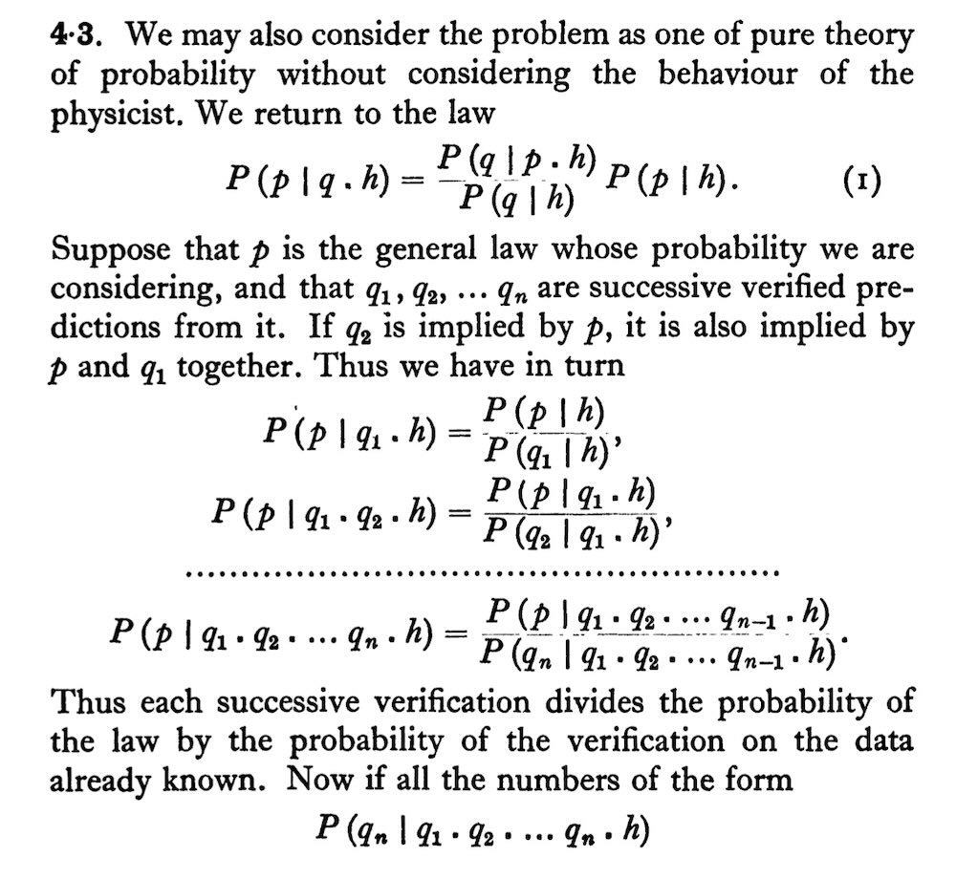
General law p
deductively entails
Consequences
q₁, q₂, q₃, …, q_{n-1}, q_{n}.
First n-1 verified
What is the probability of q_{n}?
+ more…

Slide 24
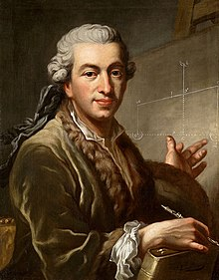
The computation
Suppressing background h
P(p) = P(p.q₁. q₂. … q_{n}) since p entails q₁. q₂. … q_{n}
= P(p|q₁. q₂. … q_{n}).P(q_{n}.q₁. q₂. … q_{n-1})
Repeated application of the product rule P(A.B) = P(A|B).P(B):
= P(p|q₁. q₂. … q_{n})
. P(q_{n}|q₁. q₂. … q_{n-1})
. P(q_{n-1}|q₁. q₂. … q_{n-2})
…
.P(q₂| q₁)
.P(q₁)
n-1 successful predictions
probability of next success → 1.
Induction works!
Assume that P(p) > 0
Lim P(q_{n}|q₁. q₂. … q_{n-1}) = 1
n→∞
This is weakened version of the rule of succession.
No uniform prior probability used.
Laplace

Slide 25
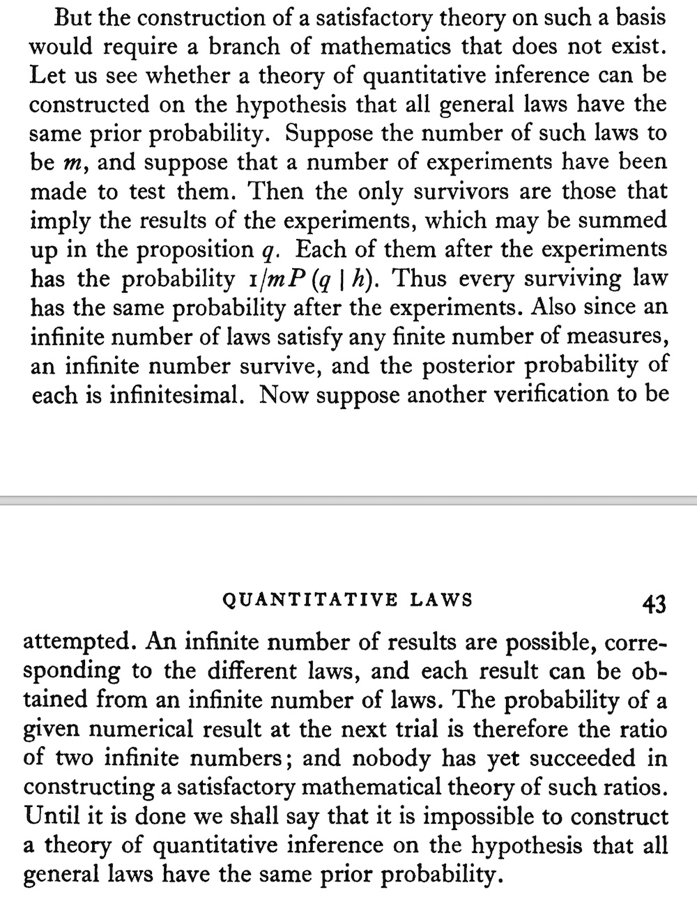
Looks great, but …
“… all general laws have the same prior probability…”
“… posterior probability … is infinitesimal…”
“… require a branch of mathematics that does not exist…”

Slide 26
A familiar
problem….
At any stage, after n-1 successes, competing hypothesis is:
p* = q₁. q₂. … q_{n-1}.junk_{n}
Any idiotic nonsense whatever.
At any stage, there are always infinitely many competing “junk” continuations.
Which is the right one?
Rule out the infinitely many p* with prior probabilities.
Prior probabilities supplied externally.
If we already know which are the junk continuations, how much more is Bayes giving us?
Bayes doesn’t know which sequence of q’s truly belong together and should be projected.

Slide 27
Prior probabilities encode simplicity ranking

Slide 28
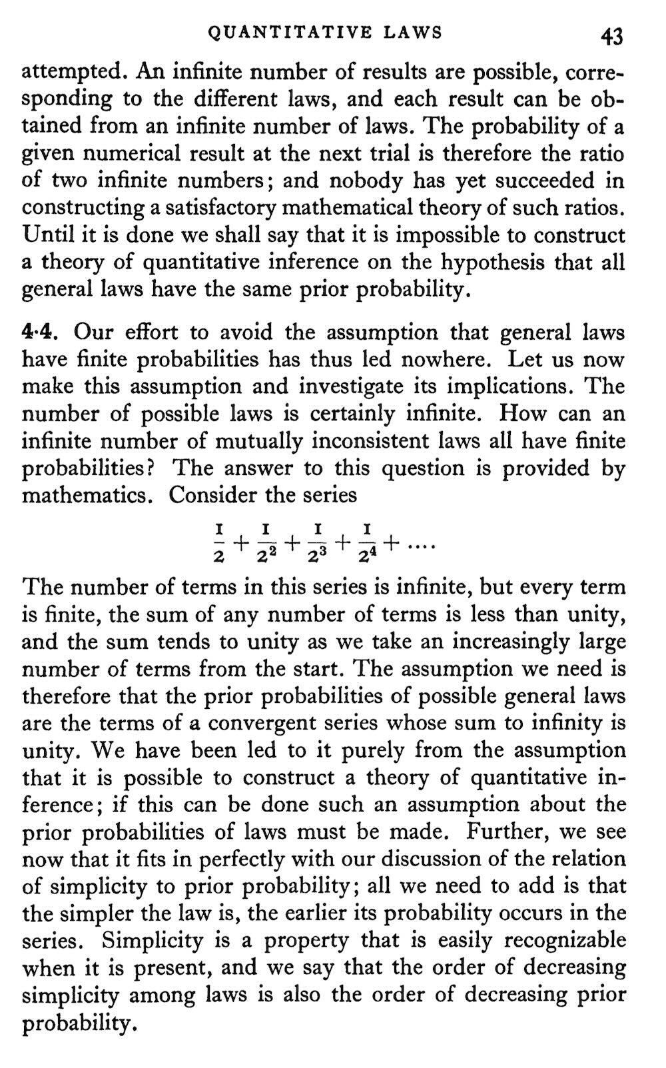
“The assumption we need to make is that the prior probabilities of possible general laws are the terms of a convergent series...”
“Simplicity is a property that is easily recognizable when it is present, and we say that the order of decreasing simplicity among laws is also the order of decreasing prior probability.”

Slide 29
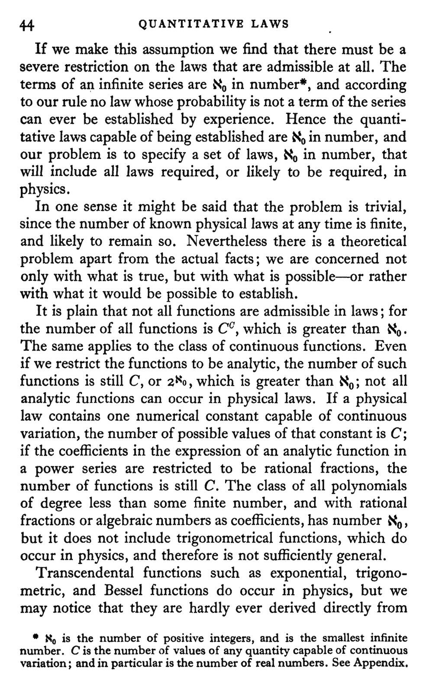
“Hence the quantitative laws capable of being establishes are aleph₀ in number and our problem is to specify a set of laws aleph₀ in number, that will include all laws required, or likely to be required, in physics.”

Slide 30
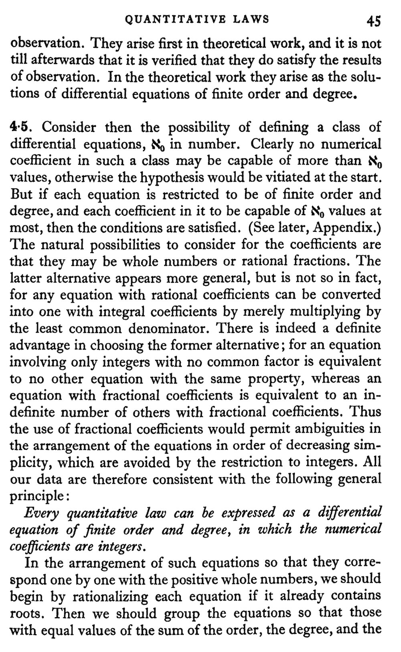
“Every quantitative law can be expressed as a differential equation of finite order and degree, in which the numerical coefficients are integers.”

Slide 31
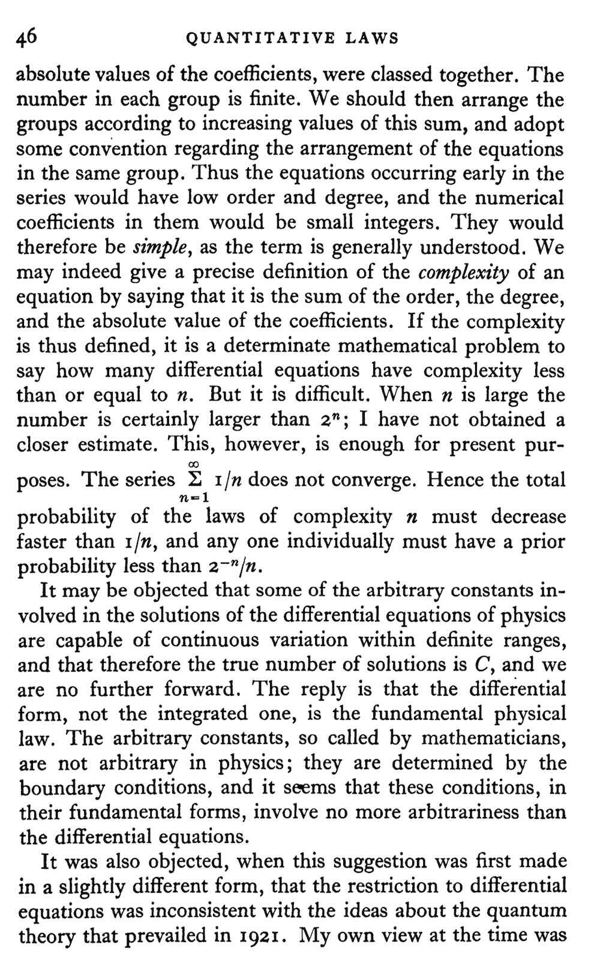
order
degree
coefficient
(d²y/dx²)³ + 27(dy/dx) = k
“… a precise definition of the complexity of an equation by … the sum of the order, the degree, and the absolute value of the coefficients.”
2 + 3 + 27 = 32
Each law of complexity n is assigned a prior probability less than
2^{-n}/n

Slide 32
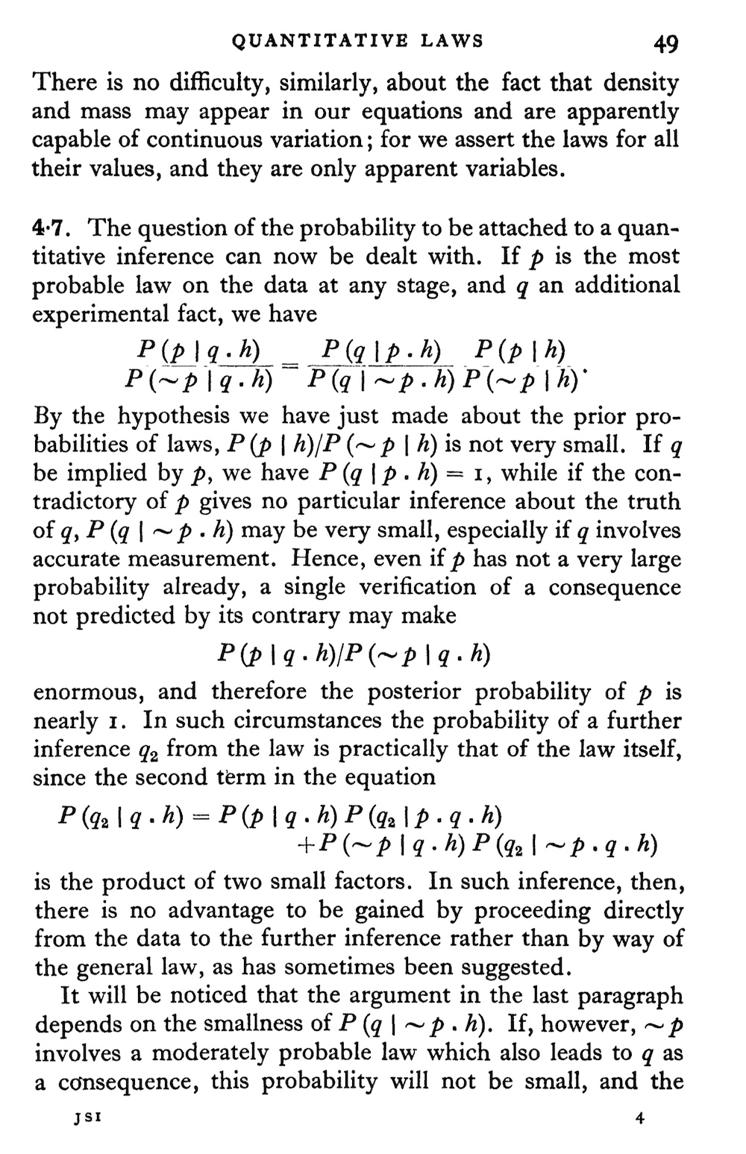
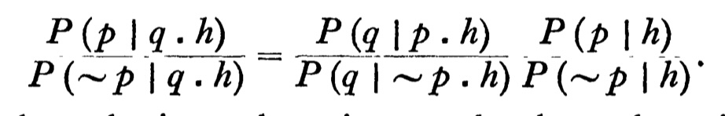
Apply through the ratio form of Bayes’ theorem.

Slide 33
Looks good…
When p entails q,
P(q|p.h) = 1 …
Then posterior ratio shifts strongly in favor of p.
… and q is improbable on ~p,
P(q|~p.h) is small.

Slide 34
A familiar
problem….
When both p and r entail q,
P(q|p.h) = P(q|r.h)
r
r
r
Posterior ratio
= prior ratio
The only discrimination between p and r is supplied externally by the ratio of prior probabilities.

Slide 35
Gems and Coals

Slide 36
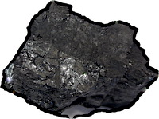
Gems and coals
“We therefore consider it best to regard probability as a primitive notion not requiring definition.”
Jeffreys’ projection theorem.
Rule of succession without uniform priors.
In these examples, all the real work is done by judgments outside the Bayesian analysis that enter as prior probabilities.
“We now introduce the notation P(p|q) …”

