Slide 1
ECE 2795
Microgrid Concepts and Distributed Generation Technologies
Spring 2017
Week #5

Slide 2
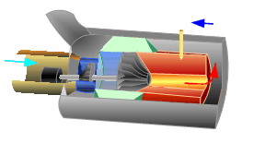
Microturbines
Microturbines are essentially low-power versions of traditional gas turbines used in large power plants.
Typical power outputs of microturbines range from a few tens of kW to a few hundred of kW.
Natural gas is the most common fuel, but other hydrocarbons, such as kerosene, or bio-fuels can be used, too.
Recuperator
Exhaust
Natural Gas
Air
Combustion
Chamber
Generator
Compressor
Turbine

Slide 3
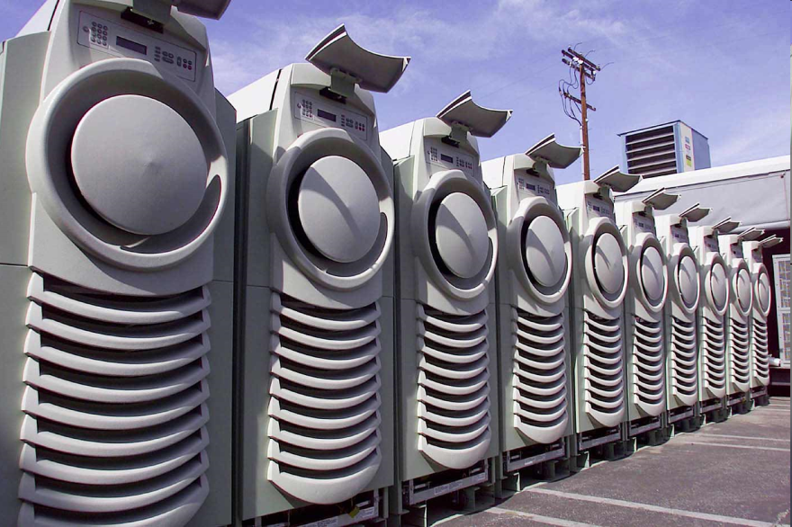
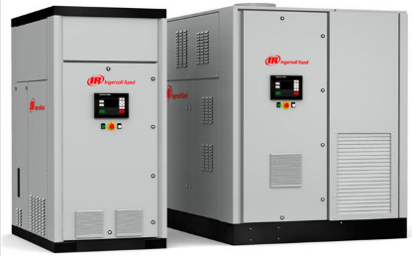
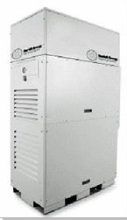
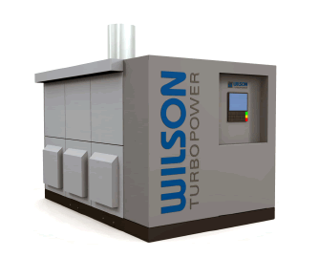
Microturbines
Capstone
30 kW and 60 kW units
Ingersoll
70 kW Induction microturbine
250 kW synchronous microturbine
Wilson TurboPower
300 kW
Mariah Energy
30 kW and 60 kW units

Slide 4
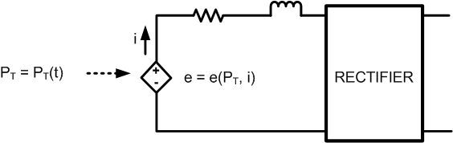
Microturbines
Moderate cost and efficiency
High-frequency output is rectified (and inverted again in ac microgrids). Generator output frequency is in the order of a few kHz (e.g. 1600 Hz for Capstone’s 30 kW microturbine).
Power shaft rotates at high speeds, usually on the order of 50 000 to 120 000 rpm
Very reliable technology (Essentially microturbines are aircraft’s APU’s). Critical parts: bearings and generator.
Generator technologies: Synchronous and permanent magnet
Moderately fast dynamic response

Slide 5
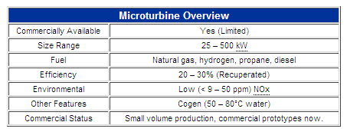
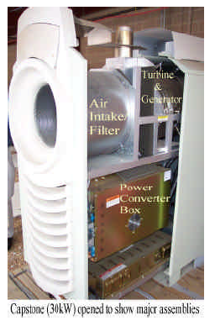
Microturbines
http://www.energy.ca.gov/distgen/equipment/microturbines/microturbines.html
Oak Ridge National Laboratory; ORNL/TM-2003/74

Slide 6
Thermodynamics: Review from week 1
Entropy: it is a property that indicates the disorder of a system or how much reversible is a process. This last definition relates entropy to energy “quality”.
In a reversible isothermal process involving a heat transfer Q_{rev} at a temperature T₀, the entropy is defined as
In all processes involving energy conversion or interactions ΔS is non-negative. ΔS is zero only in reversible processes.
For any process then
The “=“ in the above relationship will give us the minimum amount of heat Qmin required in a process.

Slide 7
Carnot Cycle
Thermodynamic cycle for heat engines
Describes the thermodynamic energy conversion process for the most efficient heat engine.
The cycle has 4 states.
Q₁ is the heat (i.e., energy) provided to the Carnot engine
Q₂ is the heat that the engine returns to the environment (heat rejection)
W is the work (i.e., energy) produced in one cycle
Without losses
        W = Q₁ - Q₂
The power produced by the engine is
        P = W.(cycles per second)

Slide 8
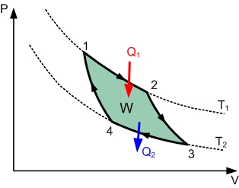
Carnot Cycle
From the definition of “work”:
If the curve is closed (a cycle), then

Slide 9
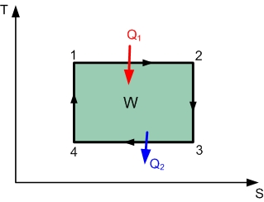
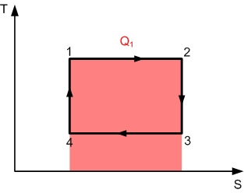
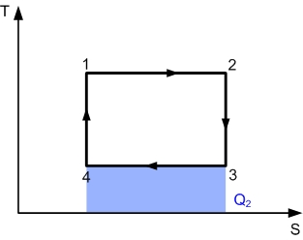
Carnot Cycle
But in a lossless process: W = Q₁ - Q₂
Since
then,
Thus,
So

Slide 10
Carnot Cycle
So
The efficiency is
Hence,
Observation #1: The efficiency increases as T₁ increases (higher quality heat) and T₂ (typically the ambient temperature) decreases.
Observation #2: Since T₂ can never be zero, the efficiency can never be 1.
Observation #3: Stirling engines operation approximates a Carnot Cycle.

Slide 11
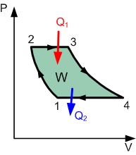
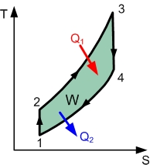
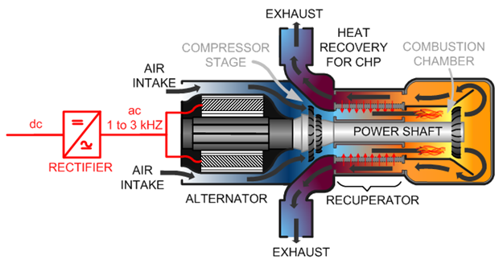
Brayton Cycle
Gas turbines operation follow a Brayton cycle
4
1
2
3

Slide 12
Brayton Cycle
We already know that
Thus, the efficiency is
Since heat injection and rejection occur at constant pressure then,
cp is the specific heat capacity (with respect to mass) at a constant pressure (how much heat needs to be added to increase temperature by 1 K)
Hence, the efficiency is

Slide 13
Brayton Cycle
Between 1 and 2, and between 3 and 4, the process is adiabatic (no heat exchange) and reversible (S is constant). Hence, the temperature changes due to work related with a pressure change acting on a varying volume.
In a reversible adiabatic process:
and
where the heat capacity ratio is
Hence,
Therefore

Slide 14
Brayton Cycle
From the previous slide:
Also, from the previous slide
Thus,

Slide 15
Brayton Cycle
Since the efficiency is (see a couple of slides ago)
Then the simplified expression for the efficiency is
Usually, the efficiency is expressed in terms of the temperature ratio (TR) or the pressure ratio (PR)
where and

Slide 16
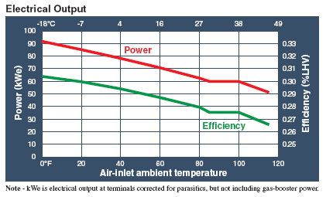
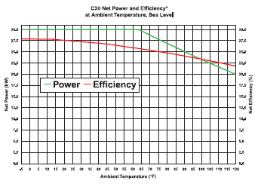
Microturbine characteristics
The efficiency is improved if T₂ is increased. The recuperator is used for that purpose. Other ways of preheating the air before the combustion stage could be to use heat from a fuel cell.
The efficiency decreases as the input temperature increases:
Ingersoll 70L datasheet
Capstone C30 datasheet

Slide 17
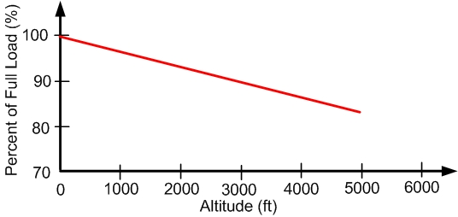
Microturbine characteristics
Efficiency is also affected by pressure differences.
Performance (capacity) decreases as altitude increases

Slide 18
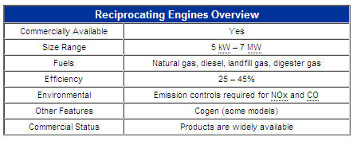
Reciprocating engines
This is likely the most common DG technology.
Some types of reciprocating engines are the internal combustion engines and the Stirling engines.
Types of internal combustion engines:
        Spark ignition (fuel: natural gas)
        Compression ignition (fuel: diesel)
The engines are used to drive synchronous or permanent magnet generators.
http://www.energy.ca.gov/distgen/equipment/reciprocating_engines/reciprocating_engines.html

Slide 19
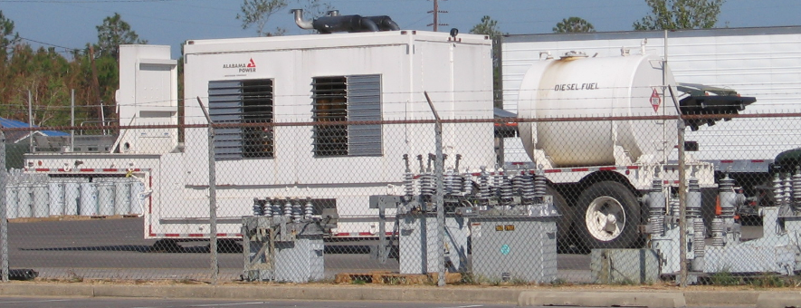
Reciprocating engines
Reciprocating engines have been used in recent natural disasters by electric power utilities in order to build “emergency microgrids” and restore service to some areas in the power distribution grid.
Hurricane Katrina
Hurricane Ike

Slide 20
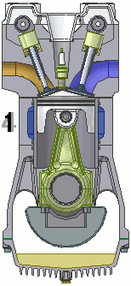
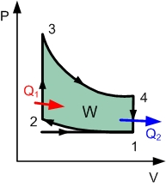
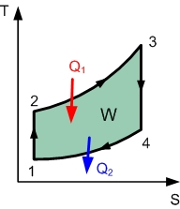
Spark Ignition engines
Natural gas is the most commonly used fuel.
Thermodynamically they follow an Otto cycle with 4 strokes:
      1. intake (induction) stroke
      2. compression stroke
      3. power stroke: combustion/expansion
      4. exhaust stroke
http://en.wikipedia.org/wiki/Image:4-Stroke-Engine.gif#file

Slide 21
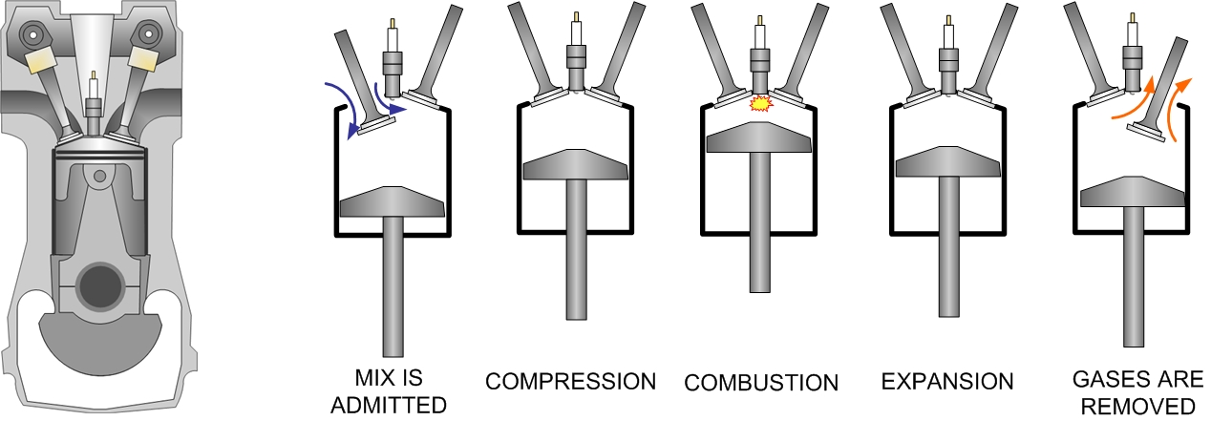
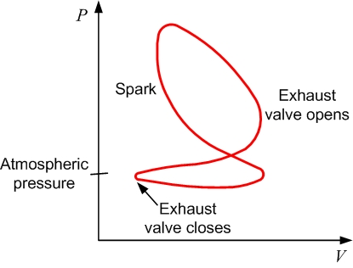
Spark Ignition engines
Ideal vs. practical Otto Cycle
Ideal
Practical

Slide 22
Spark Ignition engines
Efficiency of Otto Cycle
Since Q1 is absorbed in an isochoric (constant volume) transition and also Q2 is rejected in an isochoric process
Hence,

Slide 23
Spark Ignition engines
From the previous slide
Since the transitions from State #1 to State #2 and from
State #3 to State #4 are isentropic and V4 = V1
and V2 = V3, then
Thus,

Slide 24
Spark Ignition engines
Efficiency:
Where r is the compression ratio V₁/V₂
Moreover, since the process from State #1 to State #2 is isentropic, then
and

Slide 25
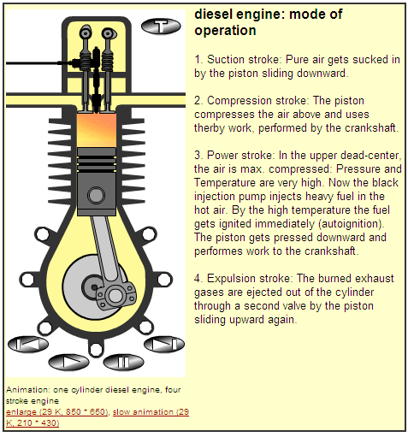
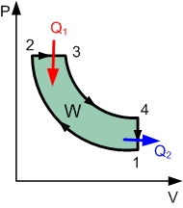
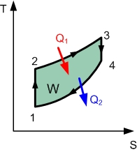
Compression Ignition engines
Natural gas is the most commonly used fuel.
Thermodynamically they follow a Diesel cycle
      1. intake (induction) stroke
      2. compression stroke
      3. power stroke
      4. expansion stroke
http://library.thinkquest.org/C006011/english/sites/diesel.php3?v=2
More animated engines:
http://library.thinkquest.org/C006011/english/sites/animations.php3?v=2

Slide 26
Compression Ignition engines
Efficiency:
Now
Hence,
r is the compression ratio V₁/V₂ and α is the ratio V₃/V₂

Slide 27
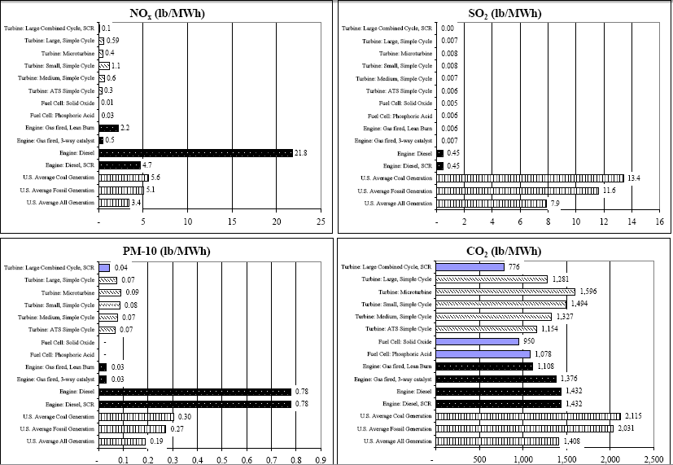
Emissions comparison
http://www.raponline.org/ProjDocs/DREmsRul/Collfile/DGEmissionsMay2001.pdf

Slide 28
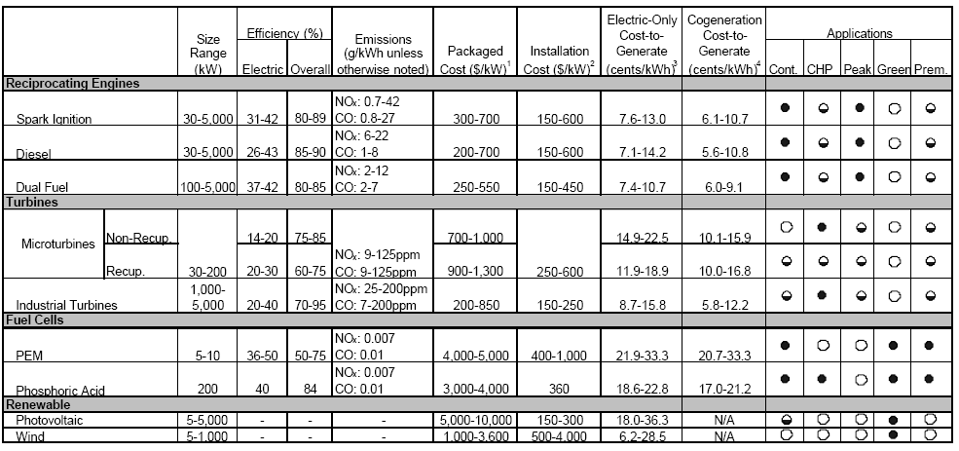
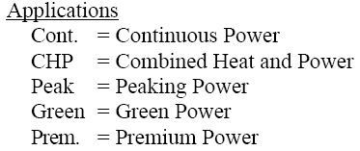

DG technologies comparison
Note: some of these costs (e.g. PV, or operations)
are now lower… we will talk about this in class
Resource Dynamics Corporation, “Assessment of Distributed Generation Technology Applications”, Feb. 2001

