Slide 1
ECE 2795
Microgrid Concepts and Distributed Generation Technologies
Spring 2017

Slide 2
Course Introduction
Meetings: Mondays from 5:00 to 7:30 PM ET in G36 Benedum Hall (Section 1010) and virtually (DL students).
Professor: Alexis Kwasinski (Benedum 1229, akwasins@pitt.edu, Ph: 412-383-6744)
Course Home Page: http://www.pitt.edu/~akwasins/ECE2795uGridSpr17.html
Also in CourseWeb/Blackboard
Office Hours: Mondays from 3 pm to 5 pm and Tuesdays from 1:30 pm to 2:30 pm, or by appointment.

Slide 3
Course Introduction
Prerequisites:
Fundamentals of power electronics and power systems or consent from the instructor.
Familiarity with at least one computer simulation software.
Knowledge on how to browse through professional publications.
Course Description:
Graduate level course. Hence, students are expected to have a proactive approach to their course work, which in some cases will require finding on their own proper ways to find unknown solutions to a given problem.
Main Goal: To discuss topics related with microgrids.
Secondary Goal: To prepare the students to conduct research or help them to improve their existing research skills.
This course is designed based on the fact that students are already graduated professionals in engineering or science. Hence, grading includes evaluating students academic maturity within the context of a graduate level course by, for example, considering how well students demonstrate independence in finding solutions to problems without guidance from the professor.

Slide 4
Course Introduction
Schedule:
Week 1 (Jan. 9) Introduction. Course description. The electric grid vs. microgrids: technical and historic perspective. The “Energy Internet.” Review of fundamental concepts for this course.
Module #1:
Week 3 (Jan. 23)* Distributed Generation units. Microturbines, reciprocating engines, wind generators, photovoltaic generators, fuel cells, and other technologies.
Week 4 (Jan. 30)* Distributed Generation units. Microturbines, reciprocating engines, wind generators, photovoltaic generators, fuel cells, and other technologies.
Module #2:
Week 5 (Feb. 6) Energy Storage – batteries, fly-wheels, ultracapacitors, and other technologies.
Week 6 (Feb. 13) * Energy Storage – batteries, fly-wheels, ultracapacitors, and other technologies.

Slide 5
Course Introduction
Schedule:
Module #3: System integration and operation
Week 7 (Feb. 20) Power electronics interfaces: multiple and single input dc-dc converters.
Week 8 (Feb. 27)* Power electronics interfaces: ac-dc and dc-ac.
Week 9 (March 6) Spring Recess.
Week 10 (March 13)* Power architectures: distributed and centralized. Dc and ac distribution systems. Stability and protections.
Week 11 (March 20) Controls: distributed, decentralized, autonomous, and centralized systems. Operation.
Week 12 (March 27)* Reliability and availability. (Remote instruction likely)
Week 13 (April 3) Economics.
Week 14 (April 10)* Grid interconnection. Issues, planning, advantages and disadvantages both for the grid and the microgrid. Microgrids as part of smart grids.
Week 15 (April 17) Course review

Slide 6
Course Introduction
Schedule (notes):
Asterisks indicate weeks when homework assignments are likely to be assigned (or, in most cases, to be due).
Italics indicate weeks when Dr. K will be attending conferences or may be unable to teach from the classroom for some other reason. However, some additional trips unknown at this time may come up during the course of the semester. For example, due to the particular nature of his research, Dr. K may need to travel to disaster areas on short notice. Although Dr. K will communicate these trips in advance along with any potential changes that these trips may cause, it is not possible to know at this time when those trips may occur. Still, provisions will be taken so no lecture classes are missed (e.g. some class may be taught remotely).

Slide 7
Course Introduction
Grading:
Homework: 40%
Project preliminary evaluation: 20%
Project report: 30%
Class participation: 10%
Letter grades assignment: Grades will be assigned based on the following scale:
A+ (grade > 97%), A (97% ≥ grade ≥ 92%), A- (92% > grade ≥ 87%), B+ (87% > grade ≥ 82%), B (82% > grade ≥ 77%), B- (77% > grade ≥ 72%), C+ (72% > grade ≥ 67%), C (67% > grade ≥ 62%), C- (62% > grade ≥ 57%), D+ (57% > grade ≥ 52%), D (52% > grade ≥ 47%), D- (47% > grade ≥ 40%), F (40% > grade),
Homework:
Homework will be assigned approximately every 2 weeks.
The lowest score for an assignment will not be considered to calculate the homework total score. However, all assignments need to be submitted showing a good-faith effort in trying to solve all problems in order to have the lowest homework score discarded.

Slide 8
Course Introduction
Project:
The class includes a project that will require successful students to survey current literature.
The project consists of carrying out a limited research work throughout the course.
The project could be to analyze some problem with a different approach, or explore some already presented approach in detail, or do a literature survey on a given topic.
The students need to identify their project topic. This topic, of course, needs to be related with microgrids.
  Examples of valid topics are the study of a microgrid power generation technology, integration of energy storage in microgrids, planning and design of microgrids, stability and control of microgrids, use of microgrids in a particular application, performance evaluation of microgrids, etc.
  Examples of topics that may likely be unsuitable for this course include the study of large wind or PV farms, technologies or operation of conventional power systems with a weak connection to microgrids, integration of microgrid technologies from the perspective of conventional power grids, smart grid or new power grid-related technologies (e.g. electric vehicles) with a weak connection to microgrids. (That is, this is a course about microgrids, not general power systems or conventional power grids, so the project needs to reflect this focus on microgrids).

Slide 9
Course Introduction
Project:
Projects with a focus on electric power grids will likely receive a low score for being out of the scope of this course
The project is divided in two phases:
1) Preliminary phase. Due date: February 6. Submission of references, description of the problem, and proposed approach to study it (1 to 2 pages long-single column document).
2) Second phase. Due date: April 10. Submission of a short paper (the report), at most 10 pages long, single column.

Slide 10
Course Introduction
Additional notes:
When sending me a message related with this course via email start your Subject line with “ECE-2795 S17:”
Class presentations and homework assignments will be posted in both CourseWeb/Blackboard and the course website.
Announcements will be posted in the course website and in most cases in CourseWeb/Blackboard, too.
So, please, check both CourseWeb/Blackboard and the class website regularly for information, class notes and homework assignments.

Slide 11
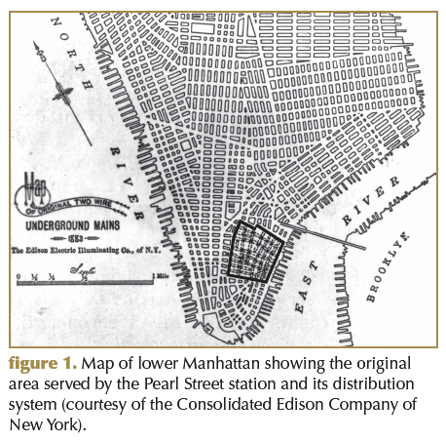
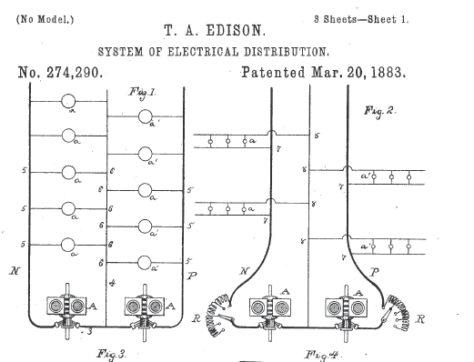
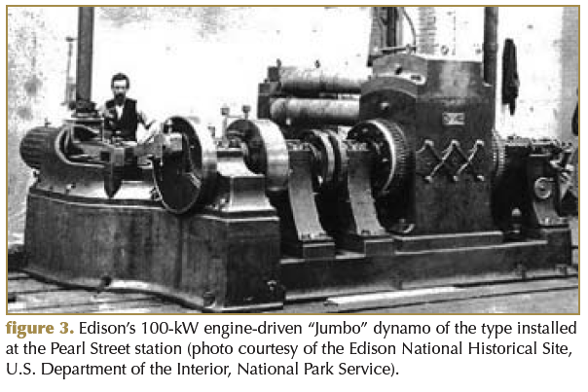
Historical Perspective
Competing technologies for electrification in 1880s:
Edison:
    dc.
    Relatively small power plants (e.g. Pearl Street Station).
    No voltage transformation.
    Short distribution loops – No transmission
    Loads were incandescent lamps and possibly dc motors (traction).
Pearl Street Station:
6 “Jumbo” 100 kW, 110 V
generators
“Eyewitness to dc history” Lobenstein, R.W. Sulzberger, C.

Slide 12
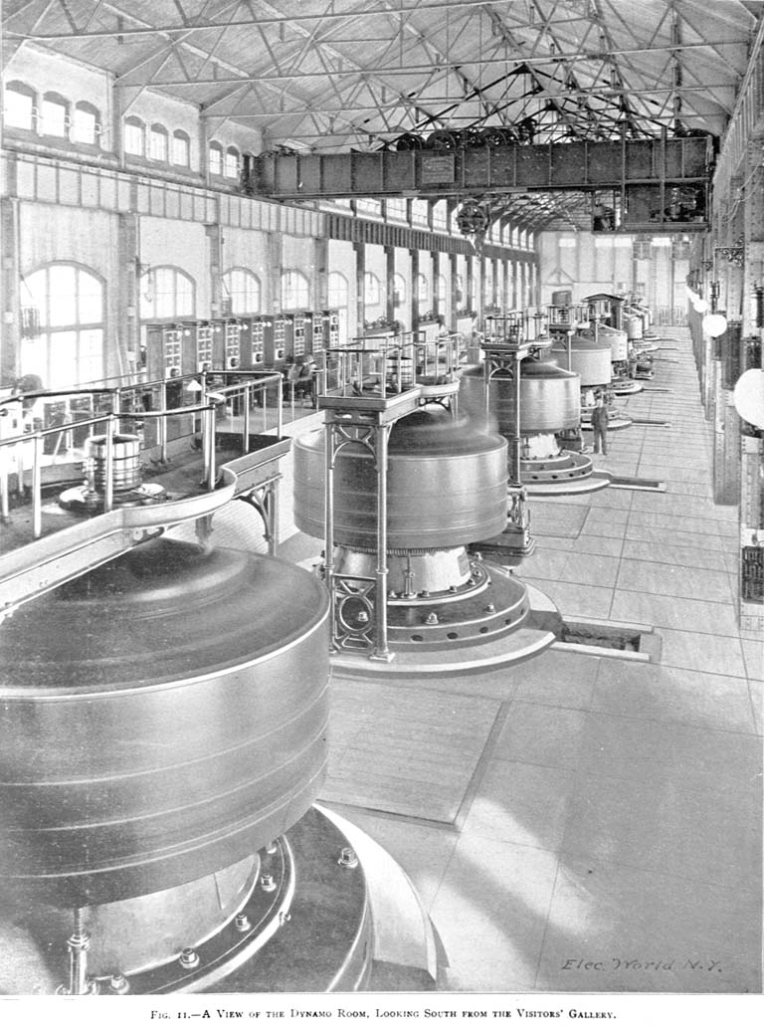
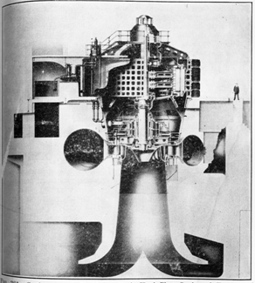
History
Competing technologies for electrification in 1880s:
Tesla:
    ac
    Large power plants (e.g. Niagara Falls)
    Voltage transformation.
    Transmission of electricity over long distances
    Loads were incandescent lamps and induction motors.
Niagara Falls historic power plant:
38 x 65,000 kVA, 23 kV, 3-phase
generatods
http://spiff.rit.edu/classes/phys213/lectures/niagara/niagara.html

Slide 13
History
Edison’s distribution system characteristics: 1880 – 2000 perspective
Power can only be supplied to nearby loads (< 1mile).
Many small power stations needed (distributed concept).
Suitable for incandescent lamps and traction motors only.
Cannot be transformed into other voltages (lack of flexibility).
Higher cost than centralized ac system.
Used inefficient and complicated coal – steam actuated generators (as oppose to hydroelectric power used by ac centralized systems).
Not suitable for induction motors.

Slide 14
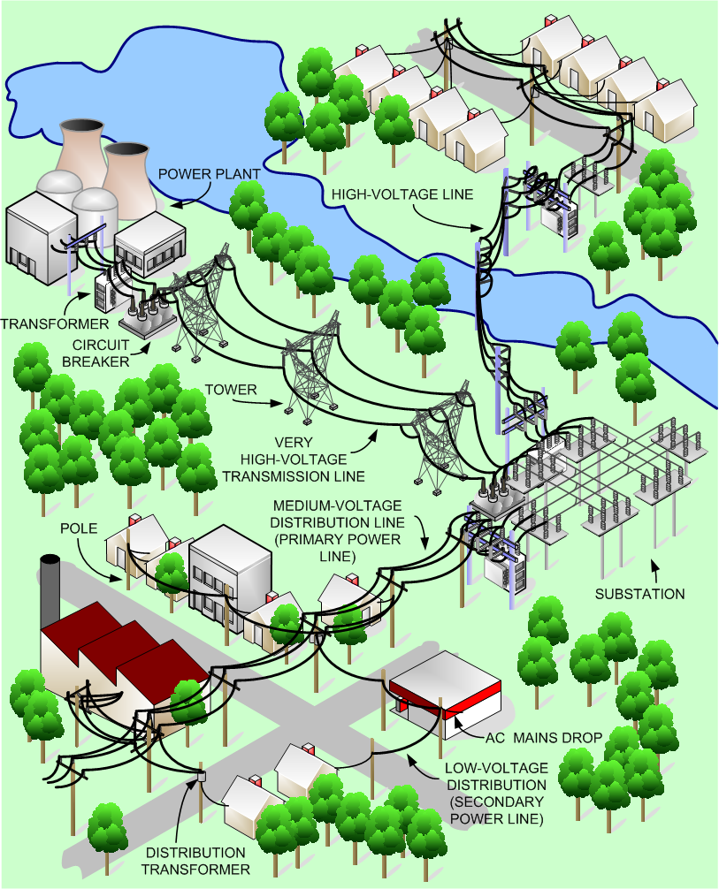
History
Traditional technology: the electric grid:
Generation, transmission, and distribution.
Centralized and passive architecture.
Extensive and very complex system.
Complicated control.
Not reliable enough for some applications.
Stability issues.
Vulnerable/fragile.
Need to balance generation and demand
Lack of flexibility.

Slide 15
History
Conventional grids operation:
In order to keep frequency within a tight stable operating range generated power needs to be balanced at all time with consumed power.
A century working around the need for adding electric energy storage through grid stiffness by:
  Interconnecting many large power generation units (high inertia = mechanical energy storage).
  Individual loads power ratings are much smaller than system’s capacity
Conventional grid “stiffness” make them lack flexibility.
Lack of flexibility is observed by difficulties in dealing with high penetration of renewable energy sources (with a variable power output).
Electric energy storage can be added to conventional grids but in order to make their effect noticeable at a system level, the necessary energy storage level needs to be too high to make it economically feasible.

Slide 16
History
Edison’s distribution system characteristics: 2000 – future perspective
Power supplied to nearby loads is more efficient, reliable and secure than long power paths involving transmission lines and substations.
Many small power stations needed (distributed concept).
Existing grid presents issues with dc loads (e.g., computers) or to operate induction motors at different speeds. Edison’s system suitable for these loads.
Power electronics allows for voltages to be transformed (flexibility).
Cost competitive with centralized ac system.
Can use renewable and alternative power sources.
Can integrate energy storage.
Can combine heat and power generation.

Slide 17
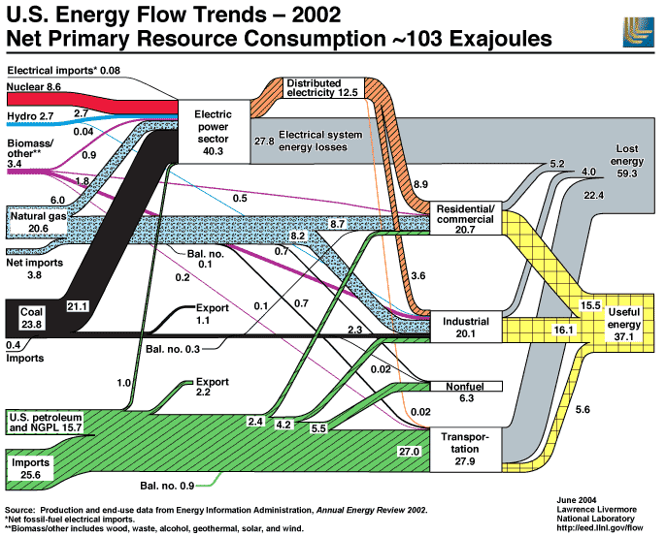
Sustainability
103 10¹⁸ Joules
Useful energy
High polluting emissions
https://eed.llnl.gov/flow/02flow.php

Slide 18
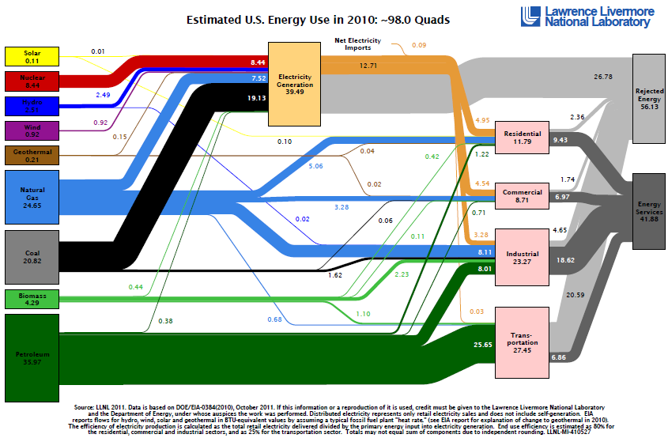
Sustainability
103.4 Exajoules
“New”
renewable sources
https://flowcharts.llnl.gov/
18
18

Slide 19
Sustainability
Issues with integration of “new” renewable sources into large conventional power grids
Variable output (part stochastic) may lead to potential stability and power quality issues.
Large footprint.
No (or very little) “inertia”
Other issues with renewable sources in general (inc. hydroelectric plants)
Not usually sufficiently available near load centers (so cost evaluation need to add construction of transmission lines)
Ecological issues.

Slide 20
Availability/Resilience
Resiliency (from PPD21):
  “The ability to prepare for and adapt to changing conditions and withstand and recover rapidly from disruptions.”
  “Withstand” refers to an “up” time
  Rapid recovery refers to a “down” time
Inclusion of an up and a down time points towards an analogy between the concept of resiliency and that of availability.
Although reliability tends to be the best known term for indicating how much time a system is working well, the term “availability” its more technically correct and fits better for assessing power systems performance both in normal conditions and during extreme events.
20
Notes:
20

Slide 21
Availability/Resilience
Availability calculation
The expected time a system is working meeting its operational goals is the “mean up time” (MUT). It equals the inverse of the failure rate λ. It is mostly related with hardware issues.
The expected “off-line time” can also be called “mean down time” (MDT). It equals the inverse of the repair rate μ. It is influenced by human processes and aspects, such as logistical management, as well as hardware-related issues.
Unavailability (U) equals 1-A
Through the failure rate, availability is a system-based concept that expands the concept of reliability.
The equation given above will be improved in a future class
21
Notes:
21

Slide 22
Availability/Resilience
Conventional U.S. grid availability in normal conditions:
Approximately 99.9 %
Availability required in critical applications:
Approximately 99.999%

Slide 23
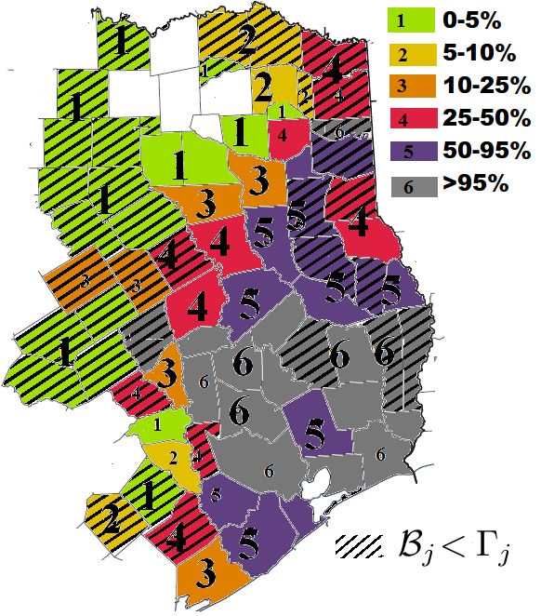
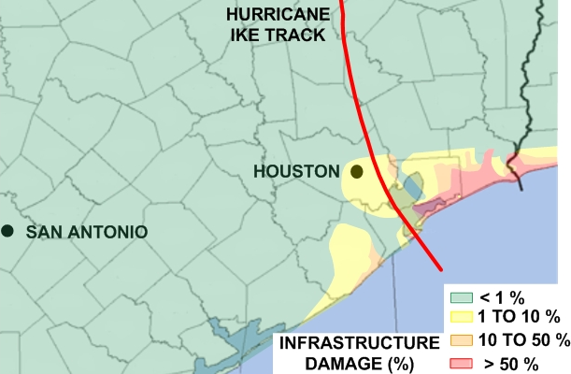

Availability/Resilience
Due to their predominately centralized control and power generation architectures, power grids are very fragile systems in which little damage may lead to extensive outages.
Maximum power outage incidence (O%_{max}) after Ike
Percentage of power grid damage after Ike
Information obtained from field damage assessments
23

Slide 24
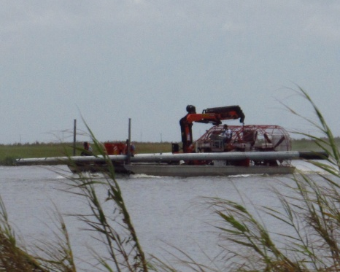
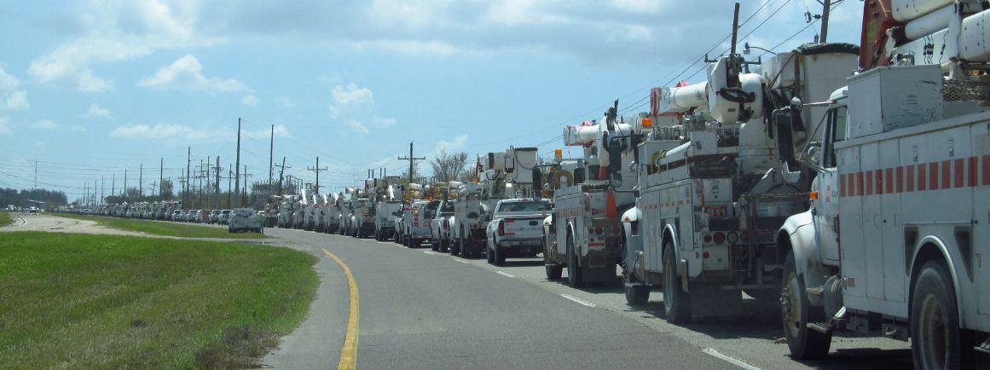
Availability/Resilience
Other weaknesses of power grids observed during natural
disasters
Very extensive network (long paths and many components).
Typically, sub-transmission and distribution portions of the grid lack redundancy. As a result, long restoration times usually originate at the distribution level of power grids.
Need for continuous balance of generation and demand.
Difficulties in integrating meaningful levels of electric energy storage
Aging infrastructure
Aging workforce (people is an essential part of infrastructure systems)
24

Slide 25
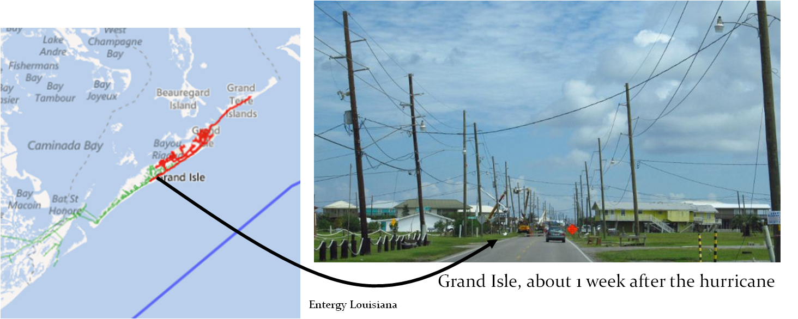
Availability/Resilience
Example of lack of redundancy at sub-transmission/distribution
Vulnerability: Sub-transmission and distribution portions of the grid lack redundancy. Most outages originate in distribution-level issues.
E.g., Only one damaged pole among many undamaged causing most of Grand Isle to lose power.
25

Slide 26
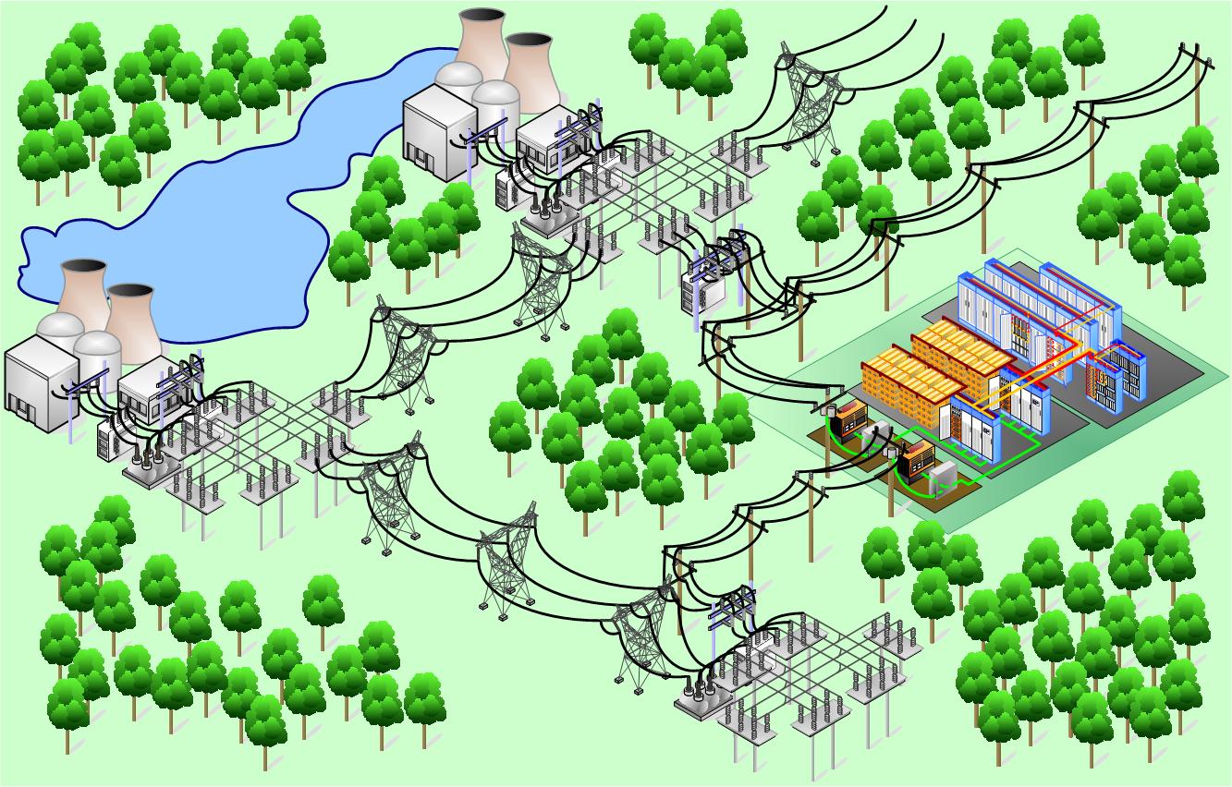
Availability/Resilience
Example of lack of diversity

Slide 27
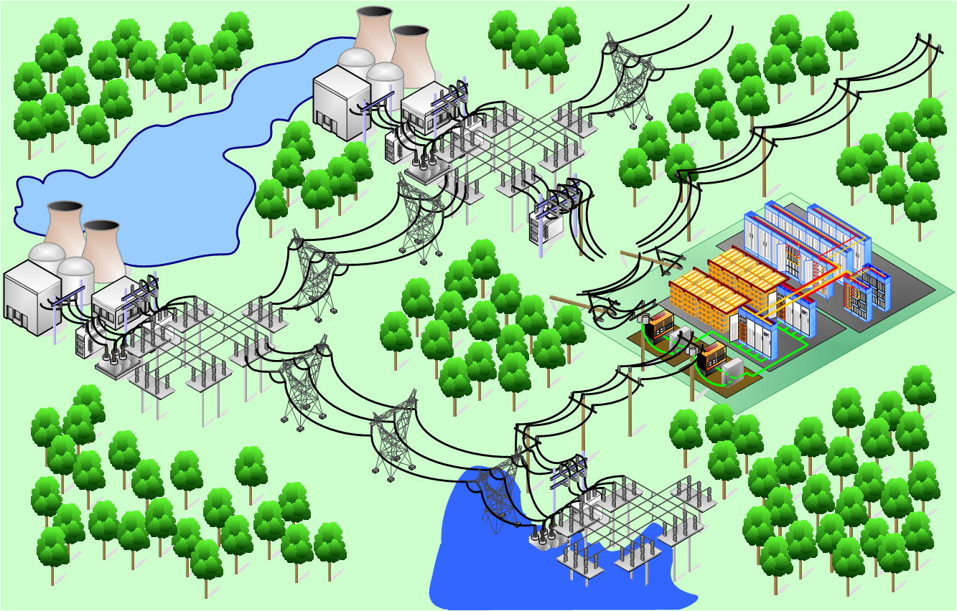
Availability/Resilience
Example of lack of diversity

Slide 28
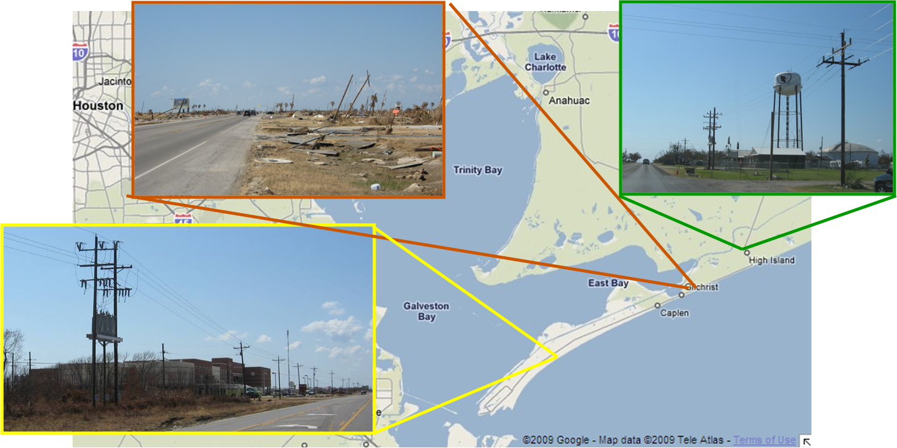
Availability/Resilience
Power grids performance during natural disasters
Severe damage is often limited to relatively small areas
During disasters damage distribution is inhomogeneous (e.g. Ike).
28

Slide 29
Availability/Resilience
Power grids performance during natural disasters
Case study: Superstorm Sandy
Relatively little damage to the power grid but outages were severe
Longer restoration times than usual observed in areas with underground power facilities.
29

Slide 30
Availability/Resilience
Power grids performance during natural disasters
Case study: Superstorm Sandy
Often, damage to power grids is less severe than for residences.
Storm surge damaged some substations in coastal areas
30

Slide 31
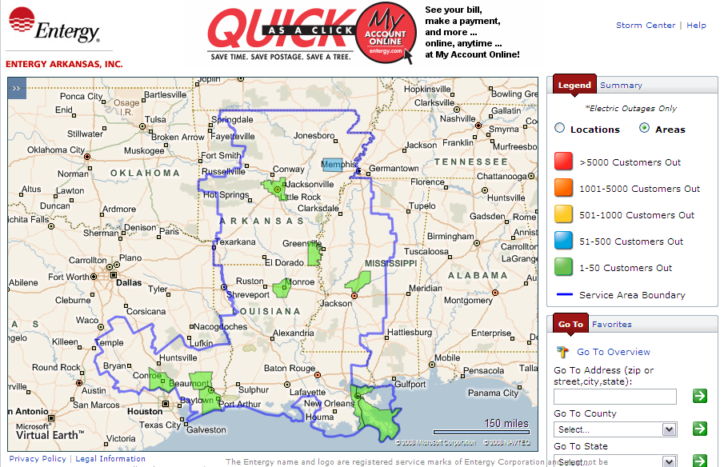
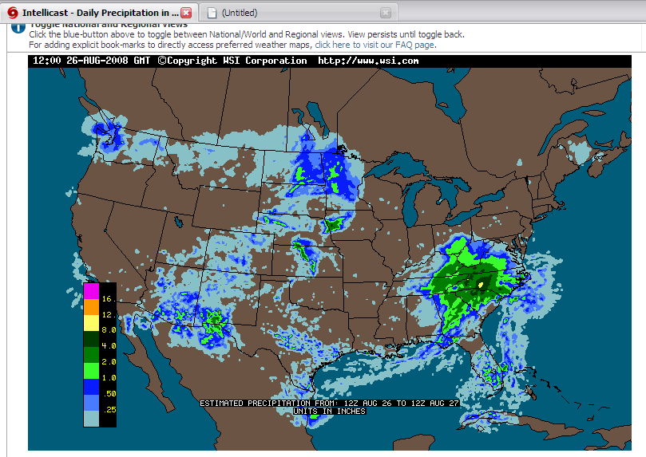
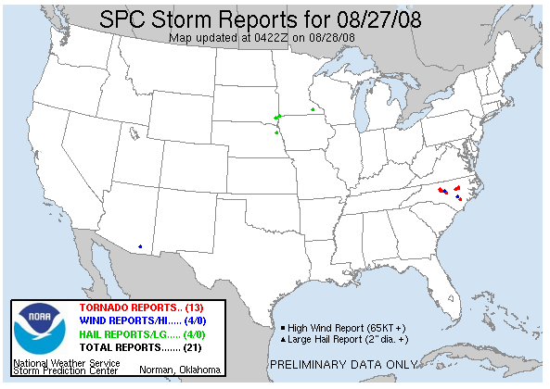
Availability/Resilience
Although they are hidden, the same reliability weaknesses are prevalent throughout the grid. Hence, power outages are not too uncommon in “normal” conditions.

Slide 32
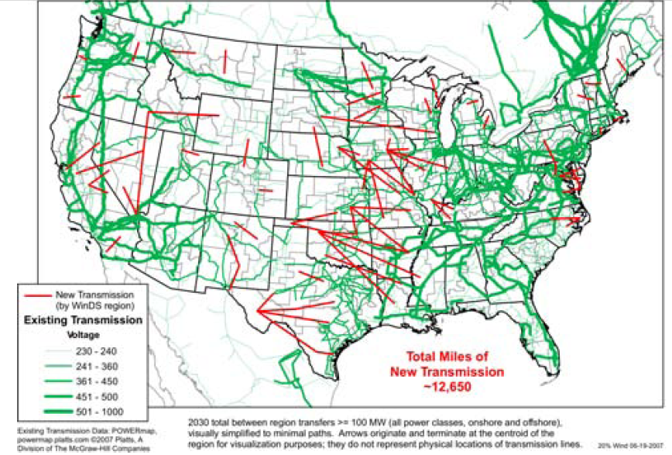
Security
Increased reliance on communications and cybernetics make power grids more vulnerable to external attacks
Long transmission lines are extremely easy targets for external attacks.
U.S. DOE OEERE “20% of Wind Energy by 2030.”

Slide 33
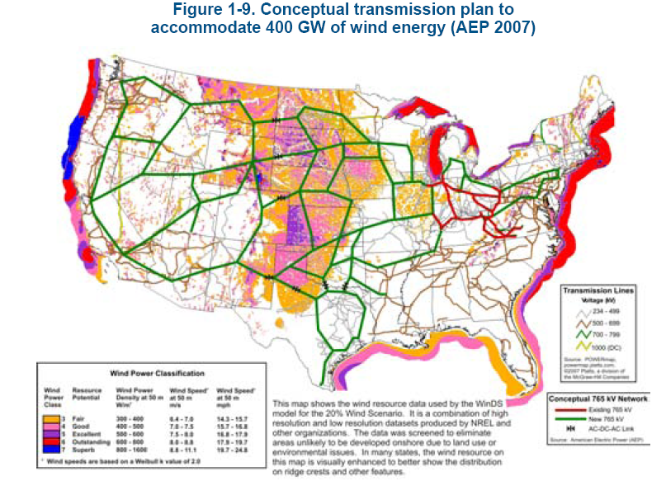
Cost
Traditional natural gas and coal power plants is not seen as a suitable solution as it used to be.
Future generation expansion capacity will very likely be done away from demand centers. Hence, more large and expensive transmission lines need to be built.
http://www.nrel.gov/wind/systemsintegration/images/home_usmap.jpg

Slide 34
Other issues in conventional grids
Centralized integration of renewable energy issue: generation profile unbalances.
Complicated stability control
The grid lacks operational flexibility because it is a passive network.
The grid user is a passive participant whether he/she likes it or not (e.g. users cannot set their own local power quality objectives)…. Electrification benefits are shared by all but effects or problems are felt by all.
The grid is old: it has the same 1880s structure. Power plants average age is > 30 years.
All these issues are added to the previously mentioned issues: sustainability, resilience, security, cost.
Good news: Conventional power grids are well designed systems that meet their design requirements.
Bad news: There are present operational and planning requirements for which conventional power grids were not designed for. Hence, current issues with power grids are systemic and inherent of their design and cannot be addressed with retrofits, or partial enhancements or improvements.

Slide 35
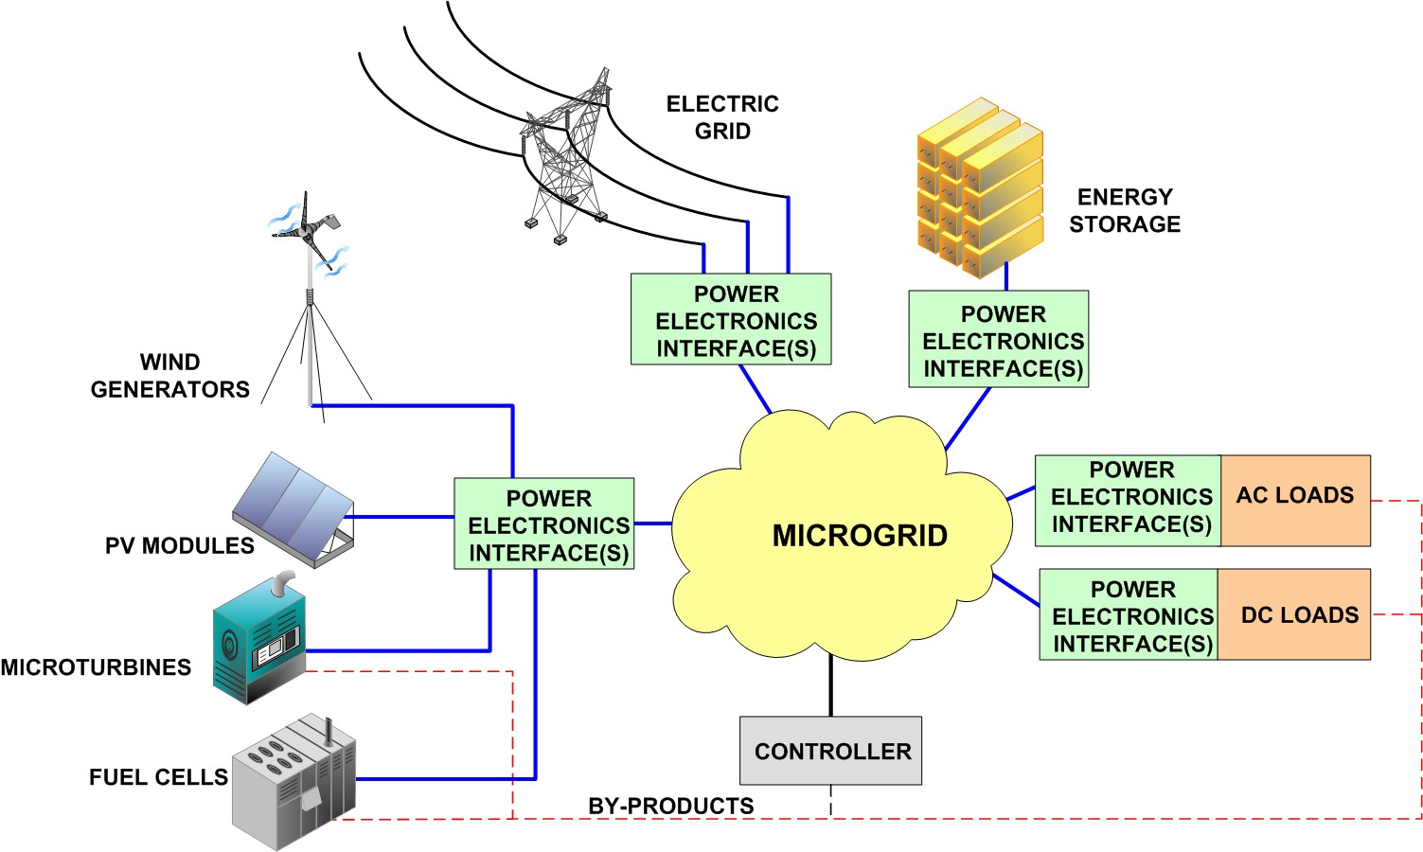
Microgrids: Concept (a first approach)
Microgrids are independently controlled (small) electric networks, powered by local units (distributed generation).

Slide 36
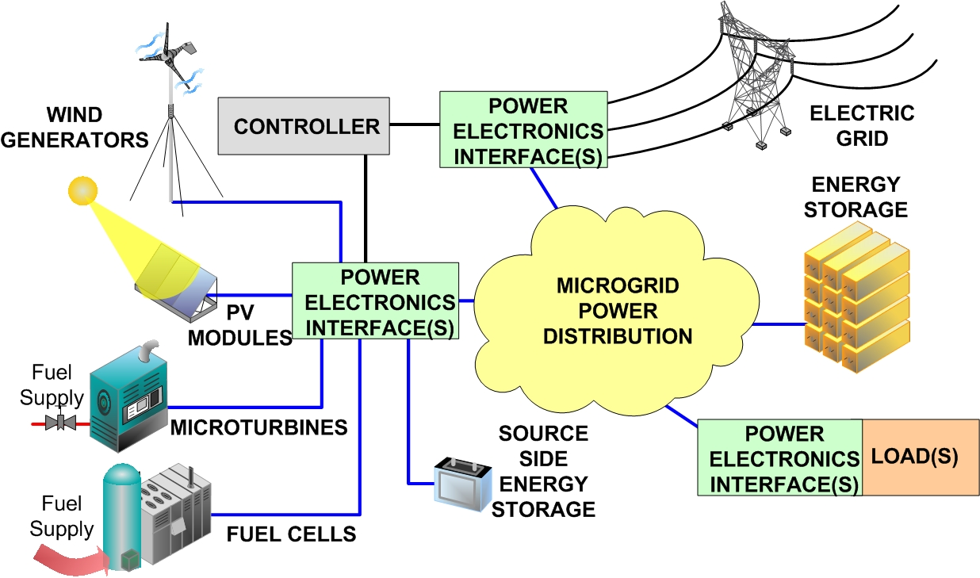
Microgrid: Concept (newest DOE def.)
What is a microgrid?
Microgrids are considered to be locally confined and independently controlled electric power grids in which a distribution architecture integrates loads and distributed energy resources—i.e. local distributed generators and energy storage devices—which allows the microgrid to operate connected or isolated to a main grid
36

Slide 37
Distributed Generation: Concept
      Key concept for microgrids: independent control.
This key concept implies that the microgrid has its own power generation sources (active control vs. passive grid).
A microgrid may or may not be connected to the main grid.
DG can be defined as “a subset of distributed resources (DR)” [T. Ackermann, G. Andersson, and L. Söder, “Distributed generation: A definition.” Electric Power Systems Research, vol. 57, issue 3, pp. 195-204, April 2001].
DR are “sources of electric power that are not directly connected to a bulk power transmission system. DR includes both generators and energy storage technologies” [T. Ackermann, G. Andersson, and L. Söder, “Distributed generation: A definition.” Electric Power Systems Research, vol. 57, issue 3, pp. 195-204, April 2001]
DG “involves the technology of using small-scale power generation technologies located in close proximity to the load being served” [J. Hall, “The new distributed generation,” Telephony Online, Oct. 1, 2001 http://telephonyonline.com/mag/telecom_new_distributed_generation/.]
Thus, microgrids are electric networks utilizing DR to achieve independent control from a large widespread power grid.
37
37

Slide 38
Microgrids
Distributed Generation: Advantages
With respect to the traditional grid, well designed microgrids can be:
More resilient (with diverse power inputs and in most cases with energy storage).
More efficient
More environmentally friendly
More flexible
Less vulnerable
More modular
Easier to control
Immune to issues occurring elsewhere
Capital investment can be scaled over time
Microgrids can be integrated into existing systems without having to interrupt the load.
Microgrids allow for combined heat and power (CHP) generation.
38
38

Slide 39
Microgrids
Distributed Generation: Issues
Load following
Power vs Energy profile in energy storage
Stability
Cost
Architecture / design
Optimization
Autonomous control
Fault detection and mitigation
Cost
Grid interconnection
39
39

Slide 40
Microgrids: System Components
Generation units = microsources ( approximately below than 100 kW each)
PV Modules.
Small wind generators
Fuel Cells
Microturbines
Energy Storage (power profile)
Batteries
Ultracapacitors
Flywheels
Loads
Electronic loads.
Plug-in hybrids.
The main grid.
Power electronics interfaces
dc-dc converters
inverters
rectifiers

Slide 41
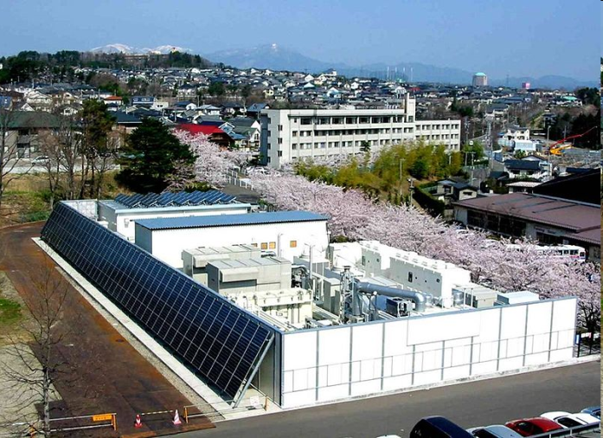
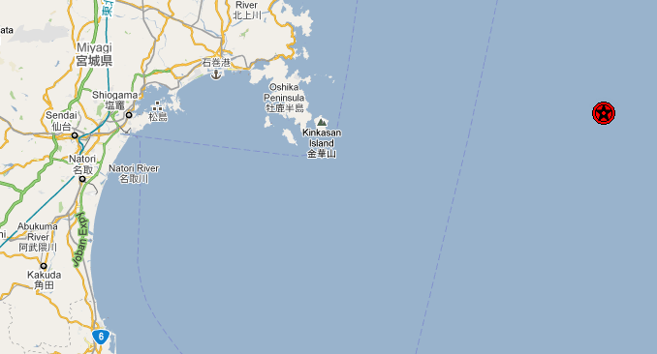
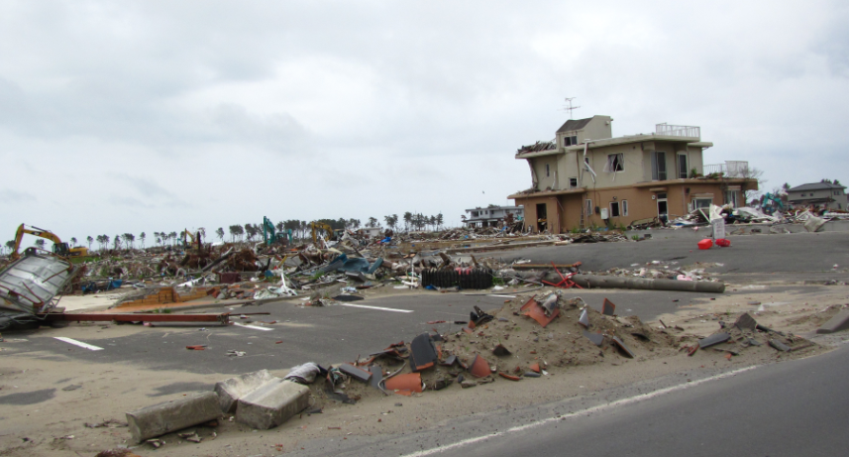
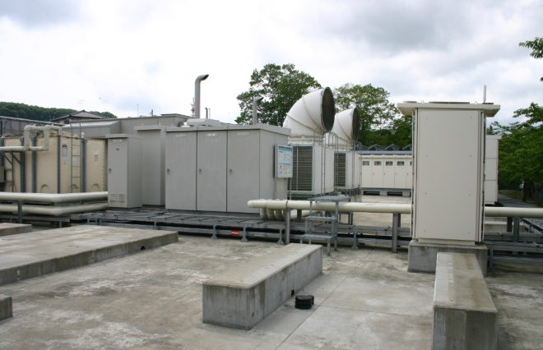
Microgrid Examples
Resilient power supply during disasters
Power electronics-enabled microgrids may be the solution that achieves resilient power during disasters (e.g. NTT’s microgrid in Sendai, Japan)

Slide 42
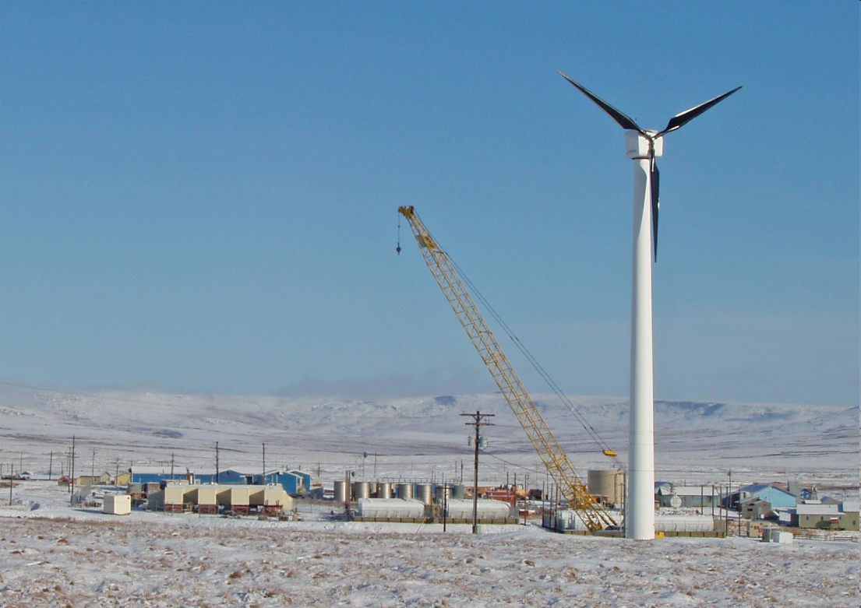
Microgrid Examples
Isolated microgrids for villages in Alaska.
Wind is used to supplement diesel generators (diesel is difficult and expensive to transport in Alaska
Toksook Bay
Current Population: 590
# of Consumers: 175
Incorporation Type: 2nd Class City
Total Generating Capacity (kw): 2,018
  1,618 kW diesel
  400 kW wind
  (tieline to Tununak and Nightmute)
Information from “Alaska Village Electric Cooperative”
http://avec.securesites.net/images/communities/Toksook%20Wind%20Tower%20Bulk%20Fuel%20and%20Power%20Plant.JPG

Slide 43
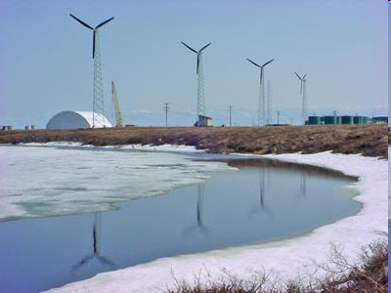
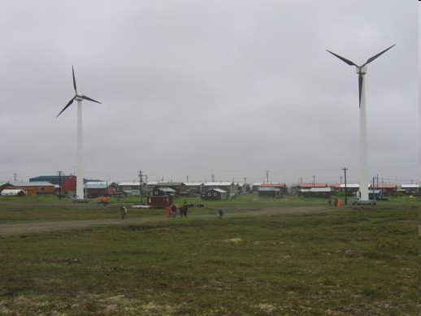
Microgrid Examples
Other examples in Alaska
Selawik
Kasigluk
http://www.alaskapublic.org/2012/01/18/wind-power-in-alaska/
http://www.akenergyauthority.org/programwindsystem.html

Slide 44
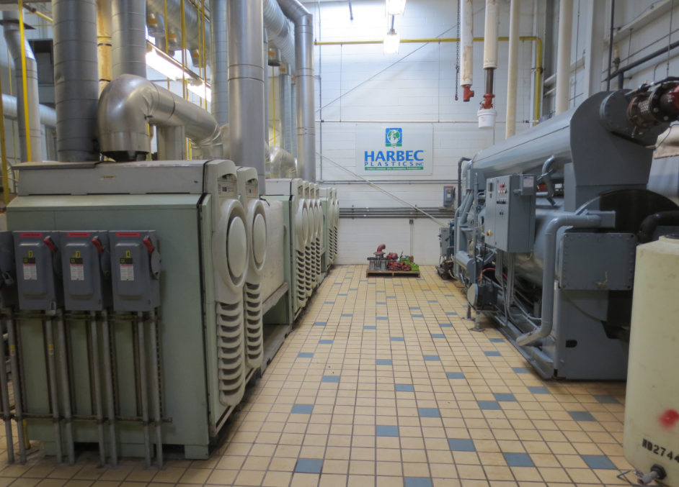
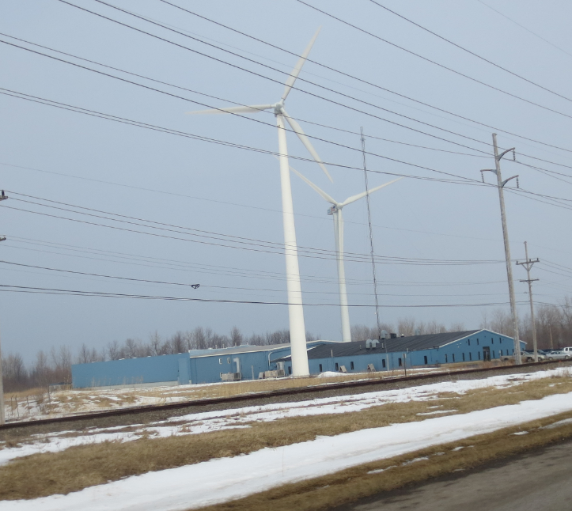
Microgrid Examples
A microgrid with combined heat and power can be used in factories to overcome power quality issues affecting product quality in manufacturing processes.

Slide 45
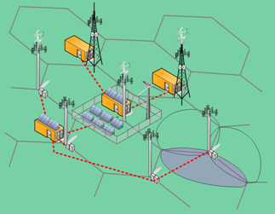
Microgrid Examples
This is a proposed microgrid concept in order to use more renewable sources in wireless communication networks by creating so-called sustainable wireless areas (SWAs).
SWAs are dc (e.g. 380V ) microgrids created by interconnecting a few (e.g. 7) base stations with, possibly, an advanced power distribution architecture.
Renewable energy sources are placed in base stations or nearby locations where there is sufficient space.
Resources (power generation and energy
storage) are shared among all base
stations within the SWA.
Communications traffic and electric energy
management is integrated. I.e., traffic
is regulated (or shaped) based on local
energy resources availability and forecast.

Slide 46
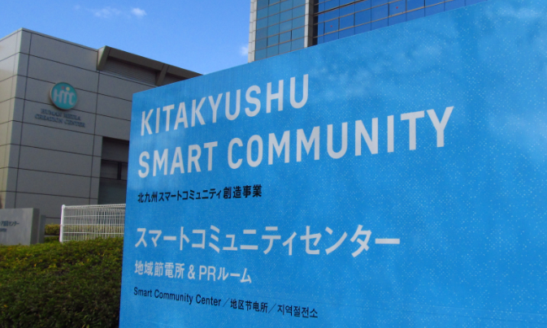
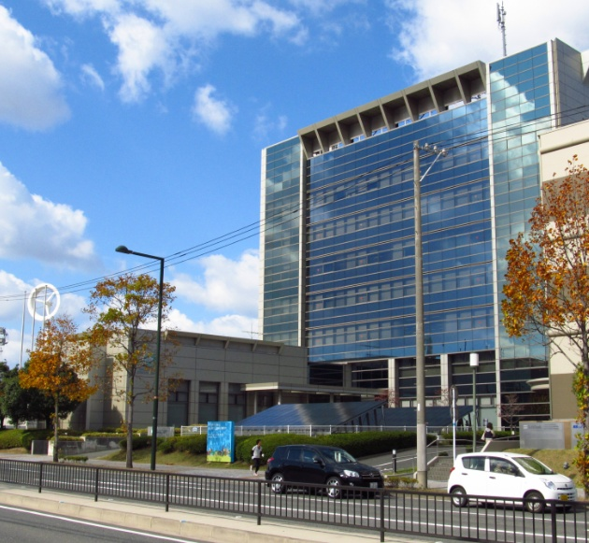
Microgrid Examples
Kitakyushu smart community (Japan)

Slide 47
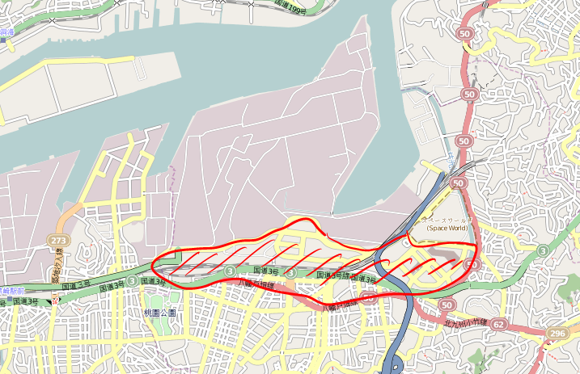
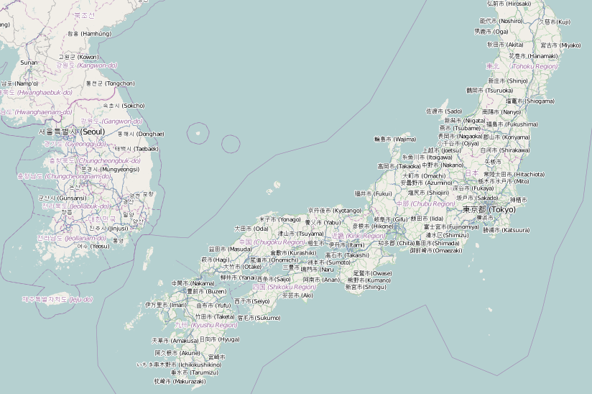
Microgrid Examples
Kitakyushu smart community (Japan)

Slide 48
Microgrid Examples
Kitakyushu smart community:
  Powered locally from the industrial area
  Power distribution grid independent from the area’s electric utility distribution company (Kyushu Electric Power Company)
  http://jscp.nepc.or.jp/en/kitakyushu/index.shtml.
Nippon Steel

Slide 49
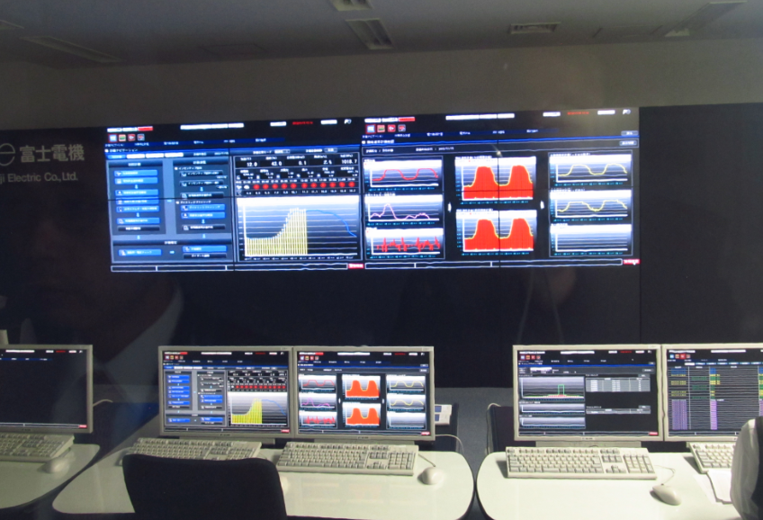
Microgrid Examples
Kitakyushu smart community (Japan)
Peak power consumption of this area = 18 MW
Main power source: 30 MW from a natural gas generator at steel mill.

Slide 50
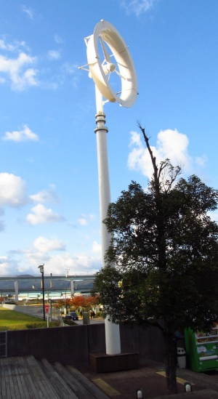
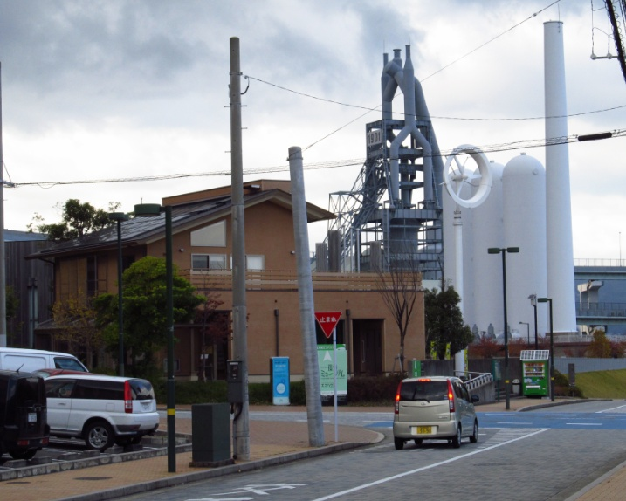
Microgrid Examples
Kitakyushu smart community (Japan)
The area has a few 3 kW wind generators.

Slide 51
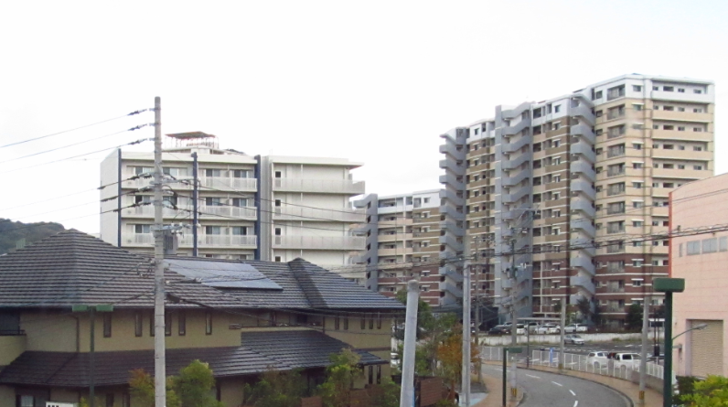
Microgrid Examples
Kitakyushu smart community (Japan)
Most buildings and homes have PV systems.
Total peak power generated by PV = 0.5 MW

Slide 52
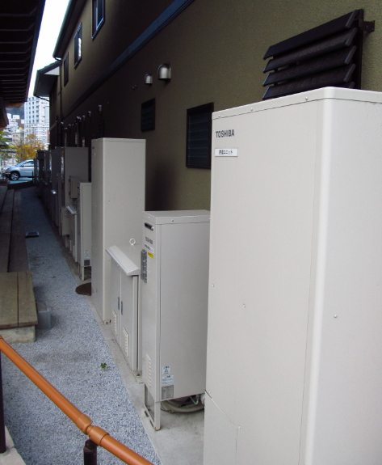
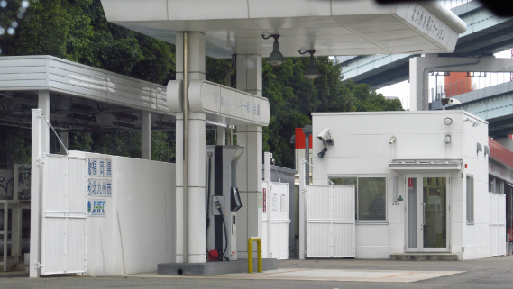
Microgrid Examples
Kitakyushu smart community (Japan)
Hydrogen produced in the industrial area is distributed with a 1.2 km pipeline for
  7 x 3 kW Toshiba residential fuel cells,
  3 kW hydrogen station
  100 kW fuel cell at a museum.

Slide 53
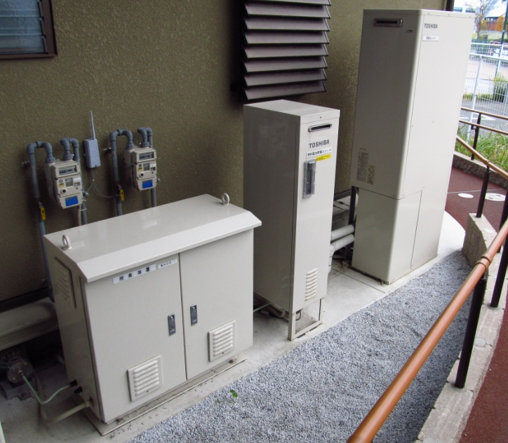
Microgrid Examples
Kitakyushu smart community (Japan)
Residential fuel cells
Deodorant and flow meter
Fuel Cell
Hot water storage

Slide 54
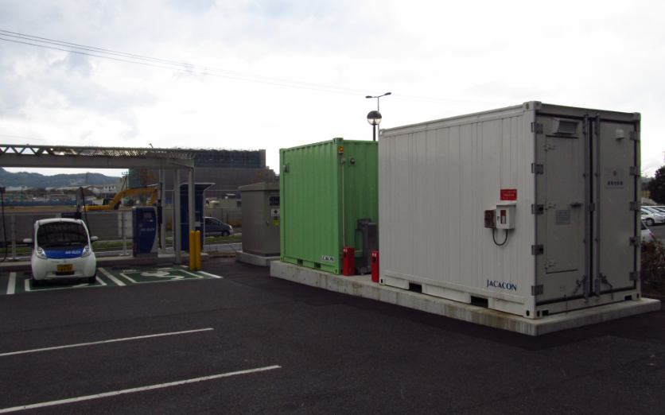
Microgrid Examples
Kitakyushu smart community (Japan)
EV fast charging (and discharging) station + 50 kWh Li-ion batteries.

Slide 55
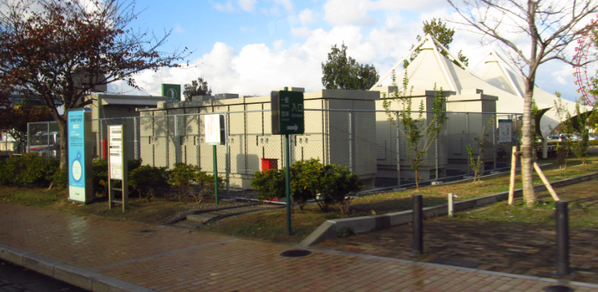
Microgrid Examples
Kitakyushu smart community (Japan)
300 kWh Lead-acid batteries

Slide 56
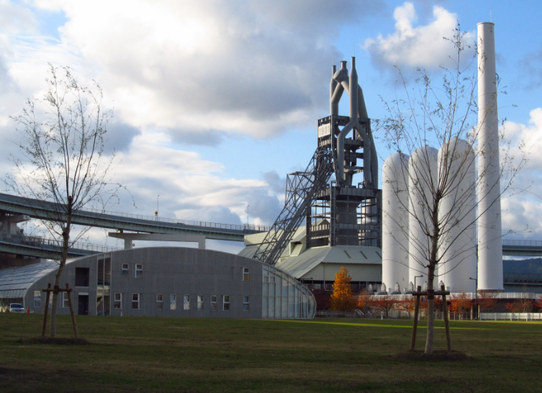
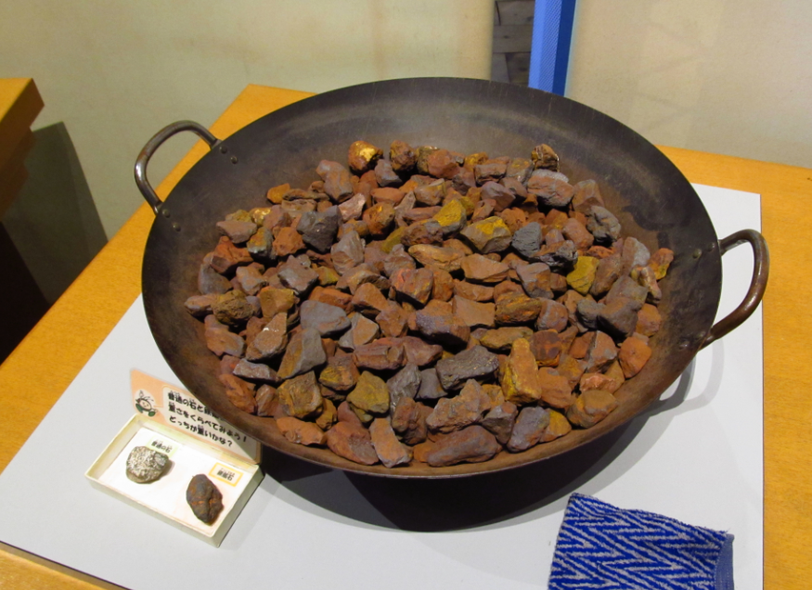
Microgrid Examples
Kitakyushu smart community (Japan)
This site is located at the “birthplace of Japan’s modern industry.” One can say that Kitakyushu is Japan’s Pittsburgh.
Kokura is located about 3 miles from the smart community site
The historic blast furnace:
Iron ore

Slide 57
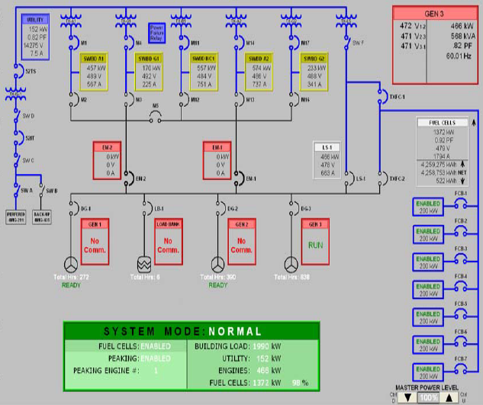
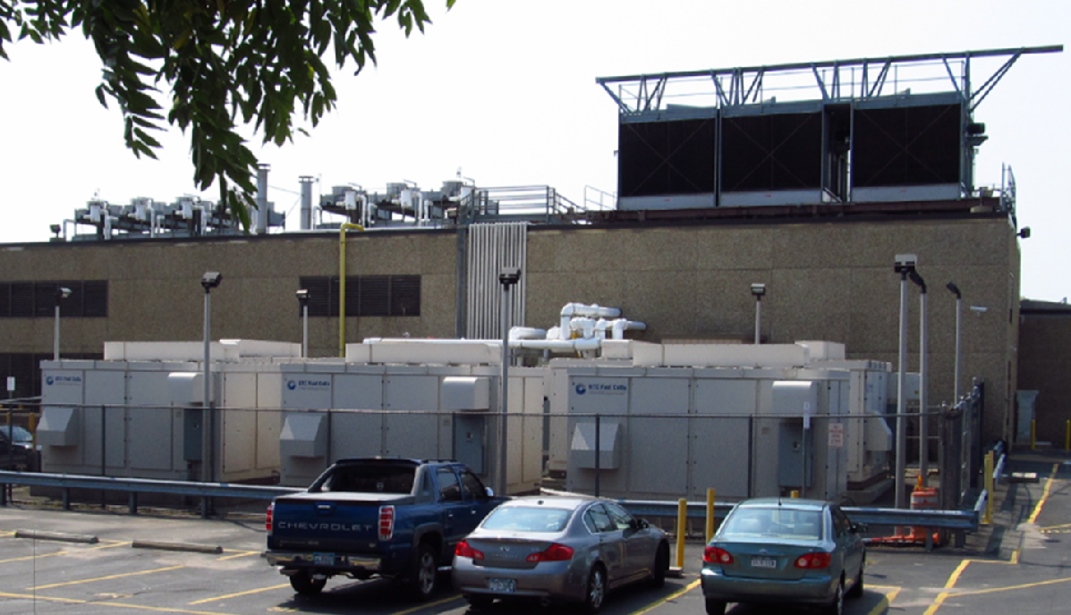
Microgrid Examples
Verizon (although technically not exactly a microgrid, it could be made a microgrid).
7 x 200 kVA fuel cells (similar to a grid-tied system).
3 x 1.59 MW diesel generators for emergency standby.
Heat of fuel cells is used in a combined heat and power system for cooling using an absorption chiller.

Slide 58

Microgrids
Application range:
  From a few kW to MW
Other applications: hospitals, military facilities, buildings, industrial complex.

Slide 59

Microgrids
What is not a microgrid?
Residential conventional PV systems (grid-tied) are not microgrids but they are distributed generation systems.
Why are they not microgrids? Because they cannot operate isolated from the grid. If the grid experiences a power outage the load cannot be powered even when the sun is shinning bright on the sky.

Slide 60
Microgrids
Several differences between microgrids and a conventional main grid:
  Control architecture (centralized/distributed)
  Ratio of generation capacity and total loads; number of generators vs. number of loads; ratio of power generation units capacity and load.
  Meaningful levels of energy storage
  Role of users / performance goals freedom
  Levels of inertial directly connected to the system
  Planning and design freedom,
  Types of loads, planning and design freedom,
  Distribution path length / Type of distribution system: Resistive or Inductive (reactive)
From an analytic point of view several assumptions commonly used in power grids without question them, may not be applicable in microgrids.

Slide 61
Microgrids and Smart Grids
European concept of smart grids based on electric networks needs [http://www.smartgrids.eu/documents/vision.pdf]:
  Flexible: fulfilling customers’ needs whilst responding to the changes and challenges ahead;
  Accessible: granting connection access to all network users, particularly for renewable power sources and high efficiency local generation with zero or low carbon emissions;
  Reliable: assuring and improving security and quality of supply, consistent with the demands of the digital age with resilience to hazards and uncertainties;
  Economic: providing best value through innovation, efficient energy management and ‘level playing field’ competition and regulation
The US concepts rely more on advanced interactive communications and controls by overlaying a complex cyberinfrastructure over the existing grid. DG is one related concept but not necessarily part of the US Smart Grid concept.

Slide 62
Smart grids
Smart grids definition:
Besides being the new buzz word is not a concept but rather many technologies.
Smart grid focus:
Reliability.
Integration of environmentally friendly generation and loads.
Concept evolution:
“Smart grid 1.0”: Smart meters, limited advanced communications, limited intelligent loads and operation (e.g. demand response).
“Smart grid 2.0” or “Energy Internet”: Distributed generation and storage, intelligent loads, advanced controls and monitoring.

Slide 63

Smart Grids
A customer-centric view of a power grid includes microgrids as one of several smart grids technologies.
63
63

Slide 64
Concepts from past courses
Basic concepts that students need to review by themselves:
Power electronics (e.g., basic circuits: rectifiers, inverters, dc-dc converters. Basic notions for analysis of power electronic circuits, general definition of power factor, harmonic content).
Power systems (e.g. single and 3-phase circuit analysis, power calculations, real and reactive power concepts, displacement power factor
Control theory (e.g., when an equilibrium point of a system is stable and when it is not, modeling, feedback systems, etc.).
Circuit theory (circuits transient and steady state behavior, capacitors and inductors, time domain vs. frequency domain models and solutions, etc.).
Basic concepts that we will review during class:
Basic thermodynamic laws (e.g. cycles)
Some chemistry (e.g. reactions)

