Slide 1
ECE 2795
Microgrid Concepts and Distributed Generation Technologies
Spring 2017
Week #8

Slide 2
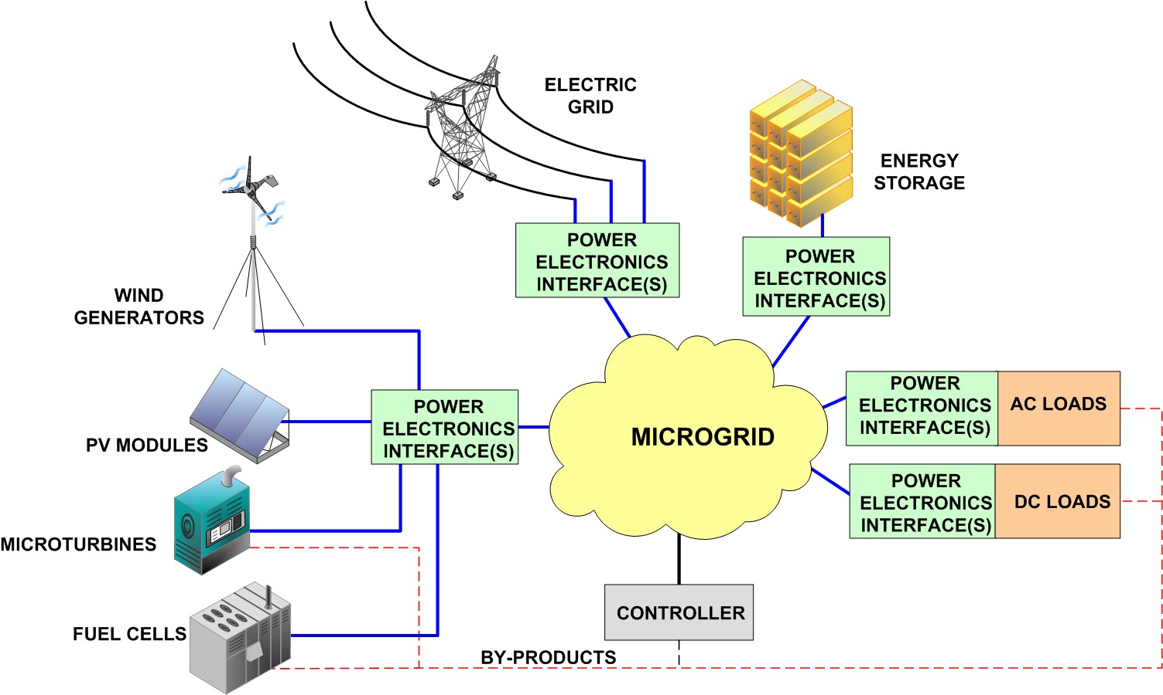
Power electronic interfaces
Power electronic converters provide the necessary adaptation functions to integrate all different microgrid components into a common system.

Slide 3
Power electronic interfaces
Integration needs:
  Component with different characteristics:
    dc or ac architecture.
    Sources, loads, and energy storage devices output.
  Control issues:
    Stabilization
  Operational issues:
    Optimization based on some goal
        Efficiency (e.g. MPPT)
        Flexibility
        Reliability
    Safety
  Other issues:
    Interaction with other systems (e.g. the main grid)

Slide 4


Power electronics basics
Types of interfaces:
  dc-dc: dc-dc converter
  ac-dc: rectifier
  dc-ac: inverter
  ac-ac: cycloconverter (used less often)
Power electronic converters components:
  Semiconductor switches:
    Diodes
    MOSFETs
    IGBTs
    SCRs
  Energy storage elements
    Inductors
    Capacitors
  Other components:
    Transformer
    Control circuit
Uncontrolled
Controlled
Diode
MOSFET
Controlled
Controlled ON
Uncontrolled OFF
SCR
IGBT

Slide 5
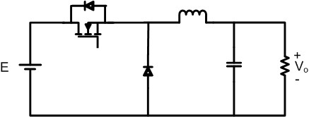
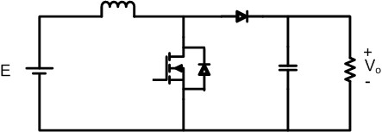
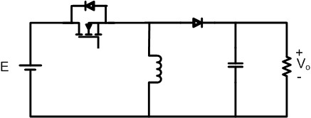

Power electronics basics
dc-dc converters
Buck converter
Boost converter
Buck-boost converter

Slide 6
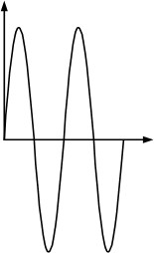
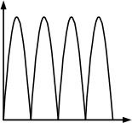
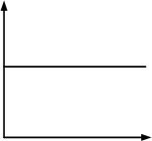
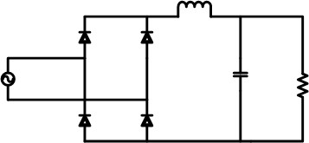
Power electronics basics
Rectifiers
v
v
v
t
t
t
Rectifier
Filter

Slide 7
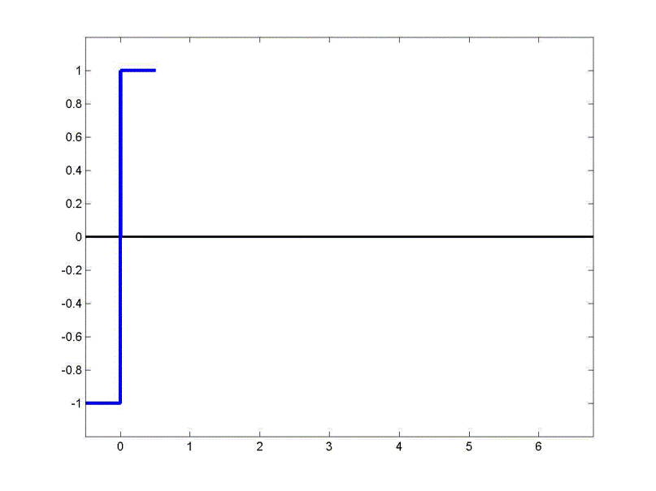
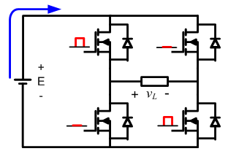
Power electronics basics
Inverters
dc to ac conversion
Several control techniques. The simplest technique is square wave modulation (seen below).
The most widespread control technique is Pulse-Width-Modulation (PWM).

Slide 8
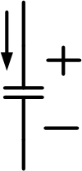

Power electronics basic concepts
Energy storage
  When analyzing the circuit, the state of each energy storage element contributes to the overall system’s state. Hence, there is one state variable associated to each energy storage element.
  In an electric circuit, energy is stored in two fields:
    Electric fields (created by charges or variable magnetic fields and related with a voltage difference between two points in the space)
    Magnetic fields (created by magnetic dipoles or electric currents)
  Energy storage elements:
  Capacitors: Inductors:
L
C

Slide 9
Power electronics basic concepts
Capacitors:
    state variable: voltage
    Fundamental circuit equation:
    The capacitance gives an indication of electric inertia. Compare the above equation with Newton’s
    Capacitors will tend to hold its voltage fixed.
    For a finite current with an infinite capacitance, the voltage must be constant. Hence, capacitors tend to behave like voltage sources (the larger the capacitance, the closer they resemble a voltage source)
    A capacitor’s energy is

Slide 10
Power electronics basic concepts
Inductors
    state variable: current
    Fundamental circuit equation:
    The inductance gives an indication of electric inertia. Inductors will tend to hold its current fixed.
    Any attempt to change the current in an inductor will be answered with an opposing voltage by the inductor. If the current tends to drop, the voltage generated will tend to act as an electromotive force. If the current tends to increase, the voltage across the inductor will drop, like a resistance.
    For a finite voltage with an infinite inductance, the current must be constant. Hence, inductors tend to behave like current sources (the larger the inductance, the closer they resemble a current source)
    An inductor’s energy is

Slide 11
Average and rms values
Average value of a periodic signal with period T
Root-mean squared value of a periodic waveform with period T

Slide 12
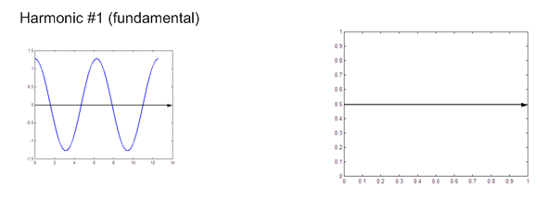
Power electronics basics
Harmonics
Concept: periodic functions can be represented by combining sinusoidal functions
Underlying assumption: the system is linear (superposition principle is valid.)
e.g. square-wave generation.

Slide 13
Power electronics basics
Additional definitions related with Fourier analysis

Slide 14
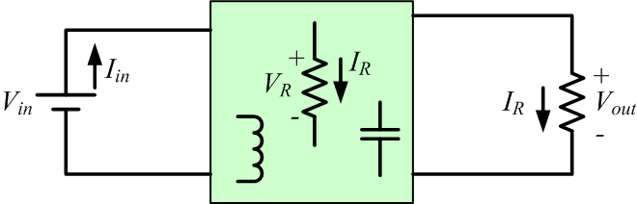
Energy in steady state conditions
In steady state:
Consider:
Then,

Slide 15
Energy in steady state conditions
Also
Then, for any inductor, including one with infinitely large L:
and since
Then, if L is infinitely large but vL , the current is constant so…..

Slide 16
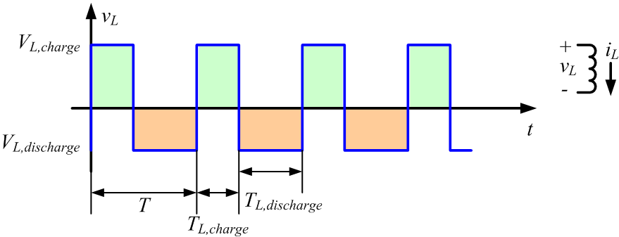
Energy in steady state conditions
and,
Then,
Notice that VL,discharge is negative
“Green” areas = “Orange” areas
So the average inductor voltage is zero

Slide 17
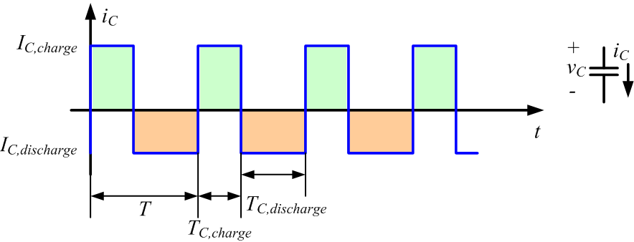
Energy in steady state conditions
So for an inductor, its average voltage in periodic steady state is zero
Since capacitors are duals of inductors, average capacitor current in periodic steady state is zero
“Green” areas = “Orange” areas
So the average inductor voltage is zero
“Green” areas = “Orange” areas
So the average capacitor current is zero

Slide 18
Other figures of merit used in power electronics
Efficiency:
% Line regulation:
% Load regulation
Total harmonic distortion (THD)
System

Slide 19
Power Factor
In the restricted case in which we have a linear circuit operating at a single frequency (hence, applicable to linear loads), the power factor is the displacement power factor:
In a more general definition when a circuit operates with multiple frequencies (e.g. power electronic loads), power factor is
In both cases the power factor provides an idea related with efficiency because the power factor is a ratio of real power (usually the useful component of power) divided by the total power which includes the power associated to the energy necessary to build fields or to conversion processes.

Slide 20
Power Factor
In a linear circuit with a single frequency excitation the power factor is not 1 when the reactance of the equivalent circuit is not zero (so the circuit is inductive or capacitive). The fact that the power factor is not 1, represents the fact that we are storing energy in magnetic and/or electric fields.
In a circuit in which the voltage and/or the current signal has multiple harmonics, the power factor is not 1. In a power electronic circuit the fact that the power factor is not 1 represents the fact that power conversion processes usually create harmonic content in the signals.

Slide 21
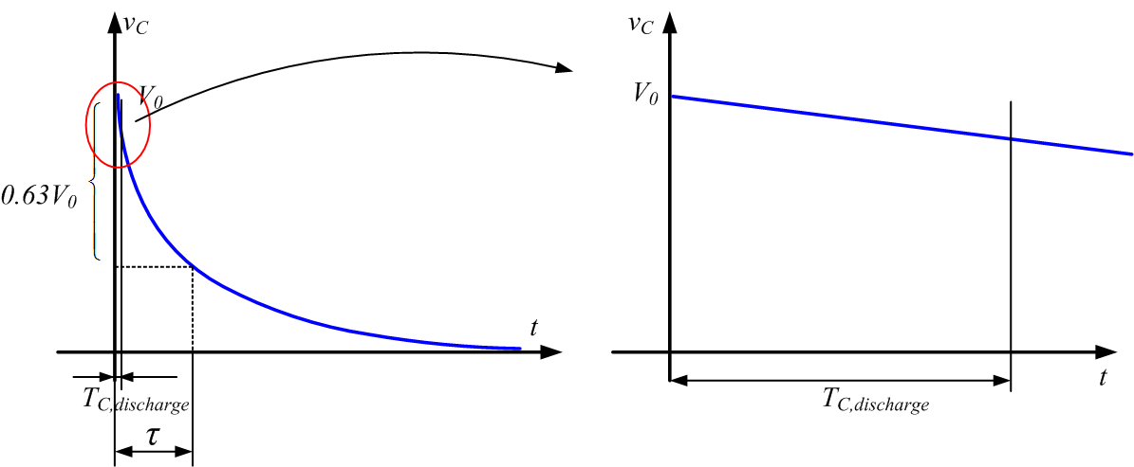
Effects of “fast” switching on waveforms
Switching is “fast” when the period of the switching function is much shorter than the circuit time constants.
As a result, charging or discharging times are much shorter than the circuit time constants
In these conditions, exponential and other waveforms representing the actual response of circuit variables can be approximated to lines.
Remember the Taylor Series Expansion of a function f(x) about a point xo:

Slide 22
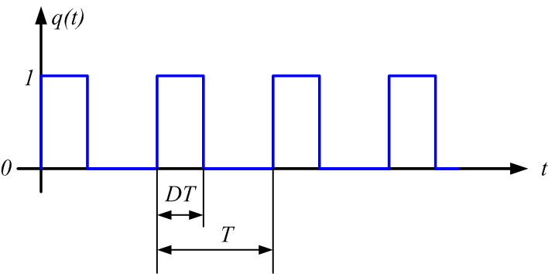
Switching function and duty cycle
The logic signal used to represent the control signal in power electronic switches is called switching signal q(t).
  When q(t) =1 the switch (e.g. a MOSFET or an IGBT) is closed
  When q(t) =0 the switch is open.
When power electronic switches are operated at a constant frequency in steady state q(t) is usually a periodic signal that may look like this:
Then the duty cycle D is the portion of the time the switch is conducting current so, mathematically it equals the average of the switching function.

Slide 23
More on power in ac circuits
Instantaneous power
Average power
Power in linear single frequency ac single phase circuits operating in steady state.
  if and
Energy exchanges with energy storage components
Displacement power factor
Average power

Slide 24
More on power in (single phase) ac circuits
  if and
Their phasors are
So complex power is defined as
where
is the reactive power representing steady state energy exchanges with energy storage components.

Slide 25
Power in steady state balanced three phase ac circuits
  Now,
  if phase voltages and their respective phasors are
  Then, line voltage phasors are
  and

Slide 26
Power in steady state balanced three phase ac circuits
  Since the phase currents are:
  In 3-phase circuits with Y configuration
  Then, the power in this type of circuits is

Slide 27
Power in steady state balanced three phase ac circuits
  Since,
  Other definitions applicable to 3-phase power in balanced circuits are

Slide 28
Full wave rectifier
Waveforms
v
vR
v
t
t
t
Rectifier
2nd order Filter
Ideally:

Slide 29
Diode Bridge Rectifier
(DBR)
v
v
Vp≈ 120√2V_{dc} ≈ 170 V
Vdc≈ 120√2V_{dc} ≈ 170Vdc
t
t
DC link
+
I_{ac}
1
3
+
≈ 120√2V_{dc} ≈ 170Vdc
−
+
≈ 120V_{ac} rms
–
4
2
–
First order low pass filter

Slide 30
Approximate Formula for DC Ripple Voltage
With a first order low pass filter
Energy consumed by constant load power P during the same time interval
Energy given up by capacitor as its voltage drops from Vpeak to Vmin

Slide 31
Approximate Formula for DC Ripple Voltage, cont.
T/2
Δt
For low ripple,
and
A second order low-pass filter realized by adding an inductor in the “dc-link” allows to reduce the required capacitance for a given ripple goal.

Slide 32
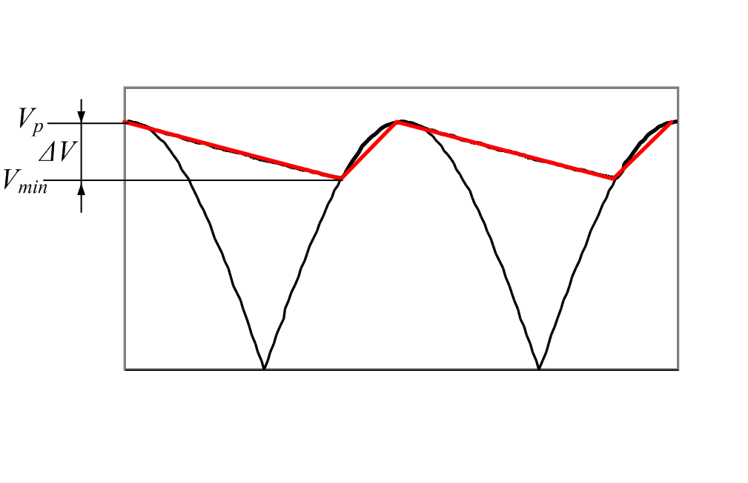
Additional waveforms details
The output voltage frequency is twice that of the input voltage.
Output voltage ripple is usually indicated as a percentage (usually < 5%) of the peak input voltage.
Output voltage ripple

Slide 33
AC Current Waveform
T
=
1
f
The ac current waveform has significant harmonic content.
High harmonic components circulating in the electric grid may create quality and technical problems (higher losses in cables and transformers).
Harmonic content measurements: total harmonic distortion (THD) and power factor.

Slide 34
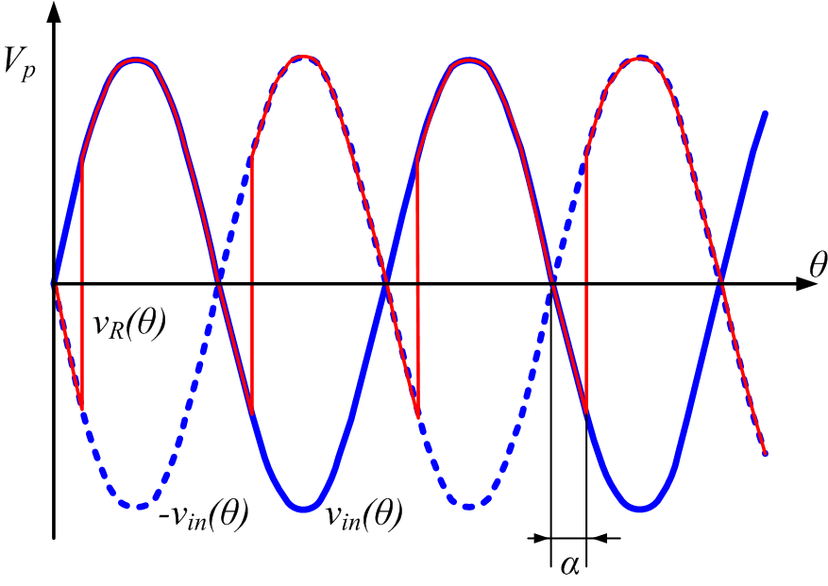
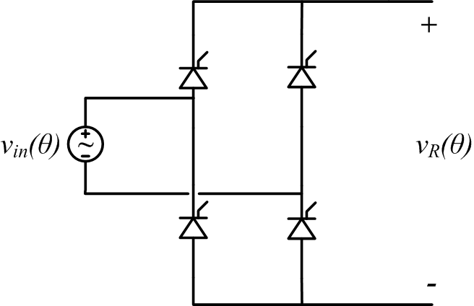
Single-phase controlled rectifier
Goal: to control the dc output voltage component. This objective is achieved by controlling the firing angle of SCRs.

Slide 35
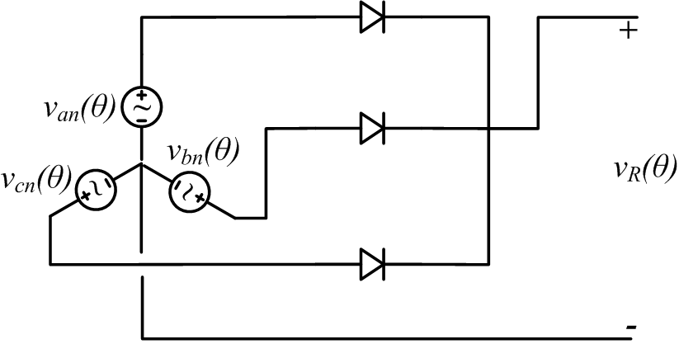
Three-phase half-wave rectifier
Assume a balanced three-phase system:

Slide 36
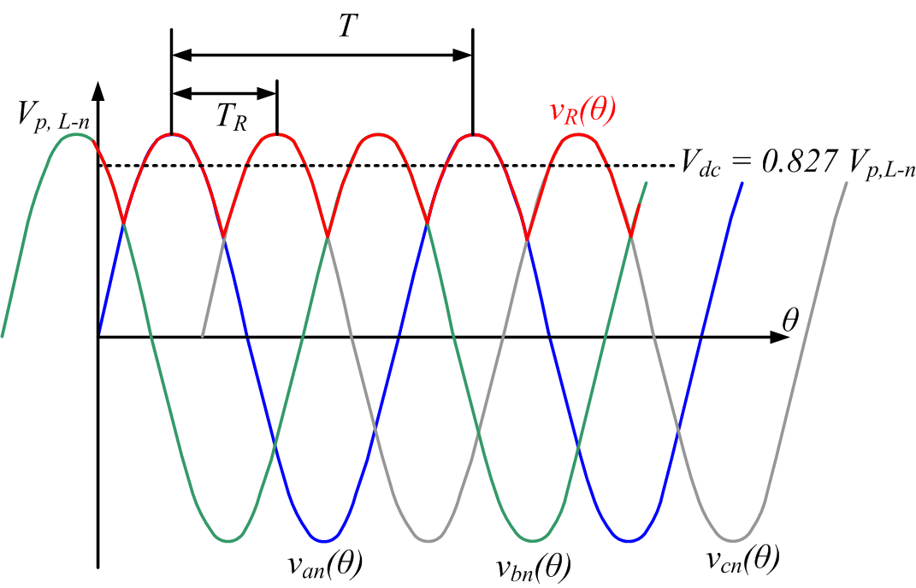
Three-phase half-wave rectifier
The output voltage ripple frequency is three times that of the input voltage waveforms.
With diodes:
With SCRs:

Slide 37
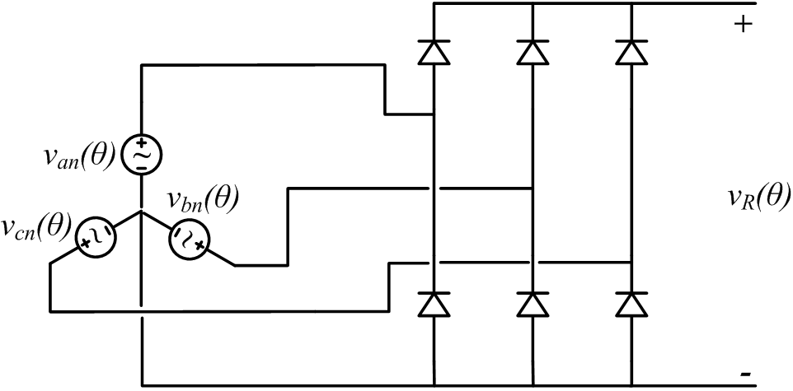
Three-phase bridge rectifier
Still, assume a balanced three-phase system:

Slide 38
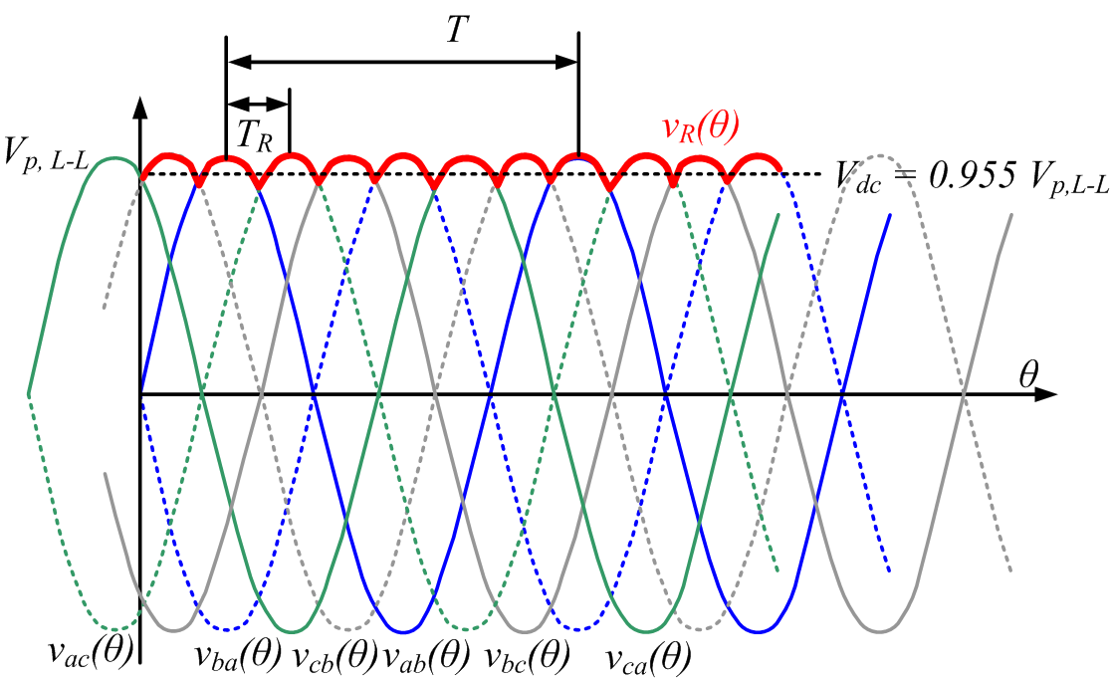
Three-phase bridge rectifier
The output voltage ripple frequency is six times that of the input voltage waveforms.
With diodes:

Slide 39
Buck converter
+ v
L
–
i
i
L
I
out
in
D
L
+
V
in
C
V
out
Load
i
C
–
If the inductor current is always positive:
So, a buck converter is like a voltage step-down dc-dc converter.

Slide 40
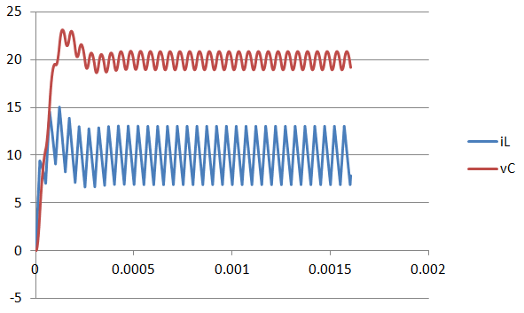
Buck converter waveforms
Consider a Buck converter with f = 20 kHz, Vin = 50 V, D = 0.4, R=2 ohms, L=100 μH, C=20 μF (horizontal axis is time in seconds).

Slide 41
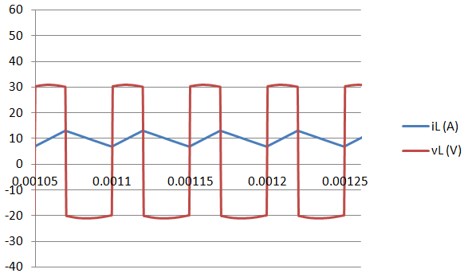
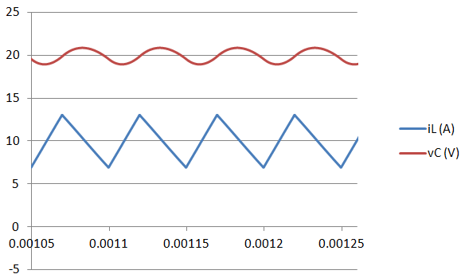
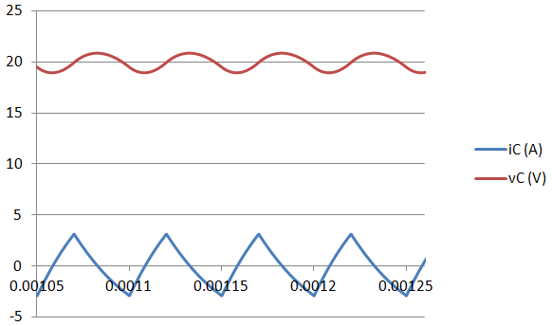
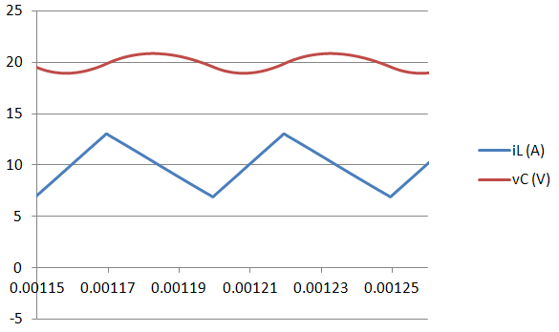
Buck converter waveforms
Consider a Buck converter with f = 20 kHz, Vin = 50 V, D = 0.4, R=2 ohms, L=100 μH, C=20 μF (horizontal axis is time in seconds).

Slide 42
Buck converter waveforms
Consider a Buck converter with f = 20 kHz, Vin = 50 V, D = 0.4, R=2 ohms, L=100 μH, C=20 μF (horizontal axis is time in seconds).
From the circuit:
Assume output current is constant
From the circuit, when the switch is open:
From the blue triangle

Slide 43
Impedance matching
I_{in}
I_{out} = I_{in} / D
DC−DC Buck Converter
+
V_{in}
−
+
V_{out} = DV_{in}
−
Source
I_{in}
+
V_{in}
−
Equivalent from source perspective
So, the buck converter makes the load resistance look larger to the source

Slide 44
Example of drawing maximum power from solar panel
P_{max} is approx. 130W (occurs at 29V, 4.5A)
I_{sc}
For max power from panels at this solar intensity level, attach
But as the sun conditions change, the “max power resistance” must also change.
Also, the load changes based on the user needs.
V_{oc}
I-V characteristic of 6.44Ω resistor

Slide 45
Example of a directed connected load different to that yielding maximum power
55W
130W
2Ω resistor
6.44Ω resistor
Consider that the user wants to connect a 2 Ohm load. If it is connected directly it consumes 55 W. To draw maximum power (130W), connect a buck converter between the panel and the load resistor, and use D to modify the equivalent load resistance seen by the source so that maximum power is transferred
D is adjusted automatically by a maximum power point tracker (MPPT)

Slide 46
Boost converter
+ v
L
–
i
L
i
D
I
out
i
in
L
+
V
D
C
V
out
Load
in
i
C
–
If the inductor current is always positive:
So, a boost converter is like a voltage step-up dc-dc converter.

Slide 47
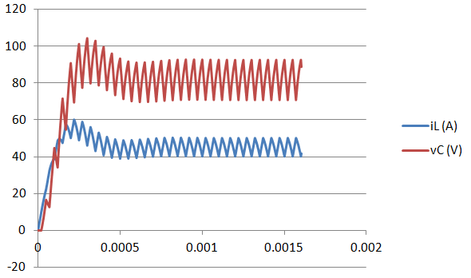
Boost converter waveforms
Consider a Boost converter with f = 20 kHz, Vin = 50 V, D = 0.4, R= 3 ohms, L=100 μH, C=25 μF (horizontal axis is time in seconds).
Output voltage ripple can be calculated considering that the capacitor needs to sustain the load by itself when the switch is closed.

Slide 48
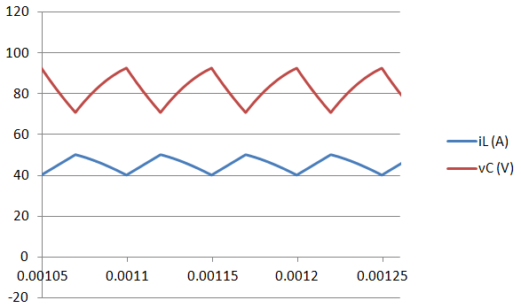
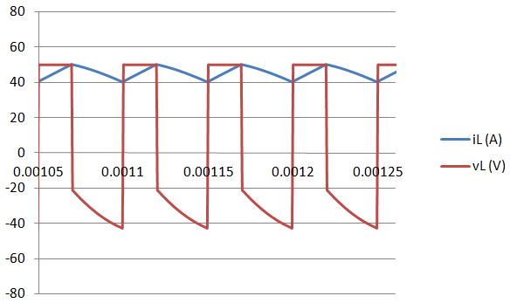
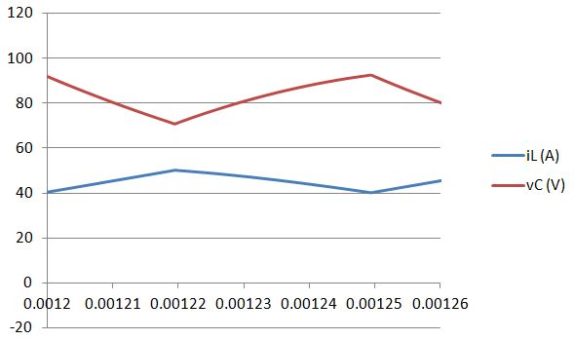
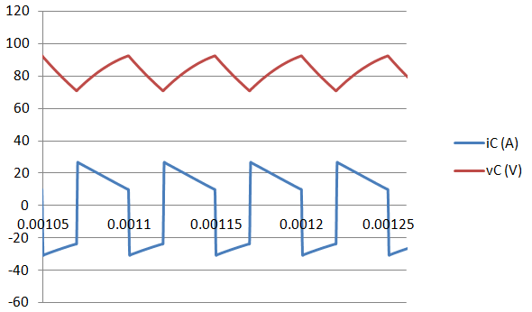
Boost converter waveforms
Consider a Boost converter with f = 20 kHz, Vin = 50 V, D = 0.4, R= 3 ohms, L=100 μH, C=25 μF (horizontal axis is time in seconds).

Slide 49
Impedance matching
I_{in}
DC−DC Boost Converter
+
V_{in}
−
+
−
Source
I_{in}
+
V_{in}
−
Equivalent from source perspective

Slide 50
Example of drawing maximum power from solar panel
P_{max} is approx. 130W (occurs at 29V, 4.5A)
I_{sc}
For max power from panels, attach
But as the sun conditions change, the “max power resistance” must also change.
Also, the load changes based on the user needs.
V_{oc}
I-V characteristic of 6.44Ω resistor

Slide 51
Example of a directed connected load different to that yielding maximum power
130W
So, the boost converter reflects a high load resistance to a low resistance on the source side
6.44Ω resistor
14W
100Ω resistor
Consider that the user wants to connect a 100 Ohm load. If it is connected directly it consumes 14 W. To draw maximum power (130W), connect a boost converter between the panel and the load resistor, and use D to modify the equivalent load resistance seen by the source so that maximum power is transferred
D is adjusted automatically by a MPPT controller

Slide 52
The single-ended primary inductor converter (SEPIC)
+ v _{L1} –
+ v _{C1} –
i
in
I
out
L1
+
v _{L2}
–
+
V
D
C1
V
in
C
out
Load
L2
–
If the currents in both inductors are always positive:
So, a SEPIC can both step-up and step-down dc voltages

Slide 53
Impedance matching
I_{in}
+
V_{in}
−
DC−DC SEPIC
+
−
Source
I_{in}
+
V_{in}
−
Equivalent from source perspective

Slide 54
Impedance matching
For any R_{load}, as D → 0, then R_{equiv} → ∞ (i.e., an open circuit)
For any R_{load}, as D → 1, then R_{equiv} → 0 (i.e., a short circuit)
Thus, the SEPIC can sweep the entire I-V curve of a solar panel in order to achieve the MPP regardless of actual load used or received solar energy

Slide 55
The Cuk converter
+ v _{L1} –
+ v _{C1} –
i
L2
I
in
out
L1
+ v _{L2} –
+
V
C1
V
Load
in
C
out
–
Since in periodic steady state, inductor average voltage is zero, then
During DT when the switch is closed
During (1-D)T when the switch is open
So

Slide 56
The buck-boost converter
Inverse polarity with respect to input
i
in
i
d
+
–
V
in
i
L
C
i
V
out
L
C
–
+
I
out
Compared with SEPIC:
        + Fewer energy storage components
        + Capacitor does not carry load current
        + In both converters isolation can be easily implemented
        - Polarity is reversed
Voltage can be stepped-up or stepped-down

Slide 57
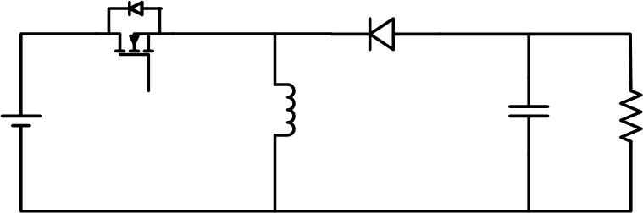
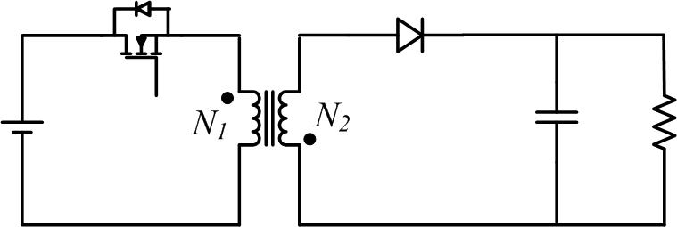
The fly-back converter
Consider a buck-boost converter:
Now, split the inductor into two magnetically coupled inductors:
This is a fly-back converter

Slide 58
The fly-back converter
The coupled inductors are not a transformer. In a transformer you can observe simultaneous currents in the primary and secondary side. In the coupled inductors when there is current on the source side there is no current on the load side and vice-versa.
Advantage: output side is electrically isolated from the input side
Output-input voltage relationship:

Slide 59
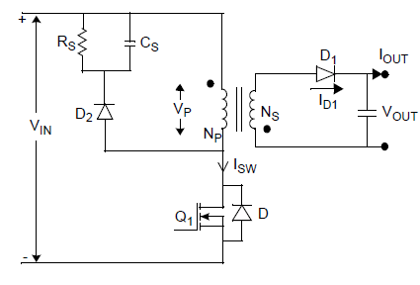
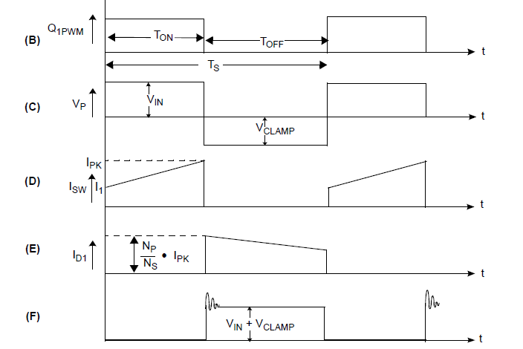
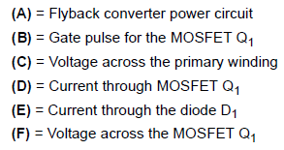
The fly-back converter
The information contained in the next slides can be found in Microchip application note AN1114 (http://ww1.microchip.com/downloads/en/AppNotes/01114A.pdf)
        (A)

Slide 60
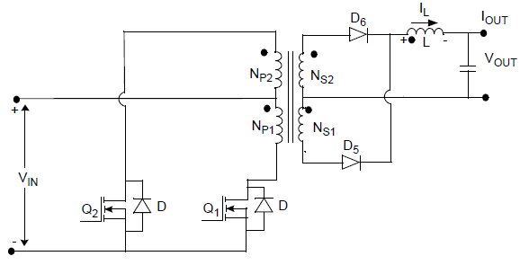

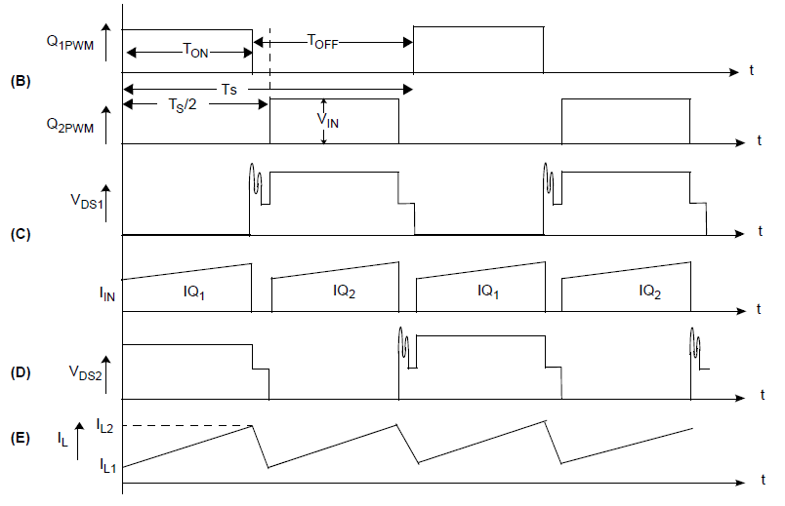
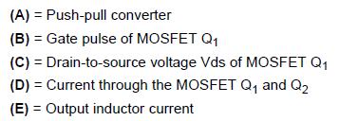
The push-pull converter
The information contained in the next slides can be found in Microchip application note AN1114 (http://ww1.microchip.com/downloads/en/AppNotes/01114A.pdf)
  (A)

Slide 61
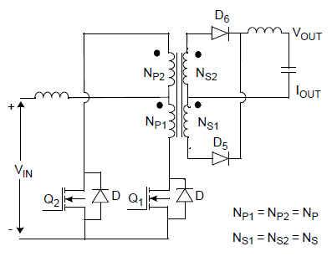

The current source push-pull converter
The information contained in the next slides can be found in Microchip application note AN1114 (http://ww1.microchip.com/downloads/en/AppNotes/01114A.pdf)

Slide 62
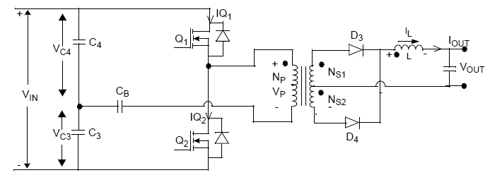
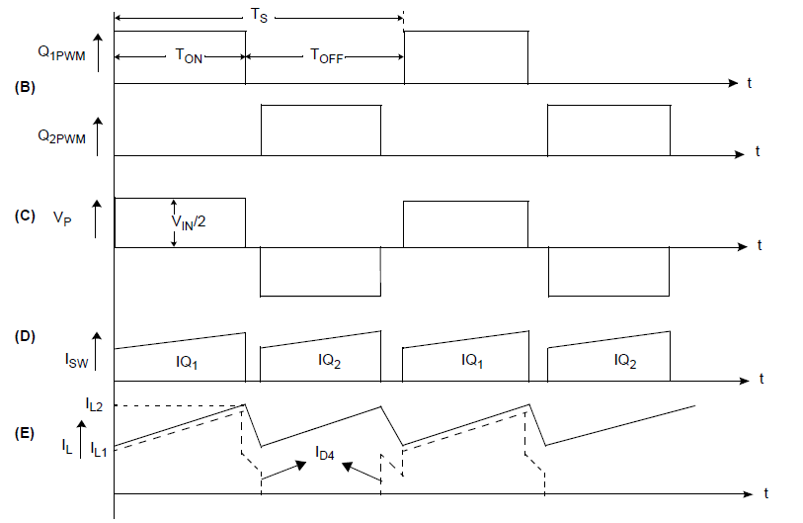
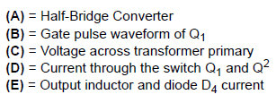
The half-bridge converter
The information contained in the next slides can be found in Microchip application note AN1114 (http://ww1.microchip.com/downloads/en/AppNotes/01114A.pdf)
  (A)

Slide 63
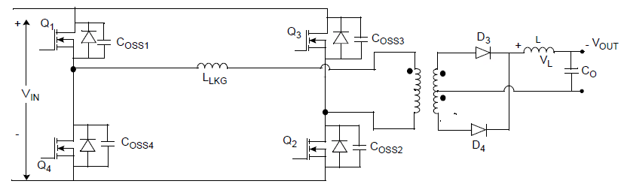

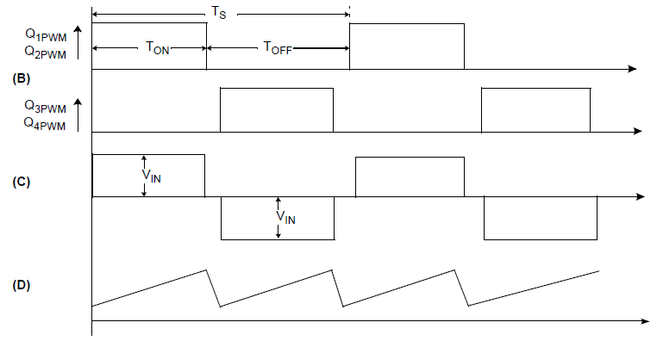

The Full Bridge or H-Bridge converter
The information contained in the next slides can be found in Microchip application note AN1114 (http://ww1.microchip.com/downloads/en/AppNotes/01114A.pdf)
  (A)

Slide 64
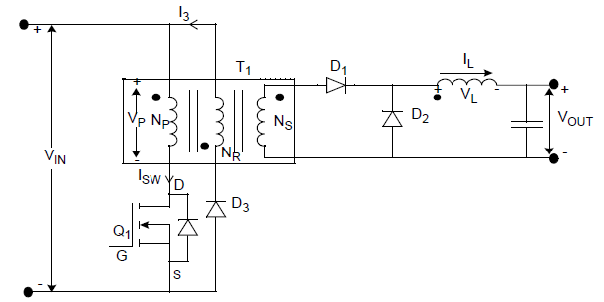

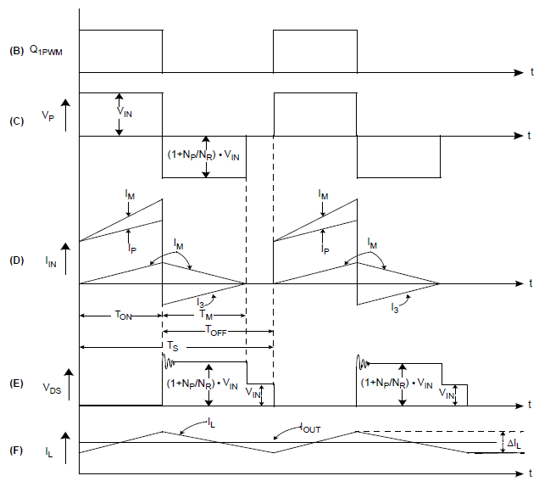

The forward converter
The information contained in the next slides can be found in Microchip application note AN1114 (http://ww1.microchip.com/downloads/en/AppNotes/01114A.pdf)
  (A)

Slide 65
H-Bridge Inverter Basics – Creating AC from DC
Single-phase H-bridge (voltage source) inverter topology:
Switching rules
•
Either A+ or A
–
is closed,
Vdc
but never at th
e same time *
•
Either B+ or B
–
is closed,
but never at the same time *
*same time closing would cause a short circuit from Vdc to ground
(shoot-through)
*To avoid dhoot-through when using real switches (i.e. there are turn-on and turn-off delays) a dead-time or blanking time is implemented
A+
B+
Va
Load
Vb
A
–
B
–
Corresponding values of Va and Vb
•
A+ closed, Va = Vdc
•
A
–
closed, Va = 0
•
B+ closed, Vb = Vdc
•
B
–
closed, Vb = 0

Slide 66
H BRIDGE INVERTER
Corresponding values of Vab
•
A+ closed
and B
–
closed, Vab = Vdc
Vdc
•
A+ closed and B+ closed, Vab = 0
•
B+ closed and A
–
closed, Vab =
–
Vdc
•
B
–
closed and A
–
closed, Vab = 0
A+
B+
+ Vdc −
•
The free wheeling diodes permit current
to flow even if al
l switches are open
Va
Load
Vb
•
These diodes also permit lagging
currents to flow in inductive loads
A
–
B
–

Slide 67
H BRIDGE INVERTER
Corresponding values of Vab
•
A+ closed
and B
–
closed, Vab = Vdc
Vdc
•
A+ closed and B+ closed, Vab = 0
•
B+ closed and A
–
closed, Vab =
–
Vdc
•
B
–
closed and A
–
closed, Vab = 0
A+
B+
+ 0 −
•
The free wheeling diodes permit current
to flow even if al
l switches are open
Va
Load
Vb
•
These diodes also permit lagging
currents to flow in inductive loads
A
–
B
–

Slide 68
H BRIDGE INVERTER
Corresponding values of Vab
•
A+ closed
and B
–
closed, Vab = Vdc
Vdc
•
A+ closed and B+ closed, Vab = 0
•
B+ closed and A
–
closed, Vab =
–
Vdc
•
B
–
closed and A
–
closed, Vab = 0
A+
B+
− Vdc +
•
The free wheeling diodes permit current
to flow even if al
l switches are open
Va
Load
Vb
•
These diodes also permit lagging
currents to flow in inductive loads
A
–
B
–

Slide 69
H BRIDGE INVERTER
Corresponding values of Vab
•
A+ closed
and B
–
closed, Vab = Vdc
Vdc
•
A+ closed and B+ closed, Vab = 0
•
B+ closed and A
–
closed, Vab =
–
Vdc
•
B
–
closed and A
–
closed, Vab = 0
A+
B+
+ 0 −
•
The free wheeling diodes permit current
to flow even if al
l switches are open
Va
Load
Vb
•
These diodes also permit lagging
currents to flow in inductive loads
A
–
B
–

Slide 70

H-Bridge Inverter
Square wave modulation:

Slide 71
H-Bridge Inverter
Harmonics with square wave modulation (switching frequency = fundamental frequency).

Slide 72

H-Bridge Inverter
Square wave modulation:
Considerable low order harmonics that are difficult to filter out
1 3 5 7 9 11 13 15 17 19 21 23 25 27 29 31 33
Cannot be changed

Slide 73
Basic Square Wave Operation
(sometimes used for 50 Hz or 60Hz applications)
Corresponding values of Vab
•
A+ closed
and B
–
closed, Vab = Vdc
•
A+ closed and B+ closed, Vab = 0
V_{load}
•
B+ closed and A
–
closed, Vab =
–
Vdc
•
B
–
closed and A
–
closed, Vab = 0
Vdc
−Vdc
The Vab = 0 time is not required but can be used to reduce the rms value of V_{load}

Slide 74
Many Loads Have Lagging Current – Consider an Inductor
There must be a provision for voltage and current to have opposite signs with respect to each other
V_{load}
Vdc
−Vdc
I_{load}
I
−I

Slide 75
Load Current Can Always Flow, Regardless of Switching State
Example - when current flows left to right through the load
Vdc
A+
B+
here
or here
Va
Load
Vb
A
–
here
B
–
or here

Slide 76
Load Current Can Always Flow, cont.
Example - when current flows right to left through the load
Vdc
A+
B+
here
here
Va
Load
Vb
A
–
B
–
or here
or here

Slide 77
Load Current Can Always Flow, cont.
H BRIDGE INVERTER
Corresponding values of Vab
•
A+ closed
and B
–
closed, Vab = Vdc
Vdc
•
A+ closed and B+ closed, Vab = 0
•
B+ closed and A
–
closed, Vab =
–
Vdc
•
B
–
closed and A
–
closed, Vab = 0
•Load consuming power
A+
B+
•Load generating power
+ Vdc −
Va
Load
Vb
A
–
B
–

Slide 78
Load Current Can Always Flow, cont.
H BRIDGE INVERTER
Corresponding values of Vab
•
A+ closed
and B
–
closed, Vab = Vdc
Vdc
•
A+ closed and B+ closed, Vab = 0
•
B+ closed and A
–
closed, Vab =
–
Vdc
•
B
–
closed and A
–
closed, Vab = 0
•Load consuming power
A+
B+
•Load generating power
+ Vdc −
Va
Load
Vb
A
–
B
–

Slide 79

Question - How can a sinusoidal (or other) input signal be amplified with low baseband distortion?
Answer – the switching can be controlled in a smart way so that the FFT of V_{load} has a strong fundamental component, plus high-frequency switching harmonics that can be easily filtered out and “thrown into the trash”
Progressivelywider pulses at the center
Progressively narrower pulses at the edges
V_{load}
Vdc
Unipolar Pulse-Width Modulation (PWM)
−Vdc

Slide 80
Implementation of Unipolar Pulse Width Modulation (PWM)
Vcont is the input signal we want to amplify at the output of the inverter.
Vcont is usually a sinewave, but it can also be a music signal.
Vcont
Vtri
−Vcont
The implementation rules are:
Vcont > Vtri , close switch A+, open
switch A
–
, so voltage Va = Vdc
Vcont < Vtri , open switch A+, close
switch A
–
, so voltage Va = 0
–
Vcont > Vtri , close switch B+, open
switch
B
–
, so voltage Vb = Vdc
–
Vcont < Vtri , open switch B+, close
switch B
–
, so voltage Vb = 0
V_{tri} is a triangle wave whose frequency is at least 30 times greater than Vcont.
Ratio m_{a} = peak of control signal divided by peak of triangle wave
Ratio m_{f} = frequency of triangle wave divided by frequency of control signal

Slide 81


Slide 83


Slide 84
Ratio m_{a} = peak of control signal (also called modulation signal) divided by peak of triangle wave
Ratio m_{f} = frequency of triangle wave divided by frequency of control signal
Load voltage with
m_{a} = 0.5
(i.e., in the linear region)

Slide 85
Load voltage with
m_{a} = 1.5
(i.e., overmodulation)

Slide 86
Variation of RMS value of no-load fundamental inverter
output voltage (V_{1rms} ) with m_{a}
For single-phase inverters m_{a} also equals the ratio between the peak output voltage and the input V_{dc} voltage.
V
1rms
4
•
V
dc
asymptotic
to
π
2
square wave
value
V
dc
2
m_{a} is called the modulation index
m
a
0 1
linear
overmodulation
saturation
The amplitude of the fundamental sinusoidal output signal can be controlled by changing ma; i.e., by changing the amplitude of the modulation signal with respect to the triangle waveform

Slide 87
RMS magnitudes of load voltage frequency components with respect to
for f_{tri} >> f_{cont}

Slide 88
Harmonic content in PWM signals

Slide 89
Harmonic content in PWM signals
Contrary to square wave modulation, if the PWM switching frequency is high enough (mf>30 but usually mf>100) all harmonic content is relatively easy to filter out with a simple low pass filter

Slide 90

Loaded (with a resistor) and no output filter
Load Voltage – No Filter. m_{a} ≈ 1.

Slide 91

With Filter
Load Voltage – With Filter. m_{a} ≈ 1.
Very Effective!

Slide 92

Three-Phase Inverter
(called a six-pack)
dc-link
Source
Loads
Three inverter legs; capacitor mid-point is fictitious
Source: Ned Mohan’s power electronics book

Slide 93

NOTE: Modulation signals for each of the three phases have a 120 degree phase difference
Three-Phase PWM Waveforms
NOTE: Modulation index is different from that on single-phase inverters. In three-phase inverters:
Source: Ned Mohan’s power electronics book

Slide 94

Three-Phase Inverter Harmonics
Compare with single-phase inverter
Source: Ned Mohan’s power electronics book

Slide 95

Three-Phase Inverter Output
Linear and over-modulation ranges
Source: Ned Mohan’s power electronics book

