Slide 1
CS 3551: Advanced Topics in Distributed Information Systems
Lab 2: TLA+
Dr. Amy Babay, Fall 2024
Slides adapted from slides by Roxana Geambasu, TLA+ video course

Slide 2
TLA+ (Temporal Logic of Actions)
Mathematical formalism for specifying asynchronous distributed systems
  Everything is expressed as logical formulas
Developed by Leslie Lamport: “Best way to describe things precisely is with simple mathematics.”
  e.g: \E x \in S : \A y \in S : y <= x (maximum element of a set)
Useful for eliminating fundamental design bugs, which are hard to find and expensive to correct in code
  But also useful for other things, like understanding systems better, comparing designs, ... [Geambasu+08]

Slide 3
TLA+ Suite
TLA+, the formalism:
  Adopts the state machine perspective of a distributed system
  Inherently assumes concurrency, non-determinism, and failures, but you can specify constraints (called “fairness”).
Supports two types of properties:
  Safety: Must hold for all states (e.g., at any state, at least one server has the committed data).
  Liveness: Must eventually must hold (e.g., eventually all replicas have the committed data).
TLC, the model checker:
  Verifies that all states/behaviors satisfy the properties within a bounded configuration space.
PlusCal: imperative wrapper around TLA+ math.
  Closer to how we typically write algorithms in pseudocode
  Can be automatically translated to TLA+

Slide 4
State Machine Specification
“State” in TLA+ refers to the entire, global state of the specified distributed system
A distributed system specification consists of:
  A set of potential initial states (Init)
  Next-state relation (Next): The set of all the possible transitions among pairs of states.
    These are defined as logical formulas that may or may not become true (“fire”) in any given state.
    TLC will try them all in any given state. Those that “fire” will be followed and may create new states.
  Then, Spec == Init /\ []Next
Properties are also specified as logical formulas, with two operators:
  Safety: Spec -> [](logical_formula) (for all states)
  Liveness: Spec -> <>(logical_formula) (eventually)

Slide 5
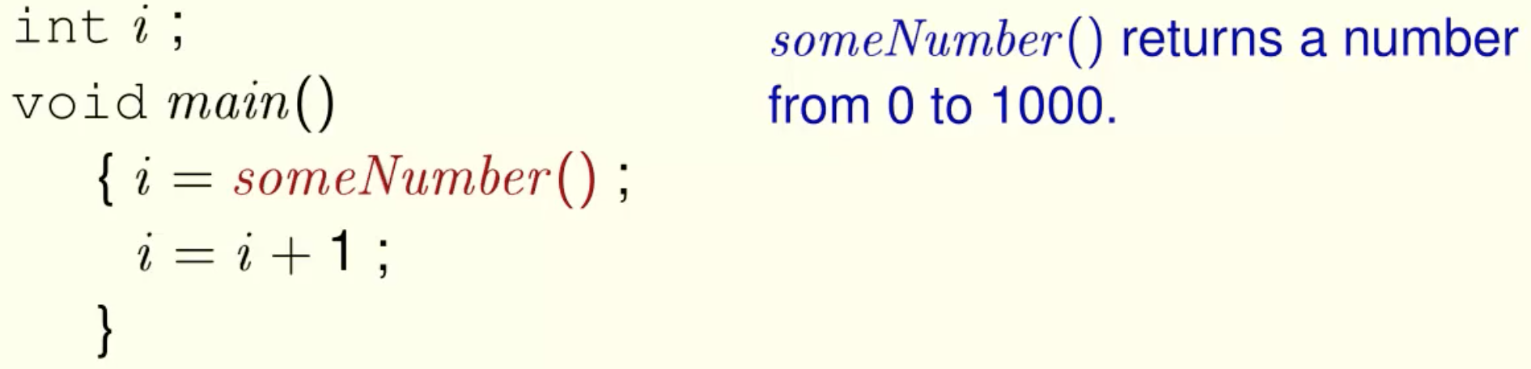
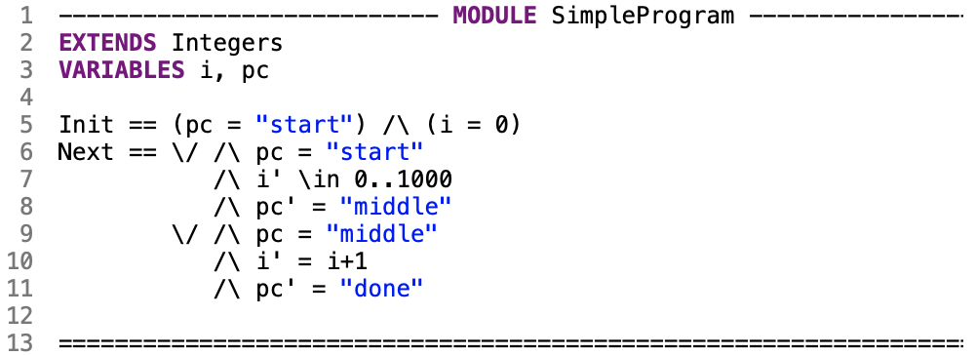
Toy TLA+ Example
http://lamport.azurewebsites.net/video/smintla.html
Consider simple C code example:
pc = program control
indicates what the next statement to execute is

Slide 6
Transaction Commit Problem
Participants (Resource Managers) must vote on whether to commit or abort a transaction
Safety criteria:
  All participants that reach a decision reach the same decision
  A commit decision can only be reached if all participants vote to commit (veto property)
Liveness criteria:
  If there are no failures, and all participants vote to commit, the decision will be commit
  At any point, if all failures are repaired and no new failures are introduced, then all the participants will eventually reach a decision

Slide 7


Two-Phase Commit: Transaction Commit Protocol
Transaction manager manages protocol for all participants
Two phases:
  Vote: all participants vote on whether to commit or abort
  Decision: transaction manager sends out final decision
Vote-Request
Vote
(Commit or Abort)
Global-Commit or Global-Abort
TM
RM₁
RM₂

Slide 8
Two-Phase Commit
TM sends vote request to each RM
RMs must determine whether they can commit the request
  Acquire necessary locks, check system invariants, write to disk (write-ahead log)
  Write commit/abort vote to disk, then send to coordinator
TM collects responses from all participants
  If all respond vote-commit, then send global-commit
  If any participant says abort, send global-abort
RMs commit/abort upon receiving decision from coordinator – write decision to disk, apply to database (or not) and release locks

Slide 9
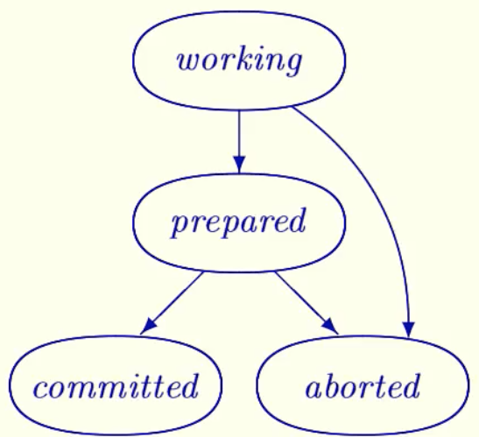
TLA+ Example: Transaction Commit
We want all participants to commit, OR all participants to abort
We can write a TLA+ specification for the set of transitions in the state machine diagram, and use TLC to show that we cannot reach an inconsistent state
  https://lamport.azurewebsites.net/video/video5.html
We can write TLA+ specification for the two-phase commit protocol, and show that it correctly implements that transaction commit spec
  https://lamport.azurewebsites.net/video/video6.html

Slide 10
Checking the TCommit Spec
Download and install the TLA+ toolbox: https://lamport.azurewebsites.net/tla/toolbox.html
Get spec from html file from video course: https://lamport.azurewebsites.net/video/video5.zip
  Download, unzip, open html file
  Copy spec into TLA+ toolbox editor
Review spec, use TLC to check TCTypeOK and TCConsistent properties for 3 and 4 RMs
  Experiment: can you make a change that breaks the invariants?

Slide 11
Two-Phase Commit: Transaction Commit Protocol
Transaction manager manages protocol for all participants
Two phases:
  Vote: all participants vote on whether to commit or abort
  Decision: transaction manager sends out final decision
Vote-Request
Vote
(Commit or Abort)
Global-Commit or Global-Abort
TM
RM₁
RM₂

Slide 12
Two-Phase Commit: Simplified Protocol
Eliminate “Vote-Request” step
RMs spontaneously send their vote (prepared)
RMs do not send “abort” vote – represented as TM spontaneously sending “global-abort”
Vote-Request
Vote
(Commit or Abort)
Global-Commit or Global-Abort
TM
RM₁
RM₂

Slide 13
Checking the 2PC Spec
Get spec from html file from video course: https://lamport.azurewebsites.net/video/video6.zip
Download, unzip, open html file
  Copy spec into TLA+ toolbox editor
Review spec, use TLC to check TCTypeOK and TCConsistent properties for 3 and 4 RMs
  Check that TPSpec implements TCSpec
  Experiment: can you make a change that breaks the invariants?

Slide 14
Liveness and Fairness
Define a liveness property for the transaction commit problem
  Eventually, all RMs must commit or abort
  In TLA, “eventually” is written as “<>”: Spec -> <>(logical_formula)
Run TLC to check this property
  Does it work? What error trace do you get?

Slide 15
Liveness and Fairness
Add a fairness constraint: require that if a TPNext action that changes one of our state variables is always enabled, it eventually occurs
  WF_<<rmState, tmState, tmPrepared, msgs>>(TPNext)
Re-run TLC to check your liveness property

Slide 16
Exercise: representing RM abort messages
Modify the spec to include RM abort messages, such that the TM only sends an abort if at least one RM has sent abort

Slide 17
Exercise: representing failures
How can you modify the spec to explicitly reason about RM failures?
Without fairness constraint, we implicitly allow failure
  A trace where one or more RMs ”stop” and never make another state transition is valid
  But, this makes it hard to say anything useful about liveness: a trace where no RM ever takes an action is valid

Slide 18
More…
Review Raft spec: https://github.com/ongardie/raft.tla
  Can we specify correctness properties and run TLC? (README suggests this is not trivial)
How should we model failures?

Slide 19
More on TLA+
Homepage: http://lamport.azurewebsites.net/tla/tla.html
Video course by Leslie Lamport: http://lamport.azurewebsites.net/video/videos.html
TLA+ and PlusCal tutorial: https://www.learntla.com/index.html
Used in industry, Amazon has reported on their use
  Paper: “Why Amazon Chose TLA+” Chris Newcombe Amazon, Inc., 2014.

