Slide 1
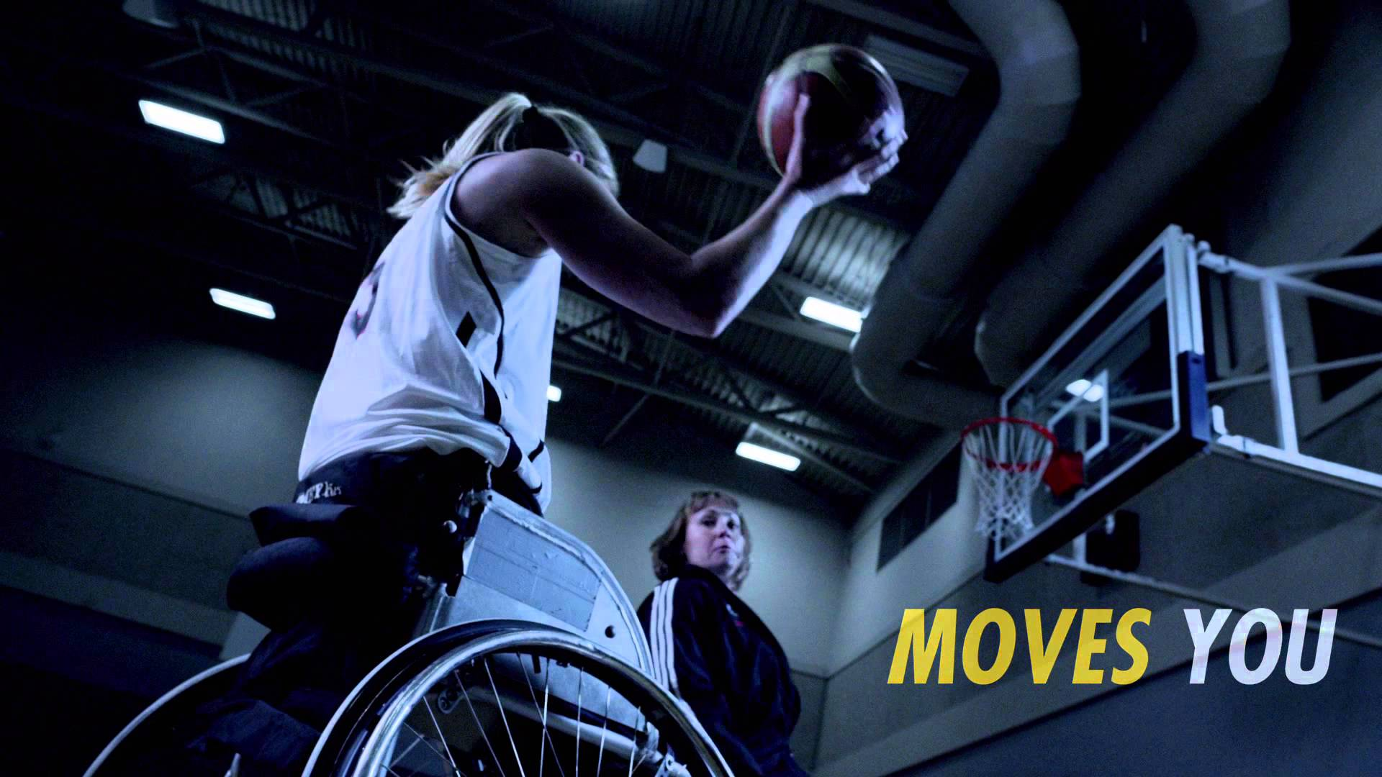

Wheelchair Disability Performance Protocol
Mackenzie Slabe
Matthew Sabatini
Karon Hawkins
Evan Hanberry
Matthew Dompreh

Slide 2
Students with Disabilities: Students in Wheelchairs
National laws adhered to, but generally not wheelchair friendly
Wheelchair IM still in early stages
Thursdays: Open wheelchair basketball scrimmages for both students with disabilities and able-bodied students
Losing promising student to more wheelchair accessible schools (Slippery Rock University)
Notes:
Evan
The University of Pittsburgh is not a wheelchair friendly campus and does not attract many disabled students to the university. Those students who do attend the university are, either not full time undergraduate students, graduate students, or doctorate students whom are not frequently on campus, or do not have the time to participate in the basketball program on top of their studies. One of the major obstacles placed in front of the wheelchair basketball program is that there is not a professional basketball team in Pittsburgh, to help gather interest around wheelchair basketball, similar to what the Pittsburgh Penguins were able to do with the local sled hockey program. The wheelchair recreation program here at the university is showing promise, which while rising quickly just does not have the funding, or the resources to push the programs further, without outside funding, in comparison to other universities in the area. The University of Pittsburgh is currently playing second fiddle to less established universities. Slippery Rock University is currently offering Disability sports night on Nov. 6, which will allow students to participate in wheelchair basketball, volleyball, tennis and other sports, to help gather interest and funding for their disability sports programs. Slippery Rock is also hosting a APAC sponsored wheelchair basketball tournament, as well as recently being awarded five new all-purpose sports wheelchairs from the Christopher and Dana Reeve Foundation.

Slide 3
Physical Activity Preparation & Injury Prevention
Current physical fitness baseline?
Current physical activity?
Injuries?
Participation interest?
Notes:
Evan
Safety is a primary concern for all individuals taking part in sporting events. It is important for the wheelchair athletes, as well as the university to make sure that all wheelchair athletes are physically ready and capable to take part in the exhibition basketball games. In order to do so, it is vitally important that a fitness regimen is created to help these individuals avoid injuries. Injuries to the rotator cuff and the neck are very common in those people confined to a wheelchair and muscular training needs to be done in order to avoid these problems all together, or even rehabilitate those already suffering from previous injuries. Getting an understanding of prior activity level, training sessions, and interest in the league is needed to provide the best and safest opportunities for these students to play basketball.
Where are these individuals now in terms of physical fitness? Is it safe for them to begin playing right away?
To answer these vital questions we will be conducting a physical activity readiness questionnaire, as well as a physical assessment to determine where these individuals are physically at this time.
Assessing;
Rotator Cuff and neck Injuries
Activity levels
Prior training to participating in the program
Free training sessions available to wheelchair athletes/students.
Interest in the wheelchair basketball program from the disabled population, as well as the able bodied.

Slide 4
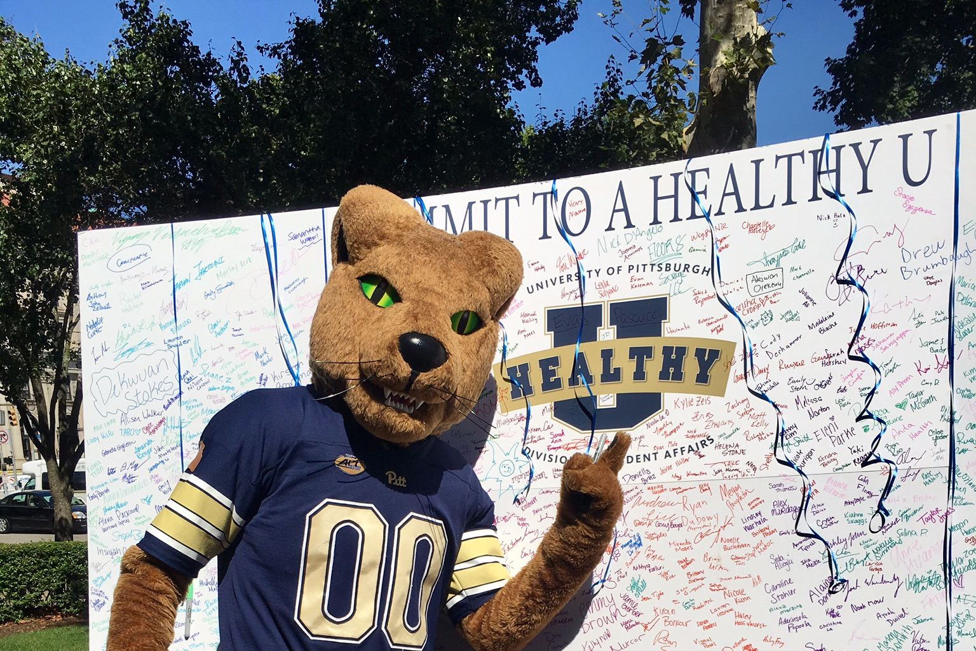
Health Approaches
The Health Belief Model
  Perceived benefits
  Perceived barriers
  Cues to action
Notes:
Mackenzie
What drives this work? The Health Belief Model. By using the Health Belief Model, we can focus on participant’s perceived benefits, perceived barriers, and cues to action. In other words, participants can evaluate the benefits of this program, such as increased muscular strength / the barriers of this program, such as having the amount of time and effort required for this program / and the motivation for wanting to participate in this program, for example, the opportunity to be a part of a college sports team. While extensive, the Health Belief Model is an excellent tool we can use to understand the thought processes of our population, ultimately allowing us to follow through with a successful program for students in wheelchairs.

Slide 5

Culture & Change
Culture & Climate
  Passionate staff
  Tough accommodations
Making Changes
  Increase awareness on campus
  Increase participation
Notes:
The University of Pittsburgh has a passion student affairs staff working to help improve participation and awareness for students with disabilities on campus. They have made significant improvements for these individuals over the past few years. However, the University of Pittsburgh’s terrain possess tough accommodations for these individuals and makes it difficult to continue to create change. But, currently wheelchair basketball intramurals are available for interested students with disabilities and able bodied students as well. We plan to assist the work the student affairs staff has done by increasing awareness and providing these students with disabilities more opportunity to become involved in group sporting activities. Preparing these students and helping to establish a foundation of wheelchair athletic programs will we can continue to make The University of Pittsburgh a more wheelchair friendly campus.

Slide 6
Teams, Partnerships & Collaborations
Collaborations with neighboring schools and groups.
Partnering and teaming up with campus groups, possibly UPMC.
Utilizing University resources such as Pitt Men’s & Women’s Basketball.
Notes:
Partnering and teaming up with local groups could be very beneficial for the University of Pittsburgh to revamp this program.
Collaborations with Slippery Rock and Edinboro University of Pennsylvania can help with the next course of action for students with disabilities as well as what needs to be in place and offered to these students to attend a top tier University that Pittsburgh is.
Working with campus groups such as sororities and fraternities can help make the Pitt community as a whole more knowledgeable of these students and their struggles and help out in different ways.
Utilizing our own resources will be a crucial factor as well. A partnership with the Pitt Men’s and Women’s Basketball programs can be vital. A halftime showcase at one of the games can make not only the audience but the City of Pittsburgh as a whole more knowledgeable.

Slide 7
Student Affairs Capacity
Accommodations and needs are not met for students with disabilities.
Also, according to Sam in the meeting we had with him there is only a handful of students that are wheelchair bound/disabled on campus.
Pitt is not one of the major colleges offering programs for those with disabilities.
Notes:
As stated earlier by my fellow colleagues, the University of Pittsburgh is not campus friendly for students with disabilities. This is not a major university that offers various programs for disabled students. For the University of Arizona which is located in Tuscon, Arizona has a full Full 5 on 5 Wheelchair Basketball Intramural League.
There needs to be more of push for these students to get what they need and have the university make the proper accommodations for the population of disabled students to grow and actually be retained here. One of the major problems currently is funding which is essential to getting this program above and beyond of what it needs to be. The pieces are in place already due to the diligent work of the Student Affair Staff and they are continuing to find ways to make this better for student with disabilities.
***Non-disabled athletes have the option to choose from 1 of 348 Division I college basketball teams. Athletes with disabilities can choose from only 1 of 12 collegiate programs that make up the Intercollegiate Division of the National Wheelchair Basketball Association. This is an example of the lack of resources we have dedicated to students with disabilities, and the dire need for more inclusive collegiate level sports that this population can be a part of.

Slide 8
Health Needs Assessment
Peak Performance
Assess Exercise Levels
Injury Prevention
Sport Performance
Notes:
With our population being students with disabilities looking for participation in wheelchair basketball, we have devised a goal to promote peak performance within these interested students and prepare them to participate within the sport. There are three main factors helping us to reach that peak performance platform. The first is assessing baseline exercise and physical activity levels. The second is injury prevention and the third is increase sports performance. Once exercise levels are assessed we will have a baseline knowledge to then provide proper that injury prevention and sport specific training.

Slide 9
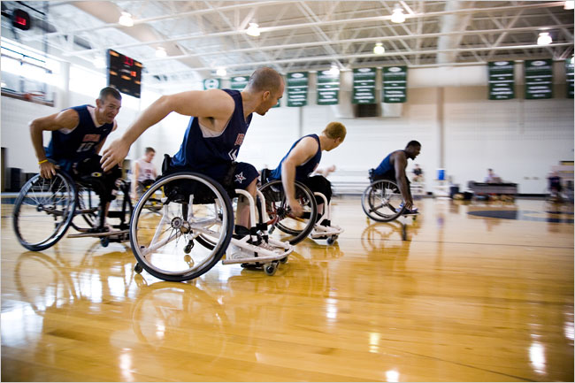
Notes:
Many of the injuries associated with wheelchair basketball occur in the upper limb portion of the body. If you look in the picture above, it provides you an example of how these athletes are in a constant posterior posture during competition. This type of posture combined with propulsion of one wheelchair puts added strain on the humeral head of the shoulder and rotator cuff. This puts an athlete competing in a wheelchair at an increased risk of developing a shoulder injury. Another factor that we increasing the risk of injury in wheelchair athletes are muscular imbalances within the upper truck and limbs. We will work to decrease the potential risk of injuries and correct muscular imbalances to help these individuals reach that peak performance level. This will be done by assessing baseline exercise and physical activity levels, then properly apply sessions to increase cardiovascular fitness, core strength, upper limb flexibility and upper limb strength. This foundation of fitness will then be applied to the movements and skills specific to those demonstrated within wheelchair basketball competition.

Slide 10
Program Overview
Physical Assessment
Fitness Sessions
Evaluation
Education
Training
Notes:
*DO NOT GO IN DEPTH*
After taking these injuries into consideration, through the use of our system of improvement we plan to better the physical well-being of students with disabilities using an iterative process. After being physically assessed we plan to conduct fitness sessions of different varieties to begin the process of bettering their physical well-being. After conducting these sessions and taking down detailed data, an evaluation process will take place in which we review the data taken and decide how best to then educate these students on how to better their health. Following this education, further training will take place and at the beginning of each semester we plan to conduct another physical assessment to track the progress and then begin the System of Improvement once again.

Slide 11

Session 1: Physical Assessment
Functional assessment
Purpose of the exercise test & equipment
Sport-specific indoor CRF assessment
Notes:
Evan
In the first session we will be conducting a physical assessment of the client to determine their current level of fitness. The functional assessment taken will include trunk range of motion, wheelchair mobility, transfer mobility, and upper and lower extremity involvement. This assessment is a very important first step, as it will facilitate the choice of exercise equipment, protocols, and adaptations. We will be using the voluntary arm ergometer machine in order to test cardio respiratory fitness. There will not be any specific skills tested during this session, we are simply looking to test the individuals current level of fitness at the beginning of the session. At the end we will be using a sport-specific indoor CRF assessment similar to a shuttle run where the individual will wheel himself up and back a basketball court for time. In reference to the ACSM guidelines for exercise prescription the strength training tests for those in a wheelchair are not different from the able bodied participants, with the wheelchair bound athletes simply doing seated lifts, instead of standing. An analysis of the persons attitude toward the exercises, as well as the persons fitness level will be taken into consideration when developing the rest of the sessions, catering to the individuals strengths and weaknesses, in order to develop a all encompassing program.

Slide 12
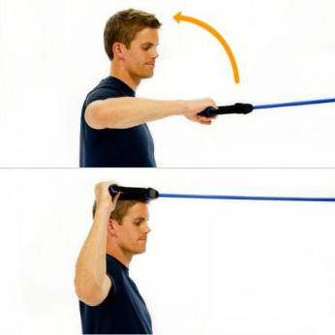
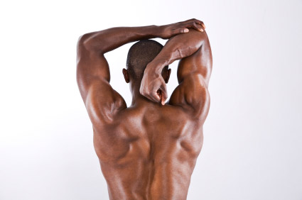
Session 2: Flexibility and Mobility
Upper Limbs, Shoulders, Back
  Stretching
  Increase Range of Motion
    Stability Exercises
Notes:
A study published in the American Journal of Sports Medicine helped us determined muscular imbalances within the shoulder region are a huge contributing factor to shoulder pain and injury within wheelchair basketball athletes. To help correct these muscular imbalances, we will incorporate this functional session to include a stretching and strengthen routine to increase the strength and stability of the shoulder and upper extremities region. The stretching routine will include both a static and a dynamic portion to help our athletes increase flexibility and maintain range of motion as we develop muscle mass. The strength routine will help create stabilization within the smaller postural muscles of the shoulder and upper back. For this portion of the routine, we will use a combination of isometric holds and resistance band exercises to strengthen that area. Incorporating both these routines will help our athletes correct muscular imbalances, decrease the risk of shoulder injuries, and help continue to prepare our athlete for peak performance in wheelchair basketball.
Burnham RS, Laura M, Nelson L, Steadward R, Reid DC. (1993). Shoulder Pain in Wheelchair Athletes, The Role of Muscle Imbalances. The American Journal of Sports Medicine. 21(2). 238-242. doi:10.1177 /036354659302100213
Churton E, Keogh J WL, (2013). Constraints influencing sports wheelchair propulsion performance and injury risk. BMC Sports Science, Medicine and Rehabilitation. 5(3) 1-10. doi:10.1186/2052-1847-5-3

Slide 13

Session 3: Core/Cardio
Warmup
Arm Ergometer
Rope Pulldown
Notes:
Karon
The arm ergometer is a staple machine used to test and increase the cardiac capacity and core strength of this community. In fact, a study comparing the work rate and heart rates of long distance runners, wheelchair athletes, and a healthy control group of able bodied subjects used an arm ergometer for the test. The wheelchair athletes had the greatest reaction displaying as high as 180 BPM with many of the individuals reaching maximal effort. While this result is not unexpected, the fact that the arm ergometer allowed these athletes to rev their heart up this high shows that it is a great method of cardiovascular training.
Another example pertaining to what I am trying to implement at Pitt are repetitive wheelchair sprint performance in wheelchair basketball athletes. A study was conducted to see if sprint performance could be improved through inspiratory muscle training. The study provided me with a wonderful warmup and sprint interval regimen that can be applied to improve the cardiovascular fitness and core strength of our wheelchair bound students.
The final exercise to really work the core as well as work the cardiovascular aspect would be rope pull downs. Designed to work the entire upper body and core, repeated intervals with a short break in between is an effective way to strengthen all areas of a wheelchair bound student. Combining all these exercises together for a full session would definitely strength the cardiac output and core strength of this community.
Warmup
5 x 20m at self-selected speed
30 seconds of rest in between
Arm Ergometer (Cardio)
20 W intervals for 2 minutes or until exhaustion
Maintain 75 to 85 RPM
Rope Pulldown (Cardio + Core)
30 second intervals at Level 4 intensity until exhaustion
30 second rest
Price, D. T., Davidoff, R., & Balady, G. J. (2000). Comparison of cardiovascular adaptations to long-term arm and leg exercise in wheelchair athletes versus long-distance runners. The American Journal of Cardiology, 85(8), 996-1001. doi:10.1016/s0002-9149(99)00917-0
Comparing the effects of certain exercises on wheelchair athletes and long distance runners, this study identifies a key exercise that can not only test but improve the well being of the wheelchair community: the arm geometer.
Goosey-Tolfrey, V., Foden, E., Perret, C., & Degens, H. (2008). Effects of inspiratory muscle training on respiratory function and repetitive sprint performance in wheelchair basketball players. British Journal of Sports Medicine, 44(9), 665-668. doi:10.1136/bjsm.2008.049486
Using respiratory muscle training, this study believed there would be a correlation between inspiratory muscle training and sprint performance improvement in wheelchair athletes. While the study found no correlation, there was still improved respiratory function and higher quality of life for these test subjects.

Slide 14
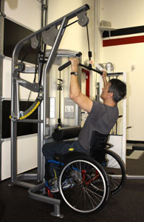
Session 4: Resistance Training
Germany Institute of Sport Sciences
International Spinal Cord Society
  Shoulder strength
  Decreased pain
  Increased muscle mass
  Decrease arm fat
Notes:
Mackenzie
In our next session, we will focus on upper body resistance training. We looked at two separate studies from Germany Institute of Sport Sciences & International Spinal Cord Society that examined the effects of resistance training in the upper extremities in wheelchair athletes. Exercises included lateral raises, horizontal rows, bicep curls, and exercises of the like. Results of these training programs showed that participants had significantly increased isometric shoulder strength and functionality, decreased pain perception, increased muscle mass, and decreased arm fat percentage. By including a similar exercise regimen in our disability performance protocol, we will be able to greatly improve upper body strength in students with disabilities.

Slide 15
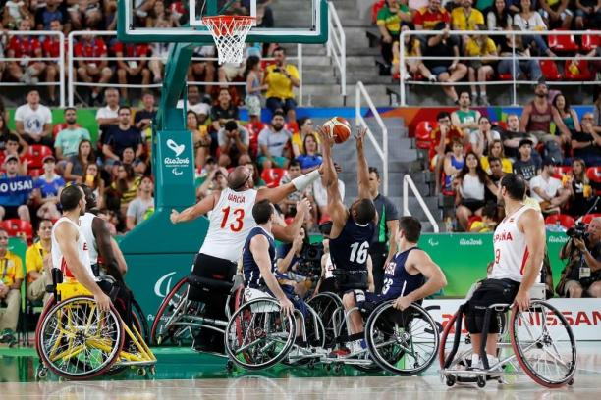
Session 5: Training for Sport
Fundamental Movements
Basic basketball fundamentals
  Pushing position
  Dribbling
  Passing & Shooting
Notes:
Matt S
According to the Athlete Development Model from Wheelchair Basketball Canada:
There are two key parts:
1. Fundamental movements – Pushing forwards, pulling backwards, stopping, starting, pivoting, turning, hopping tilting and getting up. When movements are combined they create things such as agility, balancing, throwing, catching, hoping with the wheelchair, etc. It is also important that players can perform these fundamental movements in the three planes of the body – the frontal, which divides the body between front and back; the sagittal, which divides the body into right and left; and the transverse which divides the body into top and bottom.
2. Basic basketball fundamentals – these include pushing position, dribbling, passing and shooting. It is important that the athletes again are able to perform these skills using the many planes of the body. The key fundamental in regard to motivation is enjoyment. Players need to develop a love and passion for play. The technical decisions are based around simple decisions: should I pass or shoot? Should I dribble left or right?
The wheelchairs used in Para sports are suited to fit athletes’ bodies and their impairments depending on their sport and allow them to maximize their performances in competitions.
Frogley, M., Frick, T., MacKay, M., Gittens, W., Ireland, C., Jones, C., & Woloshyn, K. (n.d.). Wheelchair Basketball Athlete Development Model Volume 1: LTAD Overview. Retrieved October 17, 2016, from http://www.wheelchairbasketball.ca/uploadedFiles/LTAD/LTAD/LTAD Vol 1 Final - Low Res.pdf
Para sport explained: Wheelchairs in wheelchair sports. (2016, June 25). Retrieved October 17, 2016, from https://www.paralympic.org/news/para-sport-explained-wheelchairs-wheelchair-sports

Slide 16
Inputs | Activities | Short-Term Outcomes | Intermediate Outcomes | Long-Term Outcomes | Goal
Funding Coaches Weights Whistles Arm Ergometer Rope Pull-down machine Weight room Basketballs Basketball court Resistance bands | Pre-assessment: baseline of Trunk range / motion, wheelchair mobility, transfer mobility, upper & lower extremity involvement | Baseline knowledge of individual’s exercise experience | Increased overall cardiovascular fitness, mobility & flexibility, & upper body strength Increased ability, understanding, & participation in wheelchair basketball | Decrease the risk of developing sport-related injury Increasing performance related to wheelchair basketball | To prepare wheelchair athletes for peak performance in wheelchair athletes
 | Flexibility / Mobility session Cardio / core session Upper limbs session | Basic understanding of program implementation
 | Training & emphasizing fundamental movement for wheelchair basketball | Gain general knowledge of wheelchair basketball as a sport
Notes:
Karon
Here is our logical consisting of a breakdown of our basic inputs or what needs to be invested in and inserted into the program for success. Our three different activities, baselines assessments, fitness sessions and training for wheelchair basketball with have short-term outcomes. We will have know each student’s exercise fitness level and experience, basic understanding of how to implement this program considering it is our first time doing it, and we will help them gain better knowledge of wheelchair basketball as a legitimate sport. As we continue to host open gym sessions and have more games the student’s cardiovascular fitness and understanding of the sport with increase as intermediate outcomes. Long-term outcomes will occur months down the road. Injury prevention and increase in performance in wheelchair basketball will come with repeated practice, effort and hard work from everyone involved! All these inputs, activities and outcomes will lead to our ultimate goal: preparing students with disabilities to become wheelchair athletes performing at their peak ability in wheelchair athletics.

Slide 17
Budget
Personnel | $ 2000. | Hourly rate for basketball coach & PT
Equipment | $ 1420 | Basketballs (65 X 12), Standing whiteboard (100), Resistance Bands 15. Upper Bod ergometer (500). Uniforms (60 x 5 + 2 extra, 420).
Transportation | $ 660. | Wheelchair van rental (110/day for 1 week)
Total Funding | $ 4,500
Notes:
Mackenzie
For program start-up, we ask for a budget of approximately $4,500. The budget for personnel would include the hourly rates for both a basketball coach and physical therapist, which would equal about $2,000. Necessary equipment, including resistance bands and an upper body ergometer for training, a standing whiteboard for plays, wheelchair-specific basket balls, and uniforms would equal approximately $1,420. Transportation to and from training, practice, and games, would equal about $660 per week. Thus, the total budget would equate to $4,500. It should be noted that for universities, colleges, and community centers that are new to wheelchair athletics entirely, and are interested in implementing this program, additional costs, such as wheelchairs, wheelchair attachments, or wheelchair-specific athletic equipment, would also need to be included into the budget.

Slide 18
 | Jan. | Feb. | March | April | May | June | July | August | Sept. | Oct. | Nov. | Dec.
Gather Participants
Prepare Session Material & Recruit Staff
Order Equipment
Setup Pre-Assessment
Conduct Weekly Sessions
Evaluation of Results
Improvement Guide Construction
Notes:
Karon Hawkins
In January we plan to gather our participation to ensure we have an audience of students with disabilities and able bodied students to enlist in the program. During this assemblance of students we will be preparing our session materials and recruting staff to run and instruct each session. Selecting appropriate staff for this task is key. Following staff recruitment we need order all the necessary equipment through the summer. We suspect that after a month or so we will have a confirmation of where and when the equipment will be delivered. Therefore after this confirmation we will setup pre-assessment sessions with the students and conduct them the following month between August and September. In the middle of September we will conduct our weekly sessions with the students collecting crucial data as we go. After evaluating our results over the next month between October and November we will construct an overall improvement guide for students with disabilities on how they can improve their cardiovascular fitness and prevent future injury.

Slide 19
Evaluation for Improvement
Indicators
Assessment Tools
Awareness
Participation
Injury prevention
Improving knowledge
Pitt Basketball half-time games
Increasing open gym time
Physical assessments
Education
Notes:
Evan
Using our S.M.A.R.T model we built an actual evaluation for improvement based upon five principles for goals: Specificity, How measureable they are, Attainability, Realism and the Time they take to implement. Using our indicators of increasing awareness of not only wheelchair basketball, but also increasing awareness of the importance of physical for students with disabilities we will effectively decrease the likelihood of injury to this community and increase the accommodation from the University of Pittsburgh for this community. Then by applying our assessment tools such as physical assessments, exercise protocols and education we will ensure this community knows how to care for their physical health and intake appropriate nutrition and will be better equipped for a better quality of life. Each of these strategies follow our S.M.A.R.T model making them effective means of improving the overall fitness and health of students with disabilities.
Indicators:
Increase awareness of wheelchair basketball on the University campus
Increase awareness to the importance of physical activity for individuals in wheelchairs.
Increase participation in wheelchair basketball on campus
Increase participation in disabled students personal training sessions
Work to increase wheelchair bound individuals injury prevention to the shoulders, neck, etc.
Assessment Tools:
-We are going to have more open gyms for wheelchair bound students, as well as able bodied students, so students are able to see how fun and difficult the sport is first hand.
-We are going to have a wheelchair basketball game played during half-time at a Pitt basketball game, to help increase exposure to the sport.
-Physical assessments and training sessions to test the functional performance of the wheelchair students, in order to help prevent injury, as well as to identify any injuries that have already occurred and need rehabilitation.
-Review of physical assessments and exercise protocols for wheelchair bound individuals through the ACSM recommended prescriptions for those confined to a wheelchair, as well as through other research material.
-Provide educational courses on the importance of physical activity and how to improve behaviors and skills concerning the appropriate nutrition needed to participate in these physically demanding activities.
-In-person surveys will be conducted after the physical assessment and nutrition courses and then again after the final exercise session to determine if they were helpful in helping to rehabilitate and strengthen past injuries and weaknesses.

Slide 20
Evaluation for Accountability
Indicators
Assessment Tools
Program Format
Athletic Training
Program Outcomes / Goals
Program Engagement
Attendance at Training Sessions
Results of Athletic and Sport Training
Surveys to determine progress and satisfaction
Notes:
Mackenzie
When measuring success and satisfaction of the overall program, we must look at program format, effectiveness of athletic training, the program outcomes and goals, and program engagement among participants. We can assess all of these indicators by monitoring attendance at training sessions, measuring physiological results of athletic and sport training, as well as administering surveys and questionnaires to determine participant’s personal progress and satisfaction with the program.
I know you did the program…did the dean get $5,000 worth
How can we guarantee if the inputs were well used (logic model) and how do we measure the satisfaction

Slide 21

Equip, Encourage, EnABLE
Notes:
Approximately 11% of college students nationwide are reported as having some type of disability. 15% of those students have an orthopedic or mobility impairment. The Americans with Disabilities Act requires that “reasonable accommodations” be made for students with disabilities, which typically includes housing, transportation, and disability counseling. While these accommodations are beneficial to students with disabilities, some aspects of student life are not as accessible for this population of students.
The University of Pittsburgh is considered a very diverse and inclusive school. At any given time, the University has over 1,000 students from approximately 108 countries. At any given time, we only have 4 – 8 students with disabilities in wheelchairs. The lack of programming for students with disabilities may be a major reason as to why many of them are not enrolling. As a result, we are denying students with outstanding potential the quality education they deserve, and in turn, denying the University the opportunity of students that possess academic excellence.
This year is the University of Pittsburgh’s Year of Diversity, where we recognize and uphold diversity and inclusion as core values. The University celebrates diversity in all of its forms, including (but not limited to) race, culture, nationality, gender identity, religion, political affiliation, socio-economic status, academic approaches, sexual orientation, age, and physical ability. The Wheelchair Disability Performance Protocol will give students with disabilities the opportunity to be included, recognized, and respected. Here, at the University of Pittsburgh, we can work together to equip, encourage, and enable our students with disabilities.

