Slide 1

Stress Management
12/02/2014
University of Pittsburgh
Dina Fabry, Josh Ricciuti, Josiah Welker & Sarah Lonzi

Slide 2
Crown Castle
Notes:
As the nation’s largest provider of shared wireless infrastructure, we’re helping enable the essential services that people rely on to stay in touch, conduct business, and live their lives every day. Since 1994, we’ve worked diligently to build our US footprint—collaborating closely with wireless carriers, communities, governments, and local property owners to provide access to the infrastructure they need. Today, access to technology and information is no longer a luxury. It’s a necessity.

Slide 3

What is Stress?
Inability in the workplace to cope with a perceived threat to one’s mental, physical, emotional, and spiritual well-being.

Slide 4

Priority Population
64% males
Age ~ 43
Employees: 2,100
~728 Pittsburgh Office
Employee Positions: On-site & Office
Locations: National
Notes:
Pittsburgh Location- One of the CEO’s resides here

Slide 5
Partner Point of View
Employee Health Concerns
Employee Satisfaction
Insurance Costs & Claims

Slide 6
Insurance Claims 2012 to 2013
Musculoskeletal Cardiovascular Psychiatric
2% 7.5% 68%

Slide 7
Program Overview
Ergonomics
E-Health
Exercise
Resiliency
Stress Reduction

Slide 8
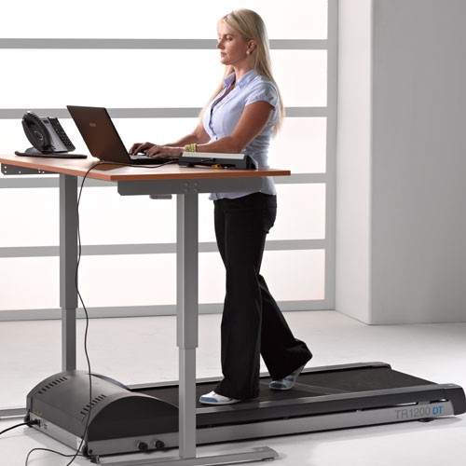
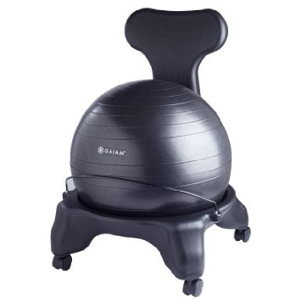
Ergonomics
Improvements at the workstation
  Desk modifications
    Treadmill Desks
    Swiss Ball
    Standing Desk
    Bosu Ball
    Resistance Bands
Notes:
Ergonomics- improve musculoskeletal issues such as back and joint pain due to physiological effects of constant sitting
Crown Castle office chairs – cost over 1,000 dollars and are ergonomically efficient.
An offer will go out to employees to gauge interest in having a swiss ball chair, minor office exercise equipment, and treadmill desks
Gaiam Balance Ball Chairs – Around $80.00/ea
Desk Station Treamill – Range from anywhere between 600.00-2,000.00.
Bosu Ball – multi-use equipment used for balance, strength, and flexibility.

Slide 9
E- Health
  Access & availability
  Engagement
  Motivation
Notes:
Access availability- Supply the employees with coping techniques to stress, empower them with knowledge on nutrition and sleep hygiene, and make all findings/reports available to them.
Engage the employees in new techniques and bring them together as a sort of community to battle stress.
Motivation will be key to continued success among the employees. Using e-health to keep the employees motivated will garner better success throughout.

Slide 10

Exercise
Affiliation w/ fitness center
  Power Yoga
  Exercise classes
  Sauna
15 minute exercise break
  Walking trail
  In-office exercise
  Facility exercise room
Notes:
Exercise- Reduce cardiovascular concerns, increase energy through biochemical activity (release of hormone epinephrine)
Yoga- Meditative
Monday and Wednesday in the morning
15 Minute break- Remove stressor (workload) to focus on exercise

Slide 11

Resiliency
Corporate Level
Employee Level

Slide 12
Resiliency Among Organization
Corporate
Effort-Reward Model
Employee Satisfaction

Slide 13
Resiliency Among Employees
S.M.A.R.T
Attention
Acceptance
Interpretation
Social Competence
Problem Solving
Autonomy

Slide 14
Logic Model
Input | Short-Term Goals | Intermediate Goals | Long-Term Goals | Goals
Ergonomics | Improve employee comfort Relieve spinal pain | Learn how to maximize benefits of new equipment | Improve Musculoskeletal Conditions | ↓ work-related stress levels ↓ health concerns associated with stress Improve employee productivity
E-Health | ↑ awareness of related factors & impact on stress & stress management | Provide Info. Pertinent to Stress Management | Create employee environment that combats stress
Exercise | Provide outlet for stress ↑ biochemical responses Meditative | ↑ self-efficacy & improve flexibility/physical activity | Improve Cardiovascular Health Increase Energy
Resiliency | ↑ employee satisfaction with employer | Implement session on handling work-related stress | Develop ↑ resistance to work-related stressors
Notes:
Ergonomics
Swiss Ball Chairs
Treadmill/Standing Desk
Bosu Ball
Yoga mat
Modified work station based on employee need
E-Health
Social Networking
Email Blast Informational Material
Exercise
Power Yoga
Gym Memberships
Gym Affiliation use
- Exercise Classes
- Sauna
15 Minute Mid-day Exercise Break
Resiliency
Training
Workshops
Review of organizational values

Slide 15
Gantt Chart Overview
Mo. 1
Organize
Mo. 2
Ergonomics
Mo. 3
E-Health
Mo. 4 & 5
Mo. 6
Exercise
Resilience

Slide 16
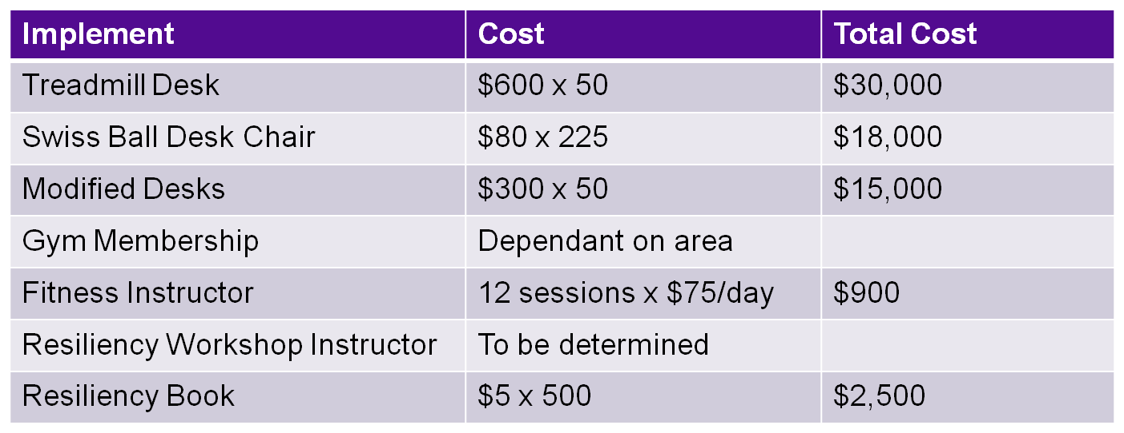
Budget Outline

Slide 17
Partner- ComPsych
GuidanceResources Program: guidanceresources.com
  Confidential Counseling
  Financial Information and Resources
  Legal Support and Resources
  Work-Life Solutions
  Tobacco Cessation Coaching
  GuidanceResources Online
Notes:
Provides support, resources and info for personal and work-life issues.
Company-sponsored, confidential and no charge to employee or dependents.
Confidential Counseling- address stress, relationship and other personal issues with clinicians
Financial Info & Resources- financial issues with Certified accountants and financial planners
Legal Support- talk with attorneys about legal issues
Work-Life- specials will do research for you to provide you with qualified referrals and resources for “to-do” list such as child care, moving/relocation, pet care, home repair, etc.
Tobacco Cessation- HealthyGuidance Tobacco Cessation program offers support to stop smoking with certified counselor
GuidanceResouces- expert info on any issue online through articles, “ask the expert” Q&A, tutorials, videos, self-assessments, etc

Slide 18
Process Evaluation – Indicators & Tools
Survey given before & after program related to program satisfaction
  Evaluate effectiveness of the program
Daily log given to participants
  Quality of Participation
  Individual Progress
  Online tracker, word document, phone app, etc.
Sign-In at Stress-Reducer stations
  Sign-in required for offered group exercise sessions
Notes:
Either a phone app, online program, or both will be available so that participants can accurately monitor their progress through our program. The online software will be
E.g. DigiFit iCardio, FitBit, Fitocracy, etc…

Slide 19
Impact Evaluation – Indications & Tools
Survey
  Attitude and Behavior change- self-reported, but will be geared toward ↑ self-awareness to stress prevention.
Meaningfulness
  Were program outcomes achieved & what changes were seen that are due to our intervention?
    Stress Awareness
    Overall well-being
    Reduced muscle and back pain
Notes:
How would outcomes have been changed if the intervention had not occurred?
Evaluate what worked and what didn’t

Slide 20
Outcome Evaluation (QOL Measure)
Employee happiness & job satisfaction
  Partner site will have effective workshops available to address various stressors that are common amongst employees.
  Did the program make a difference?
Comfort
  Replacement of office equipment
  Comfort or distraction?
Notes:
Did our variable provide positive change?

Slide 21

Thank You!
Strive To Be Stress-Free

Slide 22
References
Buckle, P. (2005). Ergonomics and Musculoskeletal Disorders: An Overview. Occupational Medicine, 55(1), 164-167.
Hartfiel N., Havenhand J., Khalsa S.B., Clarke G., & Krayer A. (2011). The Effectiveness of Yoga for the Improvement of Well-being and Resilience to Stress in the Workplace. Scand J Work Environ Health, 37(1), 70-76.
Koepp, G., Manohar, C., McCrady-Spitzer, S., Ben-Ner, A., Hamann, D., Runge, C., & Levine, J. (2013). Treadmill Desks: A 1-year Prospective Trial. Obesity, 21(4), 705-711.

