Slide 1
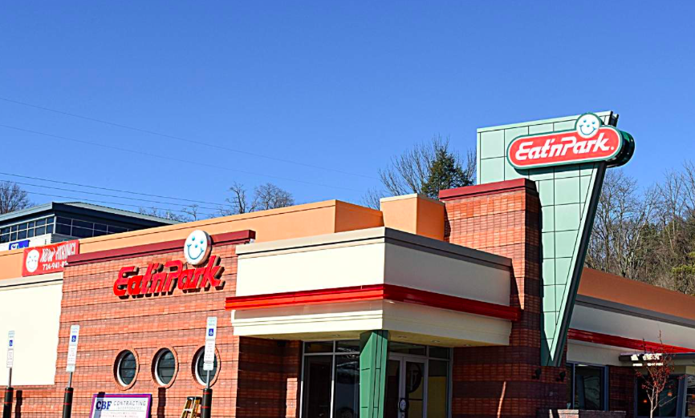
Kirsten Steiner, Nicole Bidolli, Kalyn Sigg, & Chris Frye
Stress Less Smiles Program
Notes:
CHRIS

Slide 2
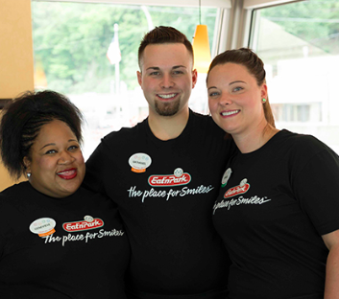
Mission Statement
“Our goal is to improve the overall health of Eat’n Park employees, physically, mentally, and socially.”
Notes:
CHRIS

Slide 3
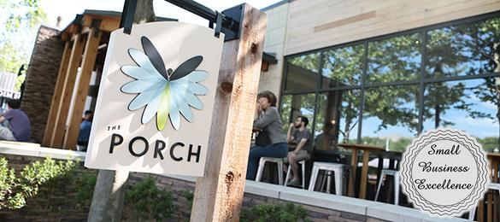
Eat’n Park Culture
Brands
Sustainability
Community
Compassion
Notes:
NICOLE
Slide 1: Title of program - who is Eat’n Park, teams, collaborations, culture, etc.
History- Eat’n Park was founded in 1949. It is a family owned restaurant chain in the states of Pennsylvania, Ohio, and West Virginia. It employs more than 8,000 people from managers, servers, hostesses, bakers, and so on. These restaurants are open for breakfast, lunch, and dinner, and a lot of them are open for 24 hours per day.
Eat’n Park Hospitality Group, Inc. has 7 different brands
Parkhurst Dining
Eat’n Park
Six Penn Kitchen
The Porch
Hello Bistro
Delicious Raw
Smileycookie.com
Our main focus is on Eat’n Park and The Porch at Schenley Park.
Sustainability
FarmSource is Eat’n Park’s local purchasing program that has been growing for over 15 years, allowing local farms to grow and produce the food that they serve on their restaurants plates. The idea of FarmSource was created for guests to enjoy fresh, wholesome foods while also supporting the local agricultural community.
Last year Eat’n Park Hospitality Group spent more than $21 million on locally-sourced food
Partnering with more than 200 farms and dairies
Began in 2002
Recycling, energy efficient materials (more energy efficient light bulbs to eliminating paper towels in their restrooms), incorporating induction cooking
Community
3 primary areas of Philanthropy
Sharing smiles - supporting family wellness and fitness
Growing smile - providing access to healthy food and education about food choices, particularly for kids
Hero smiles - enhancing the lives of military veterans and their families
Core Values of Eat N Park:
Care about people → each other, guests, communities they serve
Passionate about food → providing fresh, wholesome food made by locally sourced ingredients whenever possible. Working with over 200 local farmers each year
Embrace innovation → continually looking for ways to improve. Changing to make the business and communities better
Fiscally responsible → financial well-being of the company is key to their current and future success. Dedicated to being responsible long-term stewards of the financial resources at their disposal for the benefit of their stakeholders, team members, guests, and clients
Believe in a culture of integrity, diversity and accountability → treating everyone with respect, valuing the diverse perspectives that each and every individual has to offer

Slide 4
Stress Less Smiles Program
Notes:
CHRIS
Mission: Our mission is to help implement a program to help employees of Eat’n Park stop smoking, but specifically find alternative ways to reduce stress by working towards becoming physically active.
*Like stated before, Eat’N park focuses on helping the community through different smiles programs. Branching off of their smiles campaign, we have created the “Stress Less Smiles” program specifically for their community of employees.
Planning: Our program is fun, interactive, and educational. We hope that our program will allow employees to work together to reach their individual goals.

Slide 5
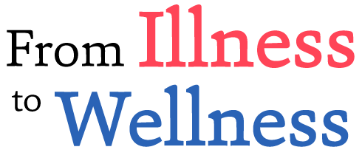
Defining the Problem: Employee Health
Decreased productivity
Health risks
Missed work
Notes:
KALYN
Slide 2: Health problem in question (Stolz, et al. 2013)
Outright banning of smoking in the workplace has not been shown to be effective in promoting smoking cessation. Other measures still need to be taken, as smoking in the workplace still an issue that causes decreased productivity, missed work, health risks, and second hand smoke.
Decreased productivity: Frequent smoke breaks during work cut into work time, and as a result decrease work productivity.
Health risks: Smoking is associated with many different health risks, such as upper respiratory infections or even more serious problems.
Missed work: Smokers tend to miss more work than non-smokers, due to these health risks stated above.
Secondhand smoke: Even those who do not smoke are exposed to smoke through secondhand smoke, which can be as dangerous and harmful as directly smoking.

Slide 6
Why is this important?
Eat’n Park pays 65% of the total premium cost for medical plan insurance (3 plans)
Primary care visits: $15, $20, $25 (virtual: $5)
Nationally: Cigarette smoking costs the workplace $92 billion/year
Poor health costs the US economy $576 billion/year, and 39% of this ($227 billion) is due to lost productivity, due to missed work or working while sick
Notes:
KIRSTEN
Slide 4-Kirsten-why do this, give a figure
Restaurants are the second biggest industry in the nation.
Only takes 21 days to make a habit, physical activity is a stress reliever and exercise has many forms appealing to anyone.
Decreased workdays missed-number of days on average, due to illness
Less cost for employers’ insurance aspect as less doctors’s visits and things, due to the employees being more healthy.
With smoking being such a big concern in the workplace, we want to do as much as we can to try and help the problem. With physical activity being such a good way to relieve stress, we are looking into ways to include that into our program. We are looking to get the employees to find a style of exercise that they love to do. Something that they can do while they are stressed and hopefully have that take the place of smoking a cigarette.
According to the CDC the highest percentage of workers who smoke are in food services at 30%.
Worker illness and injury costs U.S employers $225.8 billion annually looking at productivity due to absenteeism, which is $1,685 per employee (CDC: Business Pulse Health Workforce)
Unscheduled absenteeism cost $3600/yr for hourly worker and $2650 for salaried employee (Investopedia).
Obesity and other chronic conditions cost the U.S. ~$153 billion/yr in lost productivity and costs employers $550 billion/yr. (Washington post)
Cigarette smoking costs the workplace $92 billion/yr. (Washington post)
Adding American sporting events (SuperBowl), distractions (Facebook), and health problems (insomnia), and other factors of caregiving, transportation or stress = $1.8 trillion/yer lost in workplace due to loss of productivity. (Washington post)
The Integrated Benefits Institute (represents major U.S. employers and business coalitions) says that poor health costs the U.S. economy $576 billion/yr, and 39% of this ($227 billion) is due to lost productivity. (Forbes)
Restaurants are the second largest private sector employer in the U.S.
-According to the CDC, the highest percentage (30%) of workers who smoke are in food services. Worker illness & injury costs U.S. employers $225.8 billion annually ($1685 per employee).
-Unscheduled absences cost $3600/yr for hourly worker and $2650 for salaried.
-Obesity and other chronic conditions cost the U.S. ~$153 billion/yr in lost productivity and costs $550 billion/yr.
-Cigarette smoking costs the workplace $92 billion/yr
-Adding American sporting events (SuperBowl), distractions (Facebook), and health problems (insomnia), and other factors of caregiving, transportation or stress = $1.8 trillion/yr lost in workplace due to loss of productivity.
-The Integrated Benefits Institute says poor health costs the U.S. economy $576 billion/yr, and 39% of this ($227 billion) is due to lost productivity, due to absenteeism and presenteeism.

Slide 7
Create a community focus on stress management!
Notes:
KALYN
Slide 3: Problem continued, priority population and solution
Every employee can benefit from the program, because everyone can benefit from stress management techniques. We want to explore stress management opportunities, through increasing physical activity and mindfulness as a replacement for smoking. We do want to specifically target those part-time employees who do not have health insurance, and also those who smoke.

Slide 8
Theoretical Foundation & Program Components
Health Approaches, Theories and Models
Social Cognitive Theory
Transtheoretical Model
Theory of Planned Behavior and Reasoned Action
Social Support Theory
Outstanding components
-Physical activity good stress reliever
-The program focuses on the individual while impacting the whole restaurant/company potentially
-Better service, attitude, less workdays called off, more energetic employer, focused, as outcomes, leading to increasing sales and better customer experiences
-More awareness of benefits and services available to employees, building upon programs already in place
-Addressing the environment or atmosphere of the restaurant
Notes:
KIRSTEN
Slide 8-Kirsten-theoretical foundation, outstanding components of the program
The previous chart written out with the theories and constructs/variables
Social cognitive theory-outcome expectations and expectancies, environment, goal setting, or self control, emotional coping, 4 strategies of building self-efficacy
Transtheoretical Model-stages of change, decisional balance, self efficacy
Theory of Planned Behavior and Reasoned Action-attitude toward the behavior, normative belief, motivation to comply, perceived behavioral control, perceived power
Social Support Theory-types of social support and relationship to society
Social Cognitive Theory-This theory can go a long way with this type of program, by looking at how determined the employees are to attain a personal goal of physical activity or tobacco cessation. It can address different ways they learn and finding what strategy, whether through imitation or reading, works best for them. It can help with self control and ways to react towards their goal, such as being reflective or symbolizing. We definitely plan to use the four strategies in building self-efficacy, as reducing stress is a main component in this health plan, too. We want to look and help the employees see an outcome and address expectancies and their personal perceptions of whether or not they can or want to do be more physically active, reduce stress, and quit tobacco use. Helping them with goal setting and setting them up for success through emotional coping will truly be beneficial.
Transtheoretical Model-The employees are at all different stages of change and so we would use this and the possible strategies to help them move to the next stages. The company recognizes that some people do not want to change and therefore do not push people to change if they do not want to. However, we can help address the ten processes of change. The program could help with decisional balance especially by including support systems and addressing perceived behavior control and other various parts of other theoretical models. We Not much has been done in this in trying to address their employees’ states of change, it seems.
Theory of planned behavior and reasoned action-We are using this because it looks at intention, attitudes toward behavior (addressing barriers), motivation, perceived behavior control, control belief and perceived power. We think we can definitely build upon those last four mentioned, especially with support systems, which leads to the next theory used.
Social Support Theory-We are using this because people at Eat’n Park are like a family; they know and support each other in other things besides work, so we think they can help each other with health related goals, as well. They can have support from their personal family and work family. These relationships are also seen among the company from restaurants to the hospitality group and other parts of the company. So, building upon those relationships is possible and can have a major impact within the restaurant, but also across the company.
In some programs they have made attempts to address this tobacco cessation topic and other related health topics before, as mentioned in the examples. Fortunately, some have been successful, whereas others have not. We think that by incorporating these specific health models we can create an even bigger impact.
Outstanding components
With smoking being such a big concern in the workplace, we want to do as much as we can to try and help the problem. With physical activity being such a good way to relieve stress, we are looking into ways to include that into our program. We are looking to get the employees to find a style of exercise that they love to do. Something that they can do while they are stressed and hopefully have that take the place of smoking a cigarette. This program focuses on the individual while trying to impact the whole restaurant and company. By making these few changes we may see better service, attitude, less workdays called off, more energetic employees, less tired employees, more focused employees and increased market economy as customers receive better service. We are utilizing the opportunities and benefits they already have in place and creating more awareness of them, so that hopefully the employees will use them more. Many ideas are already in place or have been attempted, but we want to try and combine those and expand upon them. We are using many cognitive theory models that can be used to address the individual and a group of people. The managers at the restaurants we will be working with seem to be excited about incorporating this and care about their employees’ health. Also, we are addressing the environment or atmosphere of the restaurant.

Slide 9
Stress Less Smiles Program
Notes:
NICOLE
We want to raise awareness and change the norms of smoking behavior in and outside of the work environment. There are many atmospheres where being physically active is encouraged and it’s okay to not to smoke tobacco, so why not create this atmosphere within the Eat’n Park work environment? The Stress Less Smiles program would be enhancing Eat’N Park’s personal assets, caring about their employee health and well-being.
We have 4 different webinars or sessions that employees would be able to access through MyMENU or another internal website. Each of us will be explaining in order, one session each.

Slide 10
Session 1 - Meditation and Mindfulness
Less Stressed
Be Mindful
Mind and Body
Breathe Deep
Notes:
NICOLE
First we would introduce meditation and mindfulness to the employees and how it can improve their health and reduce their daily stress. Mindfulness is about focusing on what is right in front of you, being open to all feelings and being fully in control. It is an inexpensive way to relax both your mind and body thus reducing stress. The American Heart Association has examined over 400 studies and recently published an article stating that practicing meditation and stress reduction mindfulness helps decrease cardiovascular risk factors, blood pressure and much more.
On top of that, mindfulness has been used as a treatment for smoking cessation along with anxiety and depression. Statistical evidence has been shown that home based mindfulness can help reduce levels of craving and daily cigarette consumption. So employees would be taught how practicing mindfulness can help them throughout their long day shift or maybe stressful situations that they are dealing with at home.
Simply teaching mind-body practices like deep breathing or yoga poses is also a cost-effective way to help reduce stress and smoking cessation within employees. This webinar session would teach all who is watching different breathing techniques or Hatha yoga positions that are easy and no equipment is needed. Practicing deep breathing focusing on inhaling and exhaling can lead to positive effect that can help manage stress and anxiety. For example if there’s a huge rush at Dormont’s Eat’N Park one morning, one of the waitstaff can use their break in the back to focus on deep breathing or mindfulness for a couple of minutes to help them get through their shift with a smile on their face. These techniques can be used at work or even at home.

Slide 11
Session 2 - Kicking the Habit
Health Consequences
Environmental Cues
Coping Techniques
Alternative Therapy
Notes:
KALYN

Slide 12
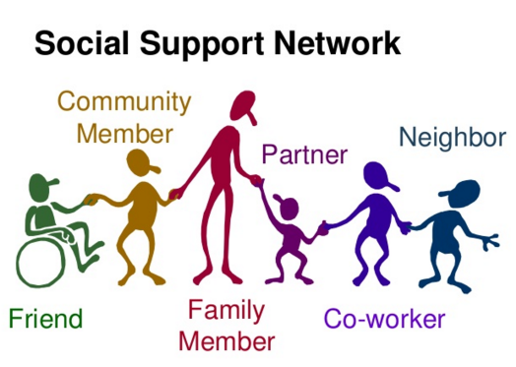
Session 3 - Social Support and Trust
Benefits of Relationships
Offline Support
Social Sharing
Coworker Support and Trust
Notes:
KIRSTEN
Session 3-Kirsten social support-a behavior involving human interaction through which individuals express, perceive and receive emotional concern, instrumental aid, or information.
1. There are health benefits of relationships, increases in thriving of life and wellbeing. Social integration a predictor of mortality and life behaviors. Family and friends are important sources of social support and are good for helping change behavior, promote opportunities and meaningfulness of life. Social support for goals led to higher goal achievements.
2. Different types of support-responsive,
Emotional-empathy, implies the expression of positive affect or affirmation toward people, creates a feeling of belonging and emotional reassurance, talking with others has been identified as one of the most helpful forms of support, respective communication partners the primary source
Instrumental-the transaction of goods or services, tangible material support, good in other contexts, similar to emotional
Informational-the exchange of information about the environment, implies questions ranging from recommendations or critiques, a broader environment as the source
Offline relationships are important for increasing health and wellbeing. Online is good for informational support.
3. Social sharing-to externalize happiness, relive the experience, venting, looking for assistance/support. The highest sharing is among friends. Women share to vent, seek help and for advice. Men share to relive an event, elicit empathy and inform/warn others. Sharing experiences reduces stress, and increases social bonds when positive goal-attainment activities are shared, increasing emotional and physical health.
4. Support is important for the workplace because of the closeness physically and psychologically. Building trust is important and helping behaviors (helping others) increases social support and trust. The person is more likely to help another person because they helped them. (How to help perceive and get better social support in the workplace).

Slide 13
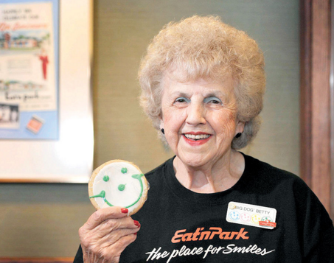
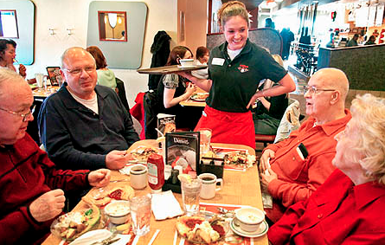
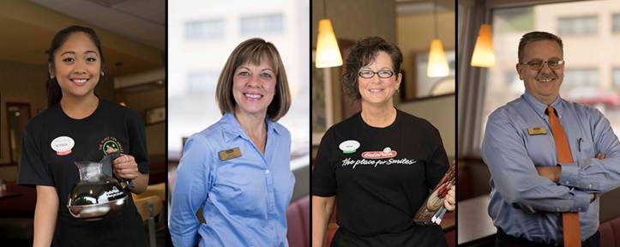
Session 4 - Mindful Movement
Mindful Practice
Mindfulness at Work
Mindful Eating
Mindful Physical Activity
Notes:
CHRIS

Slide 14
Logic Model
Inputs | Activities | Short-Term Outcomes | Intermediate Outcomes | Long-Term Outcomes | Goal
1. Yoga mats 2. Powerpoint projector 3. Projector screen 4. Low resistance bands 5. Medicine balls, weights 6. Notebooks for journaling 7. Recording equipment (camera, GB card, stand) for posting on MyMenu website | 1. Introduction to stress management and mindfulness 2. Strategies for smoking cessation 3. Building social support 4. Mindfulness in everyday activities, inside and outside of work | 1. Understand mindfulness, and strategies for application 2. Learning new ways to cope with stress 3. Learn techniques for smoking cessation, and view it as an obtainable goal 4. Understand how social support can help reach goals | 1. Application of mindfulness in everyday activities 2. Improved stress management 3. Develop an action plan for smoking cessation | Implement healthy strategies for stress management Reduce smoking and other negative health behaviors | Improve Eat’n Park employee health overall, physically, mentally and socially
Notes:
KALYN

Slide 15
Gantt Chart
Activity | 2019
 | OCT | NOV | DEC | JAN | FEB | MAR | APR | MAY | JUN | JUL | AUG | SEP
Preparation
Introduction and Surveys
Web-Based Seminars
Short-term Outcome and Process Evaluation
Follow-up Surveys
Final Evaluation and Report
Notes:
Nicole
Prep - setting up web-based and site based sessions. Mobile site based online
Introduction and

Slide 16
Budget
Item | Cost
Powerpoint projector and screen | $338.27
Journals | $2.39/person, $450 total
Recording equipment (video camera and 64GB card, tripod stand) | $204.59
Electronic blood pressure cuff machines (one for each restaurant participating) | $23.49/restaurant, $93.96 total
Exercise equipment (yoga mats, resistance bands, medicine balls, weights) (a couple sets per restaurant) | $372/restaurant, $1488 total
Advertisement | $574.39
Personnel (uploading videos/info. Recording sessions | $900
Program engagement | $950.79
Total | $5000
Notes:
KIRSTEN
This budget depends on the number of restaurants participating.
Powerpoint projector-291.82
Powerpoint screen-46.45
Recording equipment
Video camera-159
64GB card-36
Tripod stand-9.59
Journals-2.39 per person ~450
Electronic blood pressure cuff machines (one per restaurant) 23.49 (93.96 for 4 restaurants)
Exercise equipment-
Yoga mats~10 (4 sets per restaurant times 4 restaurants)
Low resistance band sets~8 (4 3 sets per restaurant times 4 restaurants)
Medicine balls/weights~372 (times 4 restuarants)
Advertisement-574.39
Personnel-uploading videos and monitoring things, recording sessions~900
Program engagement-950.79
Personnel-include for number of sessions and how many weeks, or how many sites they will lecture at, less amount if able to record lecture sessions and post on, the ENP intra web (still waiting to hear back about that). Must account for professional personnel to come in and do the screening (maybe a couple). And yoga instructor.
Equipment-unless already available renting equipment or borrowing, such as projector, projector screen, health screening equipment, exercise equipment, recording equipment if recording the seminars
Materials-journals/notebooks
Advertising-can do this on the ENP intra web, fliers/signs in the sites

Slide 17
Process Evaluation
Indicators
Program Organization
Engagement in Activities
Program Retention
Social Interaction and Feedback
Assessment Tools
Seminar Attendance, or use of the recorded sessions on myMENU
Journals
Pre and post session surveys
Notes:
KALYN they are getting a new program in addition to myMENU in 2018.
The feed back survey is one we have to make up specific to the program.
To measure social interaction we will use the Social Profile Assessment, which measures social participation in activity groups from family, schools, clinics, clubs, cultural groups, sports groups, and community groups. It emphasizes interpersonal interaction and relationships and community, social, and civic life as essential to health. It is composed of 40 items with 3 topics: activity participation, social interaction, and group membership/roles. This is used in the health field by therapists, as well. www.maryvdonohue.com/social-levels
The feedback survey will have to be made up specifically for the actual program.-Kirsten
Observational Evaluation: (still have to see whether they can upload recorded sessions to the ENP intra web)
Program Organization: Self evaluation of how well the program is organized, and how well it flows together.
Engagement in Activities: How well the employees are engaged in the sessions, based on participation and other factors.
Program Retention: How consistently the participants are attending the programs.
Social Interaction and Feedback: Interaction and feedback from the employees, to determine what they enjoyed/disliked.
Assessment Tools:
Seminar Attendance: Measure attendance rates at each seminar.
Journals: Encourage participants to use journals to help track their progress.
Surveys: Surveys to determine effectiveness of programs.

Slide 18
Impact Evaluation
Indicators
Increase awareness and use of mindful activity
Increase knowledge of smoking cessation and health benefits, and awareness of available resources
Increase awareness of social support, its importance, and ways to access it
Improve mindful movement, concerning a healthy lifestyle
Assessment Tools
Mindful Attention Awareness Scale survey to determine mindful awareness (attitude and behavior)
Completion of Online Seminars
Ryff’s positive relationships with others scale survey to determine perceived social support
Online Logging/ Self-reporting
Notes:
NICOLE
Survey is a cumulative survey
Survey to determine mindful awareness-Mindful Attention Awareness Scale (MAAS)-the longest empirical track record as a valid measure of trait mindfulness. A 15 item 6 point Likert-type scale designed to measure the extent to which individuals pay attention during several tasks, or when on “autopilot.” Does not require familiarity with meditation. Higher scores indicate greater mindfulness level.
Kirsten-Survey of perceived social support is Ryff’s positive relationships with others scale on self perceived social support. It is a 54 (medium form) that looks at 6 areas of psychological well-being: autonomy, environmental mastery, personal growth, positive relations with others, purpose in life, and self acceptance. This scale has been used in a lot of research studies. www.liberalarts.wabash.edu/ryff-scales/

Slide 19
Outcome Evaluation
Indicators
Employees’ knowledge and use of stress management techniques
Increase of employees talking and helping each other
Improve quality of life among Eat’n Park employees
Assessment Tools
Observation from the managers, summary of those using the services available
Observation of the managers and other coworkers
Notes:
KIRSTEN

Slide 20
Decrease stress and improve your health!
Notes:
KIRSTEN

