Slide 1


MUSCLE MINDFULNESS
DOREEN GONG
JIMMY LAW
BOB LUKA
MATT RICHARDSON
LIZ SPITTEL
Notes:
Our program is called Muscle Mindfulness. It was developed in response to the health needs of Allegheny County teachers. Our group is Doreen Gong, Jimmy Law, Matt Richardson, Liz Spittel and myself, Bob Luka. we hope to inspire and promote better health through this program.

Slide 2

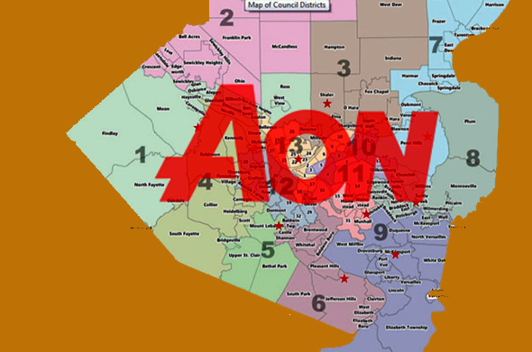
The Organization
Runs the health plan for most Allegheny County Public schools plus two community colleges, four vocational schools and two intermediate units.
Responsible for 19,000 employees and 41,300 total lives.
- Leading global provider of risk management, insurance and reinsurance brokerage, and human resources solutions and outsourcing services
Notes:
Aon is the world’s largest global insurance broker. Backed by broad resources, industry knowledge and technical expertise, Aon professionals help a wide range of clients develop risk management and workforce productivity solutions. Over the past 15 years, the Allegheny County Schools Health Insurance Consortium (ACSHIC) has provided an important service for the school districts of Allegheny County. The second phase of workplace health promotion was put together in 2014-15 to create a culture of wellness for the employees. In order to improve outcomes some of the benefits the program includes are Wellness Rewards Completion Promotion, ASCHIC WebMd Rewards Promotion, and Fitness Center Discounts. Furthermore, the four health care provider partnerships with the ASCHIC are Highmark Blue Cross Blue Shield, Davis Vision, United Concordia Dental, and Vision Benefits of America.

Slide 3
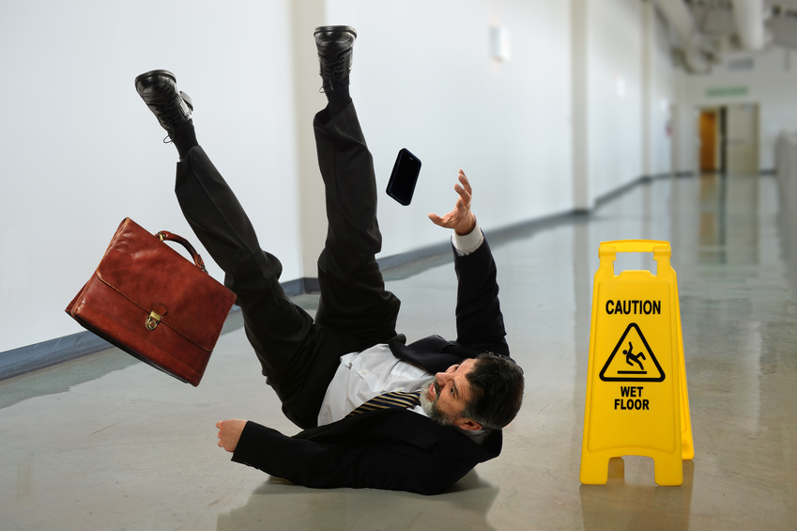
Occupational Risks
Notes:
Prolonged Standing
Teachers are on their feet almost all day. Standing for hours throughout the day can put a lot of stress on the lower back, hips, and knees. Teachers may find themselves at a higher risk of low back pain, physical fatigue, muscle pain, and joint discomfort. Dynamic movements and stretching can help to reduce.
Physical Inactivity
Teachers may find it difficult for find time for physical activity. Physical inactivtiy is linked to an increased risk for coronary heart disease, stroke, osteoporosis, cancer, diabetes, and mental health issues.
Improper handling of heavy objects
Teachers often times have to lift and carry books, boxes, supplies, etc. Musculoskeletal injuries are common from bending over and lifting heavy objects if not performed correctly.
Hanging student work and classroom decorations
Creating a positive classroom to encourage a good learning environment is important to many teachers. They may find themselves having to stand on ladders/stools to reach the top of the room. The risk of falling becomes a concern for the workplace. Falling from elevated heights may cause broken bones or sprains.
Class specific Injuries
Depending on the class a teacher is teaching, the responsibilities may be more demanding. An early education teacher might have to tie shoes, clean up toys, and other duties of that nature. A performing arts teacher may have to set up stages, carry heavy equipment, etc. Musculoskeletal injuries can occur when teachers have these more demanding responsibility.

Slide 4




Health Theories
Health Belief Theory
Social Cognitive Theory
Notes:
Applying health theory to programming helps to promote behavior modification by identifying the attitudes and beliefs held by those we are trying to reach, and applying the proper tools to break through their barriers and effect lasting change. Our goal is to reframe perceptions about the causes of muscular pain and promote self-management through body awareness, improved ergonomics, stress management, nutrition and muscle strengthening.
Using elements of these theories, we aim to reframe perceptions about the causes of pain and self-management by emphasizing body awareness, stress management and muscle strengthening. Applying theory to health programming helps to promote behavior modification by strengthening self-efficacy and positive reinforcement of the benefits of while anticipating potential barriers.
PERCEIVED SEVERITY, PERCEIVED BARRIERS PERCEIVED BENEFITS CUES TO ACTION
SOCIAL COG THEORY SELF-EFFICACY OBSERVATIONAL LEARNING, REINFORCEMENT

Slide 5

Kathy Glynn
- Health and Wellness Consultant, AON
Allegheny County Schools Health Insurance Consortium
School Level Wellness Champion
Notes:
Kathy Glynn, health and wellness consultant at AON, facilitates employer worksite wellness offerings via the Allegheny County Teachers Health Consortium and Highmark Insurance. Within each school district represented by the consortium, a wellness champion will be in place to facilitate health promotion activities, answer questions and address concerns, while also considering feedback from the participants and adjusting the program based on each school’s unique needs.
The Allegheny County Schools Health Consortium runs the health plan for all Allegheny County Public schools (except Pittsburgh Public and North Allegheny SDs), plus community colleges of Allegheny and Beaver Counties, four vocational schools and two intermediate units. The Consortium is responsible for 19,000 employees and 41,300 total lives. Saving money on health insurance for both the consortium and employees is a major goal. As a self-insured organization, the Teachers’ Consortium sets its own benefit plans and pays its own claims. Highmark, in turn, administers plans and negotiates rates with hospitals and providers.
The Consortium works with each school’s union representative who communicates concerns and ideas on the behalf of the teachers they represent. The Consortium also partners with Lytle EAP, an employee assistance program that provides a variety of resources and services to assist with the various facets of health care.

Slide 6

Partnerships
Notes:
-PSEA
-The union representative- Jan
-Lytle EAP Partners
The union is available to fight for the rights of teachers. If there are any concerns, contacting the representative with them will be the first step. That representative will them take it to the board to discuss what could be done in terms of health.
You can contact EAP Partners to talk through anything you need assistance with such as depression, changes in job responsibilities, family issues, and Drug and alcohol issues. They provide a number of services that you can call directly and get help.

Slide 7


Readiness & Capacity
Awareness and Advocates
Finance
Teacher Unions and Partnerships
Wellness Champions
Notes:
Notes:
In order to pilot the health promotion program for teachers successfully, we will select one school district as our pilot which is readiness and capacity to address challenges and opportunities together.
1, Each structures of school districts are extremely complicated and different. So we will choose the school district primarily which already has organization or department which probably includes health promotion services or products, and health awareness to improve teachers’ health.
2, This school district should have enough existing sites and space for implementation of school employee health promotion program.
3, This school district should have a well and stable financial situation, especially a reasonable fee structures, which can maintain and expand the program focused on promoting employee health.
4, To be effective, a strong union leadership is needed to play an important role to lead this program, and a variety of professional organizations for this school district to support it.

Slide 8



Health Dangers Associated
Work Related Musculoskeletal Disorders
Acute/Chronic pain
Decreased productivity
Notes:
Teachers have a high prevalence of work-related musculoskeletal disorders also known as WMSDs. Between 45- 91% of elementary and middle school teachers will be injured in a given school year. The most common WMSDs are suffered in the neck, shoulders, and low back. There are many occupational demands that put a teacher at risk such as prolonged standing, overreaching, and poor postural awareness although there are many occupational demands that put a teacher at high risk. Injuries suffered can be painful and debilitating. Acute pain will cause teachers to call off and take visits to the doctor thus missing valuable days of teaching. Failure to tend to these injuries will result in chronic pain. This being pain that lasts for over six months without subsiding. This type of pain will encourage teachers to take further measures of treatment such as surgery and miss longer periods of time in the classroom. Chronic pain may also force some teachers to retire earlier than expected. We are creating a portal to educate the teachers of the occupational risks and give evidence-based strategies for them to control or prevent them from occurring.
---------------------------------------------------------------------------------------------------------------------------------------------------------------------------------------------------------------------------------------------------------------------------------------------
Musculoskeletal disorders are among the top occupational diseases in many industrialized countries. They are second only to occupational mental disease. Teachers have a high prevalence of work-related musculoskeletal diseases (WMSDs) According to multiple studies the incidence of teachers being injured on the job is is between 45% and 91% in a school year. When teachers are injured or sick, their ability to educate students suffers and their productivity is greatly decreased. They are more likely to call out, take time off for surgery, and take visits to the doctor or chiropractor. There is a also greater risk for early retirement. Teachers are put under a lot of physical stress in their job. Demands such as prolonged standing, prolonged seating, repetitive overhead writing, decorating the classroom, developing engaging lesson plans, etc. all contribute to the risk of physical ailments. The most common injuries are seen in the lower back, neck, and shoulders. We are creating a portal to educate the teachers of these risks and give evidence-based strategies for them to control or prevent WMSDs from occurring. We will also introduce basic ergonomics training so teachers have a basic understanding of how to improve posture while seated and standing. Minimizing strain on the lower back, neck, and shoulders will lead to less WMSD and a better quality of life. Our goal is to ultimately reduce the number of WMSDs in elementary and middle school teachers.
1. Shuai, J., & Yue, P. (2014). Assessing the effects of an educational program for the prevention of work-related musculoskeletal disorders among school teachers. BMC Public Health,14.1211

Slide 9

By the Numbers
(2012 – 2014)
30,140 Non-fatal occupational injuries
  16,210 - Falls, slips, and trips
  7,600 – Musculoskeletal and overexertion
  6,550 – Muscle soreness and pain
Bureau of Labor Statistics – Nationwide
Notes:
From 2012 to 2014 there were 30,140 reported non-fatal occupational injuries to elementary and middle school teachers
More than half of them were due to falls, slips, and trips and almost a quarter of them due to WMSDs
Proper precautions and safety measures need to be taken. Awareness in the classroom and hallways has to be addressed. Education on managing muscle soreness and pain on a weekly basis must be implemented. The way we see it, these injuries are all preventable injuries. Our goal of the health program is to decrease injuries suffered on job. Xxxx is where we would like to implement our strategies in the hopes that other schools will see its success and adopt it as well.

Slide 10


1: Postural Awareness
2: Shoe Orthotics
3: Mindful Eating
4: Stress Mindfulness
5: Safety & Maintenance
6: Stretching & Recovery
Notes:
Our program consists of six components: Postural Awareness, Orthotic Devices, Mindful Eating, Stress Mindfulness, Classroom Safety, and Stretching and Recovery.

Slide 11



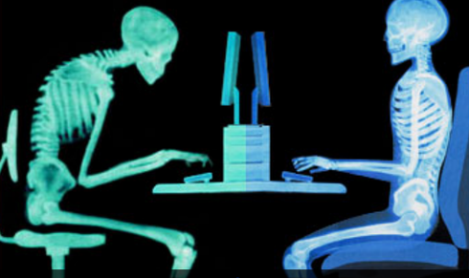


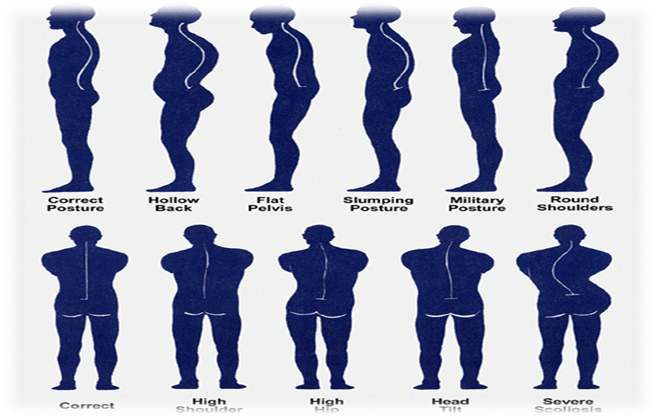
SESSION ONE
Postural Awareness
What are poor postures?
What are the effects for teachers?
Notes:
DOREEN GONG
Posture awareness:
1, Work-related musculoskeletal disorders(WMSDs) have been increasing in the education world. School teachers have a very high prevalence of WMSDs, with a prevalence of between 45% and 91% recently, which decrease productivity at work due to sick leave, absenteeism and early retirement. Musculoskeletal complaints especially of the lower back, neck and shoulders are commonest among teachers. Compared to the other occupations, these all complaints result from prolonged desk work due to frequent reading, preparation of lessons, marking of assignments, and prolonged standing in class as well as repetitive overhead writing on the board. As a results, the improvement in postural awareness, health behavior and attitude during their work time could reduce the self-reported prevalence of work-related musculoskeletal disorders for neck, shoulder, upper and lower back pain or discomfort. Thus, school teachers should be educated and promoted postural awareness and pay attention to these bad postures and health behaviors during working hours.
2, Prolonged standing has been associated with development and aggravation of low back pain. During periods of prolonged standing we change postural position more or less frequent, usually by shifting body weight from one leg to the other. These changes directly cause to the individuals perception of muscle fatigue, musculoskeletal discomfort and pain in the postural control system. According to the research, the chronic low back pain patients could compensate for relatively high muscle activation level by the increased variable postural strategy, which resulting in normal variation in muscle activation and normal reduction in strength, RE and FRR after prolonged standing. Therefore, for school teachers, we suggest to have an altered postural control system. In the other words, teachers should not only control their postures, but also adjust and have more postural changes.
Citation:
Shuai, J., Yue, P., Li, L., Liu, F., & Wang, S. (2014). Assessing the effects of an educational program for the prevention of work-related musculoskeletal disorders among school teachers. BMC public health, 14(1), 1.
Ringheim, I., Austein, H., Indahl, A., & Roeleveld, K. (2015). Postural strategy and trunk muscle activation during prolonged standing in chronic low back pain patients. Gait & Posture, 42(4), 584-589.

Slide 12


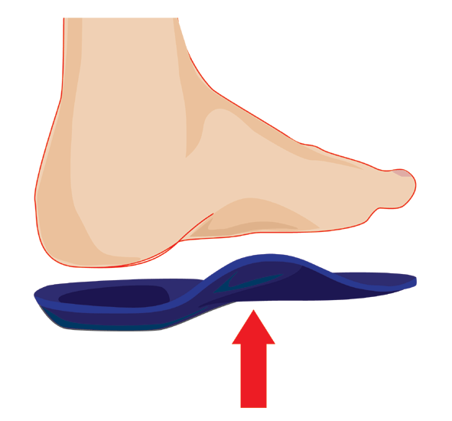
SESSION TWO
Shoe Orthotics
When to Consider Orthotics
What Type Is Right For You
Appropriate Fit
Notes:
Musculoskeletal disorders have a huge impact on work related absences in school teachers. Some of the challenges teachers face from pro-longed standing while teaching is low-back, neck and shoulder pain; tired feet, aching legs, and headaches. This “lecture-type” method for many hours causes a burden on the lower back and legs can lead to poor posture.
An orthotic is a device used to restore natural foot function. Improper foot function can lead to pain in the heels, knees and lower back. Orthotics are highly recommended for those who are on their feet for extended periods of time throughout the day. In addition to orthotics, teachers should take the opportunity to sit down after pro-longed standing, stretching to shift body weight which avoids putting too much pressure on one spot of the foot. Also, a teacher should wear comfortable shoes with good support and even put down a mat or carpet if teaching on a hard surface.
Erick, P. N., Smith, D. R. (2011). A systematic review of musculoskeletal disorders among school teachers. American Journal of Applied Sciences, 7 (5), 12.
Korkmaz, N. C., Cavlak, U., Telci, E. A., (2011). Musculoskeletal pain, associated risk factors and coping strategies in school teachers. Scientific Research and Essays 6 (3), 649-657. doi: 10.5897/SRE10.1064

Slide 13






SESSION THREE
Mindful Eating
Choosing Healthy Alternatives
Applying Mindfulness to Diet
Tracking Food Intake
  jj
Notes:
(Bob Luka)
Everyone knows the importance of maintaining a healthy diet. During this 60-minute seminar, we will discuss how mindfulness meditation can be used to attenuate food cravings by learning how to be ”present” in making dietary choices, and learning how to disengage from reactive, habitual and rushed patterns of eating. We’ll focus on food preparation and strategies for slowing down to make eating a more relaxed and enjoyable experience. Included in this session will be tips on cutting down on sugary snacks and convenient ways to track food intake using your smartphone.
Improving one’s diet goes hand-in-hand with increasing physical activity while reducing pain and stress. Physical improvements combined with beliefs in overall well-being improves the individual experience of pain. A healthier, more thoughtful diet will lead to improved body composition and improved vascular function, which in combination with strength training, will lead to a reduced the need for chiropractic services.
An improved diet is key to weight loss and overall cardiovascular health. Mindfulness meditation has been shown to be an effective strategy in reducing emotional eating as well as binge eating by raising awareness of food cravings and their origins. Through non-judgmental evaluation, individuals can learn how to cope with the emotions that lead to unhealthful eating and overeating. (1)
The need for good vascular health is well-known in the medical community and in the population at large. Evidence exists that decreased blood flow specifically to the lumbar spine from narrowed blood vessels causes pain in the lower back. Even without a need for weight loss, an improved diet can help to improve vascular health. (2)
Body pain and impaired physical functioning are recognized by the CDC as consequences of excess weight and obesity. Reducing one’s weight may be a path to reduced musculoskeletal pain and problems.
Katterman, S.N., Kleinman, B.M., Hood, M.M., Nackers, L.M., Corsica, J.A. (2014) Mindfulness meditation as an intervention for binge eating, emotional eating, and weight loss: A systematic review. Eating Behaviors, 15(2014), (197-204)
Kauppila, L.I., Mikkonen, R., Mankinen, P., Pelto-Vasenius, K., Maenpaa, I. (2004). MR Aortography and Serum Cholesterol Levels in Patients With Long-Term Nonspecific Lower Back Pain. SPINE, 29(19), 2147-2152.

Slide 14



SESSION FOUR
Stress Mindfulness
Coping Strategies
Emotional Triggers
Reactivity
Notes:
EMOTIONAL AWARENESS
BODILY AWARENESS
COPING ON THE JOB
Being aware of your stressors is the first step to being mindful. Stress will result when a person perceives situational demands as overwhelming. So when current personal and social resources are not able to meet the demands of the stressor, people tend to feel that overwhelming feeling. In relation with that overwhelming feeling comes the stress, which your body will react negatively to. People will tense up and muscles will tighten leading to stiffness and headaches.
It is important to be able to utilize coping skills to regulate the stress. This should help a persons resilience, which is effective recovery from the stress. This process will help keep people from experiencing distress which is when a person has or uses ineffective coping mechanisms to help in the recovery from the stress.
It is important to know what your triggers are emotionally. You also need to be aware of what you are feeling. How does your body respond to stress? Then once you have that self awareness, it is time to look at some stress management skills that can help you on the job. Using mindfulness to aid in attention and awareness to situations that cause stress, will help keep people from having those emotional reactions or judgements. These are essential to helping people keep their stress levels down, regulate those emotions, and in turn will have improvements on their health.
As teachers, there are more demands put on you everyday. You have to teach to the test, keep students calm and under control, and spend hours doing lesson plans. Its important to take time to assess the situation and have effective coping skills available. Good coping skills will use different self-regulation skills and having a self-compassionate mind-set.
Roeser, R. W., Schonert-Reichl, K. A., Jha, A., Cullen, M., Wallace, L., Wilensky, R., . . . Harrison, J. (2013). Mindfulness training and reductions in teacher stress and burnout: Results from two randomized, waitlist-control field trials. Journal of Educational Psychology, 105(3), 787-804. doi:10.1037/a0032093
Friedman, G. H., Lehrer, B. E., & Stevens, J. P. (1983). The Effectiveness of Self-Directed and Lecture/Discussion Stress Management Approaches and The Locus of Control of Teachers. American Educational Research Journal, 20(4), 563. doi:10.2307/1162814

Slide 15



SESSION FIVE
Safety and Proper Maintenance
Awareness
Classroom Organization
Bending – Lifting - Reaching
Notes:
_____________________________________________________________________________________________________________________________________________________________
Safety among students has been a fundamental focus in schools, but an emphasis of safety should also be given to the teachers. Between years 2012 – 2014, Over half of the injuries teachers suffered are attributed to slips, falls, and trips. Broken bones, lacerations, and concussions are some common injuries from falling and slipping. The cost of these injuries certainly adds up and time away from the classroom inhibits the students’ education. We are raising awareness of the possibility trips, slips, and falls in the classroom and school grounds.
The first area we’d like to explore is the classroom. Maintaining an organized classroom is important for the safety of both teachers and students. Desks should be evenly spread out from one another and backpacks neatly placed beside them. For elementary school teachers, all toys and games must be put away in spaces clear of walkways once students are finished using them. Any liquid that spills should be immediately cleaned up and DRIED to prevent slips. Teachers will often hang up decorations for the fall, winter, and spring. Teachers may also hang up students work or other informational posters on the walls. It is necessary to check and double check any step stool or ladder being used to hang these objects is not broken or damaged. This may be done by the maintenance staff or teachers. It is also advised that there be two people present just in case an accident were to occur. Hallways and auditoriums are another area of concern for slips and trips. Teachers should notify the maintenance staff of any liquid spills they encounter in the hallway. Students should be advised to keep the hallways as clear as possible of backpacks, lunches, sporting equipment and other obstructions.
Some classes may cause teachers to be at a higher risk of injury. Gym teachers are typically the most active teaching positions. Activities and games require the teacher to be moving. These muscle movements increase the chance of pulling a muscle or other minor injuries. PE teachers must always be aware of their surroundings while students are participating in games and activities. Other specific classes that increase the risk of injury are chemistry and physical sciences. Usually the chemicals being used in middle school level chemistry are non toxic or minimally dangerous but teachers should always be conscious of any hazard. Science experiments are another matter that must be handled with caution.
Safety and maintenance in and out of the classroom is imperative for both the students and teachers alike. Simple things such as organization and vigilance go a long way to decrease the risk of injury. Most of the slips, trips, and falls suffered can be prevented if proper attention is given to the environment which the teacher is in. Teachers are reminded to BE ALERT, DON’T GET HURT.
1. Shuai, J., & Yue, P. (2014). Assessing the effects of an educational program for the prevention of work-related musculoskeletal disorders among school teachers. BMC Public Health,14.1211

Slide 16




SESSION SIX
Stretching and Recovery
Benefits
Frequency
After-work recovery
Notes:
Stretching is very important for range of motion, flexibility, and injury prevention. Stretching loosens tight muscles which helps your muscles both relax and promote blood flow. It also encourages the release of endorphins, providing a sense of tranquility and euphoria. Stretching helps ensure correct posture by lengthening tight muscles that pull areas of the body away from their intended position and keeping your muscles loose. Stretching the muscles of the lower back, chest and shoulders can help keep the spine in better alignment and improve overall posture by relieving aches and pains. Paired with a healthy diet, engaging in prolonged stretching exercises can also help reduce cholesterol in the body. This could prevent and even reverse the hardening of arteries, helping one avoid heart diseases. Stretching challenges the body. Under this stress, the brain releases endorphins that stimulate a feeling of reward. In this sense, stretching can provide mental relief. National recommendations call for for stretching at least 3 days a week and can be performed every day.
After- work recovery is important. A great way to relieve acute pain from a long day of teaching is to use heat. While the overall qualities of warmth and heat have long been associated with comfort and relaxation, heat therapy goes a step further and can provide both pain relief and healing benefits for many types of lower back pain and other injuries. Heat promotes blood flow by dilating vessels, bring more oxygen and nutrients to the area of pain. A heating pad is inexpensive and can be purchased at any local drugstore or supermarket. Heat should be applied in 20 mins intervals.
1. Lawand, P., Lombardi, I., & E. (2015). Effect of a muscle stretching program using the global postural reeducation method for patients with chronic low back pain. Joint Bone Spine, 82(4), 272-277.
2. Nagrale, A., & Patil, S. (2012). Effect of slump stretching versus lumbar mobilization with exercise in subjects with non-radicular low back pain. Journal of Manual and Manipulative Therapy, 20(1).

Slide 17



L O G I C M O D E L
INPUTS FUNDING PERSONNEL MATERIALS LCD PROJECTOR ROOM EQUIPMENT VIDEO RECORDER | ACTIVITIES Seminars on postural awareness, stress mindfulness, mindful eating, orthotic devices and ergonomics ___________ Video on posture, stretching, strength ___________ Interactive magazine article | SHORT TERM OUTCOMES Changed attitude and behavior Improved diet Improved mood Acute pain relief ____________ Increased postural awareness ____________ Decrease sedentary time | INTERMEDIATE OUTCOMES Decreased risk of injury Reduced serum cholesterol __________ Flexibility Muscular strength Improved posture | LONG TERM OUTCOMES Weight loss Decreased chronic pain Increased functional strength | GOAL Ability to maintain healthy habits, proper posture, improved diet and functional strength
Notes:
Our logic model breaks down the ideas that went into this project. Two things listed here that we haven’t touched on yet are the instructional video and interactive magazine article. The video would be a short instructional video on strength training for posture correction and stretching for recovery and flexibility. The intent is to make this video available online for any-time viewing. An interactive magazine article promoting at-home exercise would appear in an issue of Community Health, the Allegheny County Schools Health Consortium’s seasonal magazine.

Slide 18
GANTT CHART
 | Aug | Sep | Oct | Nov | Dec | Jan | Feb | Mar | Apr | May | Jun | Jul
Hire and train staff
Physical Assessments & Magazine Article
Weekly Seminars & Video Production
Short Term Outcome Evaluation
Reassessment & Feedback
Independence Seminar
Online Video
Notes:
This chart provides a year-long timeline which begins with hiring and training staff for the six seminars. Next we move to physical assessments that will give us baseline health figures on our participants to be compared with assessments at the end of the program. Once all personnel is hired and trained, and assessments are completed, the program will officially begin. After the program wraps up, a short-term evaluation will be conducted, then participant feedback will be collected. We plan to conclude with one final seminar on maintaining independence.

Slide 19

BUDGET
$5,000
PERSONNEL | $2,000
EQUIPMENT | $500
MATERIALS | $2,000
TRANSPORTATION | $500
Notes:
Personnel will be needed to lead the weekly seminars along as well as people to demonstrate moves and proper use of equipment and materials. Equipment and materials needed include stress balls, foam rollers, resistance bands as well as AV equipment for interactive seminars. Refreshments and other incentives for attending seminars is included in the figure for materials. Ideally, the seminars would take place on-site at each school, but should the need arise, an allowance has been made for off-site transportation of participants.

Slide 20

EVALUATION FOR IMPROVEMENT
INDICATORS
Improved Posture
Improved Diet
Decreased Muscle Tension and Stress
Increase Awareness of Physical Activity and Classroom Safety
ASSESSMENT TOOLS
Postural Symmetry Assessments
Food Diaries
Stress Self-Assessment Questionnaire
Seminar Attendance and Surveys to Determine Knowledge, Attitude Changes and Behavior Changes
Notes:
To assess improvements, we will measure and evaluate changes in postural symmetry, diet, stress levels and overall attitude changes using the tools you see here. These measures will show us the parts of the program that are working the best and areas that may need to be revisited and revised for repeat programming.

Slide 21


PROCESS EVALUATION
INDICATORS
Program Engagement
Program Organization
Program Retention
ASSESSMENT TOOLS
Satisfaction Surveys
Seminar Attendance
Instructor Evaluations and Seminar Feedback
Notes:
To help determine the program’s worth to the Teachers Health Consortium and its return on investment, we look to see how the program has impacted health care costs overall and health care costs of the targeted health issue. We also assess program engagement through satisfaction surveys and seminar attendance. Engagement is obviously key in adhering to the program and getting the desired results.

Slide 22

Thank you!
Notes:
We would like to thank Kathy Glynn and Michael Garofalo for their support and feedback in designing this program, and for graciously plying us with fresh fruit and coffee during our meetings.

