Slide 1

Vegetables
Fruits
Protein
Grains
Fueling Up
Making half your truck fruits and vegetables!

Slide 2

Who is PGT?
  Ownership mindset willing to change
  Family owned and operated
  935 employees
  Bases throughout North America
Notes:
PGT is allowing us to come into their company and work with them to create a healthier PGT team. One thing that needs to be expressed about this company is their culture. This is a family run company, owned and operated, since 1981. Their mindset on how they want to run and control the company as a family has not changed, which is why they have asked us to come in and create a health program for them. They treat all 935 employees like family and want them to be as healthy as possible just like you would want your family members to be healthy. In PGTs mission statement they even state that they want their employees to have financial security and career opportunities. They state that their fundamentals, which they continue to stay true to, relationships, employees, and then lastly profitability.

Slide 3
Current Status
Socioeconomic factors
Structure and cost
Access
Adherence
Notes:
Worksite health promotion programs encourage the overall wellbeing of all employees with an important focus on improving mental and physical health. Currently, in the trucking industry there is a lack of effective heath promotion programs. In order to address these challenges, we will create a program that attracts diverse populations, minorities, and age groups. With the Affordable Care Act, there’s a lot of emphasis on using evidence based interventions and practices, therefore, we have researched programs in order to improve your employees’ health and wellbeing.

Slide 4
PGT Health Concerns
Notes:
After reviewing the insurance claims data for the first 10 months of 2016, we have determined several areas of health concern. PGT has 935 employees. We looked at the number of employees being treated in these five disease categories. 32% of all PGT employees are being treated for preventable diseases, of these 32% for Cerebrovascular disease or disease that affects the arteries and blood flow supplying the brain there are 5% employees currently being treated. 27% employees are being treated for heart disease such as heart attacks and chronic heart disease. Manageable disease such as diabetes and asthma have 41% of employees in treatment. Vascular disease like atherosclerosis a leading risk factor for heart disease has 5% employees undergoing treatment, and lastly 22% employees are being treated for weight related disease such as obesity.

Slide 5
Notes:
Besides looking at the numbers of employees being treated in these 5 preventable disease categories, we also looked at the total charges. PGT members spend about 5 million dollars each year on health claims in all disease categories.The chart you see on the screen shows 5 preventable disease categories that are costing the company 1.9 million dollars each year. Although this number seems high, the good news is that these diseases can all be managed through lifestyle changes, like improving nutrition. Participation in a nutrition program will reduce the total charges in these diagnostic categories.

Slide 6



Adam M Bisnowaty
Alex P Kunz
Emily E Pavlakovich
Tyler J Sheppard
Matthew Steinbeck
Bryan M Willey

Slide 7
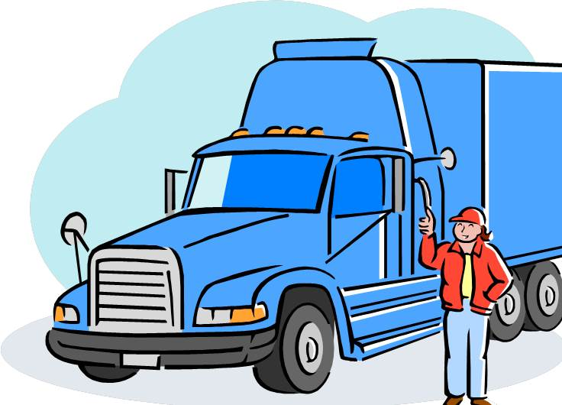
Participating Truckers
Pre-contemplation
Time
Nutritional Knowledge
Positive
Self-Efficacy
Contemplation
Preparation
Action
Maintenance
Notes:
We will use health approaches and theories to select the priority population of PGT Trucking to participate in the wellness program. Firstly, we will use the health belief model, here we will look at perceived barriers. Employees who feel that time and nutritional knowledge are a perceived barrier would be ideal for the program. These areas will be the main focus of the education provided during the 6 segments. Next, using the theory of planned behavior we want to find the employees who have a positive behavioral intention, or are likely to engage in the program. Lastly, using the transtheoretical model we want to discover those with both self-efficacy and in the stages of change contemplation (admitting there is an issue) and preparation (getting ready to make a change). We want those who know they need to make improvements and/or are ready to make the change in the program. Further, truckers are on the road by themselves and must have the ability to complete the wellness program by themselves.

Slide 8
Vegetables
Fruits
Protein
Grains
Fueling Up
Making half your truck lean protein and whole grains!

Slide 9
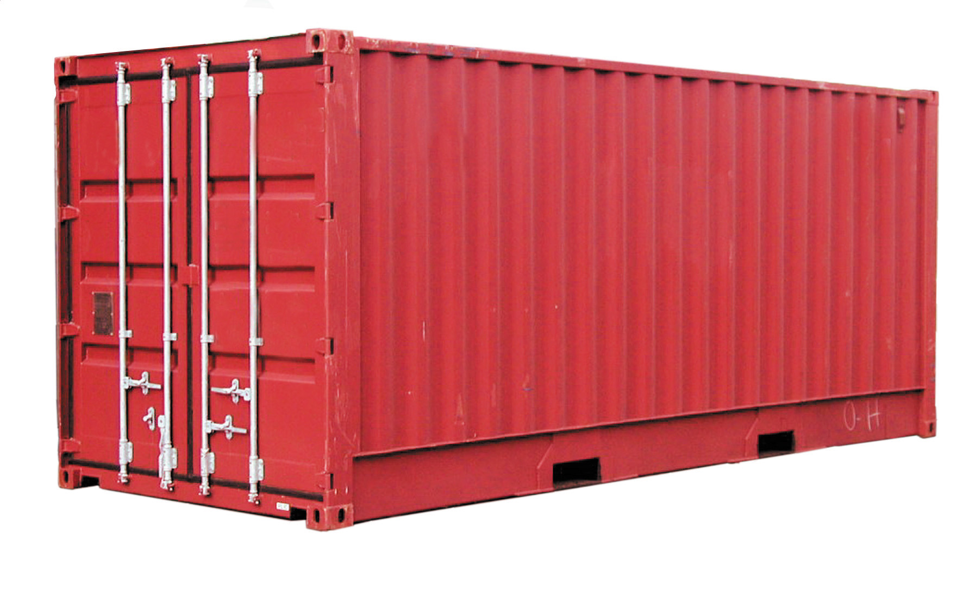
Trucking Lifestyle
Current Nutritional Education
Impact of typical Day
What is available in the truck
Interaction with other Drivers
Notes:
Cousineau, T., Houle, B., Bromberg, J., Fernandez, K. C., & Kling, W. C. (2008). A Pilot Study of an Online Workplace Nutrition Program: The Value of Participant Input in Program Development. Journal of Nutrition Education and Behavior, 40(3), 160-167. doi:10.1016/j.jneb.2007.04.376
Cox, D. N., Mckellar, S., Reynolds, J., Lean, M. E., & Mela, D. J. (1998). Take Five, a nutrition education intervention to increase fruit and vegetable intakes: Impact on attitudes towards dietary change. British Journal of Nutrition, 80(02), 133-140. doi:10.1017/s0007114598001032
Understanding current nutritional knowledge level and awareness of the impact of their daily life has an impact on overall nutritional awareness. This session is used to allow the truckers to see their current knowledge level and attitude toward nutrition. This session will directly look at a truckers lifestyle and access to various resources and how that impacts nutritional decisions. The overall purpose of this sessions is to validate the importance of the development of new skills (such as meal planning, and hydration) to enhance behavioral change toward making healthier nutritional choices.
Alex P Kunz

Slide 10
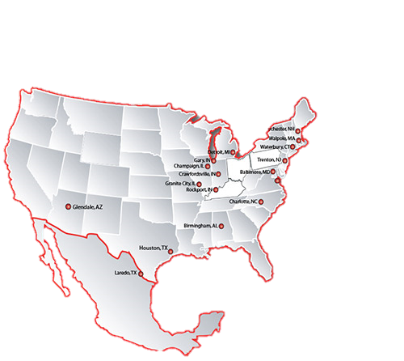
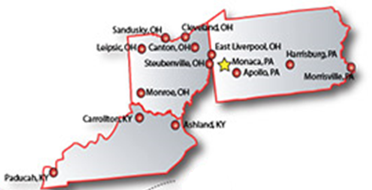
Mapping Eating
What are you currently eating?
Dietary recalls
Eating Habits
Notes:
In this session, the employees will map out what they are currently eating by using a dietary recall method, either electronically or manually. It is important to know what they are currently eating in order to improve their diet. The employees will also learn the pros and cons of using applications on their smart phones to track their progress.In order to accurately report their portion sizes, the employees will learn about serving sizes and how to report accurate measurements in their diets.
Sharp, P.B., Allman-Farinelli, M.,Ph.D., F.D.A.A. (2014). Feasbility and validity of mobile phones to assess dietary intake. Nutrition, 30, 1257-1266.
Zhu,Y.,Hollis,J.H. (2016) Associations between eating frequency and energy intake, energy density,diet quality and body weight status in adults from the USA. British Journal of Nutrition, 115, 2138-2144.
Emily Pavlakovich

Slide 11
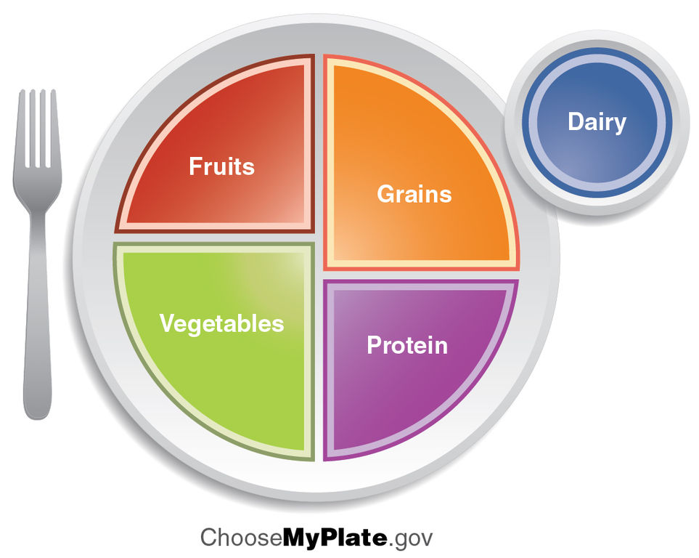
Meal Planning
Best options of food
Finding Caloric Limits
Macronutrients
When should I eat?
Notes:
Garaulet, M., & Gómez-Abellán, P. (2014). Timing of food intake and obesity: A novel association. Physiology & Behavior, 134, 44-50. doi:10.1016/j.physbeh.2014.01.001
Layman, D. K. (2014). Eating patterns, diet quality and energy balance. Physiology & Behavior, 134, 126-130. doi:10.1016/j.physbeh.2013.12.005
Adam Bisnowaty
Session information includes the types of foods to be consumed and at what meals of the day. This information will follow the myplate dietary information. It will also include the different types of foods and the different choices one has. Lastly, this session will talk about the time of eating. When to eat and when not to eat. This will allow the truck drivers to still select foods they enjoy while understanding the needs they need for a healthy lifestyle. This being said this will be a guide for them to use to eat better with many options. This will be the skill they are learning and will then effect their behaviors of eating post program.
What should I eat?
Types of food intake
MyPlate
What my plate should look like
Different Choices
Healthy Foods
When should I eat?
Breakfast, Lunch, Dinner, Snack

Slide 12


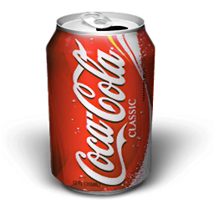
Hydration
Importance
Likes, Dislikes, and Alternatives
Common Misconceptions
Planning
PGT
Notes:
Staying hydrated is a key component of maintaining a healthy lifestyle. Maintaining a proper hydration level allows the body to function properly; on the other hand, not staying hydrated can have significant repercussions: decreased physical performance, cognitive performance, gastrointestinal function, kidney function, and heart function. Dehydration can increase the likelihood for headaches and increase the risk of chronic disease.
The substances you are consuming also play a major role in health. It is very important to find healthy drinks that provide vital vitamins, minerals, and electrolytes to support a healthy lifestyle. It is also important to explore alternatives to potentially unhealthy drinks. For example, if you really enjoy Coca-Cola, you could explore lower calorie options or consider decreasing the amount you drink on a daily basis. There are may alternatives to unhealthy drinks as well as ways to enjoy these drinks in moderation. These methods as well as common misconceptions will be discussed within this session.
Tyler Sheppard
Mclellan, T. M., Caldwell, J. A., & Lieberman, H. R. (2016). A Review of Caffeine’s Effects on Cognitive, Physical and Occupational Performance. Neuroscience & Biobehavioral Reviews. doi:10.1016/j.neubiorev.2016.09.001
Popkin, B. M., D'anci, K. E., & Rosenberg, I. H. (2010). Water, hydration, and health. Nutrition Reviews, 68(8), 439-458. doi:10.1111/j.1753-4887.2010.00304.x

Slide 13

Environment
Truck stops
Healthy food choices
Convenience
Education
Notes:
Jacobson, P. J., Prawitz, A. D., & Lukaszuk, J. M. (2007). Long-Haul Truck Drivers Want Healthful Meal Options at Truck-Stop Restaurants. Journal of the American Dietetic Association, 107(12), 2125-2129. doi:10.1016/j.jada.2007.09.003
Wardle, J., Parmenter, K., & Waller, J. (2000). Nutrition knowledge and food intake. Appetite, 34(3), 269-275. doi:10.1006/appe.1999.0311
Matt Steinbeck
This session will cover what types of food options are available at truck stops, how convenient tis certain types of food, and how appetizing is the food being offered. Then there will be a short about how the truck stop and highway restaurant owners need to be educated on what is considered healthy and same goes for truck drivers so they know which option to pick when making a stop. First, If any, what food options are healthy. Second, is it easier to grab a premade burger or to get a healthy meal. Lastly, are the healthier choices actually appetizing and good tasting.
Pilot Truck Stops: have a restaurant inside with fresh and healthy options, plus they put nutritional information for everything on their menu.They also have a movement guidebook to teach them how to perform exercises including squats, lunges, etc., and how to incorporate movement into their work lives. Pilot was the only stop that we looked at that made their health and wellness information readily available and easy to obtain.

Slide 14


Cheat Meals
Cheating in Moderation
Why it
Makes sense
Incorporation
Notes:
The last phase of our program will focus on cheat meals. Throughout this program the members will be utilizing the resources that we have provided to improve their nutritional choices, but we understand they will have cravings along the way. During this session we will talk about how to cheat in moderation, why cheat meals make sense, and provide examples of incorporating cheat meals into their daily caloric intake. We want the members to know that we are not here to parent them and that they are in control of their food choices. Incorporating cheat meals can help keep them on track to a healthy lifestyle day in and day out.
Hooper, N., Sandoz, E. K., Ashton, J., Clarke, A., & McHugh, L. (2012). Comparing thought suppression and acceptance as coping techniques for food cravings. Eating behaviors, 13(1), 62-64.
Penney, S., NASM-CPT, C. E. S., & PES, F. Do cheat meals make diet sense?.
Bryan Willey

Slide 15
Logic Model
Inputs | Activities | Short-Term Outcomes | Intermediate Outcomes | Long-Term Outcomes | Goal
Funding Survey | Assessment of Current access of truckers | Increased awareness of nutritional intake | Increased Self-Efficacy of nutritional awareness | Increased Nutritional Knowledge
Instructors Journals | Mapping of Current Nutritional habits | Increased use of provided resources |  |  | Decrease the prevalence of PGT Health Concerns
Nutritional Resource Promotional Items | Biweekly seminars on hydrations, meal planning, and rituals | Increased awareness of nutritional opportunities on the road | Reduction of number of bad nutritional habits | Decreased Risk Factors
Notes:
We have created a Logic Model in order to be of use for the planning and implementation of the program, as well as method of evaluating the implementation and progress. The overall goal of this program is to decrease the prevalence of PGT health concerns. The primary goal of this program is to decrease the prevalence of PGT Health concerns through nutritional awareness, education, structured program implementation, and motivation. The"inputs" or ingredients tat will be necessary for the program to succeed are funding, surveys to assess different areas, instructors to implement the seminars and convey the necessary information, Journals for the program participants to track their diet and plan their meals, nutritional recourses to aid the participants in making proper nutrition choices on the road, and promotional items such as water bottles to help encourage different aspects of the program. The activities involved in the program are a current needs assessment to see what areas of nutrition need to be focused on and what topics are most important. The mapping of current nutritional habits will be used to determine strategies to promote increased nutrition and facilitate ways to break bad habits. Finally, the seminary will used to educate the participants so they have the proper knowledge to make smart nutritional decisions.
The first short term goal for this program is to increase the participants awareness of their nutritional intake. Most individuals are not fully aware of how much they eat or how many calories they consume on a daily basis or during a meal. The second is to increase the use of the provided journals, surveys, promotional items, and educational opportunities. Lastly, to increase the awareness of nutritional opportunities both good and bad while on the road. The intermediate outcomes of these goals are to improve how the program participants feel about their ability to improve their nutrition. Self efficacy is very important when attempting to break bad habits or make a lifestyle change. The second intermediate goal is to see a significant reduction in bad nutritional choices and habits through use of surveys and dietary analysis. The long term outcomes for this program are to increase nutritional knowledge and the ability to make the correct nutritional choices while on the road and at home to improve quality of life. The second long term goal is to lower the risk factors of the program participants through improved nutrition, awareness, and he breaking of harmful habits.

Slide 16
Funding
Activity | Budget
Nutritional Resources
Promotional Items
Supplies
Notes:
We have split funding into three distinctive areas. Nutritional Resources include either an app development, or nutritional guideline book to be used by the truckers. Promotional Items would include PGT Water Bottles to help improve access to water during long hauls, and lastly supplies include materials needed for each seminar, and development of a quick information sheet over viewing nutrition.

Slide 17
GANTT Chart
 | Sept | Oct | Nov | Dec | Jan | Feb | Mar | April | May | June | July | Aug
Assessment of current trends “Initial Survey”
Program Introduction
Biweekly Seminars
Assessment of current trends “Short-Term Survey”
Trucker Self Evaluation of Program
Assessment of current trends “Intermediate Survey”
Assessment of current trends “Long Term Survey”
Notes:
Annually the change of year for insurance companies is January. We decided to start in September to allow for initial surveys and expectations to be laid out so that come January the biweekly seminars would begin. By beginning the education in January it will be easier to monitor if changes occur toward the goal of the health program.

Slide 18
Evaluation for Improvement
Indicators
Increased awareness of nutritional intake
Increased use of provided resources
Increased awareness of nutritional opportunities on the road
Assessment Tools
Completion of dietary recall
Survey to determine increased awareness, attitude, and behavioral changes
Review Pre- and post-assessments
Notes:
We will be using a dietary recall and a survey to evaluate the improvements of this program. The truckers at PGT trucking will be asked to recall their nutritional intake on a weekly bases and record this information in a journal. We expect that those truckers who engage in this dietary recall will have an increased awareness of their nutritional intake. We will also administer a survey to evaluate the truckers use of provided journals, promotional items, and educational opportunities which we believe will increase their awareness, attitude, and behavioral changes. Finally, we will review pre and post assessments to evaluate their awareness of nutritional opportunities on the road.

Slide 19
Evaluation of Accountability
Indicators
Participation of truckers
Nutritional Knowledge Retention
Satisfaction of program
Assessment Tools
Dietary recall completion
Completion of surveys
Self-evaluation survey completed
Notes:
We also want to evaluate the accountability of the participants and the parties involved in developing and implementing the program. We will use completed dietary recalls to evaluate the members participation and surveys to evaluate the members nutritional knowledge retention. As well as evaluating the participants accountability, it is important that we are also keeping ourselves accountable. We will use surveys completed by the members to evaluate their satisfaction of the program. We will use these indicators to make improvements for future programs offered to the members of PGT trucking.

Slide 20
Vegetables
Fruits
Protein
Grains
Fueling Up
Taking control of your food!

