Slide 1
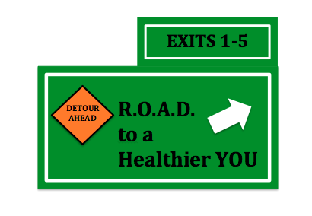
Westinghouse Corporate Wellness Program
Patrick Jacobs
Christine Jazwinski
Lexi Rzempoluch
Sara Holtzman
Yiyao Shi

Slide 2

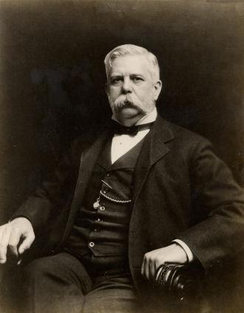

Company History
Notes:
CHRISTINE
Founded in 1886 as Westinghouse Electric Corporation by George Westinghouse in Pittsburgh, PA.
First to bring electricity to American homes.
Famous for starting KDKA in Pittsburgh, PA. World’s first radio station.
Has gone through many changes in name and ownership. Is now owned by the Toshiba Group of Japan.
8,000 employees in the US
Corporate Culture:
Average Age: 40
80% White Men
High stress levels
Rigid safety protocols
Self-insured with Aetna
Wellness Program:
Recently changed
Spouses covered under health insurance but screenings are not free
Focuses on making nuclear reactors and providing resources and support for reactors internationally.

Slide 3
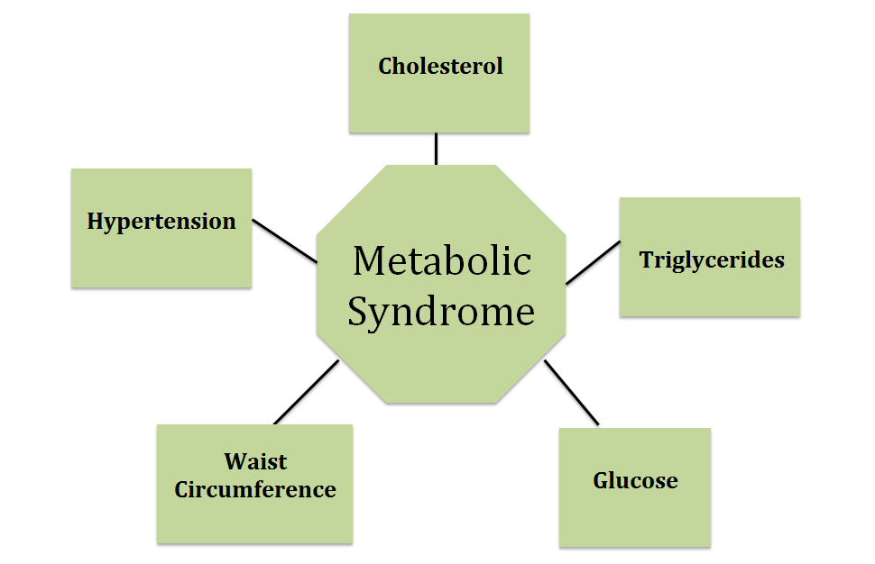
Metabolic Syndrome
Notes:
SHARI:
Group of risk factors that raise an individual’s risk of developing heart disease or other CVDs, Diabetes, or having a stroke.
These are the specific ranges/factors that Westinghouse’s vendor Health Solutions screens for and on which increased Short-term Disability is based.
Westinghouse Ranges:
Cholesterol: HDL (good cholesterol) with value of 40mg/dL or greater for Men or 50mg/dL or greater for women.
Hypertension: Blood pressure with value of <135/85 mm Hg
Waist Circumference: Value of <40 inches for men or <35 inches for women, or BMI <30.
Glucose: OGTT value of <110mg/dL
Triglycerides: Value of <150mg/dL

Slide 4
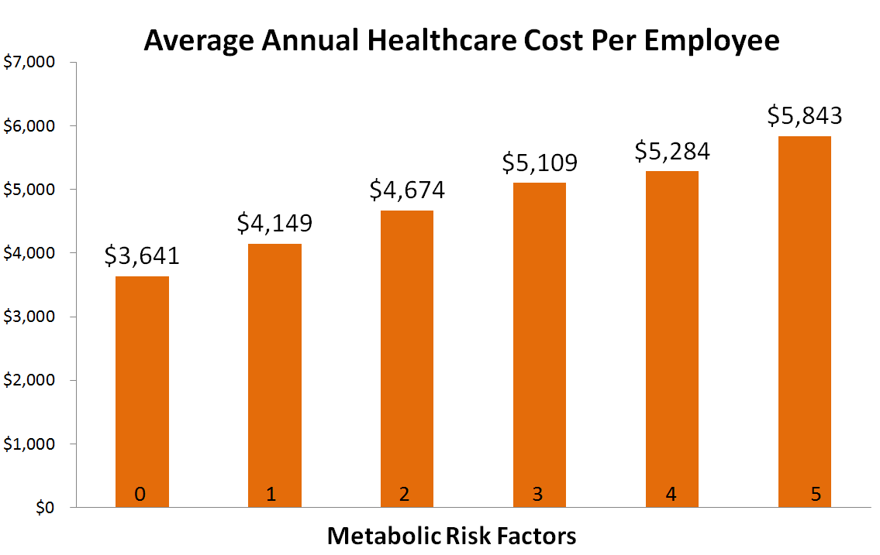
Metabolic Syndrome
Notes:
SHARI:
As risk factors for metabolic syndrome increase, the medical care per person also goes up.
Study followed 57,000+ individuals from Kaiser Permanante data over 5 years.
“In the future, metabolic syndrome may overtake smoking as the leading risk factor for heart disease.”
-NIH, 2014
http://www.ncbi.nlm.nih.gov/pmc/articles/PMC3125563/#!po=21.4286

Slide 5
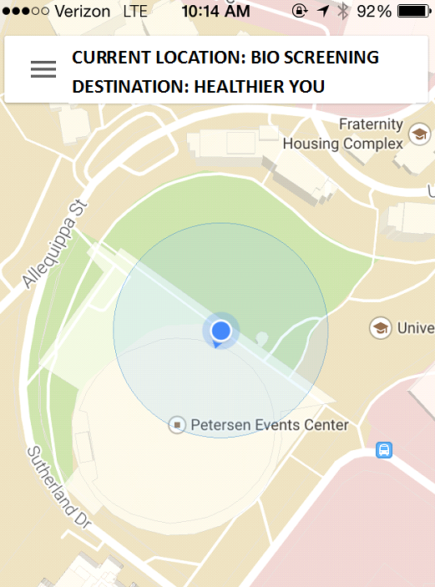
Reducing Metabolic Syndrome
Weight Loss/Maintenance
Physical Activity
Proper Nutrition
Knowing Your Numbers!
Blood Pressure
Blood Sugar
Cholesterol
Notes:
SARA:
So now that we know a bit about Metabolic Syndrome and it’s affect on business in terms of healthcare costs the question arises as to how can we reduce the risk of developing MetS?
Weight Loss/Maintenance
-A combination of physical activity & proper nutrition
-for loss ACSM 300+ minutes of P.A. for maintenance 150
-proper nutrition for risk reduction is the DASH diet
-Lexi will share more about those sorts of tips later
Knowing Your Numbers via Biometric Screenings!
-Just like any destination it’s important to know your current location in order to know where you’re going, so knowing your numbers is an important first stop on the road to health.

Slide 6
Current Wellness Program
Wellness Dollars Program
MyHealth Rewards Program
Health Assessment & Biometric Screening to qualify
Max $250
Preventative Exam
Life coaching
Accessing Health Record
Affected Short-term Disability, lowered deductible, & contributions
$250
Health Assessment
Biometric Screening
Short-term disability affected by risk factors
Health Coaching
Increases in 2016 & 2017
Notes:
SARA:
Westinghouse has had a know your numbers program for several years that has mainly been participation based...get a screening, get $50, get a check-up at the doctor, get $50 etc. However, they’ve recently launched a new version of their health incentive program that is based on physiological markers instead of participation.
Previous Wellness $$ program required a health assessment and biometric screening as qualifiers for the program with cash deposited into a Health Spending Account for participating in preventive exams, life coaching, and accessing online health records. Spouses were eligible and the outcomes of the health screening did affect the level of short-term disability they’d be able to receive via more participation in health coaching.
The new program offers the HSA funds immediately following the online health assessment update and biometric screening. However, the short-term disability is directly linked to the number of risk factors the employee/spouse has. Employees must have satisfactory levels in 4 out of 5 of the risk factor thresholds in order to receive full short-term disability. If they don’t meet the criteria they can still qualify for higher STdis via Health Coaching.
In future years, the program plans to get more stringent by linking satisfactory risk factor numbers with HRA deposits ($50 per satisfactory mark).
The total incentive in 2016 will go up to $500 for employee & $500 for spouse! BUT the employee/spouse MUST have had a biometric screening in 2015 to qualify for this new level!

Slide 7
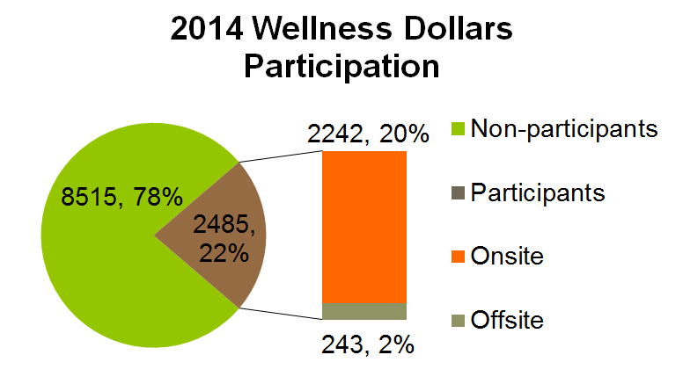
Current Wellness Program
Notes:
SARA:
So, how many employees are participating in this program?
There are approx 11,000 insured employees & their spouses across the 18 U.S. Westinghouse campuses.
22% of them (2485) participated in the Wellness Dollars program last year by receiving a biometric screening. Remember, they HAD to complete their online health assessment and screening to be eligible for HSA deposits. Of those who were screened most received an on-site screening. However, a large part of the population 78% did not participate in the program.
Why do we think this is happening?
Low perceived benefits: employees don’t see the HSA $$ or reductions in deductible and medical pay-in as enough of a benefit to participate and/or they just don’t know about the program. (what we’re doing...increase wellness program awareness)
Low perceived susceptibility: the diseases associated the MetS are oftentimes asymptomatic and therefore diseases are only discovered when progression is high and the event is severe enough to warrant attention. (what we’re doing... increase knowledge about metabolic syndrome)
Perceived barriers
Lack of time: the corporate culture is tense and very deadline drive (what we’re suggesting...make bio screenings easily accessible and have management offer lenient morning hours during screening days)
Low self-efficacy: employees may feel as though the program is confusing and are unaware of how to schedule a screening appointment (what we’re doing... increasing awareness of bio screening process & how to get healthy!)
Low social support: if no one else in the office is getting a screening then others are less likely (what we’re doing... get management involved in campaign via wellness champions).
Lexi’s going to tell you more about how we’ll focus on increasing program participation and reducing employee risk factors!

Slide 8
Program Overview
Risk
Optimal level
Adjustments
DESTINATION: Healthier YOU!

Slide 9

Program Overview
6 weeks
Quarterly Magazine article, e-Newsletters, Flyers, & Emails
Management involvement
Free on-site biometric screenings
Pre/Post screening surveys
Optional post screening Health Coach meetings
Notes:
CHRISTINE:
Our program is a six week program. The main components of the program will be e-newsletters, an article in the Westinghouse quarterly magazine, flyers, and emails. We will be getting management involved as wellness champions and endorsers of the program to ensure all employees feel supported in their decision to take part in this program. Our program will offer free on-site biometric screenings for Westinghouse employees, as well as pre and post screening surveys to assess attitudes toward the screenings and knowledge of the meaning behind the numbers. Health coaches will be available to meet right after the screenings if the employee doesn’t meet the required number or has questions about their health or how to meet the numbers.

Slide 10
Program Overview
EXIT 5: PHYSICAL ACTIVITY
EXIT 4: BLOOD PRESSURE
EXIT 3: CHOLESTEROL
EXIT 2: WEIGHT MANAGEMENT
EXIT 1: BLOOD SUGAR
Notes:
LEXI:
•The 5 weeks leading up to participation in the biometric screening correspond to one of the 5 risk factors.
improve quality of life, but increase participation
•Newsletters sent out each week via email and also posted throughout westinghouse’s campus will provide information on each risk factor highlighting why this is important and how you can adjust your lifestyle accordingly to get your numbers into the optimal range.
•For example, if an employee upon completing their screening discovers a high blood sugar issue, then the adjustments we would recommend, simply is to increase physical activity to help prevent blood sugar fluctuations and also focus on nutrition, decreasing processed foods and high sugar content foods.
•But, the purpose of the newsletters are mostly to raise awareness and increase participation in the myhealth rewards program that Sara discussed earlier in our presentation.

Slide 11
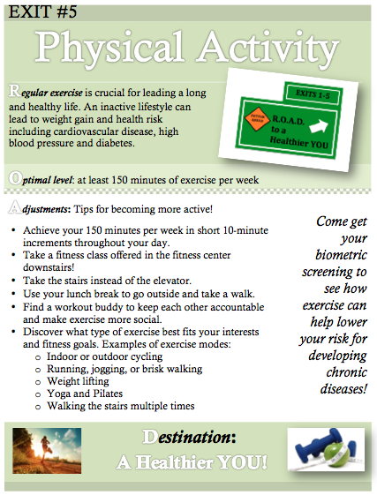
Program Overview
E-newsletter sent weekly.
Flyers hung across campus weekly.
Lifestyle tips are highlighted.
Primary goal is increased screening participation!
Notes:
LEXI:
Mention e-newsletters having link to their health portal & instructions on how to schedule a screening
this makes it easier for employees to enroll and become involved

Slide 12


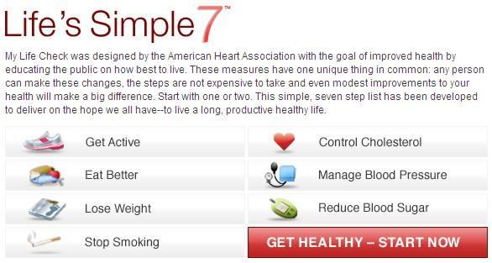
Advocacy
Notes:
https://www.apha.org/policies-and-advocacy/public-health-policy-statements/policy-database/2014/07/11/16/36/supporting-the-national-physical-activity-plan
file:///C:/Users/snh15/Desktop/Westinghouse/NationalPhysicalActivityPlan.pdf
National PA Plan Vision: “One day all Americans will be physically active and they will live, work and play in environments that facilitate regular physical activity.”
Here are examples of two organizations that are striving to increase physical activity and overall health in our population.
“The purpose of the National Physical Activity Plan is to provide a roadmap for actions that support progress in increasing Americans’ physical activity with ongoing implementation and evaluation. The plan includes recommended strategies focused on eight sectors, and each sector presents strategies aimed at promoting physical activity. The National Physical Activity Plan provides a clear roadmap for actions that support short- and long-term progress in increasing Americans’ physical activity levels with an ongoing implementation and evaluation plan. The plan is being evaluated by the Physical Activity Policy Research Network, a network of physical activity experts funded by the Centers for Disease Control and Prevention (CDC). "
Another organization focused on reducing cardiovascular disease and increasing healthy behaviors and knowledge of your health is the American Heart Association.
the AHA Simple 7’s Goal- Reducing Heart Disease
“My Life Check® was designed by the American Heart Association with the goal of improved health by educating the public on how best to live. These measures have one unique thing in common: any person can make these changes, the steps are not expensive to take and even modest improvements to your health will make a big difference. Start with one or two. This simple, seven step list has been developed to deliver on the hope we all have--to live a long, productive healthy life.”
On MyLifeCheck, you can go online, plug in your individual numbers for 7 factors and “check” how your health is, according to the AHA.

Slide 13
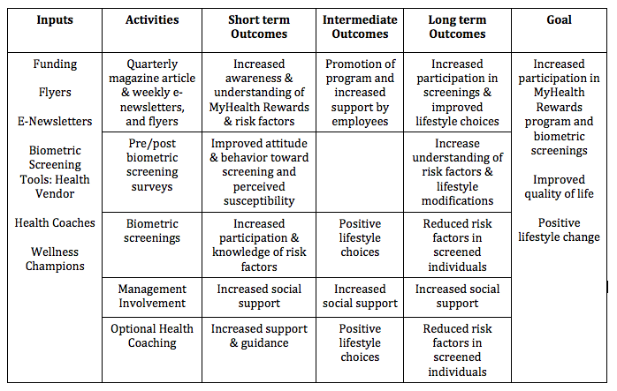
Notes:
PATRICK
Inputs: Materials and Resources for program
Activities: Use of materials and resouces
Outcomes: Work across chart for each activity. Short term, Intermediate, and Long Term for each activity
Goals: Overall goals of the program we want to reach

Slide 14
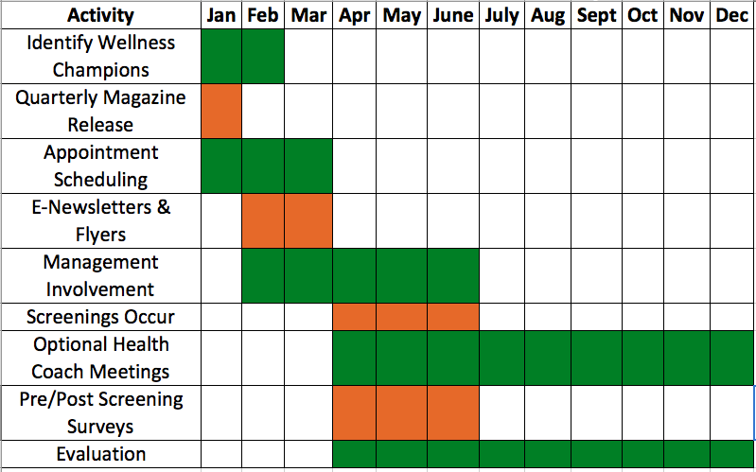
Gantt Chart
Notes:
SHARI

Slide 15
Budget
Inputs | Cost
Printing of flyers | $100
Printing of pre/post screening questionnaires | $100
Printing of quarterly magazine | $500
Salary for Program Organizer | $7,200
Bonus for Wellness Champions | $3,000 ($300 each)
Estimated Total | $10,900
Notes:
SHARI
How many wellness champions? Assumed 10!

Slide 16

Process Evaluation
Evaluation
Wellness Program Enrollment & Outcomes
Increased number of on-site biometric screenings performed.
Increased number of screened individuals who met criteria.
Reduced risk factors in screened individuals.
Notes:
PATRICK
Get more people screened and more people to meet criteria.
All goals found in logic model

Slide 17

Impact Evaluation
Evaluation
Pre & post screening surveys
Improved attitude & behavior toward biometric screenings.
Increased knowledge of metabolic syndrome risk factors.
Increased knowledge of MyHealth Rewards.
Notes:
PATRICK
Educate participants and improve attitudes to get screened.
Found in logic model.

Slide 18
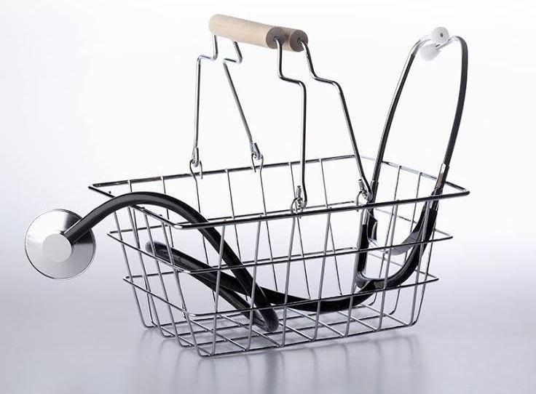
Outcome Evaluation
Evaluation
Improved overall health & quality of life of employees.
Higher enrollment in MyHealth Rewards program.
Increased knowledge about metabolic syndrome risk factors.
Higher number of employees meeting metabolic risk factor threshold.
Lowered healthcare costs.
Notes:
PATRICK
LIfestyle change in employees
Lower healthcare costs for company
Found in logic model

Slide 19
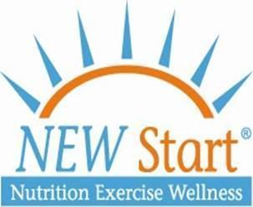
THANK YOU!
Let’s Talk!

