Slide 1
Debye – Falkenhagen theory and its computer simulation.

Slide 2
Content.
Brownian motion in the field free environment.
Brownian motion in the external harmonic potential.
Debye-Falkenhagen theory and its simulation.

Slide 3
BM in the field free environment
Run 1D BM and compare distribution of walkers with the solution of the diffusion equation.
We know that the time step is

Slide 4
BM in the external harmonic potential.
We run BM is the external field and see how the variance changes.

Slide 5
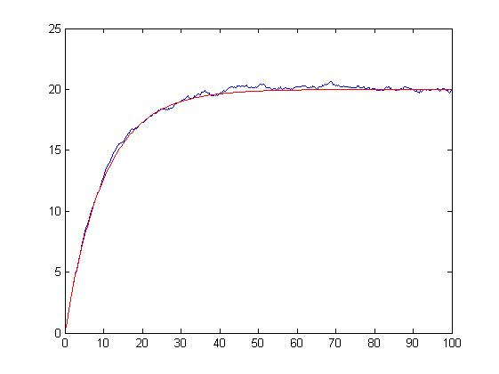
Variance. Theory vs. simulation.

Slide 6
Debye-Falkenhagen theory.
Small deviation
See reference list

Slide 7
DF theory.

Slide 8
DF theory

Slide 9
DF theory results
Equilibrium density

Slide 10
Computer simulation
Move charges on the 3D lattice using Monte-Carlo method proposed by Dr.Coalson.
New “dipole method” was used for this purpose to calculate quickly the energy difference.
OpenGL visualization was used to make the simulation more friendly.
Here comes a movie of a simulation.

Slide 11
Dipole method.
Run Poisson solver on a lattice.
Move a charge by adding a dipole.
Keep the information of each move in a data structure.
Do 2 previous steps for a number of times.
Flush the data structure and go to step 1.

Slide 12
Computer simulation
At the first stage a region of input data where the simulation must work was found.
For this purpose the simulation was run several times taking 1000 +charges and 999 –charges, 500 +charges and 499 –charges, 300 +charges and 299 –charges., etc
300 and 299 as found to be optimal and reproduced the equilibrium density obtained by DF.
We do 200000 measurements.

Slide 13
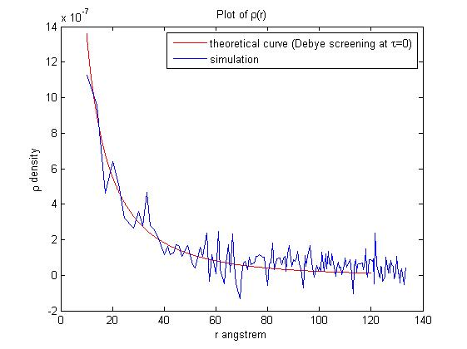
Computer simulation.

Slide 14
Computer simulation
The first stage of a simulation a number of positive and negative charges is sprinkled on the lattice. One of the charges stays fixed at the origin.
Then the system is let to relax for 10000 iterations .
Next, the central charge is removed and placed at some other lattice node according to distribution probability of charges after relaxation.
At this point we start measuring the density of charges each 2 iteration which is equivalent to some time interval.

Slide 15
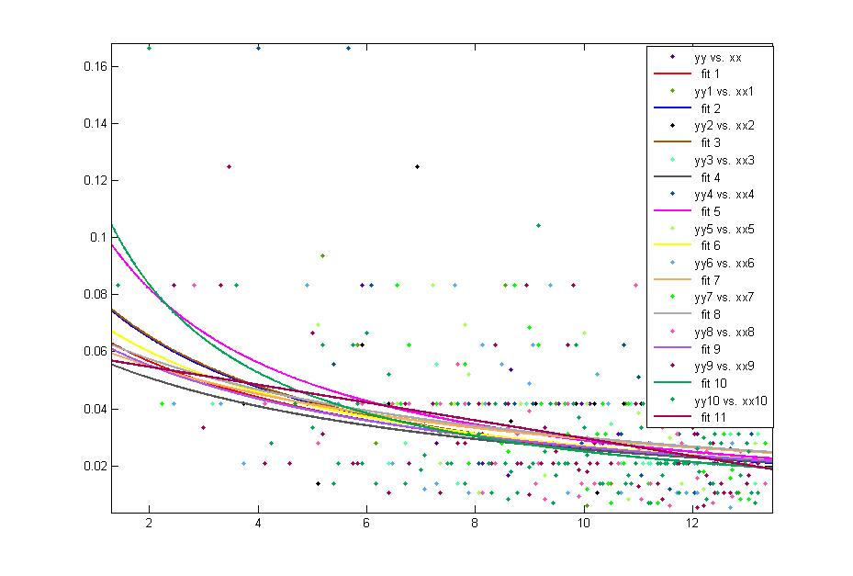
Computer simulation.

Slide 16
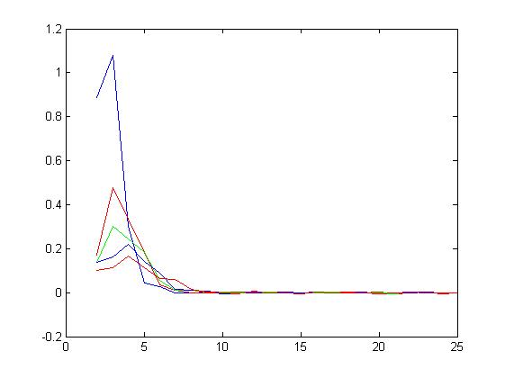
More simulations.

Slide 17
References.
Frequency dependence of the conductivity and dielectric constant of a strong electrolyte. P. Debye and H. Falkenhagen. Translated from Physikalische Zeitschrift, Vol.29, 1928, pages 121-132

