Slide 1

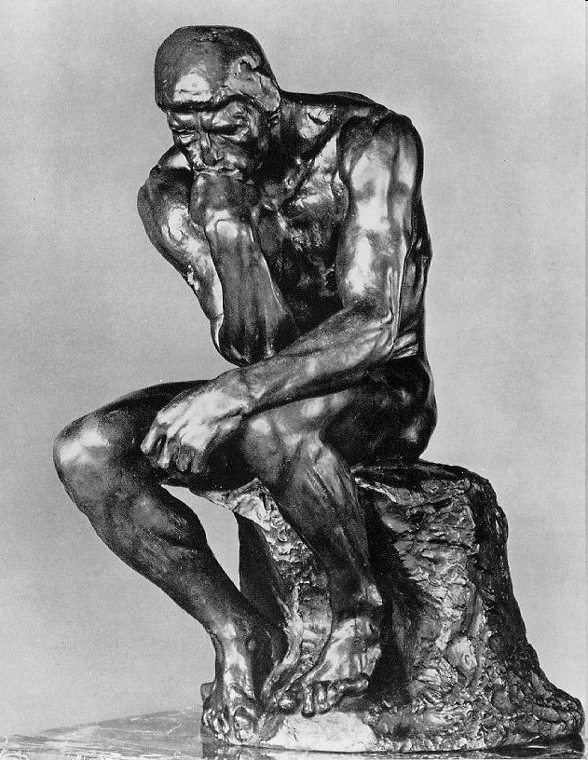
Götz Veser
Chemical Engineering Department
University of Pittsburgh

Slide 2
Syllabus/Course Objectives
Ethics is a key component of engineering education.
This section of ChE2982 aims to:
Familiarize you with different professional codes of ethics
(including AIChE, ACS, ABET) and with University Policy.
Discuss ethical conduct as graduate student and in your professional career.
Issues include plagiarism, fabrication and falsification, conflict of interest,
and assignment of credit.
Assist you in developing a personal “tool box” that will allow you to make informed decisions when ethical conflicts arise in your careers.
Prepare you to formulate, articulate, and explain your response to ethical conflicts.
Enable you to read and think critically.
And finally, to improve your writing skills in a “soft” engineering context.

Slide 3
ABET Program Outcomes
Engineering programs must demonstrate that their graduates have
Ability to apply knowledge of mathematics, science, engineering
Ability to design and conduct experiments, analyze and interpret data
Ability to design system, component, or process
Ability to function on multidisciplinary teams
Ability to identify, formulate, and solve engineering problems
An understanding of professional and ethical responsibility
Ability to communicate effectively
Broad education necessary to understand engineering impact in a global and societal context
Recognition of need for and ability to engage in life-long learning
Knowledge of contemporary issues
Ability to use techniques, skills and modern engineering tools necessary for engineering practice

Slide 4
ABET Program Outcomes: Ethics
Engineering programs must demonstrate that their graduates have
Ability to apply knowledge of mathematics, science, engineering
Ability to design and conduct experiments, analyze and interpret data
Ability to design system, component, or process
Ability to function on multidisciplinary teams
Ability to identify, formulate, and solve engineering problems
An understanding of professional and ethical responsibility
Ability to communicate effectively
Broad education necessary to understand engineering impact in a global and societal context
Recognition of need for and ability to engage in life-long learning
Knowledge of contemporary issues
Ability to use techniques, skills and modern engineering tools necessary for engineering practice

Slide 5



Why Now??
Hungarian President Resigns Amid Plagiarism Scandal; NYT, April 2, 2012
The president of Hungary, Pal Schmitt, resigned amid storm of
criticism over […]allegations of plagiarism in his 1992 doctoral
thesis. His resignation followed after the university in Budapest
stripped his doctoral degree from him a week earlier.
German defense minister quits in plagiarism scandal; CNN, 03/01/11
German Defense Minister Karl-Theodor Freiherr zu Guttenberg resigned Tuesday, in the wake of claims that he had plagiarized parts of his doctoral dissertation. Guttenberg is quitting all political posts..."
Yahoo CEO resigns over resume discrepancy; LA Times, May 14, 2012
CEO Scott Thompson steps down after a dissident shareholder calls attention to an apparent misrepresentation of his college credentials.
¹ http://www.nytimes.com/2012/04/03/world/europe/hungarian-president-pal-schmitt-resigns-amid-plagiarism-scandal.html; accessed on 09/18/12
² http://articles.cnn.com/2011-03-01/world/germany.politics_1_defense-minister-plagiarism-scandal-guttenberg; accessed on 09/18/12
³ http://articles.latimes.com/2012/may/14/business/la-fi-yahoo-thompson-resigns-20120514; accessed on 09/18/12

Slide 6




This Summer In Business News
The pace is accelerating (at least in business…)
07/17/18: Texas Instruments CEO Bryan Cutcher resigns
because of personal behavior that violated the company's code
of conduct.
07/05/18: E.P.A. Chief Scott Pruitt resigns under
a cloud of ethics scandals (too many to list here…)
07/03/18: Barnes & Noble fires CEO Demos Parneros.
B&N did not announce a specific reason for the firing
(“for violating company policies”).
06/21/18: Intel CEO Brian Krzanich resigns
after the company learned of a "past consensual
relationship with an Intel employee."

Slide 7

Project & Grading
See also: http://www.pitt.edu/~gveser/Ethics
‘Ethics Project’ - form teams of ~3 students
  Research ethical issues for your (desired) graduate
  project; approach the topic from as many angles as
  you can think of:
  ethical issues during your graduate studies, as
  professional engineer working in the respective
  industry, as law-maker on this topic, as engineer
  approaching the public, etc.
  Apply & reflect what we discussed in the course!
  Write a report summarizing and discussing these issues: ~5-8 pages in length
  (11 pt Times or similar font, 1.5 line spacing, US letter-size, 1” margins). References, figures, and tables do not count towards the page limit.
  Prepare a 15 min. oral presentation on your topic. All presentations will be given during class time (the schedule will be posted on the course webpage in due time). Each presentation will be followed by a brief open discussion.
Grading: 30% class participation, 35% oral presentation, and 35% written report.

Slide 8
Ethics Project
Please form your groups by next Wednesday, 09/04.
(Please email group member names to gveser@pitt.edu by the start of class.)
Decide on your topic by Wednesday, 10/02.
(Please email topic to gveser@pitt.edu by the start of class.)

Slide 9

Some Helpful Resources
“Engineering Ethics: Concepts and Cases”,
Ch. E. Harris, M. S. Pritchard, M. J. Rabins, Wadsworth Publishing; 3rd ed., 2004.
“Engineering Ethics: An Industrial perspective”, Gail Dawn Baura, Elsevier, 2006.
“On Being a Scientist: Responsible Conduct in Research”,
National Academy Press, Washington, DC, 2nd ed., 1995;
online available at http://www.nap.edu/openbook.php?record_id=4917
“The Online Ethics Center for Engineering and Science”,
http://onlineethics.org/index.html
“Center for the Study of Ethics in the Professions”,
http://ethics.iit.edu/index.html

Slide 10
ChE 2982
http://www.pitt.edu/~gveser/Ethics
Lecture I:
Foundations

Slide 11
Why bother with ‘Foundations’?
“ To become skilled in any domain of reasoning,
we must understand the principles that define that domain.
To be skilled in mathematical reasoning, we must understand fundamental mathematical principles. To be skilled in scientific reasoning, we must understand fundamental scientific principles.
In like manner, to be skilled in ethical reasoning, we must understand fundamental ethical principles.
Good-heartedness is not enough. We must be well-grounded in fundamental ethical concepts and principles.”
(R. Paul, L. Elder, “Critical Thinking”, Prentice Hall, 2002)

Slide 12
What is ‘Ethics’?
Branch of philosophy concerned with the nature of ultimate value and the standards by which human actions can be judged right or wrong. (Encycl. Britannica)
A system or code of morals of a particular religion, group, or members of a profession.

Slide 13
Ethics Defined…
In ethics, philosophers ask questions about morality and immorality,
about what humans should, and should not, do (‘human conduct’).
Contrast the following ethical questions, with questions from daily life:
Daily life: Is it right for me to eat all the cookies?
Ethics: Is selfishness ever right?
Daily life: What are the instructor's rules?
Ethics: What is the source of moral values?
Daily life: Should I falsify this data to make it fit the required specifications?
Ethics: Should anyone ever lie?
In daily life, when we are concerned with morality, we ask particular questions about individuals or events.
In ethics, we ask universal questions about what is right or wrong for anyone.

Slide 14
Ethics versus Morality
Some people distinguish ethics, what is right or wrong based on reason, from morals, what is considered right or wrong behavior based on social custom.
For the purpose of this class, we will not make this (somewhat artificial) distinction, but will use the terms interchangeably.
In fact, ‘ethics’ stems from the greek ‘ethos’ (εθωσ),
which means ‘customs’ or ‘habits’.
‘Morality’ stems from the latin ‘mores’, which means…
…exactly the same.

Slide 15

Ethics – Central Questions I
What is the source of moral values?
Here are three (of many) possible answers:
Moral values come from God.
This implies that genuine moral values are unchanging and universal.
What is right, has always been right; what is wrong, has always been wrong. God's laws apply to everyone, in all cultures. This is called moral absolutism.
Moral values come from societies.
In this view, moral values can legitimately vary from culture to culture. Each society can have its own standards of ethical behavior, which may change over time. This is hence called moral relativism.
Moral values are determined by an individual's pleasure or pain.
In this view, actions are right if they make people feel good, and wrong if they make people feel bad. God's commandments and society's laws are less important than individual human sensations. This is also called hedonism.

Slide 16
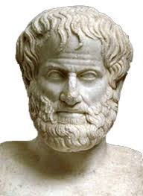
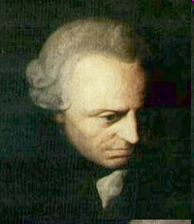
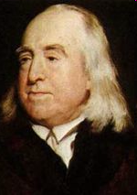
Ethics – Central Questions II
What determines the moral value of an action or person?
Three (of several) possible answers:
Moral character (“Virtue Ethics”)
In this view, it is the entire character of the person and the way they
lead their life, not just any specific action, that matter.
Aristotle is one of the best known proponents of this view.
Moral obligations (“Deontological or Duty Ethics”)
Obligations to other people should determine our actions.
Well-known example: Kant’s Categorical Imperative
(“Act only according to that maxim by which you can at the
same time will that it should become a universal law.”)
Consequences of actions (“Consequentialism or Teleological E.”)
An action is morally right if the consequences of that action are more
favorable than unfavorable.
Closely linked w/Utilitarianism (Bentham & Mill).

Slide 17
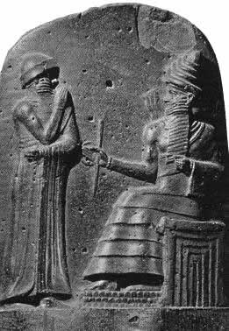
The ‘Ethical Toolbox’:
Ultra-Short History of Ethical Theories
Virtually every human society has some form of myth to explain the origin of morality.
Babylonian column in the Louvre in Paris shows the sun god Shamash presenting the code of laws to Hammurabi (died
c. 1750 BC), known as the Code of Hammurabi.
Old Testament: God gives the Ten Commandments to Moses
on Mount Sinai (~ 14th–13th century BC).
In the dialogue Protagoras, Plato (428–348 BC) gives a mythical account of how Zeus took pity on the hapless humans, who were physically no match for the other beasts.
To make up for these deficiencies, Zeus gave humans a moral sense and the capacity for law and justice, so that they could live in larger communities and cooperate with one another.

Slide 18
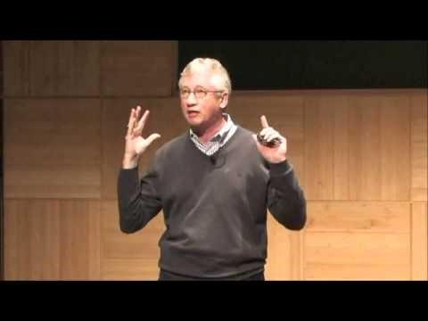
The ‘Ethical Toolbox’:
Ultra-Short History of Ethical Theories
In the dialogue Protagoras, Plato (428–348 BC) gives a mythical account of how Zeus took pity on the hapless humans, who were physically no match for the other beasts.
To make up for these deficiencies, Zeus gave humans a moral sense and the capacity for law and justice, so that they could live in larger communities and cooperate with one another.
Notes:
https://youtu.be/meiU6TxysCg

Slide 19
Moral Absolutism
Moral absolutism is the view that ethical values have a source that is independent of individual humans and society. Thus, ethical values come from God, or nature, or any other source independent of the changing human world. All known early forms of ethics are in this category.
Assume you are a Christian moral absolutist. From your point of view, the Ten Commandments are perfect, god-given laws which all humans, in all times and places, ought to obey.
Just as the law of gravity is absolute, and applies to everyone, so the Ten Commandments are absolute and apply to everyone. Just as the law of gravity wasn't created by any culture or any individual but is built into the structure of the universe, so Christian moral laws aren't created by any culture or individual, but are built into the structure of reality.
In this view, moral laws are as universal as principles of physics.

Slide 20
Early Indian Ethics – the Vedas
In one of the oldest Indian writings (~1500 BC), the Vedas,
ethics is an integral aspect of philosophical and religious speculation about the nature of reality. They have been described as the oldest philosophical literature in the world.
In the Vedic philosophy, the basic principle of the universe, the ultimate reality on which the cosmos exists, is the principle of Ritam (from which the Western notion of right is derived).
There is thus a belief in a right moral order somehow built into the universe itself. Hence, truth and right are linked; to understand the ultimate truth of human existence is to understand what is right. To be an enlightened person is to know what is real and to live rightly, since this is one and the same.

Slide 21
Problems w/ Moral Absolutism
It requires acceptance of the source of ethics (god, “nature”, …).
An atheist, for example, would not be able to accept a Christian Moral Absolutism (nor would generally do other religions).
What are the ethical values that the ‘source’ commands?
Who determines these? What are the guidelines for everyday life?
Where does the morality of this ‘source’ come from?
If there are independent of the ‘source’, it contradicts the premise of this being the ‘source’. If they are determined simply by the ‘source’s’ likes and dislikes, it creates an uncomfortably arbitrary element
(could God also just have determined that murder is OK if he wished so?)

Slide 22
Moral Relativism
Moral relativism is the view that ethical values
are determined by individuals and/or by human societies.
In this view, what is morally right for one person may be morally wrong for another, or that what is right in one culture may be wrong in another culture.
Moral values are nothing but what individuals, or societies, decide they should be. Moral values do not come from on ‘higher sources’, they are created by humans and their cultures.
Problems with Moral relativism include:
  A sense that ethics is debatable, hence may not have to be adhered.
  Confusion about which ethics are applicable (majority vs minorities, etc).
  Conflicting moral values in different cultures.
  Particularly of concern in a “Globalized World”!

Slide 23
Moral Absolutism vs Relativism
Moral absolutism and moral relativism are (obviously…) opposites.
If you are a moral absolutist, then you hold that a single set of moral values applies to all humans.
For example, you might hold that the Ten Commandments are moral absolutes which apply to everyone.
If you are a moral relativist, then you hold that moral values are determined by, or relative to, individual humans or cultures.
In some forms of moral relativism, you might still hold that the Ten Commandments could be a correct set of moral guidelines for Christians, but not necessarily for Muslims, Hindus, or Atheists.

Slide 24
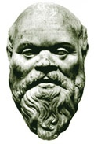
(Ancient) Greek Ethics
Western philosophy has been said to consist essentially of
nothing but footnotes to Plato (c. 427–c. 347 BC)…
The central issue around which all of Western ethics has
revolved can be traced to the debate between
  the Sophists, who claimed that goodness and justice are relative to the customs of each society — or that they are even merely a disguise for the interest of the stronger, and
  the Platonists, who maintained the possibility of knowledge of an objective form of the Good.
But even if one could know what goodness or justice is, why should one act justly if one could profit by doing the opposite? Even if one accepts that goodness is something objective, it does not follow that one has a sufficient reason to do what is good. One would have such a reason if it could be shown that goodness or justice leads, at least in the long run, to happiness.

Slide 25
Plato’s Ethics (101…)
According to Plato, justice exists in the individual when the three elements of
the soul—intellect, emotion, and desire—act in harmony with each other.
The unjust person lives in an unsatisfactory state of internal discord, trying always to overcome the discomfort of unsatisfied desire but never achieving anything better than the mere absence of want. The soul of the just person,
on the other hand, is harmoniously ordered under the governance of reason, and the just person derives truly satisfying enjoyment from the pursuit of knowledge.
Plato remarks that the highest pleasure, in fact, comes from intellectual speculation. He also proposes that the human soul is immortal; and will be rewarded by the gods in the next life. Hence, Plato asserts that we should act justly because in doing so we are “at one with ourselves and with the gods.”

Slide 26
Utilitarianism
Jeremy Bentham (1748–1832): Father of modern utilitarianism.
Based on the proposition that humans serve two masters: pleasure and pain.
Anything good must be either directly pleasurable or be a means to pleasure
or to the avoidance of pain.
To weigh the consequences of an action and decide whether it is right or wrong,
one must take account of the pleasures and pains of everyone affected by the action, and do so on an equal basis: “Each to count for one, and none for more than one.”
(At a time when Britain had a major trade in slaves, this was a radical suggestion; Bentham even explicitly extended consideration to animals.)
One must also consider how certain or uncertain the pleasures and pains are, their intensity, how long they last, etc.
Bentham did not allow for distinctions in the quality of pleasure or pain as such. Referring to a popular game, he affirmed that “quantity of pleasure being equal, pushpin is as good as poetry.”
This view was modified by John Stuart Mill (1806–73). He introduces a distinction between pleasures of higher and lower quality: it is “better to be Socrates dissatisfied than a fool satisfied.” The fool, he argued, would be of a different opinion only because he has not experienced both kinds of pleasures.

Slide 27
Problems w/ Utilitarianism
It is very difficult to
measure happiness and compare happiness of different people
(let alone different species…)
weigh matters of life and death by weighing happiness vs suffering
distinguish morally justified from unjustified emotions
(is a happy thief sign for a ‘good’ theft?)
Finally, utilitarianism can lead to the (apparent) justification of actions that most of us would consider immoral. For example, if public hanging of an innocent person could be shown to act as a deterrent and hence reduce violent crime, it would be the morally right thing to do according to a strict utilitarian viewpoint.

Slide 28
Immanuel Kant (1724 –1804)
Kant is regarded as one of the most influential thinkers
of modern Europe and the last major philosopher of the
Enlightenment.
(Amazingly, Kant never left his hometown of Königsberg
(East Prussia) throughout his long life, by some accounts
never traveling further than 100 miles from it!)
Kant insisted that actions resulting from desires cannot be free.
Freedom is to be found only in rational action.
Moreover, whatever is demanded by reason must be demanded of all rational beings; hence, rational action cannot be based on an individual's personal desires but must be in accordance with a universal law.
Kant's most distinctive contribution to ethics was his insistence that
one's actions possess moral worth only when one does his duty for its
own sake.

Slide 29
Kant’s Imperatives
Kant's ethics is based on his distinction between hypothetical and categorical imperatives.
Actions based on desires are hypothetical imperatives.
For example, “Be honest, so that people will think well of you!” is an imperative that applies only if one wishes to be thought well of.
In contrast to such approaches, Kant said that the commands of morality must be categorical imperatives: they must apply to all rational beings, regardless of their wants and feelings.
To most philosophers this posed an insurmountable problem: a moral law that applied
to all rational beings, irrespective of their personal wants and desires, could have no specific goals or aims, because all such aims would have to be based on someone's wants or desires.
Kant turned this problem into its own solution: Because nothing else but reason is left to determine the content of the moral law, the only form this law can take is the universal principle of reason. Thus, the supreme formal principle of Kant's ethics is:
“Act only on that maxim through which you can at the same time will that it
should become a universal law.”

Slide 30
Problems w/ Kant’s Ethics
Many people feel uncomfortable with Kant completely
dismissing emotions as irrelevant for ethics (pure “duty ethics”). They consider some emotions – such as compassion, empathy, guilt, and remorse – as distinctly ethical emotions.
The main criticism is typically associated with the lack of accountability for the consequences of actions.
Kant’s ethics is heavily weighted towards the intentions of the action, i.e. it is a ‘deontological ethics’. (Kant does, however, regard some kinds of incompetence culpable!)

Slide 31

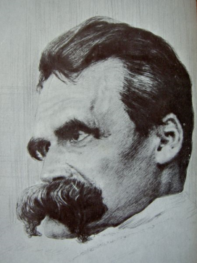
Modern Ethics: Environmental E.
Environmental issues raise many ethical questions,
including the ancient question of the nature of intrinsic value.
  Why it is so bad if dodoes become extinct or a rainforest is
  cut down? Are these things to be regretted only because of
  the experiences that would be lost to humans?
  Do trees, rivers, species, and whole ecosystems have value
  independent of the instrumental value they may have for humans or animals?
  What should the basis for this value be?
“Even using the yardstick of the ancient Greeks, our whole
modern existence is nothing but hubris and godlessness….
Hubris today characterizes our whole attitude towards nature,
our rape of nature with the help of machines and the completely
unscrupulous inventiveness of technicians and engineers.”
Friedrich Nietzsche, On the Genealogy of Mortality.

Slide 32
Modern Ethics: Environmental E.
Concern for the environment also raises the question of obligations to future generations. How much do human beings living now owe to those not yet born?
  For example, utilitarians would not think that the fact that members of future generations do not yet exist justifies giving less consideration to their interests than to the interests of present generations — provided that one can be certain that the interest of future generations will be affected by what one does.
  In the case of, say, the storage of radioactive waste, it seems clear that our actions will indeed affect the interests of generations to come. In other cases, this might be more debatable.
Climate change in particular has also been conceived of as a question of
global equity:
  How much of a scarce resource (for example, the capacity of the ecosphere to buffer waste gases produced by human activity) may each country use?
  Are industrialized countries justified in using far more of this resource, on a per capita basis, than developing countries?

Slide 33
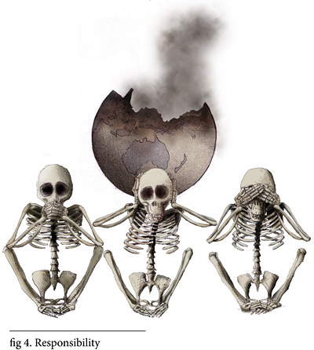



Ethics & Sustainability
http://www.ethics.org.au/resources/ img/general-content/illustrations/ LE60-responsibility.jpg
Environmental Ethics has had a formative impact
on the modern movement towards ‘sustainability’.
The World Commission on Environment and Development (WCED) was convened by the United Nations in 1983 to address growing concern "about the accelerating deterioration of the human environment and natural resources and the consequences of that deterioration for economic and social development."
In establishing the commission, the UN General Assembly recognized that environmental problems were global in nature and determined that it was in the common interest of all nations to establish policies for sustainable development.
"Sustainable development is development that meets the needs of the present without compromising the ability of future generations to meet their own needs."
(Report of the Brundtland Commission, “Our Common Future”, Oxford U. Press, 1987 )

Slide 34
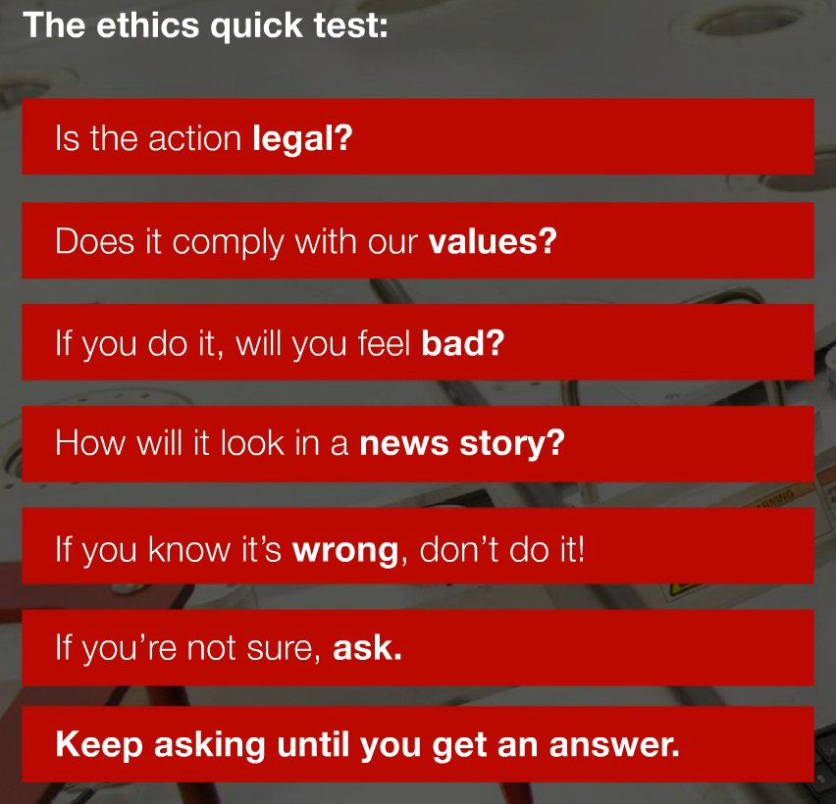

The TI “Ethics Quick Test”
This information is provided to TI employees on a business-card size mini-pamphlet to carry with them.
(from: http://www.ti.com/corp/docs/company/flipbooks/code/)

