Slide 1
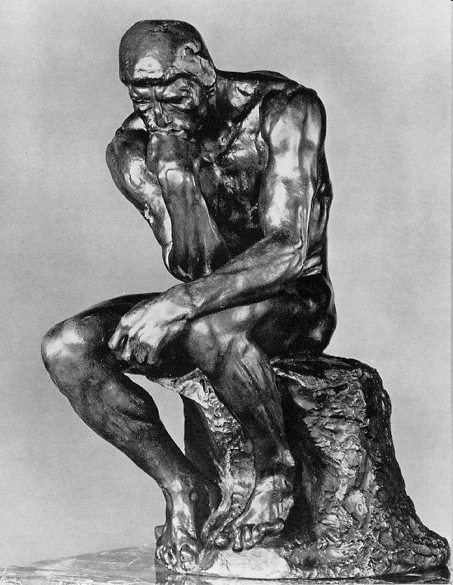
ChE 2982
Engineering Ethics
Instructor: Götz Veser
Lecture II:
Professional Codes of Ethics

Slide 2
Ethics Project
Email with group member names was due today!
Decide on your topic by next Wednesday, 09/27.
(Please email topic to gveser@pitt.edu by the start of class.)

Slide 3
Why Professional Codes of Ethics?
Codes of ethics increase the probability that people will behave in certain ways, by focusing on the character of their actions and by focusing on sanctions for violations. In addition, reliance on codes can reduce the sacrifice involved in an ethical act.
Good ethics codes can focus people on actions that result in doing the right things for the right reasons. Ethical behavior should become a habit; effective codes allow employees to test their actions against expected standards.
Codes of ethics can function as a professional statement.
They give a person joining a profession a clear set of values to which they are expected to subscribe. (Not all individuals may be comfortable with the expectations, and codes can clarify expectations).
Codes can help provide the pride of belonging to a group or a profession. Pride is a critical emotion in motivating individuals to see themselves as professional.
From: “Ethics Codes and Codes of Conduct as Tools for Promoting an Ethical and Professional Public Service”,
Stuart C. Gilman, Report for the World Bank, Washington DC, 2005

Slide 4
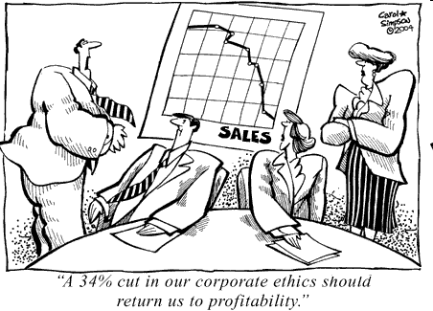
Professional/Business Ethics…
Who is a company supposed to ‘serve’:
Customers
Employees
Owner/Shareholders
Stakeholders
The country it is based or
headquartered in.
Mankind
(past – present – future)
www.cartoonwork.com/ archive/CEO/Cut-Ethics.gif

Slide 5
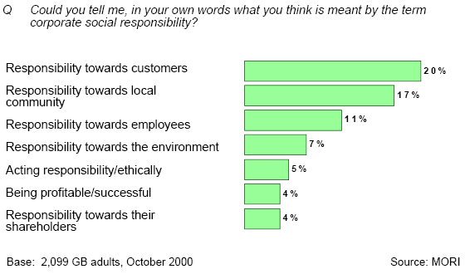
CSR in the View of the Public

Slide 6
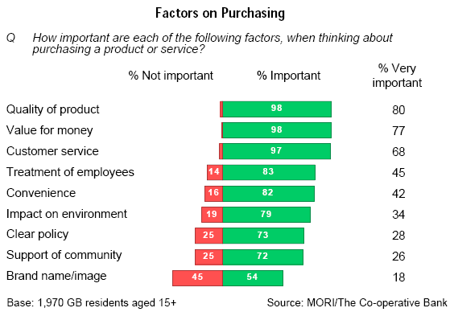
Why should a business even care??

Slide 7
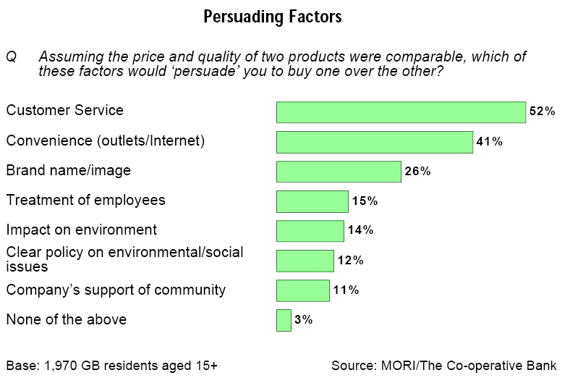
Let’s remove Price & Quality..
Compare to the ranking on the previous slide…

Slide 8





Major Professional Codes of Ethics
National Society of Professional Engineers (NSPE):
http://www.nspe.org/ethics/eh1-code.asp
American Institute of Chemical Engineers (AIChE):
http://www.aiche.org/About/Code.aspx
Accreditation Board for Engineering and Technology (ABET)
http://ethics.iit.edu/codes/coe/abet-a.html
Biomedical Engineering Society (BMES)
http://www.bmes.org/pdf/2004ApprovedCodeofEthicsShortForm.pdf
American Chemical Society (ACS)
http://www.chemistry.org/portal/a/c/s/1/acsdisplay.html?
DOC=membership%5Ccode.html
(The ‘Center for the Study of Ethics in the Professions’ (Illinois Institute of Technology) lists an extensive catalogue of several hundreds codes of ethics on their webpage: http://ethics.iit.edu/codes/codes_index.html )

Slide 9
ABET – Code of Ethics of Engineers
The Fundamental Principles
Engineers uphold and advance the
integrity, honor and dignity of the engineering profession by:
using their knowledge and skill for the enhancement of human welfare;
being honest and impartial, and serving with fidelity the public, their employers and clients
striving to increase the competence and prestige of the engineering profession; and
supporting the professional and technical societies of their disciplines.

Slide 10
Who are the groups
to be benefited in the
ABET Code of Ethics?

Slide 11
ABET – Code of Ethics of Engineers
The Fundamental Principles
Engineers uphold and advance the
integrity, honor and dignity of the engineering profession by:
using their knowledge and skill for the enhancement of human welfare;
being honest and impartial, and serving with fidelity the public, their employers and clients
striving to increase the competence and prestige of the engineering profession; and
supporting the professional and technical societies of their disciplines.

Slide 12
ABET – Code of Ethics of Engineers
The Fundamental Canons
Engineers shall hold paramount the safety, health and
welfare of the public in the performance of their professional duties.
Engineers shall perform services only in the areas of their competence.
Engineers shall issue public statements only in an objective and truthful manner.
Engineers shall act in professional matters for each employer or client as faithful agents or trustees, and shall avoid conflicts of interest.
Engineers shall build their professional reputation on the merit of their services and shall not compete unfairly with others.
Engineers shall act in such a manner as to uphold and enhance the honor, integrity and dignity of the profession.
Engineers shall continue their professional development throughout their careers and shall provide opportunities for the professional development of those engineers under their supervision.

Slide 13
Ethical Problems in ChE:
Case Studies
“Chemical Engineering”, a major trade journal in ChemE, printed an ethics survey in its April 2007 edition. It consists of six “case studies” in which the reader is supposed to take a decision.
Results of the survey will be published in the Sept. 2007 issue (delayed until Oct. ’07…).

Slide 14
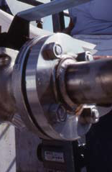
Case#1: “Just This Once”
(Source: Chemical Engineering, April 2007)
Albert is supposed to perform one final batch run at his multipurpose pilot plant before shutting down the unit for good. The reaction involves the use of an extremely toxic chemical that can also ignite spontaneously in air. It is Friday afternoon; the test results from the pilot plant are needed by his superiors the following Monday in order to bid on a project involving a large sum of money. After cleaning the reactor vessel from the previous batch, Albert begins to reconnect the flanges when he discovers that there is no replacement available for a critical gasket; the procedure for this particular reaction specifies that the gasket not be used a second time due to the hazards involved. Because its Friday afternoon, there’s no chance of obtaining another gasket until the following week. On the other hand, Albert knows from experience (involving less-hazardous reactants) that this type of gasket can often be used more than once without leaking.
Should Albert (check one):
Finish the pilot test, using the old gasket on the basis that it will
probably not leak?
Order a new gasket, send the assistants home early and mail an email to
the superiors explaining that the test will have to be postponed until a
new gasket is available?
Skip the test completely and extrapolate (fudge) the existing data to
make up for the missing data?

Slide 15

AIChE – Code of Ethics
(Revised January 17, 2003)
Members of the American Institute of Chemical Engineers shall uphold and advance the integrity, honor and dignity of the engineering profession by: being honest and impartial and serving with fidelity their employers, their clients, and the public; striving to increase the competence and prestige of the engineering profession; and using their knowledge and skill for the enhancement of human welfare.
To achieve these goals, members shall
Hold paramount the safety, health and welfare of the public and protect the environment in
performance of their professional duties.
Formally advise their employers or clients (and consider further disclosure, if warranted) if they
perceive that a consequence of their duties will adversely affect the present or future health or
safety of their colleagues or the public.
Accept responsibility for their actions, seek and heed critical review of their work and offer
objective criticism of the work of others.
Issue statements or present information only in an objective and truthful manner.
Compare this to ABET’s code…
…a case of plagiarism??
http://www.aiche.org/About/Code.aspx

Slide 16
AIChE – Code of Ethics (cont’d)
Act in professional matters for each employer or client as faithful agents or trustees,
avoiding conflicts of interest and never breaching confidentiality.
Treat fairly and respectfully all colleagues and co-workers,
recognizing their unique contributions and capabilities.
Perform professional services only in areas of their competence.
Build their professional reputations on the merits of their services.
Continue their professional development throughout their careers,
and provide opportunities for the professional development of those
under their supervision.
Never tolerate harassment.
Conduct themselves in a fair, honorable and respectful manner.
http://www.aiche.org/About/Code.aspx

Slide 17
How are the
AIChE and the ABET
Code of Ethics
different?

Slide 18
Case#2: “To Err Is Human”
(Source: Chemical Engineering, April 2007)
Emmily is the plant manager of a facility in which organic syntheses are performed.
In one of the operations, an aqueous solution of sodium cyanide is reacted with another material to form the desired end-product. One night, on the midnight shift, an error is made, and too much cyanide is added to the water. There is not enough room in the mix tank to make an adjustment, so the shift foreman has the tank emptied into drums and starts another batch. Two weeks later, there is a lull in production, and the dayshift foreman decides to use the time in reworking the erroneous cyanide batch. No one can find the drums that the batch should be in. Upon questioning the night foreman, Emmily finds that the batch has been illegally dumped into the sanitary sewer, rather than saved in drums as dictated by the company policy. Emmily severely disciplines the nightshift foreman for his action. Upon making discreet inquires of friends at the sewage plant, the health department and the river-monitoring authorities, Emmily finds that no apparent harm resulted from the dumping.
Should Emmily (check one):
Inform government authorities about the incident, as required by law,
even though no apparent harm resulted?
Keep the incident quiet (in violation of the law) since no harm resulted,
the foreman has been punished, and a report would only cause trouble
for the company, without doing the public any good?
Let the corporate management make the decision?

Slide 19
ACS Chemist's Code of Conduct
Chemists Acknowledge Responsibilities To:
The Public
Chemists have a professional responsibility to serve the public interest and welfare and to further knowledge of science. Chemists should actively be concerned with the health and welfare of co-workers, consumers and the community. Public comments on scientific matters should be made with care and precision, without unsubstantiated, exaggerated, or premature statements.
The Science of Chemistry
Chemists should seek to advance chemical science, understand the limitations of their knowledge, and respect the truth. Chemists should ensure that their scientific contributions, and those of the collaborators, are thorough, accurate, and unbiased in design, implementation, and presentation.
The Profession
Chemists should remain current with developments in their field, share ideas and information,
keep accurate and complete laboratory records, maintain integrity in all conduct and publications, and give due credit to the contributions of others. Conflicts of interest and scientific misconduct, such as fabrication, falsification, and plagiarism, are incompatible with this Code.
The Employer
Chemists should promote and protect the legitimate interests of their employers, perform work honestly and competently, fulfill obligations, and safeguard proprietary information.

Slide 20
ACS Chemist's Code of Conduct
Chemists Acknowledge Responsibilities To (Cont’d):
Employees
Chemists, as employers, should treat subordinates with respect for their professionalism and concern for their well-being, and provide them with a safe, congenial working environment,
fair compensation, and proper acknowledgment of their scientific contributions.
Students
Chemists should regard the tutelage of students as a trust conferred by society for the promotion of the student's learning and professional development. Each student should be treated respectfully and without exploitation.
Associates
Chemists should treat associates with respect, regardless of the level of their formal education, encourage them, learn with them, share ideas honestly, and give credit for their contributions.
Clients
Chemists should serve clients faithfully and incorruptibly, respect confidentiality, advise honestly, and charge fairly.
The Environment
Chemists should understand and anticipate the environmental consequences of their work. Chemists have responsibility to avoid pollution and to protect the environment.

Slide 21
How is the
ACS code of ethics
different from the
AIChE & ABET codes of ethics?

Slide 22
Case#3: “Just a Pinch of Poison”
(Source: Chemical Engineering, April 2007)
Jeremy’s company has been using a flavor additive in one of its products, but there have been problems with the flavor’s stability. One of Jeremy’s chemists accidentally finds that the flavor can be stabilized by adding a mixture of tin and lead salts in very small quantities. This product enhancement would likely increase sales and profits. Although both the lead and tin are recognized poisons, the chemist points out that the amounts added are no more than might be leached out from the soldered seams of common tin cans used for a multitude of food products. The new product will be packaged in glass, so no further addition of heavy metals will occur.
Should Jeremy (check one):
Report his findings, but recommend that the additive not be used,
because it is unethical to add poison no matter what the quantity?
Prevent any further consideration of this dilemma by suppressing the
findings?
Recommend the open use of this heavy-metals-stabilized additive?
Recommend that it be used, but that the deliberate addition of heavy
metals be considered a trade secret, and be kept from leaking to the
public because it would only cause unnecessary worry?

Slide 23
BMES Code of Ethics
Biomedical engineering is a learned profession that combines expertise and responsibilities in engineering, science, technology, and medicine. Mindful that public health and welfare are paramount considerations in each of these areas, the Society identifies in this Code principles of ethical conduct in professional practice, health care, research, and training.. This Code reflects voluntary standards of professional and personal practice recommended for biomedical engineers.
Biomedical Engineering Professional Obligations
Biomedical engineers in the fulfillment of their professional engineering duties shall:
1. Use their knowledge, skills, and abilities to enhance the safety, health, and
welfare of the public.
2. Strive by action, example, and influence to increase the competence, prestige,
and honor of the biomedical engineering profession.

Slide 24
BMES Code of Ethics (Cont.)
Biomedical Engineering Health Care Obligations
Biomedical engineers involved in health care activities shall:
1. Regard responsibility toward and rights of patients, including those of confidentiality
and privacy, as a primary concern.
2. Consider the broader consequences of their work in regard to cost, availability, and
delivery of health care.
Biomedical Engineering Research Obligations
Biomedical engineers involved in research shall:
1. Comply fully with legal, ethical, institutional, governmental, and other applicable
research guidelines, respecting the rights of and exercising the responsibilities to
human and animal subjects, colleagues, the scientific community and the general public.
2. Publish and/or present properly credited results of research accurately and clearly.
Biomedical Engineering Training Obligations
Biomedical engineers entrusted with the responsibilities of training others shall:
1. Honor the responsibility not only to train biomedical engineering students in proper
professional conduct in performing research and publishing results,
but also to model such conduct before them.
2. Keep training methods and content free from inappropriate influence of special interests..

Slide 25
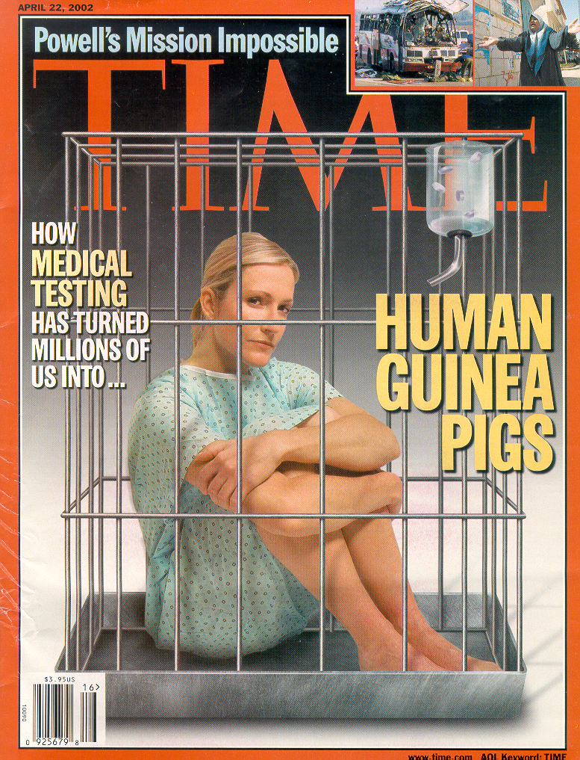
The Dilemma Of Bioengineering
Research on Human Subjects
“Make the rules protecting patients too lax, and subjects will suffer and even die needlessly. Make them too strict, and lifesaving medications won’t make it out of the lab quickly enough to help the people who need them most.”
(Time, April 22, 2002)

Slide 26
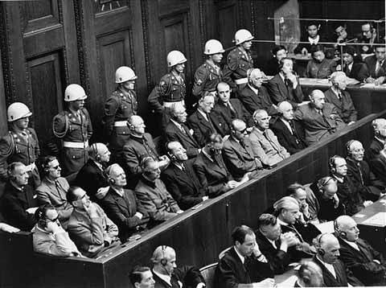
Nuremberg Code (1947)
“ethical yardstick against which
defendants were judged”:
informed consent
risk & benefit (equipoise)
subject can terminate her/his involvement
experiment should be based upon prior animal studies
only scientifically qualified individuals should conduct human experimentation
physical and mental suffering and injury should be avoided
there should be no expectation that death or disabling injury will occur from the experiment

Slide 27
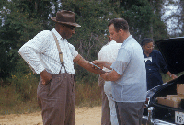
USPHS Study of Syphilis
1932: Started as a short study (6-8 months) with 600 black males (400 with, 200 w/o syphilis)
Free medical examinations
Not told of their disease
not treated even after penicillin
become ‘drug of choice’ in ‘47
Study continued for 40 years…
(http://www.cdc.gov/tuskegee/timeline.htm)

Slide 28
USPHS Study of Syphilis
(http://www.cdc.gov/tuskegee/timeline.htm)
July 1972, Ad Hoc Advisory Panel is
formed after an AP story caused a public outcry.
The panel had nine members from medicine, law, religion, labor, education, health administration, and public affairs.
Panel conclusion: Tuskegee Study was "ethically unjustified“ -- the knowledge gained was sparse compared with the risks for the subjects.
October 1972: panel advised stopping the study at once.
A month later, the Assistant Secretary for Health and Scientific Affairs announced the end of the Tuskegee Study.
“The United States government did something that was
wrong – deeply, profoundly, morally wrong.”
President Clinton’s apology, May 16th, 1997

Slide 29


…and it hits closer to home…
“President’s Bioethics Commission Concludes Investigation into 1940s
STD Experiments in Guatemala”; http://bioethics.gov/cms/node/280
John C. Cutler, former assistant U.S. surgeon general and an acting dean of Pitt’s School of Public Health (1968-69) led a study in which >1,000 Guatemalan prisoners, mental patients, soldiers and prostitutes were intentionally infected with syphilis from 1946-48, some of whom died.
He was also a lead investigator in the Tuskagee study in the 1940s and 50s.
Cutler also established health projects in West Africa and several “3rd World nations” and took on such missions as organizing a program that brought obstetricians from poor countries to the U.S. for training. He was a well-regarded instructor both at Pitt's Graduate School of Public Health and at the Graduate School of Public and International Affairs.
(image: Post-Gazette)
“It is important that we accurately document this clearly unethical historical injustice. We do this to honor the victims. In addition, we must look to and learn from the past so that we can assure the public that scientific and medical research today is conducted in an ethical manner. Research with human subjects is a sacred trust. Without public confidence, participation will decline and critical research will be stopped. It is imperative that we get this right.”

Slide 30
Case#4: “The Christmas Gift”
(Source: Chemical Engineering, April 2007)
Tracey is in a position to influence the selection of suppliers for the large volume of equipment that her firm purchases each year. At Christmas time, she usually receives small tokens from several salespersons, ranging from inexpensive ballpoint pens to a bottle of wine. This year, however, one salesperson sends an expensive Blackberry in a leather case stamped with Tracey’s initials. The gift is very much out of the ordinary.
Should Tracey (check one):
Keep the gift, on the grounds that her judgement will not be affected
in any way?
Keep the gift, since it would only cause embarrassment all around
if the gift were returned.
Return the gift?

Slide 31
One last Word…
“The editors of this magazine feel that its readers might be helped in making ethical decisions if they know how other engineers would handle some of these sticky problems.”
(Chemical Engineering, April 2007, p.1)

