Slide 1
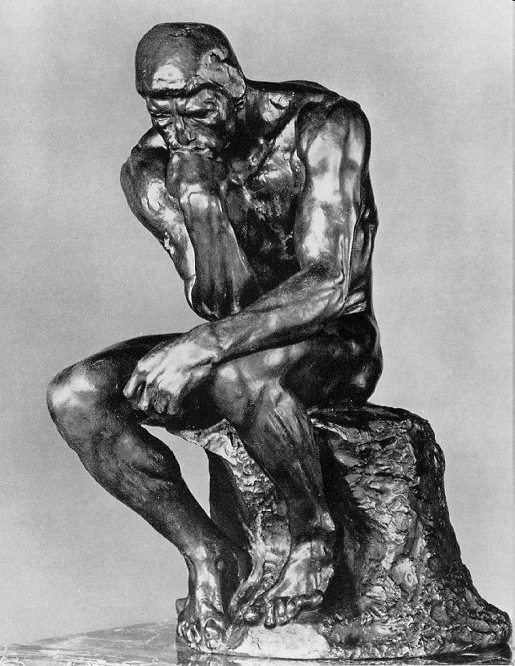
ChE 2982
Engineering Ethics
Instructor: Götz Veser
Lecture IV:
Scientific (Mis)Conduct

Slide 2

Fun & Frustration of Research
Research offers:
The excitement of discovery
A (global!) community of people who like to ‘think deeply’
A continuous challenge to your believes & convictions
Considerable freedom in choosing the topic of your work
Unrivaled freedom in organization of private & professional life
Potential to have a direct impact on current & future generations
(This section is largely based on: ‘On Being A Scientist: Responsible Conduct in Research, 2nd ed., Nat’l Acad. Sciences, 1995)

Slide 3

Fun & Frustration of Research
Research also entails many frustrations:
The failure of an experiment (after many months of preparation) due to poor design; technical complications; intractability of nature…
The basic hypothesis of a research plan may prove to be wrong after months (e.g. a whole summer…) of hard work.
Colleagues may disagree over the validity of experimental data, the interpretation of results, or credit for work done.
The realization that a competing research group ‘beat you’ to the results, i.e. demonstrated the key element of your research program first, more convincingly, or with higher visibility.

Slide 4
Fun & Frustration of Research
The number of researchers has grown much faster than available financial resources, which has increased the pressure on the research system and on individual scientists.
The role of science in society has become more prominent and more complex, with consequences that are both invigorating and stressful.
Science results in knowledge that is often presented as being fixed and universal. Yet scientific knowledge obviously emerges from a process that is intensely human, a process shaped by human virtues, values, and limitations and by societal contexts.
How is the limited, sometimes fallible, work of individual scientists converted into the “enduring edifice of scientific knowledge”?

Slide 5
Treatment of Data…
Independent verification of scientific observations is a key component of the “scientific method”. Many experimental techniques, such as statistical tests of significance, double-blind trials, or proper phrasing of questions on surveys, have been designed to minimize the influence of individual bias in research.
Distinguishing "facts" at the forefront of a given area of science is particularly challenging. Experimental techniques are often pushed to the limit, the signal is difficult to separate from the noise, unknown sources of error abound, and even the question to be answered is not well defined. In this stage of an investigation, researchers have to be extremely clear, both to themselves and to others, about the methods being used to gather and analyze data.

Slide 6
Treatment of Data: Example
Deborah, a third-year graduate student, and Kathleen, a postdoc, have made a series of measurements on a new experimental semiconductor material using an expensive neutron source at a national laboratory. When they get back to their own laboratory and examine the data, they get the data points shown in the graph above. A newly proposed theory predicts results indicated by the curve.
During the measurements at the national laboratory, Deborah and Kathleen observed that there were power fluctuations they could not control or predict. Furthermore, they discussed their work with another group doing similar experiments, and they knew that the other group had gotten results confirming the theoretical prediction and was writing a manuscript describing their results.
In writing up their own results for publication, Kathleen suggests dropping the two anomalous data points near the abscissa (the solid squares) from the published graph and from a statistical analysis. She proposes that the existence of the data points be mentioned in the paper as possibly due to power fluctuations and being outside the expected standard deviation calculated from the remaining data points. "These two runs," she argues to Deborah, "were obviously wrong."

Slide 7
Treatment of Data: Example
1. How should the data from the two suspected runs be handled?
2. Should the data be included in tests of statistical significance and why?
3. What other sources of information could Deborah and Kathleen use to help decide?

Slide 8
Values in Science
Science is more than the application of a toolbox of techniques; it involves complex decisions about the interpretation of data, about which problems to pursue, and about when to conclude an experiment.
Much of the knowledge and skill needed to make good decisions in science is learned through personal experience and interactions with other scientists (such as your advisor!). But some of this ability is hard to teach or even describe. Many of the intangible influences on scientific discovery—curiosity, intuition, creativity—largely defy rational analysis, yet they are among the tools that scientists bring to their work.
Scientific work is based on many (implicit and explicit) values: self-consistency and possible falsification of hypotheses, as well as simplicity are among the ‘explicit’ ones, but personal, religious, social believes often can taint (or guide) scientists, too. (Example: Einstein’s early and long standing rejection of Quantum Mechanics: “God does not play dice”!)

Slide 9

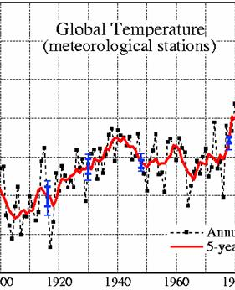
And another example…
Few topics are currently as hotly debated as ‘Global Warming’. Since this topic involves many scientific (!), political and other interest groups, biased and outright fraudulent data abounds in the discussion.
Clearly, most of the temperature increase occurred before 1940, hence no correlation with industrial development!
19
80
(source: NASA, http://data.giss.nasa.gov/gistemp/graphs/ )

Slide 10
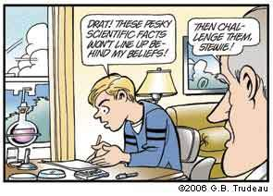
Fraud
“fraud - specifically :
a misrepresentation or concealment with reference to some fact material to a transaction that is made with knowledge of its falsity or in reckless disregard of its truth or falsity and with the intent to deceive another”
“Merriam-Webster’s Dictionary of Law” cited after: http://dictionary.reference.com/browse/fraud

Slide 11
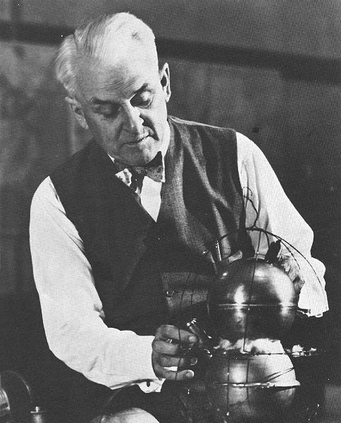
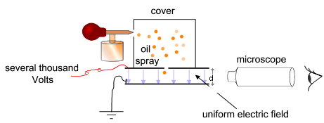
Robert Millikan: Background
Starting in 1909, while a professor at the University of Chicago, Millikan worked on an oil-drop experiment in which he measured the charge on a single electron. Publication of his first results in 1910 and contradictory observations by Felix Ehrenhaft started a controversy between the two physicists. After improving his setup Millikan published his seminal study in 1913. In 1923, Millikan won the Nobel Prize for physics largely based on this experiment.
The so-called ‘elementary charge’ is one of the fundamental physical constants and accurate knowledge of its value is of great importance. Millikan’s experiment measured the force on tiny charged droplets of oil suspended against gravity between two metal electrodes. Knowing the electric field, the charge on the droplet could be determined. Repeating the experiment for many droplets, Millikan showed that the results could be explained as integer multiples of a common value, the charge on a single electron.
(Source: Wikipedia)

Slide 12
Robert Millikan: The Data
Based on Franklin ([1981]) the oil drops could be classified as follows:
i. Total number of drops in the notebooks 175
ii. Number of drops studied before 13 February 1912 68
iii. Number of valid drops 107
iv. Of the valid drops, number published by Millikan 58
v. Of the valid drops, number excluded by Millikan 49
vi. Of the valid drops, number excluded with no calculation 22
vii. Of the valid drops, number excluded after calculating e 27
Reasons for excluding 27 valid drops even after having calculated the value of e:
12 drops: their pressure and radius were such as to require second order correction to Stokes’s law
2 drops: on experimental grounds
5 drops: too few reliable measured values of t_{f} (rising time)
2 drops: for no apparent reason, probably because Millikan did not need them for calculating e
1 drop: anomalous (Franklin provides no further information)
5 drops: according to Franklin, ‘His only evident reason for rejecting these five events is that their values did not agree with his expectations’ (p. 195)

Slide 13
Millikan: An Epilogue…
“ We have learned a lot from experience about how to handle some of the ways we fool ourselves. One example: Millikan measured the charge on an electron by an experiment with falling oil drops, and got an answer which we now know not to be quite right. It's a little bit off because he had the incorrect value for the viscosity of air. It's interesting to look at the history of measurements of the charge of an electron, after Millikan. If you plot them as a function of time, you find that one is a little bit bigger than Millikan's, and the next one's a little bit bigger than that, and the next one's a little bit bigger than that, until finally they settle down to a number which is higher.
Why didn't they discover the new number was higher right away? It's a thing that scientists are ashamed of - this history - because it's apparent that people did things like this: When they got a number that was too high above Millikan's, they thought something must be wrong - and they would look for and find a reason why something might be wrong. When they got a number close to Millikan's value they didn't look so hard. And so they eliminated the numbers that were too far off, and did other things like that. We've learned those tricks nowadays, and now we don't have that kind of a disease. “
(Richard Feynman, commencement lecture at Caltech, 1974; quoted after: Wikipedia article on ‘Oil Drop Experiment’)

Slide 14
Misconduct in Science & Research
Beyond honest errors and errors caused through negligence are a third category of errors: those that involve deception. Making up data or results (fabrication), changing or misreporting data or results (falsification), and using the ideas or words of another person without giving appropriate credit (plagiarism)—all strike at the heart of the values on which science is based.
These acts of scientific misconduct not only undermine progress but the entire set of values on which the scientific enterprise rests. Anyone who engages in any of these practices is putting his or her scientific career at risk. Even infractions that may seem minor at the time can end up being severely punished.

Slide 15
Misconduct: Plagiarism
“During the course of this long volume I have undoubtedly plagiarized from many sources–to use the ugly term that did not bother Shakespeare’s age. I doubt whether any criticism or cultural history has ever been written without such plagiary, which inevitably results from assimilating the contributions of your countless fellow-workers, past and present. The true function of scholarship as a society is not to stake out claims on which others must not trespass, but to provide a community of knowledge in which others may share.”
F. O. Matthiessen, American Renaissance 1941.
(Cited after: http://academhack.outsidethetext.com/home/2009/on-plagiarism-scholarship-and-community-knowledge/; accessed on 09/02/09)

Slide 16
Plagiarism: Definition
(One) Definition: “Plagiarism is the appropriation of another person’s ideas, processes, results, or words without giving appropriate credit, including those obtained through confidential review of others’ research proposals and manuscripts.” (Office of Science and Technology Policy, 1999)
Common misunderstandings:
Ideas ARE owned (not just patents!) - “intellectual property”
Are citations even important?? “An author should cite those publications that have been influential in determining the nature of the reported work and that will guide the reader quickly to earlier work that is essential for understanding the present investigation.” (Ethical Guidelines to Publication of Chemical Research, ACS January 1985).
Form as well as content is owned (paraphrasing) Substituting words but copying sentence structure, organization, and “borrowing” thoughts of an author without attribution is plagiarism!
No excuse: referencing software powerful, easy to use, and (almost) free (Pitt CSSD: Endnote™ for $5!)
Exception: ideas & concepts that have become part of the ‘working knowledge’ in your field do not need to be cited (example: Langmuir-Hinshelwood or Michaelis-Menten Kinetics etc). Rule: If in doubt, cite!

Slide 17
Plagiarism: Example
May is a second-year graduate student preparing the written portion of her qualifying exam. She incorporates whole sentences and paragraphs verbatim from several published papers. She does not use quotation marks, but the sources are suggested by statements like "(see . . . for more details)." The faculty on the qualifying exam committee note inconsistencies in the writing styles of different paragraphs of the text and check the sources, uncovering May's plagiarism.
After discussion with the faculty, May's plagiarism is brought to the attention of the dean of the graduate school, whose responsibility it is to review such incidents. The graduate school regulations state that "plagiarism, that is, the failure in a dissertation, essay, or other written exercise to acknowledge ideas, research or language taken from others" is specifically prohibited. The dean expels May from the program with the stipulation that she can reapply for the next academic year.
1. Is plagiarism like this a common practice?
2. Are there circumstances that should have led to May's being forgiven for plagiarizing?
3. Should May be allowed to reapply to the program?

Slide 18
Plagiarism – How to Avoid It
To avoid plagiarism, you must give credit whenever you use
another person’s idea, opinion, or theory;
any facts, statistics, graphs, drawings—any pieces of information—that are not common knowledge;
quotations of another person’s actual spoken or written words; or
paraphrase of another person’s spoken or written words.
(From: Writing Tutorial Services, Indiana University, Bloomington, IN)

Slide 19
Plagiarism – How to Recognize It
How to Recognize Unacceptable and Acceptable Paraphrases
Here’s the ORIGINAL text, from page 1 of Lizzie Borden: A Case Book of Family and Crime in the 1890s by Joyce Williams et al.:
The rise of industry, the growth of cities, and the expansion of the population were the three great developments of late nineteenth century American history. As new, larger, steam-powered factories became a feature of the American landscape in the East, they transformed farm hands into industrial laborers, and provided jobs for a rising tide of immigrants. With industry came urbanization the growth of large cities (like Fall River, Massachusetts, where the Bordens lived) which became the centers of production as well as of commerce and trade.
Here’s an UNACCEPTABLE paraphrase that is plagiarism:
The increase of industry, the growth of cities, and the explosion of the population were three large factors of nineteenth century America. As steam-driven companies became more visible in the eastern part of the country, they changed farm hands into factory workers and provided jobs for the large wave of immigrants. With industry came the growth of large cities like Fall River where the Bordens lived which turned into centers of commerce and trade as well as production.
What makes this passage plagiarism? The preceding passage is considered plagiarism for two reasons:
the writer has only changed around a few words and phrases, or changed the order of the original’s sentences.
the writer has failed to cite a source for any of the ideas or facts.
If you do either or both of these things, you are plagiarizing.
(From: Writing Tutorial Services, Indiana University, Bloomington, IN)

Slide 20
Plagiarism – How to Recognize It
How to Recognize Unacceptable and Acceptable Paraphrases
Here’s the ORIGINAL text, from page 1 of Lizzie Borden: A Case Book of Family and Crime in the 1890s by Joyce Williams et al.:
The rise of industry, the growth of cities, and the expansion of the population were the three great developments of late nineteenth century American history. As new, larger, steam-powered factories became a feature of the American landscape in the East, they transformed farm hands into industrial laborers, and provided jobs for a rising tide of immigrants. With industry came urbanization the growth of large cities (like Fall River, Massachusetts, where the Bordens lived) which became the centers of production as well as of commerce and trade.
Here’s an ACCEPTABLE paraphrase:
Fall River, where the Borden family lived, was typical of northeastern industrial cities of the nineteenth century. Steam-powered production had shifted labor from agriculture to manufacturing, and as immigrants arrived in the US, they found work in these new factories. As a result, populations grew, and large urban areas arose. Fall River was one of these manufacturing and commercial centers (Williams 1).
Why is this passage acceptable? This is acceptable paraphrasing because the writer:
accurately relays the information in the original
uses her own words.
lets her reader know the source of her information.
(From: Writing Tutorial Services, Indiana University, Bloomington, IN)

Slide 21
Plagiarism – How to Recognize It
How to Recognize Unacceptable and Acceptable Paraphrases
Here’s the ORIGINAL text, from page 1 of Lizzie Borden: A Case Book of Family and Crime in the 1890s by Joyce Williams et al.:
The rise of industry, the growth of cities, and the expansion of the population were the three great developments of late nineteenth century American history. As new, larger, steam-powered factories became a feature of the American landscape in the East, they transformed farm hands into industrial laborers, and provided jobs for a rising tide of immigrants. With industry came urbanization the growth of large cities (like Fall River, Massachusetts, where the Bordens lived) which became the centers of production as well as of commerce and trade.
Here’s an example of quotation and paraphrase used together, which is also ACCEPTABLE:
Fall River, where the Borden family lived, was typical of northeastern industrial cities of the nineteenth century. As steam-powered production shifted labor from agriculture to manufacturing, the demand for workers "transformed farm hands into industrial laborers," and created jobs for immigrants. In turn, growing populations increased the size of urban areas. Fall River was one of these hubs "which became the centers of production as well as of commerce and trade" (Williams 1).
Why is this passage acceptable? This is acceptable paraphrasing because the writer:
records the information in the original passage accurately.
gives credit for the ideas in this passage.
indicated which part is taken directly from her source by putting the passage in quotation marks and citing the page number.
(From: Writing Tutorial Services, Indiana University, Bloomington, IN)

Slide 22
Plagiarism and the WWW
The World Wide Web has become a highly popular source of information for student papers, and many questions have arisen about how to avoid plagiarizing these sources. In most cases, the same rules apply as to a printed source: when a writer must refer to ideas or quote from a WWW site, she must cite that source.
If a writer wants to use visual information from a WWW site, many of the same rules apply. Copying visual information or graphics from a WWW site (or from a printed source) is very similar to quoting information, and the source of the visual information or graphic must be cited.
These rules also apply to other uses of textual or visual information from WWW sites; for example, if a student is constructing a web page as a class project, and copies graphics or visual information from other sites, she must also provide information about the source of this information. In this case, it might be a good idea to obtain permission from the WWW site’s owner before using the graphics.
(From: Writing Tutorial Services, Indiana University, Bloomington, IN)

Slide 23
How to Avoid Plagiarism
Put in quotations everything that comes directly from the text especially when taking notes.
Paraphrase, but be sure you are not just rearranging or replacing a few words. Instead, read over what you want to paraphrase carefully; cover up the text with your hand, or close the text so you can’t see any of it (and so aren’t tempted to use the text as a “guide”). Write out the idea in your own words without peeking.
Check your paraphrase against the original text to be sure you have not accidentally used the same phrases or words, and that the information is accurate.
Terms You Need to Know:
Common knowledge: facts that can be found in numerous places and are likely to be known by a lot of people.
Example: John F. Kennedy was elected President of the United States in 1960.
This is generally known information. You do not need to document this fact. However, you must document facts that are not generally known and ideas that interpret facts!
Quotation: using someone’s words. When you quote, place the passage you are using in quotation marks, and document the source according to a standard documentation style.
Example: According to Peter S. Pritchard in USA Today, “Public schools need reform but they’re irreplaceable in teaching all the nation’s young” (14).
Paraphrase: using someone’s ideas, but putting them in your own words. You will probably use this often when incorporating sources into your writing. Although you use your own words to paraphrase, you must still acknowledge the source of the information.
(From: Writing Tutorial Services, Indiana University, Bloomington, IN)

Slide 24
Falsification & Fabrication
Falsification is manipulating research materials, equipment, or processes, or changing or omitting data or results such that the research is not accurately represented in the research record.
Fabrication is making up results and recording or reporting them.
(Office of Science and Technology Policy, 1999)
Common reasons
career pressure (ambition, peers, family, etc)
Intellectual arrogance (knowing or thinking you know the expected answer)
“working in a field where individual experiments are not expected to be precisely reproducible” (don’t laugh…!)
“Safe-guards”
Record all data in proper lab book at the time when measurements are made
Do not “anticipate” results!
Be your own worst skeptic!!
Have a life !!!

Slide 25
Misrepresentation: Example
(From the “Chronicle of Higher Education, Oct. 22, 1999)
Col. Henry A. Zimon had an impressive military career that had culminated in a high-profile strategic-planning job at the Pentagon before he became Albright's president this summer. But some faculty members at the liberal-arts college have questioned the veracity of several claims on his resume. Evidence obtained by The Chronicle supports the faculty members' suspicions.
Colonel Zimon had listed the book, Reshaping U.S. National Security Strategy: Peacetime Engagement, Regional Stability, and Global Security, on his resume under the heading "Selected Professional Publications and Presentations," noting that it was due to be published in 1998-99. But Peter Kracht, the publisher at Praeger, said this month that his company had not published the book and does not plan to do so. "We've carefully checked all of our records, and I have not been able to find any record of a contract or publishing agreement with Colonel Zimon," Mr. Kracht said.
Colonel Zimon said that the contract was with Auburn House, another division of Greenwood, although the book itself was to be published by Praeger. He said that the agreement had been signed by John T. Harney, a freelance acquisitions editor for Praeger. Mr. Harney said this month that in 1992, he had discussed the publication of a book written by Colonel Zimon and an Air Force officer, Col. Chuck Gagnon. But Mr. Harney said he had no record of any contract with either Auburn or Praeger. "They never delivered a completed manuscript." Colonel Zimon's resume also did not list Colonel Gagnon, who has since retired from the Air Force, as a co-author of the book described as forthcoming.

Slide 26
Misrepresentation: Example, cont’d
(From the “Chronicle of Higher Education, Oct. 22, 1999; cont’d)
Zimon said on his resume that he was editing a book (“forthcoming/in progress”) with R.J. Woolsey, CIA director from 1993 to 1995. Mr. Woolsey was the ambassador who led the U.S. delegation that negotiated the 1990 Treaty on Conventional Armed Forces in Europe, and Colonel Zimon was his assistant during those talks. But Mr. Woolsey said that he was not working on a book with Zimon: "I don't know anything about the book", adding that while he had spoken occasionally by telephone with Colonel Zimon, he had not "kept close track" of him since 1991. Zimon insisted that he had discussed the idea for the book with Mr. Woolsey in the summer of 1991. "I talked to Ambassador Woolsey about he and I doing kind of a summary chapter," Colonel Zimon said. "Once I confirmed to him that I was willing to do by far the majority of the work, he said to me that it sounded like a very interesting project." Zimon added, however, that he had not worked on the project since 1991, nor spoken about it with Mr. Woolsey since then. "He will be a co-editor of the book if we finish this project, and I fully intend to finish this project at some point," he said.
Zimon's resume said he had been a postdoctoral fellow at Harvard's Kennedy School and business school. But Harvard officials say he never had postdoctoral fellowships at either school, although they confirm that he held a National Security Fellowship, a position for active-duty military officers at the Kennedy School. Fellows in that program are not required to have doctorates.
Zimon's resume said that he had taught "seminars" at the Kennedy School. School officials say that he never taught there and that the policy agreement between the military and the school precludes military officers from teaching. But the director of the National Security Fellows program said that Colonels Gagnon and Zimon had made a one-time presentation of a research paper in 1992, when they were fellows.

Slide 27


On to the Next Stage!
You have taken advantage of the many opportunities at Pitt! You are heavily involved in the several student organizations, are volunteering at the local food shelter, and have season tickets for the Panther football and basketball teams.
Engineering studies have proven challenging, but you have kept up in your classes to the best of your abilities. You often feel that your schedule is overloaded and that your efforts have not always been appropriately rewarded by professors, but you have always preferred to be well-rounded.
This fall, Tesla is coming to campus to interview engineering students to hire for their Materials division. However, they are only interviewing students with a GPA >3.6. Despite your schedule and commitments, you have maintained a respectable GPA of 3.55…
If you put “3.6 GPA” on your resume, you will likely get an interview. You heard that monitoring is not very consistent and it might hence go unnoticed and—who knows?—if Tesla likes you enough, maybe they will waive the GPA requirement for your hire…

Slide 28
Fabrication: Example
(This example might be considered borderline between falsification and fabrication. How so?)
FABRICATION IN A GRANT APPLICATION
Don is a first-year graduate student applying to the National Science Foundation for a predoctoral fellowship. His work in a lab where he did a rotation project was later carried on successfully by others, and it appears that a manuscript will be prepared for publication by the end of the summer. However, the fellowship application deadline is June 1, and Don decides it would be advantageous to list a publication as "submitted." Without consulting the faculty member or other colleagues involved, Don makes up a title and author list for a "submitted" paper and cites it in his application.
After the application has been mailed, a lab member sees it and goes to the faculty member to ask about the "submitted" manuscript. Don admits to fabricating the submission of the paper but explains his actions by saying that he thought the practice was not uncommon in science.

Slide 29
Fabrication: Example, cont’d
The faculty members in Don's department demand that he withdraw his grant application and dismiss him from the graduate program. After leaving the university, Don applies for a master's degree, since he has fulfilled the course requirements. Although the department votes not to grant him a degree, the university administration does so because it is not stated in the university graduate bulletin that a student in Don's department must be in "good standing" to receive a degree. They fear that Don will bring suit against the university if the degree is denied. Likewise, nothing will appear in Don's university transcript regarding his dismissal.
1. Do you agree with Don that scientists often exaggerate the publication status of their work in written materials?
2. Do you think the department acted too harshly in dismissing Don from the graduate program?
3. Do you believe that being in ''good standing" should be a prerequisite for obtaining an advanced degree in science? If Don later applied to a graduate program at another institution, does that institution have the right to know what happened?

Slide 30
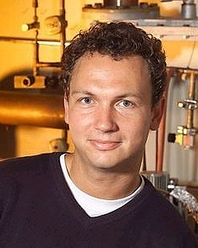
Fabrication: Jan Hendrick Schön
Jan Hendrik Schön (b. 1970) is a German physicist in the area of condensed matter physics and nanotechnology. He received his Ph.D. from the University of Konstanz in 1997, and was hired by Bell Labs where he quickly showed an outstanding scientific productivity. By 2001, he was listed as an author on an average of one research paper every eight days.
[In 2000 and 2001 alone, Schoen published 15 papers in Nature and Science! Schön was considered one of the most outstanding talents in science, and on the fast track to a Nobel Price. The Max-Planck-Society, Germany’s flag-ship national research labs, was in talks with Schoen, considering to create a complete new research institute for Schön.]
In 2001 he announced in Nature that he had produced a transistor on the molecular scale. Schön claimed to have used a thin layer of organic dye molecules to assemble an electric circuit that, when acted on by an electric current, behaved as a transistor. The implications of his work were significant. It would have been the beginning of a move away from silicon-based electronics and towards organic electronics. It would have allowed chips to continue shrinking past the point at which silicon breaks down, and therefore continue Moore's Law for much longer than is currently predicted. It also would have drastically reduced the cost of electronics.
(Adapted from Wikipedia; accessed Sept. 2006).)
http://www.wissenschaft-online.de/sixcms/ media.php/912/thumbnails/34853.jpg.274708.jpg

Slide 31
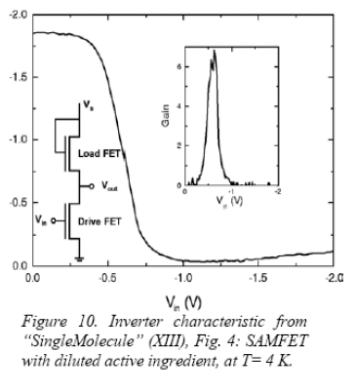
Fabrication: Schön, cont’d
Soon after he published his work, others in the physics community alleged that Schön's data contained anomalies. In particular, they said the data seemed overly precise, and that some of it contradicted the prevailing understanding of physics. Professor Lydia Sohn (UC Berkeley), noticed that two experiments carried out at very different temperatures had identical noise. When the editors of Nature pointed this out to Schön, he claimed to have accidentally submitted the same graph twice. Paul McEuen (Cornell) then found the same noise in a paper describing a third experiment. More research by McEuen, Sohn, and others uncovered a number of examples of duplicate data in Schön's work. In total, 25 papers by Schön and 20 coauthors were considered suspect.
Paper #1
(Nature)
Paper #2
(Science)

Slide 32
Fabrication: Schön, cont’d
In May, 2002, Bell Labs appointed Malcolm Beasley (Stanford) to chair a committee to investigate possible scientific fraud. The committee sent questionnaires to all of Schön's coauthors, and interviewed his three principal coauthors (Z. Bao, Bertram Batlogg, and C. Kloc). They examined electronic drafts of the disputed papers, which included processed numeric data. They requested copies of raw data but found that Schön had kept no laboratory notebooks. His raw data files had been erased from his computer. According to Schön, the files were erased because his computer had limited hard drive space. In addition, all of his experimental samples had been discarded or damaged beyond repair.
On September 25, 2002, the committee publicly released its report. The report contained details of 24 allegations of misconduct. They found evidence of Schön's scientific misconduct in at least 16 of them. They found that whole data sets were “reused” in a number of different experiments. They also found that some of his graphs, which purportedly had been plotted from experimental data, had instead been produced using mathematical functions.
(From Wikipedia (accessed Sept. 2006), with minor changes.)

Slide 33
Fabrication: Schön, cont’d
The report found that all of the misdeeds had been performed by Schön alone. All coauthors were completely exonerated of scientific misconduct. However, it was unclear whether all of them had exercised sufficient professional responsibility in trusting the integrity of his data. Minor coauthors were found to have reasonably fulfilled their responsibilities, but the question was raised of whether Bertram Batlog, the leader of Schön's research group until mid 2000, was sufficiently critical. Although Batlog, professor at ETH Zurich since Sept. 2000, took appropriate action once concerns were explicitly raised to him, perhaps he should have more closely examined the results earlier, in view of their exceptional nature. There existed no general consensus on the responsibility of coauthors of a paper, so the committee declared itself unqualified to resolve this issue. Batlog was not formally reprimanded. Please download and read the summary report from the course web page.
Bell Labs fired Schön on the day they received the report. It was the first known case of fraud in the lab's history.
Schön was deprived of his doctoral degree by the University of Konstanz in June 2004, even though there was no indication that his work conducted as a student was related to his subsequent scandal at Bell Labs. (Schön challenged the University, but a German court upheld the decision to rescind Schön’s doctoral title.)
Do you consider the actions taken in this case satisfactory? What additional actions would you suggest?
What do you think of the University of Konstanz’s reaction to this scandal?

Slide 34
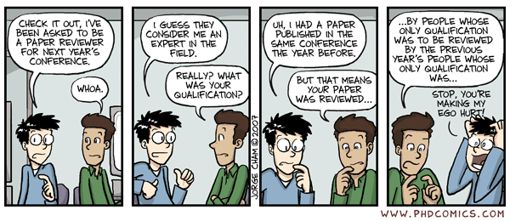
What IS the Role of a Reviewer?
“The Schön scandal provoked discussion in the scientific community about the degree of responsibility of coauthors and reviewers of scientific papers. Peer review is designed to find errors, as well as determine relevance and originality of papers, rather than detect fraud. It was still disturbing to some that none of Schön's misrepresentations were caught by the peer review process.”
(http://en.wikipedia.org/wiki/Jan_Hendrik_Sch%C3%B6n)

Slide 35

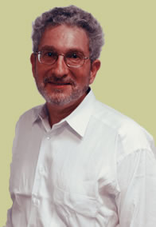
Local Case: Schatten
Gerald P. Schatten is a internationally reknowned stem cell researcher at the University of Pittsburgh. His research during the last years has mainly focused on human reproduction and development and on potential medical therapies that use stem cell and gene therapy.
In 2005, Gerald Schatten came to widespread media attention when he broke off his 20 month collaboration with Hwang Woo-suk, a Korean stem cell researcher.
In an interview, Schatten commented that "my decision is grounded solely on concerns regarding oocyte (egg) donations in Dr. Hwang's research reported in 2004.“ This event led to a chain reaction of events, which has culminated in close scrutiny of the scientific validity of his joint work with Hwang.
He has since requested that the editors of Science remove his name from a joint paper he wrote with Hwang (and 23 other co-authors) in June 2005. While the journal normally requires requests from all the authors of a paper, the article will be retracted in any case, because of the situation.
(From: Wikipedia, accessed Sept. 2006)
http://www.pdc.magee.edu/assets/ images/schatten05.jpg

Slide 36
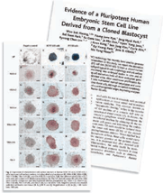
Schatten, cont’d
Retraction of Hwang et al., Science 308 (5729) 1777-1783 and of Hwang et al., Science 303 (5664) 1669-1674. Editorial Retraction:
“The final report from the investigation committee of Seoul National University has concluded that the authors of two papers published in Science have engaged in research misconduct and that the papers contain fabricated data. With regard to Hwang et al., 2004, the Investigation Committee reported that the data […] are invalid because they are the result of fabrication […]. Further, the committee found that the claim in Hwang et al., 2005 that 11 patient-specific embryonic stem cells line were derived from cloned blastocystsis based on fabricated data. […]
Because the final report of the […] investigation indicated that a significant amount of the data presented in both papers is fabricated, the editors of Science feel that an immediate and unconditional retraction of both papers is needed. We therefore retract these two papers and advise the scientific community that the results reported in them are deemed to be invalid.
As we post this retraction, seven of the 15 authors of Hwang et al., 2004 (2) have agreed to retract their paper. All of the authors of Hwang et al., 2005 (3) have agreed to retract their paper.
Science regrets the time that the peer reviewers and others spent evaluating these papers as well as the time and resources that the scientific community may have spent trying to replicate these results.”
(From: http://www.sciencemag.org/cgi/content/full/311/5759/335b with minor changes/omissions)

Slide 37
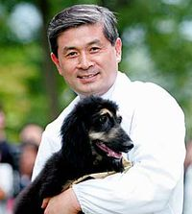
Schatten, cont’d
Because the controversies surrounding his collaboration with Hwang Woo-Suk, Dr. Schatten was the subject of an investigation by this university, which was finished in February 2006.
The investigation committee concluded that Gerald Schatten was not guilty of scientific misconduct because he had not known of the fraudulent data in their 2005 paper and because he reacted swiftly when he discovered the severe problems with the paper.
The committee, however, thought it was troublesome that Dr. Schatten was not more familiar with the data in both the 2005 Science paper and the paper describing cloning of the dog Snuppy, of which he also was a co-author.
In the first case, Dr. Schatten may have become suspicious of the data had he paid more attention and in the second case, his only contribution (according to himself) was the suggestion that a professional photographer be hired to photograph the cloned dog.
Because Dr. Schatten apparently took significant credit (being a co-author on these high impact papers) for only small contributions, the committee did accuse him of scientific misbehavior. Whether or not Dr. Schatten will face any disciplinary actions is up to the board of the University and is currently unknown. (It was reported in the Seoul Times that Gerald Schatten is being sought by the prosecution in the case of Hwang Woo-Suk and the fabrication of stem cell results. According to this report Gerald Schatten had failed to reply to the prosecution's request to-date (January 2006).
(From: Wikipedia, accessed Sept. 2006)
Please also read the final report of the UPitt’s investigation (pdf file on the course web page)
http://en.wikipedia.org/wiki/Image: Dr-hwang-snuppy.jpg

Slide 38
Schatten, cont’d
From Schatten’s web page: http://www.pdc.magee.edu/faculty/schatten.html
Gerald P. Schatten, Ph.D. Director, Pittsburgh Development Center Deputy Director, Magee-Womens Research Institute Professor & Vice Chair of Obstetrics, Gynecology and Reproductive Sciences, and Cell Biology and Physiology, University of Pittsburgh Director of the Division of Developmental and Regenerative Medicine, University of Pittsburgh School of Medicine
Dr. Schatten is a […] the only American on the executive committee of UNESCO’s International Cell Research Organization. Along with extensive funding from the National Institutes of Health, Dr. Schatten is the recipient of a MERIT award and was recently honored by the Czech Academy of Sciences with the Purkinje Medal. His numerous authored and co-authored papers on fertilization, cell biology, development, infertility, and assisted reproductive technologies have appeared in premier journals such as Fertility and Sterility and Science. Dr. Schatten is also an eloquent advocate for research in reproduction, development, and stem cells and has testified to the US Senate and the President’s Council on Bioethics.
How does Schatten’s professional record affect your view of this controversy? What impact might it have on an investigative panel?
Should it matter?

Slide 39

Schatten, cont’d
(From UPMC press release, see: http://newsbureau.upmc.com/TX/SchattenPanelRelease.htm These are brief excerpts with emphases NOT in the original)
“Dr. Levine has accepted the findings of the panel. As recommended by the panel, further corrective action, if any, will be at the discretion of the dean, and, like all other such personnel matters, is confidential. Dr. Schatten remains as a tenured professor at the University of Pittsburgh and an active researcher.”
“... The document stands on its own. Therefore, no University of Pittsburgh official nor any panel member will be granting press interviews regarding this matter.”
What are pros and cons to the ‘confidential’ nature of further steps and of pre-emptively not granting any further interviews in this matter?

Slide 40
Schatten, one more…
Should this affect the way that the university is handling his case? If so, why and how?
Schatten[…] was involved in laboratory-related misconduct investigations at both of his previous university jobs prior to arriving at Pitt in mid-2001.
University of Wisconsin-Madison, ‘93-94. Schatten, […], used eggs for research that later were discovered to have been obtained illegally by a University of California-Irvine fertility clinic from women without their consent.
Two University of California-Irvine physicians were charged by the federal government […]. Both fled the United States. A third UC-Irvine physician was convicted in 1998 of fraudulently billing insurance companies; he was fined $64,000 and sentenced to three years probation. […] a University of Wisconsin investigation determined that [Schatten] "unintentionally" received the misappropriated eggs. […] "He did receive written documents that purported to be consent forms ... and relied upon those and had provided those to the appropriate oversight bodies.“
Oregon National Primate Research Center. [Schatten] directed the researchers who in early 2001 produced the world's first genetically modified nonhuman primate, a transgenic monkey.
Later that year, the center's Institutional Biosafety Committee investigated Schatten for three "miscommunications" that included a misstatement to the committee about his research work. All three issues were remedied "in a relatively short period of time," a research center spokesman said. "They were fairly minor issues," said the spokesman, Jim Newman. "However, if they were not addressed so quickly, they would have been more serious issues."
(From: Pittsburgh Post-Gazette, quoted after http://ipbiz.blogspot.com/2006/03/post-gazette-on-gerald-schatten.html)

Slide 41

Schatten - Epilogue
“ Mr. Schatten's career is likely to suffer even if Pitt finds him blameless. Scientists may be reluctant to work with him, agencies may hesitate to sponsor his research, and journals may think twice before publishing his papers. "If you ask the question, What does a scientist have? He has a reputation. That's all you have," says Dr. Jaenisch.
"I think he'll always be looked at with a skewed eye," says Dr. Snyder, of the Burnham Institute. "On the other hand, I think, with time, people will come to recognize that he probably was not involved in the actual fabrication — that he was a victim."
Perhaps time will heal wounds. But it may not solve mysteries. Why the researchers committed fraud, who did what, and what could have been done to prevent it have yet to become clear. “
From: The Chronicle of Higher Education, February 3, 2006 (http://chronicle.com/weekly/v52/i22/22a01501.htm)

