Slide 1
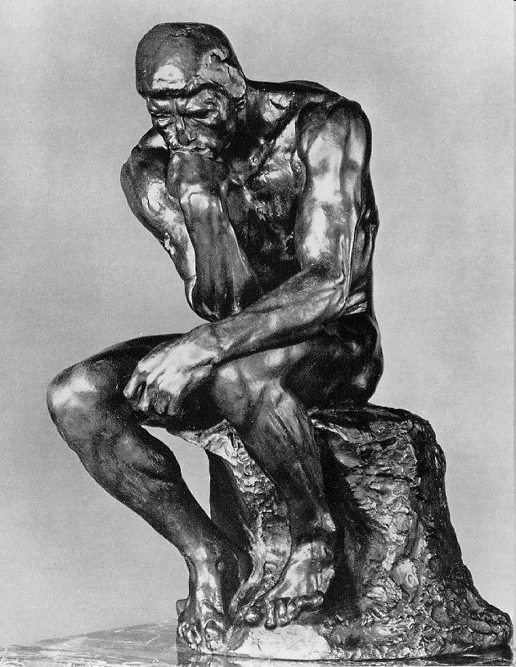
ChE 2982
Engineering Ethics
Instructor: Götz Veser
Lecture V:
COI, Authorship, Life as Grad Student…

Slide 2
Conflict of Interest
“A conflict of interest is a situation in which someone in a position of trust, such as a lawyer, insurance adjuster, a politician, executive or director of a corporation or a medical research scientist or physician, has competing professional or personal interests. Such competing interests can make it difficult to fulfill his or her duties impartially.
A conflict of interest exists even if no unethical or improper act results from it. A conflict of interest can create an appearance of impropriety that can undermine confidence in the person, profession, or court system. A conflict can be mitigated by third party verification or third party evaluation noted below—but it still exists.”
(Source: Wikipedia.)

Slide 3
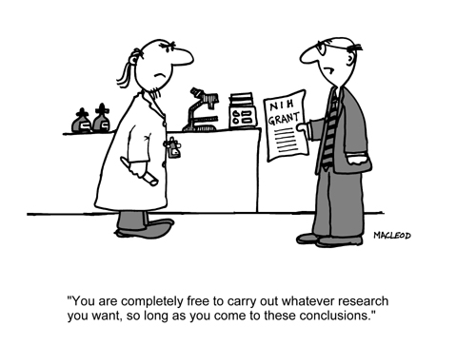
Conflict of Interest: Financial
Sponsored Research
Spin-off companies by university researchers
Any form of financial interest in the research outcome (stock owned in business or business sector etc)
This can be indirect, i.e. financial interest by a (close) family member, rather than yourself. (Problem: define “close”…)

Slide 4
Conflict of Interest: Scientific
Reviewing privileged information (manuscripts, proposals)
by competitors
by close collaborators
by a friend or relative
Difficulty: your competitor may be one of the few experts to truly judge the work!

Slide 5
Conflict of Interest: Personal
Should therapists, such as psychiatrists, be allowed to have extraprofessional relations with patients? Ex-patients?
Should a faculty member be allowed to have an extraprofessional relationship with a student, and should that depend on whether the student is in a class of, or being advised by, the faculty member?

Slide 6
COI – from Pitt ORI
There are some circumstances in which conflicts of interest could compromise the integrity of research or even lead to research misconduct […]. The annual disclosures of outside interests by researchers required under the University's Conflict of Interest Policy and the review of these disclosures by academic administrators are intended to avoid the escalation of conflicts into improper behavior or misconduct.
Possible preventive measures provided under that policy include
divestiture,
public disclosure of outside interests,
reduction of the conflicted researcher’s role in the research, and
internal monitoring of the research within the University.
A notice of conflicting financial interests should be included, possibly as a footnote, in publications, in research proposals and reports, and in clinical research protocols. Many journals and funding agencies require such disclosures.
A faculty member should also disclose to research students and members of the research staff the existence of his or her financial interests in activities related to the research.

Slide 7
COI – from Pitt ORI, Cont’d
The author(s) of a commercially sponsored study report must have access to all the data underlying a publication, including data from all sites in a multi-site study, and must have full control over the decision to publish. University researchers should not allow their names to be used as “ghost” authors of manuscripts written by commercial sponsors.
Conflict of commitment must be avoided so as not to threaten a University researcher’s primary professional allegiance and responsibility to the University. Although outside activities occupying no more than one day a week may be allowed for faculty (but not staff) members, the approval of each such activity from the academic supervisor must be obtained in advance. In no case are University facilities to be used in the conduct of an outside activity, and the University name and logo may be used by outside entities only with permission of designated University business officers.

Slide 8
Conflict of Interest: Example
A CONFLICT OF INTEREST
John, a third-year graduate student, is participating in a department-wide seminar where students, postdocs, and faculty members discuss work in progress. An assistant professor prefaces her comments by saying that the work she is about to discuss is sponsored by both a federal grant and a biotechnology firm for which she consults. In the course of the talk John realizes that he has been working on a technique that could make a major contribution to the work being discussed. But his faculty advisor consults for a different, and competing, biotechnology firm.
1. How should John participate in this seminar?
2. What, if anything, should he say to his advisor-and when?

Slide 9
Industrial Sponsorship: Example
INDUSTRIAL SPONSORSHIP OF ACADEMIC RESEARCH
Sandra was excited about being accepted as a graduate student in the laboratory of Dr. Frederick, a leading scholar in the field, and she embarked on her assigned research project eagerly. But after a few months she began to have misgivings. Though part of Dr. Frederick's work was supported by federal grants, the project on which she was working was totally supported by a grant from a single company. She had known this before coming to the lab and had not thought it would be a problem. But she had not known that Dr. Frederick also had a major consulting agreement with the company. She also heard from other graduate students that when it came time to publish her work, any paper would be subject to review by the company to determine if any of her work was patentable.
1. What are the advantages and disadvantages of Sandra doing research sponsored entirely by a single company?
2. How can she address the specific misgivings she has about her research?

Slide 10
Allocation of Credit
Science is not an individual experience. It is shared knowledge. For that reason, the social conventions of science play an important role in establishing the reliability of scientific knowledge. If these conventions are disrupted, the quality of science can suffer.
Many scientists are generous in discussing their preliminary theories or results with colleagues, and some even provide copies of raw data to others prior to public disclosure. But scientists are not expected to make their data and thinking available to others at all times. During the initial stages of research, a scientist deserves a period of privacy in which data are not subject to disclosure. This privacy allows individuals to advance their work to the point at which they have confidence both in its accuracy and its meaning.
Publication in a peer-reviewed journal remains the standard means of disseminating scientific results, but other methods of communication are altering how scientists divulge and receive information. Posters, abstracts, lectures at professional gatherings, and proceedings volumes are being used more often to present preliminary results before full review. Preprints and computer networks are increasing the ease and speed of scientific communications.

Slide 11
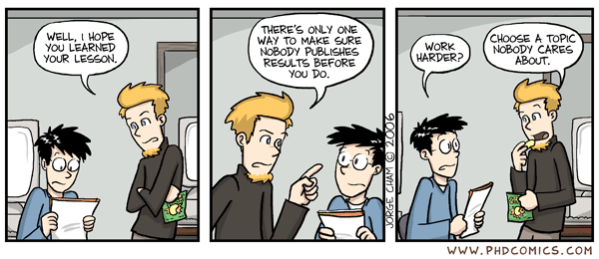
Allocation of Credit
The importance of publication in journals accounts for the convention that the first to publish a view or finding, not the first to discover it, tends to get most of the credit for the discovery.
Once results are published, they can be freely used by other researchers to extend knowledge. But until the results become common knowledge, people who use them are obliged to recognize the discoverer through citations.

Slide 12
Allocation of Credit: Example
Ben, a third-year graduate student, had been working on a research project that involved an important new experimental technique. For a national meeting in his discipline, Ben wrote an abstract and gave a brief presentation that mentioned the new technique. After his presentation, he was surprised and pleased when Dr. Freeman, a leading researcher from another university, engaged him in an extended conversation. Dr. Freeman asked Ben extensively about the new technique, and Ben described it fully. Ben's own faculty advisor encouraged his students not to keep secrets from other researchers, and Ben was flattered by Dr. Freeman’s interest in his work.
Six months later Ben was leafing through a journal when he noticed an article by Dr. Freeman. The article described an experiment that clearly depended on the technique that Ben had developed. He didn't mind; in fact, he was flattered that his technique had so strongly influenced Dr. Freeman's work. But when he turned to the citations, expecting to see a reference to his abstract or presentation, his name was nowhere to be found.
1. Does Ben have any way of receiving credit for his work?
2. Should he contact Dr. Freeman in an effort to have his work recognized?
3. Is Ben's faculty advisor mistaken in encouraging his students to be open about their work?

Slide 13
Allocation of Credit: Real Life Example
Postdoc Peter Schwartz and Prof. Chad Mirkin (Northwestern U.) Postdoc attempted to publish paper in Langmuir without supervisor
Please read: D. Curry. (2001) Chronicle of Higher Education. June 4. URL: http://chronicle.com/daily/2001/06/2001060404n.htm
See also: http://www.newtimes-slo.com/archives/cov_stories_2001/cov_08162001.html
Coverage in ‘Science’ magazine (see course webpage).

Slide 14
Allocation of Credit: Example, cont’d
The stories draws focus on two main issues: May a junior researcher publish findings without the permission of his or her senior professor? And if so, what are the implications for future intellectual property rights?
For Leonard Minsky, executive director of the National Coalition for Universities in the Public Interest, Schwartz’s case highlights how big corporate money and […] the Baye-Dole Act of 1980 have forced university scientists to become entrepreneur-scientists. Adding financial incentives to science has created incentives for bad (or even outright fraudulent) science, and can work to suppress, rather than disseminate, scientific truths.
The Baye-Dole Act of 1980 is significant because it allowed ownership of federally-sponsored inventions to be taken from the public, and sold to corporations. Because Schwartz’s invention could potentially be worth a lot of money, and because the work he did refuting Mirkin’s claims could also cost Northwestern’s lab (and Mirkin’s two start-up companies) lost revenue, it’s easy to see why efforts to stop Schwartz from publishing his work have been vigorous, Minsky says.
Mirkin has a much different claim. He has said in letters and interviews that the reason Schwartz’s work should not be published is two-fold: the science is not complete, and, if and when it is, Schwartz would hardly be the sole author, but one of many who worked on the project. He claims Schwartz is a rogue–a young and irresponsible scientist trying to claim others’ work as his own. Mirkin has also said that no one in his lab has reproduced Schwartz’s results.
(Source: http://www.newtimes-slo.com/archives/cov_stories_2001/cov_08162001.html)

Slide 15
Guidelines for Publication…
From: https://paragon.acs.org/paragon/ShowDocServlet?contentId=paragon/module_content/ registration/ethical_guidelines/ethic2000.pdf
An author’s central obligation is to present an accurate account of the research performed as well as an objective discussion of its significance.
An author should recognize that journal space is a precious resource created at considerable cost. An author therefore has an obligation to use it wisely and economically.
A primary research report should contain sufficient detail and reference to public sources of information to permit the author’s peers to repeat the work. […].
An author should cite those publications that have been influential in determining the nature of the reported work and that will guide the reader quickly to the earlier work that is essential for understanding the present investigation. […].
Any unusual hazards inherent in the chemicals, equipment, or procedures used in an investigation should be clearly identified in a manuscript reporting the work.
Fragmentation of research reports should be avoided. A scientist who has done extensive work on a system or group of related systems should organize publication so that each report gives a well-rounded account of a particular aspect of the general study. […].
In submitting a manuscript for publication, an author should inform the editor of related manuscripts that the author has under editorial consideration or in press. […].

Slide 16
Guidelines for Publication…
From: https://paragon.acs.org/paragon/ShowDocServlet?contentId=paragon/module_content/ registration/ethical_guidelines/ethic2000.pdf
It is improper for an author to submit manuscripts describing essentially the same research to more than one journal of primary publication […]. It is generally permissible to submit a manuscript for a full paper expanding on a previously published brief preliminary account (a “communication” or “letter”) of the same work. […]
An author should identify the source of all information quoted or offered, except that which is common knowledge.[…].
An experimental or theoretical study may sometimes justify criticism, even severe criticism, of the work of another scientist. When appropriate, such criticism may be offered in published papers. However, in no case is personal criticism considered to be appropriate.
The co-authors of a paper should be all those persons who have made significant scientific contributions to the work reported and who share responsibility and accountability for the results. Other contributions should be indicated in a footnote or an “Acknowledgments” section. [...] The submitting author should have sent each living co-author a draft copy of the manuscript and have obtained the co-author’s assent to co-authorship of it.
The authors should reveal to the editor any potential conflict of interest, e.g., a consulting or financial interest in a company, that might be affected by publication of the results contained in a manuscript. […]

Slide 17
Authorship (Pitt ORI)
Publication of research results is important as a means of communicating to the scholarly world so that readers may be informed of research results and other researchers may build on the reported findings. In fact, it is an ethical obligation for an investigator at the University to make research findings accessible […].
The reported data and methods should be sufficiently detailed so that other researchers could attempt to replicate the results. Publication should be timely but should not be hastened unduly if premature publication involves a risk of not subjecting all results to adequate internal confirmation or of not considering adequately all possible interpretations.
A sponsor of a research project may not have a veto over a decision to publish, but a delay of publication for an agreed period, not to exceed six months, may be allowed in order to permit filing of a patent application.
A group of journal editors, acknowledging the potential abuse of published information by perpetrators of bioterrorist acts, have suggested that on occasion the potential harm to society of publication outweighs the potential societal benefits of open publication of research results. Editors should be consulted about procedures that might be employed in such cases, such as modifying or withholding publication.

Slide 18

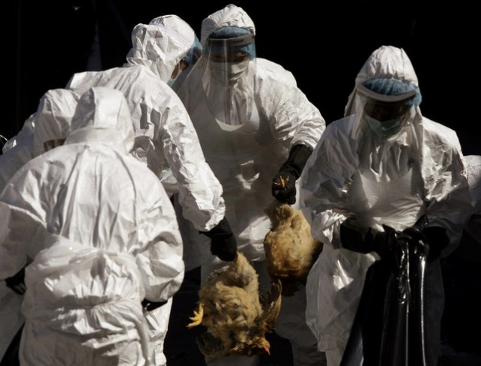
Withholding Publication…
In 2011, two research teams (at the Erasmus Medical Center in the Netherlands and the U of Wisconsin) created a highly transmissible form of the avian flu virus H5N1 and prepared to publish their results in Science and Nature, respectively.
Following much international pressure (and an investigation by a government advisory panel, the National Science Advisory Board for Biosecurity), they reluctantly agreed to withhold vital details of their work for national-security reasons. This is the first time such a step was taken.
Both groups created a highly transmissible form of H5N1 in ferrets, which are considered a good model for humans.
H5N1 rarely infects people but has an extraordinarily high death rate when it does. Since the virus was detected in 1997, ~600 people have contracted it, more than half died. Nearly all caught it from birds (most cases in Asia).
If H5N1 developed the ability to spread easily from person to person, it could create one of the deadliest pandemics ever – or one of the deadliest biological weapons...
Sources: http://www.nti.org/gsn/article/scientists-agree-unprecedented-withholding-flu-virus-research/; http://www.nytimes.com/2011/12/21/health/fearing-terrorism-us-asks-journals-to-censor-articles-on-virus.html?_r=0; last accessed on 10/16/2013

Slide 19


Authorship - Criteria
Publication must give appropriate credit to all authors for their roles in the research. The list of co-authors should reflect the relative contributions of participants in the research.
Many professional associations and research journals have specified criteria for authorship. One common standard […] is that each author should have participated in
formulating the research problem,
interpreting the results, and
writing the research paper, and
should be prepared to defend the publication against criticisms.
Other statements require meeting two or three of the above criteria.

Slide 20
Authorship - Criteria
A person's name should not be listed as author without his or her knowledge, permission, and review of the final version of the manuscript, which includes the names of all co-authors. A procedure that has been adopted by some journals and some universities is that each author must sign a statement attesting to having read and approved the final manuscript and/or to having made a substantial contribution to the manuscript. […]
A person whose contribution merits co-authorship should be named even in oral presentations […]. The entitlement to authorship should be the same whether or not a person is still at the original location of the research when a paper is submitted for publication.
[…] one should avoid the listing of so-called honorary authors, who do not meet the criteria for authorship. Many […] standards for authorship suggest the use of alternative forms of acknowledgment within the paper for contributions that do not merit co-authorship, e.g., for technical assistance, for providing research materials or facilities, or for meeting some but not all of the stated criteria for authorship.
To avoid misunderstandings and even recriminations, the inclusion and exclusion of names of research participants as co-authors should be made clear to all participants in the research prior to submission of the manuscript.

Slide 21
Authorship - Order of Authors
Customs regarding the order in which co-authors' names appear vary with the discipline. Whatever the discipline, it is important that all co-authors understand the basis for assigning an order of names and agree in advance to the assignments.
A corresponding, or senior, author (usually the first or last of the listed names in a multi-authored manuscript) should be designated for every paper, who will be responsible for communicating with the publisher and for informing all co-authors of the status of review and publication […] and who will ensure that all listed authors have approved the submitted version of the manuscript. This person has a greater responsibility than other co-authors to vouch for the integrity of the research report and should make every effort to understand and defend every element of the reported research, even though this may be challenging when the report depends on data generated by co-authors using technical methods in which the senior or corresponding author has no or limited expertise.

Slide 22
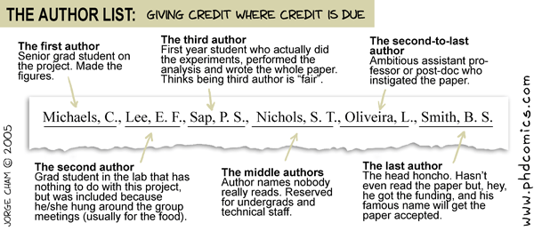
Publication: The Author List

Slide 23
Authorship: Example
Nature 447, 1087-1093 (28 June 2007) | doi:10.1038/nature05887 Genome-wide association study identifies novel breast cancer susceptibility loci
Douglas F. Easton¹, Karen A. Pooley², Alison M. Dunning², Paul D. P. Pharoah², Deborah Thompson¹, Dennis G. Ballinger³, Jeffery P. Struewing⁴, Jonathan Morrison², Helen Field², Robert Luben⁵, Nicholas Wareham⁵, Shahana Ahmed², Catherine S. Healey², Richard Bowman⁶, The SEARCH collaborators and , Kerstin B. Meyer⁷, Christopher A. Haiman⁸, Laurence K. Kolonel⁹, Brian E. Henderson⁸, Loic Le Marchand⁹, Paul Brennan¹⁰, Suleeporn Sangrajrang¹¹, Valerie Gaborieau¹⁰, Fabrice Odefrey¹⁰, Chen-Yang Shen¹², Pei-Ei Wu¹², Hui-Chun Wang¹², Diana Eccles¹³, D. Gareth Evans¹⁴, Julian Peto¹⁵, Olivia Fletcher¹⁶, Nichola Johnson¹⁶, Sheila Seal¹⁷, Michael R. Stratton^{17,18}, Nazneen Rahman¹⁷, Georgia Chenevix-Trench¹⁹, Stig E. Bojesen²⁰, Børge G. Nordestgaard²⁰, Christen K. Axelsson²¹, Montserrat Garcia-Closas²², Louise Brinton²², Stephen Chanock²³, Jolanta Lissowska²⁴, Beata Peplonska²⁵, Heli Nevanlinna²⁶, Rainer Fagerholm²⁶, Hannaleena Eerola^{26,27}, Daehee Kang²⁸, Keun-Young Yoo^{28,29}, Dong-Young Noh²⁸, Sei-Hyun Ahn³⁰, David J. Hunter^{31,32}, Susan E. Hankinson³², David G. Cox³¹, Per Hall³³, Sara Wedren³³, Jianjun Liu³⁴, Yen-Ling Low³⁴, Natalia Bogdanova^{35,36}, Peter Schürmann³⁶, Thilo Dörk³⁶, Rob A. E. M. Tollenaar³⁷, Catharina E. Jacobi³⁸, Peter Devilee³⁹, Jan G. M. Klijn⁴⁰, Alice J. Sigurdson⁴¹, Michele M. Doody⁴¹, Bruce H. Alexander⁴², Jinghui Zhang⁴, Angela Cox⁴³, Ian W. Brock⁴³, Gordon MacPherson⁴³, Malcolm W. R. Reed⁴⁴, Fergus J. Couch⁴⁵, Ellen L. Goode⁴⁵, Janet E. Olson⁴⁵, Hanne Meijers-Heijboer^{46,47}, Ans van den Ouweland⁴⁷, André Uitterlinden⁴⁸, Fernando Rivadeneira⁴⁸, Roger L. Milne⁴⁹, Gloria Ribas⁴⁹, Anna Gonzalez-Neira⁴⁹, Javier Benitez⁴⁹, John L. Hopper⁵⁰, Margaret McCredie⁵¹, Melissa Southey⁵⁰, Graham G. Giles⁵², Chris Schroen⁵³, Christina Justenhoven⁵⁴, Hiltrud Brauch⁵⁴, Ute Hamann⁵⁵, Yon-Dschun Ko⁵⁶, Amanda B. Spurdle¹⁹, Jonathan Beesley¹⁹, Xiaoqing Chen¹⁹ kConFab and AOCS Management Group and , Arto Mannermaa^{118,119}, Veli-Matti Kosma^{118,119}, Vesa Kataja^{118,120}, Jaana Hartikainen^{118,119}, Nicholas E. Day⁶⁵, David R. Cox⁶³ & Bruce A. J. Ponder^{62,67}

Slide 24
…and there is more…!
The SEARCH collaborators
Craig Luccarini⁶¹, Don Conroy⁶¹, Mitul Shah⁶¹, Hannah Munday⁶¹, Clare Jordan⁶¹, Barbara Perkins⁶¹, Judy West⁶¹ & Karen Redman^{61,4}
kConFab
Morteza Aghmesheh⁶², David Amor⁶³, Lesley Andrews⁶⁴, Yoland Antill⁶⁵, Jane Armes⁶⁶, Shane Armitage⁶⁷, Leanne Arnold⁶⁷, Rosemary Balleine68, Glenn Begley69, John Beilby70, Ian Bennett71, Barbara Bennett64, Geoffrey Berry72, Anneke Blackburn73, Meagan Brennan74, Melissa Brown75, Michael Buckley76, Jo Burke77, Phyllis Butow78, Keith Byron79, David Callen80, Ian Campbell81, Georgia Chenevix-Trench82, Christine Clarke83, Alison Colley84, Dick Cotton85, Jisheng Cui86, Bronwyn Culling87, Margaret Cummings88, Sarah-Jane Dawson65, Joanne Dixon89, Alexander Dobrovic90, Tracy Dudding91, Ted Edkins92, Maurice Eisenbruch93, Gelareh Farshid94, Susan Fawcett95, Michael Field96, Frank Firgaira97, Jean Fleming98, John Forbes99, Michael Friedlander100, Clara Gaff101, Mac Gardner101, Mike Gattas102, Peter George103, Graham Giles104, Grantley Gill105, Jack Goldblatt106, Sian Greening107, Scott Grist97, Eric Haan108, Marion Harris109, Stewart Hart110, Nick Hayward82, John Hopper111, Evelyn Humphrey77, Mark Jenkins112, Alison Jones67, Rick Kefford113, Judy Kirk114, James Kollias115, Sergey Kovalenko116, Sunil Lakhani117, Jennifer Leary114, Jacqueline Lim118, Geoff Lindeman119, Lara Lipton120, Liz Lobb121, Mariette Maclurcan122, Graham Mann83, Deborah Marsh123, Margaret McCredie124, Michael McKay109, Sue Anne McLachlan125, Bettina Meiser64, Roger Milne86, Gillian Mitchell109, Beth Newman126, Imelda O'Loughlin127, Richard Osborne111, Lester Peters128, Kelly Phillips65, Melanie Price122, Jeanne Reeve129, Tony Reeve130, Robert Richards131, Gina Rinehart132, Bridget Robinson133, Barney Rudzki134, Elizabeth Salisbury135, Joe Sambrook81, Christobel Saunders136, Clare Scott65, Elizabeth Scott137, Rodney Scott91, Ram Seshadri97, Andrew Shelling138, Melissa Southey86, Amanda Spurdle82, Graeme Suthers108, Donna Taylor139, Christopher Tennant118, Heather Thorne81, Sharron Townshend106, Kathy Tucker64, Janet Tyler64, Deon Venter140, Jane Visvader141, Ian Walpole106, Robin Ward142, Paul Waring90, Bev Warner¹⁴³, Graham Warren¹²⁷, Elizabeth Watson¹²⁷, Rachael Williams¹⁴⁴, Judy Wilson¹⁴⁵, Ingrid Winship¹²⁹ & Mary Ann Young¹⁰⁹
AOCS Management Group
David Bowtell¹⁴⁶, Adele Green⁸², Anna deFazio¹⁴⁷, Georgia Chenevix-Trench⁸², Dorota Gertig¹¹¹ & Penny Webb⁸²

Slide 25
…but different affiliations:
CR-UK Genetic Epidemiology Unit, Department of Public Health and Primary Care and,
Department of Oncology, University of Cambridge, Cambridge CB1 8RN, UK.
Perlegen Sciences, Inc., 2021 Stierlin Court, Mountain View, California 94043, USA.
Laboratory of Population Genetics, US National Cancer Institute, Bethesda, Maryland 20892, USA.
EPIC, Department of Public Health and Primary Care, University of Cambridge, Cambridge CB1 8RN, UK.
MRC Dunn Clinical Nutrition Centre, Cambridge CB2 0XY, UK.
Cancer Research UK Cambridge Research Institute, Cambridge CB2 0RE, UK.
Department of Preventive Medicine, Keck School of Medicine, University of Southern California, Los Angeles, California 90033, USA.
Epidemiology Program, Cancer Research Center of Hawaii, University of Hawaii, Honolulu, Hawaii 96813, USA.
International Agency for Research on Cancer, 150 Cours Albert Thomas, Lyon 69008, France.
National Cancer Institute, Bangkok 10400, Thailand.
Institute of Biomedical Sciences, Academia Sinica, Taipei 11529, Taiwan.
Wessex Clinical Genetics Service, Princess Anne Hospital, Southampton SO16 5YA, UK.
Regional Genetic Service, St Mary's Hospital, Manchester M13 0JH, UK.
London School of Hygiene and Tropical Medicine, London WC1E 7HT, UK, and Institute of Cancer Research, Sutton, Surrey SM2 5NG, UK.
Breakthrough Breast Cancer Research Centre, London SW3 6JB, UK.
Section of Cancer Genetics, Institute of Cancer Research, Sutton, Surrey SM2 5NG, UK.
Cancer Genome Project, Wellcome Trust Sanger Institute, Wellcome Trust Genome Campus, Hinxton, Cambridge CB10 1SA, UK.
Queensland Institute of Medical Research, Brisbane, Queensland 4006, Australia.
Departments of Clinical Biochemistry and
Breast Surgery, Herlev and Bispebjerg University Hospitals, University of Copenhagen, DK-2730 Herlev, Denmark.
Division of Cancer Epidemiology and Genetics, National Cancer Institute, Rockville, Maryland 20852, USA.
Advanced Technology Center, National Cancer Institute, Gaithersburg, Maryland 20877, USA.
Cancer Center and M. Sklodowska-Curie Institute of Oncology, Warsaw 02781, Poland.
Nofer Institute of Occupational Medicine, Lodz 90950, Poland.
Departments of Obstetrics and Gynecology, and
Department of Oncology, Helsinki University Central Hospital, Helsinki 00029, Finland.
Seoul National University College of Medicine, Seoul 151-742, Korea.
National Cancer Center, Goyang 411-769, Korea.
Ulsan University College of Medicine, Ulsan 680-749, Korea.
Program in Molecular and Genetic Epidemiology, Harvard School of Public Health, 677 Huntington Ave., Boston, Massachusetts 02115, USA.
Channing Laboratory, Brigham and Women's Hospital and Harvard Medical School, 181 Longwood Ave., Boston, Massachusetts 02115, USA.
Department of Medical Epidemiology and Biostatistics, Karolinska Institute, Stockholm SE-171 77, Sweden.
Population Genetics, Genome Institute of Singapore, 60 Biopolis Street, Singapore 138672, Republic of Singapore.
Department of Radiation Oncology and

Slide 26
…but different affiliations:
Department of Gynecology and Obstetrics, Hannover Medical School, D-30625 Hannover, Germany.
Department of Surgery and
Department of Medical Decision Making and
Departments of Human Genetics and Pathology, Leiden University Medical Center, Albinusdreef 2, 2333 ZA Leiden, the Netherlands.
Family Cancer Clinic, Department of Medical Oncology, Erasmus MC-Daniel den Hoed Cancer Center, Groene Hilledijk 301, 3075 EA Rotterdam, the Netherlands.
Radiation Epidemiology Branch, Division of Cancer Epidemiology and Genetics, National Cancer Institute, NIH, DHHS, Bethesda, Maryland 20892, USA.
Environmental Health Sciences, University of Minnesota, Minneapolis, Minnesota 55455, USA.
Institute for Cancer Studies and
Academic Unit of Surgical Oncology, Sheffield University Medical School, Sheffield S10 2RX, UK.
Mayo Clinic College of Medicine, Rochester, Minnesota 55905, USA.
VU University Medical Center, 1007 MB Amsterdam, the Netherlands.
Department of Clinical Genetics and
Internal Medicine, Erasmus University, Rotterdam NL-3015-GE, the Netherlands.
Spanish National Cancer Centre (CNIO), Madrid E-28029, Spain.
Centre for Molecular, Environmental, Genetic and Analytical Epidemiology, University of Melbourne, Carlton, Victoria 3053, Australia.
Department of Preventive and Social Medicine, University of Otago, Dunedin 9001, New Zealand.
Cancer Epidemiology Centre, Cancer Council Victoria, Carlton, Victoria 3053, Australia.
Genetic Epidemiology Laboratory, Department of Pathology, University of Melbourne, Parkville, Victoria 3052, Australia.
Dr. Margarete Fischer-Bosch-Institute of Clinical Pharamcology, 70376 Stuttgart and University of Tuebingen, 72074 Tuebingen, Germany.
Deutsches Krebsforschungszentrum, Heidelberg 69120, Germany.
Evangelische Kliniken Bonn gGmbH Johanniter Krankenhaus, 53113 Bonn, Germany.
Peter MacCallum Cancer Centre, Melbourne, Victoria 3002, Australia.
Insitute of Clinical Medicine, Pathology and Forensic Medicine, University of Kuopio, Kuopio FIN-70210, Finland.
Departments of Oncology and Pathology, University Hospital of Kuopio, Kuopio FIN-70211, Finland.
Department of Oncology, Vaasa Central Hospital, Vaasa 65130, Finland.
Department of Oncology, University of Cambridge, Cambridge CB1 8RN, UK.
Oncology Research Centre, Prince of Wales Hospital, Randwick, New South Wales 2031, Australia.
Genetic Health Services Victoria, Royal Children's Hospital, Melbourne, Victoria 3050, Australia.
Hereditary Cancer Clinic, Prince of Wales Hospital, Randwick, New South Wales 2031, Australia.
Department of Haematology and Medical Oncology, Peter MacCallum Cancer Centre, St Andrews Place, East Melbourne, Victoria 3002, Australia.
Anatomical Pathology, Royal Women's Hospital, Carlton, Victoria 3053, Australia.
Molecular Genetics Laboratory, Royal Brisbane and Women's Hospital, Herston, Queensland 4029, Australia.
Departments of Translational and Medical Oncology, Westmead Hospital, Westmead, New South Wales 2145, Australia.
Cancer Biology Laboratory, TVW Institute for Child Health Research, Subiaco, Western Australia 6008, Australia.
Pathology Centre, Queen Elizabeth Medical Centre, Nedlands, Western Australia 6009, Australia.

Slide 27
…but different affiliations:
Silverton Place, 101 Wickham Terrace, Brisbane, Queensland 4000, Australia.
Department of Public Health and Community Medicine, University of Sydney, Sydney, New South Wales 2006, Australia.
John Curtin School of Medical Research, Australian National University, PO Box 334, Canberra, Australian Capital Territory 2601, Australia.
NSW Breast Cancer Institute, PO Box 143, Westmead, New South Wales 2145, Australia.
Department of Biochemistry, University of Queensland, St. Lucia, Queensland 4072, USA.
Molecular and Cytogenetics Unit, Prince of Wales Hospital, Randwick, New South Wales 2031, Australia.
Royal Hobart Hospital, GPO Box 1061L, Hobart, Tasmania 7001, Australia.
Medical Psychology Unit, Royal Prince Alfred Hospital, Camperdown, New South Wales 2204, Australia.
Australian Genome Research Facility, Walter & Eliza Hall Medical Research Institute, Royal Melbourne Hospital, Parkville, Victoria 3050, Australia.
Dame Roma Mitchell Cancer Research Laboratories, University of Adelaide/Hanson Institute, PO Box 14, Rundle Mall, South Australia 5000, Australia.
Peter MacCallum Cancer Centre, St Andrew's Place, East Melbourne, Victoria 3002, Australia.
Queensland Institute of Medical Research, Herston, Queensland 4006, Australia.
Westmead Institute for Cancer Research, University of Sydney, Westmead Hospital ,Westmead, New South Wales 2145, Australia.
Department of Clinical Genetics, Liverpool Health Service, PO Box 103, Liverpool, New South Wales 2170, Australia.
Mutation Research Centre, St Vincent's Hospital, Victoria Parade, Fitzroy, Victoria 3065, Australia.
Centre for Genetic Epidemiology, The University of Melbourne, Level 2 723 Swanston Street, Carlton, Victoria 3053, Australia.
Molecular and Clinical Genetics, Level 1 Building 65, Royal Prince Alfred Hospital, Camperdown, New South Wales 2050, Australia.
Department of Pathology, University of Queensland Medical School, Herston, New South Wales 4006, Australia.
Central Regional Genetic Services, Wellington Hospital, Private bag 7902, Wellington South 6039, New Zealand.
Molecular Department of Pathology, Peter MacCallum Cancer Centre, St Andrew's Place, East Melbourne, Victoria 3002, Australia.
Hunter Genetics, Hunter Area Health Service, Waratah, New South Wales 2310, Australia.
Clinical Chemistry, Princess Margret Hospital for Children, Box D184, Perth, Western Australia 6001, Australia.
Department of Multicultural Health, University of Sydney, New South Wales 2052, Australia.
Tissue Pathology, Institute of Medical & Veterinary Science, Adelaide, South Australia 5000, Australia.
Family Cancer Clinic, Monash Medical Centre, Clayton, Victoria 3168, Australia.
Faculty of Medicine, Royal North Shore Hospital, Vindin House, St Leonards, New South Wales 2065, Australia.
Department of Haematology, Flinders Medical Centre, Bedford Park, South Australia 5042, Australia.
Eskitis Institute of Cell & Molecular Therapies, School of Biomolecular and Biomedical Sciences, Griffith University, Nathan, Queensland 4111, Australia.
Surgical Oncology, University of Newcastle, Newcastle Mater Hospital, Waratah, New South Wales 2298, Australia.
Department of Medical Oncology, Prince of Wales Hospital, Randwick, New South Wales 2031, Australia.
Victorian Clinical Genetics Service, Royal Melbourne Hospital, Parkville, Victoria 3052, Australia.
Queensland Clinical Genetic Service, Royal Children's Hospital, Bramston Terrace, Herston, Queensland 4020, Australia.
Clinical Biochemistry Unit, Canterbury Health Labs, PO Box 151, Christchurch 8140, New Zealand.
Cancer Epidemiology Centre, The Cancer Council Victoria, 1 Rathdowne Street, Carlton, Victoria 3053, Australia.
Department of Surgery, Royal Adelaide Hospital, Adelaide, South Australia 5000, Australia.

Slide 28
…but different affiliations:
Genetic Services of WA, King Edward Memorial Hospital, 374 Bagot Road, Subiaco, Western Australia 6008, Australia.
Wollongong Hereditary Cancer Clinic, Wollongong Public Hospital, Private Mail Bag 8808, South Coast Mail Centre, New South Wales 2521, Australia.
Department of Medical Genetics, Women's and Children's Hospital, North Adelaide, South Australia 5006, Australia.
Familial Cancer Clinic, Peter MacCallum Cancer Centre, St Andrew's Place, East Melbourne, Victoria 3002, Australia.
Breast and Ovarian Cancer Genetics, Monash Medical Centre, 871 Centre Road, Bentleigh East, Victoria 3165, Australia.
Centre for Molecular Environmental, Genetic & Analytic Epidemiology, University of Melbourne, Melbourne, Victoria 3010, Australia.
School of Population Health, The University of Melbourne, 723 Swanston Street, Carlton, Victoria 3053, Australia.
Medical Oncology, Westmead Hospital, Westmead, New South Wales 2145, Australia.
Familial Cancer Service, Department of Medicine, Westmead Hospital, Westmead, New South Wales 2145, Australia.
Breast Endocrine and Surgical Unit, Royal Adelaide Hospital, North Terrace, South Australia 5000, Australia.
Molecular Pathology Department, Southern Cross Pathology, Monash Medical Centre, Clayton, Victoria 3168, Australia.
Molecular and Cellular Pathology, The University of Queensland, Herston, Queensland 4006, Australia.
Department of Psychological Medicine, Royal North Shore Hospital, St Leonards, New South Wales 2065, Australia.
Breast Cancer Laboratory, Walter and Eliza Hall Institute, PO Royal Melbourne Hospital, Parkville, Victoria 3050, Australia.
Medical Oncology and Clinical Haematology Unit, Western Hospital, Footscray, Victoria 3011, Australia.
WA Centre for Cancer, Edith Cowan University, Churchlands, Western Australia 6018, Australia.
Department of Psychological Medicine, University of Sydney, New South Wales 2006, Australia.
Kolling Institute of Medical Research, Royal North Shore Hospital, St Leonards, New South Wales 2065, Australia.
Cancer Epidemiology Research Unit, NSW Cancer Council, 153 Dowling Street, Woolloomooloo, New South Wales 2011, Australia.
Department of Oncology, St Vincent's Hospital, 41 Victoria Parade, Fitzroy, Victoria 3065, Australia.
School of Public Health, Queensland University of Technology, Victoria Park, Kelvin Grove, Queensland 4059, Australia.
St Vincent's Breast Clinic, PO Box 4751, Toowoomba, Queensland 4350, Australia.
Radiation Oncology, Peter MacCallum Cancer Centre, St Andrew's Place, East Melbourne, Victoria 3002, Australia.
Genetic Services, Auckland Hospital, Private Bag 92024, Auckland 1142, New Zealand.
Cancer Genetics Laboratory, University of Otago, PO Box 56, Dunedin 9054, New Zealand.
Department of Cytogenetics and Molecular Genetics, Women and Children's Hospital, Adelaide, South Australia 5006, Australia.
Hancock Family Breast Cancer Foundation, PO Locked Bag 2, West Perth, Western Australia 6005, Australia.
Oncology Service, Christchurch Hospital, Private Bag 4710, Christchurch 8140, New Zealand.
Molecular Pathology Institute of Medical and Veterinary Science, Frome Road, Adelaide, South Australia 5000, Australia.
Section of Cytology, Institute of Clinical Pathology and Medical Research, Westmead Hospital, Westmead, New South Wales 2145, Australia.
School of Surgery and Pathology, QE11 Medical Centre, M block 2nd Floor, Nedlands, Western Australia 6907, Australia.
South View Clinic, Suite 13, Level 3 South Street, Kogarah, New South Wales 2217, Australia.
Department of Obstetrics and Gynaecology, University of Auckland, Private Bag 92019, Auckland 1142, New Zealand.
Department of Radiology, Royal Perth Hospital, Box X2213, Perth 6011, Western Australia, Australia.

Slide 29
…but different affiliations:
Murdoch Institute, Royal Children's Hospital, Parkville, Victoria 3050, Australia.
Family Cancer Clinic, St Vincent's Hospital, Darlinghurst, New South Wales 2010, Australia.
Medical Psychology Research Unit, Royal North Shore Hospital, St Leonards, New South Wales 2065, Australia.
Cancer Genomics & Biochemistry Laboratory, Peter MacCallum Cancer Centre, St Andrew's Place, East Melbourne, Victoria 3002, Australia.
Obstetrics & Gynaecology, Westmead Hospital, University of Sydney, New South Wales 2006, Australia.
…wow… Are we really done yet??
Remember??
“The co-authors of a paper should be all those persons who have made significant scientific contributions to the work reported and who share responsibility and accountability for the results. Other contributions should be indicated in a footnote or an “Acknowledgments” section.” (ACS Guidelines)
Do you think these guidelines are upheld in the above example?
Where is the problem?
How could this be handled?

Slide 30
Author Responsibilities
Correspondence to:
Correspondence and requests for materials should be addressed to D.F.E. (Email: d.easton@srl.cam.ac.uk).
Author Contributions
D.F.E., A.M.D., P.D.P.P., D.R.C. and B.A.J.P. designed the study and obtained financial support.
D.G.B. and D.R.C. directed the genotyping of stages 1 and 2.
D.F.E. and D.T. conducted the statistical analysis.
K.A.P. and A.M.D. coordinated the genotyping for stage 3 and the fine-scale mapping of the FGFR2 and TNRC9 loci.
J.P.S. and J.Z. performed resequencing and analysis of the FGFR2 locus.
K.A.P., S.A., C.S.H., R.B., C.A.H., L.K.K., B.E.H., L.L.M., P.B., S.S., V.G., F.O., C-Y. S., P-E.W. and H-C.W. conducted genotyping for the fine-scale mapping.
R.L., J.M., H.F. and K.B.M. provided bioinformatics support.
D.E., D.G.E., J.P., O.F., N.J., S.S., M.R.S. and N.R. coordinated the studies used in stage 1.
N.W. and N.E.D. coordinated the EPIC study used in stages 1 and 2.
The remaining authors coordinated the studies in stage 3 and undertook genotyping in those studies.
D.F.E. drafted the manuscript, with substantial contributions from K.A.P., A.M.D., P.D.P.P. and B.A.J.P.
All authors contributed to the final paper.

Slide 31
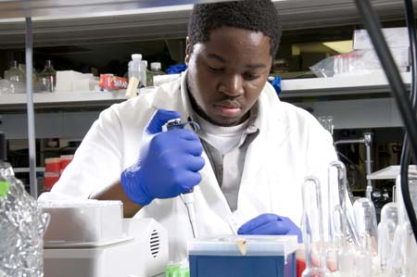
Authorship: A Quick Win…!?
You are an undergraduate research intern. Your supervisor hands you a manuscript by a postdoc in the group and asks you to check the numbers in a data file vs those in the paper and to proofread it carefully. All of the described work was completed before you arrived at the lab. You do as you are asked, verifying that all numbers were transferred correctly to the paper and suggesting some minor editorial changes.
Your supervisor then sends you the following note:
Please send me an email stating that you have examined the data with Dr. PostDoc and find the presentation of data in the manuscript to be accurate (as best you can tell.) After you are done modifying the manuscript with figures, etc., send me a separate email stating that you feel the manuscript is ready for journal submission to enable me to confirm that with the editor-in-chief.
Two months later, you learn that the paper was submitted for publication the day after your proofreading was complete and accepted for publication not long thereafter. You are listed as a (co-)author on the paper.
CONGRATULATIONS – Your first publication!!

Slide 32
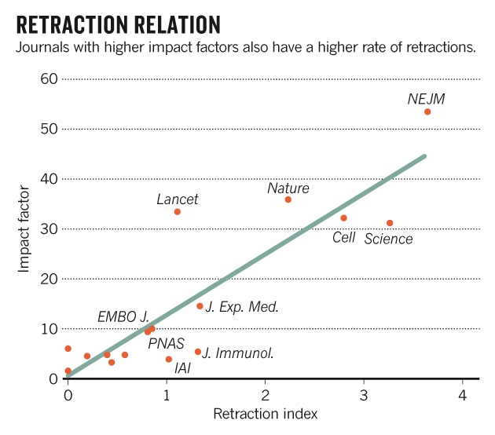
Scientific Publishing and “Impact”…
https://www.nature.com/news/why-high-profile-journals-have-more-retractions-1.15951

Slide 33
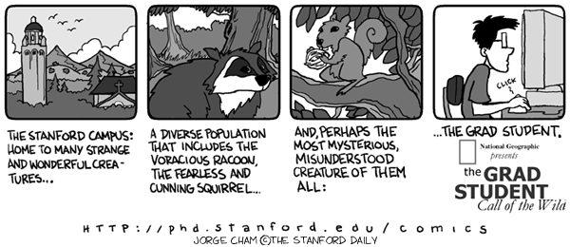
Life as a Graduate Student
Pitt

Slide 34

You MUST read & understand…
http://www.pitt.edu/~provost/ethresearch.html
(moved to: http://www.provost.pitt.edu/documents/GUIDELINES%20FOR%20ETHICAL%20PRACTICES%20IN%20RESEARCH-FINALrevised2-March%202011.pdf The above link forwards automatically to this document.)

Slide 35
Some Rules of Graduate Life
“Work expands so as to fill the time available for its completion” (Parkinson’s Law)
a task will also swell in perceived complexity and importance in direct proportion to the amount of time you allot to it.
This is made worse by Hofstadter's Law: “It always takes longer than you expect, even when you take into account Hofstadter's law.”

Slide 36
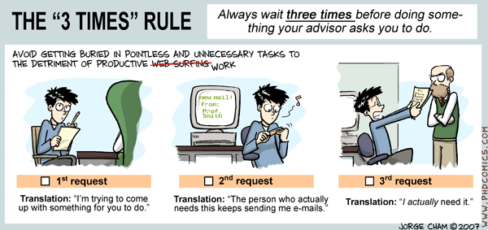
Solutions… (??)
Limit the amount of time you have to do tasks! Do not procrastinate!
For every hour of your working day, have a clear idea of what you have to accomplish in that time.
Have tasks that follow which depend on completion of work in the preceding time period.
These mini deadlines in conjunction with fixed items in your calendar (meetings, talks etc) give you a hard landscape which helps enforce deadline pressure early on (i.e. avoid last minute panic!).

Slide 37
Responsibilities for PhD Students
(From: ACS Academic Professional Guidelines)
Responsibilities to the Faculty and the Institution
The student should demonstrate honesty, integrity, and diligence in the conduct of research, teaching, and in the completion of academic courses. The graduate student should diligently pursue coursework and, as appropriate, teaching and thesis research. Included in this obligation is the timely completion of manuscripts, publications, and a dissertation.
Students have the responsibility to vigorously pursue educational opportunities directed toward becoming professionals.
Students should broaden their educational and professional development through experiences such as industrial internships, coursework in other disciplines, and other experiential programs.
It is the responsibility of the student to monitor progress in coursework, consult with appropriate individuals when difficulty arises, and cooperate in efforts to resolve these difficulties. The student should seek further guidance from an appropriate higher academic or administrative level if a problem cannot be resolved with the faculty member.

Slide 38
Responsibilities for PhD Students
(From: ACS Academic Professional Guidelines)
The research student or postdoctoral associate should consult the supervising faculty advisor/mentor at appropriate intervals regarding progress and should openly discuss relevant technical and administrative problems. If a problem cannot be resolved with the faculty advisor/mentor, the graduate student or postdoctoral associate should seek further guidance from an appropriate higher academic or administrative level.
The student should honor commitments relating to teaching and research. The student should recognize that the faculty member devotes significant time and effort to classroom teaching, supervision of research, and other professional activities. The commitment by the faculty member should be matched by the student.
Students should maintain open lines of communication with other students and with faculty members.

Slide 39
Responsibilities for PhD Students
(From: ACS Academic Professional Guidelines)
Students should clearly understand their rights and obligations related to intellectual property and authorship, keep accurate and complete laboratory notebooks and records to document their work and ideas, and communicate their results as appropriate.
Students should be fully aware of the ethical, legal, health, and safety implications of their education, research, and teaching.
Students and postdoctoral associates should take personal responsibility for understanding, practicing, and promoting appropriate safety procedures .

Slide 40
Responsibilities for PhD Students
(From: ACS Academic Professional Guidelines)
Mentoring opportunities should be actively sought. More experienced students should serve as mentors and educators for others. Prospective mentors should seek professional development opportunities to increase their mentoring skills.
Postdoctoral associates should recognize their dual role as both employees and scientific peers of their research mentor. Postdoctoral appointments should be considered a short term transitional period between graduate school and an independent professional position.
Postdoctoral appointments should broaden the base of the associate’s knowledge and be of mutual benefit to the associate and host laboratory.

Slide 41
Responsibilities for Faculty
(From: ACS Academic Professional Guidelines)
The faculty member should exhibit honesty, integrity, and diligence in the conduct of research, teaching, mentoring, and all other professional responsibilities.
The faculty member must take responsibility for establishing a laboratory environment consistent with the current best practices in chemical safety […].
The faculty member should contribute to building a collegial environment among all full and part-time faculty members, students, postdoctoral associates, and staff.
The faculty member should be a model for the professional development of students, colleagues, and staff by continuing professional development and scholarship. Broader self-education within the discipline of chemistry and chemical education as well as outside of chemistry is appropriate.
Full attention should be directed to student learning, recognizing that the acquisition, interpretation, and dissemination of knowledge are the principal functions of an academic institution. In this role as a teacher, the faculty member should stimulate the students' interest, broaden their outlook, and encourage a sense of inquiry.

Slide 42
Responsibilities for Faculty
(From: ACS Academic Professional Guidelines)
The faculty member should willingly serve as a mentor to students, postdoctoral associates, and other faculty members. Mentoring should include assistance in developing a successful career and should encourage the development of a sense of inquiry, a habit of broad-based learning, and professional communication skills. The special obligation to provide sound guidance to undergraduate students should be recognized. […].
The faculty member should encourage and provide opportunities for students to develop writing, speaking, listening, or other communication skills necessary to achieve success in their careers.
The faculty member should encourage the development of initiative and independent thinking by students and postdoctoral associates.
The faculty member should maintain an environment in the research laboratory that fosters productivity, collaboration, and respect among co-workers.

Slide 43
Responsibilities for Faculty
(From: ACS Academic Professional Guidelines)
The faculty member should recognize the research contributions of students, postdoctoral associates, or staff by co-authorship or appropriate acknowledgment in publications.
Regular and periodic evaluation should be provided to students and postdoctoral associates. This communication should concern the progress of the research and provide feedback regarding the status relevant to the project, as well as constructive suggestions toward resolution of any research difficulties encountered. A functioning advisory committee should be formed for each graduate student as soon as the research is initiated. The committee should meet periodically with the student and faculty member to evaluate progress and to provide further guidance to the student.
The faculty member should guide the student so the degree requirements, including coursework and research, can be satisfactorily completed in a reasonable amount of time. If satisfactory progress is not being made, the faculty member should inform the student that a problem exists and offer the student opportunities to correct the situation. Options may include changing research projects or faculty advisors. This discussion should occur as soon as a problem is noticed.

Slide 44
Common Causes for Problems during Graduate Studies
Failure to appreciate fundamental nature of graduate studies.
Inability to demonstrate progress (Your PhD or MS degree is not awarded for time spent in the lab…).
Unreasonable demands by advisor (due to career stress, ambition, etc).
Failure to communicate effectively with research advisor.
Failure to communicate effectively with research advisor.
Failure to communicate effectively with research advisor..
Failure to communicate effectively with research advisor…
Failure to communicate effectively with research advisor…

Slide 45
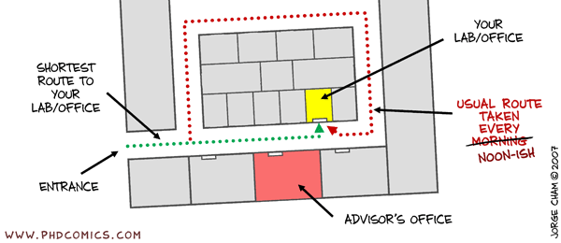
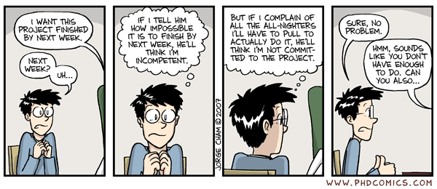
Communicate! (that means: TALK!)

Slide 46


And a “Final Resource”…
Pitt has a new ‘D&PD Career Development’ Program!!
http://www.dpcd.pitt.edu/
It has a wide range of resources and a list of events.
Check it out!!

