Slide 1


Analogy Abduction Simplicity
John D. Norton
Department of History and Philosophy of Science
University of Pittsburgh
June 28, 2022
Mangoletsi-Potts Lectures 2022

Slide 2
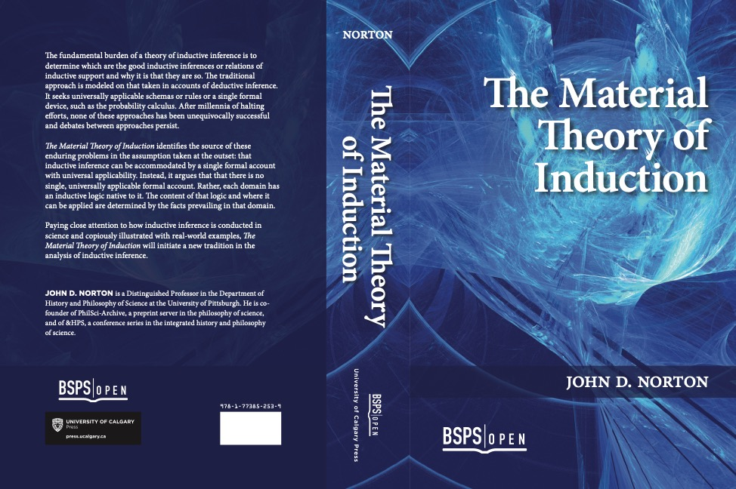
Material Theory of Induction

Slide 4
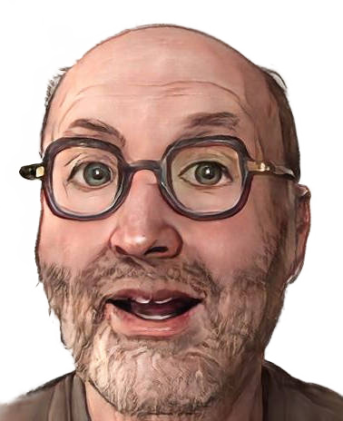
The Material Theory of Induction
There are no universal, formal schema for inductive inference.
Inductive inferences are warranted by local facts.
Existing accounts of inductive inference succeed—when they do—because of background facts.
SHOW THIS

Slide 5
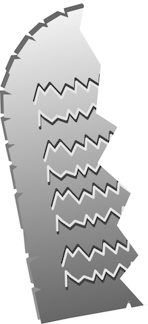
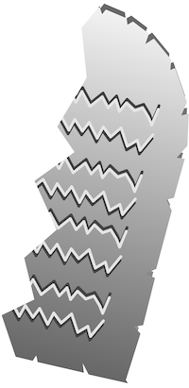
Mode of Failure
Candidate universal schema
Material theory of induction
counterexample in new domain
Embellished universal schema
Different facts in each domain warrant superficially similar inferences.
counterexample in new domain
Embellished, embellished universal schema
This mode of failure is expected.
counterexample in new domain

Slide 6
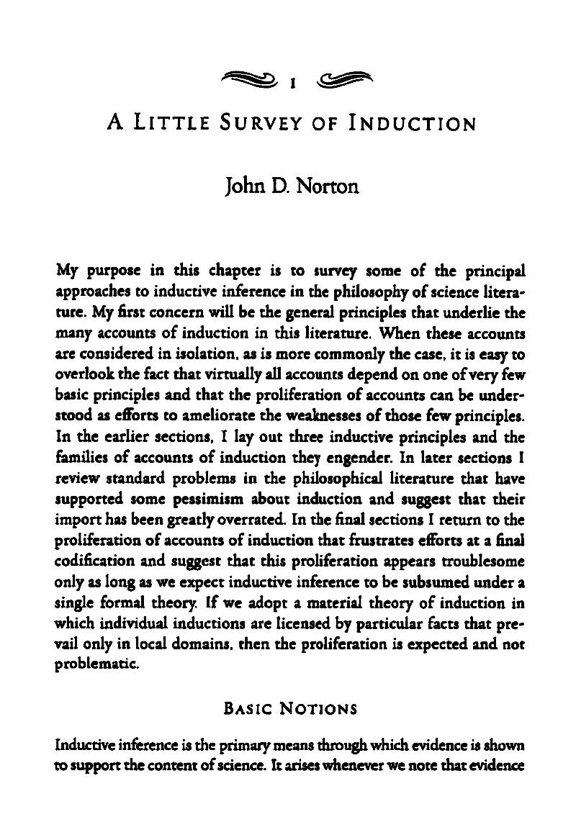
"A Little Survey of Induction," in P. Achinstein, ed., Scientific Evidence: Philosophical Theories and Applications. Johns Hopkins University Press, 1905. pp. 9-34.

Slide 7
Three families
Family
Inductive generalization
Hypothetical induction
Probabilistic
induction
Principle
An instance confirms the generalization
Entailing the evidence is a mark of truth
Degrees of support are governed by a calculus
Enumerative Induction
Saving the phenomena
Probabilities in games of chance
Archetype
Enumerative induction
Inference to the best explanation (abduction)
Elaborations
Analogy
Inference to the best explanation (abduction)
Exclusionary accounts
Simplicity
Reliabilism
Bayesianism
Imprecise probabilities
Alternative calculi
Analogy
Hempel’s satisfaction criterion
Mill’s methods
Glymour bootstrap
Simplicity

Slide 8
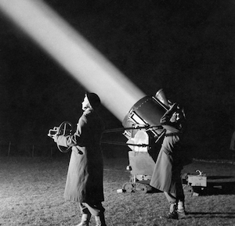
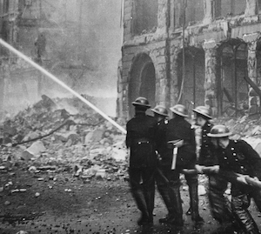
Analogy

Slide 9
Understood,
Formally

Slide 10


Bare Analogy
S₁ is P.
S₂ resembles S₁ in being M.
----------------------------------
[therefore] S₂ is P.
(Joyce, 1936)
A fixture in traditional accounts of logic back to Aristotle.
Failures
Seas on the moon have no water.
Canals of Mars aren’t.
Whales are like fish but aren’t.
Heat flows like a fluid but isn’t.
Light undulates like waves in a medium, but hasn’t got one.
…
Successes
Galileo and the mountains of the moon.
Electrostatics and gravity in the 18th c.
Darwin and artificial and natural selection.
…
Reynolds’ analogy.
Liquid drop model of the nucleus.
…

Slide 11
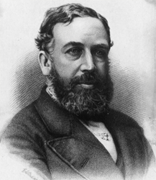
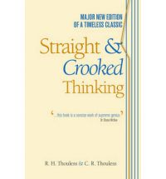
Doubts
Merely bad luck for a good inference form? Or…
There is no way in which we can really assure ourselves that we are arguing safely by analogy. The only rule that can be given is this, that the more closely two things resemble each other, the more likely it is that they are the same in other respects, especially in points closely connected with those observed . … In order to be clear about our conclusions, we ought in fact never to rest satisfied with mere analogy, but ought to try to discover the general laws governing the case.
William Stanley Jevons, 1879.
Even the most successful analogies in the history of science break down at some point. Analogies are a valuable guide as to what facts we may expect, but are never final evidence as to what we shall discover. A guide whose reliability is certain to give out at some point must obviously be accepted with caution. We can never feel certain of a conclusion which rests only on analogy, and we must always look for more direct proof. Also we must examine all our methods of thought carefully, because thinking by analogy is much more extensive than many of us are inclined to suppose.
Thouless, Straight and Crooked Thinking

Slide 12
Two-Dimensional Account
Mary B. Hesse, Models and Analogies in Science. (1966)
Source
Target
Bartha’s synopsis
Positive Analogy
Property P
Property P*
Property A
Property not-A*
Negative Analogy
Property not-B
Property B*
Property Q
Property Q*
When the weight of the positive analogy prevails…
infer

Slide 13
Two-Dimensional Account
Mary B. Hesse, Models and Analogies in Science. (1966)
Source
Target
Vertical relations:
“causal relations in some acceptable scientific sense…”
Property P
Property P*
Property A
Property not-A*
?? The cogency of the account depends on the cogency of our account of causation. ??
Property not-B
Property B*
Property Q
Property Q*
Horizontal relations:
?? No formal analogies??
NO: Formal analogies = isomorphic interpretations of the same formal theory
YES: Pre-theoretic material analogies between observables

Slide 14
The Articulation Model
Paul Bartha, By Parallel Reasoning: The Construction and Evaluation of Analogical Arguments. (2010)
Vertical relations:
1. Predictive
2. Explanatory
3. Functional
4. Correlative.
Source
Target
inductive or deductive
Property P
Property P*
inductive
Property A
Property not-A*
determinants of plausibility
Property not-B
Property B*
Property Q
Property Q*
is plausible.
a. strength of prior association
b. extent of correspondence
c. existence of multiple favorable analogs
d. only non-defeating competing analogs
e. only non-defeating counteracting causes
I. Prior association:
Vertical relation to be extended to target.
II. Potential for Generalization:
“no compelling reason” precludes extension.
Assessment extended through multistage process:
prima facie plausibility, qualitative plausibility…

Slide 15
Understood, Materially

Slide 16
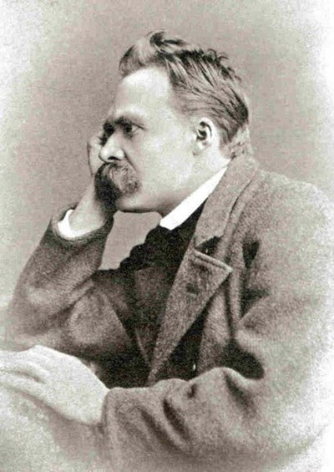
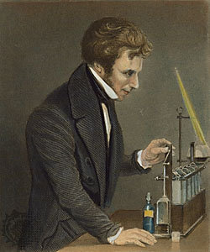
Philosophers
Scientists
Analogy is a part of the
theory of inference.
It is investigated by seeking general formal rules.
Analogies are facts of nature. They are uncovered by empirical investigation.
…but no complete formal scheme has been found.
(I add)… and are the warrants of analogical inferences.
Notes:
Philosopher is Nietsche. Scientist in Faraday.

Slide 17
A Single Material Fact for all Analogical Inference?
Universal Principle of Similarity
Things similar in some properties.
Things similar in other properties.
FAILS. Else a formal schema would be possible.
Each analogical inference.
particular fact peculiar to its domain.
Endpoint of the chain of warrants.
warranted by

Slide 18
Case Studies
All three turn out to be demonstrative inductions! Inductive risk taken in accepting fact of analogy.
Fact of analogy
Inference
Galileo and the mountains of the moon
Darknesses on moon due to prominences obstructing linearly propagating sunlight, similar to shadows on earth.
There are mountains and valleys on the moon.
The mountains are up to 4 miles high.
Reynolds analogy
The mechanism of momentum and heat transfer the same.
Rates are proportional.
Stanton = friction factor/8
From rates of momentum transport (pressure drop) to rates of heat transport.
Liquid drop model of the nucleus
Energy term in
(nucleon number)^{2/3}.
Excitation modes match classical liquid drop.
Which nuclei are stable. (OK)
Energy of nuclear excitations.
(poor)

Slide 19
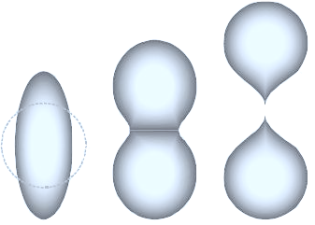

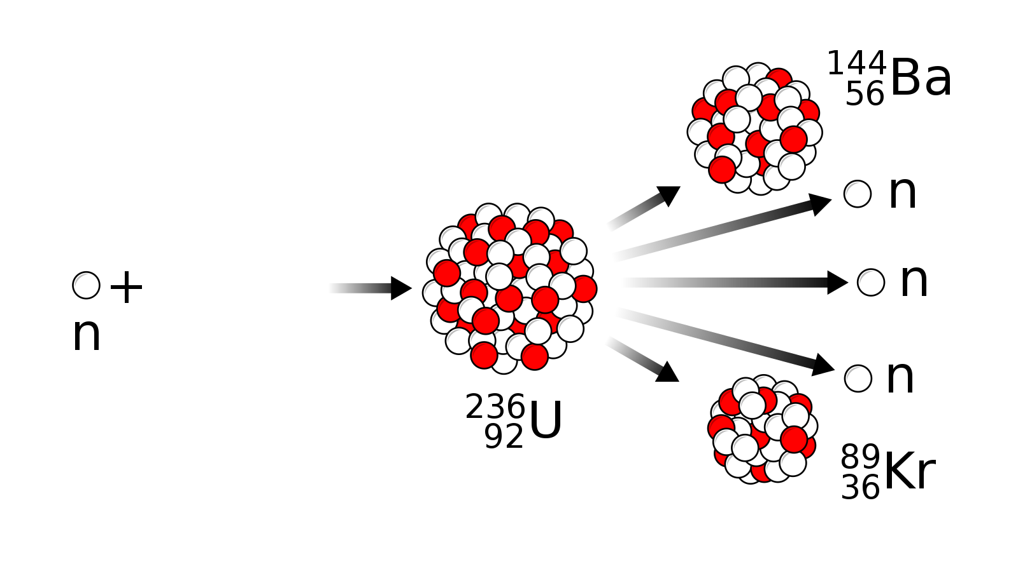
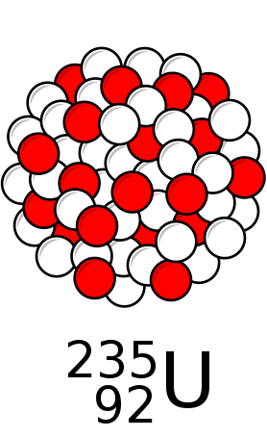
Liquid Drop Model of the Nucleus
A liquid drop is stable because it minimizes surface energy.
Surface energy
area
α
volume^{2/3}
α
Same
mechanism
=
Fact of analogy
Disturbance leads to fission of drop.
A nucleus is stable because it minimizes surface energy.
Surface energy
volume^{2/3}
α
α
(nucleon number)^{2/3}

Slide 20

Simplicity

Slide 21

The Principle of Parsimony
WINNER
Among many theories adequate to experience, choose …
Theory₂
Theory₃
Theory₁
Theory₄
… the simplest.
Observation and experiment.

Slide 22
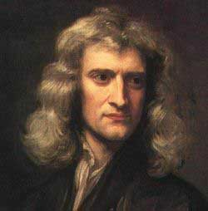
Nature is Simple: Newton
Rule I. We are to admit no more causes of natural things than such as are both true and sufficient to explain their appearances.
To this purpose the philosophers say that Nature does nothing in vain, and more is in vain when less will serve; for Nature is pleased with simplicity, and affects not the pomp of superfluous causes.
Rule II. Therefore to the same natural effects we must, as far as possible, assign the same causes.
As to respiration in a man and in a beast; the descent of stones in Europe and in America; the light of our culinary fire and of the sun; the reflection of light in the earth, and in the planets.
Isaac Newton, Rules of reasoning in philosophy
“Nature is pleased with simplicity, and affects not the pomp of superfluous causes.”

Slide 23
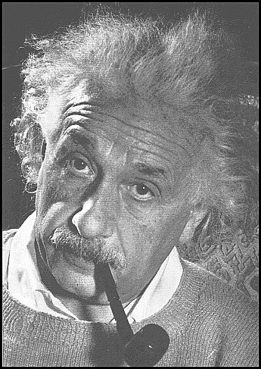
Nature is Simple: Einstein
“…I would like to state a proposition that at present cannot be based upon anything more than upon
a faith in the simplicity, i.e., intelligibility, of nature: there are no arbitrary constants of this kind…”
Autobiographical Notes.
Our experience hitherto justifies us in
believing that nature is the realization of the simplest conceivable mathematical ideas.”
On the Methods of Theoretical Physics, 1933.

Slide 24
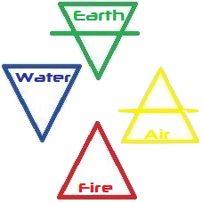
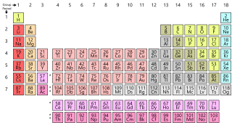
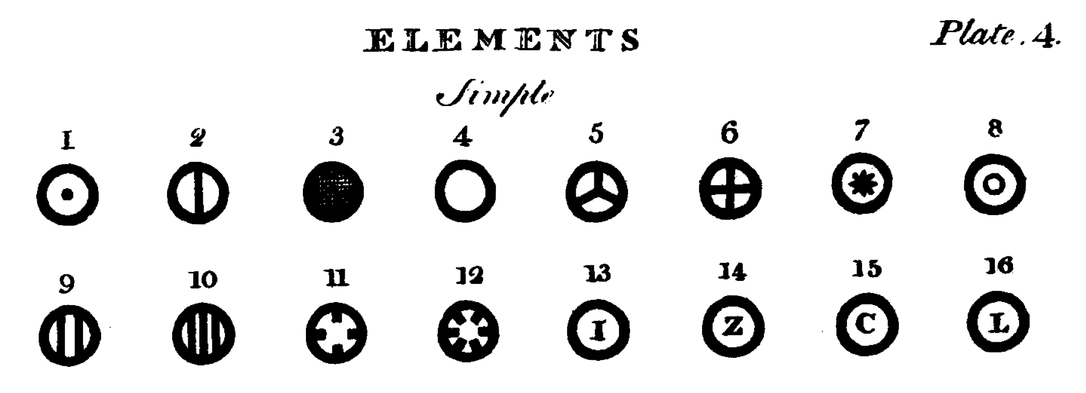
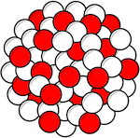
Nature is NOT Simple
Simple
Nature
Number of elements
FOUR
Earth, Air, Fire, Water
ONE HUNDRED +
elements in periodic table
Types of atoms for each element.
ONE
MANY
Dalton
Isotopes

Slide 25
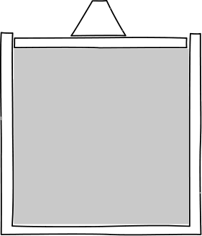
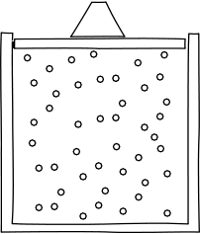
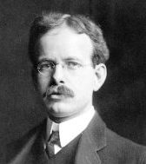
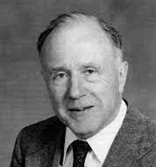
Simple is NOT Simple.
continuum gas
molecular gas
No single meaning
broad enough to support a universal principle of parsimony.
one entity
10²³ entities
infinitely many parts
finitely many parts
Aesthetic judgments
of simplicity are made post hoc and reflect the achievement of comfort with a new theory.
General relativity in 1920
"... the complications of the theory of relativity are altogether too much ... I fear it will always remain beyond my grasp ..."
Hale, 1920
General relativity in 1973
“Einstein’s theory of gravity is simple; Newton’s is complex.”
Misner, Thorne and Wheeler, 1973

Slide 26
Understood
Materially

Slide 27


Simplicity is a Surrogate for background facts that warrant the conclusion.
Spelling out all the complications of these background facts can be tiresome.
The simplest thing is to say:
“The simplest thing is…”

Slide 28
Curve Fitting,
Abstractly

Slide 29
Hierarchy of Functions
quartic
cubic
quadratic
linear
constant
Real least squares fit to the data.
Choose the simplest that works.
Notes:
Data plotted is n = number of primes in the interval (x+20)^2 to (x+21)^2 for x= 0 to 80. y = n^3/100

Slide 30
Background Assumptions make simplicity a mark of truth.
Reparametrize
I. The right parameterization is used.
1, x, x², x³, x⁴, x⁵, x⁶, x⁷, …
rescale z = x³
1, z, z², …
The right parametrization well-adapted to the true processes.
II. Order hierarchy matches the strength, likelihood of processes, causes.
For cyclic processes,
first fit periodic function
sin (t) = x – (1/3!) t³ + (1/5!) t⁵ - …
before any finite order polynomial in t.
Simplicity in curve fitting is a surrogate for these background assumptions.

Slide 31
I. and II. Combined.
Reparameterize
same data with
z = sin⁻¹x
True curve
y = sin z = z – (1/3!)z³ + (1/5!)z⁵ - …
cannot be found in finite ascent of polynomial hierarchy.
Data generated by true curve y=x

Slide 32
Curve Fitting,
Concretely

Slide 33
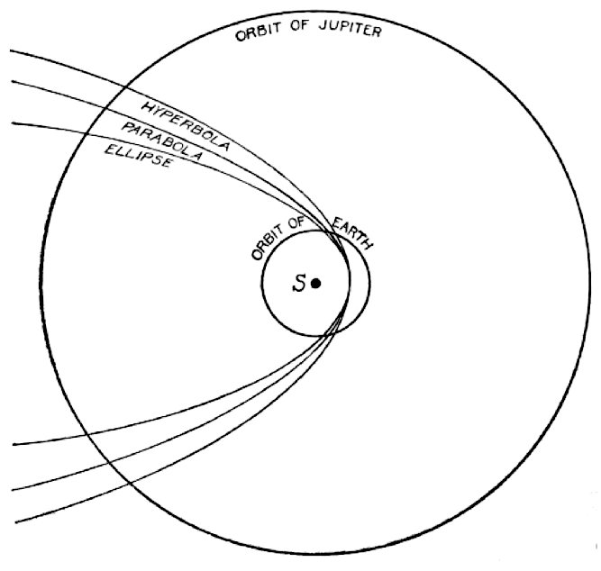
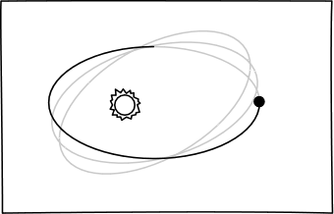
Fitting trajectories to planets, comets…
Background assumptions
Fit parabola, ellipse, hyperbola.
(Not straight line.)
Newton’s theory of gravity holds.
Object deflected by sun.
No other object exerts a perceptible deflecting force.
Ellipse most likely since then comet returns periodically.
Fit ellipse whose elements change with time.
There must be another object deflecting.
1846: successful prediction of Neptune for perturbations in Uranus.
1915: anomalous motion of Mercury explained by general relativity. Background assumption fails.
Advancing perihelion

Slide 34
Harmonic analysis of tides: the toy theory

Slide 35
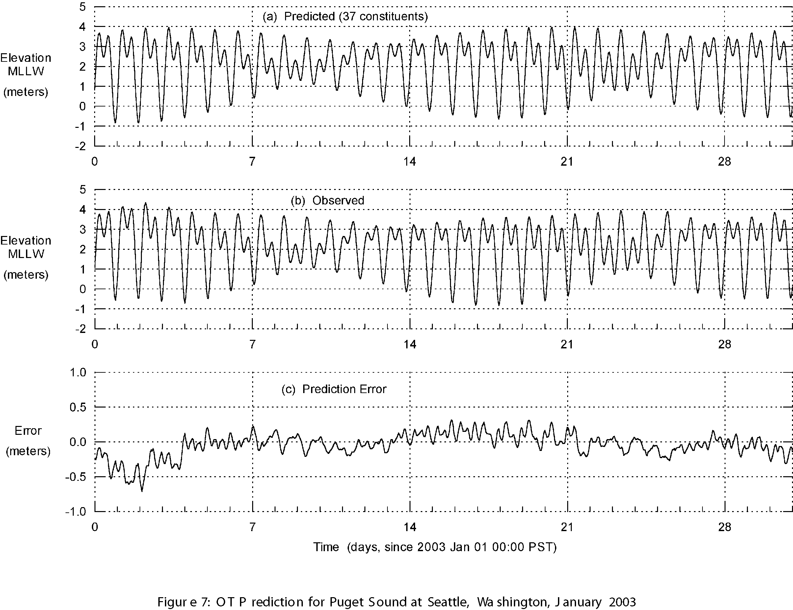
Harmonic analysis of tides: the real theory
Joe S. Depner, “Mathematical Description of Oceanic Tides,” 2012

Slide 36
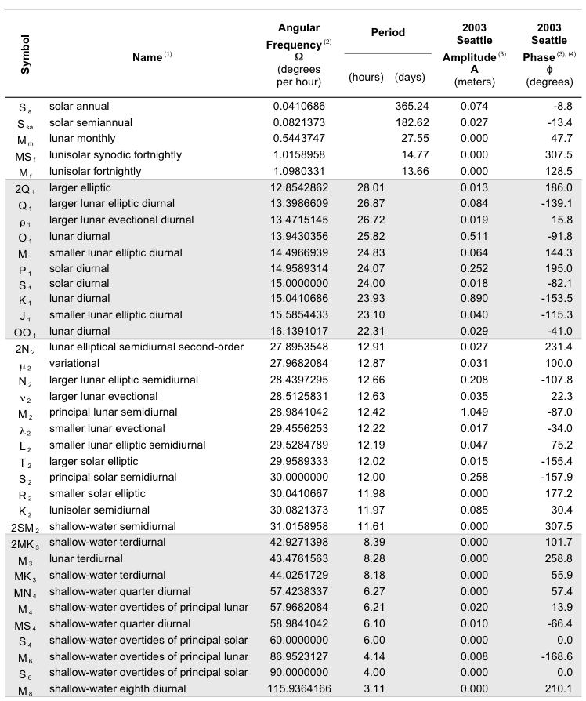
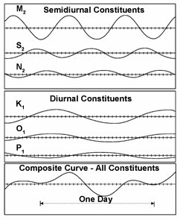
Physical Basis of 37 Harmonic Constituents Fitted

Slide 37
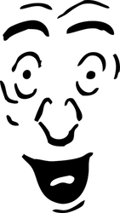
Abduction
Inference to the Best Explanation

Slide 38
The Principle
WINNER
Among many theories adequate to experience, choose …
Theory₂
Theory₃
Theory₁
Theory₄
… the best explnation.
Observation and experiment.

Slide 39
Understood, Formally

Slide 40
A better explanation is…
… more consilient
… simpler
… better analogy
… more plausible
… less ad hoc
… lovelier
and
…mechanism, scope,
fertility, fit, unification,
…
…
One task
Explicate explanation.
Complicated, heterogeneous notion of explanation.
????
Many tasks
Explicate all these …
Simple homogenous notion of truth?

Slide 41
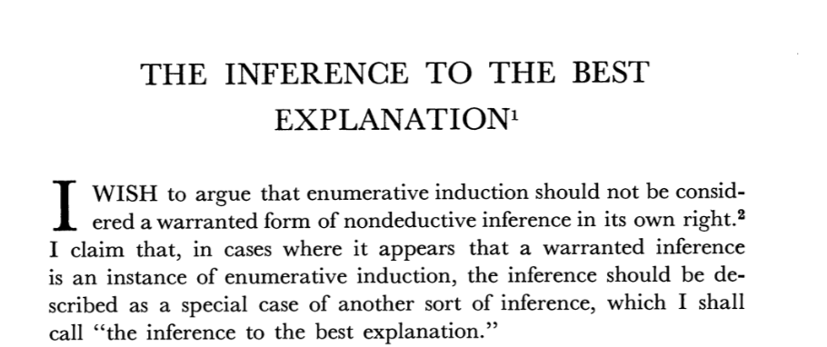
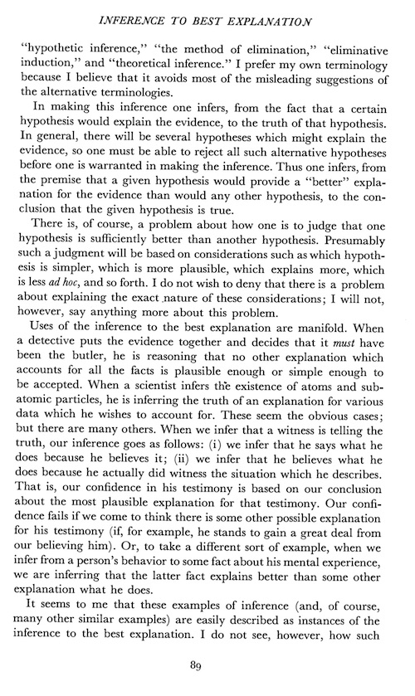
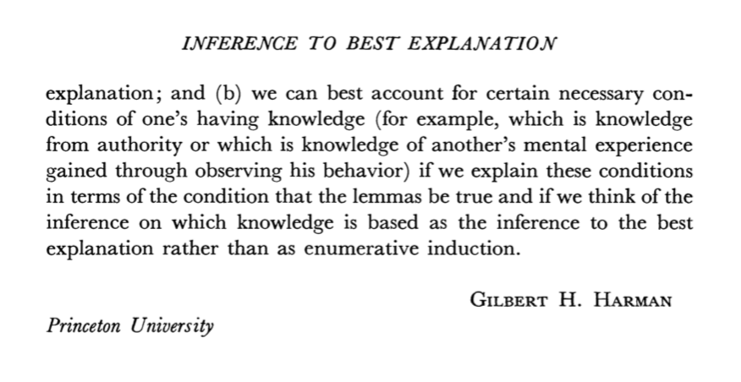
Gilbert Harman
“There is, of course, a problem about how one is to judge that one hypothesis is sufficiently better than another hypothesis. Presumably such a judgment will be based on considerations such as
which hypothesis is simpler,
which is more plausible,
which explains more,
which is less ad hoc,
and so forth. I do not wish to deny that there is a problem about explaining the exact nature of these considerations; I will not, however, say anything more about this problem.”

Slide 42
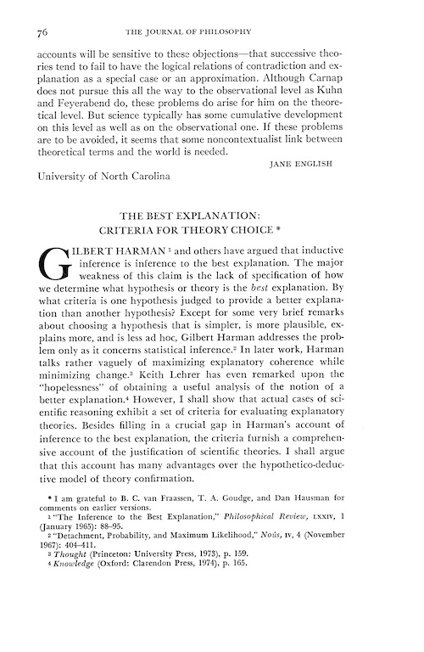
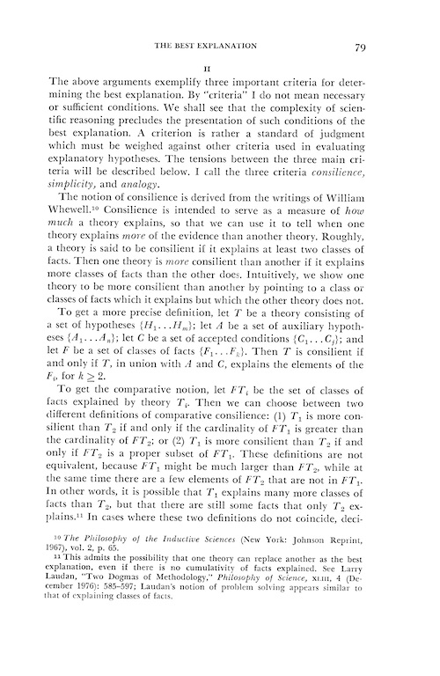
Paul Thagard
“ … three important criteria for determining the best explanation …
… standard of judgment which must be weighed against other criteria …
… I call the three criteria
consilience,
simplicity,
and analogy.”

Slide 43
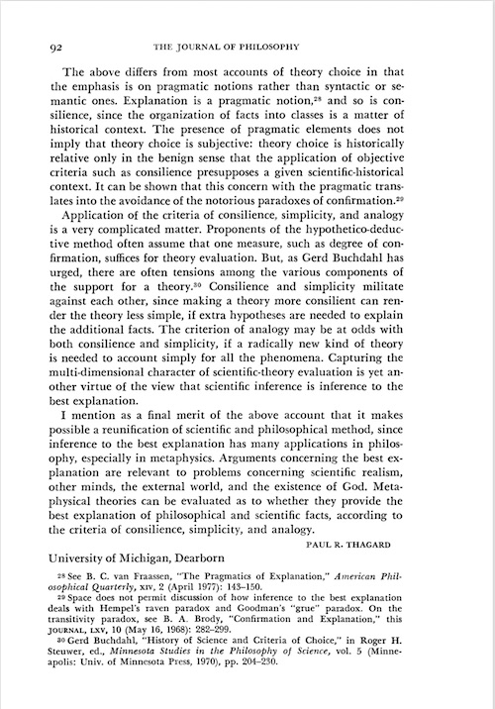
Paul Thagard
“Application of the criteria of consilience, simplicity, and analogy is a very complicated matter.
… Consilience and simplicity militate against each other…
… analogy may be at odds both consilience and simplicity.”

Slide 44
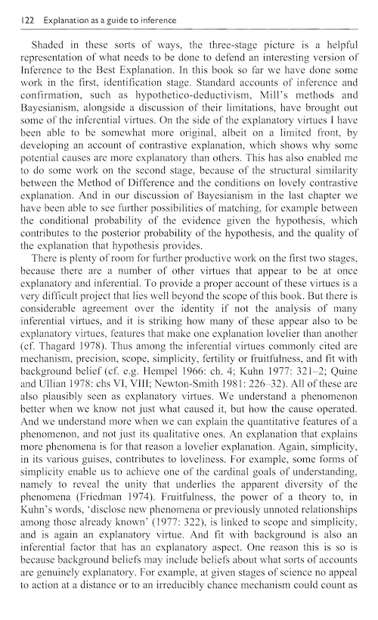
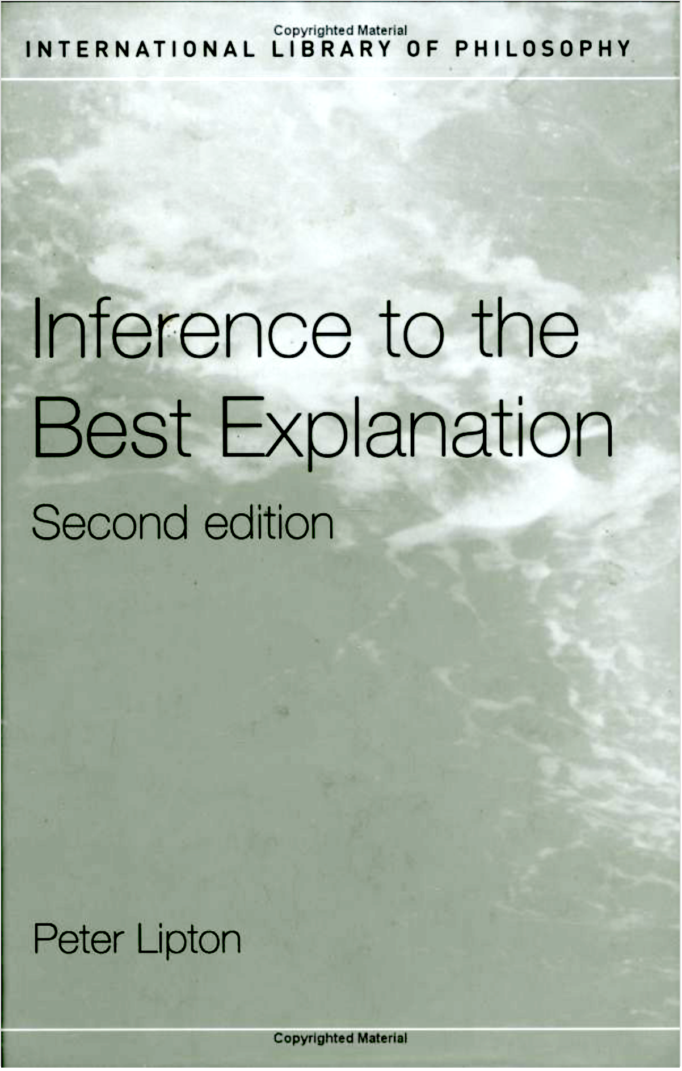
Peter Lipton
“…inferential virtues commonly cited are
mechanism,
precision,
scope,
simplicity,
fertility or fruitfulness, and
fit with background belief…
All these are plausibly seen as explanatory virtues.”
Added, p. 139 “unification”

Slide 45
Understood, Materially

Slide 46
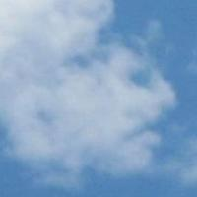
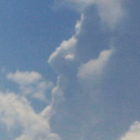
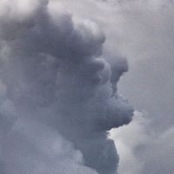
There is …
no inductively potent notion of scientific explanation.
Unity of abductive inferences is merely a superficial similarity.
Discovered inductively.
Faces in clouds.

Slide 47
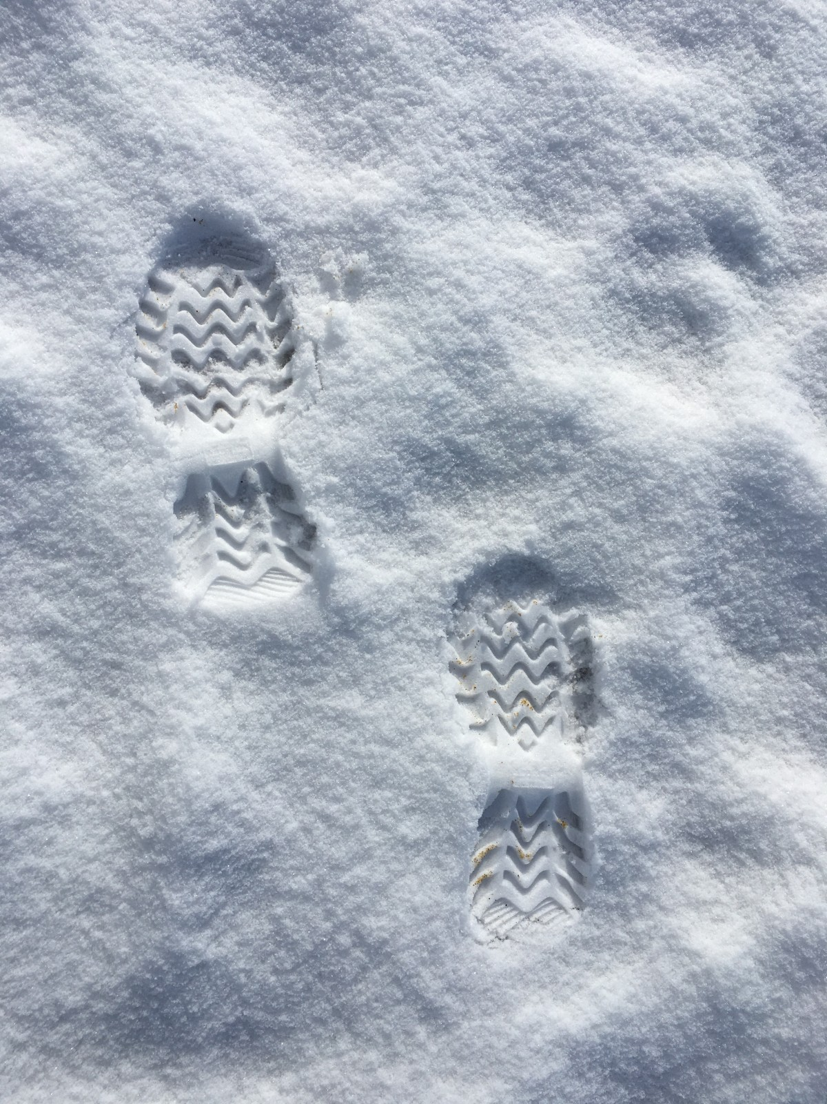
Importance of real case studies
“Faced with tracks in the snow of a certain peculiar shape, I infer that a person on snowshoes has recently passed this way.”
(Lipton, 2004, p. 6)
“Of course, there is always more than one possible explanation for any phenomenon–the tracks might have instead been caused by a trained monkey on snowshoes, or by the elaborate etchings of an environmental artist–so we cannot infer something simply because it is a possible explanation. It must somehow be the best of competing explanations.”
(p. 56)

Slide 48
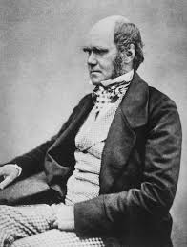
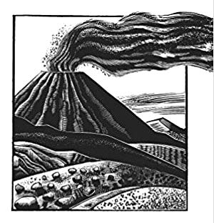
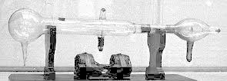
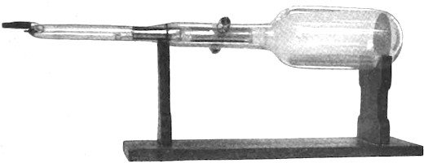
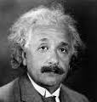
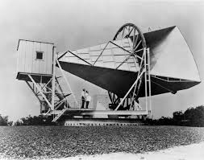
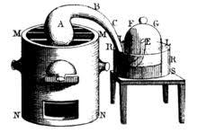
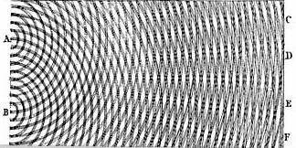
Case Studies
Darwin on the origin of species
Lyell’s uniformitarian geology
Thomson for cathode rays as charged particles
Lenard for cathode rays as ether processes
Einstein’s explanation of Mercury’s anomalous motion
Cosmic background radiation from the big bang
Lavoisier’s oxygen chemistry.
Wave theory of light.

Slide 49
Two Step Structure
Step 1
Favored theory or hypothesis.
vs
Foil
(one or more)
Adequate to the evidence, usually deductively entails it.
Fails.
Evidence contradicts it; or incurs evidential debt.
No distinctive, inductively potent notion of explanation.
Strength of abduction from failure of foil.
Step 2
Favored theory is better.
Favored theory is best.
Hard to establish. Often neglected.

Slide 50

Darwin for Natural Selection
“Many other facts are, as it seems to me, explicable on this theory. How strange it is that a bird, under the form of a woodpecker, should prey on insects on the ground; that upland geese which rarely or never swim, should possess webbed feet; that a thrushlike bird should dive and feed on sub-aquatic insects; and that a petrel should have the habits and structure fitting it for the life of an auk! and so in endless other cases. But on the view of each species constantly trying to increase in number, with natural selection always ready to adapt the slowly varying descendants of each to any unoccupied or ill-occupied place in nature, these facts cease to be strange, or might even have been anticipated.”
6th ed, 1876, p. 414.

Slide 51
Two Step Structure
Step 1
Natural selection
vs
Special creation
Webbed feet from adaptation of aquatic bird to land.
Webbed due to arbitrary choice of designer.
Step 2
Favored theory is better.
Favored theory is best.
??? Tacit assumption that options are exhaustive.

Slide 52

“Explanation of the Perihelion Motion of Mercury by the General Theory of Relativity.”
In the present paper, I find an important confirmation of this most radical theory of relativity; that is, it turns out that the secular rotation of Mercury’s orbit in the direction of the orbital motion, discovered by Leverrier, which amounts to about 45” in a century, is explained qualitatively and quantitatively, without having to posit any special hypothesis at all.
November 18, 1915

Slide 53

Two Step Structure
Step 1
General relativity
vs
Foils
1. Other planet or planets
2. Flattened sun
3. Distributed matter in zodiacal light
4. Deviations from 2 in inverse square law
Perihelion motion of Mercury derived.
Contradicted by the (extended) evidence
February 27, 1915
Step 2
Favored theory is better.
Favored theory is best.
??? Tacit assumption that options are exhaustive.

Slide 54
Abduction
Foil
Foil eliminated
Generalization from better to best
Darwin on the origin of species
Independent creation
Refuted by traits without function
Tacit assumption of exhaustive choice
Lyell’s uniformitarian geology
Geologies using presently unknown causes
Novel causes incur an undischarged evidential debt
Known versus unknown causes is exhaustive
Thomson for cathode rays as charged particles
Cathode rays are processes in the ether.
Contradiction with experiment: Ether waves are bent by a uniform field
Tacit assumption of exhaustive choice
Lenard for cathode rays as ether processes
Cathode rays are processes in matter
Contradiction with experiment: cathode rays in evacuated tubes
Choice between matter and ether posed as exhaustive dilemma.
Einstein’s explanation of Mercury’s anomalous motion
Many. Modifications to Newtonian theory. Unobserved masses.
Contradiction with experience. Undischarged evidential debt.
Step not taken.
Cosmic background radiation from the big bang
Alternative cosmologies, especially steady state cosmology
Taken tacitly
Empirical failure
Lavoisier’s oxygen chemistry.
Contradiction. Matter has weight (gravity), but phlogiston has levity.
Fact (matter has weight) is one of many warranting facts.
Phlogiston chemistry.
Newtonian corpuscular theory.
Undischarged evidential debt. Contradiction with experiment.
Wave theory of light.
Complicated.

Slide 55
Conclusion

Slide 56
Mode of Failure
Candidate universal schema
Material theory of induction
counterexample in new domain
Embellished universal schema
Different facts in each domain warrant superficially similar inferences.
counterexample in new domain
Embellished, embellished universal schema
This mode of failure is expected.
counterexample in new domain

Slide 57

Read

Slide 59


