Slide 1

Why Not Bayes
John D. Norton
Department of History and Philosophy of Science
University of Pittsburgh
June 28, 2022
Mangoletsi-Potts Lectures 2022

Slide 2
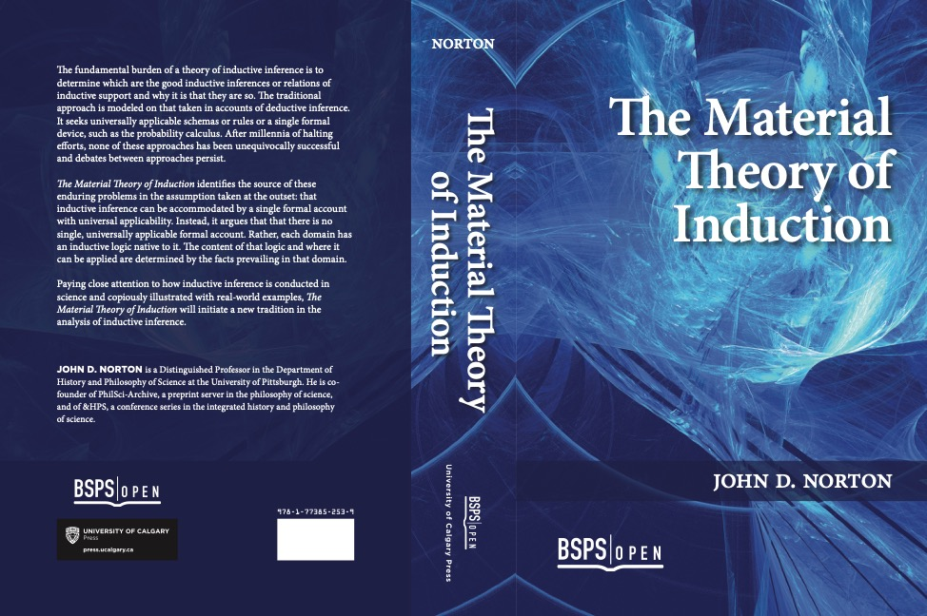
Material Theory of Induction

Slide 4
The Claims

Slide 5
Main Claim
Probabilism: All cases of indefiniteness and uncertainty can be treated BY DEFAULT by probabilities.
Bayesian analysis can be applied everywhere.
There is a POSTIVE OBLIGATION to show that probabilities apply in each case. Without it, they cannot be applied.
Bayesian analysis does not apply universally.

Slide 6
Four Supporting Claims
1.
Inductive inference is ampliative. Therefore, it only succeeds in environments factually hospitable to it.
2.
There are cases to which probabilistic analysis is demonstrably inapplicable.
3.
All arguments for probabilism are circular.
4.
A general result: all calculi of inductive inference are incomplete.

Slide 7
Inductive inference is ampliative.
Therefore, it only succeeds in environments factually hospitable to it.
1

Slide 8
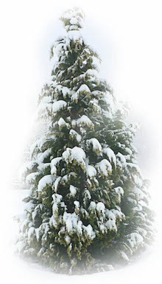


Induction
Winters past
have been snowy.
warrant outside the premises
Winters past
have been snowy.
AND
Winters future will be snowy.
FACT: our world is hospitable to this inductive inference.
Conclusion asserts
more than premises.
Hospitable:
World without climate change.
Inhospitable:
World with warming climate change.
vs
Cascade
of warrants
Whether a schema applies in some domain depends on the facts prevailing in the domain.

Slide 9

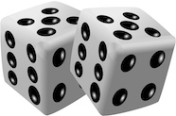
Probabilistic Success
Present climate and related terrestrial processes.
warrant outside the premises
P( )
warming climate
is high.
FACT: our world is hospitable to this inductive inference.
Conclusion asserts
more than premises.
Warranting facts in the detailed climate models.
Includes warrant for probabilities.
e.g. chaotic processes are pseudo-random.

Slide 10
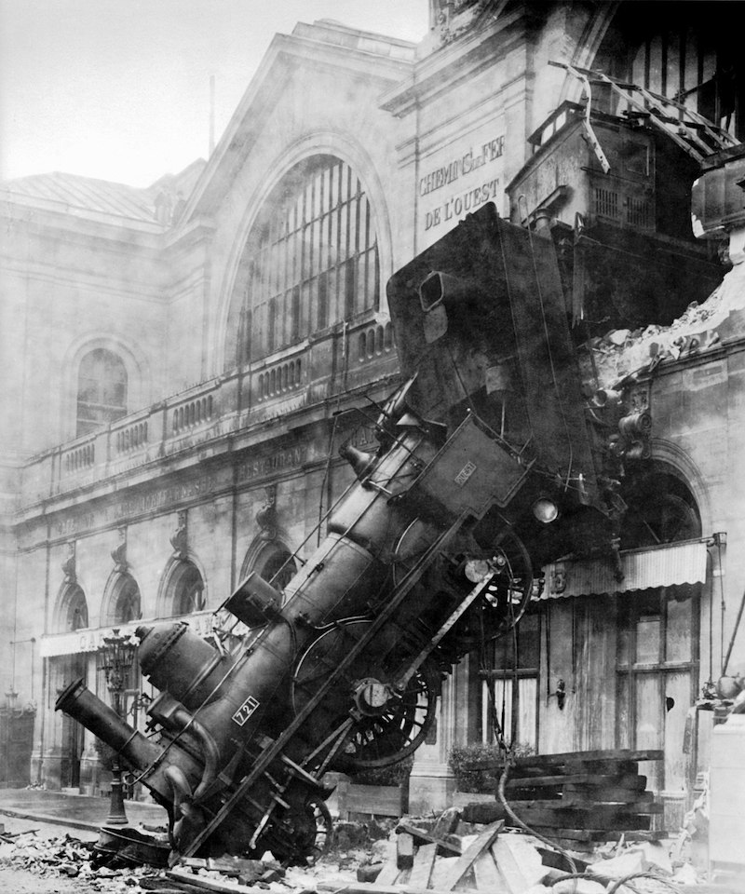
What can go wrong?

Slide 11
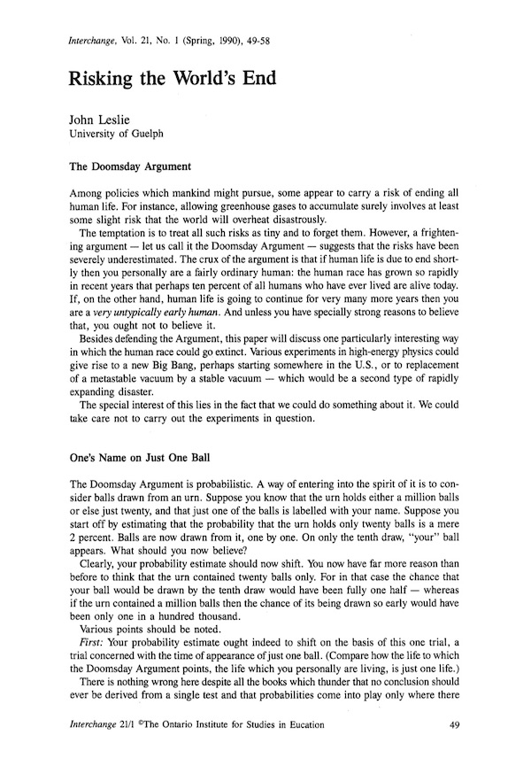
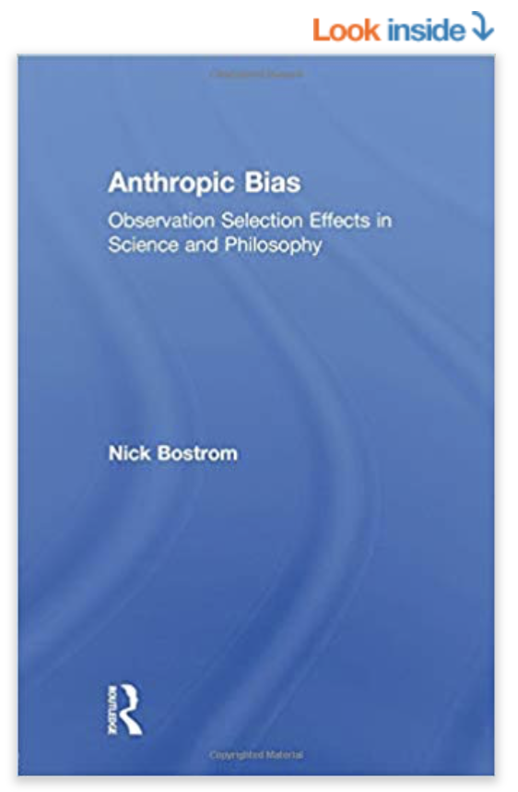
Probabilistic Failure
Our world has survived t years.
“Doomsday argument”
NO warrant outside the premises
P( )
greater for smaller T>t.
doom at time T
Failed warrant:
“Self-sampling assumption”
“One should reason as if one were a random sample from the set of all observers in one’s reference class.”
Nick Bostrom, Anthropic Bias. Routledge, 2002. p.57.
Conclusion asserts
more than premises.

Slide 12
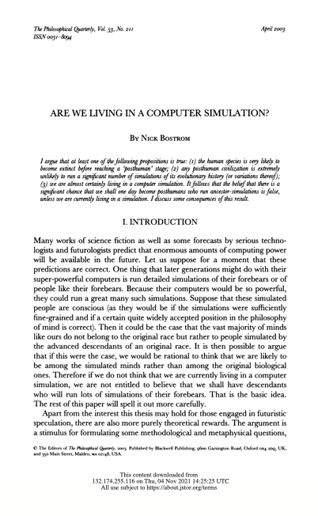

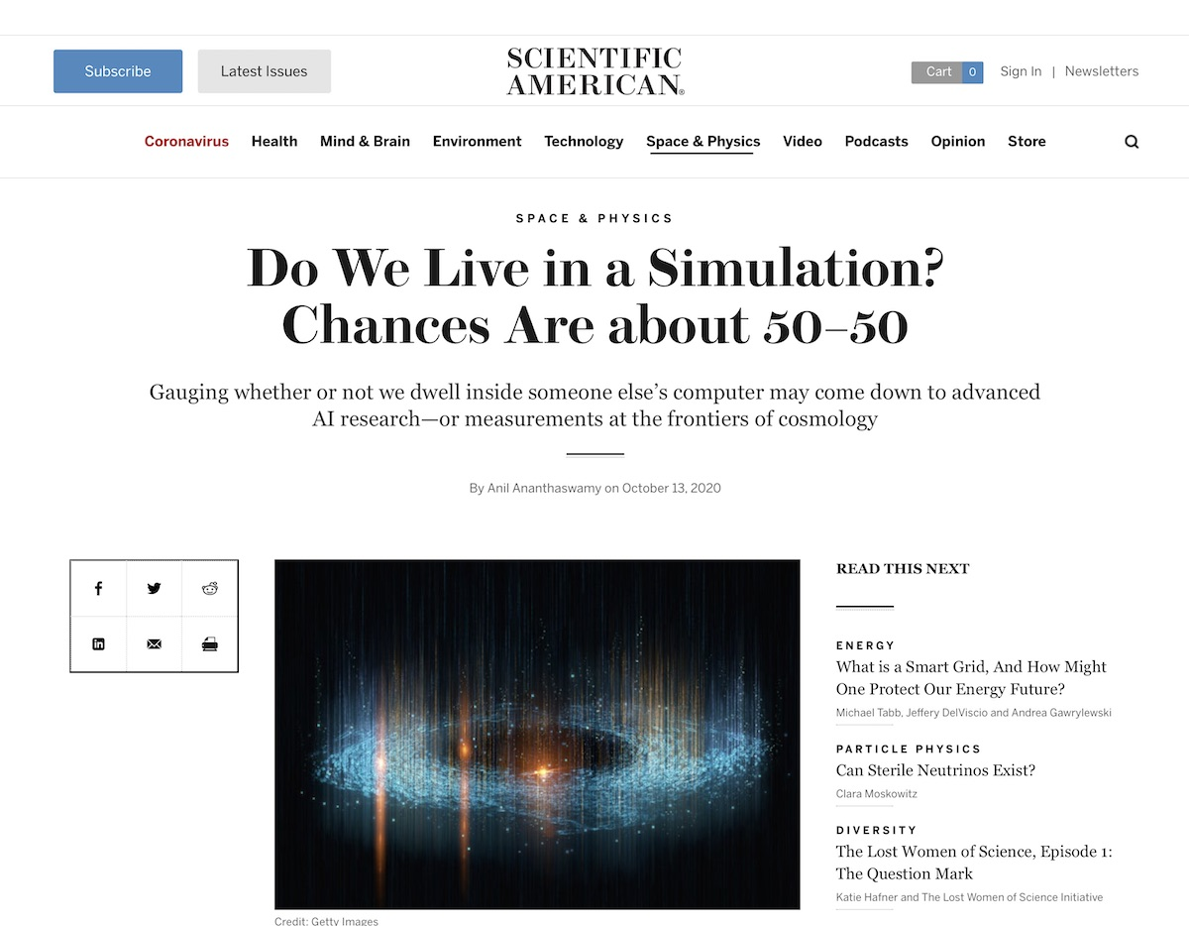

Slide 13

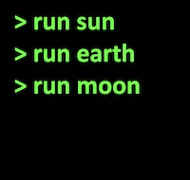
The Fallacy
Relatively few real worlds are possible.
Very many more simulated worlds are possible.

Slide 14
The Fallacy
We do not know which is ours.
Distribute probabilities roughly uniformly over all cases.
Very probably, we are in a computer simulation.
“Inductive disjunctive fallacy”
No background facts authorize probabilities.

Slide 15
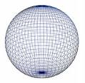

Our Space: Finite or Infinite?
Informal test of commitment to anthropic reasoning.
Fewer ways we can be observers in a finite space.
Infinitely many more ways
we can be observers in an infinite space.
…
Distribute probabilities roughly uniformly over all the possibilities.
Hence our space is infinitely more likely to be geometrically infinite.

Slide 16

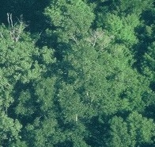
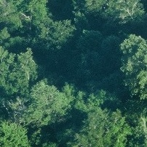
“Why is There Anything At All?”
van Inwagen, Proc. Arist. Soc., Supp., 70 (1996). pp.. 95-120.
One way not to be.
Infinitely many ways to be.
…
Distribute probabilities roughly uniformly over all the possibilities.
Probability zero.
“As improbable as anything can be.”
Probability one.
As probable as anything can be.

Slide 17
There are cases to which probabilistic analysis is demonstrably inapplicable.
2

Slide 18
Material Theory of Induction

Slide 19
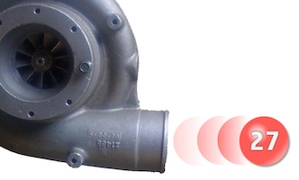
Complete neutrality, indifference
Invariances under redescription, negation preclude probabilities.
Physical cases of spontaneous excitation
Physical properties preclude probabilities.
Infinite lottery machines
Invariance induce a non-probabilistic inductive logic.
Entangled quantum spin systems
Inductive support represented by density matrices.

Slide 20
Completely Neutral Support

Slide 21
Cosmic parameter h over which we are completely ignorant (completely neutral support)
I
I
I
I
I
h
0
1
2
3
4
5
I. Invariance under redescription
(= principle of indifference reasoning)
Ignorance over h: equal intervals have equal support
=
Ignorance over h’ = f(h): equal intervals have equal support
=
II. Invariance under negation
e.g. A = “h lies in [0,1].”
Support for proposition A concerning h
Support for proposition not-A concerning h
I
Invariance under
h’ = f(h) = 1/h
II

Slide 22
Invariance under h’=1/h
I
I
I
I
I
h
0
1
2
3
4
5
Assume smaller interval cannot have greater support.
relabel h to 1/h
I
I
h
0
1
2
3
4
5
Additivity fails
support in
h in [1,2]
support in
h in [1,2] OR
h in [2, ∞]
=

Slide 23
Completely Neutral Support
[A|B] = support
A accrues from B
[ |B] = I
“indifference”
“ignorance”
any contingent proposition
I
I
I
I
I
h
0
1
2
3
4
5
I
I
I

Slide 24
Completely neutral support
Inductive disjunctive fallacy
Strongly disfavoring support
conflated with
Neutral support
Disfavoring
I
I
I
…
I
a₁
a₁ or a₂
a₁ or a₂ or a₃
…
a₁ or a₂ or … or a₉₉
prob = 0.01
prob = 0.02
prob = 0.03
…
prob = 0.99
Disjunction of very many neutrally supported outcomes
a strongly supported outcome.
is NOT

Slide 25
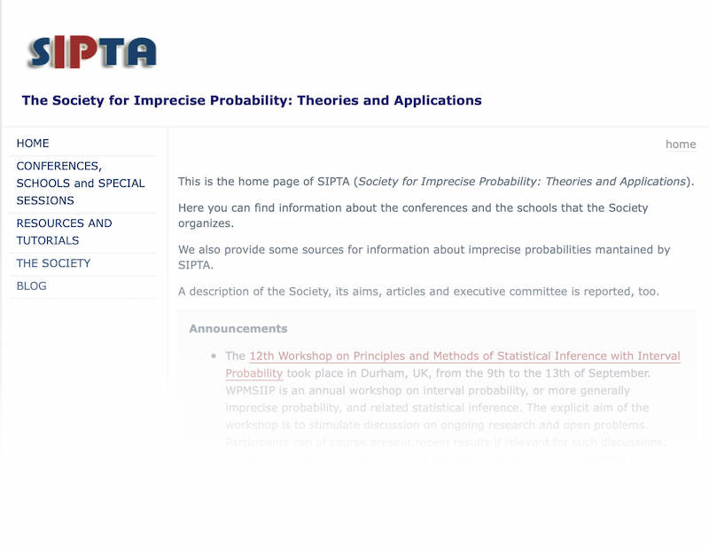


Imprecise
Probabilities?
Main argument applies.
Inferences using imprecise probabilities
Evidence
Results
Results assert more than the conclusion.
Requires an hospitable context.
Problem context calls for
A new logic
Simulate it within the old logic?
NO
Mistaken approach
Recognize the new logic?
YES

Slide 26
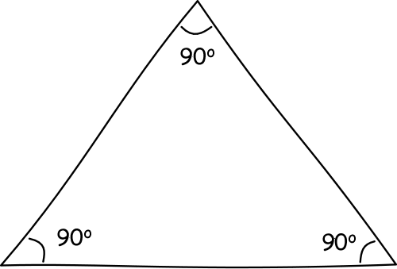
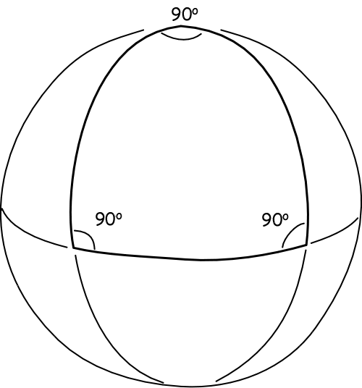
“Surface Logic” Analogy in Geometry
We can simulate virtually any non-Euclidean geometry …
…by embedding the surface in a higher dimensioned Euclidean space.
That does not make Euclidean geometry the One True geometry.

Slide 27
The Infinite Lottery

Slide 28
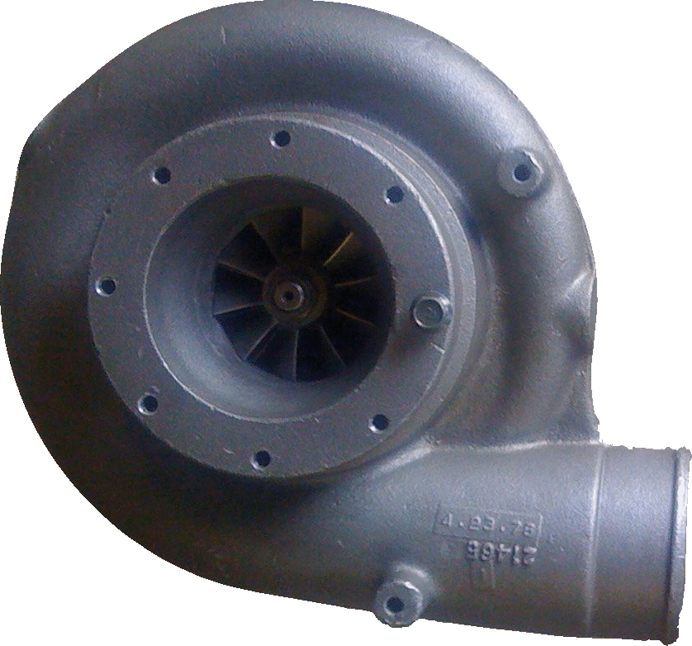
A fair lottery machine
27
Selection made among infinitely many balls 1, 2, 3, … without favor.
Chances of each ball or each set is invariant under relabeling of the balls.
=
1
3
2

Slide 29
Odd and even
1
2
3
4
5
6
7
8
9
…
2
1
4
3
6
5
8
7
9
…
Chance [Even] = Chance [Odd]

Slide 30
Co-infinite Infinite Sets
1
2
3
4
5
6
7
8
9
…
1
2
3
4
…
10¹
10²
10³
10⁴
10⁵
All Co-infinite infinite sets have the same chance.
Additivity fails.

Slide 31
Outcome sets equivalent under label independence
finite_{n}: finite set with n members
n = 1, 2, 3, …
e.g. Members of finite₃ are
{1, 2, 3}, {27, 5, 134}, …
infinite_{co-infinite}: infinite set whose complement is also infinite
e.g. even numbers, odd numbers, prime numbers, powers of ten, …
infinite_{co-finite}: infinite set whose complement is finite of size n
n = 1, 2, 3, …
e.g. complements of finite_{3,} all numbers greater than ten, …

Slide 32
Equivalent sets have equal chances.
Ch(finite_{n}) = V_{n}
n = 1, 2, 3, …
Ch(infinite_{co-infinite}) = V∞
Ch(infinite_{co-finite-n}) = V_{-n}
n= 1, 2, 3, …
“unlikely”
Ch(empty-set) = V₀
“certainly not”
Ch(all-outcomes) = V₋₀
“certain”
“as likely
as not”
“likely”
V₂
V∞
V∞
V₋₂
Ch( ) < Ch( ) = Ch( ) < Ch( )
10, 100,
1000,
10000, …
3, 4, 5, 6
7, 8, 9, …
1, 2
odd
for a generic lottery machine.

Slide 33
Chance Properties of Infinite Lottery Inhospitable to Probabilites
even = {2, 4, 6, ..}
hundredth = {100, 200, 300, …}
Map even set to hundredth set by relabeling.
P(even) = 1/2
With high probability, roughly 1 in 2 are even in many draws.
P(hundredth) = 1/100
With high probability, roughly 1 in 100 are hundredth in many draws.
Chance (0 even in N draws) = Chance (0 hundredth in N draws)
Chance (1 even in N draws) = Chance (1 hundredth in N draws)
Chance (2 even in N draws) = Chance (2 hundredth in N draws)
…
Chance (N/2 even in N draws) = Chance (N/2 hundredth in N draws)
…
Chance (N-1 even in N draws) = Chance (N-1 hundredth in N draws)
Chance (N even in N draws) = Chance (N hundredth in N draws)
Relative frequencies of even cannot stabilize to probabilistic values in many repeated draws.

Slide 34
All arguments for probabilism are circular.
3

Slide 35
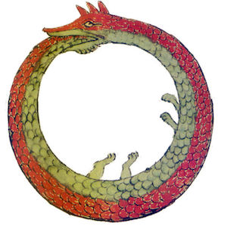
Arguments for Probabilism
Premises
contingent…
… and logically at least as strong as the conclusion.
deduction
Dominance:
Least risk lies in positing the conclusion directly.
Conclusion of the necessity of probabilities
contingent

Slide 36
A Dutch Book
ONE = {1, 4, 7, 10, …}
TWO = {2, 5, 8, 11, ...}
THREE = {3, 6, 9, 12, ...}
Ch(ONE) =
Ch(not-ONE)
Ch(TWO) =
Ch(not-TWO)
Ch(THREE) =
Ch(not-THREE)
ONE
TWO
THREE
TWO
THREE
ONE
THREE
ONE
TWO
Accept even odds bets on outcomes of equal chance.
On ONE
On TWO
On THREE
Net
ONE
gain $1
lose $1
lose $1
lose $1
TWO
lose $1
gain $1
lose $1
lose $1
THREE
lose $1
lose $1
gain $1
lose $1

Slide 37
A Dutch Book Theorem
IF
Therefore…
Your credences match the non-probabilistic, infinite lottery chances.
…Non-probabilistic credences are incoherent.
and
You accept even odds bets on (exclusive, exhaustive) outcomes with equal credences.
… If you hold non-probabilistic credences, this betting behavior is incoherent.
THEN
The Dutch book scenario is not benign. It covertly favors probabilistic credences by supposition.
A sure-loss Dutch book can be made against you.

Slide 39





Accuracy/Scoring Rules
Choose accuracy dominating credences under Brier score/ strictly proper score.
Use of these scoring rules encodes probabilities.
deduction
Most scoring rules give different calculi.
Credences must be probabilities

Slide 40
Alternative Scoring Rules
For credences x₁, …, x_{r}, on r outcomes, when the i-th outcome obtains:
Brier score: L_{i} = x₁² + … + (1-x_{i})² + … + x_{r}²
n-power score: L_{i} = x₁^{n} + … + (1-x_{i})^{n} + … + x_{r}^{n}
superadditive
additive
subadditive
sum of r dominating credences for equal credence outcomes
n

Slide 41
Regress of Reasons
…
Premises
Premises
Premises
Premises
Premises
Premises
Contingent, therefore more reasons needed.
Premises
Contingent, therefore more reasons needed.
deduction
Conclusion of the necessity of probabilities

Slide 42
All calculi of inductive inference are incomplete.
4

Slide 43
The Bayesian Lacuna
P(H)
We want “informationless,” “vacuous” priors.
But priors always add inductive content.
No computation is inductively self-contained.
“incompleteness”
…
conditionalize on E_{n-2}
Is there another, generalized, modified calculus that is complete?
P(H|E_{n-2}…)
conditionalize on E_{n-1}
P(H|E_{n-1}&E_{n-2}…)
NO
conditionalize on E_{n}
P(H|E_{n}&E_{n-1}&E_{n-2}…)

Slide 44
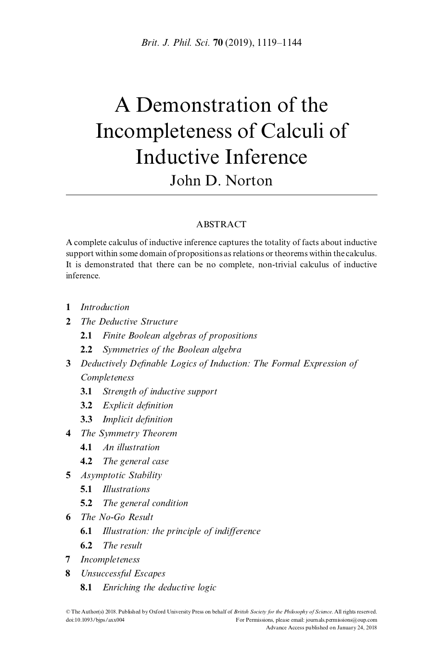

Slide 45
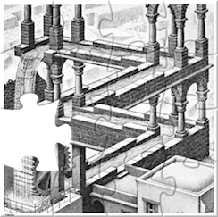
Incompleteness sketched
Deductive Definability
Inductive strength [A|B] defined implicitly or explicit by deductive relations among propositions of a Boolean algebra.
Symmetry of Boolean algebras.
Triviality
All strengths have the same value.
Asymptotic Stability
Principle of indifference reasoning in the extreme.
Inductive strength [A|B] for some fixed propositions eventually stabilize to unique values as the propositions are embedded in larger algebras of propositions.

Slide 46
Conclusion

Slide 47
Main Claim
Probabilism: All cases of indefiniteness and uncertainty can be treated BY DEFAULT by probabilities.
Bayesian analysis can be applied everywhere.
There is a POSTIVE OBLIGATION to show that probabilities apply in each case. Without it, they cannot be applied.
Bayesian analysis does not apply universally.

Slide 48
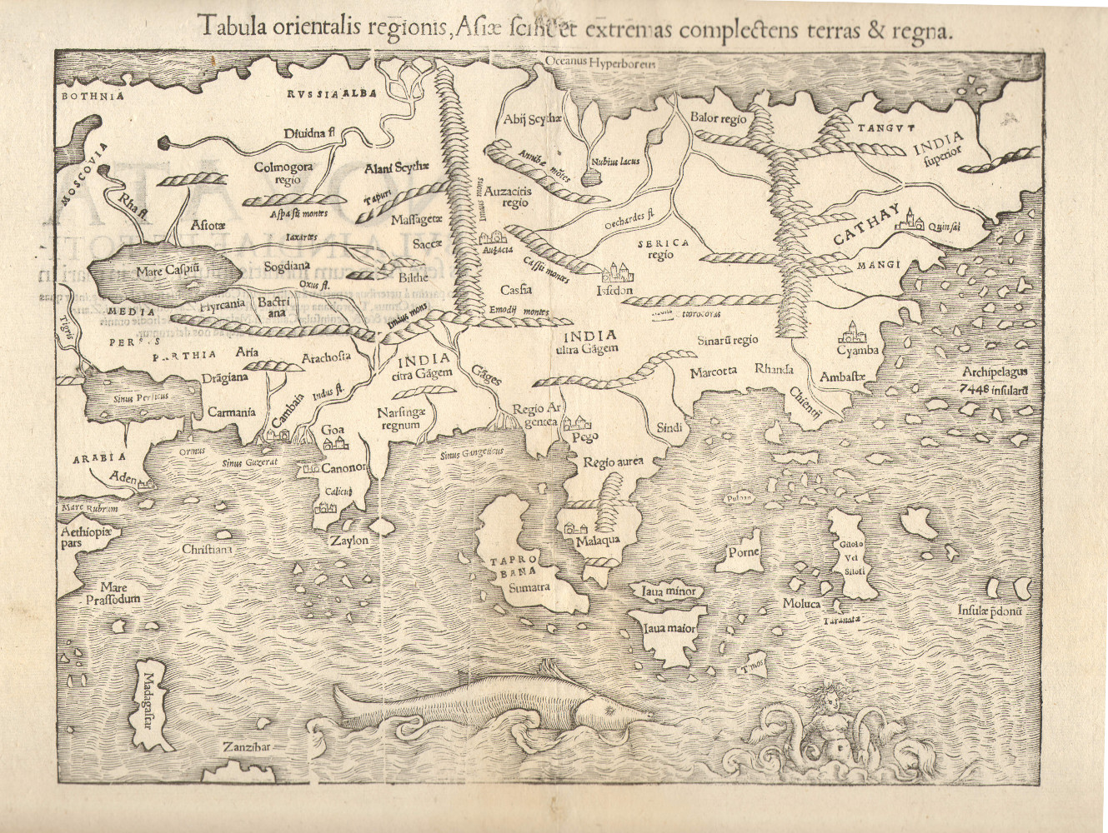
Something else here
Probabilistic inference here
Something else here
Something else here
Something else here
What determines which logic goes where?
Background facts.

Slide 49


Slide 50
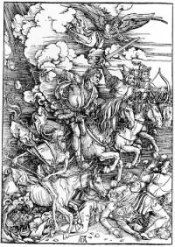
The Doomsday Argument

Slide 51
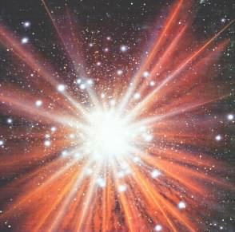
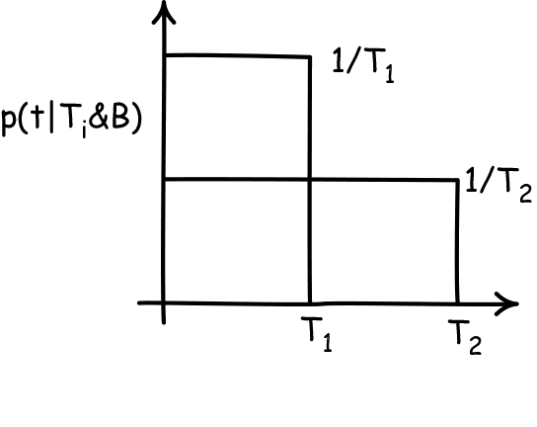

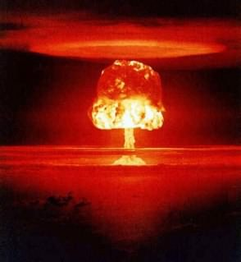
Doomsday Argument
(Bayesian analysis)
Bayes’ theorem
p(T|t&B) ~ p(t|T&B) . p(T|B)
time = 0
Compute likelihood by assuming t is sampled uniformly from available times 0 to T.
p(t|T&B) = 1/T
we learn time t has passed
For later: which is the right “clock” in which to sample uniformly? Physical time T? Number of people alive T’?…
Variation in likelihoods arise entirely from normalization.
time of doom T
p(T|t&B) ~ 1/T
Support for early doom
Entire result depends on additivity of probabilities.
What support does t give to different times of doom T?
Entire result is an artifact of the use of the wrong inductive logic.

Slide 52
Discard Additivity, Keep Bayesian Dynamics
If
T₁ entails E. T₂ entails E.
P(T₁|B) = P(T₂|B)
then
P(T₁|E&B) = P(T₂|E&B)
Bayesian conditionalization.
equal priors
equal posteriors
Postulate same rule in a new, non-additive inductive logic.
Conditionalizing from Complete Neutrality of Support
If
T₁ entails E. T₂ entails E.
[T₁|B] = [T₂|B] = I
then
[T₁|E&B] = [T₂|E&B]

Slide 53
Doomsday Argument
(Barest non-probabilistic reanalysis.)
Take evidence E is just that T>t.
T₁>t entails E. T₂>t entails E.
time = 0
E = T>t
[T₁|E&B] = [T₂|E&B]
[T₁|B] = [T₂|B] = I
we learn time t has passed
Apply rule of conditionalization on completely neutral support.
The evidence fails to discriminate between T₁ and T₂.
time of doom T
What support does t give to different times of doom T?

Slide 54
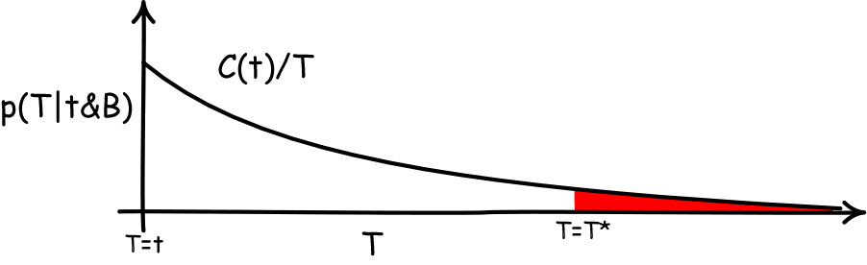
Doomsday Argument
(Bayesian analysis again)
Consider only the posterior
p(T|t&B)
time = 0
Require invariance of posterior under changes of units used to measure times T, t.
Invariance under T’=AT, t’=At
Days, weeks, years? Problem as posed presumes no time scale, no preferred unit of time.
we learn time t has passed
Unique solution is the “Jeffreys’ prior.”
p(T|t&B) = C(t)/T
time of doom T
Disaster! This density cannot be normalized.
Infinite probability mass assigned to T>T*, no matter how large.
Evidence supports latest possible time of doom.
What support does t give to different times of doom T?

Slide 55
A Richer Non-Probabilistic Analysis
Consider the non-probabilistic degree of support for T in the interval
[T₁,T₂|t&B]
time = 0
Presume that there is a “right” clock-time in which to do the analysis, but we don’t know which it is. So we may privilege no clock, which means we require invariance under change of clock:
T’ = f(T), t’ = f(t),
for strictly monotonic f.
we learn time t has passed
time of doom T
[T₁,T₂|t&B] = [T₃,T₄|t&B] = I
for all T₁,T_{2,} T₃,T₄
What support does t give to different times of doom T?

