Slide 1


Galileo and Einstein
Two Recalcitrant Thought Experiments
John D. Norton
Department of History and Philosophy of Science
University of Pittsburgh
Bryan W. Roberts
Philosophy, Logic and Scientific Method
London School of Economics & Political Science
SWC Scientific World Conceptions
University of Vienna
Summer School
July 2 to July 13, 2018

Slide 2
Galileo and the speed-distance law of fall

Slide 3
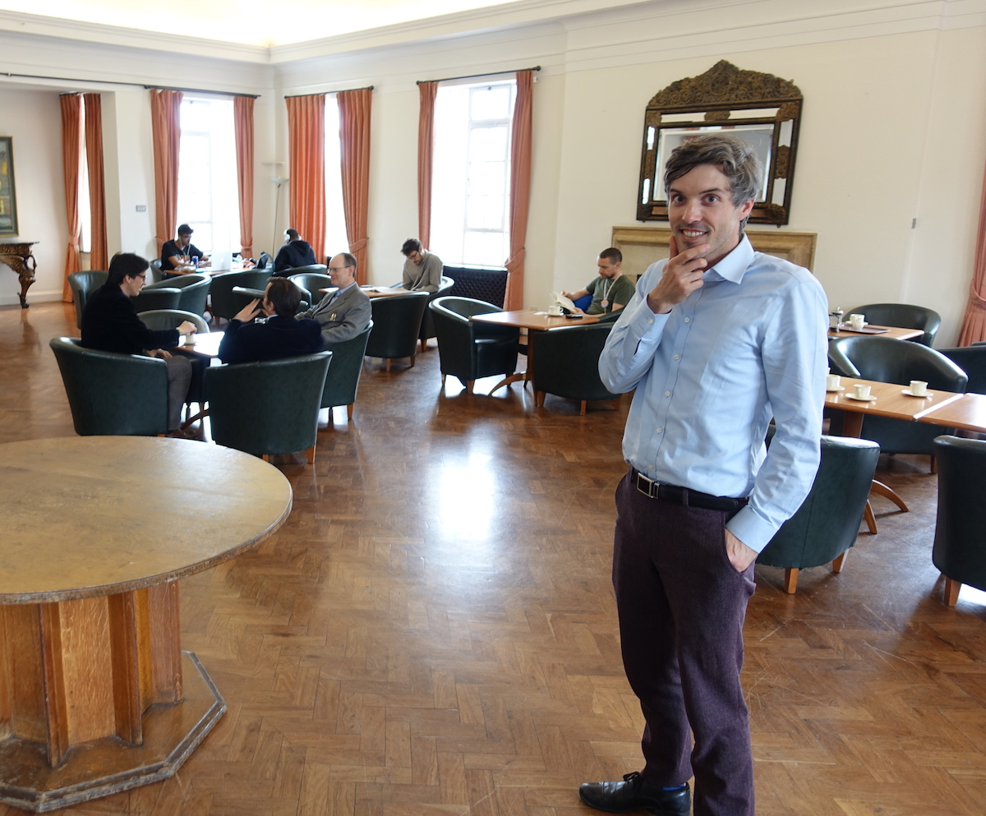
Slides prepared by Bryan Roberts

Slide 4
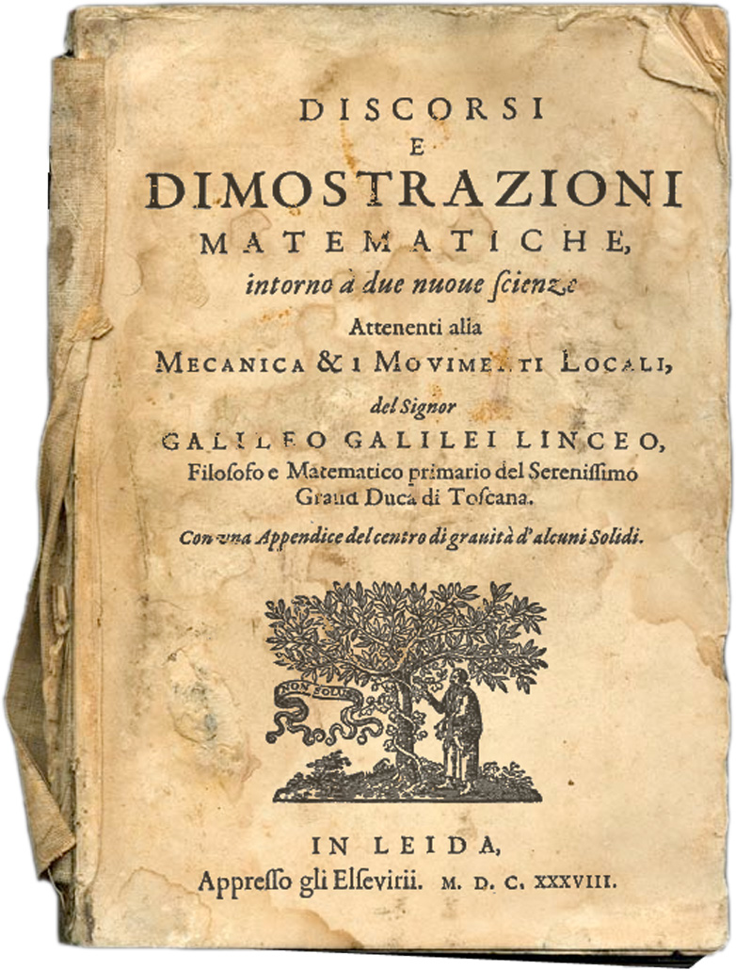
Galileo Galilei, Discourses and Mathematical Demonstrations Concerning Two New Sciences. 1638.
First and second day.
First new science
Resistance bodies offer to fracture.
Third and fourth day.
Second new Science
Motion.
including
Naturally accelerated motion.

Slide 5
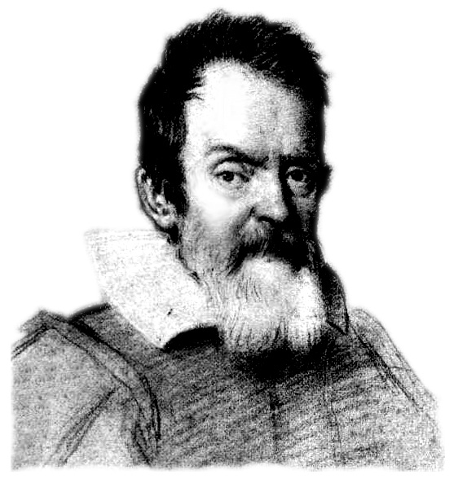
Speed-Distance Law of Fall:
“Uniformly accelerated motion is that in which the speed goes increasing according to the increase of space traversed.”
— Sagredo
Two New Sciences

Slide 6
Speed-Distance Law of Fall:
“… has so much the plausible and probable, that our Author himself… had labored for some time under the same fallacy.”
— Salviati
Two New Sciences

Slide 7
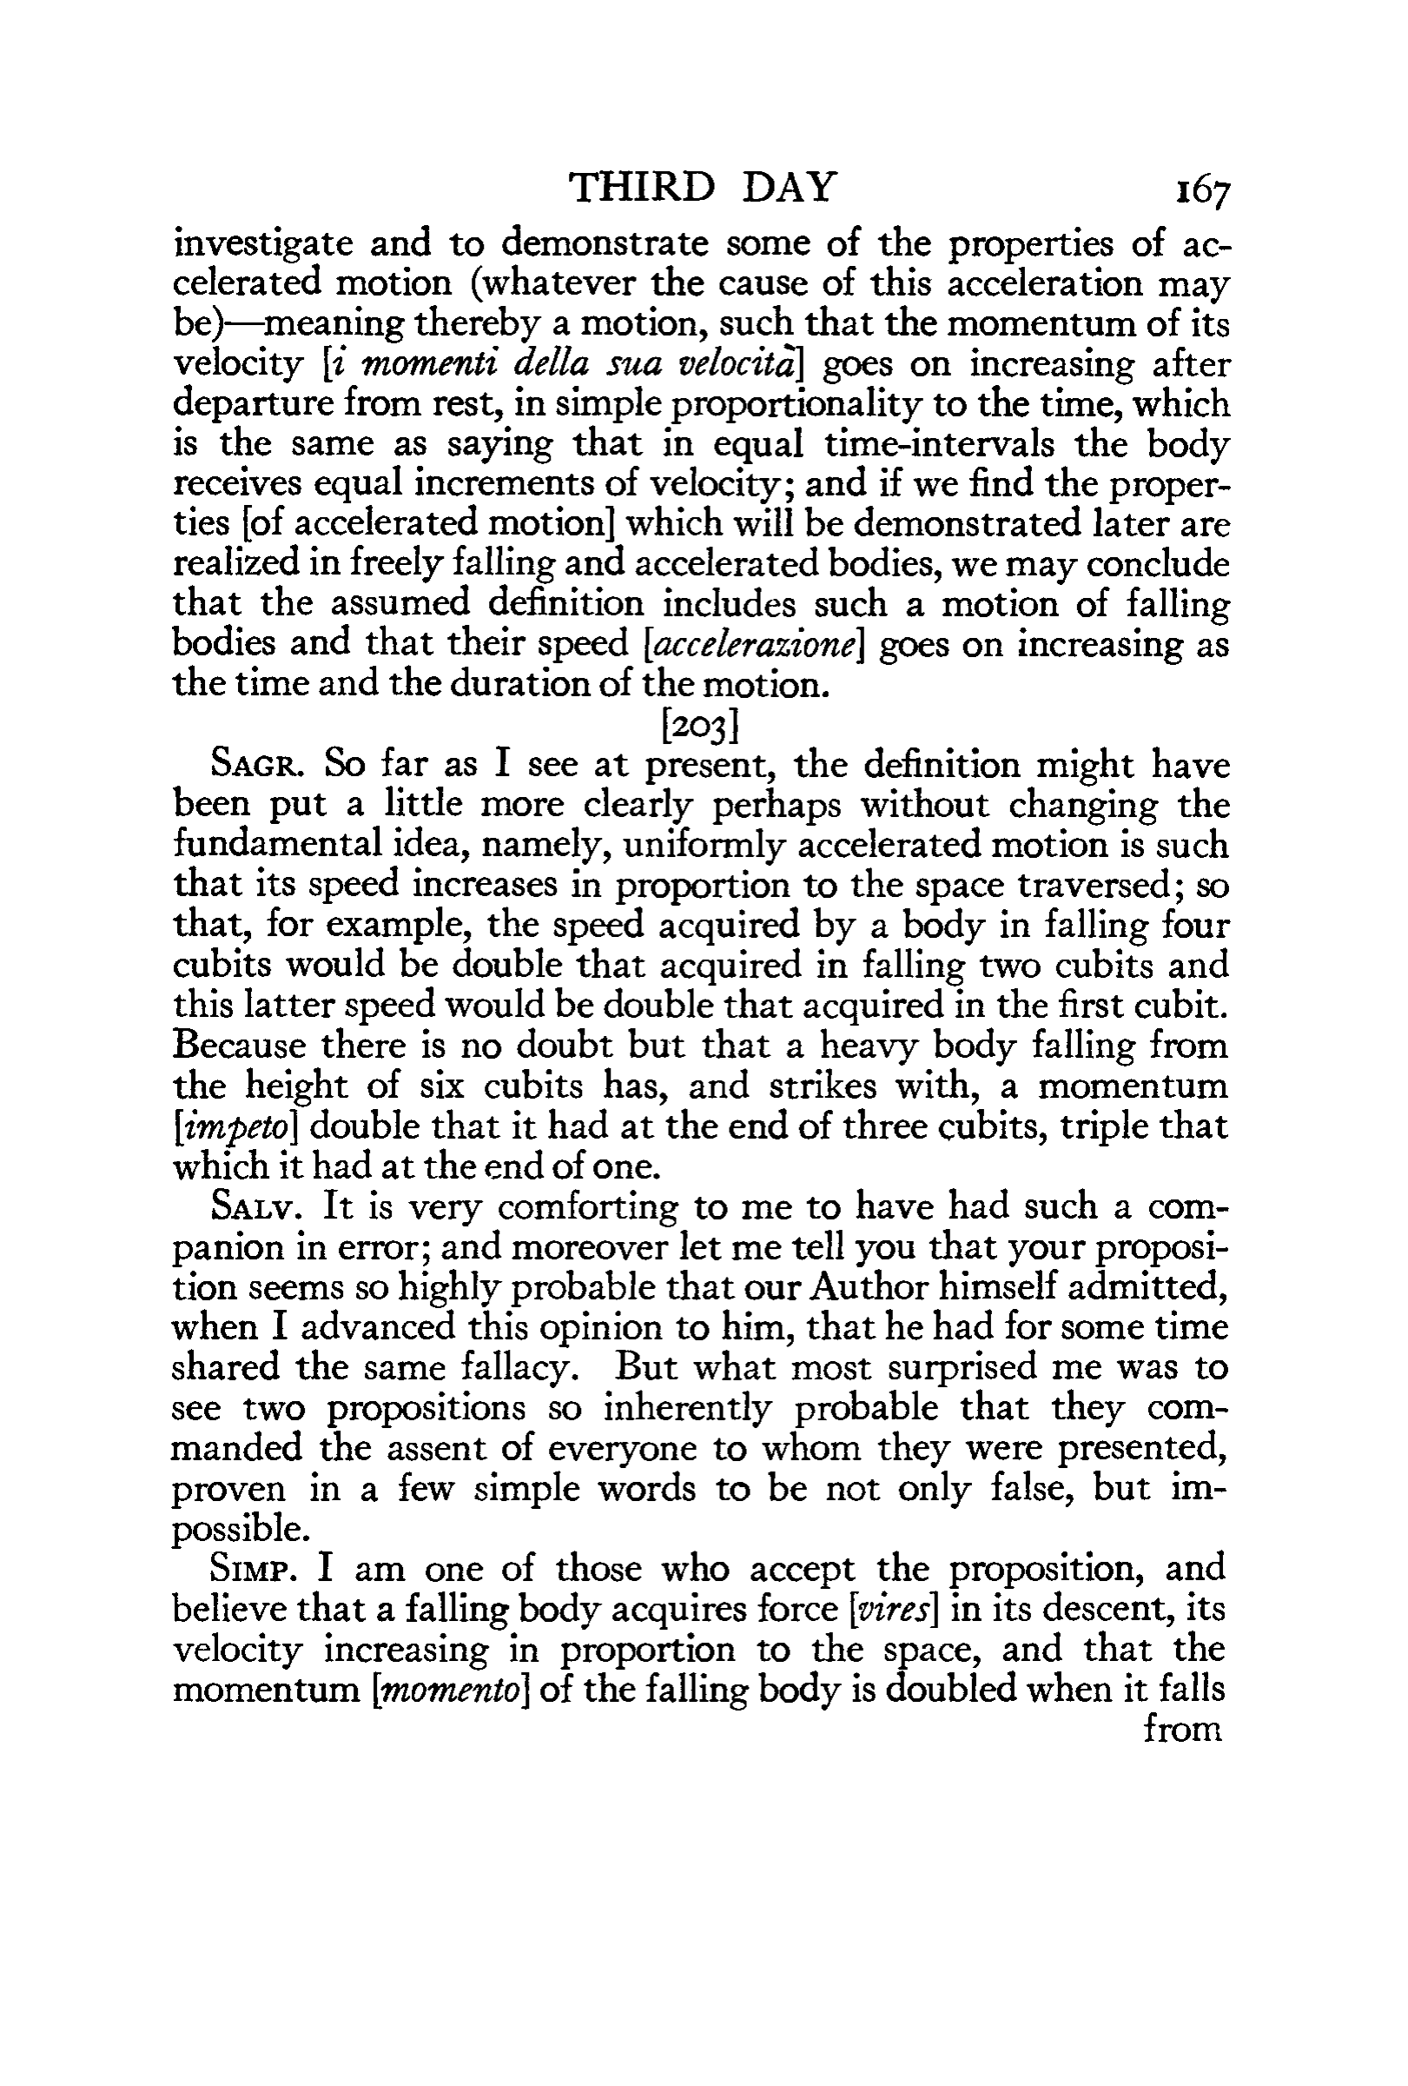
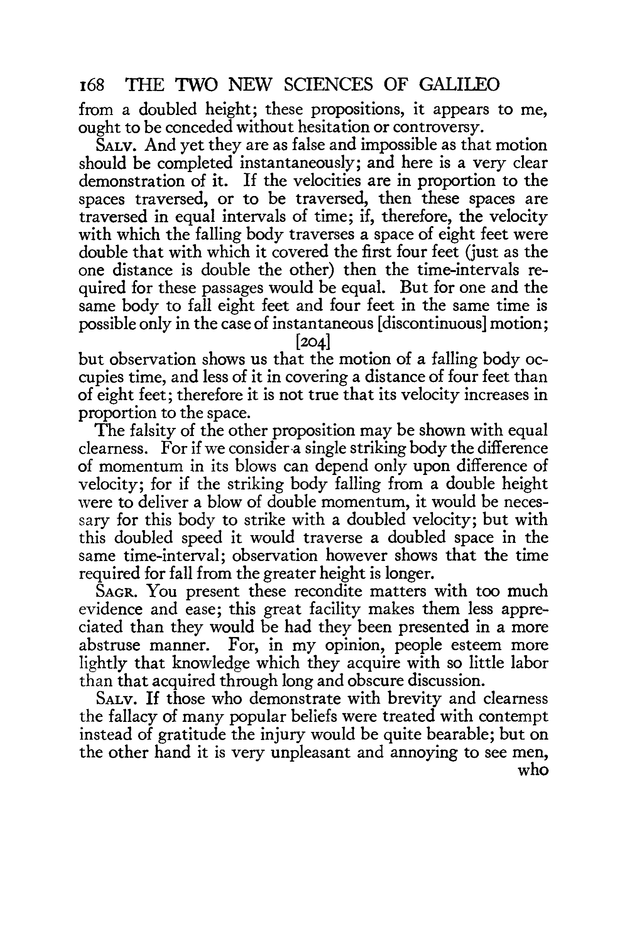

Slide 8
Galileo’s “very clear proof” that it is false:
“
When speeds have the same ratio as the spaces passed or to be passed, those spaces come to be passed in equal times;
if therefore the speeds with which the falling body passed the space of four braccia were the doubles of the speeds with which it passed the first two braccia, as one space is double the other space, then the times of those passages are equal;
but for the same moveable to pass the four braccia and the two in the same time cannot take place except in instantaneous motion. But we see that the falling heavy body makes its motion in time, and passes the two braccia in less [time] than the four; therefore it is false that its speed increases as the space. (Galileo’s Two New Sciences, 1638)
”
Better translation from a different edition.

Slide 9
Illustrious tradition of confusion

Slide 10
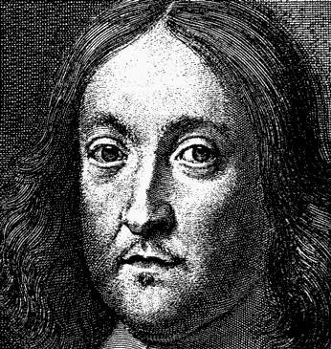
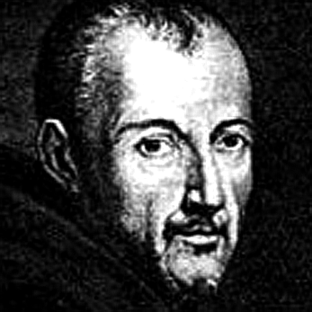
“the undemonstrated conclusion of a clear-sighted and Lyncaeo man”
— P. Fermat, c.1646
“[the speed-distance law] can
nevertheless be understood in a correct way”
— M. Mersenne, 1639

Slide 11
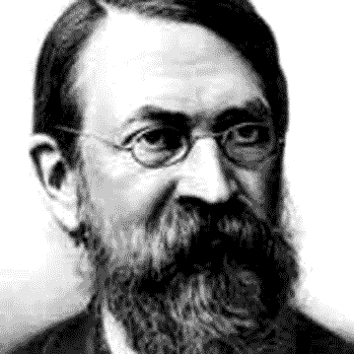
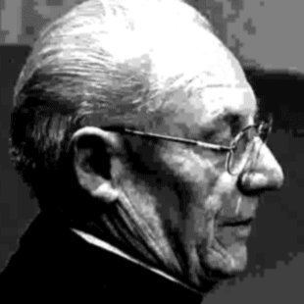
“a course of fallacious reasoning”
— E. Mach, 1893
“a slip of the pen… applying the law of uniform motion to motion which is not so”
— Costabel & Lerner, 1973

Slide 12
“The refutation of space proportionality in the Discorsi is thus no refutation…. Galileo’s argument is also incompatible with classical mechanics”
— Damerow, McLaughlin,
Freudenthal & Renn, 1992

Slide 13
We claim…

Slide 14
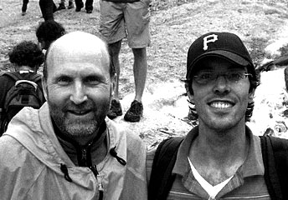
There is a simple, cogent, correct reconstruction of Galileo’s argument.

Slide 15
Galileo’s argument…
…was not “a course in fallacious reasoning.”
…ingeniously and correctly identifies why the speed-distance law in untenable.
…fails only in the last step.

Slide 16
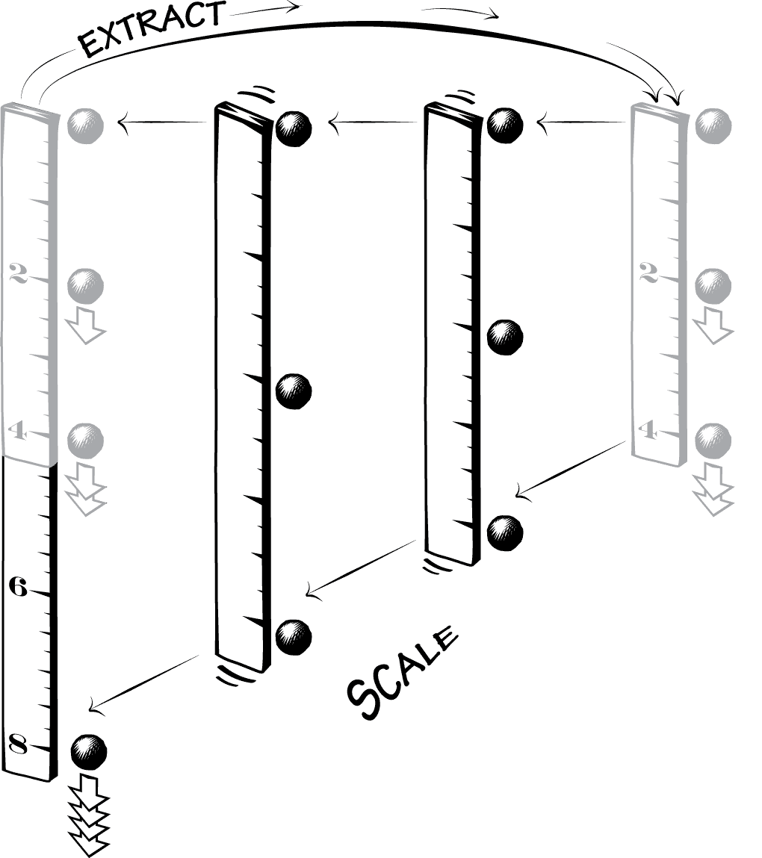
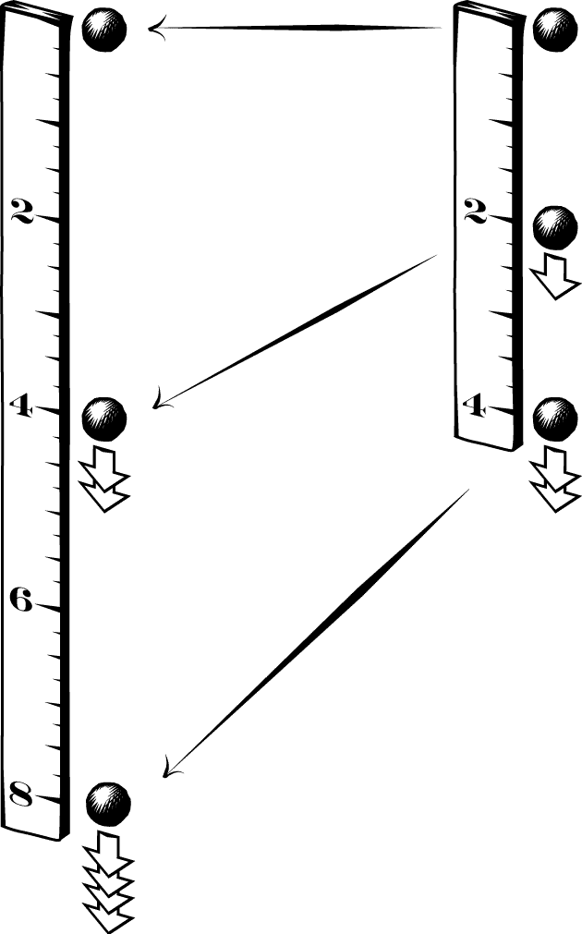
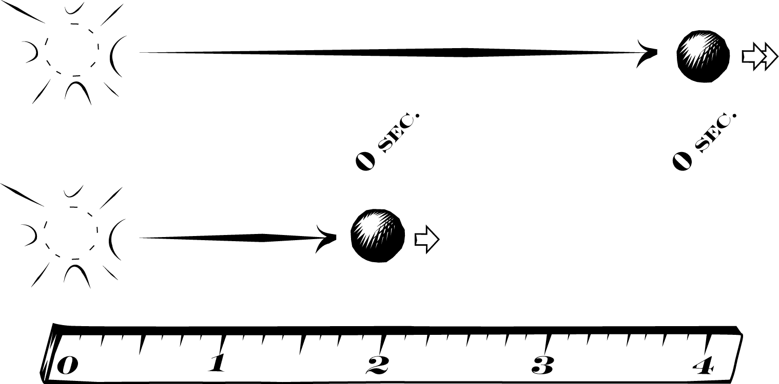
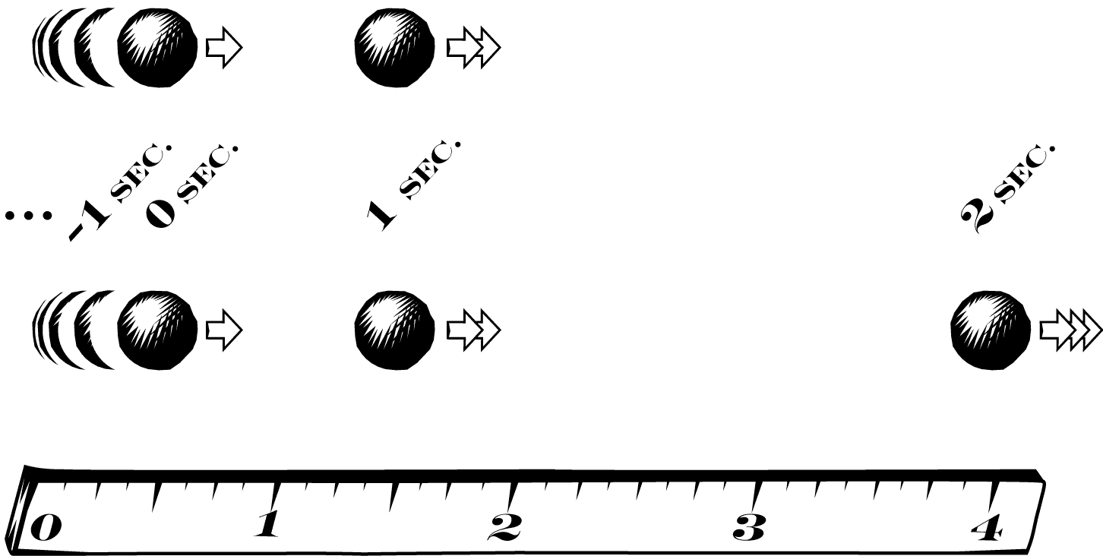
1.
Scaling
2.
Self-Similarity
+
3.
Equal Time
4.
Instantaneous motion
Infinite time motion

Slide 17
1.

Slide 18
Galileo’s Text | Our Interpretation
When speeds have the same ratio as the spaces passed or to be passed, those spaces come to be passed in equal times…
Scaling: if any motion is scaled up by doubling all its speeds and distances, then the original and scaled motions take place in the same time. (General result about any motion)
1.

Slide 19
1. Scaling

Slide 20
The Two New Sciences is largely about scaling.
What is the effect on the support blocks required when you scale up a boat?
— Sagredo’s opening query

Slide 21
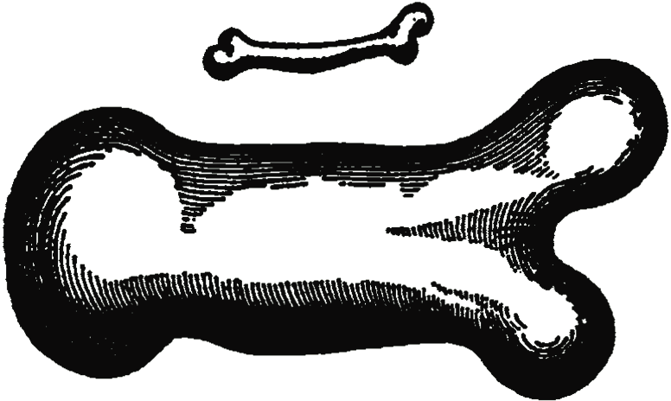
Galileo displays adeptness at expressing a variety of arguments in terms of scaling.
Discussion of the strength of cylinders, and also irregular objects, under scaling.

Slide 22
Galileo expresses a similar scaling argument a few pages before the passage in question.
“If a [uniformly moving] moveable passes through two spaces in equal times, these spaces will be to one another as the speeds. And if the spaces are as the speeds, the time will be equal” (Proposition II Theorem II).

Slide 23
Galileo’s Text | Standard View | Our View
When speeds have the same ratio as the spaces passed or to be passed, those spaces come to be passed in equal times… | ONE Motion | TWO Motions
1.

Slide 24
2.

Slide 25
Galileo’s Text | Our Interpretation
…If the speeds with which the falling body passed the space of four braccia were the doubles of the speeds with which it passed the first two braccia, as one space is double the other space…
IF Self-Similarity: the motion over four braccia is a scaled up duplicate of the motion over two braccia… (Result holds only for motions whose speed is proportional to distance)
2.

Slide 26
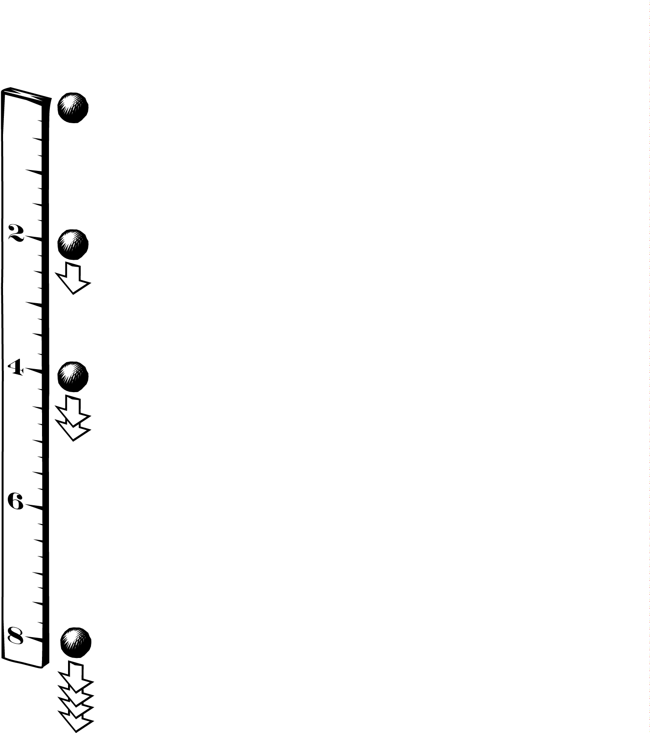
2. Self-Similarity

Slide 27
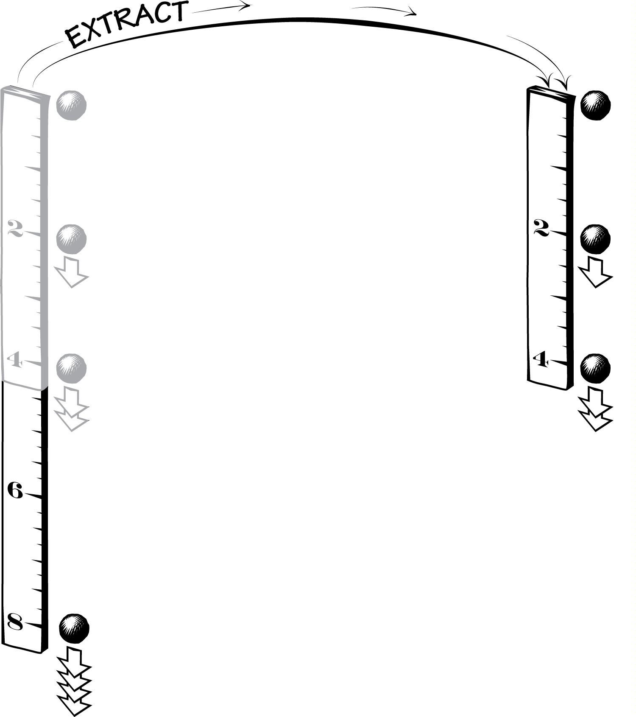
2. Self-Similarity

Slide 28
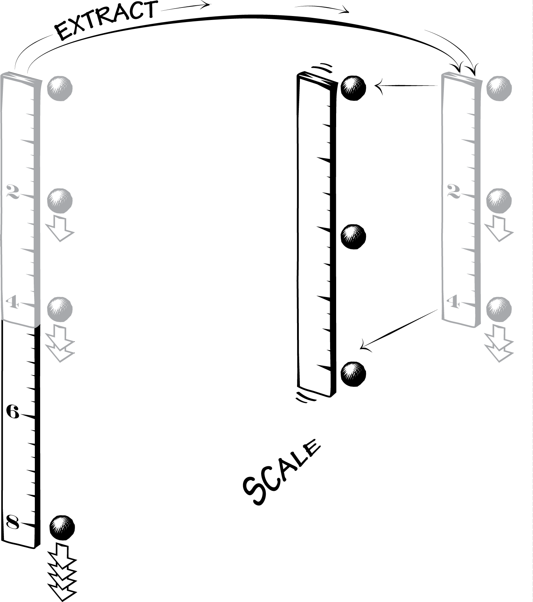
2. Self-Similarity

Slide 29
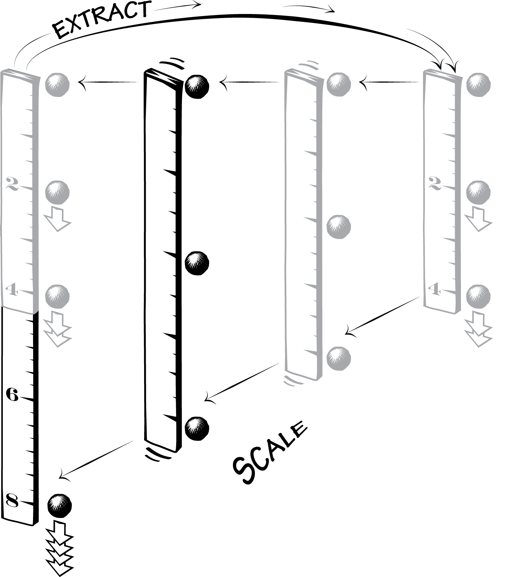
2. Self-Similarity

Slide 30
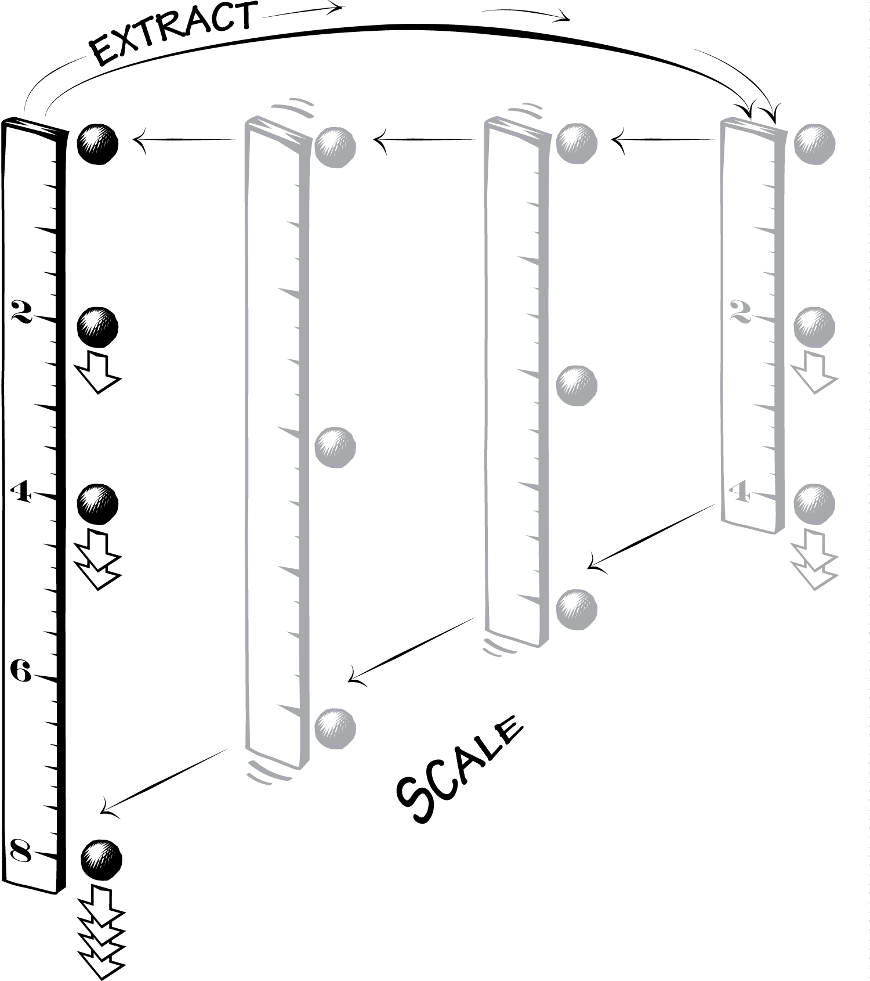
2. Self-Similarity

Slide 31
3.

Slide 32

Galileo’s Text | Our Interpretation
…then the times of those passages are equal…
3.
THEN Equal Time Result (ET): the times a body takes to fall 2 braccia and 4 braccia are equal.
=

Slide 33
Galileo’s Text | Standard View | Our View
When speeds have the same ratio as the spaces passed or to be passed, those spaces come to be passed in equal times… | ONE Motion | TWO Motions
…then the times of those passages are equal… | 3 reasserts 1 (argument is circular) | 3 is a novel conclusion (argument not circular)
1.
3.

Slide 34
4.

Slide 35
Galileo’s Text | Our Interpretation
…but for the same moveable to pass the four braccia and the two in the same time cannot take place except in instantaneous motion.
Downfall: Galileo assumes that ET is only possible if motion is instantaneous. But it is also possible for infinite time motion.
4.

Slide 36
4. Downfall

Slide 37
4. Downfall
Speed-Distance Law of Fall:

Slide 38
4. Downfall

Slide 39
4. Downfall
… + 1 + 1 + 1 + 1 + 1 + 1
… + 1 + 1 + 1 + 1 + 1 + 1 + 1

Slide 40
a modern view

Slide 41
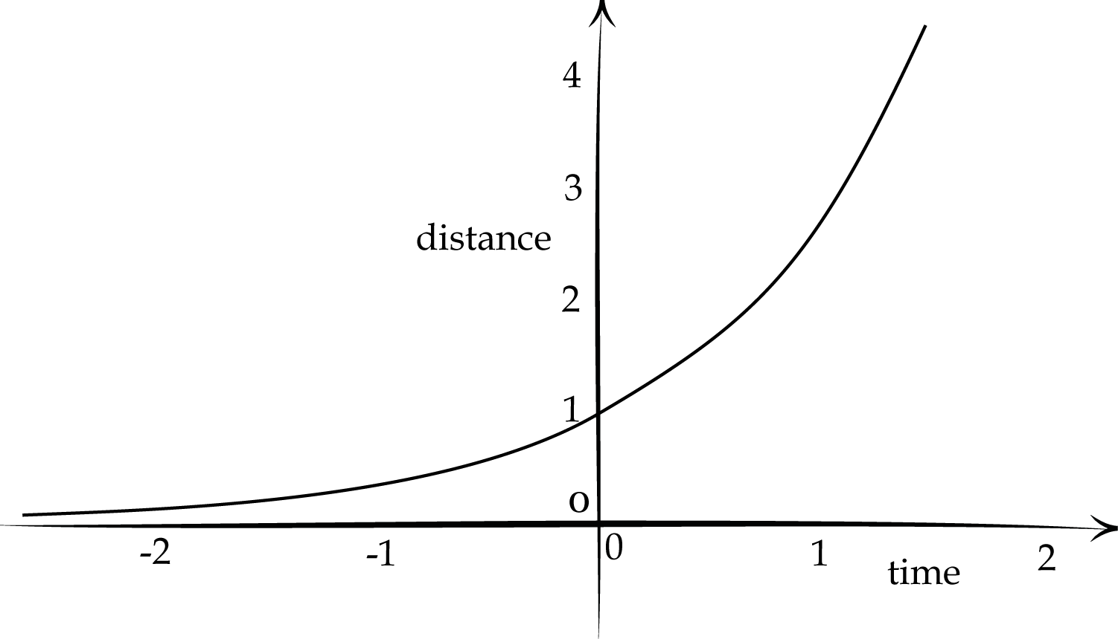
Speed is proportional to distance
dx/dt = x
x(t) = exp(t)
v(t) = exp(t)
∞ time
∞ time

Slide 42
Summary

Slide 43
Galileo’s Text | Our Interpretation
When speeds have the same ratio as the spaces passed or to be passed, those spaces come to be passed in equal times… | Scaling: if any motion is scaled up by doubling all its speeds and distances, then the original and scaled motions take place in the same time. (General result about any motion)
…If the speeds with which the falling body passed the space of four braccia were the doubles of the speeds with which it passed the first two braccia, as one space is double the other space… | IF Self-Similarity: the motion over four braccia is a scaled up duplicate of the motion over two braccia… (Result holds only for motions whose speed is proportional to distance)
…then the times of those passages are equal… | THEN Equal Time Result (ET): the times a body takes to fall 2 braccia and 4 braccia are equal.
…but for the same moveable to pass the four braccia and the two in the same time cannot take place except in instantaneous motion. | Downfall: Galileo assumes that ET is only possible if motion is instantaneous. But it is also possible for infinite time motion.
1.
2.
3.
4.

Slide 44
1.
Scaling
2.
Self-Similarity
+
3.
Equal Time
4.
Instantaneous motion
Infinite time motion

Slide 45
Einstein
Chasing the Light

Slide 46
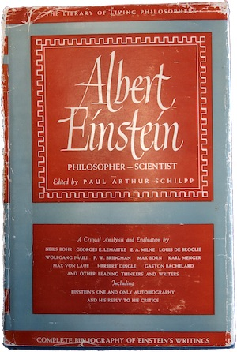

Slide 47
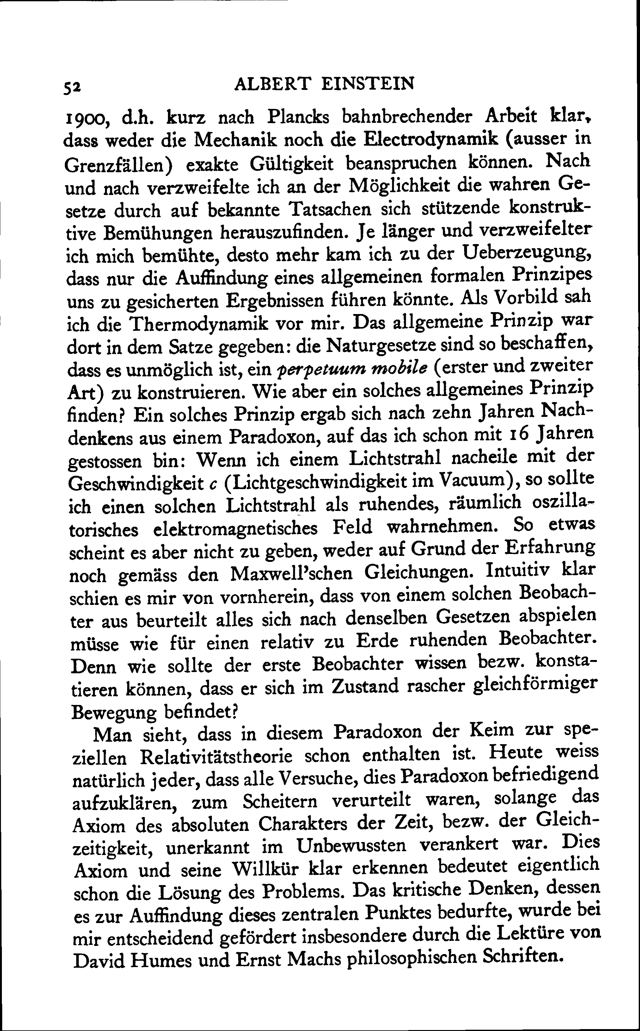
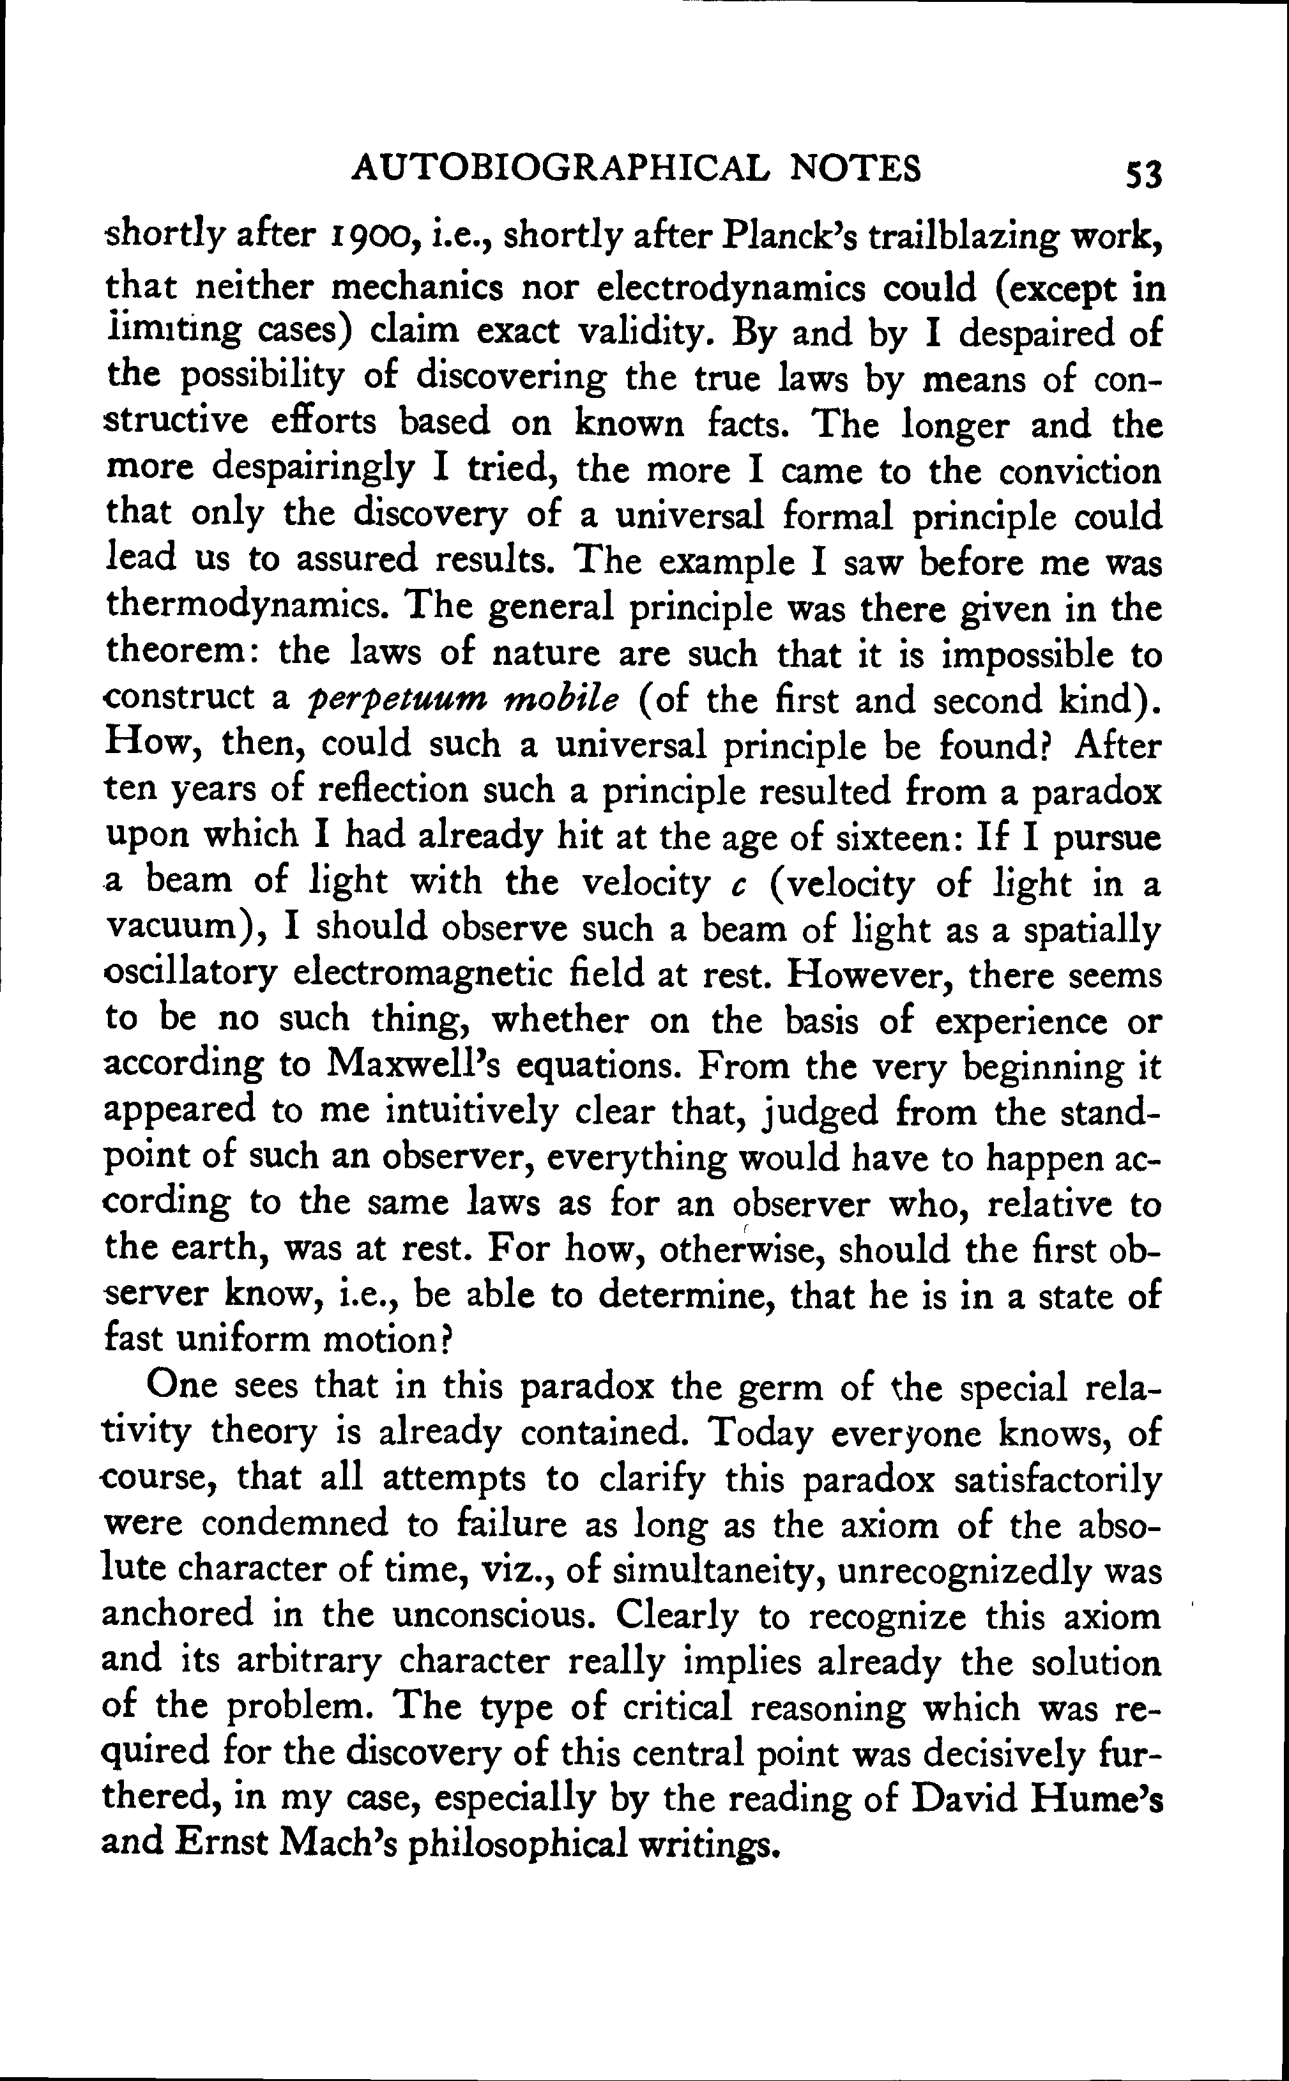

Slide 48
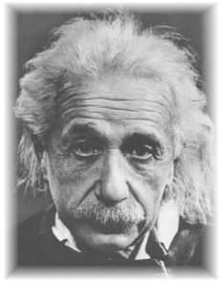
Einstein, Autobiographical Notes, 1946
“After ten years of reflection such a principle resulted from a paradox upon which I had already hit at the age of sixteen:
If I pursue a beam of light with the velocity c (velocity of light in a vacuum),
I should observe such a beam of light as an electromagnetic field at rest though spatially oscillating. There seems to be no such thing, however, neither on the basis of experience nor according to Maxwell’s equations.
From the very beginning it appeared to me intuitively clear that, judged from the standpoint of such an observer, everything would have to happen according to the same laws as for an observer who, relative to the earth, was at rest. For how should the first observer know or be able to determine, that he is in a state of fast uniform motion?
One sees in this paradox the germ of the special relativity theory is already contained.”

Slide 49
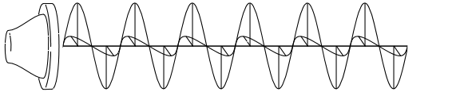

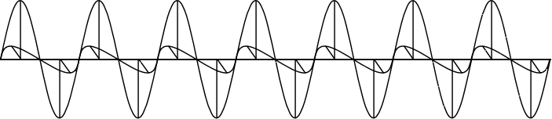
The Thought
A frozen waveform!

Slide 50
All clear?

Slide 51



The thought experiment generates no trouble for an ether based
Maxwell electrodynamics.
“…I should observe such a beam of light as an electromagnetic field at rest though spatially oscillating.
…but only because we have no experience of moving at the speed light in the ether.
There seems to be no such thing, however, neither on the basis of experience
nor according to Maxwell’s equations.
…but it is allowed by Maxwell’s equations through the simplest transformation.
From the very beginning it appeared to me intuitively clear that, judged from the standpoint of such an observer, everything would have to happen according to the same laws as for an observer who, relative to the earth, was at rest. For how should the first observer know or be able to determine, that he is in a state of fast uniform motion?”
…but the observer would know he is moving rapidly because the light would appear frozen.

Slide 52
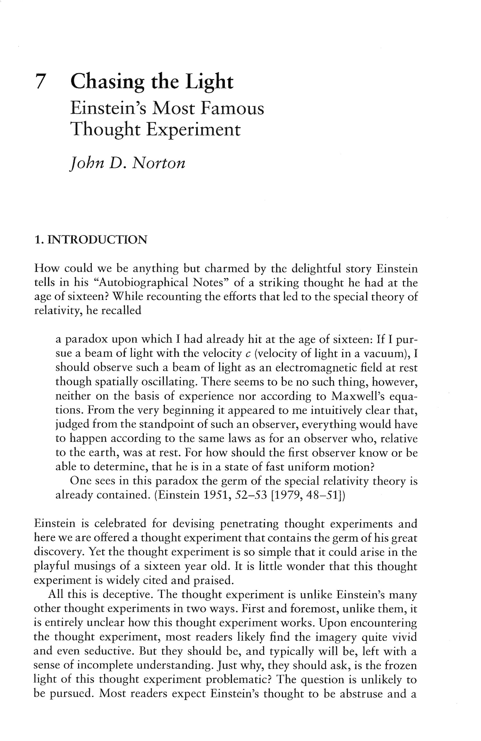
Literature survey
I found many words but no cogent account.

Slide 53
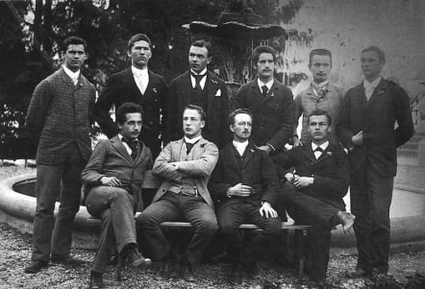
Why does the thought experiment merit pride of place in Einstein’s defining autobiography?
Is it merely the recording of the visceral hunches of a precocious sixteen year old, who did not study Maxwell’s theory until two years later?
Or does it have a cogency that extends beyond Einstein’s final high school year?
Einstein (16yrs) in 1896 in the cantonal school of Aarau

Slide 54
A Solution

Slide 55
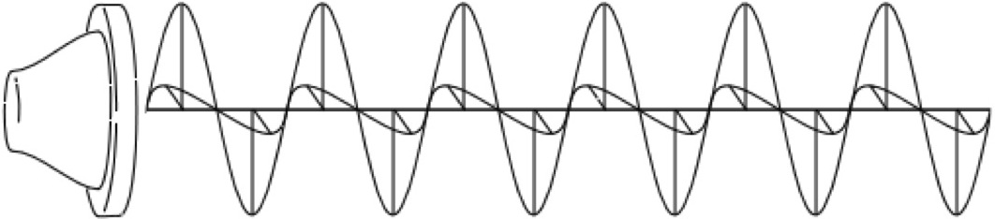
Ritz’s 1908 Emission “Theory” of light
A modified electrodynamics in which the velocity of the emitter is added vectorially to the velocity of light and electrodynamic action.
The new theory conforms to the principle of relativity without modifying Newtonian notions of space and time.
The constancy of the speed of light is abandoned. All speeds are possible.
c
v
c+v
Einstein later reported that he had given long and serious consideration to a Ritz-like electrodynamics during the seven years prior to 1905 in which he struggled to reconcile electrodynamics and the principle of relativity.
“…Ritz’s conception, which incidentally was also mine before rel. theory.”
Einstein to Ehrenfest,
June, 1912 and elsewhere

Slide 56
Einstein’s Objections to All Emission Theories of Light.
Collected from remarks in many places.
The physical state of a light ray is determined completely by its intensity and color [and polarization].
“ I decided [against an emission theory], since I was convinced that each light [ray] should be defined by frequency and intensity alone, quite independently of whether it comes from a moving or a resting light source.”
Einstein to Ehrenfest, mid June 1912
The theory cannot be formulated in terms of differential equations.
Different velocities entail that light can back up on itself (later parts overtakes earlier).
e.g. Einstein to Shankland, 1950s
e.g. Einstein to Shankland, 1950s;
to Hines Feb. 1952
Problems with shadow formation by a moving screen.
e.g. To Mario Viscardini, April 1922

Slide 57


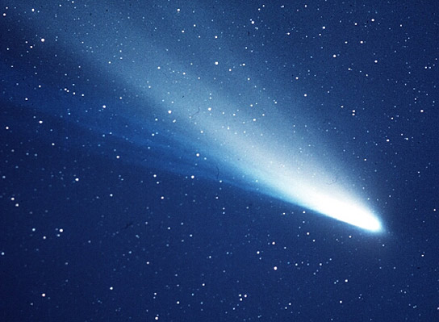
The Thought Experiment succeeds against an emission theory of light.
i.e. a theory that conforms to the principle of relativity using Newtonian notions of space and time.
Frozen lightwaves? “…There seems to be no such thing, however, neither on the basis of experience...”
A light source receding at c leaves a frozen wave behind.
We should expect to experience these frozen waves if there are rapidly receding light sources. There is no need for us to move at c.

Slide 58
“…or according to Maxwell’s equations…”
Frozen electromagnetic waves are possible in any inertial frame of reference.
Frozen electromagnetic waves must be admissible in electrostatics and magnetostatics.
Electrostatics and magnetostatics of an emission theory should agree with the electrostatics and magnetostatics of Maxwell’s theory. (Oldest and most secure part of theory.)
BUT Maxwell’s equations prohibit frozen waves.

Slide 59
“…For how should the first observer know or be able to determine, that he is in a state of fast uniform motion?”
i.e., fast uniform motion with respect to the source.
Why should “the first observer know or be able to determine , that he is in a state of fast uniform motion”?
Otherwise
the theory is indeterministic! The present does not fix the future.

Slide 60
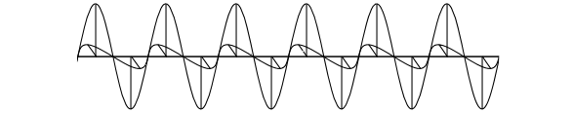
“…For how should the first observer know or be able to determine, that he is in a state of fast uniform motion?”
A light wave
of definite color,
amplitude, polarization
at an instant.
What happens next?
Is it a propagating wave?
Observer
at rest with respect to source.
Observer moves with respect to source.
Or a frozen wave?
An extra property is needed for the instantaneous state to determine the future.
But color, amplitude and polarization are the only properties light has.

Slide 61
An emission theory of light
cannot be formulated in terms of differential field equations.
Field theory formulated with differential equations: present, local state of the field determines its future time development.
Precluded in an emission theory of light. An extra property is needed to distinguish frozen from propagating waves.
Example: Maxwell’s theory
xH = (1/c)(∂E/∂t)
xE = - (1/c)(∂H/∂t)
Present state of field
Rate of change of field
Future time development of field.

Slide 62
An Historical Puzzle

Slide 63
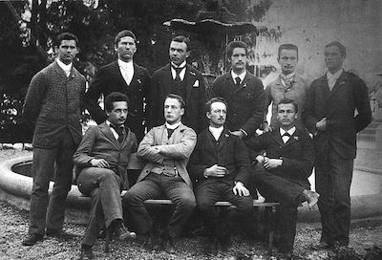
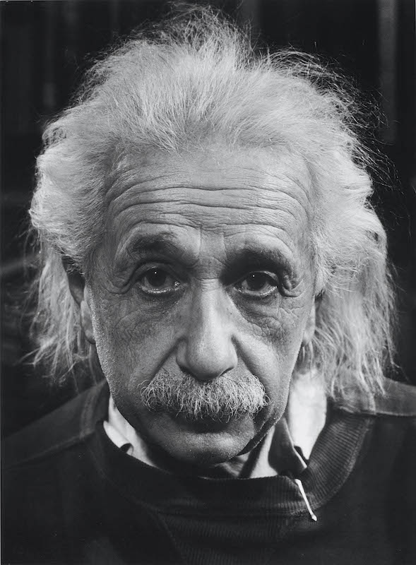
Why the delay?
1895-1896
Einstein was 16 years old. Did not know Maxwell’s electrodynamics.
+ 50 years.
1946
Einstein first writes of the thought experiment.

Slide 64
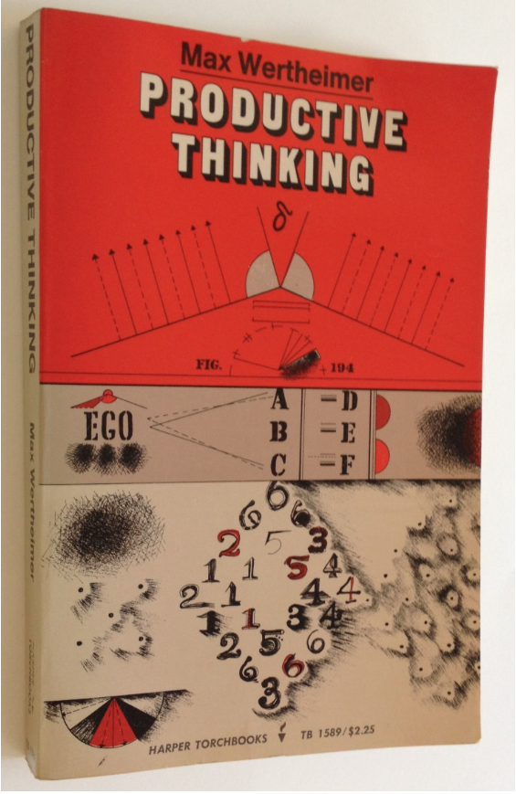
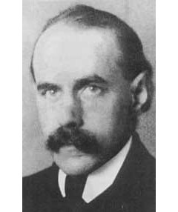
First written report
Max Wertheimer interviews Einstein in 1916
“These were wonderful days, beginning in 1916, when for hours and hours I was fortunate enough to sit with Einstein, alone in his study, and hear from him the story...”
active interrogation
“During these long discussions I questioned Einstein in great detail about the concrete events in his thought...”
no concrete result
“Back of all of this there had to be something that was not yet grasped, not yet understood. Uneasiness about this characterized young Einstein’s state of mind at the time.”

Slide 65
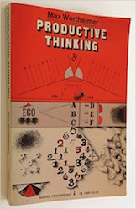
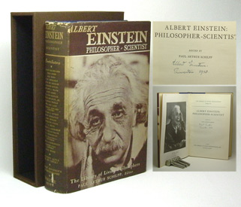
A Recovered Memory?
1943
Max Wertheimer sends Einstein’s drafts of the unpublished Productive Thinking. Einstein responds. Wertheimer dies.
1945
Productive Thinking is published posthumously.
1946
Einstein drafts his Autobiographical Notes. He recounts the chasing a light beam thought experiment. It is
recovered memories of his 16 year old self from the Wertheimer interviews
later use of the thought experiment to refute an emission theory of light
+
+ … ?

Slide 66
Concluding

Slide 67
We are not infallible, but if what we say doesn’t make sense, perhaps you should give it a second look and think a little more about it.

Slide 68


Slide 69
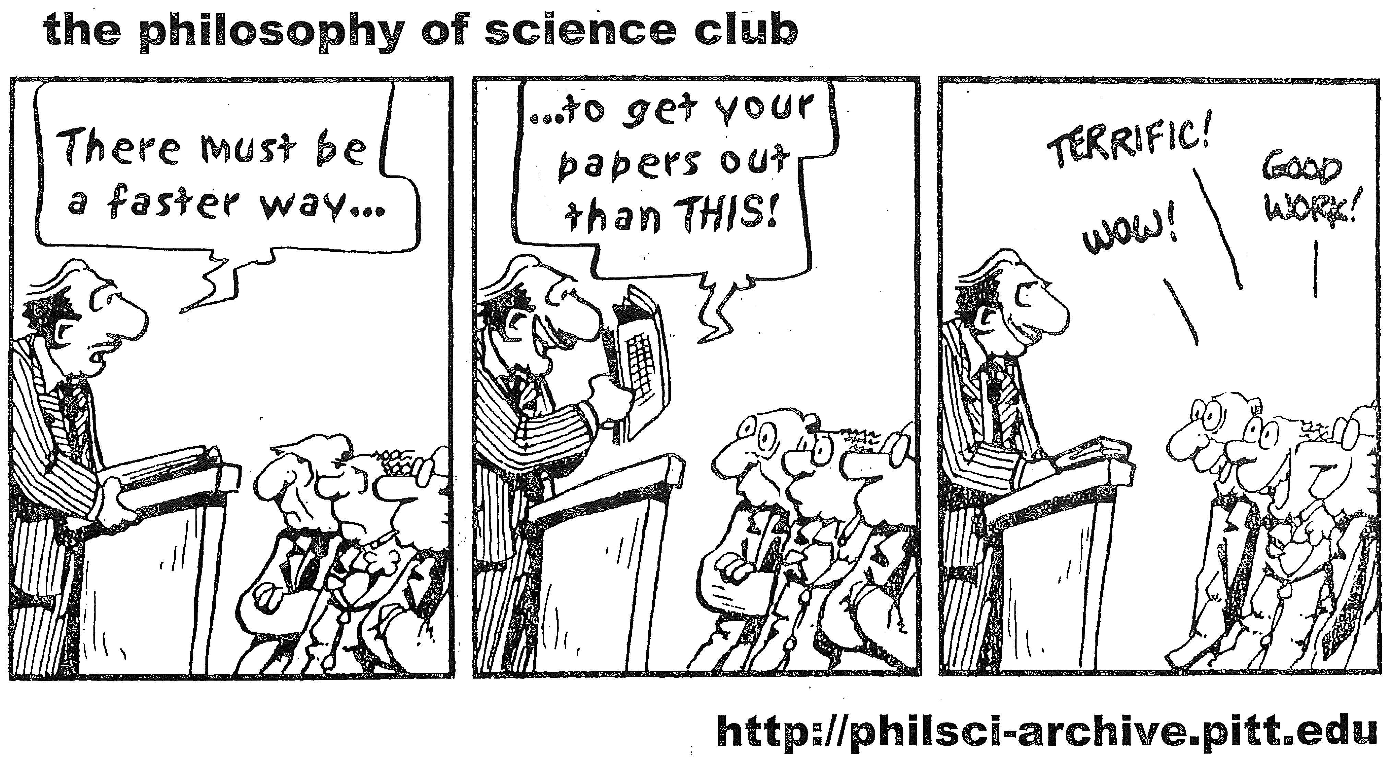

Slide 70
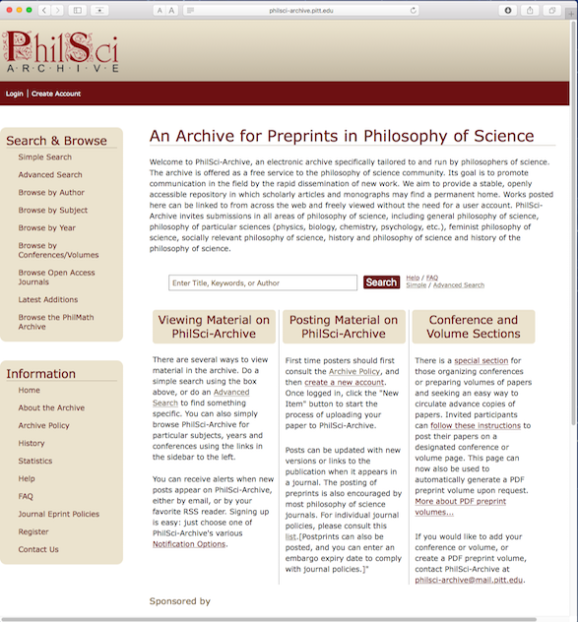


Slide 71
THE END

