Slide 1
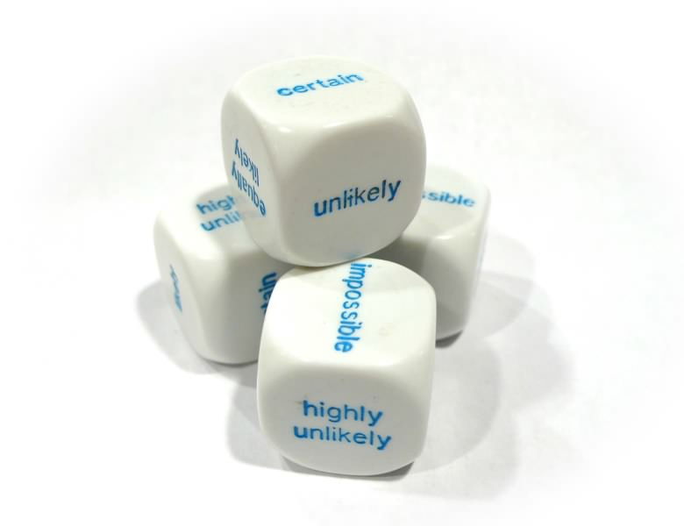
Cosmic Confusions
Not Supporting versus
Supporting Not-
John D. Norton
Department of History and
Philosophy of Science
University of Pittsburgh
www.pitt.edu/~jdnorton

Slide 2

This Talk
Bayesian probabilistic analysis conflates neutrality of evidential support with disfavoring evidential support.
Wrong formal tool for many problems in cosmology where neutral support is common.
Fragments of inductive logics that tolerate neutral support displayed.
Non-probabilistic state of completely neutral support.
Artifacts are introduced by the use of the wrong inductive logic.
“Inductive disjunctive fallacy.”
Doomsday argument.

Slide 3
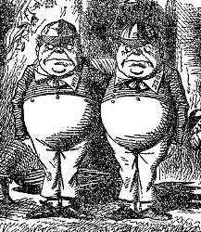
Principle of Indifference (evidential version)
If the evidence does not distinguish among propositions,
then they accrue the same inductive support.
… or withhold support
(Ben Eva)
maximum indifference over propositions
State of completely neutral evidential support
More options…

Slide 4
Completely
Neutral Evidential Support

Slide 5
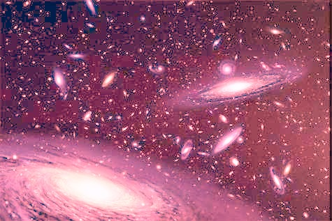
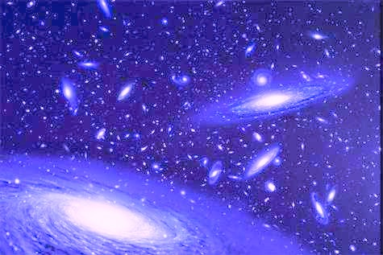
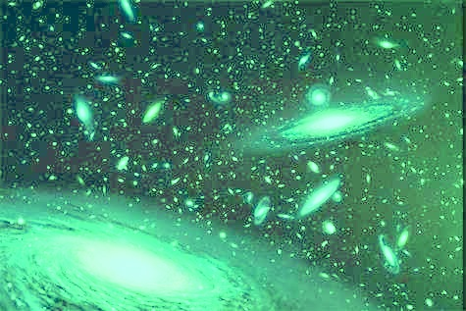
Unconnected Parallel Universes: Completely Neutral Support
Same laws, but constants undetermined.
h = ? c = ?
G = ? …
h = ? c = ?
G = ? …
Background evidence is neutral on whether h lies
in some tiny interval
or
outside it.
h = ? c = ?
G = ? …
h
0
1
2
3
4
5

Slide 6

Parallel Universes Born in a Singularity: Disfavoring Evidence
Stochastic law assigns probabilities to values of constants.
P(h₁) = 0.01
…
P(h₂) = 0.01
…
Background evidence strongly disfavors h lying
in some tiny interval; and strongly favors h outside it.
P(h₃) = 0.01
…
very probable
very improbable
very probable
h
0
1
2
3
4
5

Slide 7
How to Represent
Completely
Neutral Evidential Support

Slide 8

Probabilities from 1 to 0 span support to disfavor
P(H|B) + P(not-H|B) = 1
P(not-H|B)
P(H|B)
P(not-H|B)
P(H|B)
Large.
Strong favoring.
Small.
Strong disfavoring.
Small.
Strong disfavoring.
Large.
Strong favoring.
No neutral probability value available for neutral support.

Slide 9

Underlying Conjecture of Bayesianism…
Logic of physical chances
Logic of
all evidence
…Fails

Slide 10
Completely Neutral Support
[A|B] = support
A accrues from B
[ |B] = I
“indifference”
“ignorance”
any contingent proposition
I
I
I
I
I
h
0
1
2
3
4
5
I
I
I
Argued in some detail in
John D. Norton, "Ignorance and Indifference." Philosophy of Science, 75 (2008), pp. 45-68.
"Disbelief as the Dual of Belief." International Studies in the Philosophy of Science, 21(2007), pp. 231-252.

Slide 11
I. Invariance under Redescription
Justification…
using the Principle of Indifference
I
I
I
I
I
Equal support for h in equal h-intervals.
h
0
1
2
3
4
5
rescale h to h’ = f(h)
I
I
I
I
I
Equal support for h’ in equal h’-intervals.
h’
0
1
2
3
4
5
[ h in [0,1] OR h in [1,2] | B] = [ h in [0,1] | B] = [ h in [1,2] | B]
The principle of indifference does not lead to paradoxes.
Paradoxes come from the assumption that evidential support must always be probabilistic.

Slide 12
II. Invariance under Negation
Justification…
I
I
Equal (neutral) support for h in [0,1] and outside [0,1].
h
0
1
2
3
4
5
I
I
Equal (neutral) support for h in [0,2] and outside [0,2].
h
0
1
2
3
4
5
[ h in [0,1] OR h in [1,2] | B] = [ h in [0,1] | B]

Slide 13
Inductive Disjunctive Fallacy

Slide 14
Completely neutral support
Strongly disfavoring support
conflated with
Neutral support
Disfavoring
I
I
I
…
I
a₁
a₁ or a₂
a₁ or a₂ or a₃
…
a₁ or a₂ or … or a₉₉
prob = 0.01
prob = 0.02
prob = 0.03
…
prob = 0.99
Disjunction of very many neutrally supported outcomes
a strongly supported outcome.
is NOT

Slide 15



van Inwagen, “Why is There Anything At All?”
Proc. Arist. Soc., Supp., 70 (1996). pp.. 95-120.
One way not to be.
Infinitely many ways to be.
…
Probability zero.
“As improbable as anything can be.”
Probability one.
As probable as anything can be.

Slide 16

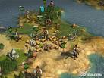


Our Large Civilization
Ken Olum, “Conflict between Anthropic Reasoning and Observations,” Analysis, 64 (2004). pp. 1-8.
Fewer ways we can be in small civilizations.
Vastly more ways
we can be in large civilizations.
…
“Anthropic reasoning predicts we are typical…”
“… [it] predicts with great confidence that we belong to a large civilization.”

Slide 17
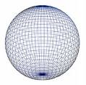

Our Infinite Space
Informal test of commitment to anthropic reasoning.
Fewer ways we can be observers in a finite space.
Infinitely more ways
we can be observers in an infinite space.
…
Hence our space is infinitely more likely to be geometrically infinite.

Slide 18
Inductive Logics that Tolerate Neutrality of Support

Slide 19
Discard Additivity, Keep Bayesian Dynamics
If
T₁ entails E. T₂ entails E.
P(T₁|B) = P(T₂|B)
then
P(T₁|E&B) = P(T₂|E&B)
Bayesian conditionalization.
equal priors
equal posteriors
Postulate same rule in a new, non-additive inductive logic.
Conditionalizing from Complete Neutrality of Support
If
T₁ entails E. T₂ entails E.
[T₁|B] = [T₂|B] = I
then
[T₁|E&B] = [T₂|E&B]

Slide 20
Subjective Prior Problems

Slide 21
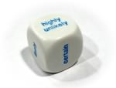
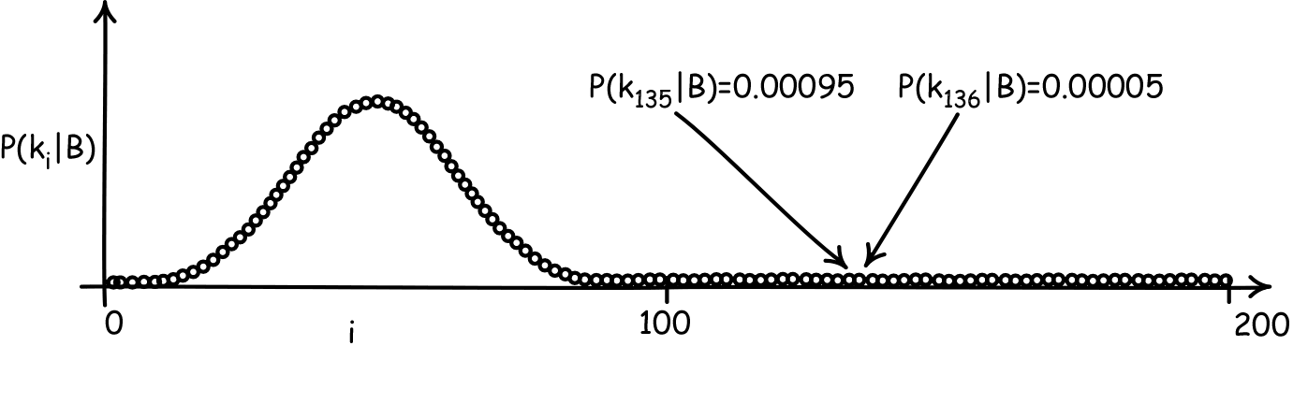
Pure Opinion Masquerading as Knowledge
1. Subjective Bayesian sets arbitrary priors on k₁, k₂, k₃, …
Pure opinion.
2. Learn richest evidence
= k₁₃₅ or k₁₃₆
3. Apply Bayes’ theorem
P(k₁₃₅|E&B)
P(k₁₃₅|B)
0.00095
=
=
P(k₁₃₆|E&B)
P(k₁₃₆|B)
0.00005
P(k₁₃₅|E&B) = 0.95
Endpoint of conditionalization dominated by pure opinion.
P(k₁₃₆|E&B) = 0.05

Slide 22
Pure Opinion Masquerading as Knowledge Solved
“Priors” are completely neutral support over all values of k_{i}.
[k₁|B] = [k₂|B] = [k₃|B] =… = [k₁₃₅|B] = [k₁₃₆|B] = … = I
No normalization imposed.
[k₁|B] = [k₁ or k₂|B] = [k₁ or k₂ or k₃|B] =… = I
Apply rule of conditionalization on completely neutral support.
E = k₁₃₅ or k₁₃₆
[k₁₃₅|E&B] = [k₁₃₆|E&B]
[k₁₃₅|B] = [k₁₃₆|B] = I
Nothing in evidence discriminates between k₁₃₅ or k₁₃₆.
Bayesian result of support for k₁₃₅ over k₁₃₆ is an artifact of the inability of a probability measure to represent neutrality of support.

Slide 23
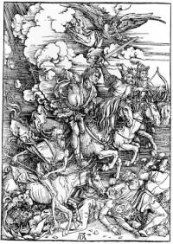
The Doomsday Argument

Slide 24
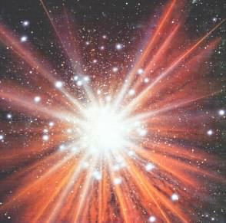
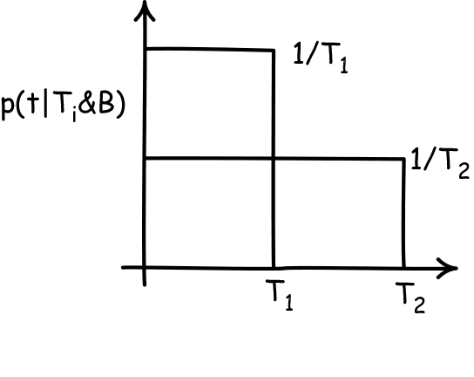

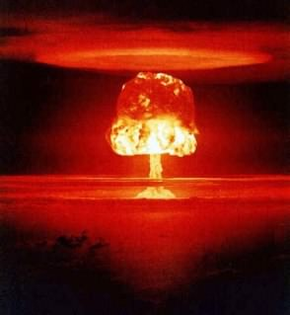
Doomsday Argument (Bayesian analysis)
Bayes’ theorem
p(T|t&B) ~ p(t|T&B) . p(T|B)
time = 0
Compute likelihood by assuming t is sampled uniformly from available times 0 to T.
p(t|T&B) = 1/T
we learn time t has passed
For later: which is the right “clock” in which to sample uniformly? Physical time T? Number of people alive T’?…
Variation in likelihoods arise entirely from normalization.
p(T|t&B) ~ 1/T
Support for early doom
Entire result depends on this normalization.
time of doom T
What support does t give to different times of doom T?
Entire result is an artifact of the use of the wrong inductive logic.

Slide 25
Doomsday Argument (Barest non-probabilistic reanalysis.)
Take evidence E is just that T>t.
T₁>t entails E. T₂>t entails E.
time = 0
E = T>t
[T₁|E&B] = [T₂|E&B]
[T₁|B] = [T₂|B] = I
we learn time t has passed
Apply rule of conditionalization on completely neutral support.
The evidence fails to discriminate between T₁ and T₂.
time of doom T
What support does t give to different times of doom T?

Slide 26
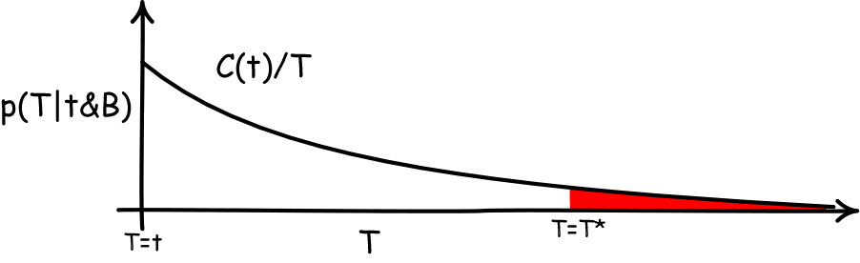
Doomsday Argument (Bayesian analysis again)
Consider only the posterior
p(T|t&B)
Require invariance of posterior under changes of units used to measure times T, t.
Invariance under T’=AT, t’=At
Days, weeks, years? Problem as posed presumes no time scale, no preferred unit of time.
time = 0
Unique solution is the “Jeffreys’ prior.”
we learn time t has passed
p(T|t&B) = C(t)/T
time of doom T
Disaster! This density cannot be normalized.
Infinite probability mass assigned to T>T*, no matter how large.
Evidence supports latest possible time of doom.
What support does t give to different times of doom T?

Slide 27
A Richer Non-Probabilistic Analysis
Consider the non-probabilistic degree of support for T in the interval
[T₁,T₂|t&B]
time = 0
Presume that there is a “right” clock-time in which to do the analysis, but we don’t know which it is. So we may privilege no clock, which means we require invariance under change of clock:
T’ = f(T), t’ = f(t),
for strictly monotonic f.
we learn time t has passed
time of doom T
[T₁,T₂|t&B] = [T₃,T₄|t&B] = I
for all T₁,T_{2,} T₃,T₄
What support does t give to different times of doom T?

Slide 28
Winding Up

Slide 29
This Talk
Bayesian probabilistic analysis conflates neutrality of evidential support with disfavoring evidential support.
Wrong formal tool for many problems in cosmology where neutral support is common.
Fragments of inductive logics that tolerate neutral support displayed.
Non-probabilistic state of completely neutral support.
Artifacts are introduced by the use of the wrong inductive logic.
“Inductive disjunctive fallacy.”
Doomsday argument.

Slide 30
Finis

Slide 31
Appendices

Slide 32
Neutrality and Probabilistic Independence

Slide 33
Probabilistic independence
Neutrality of (total) support
vs.
For a partition of all outcomes
A₁, A₂, …
P(A_{i}|E&B) = P(A_{i}|B) all i
For incremental measures of support*
inc (A_{i}, E, B) = 0
[A_{i}|B] = I all contingent A_{i}
Tertiary function
Binary function
Presupposes background probability measure.
Presupposes NO background probability measure.
* e.g. d(A_{i}, E, B) = P(A_{i}|E&B) - P(A_{i}|B)
s(A_{i}, E, B) = P(A_{i}|E&B) - P(A_{i}|not-E&B)
r(A_{i}, E, B) = log[ P(A_{i}|E&B)/P(A_{i}|B) ]
etc.

Slide 34
Objective vs Subjective

Slide 35



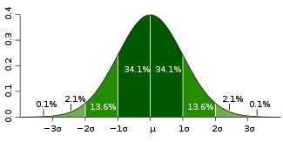
Neutrality and Disfavor
Ignorance
and Disbelief
or
mad dog
Bruno de Finetti
Objective Bayesianism
degrees of support
Subjective Bayesianism
degrees of belief
In each evidential situation,
Only one conditional probability correctly represents the import of evidence.
Many conditional probability represents opinion + the import of evidence.
Initial “informationless” priors?
Impossible.
No probability measure captures complete neutrality.
Pick any.
They merely encode arbitrary opinion that will be wash out by evidence.

