Slide 1
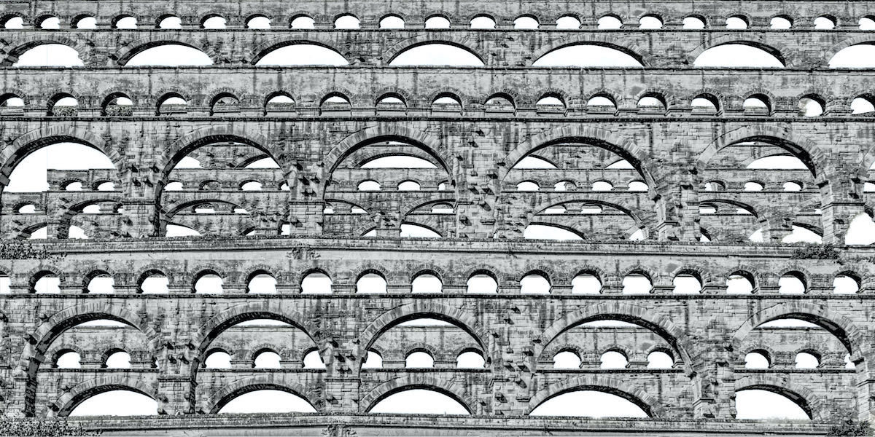
The Large-Scale Structure of Inductive Inference
Four Claims
John D. Norton
Department of History and
Philosophy of Science
Based on “Large-Scale Structure: Four Claims,”
Chapter 2, The Large-Scale Structure of Inductive Inference
http://www.pitt.edu/~jdnorton/homepage/cv.html#material_large

Slide 3
1. Relations of inductive support have a non-hierarchical structure.
2. Hypotheses, initially without known support, are used to erect non-hierarchical structures.
3. Locally deductive relations of support can be combined to produce an inductive totality.
4. There are self-supporting inductive structures.

Slide 4

Why Worry about Large-Scale Structure?
?
?

Slide 5
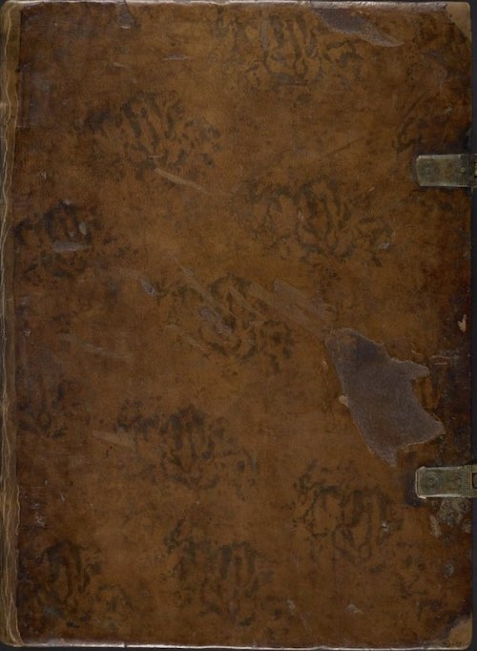
Inductive inferences are warranted by facts of the pertinent domain.
Book of Valid Inductive Inference Schemas
Must be truths, else inductive fallacy.
Inductive inference to
Inductive inference to
Inductive inference to
…
warranted by
warranted by
warranted by
Proposition
Proposition
Proposition
Proposition

Slide 6
A Fatal Infinite Regress…?
Propositions of increasing generality.
Inductive inference to
Inductive inference to
Inductive inference to
…
warranted by
warranted by
warranted by
Proposition
Proposition
Proposition
Proposition

Slide 7
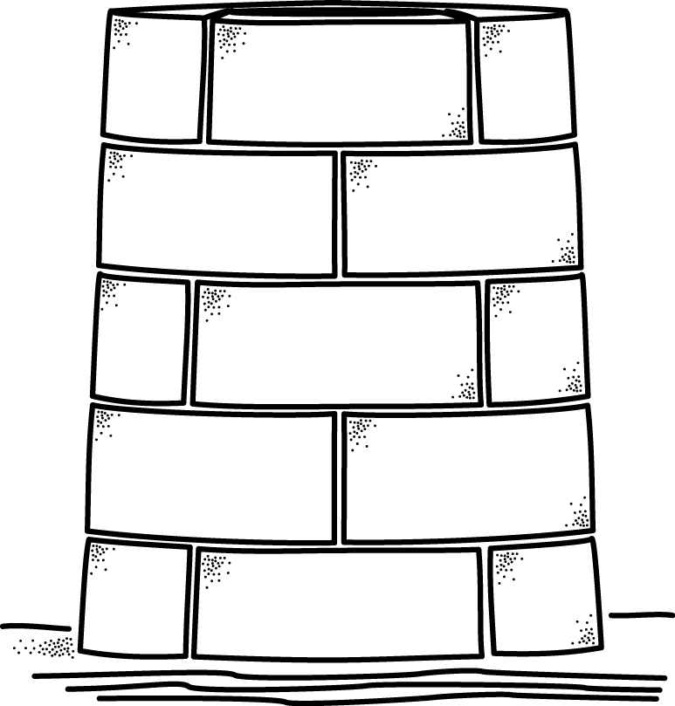
… assumes a hierarchical view of inductive support.
Inference must be warranted by (unsupported) proposition still higher up.
still more general facts
proposition higher up
propositions of increasing generality
more general facts
can ONLY be supported by
particular facts of experience
propositions lower down.
No proposition general enough to support an inductive inference to proposition higher up
observational bedrock

Slide 8
1. Relations of inductive support have a non-hierarchical structure.

Slide 9
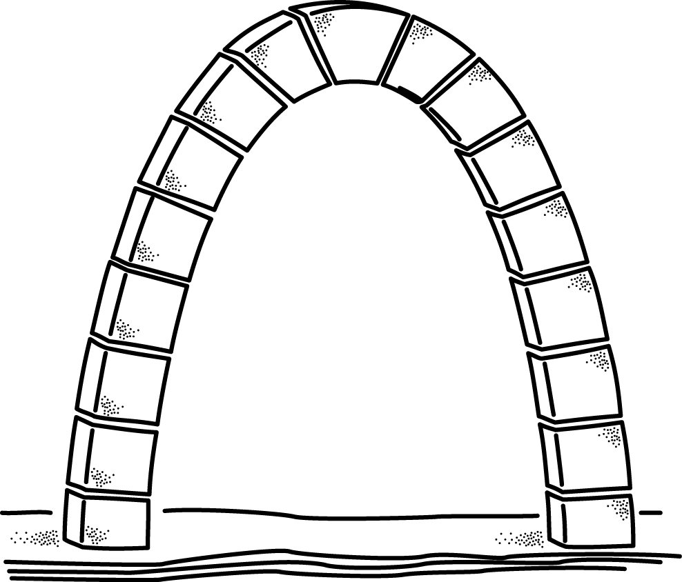
The Arch
proposition here
supported by
propositions above
and
propositions of increasing generality
propositions below
observational bedrock

Slide 10
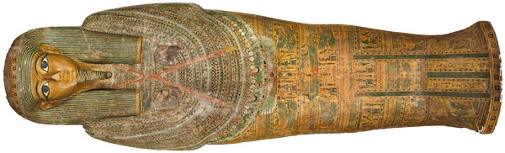
Radiocarbon Dating
H: historical dating by traditional archeological methods
R: radiocarbon dating, from residual level of decaying carbon-14.
?
?
Uncertainty: Are the historical records correctly interpreted?
Uncertainty: What was the atmospheric carbon-14 level at the time of creation of the artefact?

Slide 11
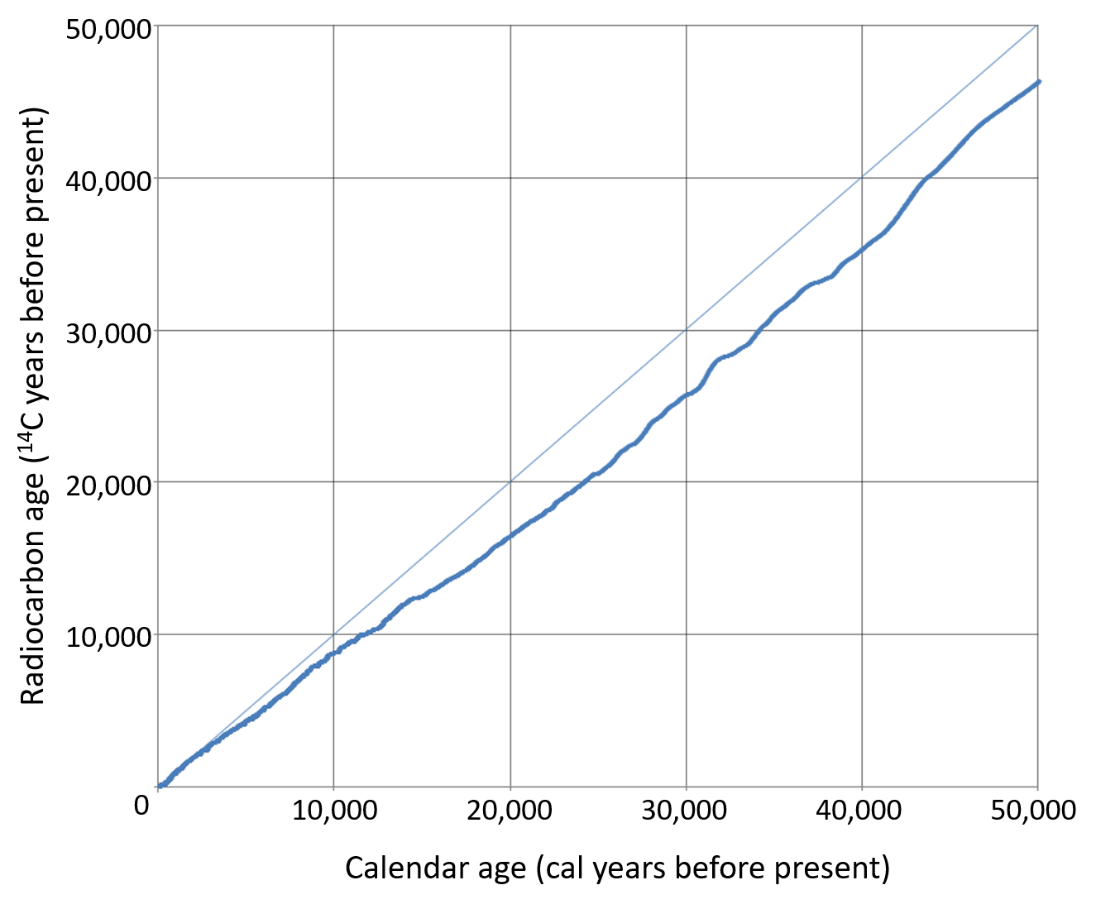
Radiocarbon Dating
H: historical dating by traditional archeological methods
R: radiocarbon dating, from residual level of decaying carbon-14.
Basis for calibration curve.
?
Uncertainty: What was the atmospheric carbon-14 level at the time of creation of the artefact?

Slide 12
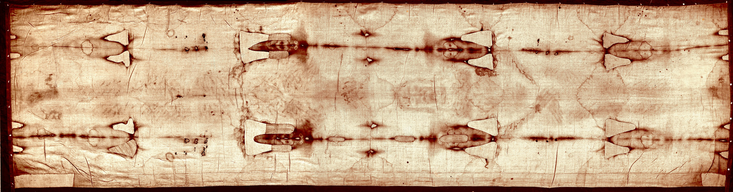
Radiocarbon Dating
H: historical dating by traditional archeological methods
R: radiocarbon dating, from residual level of decaying carbon-14.
?
Independent confirmation of H dating.
Uncertainty: Are the historical records correctly interpreted?
Shroud of Turin,
14th century?

Slide 13
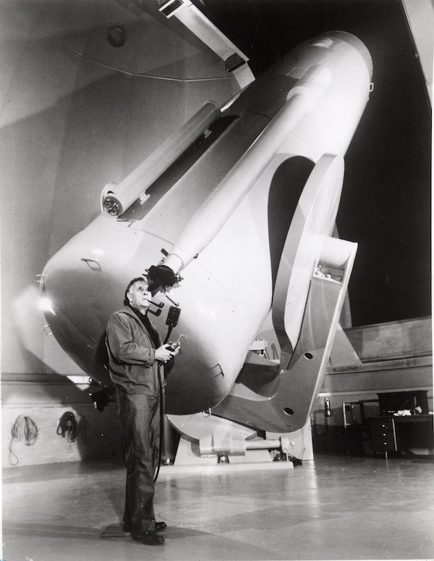
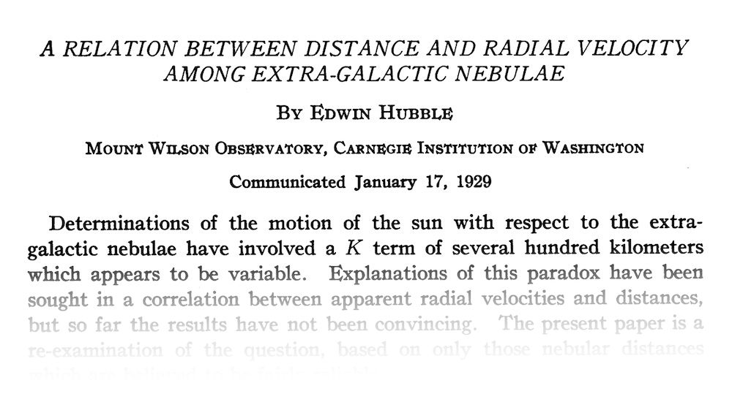
Hubble’s Law, 1929
velocity of recession of nebula
= H x
distance to nebula

Slide 14
A Simple Generalization?
Hubble’s law
Direct distance estimates missing for 22 nebulae.
generalize
Observed velocities and distances of 46 nebulae

Slide 15
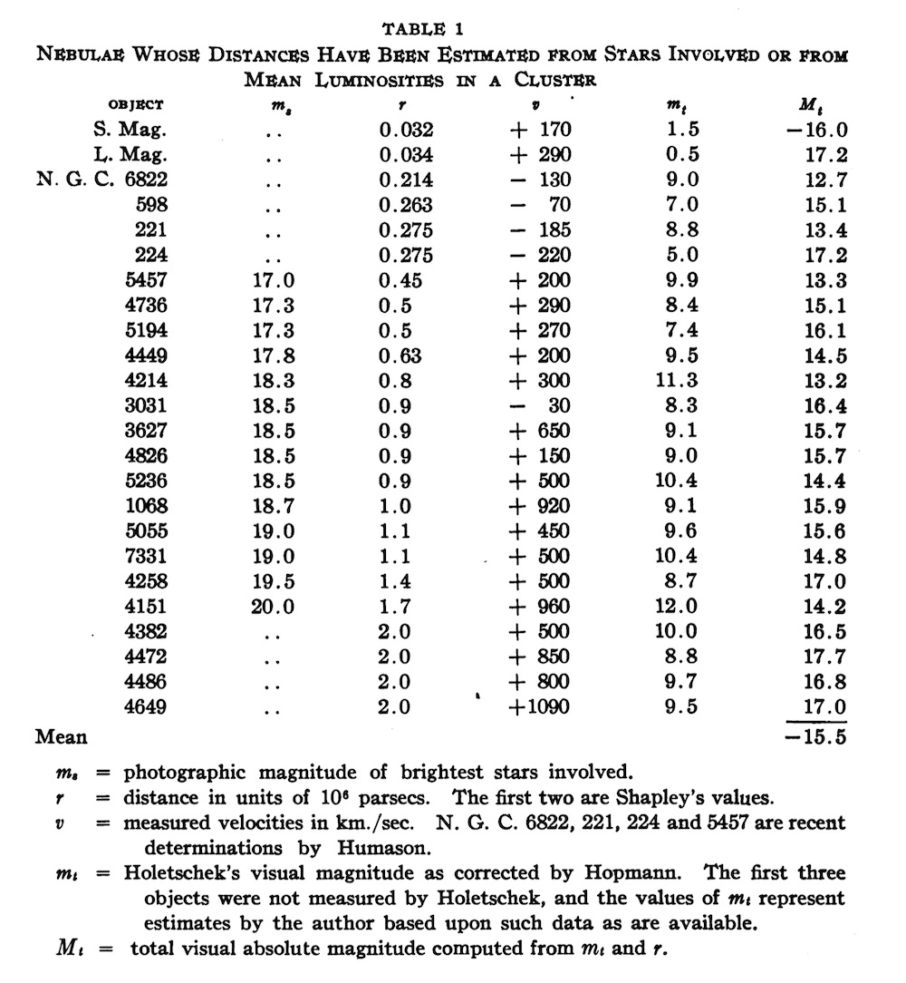
For 24 Nebulae with distance estimates
Hubble’s law
velocities
distances

Slide 16
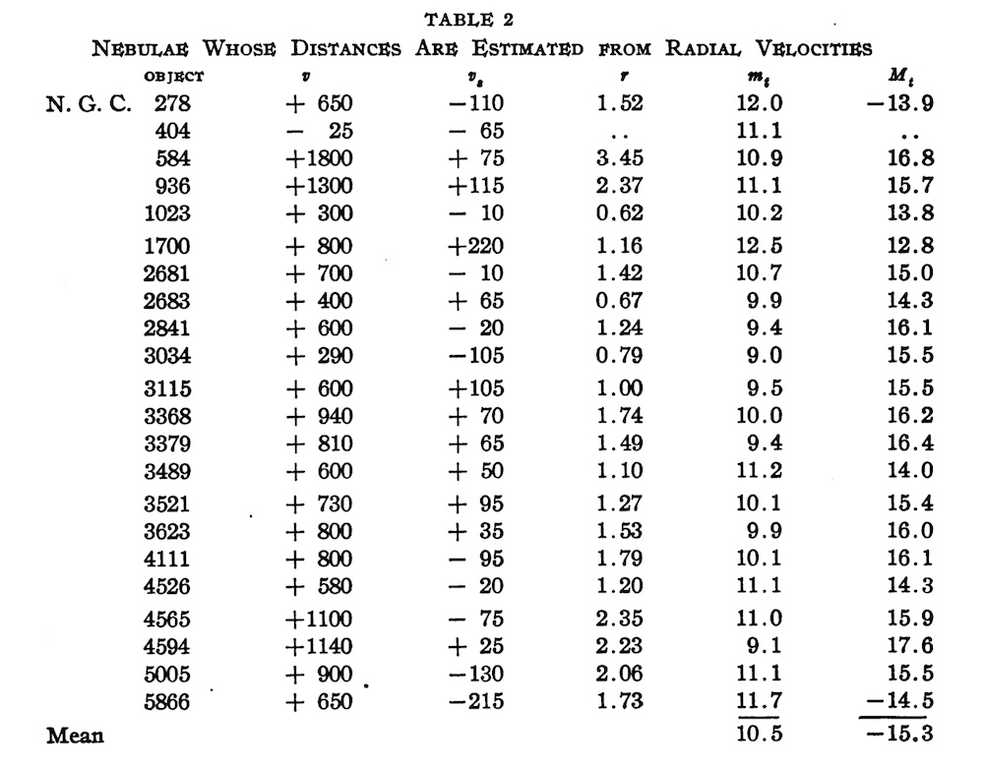
For 22 Nebulae without distance estimates
Hubble’s law
velocities
distances
Then check that the resulting absolute magnitudes are as expected.

Slide 17
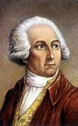

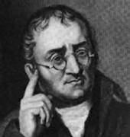
Simple inferences rapidly entangled with much science
This sample of Radium Chloride
crystals just like Barium Chloride
Generally, each crystalline substance has a single characteristic crystallographic form.
has
Haüy’s principle
All samples of Radium Chloride
crystals just like Barium Chloride
have
justify
Further inductive inferences that explore science.
Lavoisier’s system of elements.
Geometry of packing solids.
Dalton’s atomic theory.

Slide 18
Picture Gallery

Slide 19
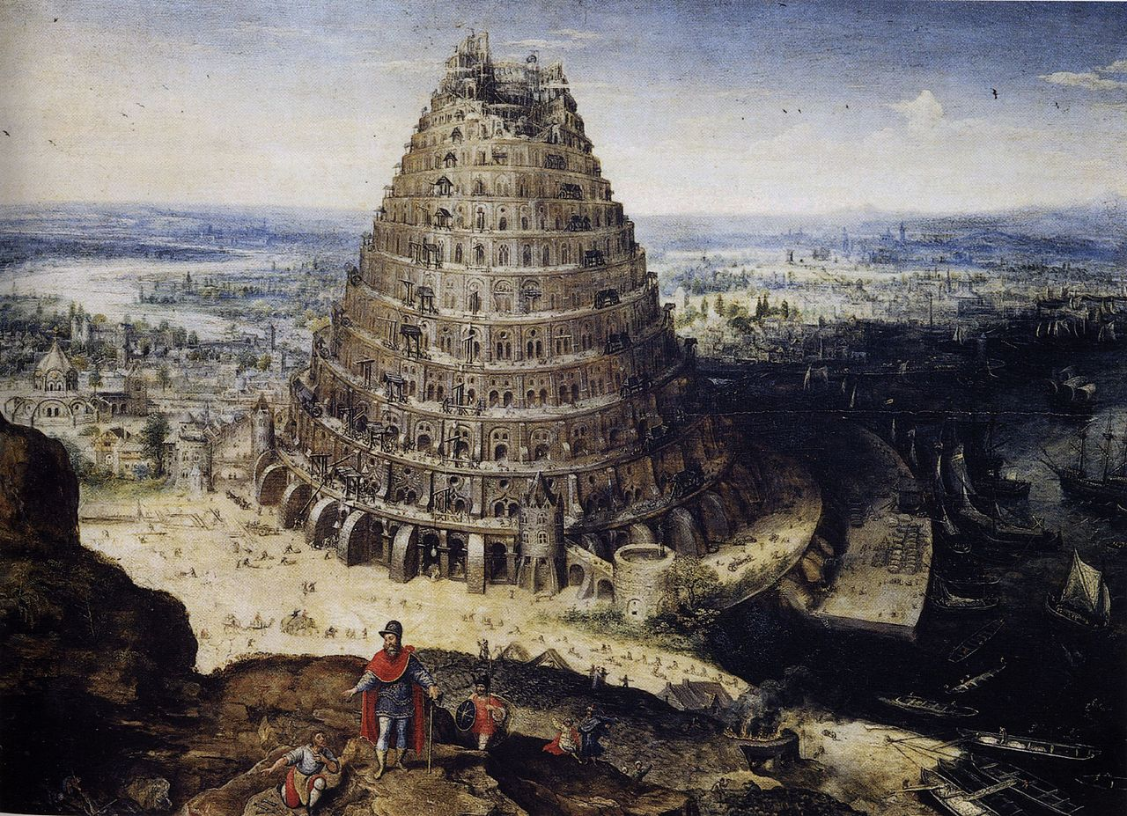
The hierarchical view

Slide 20
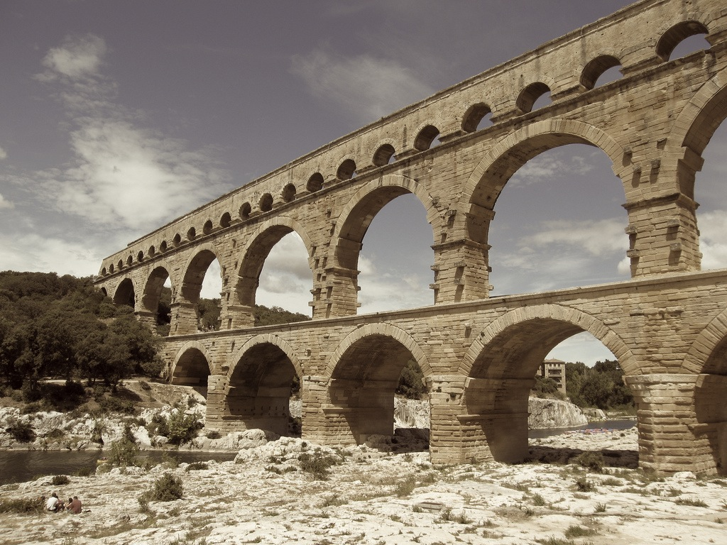
The non-hierarchical view

Slide 21
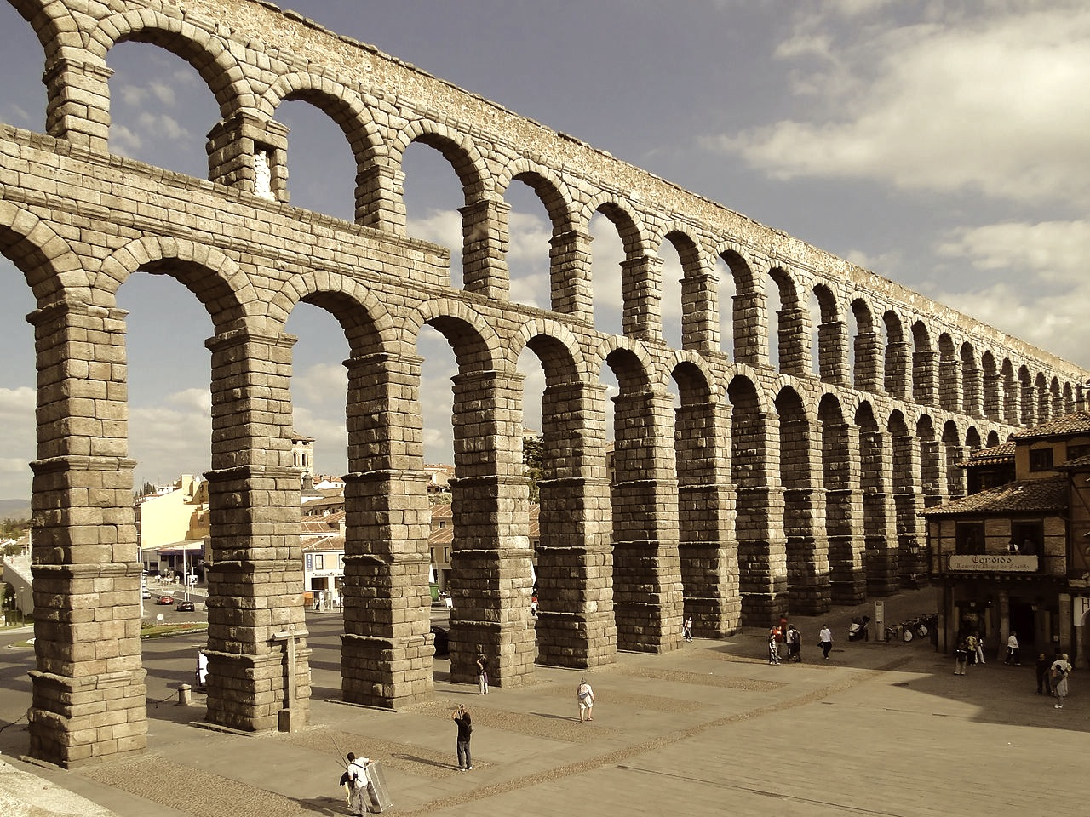
The non-hierarchical view

Slide 22
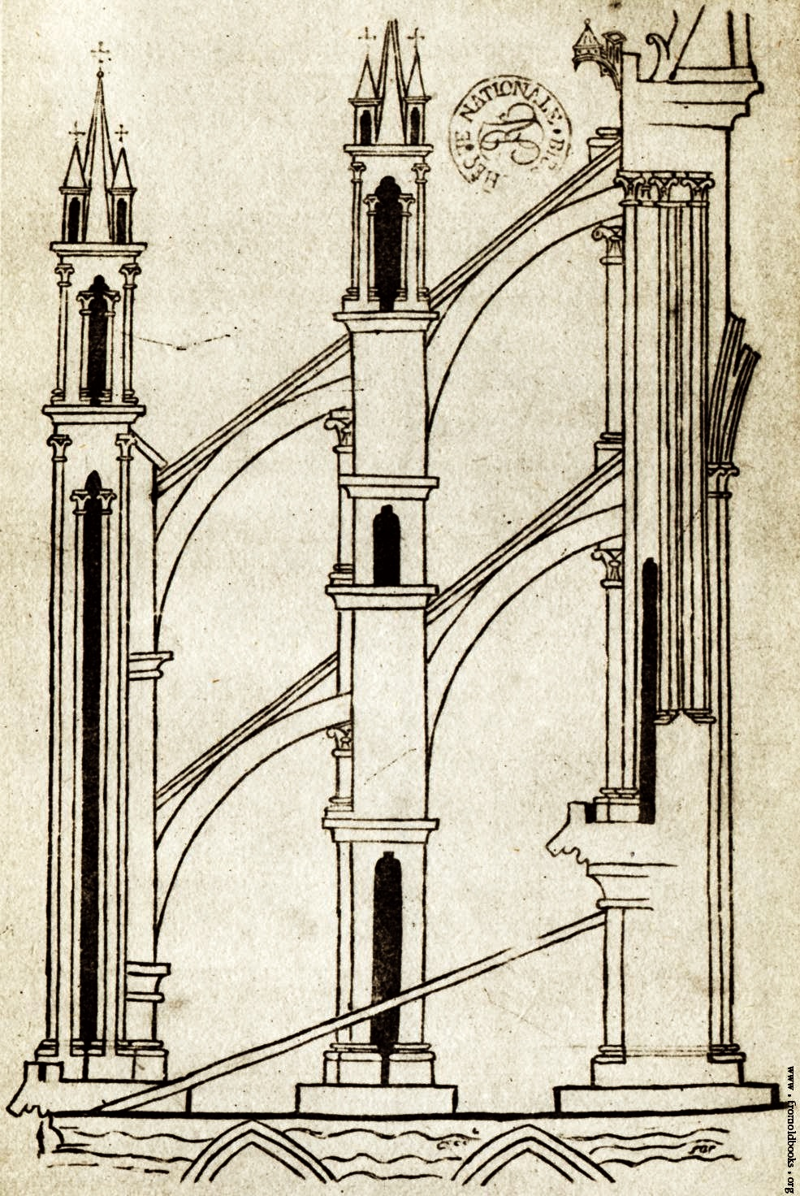
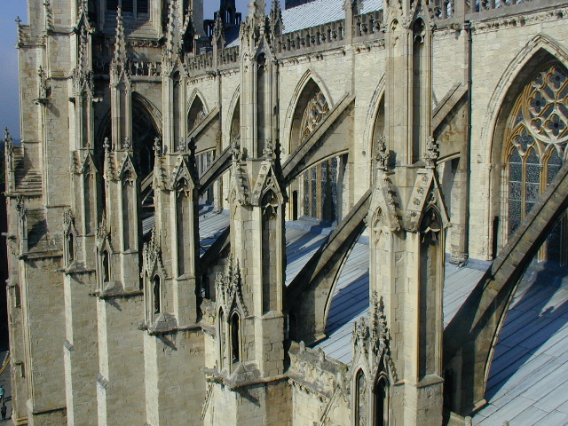
The non-hierarchical view

Slide 24


Slide 25
2. Hypotheses, initially without known support, are used to erect non-hierarchical structures.

Slide 26

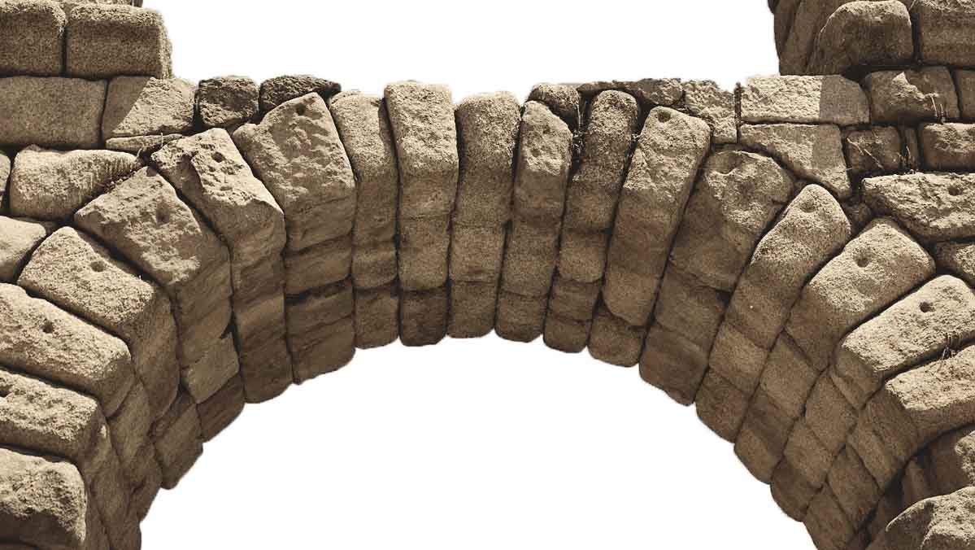
But How…?
How can an arch be constructed?
Not by
stacking stones.
Does it matter?
An arch that stands, still stands however it came to be!
How can inductively self- supporting structures be built?
Not by a linear chain of inferences.

Slide 27
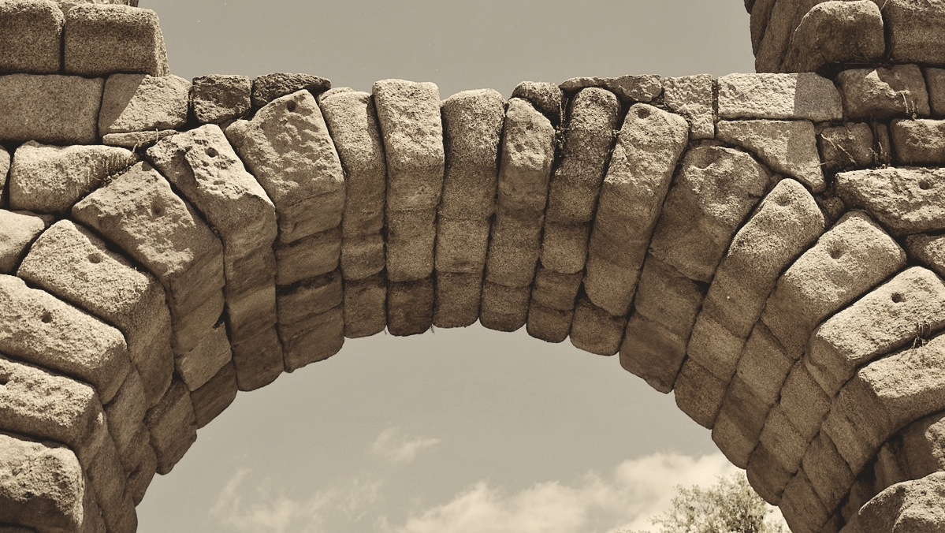
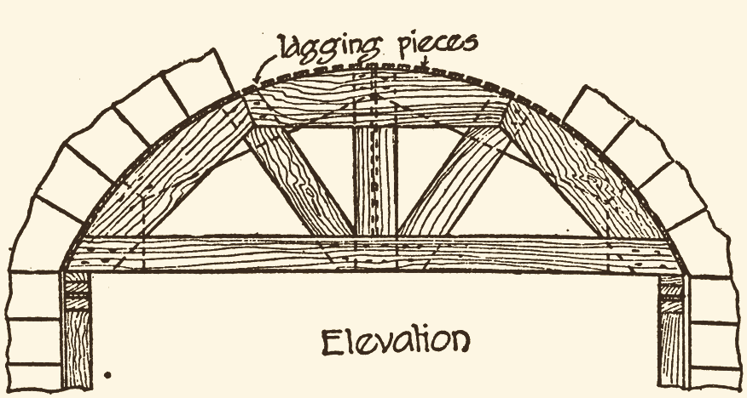
But How…?
How can an arch be constructed?
Not by
stacking stones.
Scaffolding “centring”

Slide 28
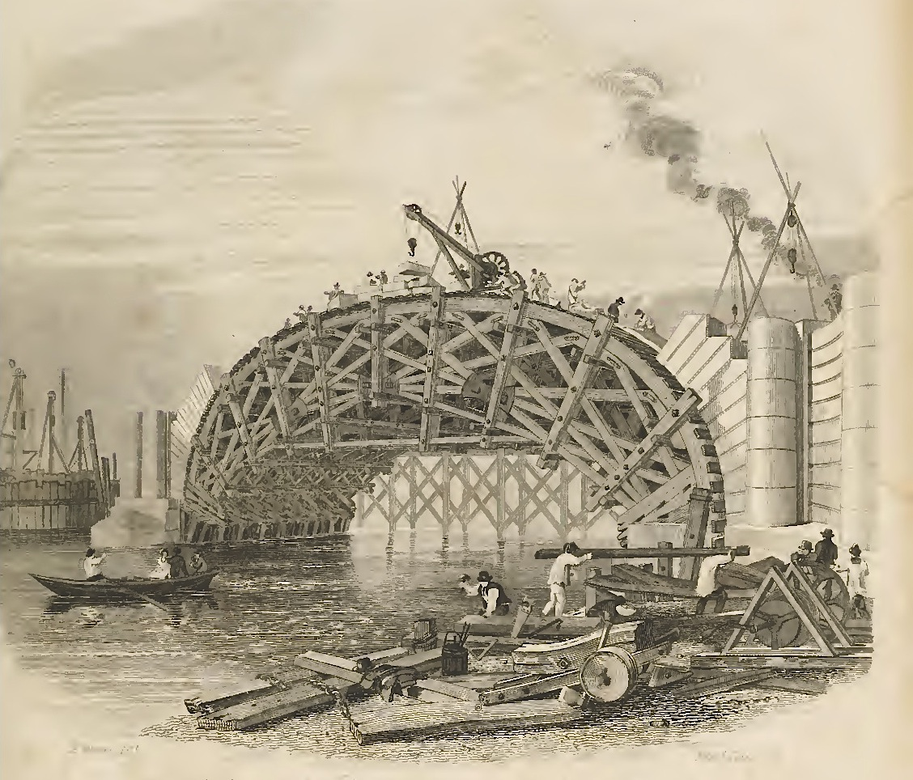
Construction of Waterloo Bridge

Slide 29
But How…?
How can inductively self-supporting structures be built?
Not by a linear chain of inferences.
Hypotheses
Introduced provisionally without proper inductive support.
NOT
hypothetico-deductive confirmation.
Inductive debt.
Support must eventually be provided to complete the securing of inductive support.
Hypotheses introduced to enable support for other propositions.

Slide 30
Avogadro’s Hypothesis

Slide 31
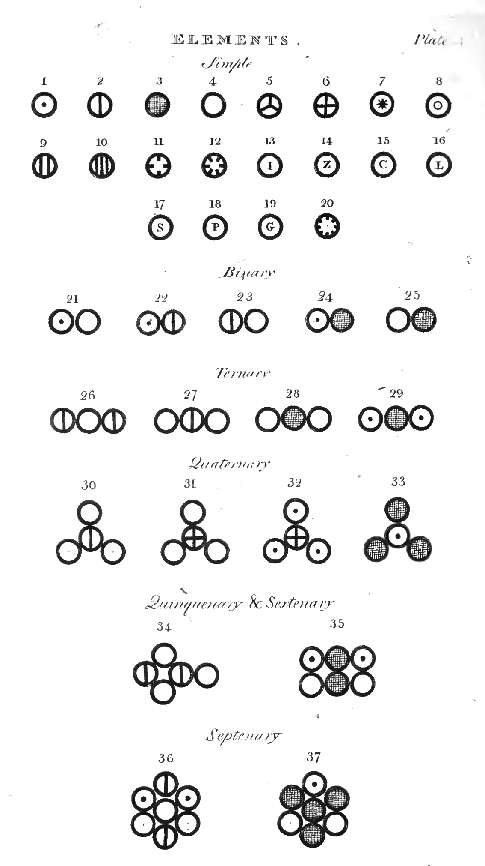
Dalton’s New System of Chemical Philosophy 1808
oxygen
hydrogen
“HO”
water
Dalton’s table of elements and compounds

Slide 32
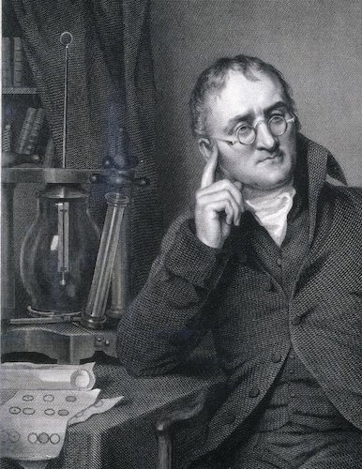
Dalton’s New System of Chemical Philosophy 1808
oxygen
Molecular formulae
HO? H₂O? HO₂? ...
Dalton knew NEITHER.
hydrogen
8 g of oxygen combing with 1 g of hydrogen to make water.
water
Relative weights of atoms
1 to 1? 1 to 2? 1 to 16? …

Slide 33
Avogadro’s hypothesis breaks the circle
Ratio of molecular weights of the two gases.
Avogadro’s hypothesis: equal volumes of gases have the same number of molecules.
…and more hypotheses:
Dulong-Petit law of specific heats, Mitscherlich’s law of isomorphism.
Measured ratio of densities of two gases

Slide 34
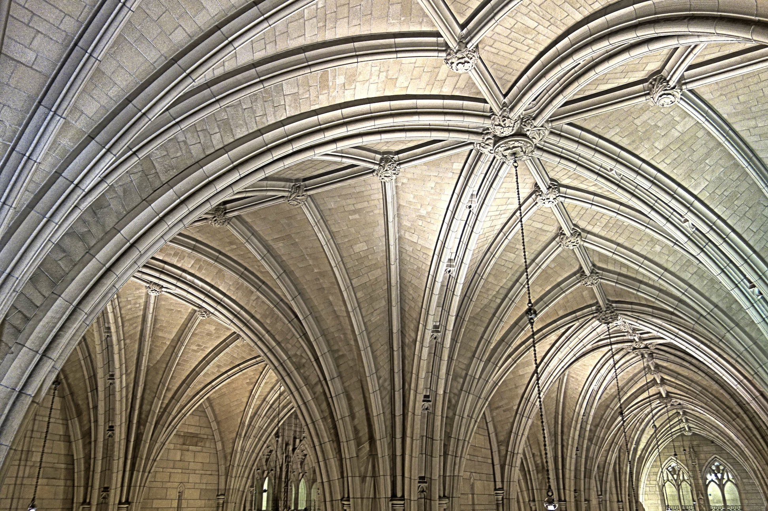
Resolution: Dalton 1808 to Cannizzaro 1858
Molecular formulae of elements and compounds.
Weights of atoms of elements.
Avogadro’s hypothesis
Dulong-Petit law of specific heats
Mitscherlich’s law of isomorphism
Densities of element and compounds, gaseous and vaporized.
Heat capacities of solids and gases.
Crystalline structures of solids

Slide 35
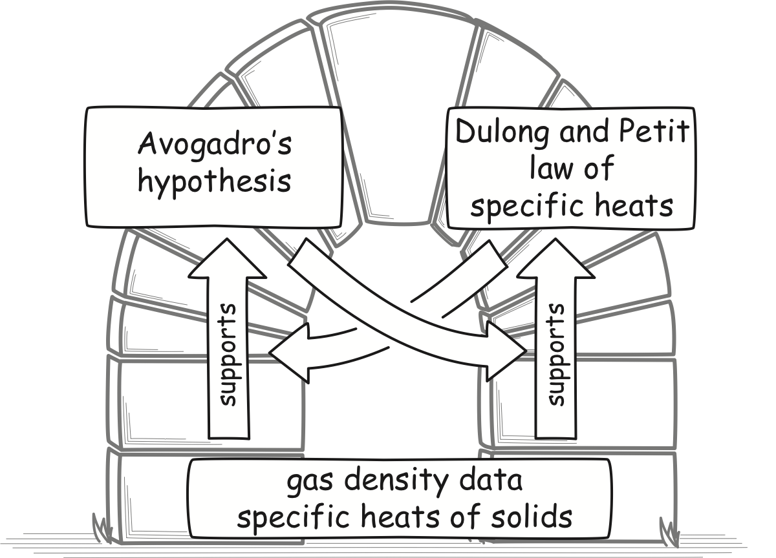
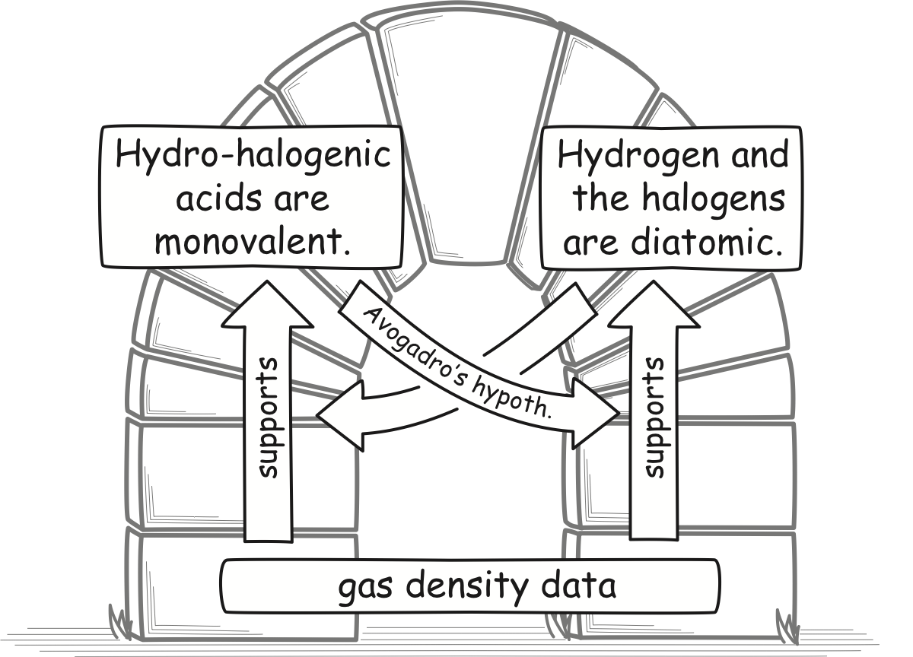
Many Arches
HCl
HBr
HI
H₂, Cl₂
Br₂, I₂
at a larger scale
at the smallest scale

Slide 36
Mutual Support Across Sciences
Chemistry and Physics
Thermal equilibrium:
molecules have same
mean kinetic energy
(1/2)mv²
Avogadro’s hypothesis
The chemists
Cannizzaro
Lothar Meyer
Krönig-Clausius
pressure formula
P = (1/3) nmv²
Any two entails the third.

Slide 37
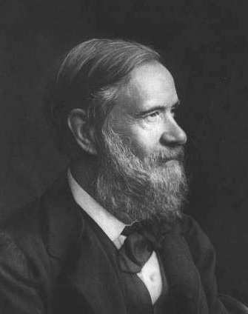
The Chemists
“…at the same time physicists, by considering the constitution of gases under a new point of view, have been brought, independently of chemical considerations, to the supposition of equal numbers of molecules in equal volumes of perfect gases, to which Avogadro and Ampère had previously been led by different modes of interpreting physical phenomena.
Who can fail to see in this long and unconscious march of the science, around and towards a fixed point, the decisive proof of the theory of Avogadro and Ampère?...”
Stanislao Cannizzaro, 1872
Lothar Meyer, 1892 “This is one of the most powerful arguments in support of Avogadro’s hypothesis. Its truth is now no longer disputed.”

Slide 38
Mutual Support Across Sciences
Chemistry and Physics
Thermal equilibrium:
molecules have same
mean kinetic energy
(1/2)mv²
Avogadro’s hypothesis
early physicists
Clausius 1858
Krönig-Clausius
pressure formula
P = (1/3) nmv²
Any two entails the third.

Slide 39
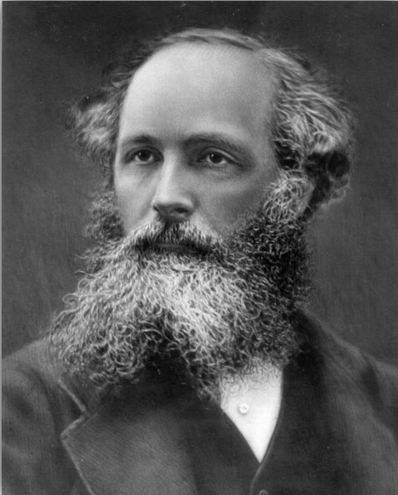
The Physicists
“The result of the kinetic theory, therefore, is to give us information about the relative masses of molecules considered as moving bodies. The consistency of this information with the deductions of chemists from the phenomena of combination, greatly strengthens the evidence in favour of the actual existence and motion of gaseous molecules.”
James Clerk Maxwell, 1875
on the fact that purely chemical arguments for Avogadro’s hypothesis yield the same result as physical arguments.

Slide 40
3. Locally deductive relations of support can be combined to produce an inductive totality.

Slide 41
Newton on Universal Gravitation
Newton’s “moon test”
Terrestrial gravity =
solar system centipetal force
Elliptical orbits and the inverse square law of gravity

Slide 42
4. There are self-supporting inductive structures.

Slide 43
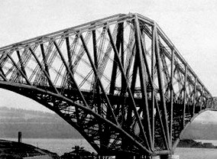
Inductive Rigidity of Mature Sciences
…not infallibility
Conservation of energy
Atomic nature of matter
Quantum nature of particles
Each proposition is well-supported inductively.
Evolutionary origin of diversity of species
Periodic table of elements
No capacity to accommodate anomalous evidence.
Uniformitarian origin of geological structures
Germ theory of many familiar diseases.
Etc., etc.

Slide 44
Inductive Support for a Mature Sciences
Materially mediated inductive support
Something extra.
Some universal rule or rules of inductive inference.
?
Totality of support
=
+
Argument for the material theory of induction:
Any universal rule is ampliative. Fails in inhospitable environments.
All propositions of a mature science are well supported.
Mature sciences are inductively self-supporting structures.

Slide 45
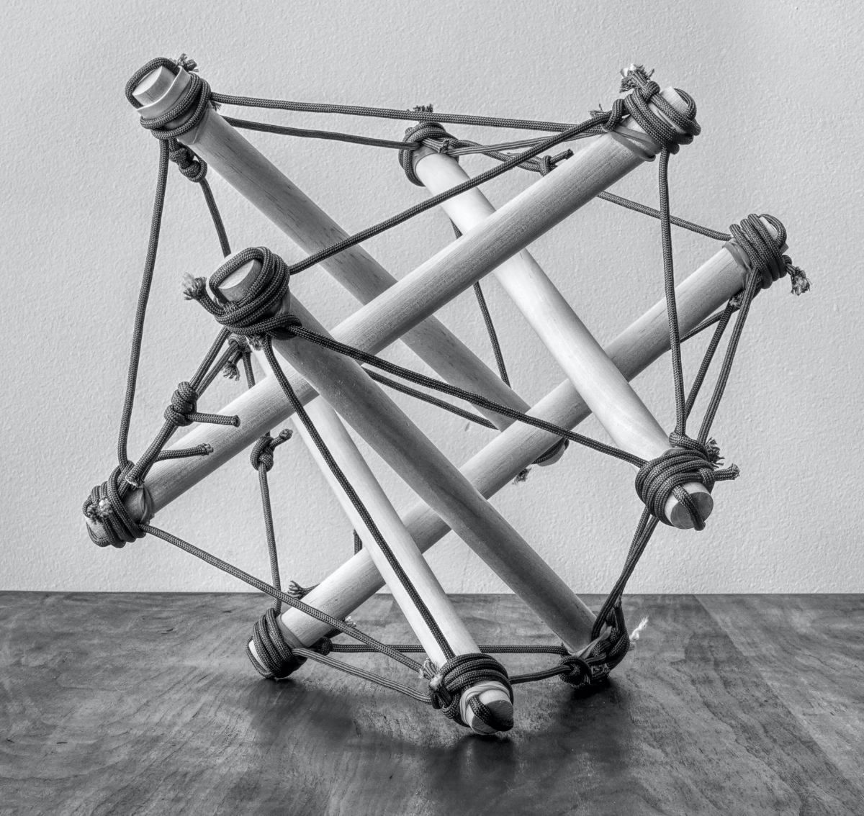
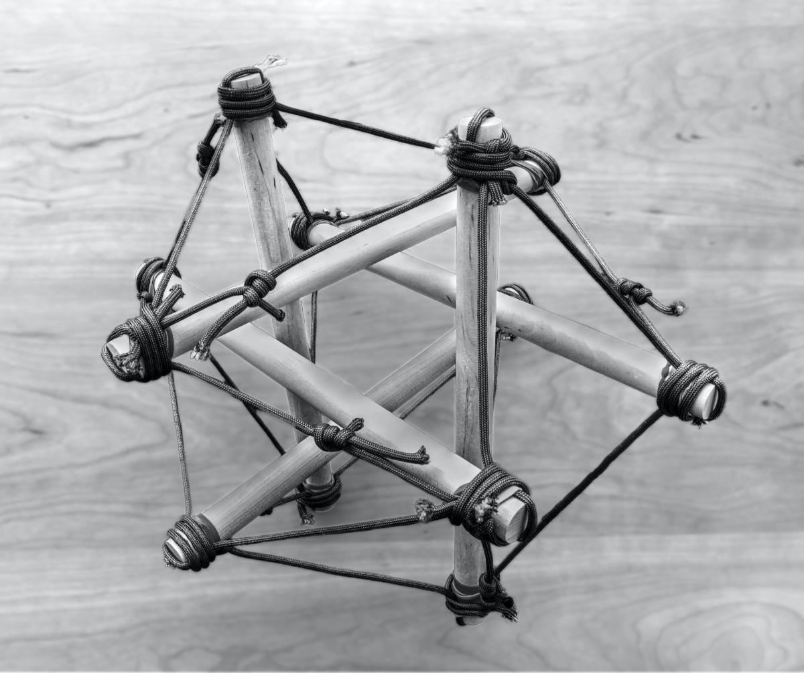
Are Self-Supporting Structures Paradoxical?
No rods touch.
All rods connect via cords in tension.
No cord tied to a higher support above the icosahedron.
Tensegrity icosahedron
Structure is self-supporting
=
Each individual member is well-supported.

Slide 46
Are Self-Supporting Structures Paradoxical?
Molecular formulae of elements and compounds.
Weights of atoms of elements.
Mature science is inductively self-supporting
=
Each individual proposition is inductively well-supported.
Avogadro’s hypothesis
Dulong-Petit law of specific heats
Mitscherlich’s law of isomorphism
Densities of element and compounds, gaseous and vaporized.
Heat capacities of solids and gases.
Crystalline structures of solids

Slide 47
Conclusion

Slide 48
1. Relations of inductive support have a non-hierarchical structure.
2. Hypotheses, initially without known support, are used to erect non-hierarchical structures.
3. Locally deductive relations of support can be combined to produce an inductive totality.
4. There are self-supporting inductive structures.

Slide 49
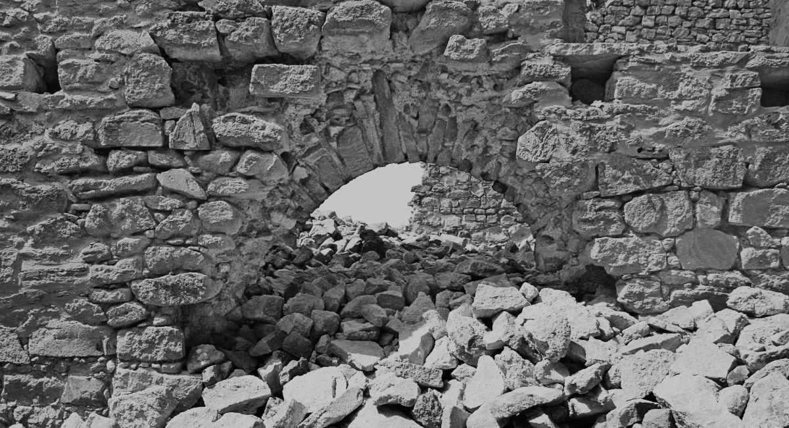
THE END

