Slide 1
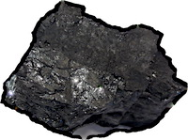
Material Theory, Introduced
It always bothered me that I could never quite see how formal theories of inductive inference worked.
I can use the material theory in real cases in history of science without contrivance.
The material theory of induction looks simple, but is really complicated.
Every case is, in principle, different.

