Slide 1
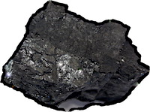
Why Not Bayes
I now know when to apply probabilities and when not to apply them.
I now know how to undo any new proof of the necessity of probabilities.
Bayesians ignore these problems and just keep going.

