Slide 1
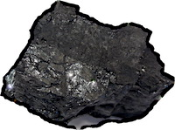
Evidence in Science
Evidence and inductive inference is really important in science.
There are too many competing accounts of inductive inference. Can I go “doctor shopping” for the result I want in a case that interests me?
Philosophers of science have too little presence in the scientists’ literature on evidence and induction.

