Slide 1
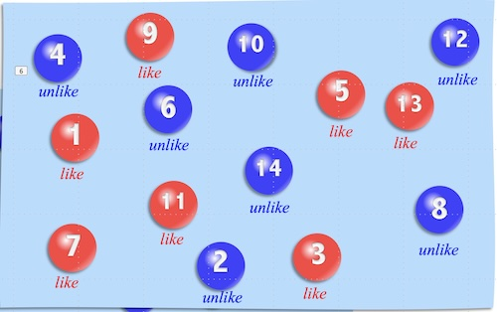
Eternal Inflation
When Probabilities Fail
John D. Norton
Department of History
and Philosophy of Science
University of Pittsburgh

Slide 2
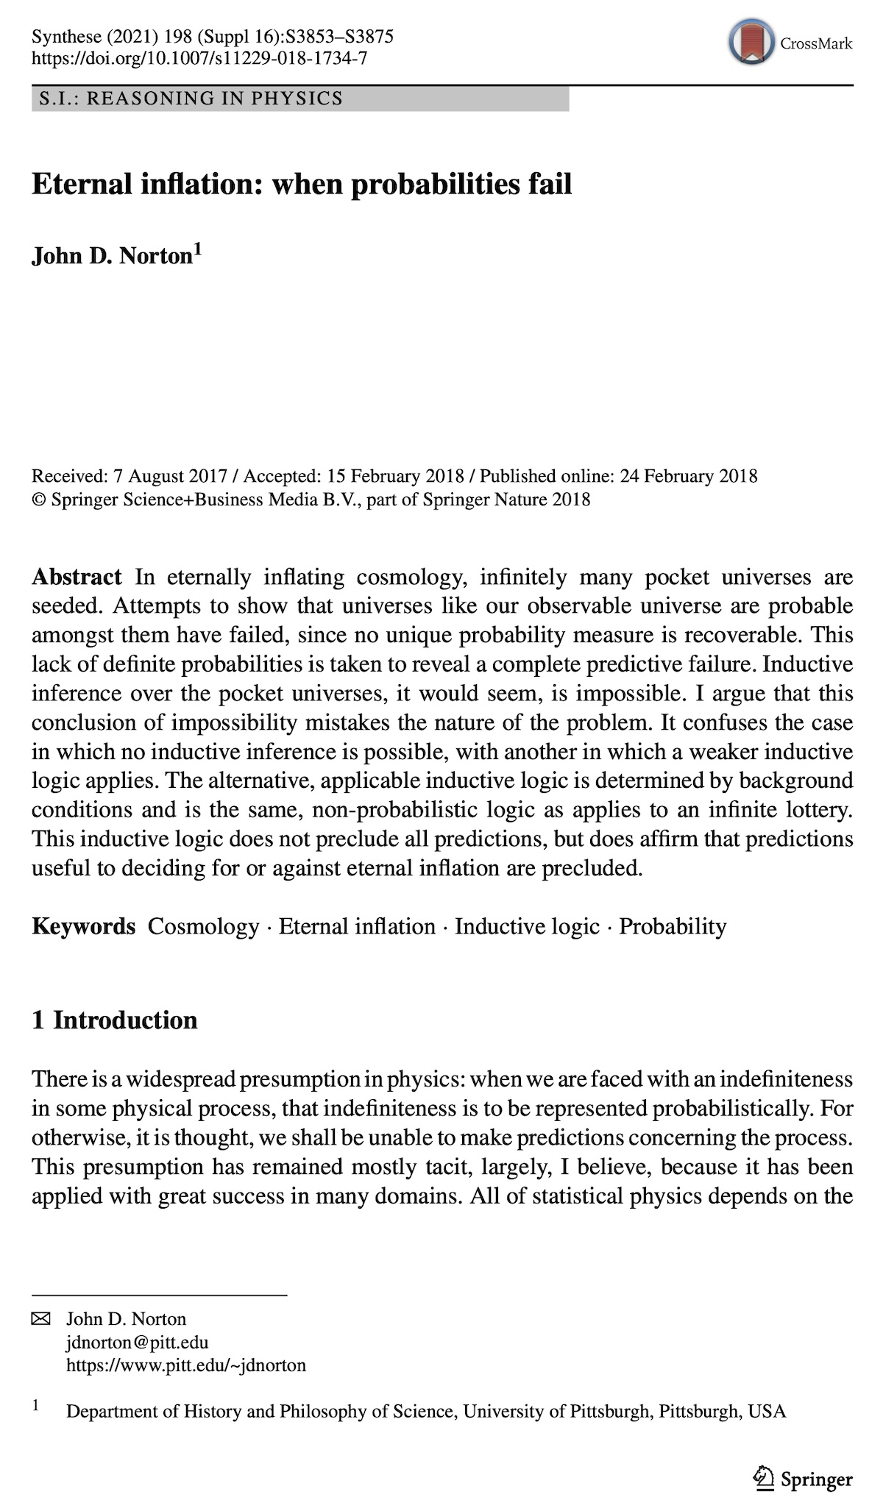

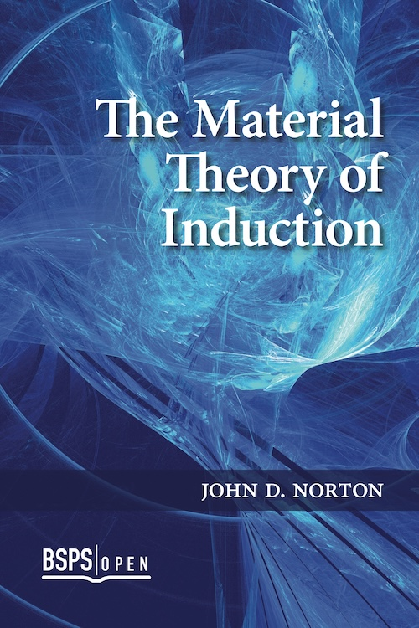
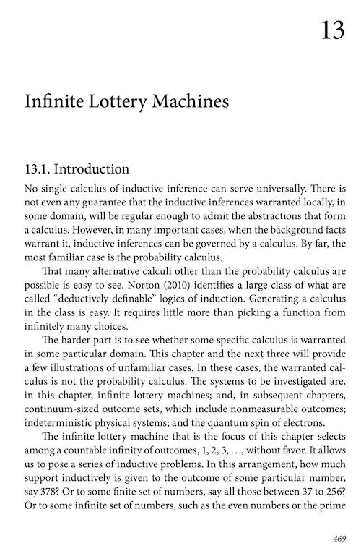
Oops! Treatment of chances of frequencies corrected:

Slide 3
Accounts of Inductive Inference

Slide 4
Three families
Family
Inductive generalization
Hypothetical induction
Probabilistic
induction
Principle
An instance confirms the generalization
Entailing the evidence is a mark of truth
Degrees of support are governed by a calculus
Archetype
Enumerative induction
Saving the phenomena
Probabilities in games of chance
Elaborations
Hempel’s satisfaction criterion
Mill’s methods
Glymour bootstrap
Inference to the best explanation
Exclusionary accounts
Simplicity
Reliabilism
Bayesianism
Imprecise probabilities
Alternative calculi

Slide 5
No account succeeds universally
Bayesian analysis
Now most popular in philosophy of science.
Inference to the best explanation
Flatness
Homogeneity
Absence magnetic monopoles
Density fluctuations
for structure formation
Inflationary cosmology
best explained by
therefore
Inflationary cosmology

Slide 6

=
Inductive inference
Probabilistic reasoning
Not always!

Slide 7
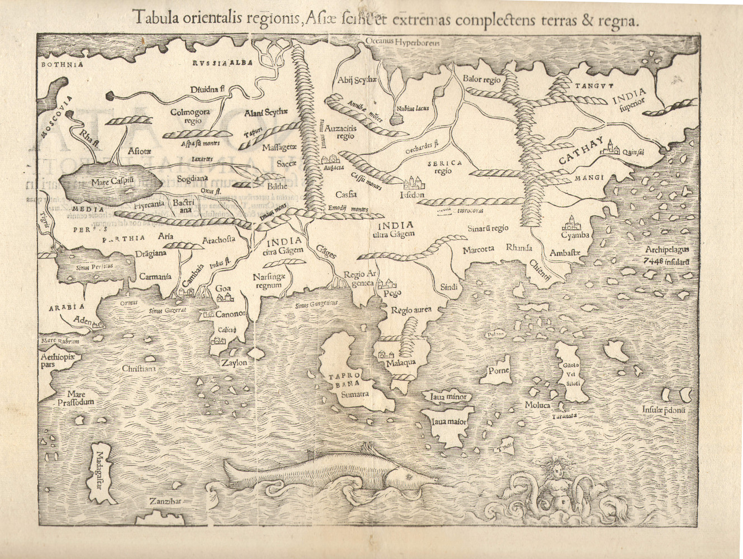
Something else here
Probabilistic inference here
Something else here
Something else here
Something else here
What determines which logic goes where?
Background facts.

Slide 8
Measure Problem in
Eternal Inflation
Cosmology

Slide 9
Countable infinity of pocket universes spawned in eternal inflation.
Countable infinity like ours.
9
10
12
4
like
unlike
5
unlike
unlike
6
13
4
1
10
like
unlike
like
6
14
like
13
11
8
unlike
7
11
like
3
6
2
8
unlike
7
like
3
2
like
11
8
unlike
6
3
3
Countable infinity unlike ours.

Slide 10
The Measure Problem
What is the probability that a pocket universe is like our universe?
Guth (2000, p. 568; 2007, p. 11)
“However, as soon as one attempts to define probabilities in an eternally inflating spacetime, one discovers ambiguities. The problem is that the sample space is infinite, in that an eternally inflating universe produces an infinite number of pocket universes. The fraction of universes with any particular property is therefore equal to infinity divided by infinity—a meaningless ratio. To obtain a well-defined answer, one needs to invoke some method of regularization.”
Guth (2000, p. 568; 2007, p. 11)

Slide 11
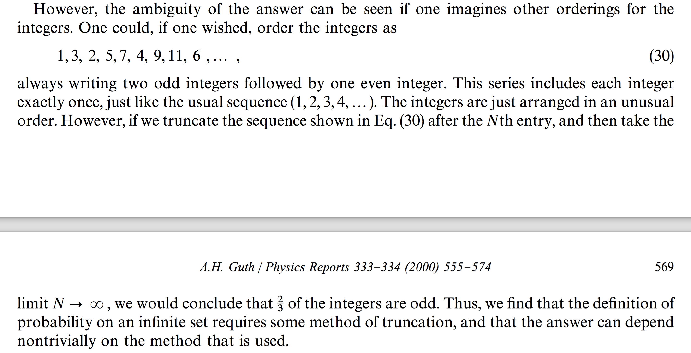
The Counting Argument

Slide 12
The Counting Argument
1, 2, 3, 4, 5, 6, 7, 8, 9, …
Half are odd.
1, 3, 2, 5, 7, 4, 9, 11, 6, …
Two-thirds are odd.
Therefore, Probability(odd) cannot be defined.

Slide 13
Prediction Impossible?
In an eternally inflating universe, anything that can happen will happen; in fact, it will happen an infinite number of times. Thus, the question of what is possible becomes trivial -- anything is possible, unless it violates some absolute conservation law.
To extract predictions from the theory, we must therefore learn to distinguish the probable from the improbable.
Guth (2000, §6, 2007, §4)
And if inflation produces a multiverse in which, to quote a previous statement from one of the responding authors (Guth), “anything that can happen will happen”—it makes no sense whatsoever to talk about predictions.
Ijjas, Steinhardt and Loeb (2017)

Slide 14
Prediction Impossible?
Probabilistic prediction is impossible because a probabilistic logic is not the inductive logic warranted by background facts.
And if inflation produces a multiverse in which, to quote a previous statement from one of the responding authors (Guth), “anything that can happen will happen”—it makes no sense whatsoever to talk about predictions.
Ijjas, Steinhardt and Loeb (2017)

Slide 15
An infinite lottery machine

Slide 16
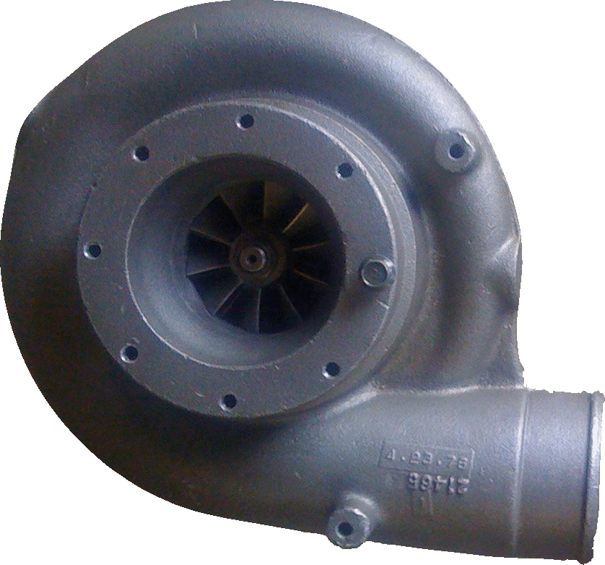
An infinite lottery machine
27
Fair selection made among infinitely many balls 1, 2, 3, …
= without favor to any number or numbers.
1
3
2

Slide 17
“Choosing without favor”
≠ each outcome has equal probability.
Probability may not be well-defined.
Label independence
All true statements pertinent to the chances of different outcomes remain true when the labels are arbitrarily permuted.
1
2
1
3
2
3
4
3
2
4
1
4
“1 or 2 have the same chance.”
“1 or 2 have the same chance.”
“1 or 2 have the same chance.”

Slide 18
“Choosing without favor.”
27
Permuting the labels on the balls has no effect on the chances of the outcomes.
1
3
2
“Chance” is now generalized beyond probability. A general, as yet unspecified, measure of indefiniteness.

Slide 19
Odd and even
…
odd
1
3
5
7
9
…
even
2
4
6
8
10
Not invariant under label permutation.
Not invariant under label permutation.
Chance (odd) =
Chance (even)
Chance (odd) >
Chance (even)
Chance (odd) =
Chance (even)
Chance (odd) <
Chance (even)

Slide 20
Odd and even, again
…
1
3
5
7
9
odd
13
17
odd sub₁
…
2
4
6
8
19
even
11
15
10
odd sub₂
From permutation of row labels:
Ch(even) = Ch(odd sub₁) = Ch (odd sub₂)
=
Ch (odd)
= Ch(odd sub₁ OR odd sub₂)
Additivity fails.

Slide 21
Outcome sets equivalent under label independence
finite_{n}: finite set with n members
n = 1, 2, 3, …
e.g. Members of finite₃ are
{1, 2, 3}, {27, 5, 134}, …
infinite_{co-infinite}: infinite set whose complement is also infinite
e.g. even numbers, odd numbers, prime numbers, powers of ten, …
infinite_{co-finite}: infinite set whose complement is finite of size n
n = 1, 2, 3, …
e.g. complements of finite_{3,} all numbers greater than ten, …

Slide 22
Equivalent sets have equal chances.
Ch(finite_{n}) = V_{n}
n = 1, 2, 3, …
Ch(infinite_{co-infinite}) = V∞
Ch(infinite_{co-finite-n}) = V_{-n}
n= 1, 2, 3, …
“unlikely”
Ch(empty-set) = V₀
“certainly not”
Ch(all-outcomes) = V₋₀
“certain”
“as likely
as not”
“likely”
V₂
V∞
V∞
V₋₂
Ch( ) < Ch( ) = Ch( ) < Ch( )
10, 100,
1000,
10000,
3, 4, 5, 6
7, 8, 9, …
1, 2
odd
for a generic lottery machine.

Slide 23
Using the Logic

Slide 24
Chance of a number less than or equal to N?
1
2
…
N
…
N+1
N+2
Chance is V_{N}
Does not happen
Chance is V_{-N}
Does happen
…no matter how big N is!

Slide 25
1000 independent drawings
All 1000 numbers are less than or equal to N.
All 1000 numbers are the same
8
8
8
…
8
1
N
7
…
3
Chance is V_{N1000}
“unlikely”
Chance is V∞
“as likely as not”

Slide 26
Applied to eternal inflation
Ch( ) = Ch( ) = V∞
Universe like ours
Universe unlike ours

Slide 27
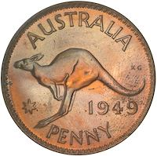
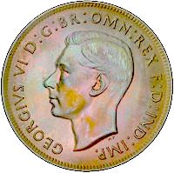
Recover probabilities from frequencies?

Slide 28
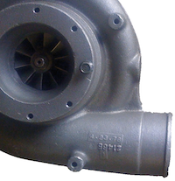
Frequencies?
The empirical approach:
A large number of infinite lottery machines.
Find roughly equal frequencies of odd and even???
Run them.
2
8
2
7
13
1

Slide 29
Frequencies?
Divide the eternally inflating universe into very many—N—sectors.
Pick one in each
(following infinite lottery rules).
…
1
2
3
N

Slide 30
Compare
Frequencies of universes
like-10% ours.
(generically)
greater than
Frequencies of universes
like-1% ours.
>
Value of cosmological constant λ is within 10% of our value.
Value of cosmological constant λ is within 1% of our value.
Probability of universes
like-10% ours.
(generically)
greater than
Probability of universes
like-1% ours.
>

Slide 31
Chance Properties in Infinite Lottery of Frequencies
Inhospitable to Probabilites
P(like-10%) entails
more like-10% universes in N sectors
Map like-10% set to like-1% set by relabeling.
P(like-1%) entails
fewer like-1% universes in N sectors
Chance (0 like-10% in N draws) = Chance (0 like-1% in N draws)
Chance (1 like-10% in N draws) = Chance (1 like-1% in N draws)
Chance (2 like-10% in N draws) = Chance (2 like-1% th in N draws)
…
Chance (N/2 like-10% in N draws) = Chance (N/2 like-1% in N draws)
…
Chance (N-1 like-10% in N draws) = Chance (N-1 like-1% in N draws)
Chance (N like-10% in N draws) = Chance (N like-1% in N draws)
Relative frequencies cannot stabilize to probabilistic values in many repeated draws.

Slide 32
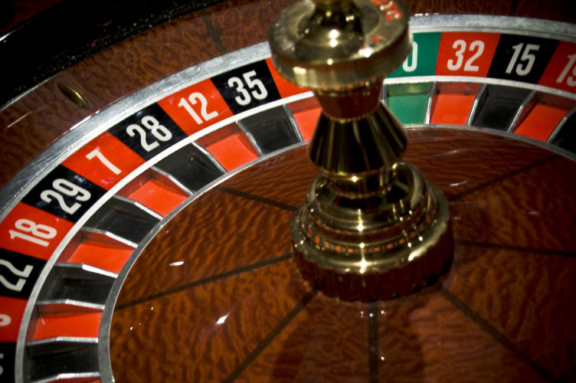
Prediction IS possible, but negative
The best we get is that like and unlike have equal chance in the sense of the infinite lottery logic.
Cataloging frequencies cannot override chance theory known to prevail.
Analogy
Gambler’s fallacy
Long run of red
Change in probability of next red
12
32
7
18

Slide 33
How to think about infinite lottery chances.

Slide 34
Probabilities: The Hard Case
fapp = “for all practical purposes.”
Probability very near 1:
fapp, will occur.
1.0
0.9
Pr = 0.6: occurs with probability very near 1 in about 60% of many trials.
0.8
0.7
Intermediate values represent distinct cases. How do we separate Pr = 0.5 from Pr = 0.6?
0.6
0.5
0.4
Pr = 0.5: occurs with probability very near 1 in about 50% of many trials.
0.3
0.2
Probability very near 0:
fapp, will not occur.
0.1
0

Slide 35
Infinite Lottery
Chances: The Easy Case
fapp = “for all practical purposes.
fapp, will occur.
V₋₁, V₋₂, …
All intermediate outcomes have the same inductive support.
“As likely as not.”
V∞
fapp, will not occur.
V₁, V₂, …

Slide 36
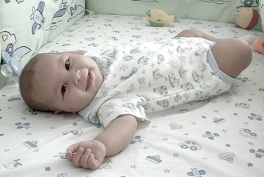
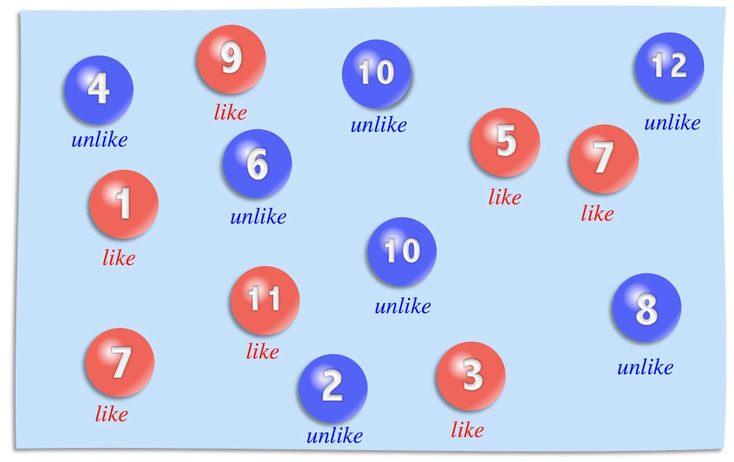
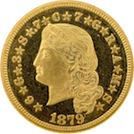
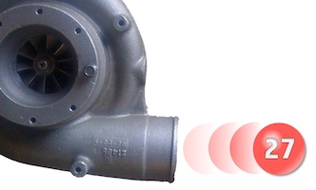
Benchmarking with a randomizer
The probability that your unborn child will be a girl is 0.5.
The chance
that eternal inflation spawns a pocket universe like ours is “as likely as not.”
The probability
is the same as tossing a head in a fair coin toss.
The chance is the same as drawing an even number in an infinite lottery.

Slide 37


Slide 38

Whether an inductive logic applies in some domain is decided entirely by background facts.
Assuming that a probabilistic logic always applies by default can lead to inductive fallacies.
The infinite lottery logic is really weird, but with practice it becomes natural.

Slide 39
Appendices

Slide 40
All co-infinite infinite sets have the same chance.
1
2
3
4
5
6
7
4
…
1
10²
2
3
8
9
10¹
10³
10⁴
10⁵
10, 100,
1000,
10000, …
Ch( )
= Ch(odd)
= Ch(even)
= Ch[ ]
no powers of 10
1, 2, 3, 4,
5, 6,7, 8, 9,
11, 12, …

Slide 41

Probabilistic Analysis
Probability P(n) of outcome n must satisfy:
1
Fairness of selection
ε = P(1) = P(2) = P(3) = ….
ε = 0
P(1) + P(2) + P(3)+ …
= 0 + 0 + 0 + …
= 0
2
Normalization
P(1) + P(2) + P(3)+ … = 1
ε > 0
P(1) + P(2) + P(3)+ …
= ε + ε + ε + …
= ∞
Contradiction

Slide 42
Escapes?
Drop countable additivity.
Finite additivity only.
Infinitesimal probabilities
OR
P(1) = 0
P(1) + P(2) = 0
P(1) + P(2) + P(3) = 0
...
ε = P(1) = P(2) = P(3) = ….
where
0 < ε <
( )
any positive real number
CANNOT take infinite limit.
Both preserve finite additivity.
My claim:
Finite additivity must go!
Posit independently:
P({1, 2, 3, …}) = 1
P(even) = P({2, 4, 6, ...}) = ½
= P(odd) = P({1, 3, 5, ...})
...

Slide 43
Match Credences to Chances?

Slide 44
A Dutch Book
ONE = {1, 4, 7, 10, …}
TWO = {2, 5, 8, 11, ...}
THREE = {3, 6, 9, 12, ...}
Ch(ONE) =
Ch(not-ONE)
Ch(TWO) =
Ch(not-TWO)
Ch(THREE) =
Ch(not-THREE)
ONE
TWO
THREE
TWO
THREE
ONE
THREE
ONE
TWO
Accept even odds bets on outcomes of equal chance.
On ONE
On TWO
On THREE
Net
ONE
gain $1
lose $1
lose $1
lose $1
TWO
lose $1
gain $1
lose $1
lose $1
THREE
lose $1
lose $1
gain $1
lose $1

Slide 45
A Dutch Book Theorem
IF
Therefore…
Your credences match the non-probabilistic, infinite lottery chances.
…Non-probabilistic credences are incoherent.
and
You accept even odds bets on (exclusive, exhaustive) outcomes with equal credences.
… If you hold non-probabilistic credences, this betting behavior is incoherent.
THEN
The Dutch book scenario is not benign. It covertly favors probabilistic credences by supposition.
A sure-loss Dutch book can be made against you.

