Slide 1
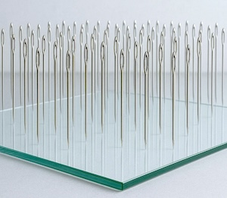
The Cosmological Woes of Newtonian Gravitation Theory
John D. Norton
Department of History and
Philosophy of Science
University of Pittsburgh
My text

Slide 2
A Generic Newtonian Cosmology

Slide 3
Elements
Infinite Euclidean space.
Roughly uniform matter distribution with density ρ.
Force on each body is sum of inverse square law attraction from all other bodies.

Slide 4
Newton on cosmology

Slide 5
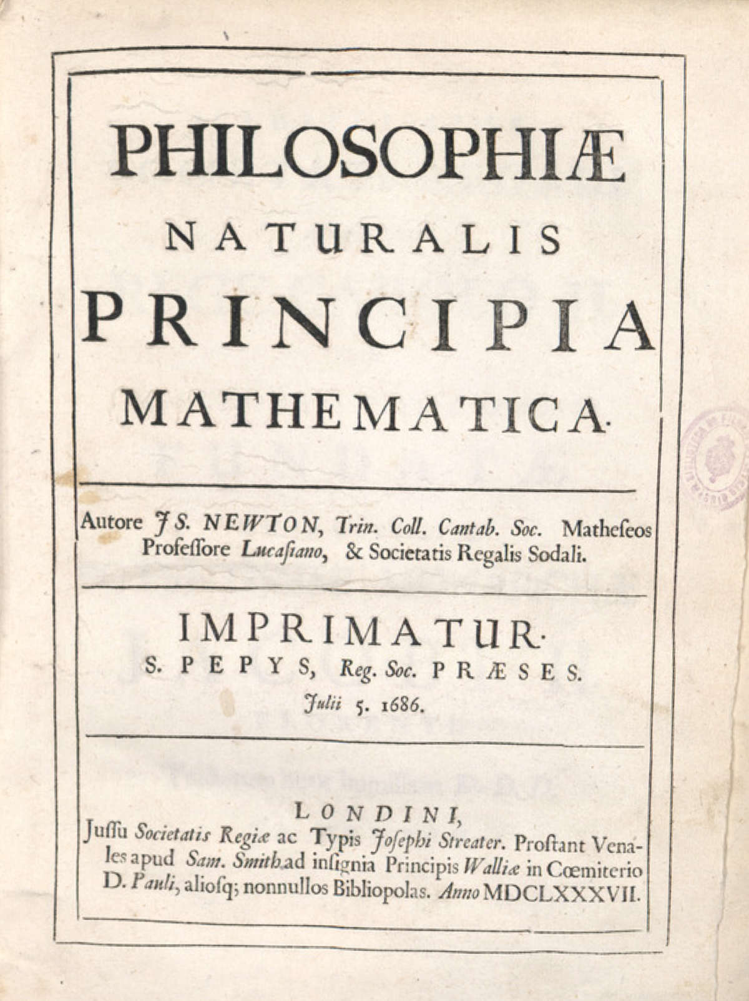
Newton’s Principia of 1686 has no Newtonian cosmology.

Slide 6
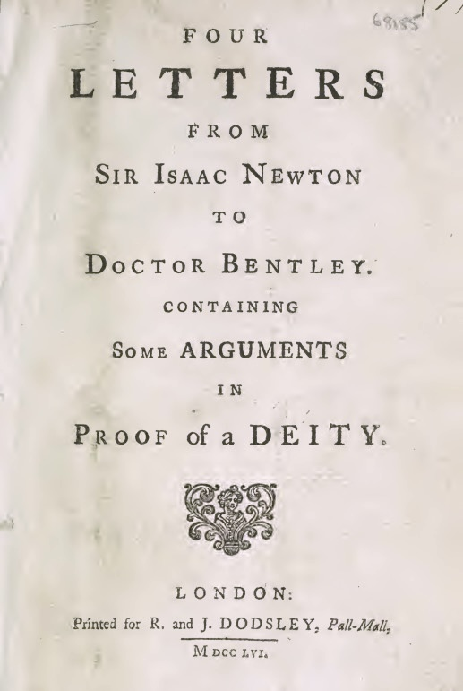
Letters from 1692
Origin of Newton’s cosmological thinking.

Slide 7
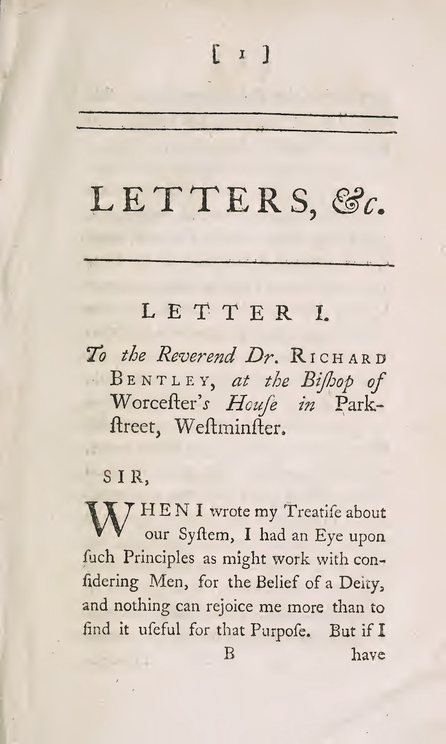
“I had an Eye upon such Principles as might work with considering Men, for the Belief of a Deity,…”

Slide 8
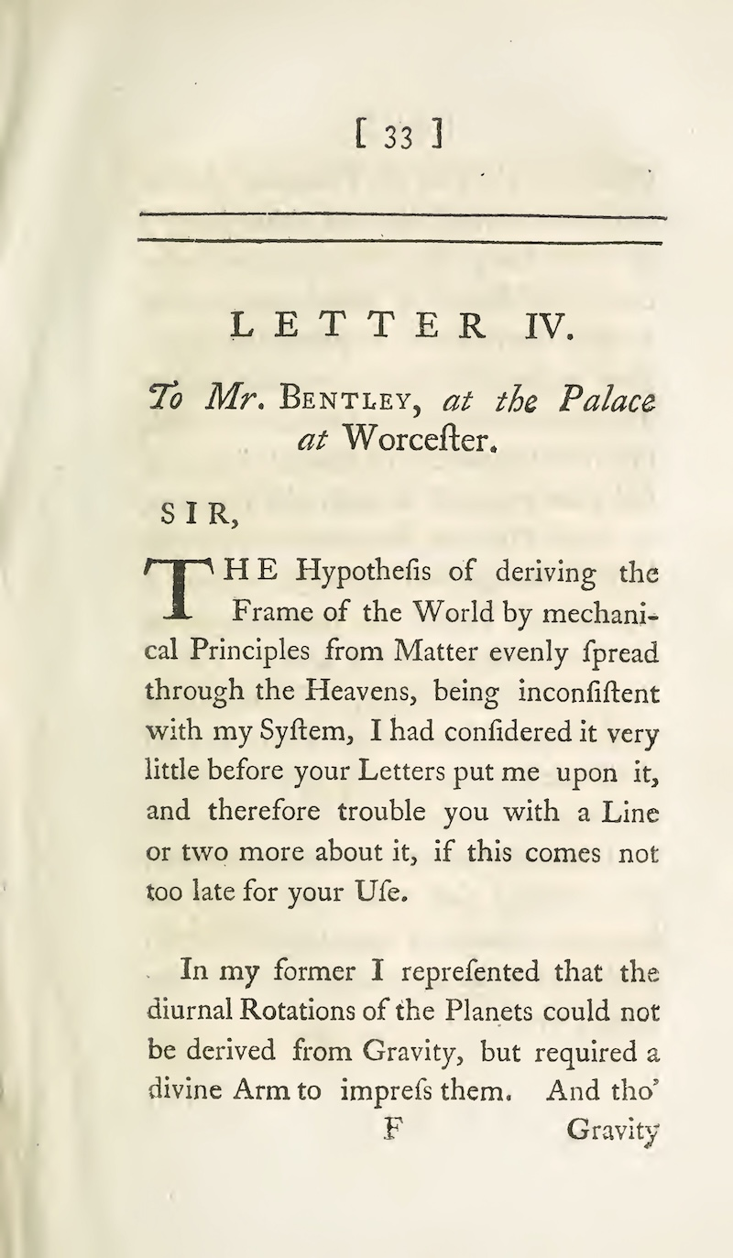
“…I had considered it very little before your Letters put me upon it…”

Slide 9
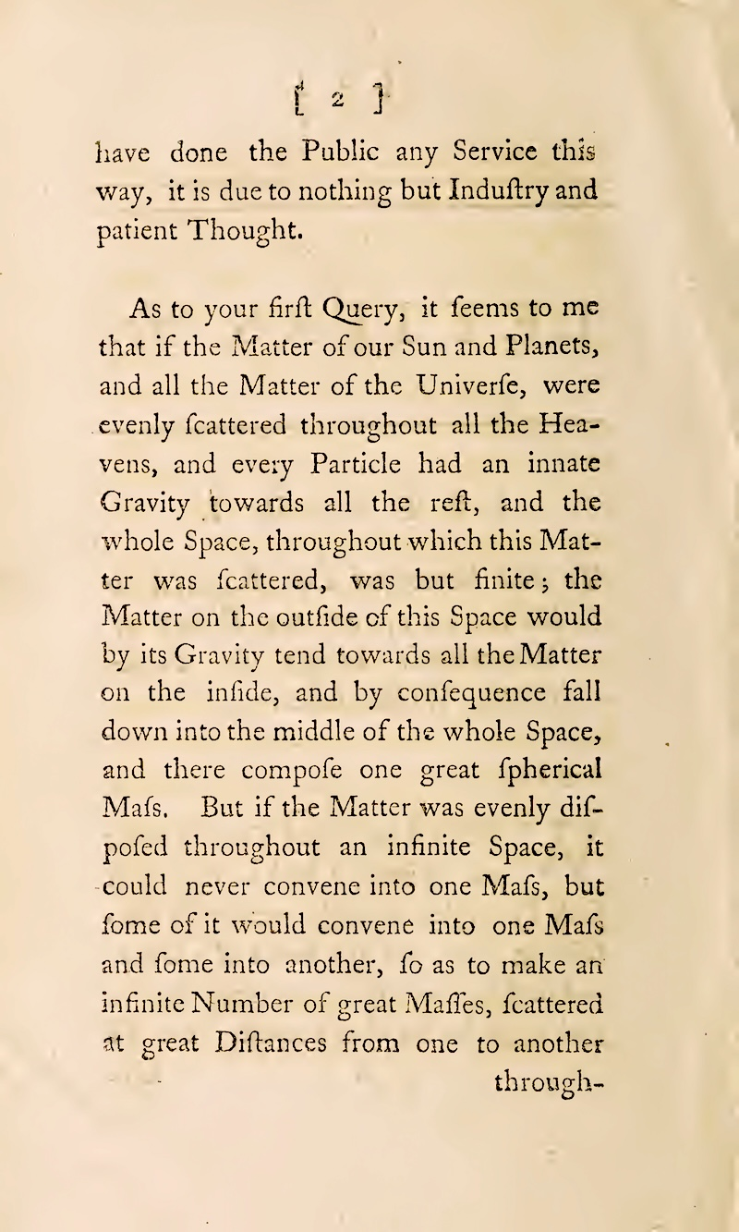
“But if the Matter was evenly disposed throughout an infinite Space,
…
it would convene into one Mass and some into another, so as to make an infinite Number of great Massies, scattered at great Distances from one to another through-…”

Slide 10
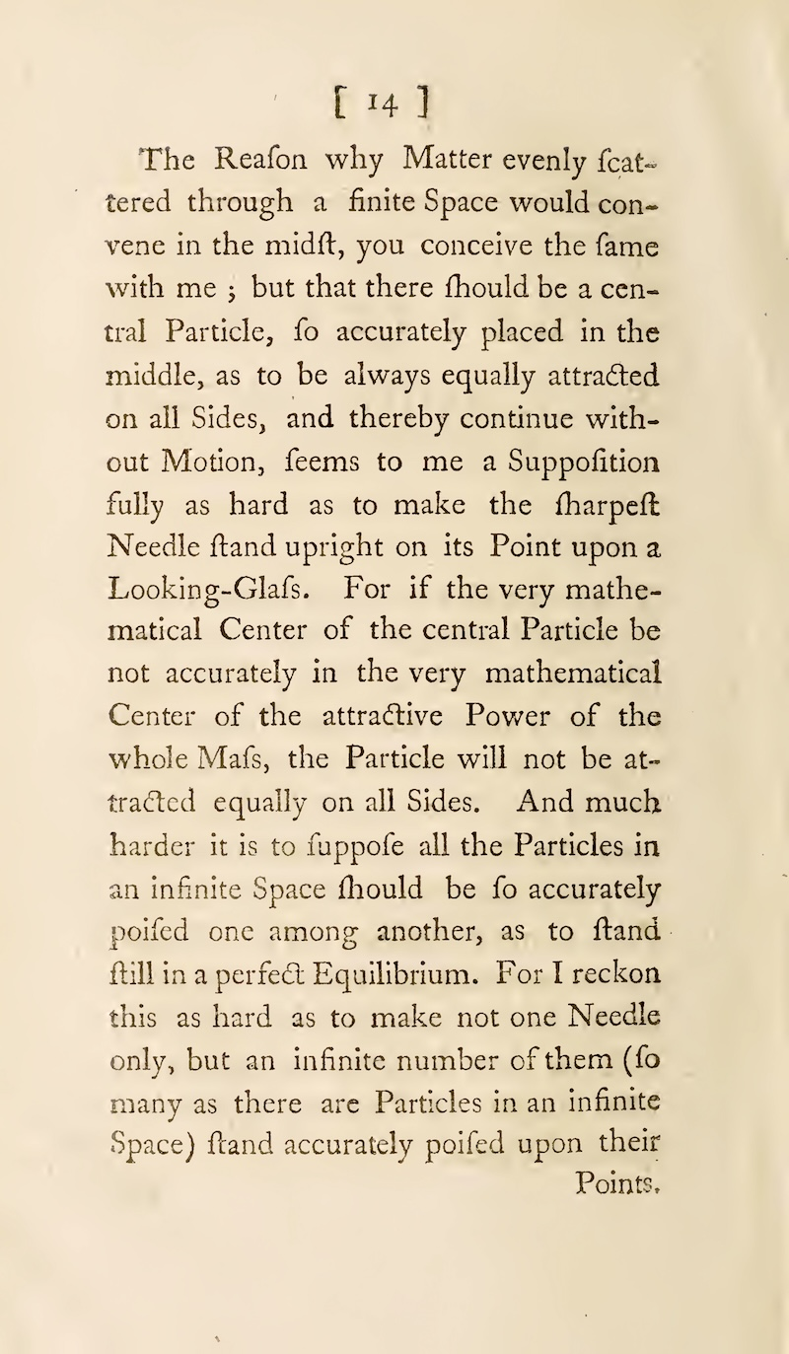
“And much harder it is to suppofe all the Particles in an infinite Space should be so accurately poised one among another, as to stand still in a perfect Equilibrium.
For I reckon this as hard as to make not one Needle only, but an infinite number of them (so many as there are Particles in an infinite Space) stand accurately poised upon their Points.”

Slide 11
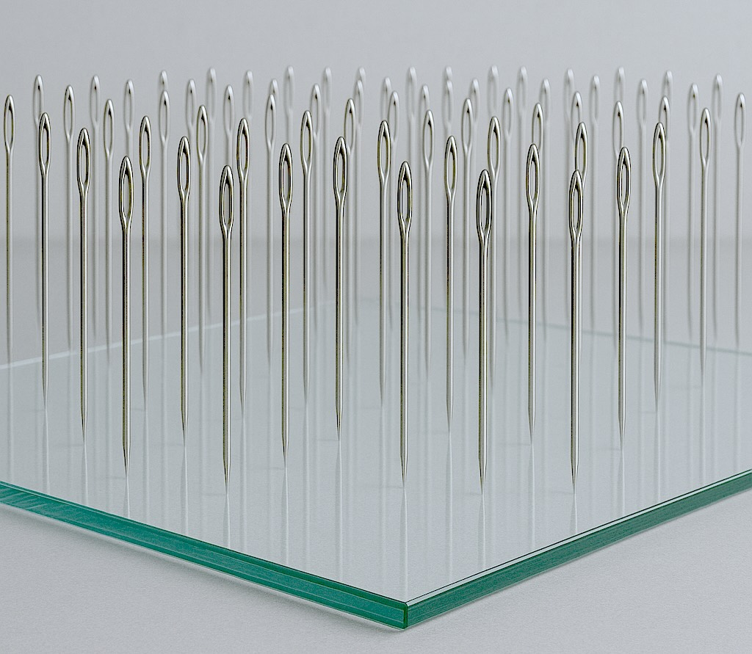

Slide 12
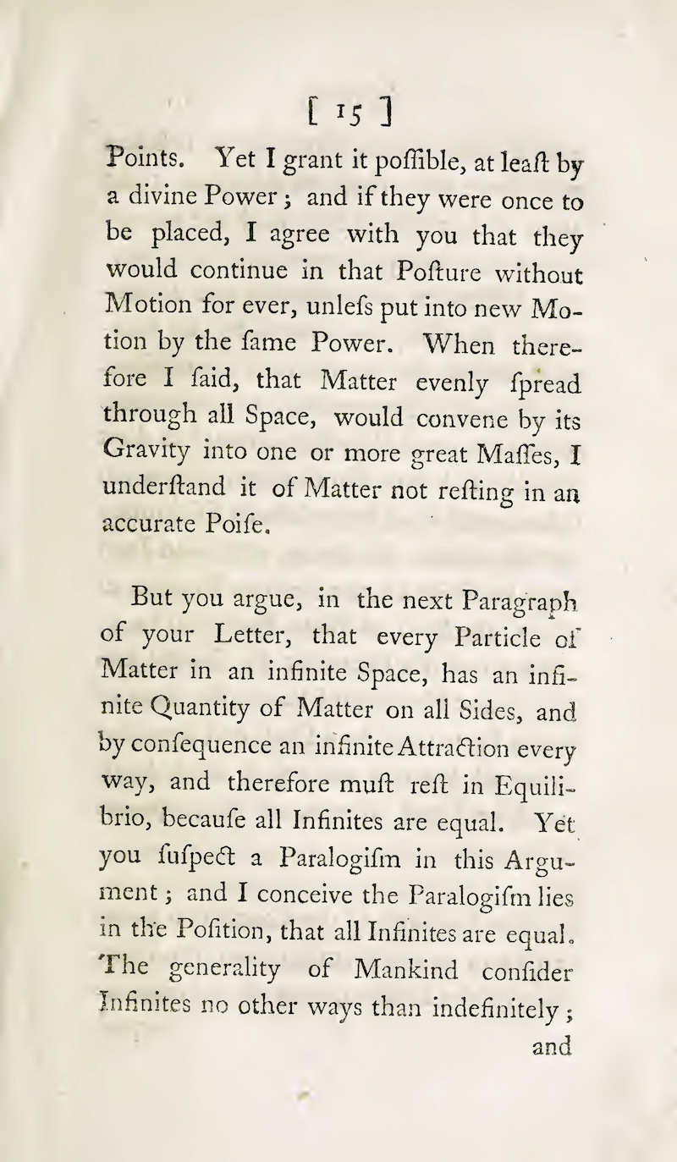
“ But you argue, in the next Paragraph of your Letter, that every Particle of Matter in an infinite Space, has an infinite Quantity of Matter on all Sides, and by consequence an infinite Attraction every way, and therefore must ret in Equilibrio, because all Infinites are equal. Yet you suspect a Paralogism in this Argument ; …”

Slide 13
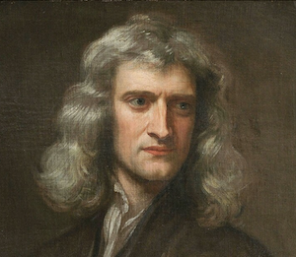
Infinities cancel?
No net gravitational force on body?
Yet you suspect a Paralogism in this Argument…

Slide 14
“… and I conceive the Paralogism lies in the Position, that all Infinites are equal. The generality of Mankind consider Infinites no other ways than indefinitely; and …”

Slide 15
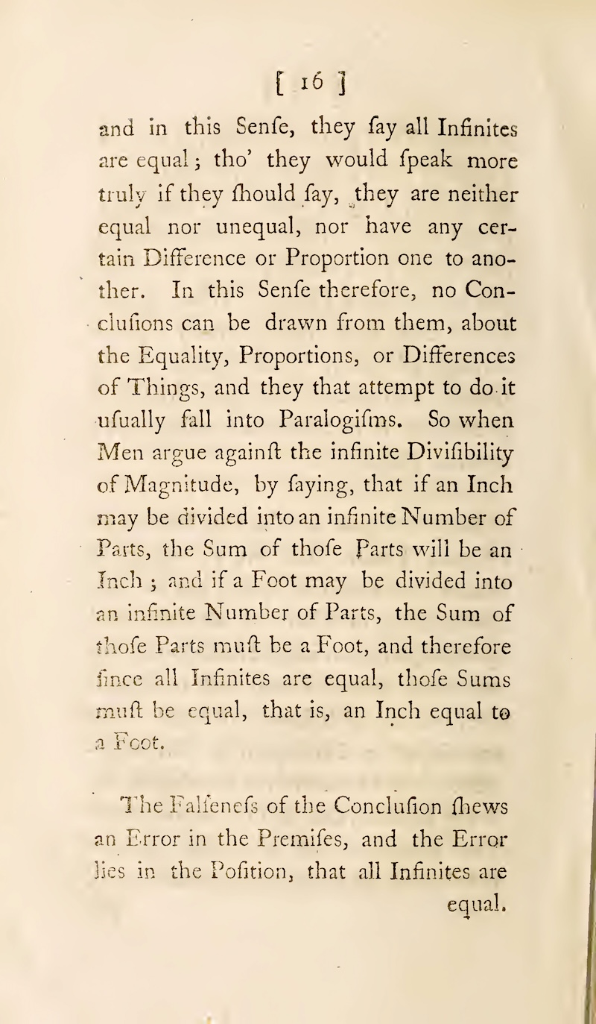
“… they are neither equal nor unequal, nor have any certain Difference or Proportion one to another. In this Sense therefore, no Conclusions can be drawn from them, about the Equality, Proportions, or Differences of Things, and they that attempt to do it usually fall into Paralogisms. …
the Error lies in the Position, that all Infinites are equal.”

Slide 16
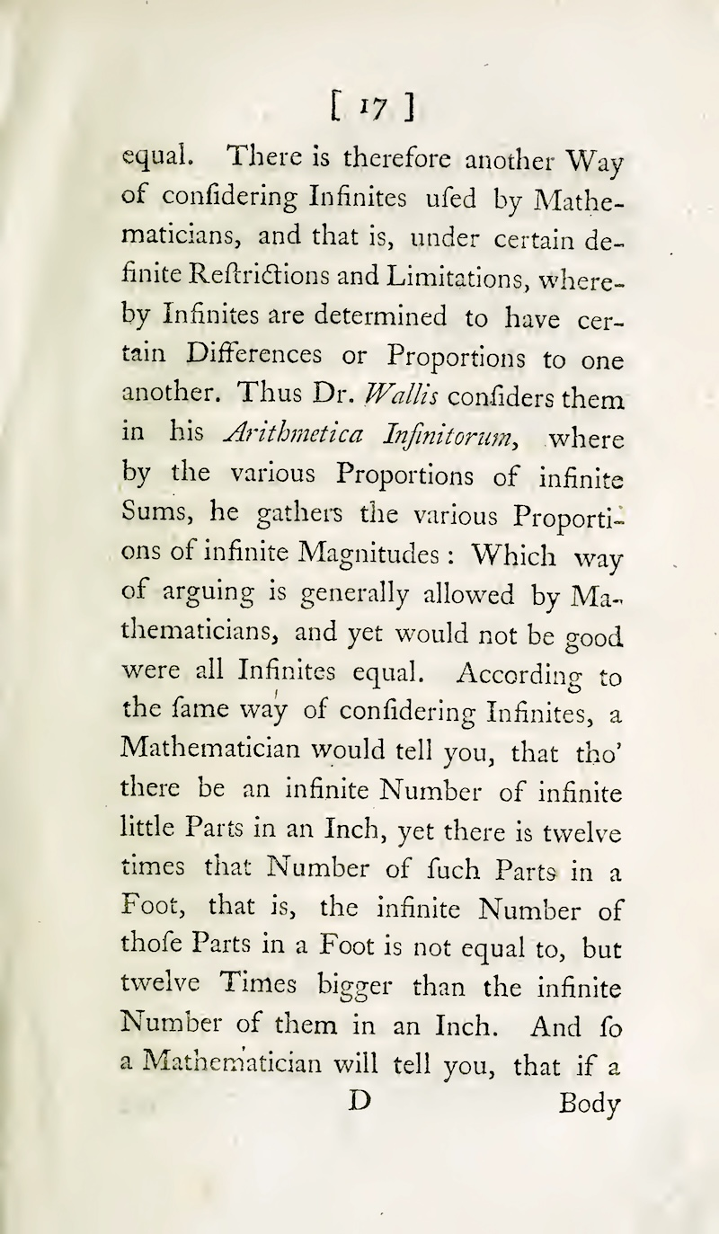
“… another Way of considering Infinites used by Mathematicians, and that is, under certain definite Restrictions and Limitations, whereby Infinites are determined to have certain Differences or Proportions to one another. Thus Dr. Wallis considers them in his Arithmetica Infinitorum, …”

Slide 17
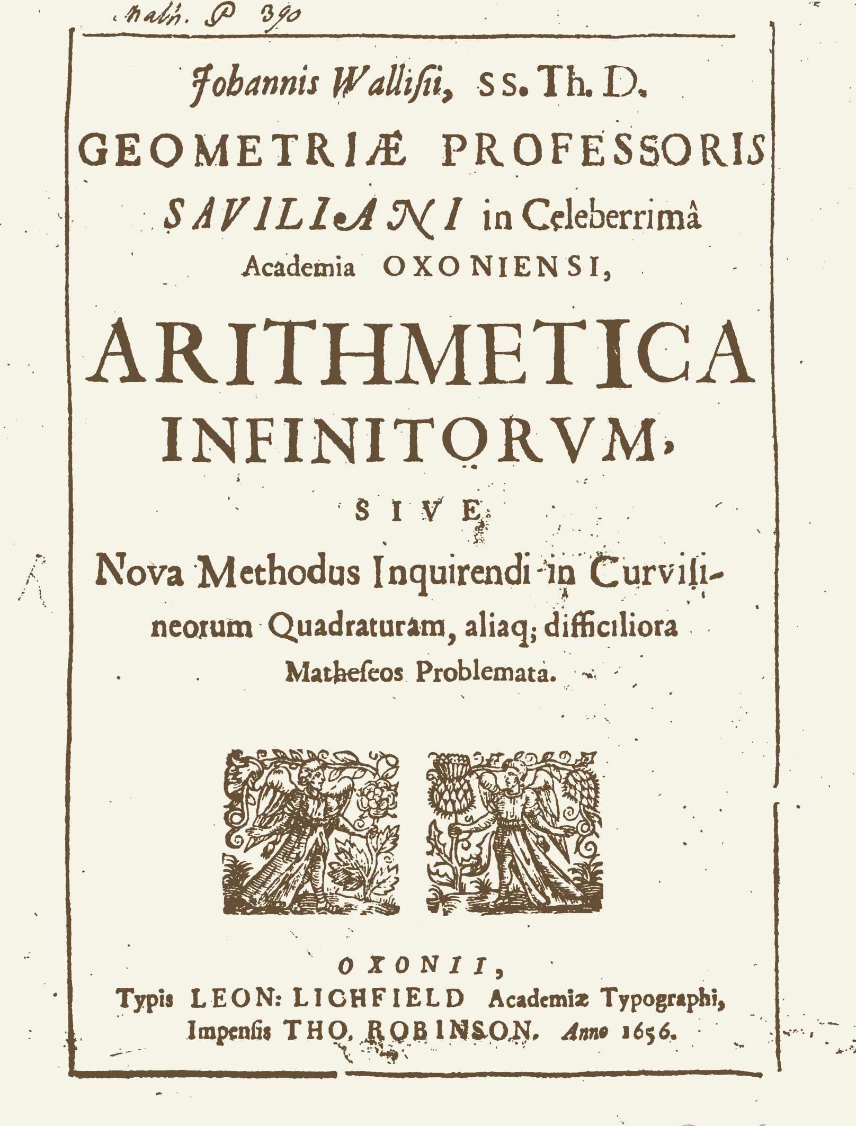

Slide 18
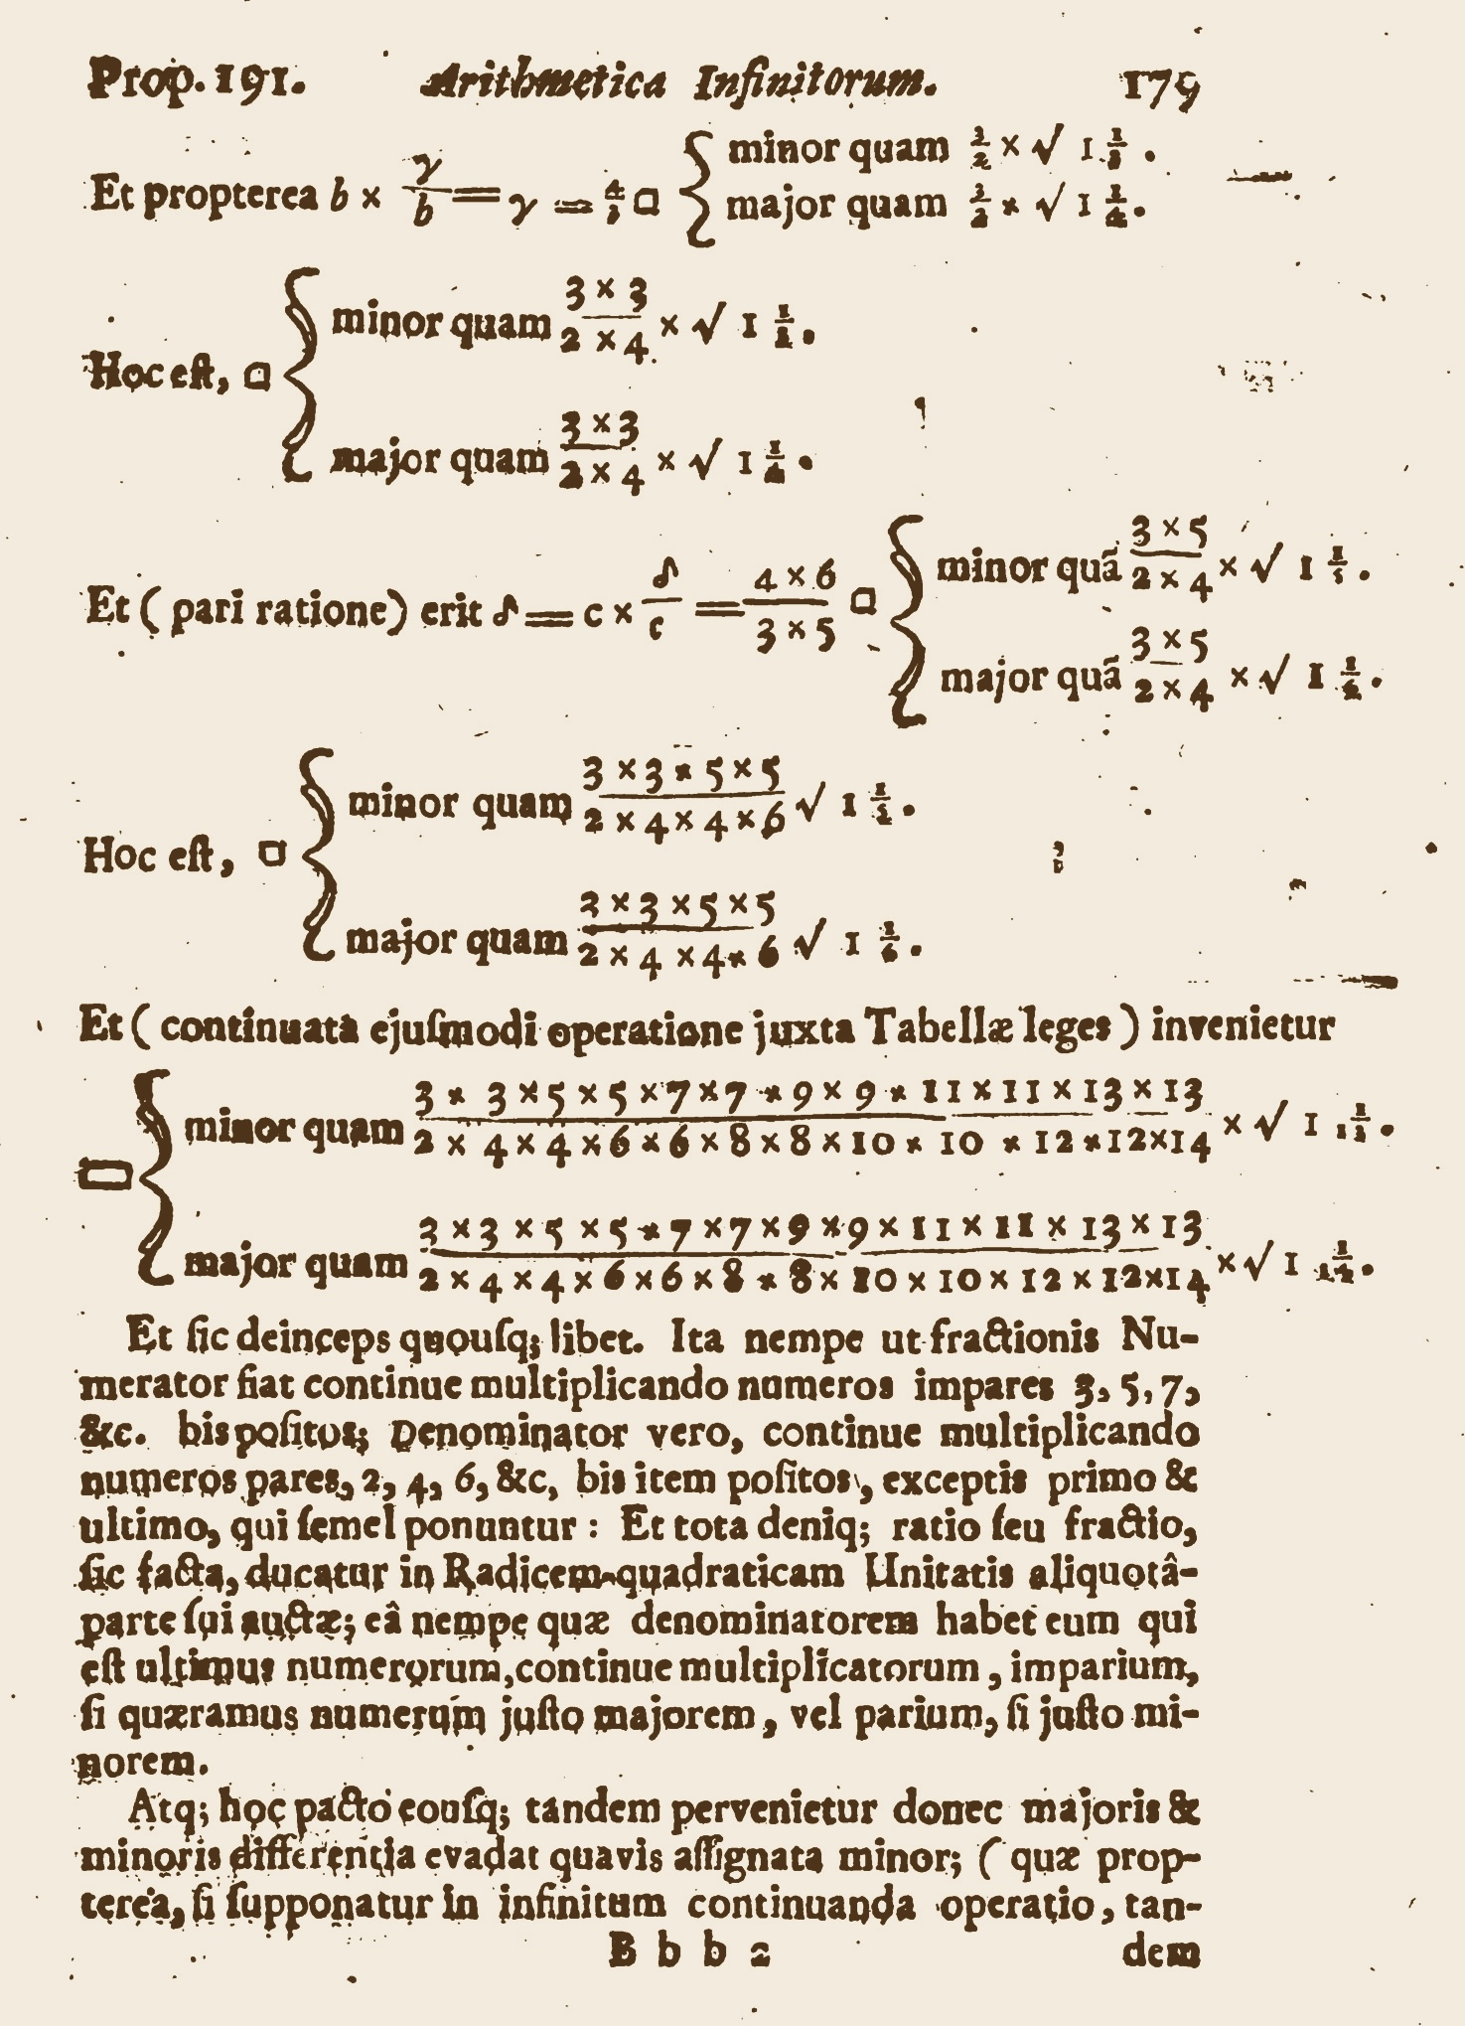
Wallis finds a definite ratio between the two infinites
3x3x5x5x7x7x9x9x …
and
2x4x4x6x6x8x8x10x10x…
Wallis’ formula for 4/π

Slide 19
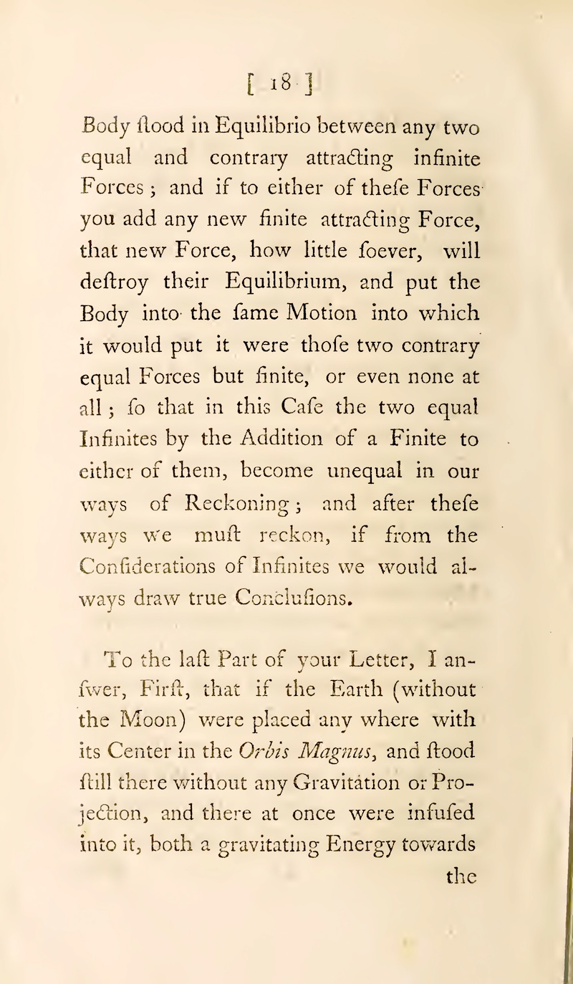
“And so a Mathematician will tell you, that if a Body stood in Equilibrio between any two equal and contrary attracting infinite Forces ; and if to either of these Forces you add any new finite attracting Force, that new Force, how little soever, will destroy their Equilibrium, and put the Body into the same Motion into which it would put it were those two contrary equal Forces but finite, or even none at all; …

Slide 20
Newton’s final analysis.
“… new Force, how little soever, will destroy their Equilibrium, …”
“.. in Equilibrio between any two equal and contrary attracting infinite Forces …”

Slide 21
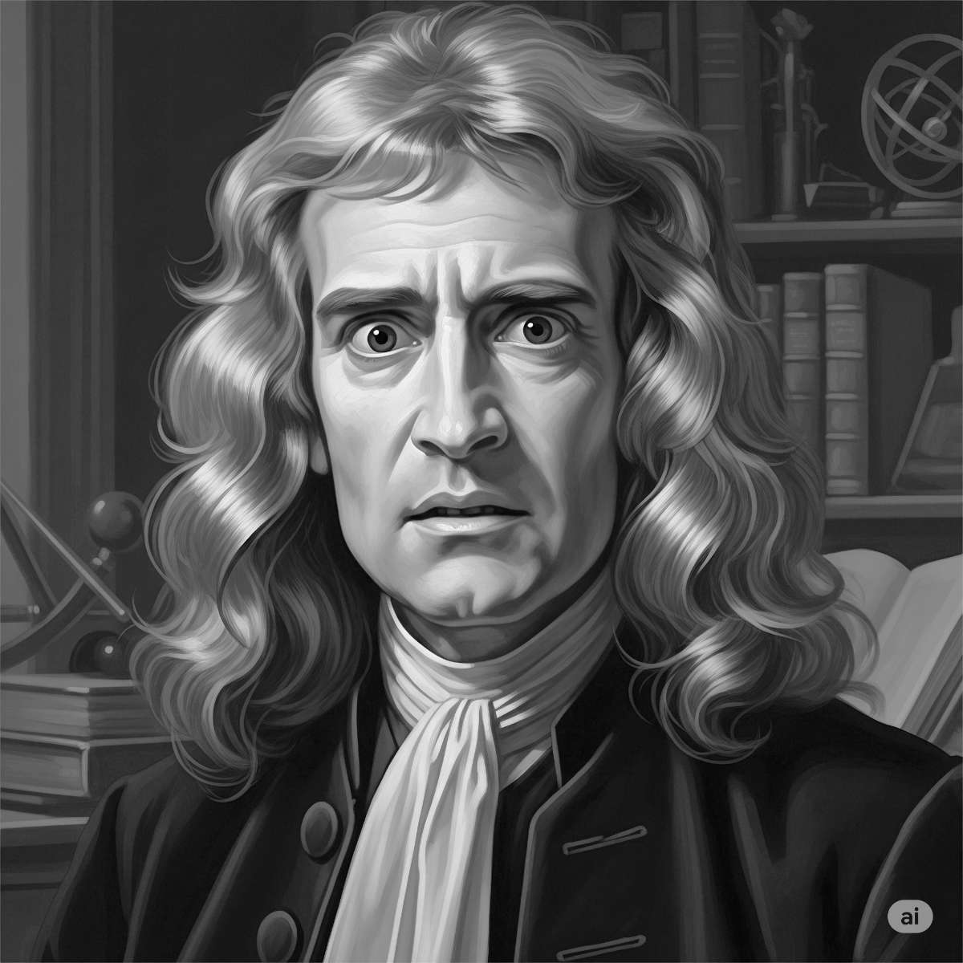
Seems good to me… What could possibly go wrong?…

Slide 22
What Newton Missed

Slide 23
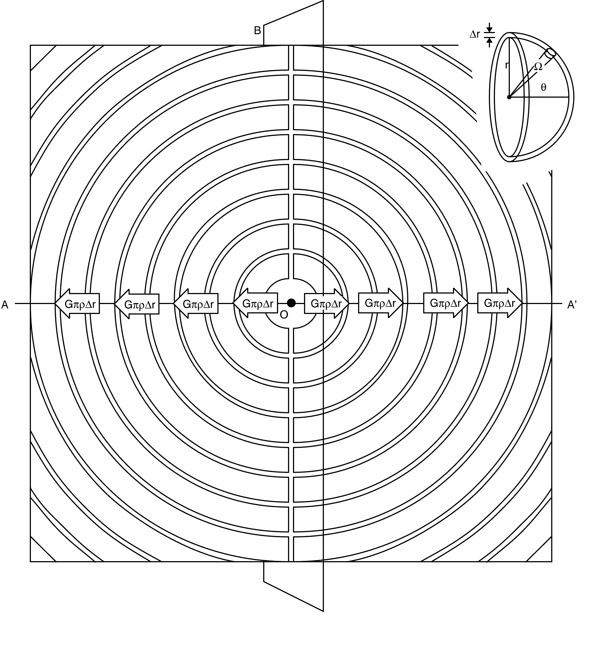
Divide uniform matter distribution ρ into hemispherical shells of thickness Δr.
G=gravitational constant.
Force from each shell on unit test mass is
GπρΔr
Net force = GπρΔr – GπρΔr + GπρΔr – GπρΔr + …

Slide 24
Net force = GπρΔr – GπρΔr + GπρΔr – GπρΔr + …
= ?????
= anything
Sum is not
uniformly convergent
Result depends on order of summation
(1 - 1) + (1 - 1) + (1 - 1) + (1 - 1) + (1 - 1) + …
= 0 + 0 + 0 + 0 + 0 + … = 0
1 + 1 + 1 + (1 - 1) + (1 - 1) + (1 - 1) + (1 - 1) + (1 - 1) + …
= 3 + 0 + 0 + 0 + 0 + 0 + … = 3
(1 + 1 - 1) + (1 + 1 - 1) + (1 + 1 - 1) + (1 + 1 - 1) + (1 + 1 - 1) + …
= 1 + 1 + 1 + 1 + 1 + … =
∞

Slide 25
The Result in Pictures

Slide 26
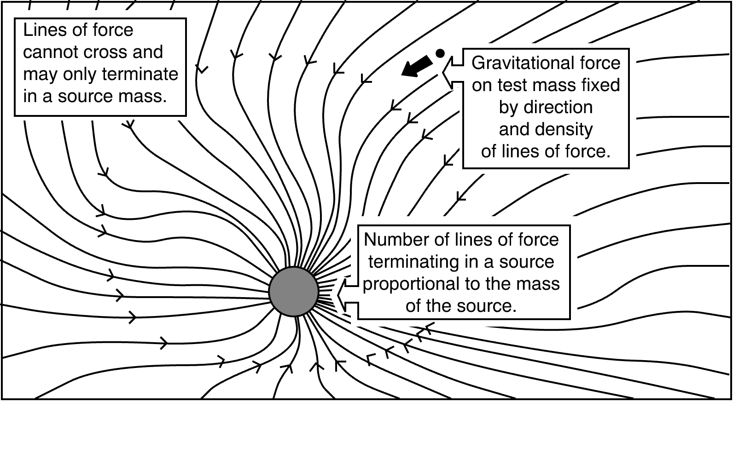
Lines of force model for gravity

Slide 27
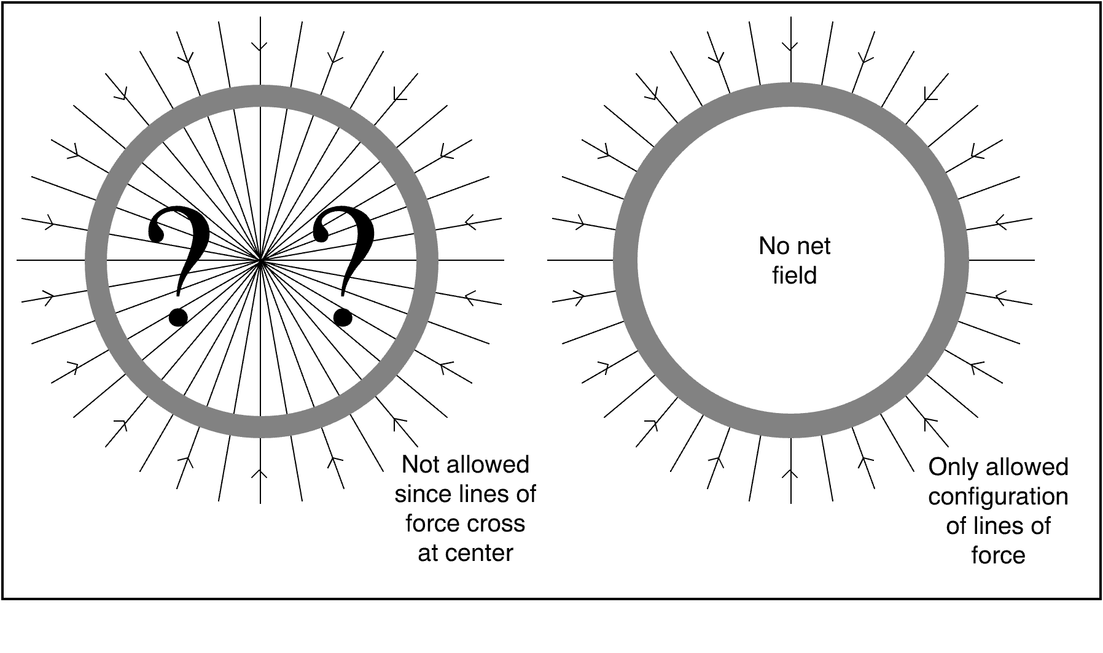
No net forces on test bodies
inside uniform spherical shell of matter.

Slide 28
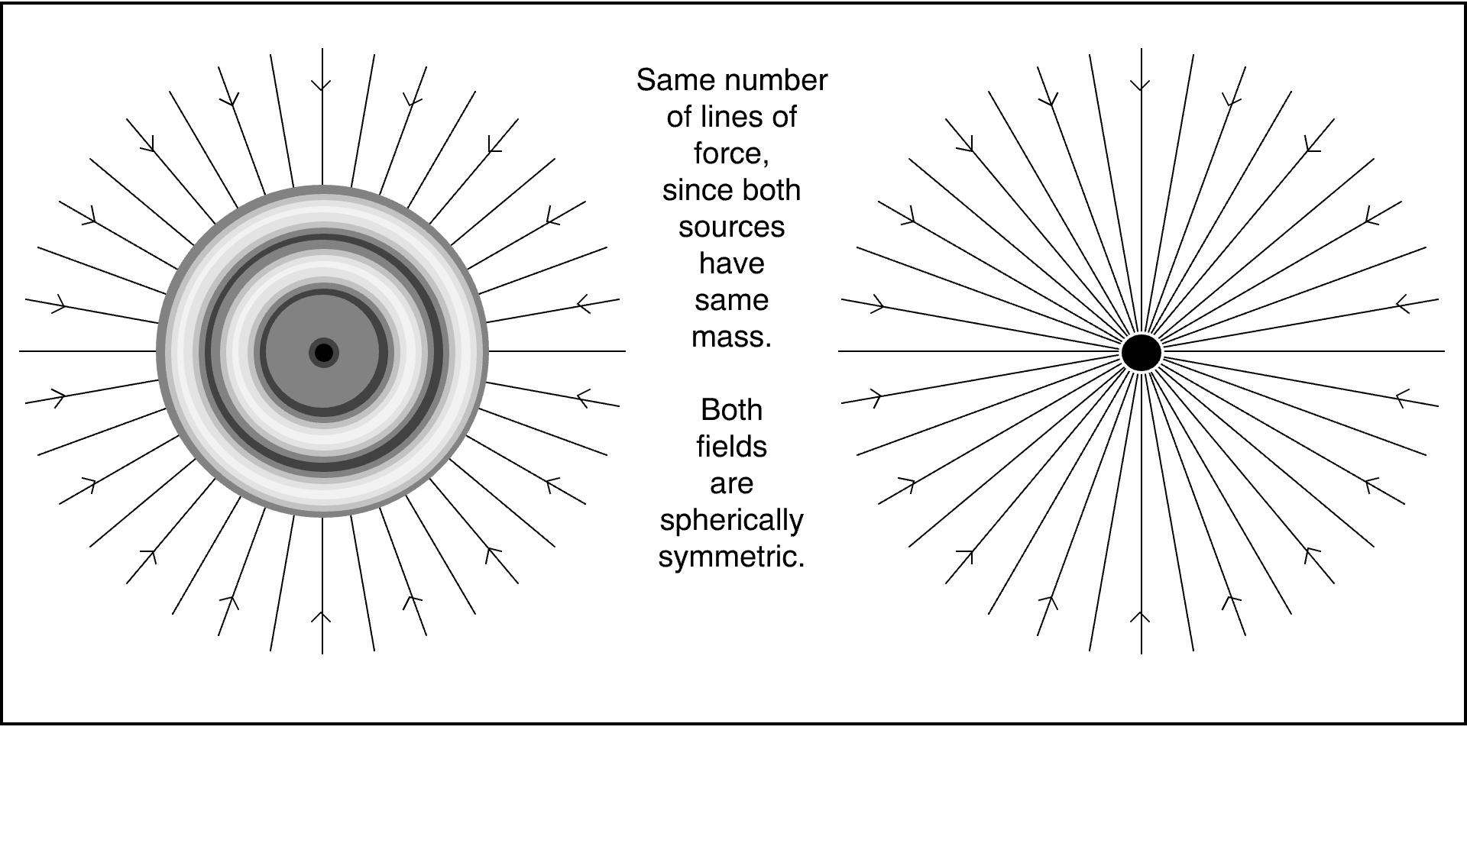
Radially symmetric sphere of matter
has the same external field as a point with the same mass.

Slide 29
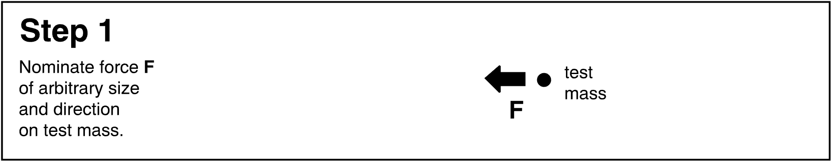
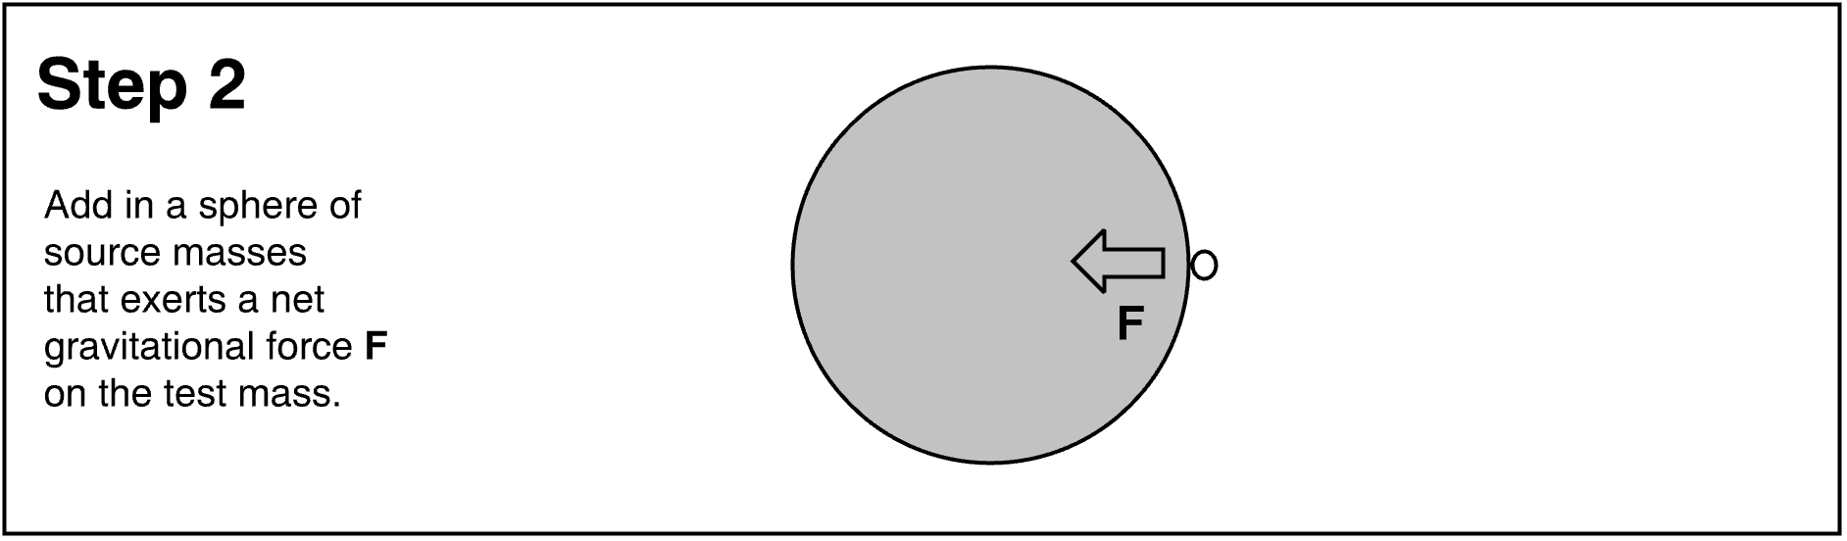
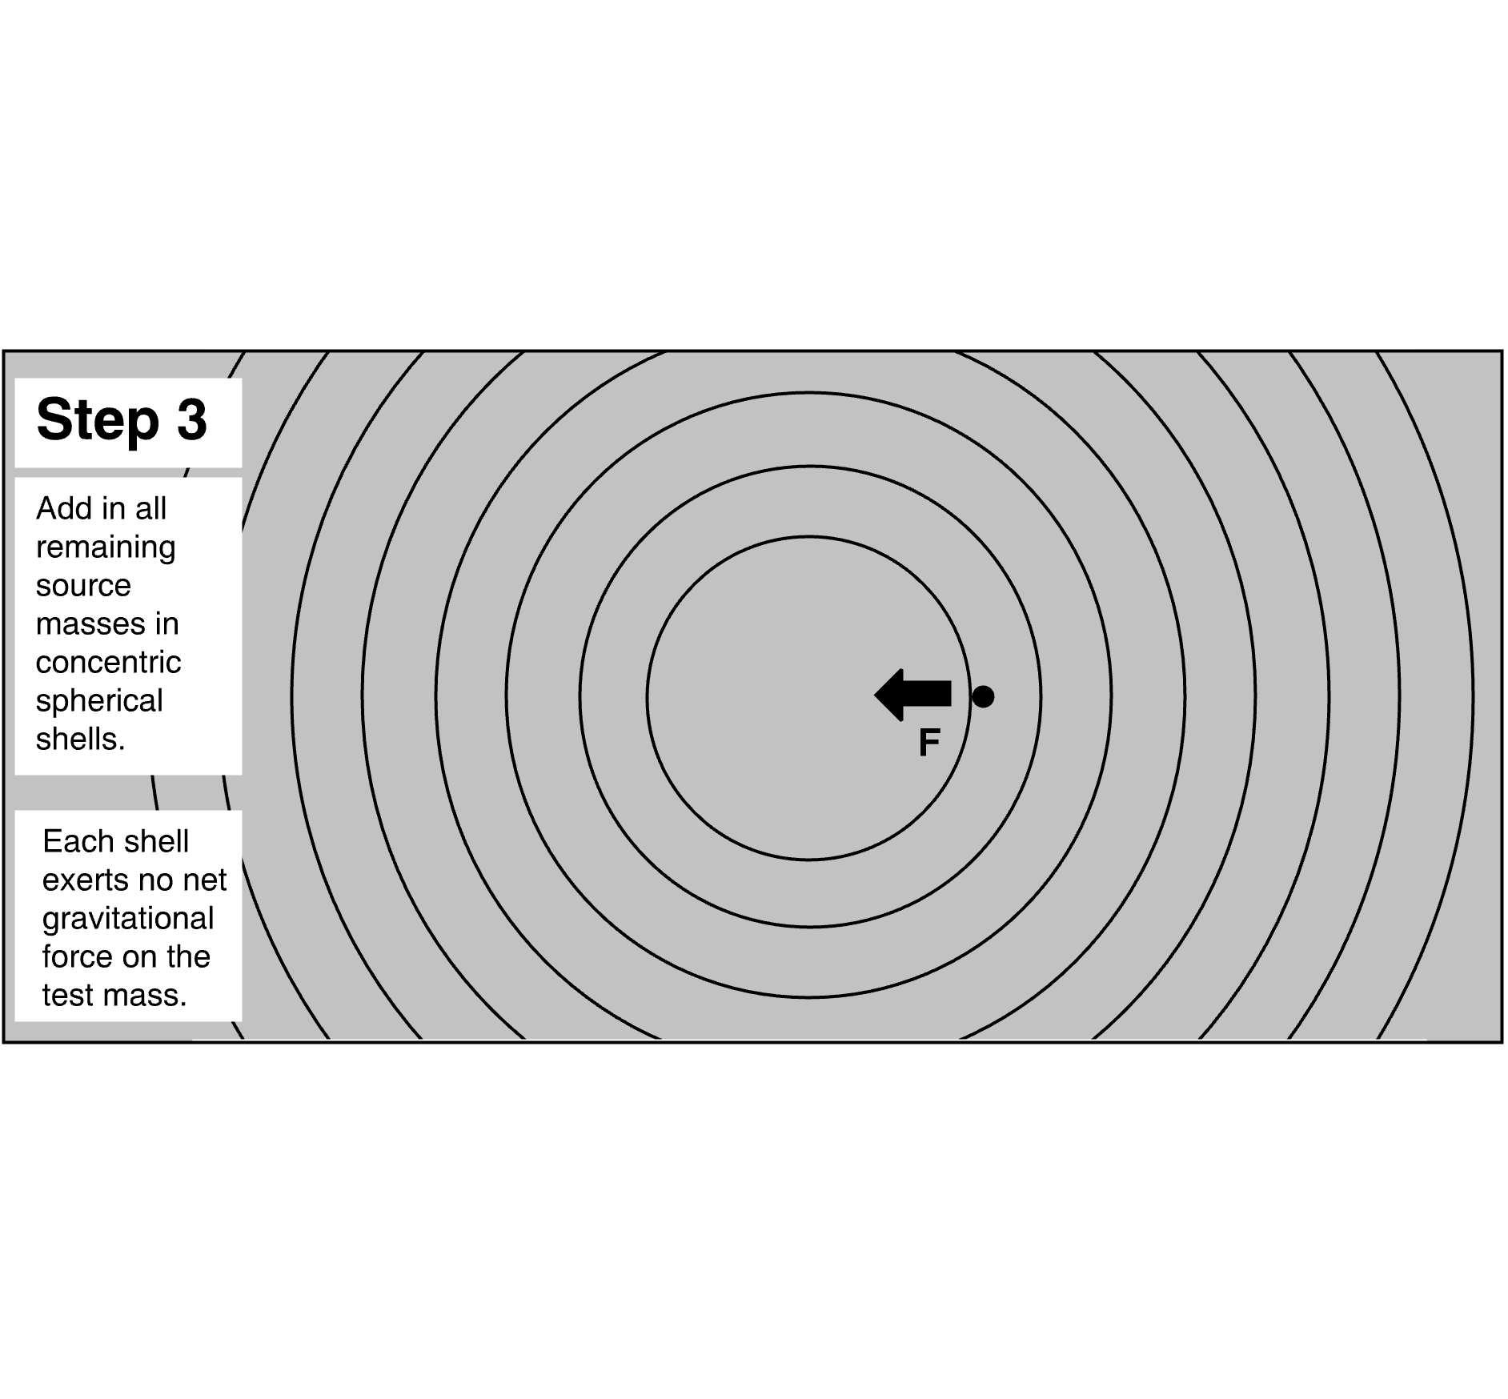

Slide 30
Hugo von Seeliger

Slide 31
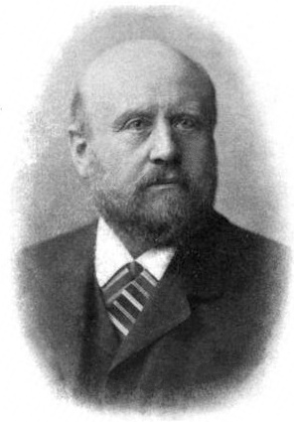

Professor of Astronomy and Director of the Observatory at the University of Munich.
Uh oh… I think there’s a problem…
Teacher of Karl Schwarzschild.

Slide 32
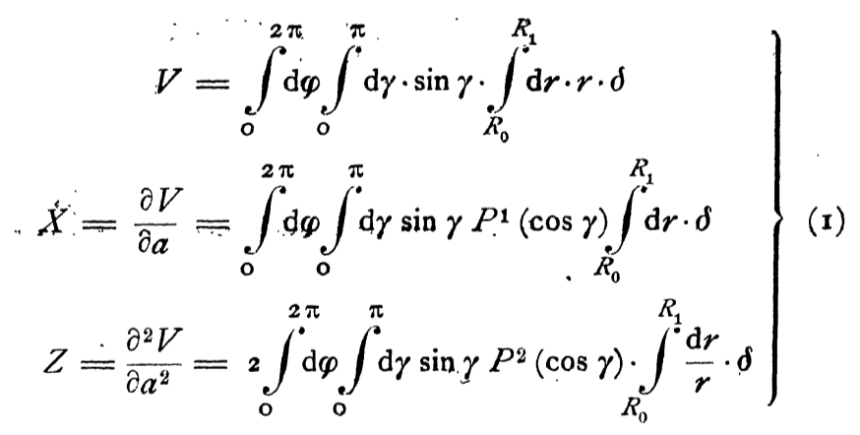
Seeliger’s integrals
Gravitational field quantities at r = 0 due to uniform matter distribution δ at radial distances r = R₀ to R₁.
Becomes infinite, when R₁ is infinite.
gravitational potential
gravitational force
gravitational tidal force
Becomes indeterminate, when R₁ is infinite.

Slide 33
If [the matter density] is a finite magnitude for infinitely large regions, then, in general, [gravitational force] and [gravitational tidal force] are completely undetermined,
as long as one makes no definite assumption on the way in which the finite values of R₁ become infinitely great.
Therefore both quantities can equally well become infinite or remain finite.

Slide 34
Solutions proposed

Slide 35
Responses
No-solution solution
Symmetry requires a uniform distribution of matter at rest
Alter one assumption of Newtonian cosmology.
Adjust Newton’s inverse square law
Many tiny adjustments work.
Which is right?
Total mass of universe is finite
All matter in huge, finite island. Hierarchical universe.
Finitude of space
Finite, closed space has finite total matter.
Dynamical Newtonian cosmology
Huh?....

Slide 36
More details

Slide 37
Seeliger

Slide 38
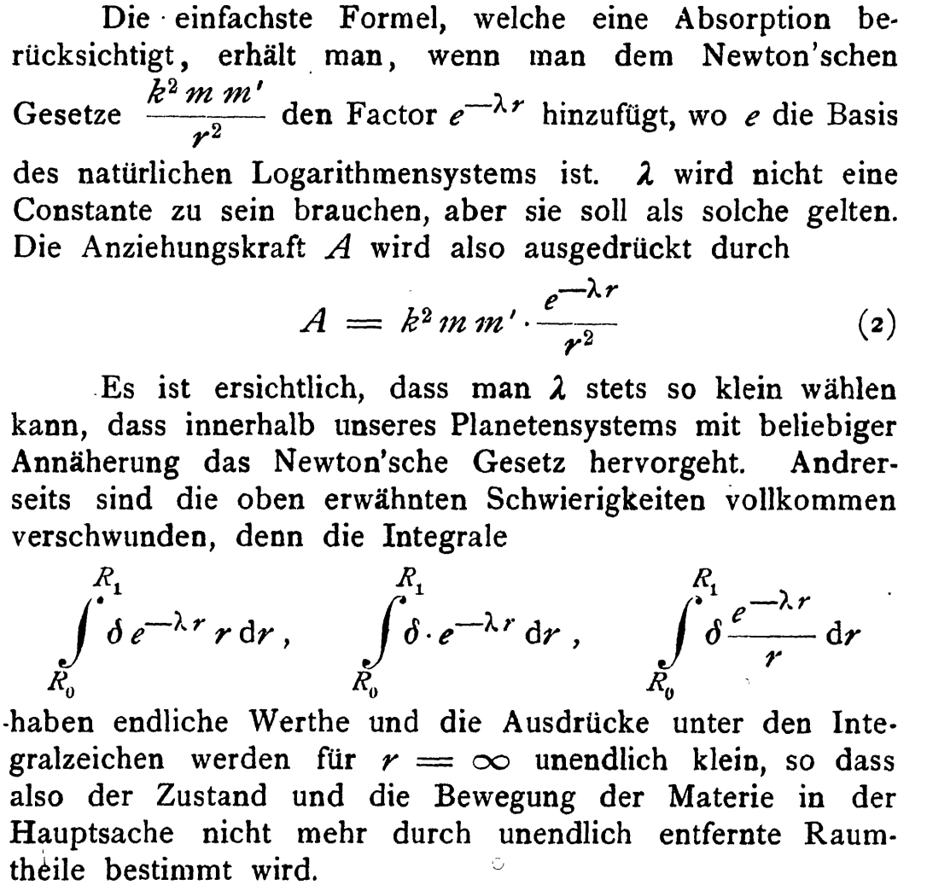
Exponential decay of gravitational force
Very slight absorption of gravitational force by space.
Add factor e^{-λr} to the inverse square law
Infinite integrals for gravitational potential, force and tidal force become finite.

Slide 39
Einstein 1917

Slide 40
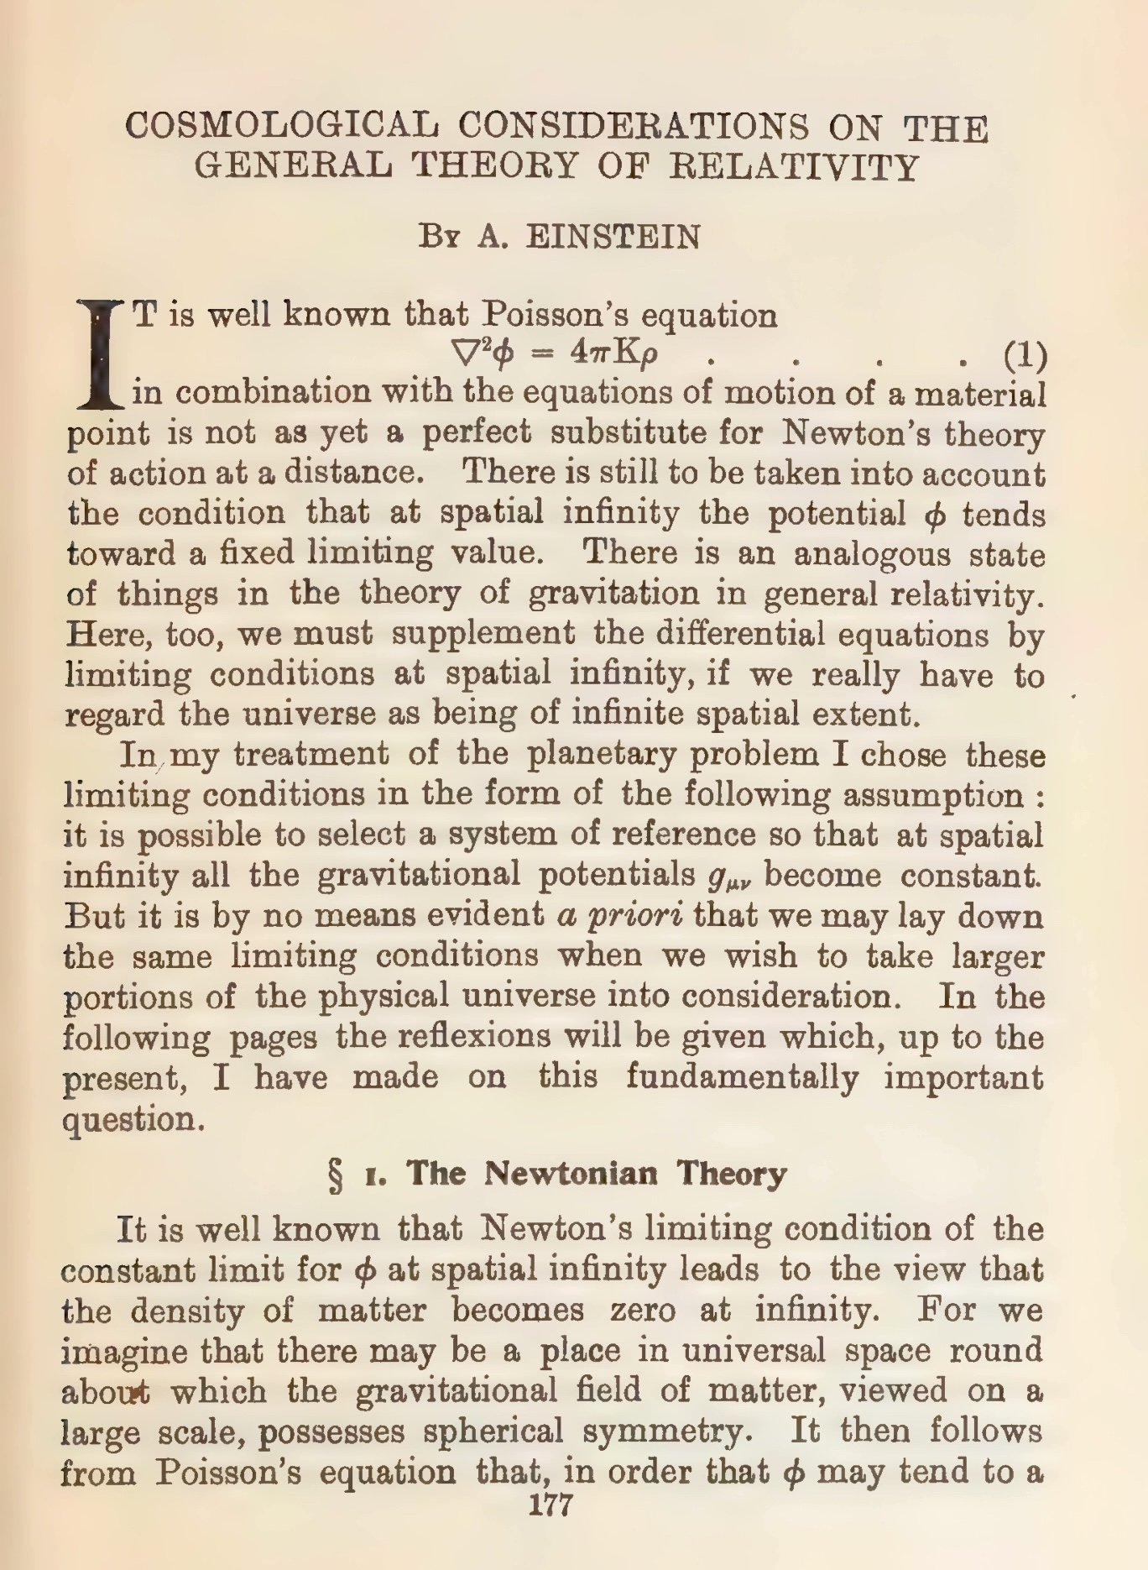
Poisson’s equation is the field version of Newton’s inverse square law for gravitational force.
Uniform matter distribution (ρ = constant>0) does not allow a solution φ = constant.
Radially symmetric solution is φ = 2πKρr²

Slide 41
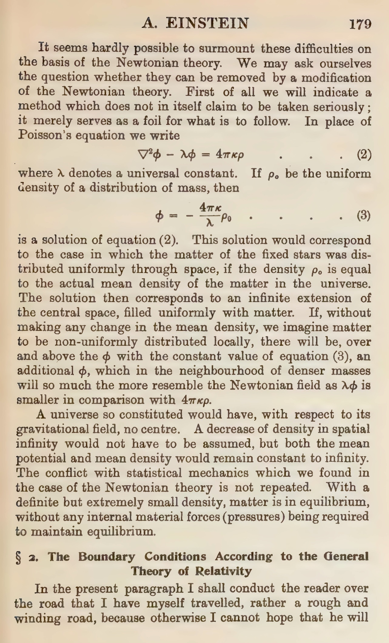


Add λ term to Poisson’s equation
Constant φ solution now possible by inspection:

Slide 42
Hierarchical Cosmology

Slide 43
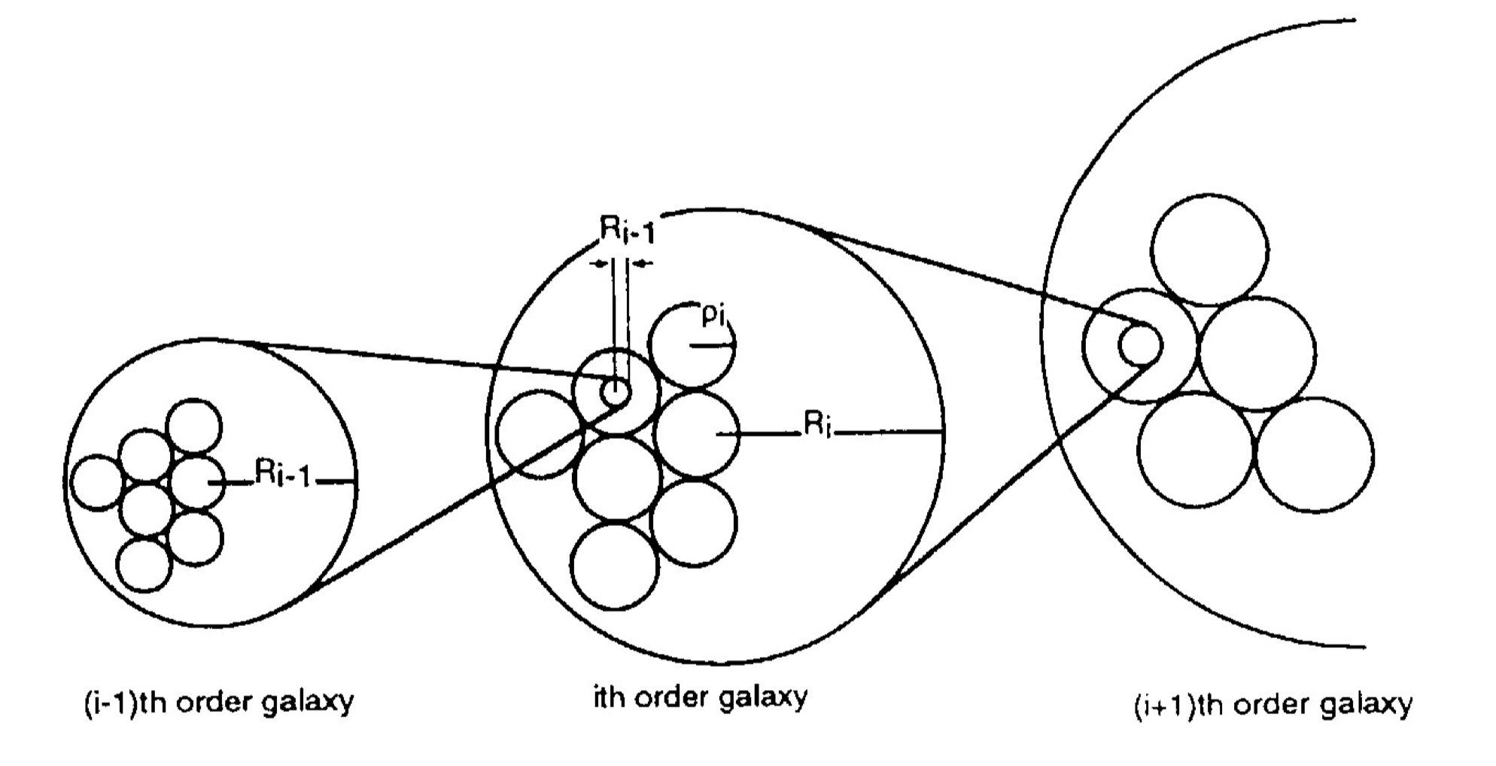
Charlier’s Hierarchical Universe

Slide 44
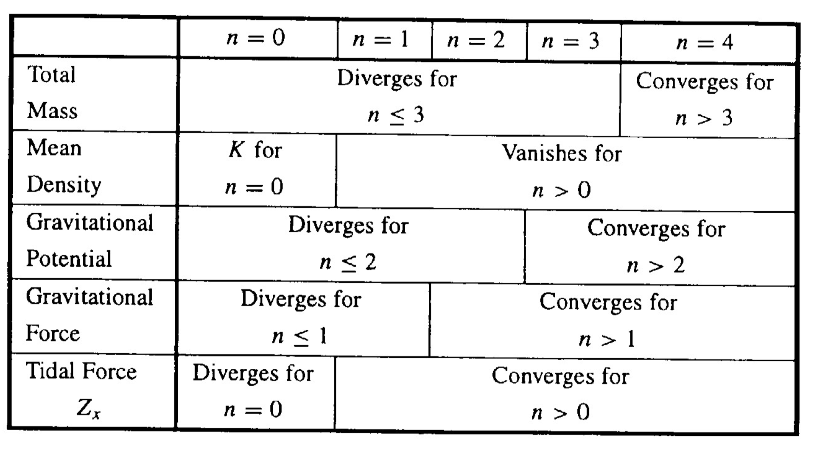
Convergence properties of quantities in hierarchic cosmology
Mean density of matter on surface of sphere r distant from origin
ρ = K/r²

Slide 45
Winding up…

Slide 46
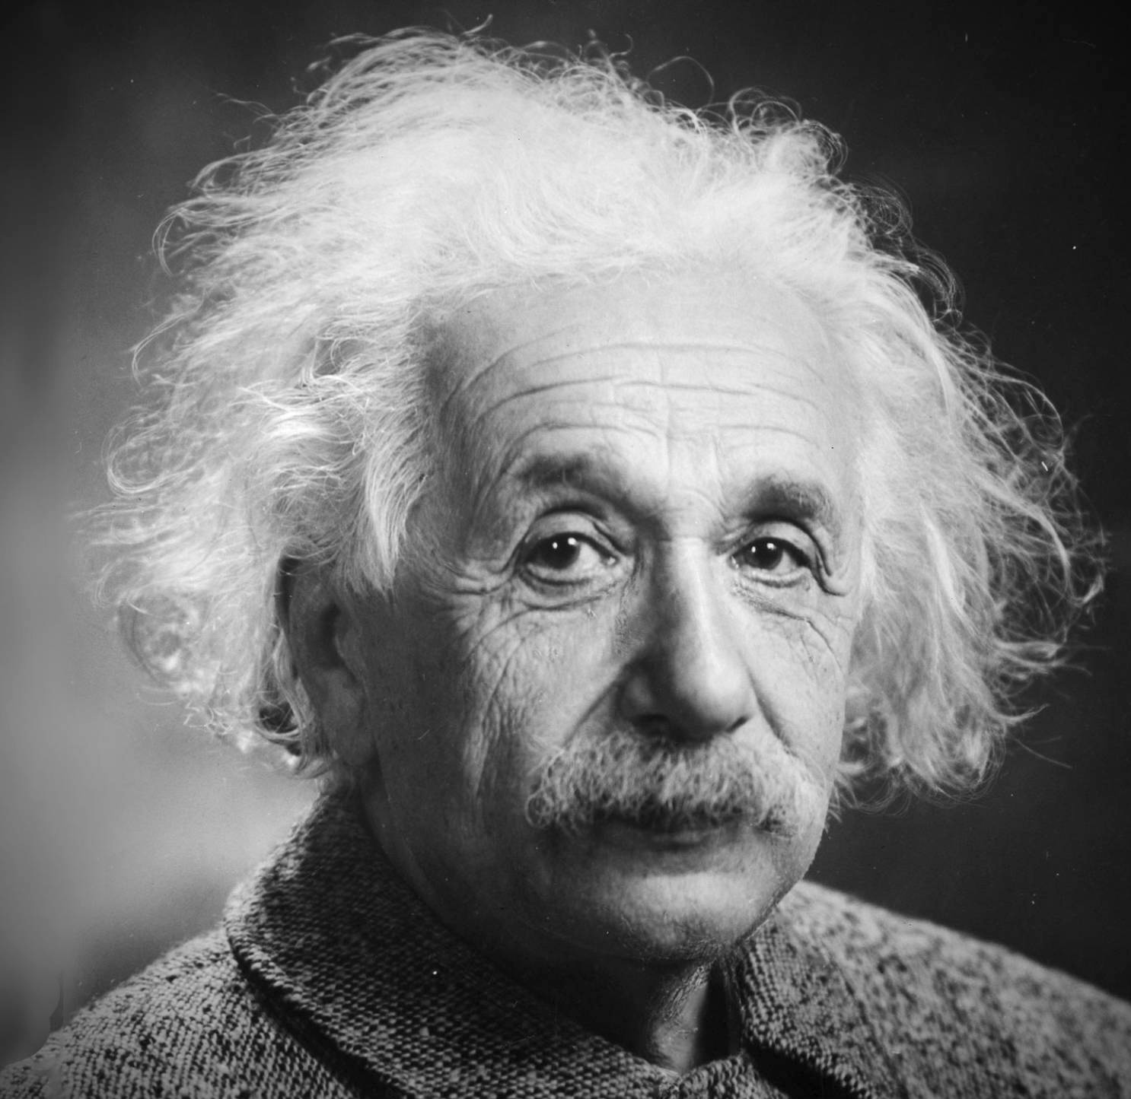
Seems good to me…
What could go wrong?…
To be
continued…

Slide 47


Newton was not sufficiently interested in cosmology (outside the solar system) until Bentley pushed him.
Newton was so hasty in his appraisal that he got it wrong.
This episode is an accessible case study in how scientists react to inconsistencies in their theories.

