Slide 1
Dynamic Newtonian Cosmology
John D. Norton
Department of History and
Philosophy of Science
University of Pittsburgh
My text

Slide 2
Newton, Kant, … Gravity produces local collapses

Slide 3
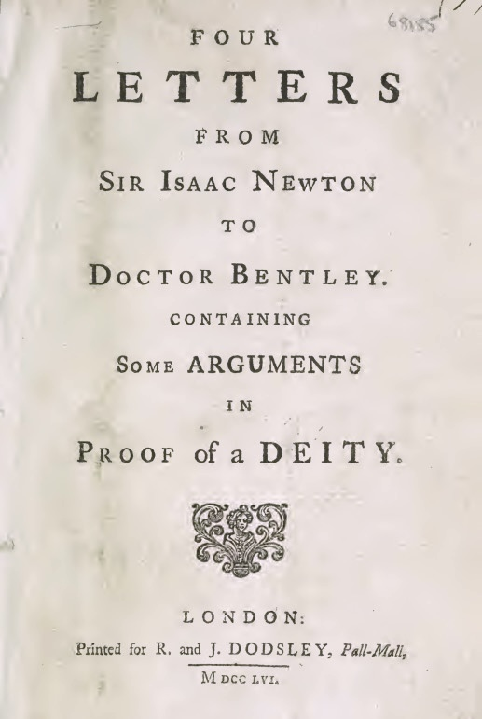
Letters from 1692
Origin of Newton’s cosmological thinking.

Slide 4
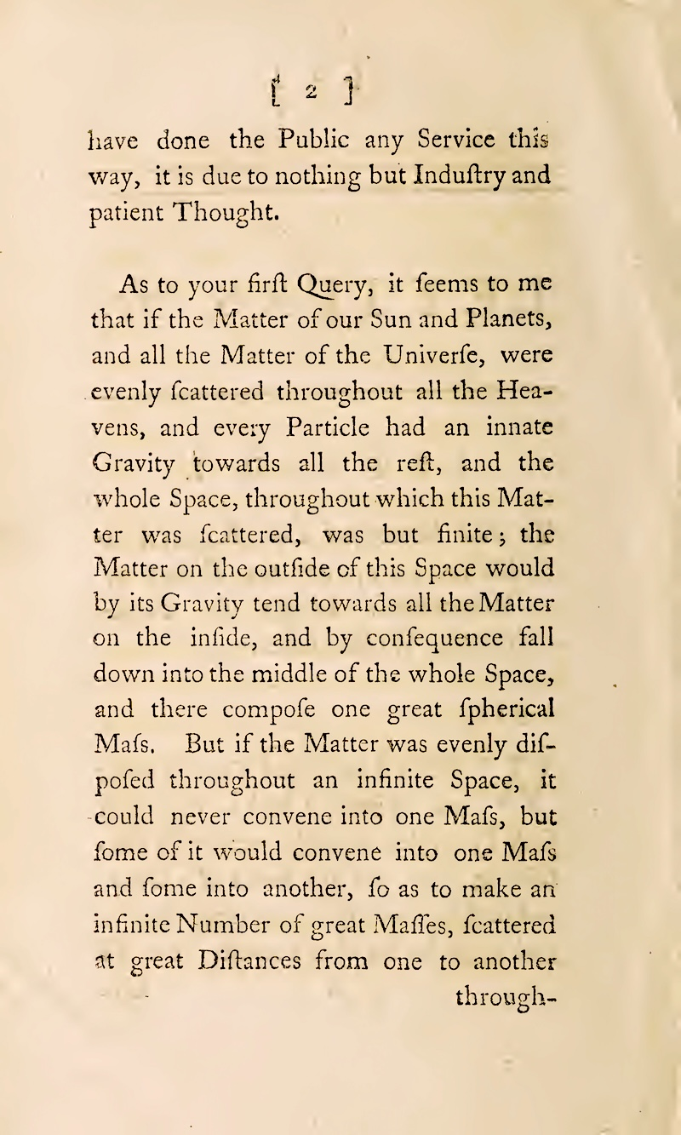
“But if the Matter was evenly disposed throughout an infinite Space,
…
it would convene into one Mass and some into another, so as to make an infinite Number of great Massies, scattered at great Distances from one to another through-…”

Slide 5
“… if this Matter was scattered, was but finite; the matter on the outside of this space would by its Gravity tend towards all the Matter on the inside, and by consequence fall down into the middle of the whole space, and there compose one great spherical Mass.”

Slide 6
Newton’s finite mass case

Slide 7
What Newton, Kant, … missed:
Newtonian mechanics admits then same collapse for an infinite, uniform matter distribution

Slide 8
What changed?

Slide 9
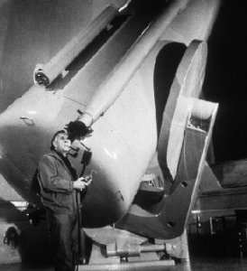
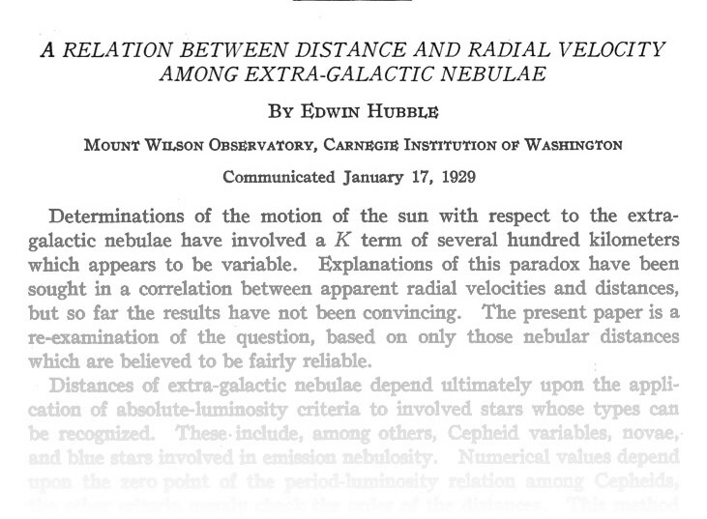
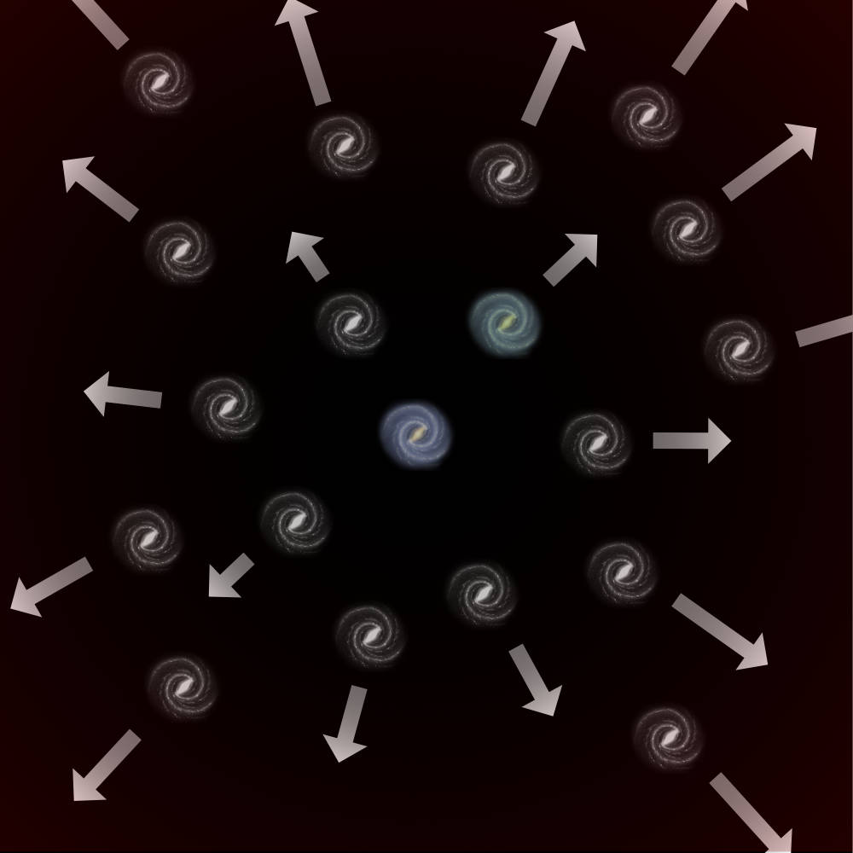
Edwin Hubble, 1929
Recession of the nebulae.
Cosmology becomes dynamic

Slide 10
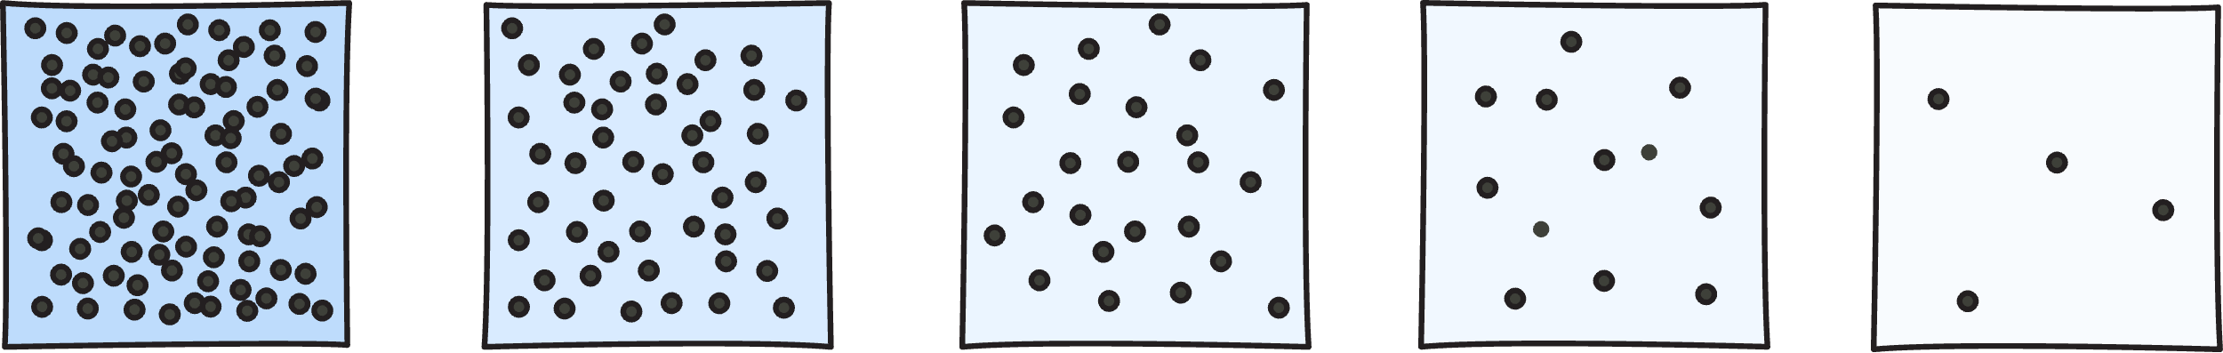
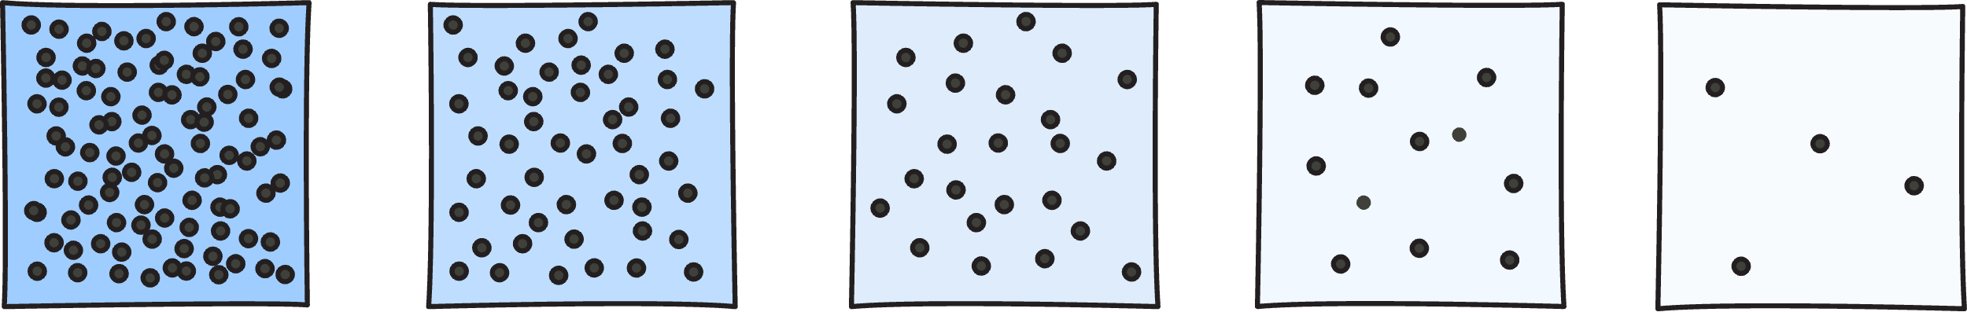
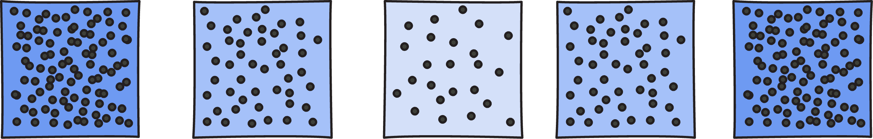
Friedman, Lemaitre relativistic cosmologies
(with λ = 0)
time
“hyperbolic”
no big crunch
“parabolic”
intermediate
“elliptic”
big crunch

Slide 11
Edward A. Milne William C. Mcrea

Slide 12
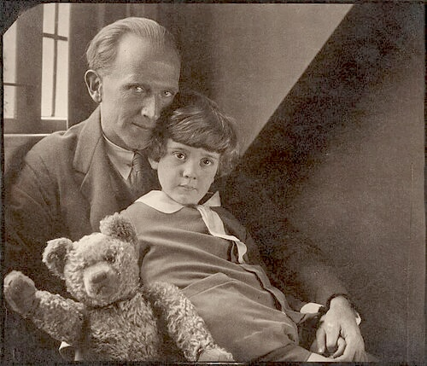

Alan Alexander Milne

Slide 13
There are Newtonian analogs of the three relativistic cosmologies with the same equations for their dynamics.

Slide 14
Net gravitational force on unit mass, r distant from center
Uniform matter density ρ
Net gravitational force due solely to that exerted by sphere.
r
r
Spherical shells exert no net force

Slide 15
Expansion decelerates due to force acting towards center

Slide 16
Analytically very easy parabolic case Milne, “A Newtonian Expanding Universe,” 1934

Slide 17
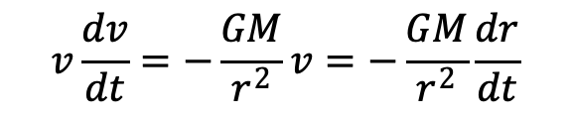
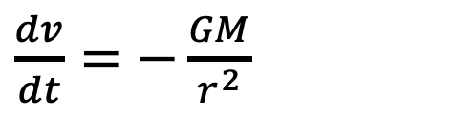
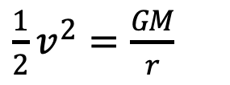
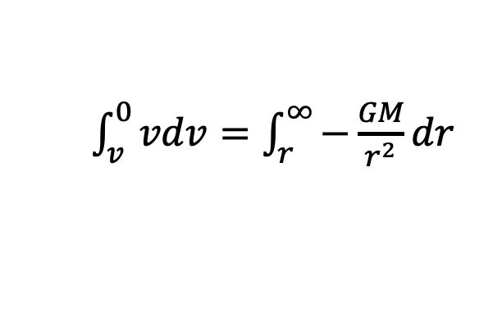
Expansion comes to rest as t →∞
Functions of time t.
r(t) (scalar) distance from center to co-moving point in matter distribution.
v(t) = dr(t)/dt
r
ρ(t) uniform density of matter distribution
Conservation of energy
+
= 0
kinetic energy
potential energy
(-GM/r)
v²/2 - 4πGρr²/3 = 0
Spherical mass
M = 4πGρr³/3
v = (8πGρ/3)^{(1/2)} r
Inverse square law of gravitational force
(for unit mass)
$$v\frac{dv}{dt}=−\frac{GM}{r^{2}}v=−\frac{GM}{r^{2}}\frac{dr}{dt}$$
$\frac{dv}{dt}=−\frac{GM}{r^{2}}$
$\int_{v}^{0}{vdv=\int_{r}^{∞}{−\frac{GM}{r^{2}}dr}}$
Integrate for boundary condition
v = 0 at r = ∞.
$\frac{1}{2}v^{2}=\frac{GM}{r}$

Slide 18
Expansion comes to rest as t →∞
Functions of time t.
r(t) distance from center to co-moving point in matter distribution.
v(t) = dr(t)/dt
r
ρ(t) uniform density of matter distribution
Conservation of energy (for unit mass)
+
= 0
kinetic energy
potential energy
(-GM/r)
v²/2 - 4πGρr²/3 = 0
Spherical mass
M = 4πGρr³/3
v = (8πGρ/3)^{(1/2)} r
Continuity (source mass in sphere constant)
M = 4πGρr³/3 = constant
Differentiating dρ/dt = – (3ρ/r)(dr/dt)

Slide 19
Main results
Conservation of energy
Continuity
v = (8πGρ/3)^{(1/2)} r
dρ/dt = – (3ρ/r)(dr/dt)
deduce
Mass density
Density stays uniform. Expansion from infinite density at t=0 to zero density at t = ∞.
ρ(t) = 1/6πGt²
Speed-distance
Hubble law. v ~ r.
Hubble constant = 2/(3t)
v = (2/3)(r/t)
Force
dv/dt = – (2/9)(r/t²)
At any nominated, fixed position r, restraining force drops to zero as t → ∞

Slide 21
But… What about Seeliger’s problem?

Slide 22
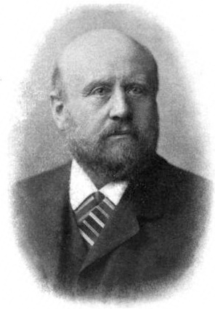
Uh oh… I think there’s a problem…
?
Uniform distribution of matter has no preferred center.
?
Gravitational force is indeterminate.
Energy is indeterminate.

Slide 23
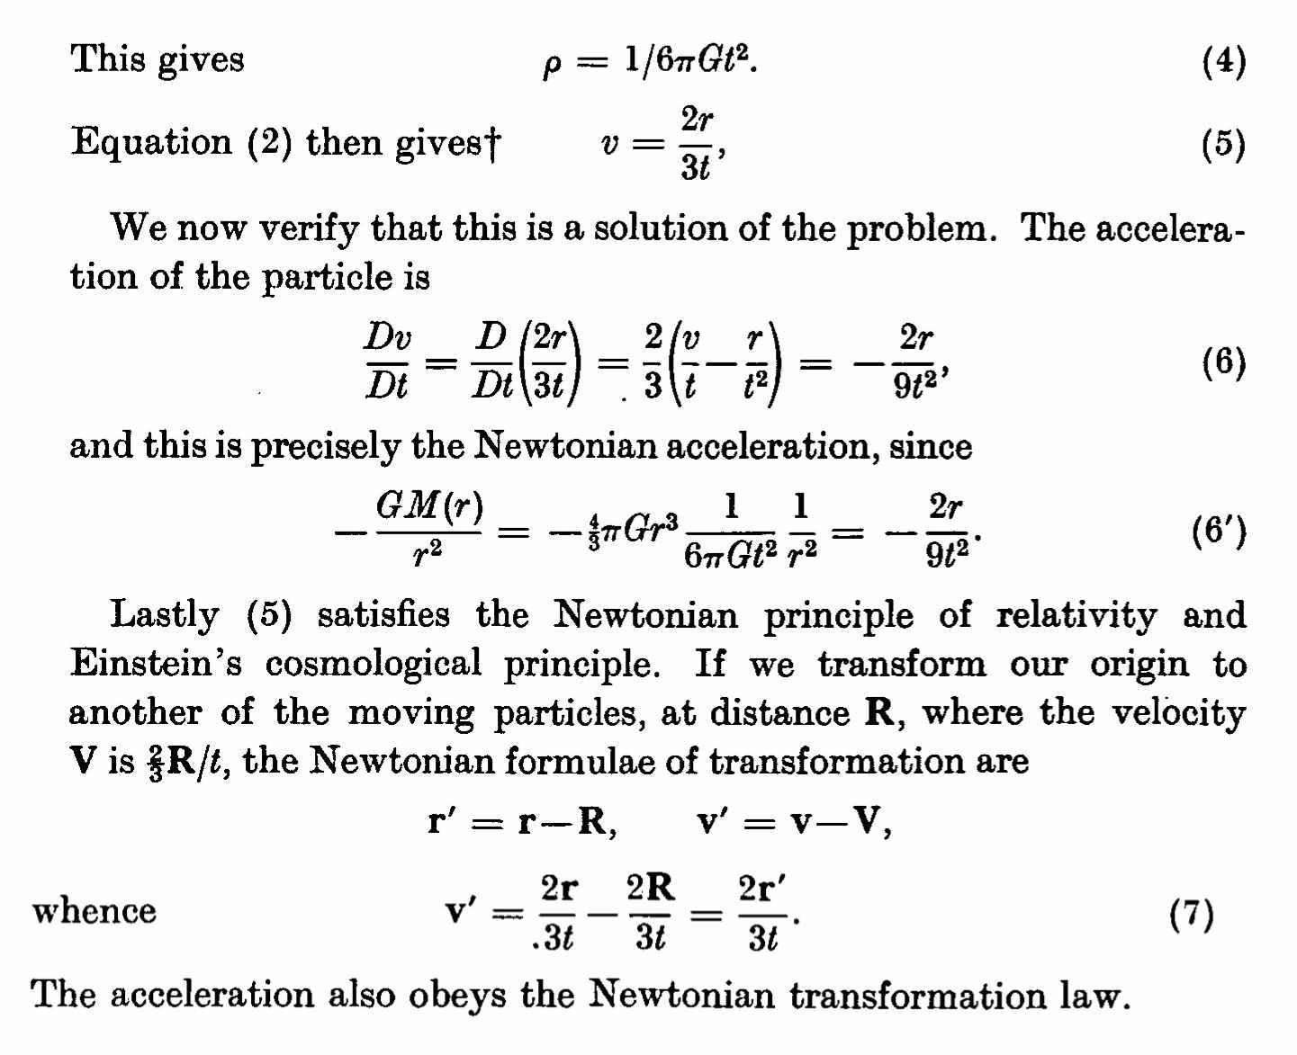
Milne’s answer
Hubble law expansion has no preferred center.
It is homogeneous.

Slide 24
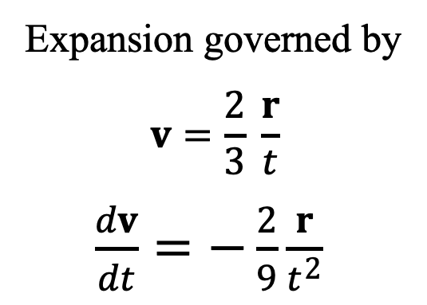
Homogeneity of Hubble expansion
Green galaxy at position r = R has velocity of recession v = V.
Expansion governed by
$$v=\frac{2}{3} \frac{r}{t}$$
$\frac{dv}{dt}=−\frac{2}{9}\frac{r}{t^{2}}$
First frame of reference r, v, puts blue galaxy at center at rest
r = 0 v = 0

Slide 25
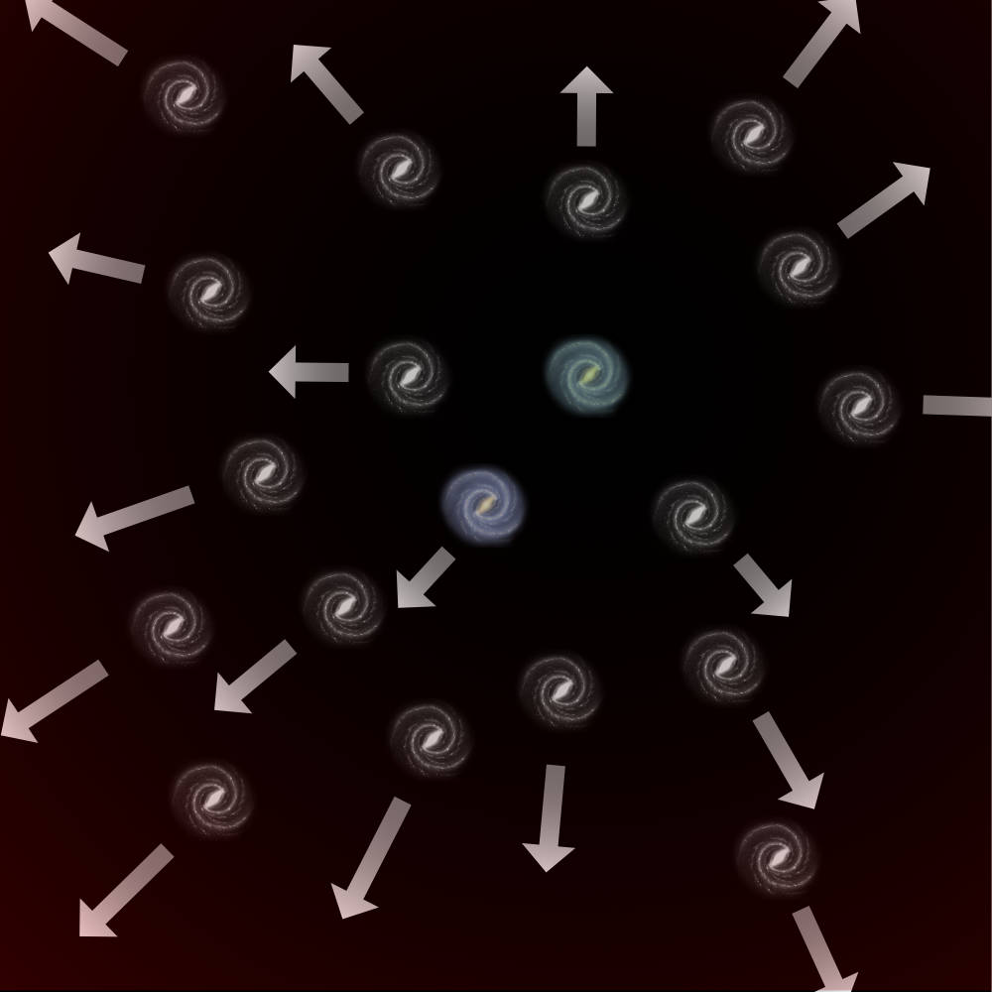
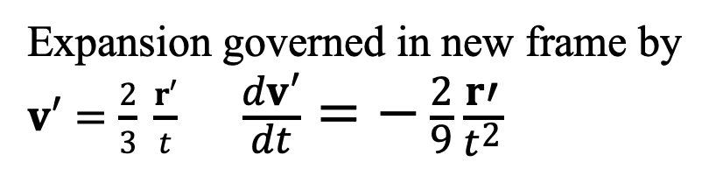
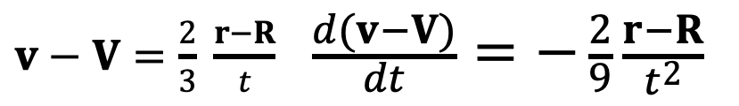
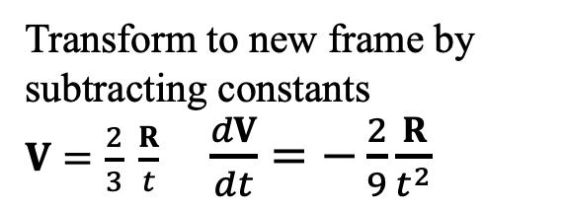
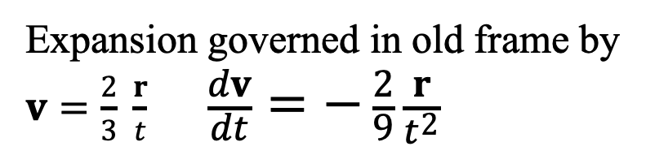
Transform to See Homogeneity
Expansion governed in old frame by
$v=\frac{2}{3} \frac{r}{t} \frac{dv}{dt}=−\frac{2}{9}\frac{r}{t^{2}}$
Transform to new frame by subtracting constants
$V=\frac{2}{3} \frac{R}{t}$ $\frac{dV}{dt}=−\frac{2}{9}\frac{R}{t^{2}}$
$v−V=\frac{2}{3} \frac{r−R}{t} \frac{d(v−V)}{dt}=−\frac{2}{9}\frac{r−R}{t^{2}}$
In new frame, defined as
r’ = r – R with galaxy speeds v’ = v – V,
green galaxy has
r’ = 0 v’ = 0
Expansion governed in new frame by
$v′=\frac{2}{3} \frac{r′}{t} \frac{dv′}{dt}=−\frac{2}{9}\frac{r′}{t^{2}}$

Slide 26
Uh oh… I think there’s a problem…
One problem still outstanding?
?
OK
Uniform distribution of matter has no preferred center.
?
Gravitational force is indeterminate.
Energy is indeterminate.

Slide 27
Milne is obscure…
“(5) satisfies the Newtonian principle of relativity.”
“The acceleration also obeys the Newtonian transformation law.”
?
?
?
Transformation
r to r’ is to a frame in relative acceleration.
Newtonian relativity is expressed by Galilean covariance under which acceleration is invariant.

Slide 28
What Happens Next?

Slide 29
Paper presented in the symposium “Logical Inconsistency in Scientific Theories” at PSA 1992: Biennial Meeting of the Philosophy of Science Association
PSA: Proceedings of the Biennial Meeting of the Philosophy of Science Association,
Vol. 1992, Volume Two: Symposia and Invited Papers (1992), pp. 412-420

Slide 30
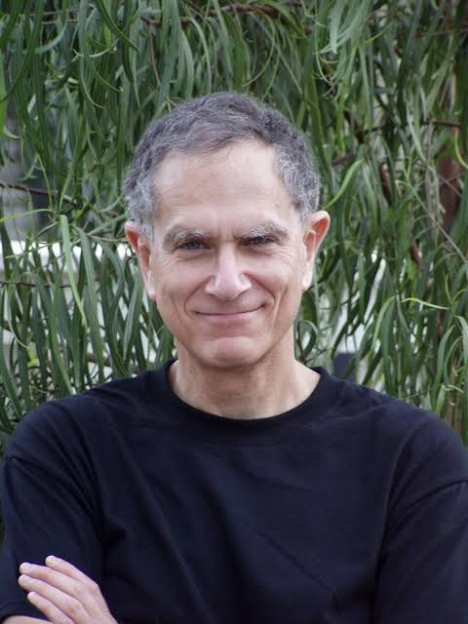
“I am not convinced…”

Slide 31
“Is Newtonian Cosmology Really Inconsistent?”
NO
“… the difficulties they face, I will argue, are only apparent. They are artifacts of the formulations themselves, and disappear if one passes to the so-called "geometrized" formulation of the theory, first introduced by Cartan (1923, 1924) and Friedrichs (1927).”

Slide 32
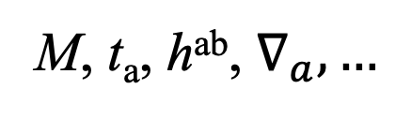
How does it work?
Differential operator defines curved affine structure governing free falls.
All that matters
Build geometric, spacetime theory with curved affine structure.
M, t_{a}, h^{ab}, $∇_{a},…$
Free fall motion
Uniform inertial motion
Deflection due to gravitational force.
=
+
Indeterminacy of gravitational force
Different, conventional ways of decomposing free fall motions.
No difference in free fall motions

Slide 33
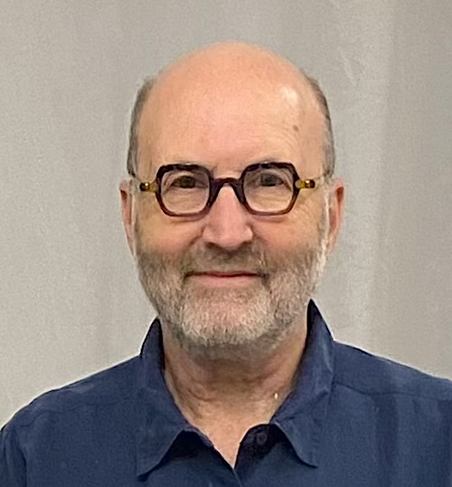
“Represent it as a gauge freedom in the original formulation”

Slide 35
Separate physical from conventional.
Physical
Conventionally chosen
from set adapted to the physical
Mass density ρ
Absolute position, velocity, acceleration.
All galaxies in free fall.
Which frames of reference are inertial.
Relative position
of a galaxy with respect
to other galaxies
Gravitational force
Gravitational potential.
Relative velocity
Relative acceleration

Slide 36
Transform between galactic frames
Same relative motions in different frames of reference.
Blue galaxy at rest.
Green galaxy accelerates.
Green galaxy at rest.
Blue galaxy accelerates.
r, v, F, φ
r', v', F', φ'
Green galaxy position and velocity R, V.
R' = – R
V' = –V
Blue galaxy position and velocity R', V'.
r' = r – R
r = r' – R'

Slide 37
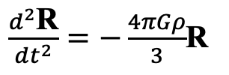


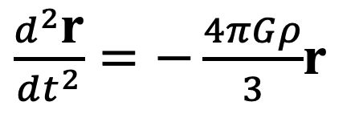
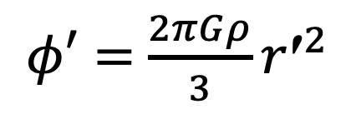
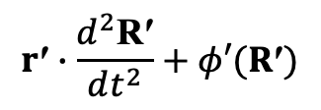
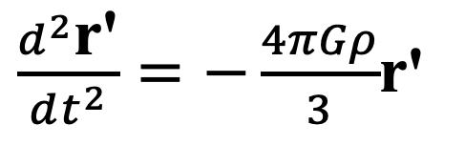
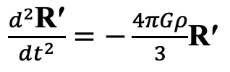

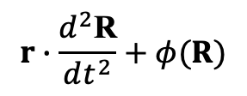
Motions in blue frame
Motions in green frame
$\frac{d^{2}\text{R}}{dt^{2}}=−\frac{4πGρ}{3}$R
$\frac{d^{2}\text{r}}{dt^{2}}=−\frac{4πGρ}{3}$r
Subtract homogeneous force field
$\frac{d^{2}\text{r}\text{′}}{dt^{2}}=−\frac{4πGρ}{3}$r'
$$\frac{d^{2}\text{r}}{dt^{2}}=−∇φ$$
$\frac{d^{2}\text{R}\text{′}}{dt^{2}}=−\frac{4πGρ}{3}$R$\text{′}$
$$\frac{d^{2}\text{r}\text{′}}{dt^{2}}=−∇φ′$$
$$r∙\frac{d^{2}\text{R}}{dt^{2}}+φ(R)$$
$φ=$ $\frac{2πGρ}{3}r^{2}$
$φ′=$ $\frac{2πGρ}{3}{r\text{′}}^{2}$
add homogenous directed field
$$r\text{′}∙\frac{d^{2}\text{R}\text{′}}{dt^{2}}+φ′(R\text{′})$$

Slide 38
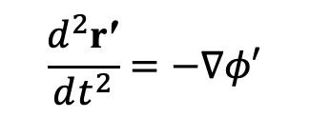
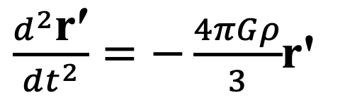
Motions in blue frame
Motions in green frame
Complete symmetry
$\frac{d^{2}\text{r}}{dt^{2}}=−\frac{4πGρ}{3}$r
$\frac{d^{2}\text{r}\text{′}}{dt^{2}}=−\frac{4πGρ}{3}$r'
Relation in blue frame
Relation in green frame
$$\frac{d^{2}\text{r}}{dt^{2}}=−∇φ$$
$$\frac{d^{2}\text{r}\text{′}}{dt^{2}}=−∇φ′$$
No fact expressible in either frame distinguishes it.
$φ=$ $\frac{2πGρ}{3}r^{2}$
$φ′=$ $\frac{2πGρ}{3}{r\text{′}}^{2}$

Slide 39
Perfect symmetry
No fact expressible in the physics can single out any decomposition as preferred.
All that matters
Free fall motion
Uniform inertial motion
Deflection due to gravitational force.
=
+
Indeterminacy of gravitational force
Different, conventional ways of decomposing free fall motions.
No difference in free fall motions

Slide 40
Winding up

Slide 41
Einstein’s famous 1905 special relativity paper.
Same symmetry of physics.

Slide 44

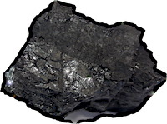
Old, lingering problems can have new solutions.
Newtonian cosmology and FLRW relativistic cosmology are governed by exactly the same dynamical equations. Why?
It is possible to have fun doing historical research.

