Slide 1
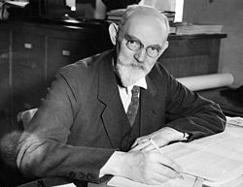
de Sitter Universe
John D. Norton
Department of History and
Philosophy of Science
University of Pittsburgh
My t. ext

Slide 2
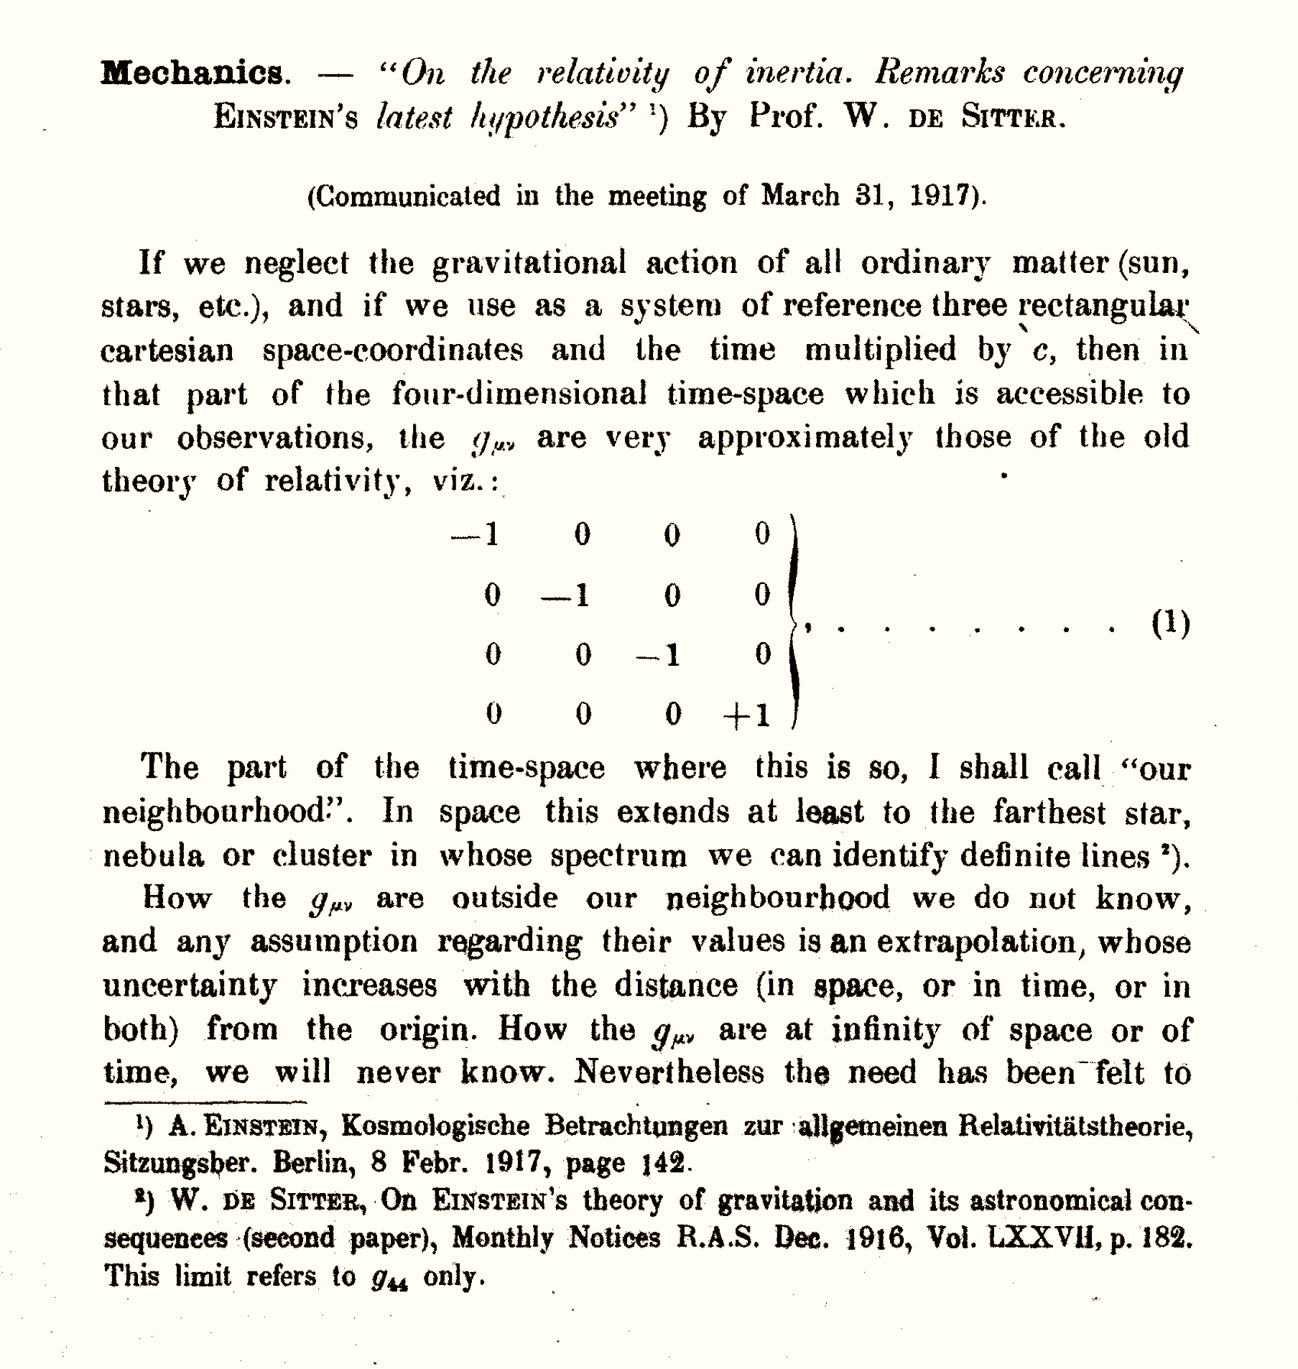
W. de Sitter, "On the relativity of inertia. Remarks concerning Einstein's latest hypothesis,”
Royal Netherlands Academy of Arts and Sciences, Proceedings, 19 II, 1917, Amsterdam, pp. 1217-1225.

Slide 3
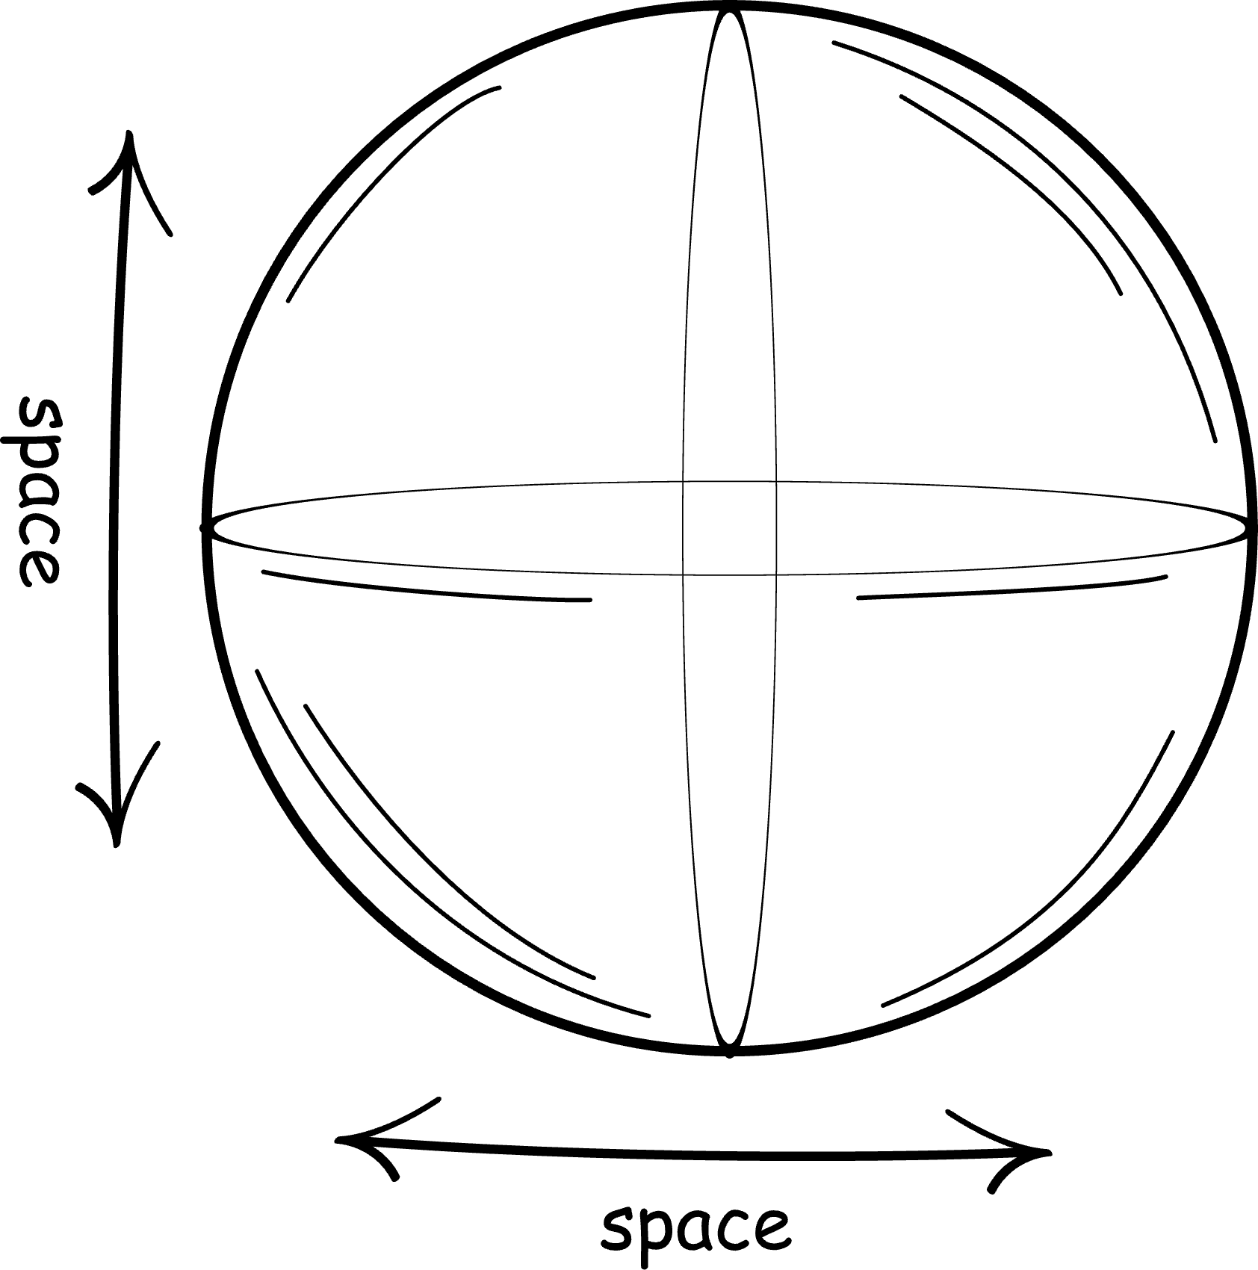
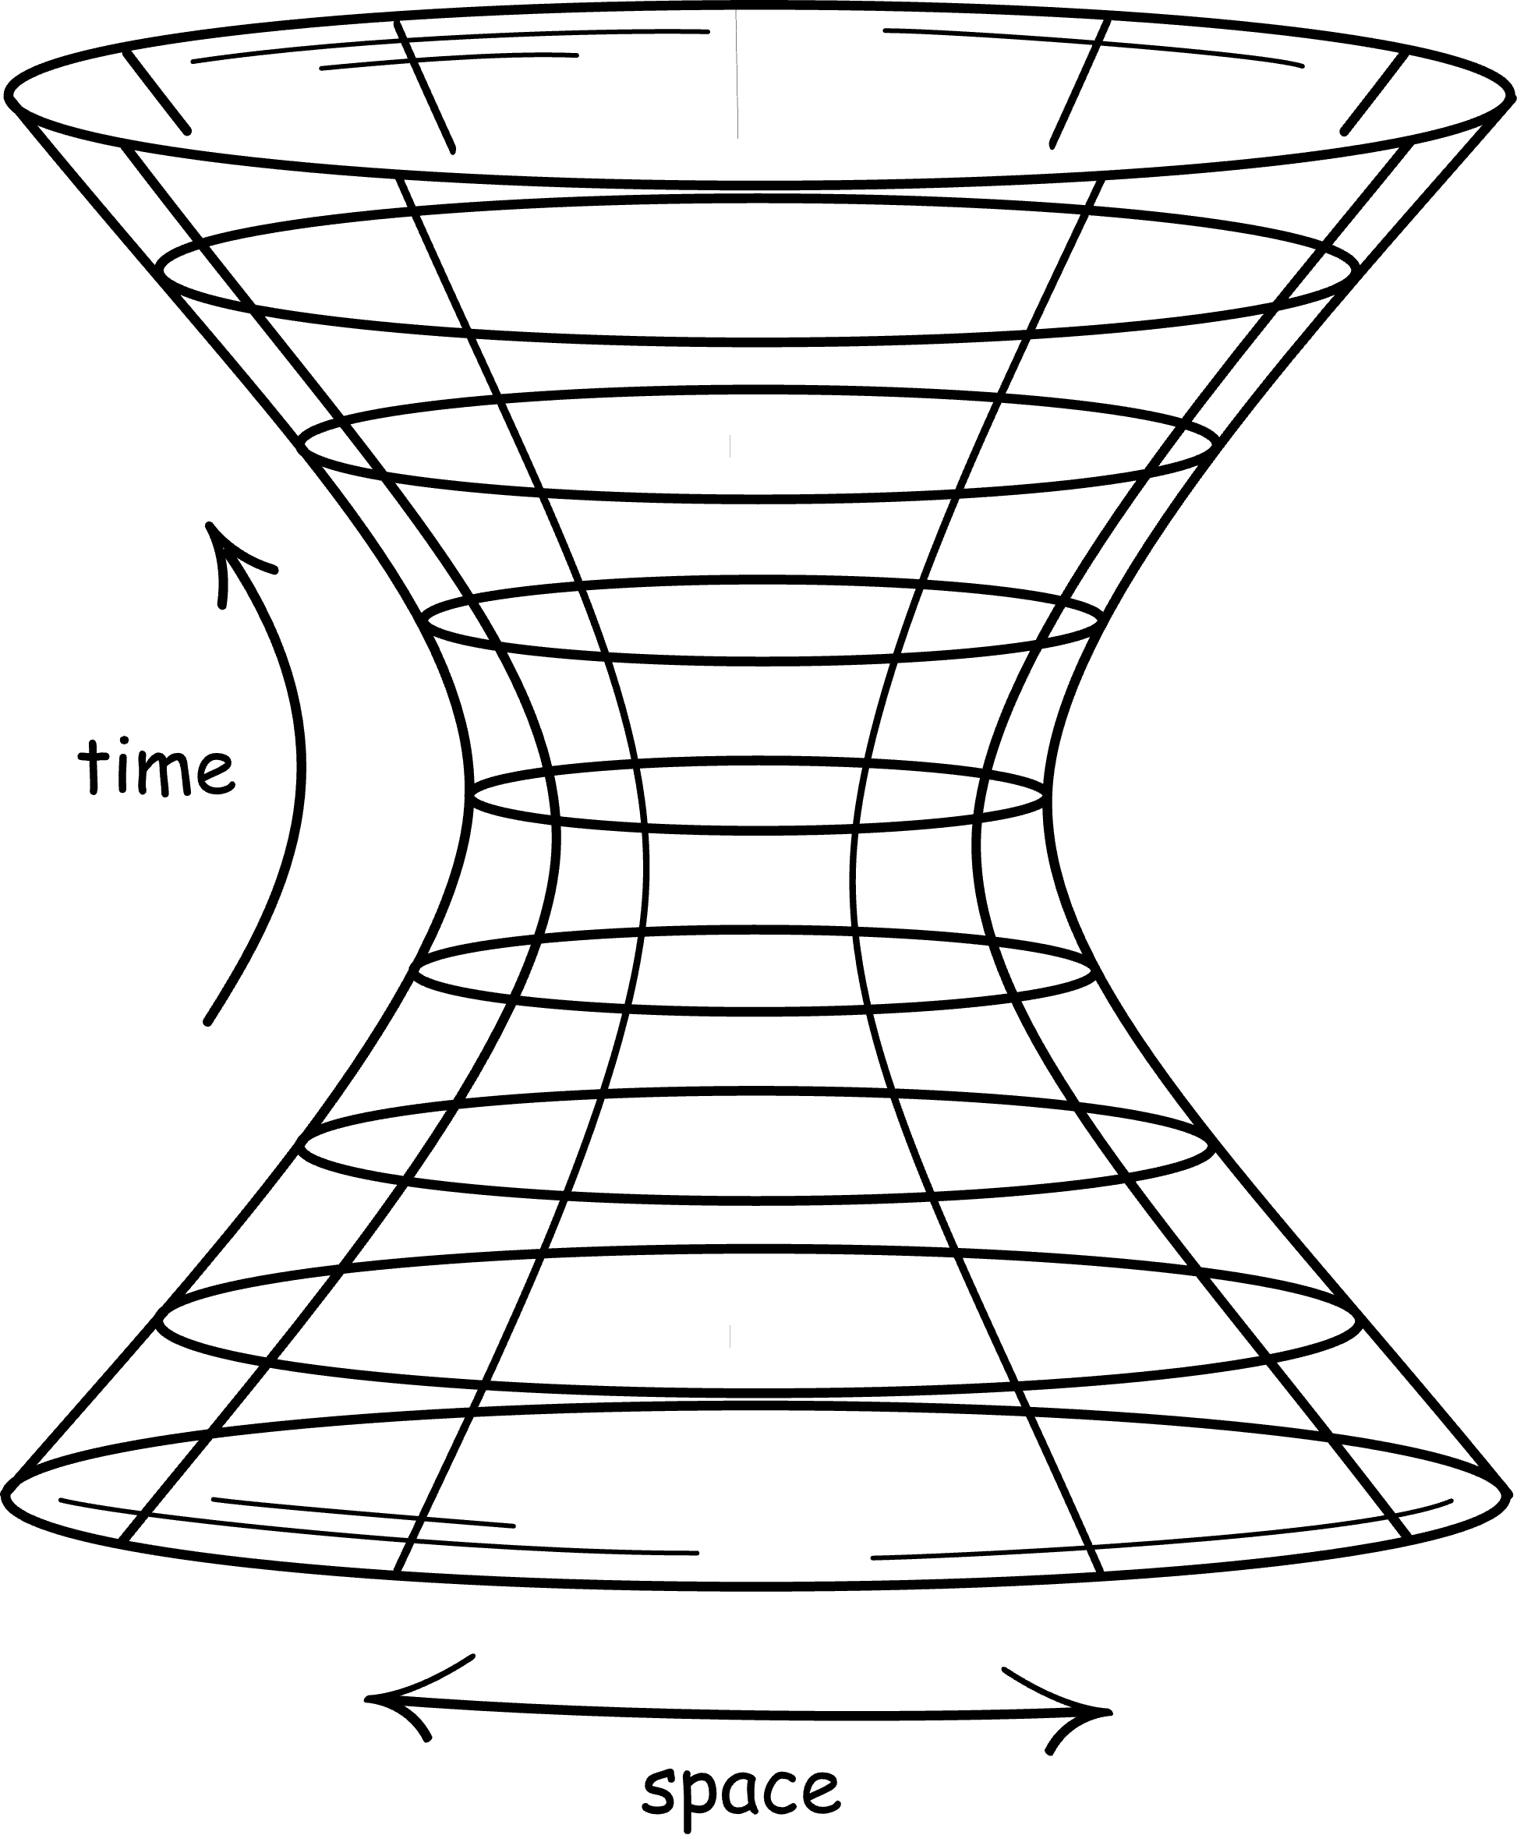
Simplest relativistic space of constant, non-zero curvature
Simplest ordinary space of constant, non-zero curvature

Slide 4
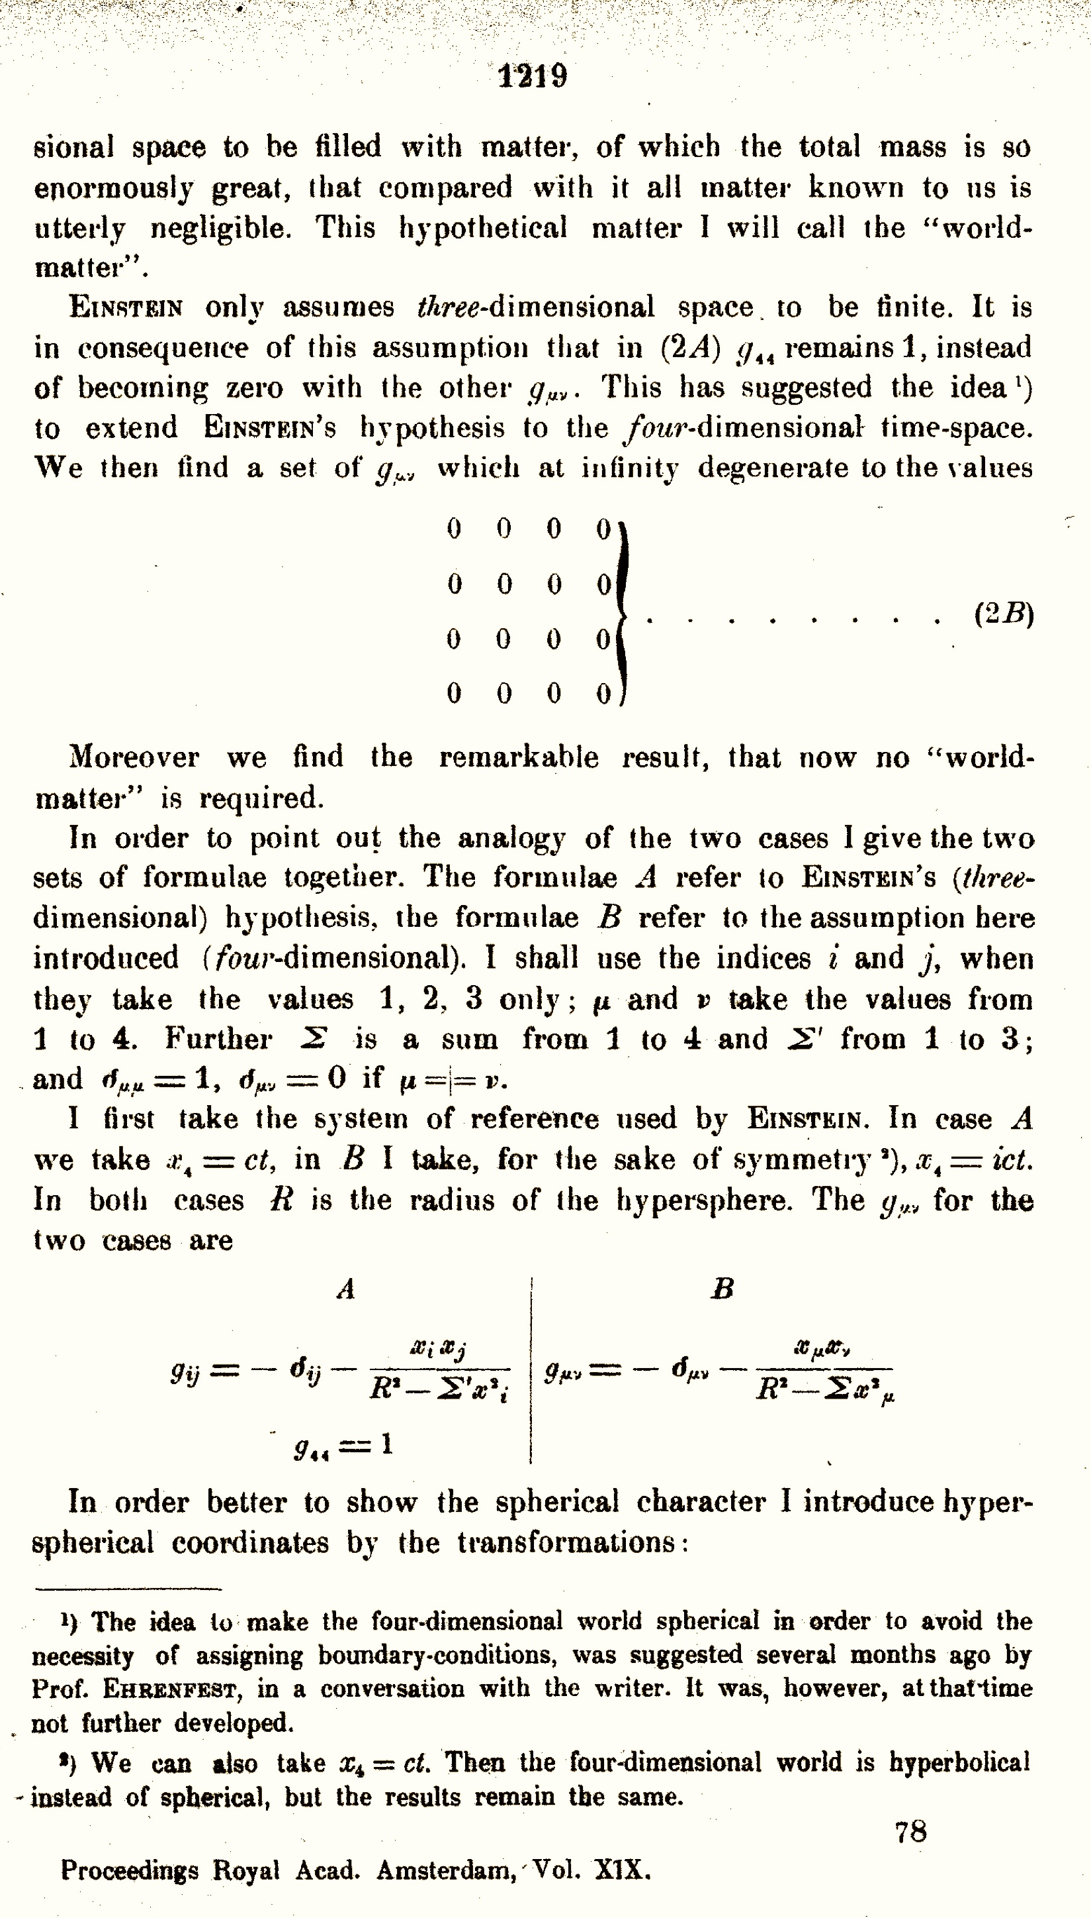
Einstein universe: “matter without motion”
De Sitter universe: “motion without matter”

Slide 5
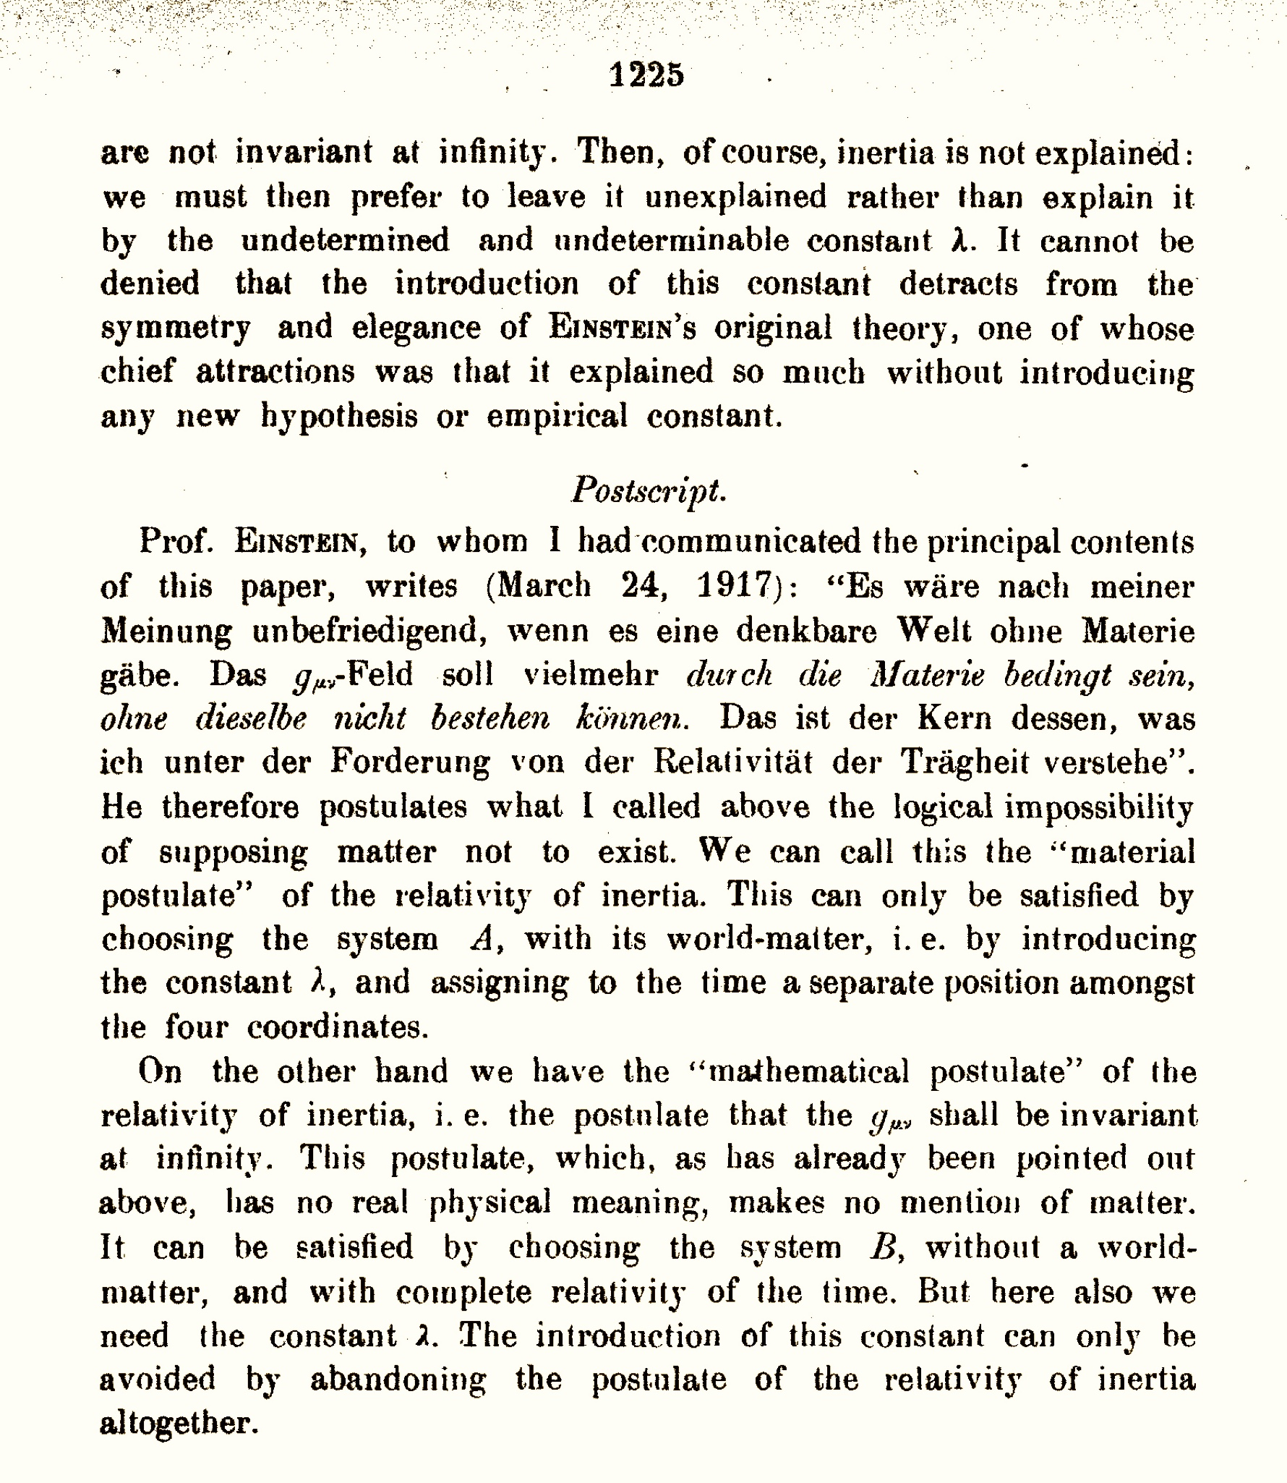
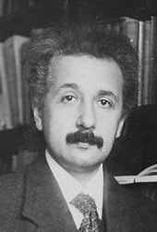
In my opinion, it would be unsatisfactory if a world were conceivable without matter. Rather, the g_{μν}-field should be determined by matter and cannot exist without it. This is the core of what I understand by the requirement of the relativity of inertia.

Slide 6
Einstein’s “Mass horizon”
Singular “mass horizon” is a surrogate for the masses that allow the spacetime to exist.
ds² = - dr² - R²sin²(r/R) [dψ² + sin²ψ dθ²] + cos²(r/R) c²dt²

