Slide 1
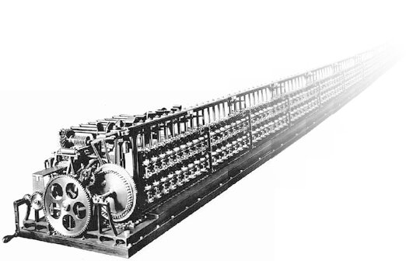

The Infinite Lottery Machine
John D. Norton
Department of History and
Philosophy of Science
University of Pittsburgh
center for
PHILOSOPHY
OF SCIENCE
University of Pittsburgh
January 11, 2019

Slide 2
What is it?

Slide 3
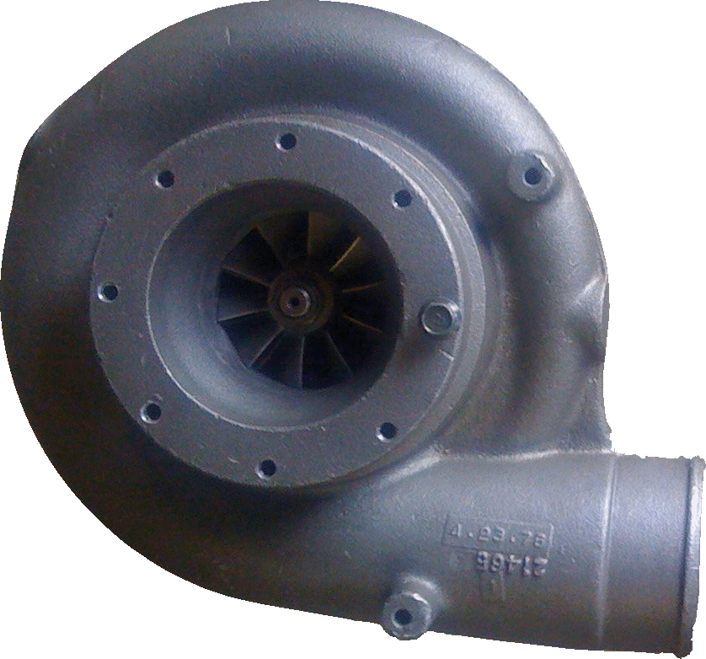
An infinite lottery machine
27
Fair selection made among infinitely many balls 1, 2, 3, …
without favor to any number or numbers.
1
3
2

Slide 4
Choosing without favor?
27
Permuting the labels on the balls has no effect on the chances of the outcomes.
1
3
2
“Chance” is now generalized beyond probability. A general, as yet unspecified, measure of indefiniteness.

Slide 5
Why care about it?

Slide 6
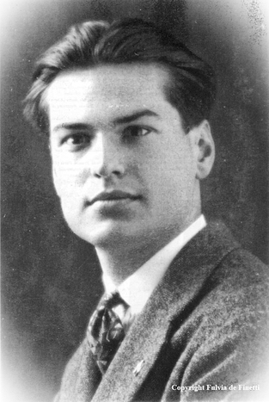
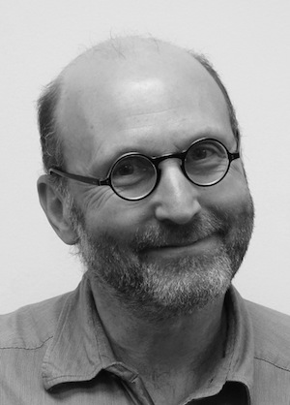
Logics of inductive inference
A probability measure that is only finitely additive
P(1) + P(2)
P(1) + P(2) + P(3)
P(1) + P(2) + P(3) + P(4)
…
Yes
Bruno de Finetti
No
P(1) + P(2) + P(3) + P(4) + …
An inductive logic with non-additive chances
Ch( ) = Ch( ) = Ch( ) = Ch( )
any power of ten
Any non- power of ten
even
odd
10, 100, 1,000, …
1, 2, 3, 4, …,
9, 11, 12, ...
Bozo the Clown

Slide 7
The Exercise

Slide 8
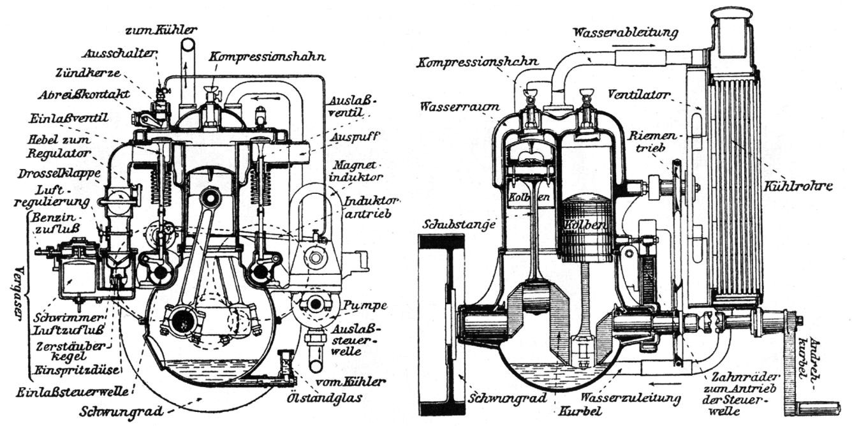
Can we build an infinite lottery machine…?

Slide 9
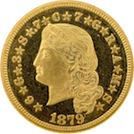
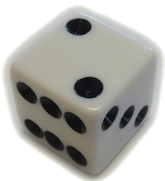
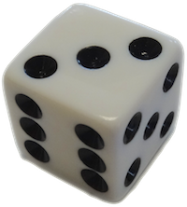
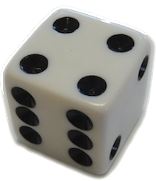

… using ordinary probabilistic randomizers?

Slide 10

How hard can it be?

Slide 11
Spin of Pointer on a Dial
Pointer chooses angles with uniform probability distribution.
Map non-redundant rational-valued angles to natural numbers
1/2 1/3 2/3 1/4 2/4 3/4 1/5 2/5 3/5 4/5 …
1 2 3 4 5 6 7 8 9 …
scale angles 0 to 1
BUT
Set of rational angles are measure zero among the real angles.
successful operation
rational
among reals
Probability ( ) = Probability ( ) = 0
Infinitely fine discrimination needed to read the result.
Rationals are dense among the reals.

Slide 12
Jumping Flea
For tape size N
Prob jump
cell n to n+1
P(n,n+1) =
N-n
Prob ends in cell n
P(1) = P(2) = … = P(N) = 1/N
N-(n-1)
N → ∞
Infinite tape
Prob jump
cell n to n+1
∞
Prob ends in cell n
P(n,n+1) = = 1
P(1) = P(2) = … = 0
∞
Flea has left each cell with certainty.
Where is it?

Slide 13
Supertasks needed….
Complete the flea’s jumps
Measure with infinitely fine discrimination.

Slide 14

Infinitely Accelerated Random Walk
P = 1/4
P = 1/2
P = 1/4

Slide 15
As number of stages N increases…
Accelerate jumps so that infinitely many completed in finite time.
Chances now distributed uniformly over all cells.
??Infinite lottery realized??

Slide 16
Probability of a definite result is zero.
stage ∞
Thomson lamp failure to converge.
Jumping flea escape to infinity.
Definite result
only when walker “stays put” after finitely many jumps. Probability zero.

Slide 17
Infinite Array of coin tosses
HHHHHTTTTTT…
encodes 5.
HTHTTHHTTHTTTHT…
encodes nothing.
Lottery outcome is first row that encodes a number.
Probability = 0 that any row encodes a number.
Probability = 0 that infinite lottery machine succeeds.

Slide 18

Hansen’s Reversed Supertask
Urn with an infinity of balls numbered 1, 2, 3, …
14
53
67
5
14
remove one randomly chosen ball
14
14
14
53
53
53
53
n balls
n-1 balls
2 balls
1 ball
time
0
1/n
1/n-1
1/2
1
The problem
There is no assured way to initiate the supertask at time 0 so that there are only n balls in the urn at time 1/n.
Analog: reversed bird flight in bird-train supertask.

Slide 19
Nothing Works!

Slide 20
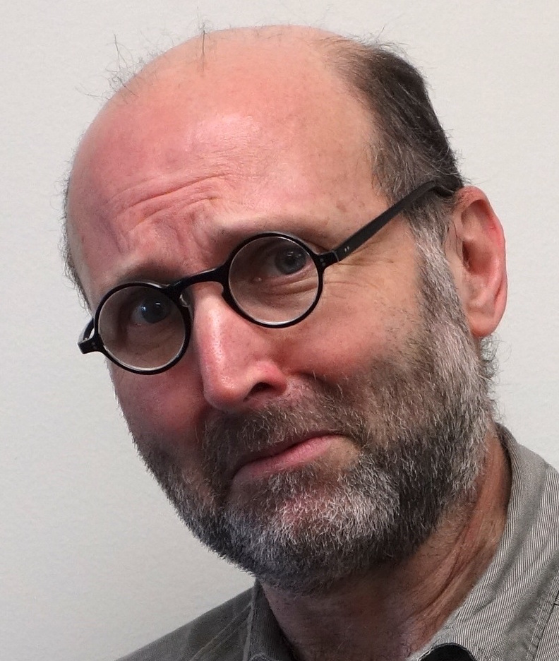
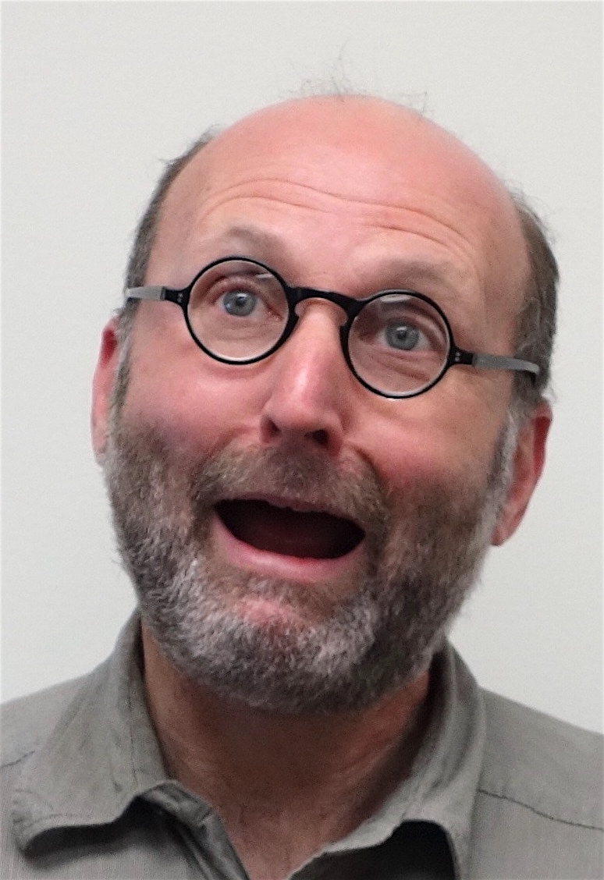
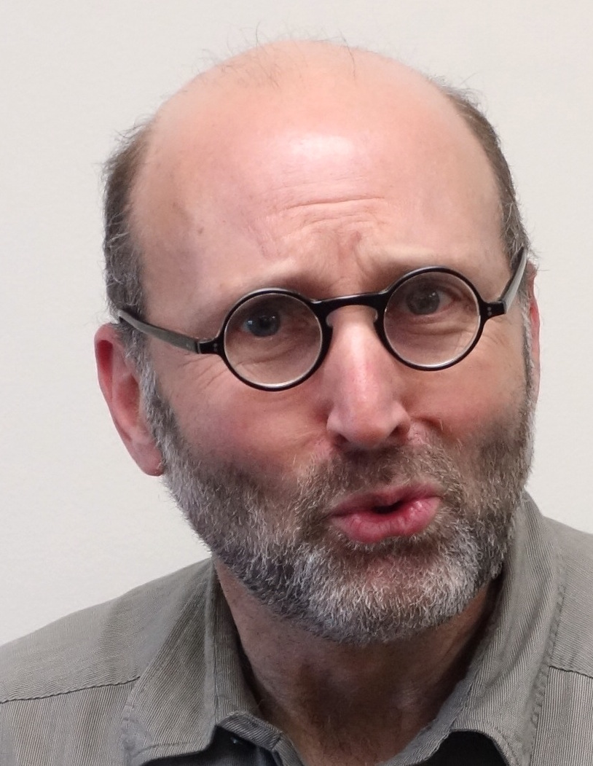

Slide 21
I. Nonmeasurable outcome sets are needed for successful operation.
1
3
total outcome space
Probabilistic randomizers
4
2
5
etc.
Probability is defined for outcomes
P(1) = P(2) = P(3) = … =0
EITHER
P(success)
= P(1 or 2 or 3 or …)
= P(1) + P(2) + P(3) +
= 0 + 0 + 0 + … = 0
1
2
3
etc.
OR
Outcome sets
are nonmeasurable.
It is not defined.
1
2
3
etc.

Slide 22



II. Nonmeasurable outcome sets are not constructible.
A folk theorem that has survived for a century.
We know they exist
in a sufficiently large outcome space.
We cannot specify which they are.
We cannot know
which outcome set is chosen when the lottery machine completes its operation.
1
2
3
etc.
1
2
4
7
11
15
…
3
5
8
12
16
19
…
6
9
13
17
20
22
…
10
14
18
21
23
24
…
…
…
…
…
…
…

Slide 23
A dilemma
for any infinite lottery machines based on probabilistic randomizers.
1
3
total outcome space
Probabilistic randomizers
4
2
5
etc.
EITHER
Success with probability zero.
OR
Success with probability
greater than zero,
but we cannot access the result.

Slide 24

Dropping Countable Additivity…
…does not help.
A merely finitely additivity measure has no nonmeasurable outcomes.
P(1) =0
P(1 or 2 or 3 or …) = 1
P(2) =0
P(3) =0 ...
Adapt a countably additive measure P’ to the same outcome space.
A countably additive measure has nonmeasurable outcomes.
Outcome 1 in nonmeasurable.
P’(1 or 2 or 3 or …) = 1
Outcome 2 in nonmeasurable.
Outcome 3 in nonmeasurable. …
Nonconstructibility of 1, 2, 3, … is a property of the outcome set,
not the probability measure.

Slide 25
Nonmeasurable Outcomes?

Slide 26
Nonmeasurable outcomes
The Vitali sets
1
p(x)
0
0
x
1
Uniform probability distribution over [0,1).
Pick 0 as a seed.
Add in all reals in [0,1) that differ from the seed by a rational number.

Slide 27
Nonmeasurable outcomes
The Vitali sets
1
p(x)
0
0
x
1
Uniform probability distribution over [0,1).
Pick another
seed.
Add in all reals in [0,1) that differ from the seed by a rational number.

Slide 28
Nonmeasurable outcomes
The Vitali sets
1
p(x)
0
0
x
1
Uniform probability distribution over [0,1).
Repeat for all possible seeds, avoiding any duplication.

Slide 29
Nonmeasurable outcomes
The Vitali sets
1
p(x)
0
0
x
1
Uniform probability distribution over [0,1).
Call the new set “Vit(o).”
Pick one element from each of the resulting sets.
Which ones?
No rule is available to specify the choice. We assume such a choice is possible. Such a set exists, even if we cannot specify explicitly which it is.
The existence of Vit(0) is authorized by the “Axiom of Choice.”

Slide 30
Nonmeasurable outcomes
The Vitali sets
1
p(x)
0
0
x
1
Uniform probability distribution over [0,1).
Create Vit(0.25) by adding 0.25 to elements in Vit(0).
Addition is modulus 1.

Slide 31
Nonmeasurable outcomes
The Vitali sets
1
p(x)
0
0
x
1
Uniform probability distribution over [0,1).
Create a countable infinity of sets Vit(r) one for each rational number r in [0,1).
These sets jointly exhaust the outcome space of reals [0,1).

Slide 32
The Vitali Sets are nonmeasurable…
1
p(x)
0
0
x
1
Uniform probability distribution over [0,1).
Since otherwise
1 = P(total outcome space)
= P(Vit(0)) + P(Vit(1/2)) + …
= 0 + 0 + 0 + ...
= 0

Slide 33
The dilemma, illustrated

Slide 34
Spin of a pointer on a dial
Original version
Outcome of rational r
dial points to r
Enhanced version
Outcome of rational r
dial points to outcome in Vit(r)
Outcomes lie in a probability zero subset.
Probability of success = 0
Probability of success = 1,
but result is inaccessible.

Slide 35
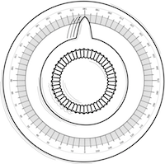
Pruss’ infinite lottery machine
4
2
1
5
3
6
0
1
1
2
3
4
5
6
Pick a countable infinity of reals in (0,1) with uniform probability.

Slide 36
Pruss’ infinite lottery machine
4
2
1
5
3
6
0
1
Choose a
“well-ordering”
over the reals.
“Less than” relation, such that every set of reals has a least member.
Lottery outcome
= number of randomizer with smallest real.
Lottery outcome
= number of randomizer with least real under the well ordering.
There is a smallest real only with probability zero.
Well-orderings are assumed to exist but
cannot be displayed. Assuming their existence is equivalent to assuming the axiom of choice.
Probability of successful operation is zero.
Probability of successful operation is one,
but the result is inaccessible.

Slide 37
Abandon all hope ye who enter here?

Slide 38
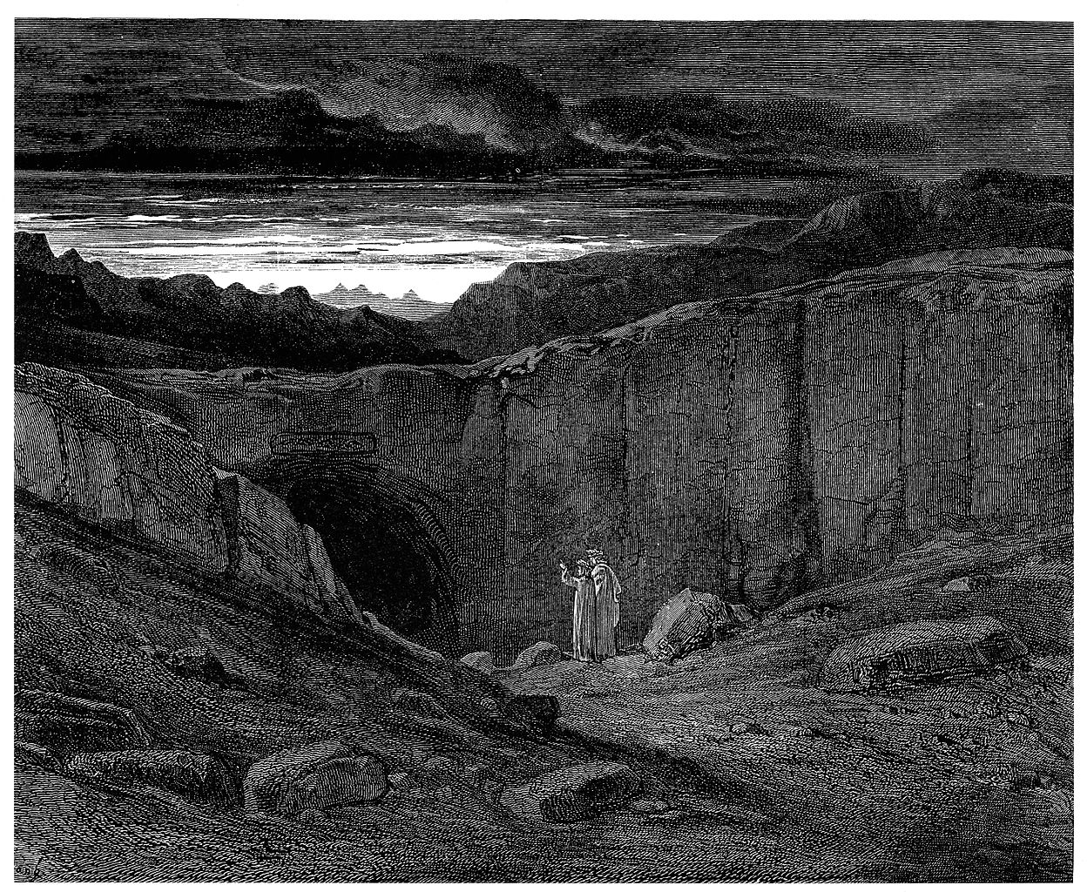
Gustave Doré, Gates of Hell

Slide 39
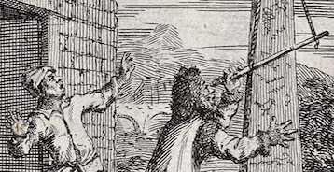
Measuring the position of a quantum particle of definite momentum
7
5
3
1
0
2
4
6
8
Equal chances for each from translation symmetry.
State is unnormalizable, so usual Born rule cannot be applied.

Slide 40
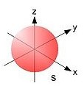
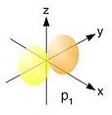


Measuring the state of a quantum system in a countably infinite unnormalizable superposition vector space basis states.
|ψ> = |1> + |2> + |3> + |4> + |5> + |6> + |7> + …
3
4
6
Particle in a box.
Energy states of an electron in an atom

Slide 41
Concluding thoughts

Slide 42
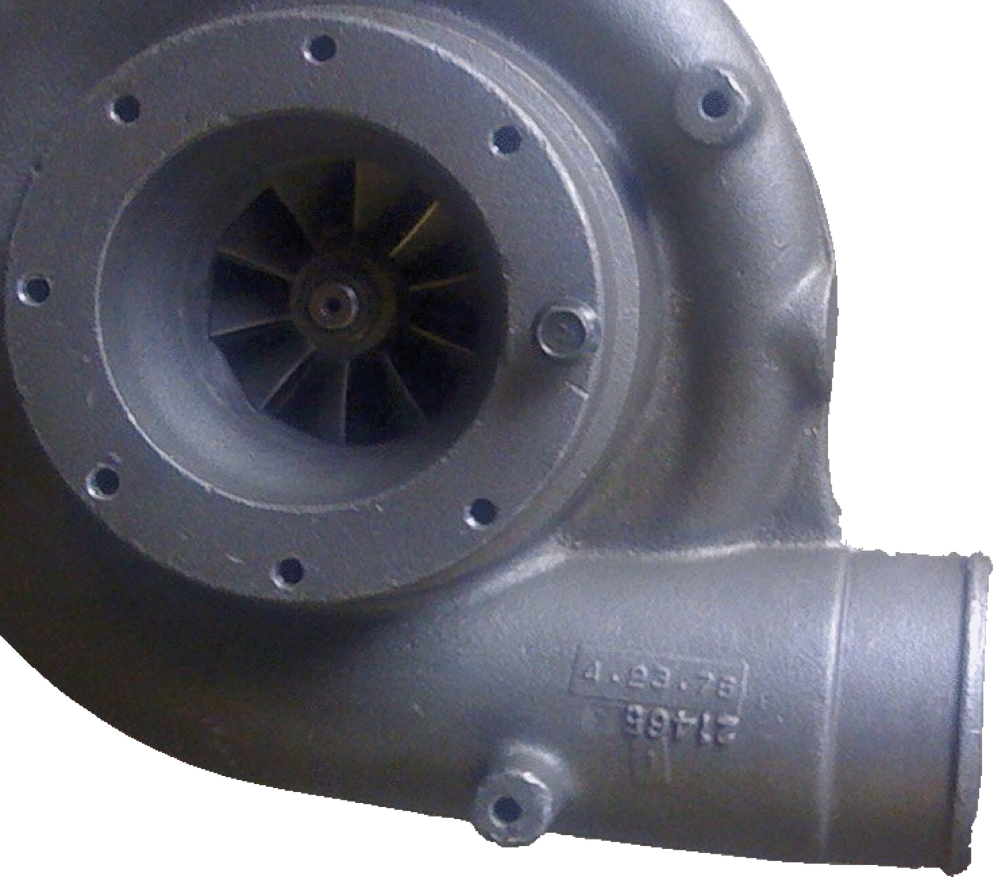
Which are our primitive randomizers?
Neither are true randomizers in classical physics.
We ignore their failings, idealize them and treat them as our primitive randomizers.
Why not add an idealized infinite lottery machine to our repertoire?
27

Slide 43
A parting puzzle
Can we use infinite lottery machines to create a finite randomizer?
27

Slide 44

Read

Slide 45
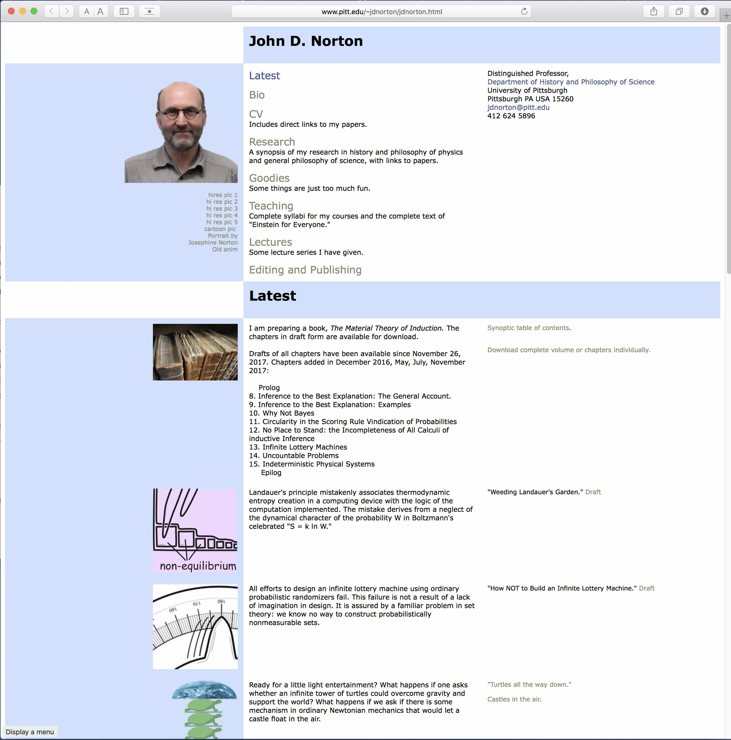

“How NOT to Build an Infinite Lottery Machine”

Slide 46

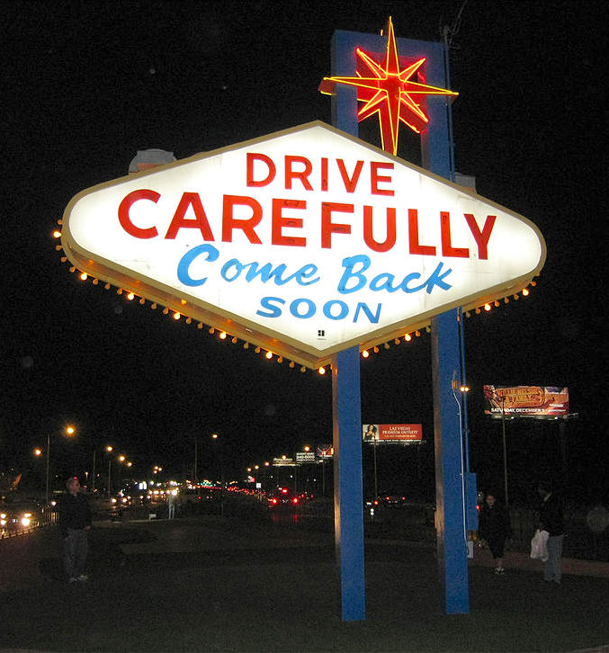

Slide 47
Appendices

Slide 48
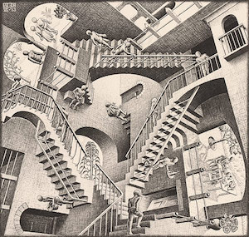
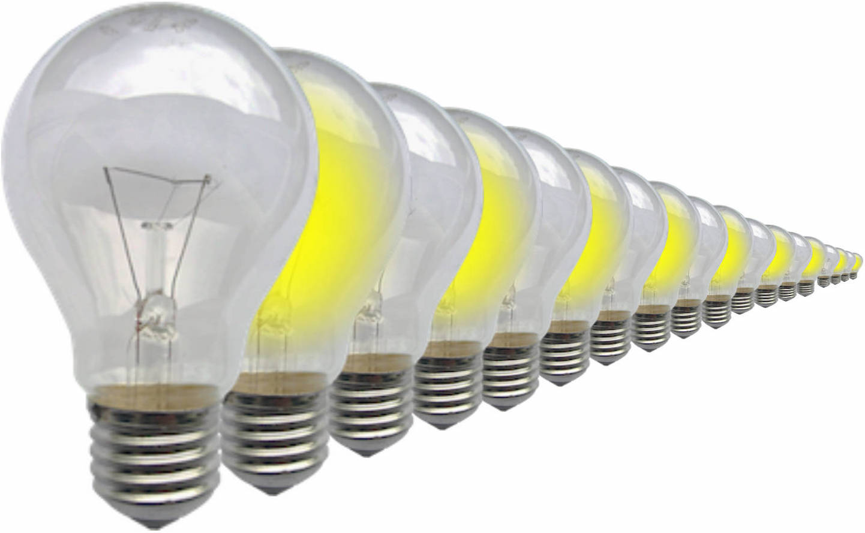
Cascade of problems
How exotic can “possible” be in a thought experiment?
Probabilistic randomizers?
Non-probabilistic randomizers?
Infinite Discriminations?
Supertasks?
Reversed Supertasks?
Nomeasurable sets
Axiom of choice

Slide 49
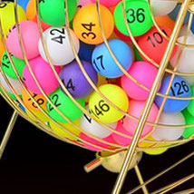
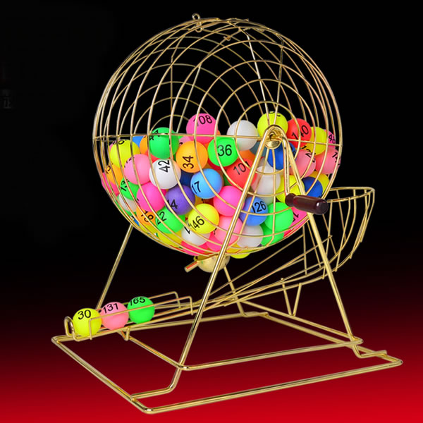
Lotto Machine
Infinitely Large
How many times must it turn to properly mix the balls?
How do we rotate an infinite object?
How do we demonstrate equal chances for each outcome?

Slide 50
How many liberties can we take with physical possibility?

Slide 51
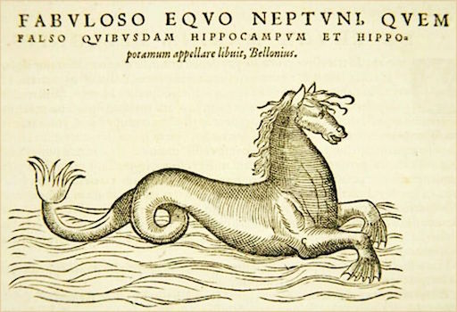

Slide 52
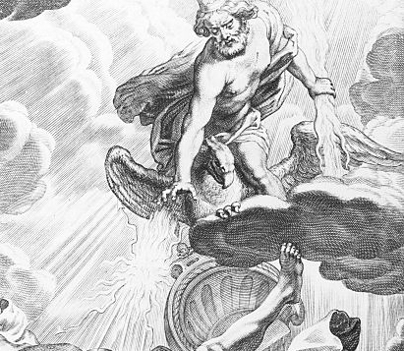
Purpose determines what is admissible
Understand inductive inference
Exotic possibilities are admissible if the domain is one in which inductive inference is possible.
An admissible domain
(a) can be described without logical contradiction and;
Deductive inference is possible.
(b) is governed by some regularities.
Inductive inference is possible.
How can it fail?
“In an entirely fair and purely random way, God would simply choose a number.”
McCall and Armstrong, 1989.
43

Slide 53
Supertasks

Slide 54



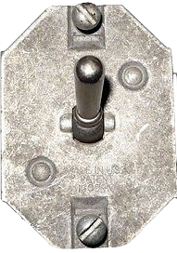
Complete an infinity of actions in finite time.
Zeno’s dichotomy completed.
Thomson lamp
ON
Is the lamp ON or OFF at time 0?
OFF
time
-1
-1/2
-1/3
-1/4
-1/5
-1/6 …

Slide 55
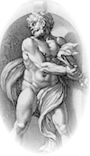
Reversed supertasks
Zeno’s reversed dichotomy completed.
Bernadete “Gods.”
God at 1/n drops a wall
if the runner passes the god at 1/(n+1).
Solution. We are supposing conditions incompatible with the assumed dynamics: the runner stops if and only if obstructed by a wall.
… 1/6
1/5
1/4
1/3
1/2
1

Slide 56
Bird and train
Where is the bird when the task is complete?
Initial conditions fail to specify the end state.

