Slide 1
Moneyball 2.0: Winning in Sports With Data
Spring 2018

Slide 2
Overfitting
When learning a model we have a set of data (training set) that we use to learn the model parameters
The evaluation of the model needs to happen out-of-sample, i.e., on a different set that was not used for learning model parameters
One of the most common problems during training is tying the model to the training set
  Overfitting

Slide 3
Overfitting
When a model is over fitted it is not expected to perform well to new data
  It is not generalizable
Overfitting occurs when the model chosen is too complex that ends up describing the noise in the data instead of the trend
  E.g., too many parameters relative to the size of the training dataset
  An over fitted model memorizes the training instances and does not learn the general trend in them

Slide 4
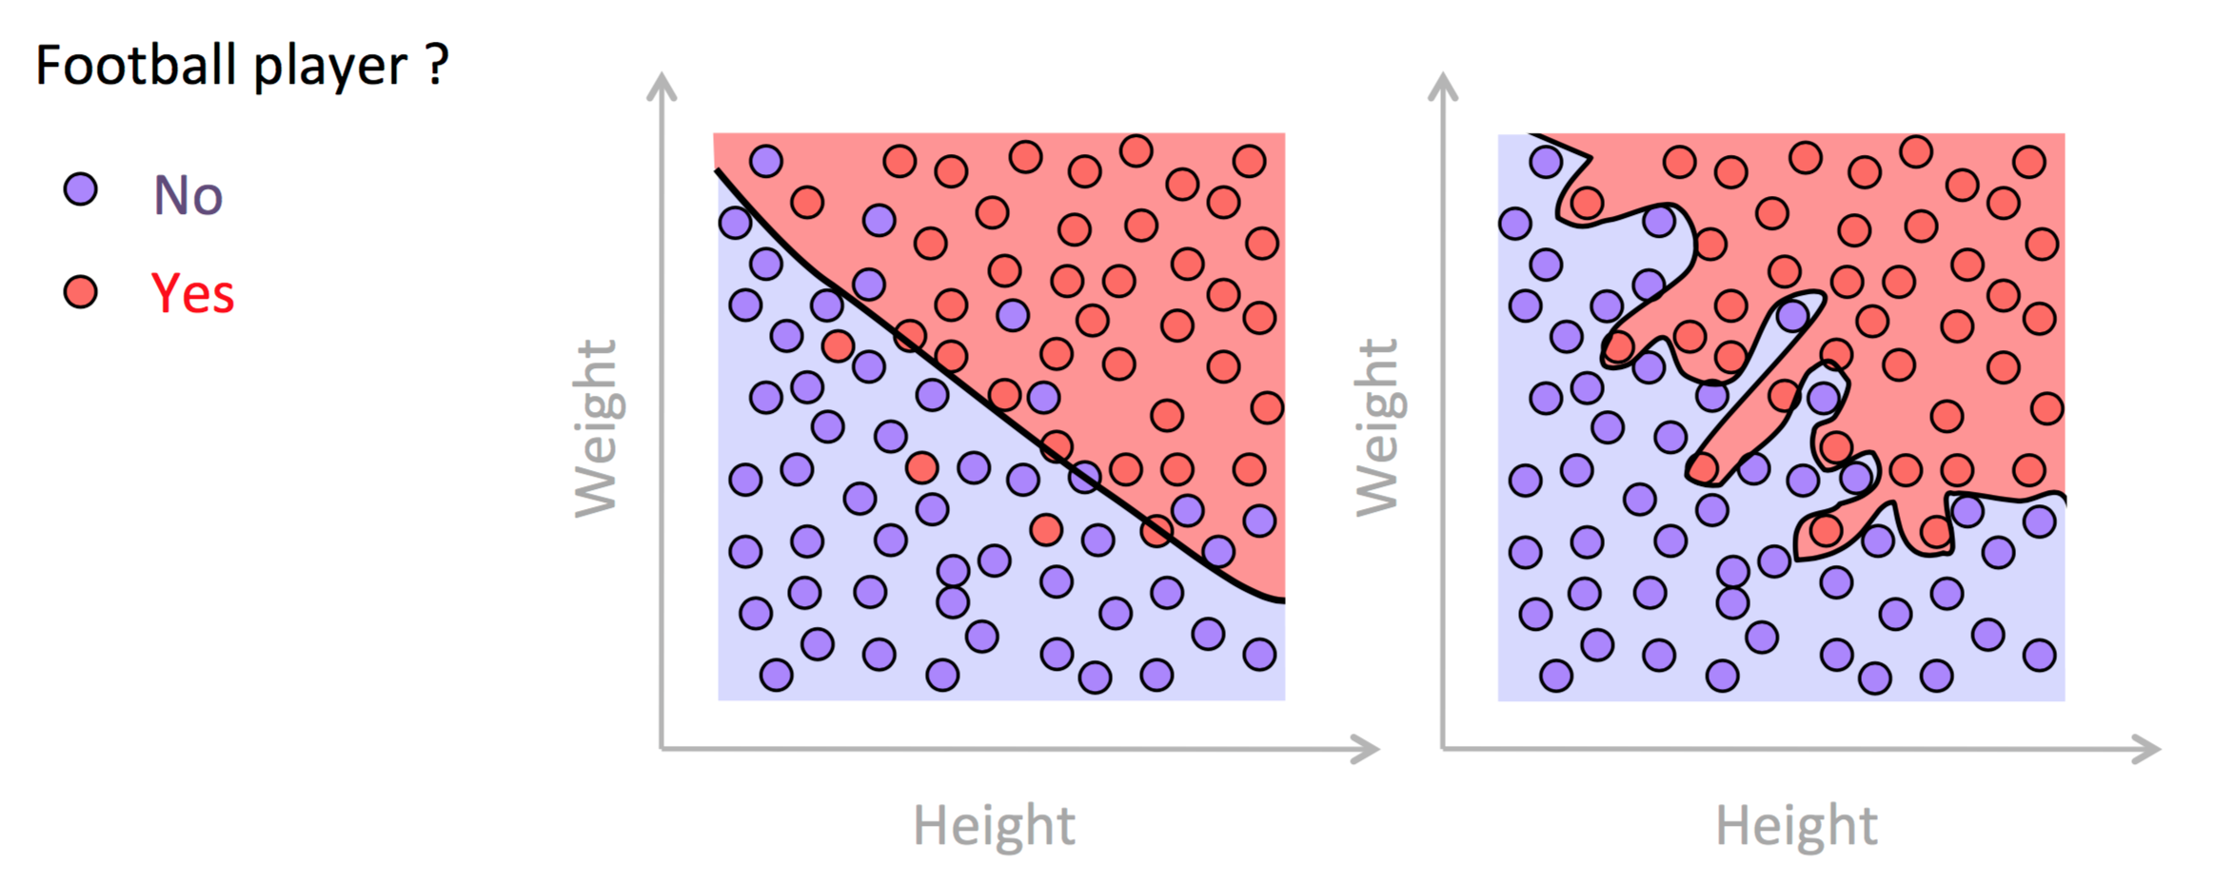
Overfitting

Slide 5
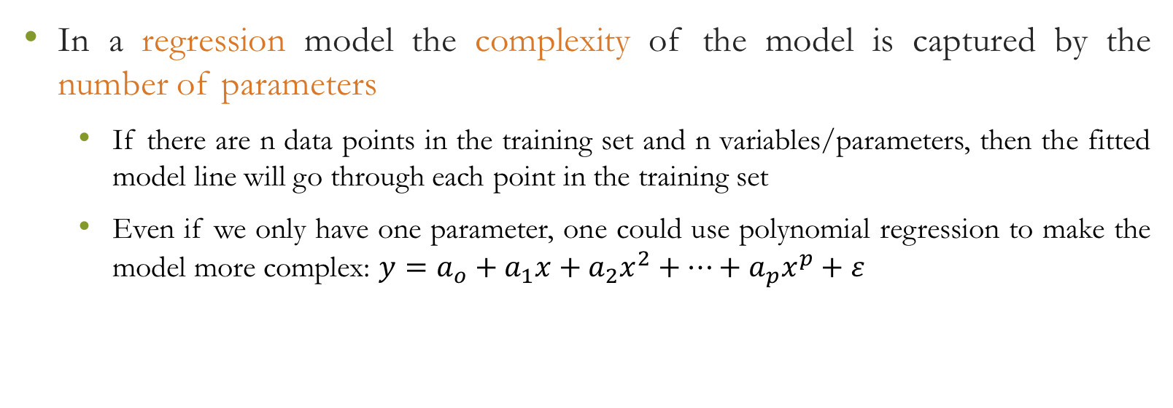
Overfitting
In a regression model the complexity of the model is captured by the number of parameters
  If there are n data points in the training set and n variables/parameters, then the fitted model line will go through each point in the training set
  Even if we only have one parameter, one could use polynomial regression to make the model more complex: $y=a_{o}+a_{1}x+a_{2}x^{2}+…+a_{p}x^{p}+ε$

Slide 6
Overfitting
What is the relationship between number of Pro Bowl appearances for an NFL player?
Data: https://www.kaggle.com/ronaldjgrafjr/nfl-draft-outcomes/version/1

Slide 8
Underfitting
One might face the opposite problem – underfitting
  The model is too simplistic to capture any useful information in the data

Slide 9

Occam’s razor
When there are two explanations for an observation, the simpler is usually better
In modeling this means that between two model hypothesis the simpler is preferable
  The more complex a model is the more probable it is not true, and,
  thus we have overfitting

Slide 10
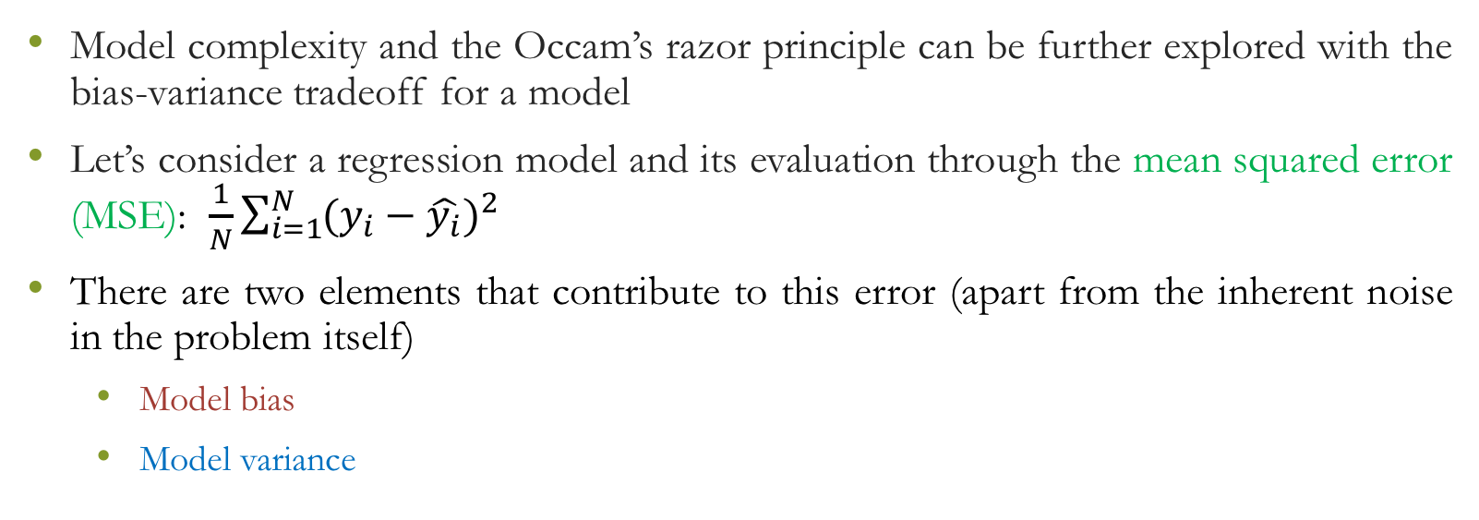
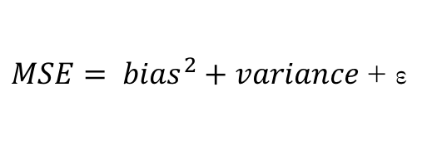
Bias-Variance tradeoff
Model complexity and the Occam’s razor principle can be further explored with the bias-variance tradeoff for a model
Let’s consider a regression model and its evaluation through the mean squared error (MSE): $\frac{1}{N}\sum_{i=1}^{N}{(y_{i}−\hat{y_{i}})^{2}}$
There are two elements that contribute to this error (apart from the inherent noise in the problem itself)
  Model bias
  Model variance
$MSE= {bias}^{2}+variance$ + ε

Slide 11
Bias-Variance Tradeoff
If we want to minimize MSE, we need to minimize both bias and variance
  However, when bias gets smaller, variance increases and vice versa
A model that is underfitted has high bias
  Misses relevant relations between the independent variables and the response variable
  Bias is reduced by increasing model complexity
A model that is overfitted has high variance
  The model captures the noise in the training data instead of the trend
  Variance is reduced by decreasing model complexity

Slide 12
Bias-Variance Tradeoff

Slide 13
Model Selection
To avoid overfitting and pick the best possible model we need three sets:
  Training set: Identify the weights of different regression models by minimizing the (squared) error on the training set
    Different regression models can include linear-vs-polynomial regression, different set of features etc.
  Validation set: Evaluate the performance of the different regression models identified from the training set and pick the best
  Test set: Evaluate the performance of the model chosen from the validation set → this is the expected performance for the model

Slide 14
Model Selection
Learn
Choose
Training Set
M₁
M₂
…
M_{n}
Validation Set
M_{o}
Test Set
M_{o}
Evaluate out-of-sample performance

Slide 15
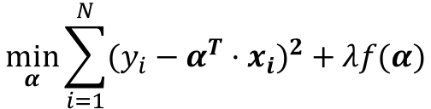
Regularization
In order to avoid overfitting we can slightly alter the optimization problem we have to solve for training the model
  Implicitly constraint the values that the model parameters can take
Key idea: Penalize overly complicated answers
  Extreme curves/models typically require extreme values → susceptible to high variance
$$\min_{α}{\sum_{i=1}^{N}{(y_{i}−α^{T}⋅x_{i})^{2}+λf(α)}}$$
Regularization term

Slide 16

Regularization
The regularization term can take different forms
$$\begin{matrix}f\left(α\right)={\left\|α\right\|}_{2}^{2} & Ridge regression \\ f\left(α\right)={\left\|α\right\|}_{1} & Lasso regression\end{matrix}$$

Slide 17
Ridge Regression
The solution obtained depends on the shrinkage parameter λ
  λ controls the size of the coefficients, i.e., the amount of regularization
  Reducing λ leads to solutions closer to the least squares (λ=0)
  Increasing λ will give us an intercept only
How to choose λ?
  Use a validation set!

Slide 18
Lasso Regression
Very similar to ridge regression but with subtle and important differences
  The optimization problem is not linear anymore
Ridge regression forced the square of the coefficients to be less tan a fixed value
  This shrinks the size of the coefficients but does not set any of them exactly equal to 0
Lasso forces the sum of the absolute values of the coefficients to be less than a fixed value
  This forces some of the coefficients to be equal to 0 → essentially this chooses a simpler model that does not include these features

Slide 19
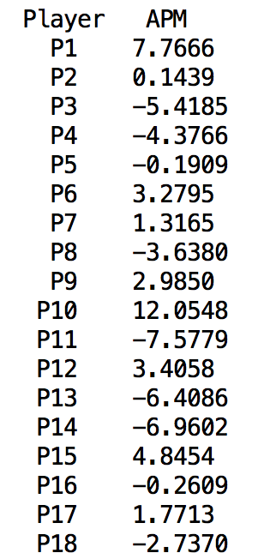
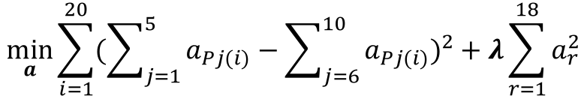
Regularized Plus-Minus
$$\min_{a}{\sum_{i=1}^{20}{(\sum_{j=1}^{5}{a_{Pj(i)}}−\sum_{j=6}^{10}{a_{Pj(i)}})^{2}}+λ\sum_{r=1}^{18}{a_{r}^{2}}}$$
λ=2

Slide 20





Regularized Team Ratings
NFL 2016 ratings
Ridge regression shrinks team ratings
Particularly the ratings with extreme absolute values

Slide 22
Discrete Event Simulation
Many times the operation of a system can be abstracted to a series of discrete events taking place with some probability
  Special case of Monte Carlo simulations
Each event changes the state of the system
The dependencies of these events can be overly complicated → formal treatment might not be possible
  However, these discrete events can be simulated several times in order to obtain an estimation of state probabilities

Slide 23
Discrete Event Simulation
A sports tournament is a series of matchups
The outcome of each matchup is associated with a given probability
The “state of the league” (e.g., who gets into the playoffs, who gets a buy week in the playoffs, who gets the championship etc.) could be estimated probabilistically by combining the probabilities of individual matchups
  Tedious
  Solution: discrete event simulation (DES)

Slide 24
Discrete Event Simulation
The smallest unit of a DES is the event
In the case of a tournament this event correspond to a matchup
  Building block for the DES is to simulate a single event
The single event simulation resembles a coin flip
  Biased coin

Slide 25
Discrete Event Simulation
Spurs rating: +6.4
Warriors rating: + 11.2
Home edge: 3
Home
Projected point differential: 3+6.4-11.2= - 1.8
Projected Spurs win probability: 43%
0.43
0
1

Slide 26
Discrete Event Simulation
Spurs rating: +6.4
Warriors rating: + 11.2
Home edge: 3
Home
Projected point differential: 3+6.4-11.2= - 1.8
Projected Spurs win probability: 43%
Imagine that you draw a line
intersecting the green line
vertically with your eyes closed
Spurs win
0.43
Warriors win
Why with closed eyes?
0
1
If you repeat this process 1,000 times how many times do you expect Spurs to win?

Slide 27
Discrete Event Simulation
Simulate upcoming matchups
Update standings, playoff pairings, etc.
Store results
Tournament over?
Tournament not over?
Final probabilities
Number of simulations not reached?

Slide 28
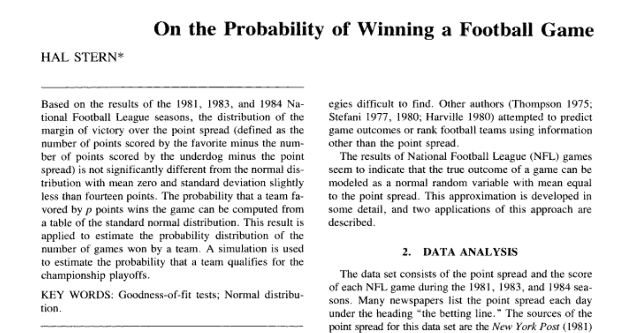
Discrete Event Simulations
How can we obtain the probability of each event? (i.e., for each matchup)
We can use team ratings
  Team ratings provide an estimate for the final point difference between a matchup
  How to translate this to a probability?

Slide 29

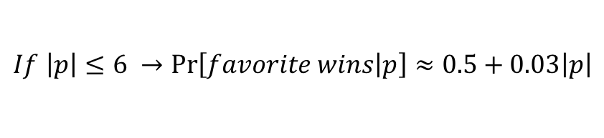
Discrete Event Simulations
Hal Stern in his seminal work “On the Probability of Winning a Football Game” showed that the difference between the final point margin of a game and the point spread follows a normal distribution with mean 0 and standard deviation of 13.86
  Stern’s study was focused on Vegas’ point spread
  If one uses Vegas point spreads then can simply calculate the probability of the favorite (by p points) wins as:
$$\operatorname{Pr}\left[favorite wins | p\right]=Φ(\frac{p}{13.85})$$
Cumulative Distribution Function for
the standard normal distribution
$$If \left|p\right|≤6 →\operatorname{Pr}\left[favorite wins | p\right]≈0.5+0.03\left|p\right|$$

Slide 30
Discrete Event Simulations
We do not need to obtain Vegas’ spreads
  We can use our own regression-based rating method
  Will the difference between the point margin and our prediction follow N(0,13.86)?
    Most probably not
    But we can examine this on past data
      Most probably it will still be a normal distribution but with different variance

Slide 31
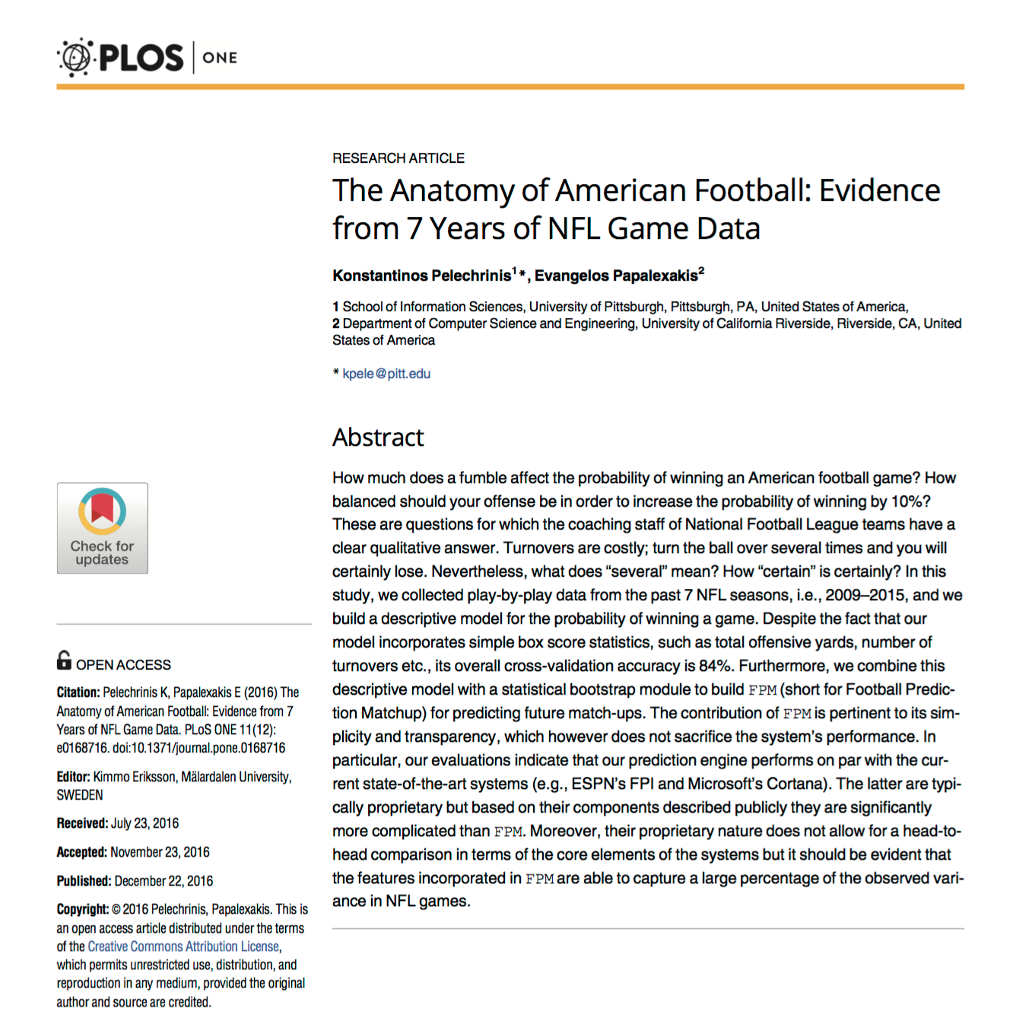
Discrete Event Simulation

