Slide 1
Moneyball 2.0: Winning in Sports With Data
Spring 2018

Slide 2
Not all schedules are created equal
The professional leagues in US do not follow a round-robin schedule
  Not everyone plays with everyone else, or at least not the same amount of times
This creates schedules of uneven strength
How can one rank the strength of schedule for each team?
  We can use team ratings!

Slide 3
Strength of schedule
Case study: NFL
Teams play 16 games based on a complicated algorithm based on the divisions and last year’s standings
This can potentially create large differences in the strength
of the opponents that a team plays

Slide 4
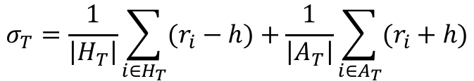
Strength of schedule
With H_{T} being the set of teams that T faces during the season at home, and A_{T} the set of teams that T faces away, the strength of schedule for T is:
Which rating should we use?
  Pre-season ratings
  End-of-season ratings
$$σ_{T}=\frac{1}{\left|H_{T}\right|}\sum_{i∈H_{T}}{(r_{i}−h)}+\frac{1}{\left|A_{T}\right|}\sum_{i∈A_{T}}{(r_{i}+h)}$$
Home edge

Slide 5
Strength of schedule
Even though we have solved for team ratings regardless of whether they play home or away it is very realistic to consider that teams might play differently at home and when visiting
  This difference can be above and beyond the home edge we have incorporated
    For example, teams would certainly prefer playing the Broncos at home as compared to the high altitude in Denver
  We can obtain two ratings for a team
    Home rating
    Away rating

Slide 6
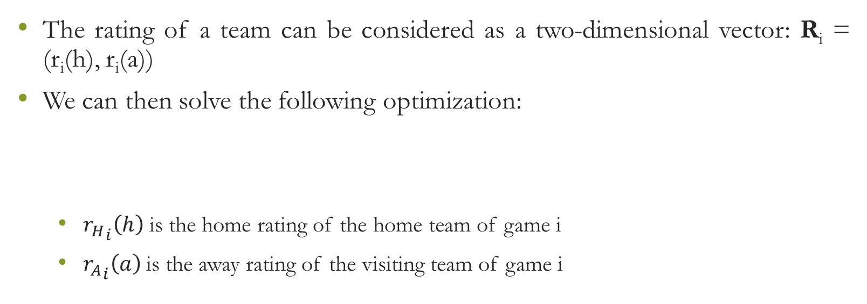
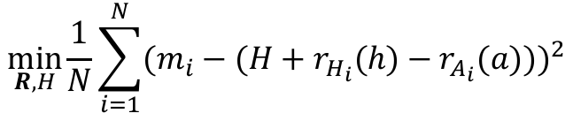
Strength of schedule
The rating of a team can be considered as a two-dimensional vector: R_{i} = (r_{i}(h), r_{i}(a))
We can then solve the following optimization:
  ${r_{H}}_{i}\left(h\right)$ is the home rating of the home team of game i
  ${r_{A}}_{i}\left(a\right)$ is the away rating of the visiting team of game i
$$\min_{R, H}{\frac{1}{N}}\sum_{i=1}^{N}{(m_{i}−(H+r_{H_{i}}(h)−r_{A_{i}}(a)))^{2}}$$

Slide 7
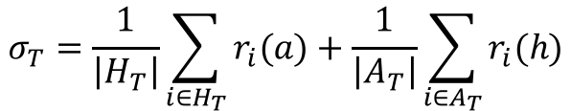
Strength of schedule
The strength of schedule is then given by:
The strength of schedule σ_{T} is essentially an indicator of how many points better than an average team are the teams that T faced
$$σ_{T}=\frac{1}{\left|H_{T}\right|}\sum_{i∈H_{T}}{r_{i}(a)}+\frac{1}{\left|A_{T}\right|}\sum_{i∈A_{T}}{r_{i}(h)}$$

Slide 8
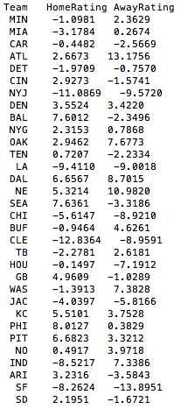
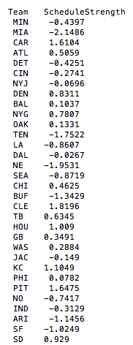


Slide 9
Division strength
One can also use a similar approach to evaluate the strength of each division

Slide 10
NFL point values per play
NFL players are currently evaluated on the basis of how many yards per game they gain
  This is good for winning in fantasy but not for winning the super bowl
  Elliott gains 11 yards on 3rd and 15 < Bell gains 2 yards on 3rd and 1
  Elliot gains 10 yards on a 1st and 10 against Broncos > Bell gains 10 yard on a 1st and 10 against the Browns
  Clearly using the total yards gained on the ground does not accurately capture the value of these plays

Slide 11
NFL point values per play
How can we assign to every situation a point value?
The term situation essentially describes the state of the game as defined by the tuple: <yard_line, down, yards_to_go, time_left>
Depending on the approach one takes to quantify the point value of a state, this value can take (slightly) different interpretations
  Expected points scored for the team with ball possession in the next score
  Expected number of points that the team with ball possession will outscore its opponents from that point on

Slide 12
NFL point values per play
nflWAR developed in conjunction with nflscrapR is an effort to assign a point value on its state
This point value provides the expected points for the team with ball possession of the next scoring play
One could check all the similar situations/states and obtain the average of these.
  What does similar mean?
  Are there enough data for this?

Slide 13
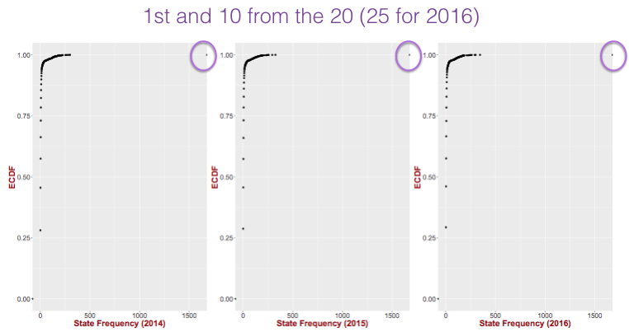
NFL point values per play

Slide 14
NFL point values per play
Can we model the expected number of points for the ball possession team from the next score using as independent variables the state of the game?
Linear regression (?)
What is the problem with using linear regression?
  Scores in football are not continuous!!
$$Y=a_{0}+a_{1}⋅X_{Down}+a_{2}⋅X_{Yards2go}+…$$

Slide 15
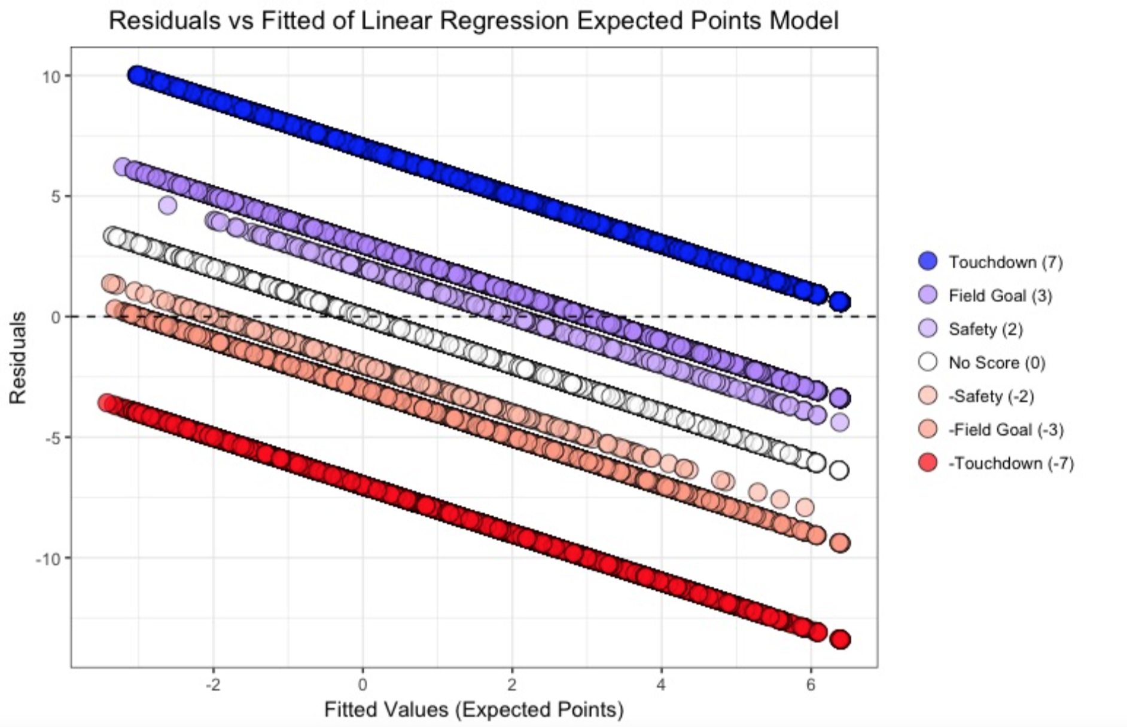
NFL points values per play
What was the first diagnostic check for a good linear regression model?
  Residuals follow a normal distribution with zero mean
  How does the residual plot look like for a linear regression for the next score?

Slide 16

NFL points value per play
We should treat the dependent variable as a categorical one
Multinomial logistic regression
  Similar to linear logistic regression but the outcome variable is not binary
  We have to choose a reference value for the dependent variable
    No score (i.e., 0 points)
$$Y∈\left\{7, 3, 2, −7, −3, −2, 0\right\}$$

Slide 17

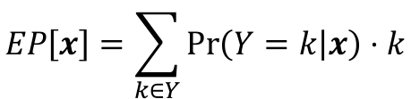
NFL points value per play
We then have the following logit transformations:
The expected points are then simply:
$$\begin{matrix}\log\left(\frac{\operatorname{Pr}\left(Y=7 | x\right)}{\operatorname{Pr}\left(Y=0 | x\right)}\right)=a_{10}+a_{1}^{T}x \\ \begin{matrix}… \\ \log\left(\frac{\operatorname{Pr}\left(Y=−7 | x\right)}{\operatorname{Pr}\left(Y=0 | x\right)}\right)=a_{60}+a_{6}^{T}x\end{matrix}\end{matrix}$$
$$EP\left[x\right]=\sum_{k∈Y}{\operatorname{Pr}\left(Y=k | x\right)⋅k}$$

Slide 18

NFL points value per play
The expected points calculated above simply gives us the expected number of points the possession team will get from the next score
We can use this information to provide a point value to a specific play
  A specific play will change the state of the game
  The two different states will have different expected points
  The difference between the expected points for each state is the expected points added by the play
$$EPA_{play(i)}=EP_{play(i+1)}−EP_{play(i)}$$

Slide 19
NFL points value per play
At every point of the game a good approximation of the objective of a team is to maximize the expected number of points by which it beats its opponent from that point on
  Of course towards the end of the game this approximation gets worse
    E.g., a team down 2 points at the end of the game might have as goal to maximize the chance of reaching their field goal range
  For the most of the game, an expected points margin maximizer will choose decisions that maximize a team’s chance of victory

Slide 20
NFL point values per play
Cabot, Sagarin and Winston (CSW) developed a model based on stochastic games that provides an expected points margin moving forward given the current state of the game
  State: <yard line, down, yards to go>
  Yards to go are limited up to 30 yards to go
The CSW model requires to estimate the probability of gaining 6 yards at a first and 10 on our own 25 yard line
  To avoid the problem of data sparsity CSW relied on simulations from the Pro Quarterback game

Slide 21
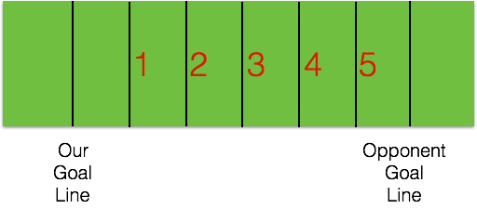
NFL point value per play
In order to understand the idea behind the calculation of the CSW point values let’s examine a simplified game of football
  7-yard field
  One play to make a first down
  One yard for first down
  50% chance of gaining 1 yard and 50% chance of
  gaining 0 yards
  After a score we get 7 points and the opponent gets
  the ball at their own 1-yard line

Slide 22
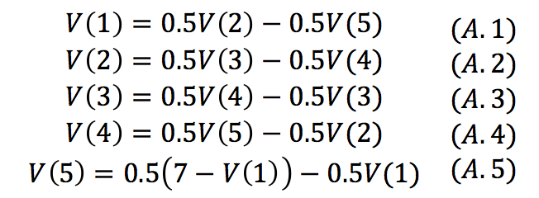
NFL point value per play
V(i): expected number of points by which our team should win an infinite game if we have the ball on yard line i
We can use the following equations for getting the values V(i), for i∈ {1,2,3,4,5}

Slide 23
NFL point value per play
We can solve these equations and obtain:
  V(1) = -5.25, V(2) = -1.75, V(3) = 1.75, V(4) = 5.25 and V(5) = 8.75
The same process is followed for obtaining the values for the actual game of football
  The transitions probabilities (i.e., the probability of going from state i to state j after a play) are calculated through simulations from a modified Pro Quarterback game to include kickoff return data and field goal accuracy

Slide 24
Adjusting point values for opponent
The idea behind expected points (added) takes care of the yardage inequality with regards to the situation
However, there is still a problem related with the opponent strength
  10 rushing yards against team A is not necessarily the same as 10 rushing yards against team B
In order to tackle this problem we can adjust the point values we get based on the opponent

Slide 25
Adjusting point values for opponent
The adjustment process needs to consider offense and defense separately
Basic idea: Team A makes a rushing play worth 0.4 (unadjusted) points against team B
  The defensive ability against the run for team B is -0.05 points per play → they allow 0.05 points less compared to an average rushing defense
    The adjusted point value for team A’s offense for this rushing play is then 0.4-(-0.05) = 0.45
  The rushing offensive ability of team A is 0.1 → 0.1 points better than average
    The adjusted point value for team B’s defense for this rushing play is then 0.4-0.1 = 0.3

Slide 26
Adjusting point values for opponent
In order to perform this adjustment we need to identify the offensive and defensive ratings of the teams for the different aspects of the game
  Rushing, passing, special teams, etc.
These ratings capture how much better/worse a team’s unit is from a league average unit
  For offensive units a positive rating is good (i.e., scores more points than average)
  For defensive units a negative rating is good (i.e., allows less points than average)

Slide 27

Adjusting point values for opponent
If we had the offensive and defensive ratings for the teams we could use them to predict the expected point value for a rushing play i between A’s offense and B’s defense:
League average points per rush
$$\hat{p_{i}}=m_{rush}+r_{o_{A}}+r_{D_{B}}+ε$$
Error term for the prediction
Offensive rushing rating for team A
Defensive rushing rating for team B

Slide 28
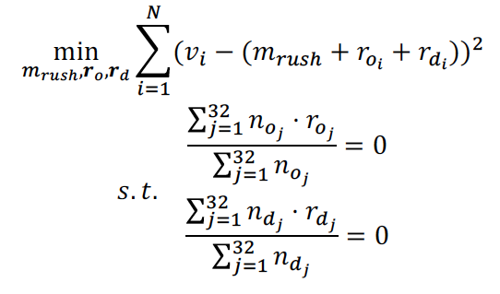
Adjusting point values for opponent
For each rushing play i we have the actual (unadjusted) points gained v_{i}
We can then learn the teams’ rushing ratings (and the league average points/rush) by solving the following constraint optimization problem:

Slide 29
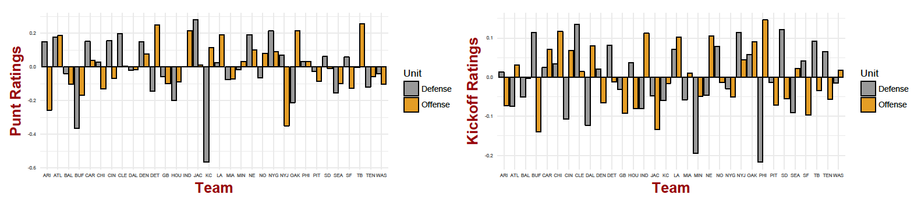
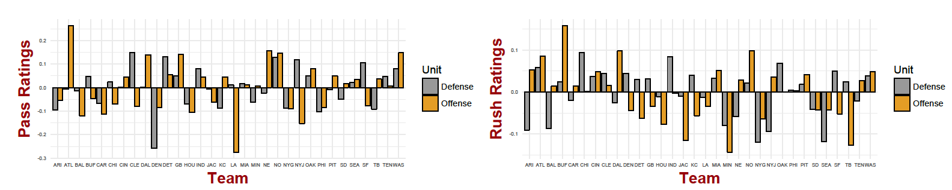
Adjusting point values for opponent
The adjustment for the 2014-2016 seasons gave a discrepancy of about 0.06 points per play
  3.8 wins for every team not being credited correctly

Slide 30
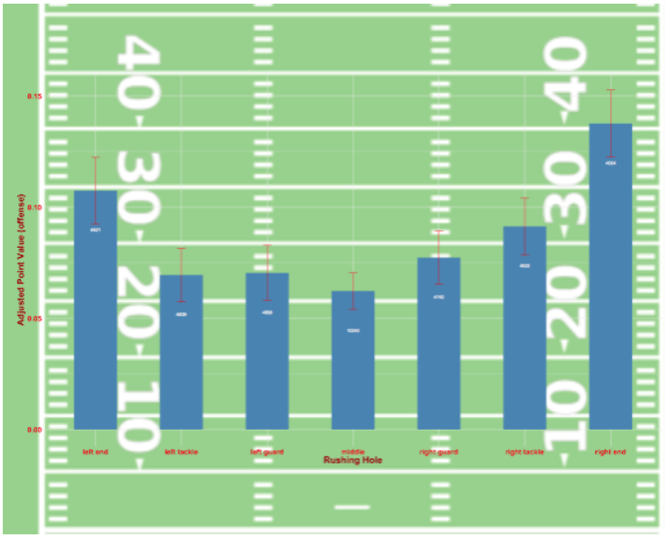
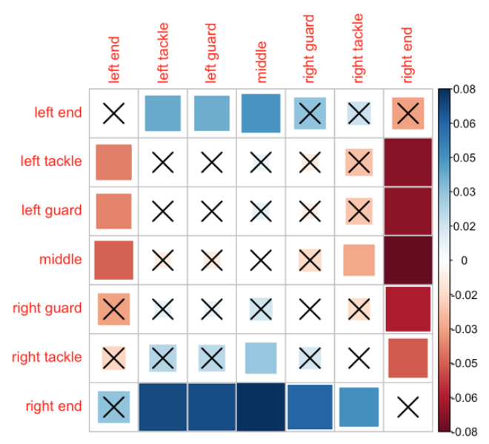
Applications of expected points
Can we evaluate rushing as a function of the gap the runner chose?

Slide 31
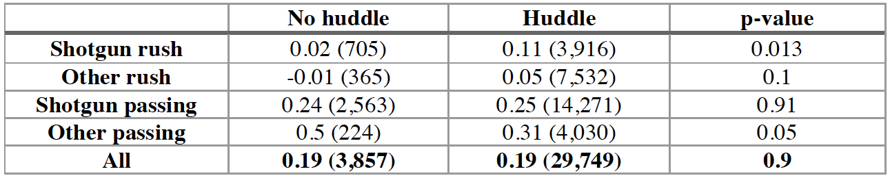
Applications of expected points
Is no huddle offense effective?

Slide 32
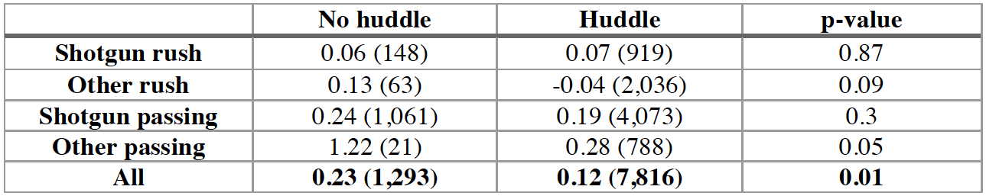
Applications of expected points
Is no huddle offense effective?
  But…focusing on the fourth quarter where the defense is tired

