Slide 1
Moneyball 2.0: Winning in Sports With Data
Spring 2018

Slide 2
Bayesian player evaluation
When evaluating prospects for draft or for a potential trade many times we have limited information on their abilities
E.g., you want to trade for the second string QB of a team but he has only played 100 snaps
How can we make an educated decision using the limited information available to us?
Bayes theorem!

Slide 3
Prior belief
New data
Posterior belief

Slide 4
Bayesian player evaluation
We have seen earlier the version of Bayes theorem that deals with point estimate probabilities
It is not always possible to estimate a single value for a probability
There is a version of the theorem that deals with probability distributions:
$$π\left(θ | data\right)=\frac{f(data|θ)}{f(data)}⋅π(θ)$$
Prior probability distribution
for the quantity of interest θ
Posterior probability distribution for the quantity
of interest θ after observing new evidence
Likelihood of observing the data given θ
Total probability of observing the data

Slide 5
Bayesian player evaluation
Your team has brought in practice a kicker for evaluation
The special teams coach has him attempt 20 50-yard FGs
He makes 16 of them
What is his true success rate σ on 50-yard FGs ?
He is an 80% kicker on 50-yard FGs, right?
NO

Slide 6
Bayesian player evaluation
Before having the kicker shot any FGs we have a prior belief on his ability
This is the success rate of the NFL kickers collectively on 50-yard FGs
The average success rate is ~70%
Some kickers are exceptional (e.g., Tucker) and above average
Some kickers are bad in long FGs
Most of them are about average
Beta distribution

Slide 7
Bayesian player evaluation
$$f_{Beta}\left(σ;α,β\right)=\frac{1}{B\left(α,β\right)}σ^{α−1}{\left(1−σ\right)}^{β−1},$$
$$B\left(α,β\right)=\frac{\left(α−1\right)!\left(β−1\right)!}{\left(α+β−1\right)!} , 0≤σ≤1$$
α=5, β=2

Slide 8
Bayesian player evaluation
Next we need to calculate the likelihood of observing the data we have observed given the success rate σ
The likelihood function for our example is simply a binomial with a success probability σ:
Finally, the total probability is:
$$f\left("16−of−20" | σ\right)=\left(\begin{matrix}20 \\ 16\end{matrix}\right)σ^{16}(1−σ)^{4}$$
$$f\left("16−of−20"\right)=\int_{0}^{1}{{\left(\begin{matrix}20 \\ 16\end{matrix}\right)σ}^{16}(1−σ)^{4}\frac{1}{B\left(α,β\right)}σ^{α−1}{\left(1−σ\right)}^{β−1}dσ}$$

Slide 9
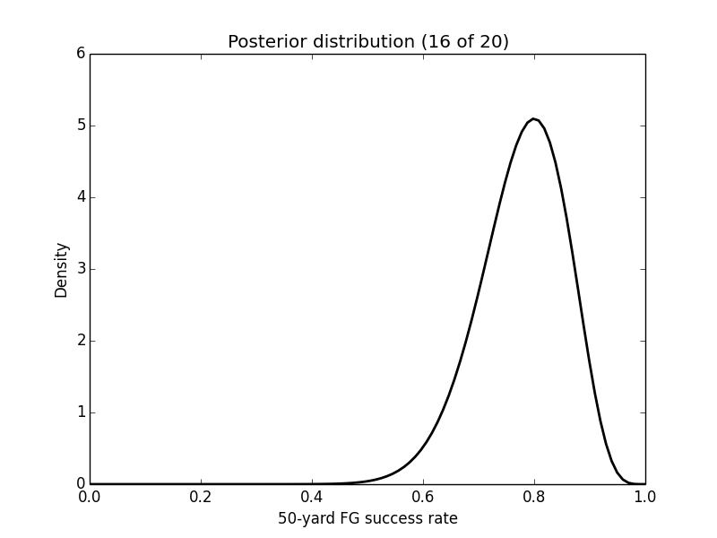
Bayesian player evaluation
The posterior distribution is still a Beta distribution (with different parameters)
Using this posterior distribution the probability that the kicker is an 80% success rate or better at 50-yard FGs is:
$\operatorname{Pr}\left[kicker σ≥80\%\right]=\int_{0.8}^{1}{π\left(σ | \text{"16}\text{−}\text{of}\text{−}\text{20"}\right)dσ}$ = 0.42

Slide 10
Conjugate priors
When the posterior and the prior distributions belong to the same family they are called conjugate distributions
The prior is called conjugate prior for the likelihood function
Depending on the process that we describe the choice of likelihood function might be straightforward
E.g., for the example earlier, the success of a FG (trial) can be described Bernoulli distribution

Slide 11
Likelihood | Prior
Bernoulli | Beta
Poisson | Gamma
Multinomial | Dirichlet
Normal | Normal
Uniform | Pareto
Exponential | Gamma

Slide 12
Bayesian Average
Sometimes we have to compare averages that were obtained with different number of observations
How reliable is a 300 offensive efficiency rating for a lineup that has played only 1 possession?
We can adjust the averages using a similar approach with the Bayes rule
Average # of possessions for all lineups
$$\tilde{μ_{i}}=\frac{\overline{N}⋅μ+ N_{i}{⋅μ}_{i}}{\overline{N}+N_{i}}$$
# of possessions for lineup i
Average rating over all lineups
“Raw” efficiency for lineup i

Slide 13
Bayesian Average
The Bayesian average essentially assigns a prior rating to a lineup that has no or very few observations (N_{i} ≪$\overline{N}$)
In the case above we use the average rating of all lineups as our prior belief
Other options are possible
As we accumulate more evidence for a lineup i these observations will outweigh the prior

Slide 14
Ranking correlation: 0.83
Largest adjustments for lineups with few
possessions
2017 - 18

Slide 15
Competitive Balance
Competitive balance is important for a league in order to keep its fans interest
Having the same team win every year leads to fans losing their interest
There are a few mechanism that can be employed to ensure competitive balance to some extent
Salary cap
Draft

Slide 16
Draft
General idea: teams select among (college) prospects in inverse order of their last year’s standing
In order to avoid teams intentionally tanking in order to get the first draft pick some leagues include a lottery system
The worst-k teams enter a lottery that determines their draft pick order
The lottery is not uniform at random, but teams with worse record have higher chance of landing the number one draft pick

Slide 17
Draft
Do teams take advantage of the draft? What is the value of a high draft pick over a lower pick? Do team executives make their picks in a rational fashion?
Massey and Thaler (MT) studied the NFL draft and identified large inefficiencies associated with the value placed on top picks
In terms of performance per dollar, the top draft pick is actually the worst choice in the first round!
Since the cost of players falls off far more quickly than the average performance in the draft, teams are better off trading down to late in the first or even into the second round

Slide 18
NFL Draft
There are three things that one needs to calculate in order to study the efficiency of decision making with regards to NFL draft:
Market value of a draft pick
Monetary compensation of each draft pick
On-field performance of a draft pick as a function of the pick order

Slide 19
NFL Draft
The market value of a draft pick can be defined based on the picks another team is willing to trade for it
Complications arise when a trade includes players as well or future picks
The expected surplus of a drafted player is the difference between the salary of a veteran and the drafted player with the same performance
$$\begin{matrix}H_{0}: & \frac{MV_{i}}{MV_{i+k}}=\frac{E\left(SV_{i}\right)}{E(SV_{i+k})} \\ H_{1}: & \frac{MV_{i}}{MV_{i+k}}>\frac{E\left(SV_{i}\right)}{E(SV_{i+k})}\end{matrix}$$

Slide 20
NFL Draft
NFL draft trades from 1988-2004
334 trades in total from which 83% includes trades of only draft picks
213 trades include picks from the same year and 63 includes trades across multiple years
53% of the trades include a first or second round draft pick
The average number of draft picks acquired by a team trading down was 2.2, while for teams trading up was 1.2
Modal trade: 2-for-1 (58% of the trades)

Slide 21
NFL Draft
Let us assume that v(1) represents the value of the first draft pick and is equal to 1
Then v(k) expresses the relative value of the k-th pick relative to the first pick
v is a monotonically decreasing function
For a trade that involves m picks from the team that is trading down and n picks from the team that trades up the values of this picks should satisfy:
$$\sum_{i=1}^{m}{v\left(t_{i}^{H}\right)}=\sum_{i=1}^{n}{v(t_{j}^{L})}$$

Slide 22
NFL Draft
MT assumed a Weibull distribution for the value of a pick relative to the first one: $v\left(t_{i}^{r}\right)=e^{−λ{\left(t_{i}^{r}−1\right)}^{β}}$
λ and β are the parameters to be estimated
β>1 → draft value decays at an increasing rate
β<1 → draft value decays at a decreasing rate
$v\left(1\right)=e^{−λ(1−1)^{β}}=1$

Slide 23
NFL Draft
$$\sum_{i=1}^{m}{v\left(t_{i}^{H}\right)}=\sum_{i=1}^{n}{v(t_{j}^{L})}$$
$$t_{1}^{H}={\left(−\frac{1}{λ}\log\left(\sum_{j=1}^{n}{e^{−λ{\left(t_{j}^{L}−1\right)}^{β}}}−\sum_{i=2}^{m}{e^{−λ{\left(t_{i}^{H}−1\right)}^{β}}}\right)\right)}^{\frac{1}{β}}+1$$
$$v\left(t_{i}^{r}\right)=e^{−λ{\left(t_{i}^{r}−1\right)}^{β}}$$
Value of the highest pick involved in the trade

Slide 24
NFL Draft
Using trade data (i.e., which picks were involved in each trade) we can fit a non-linear regression
Specifically your dependent variable is $t_{1}^{H}(τ)$, i.e., the highest draft pick involved in trade τ
Using the previous equation we can estimate/predict the value $\hat{t_{1}^{H}}$
We then solve: $\min_{λ,β}{\sum_{τ}{(t_{1}^{H}(τ)−\hat{t_{1}^{H}}(τ))^{2}}}$

Slide 25
NFL Draft
If we want to account for draft picks n years in the future we can include a third parameter ρ, which captures a discount rate
$$v\left(t_{i}^{r}\right)=\frac{e^{−λ{\left(t_{i}^{r}−1\right)}^{β}}}{(1+ρ)^{n}}$$
$$t_{1}^{H}={\left(−\frac{1}{λ}\log\left(\sum_{j=1}^{n}{\left(\frac{e^{−λ{\left(t_{j}^{L}−1\right)}^{β}}}{(1+ρ)^{n}}\right)}−\sum_{i=2}^{m}{\left(\frac{e^{−λ{\left(t_{i}^{H}−1\right)}^{β}}}{(1+ρ)^{n}}\right)}\right)\right)}^{\frac{1}{β}}+1$$

Slide 26
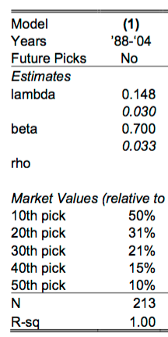
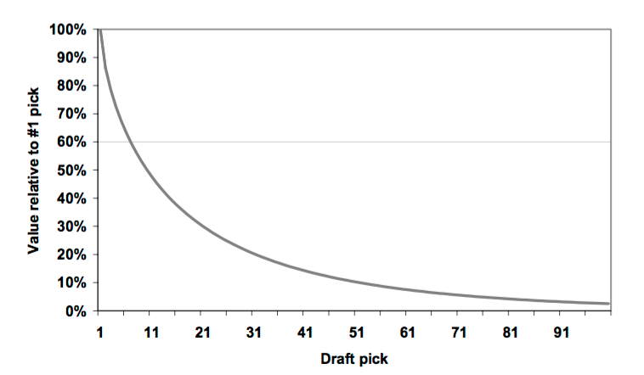
NFL Draft

Slide 27
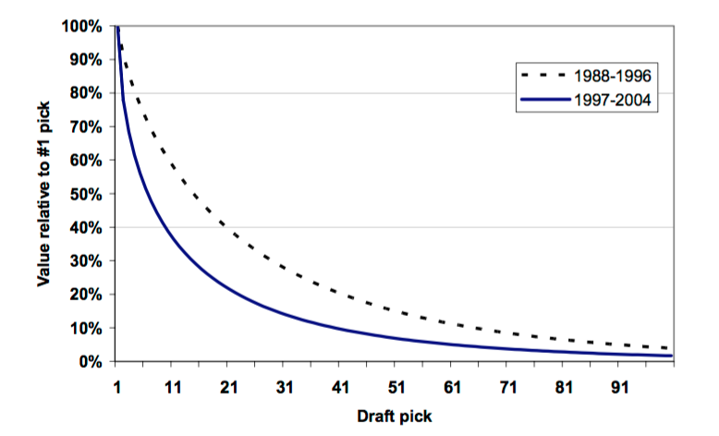
NFL Draft
Running the regression over two different time periods can reveal changes in the market
Between 1997-2004 we observe a steeper draft-pick value curve
Pick #10 was worth 60% the value of #1 between 1988-1996, but only 39% of #1 pick between 1997-2004

Slide 28
NFL Draft
There is a well-understood market price for draft picks
This consensus is riding the power of inertia, leading to over-valuation of picks
The draft-pick value curve is very steep
Prices are getting steeper over time!
When analyzing trades including future picks, there is a remarkably high discount rate
Rule of thumb: A pick in the n round this year is equivalent to a pick in the n-1 round next year

Slide 29
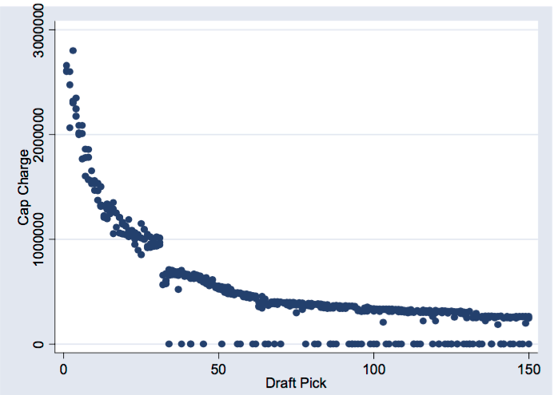
NFL Draft
Rookie compensations are capped as well
Separate cap; cap within a cap
Teams with higher draft picks have higher rookie cap
Rookie compensation curves follow a curve very close to the draft-pick value curve

Slide 30
NFL Draft
In order for the value (and compensation) of rookies to be rational, their performance should also follow a steep curve with the draft order
MT used four metrics as a proxy for on-field performance:
Probability of being on the roster
# of games played
# of games started
Probability of making the Pro Bowl

Slide 31
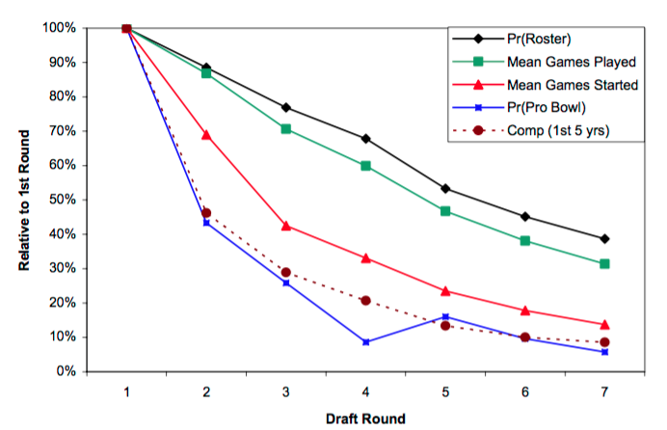
NFL Draft
The probability of making the Pro Bowl has the steepest curve (as expected)
The compensation curve closely follows this curve
Is it appropriate to use full rounds as our variable?

Slide 32
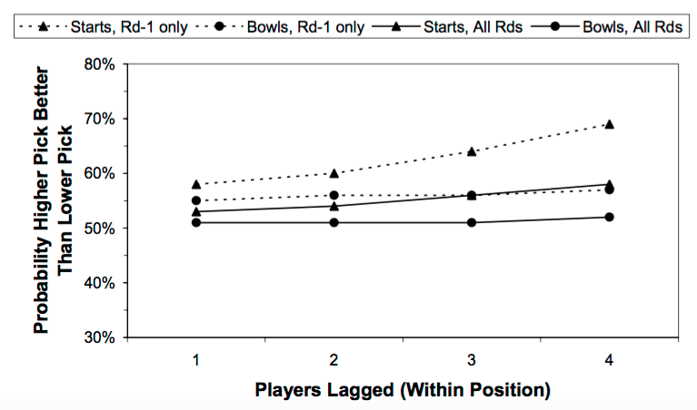
NFL Draft
Focusing on players that play the same position MT estimate the probability of the player chosen earlier being better over his whole career
Number of games started and pro bowl selections are used

Slide 33
NFL Draft
In summary,
Performance declines with draft round
The decline is steeper for more extreme performance metrics
Only the steepest decline is as steep as the compensation cost of the draft picks
Possible biases
Monetary value for a high draft pick might extend beyond wins on the field
Pro Bowl selection is partly a popularity contest

Slide 34
NFL Draft
MT defined the surplus value of a drafted player as the difference between his rookie compensation and the compensation of a veteran (6th year) player with the same performance
The (realistic) assumption is that the market is efficient for veteran players
In order to calculate the surplus value of a rookie player we need to have an estimate of the value of a veteran player with similar performance with the rookie under consideration
Model for veteran compensation

Slide 35
NFL Draft
Five (binary) features c_{i} for each player:
Not in the league (NIL)
Started 0 games (DNS)
Started ≤ 8 games
Started > 8 games
Selected to the Pro Bowl
I is a vector of indicator variables
for the position the players
$$Log\left(comp_{i,6}\right)=α+\sum_{j=1}^{5}{β_{j}c_{j}(i,5)}+BI+ε_{i,t}$$
Average of the j-th feature for
player i over his first 5 years

Slide 36
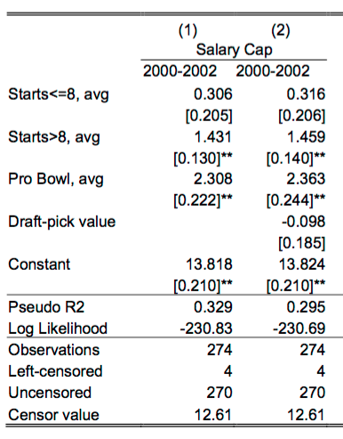
NFL Draft
MT examined also a model that included the draft pick order (value) as an independent variable
The coefficient is not significant
Controlling for the performance, the draft order of a player does not impact his veteran compensation

Slide 37
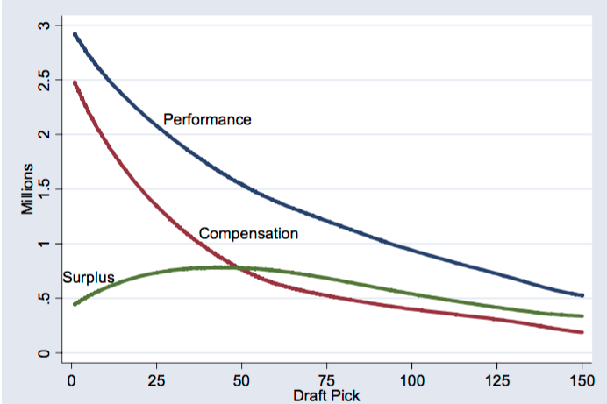
NFL Draft
$${\hat{SV}}_{i,t}={\hat{PV}}_{i,t}−comp_{i,t}$$

Slide 38
NFL Draft
A formal test for the inefficiency hypothesis will have to examine whether the relationship between surplus and draft order is less negative than the one between the market value and draft order
A conservative way to do this (since we have already seen that the relationship between market value and draft order is strongly negative) is to examine whether the relationship between surplus and draft order is positive
This relationship varies with draft order (→ use of splines for regions of the draft)
Particularly interested in the first draft rounds where the majority of the trading occurs

Slide 39
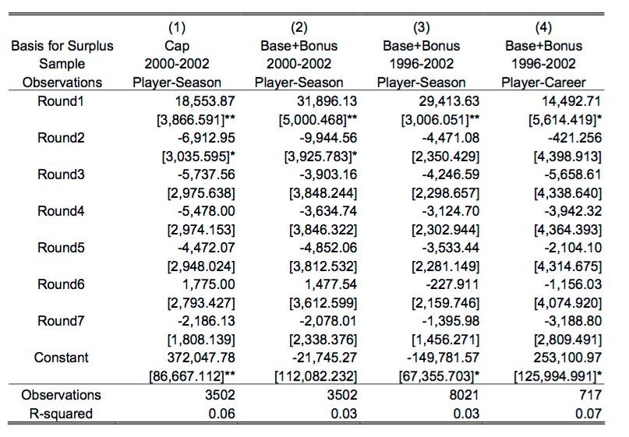
NFL Draft
Linear spline for round r
$${\hat{SV}}_{i,t}=α+\sum_{r=1}^{7}{β_{r}Round_{r}}+ε_{i,t}$$
β_{r} provides the estimated per-pick change in
surplus value during round r

Slide 40
NFL Draft
Overall NFL teams exhibit overconfidence in their draft picks
Loser’s curse: there are limits to arbitrage
The study itself exhibits limitations mainly at the definition of the on-field performance
A player who started 1 game and 8 games are considered to be equal
Making starts does not necessarily mean that the player players well too
Pro Bowl selection is more related with quality of play and also is the only metric that follows well the relationship between market value and draft order …. !

Slide 41
NBA Draft
One of the major critiques of MT study is the on-field performance metrics used
A metric that directly reflects the contribution of a player on winning is more appropriate
Such metrics have been developed for sports like baseball and basketball
We will also need to estimate a fair salary for a player based on the minutes played and his win contributions (similar to the model for NFL veteran contribution)

Slide 42
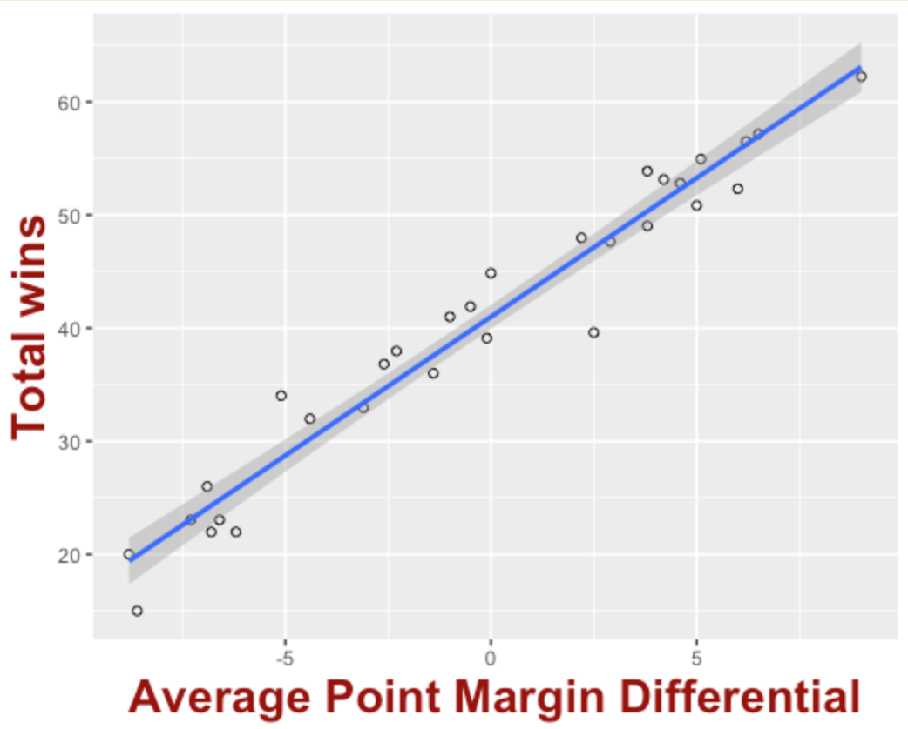
NBA Draft
Winston and Medland (WM) performed an analysis on the efficiency of the NBA draft
Assumption: point value for a replacement player is -6
Points above replacement: player point rating + 6
Recall that in order to have a 41-41 record in the
NBA a team needs to have a scoring ratio of 1

Slide 43
NBA Draft
The average payroll of an NBA team in 2006-07 was $66 millions
Cost of a win: $66/41 = $1,560,976
Fair salary for a player: wins_contributed x $1,560,976
Player | Point Rating | Wins Contributed | Estimated Worth | Actual Salary
Garnett | 18.98 | 25.97 | $40,550,189.70 | $21,000,000
James | 15.12 | 19.62 | $30,637,831.98 | $5,828,000
Millicic | -1.02 | 1.04 | $1,638,233.06 | $5,218,000
Bryant | 10.17 | 13.99 | $21,733,224.93 | $17,718,000
Carter | 3.2 | 6.29 | $9,826,991.87 | $15,101,000
Kidd | 7.66 | 10.44 | $16,310,341.46 | 18,084,000

Slide 44
NBA Draft
NBA has a “soft” salary cap
Teams are allowed to go over the cap but they have to pay a luxury tax
$1 for every $1 over the salary cap
Salary cap in 2006-07 season: $65.42 millions
Even though a team can exceed the cap, it is clear that teams try to manage their roster in order to avoid having to pay the luxury tax

Slide 45
NBA Draft
Using the above process WM calculated a fair salary for each of the players that were drafted during the 1998-2002 period for their first three seasons
The surplus value of a player is then defined: $\sum_{i=1}^{3}{fair salary year_{i}}−salary paid for first 3 years$
WM then estimated the average surplus value of a player as a function of its draft position

Slide 46
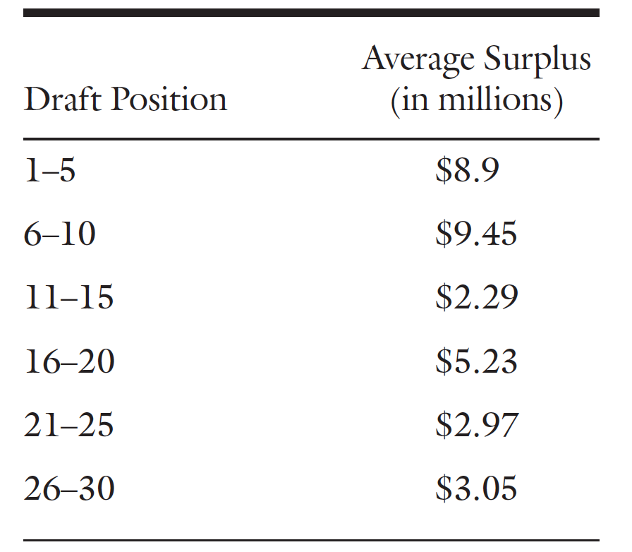
NBA Draft
Positions 6-10 are a little “pumped up” because of the phenomenal success of #10 picks: Paul Pierce, Jason Terry, Joe Johnson and Caron Butler
Breaking down by pre-entry experience
High school players: overvalued by 31%
International/2 years college: correctly valued
3 years college: undervalued by 8%
4 years college: undervalued by 13%

