Slide 1

CS 1674/2074: Intro to Computer Vision
PhD. Nils Murrugarra-Llerena
nem177@pitt.edu

Slide 2
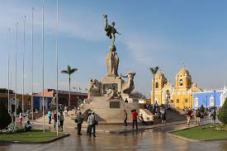
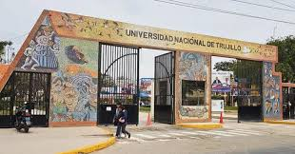

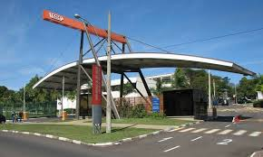


Who am I?
B.S. Computer Science at National University of Trujillo
M.S. in Computer Science at University of São Paulo in AI

Slide 3



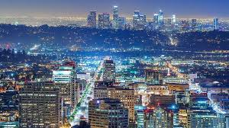

Who am I?
PhD in Computer Science at University of Pittsburgh in Computer Vision
Research scientist at Snap Inc.

Slide 4
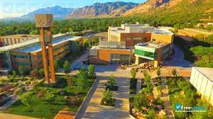

Who am I?
Assistant professor at Weber State University
Teaching Assistant Professor at University of Pittsburgh
[Students’ presentations]
Name, hobbies, and mention one thing that you expect to learn in this course ☺

Slide 5

Course intro: Syllabus
Contact Information
  Prof. Nils Murrugarra
  nem177@pitt.edu
  Please, add prefix “[CS 1674]” in all emails.
  Website: https://nineil.github.io/courses/fall24_cs1674/
Lectures:
  Tue/Thu 11:00 am – 12:15 pm [SENSQ 5313]
Office hours:
  Tue/Wed 9:00 am – 11:00 am [SENSQ 5419]

Slide 6

Course intro: Textbook
Computer Vision algorithms and applications
Edition: 2nd
By Richard Szeliski
ISBN: 978-3030343712
Year: 2022

Slide 7
Course intro: What to expect?
Material is based on previous iterations of Computer Vision course from Prof. Adriana Kovashka.
Exams mainly cover this material
We will do around 7 to 9 programming assignments

Slide 8

Course intro: What to expect?
There will be a lot of work!
However, you will learn a lot :). Please, ask
questions in class and use my office hours
as needed.
I would like to help you much as possible.

Slide 9
Course intro: What to expect? [Warning #1]
I’ve opted for shorter, more manageable HW assignments, but there is a lot of them
I expect you’d be spending 4-6 hours on each assignment
… But you get to understand algorithms and concepts in detail!

Slide 10
Course intro: What to expect? [Warning #2]
Some parts will be hard and require that you pay close attention!
Use instructor’s office hours
… You will learn a lot!

Slide 11
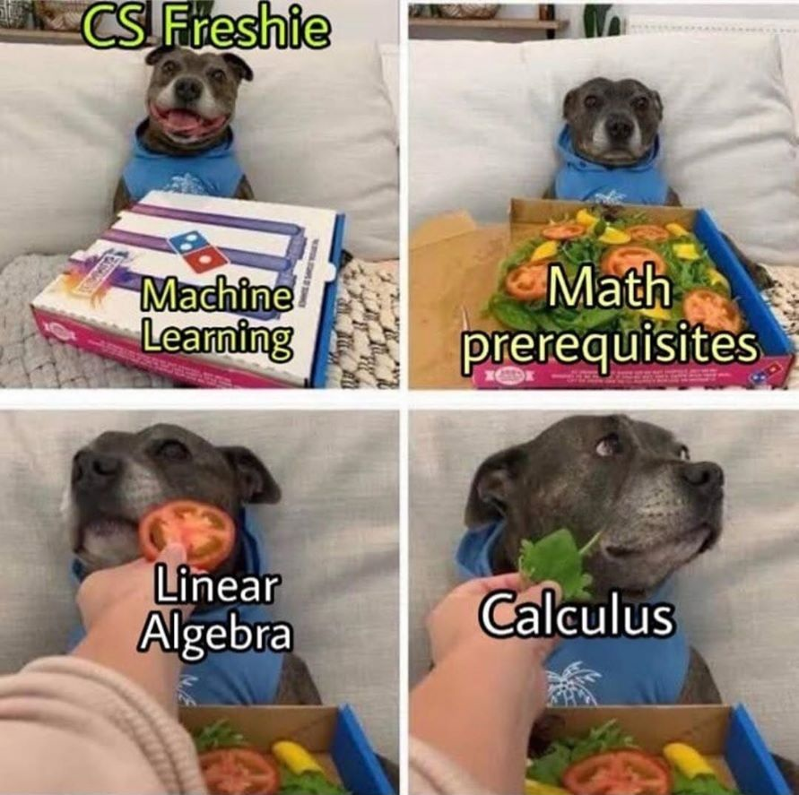
Course intro: What to expect?
H/T Kirk Pruhs

Slide 12

Course intro: programming assignments
We will learn Python programming language
﻿You get 3 "free" late days counted in minutes, i.e., you can submit a total of 72 hours late. Once you've used up your free late days, you will incur a penalty of 25% from the total assignment credit possible for each late day.

Slide 13
Review Syllabus
Canvas Link:
https://canvas.pitt.edu/courses/288692/files/17497249?module_item_id=5015518

Slide 14
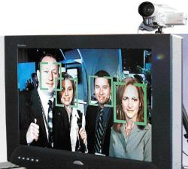
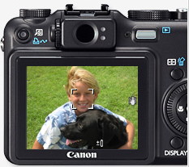
Motivation: Faces and digital cameras
Setting camera focus via face detection
Camera waits for everyone to smile to take a photo [Canon]
Kristen Grauman
Notes:
The recent New York Canon Expo was a chance for Canon to display its cutting-edge digital camera technologies, such as the ability to track all the faces in a group photo and take the photo as soon as everyone smiles.
Photograph by : Steve Makris, The Journal

Slide 15
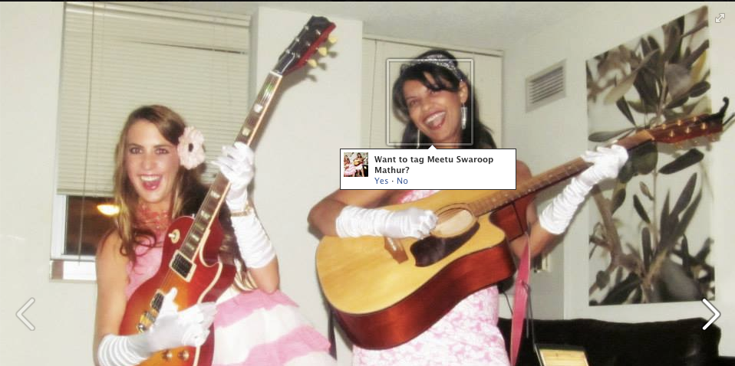

Motivation: Face recognition
Devi Parikh

Slide 16
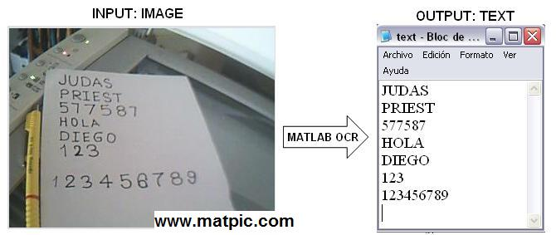
Motivation: Optical Character Recognition
https://www.mathworks.com/matlabcentral/fileexchange/18169-optical-character-recognition-ocr

Slide 17
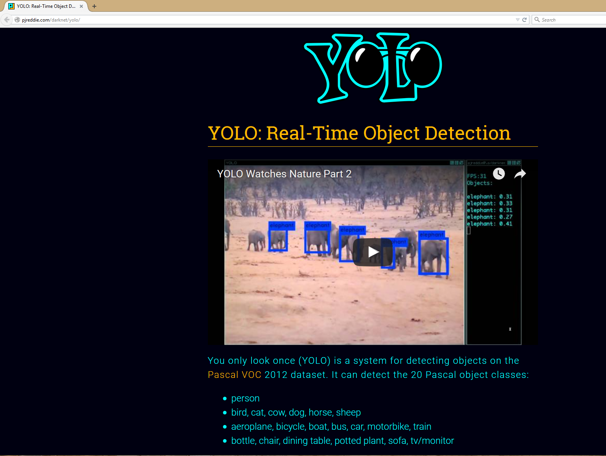
Motivation: Accurate object detection
Redmon et al., “You Only Look Once: Unified, Real-Time Object Detection”, CVPR 2016

Slide 18
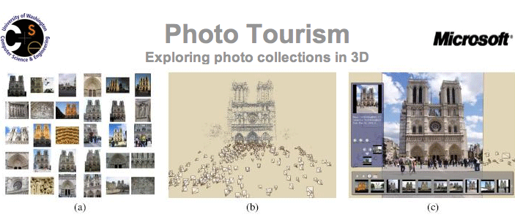
Motivation: Exploring photo collections
Snavely et al.
Kristen Grauman
Notes:
18

Slide 19
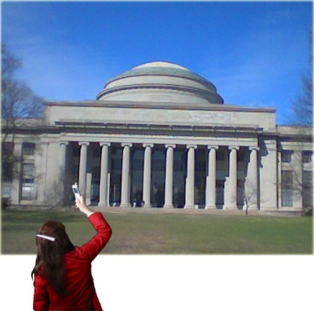
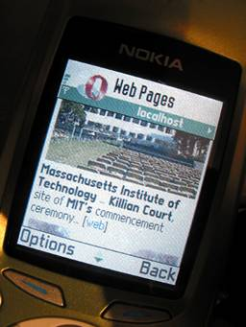
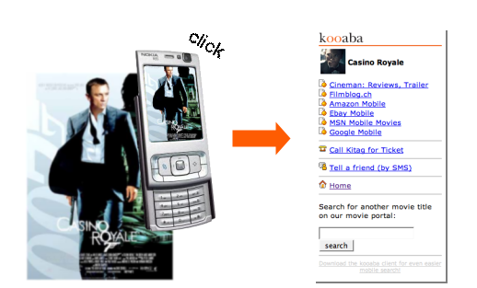
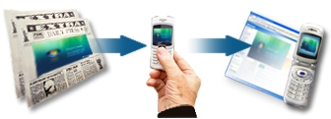
Motivation: Linking info with a mobile device
Situated search
Yeh et al., MIT
kooaba
MSR Lincoln
Kristen Grauman

Slide 20
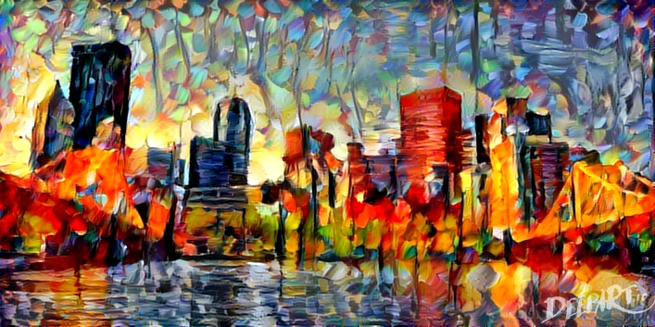
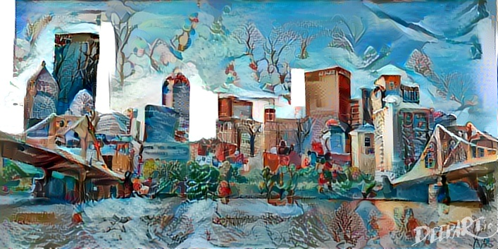
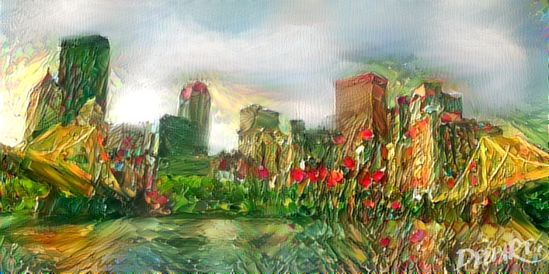
Motivation: Transferring art styles
DeepArt.io – try it for yourself!
Gatys et al., CVPR 2016

Slide 21
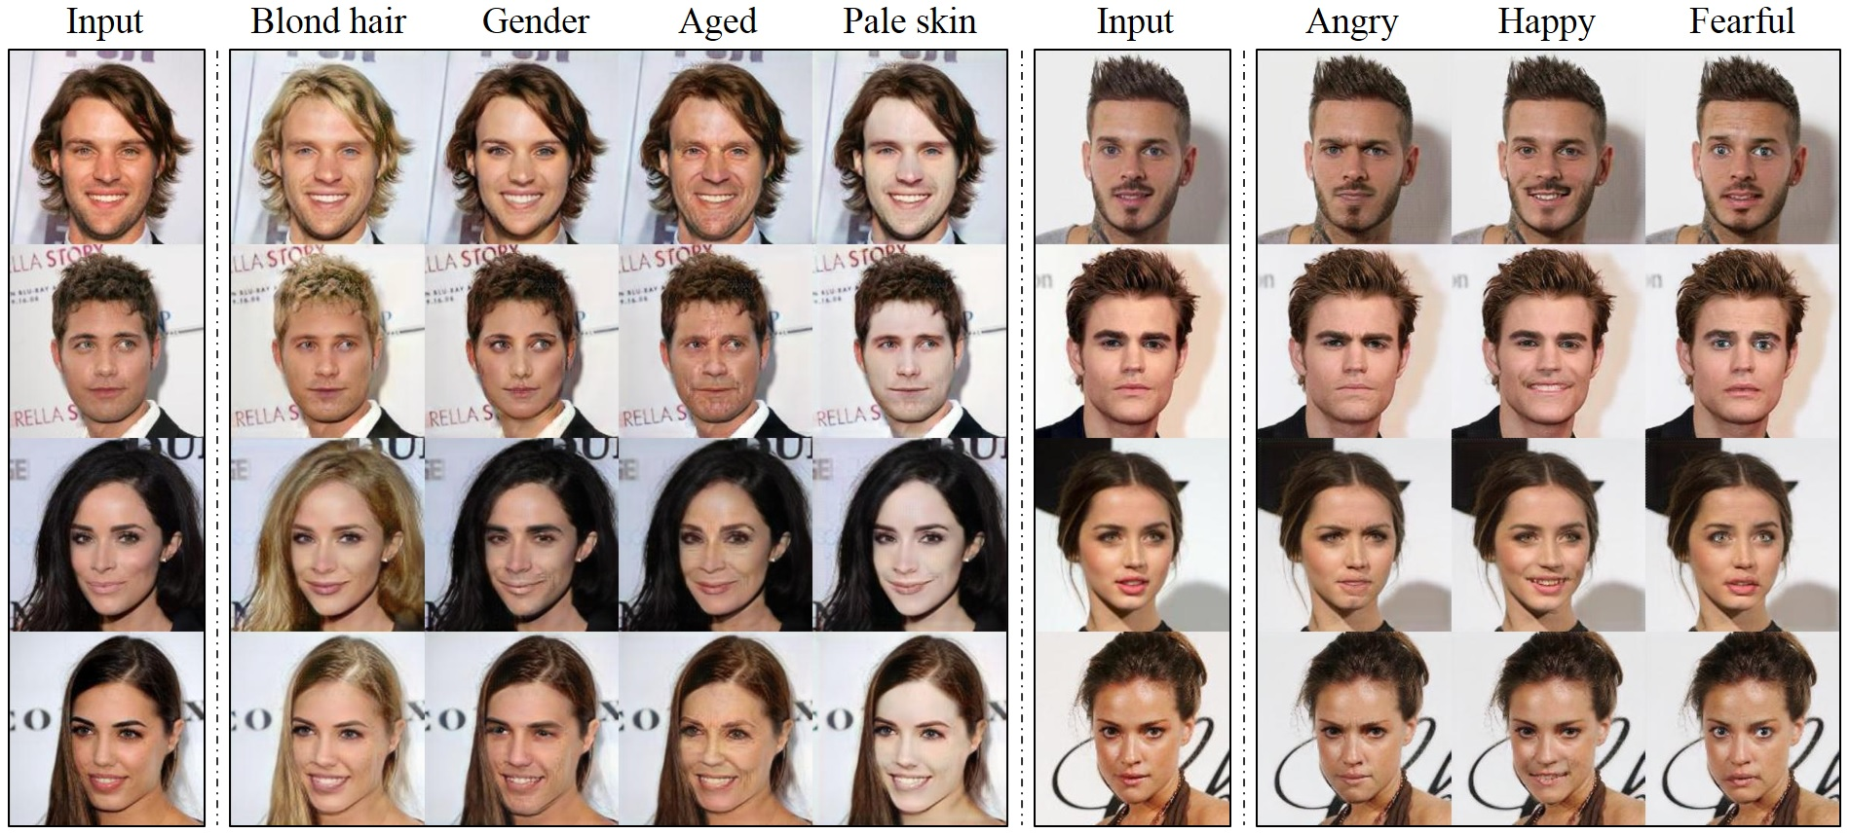
Motivation: Image Generation (faces)
Choi et al., CVPR 2018

Slide 22
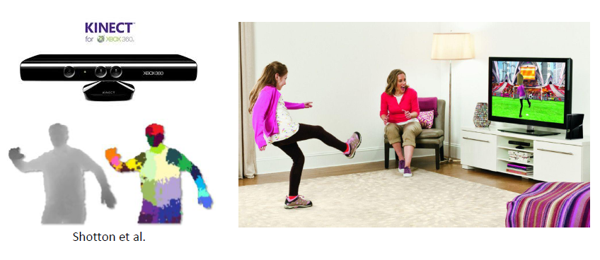
Motivation: Interactive Systems
Yong Jae Lee

Slide 23
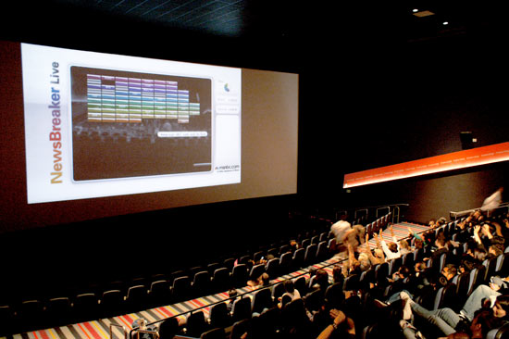
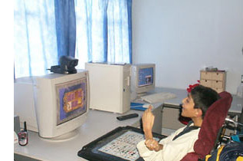
Motivation: Video-based interfaces
YouTube Link
Assistive technology systems
Camera Mouse
Boston College
Human joystick
NewsBreaker Live
Kristen Grauman
Notes:
http://www.youtube.com/watch?v=y6izXII54Qc

Slide 24
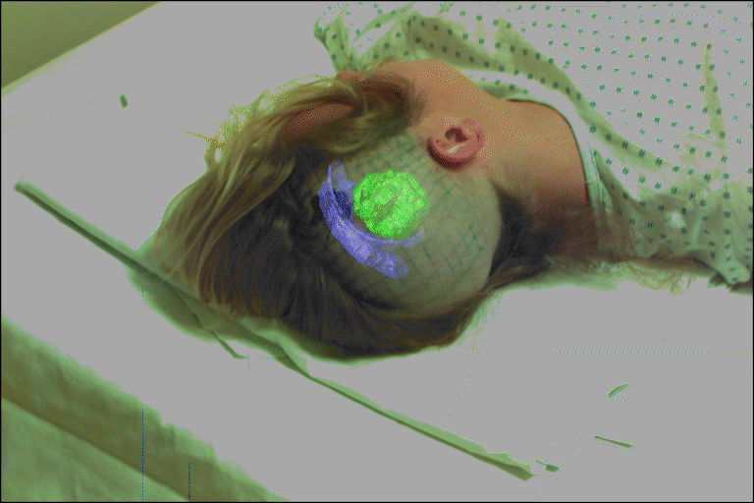
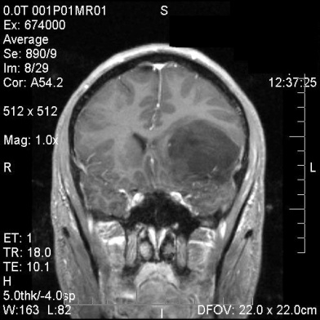
Motivation: Computer Vision for Medicine
fMRI data
Golland et al.
Image guided surgery
MIT AI Vision Group
Kristen Grauman

Slide 25
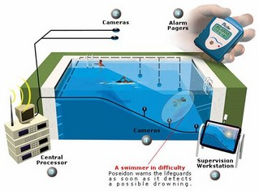
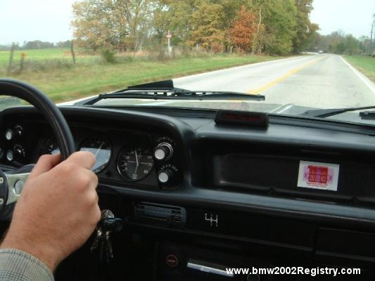
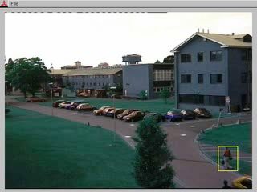
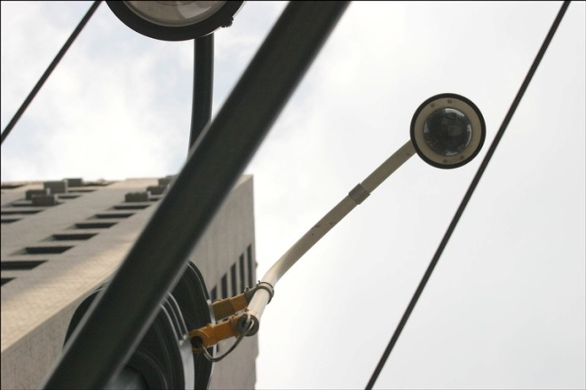
Motivation: Safety and security
Navigation, driver safety
Monitoring pool (Poseidon)
Pedestrian detection
MERL, Viola et al.
Surveillance
Kristen Grauman

Slide 26

Setup Environment
Create Github Account
Install Github Desktop
You may use any IDE for Python
  I use Pycharm: https://www.jetbrains.com/pycharm/
  Apply for your educational free license: https://www.jetbrains.com/community/education/#students

Slide 27
Setup Learning Environment
Installation and learning environment:
https://github.com/nineil-pitt/cs1674_2074_fall23

