Slide 1

CS 1674: Grouping: edges, lines, circles, and segments
PhD. Nils Murrugarra-Llerena
nem177@pitt.edu

Slide 2
Plan for this lecture
Edges
  Extract gradients and threshold
Lines and circles
  Find which edge points are collinear or belong to another shape e.g. circle
  Automatically detect and ignore outliers
Segments
  Find which pixels form a consistent region
  Clustering (e.g. K-means)

Slide 3

Edge detection
Goal: map image from 2d array of pixels to a set of curves or line segments or contours.
Why?
Main idea: look for strong gradients, post-process
Figure from J. Shotton et al., PAMI 2007
Source: K. Grauman

Slide 4
Designing an edge detector
Criteria for a good edge detector
  Good categorization (edge vs not edge)
    find all real edges, ignoring noise or other artifacts
  Good localization
    detect edges as close as possible to the true edges
    return one point only for each true edge point (true edges = the edges humans drew on an image)
Cues of edge detection
  Bottom-up: Differences in color, intensity, or texture across the boundary
  Top-down: Continuity and closure, high-level knowledge
Adapted from L. Fei-Fei

Slide 5
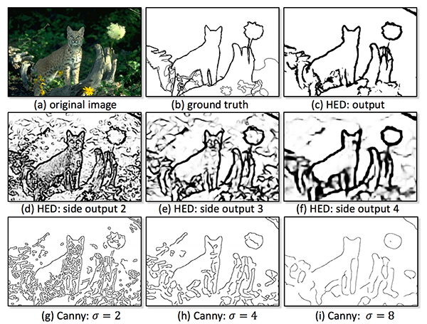
Examples of edge detection results
Xie and Tu, Holistically-Nested Edge Detection, ICCV 2015

Slide 6
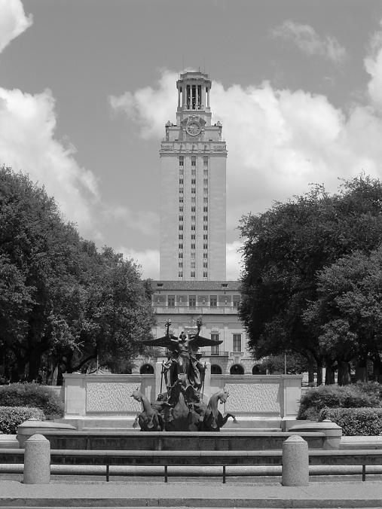
What causes an edge?
Depth discontinuity: object boundary
Reflectance change: appearance information, texture
Cast shadows
Adapted from K. Grauman

Slide 7

Characterizing edges
An edge is a place of rapid change in the image intensity function
intensity function
(along horizontal scanline)
image
first derivative
edges correspond to
extrema of derivative
Source: L. Lazebnik

Slide 8
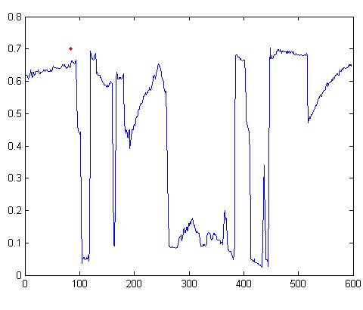
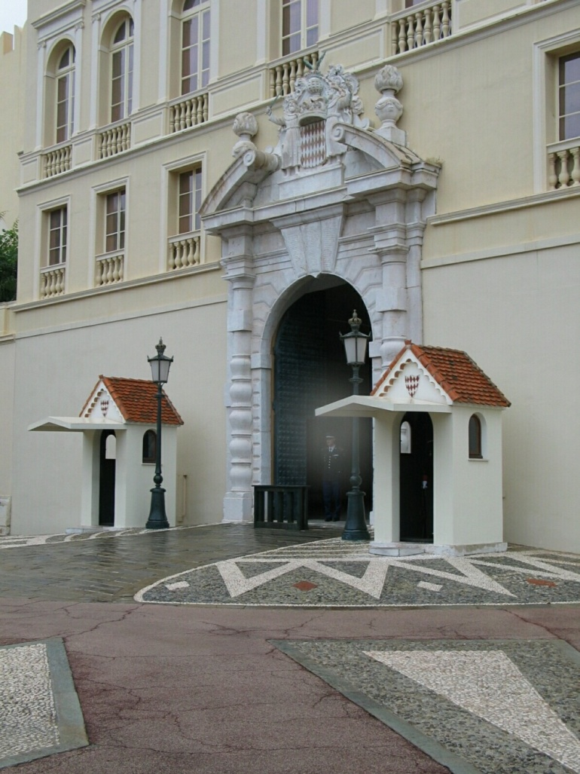
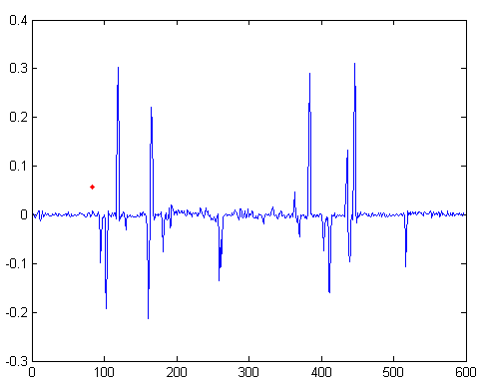
Intensity profile
Intensity
Gradient
Source: D. Hoiem

Slide 9
Plan for this lecture
Edges
  Extract gradients and threshold
Lines and circles
  Find which edge points are collinear or belong to another shape e.g. circle
  Automatically detect and ignore outliers
Segments
  Find which pixels form a consistent region
  Clustering (e.g. K-means)

Slide 10
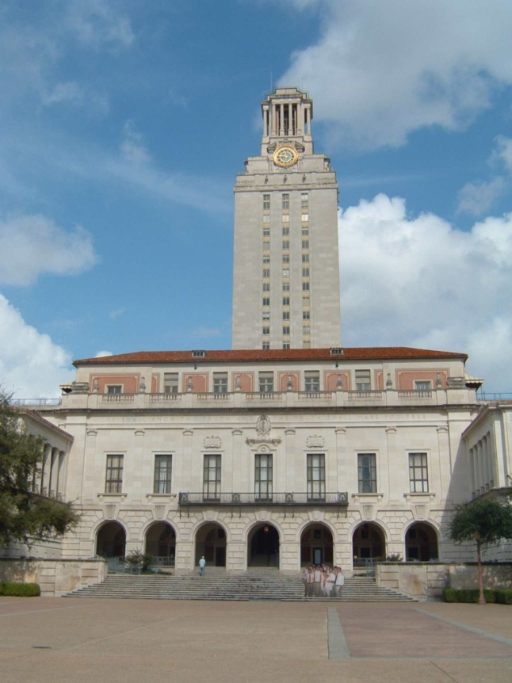
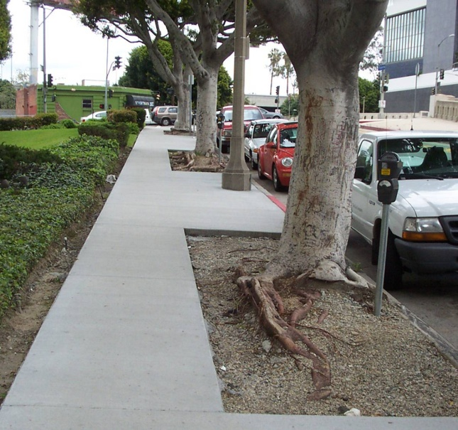
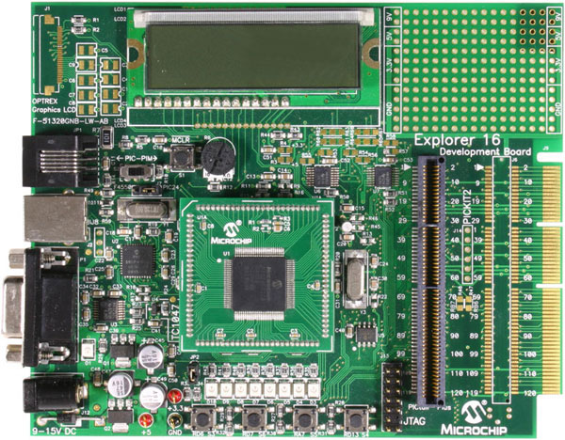
Line detection (fitting)
Why fit lines?
Many objects characterized by presence of straight lines
Why aren’t we done just by running edge detection?
Kristen Grauman

Slide 11
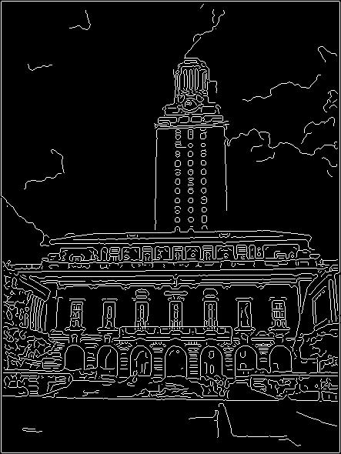
Difficulty of Line Fitting
Noise in measured edge points, orientations:
e.g. edges not collinear where they should be
  how to detect true underlying parameters?
Extra edge points (clutter):
  which points go with which line, if any?
Only some parts of each line detected, and some parts are missing:
  how to find a line that bridges missing evidence?
Adapted from Kristen Grauman

Slide 12
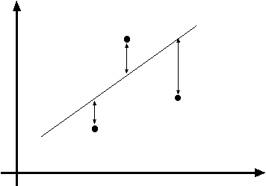
Least squares line fitting
Data: (x₁, y₁), …, (x_{n}, y_{n})
Line equation: y_{i} = m x_{i} + b
Find (m, b) to minimize
y=mx+b
(x_{i}, y_{i})
You want to find a single line that “explains” all of the points in your data, but data may be noisy!
where line you found tells you point is along y axis
where point really is along y axis
Matlab: p = A \ y; or p = pinv(A)*y;
Adapted from Svetlana Lazebnik

Slide 13
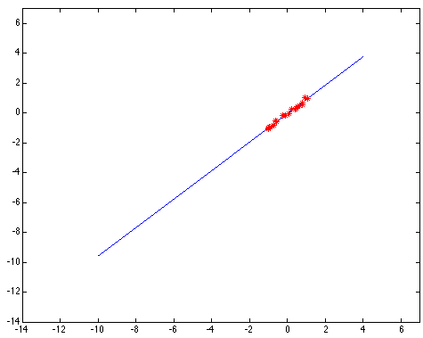
Outliers affect least squares fit
Kristen Grauman
Notes:
13
Outliers affect least squares fit

Slide 14
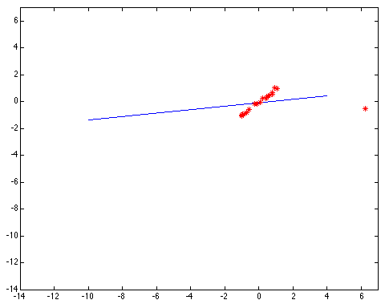
Outliers affect least squares fit
Kristen Grauman
Notes:
14

Slide 15

Dealing with outliers: Voting
Voting is a general technique where we let the features vote for all models that are compatible with it.
  Cycle through features, cast votes for model parameters.
  Look for model parameters that receive a lot of votes.
Noise & clutter features?
  They will cast votes too, but typically their votes should be inconsistent with the majority of “good” features.
Common techniques
  Hough transform
  RANSAC
Adapted from Kristen Grauman

Slide 16

Finding lines in an image: Hough space
y
b
b₀
x
m₀
m
image space
Hough (parameter) space
Connection between image (x,y) and Hough (m,b) spaces
  A line in the image corresponds to a point in Hough space
Steve Seitz

Slide 17

Finding lines in an image: Hough space
y
b
y₀
x₀
x
m
image space
Hough (parameter) space
Connection between image (x,y) and Hough (m,b) spaces
  A line in the image corresponds to a point in Hough space
  What does a point (x₀, y₀) in the image space map to?
    Answer: the solutions of b = -x₀m + y₀
    This is a line in Hough space
    Given a pair of points (x,y), find all (m,b) such that y = mx + b
Adapted from Steve Seitz

Slide 18
Finding lines in an image: Hough space
y
b
(x₁, y₁)
y₀
(x₀, y₀)
b = –x₁m + y₁
x₀
x
m
image space
Hough (parameter) space
What are the line parameters for the line that contains both (x₀, y₀) and (x₁, y₁)?
  It is the intersection of the lines b = –x₀m + y₀ and
  b = –x₁m + y₁
Steve Seitz

Slide 19
Finding lines in an image: Hough space
y
b
m = 17.5
x
0 5 10 15 20
m
image space
Hough (parameter) space
How can we use this to find the most likely parameters (m,b) for the most prominent line in the image space?
Let each edge point in image space vote for a set of possible parameters in Hough space
Accumulate votes in discrete set of bins; parameters with the most votes indicate line in image space.
Steve Seitz

Slide 20
Finding lines in an image: Hough space
y
m
x
b
y
m
3
5
3
3
2
2
3
7
11
10
4
3
2
3
1
4
5
2
2
1
0
1
3
3
x
b
Adapted from Silvio Savarese

Slide 21
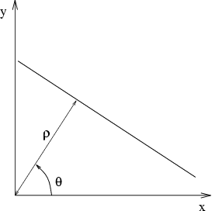
Parameter space representation
Problems with the (m, b) space:
  Unbounded parameter domains
  Vertical lines require infinite m
Alternative: polar representation
Each point (x,y) will add a sinusoid in the (θ,ρ) parameter space
Svetlana Lazebnik

Slide 22
Parameter space representation
Problems with the (m,b) space:
  Unbounded parameter domains
  Vertical lines require infinite m
Alternative: polar representation
y
x
Hough space
Each point (x,y) will add a sinusoid in the (θ,ρ) parameter space
Svetlana Lazebnik
Notes:
TODO: Take a look to the 180.

Slide 23
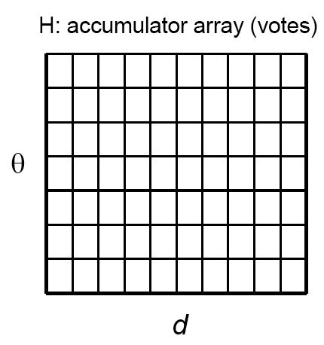
Algorithm outline: Hough transform
Initialize accumulator H to all zeros
For each edge point (x,y)
in the image
For θ = 0 to 180
ρ = x cos θ + y sin θ
H(θ, ρ) = H(θ, ρ) + 1
end
end
Find the value(s) of (θ*, ρ*) where H(θ, ρ) is a local maximum
  The detected line in the image is given by
  ρ* = x cos θ* + y sin θ*
ρ
Why only until 180 degrees?
θ
Svetlana Lazebnik
Notes:
https://www.alamo.edu/contentassets/35e1aad11a064ee2ae161ba2ae3b2559/additional/math2412-polar-coordinates.pdf
Negative radius can handle negative angles or angles greater than 180

Slide 24



Incorporating Image Gradients
Recall: when we detect an
edge point, we also know its
gradient direction
But this means that the line
is uniquely determined!
Modified Hough transform:
For each edge point (x,y) in the image
θ = gradient orientation at (x,y)
ρ = x cos θ + y sin θ
H(θ, ρ) = H(θ, ρ) + 1
end
Svetlana Lazebnik

Slide 25
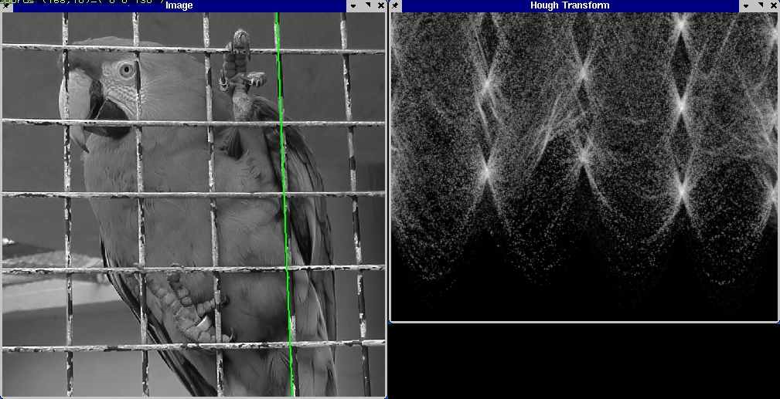
Hough transform example
Derek Hoiem

Slide 26
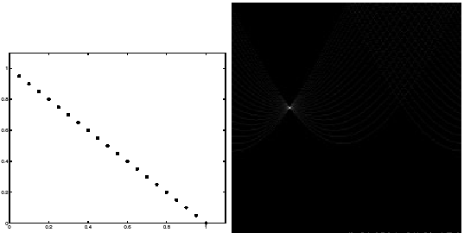
Impact of noise on Hough
y
d
x
θ
Image space
edge coordinates
Votes
Kristen Grauman

Slide 27
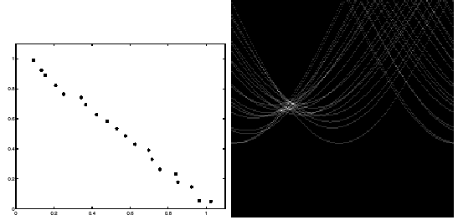
Impact of noise on Hough
y
d
x
θ
Image space
edge coordinates
Votes
What difficulty does this present for an implementation?
Kristen Grauman

Slide 28
Voting: practical tips
Minimize irrelevant tokens first (reduce noise)
Choose a good grid / discretization
  Too coarse: large votes obtained when too many different lines correspond to a single bucket
  Too fine: miss lines because points that are not exactly collinear cast votes for different buckets
Vote for neighbors (smoothing in accumulator array)
Use direction of edge to reduce parameters by 1
To read back which points voted for “winning” peaks, keep tags on the votes
Too coarse
?
Too fine
Kristen Grauman

Slide 29

Hough Transform: Example
y
14
13
12
11
10
9
8
7
6
5
4
3
2
1
0 | 1 | 2 | 3 | 4 | 5 | 6 | 7 | 8 | 9 | 10 | 11 | 12 | 13 | 14 | 15 | 16 | 17 | 18 | 19
ρ = x cos(Θ) + y sin(Θ)
ρ = 11 cos(45) + 7 sin(45)
ρ = 12.73
H(θ=45, ρ=12.73) = 1
Θ(x, y) = atan(-1/-1) = 45
(0, 0)
x
Notes:
0: black
255: white (1)

Slide 30
Hough Transform: Example
y
14
13
12
11
10
9
8
7
6
5
4
3
2
1
0 | 1 | 2 | 3 | 4 | 5 | 6 | 7 | 8 | 9 | 10 | 11 | 12 | 13 | 14 | 15 | 16 | 17 | 18 | 19
Θ(x, y) = atan(-1/-1) = 45
ρ = x cos(Θ) + y sin(Θ)
ρ = 6 cos(45) + 11 sin(45)
ρ = 12.02
H(θ=45, ρ= 12.02) = 1
(0, 0)
x
Notes:
0: black
255: white (1)

Slide 31
Hough Transform: Example
y
14
13
12
11
10
9
8
7
6
5
4
3
2
1
0 | 1 | 2 | 3 | 4 | 5 | 6 | 7 | 8 | 9 | 10 | 11 | 12 | 13 | 14 | 15 | 16 | 17 | 18 | 19
ρ = x cos(Θ) + y sin(Θ)
ρ = 13 cos(45) + 4 sin(45)
ρ = 12.02
H(θ=45, ρ= 12.02) = 2
Θ(x, y) = atan(-1/-1) = 45
H(θ=45, ρ=12.73) = 1
H(θ=45, ρ= 12.02) = 2
(0, 0)
x
Notes:
0: black
255: white (1)

Slide 32
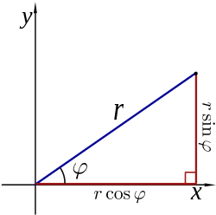
Hough Transform for Circles
A circle with radius r and center (a, b) can be described as:
x = a + r cos(θ)
y = b + r sin(θ)
(x, y)
ϴ
ϴ
(a, b)
ϴ

Slide 33
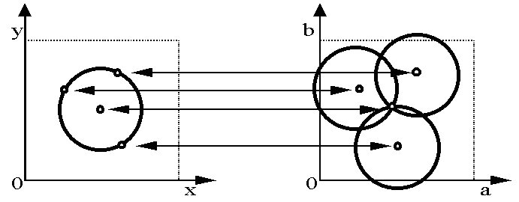
Hough Transform for Circles
Circle: center (a, b) and radius r
For a fixed radius r, unknown gradient direction
Image space
Hough space
Kristen Grauman
Notes:
1. We can have different circles with the same center
2. Map to hough space. Each point is a circle
3.

Slide 34
Hough Transform for Circles
Circle: center (a, b) and radius r
For a fixed radius r, unknown gradient direction
Intersection: most votes for center occur here.
Image space
Hough space
Kristen Grauman

Slide 35
Hough Transform for Circles
x = a + r cos(θ)
y = b + r sin(θ)
For every edge pixel (x,y) :
For each possible radius value r:
For each possible gradient direction θ:
// or use estimated gradient at (x,y)
a = x – r cos(θ) // column
b = y – r sin(θ) // row
H[a,b,r] += 1
end
end
end
x
θ
Your homework!
Modified from Kristen Grauman

Slide 36
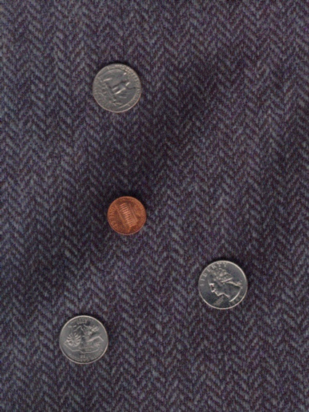
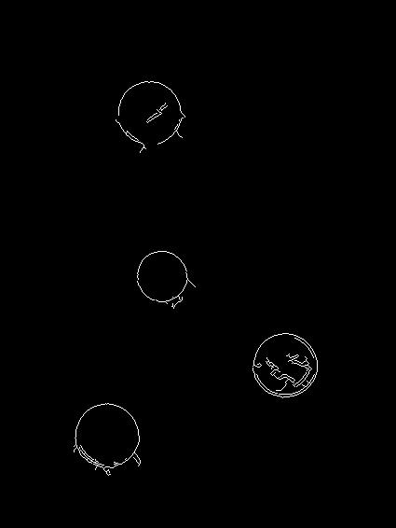
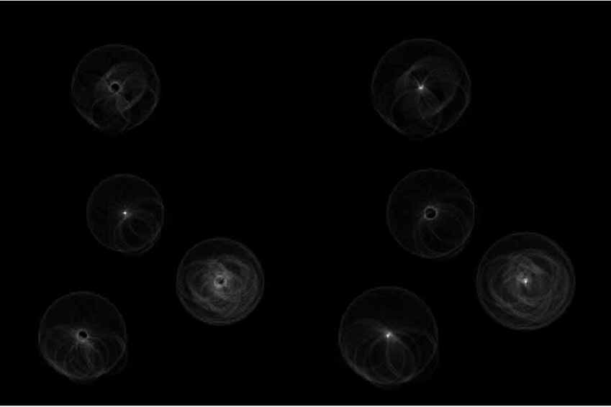
Example: Detecting Circles with Hough
Original
Edges
Votes: Penny
Note: a different Hough transform (with separate accumulators) was used for each circle radius (quarters vs. penny).
Kristen Grauman, images from Vivek Kwatra

Slide 37
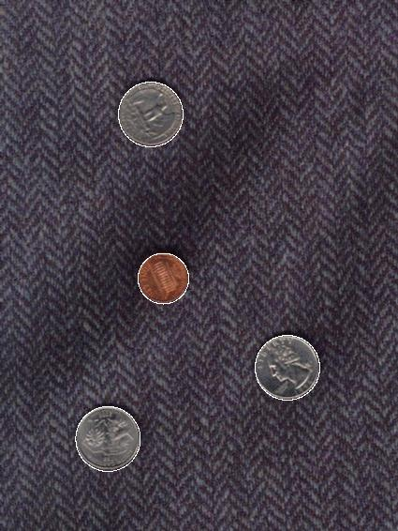
Example: Detecting Circles with Hough
Original
Edges
Votes: Quarter
Note: a different Hough transform (with separate accumulators) was used for each circle radius (quarters vs. penny).
Kristen Grauman, images from Vivek Kwatra

Slide 38
Hough transform: pros and cons
Pros
All points are processed independently, so can cope with occlusion, gaps
Some robustness to noise: noise points unlikely to contribute consistently to any single bin
Can detect multiple instances of a model in a single pass
Cons
Complexity of search time for maxima increases exponentially with the number of model parameters
  If 3 parameters and 10 choices for each, search is O(10³)
Quantization: can be tricky to pick a good grid size
Adapted from Kristen Grauman

Slide 39
Hough transform
Hough Transform Demo

Slide 40
RANSAC
RANdom Sample Consensus
Approach: we want to avoid the impact of outliers, so let’s look for “inliers”, and use those only.
Intuition: if an outlier is chosen to compute the current fit, then the resulting line won’t have much support from rest of the points.
Kristen Grauman

Slide 41
RANSAC: General Form
RANSAC loop:
Randomly select a seed group of s points on which to base model estimate (e.g. s=2 for a line)
Fit model to these s points
Find inliers to this model (i.e., points whose distance from the line is less than t)
Repeat N times
Keep the model with the largest number of inliers
Adapted from Kristen Grauman and Svetlana Lazebnik

Slide 42
RANSAC
_{(RANdom SAmple Consensus) :}
Fischler & Bolles in ‘81.
Line fitting example
Algorithm:
Sample (randomly) the number of points required to fit the model
Solve for model parameters using samples
Score by the fraction of inliers within a preset threshold of the model
Repeat 1-3 until the best model is found with high confidence
Silvio Savarese
Notes:
Let me give you an intuition of what is going on. Suppose we have the standard line fitting problem in presence of outliers.
We can formulate this problem as follows: want to find the best partition of points in inlier set and outlier set such that…
The objective consists of adjusting the parameters of a model function so as to best fit a data set.
"best" is defined by a function f that needs to be minimized.
Such that the best parameter of fitting the line give rise to a residual error lower that delta
as when the sum, S, of squared residuals

Slide 43
RANSAC
_{(RANdom SAmple Consensus) :}
Fischler & Bolles in ‘81.
Line fitting example
Algorithm:
Sample (randomly) the number of points required to fit the model (#=2)
Solve for model parameters using samples
Score by the fraction of inliers within a preset threshold of the model
Repeat 1-3 until the best model is found with high confidence
Silvio Savarese
Notes:
Let me give you an intuition of what is going on. Suppose we have the standard line fitting problem in presence of outliers.
We can formulate this problem as follows: want to find the best partition of points in inlier set and outlier set such that…
The objective consists of adjusting the parameters of a model function so as to best fit a data set.
"best" is defined by a function f that needs to be minimized.
Such that the best parameter of fitting the line give rise to a residual error lower that delta
as when the sum, S, of squared residuals

Slide 44
RANSAC
_{(RANdom SAmple Consensus) :}
Fischler & Bolles in ‘81.
Line fitting example
Algorithm:
Sample (randomly) the number of points required to fit the model (#=2)
Solve for model parameters using samples
Score by the fraction of inliers within a preset threshold of the model
Repeat 1-3 until the best model is found with high confidence
Silvio Savarese
Notes:
Let me give you an intuition of what is going on. Suppose we have the standard line fitting problem in presence of outliers.
We can formulate this problem as follows: want to find the best partition of points in inlier set and outlier set such that…
The objective consists of adjusting the parameters of a model function so as to best fit a data set.
"best" is defined by a function f that needs to be minimized.
Such that the best parameter of fitting the line give rise to a residual error lower that delta
as when the sum, S, of squared residuals

Slide 45
RANSAC
_{(RANdom SAmple Consensus) :}
Fischler & Bolles in ‘81.
Line fitting example
Algorithm:
Sample (randomly) the number of points required to fit the model (#=2)
Solve for model parameters using samples
Score by the fraction of inliers within a preset threshold of the model
Repeat 1-3 until the best model is found with high confidence
Silvio Savarese
Notes:
Let me give you an intuition of what is going on. Suppose we have the standard line fitting problem in presence of outliers.
We can formulate this problem as follows: want to find the best partition of points in inlier set and outlier set such that…
The objective consists of adjusting the parameters of a model function so as to best fit a data set.
"best" is defined by a function f that needs to be minimized.
Such that the best parameter of fitting the line give rise to a residual error lower that delta
as when the sum, S, of squared residuals

Slide 46
RANSAC
_{(RANdom SAmple Consensus) :}
Fischler & Bolles in ‘81.
Line fitting example
Algorithm:
Sample (randomly) the number of points required to fit the model (#=2)
Solve for model parameters using samples
Score by the fraction of inliers within a preset threshold of the model
Repeat 1-3 until the best model is found with high confidence
Silvio Savarese
Notes:
Let me give you an intuition of what is going on. Suppose we have the standard line fitting problem in presence of outliers.
We can formulate this problem as follows: want to find the best partition of points in inlier set and outlier set such that…
The objective consists of adjusting the parameters of a model function so as to best fit a data set.
"best" is defined by a function f that needs to be minimized.
Such that the best parameter of fitting the line give rise to a residual error lower that delta
as when the sum, S, of squared residuals

Slide 47
RANSAC pros and cons
Pros
  Applicable to many different problems, e.g. image stitching, relating two views
  Often works well in practice
Cons
  Lots of parameters to tune (see previous slide)
  Doesn’t work well for low inlier ratios (too many iterations, or can fail completely)
Adapted from Svetlana Lazebnik

Slide 48
Plan for today
Edges
  Extract gradients and threshold
Lines and circles
  Find which edge points are collinear or belong to another shape e.g. circle
  Automatically detect and ignore outliers
Segments
  Find which pixels form a consistent region
  Clustering (e.g. K-means)

Slide 49
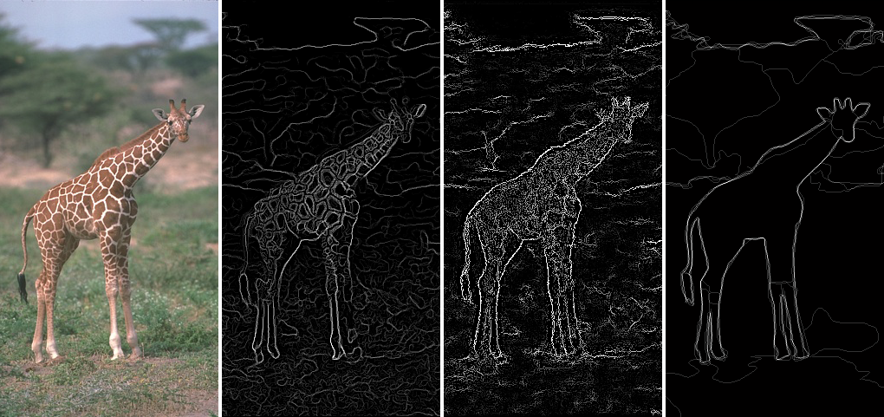
Edges vs Segments
Edges: More low-level; don’t need to be closed
Segments: Ideally one segment for each semantic group/object; should include closed contours
Figure adapted from J. Hays

Slide 50


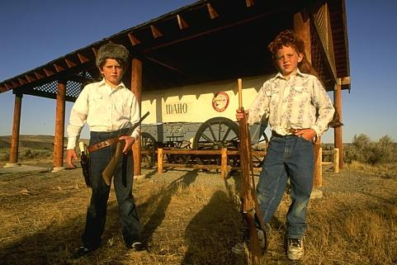

The goals of segmentation
Separate image into coherent “objects”
image
human segmentation
Source: L. Lazebnik

Slide 51
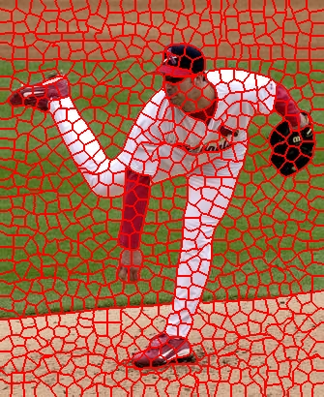
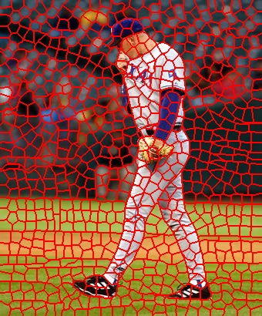
The goals of segmentation
Separate image into coherent “objects”
Group together similar-looking pixels for efficiency of further processing
“superpixels”
X. Ren and J. Malik. Learning a classification model for segmentation. ICCV 2003.
Source: L. Lazebnik

Slide 52
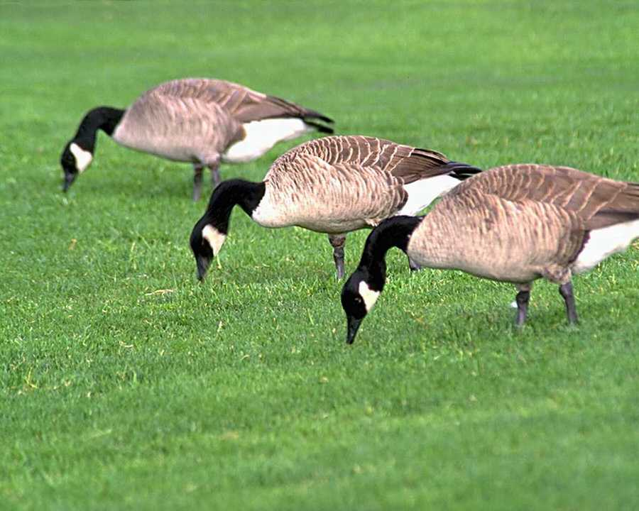
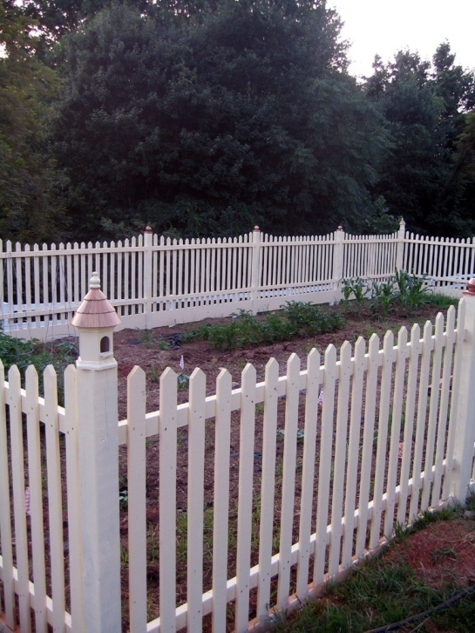
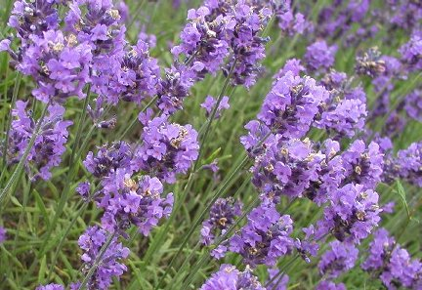
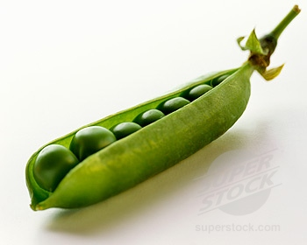
Similarity
Slide: K. Grauman

Slide 53
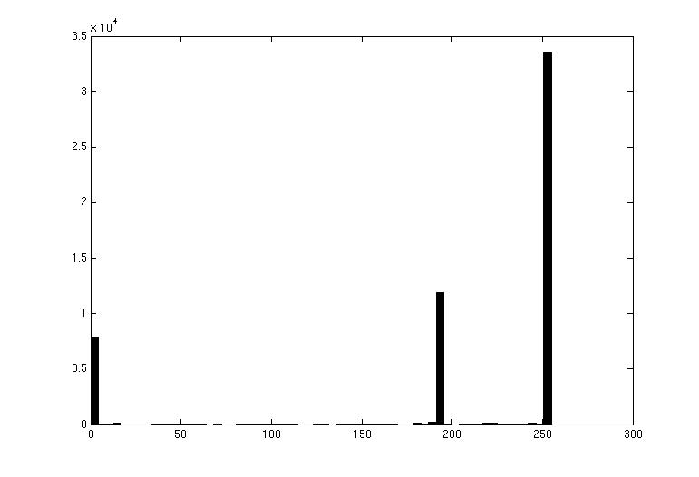

Image Segmentation: Toy Example
white pixels
pixel count
3
black pixels
gray pixels
1
2
input image
intensity
These intensities define the three groups.
We could label every pixel in the image according to which of these primary intensities it is.
  i.e., segment the image based on the intensity feature.
What if the image isn’t quite so simple?
Source: K. Grauman

Slide 54
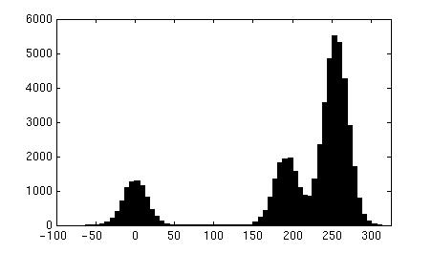
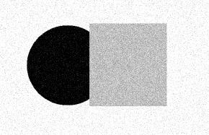
Image Segmentation: Toy Example
pixel count
input image
intensity
Now how to determine the three main intensities that define our groups?
We need to cluster.
Source: K. Grauman

Slide 55
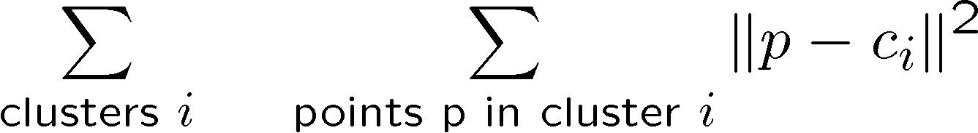
Image Segmentation: Toy Example
0
190
255
intensity
3
1
2
Goal: choose three “centers” as the representative intensities, and label every pixel according to which of these centers it is nearest to.
Best cluster centers are those that minimize sum of squared differences (SSD) between all points and their nearest cluster center ci:
Source: K. Grauman

Slide 56
Clustering
With this objective, it is a “chicken and egg” problem:
  If we knew the cluster centers, we could allocate points to groups by assigning each to its closest center.
  If we knew the group memberships, we could get the centers by computing the mean per group.
Source: K. Grauman

Slide 57
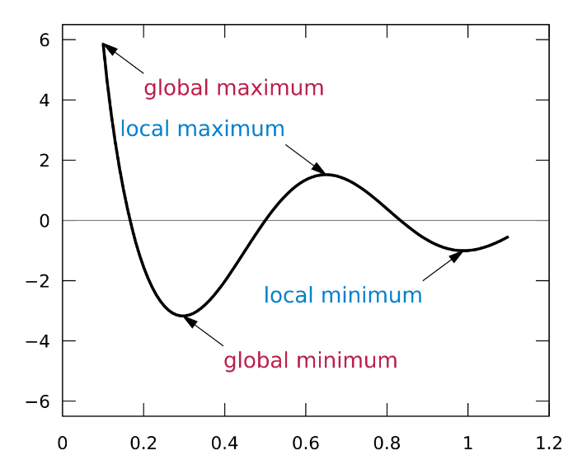
K-means clustering
Basic idea: randomly initialize the k cluster centers, and iterate between the two steps we just saw.
  Randomly initialize the cluster centers, c₁, ..., c_{K}
  Given cluster centers, determine points in each cluster
    For each point p, find the closest c_{i}. Put p into cluster i
  Given points in each cluster, solve for c_{i}
    Set c_{i} to be the mean of points in cluster i
  If c_{i} have changed, repeat Step 2
Properties
  Will always converge to some solution
  Can be a “local minimum” of objective:
Slide: Steve Seitz, image: Wikipedia

Slide 58
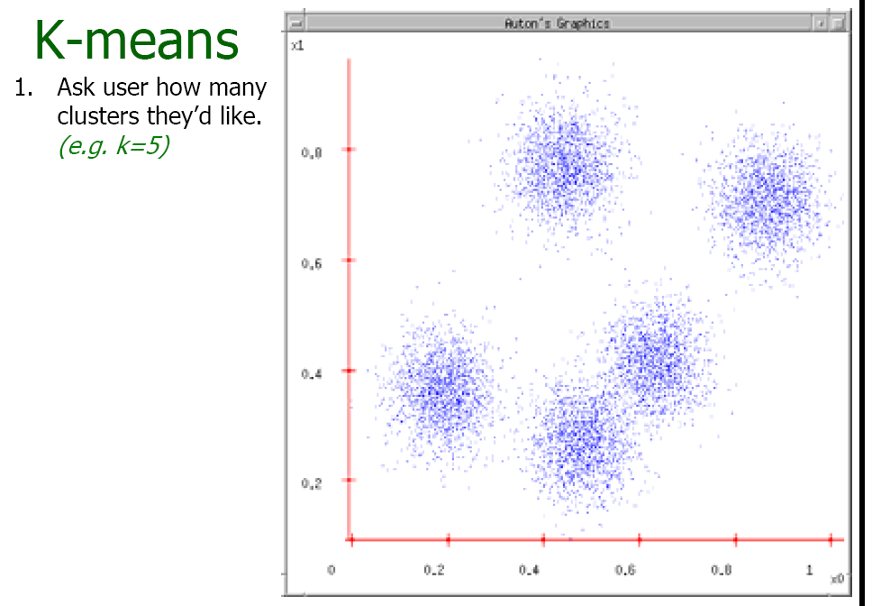
Source: A. Moore

Slide 59
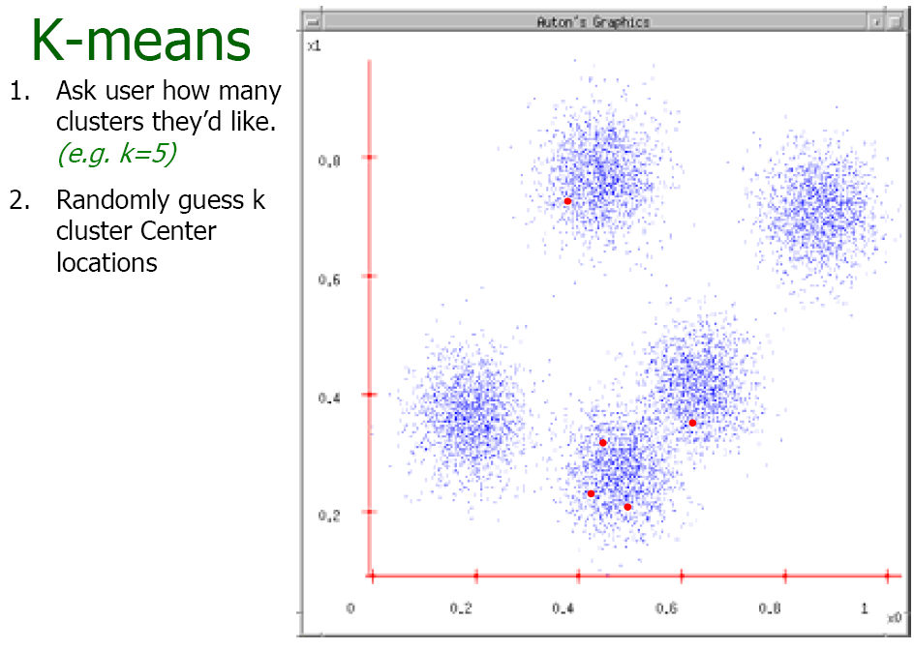
Source: A. Moore

Slide 60
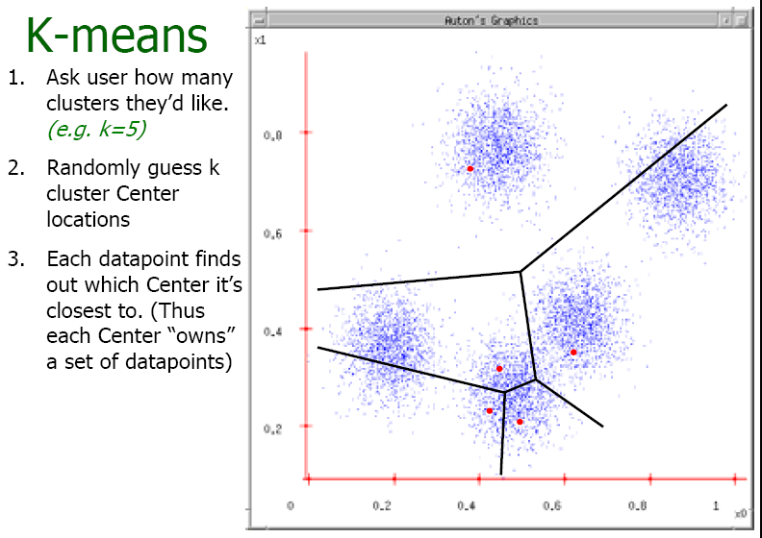
Source: A. Moore

Slide 61
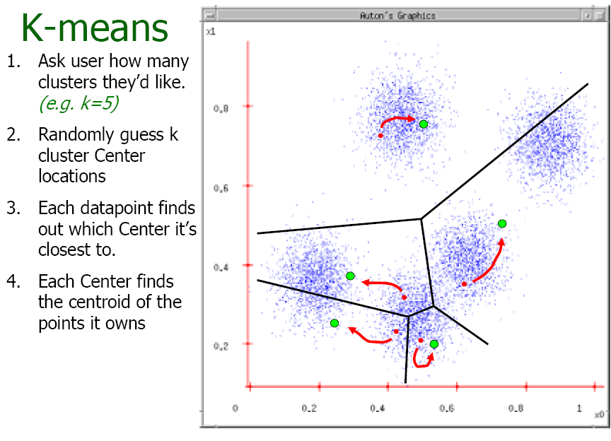
Source: A. Moore

Slide 62
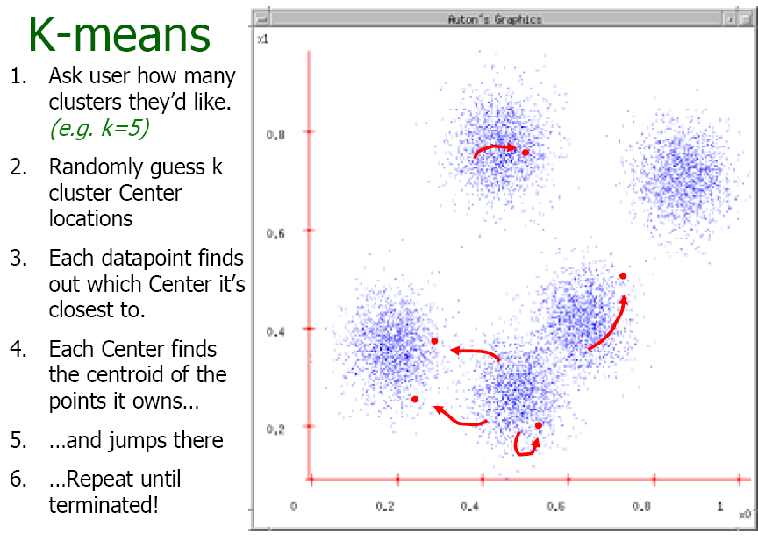
Source: A. Moore

Slide 63
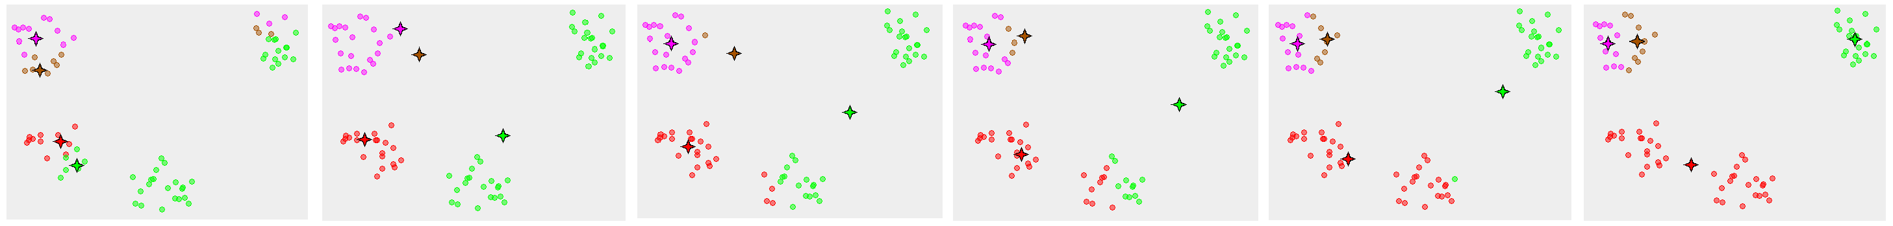
K-means converges to a local minimum
How can I try to fix this problem?
Adapted from James Hays
Notes:
Many random initializations

Slide 64
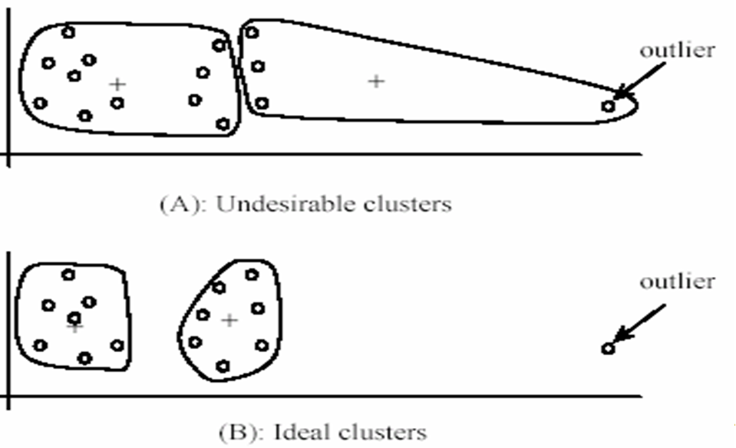
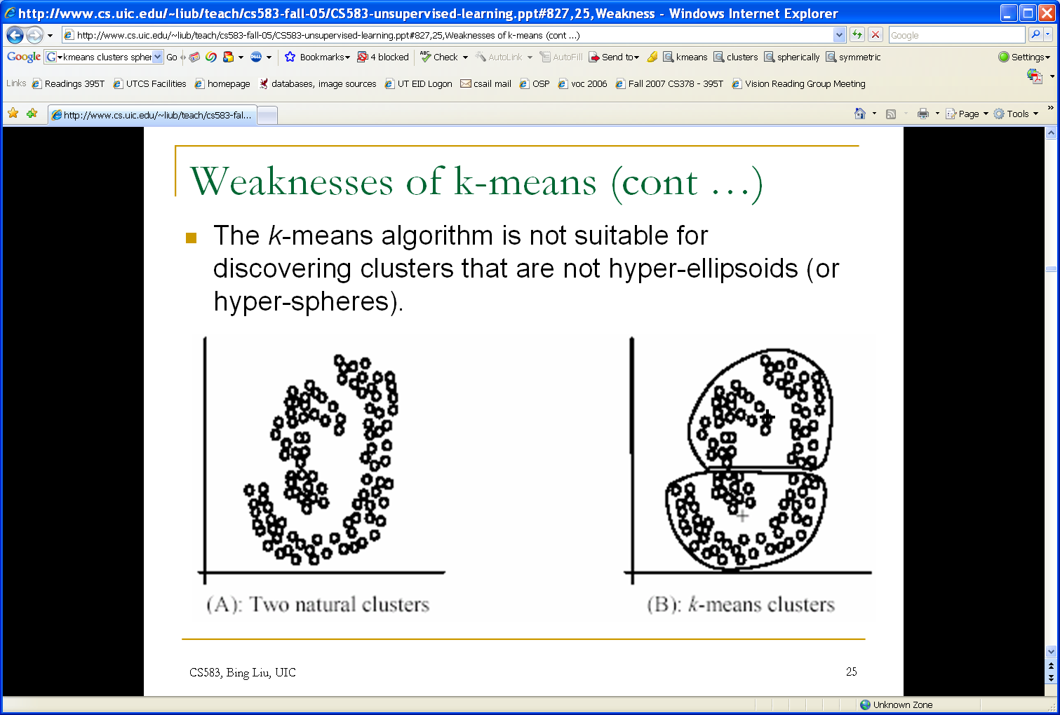
K-means: pros and cons
Pros
Simple, fast to compute
Converges to local minimum of within-cluster squared error
Cons/issues
Setting k?
  One way: silhouette coefficient
Sensitive to initial centers
  Use heuristics or output of another method
Sensitive to outliers
Detects spherical clusters
Adapted from K. Grauman
Notes:
64

Slide 65
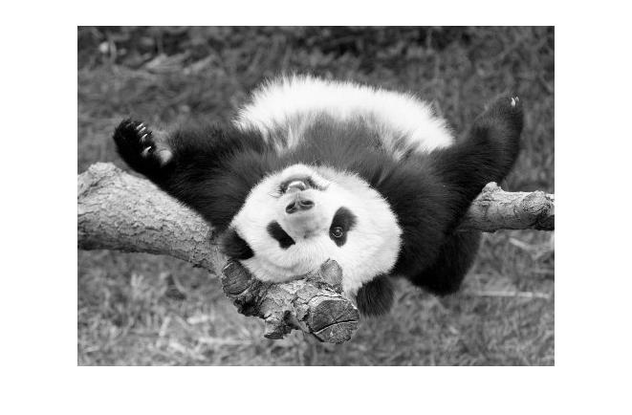
Segmentation as Clustering
Depending on what we choose as the feature space, we can group pixels in different ways.
Grouping pixels based on intensity similarity
Feature space: intensity value (1-d)
Source: K. Grauman
Notes:
65

Slide 66
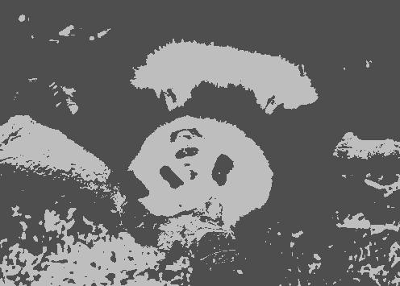
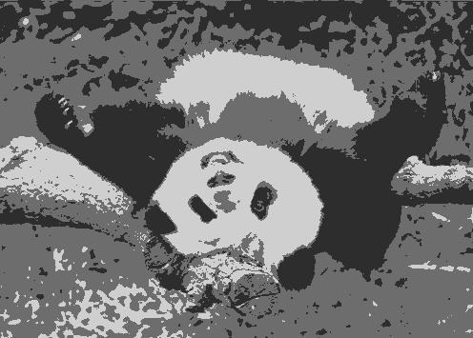
K=2
K=3
Adapted from K. Grauman

Slide 67
Segmentation as Clustering
Depending on what we choose as the feature space, we can group pixels in different ways.
Grouping pixels based on intensity similarity
Clusters based on intensity similarity don’t have to be spatially coherent.
Source: K. Grauman
Notes:
67

Slide 68
Segmentation as Clustering
Depending on what we choose as the feature space, we can group pixels in different ways.
Grouping pixels based
on intensity+position similarity
Intensity
Y
X
Both regions are black, but if we also include position (x,y), then we could group the two into distinct segments; way to encode both similarity & proximity.
Source: K. Grauman
Notes:
68

Slide 69
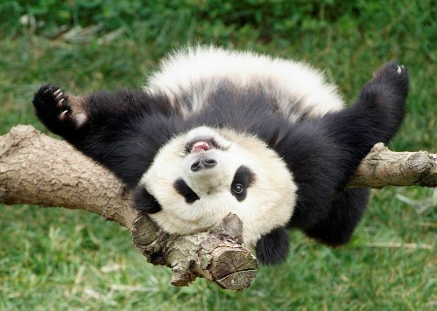
Segmentation as Clustering
Depending on what we choose as the feature space, we can group pixels in different ways.
R=255
G=200
B=250
Grouping pixels based on color similarity
B
R=245
G=220
B=248
G
R=15
G=189
B=2
R=3
G=12
B=2
R
Feature space: color value (3-d)
Adapted from K. Grauman
Notes:
69

Slide 70
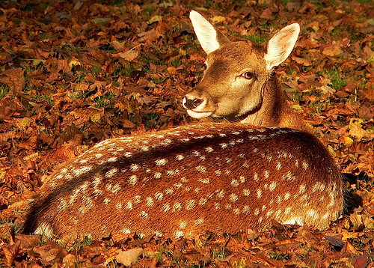
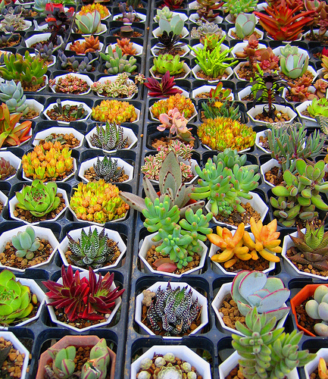

Segmentation as Clustering
Color, brightness, position alone are not enough to distinguish all regions…
Source: L. Lazebnik

Slide 71

Segmentation as Clustering
Depending on what we choose as the feature space, we can group pixels in different ways.
Grouping pixels based on texture similarity
F₁
F₂
Filter bank of 24 filters
…
F₂₄
Feature space: filter bank responses (e.g., 24-d)
Source: K. Grauman
Notes:
71

Slide 72




State-of-the-art (instance) segmentation: Mask R-CNN
72
Classification Scores: C
Box coordinates (per class): 4 * C
CNN
Conv
Conv
RoI Align
Predict a mask for each of C classes
May 10, 2017
He et al, “Mask R-CNN”, ICCV 2017; slide adapted from Justin Johnson

Slide 73
Summary: classic approaches
Edges: threshold gradient magnitude
Lines: edge points vote for parameters of line, circle, etc. (works for general objects)
Segments: use clustering (e.g. K-means) to group pixels by intensity, texture, etc.

