Slide 1

CS 1674: Visual Recognition
PhD. Nils Murrugarra-Llerena
nem177@pitt.edu

Slide 2

Plan for this lecture
What is recognition?
  a.k.a. classification, categorization
Support vector machines
  Separable case / non-separable case
  Linear / non-linear (kernels)
Example approach for scene classification
The importance of generalization
  The bias-variance trade-off (applies to all classifiers)

Slide 3
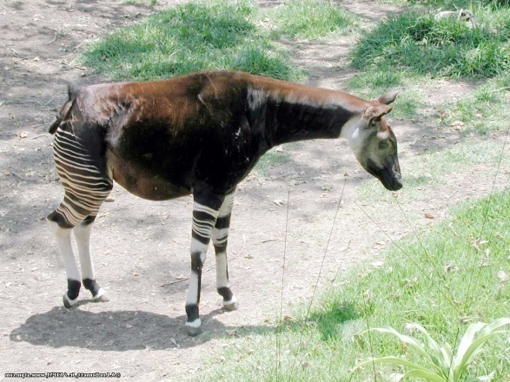
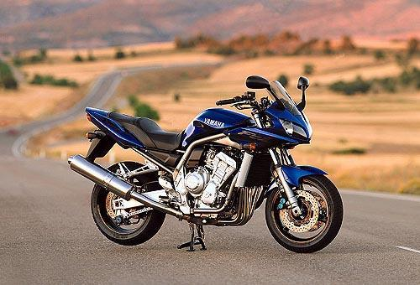
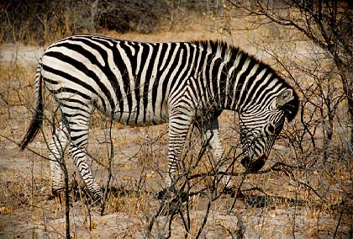
Classification
Given a feature representation for images, how do we learn a model for distinguishing features from different classes?
Decision
boundary
Zebra
Non-zebra
Slide credit: L. Lazebnik

Slide 4
Classification
Assign input vector to one of two or more classes
Input space divided into decision regions separated by decision boundaries
Slide credit: L. Lazebnik

Slide 5
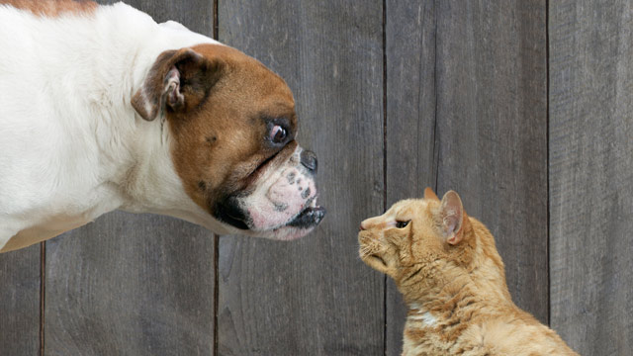
Examples of image classification
Two-class (binary): Cat vs Dog
Adapted from D. Hoiem

Slide 6
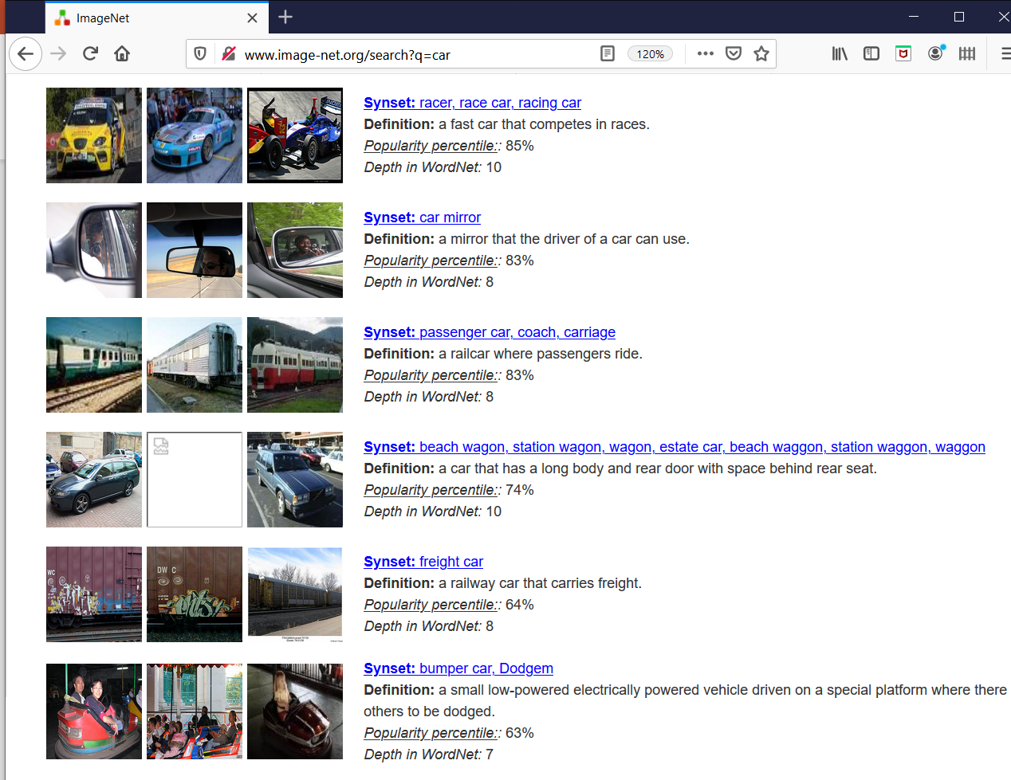
Examples of image classification
Multi-class (often): Object recognition

Slide 7
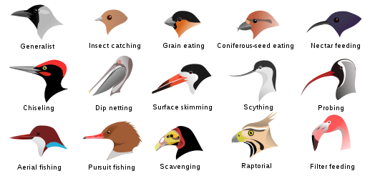
Examples of image classification
Fine-grained recognition
Visipedia Project
Slide credit: D. Hoiem

Slide 8
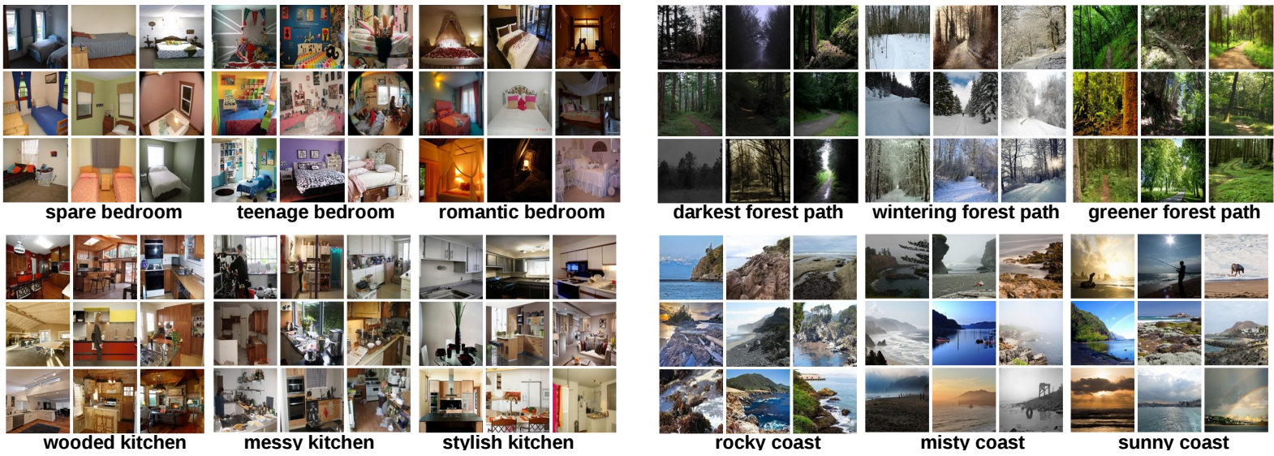
Examples of image classification
Place recognition
Places Database [Zhou et al. NIPS 2014]
Slide credit: D. Hoiem

Slide 9
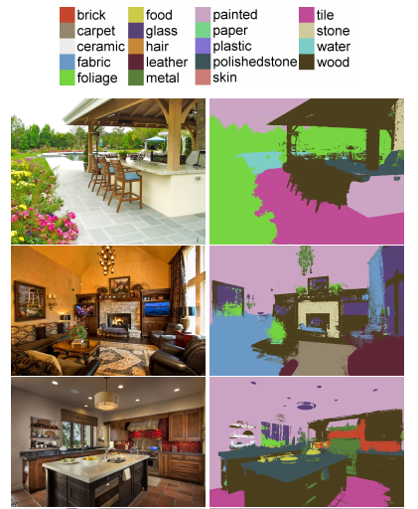

Examples of image classification
Material recognition
[Bell et al. CVPR 2015]
Slide credit: D. Hoiem

Slide 10
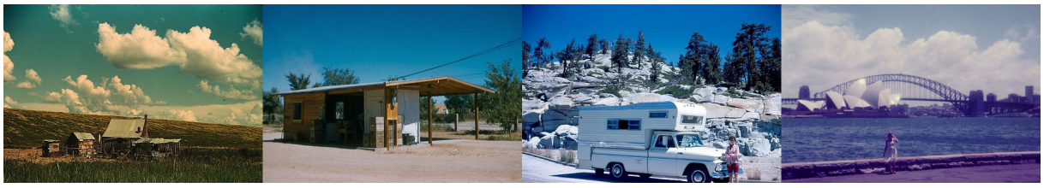
Examples of image classification
Dating historical photos
1940
1953
1966
1977
[Palermo et al. ECCV 2012]
Slide credit: D. Hoiem

Slide 11
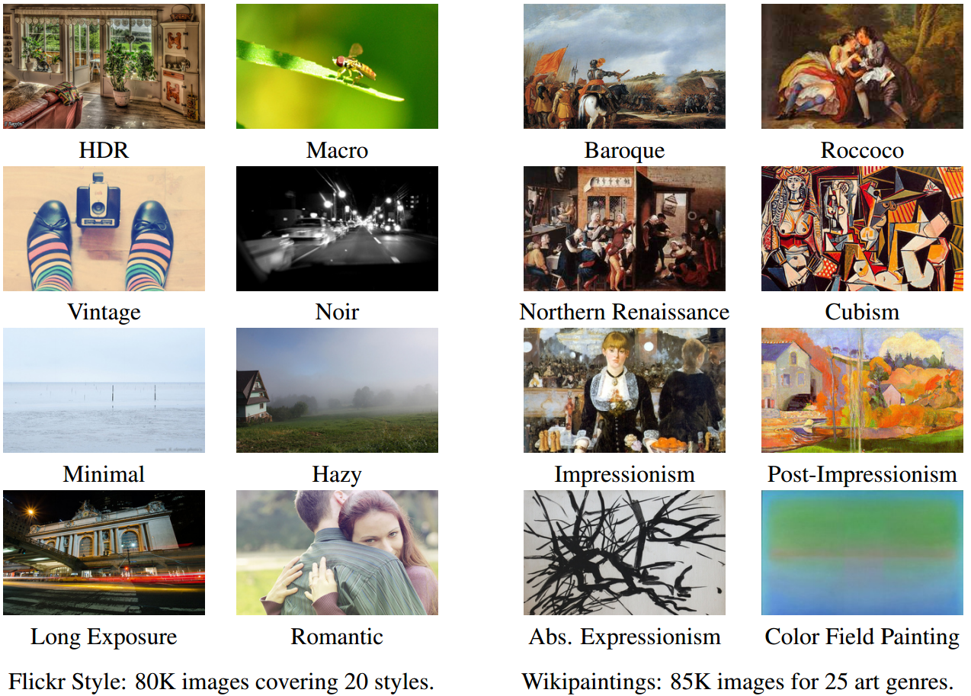
Examples of image classification
Image style recognition
[Karayev et al. BMVC 2014]
Slide credit: D. Hoiem

Slide 12
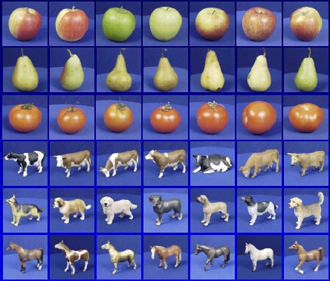
Recognition: A machine learning approach

Slide 13



The machine learning framework
Apply a prediction function to a feature representation of the image to get the desired output:
f( ) = “apple”
f( ) = “tomato”
f( ) = “cow”
Slide credit: L. Lazebnik

Slide 14
The machine learning framework
y* = f(x)
Training: given a training set of labeled examples {(x₁,y₁), …, (x_{N},y_{N})}, estimate the prediction function f by minimizing the prediction error on the training set, e.g. |f(x_{i}) – y_{i}|
  Evaluate multiple hypotheses f₁, f₂, f_{H} … and pick the best one as f
Testing: apply f to a never-before-seen test example x and output the predicted value y* = f(x)
output (may differ from ground-truth label y)
prediction function
image / image features
Slide credit: L. Lazebnik

Slide 15

The old-school way
Training Labels
Training Images
Image Features
Training
Learned model
Training
Image Features
Learned model
Prediction
Testing
Test Image
Slide credit: D. Hoiem and L. Lazebnik

Slide 16
The simplest classifier
Training examples from class 2
Training examples from class 1
Test example
f(x) = label of the training example nearest to x
All we need is a distance function for our inputs
No training required!
Slide credit: L. Lazebnik

Slide 17
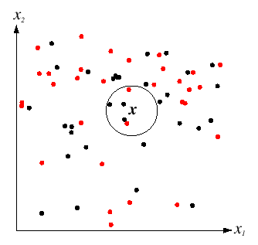
K-Nearest Neighbors classification
For a new point, find the k closest points from training data
Labels of the k points “vote” to classify
k = 5
Black = positive
Red = negative
If query lands here, the 5 NN consist of 3 positives and 2 negatives, so we classify it as positive.
Slide credit: D. Lowe

Slide 18
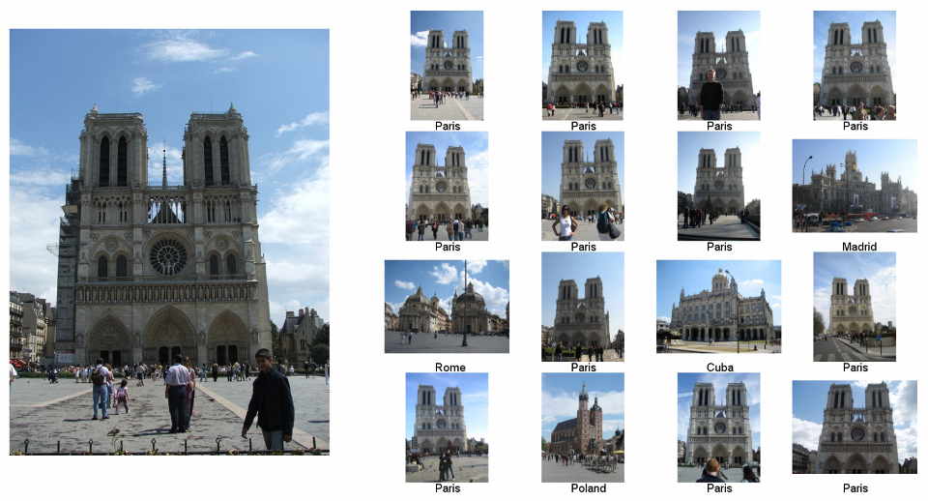
Im2gps: Estimating Geographic Information from a Single Image
[James Hays and Alexei Efros, CVPR 2008]
Where was this image taken?
Nearest Neighbors according to BOW-SIFT + color histogram + a few others
Slide credit: James Hays

Slide 19
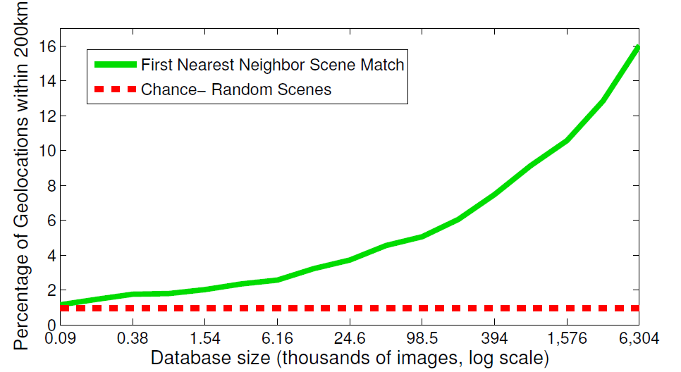
The Importance of Data
Slides: James Hays

Slide 20
Linear classifier
Find a linear function to separate the classes
f(x) = sgn(w₁x₁ + w₂x₂ + … + w_{D}x_{D}) = sgn(w ⋅ x)
Slide credit: L. Lazebnik

Slide 21
Linear Classifier
Decision = sign(w^{T}x) = sign(w1*x1 + w2*x2)
x2
x1
(0, 0)
What should the weights be?

Slide 22
Lines in R²
Let
Compare to:
slope*x + y-intercept = y
ax + b = -cy
(-a/c) x + (-b/c) = y
Slope: -a/c
Y-intercept: -b/c
Kristen Grauman

Slide 23
Lines in R²
Slope: -a/c
Y-intercept: -b/c
Let
Kristen Grauman
Notes:
TODO: update w transpose

Slide 24
Lines in R²
Slope: -a/c
Y-intercept: -b/c
Let
Kristen Grauman

Slide 25
Lines in R²
Slope: -a/c
Y-intercept: -b/c
Let
distance from point to line
Kristen Grauman
Notes:
https://brilliant.org/wiki/distance-between-point-and-line/

Slide 26
Lines in R²
Slope: -a/c
Y-intercept: -b/c
Let
distance from point to line
Adapted from Kristen Grauman

Slide 27
Linear classifiers
Find linear function to separate positive and negative examples
B
C
A
D
Which line
is best?
C. Burges, A Tutorial on Support Vector Machines for Pattern Recognition, Data Mining and Knowledge Discovery, 1998

Slide 28
Linear classifiers
Find linear function to separate positive and negative examples
B
C
A
D
Not seen until test time,
of class blue
Which line
is best?
C. Burges, A Tutorial on Support Vector Machines for Pattern Recognition, Data Mining and Knowledge Discovery, 1998

Slide 29
Support vector machines
Discriminative classifier based on optimal separating line (for 2d case)
Maximize the margin between the positive and negative training examples
C. Burges, A Tutorial on Support Vector Machines for Pattern Recognition, Data Mining and Knowledge Discovery, 1998

Slide 30
Support vector machines
Want line that maximizes the margin.
wx+b=1
wx+b=0
wx+b=-1
For support, vectors,
Support vectors
Margin
C. Burges, A Tutorial on Support Vector Machines for Pattern Recognition, Data Mining and Knowledge Discovery, 1998

Slide 31
Support vector machines
Want line that maximizes the margin.
wx+b=1
wx+b=0
wx+b=-1
For support, vectors,
Distance between point and line:
For support vectors:
Support vectors
Margin
C. Burges, A Tutorial on Support Vector Machines for Pattern Recognition, Data Mining and Knowledge Discovery, 1998

Slide 32
Support vector machines
Want line that maximizes the margin.
wx+b=1
wx+b=0
wx+b=-1
For support, vectors,
Distance between point and line:
Therefore, the margin is 2 / ||w||
Support vectors
Margin
C. Burges, A Tutorial on Support Vector Machines for Pattern Recognition, Data Mining and Knowledge Discovery, 1998

Slide 33
Finding the maximum margin line
Maximize margin 2/||w||
Correctly classify all training data points:
Quadratic optimization problem:
Minimize
Subject to y_{i}(w·x_{i}+b) ≥ 1
One constraint per training point.
Note sign trick:
w·x_{i} + b >= 1 (if y_{i} = 1)
w·x_{i} + b <= -1 (if y_{i} = -1)
(-1) w·x_{i} - b >= 1
Adapted from C. Burges, A Tutorial on Support Vector Machines for Pattern Recognition

Slide 34
Finding the maximum margin line
Solution:
Learned
weight
Support
vector
C. Burges, A Tutorial on Support Vector Machines for Pattern Recognition, Data Mining and Knowledge Discovery, 1998

Slide 35
Finding the maximum margin line
Solution:
b = y_{i} – w·x_{i} (for any support vector)
Classification function:
Notice that it relies on an inner product between the test point x and the support vectors x_{i}
(Solving the optimization problem also involves computing the inner products x_{i} · x_{j} between all pairs of training points)
If f(x) < 0, classify as negative, otherwise classify as positive.
C. Burges, A Tutorial on Support Vector Machines for Pattern Recognition, Data Mining and Knowledge Discovery, 1998

Slide 36
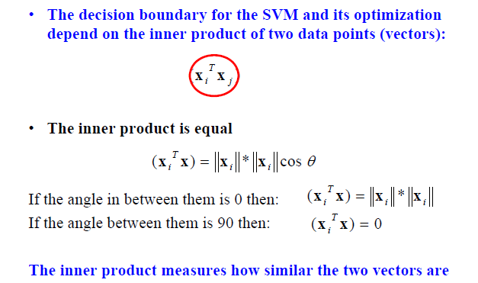
Inner product
Adapted from Milos Hauskrecht

Slide 37
Nonlinear SVMs
Datasets that are linearly separable work out great:
But what if the dataset is just too hard?
We can map it to a higher-dimensional space:
0
x
0
x
x²
Andrew Moore
0
x

Slide 38
Nonlinear SVMs
General idea: the original input space can always be mapped to some higher-dimensional feature space where the training set is separable:
Φ: x → φ(x)
Andrew Moore

Slide 39
Nonlinear kernel: Example
Consider the mapping
x²
Svetlana Lazebnik

Slide 40
The “Kernel Trick”
The linear classifier relies on dot product between vectors K(x_{i} , x_{j}) = x_{i} · x_{j}
If every data point is mapped into high-dimensional space via some transformation Φ: x_{i} → φ(x_{i} ), the dot product becomes: K(x_{i} , x_{j}) = φ(x_{i} ) · φ(x_{j})
A kernel function is similarity function that corresponds to an inner product in some expanded feature space
The kernel trick: instead of explicitly computing the lifting transformation φ(x), define a kernel function K such that: K(x_{i} , x_{j}) = φ(x_{i} ) · φ(x_{j})
Andrew Moore

Slide 41
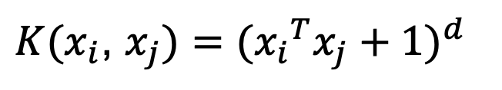
Examples of kernel functions
Linear:
Polynomials of degree up to d:
Gaussian RBF:
Histogram intersection:
$K(x_{i}$, $x_{j})={({x_{i}}^{T}x_{j}+1)}^{d}$
Andrew Moore / Carlos Guestrin

Slide 42
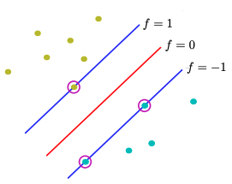
Hard-margin SVMs
The w that minimizes…
Maximize margin

Slide 43
Soft-margin SVMs
# data samples
Misclassification
cost
Slack variable
The w that minimizes…
Maximize margin
Minimize misclassification
Figure from Chris Bishop

Slide 44
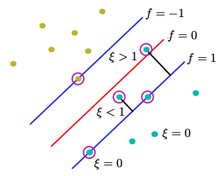
Soft-margin SVMs
ε>1
[Miss-classified points]
ε=0
[Easy to classify]
ε<1
[Points close to decision boundary]
Ideal Case
Figure from Chris Bishop
Notes:
http://www.cs.toronto.edu/~mbrubake/teaching/C11/Handouts/SupportVectorMachines.pdf

Slide 45
Soft-margin SVMs
ε>1
[Miss-classified points]
Slack variables allow:
Certain training points can be within the margin.
We want these number of points as small as possible.
How do we minimize the second term in the optimization?
A lot of examples with ε=0 (easy correctly classified)
Medium quantity of examples with 0<ε<1 (correct classified inside margin)
Few examples with ε>1 (misclassified examples)
ε<1
[Points close to decision boundary]
Figure from Chris Bishop
Notes:
http://www.cs.toronto.edu/~mbrubake/teaching/C11/Handouts/SupportVectorMachines.pdf
We minimize the second term having a lot of e=0, middle portion on 0<e<1, and less in e>1 (misclassified points)

Slide 46
What about multi-class SVMs?
Unfortunately, there is no “definitive” multi-class SVM formulation
In practice, we have to obtain a multi-class SVM by combining multiple two-class SVMs
One vs. others/all
  Training: learn an SVM for each class vs. the others
  Testing: apply each SVM to the test example, and assign it to the class of the SVM that returns the highest decision value
One vs. one
  Training: learn an SVM for each pair of classes
  Testing: each learned SVM “votes” for a class to assign to the test example
Svetlana Lazebnik

Slide 47
Multi-class problems
One-vs-all (a.k.a. one-vs-others)
  Train K classifiers
  In each, pos = data from class i, neg = data from classes other than i
  The class with the most confident prediction wins
  Example:
    You have 4 classes, train 4 classifiers
    1 vs others: score 3.5
    2 vs others: score 6.2
    3 vs others: score 1.4
    4 vs other: score 5.5
    Final prediction: class 2

Slide 48
Multi-class problems
One-vs-one (a.k.a. all-vs-all)
  Train K(K-1)/2 binary classifiers (all pairs of classes)
  They all vote for the label
  Example:
    You have 4 classes, then train 6 classifiers
    1 vs 2, 1 vs 3, 1 vs 4, 2 vs 3, 2 vs 4, 3 vs 4
    Votes: 1, 1, 4, 2, 4, 4
    Final prediction is class 4

Slide 49
Using SVMs
Select a kernel function.
Compute pairwise kernel values between labeled examples.
Use this “kernel matrix” to solve for SVM support vectors & alpha weights.
To classify a new example: compute kernel values between new input and support vectors, apply alpha weights, check sign of output.
Adapted from Kristen Grauman

Slide 50
Some SVM packages
LIBSVM http://www.csie.ntu.edu.tw/~cjlin/libsvm/
LIBLINEAR https://www.csie.ntu.edu.tw/~cjlin/liblinear/
SVM Light http://svmlight.joachims.org/
Scikit Learn https://scikit-learn.org/stable/modules/svm.html

Slide 51
Linear classifiers vs nearest neighbors
Linear pros:
  Low-dimensional parametric representation
  Very fast at test time
Linear cons:
  Can be tricky to select best kernel function for a problem
  Learning can take a very long time for large-scale problem
NN pros:
  Works for any number of classes
  Decision boundaries not necessarily linear
  Nonparametric method
  Simple to implement
NN cons:
  Slow at test time (large search problem to find neighbors)
  Storage of data
  Especially need good distance function (but true for all classifiers)
Adapted from L. Lazebnik

Slide 52

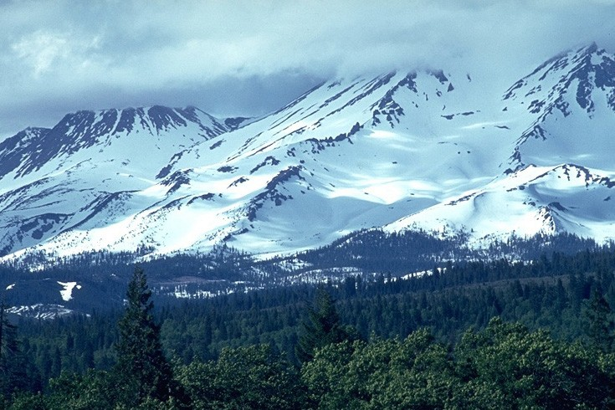
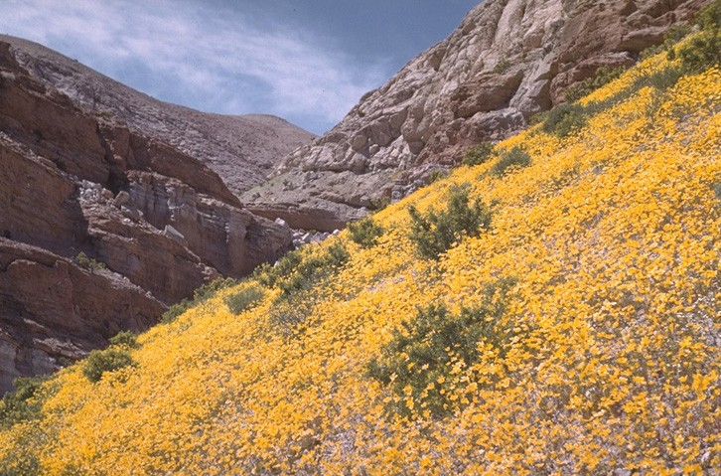
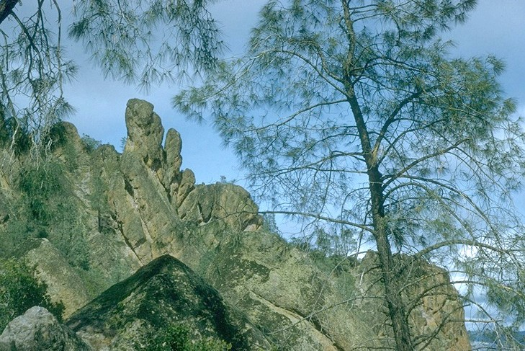
Beyond Bags of Features: Spatial Pyramid Matching for Recognizing Natural Scene Categories
CVPR 2006
Svetlana Lazebnik (slazebni@uiuc.edu)
Beckman Institute, University of Illinois at Urbana-Champaign
Cordelia Schmid (cordelia.schmid@inrialpes.fr)
INRIA Rhône-Alpes, France
Jean Ponce (ponce@di.ens.fr)
Ecole Normale Supérieure, France
Winner of 2016 Longuet-Higgins Prize

Slide 53
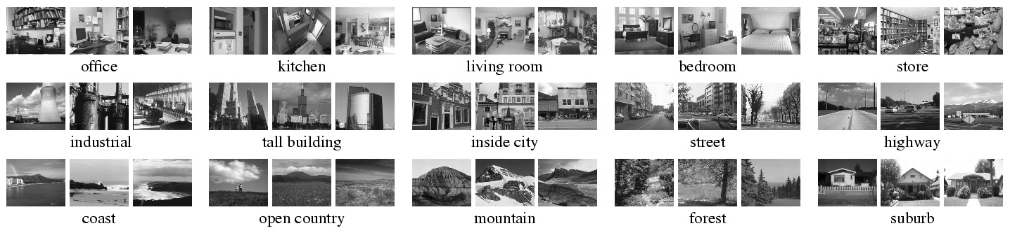
Scene category dataset
Fei-Fei & Perona (2005), Oliva & Torralba (2001)
http://www-cvr.ai.uiuc.edu/ponce_grp/data
Slide credit: L. Lazebnik

Slide 54



Bag-of-words representation
Extract local features
Learn “visual vocabulary” using clustering
Quantize local features using visual vocabulary
Represent images by frequencies of “visual words”
Slide credit: L. Lazebnik

Slide 55
Image categorization with bag of words
Training
Compute bag-of-words representation for training images
Train classifier on labeled examples using histogram values as features
Labels are the scene types (e.g. mountain vs field)
Testing
Extract keypoints/descriptors for test images
Quantize into visual words using the clusters computed at training time
Compute visual word histogram for test images
Compute labels on test images using classifier obtained at training time
Evaluation only, do only once: Measure accuracy of test predictions by comparing them to ground-truth test labels (obtained from humans)
Adapted from D. Hoiem

Slide 56

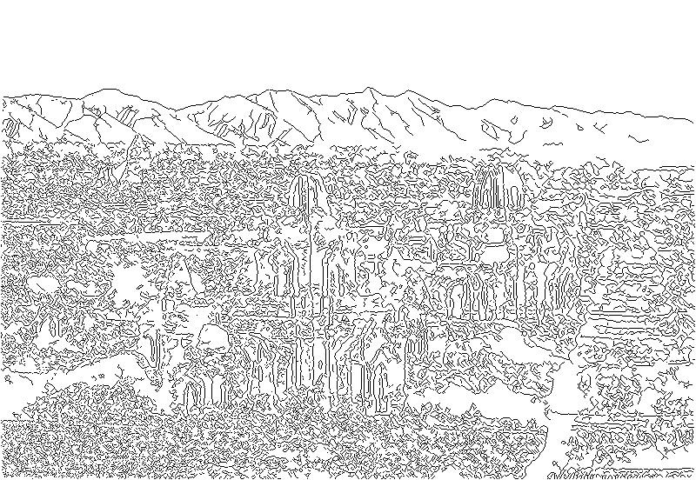
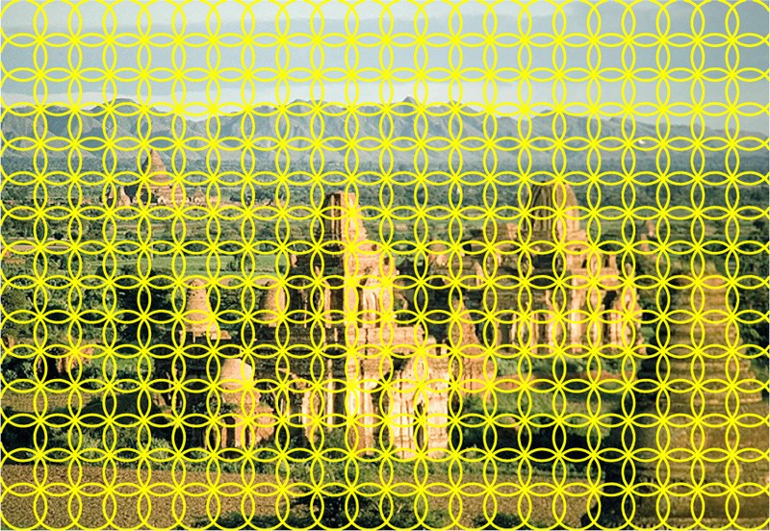
Feature extraction (on which BOW is based)
Weak features
Strong features
Edge points at 2 scales and 8 orientations (vocabulary size 16)
SIFT descriptors of 16x16 patches sampled on a regular grid, quantized to form visual vocabulary (size 200, 400)
Slide credit: L. Lazebnik

Slide 57
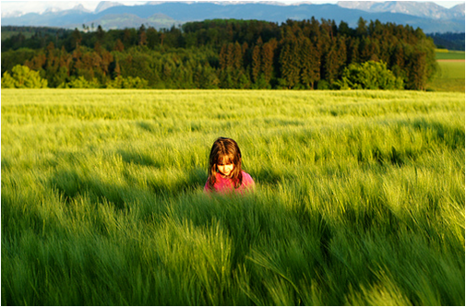
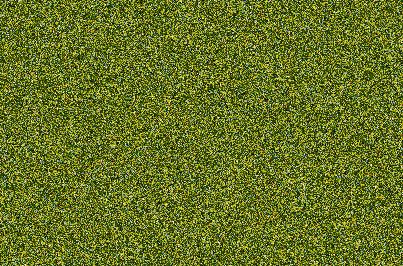
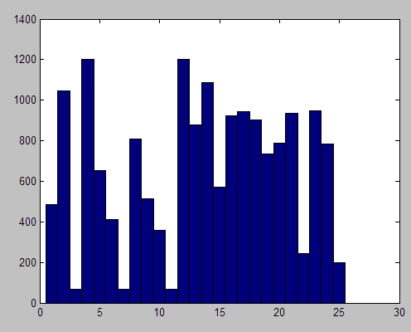
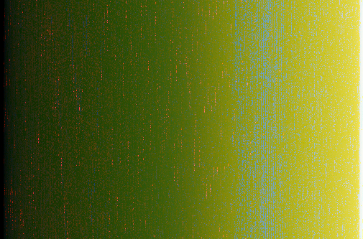
What about spatial layout?
All of these images have the same color histogram
Slide credit: D. Hoiem
Notes:
So far, global histogram over the whole image discard spatial information
Images contain structures and looking at a scene spatial distribution of feature we want to capture but we throw them away
Result in the fact that I can construct a very different image and still get the same histogram
This image is obvious a scene on grassland but with the noisy and gradient image on the bottom, color histogram

Slide 58
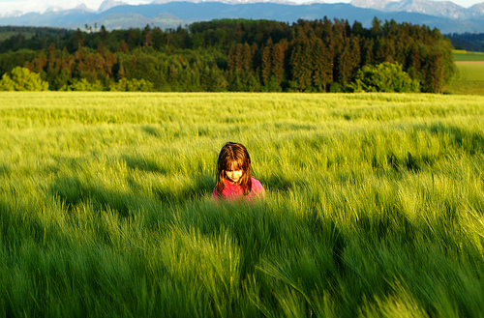
Spatial pyramid
Compute histogram in each spatial bin
Slide credit: D. Hoiem
Notes:
Overcome this, global, pyramid of histogram
Split into spatial bins at several levels and compute the histogram in each of them

Slide 59
Spatial pyramid
[Lazebnik et al. CVPR 2006]
Slide credit: D. Hoiem
Notes:
In more details, we still have the global histogram, but then I also have histograms computed in this 2x2 grid and histogram computed in 4x4 grid
Each of the histograms are individual normalized. They are weighted because you want each level to have equal weights, and combined together.
This spatial pyramid bag of bow is often considered as the goto feature to image categorization, works best for scenes, also works for most object.
One critism high dimensionality and you can deal with by doing PCA dimension reduction

Slide 60
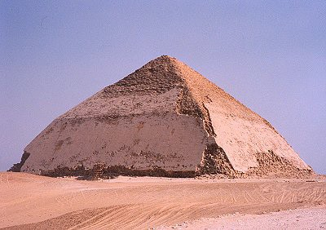
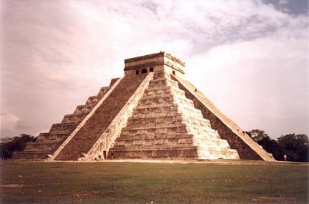
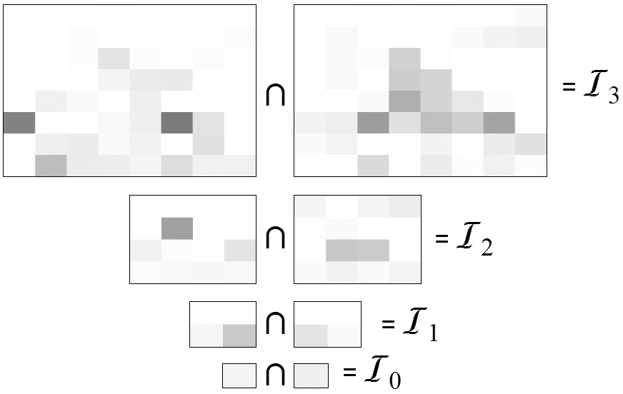
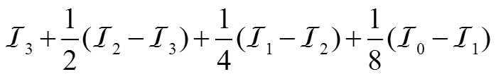
Pyramid Matching
[Indyk & Thaper (2003), Grauman & Darrell (2005)]
x_{i}
x_{j}
Matching using pyramid and histogram intersection for some particular visual word:
Original images
Feature histograms: Level 3
Level 2
Level 1
Level 0
Total weight (value of pyramid match kernel):
K( x_{i} , x_{j} )
Adapted from L. Lazebnik

Slide 61
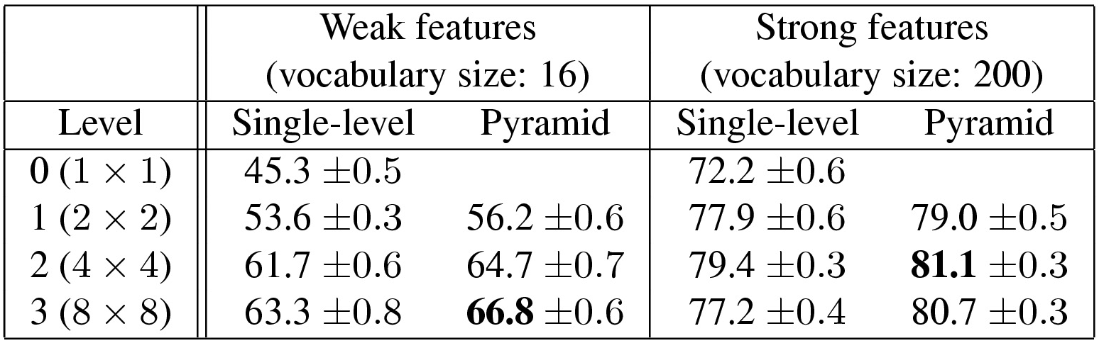
Scene category dataset
Fei-Fei & Perona (2005), Oliva & Torralba (2001)
http://www-cvr.ai.uiuc.edu/ponce_grp/data
Multi-class classification results (100 training images per class)
Fei-Fei & Perona: 65.2%
Slide credit: L. Lazebnik

Slide 62
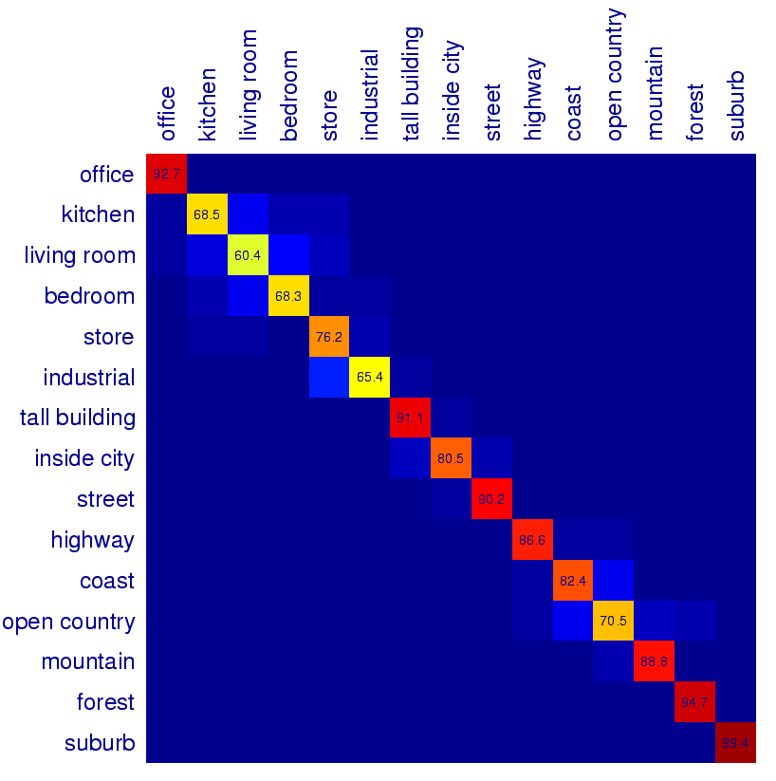
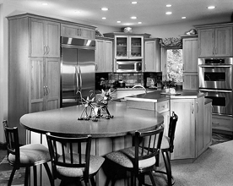
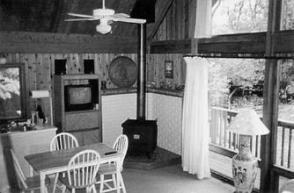
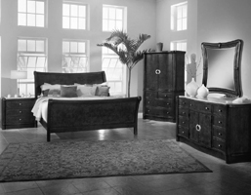
Scene Category Confusions
Predicted
Ground Truth
Difficult indoor images
kitchen
living room
bedroom
Slide credit: L. Lazebnik

Slide 63
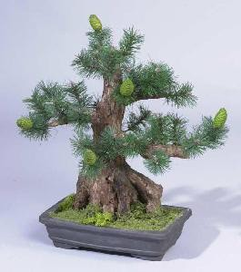
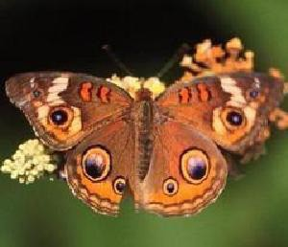
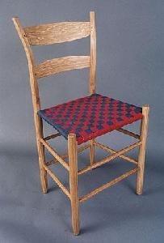
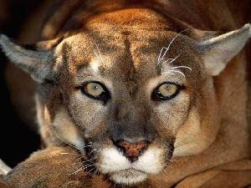

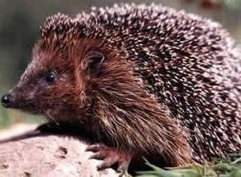
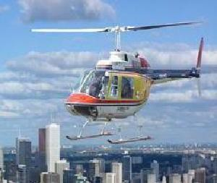
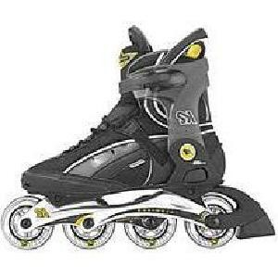


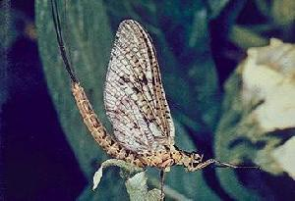
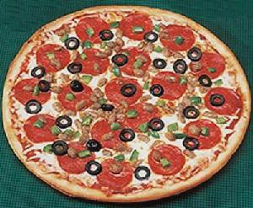
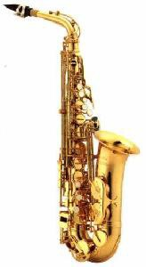
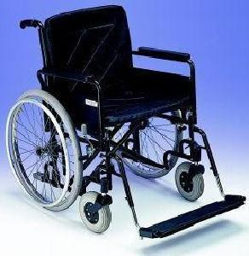
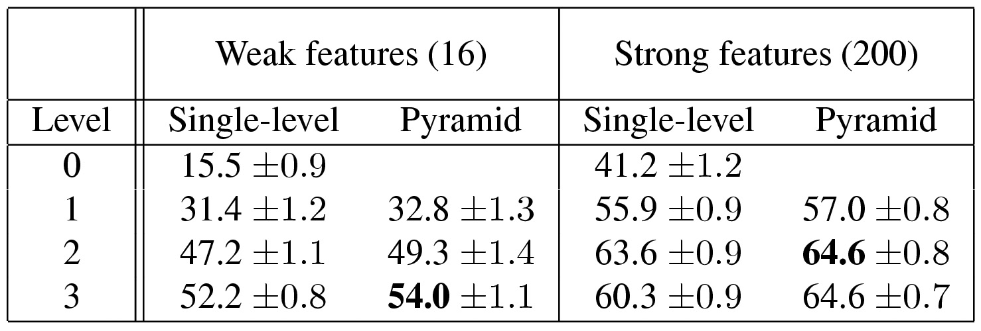
Caltech101 dataset
Fei-Fei et al. (2004)
http://www.vision.caltech.edu/Image_Datasets/Caltech101/Caltech101.html
Multi-class classification results (30 training images per class)
Slide credit: L. Lazebnik

Slide 64
Training vs Testing
What do we want?
  High accuracy on training data?
  No, high accuracy on unseen/new/test data!
  Why is this tricky?
Training data
  Features (x) and labels (y) used to learn mapping f
Test data
  Features (x) used to make a prediction
  Labels (y) only used to see how well we’ve learned f!!!
Validation data
  Held-out set of the training data
  Can use both features (x) and labels (y) to tune parameters of the model we’re learning

Slide 65

Generalization
Training set (labels known)
Test set (labels unknown)
How well does a learned model generalize from the data it was trained on to a new test set?
Slide credit: L. Lazebnik

Slide 66




Generalization
Example: Line fitting (regression)
Error
Train Error: E_{train}
Predicted
Ground Truth
Error
Underfitting
Overfitting
1
2 …
Degree of polynomial d
…. n
Adapted from Andrew Ng - Coursera
Notes:
https://towardsdatascience.com/understanding-the-bias-variance-tradeoff-165e6942b229

Slide 67

Generalization: Bias/Variance
w₀+w₁x
w₀+w₁x+w₂x²
w₀+w₁x+w₂x²+w₃x³+w₄x⁴
Adapted from Andrew Ng - Coursera
Notes:
https://towardsdatascience.com/understanding-the-bias-variance-tradeoff-165e6942b229

Slide 68
Generalization: Bias/Variance
Error
Error_{test}
Bias (underfit)
- Error_{train} is high
- Error_{test} is similar Error_{train}
Variance (overfit)
- Error_{train} is low
- Error_{test} >> Error_{train}
Error_{train}
1
2 …
Degree of polynomial d
…. n
High Bias
High Variance
Adapted from Andrew Ng - Coursera

Slide 69
Generalization: Bias/Variance
Components of generalization error
  Noise in our observations: unavoidable
Underfitting (High Bias): model is too “simple” to represent all the relevant class characteristics
  High training error and high test error
Overfitting (High Variance): model is too “complex” and fits irrelevant characteristics (noise) in the data
  Low training error and high test error
Slide credit: L. Lazebnik
Notes:
https://towardsdatascience.com/understanding-the-bias-variance-tradeoff-165e6942b229

Slide 70


Generalization
Models with too few parameters are inaccurate because of a large bias [Underfit] (not enough flexibility).
Models with too many parameters are inaccurate because of a large variance [Overfit] (too much sensitivity to the sample).
Model
Model
Purple dots = possible test points
Red dots = training data (all that we see before we ship off our model!)
Green curve = true underlying model Blue curve = our predicted model/fit
Adapted from D. Hoiem

Slide 71


Polynomial Curve Fitting
Slide credit: Chris Bishop

Slide 72

Sum-of-Squares Error Function
Predicted
Ground Truth
Slide credit: Chris Bishop

Slide 73

0th Order Polynomial
Slide credit: Chris Bishop

Slide 74

1st Order Polynomial
Slide credit: Chris Bishop

Slide 75

3rd Order Polynomial
Slide credit: Chris Bishop

Slide 76

9th Order Polynomial
Slide credit: Chris Bishop

Slide 77


Over-fitting
Polynomial degree
Root-Mean-Square (RMS) Error:
Slide credit: Chris Bishop

Slide 78


Data Set Size:
9th Order Polynomial
Slide credit: Chris Bishop

Slide 79


Data Set Size:
9th Order Polynomial
Slide credit: Chris Bishop

Slide 80

Regularization
Penalize large coefficient values → Make function simpler.
(Remember: We want to minimize this expression.)
Regularization weight: λ
Adapted from Chris Bishop

Slide 81
Regularization
w₀+w₁x
Intermediate λ
Small λ
Large λ
λ = 1000
λ = 0
w₀ ≈ 0, w₁ ≈ 0 , w₂ ≈ 0, …, w_{n} ≈ 0
Adapted from Andrew Ng - Coursera

Slide 82


Regularization:
(medium regularization)
Slide credit: Chris Bishop

Slide 83


Regularization:
(huge regularization)
What's happening from medium to huge regularization?
Slide credit: Chris Bishop

Slide 84

Polynomial Coefficients
Slide credit: Chris Bishop

Slide 85

Polynomial Coefficients
No regularization Huge regularization
Increase λ
Adapted from Chris Bishop
Notes:
Ln lambda = huge regularization
Ln -18 = mid regularization
Ln –inf = no regularization

Slide 86




Regularization: vs.
Google Search
Overfitting
Increase λ
Slide credit: Chris Bishop

Slide 87
Training vs test error
Underfitting
Overfitting
Error
Test error
Training error
High Bias
Low Variance
Model Complexity
Low Bias
High Variance
Slide credit: D. Hoiem

Slide 88
The effect of training set size
Few training examples
Test Error
Many training examples
High Bias
Low Variance
Model Complexity
Low Bias
High Variance
Slide credit: D. Hoiem
Notes:
Note: these figures don’t work in pdf

Slide 89
Choosing the trade-off between bias and variance
Need validation set (separate from the test set)
Apply this model to test set
Validation error
Error
Training error
High Bias
Low Variance
Complexity
Low Bias
High Variance
Slide credit: D. Hoiem

Slide 90
Generalization tips
Try simple classifiers first
Better to have smart features and simple classifiers than simple features and smart classifiers
Use increasingly powerful classifiers with more training data
As an additional technique for reducing variance, try regularizing the parameters (penalize high magnitude weights)
Slide credit: D. Hoiem
Notes:
You can only get generalization through assumptions.

Slide 91
Generalization tips: Bias/Variance
Error
Error_{test}
Error_{train}
Polynomial features
- Add
Features
- Try additional
Regularizer
- Decrease λ
1
2 …
Degree of polynomial d
…. n
Training Examples
- Get more
Features
- Try smaller set
Regularizer
- Increase λ
Model Complexity
High Bias
(Underfit)
High Variance
(Overfit)
Adapted from Andrew Ng - Coursera
Notes:
To avoid underfit → Make model more complex
To fix overfit → Make model more simple

