Slide 1

CS 1674/2074: Sequential Data: Language and Vision; Video and Motion
PhD. Nils Murrugarra-Llerena
nem177@pitt.edu

Slide 2
Plan for this lecture
2
Language and vision
  Application: Image and video captioning
  Tool: Recurrent neural networks
  Tool: Transformers
  Application: Visual question answering
Motion and video
  Video classification
  Measuring motion
  Tracking objects

Slide 3
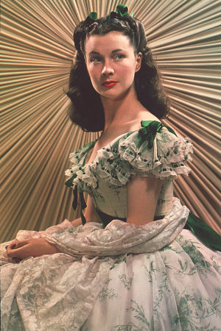
Motivation: Descriptive Text for Images
3
“It was an arresting face, pointed of chin, square of jaw. Her eyes were pale green without a touch of hazel, starred with bristly black lashes and slightly tilted at the ends. Above them, her thick black brows slanted upward, cutting a startling oblique line in her magnolia-white skin–that skin so prized by Southern women and so carefully guarded with bonnets, veils and mittens against hot Georgia suns”
Scarlett O’Hara described in Gone with the Wind
Tamara Berg
Notes:
People sometimes produce very vivid and richly informative descriptions about the visual world. For example, here the writer says “it was an arresting face, pointed of chin, …”

Slide 4
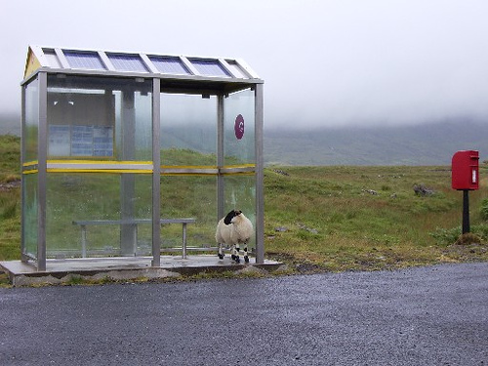
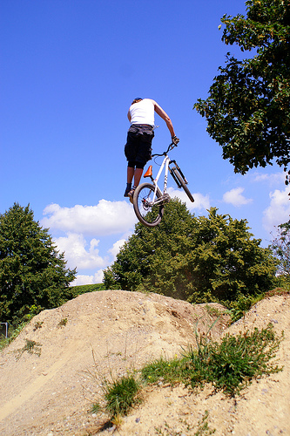
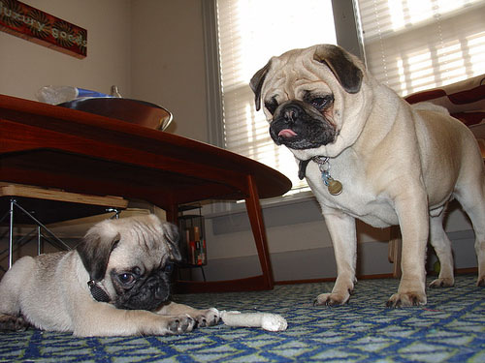
Some pre-RNN Good Results
4
This is a picture of one sky, one road and one sheep. The gray sky is over the gray road. The gray sheep is by the gray road.
Here we see one road, one sky and one bicycle. The road is near the blue sky, and near the colorful bicycle. The colorful bicycle is within the blue sky.
This is a picture of two dogs. The first dog is near the second furry dog.
Kulkarni et al., CVPR 2011
Notes:
This is a picture of one sky, one road…

Slide 5
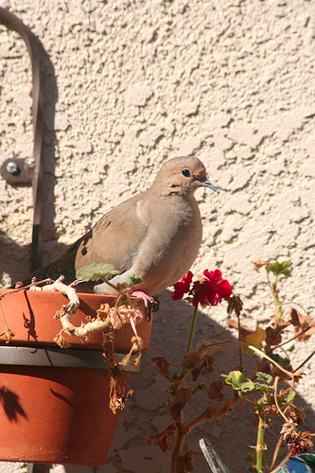
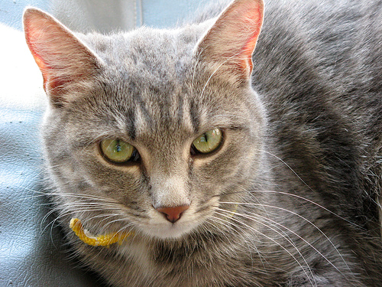
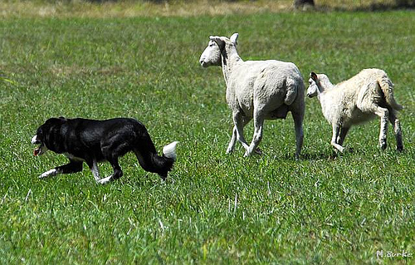
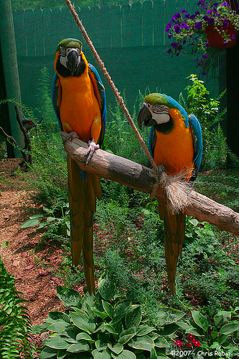
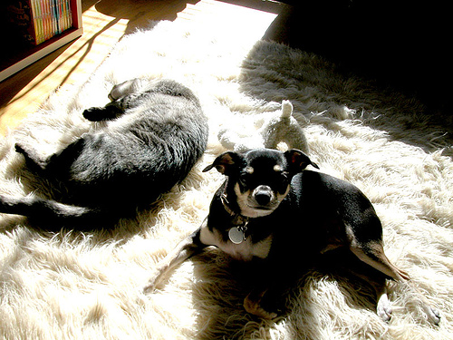
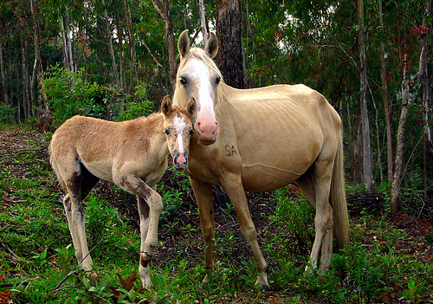
Some pre-RNN Good Results
5
Missed detections:
False detections:
Incorrect attributes:
There are one road and one cat. The furry road is in the furry cat.
This is a photograph of two sheeps and one grass. The first black sheep is by the green grass, and by the second black sheep. The second black sheep is by the green grass.
Here we see one potted plant.
This is a picture of one tree, one road and one person. The rusty tree is under the red road. The colorful person is near the rusty tree, and under the red road.
This is a photograph of two horses and one grass. The first feathered horse is within the green grass, and by the second feathered horse. The second feathered horse is within the green grass.
This is a picture of one dog.
Kulkarni et al., CVPR 2011
Notes:
Of course it doesn’t always work!
Some common mistakes are: missing detections, false detections,
Incorrectly predicted attributes.

Slide 6
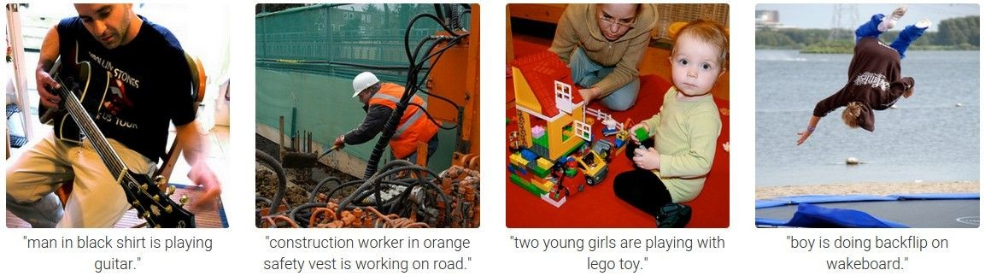
6
Results with Recurrent Neural Networks
Karpathy and Fei-Fei, CVPR 2015

Slide 7
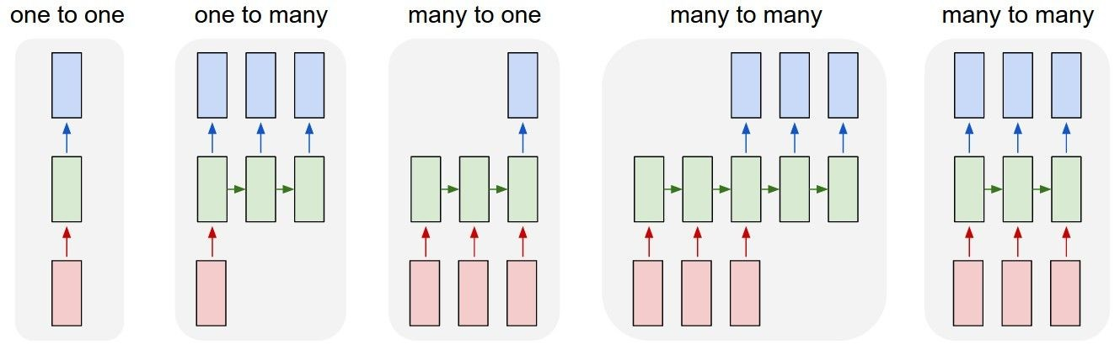
7
Recurrent Networks offer a lot of flexibility:
vanilla neural networks
Andrej Karpathy

Slide 8
8
Recurrent Networks offer a lot of flexibility:
e.g. image captioning
image -> sequence of words
Andrej Karpathy

Slide 9
9
Recurrent Networks offer a lot of flexibility:
e.g. sentiment classification
sequence of words -> sentiment
Andrej Karpathy

Slide 10
10
Recurrent Networks offer a lot of flexibility:
e.g. machine translation
seq of words -> seq of words
Andrej Karpathy

Slide 11
11
Recurrent Networks offer a lot of flexibility:
Output
Input
e.g. video classification on frame level
Andrej Karpathy

Slide 12
Recurrent Neural Network
12
RNN
RNN
x
Andrej Karpathy

Slide 13
Recurrent Neural Network
13
y
usually want to output a prediction at some time steps
RNN
x
Adapted from Andrej Karpathy

Slide 14

Recurrent Neural Network
14
We can process a sequence of vectors x by applying a recurrence formula at every time step:
y
RNN
new state
old state input vector at
some time step
some function
with parameters W
x
Andrej Karpathy

Slide 15
Recurrent Neural Network
15
We can process a sequence of vectors x by applying a recurrence formula at every time step:
y
RNN
Notice: the same function and the same set of parameters are used at every time step.
x
Andrej Karpathy

Slide 16

(Vanilla) Recurrent Neural Network
16
y
RNN
x
Andrej Karpathy

Slide 17
Character-level language model example
17
Example
RNN
x
y
Vocabulary: [h,e,l,o]
Example training sequence: “hello”
Andrej Karpathy

Slide 18
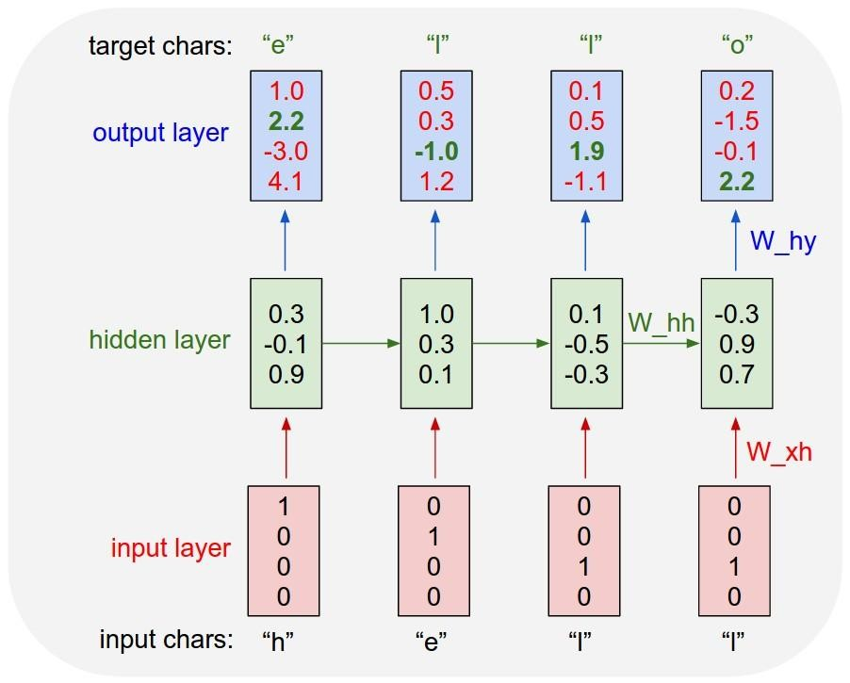
18
Example
Character-level language model example
Vocabulary: [h,e,l,o]
Example training sequence: “hello”
Andrej Karpathy

Slide 19
19
Example
Character-level language model example
Vocabulary: [h,e,l,o]
Example training sequence: “hello”
Andrej Karpathy

Slide 20
20
Example
Character-level language model example
Vocabulary: [h,e,l,o]
Example training sequence: “hello”
Andrej Karpathy

Slide 21
Extensions
21
Vanishing gradient problem makes it hard to model long sequences
  Multiplying together many values between 0 and 1 (range of gradient of sigmoid, tanh)
One solution: Use RELU
Another solution: Use RNNs with gates
  Adaptively decide how much of memory to keep
  Gated Recurrent Units (GRUs), Long Short Term Memories (LSTMs)

Slide 22
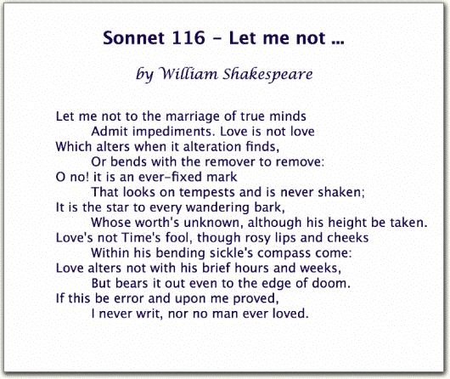
22
Generating poetry with RNNS
Fei-Fei Li & Andrej Karpathy & Justin Johnson Lecture 10 - 8 Feb 2016
Lecture 10 -
35
Andrej Karpathy

Slide 23
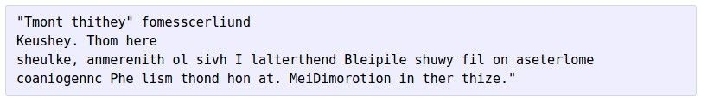


at first:
23
Generating poetry with RNNS
train more
train more
train more
Fei-Fei Li & Andrej Karpathy & Justin Johnson Lecture 10 - 8 Feb 2016
Lecture 10 -
36
More info: http://karpathy.github.io/2015/05/21/rnn-effectiveness/
Andrej Karpathy

Slide 24
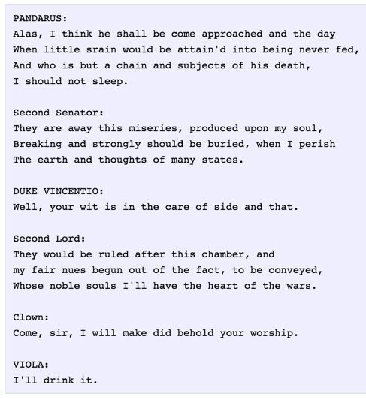
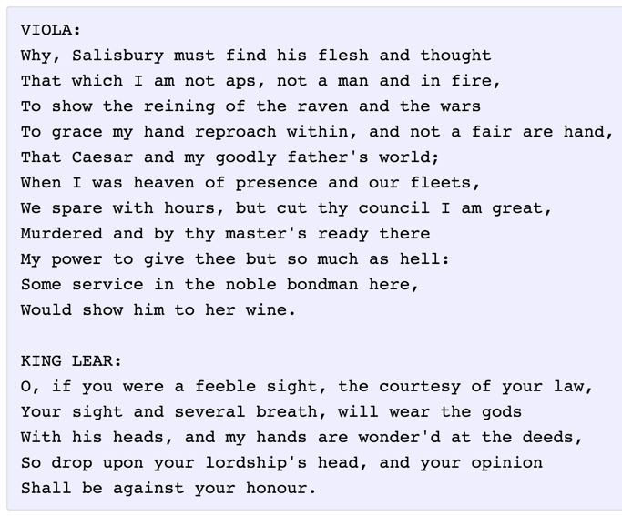
24
Generating poetry with RNNS
Fei-Fei Li & Andrej Karpathy & Justin Johnson Lecture 10 - 8 Feb 2016
Lecture 10 -
37
Andrej Karpathy
Notes:
https://huggingface.co/ashiqabdulkhader/GPT2-Poet
https://medium.com/@DenisKrivitski/generation-of-poems-with-a-recurrent-neural-network-128a5f62b483
https://github.com/AvoncourtPartners/poems
https://sballas8.github.io/2015/08/11/Poet-RNN.html

Slide 25
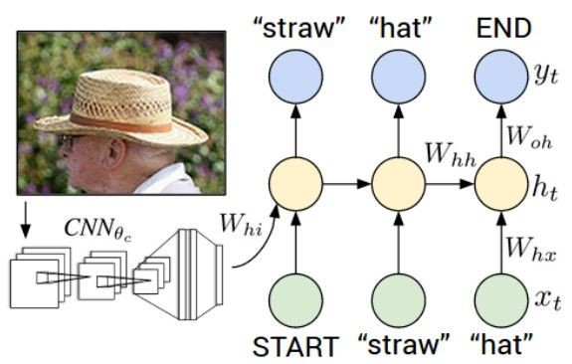
25
Image Captioning
CVPR 2015:
Deep Visual-Semantic Alignments for Generating Image Descriptions, Karpathy and Fei-Fei Show and Tell: A Neural Image Caption Generator, Vinyals et al.
Long-term Recurrent Convolutional Networks for Visual Recognition and Description, Donahue et al. Learning a Recurrent Visual Representation for Image Caption Generation, Chen and Zitnick
Adapted from Andrej Karpathy

Slide 26
Recurrent Neural Network
26
Image Captioning
Convolutional Neural Network
Andrej Karpathy

Slide 27

test image
27
Image Captioning
Andrej Karpathy

Slide 28
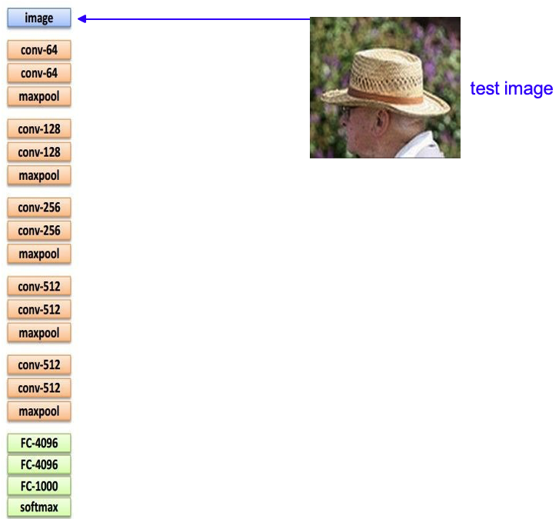
28
Image Captioning
Andrej Karpathy

Slide 29
29
Image Captioning
X
Andrej Karpathy

Slide 30
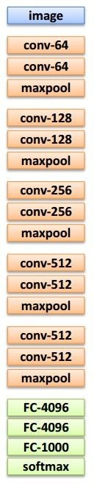
test image
30
Image Captioning
x0
<START>
<START>
Andrej Karpathy

Slide 31
31
Image Captioning
test image
y0
before:
h = tanh(W_{xh} * x + W_{hh} * h)
h0
Wih
now:
h = tanh(W_{xh} * x + W_{hh} * h + W_{ih} * im)
x0
<START>
im
<START>
Andrej Karpathy

Slide 32
test image
32
Image Captioning
y0
sample!
h0
x0
<START>
straw
<START>
Andrej Karpathy

Slide 33
test image
33
Image Captioning
y0
y1
h0
h1
x0
<START>
straw
<START>
Andrej Karpathy

Slide 34
test image
34
Image Captioning
y0
y1
sample!
h0
h1
x0
<START>
straw
hat
<START>
Andrej Karpathy

Slide 35
test image
35
Image Captioning
y0
y1
y2
h0
h1
h2
x0
<START>
straw
hat
<START>
Andrej Karpathy

Slide 36
test image
36
Image Captioning
Caption generated:
“straw hat”
y0
y1
y2
sample
<END> token
=> finish.
h0
h1
h2
x0
<START>
straw
hat
<START>
Adapted from Andrej Karpathy

Slide 37
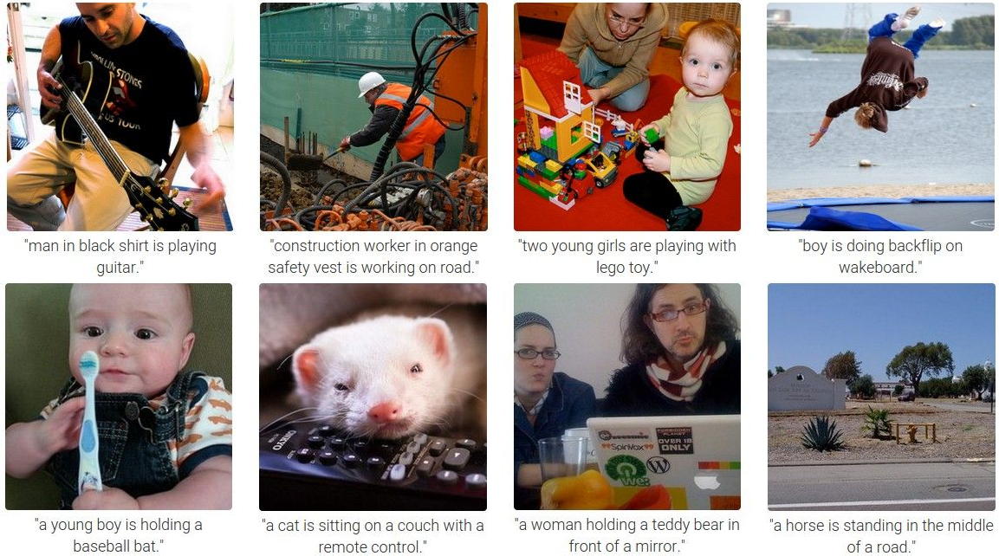
37
Image Captioning
Andrej Karpathy

Slide 38
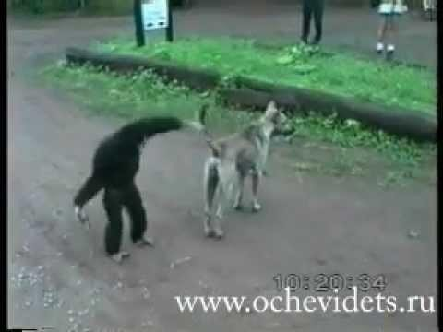
Generate descriptions for events depicted in video clips
38
Video Captioning
A monkey pulls a dog’s tail and is chased by the dog.
Venugopalan et al., “Translating Videos to Natural Language using Deep Recurrent Neural Networks”, NAACL-HTL 2015

Slide 39


39
Video Captioning
English Sentence
RNN
encoder
RNN
decoder
French Sentence
[Sutskever et al. NIPS’14]
RNN
decoder
[Donahue et al. CVPR’15] [Vinyals et al. CVPR’15]
Encode
Sentence
RNN
decoder
Encode
Sentence
[Venugopalan et. al. NAACL’15] (this work)
Key Insight:
Generate feature representation of the video and “decode” it to a sentence
Venugopalan et al., “Translating Videos to Natural Language using Deep Recurrent Neural Networks”, NAACL-HTL 2015

Slide 40
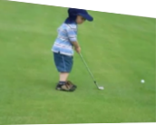
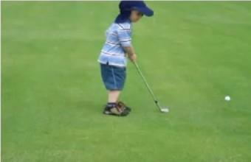
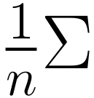

40
Video Captioning
CNN
Input
Video
Forward propagate Output: “fc7” features
(activations before classification layer)
Sample frames
@1/10
fc7: 4096 dimension “feature vector”
Venugopalan et al., “Translating Videos to Natural Language using Deep Recurrent Neural Networks”, NAACL-HTL 2015

Slide 41
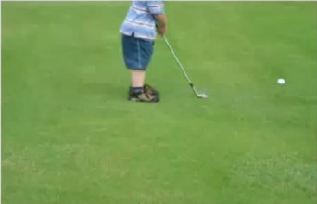
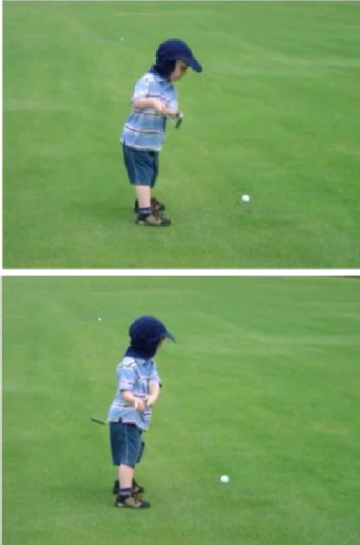
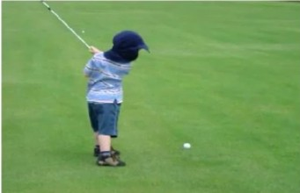
41
Video Captioning
Input Video
Convolutional Net Recurrent Net
LSTM LSTM
LSTM LSTM
LSTM LSTM
LSTM LSTM
LSTM LSTM
LSTM LSTM
Output
A
boy
. .
.
is
playing
golf
<EOS>
Mean across all frames
Venugopalan et al., “Translating Videos to Natural Language using Deep Recurrent Neural Networks”, NAACL-HTL 2015

Slide 42
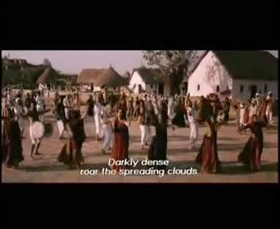
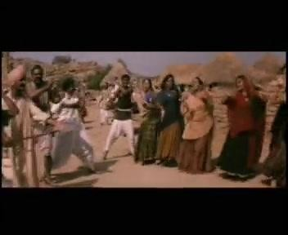
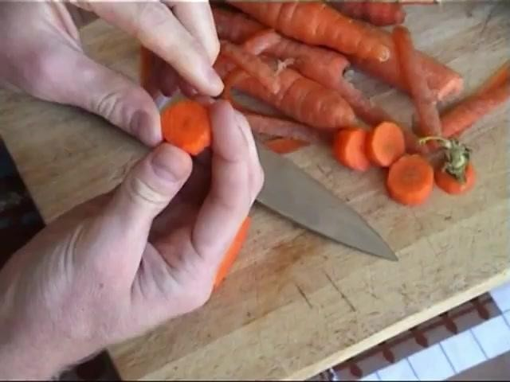
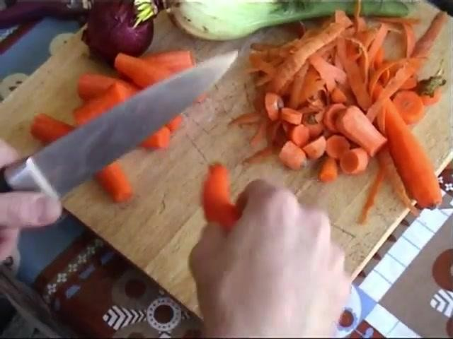
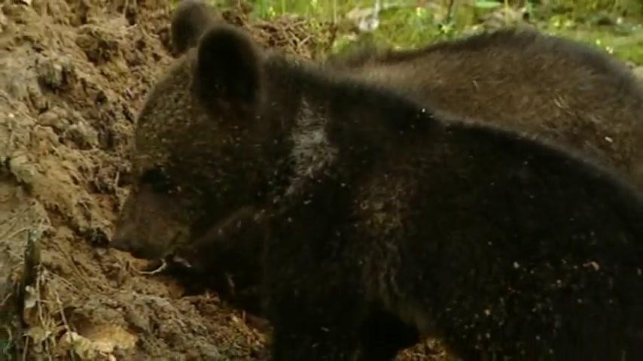
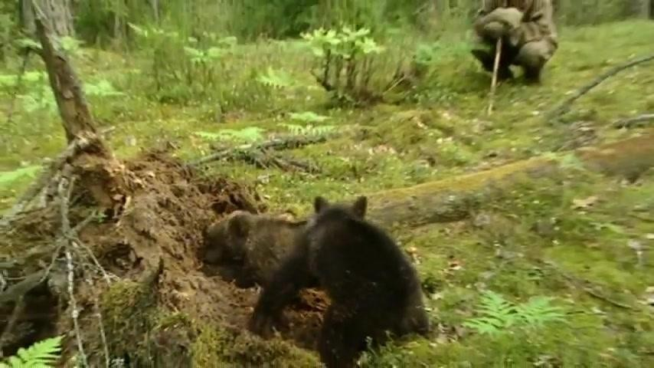
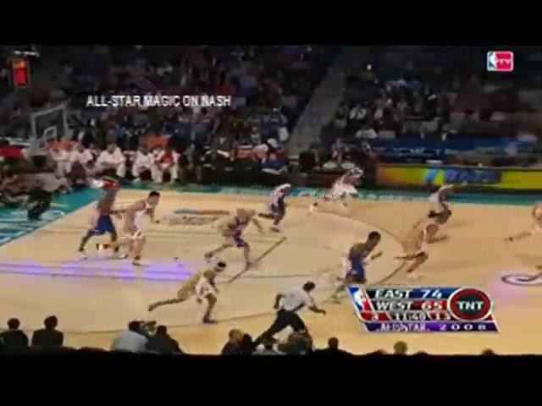
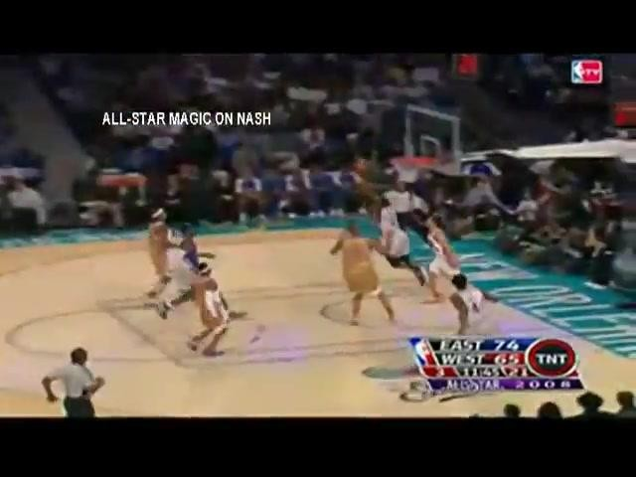
42
Video Captioning
FGM: A person is dancing with the person on the stage. YT: A group of men are riding the forest.
I+V: A group of people are dancing.
GT: Many men and women are dancing in the street.
FGM: A person is cutting a potato in the kitchen. YT: A man is slicing a tomato.
I+V: A man is slicing a carrot.
GT: A man is slicing carrots.
FGM: A person is walking with a person in the forest. YT: A monkey is walking.
I+V: A bear is eating a tree.
GT: Two bear cubs are digging into dirt and plant matter at the base of a tree.
FGM: A person is riding a horse on the stage. YT: A group of playing are playing in the ball. I+V: A basketball player is playing.
GT: Dwayne wade does a fancy layup in an allstar game.
Venugopalan et al., “Translating Videos to Natural Language using Deep Recurrent Neural Networks”, NAACL-HTL 2015

Slide 43

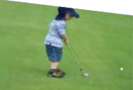
43
Video Captioning
English Sentence
RNN
encoder
RNN
decoder
French Sentence
[Sutskever et al. NIPS’14]
RNN
decoder
[Donahue et al. CVPR’15] [Vinyals et al. CVPR’15]
Encode
Sentence
RNN
decoder
Encode
Sentence
[Venugopalan et. al. NAACL’15]
Encode
RNN
encoder
RNN
decoder
Sentence
[Venugopalan et. al. ICCV’ 15] (this work)
3
Venugopalan et al., “Sequence to Sequence - Video to Text”, ICCV 2015

Slide 44




S2VT Overview
44
Video Captioning
CNN
CNN
CNN
CNN
Now decode it to a sentence!
LSTM
LSTM
LSTM
LSTM
LSTM
LSTM
LSTM
LSTM
...
LSTM
LSTM
LSTM
LSTM
LSTM
LSTM
LSTM
LSTM
Encoding stage
A
man
is
talking ...
Decoding stage
Venugopalan et al., “Sequence to Sequence - Video to Text”, ICCV 2015

Slide 45
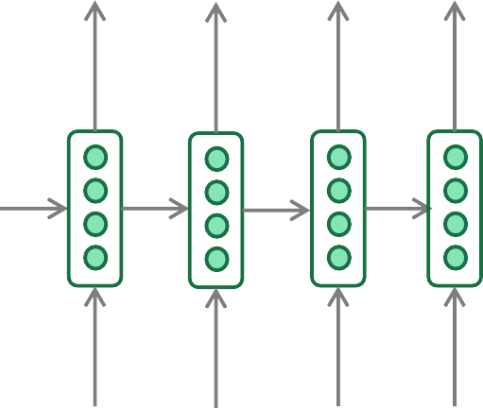
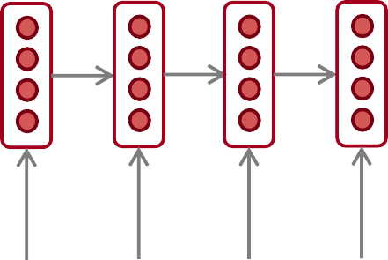
45
Neural Machine Translation (NMT)
The sequence-to-sequence model
Encoding of the source sentence.
Target sentence (output)
Provides initial hidden state
for Decoder RNN.
he
hit
me
with
a
pie <END>
argmax
argmax
argmax
argmax
argmax
argmax
argmax
Encoder RNN
Decoder RNN
il
a
m’ entarté
<START> he hit me with a pie
Source sentence (input)
Decoder RNN is a Language Model that generates target sentence, conditioned on encoding.
Encoder RNN produces an encoding of the source sentence.
Note: This diagram shows test time behavior:
decoder output is fed in as next step’s input
Abigail See

Slide 46
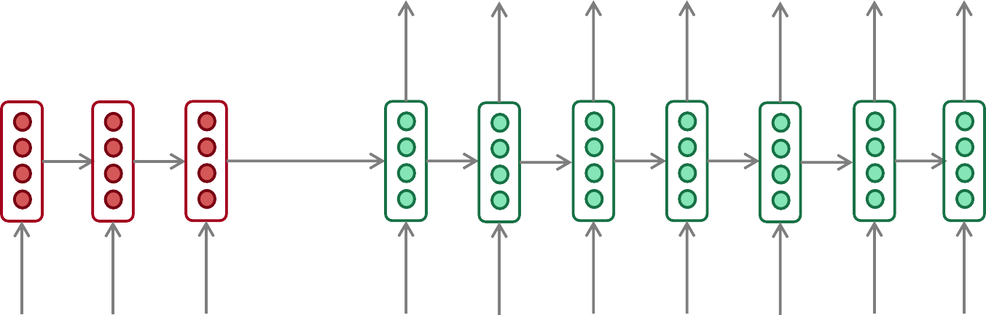
46
Sequence-to-sequence: the bottleneck problem
Encoding of the
source sentence.
This needs to capture all information about the source sentence.
Information bottleneck!
Target sentence (output)
he
hit
me with
a
pie <END>
Encoder RNN
Decoder RNN
il
a
m’ entarté
<START> he
hit
me with
a
pie
Source sentence (input)
Abigail See

Slide 47

47
Attention
Attention provides a solution to the bottleneck problem.
Core idea: on each step of the decoder, use direct connection to the encoder to focus on a particular part of the source sequence
First we will show via diagram (no equations), then we will show with equations
Abigail See

Slide 48
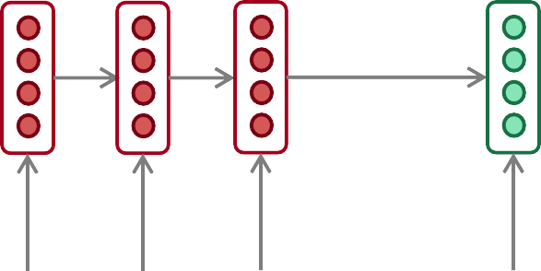
48
Sequence-to-sequence with attention
dot product
Attention
scores
Decoder RNN
Encoder
RNN
il
a
m’ entarté
<START>
Source sentence (input)
Abigail See

Slide 49
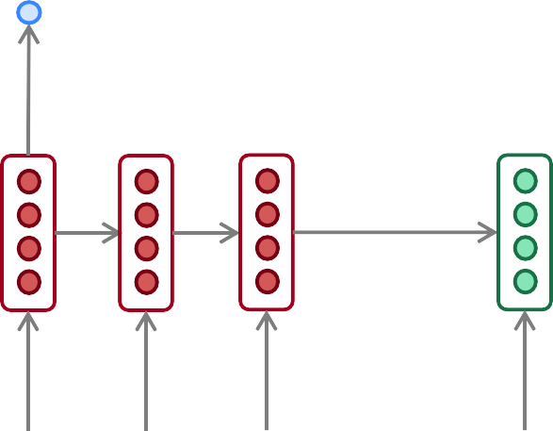
49
Sequence-to-sequence with attention
dot product
Attention
scores
Decoder RNN
Encoder
RNN
il
a
m’ entarté
<START>
Source sentence (input)
Abigail See

Slide 50
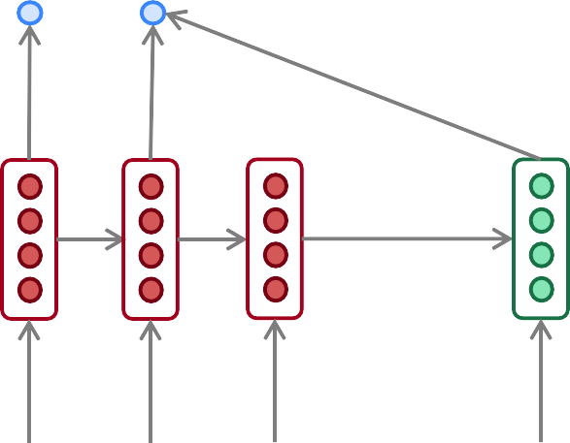
50
Sequence-to-sequence with attention
dot product
Attention
scores
Decoder RNN
Encoder
RNN
il
a
m’ entarté
<START>
Source sentence (input)
Abigail See

Slide 51
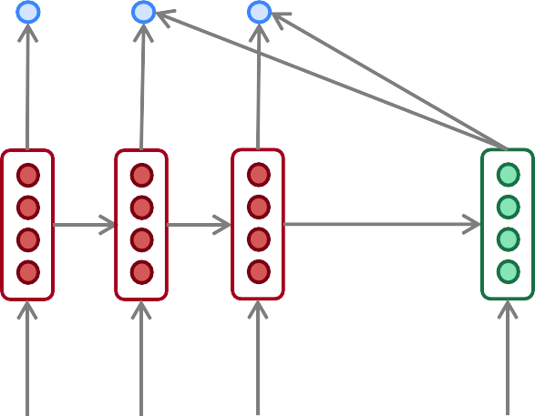
51
Sequence-to-sequence with attention
dot product
Attention
scores
Decoder RNN
Encoder
RNN
il
a
m’ entarté
<START>
Source sentence (input)
Abigail See

Slide 52
52
Sequence-to-sequence with attention
On this decoder timestep, we’re mostly focusing on the first encoder hidden state (”he”)
Attention
distribution
Take softmax to turn the scores into a probability distribution
Attention
scores
Decoder RNN
Encoder
RNN
il
a
m’ entarté
<START>
Source sentence (input)
Abigail See

Slide 53
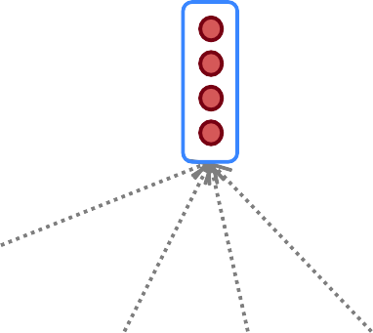
53
Sequence-to-sequence with attention
Attention output
Use the attention distribution to take a weighted sum of the encoder hidden states.
The attention output mostly contains information from the hidden states that received high attention.
Attention
distribution
Attention
scores
Decoder RNN
Encoder
RNN
il
a
m’ entarté
<START>
Source sentence (input)
Abigail See

Slide 54
54
Sequence-to-sequence with attention
Attention output
he
Concatenate attention output with decoder hidden state, then use to compute 𝑦₁ as before
Attention
distribution
𝑦₁
Attention
scores
Decoder RNN
Encoder
RNN
il
a
m’ entarté
<START>
Source sentence (input)
Abigail See

Slide 55
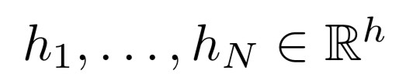






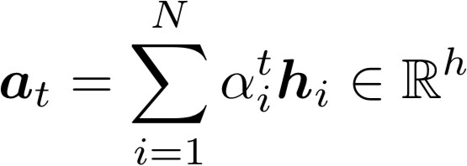



Attention in equations
55
We have encoder hidden states
On timestep t, we have decoder hidden state
We get the attention scores for this step:
We take softmax to get the attention distribution
distribution and sums to 1)
for this step (this is a probability
We use to take a weighted sum of the encoder hidden states to get the attention output
Finally we concatenate the attention output with the decoder hidden state and proceed as in the non-attention seq2seq model
Abigail See

Slide 56
Attention is great!
56
Attention significantly improves NMT performance
  It’s very useful to allow decoder to focus on certain parts of the source
Attention solves the bottleneck problem
  Attention allows decoder to look directly at source; bypass bottleneck
Attention helps with vanishing gradient problem
  Provides shortcut to faraway states
Attention provides some interpretability
  By inspecting attention distribution, we can see what the decoder was focusing on
  We get (soft) alignment for free!
  This is cool because we never explicitly trained an alignment system
  The network just learned alignment by itself
he | hit | me | with | a | pie
il
a
m’
entarté
Abigail See
Notes:
NMT: Neural Machine Translation

Slide 57
Attention is a general deep-learning technique
57
We’ve seen that attention is a great way to improve the sequence-to-sequence model for Machine Translation.
However: You can use attention in many architectures (not just seq2seq) and many tasks (not just MT)
More general definition of attention:
  Given a set of vector values, and a vector query, attention is a technique to compute a weighted sum of the values, dependent on the query.
We sometimes say that the query attends to the values.
For example, in seq2seq + attention model, each decoder hidden state (query) attends to all encoder hidden states (values).
Abigail See

Slide 58
58
Issues with recurrent models: Linear interaction distance
O(sequence length) steps for distant word pairs to interact means:
  Hard to learn long-distance dependencies (because gradient problems!)
  Linear order of words is “baked in”; not necessarily the right way to think about sentences…
The chef who …
was
Info of chef has gone through O(sequence length) many layers!
Adapted from John Hewitt

Slide 59
59
Issues with recurrent models: Lack of parallelization
Forward and backward passes have O(sequence length) unparallelizable operations
  GPUs can perform a bunch of independent computations at once!
  But future RNN hidden states can’t be computed in full before past RNN
hidden states have been computed
  Inhibits training on very large datasets!
1
2
3
T
0
1
2
T-1
h₁ h₂
h_{T}
Numbers indicate min # of steps before a state can be computed
John Hewitt

Slide 60
60
If not recurrence, then what? How about attention?
Attention treats each word’s representation as a query to access and incorporate information from a set of values.
  We saw attention from the decoder to the encoder; next we’ll think about
attention within a single sentence.
If attention gives us access to any state… maybe we can just use attention and don’t need the RNN?
Number of unparallelizable operations not tied to sequence length.
All words interact at every layer!
2 |  | 2 |  | 2 |  | 2 |  | 2 |  | 2 |  | 2 |  | 2
1 |  | 1 |  | 1 |  | 1 |  | 1 |  | 1 |  | 1 |  | 1
0 |  | 0 |  | 0 |  | 0 |  | 0 |  | 0 |  | 0 |  | 0
All words attend
to all words in previous layer; most arrows here are omitted
attention
attention embedding
h₁
h₂
h_{T}
Adapted from John Hewitt

Slide 61
61
Self-Attention
Attention operates on queries, keys, and values.
The number of queries can differ from the number of keys and
values in practice.
We have some queries 𝑞 , 𝑞 , … , 𝑞. Each query is 𝑞_{i} ∈ ℝ^{𝑑}
1 2 𝑇
We have some keys 𝑘₁, 𝑘₂, … , 𝑘_{𝑇}. Each key is 𝑘_{𝑖} ∈ ℝ^{𝑑}
We have some values 𝑣₁, 𝑣₂, … , 𝑣_{𝑇}. Each value is 𝑣_{𝑖} ∈ ℝ^{𝑑}
In self-attention, the queries, keys, and values are drawn from the same source.
  For example, if the output of the previous layer is 𝑥₁, … , 𝑥_{𝑇}, (one vec per word) we could let 𝑣_{𝑖} = 𝑘_{𝑖} = 𝑞_{𝑖} = 𝑥_{𝑖} (that is, use the same vectors for all of them!)
The (dot product) self-attention operation is as follows:
exp(𝑒_{𝑖𝑗})
𝑒 = 𝑞_{i}^{𝖳}𝑘 𝛼 =
output = Σ _{𝑗} 𝛼 𝑣
𝑖𝑗 𝑗
𝑖j
𝑖 𝑖𝑗 𝑗
𝑖
Σ
_{𝑗'}
exp(𝑒_{𝑖𝑗’} )
Compute outputs as weighted sum of values
Compute key- query affinities
Compute attention weights from affinities
(softmax)
John Hewitt

Slide 62
62
Barriers and solutions for Self-Attention as a building block
Barriers
Doesn’t have an inherent
notion of order!
Solutions
John Hewitt

Slide 63
63
Fixing the first self-attention problem: Sequence order
Since self-attention doesn’t build in order information, we need to encode the order of the
sentence in our keys, queries, and values.
Consider representing each sequence index as a vector
𝑝_{𝑖} ∈ ℝ^{𝑑}, for 𝑖 ∈ {1,2, … , 𝑇} are position vectors
Don’t worry about what the 𝑝_{𝑖} are made of yet!
Easy to incorporate this info into our self-attention block: just add the 𝑝_{𝑖} to our inputs!
Let 𝑣_{𝑖} ‘, 𝑘_{𝑖} ‘, 𝑞_{𝑖} ‘ be our old values, keys, and queries.
𝑣_{𝑖} = 𝑣_{𝑖} ‘ + 𝑝_{𝑖}
𝑞_{𝑖} = 𝑞_{𝑖} ‘ + 𝑝_{𝑖}
𝑘_{𝑖} = 𝑘_{𝑖} ‘ + 𝑝_{𝑖}
In deep self-attention networks, we do this at the first layer! You could concatenate them as well, but people mostly just add…
John Hewitt

Slide 64

64
Position representation vectors through sinusoids
Sinusoidal position representations: concatenate sinusoidal functions of varying periods:
sin(𝑖/10000^{2∗1/𝑑})
𝑝_{𝑖} = cos(𝑖/10000^{2∗1/𝑑})
𝑑
Dimension
sin(𝑖/10000^{2∗}2^{/𝑑})
𝑑
cos(𝑖/10000^{2∗}2^{/𝑑})
Index in the sequence
Periodicity indicates that maybe “absolute position” isn’t as important
Image: https://timodenk.com/blog/linear-relationships-in-the-transformers-positional-encoding/
John Hewitt

Slide 65
65
Barriers and solutions for Self-Attention as a building block
Barriers
Doesn’t have an inherent
notion of order!
Solutions
Add position representations to the inputs
No nonlinearities for deep
learning! It’s all just weighted
averages
John Hewitt

Slide 66
66
Adding nonlinearities in self-attention
Note that there are no elementwise nonlinearities in self-attention; stacking more self-attention layers just re-averages value vectors
Easy fix: add a feed-forward network
to post-process each output vector.
FF
FF
FF
self-attention
FF
…
FF
FF
FF
self-attention
FF
𝑚_{𝑖} = 𝑀𝐿𝑃 output_{𝑖}
= 𝑊₂ ∗ ReLU 𝑊₁ × output_{𝑖} + 𝑏₁
…
+ 𝑏₂
𝑤₁
The
𝑤₂
chef
𝑤₃
who
𝑤_{𝑇}
food
Intuition: the FF network processes the result of attention
John Hewitt

Slide 67
67
Barriers and solutions for Self-Attention as a building block
Barriers
Doesn’t have an inherent
notion of order!
No nonlinearities for deep learning magic! It’s all just weighted averages
Need to ensure we don’t “look at the future” when predicting a sequence
  Like in machine translation
  Or language modeling
Solutions
Add position representations to the inputs
Easy fix: apply the same feedforward network to each self- attention output.
John Hewitt

Slide 68
68
Masking the future in self-attention
We can look at these (not greyed out) words
To use self-attention in decoders, we need to ensure we can’t peek at the future.
0 | 0 | 0 | 0
 | 0 | 0 | 0
 |  | 0 | 0
 |  |  | 0
[START]
At every timestep, we could change the set of keys and queries to include only past words. (Inefficient!)
To enable parallelization, we mask out attention to future words by setting attention scores to 0.
𝑒_{𝑖𝑗} =
The
For encoding these words
chef
who
𝑞_{i}^{𝖳}𝑘_{𝑗}, 𝑗 < 𝑖
𝑖
0, 𝑗 ≥ 𝑖
John Hewitt

Slide 69
69
Barriers and solutions for Self-Attention as a building block
Barriers
Doesn’t have an inherent
notion of order!
No nonlinearities for deep learning magic! It’s all just weighted averages
Need to ensure we don’t “look at the future” when predicting a sequence
  Like in machine translation
  Or language modeling
Solutions
Add position representations to the inputs
Easy fix: apply the same feedforward network to each self- attention output.
Mask out the future by artificially setting attention weights to 0!
John Hewitt

Slide 70
70
Necessities for a self-attention building block:
Self-attention:
  the basis of the method.
Position representations:
  Specify the sequence order, since self-attention is an unordered function of its inputs.
Nonlinearities:
  At the output of the self-attention block
  Frequently implemented as a simple feed-forward network.
Masking:
  In order to parallelize operations while not looking at the future.
  Keeps information about the future from “leaking” to the past.
That’s it! But this is not the Transformer model we’ve been hearing about.
John Hewitt

Slide 71
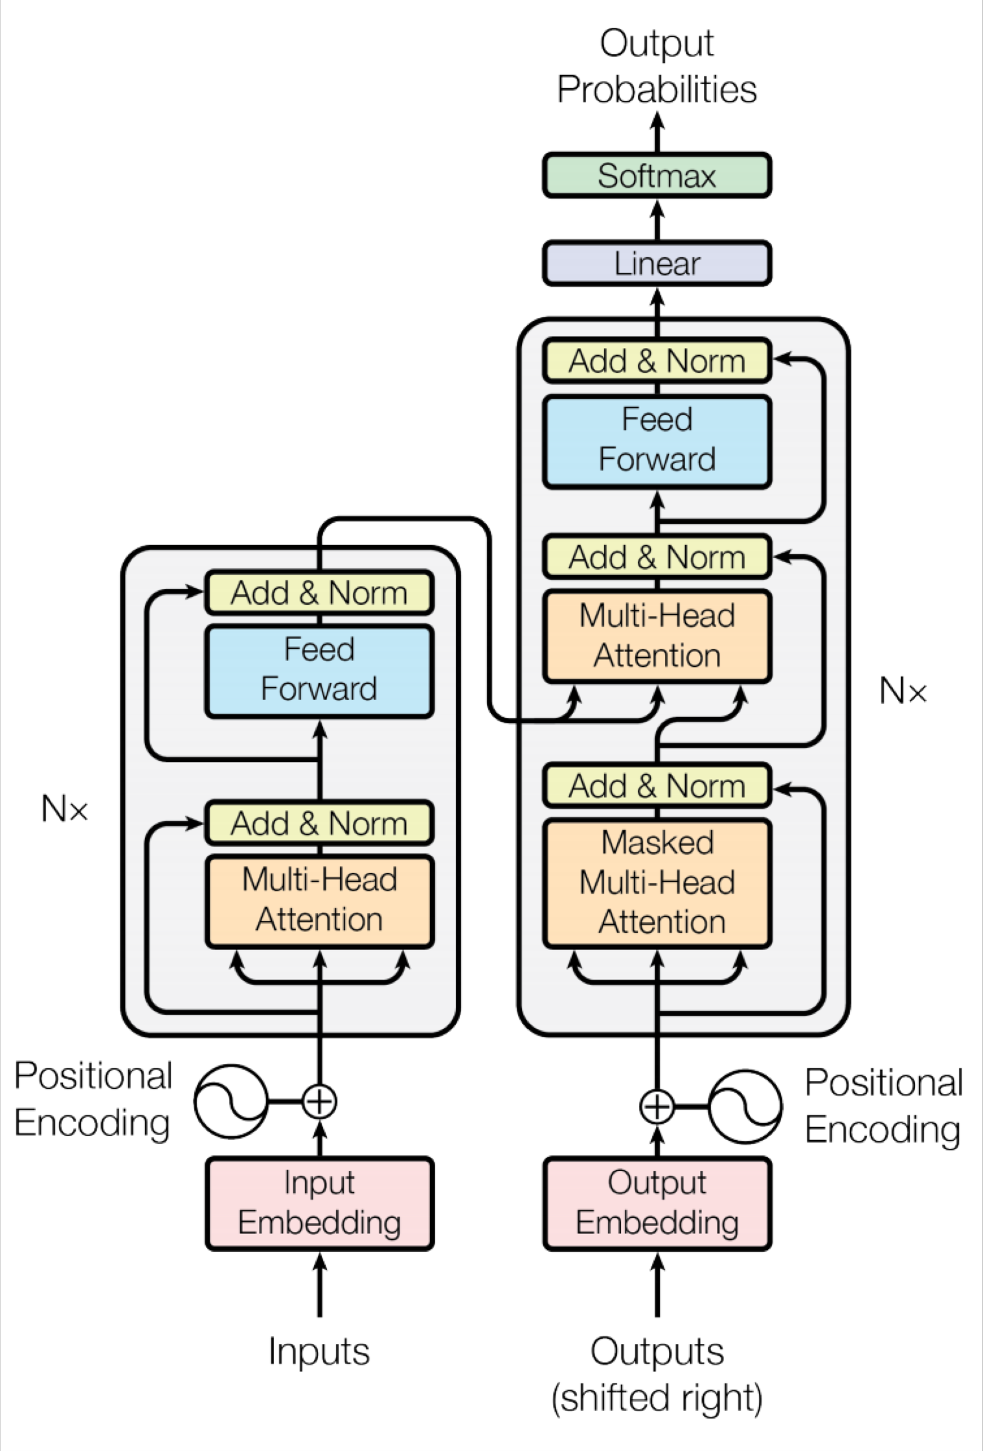
71
Transformer Overview
Attention is all you need. 2017. Aswani, Shazeer, Parmar, Uszkoreit, Jones, Gomez, Kaiser, Polosukhin https://arxiv.org/pdf/1706.03762.pdf
Non-recurrent sequence-to-sequence encoder-decoder model
Task: machine translation with parallel corpus
Predict each translated word
Final cost/error function: Standard cross-entropy error on top of a softmax classifier
This and related figures from paper ⇑
Christopher Manning

Slide 72
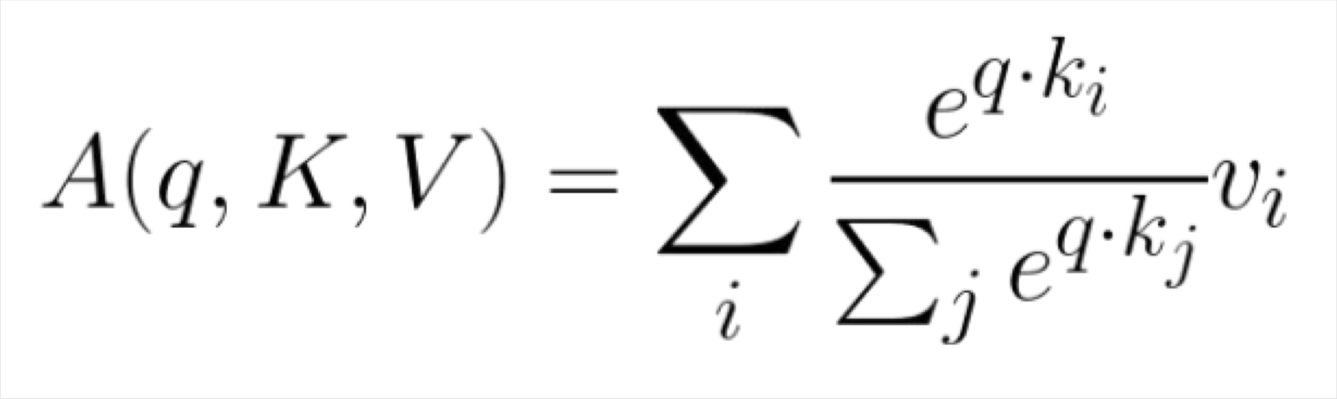
72
The Transformer Encoder: Dot-Product Attention
Inputs: a query q and a set of key-value (k-v) pairs to an output
Query, keys, values, and output are all vectors
Output is weighted sum of values, where
Weight of each value is computed by an inner product of query and corresponding key
Queries and keys have same dimensionality d_{k ,} value have d_{v}
Christopher Manning

Slide 73
73
The Transformer Encoder: Key-Query-Value Attention
We saw that self-attention is when keys, queries, and values come from the same
source. The Transformer does this in a particular way:
  Let 𝑥₁, … , 𝑥_{𝑇} be input vectors to the Transformer encoder; 𝑥_{𝑖} ∈ ℝ^{𝑑}
Then keys, queries, values are:
  𝑘_{𝑖} = 𝐾𝑥_{𝑖}, where 𝐾 ∈ ℝ^{𝑑×𝑑} is the key matrix.
  𝑞_{𝑖} = 𝑄𝑥_{𝑖}, where Q ∈ ℝ^{𝑑×𝑑} is the query matrix.
  𝑣_{𝑖} = 𝑉𝑥_{𝑖}, where V ∈ ℝ^{𝑑×𝑑} is the value matrix.
These matrices allow different aspects of the 𝑥 vectors to be used/emphasized in each of the three roles.
John Hewitt

Slide 74



74
The Transformer Encoder-Decoder [Vaswani et al., 2017]
Looking back at the whole model, zooming in on an Encoder block:
[predictions!]
Transformer Encoder
Transformer Decoder
[decoder attends to encoder states]
Transformer
Encoder
Transformer Decoder
Word Embeddings
+
Position Representations
Word
Embeddings
+
Position
Representations
[input sequence]
[output sequence]
John Hewitt
Notes:
https://huggingface.co/google-bert/bert-base-uncased
https://huggingface.co/docs/transformers/model_doc/bert
* Multiple choice?

Slide 75
75
Pretraining models
In modern NLP:
All (or almost all) parameters in NLP
networks are initialized via pretraining.
Pretraining methods hide parts of the input from the model, and train the model to reconstruct those parts.
This has been exceptionally effective at building strong:
  representations of language
  parameter initializations for strong NLP
models.
𝒚
Pretrained jointly
… the movie was …
[This model has learned how to represent entire sentences through pretraining]
Adapted from John Hewitt

Slide 76

76
Pretraining through language modeling [Dai and Le, 2015]
Recall the language modeling task:
Model 𝑝_{𝜃}(𝑤_{𝑡 |} 𝑤_{1:𝑡−1}), the probability distribution over words given their past contexts.
There’s lots of data for this! (In English.)
Future
See on our
goes
to
make
tasty
tea END
Decoder
(Transformer, LSTM, ++ )
Pretraining through language modeling:
Train a neural network to perform language modeling on a large amount of text.
Save the network parameters.
Iroh goes to
make
tasty tea
Past
John Hewitt

Slide 77

77
The Pretraining / Finetuning Paradigm
Pretraining can improve NLP applications by serving as parameter initialization.
Step 1: Pretrain (on language modeling)
Lots of text; learn general things!
Step 2: Finetune (on your task)
Not many labels; adapt to the task!
goes to
make tasty tea END
☺/☹
Decoder
Decoder
(Transformer, LSTM, ++ )
(Transformer, LSTM, ++ )
Iroh
goes
to
make
tasty
tea
… the movie was …
John Hewitt

Slide 78
78
Generative Pretrained Transformer (GPT) [Radford et al., 2018]
2018’s GPT was a big success in pretraining a decoder!
Transformer decoder with 12 layers.
768-dimensional hidden states, 3072-dimensional feed-forward hidden layers.
Byte-pair encoding with 40,000 merges
Trained on BooksCorpus: over 7000 unique books.
  Contains long spans of contiguous text, for learning long-distance dependencies.
The acronym “GPT” never showed up in the original paper; it could stand for
“Generative PreTraining” or “Generative Pretrained Transformer”
John Hewitt
[Devlin et al., 2018]

Slide 79
79
Generative Pretrained Transformer (GPT) [Radford et al., 2018]
How do we format inputs to our decoder for finetuning tasks?
Natural Language Inference: Label pairs of sentences as entailing/contradictory/neutral
Premise: The man is in the doorway
Hypothesis: The person is near the door
entailment
Radford et al., 2018 evaluate on natural language inference.
Here’s roughly how the input was formatted, as a sequence of tokens for the decoder.
[START] The man is in the doorway [DELIM] The person is near the door [EXTRACT]
The linear classifier is applied to the representation of the [EXTRACT] token.
John Hewitt

Slide 80
80
GPT-3, in-context learning, very large models
So far, we’ve interacted with pretrained models in two ways:
Sample from the distributions they define (maybe providing a prompt)
Fine-tune them on a task we care about, and take their predictions.
Very large language models seem to perform some kind of learning without gradient steps simply from examples you provide within their contexts.
GPT-3 is the canonical example of this.
GPT-3 has 175 billion parameters.
Adapted from John Hewitt

Slide 81
81
GPT-3, in-context learning, very large models
Very large language models seem to perform some kind of learning without gradient steps simply from examples you provide within their contexts.
The in-context examples seem to specify the task to be performed, and the conditional distribution mocks performing the task to a certain extent.
Input (prefix within a single Transformer decoder context):
“
thanks -> merci hello -> bonjour mint -> menthe otter -> ”
Output (conditional generations):
loutre…”
John Hewitt

Slide 82
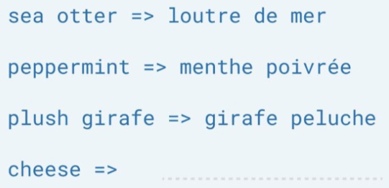

82
GPT-3: Prompt Engineering
Translate English to French
﻿https://arxiv.org/abs/2005.14165
Vicente Ordoñez

Slide 83

83
Prompt Engineering
Vicente Ordoñez

Slide 84

84
How would you come with a solution for this problem?
Vicente Ordoñez

Slide 85
85
Prompt Engineering
﻿Input: The cat is throwing the ball into the ground
Output: The <subject>cat</subject> is throwing the <object>ball</object> into the <destination>ground</ground>
Input: The snake is being attacked by the wolf
Output: The <object>snake</object> is being attacked by the <actor>wolf</actor>
Input: The kid is throwing rocks at the window
Output:
Vicente Ordoñez

Slide 86


86
Prompt Engineering
﻿Any Large Language Model (LLM) such as GPT-3 can be turned into a general purpose problem solver in this way.
Obviously, it is not going to work well for every use case.
Other Large Language Models trained at the scale of GPT-3 that are actually publicly available.
BLOOM-176B and OPT-175B:
https://huggingface.co/bigscience/bloom
https://huggingface.co/docs/transformers/model_doc/opt
Vicente Ordoñez

Slide 87
87
However these are still limited
﻿Predicting the next word can lead to intelligent behavior such as the one exemplified earlier however this still limited
What makes some of the new LLMs special? ChatGPT (GPT-3.5, 3.5 Turbo, 4, 4-turbo), FLAN-T5, OPT-IML
Vicente Ordoñez

Slide 88

88
﻿Instruction Tuning (e.g. FLAN-T5 by Google)
See on our
﻿https://arxiv.org/pdf/2210.11416.pdf
Vicente Ordoñez
Notes:
https://heidloff.net/article/running-llm-flan-t5-locally/
https://huggingface.co/docs/transformers/v4.26.1/en/model_doc/flan-t5
-------------------------------------------------------------
https://huggingface.co/google/flan-t5-small
https://github.com/google-research/t5x/blob/main/t5x/notebooks/README.md

Slide 89

89
﻿FLAN-T5
Vicente Ordoñez

Slide 90

90
﻿FLAN-T5
Vicente Ordoñez

Slide 91

91
﻿InstructGPT (ChatGPT)
﻿https://arxiv.org/abs/2203.02155
Vicente Ordoñez

Slide 92

92
Step by step: Train a reward model that learns from Human Ratings (e.g. from 1 to 5)
﻿https://gist.github.com/JoaoLages/c6f2dfd13d2484aa8bb0b2d567fbf093
Vicente Ordoñez

Slide 93

93
Step by step: Train the LM to generate text that get high reward but still produces stuff that makes sense
﻿https://gist.github.com/JoaoLages/c6f2dfd13d2484aa8bb0b2d567fbf093
Vicente Ordoñez

Slide 94
94
Pretraining encoders: What pretraining objective to use?
So far, we’ve looked at language model pretraining. But encoders get bidirectional context, so we can’t do language modeling!
Idea: replace some fraction of words in the input with a special [MASK] token; predict these words.
store
𝐴, 𝑏
ℎ₁, … , ℎ_{𝑇}
went
ℎ₁, … , ℎ_{𝑇} = Encoder 𝑤₁, … , 𝑤_{𝑇}
𝑦_{𝑖} ∼ 𝐴𝑤_{𝑖} + 𝑏
Only add loss terms from words that are “masked out.” If 𝑥 ’ is the masked version of 𝑥, we’re learning 𝑝_{𝜃}(𝑥|𝑥’ ). Called Masked LM.
Example: BERT: Bidirectional Encoder Representations from Tranformers
I [M] to the [M]
[Devlin et al., 2018]
Adapted from John Hewitt

Slide 95

95
Case Study: Improving Embeddings Representations for Comparing Higher Education Curricula
Umap (MacInnes et al, JOSS 2018) visualizations for Bert and our approach.
Our approach separates computing programs more clearly.
Murrugarra-Llerena et al, EMNLP 2022

Slide 96

96
Case Study: Improving Embeddings Representations for Comparing Higher Education Curricula
Course-Based attention: Identifies the most and the least important courses following the intuition of core and elective courses.
Metric Learning: Learns boundaries to form well-defined groups.
Murrugarra-Llerena et al, EMNLP 2022

Slide 97
97
Capturing meaning via context: What kinds of things does pretraining learn?
There’s increasing evidence that pretrained models learn a wide variety of things about
the statistical properties of language:
Stanford University is located in , California. [Trivia]
I put fork down on the table. [syntax]
The woman walked across the street, checking for traffic over shoulder. [coreference]
I went to the ocean to see the fish, turtles, seals, and . [lexical semantics/topic]
Overall, the value I got from the two hours watching it was the sum total of the popcorn
and the drink. The movie was . [sentiment]
Iroh went into the kitchen to make some tea. Standing next to Iroh, Zuko pondered his destiny. Zuko left the . [some reasoning – this is harder]
I was thinking about the sequence that goes 1, 1, 2, 3, 5, 8, 13, 21, [some basic
arithmetic; they don’t learn the Fibonnaci sequence]
Models also learn – and can exacerbate racism, sexism, all manner of bad biases.
Adapted from John Hewitt

Slide 98

98
Transformers in vision
Dosovitskiy, ICLR 2021, https://github.com/google-research/vision_transformer
https://www.youtube.com/watch?v=TrdevFK_am4

Slide 99

99
Cross-modal transformers
Chen et al., “UNITER: Learning UNiversal Image-TExt Representations”, arxiv 2019

Slide 100


100
Visual Commonsense Reasoning leaderboard
https://visualcommonsense.com/leaderboard/

Slide 101

101
Visual Question Answering (VQA)
Task: Given an image and a natural language open-ended question, generate a natural language answer.
Agrawal et al., “VQA: Visual Question Answering”, ICCV 2015

Slide 102




102
Visual Question Answering (VQA)
Neural Network
Softmax
over top K answers
Image
Embedding
4096-dim
Convolution Layer
+ Non-Linearity
Pooling Layer
Convolution Layer
+ Non-Linearity
Pooling Layer
Fully-Connected
Embedding
Question
“How many horses are in this image?”
1024-dim
RNN
Agrawal et al., “VQA: Visual Question Answering”, ICCV 2015

Slide 103
Plan for this lecture
103
Language and vision
  Application: Image and video captioning
  Tool: Recurrent neural networks
  Tool: Transformers
  Application: Visual question answering
Motion and video
  Video classification
  Measuring motion
  Tracking objects

Slide 104

Video Classification
104
Swimming Running Jumping Eating Standing
Input video: T x 3 x H x W
Running video is in the public domain
Fei-Fei Li, Yunzhu Li, Ruohan Gao
Slide credit: Justin Johnson
May 4, 2023

Slide 105
105
Problem: Videos are big!
Videos are ~30 frames per second (fps)
Size of uncompressed video (3 bytes per pixel):
SD (640 x 480): ~1.5 GB per minute
HD (1920 x 1080): ~10 GB per minute
Solution: Train on short clips: low fps and low spatial resolution
e.g. T = 16, H=W=112
(3.2 seconds at 5 fps, 588 KB)
Input video: T x 3 x H x W
Slide credit: Justin Johnson023

Slide 106





Training on Clips
106
Raw video: Long, high FPS
Training: Train model to classify short clips with low FPS
Testing: Run model on different clips, average predictions
Slide credit: Justin Johnson
May 4, 2023

Slide 107
Video Classification: Single-Frame CNN
107
Simple idea: train normal 2D CNN to classify video frames independently! (Average predicted probs at test-time)
Often a very strong baseline for video classification
“Running” “Running” “Running” “Running” “Running” “Running”
CNN CNN CNN CNN CNN CNN
“Running”
CNN
Slide credit: Justin Johnson
May 4, 2023

Slide 108
Video Classification: Late Fusion (with FC layers)
108
Intuition: Get high-level appearance of each frame, and combine them
Class scores: C
Run 2D CNN on each frame, concatenate features and feed to MLP
Clip features: TDH’W’
MLP
Frame features
T x D x H’ x W’
2D CNN
on each frame
Flatten
CNN CNN CNN CNN CNN CNN
Input:
T x 3 x H x W
Karpathy et al, “Large-scale Video Classification with Convolutional Neural Networks”, CVPR 2014
Slide credit: Justin Johnson
May 4, 2023

Slide 109
Video Classification: Late Fusion (with pooling)
109
Intuition: Get high-level appearance of each frame, and combine them
Class scores: C
Run 2D CNN on each frame, pool features and feed to Linear
Linear
Clip features: D
Frame features
T x D x H’ x W’
Average Pool over space and time
2D CNN
on each frame
CNN CNN CNN CNN CNN CNN
Input:
T x 3 x H x W
Slide credit: Justin Johnson
May 4, 2023

Slide 110






Video Classification: Early Fusion
110
Intuition: Compare frames with very first conv layer,
after that normal 2D CNN
Class scores: C
Rest of the network is standard 2D CNN
First 2D convolution collapses all temporal information:
Input: 3T x H x W
Output: D x H x W
2D CNN
Reshape: 3T x H x W
Input:
T x 3 x H x W
Karpathy et al, “Large-scale Video Classification with Convolutional Neural Networks”, CVPR 2014
Slide credit: Justin Johnson
May 4, 2023

Slide 111




Video Classification: 3D CNN
111
Intuition: Use 3D versions of convolution and pooling to slowly fuse temporal
Class scores: C
information over the course of the network
Each layer in the network is a 4D tensor: D x T x H x W Use 3D conv and 3D pooling operations
3D CNN
Input:
3 x T x H x W
Ji et al, “3D Convolutional Neural Networks for Human Action Recognition”, TPAMI 2010 ; Karpathy et al, “Large-scale Video Classification with Convolutional Neural Networks”, CVPR 2014
Slide credit: Justin Johnson
May 4, 2023

Slide 112
3D Convolution
112
6x6x6 conv
5x5x5 conv
4x4x4 conv
Input:
C x T x H x W
FC
Layer
Class Scores
Slide credit: Fei-Fei Li, Yunzhu Li, Ruohan Gao
May 4, 2023

Slide 113
C3D: The VGG of 3D CNNs
113
Layer | Size
Input | 3 x 16 x 112 x 112
Conv1 (3x3x3) | 64 x 16 x 112 x 112
Pool1 (1x2x2) | 64 x 16 x 56 x 56
Conv2 (3x3x3) | 128 x 16 x 56 x 56
Pool2 (2x2x2) | 128 x 8 x 28 x 28
Conv3a (3x3x3) | 256 x 8 x 28 x 28
Conv3b (3x3x3) | 256 x 8 x 28 x 28
Pool3 (2x2x2) | 256 x 4 x 14 x 14
Conv4a (3x3x3) | 512 x 4 x 14 x 14
Conv4b (3x3x3) | 512 x 4 x 14 x 14
Pool4 (2x2x2) | 512 x 2 x 7 x 7
Conv5a (3x3x3) | 512 x 2 x 7 x 7
Conv5b (3x3x3) | 512 x 2 x 7 x 7
Pool5 | 512 x 1 x 3 x 3
FC6 | 4096
FC7 | 4096
FC8 | C
3D CNN that uses all 3x3x3 conv and 2x2x2 pooling
(except Pool1 which is 1x2x2)
Released model pretrained on Sports-1M: Many people used this as a video feature extractor
See on our
May 4, 2023
Slide credit: Fei-Fei Li, Yunzhu Li, Ruohan Gao
Tran et al, “Learning Spatiotemporal Features with 3D Convolutional Networks”, ICCV 2015

Slide 114

Early Fusion vs Late Fusion vs 3D CNN
114
Karpathy et al, “Large-scale Video Classification with Convolutional Neural Networks”, CVPR 2014
Slide credit: Justin Johnson 2023
Tran et al, “Learning Spatiotemporal Features with 3D Convolutional Networks”, ICCV 2015

Slide 115

Motion: Why is it useful?
115
Derek Hoiem

Slide 116
Motion: Why is it useful?
116
Even “impoverished” motion data can evoke a strong percept
G. Johansson, “Visual Perception of Biological Motion and a Model For Its Analysis", Perception and Psychophysics 14, 201-211, 1973.
Derek Hoiem

Slide 117





Optical Flow highlights
117
Measuring Motion: Optical Flow
Optical flow gives a
local motion
Horizontal flow dx
Image at frame t
displacement field F between images I_{t} and I_{t+1}
Tells where each pixel will move in the next frame:
F(x, y) = (dx, dy)
I_{t+1}(x+dx, y+dy) = I_{t}(x, y)
Image at frame t+1
Vertical Flow dy
Simonyan and Zisserman, “Two-stream convolutional networks for action recognition in videos”, NeurIPS 2014
Fei-Fei Li, Yunzhu Li, Ruohan Gao
Slide credit: Justin Johnson
May 4, 2023

Slide 118

Separating Motion and Appearance: Two-Stream Networks
118
Input: Single Image 3 x H x W
Input: Stack of optical flow: [2*(T-1)] x H x W
Early fusion: First 2D conv processes all flow images
Simonyan and Zisserman, “Two-stream convolutional networks for action recognition in videos”, NeurIPS 2014
Fei-Fei Li, Yunzhu Li, Ruohan Gao
Slide credit: Justin Johnson
May 4, 2023

Slide 119

Modeling Motion: Optical Flow
119
Walker et al., “Dense Optical Flow Prediction from a Static Scene”, ICCV 2015

Slide 120


Transferring Motion
120
Optical flow in generated video
Optical flow in source video
Key idea: Generate videos with similar flow patterns as source videos (+ many details).
Thomas, Song and Kovashka

Slide 121







Transferring Motion
121
Thomas, Song and Kovashka

Slide 122








Transferring Motion
122
Baking
Blooming
Thomas, Song and Kovashka

Slide 123





Tracking: some applications
123
Body pose tracking, activity recognition
Censusing a bat population
Video-based interfaces
Medical apps
Surveillance
Kristen Grauman

Slide 124
Tracking examples
124
Traffic: https://www.youtube.com/watch?v=DiZHQ4peqjg
Soccer: http://www.youtube.com/watch?v=ZqQIItFAnxg
Face: http://www.youtube.com/watch?v=i_bZNVmhJ2o
Body: https://www.youtube.com/watch?v=_Ahy0Gh69-M
Eye: http://www.youtube.com/watch?v=NCtYdUEMotg
Gaze: http://www.youtube.com/watch?v=-G6Rw5cU-1c
Amin Sadeghi

Slide 125

Things that make visual tracking difficult
125
Erratic movements, moving very quickly
Occlusions, leaving and coming back
Surrounding similar-looking objects
Adapted from Amin Sadeghi

Slide 126
Strategies for tracking
126
Tracking by repeated detection
  Works well if object is easily detectable (e.g., face or colored glove) and there is only one
  Need some way to link up detections
Amin Sadeghi

Slide 127

Strategies for tracking
127
Tracking w/ dynamics: Using model of expected motion, predict object location in next frame
  Restrict search for the object
  Measurement noise is reduced by trajectory smoothness
  Robustness to missing or weak observations
  Assumptions: Camera is not moving instantly to new viewpoint, objects do not disappear/reappear in different places in the scene
Amin Sadeghi

Slide 128


General model for tracking
128
State X: The actual state of the moving object that we want to estimate but cannot observe
  E.g. position, velocity
Observations Y: Our actual measurement or observation of state X, which can be very noisy
At each time t, the state changes to X_{t} and we get a new observation Y_{t}
Our goal is to recover the most likely state X_{t} given:
  All observations so far, i.e. y₁ , y₂ , … , y_{t-1}
  Knowledge about dynamics of state transitions
X₀
X₁
X₂
…
X_{t-1}
X_{t}
Y₀
Y₁
Y₂
Y_{t-1}
Y_{t}
Google Colab: link
Adapted from Amin Sadeghi and Kristen Grauman

Slide 129
Steps of tracking
129
Prediction: What is the next state of the object given past measurements?
…
Kristen Grauman

Slide 130
Steps of tracking
130
Prediction: What is the next state of the object given past measurements?
Correction: Compute an updated estimate of the state from prediction and measurements
…
…
Kristen Grauman

Slide 131
Problem statement
131
We have models for
  Likelihood of next state given current state (dynamics model):
  Likelihood of observation given the state (observation or measurement model):
We want to recover, for each t:
…
Amin Sadeghi

Slide 132

132
Example: Constant velocity (1D points)
1 d position
1 d position
measurements
states
time
Kristen Grauman

Slide 133
133
Example: Constant velocity (1D points)
State vector: position p and velocity v
Measurement is position only
Kristen Grauman

Slide 134
Prediction and correction
134
Prediction:
Correction:
…
…
dynamics
model
corrected estimate
from previous step
t++
observation
model
predicted
estimate
…
…
…
Adapted from Amin Sadeghi

