Slide 1

CS 441: Growth Rates
PhD. Nils Murrugarra-Llerena
nem177@pitt.edu

Slide 2

Today's topics
Growth rates of functions
  Big-O notation and its relation to CS
  Growth rates of combined functions
  Big-Omega and Big-Theta notations

Slide 3
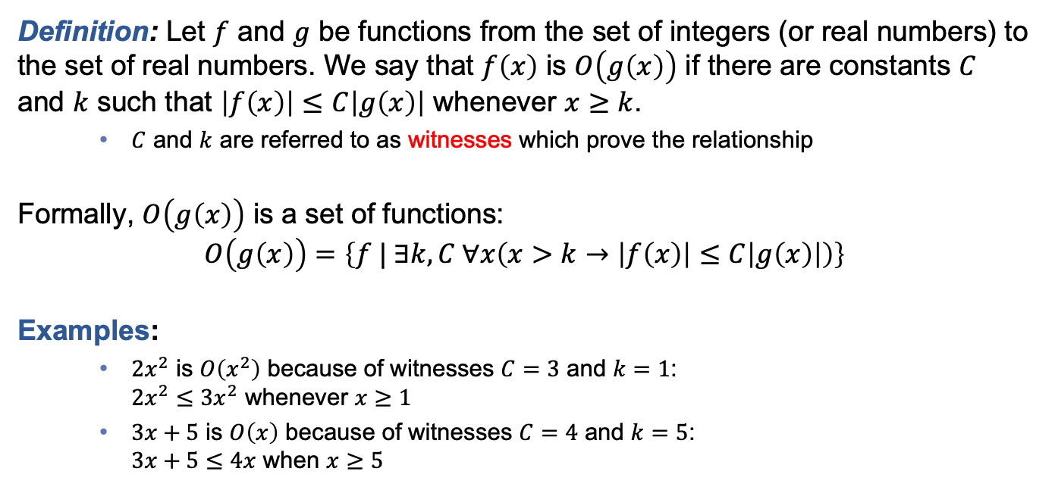
Let’s define this “big-O notation” that you’ve probably heard of (and maybe used)
Definition: Let $f$ and $g$ be functions from the set of integers (or real numbers) to the set of real numbers. We say that $f\left(x\right)$ is $O\left(g\left(x\right)\right)$ if there are constants $C$ and $k$ such that $\left|f\left(x\right)\right|≤C\left|g\left(x\right)\right|$ whenever $x≥k$.
  $C$ and $k$ are referred to as witnesses which prove the relationship
Formally, $O\left(g\left(x\right)\right)$ is a set of functions:
$$O\left(g\left(x\right)\right)=\left\{f | ∃k,C ∀x\left(x>k→\left|f\left(x\right)\right|≤C\left|g\left(x\right)\right|\right)\right\}$$
Examples:
  $2x^{2}$ is $O\left(x^{2}\right)$ because of witnesses $C=3$ and $k=1$:
  $2x^{2}≤3x^{2}$ whenever $x≥1$
  $3x+5$ is $O\left(x\right)$ because of witnesses $C=4$ and $k=5$:
  $3x+5≤4x$ when $x≥5$
When considering positive values only, we will often drop the absolute value
Notes:
Intuitively, the set of functions whose growth is bounded above by g’s, ignoring constant multiples

Slide 4
The part of the graph f(x) that satisfies f(x)< C g(x) is shown in color.
Notes:
Intuitively, the set of functions whose growth is bounded above by g’s, ignoring constant multiples

Slide 5
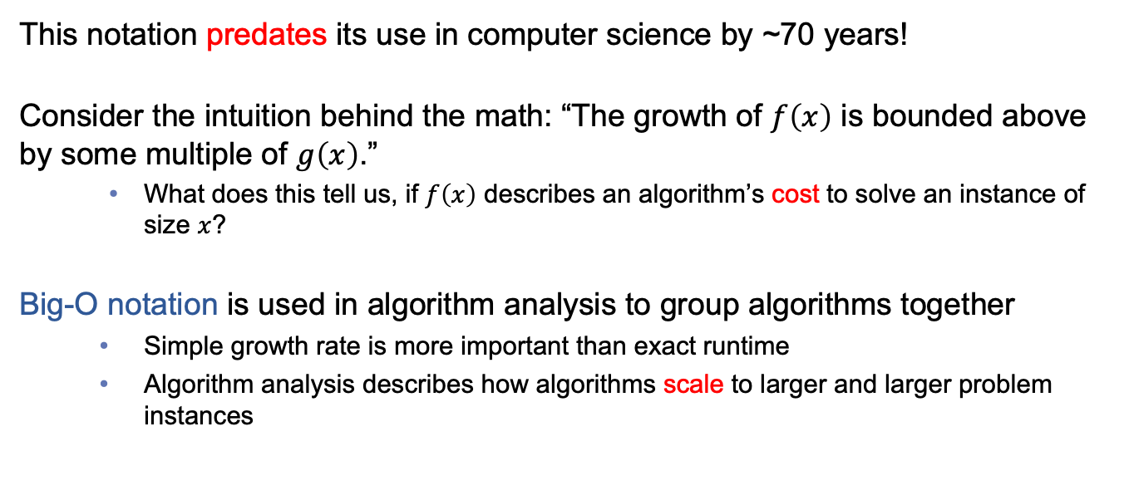
Why does this matter to computing?
This notation predates its use in computer science by ~70 years!
Consider the intuition behind the math: “The growth of $f\left(x\right)$ is bounded above by some multiple of $g\left(x\right)$.”
  What does this tell us, if $f\left(x\right)$ describes an algorithm’s cost to solve an instance of size $x$?
Big-O notation is used in algorithm analysis to group algorithms together
  Simple growth rate is more important than exact runtime
  Algorithm analysis describes how algorithms scale to larger and larger problem instances
Notes:
If our hardware gets 10x better, most everything will be 1/10 the time, just need the trend.
On the other hand, growth rates tell us something fundamental about an algorithm that better hardware can’t fix forever.

Slide 6
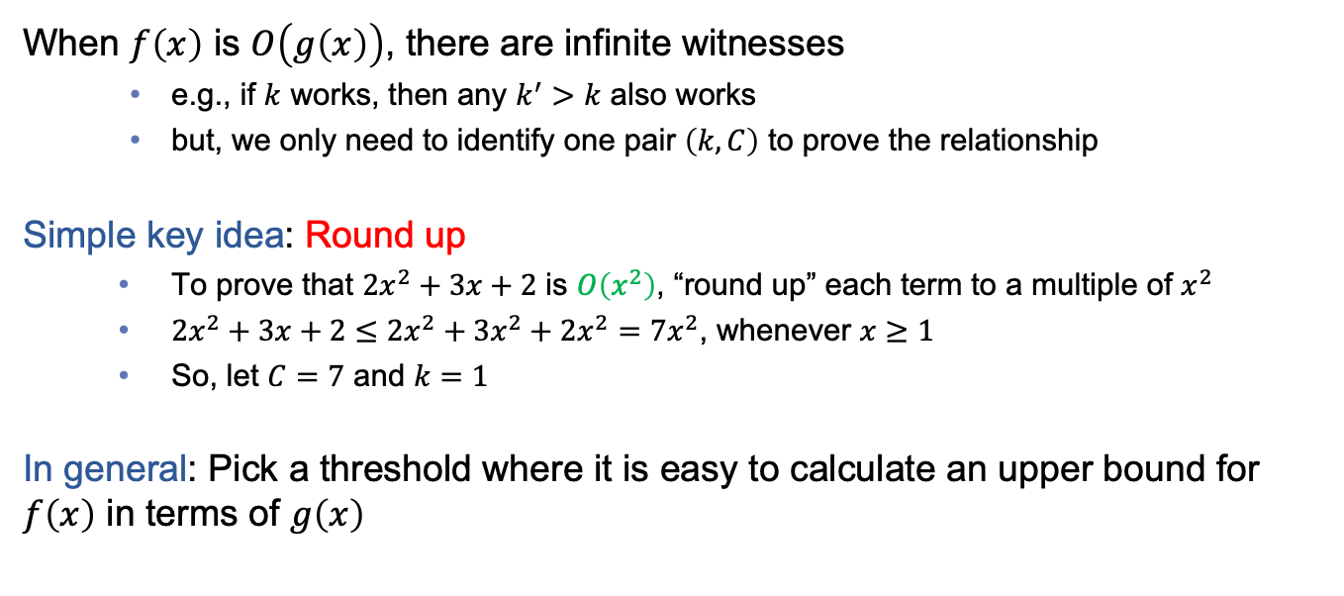
How to find witnesses to prove a big-O relationship
When $f\left(x\right)$ is $O\left(g\left(x\right)\right)$, there are infinite witnesses
  e.g., if $k$ works, then any $k^{′}>k$ also works
  but, we only need to identify one pair $\left(k, C\right)$ to prove the relationship
Simple key idea: Round up
  To prove that $2x^{2}+3x+2$ is $O\left(x^{2}\right)$, “round up” each term to a multiple of $x^{2}$
  $2x^{2}+3x+2≤2x^{2}+3x^{2}+2x^{2}=7x^{2}$, whenever $x≥1$
  So, let $C=7$ and $k=1$
In general: Pick a threshold where it is easy to calculate an upper bound for $f\left(x\right)$ in terms of $g\left(x\right)$

Slide 7
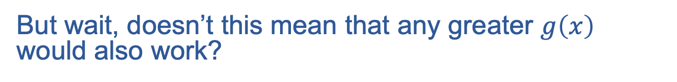
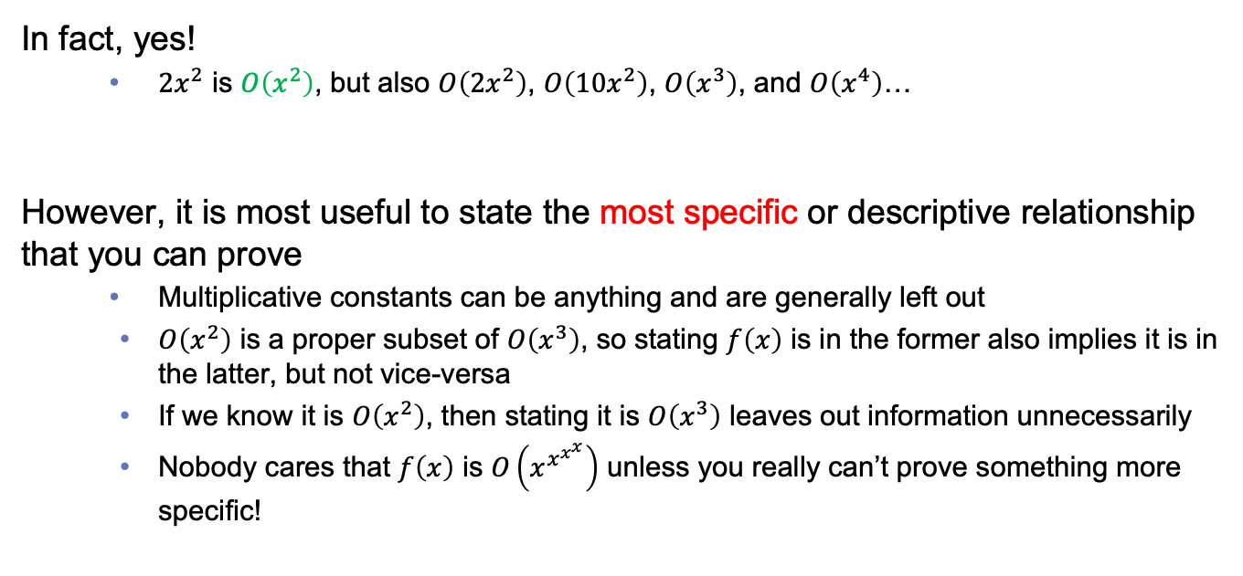
But wait, doesn’t this mean that any greater $g\left(x\right)$ would also work?
In fact, yes!
  $2x^{2}$ is $O\left(x^{2}\right)$, but also $O\left(2x^{2}\right)$, $O\left(10x^{2}\right)$, $O\left(x^{3}\right)$, and $O\left(x^{4}\right)$…
However, it is most useful to state the most specific or descriptive relationship that you can prove
  Multiplicative constants can be anything and are generally left out
  $O\left(x^{2}\right)$ is a proper subset of $O\left(x^{3}\right)$, so stating $f\left(x\right)$ is in the former also implies it is in the latter, but not vice-versa
  If we know it is $O\left(x^{2}\right)$, then stating it is $O\left(x^{3}\right)$ leaves out information unnecessarily
  Nobody cares that $f\left(x\right)$ is $O\left(x^{x^{x^{x}}}\right)$ unless you really can’t prove something more specific!

Slide 8
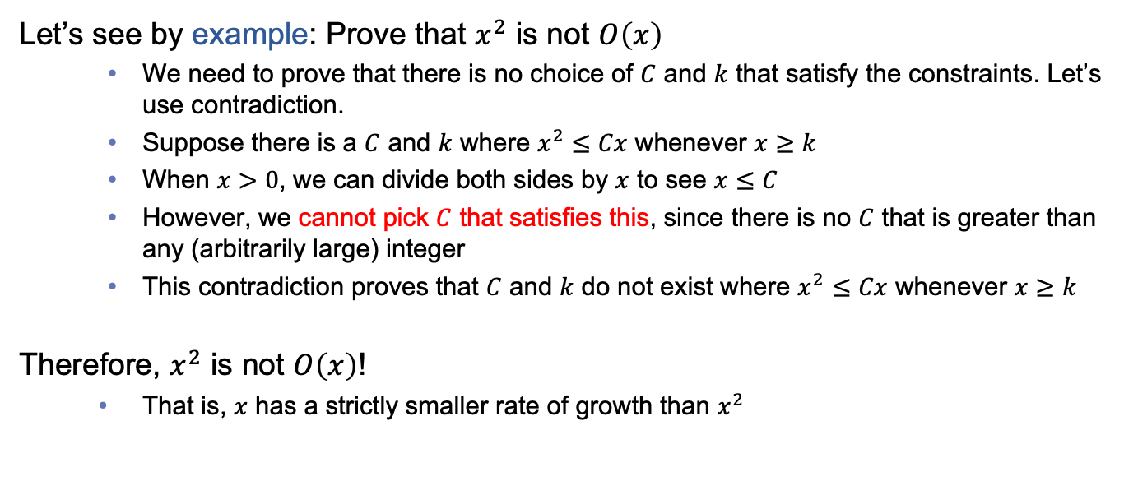
How do we know when we can’t use a smaller bound?
Let’s see by example: Prove that $x^{2}$ is not $O\left(x\right)$
  We need to prove that there is no choice of $C$ and $k$ that satisfy the constraints. Let’s use contradiction.
  Suppose there is a $C$ and $k$ where $x^{2}≤Cx$ whenever $x≥k$
  When $x>0$, we can divide both sides by $x$ to see $x≤C$
  However, we cannot pick $C$ that satisfies this, since there is no $C$ that is greater than any (arbitrarily large) integer
  This contradiction proves that $C$ and $k$ do not exist where $x^{2}≤Cx$ whenever $x≥k$
Therefore, $x^{2}$ is not $O\left(x\right)$!
  That is, $x$ has a strictly smaller rate of growth than $x^{2}$

Slide 9
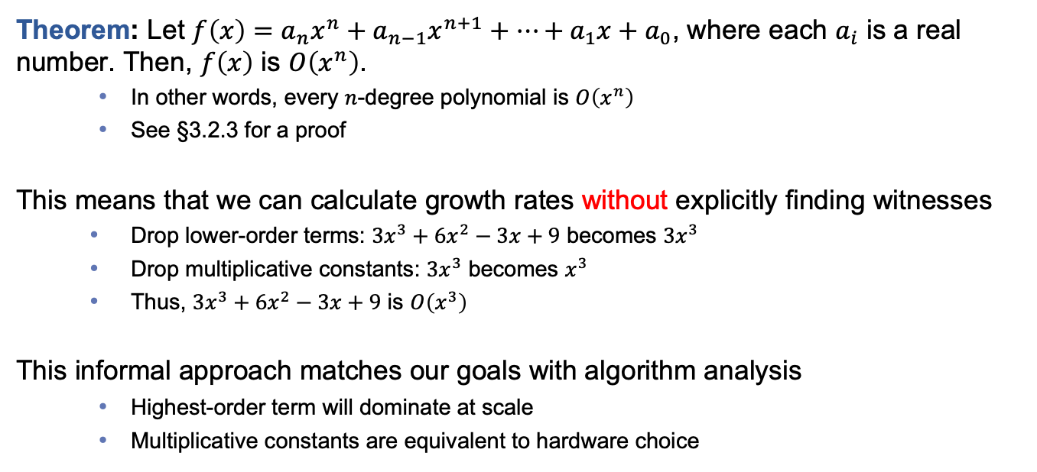
A heuristic for growth rates of polynomials: Drop multiplicative constants and lower-order terms
Theorem: Let $f\left(x\right)=a_{n}x^{n}+a_{n−1}x^{n+1}+…+a_{1}x+a_{0}$, where each $a_{i}$ is a real number. Then, $f\left(x\right)$ is $O\left(x^{n}\right)$.
  In other words, every $n$-degree polynomial is $O\left(x^{n}\right)$
  See §3.2.3 for a proof
This means that we can calculate growth rates without explicitly finding witnesses
  Drop lower-order terms: $3x^{3}+6x^{2}−3x+9$ becomes $3x^{3}$
  Drop multiplicative constants: $3x^{3}$ becomes $x^{3}$
  Thus, $3x^{3}+6x^{2}−3x+9$ is $O\left(x^{3}\right)$
This informal approach matches our goals with algorithm analysis
  Highest-order term will dominate at scale
  Multiplicative constants are equivalent to hardware choice

Slide 10
Common rates of growth

Slide 11
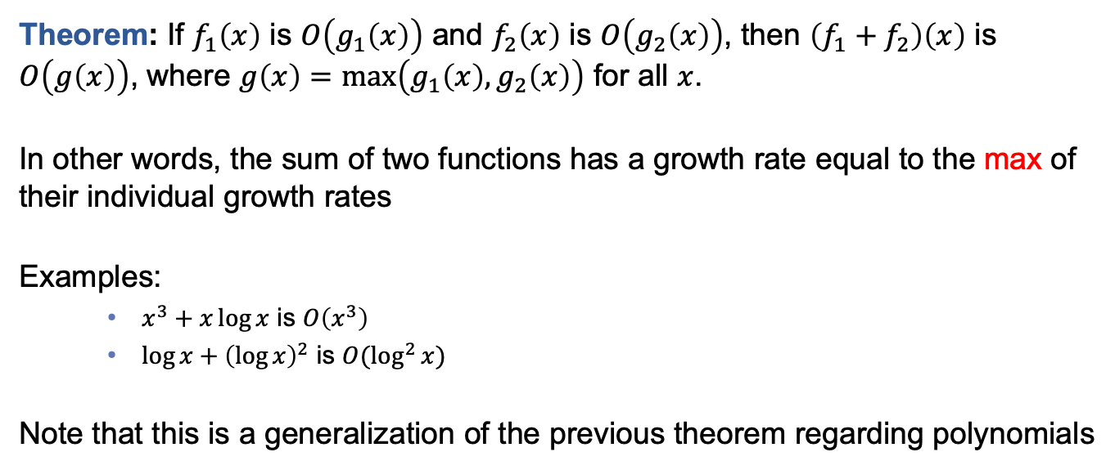
Growth rates of combined functions
Theorem: If $f_{1}\left(x\right)$ is $O\left(g_{1}\left(x\right)\right)$ and $f_{2}\left(x\right)$ is $O\left(g_{2}\left(x\right)\right)$, then $\left(f_{1}+f_{2}\right)\left(x\right)$ is $O\left(g\left(x\right)\right)$, where $g\left(x\right)=\max\left(g_{1}\left(x\right),g_{2}\left(x\right)\right)$ for all $x$.
In other words, the sum of two functions has a growth rate equal to the max of their individual growth rates
Examples:
  $x^{3}+x\log{x}$ is $O\left(x^{3}\right)$
  $\log{x}+{\left(\log{x}\right)}^{2}$ is $O(\log^{2}{x})$
Note that this is a generalization of the previous theorem regarding polynomials
Notes:
In algorithms, this means executing multiple routines has the growth rate of the highest among them

Slide 12
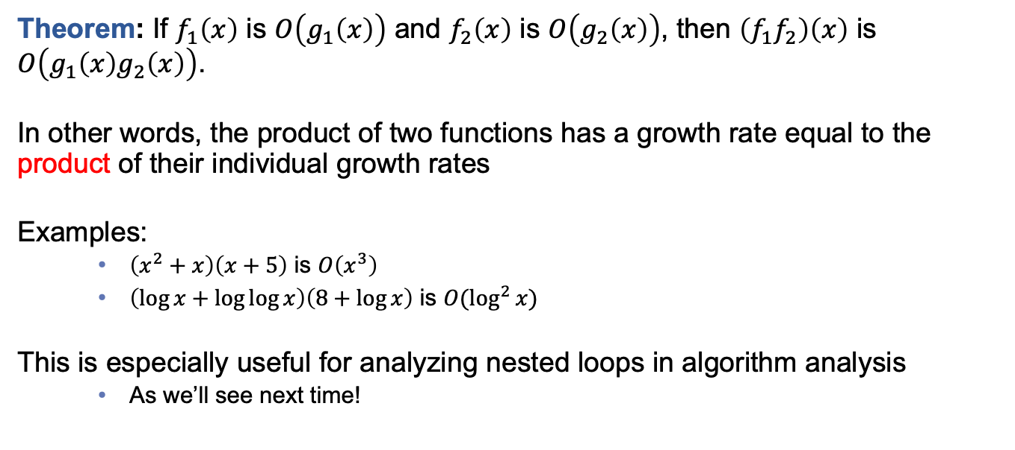
Growth rates of combined functions
Theorem: If $f_{1}\left(x\right)$ is $O\left(g_{1}\left(x\right)\right)$ and $f_{2}\left(x\right)$ is $O\left(g_{2}\left(x\right)\right)$, then $\left(f_{1}f_{2}\right)\left(x\right)$ is $O\left(g_{1}\left(x\right)g_{2}\left(x\right)\right)$.
In other words, the product of two functions has a growth rate equal to the product of their individual growth rates
Examples:
  $\left(x^{2}+x\right)\left(x+5\right)$ is $O\left(x^{3}\right)$
  $\left(\log{x}+\log{\log{x}}\right)\left(8+\log{x}\right)$ is $O(\log^{2}{x})$
This is especially useful for analyzing nested loops in algorithm analysis
  As we’ll see next time!

Slide 13
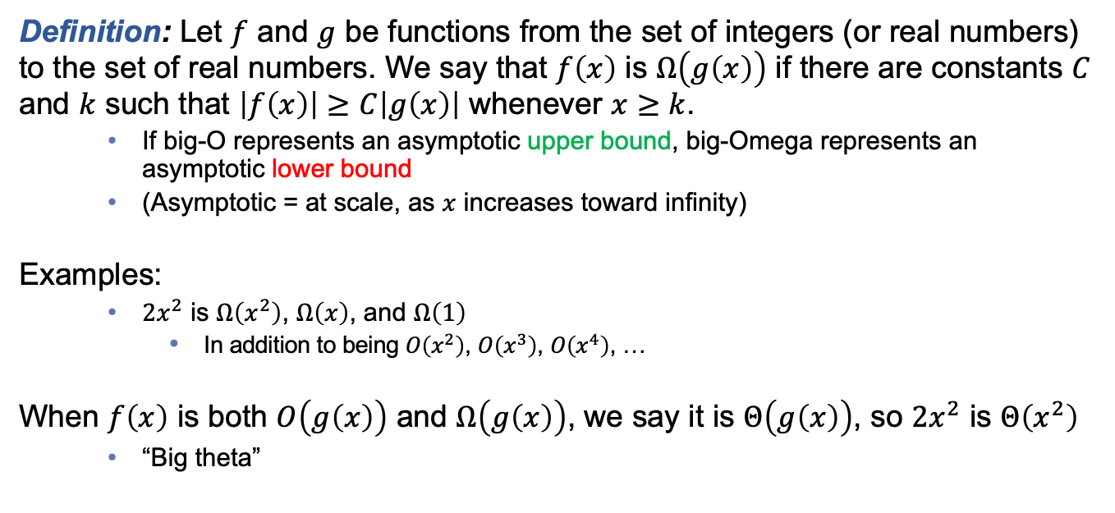
Related notations to big-O
Definition: Let $f$ and $g$ be functions from the set of integers (or real numbers) to the set of real numbers. We say that $f\left(x\right)$ is $Ω\left(g\left(x\right)\right)$ if there are constants $C$ and $k$ such that $\left|f\left(x\right)\right|≥C\left|g\left(x\right)\right|$ whenever $x≥k$.
  If big-O represents an asymptotic upper bound, big-Omega represents an asymptotic lower bound
  (Asymptotic = at scale, as $x$ increases toward infinity)
Examples:
  $2x^{2}$ is $Ω\left(x^{2}\right)$, $Ω\left(x\right)$, and $Ω\left(1\right)$
    In addition to being $O\left(x^{2}\right)$, $O\left(x^{3}\right)$, $O\left(x^{4}\right)$, …
When $f\left(x\right)$ is both $O\left(g\left(x\right)\right)$ and $Ω\left(g\left(x\right)\right)$, we say it is $Θ\left(g\left(x\right)\right)$, so $2x^{2}$ is $Θ\left(x^{2}\right)$
  “Big theta”
Notes:
Often we say big-O when we mean big-Theta, especially in computing. Say what you mean!

Slide 14
In-class exercises
On Top Hat
Notes:
Submit Problem 2 on Top Hat

Slide 15
Final thoughts
Growth rates are commonly expressed using big-O and related notations
These notations were not developed for computing, but fit well for algorithm analysis
Next time:
  Algorithm analysis (Section 3.3)

