Slide 1

CS 441: Integer representation and Algorithms
PhD. Nils Murrugarra-Llerena
nem177@pitt.edu

Slide 2

Today's topics
Integer representations
  Base b expansions
  Common bases: Binary, octal, hexadecimal
  Base conversions
Integer algorithms
  Addition
  Multiplication
  Connection to computing and pen-and-paper arithmetic

Slide 3
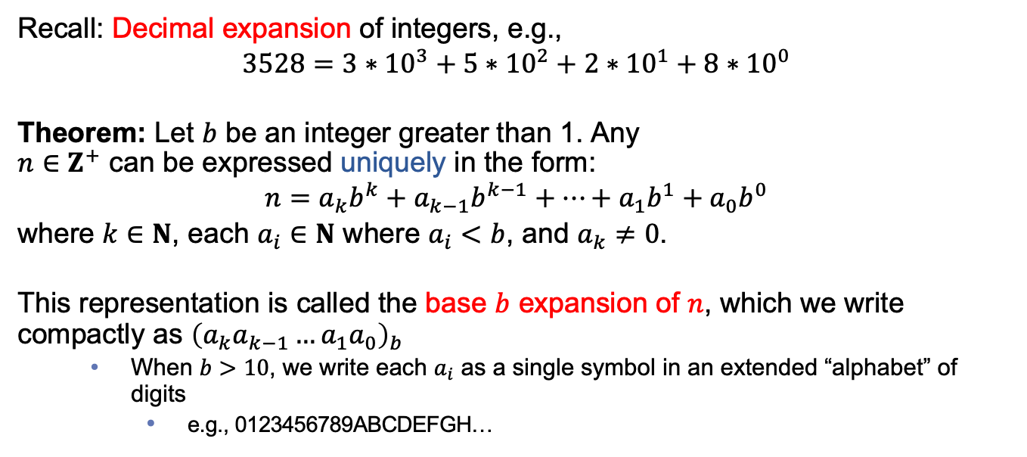
While we typically use decimal, other base systems work very similarly
Recall: Decimal expansion of integers, e.g.,
$$3528=3∗{10}^{3}+5∗{10}^{2}+2∗{10}^{1}+8∗{10}^{0}$$
Theorem: Let $b$ be an integer greater than 1. Any
$n∈Z^{+}$ can be expressed uniquely in the form:
$$n=a_{k}b^{k}+a_{k−1}b^{k−1}+…+a_{1}b^{1}+a_{0}b^{0}$$
where $k∈N$, each $a_{i}∈N$ where $a_{i}<b$, and $a_{k}≠0$.
This representation is called the base $b$ expansion of $n$, which we write compactly as ${\left(a_{k}a_{k−1}…a_{1}a_{0}\right)}_{b}$
  When $b>10$, we write each $a_{i}$ as a single symbol in an extended “alphabet” of digits
    e.g., 0123456789ABCDEFGH…

Slide 4
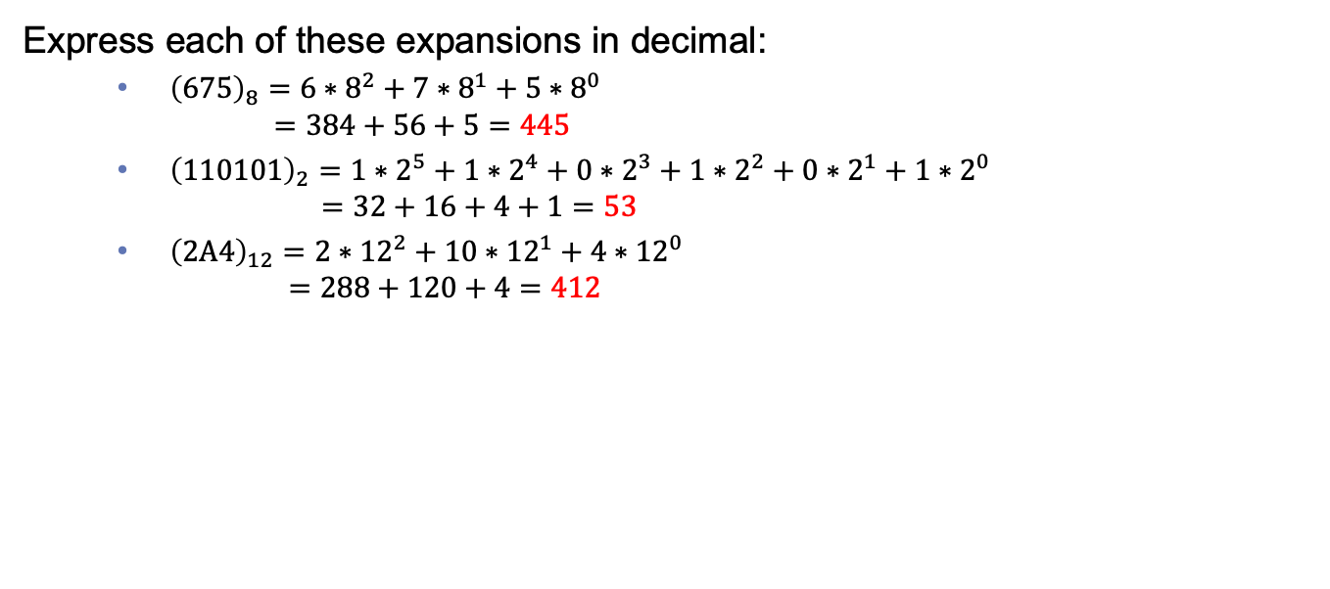
Examples of base $b$ expansions
Express each of these expansions in decimal:
  ${\left(675\right)}_{8}=6∗8^{2}+7∗8^{1}+5∗8^{0}$
  $=384+56+5=445$
  ${\left(110101\right)}_{2}=1∗2^{5}+1∗2^{4}+0∗2^{3}+1∗2^{2}+0∗2^{1}+1∗2^{0}$
  $=32+16+4+1=53$
  ${\left(2A4\right)}_{12}=2∗{12}^{2}+10∗{12}^{1}+4∗{12}^{0}$
  $=288+120+4=412$
Here, A has value 10

Slide 5
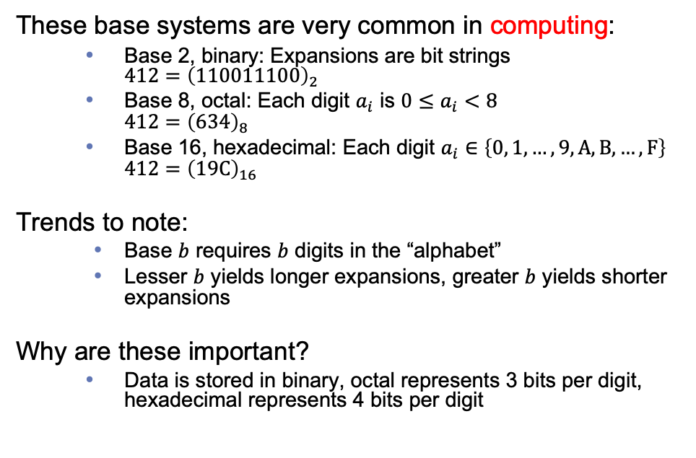
Common base expansions
These base systems are very common in computing:
  Base 2, binary: Expansions are bit strings
  $412={\left(110011100\right)}_{2}$
  Base 8, octal: Each digit $a_{i}$ is $0≤a_{i}<8$
  $412={\left(634\right)}_{8}$
  Base 16, hexadecimal: Each digit $a_{i}∈\left\{0, 1,…,9, A, B,…,F\right\}$
  $412={\left(19C\right)}_{16}$
Trends to note:
  Base $b$ requires $b$ digits in the “alphabet”
  Lesser $b$ yields longer expansions, greater $b$ yields shorter expansions
Why are these important?
  Data is stored in binary, octal represents 3 bits per digit, hexadecimal represents 4 bits per digit

Slide 6
Constructing base $b$ expansions
procedure base b expansion(n, b: positive integers with b > 1)
q := n
k := 0
while q ≠ 0
a_{k} := q mod b
q := q div b
k := k + 1
return (a_{k-1}, a_{k-2} …, a₁, a₀)
{(a_{k-1}a_{k-2}⋯a₁a₀)_{b} is the base b expansion of n}
Digits are produced right-to-left
Repeat: Divide q by b; remainder becomes a digit, quotient replaces q
Return when q = 0

Slide 7
Constructing base $b$ expansions, examples
Express 1501 in hex
  1501 divided by 16
  q = 93, r = 13 = (D)₁₆
  93 divided by 16
  q = 5, r = 13 = (D)₁₆
  5 divided by 16
  q = 0, r = 5
  Thus, 1501 = (5DD)16
Express 441 in octal
  441 divided by 8
  q = 55, r = 1
  55 divided by 8
  q = 6, r = 7
  6 divided by 8
  q = 0, r = 6
  Thus, 441 = (671)₈
Express 441 in base-30
  441 divided by 30
  q = 14, r = 21 = (I)₃₀
  14 divided by 30
  q = 0, r = 14 = (E)₃₀
  Thus, 441 = (EI)₃₀
Express 441 in base-4
  441 divided by 4
  q = 110, r = 1
  110 divided by 4
  q = 27, r = 2
  27 divided by 4
  q = 6, r = 3
  6 divided by 4
  q = 1, r = 2
  1 divided by 4
  q = 0, r = 1
  Thus, 441 = (12321)₄
Notes:
Converting back to decimal: Use the definition!

Slide 8
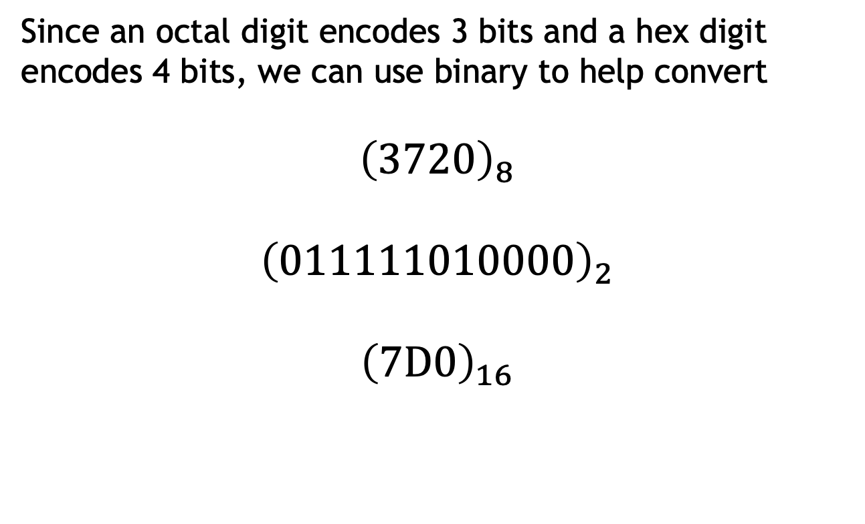

When $b=2^{i}$, conversion can be done on $i$ bits at a time
Since an octal digit encodes 3 bits and a hex digit encodes 4 bits, we can use binary to help convert
$${\left(3720\right)}_{8}$$
$${\left(011111010000\right)}_{2}$$
$${\left(7D0\right)}_{16}$$

Slide 9
In-class exercises
Problem 1: Find the octal expansion of 100
Problem 2: Find the octal expansion of (100)₂
Problem 3: Find the octal expansion of (100)₁₆
Problem 4: Find the octal expansion of (100)₃₆
Notes:
1. 144 [Divide by 8 and successively …]
2. 4
3. 400 [convert to binary and then to octal]
4. 2420 [convert to decimal and then to octal]

Slide 10
Adding base $b$ expansions
procedure add(x, y: positive integers, b: integer > 1)
{The base b expansions of x and y are (x_{n-1}x_{n-2}⋯x₁x₀)_{b} and (y_{n-1}y_{n-2}⋯y₁y₀)_{b}, respectively}
c := 0
for j := 0 to n–1 {Move right-to-left}
t := x_{j} + y_{j} + c {Add the jth digits together}
c := ⌊t/b⌋ {Carry a digit if needed}
s_{j} := t – bc {Remove carry and save as s_{j}}
s_{n} := c {Final carry becomes s_{n}}
return (s_{n}, s_{n-1}, …, s₁, s₀)
{The base b expansion of the sum is (s_{n}s_{n-1}⋯s₁s₀)_{b}}
Does this sound familiar?
What is its complexity?
Notes:
Note that this assumes we can add individual digits

Slide 11
Addition examples in hexadecimal/octal
Hex | Octal
₁
B8C0
+ 827F
13B3F
₁₁
13AC4F
+ 3B9E00
4F4A4F
₁₁
5630
+ 3766
11616
₁ ₁
723405
+ 27305
752712

Slide 12
Multiplying base $b$ expansions
procedure multiply(x, y: positive integers, b: integer > 1)
{The base b expansions of x and y are (x_{n-1}x_{n-2}⋯x₁x₀)_{b} and (y_{n-1}y_{n-2}⋯y₁y₀)_{b}, respectively}
p := 0 {Resulting product}
for j := 0 to n–1 {Move right-to-left in y}
c := 0 {Reset carry}
for i := 0 to n-1 {Move right-to-left in x}
t := x_{i} * y_{j} + c {Multiply digits and add carry}
c := ⌊t/b⌋ {Carry a digit if needed}
r_{i} := t - bc {Partial product, digit i}
r_{n} := c {Final carry becomes r_{n}}
r := r shifted j places {Shift position to align with j}
p := add(p, r) {Add r to the result}
return (p_{2n}, p_{2n-1}, …, p₁, p₀)
{The base b expansion of the sum is (p_{2n}p_{2n-1}⋯p₁p₀)_{b}}
What is its complexity?
Notes:
Again, this assumes we have a multiplication table

Slide 13
Multiplication examples in hexadecimal/octal
C38
* 6A4
30E0
7A30
+ 4950
5123E0
365
* 457
3263
2311
+ 1724
220773
Hex | Octal

Slide 14
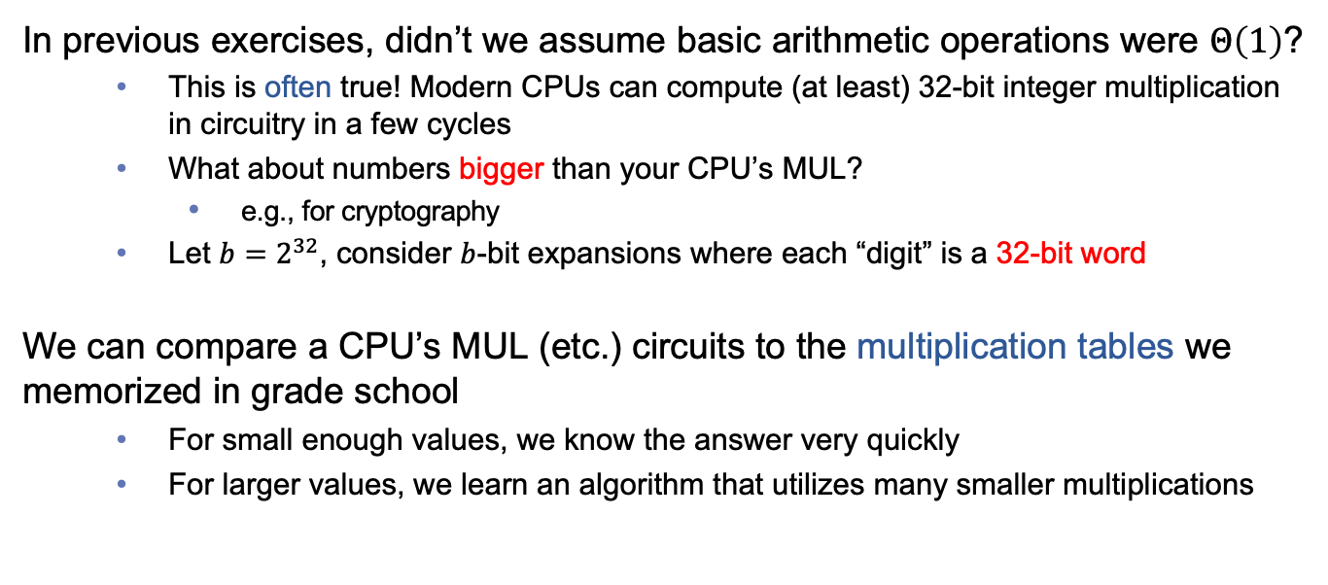
How are these algorithms used in practice?
In previous exercises, didn’t we assume basic arithmetic operations were $Θ\left(1\right)$?
  This is often true! Modern CPUs can compute (at least) 32-bit integer multiplication in circuitry in a few cycles
  What about numbers bigger than your CPU’s MUL?
    e.g., for cryptography
  Let $b=2^{32}$, consider $b$-bit expansions where each “digit” is a 32-bit word
We can compare a CPU’s MUL (etc.) circuits to the multiplication tables we memorized in grade school
  For small enough values, we know the answer very quickly
  For larger values, we learn an algorithm that utilizes many smaller multiplications

Slide 15
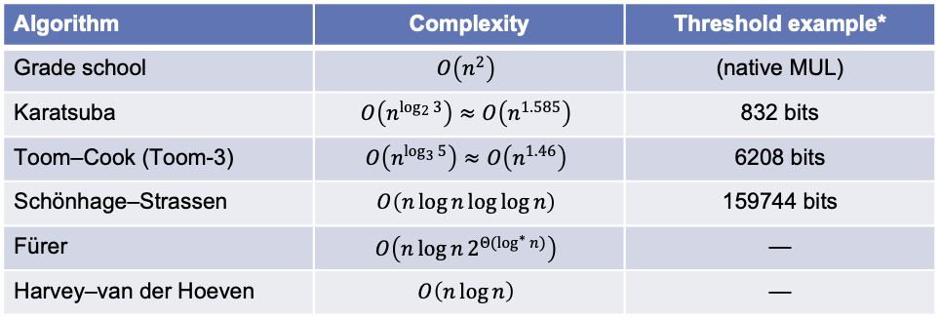
Other multiplication algorithms for even larger values
Algorithm | Complexity | Threshold example*
Grade school | $$O\left(n^{2}\right)$$ | (native MUL)
Karatsuba | $$O\left(n^{\log_{2}{3}}\right)≈O\left(n^{1.585}\right)$$ | 832 bits
Toom–Cook (Toom-3) | $$O\left(n^{\log_{3}{5}}\right)≈O\left(n^{1.46}\right)$$ | 6208 bits
Schönhage–Strassen | $$O\left(n\log{n}\log{\log{n}}\right)$$ | 159744 bits
Fürer | $$O\left(n\log{n}2^{{Θ(log}^{∗}{n})}\right)$$ | —
Harvey–van der Hoeven | $$O\left(n\log{n}\right)$$ | —
Notes:
Threshold is for Alder Lake x86_64 with 64-bit limbs in GMP.
The new algorithm is not really practical in its current form, because the proof given in our paper only works for ludicrously large numbers. Even if each digit was written on a hydrogen atom, there would not be nearly enough room available in the observable universe to write them down.

Slide 16
In-class exercises
Problem 5: Use the integer addition algorithm to compute (734)₈ + (225)₈
Problem 6: Use the integer multiplication algorithm to compute (110110)₂ × (100101)₂
Problem 7: Calculate (FF)₁₆ × (FF)₁₆, (77)₈ × (77)₈, and 99 × 99 and compare
Notes:
5. 0o1161
6. 0b11111001110
7. 0xFE01, 0o7601, 9801

Slide 17
Final thoughts
Integers can be represented uniquely in any specified base
Integer arithmetic can be computed in other bases, and even pen-and-paper algorithms can be useful in computing
  Arithmetic isn’t always constant
Next time:
  Primes and composites (Section 4.3)

