Slide 1

CS 441: Proof by induction
PhD. Nils Murrugarra-Llerena
nem177@pitt.edu

Slide 2

Today's topics
Proof by Induction
Examples
  Equations
  Inequalities
  Sets

Slide 3
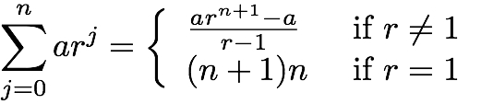
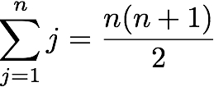
We’ve learned a lot of proof methods…
Basic proof methods
  Direct proof, contradiction, contraposition, cases, …
Proof of quantified statements
  Existential statements (i.e., ∃x P(x))
    Finding a single example suffices
  Universal statements (i.e., ∀x P(x)) can be harder to prove
Bottom line: We need new tools!

Slide 4
Mathematical induction lets us prove universally quantified statements!
Goal: Prove ∀x∈N P(x).
Procedure:
  Prove P(0)
  Show that P(k) → P(k+1) for any arbitrary k
  Conclude that P(x) is true ∀x∈N
Intuition: If P(0) is true, then P(1) is true. If P(1) is true, then P(2) is true…
P(0)
For arb. k, P(k) → P(k+1)
∴∀x∈N P(x)

Slide 5
Analogy: Climbing a ladder
Proving P(0):
  You can get on the first rung of the ladder
Proving P(k) → P(k+1):
  If you are on the kth step, you can get to the (k+1)th step
∴ ∀x P(x)
  You can get to any step on the ladder

Slide 6

Analogy: Playing with dominoes
Proving P(0):
  The first domino falls
Proving P(k) → P(k+1):
  If the kth domino falls, then the (k+1)th domino will fall
∴ ∀x P(x)
  All dominoes will fall!

Slide 7
All of your proofs should have the same overall structure
P(x) ≡
Define the property that you are trying to prove
Base case:
Prove the “first step onto the ladder.” Typically,
but not always, this means proving P(0) or P(1).
Inductive Hypothesis:
Assume that P(k) is true for an arbitrary k
Inductive step:
Show that P(k) → P(k + 1). That is, prove that once you’re on one step, you can get to the next step. This is where many proofs will differ from one another.
Conclusion:
Since you’ve proven the base case and
P(k) → P(k + 1), the claim is true! ❏
Notes:
Tie the base case and inductive step back to the rule of inference…

Slide 8
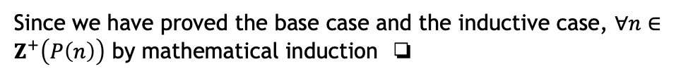
Prove that
P(n) ≡
✔
Base case:
P(1): 1(1+1)/2 = 1
I.H.:
Assume that P(k) holds for an arbitrary positive integer k
Inductive step:
We will now show that P(k) → P(k+1)
1+2+…+k = k(k+1)/2 by I.H.
1+2+…+k+(k+1) = k(k+1)/2 + (k+1) k+1 to both sides
1+2+…+k+(k+1) = k(k+1)/2 + 2(k+1)/2
1+2+…+k+(k+1) = (k² + 3k + 2)/2
1+2+…+k+(k+1) = (k+1)(k+2)/2 factoring
Conclusion:
Since we have proved the base case and the inductive case, $∀n∈Z^{+}\left(P\left(n\right)\right)$ by mathematical induction ❏
Notes:
The IS in this case is a straightforward application of forward reasoning

Slide 9
Induction cannot give us a formula to prove, but can allow us to verify conjectures
Mathematical induction is not a tool for discovering new theorems, but rather a powerful way to prove them
Example: Make a conjecture about the sum of the first n odd positive numbers, then prove it.
  1 = 1
  1 + 3 = 4
  1 + 3 + 5 = 9
  1 + 3 + 5 + 7 = 16
  1 + 3 + 5 + 7 + 9 = 25
Conjecture: The sum of the first n odd positive integers is n²
The sequence 1, 4, 9, 16, 25, … appears to be the sequence {n²}

Slide 10
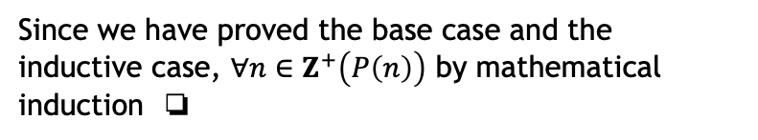
Prove that the sum of the first n positive odd integers is n²
P(n) ≡
The sum of the first n positive odd numbers is n²
✔
Base case:
P(1): 1 = 1
I.H.:
Assume that P(k) holds for an arbitrary positive integer k
Inductive step:
We will now show that P(k) → P(k+1)
1+3+…+(2k-1) = k² by I.H.
1+3+…+(2k-1)+(2k+1) = k²+2k+1 2k+1 to both sides
1+3+…+(2k-1)+(2k+1) = (k+1)² factoring
Note: The kth odd integer is 2k-1, the (k+1)th odd integer is 2k+1
Conclusion:
Since we have proved the base case and the inductive case, $∀n∈Z^{+}\left(P\left(n\right)\right)$ by mathematical induction ❏
Notes:
Again, forward reasoning in IS

Slide 11
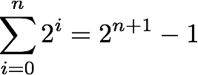
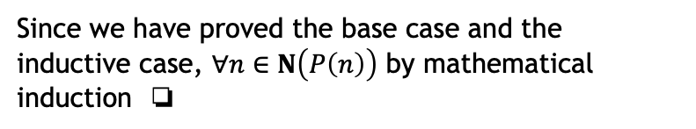
Prove that the sum 1 + 2 + 2² + … + 2^{n} = 2^{n+1} - 1 for all nonnegative integers n
P(n) ≡
✔
Base case:
P(0): 2⁰ = 1
I.H.:
Assume that P(k) holds for an arbitrary natural number k
Inductive step: We will now show that P(k) → P(k+1)
1+2+…+2^{k} = 2^{k+1}-1 by I.H.
1+2+…+2^{k}+2^{k+1} = 2^{k+1}-1+2^{k+1} 2^{k+1} to both sides
1+2+…+2^{k}+2^{k+1} = 2^{k+1}+2^{k+1}-1 associative law
1+2+…+2^{k}+2^{k+1} = 2×2^{k+1}-1 def’n of ×
1+2+…+2^{k}+2^{k+1} = 2^{k+2}-1 def’n of exp.
Conclusion:
Since we have proved the base case and the inductive case, $∀n∈N\left(P\left(n\right)\right)$ by mathematical induction ❏
Notes:
Note that base case is P(0) not P(1)
Yet again, forward reasoning in I.S.

Slide 12
Why does mathematical induction work?
This follows from the well ordering axiom
  i.e., Every set of positive integers has a least element
We can prove that mathematical induction is valid using a proof by contradiction.
  Assume that P(1) holds and P(k) → P(k+1), but ¬∀x P(x)
  This means that the set S = {x | ¬P(x)} is nonempty
  By well ordering, S has a least element m with ¬P(m)
  Since m is the least element of S, P(m-1) is true
  By P(k) → P(k+1), P(m-1) → P(m)
  Since we have P(m) ∧ ¬P(m) this is a contradiction!
Result: Mathematical induction is a valid proof method

Slide 13
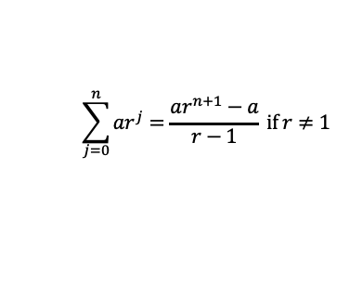
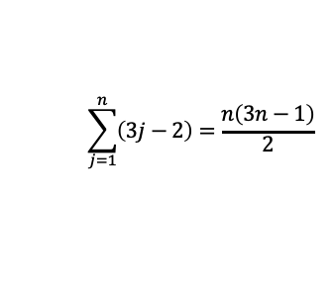
In-class exercises
Problem 1: Prove that
Problem 2: Prove that
Hint: Be sure to
  Define P(x)
  Prove the base case
  Make an inductive hypothesis
  Carry out the inductive step
  Draw the final conclusion
$$\sum_{j=0}^{n}{ar^{j}=\frac{ar^{n+1}−a}{r−1}} if r≠1$$
$$\sum_{j=1}^{n}{\left(3j−2\right)=\frac{n\left(3n−1\right)}{2}}$$
Notes:
Do first 3 steps as a group. We’ll do 4th step individually (then together).

Slide 14
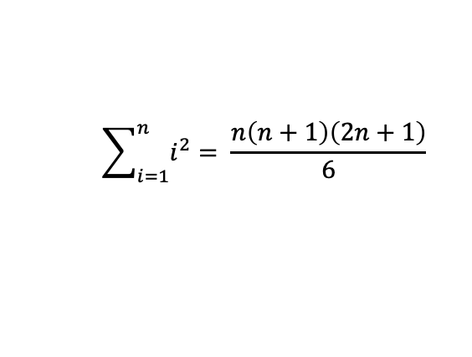
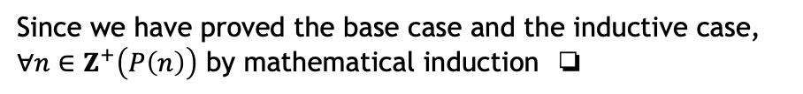

Prove the formula for the sum of the first n positive squares
$$\sum_{i=1}^{n}{i^{2}}= \frac{n\left(n+1\right)\left(2n+1\right)}{6}$$
P(n) ≡
P(1): $1^{2}= \frac{1(1+1)(2+1)}{6}$
✔
Base case:
I.H.:
Assume that P(k) holds for an arbitrary positive integer k
Inductive step:
We will now show that P(k) → P(k+1)
1+4+9+…+k² = k(k+1)(2k+1)/6 by I.H.
1+4+9+...+(k+1)² = k(k+1)(2k+1)/6 + (k+1)² (k+1)² to both sides
= k(k+1)(2k+1)/6 + 6(k+1)²/6 common denom.
= (k+1)(2k²+k+6k+6)/6 = (k+1)(2k²+7k+6)/6 factor k+1, mult.
= (k+1)(k+2)(2k+3)/6 factor
= (k+1)((k+1)+1)(2(k+1)+1)/6, ∴P(k+1) proved for k+1
Conclusion:
Since we have proved the base case and the inductive case, $∀n∈Z^{+}\left(P\left(n\right)\right)$ by mathematical induction ❏
Notes:
Again, forward reasoning in IS

Slide 15
≡
Induction can also be used to prove properties other than summations!
|
≥
φ(p)
<
Inequalities
Divisibility and results from number theory
∈
⊆
∪
Set theory
Algorithms and data structures

Slide 16
Prove that 2^{n} < n! for every positive integer n ≥ 4
Prelude: The expression n! is called the factorial of n.
Definition: n! = n × (n-1) × … × 3 × 2 × 1
Examples:
  4! = 4 × 3 × 2 × 1 = 24
  5! = 5 × 4 × 3 × 2 × 1 = 120
  6! = 6 × 5 × 4 × 3 × 2 × 1 = 720
  7! = 7 × 6 × 5 × 4 × 3 × 2 × 1 = 5,040
  8! = 8 × 7 × 6 × 5 × 4 × 3 × 2 × 1 = 40,320
Note how quickly the factorial of n “grows”
Notes:
Changing 2 to (k+1) is a tricky step

Slide 17
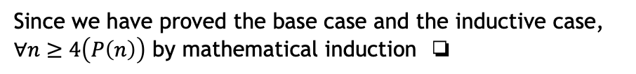
Prove that 2^{n} < n! for every positive integer n ≥ 4
P(n) ≡
2^{n} < n!
✔
Base case:
P(4): 2⁴ < 4!
I.H.:
Assume that P(k) holds for an arbitrary integer k ≥ 4
Inductive step: We will now show that P(k) → P(k+1)
2^{k} < k! by I.H.
2 × 2^{k} < 2 × k! multiply by 2
2^{k+1} < 2 × k! def’n of exp.
2^{k+1} < (k+1) × k! since 2 < (k+1)
2^{k+1} < (k+1)! def’n of factorial
Conclusion:
Since we have proved the base case and the inductive case, $∀n≥4\left(P\left(n\right)\right)$ by mathematical induction ❏
Notes:
Changing 2 to (k+1) is a tricky step

Slide 18
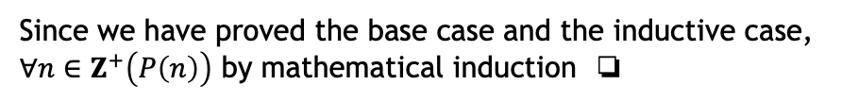
Prove that n³ – n is divisible by 3 whenever n is a positive integer
3 | (n³ – n)
P(n) ≡
P(1): 3 | 0
✔
Base case:
Assume that P(k) holds for an arbitrary positive integer k
I.H.:
Inductive step: We will now show that P(k) → P(k+1)
(k+1)³ – (k+1) = k³ + 3k² + 3k + 1 – (k+1)
= k³ + 3k² + 2k
= (k³ – k) + (3k² + 3k)
= (k³ – k) + 3(k² + k)
Note that 3 | (k³ – k) by the I.H. and 3 | 3(k² + k) by definition,
so 3 | [(k+1)³ – (k+1)]
Since we have proved the base case and the inductive case, $∀n∈Z^{+}\left(P\left(n\right)\right)$ by mathematical induction ❏
Conclusion:
Notes:
This proof uses backward reasoning
Rearranging terms algebraically can be tricky. Want to try to end up with things we know about (i.e., by the IH)

Slide 19
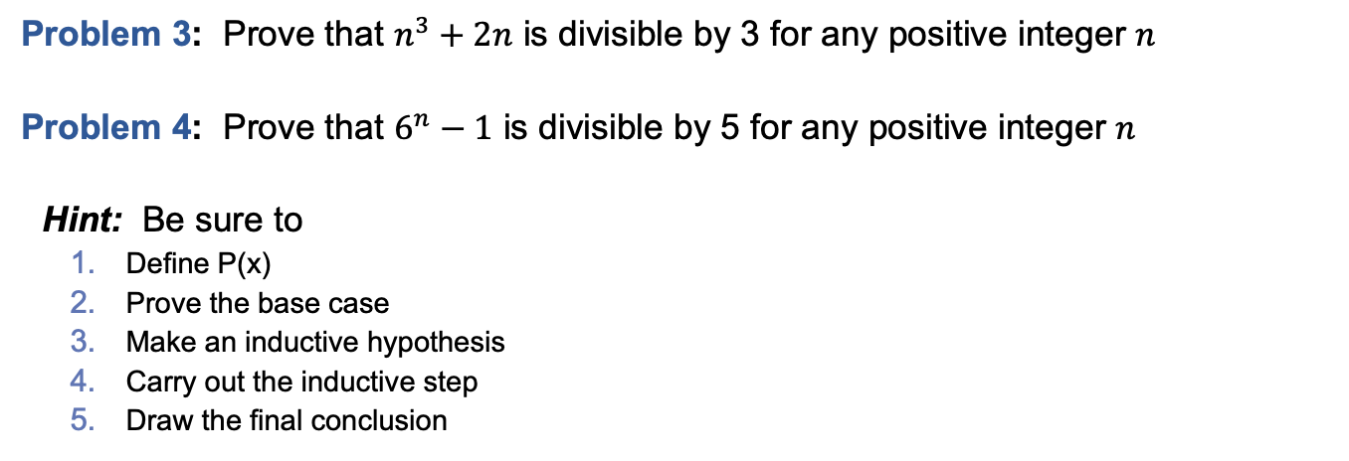
In-class exercises
Problem 3: Prove that $n^{3}+2n$ is divisible by 3 for any positive integer $n$
Problem 4: Prove that $6^{n}−1$ is divisible by 5 for any positive integer $n$
Hint: Be sure to
  Define P(x)
  Prove the base case
  Make an inductive hypothesis
  Carry out the inductive step
  Draw the final conclusion
Notes:
Do first 3 steps as a group. We’ll do 4th step together.

Slide 20
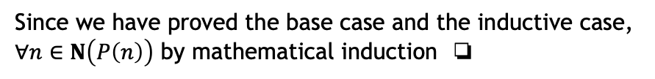
Prove that if S is a finite set with n elements, then S has 2^{n} subsets.
P(n) ≡
Set S with cardinality n has 2^{n} subsets
✔
Base case:
P(0): ∅ has 2⁰ = 1 subsets (i.e., ∅ ⊆ ∅)
I.H.:
Assume that P(k) holds for an arbitrary natural number k
Inductive step: We will now show that P(k) → P(k+1)
Let S be a set of size k
Assume without loss of generality that x ∉ S
Let T = S ∪ {x}, so |T| = k+1
∀s⊆S (s ⊆ T) since T is a superset of S
Furthermore, ∀s⊆S (s ∪ {x} ⊆ T) since x ∈ T
Since S has 2^{k} subsets by the I.H., T has 2×2^{k} = 2^{k+1} subsets
Conclusion:
Since we have proved the base case and the inductive case, $∀n∈N\left(P\left(n\right)\right)$ by mathematical induction ❏

Slide 21
Final Thoughts
Mathematical induction lets us prove universally quantified statements using this inference rule:
Induction is useful for proving:
  Summations
  Inequalities
  Claims about countable sets
  Theorems from number theory
  …
Next time: Strong induction and recursive definitions (Sections 5.2 & 5.3)
P(0)
For arb. k, P(k) → P(k+1)
∴∀x∈N P(x)

