Slide 1

CS 1674/2074: Intro to Computer Vision
PhD. Nils Murrugarra-Llerena
nem177@pitt.edu

Slide 2
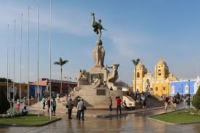
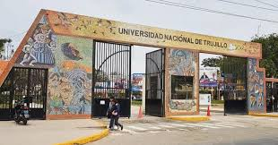

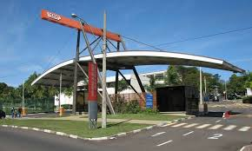


Who am I?
B.S. Computer Science at National University of Trujillo
M.S. in Computer Science at University of São Paulo in AI

Slide 3
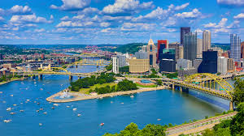
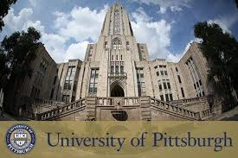

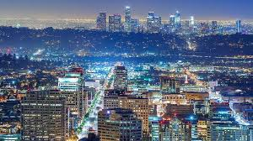

Who am I?
PhD in Computer Science at University of Pittsburgh in Computer Vision
Research scientist at Snap Inc.

Slide 4
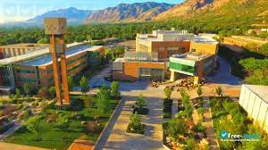

Who am I?
Assistant professor at Weber State University
Teaching Assistant Professor at University of Pittsburgh
[Students’ presentations]
Name, hobbies, and mention one thing that you expect to learn in this course ☺

Slide 5
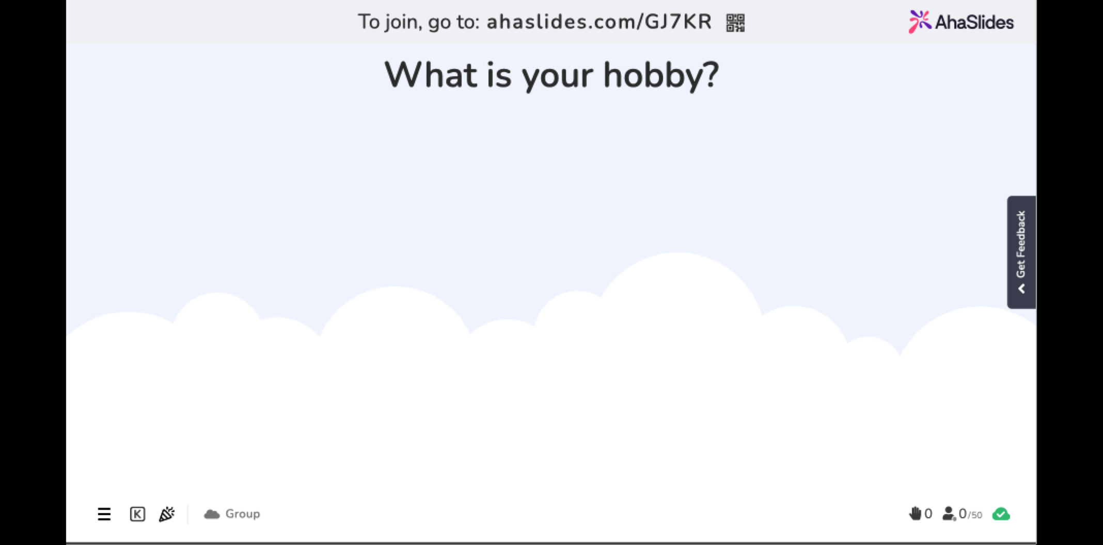

Slide 6
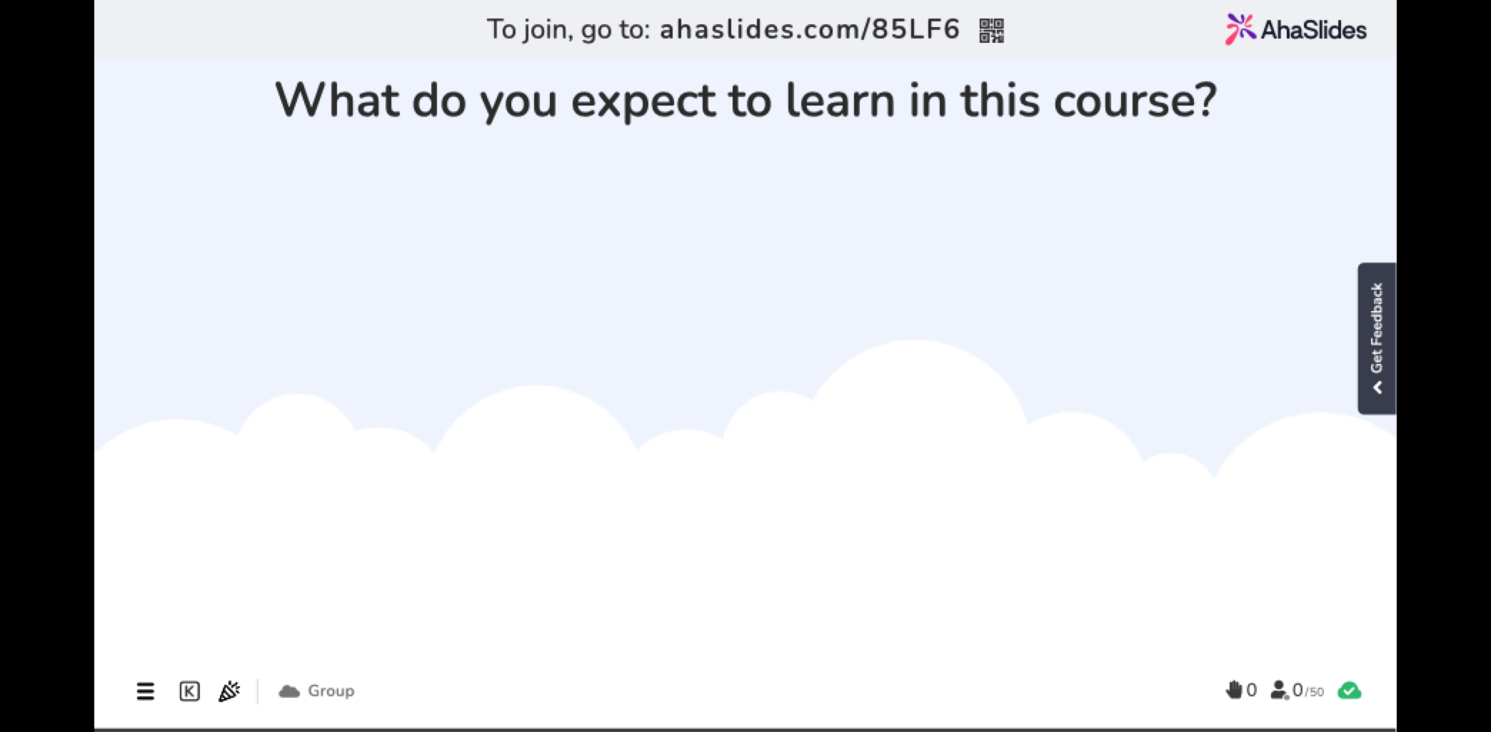

Slide 7
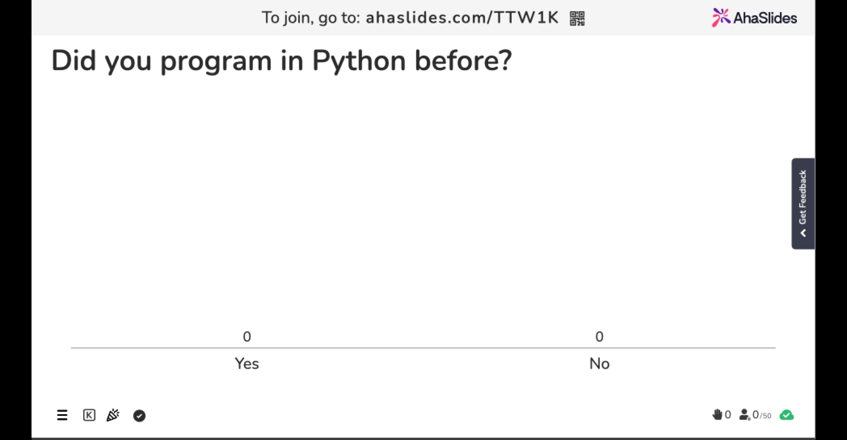

Slide 8

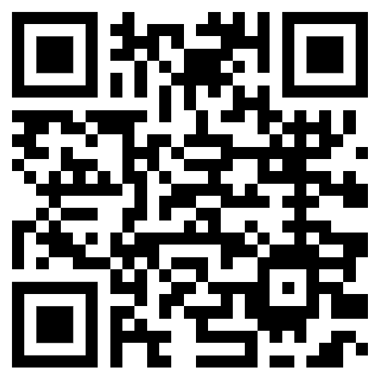
Course intro: Syllabus
Contact Information
  Prof. Nils Murrugarra
  nem177@pitt.edu
  Please, add prefix “[CS 1674]” in all emails.
  Website: https://nineil.github.io/courses/fall25_cs1674/
Lectures:
  Tue/Thu 2:30 pm – 3:45 pm [SENSQ 5129]
Office hours:
  TBD (Please, fill this form). Inputs will be considered with my other courses, and my own schedule

Slide 9
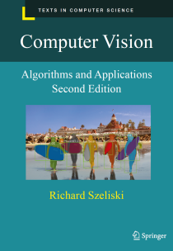
Course intro: Textbook
Computer Vision algorithms and applications
Edition: 2nd
By Richard Szeliski
ISBN: 978-3030343712
Year: 2022

Slide 10
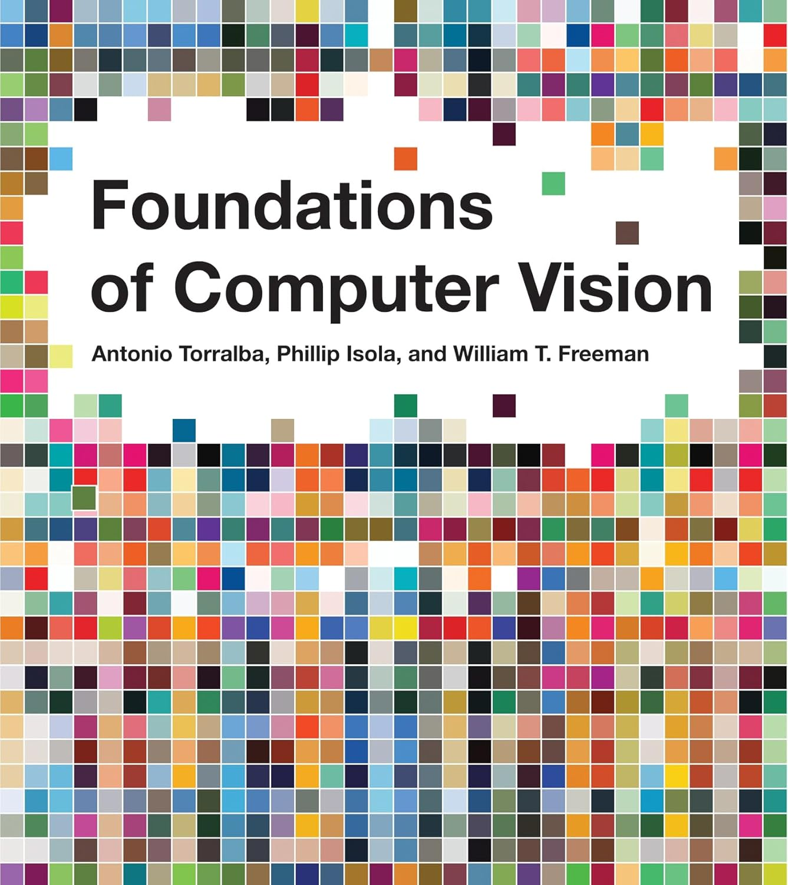
Course intro: Textbook
Foundations of Computer Vision
Edition: 1st
By Antonio Torralba, Phillip Isola, and William Freeman
ISBN: 978-0262048972
Year: 2024

Slide 11
Course intro: What to expect?
Material is based on previous iterations of my Computer Vision courses and material from US well-recognized Universities.
Exams mainly cover this material
We will do around 7 to 9 programming assignments

Slide 12
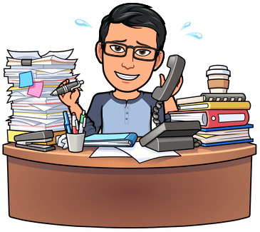
Course intro: What to expect?
There will be a lot of work!
However, you will learn a lot :). Please, ask
questions in class and use my office hours
as needed.
I would like to help you much as possible.

Slide 13
Course intro: What to expect? [Warning #1]
I’ve opted for shorter, more manageable HW assignments, but there is a lot of them
I expect you’d be spending 4-6 hours on each assignment
… But you get to understand algorithms and concepts in detail!

Slide 14
Course intro: What to expect? [Warning #2]
Some parts will be hard and require that you pay close attention!
Use instructor’s office hours
… You will learn a lot!

Slide 15
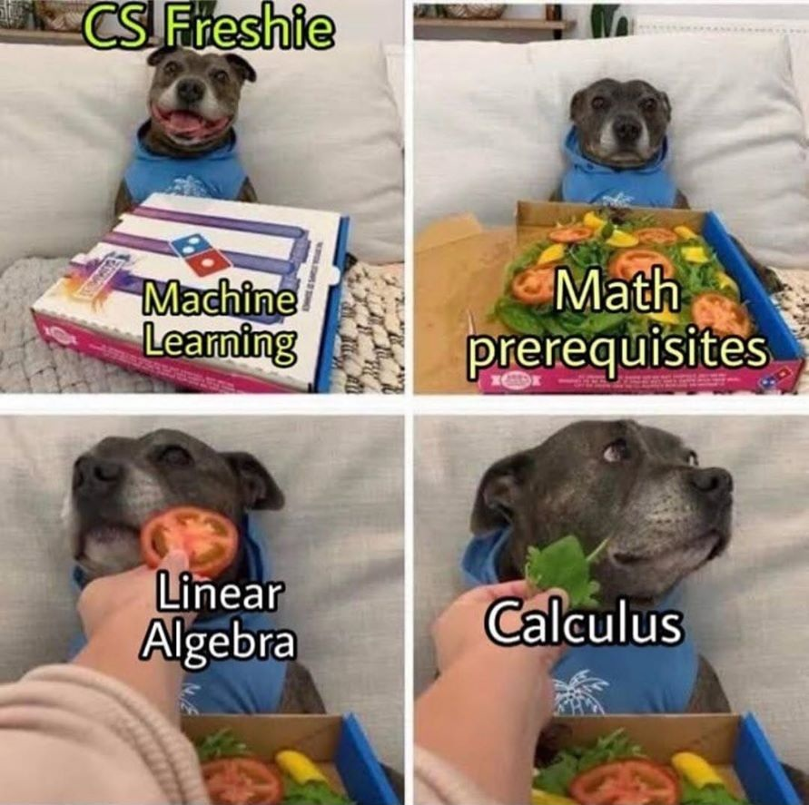
Course intro: What to expect?
H/T Kirk Pruhs

Slide 16

Course intro: programming assignments
We will learn Python programming language
﻿Exam and projects cannot be made up unless arrangements are made to take/submit them ahead of time.
Late assignments will be accepted with a 10% penalty per day up to 3 days to provide for unforeseen circumstances.

Slide 17
Review Syllabus
Canvas Link:
CS 1674
CS 2074

Slide 18
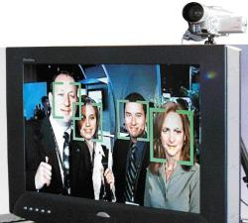
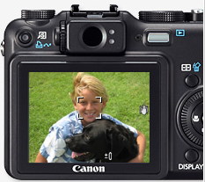
Motivation: Faces and digital cameras
Setting camera focus via face detection
Camera waits for everyone to smile to take a photo [Canon]
Kristen Grauman
Notes:
The recent New York Canon Expo was a chance for Canon to display its cutting-edge digital camera technologies, such as the ability to track all the faces in a group photo and take the photo as soon as everyone smiles.
Photograph by : Steve Makris, The Journal

Slide 19
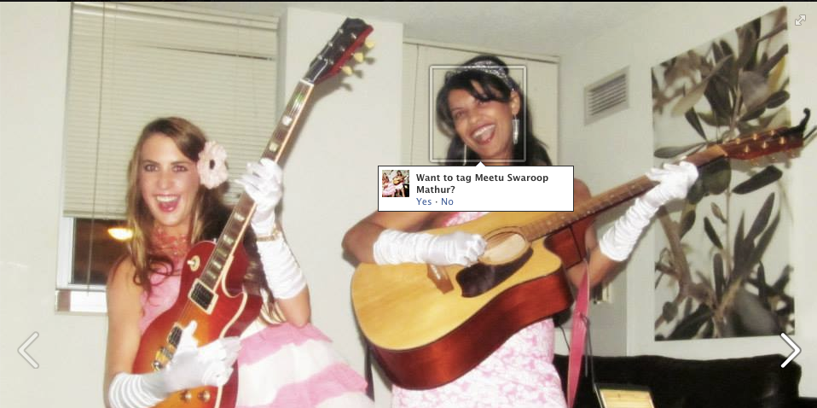

Motivation: Face recognition
Devi Parikh

Slide 20
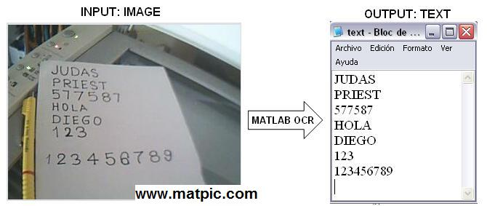
Motivation: Optical Character Recognition
https://www.mathworks.com/matlabcentral/fileexchange/18169-optical-character-recognition-ocr

Slide 21
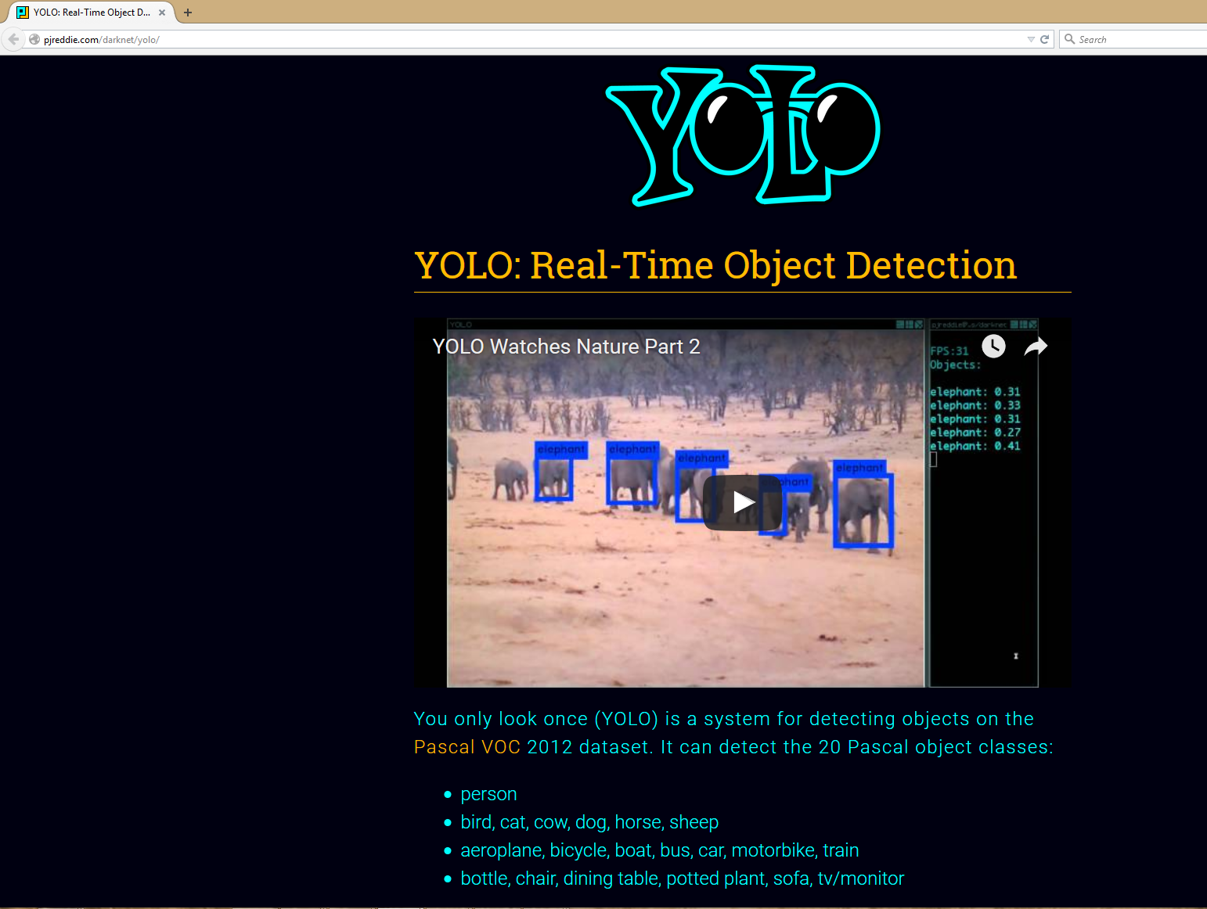
Motivation: Accurate object detection
Redmon et al., “You Only Look Once: Unified, Real-Time Object Detection”, CVPR 2016

Slide 22
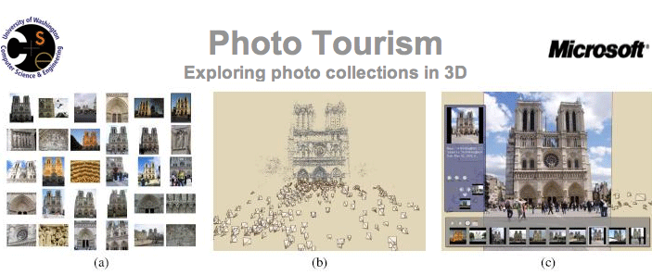
Motivation: Exploring photo collections
Snavely et al.
Kristen Grauman
Notes:
22

Slide 23
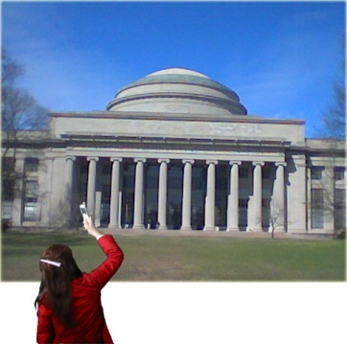
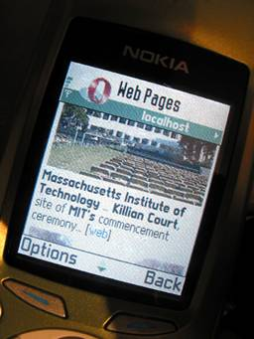
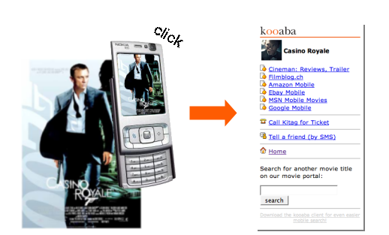
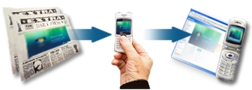
Motivation: Linking info with a mobile device
Situated search
Yeh et al., MIT
kooaba
MSR Lincoln
Kristen Grauman

Slide 24
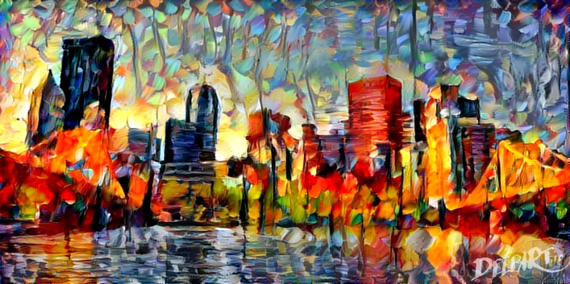
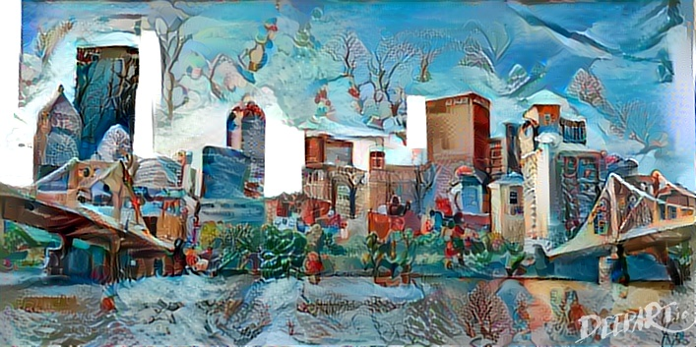
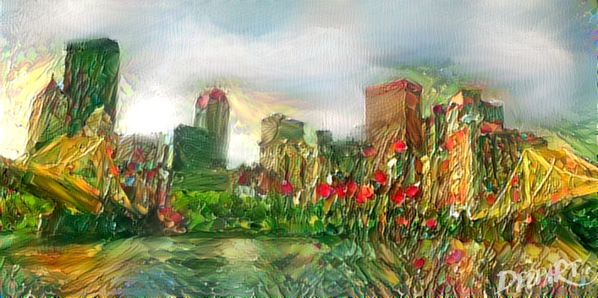
Motivation: Transferring art styles
DeepArt.io – try it for yourself!
Gatys et al., CVPR 2016

Slide 25
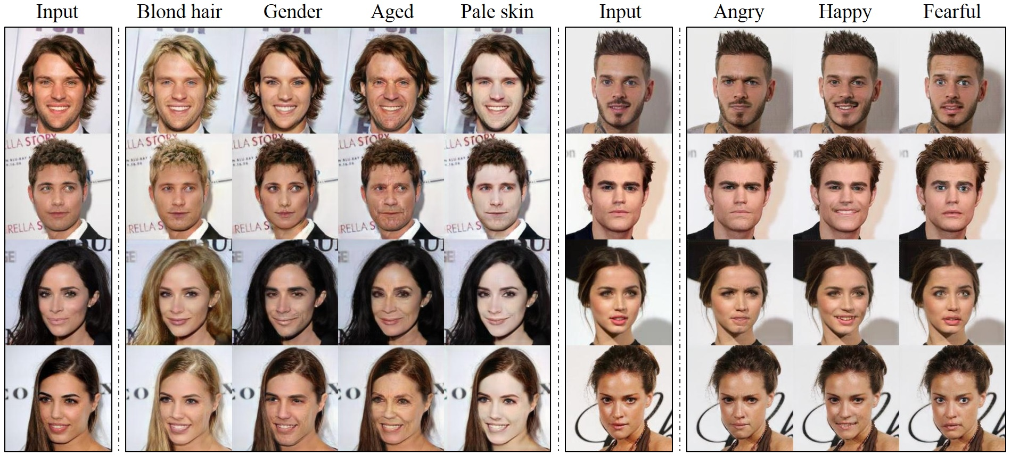
Motivation: Image Generation (faces)
Choi et al., CVPR 2018

Slide 26
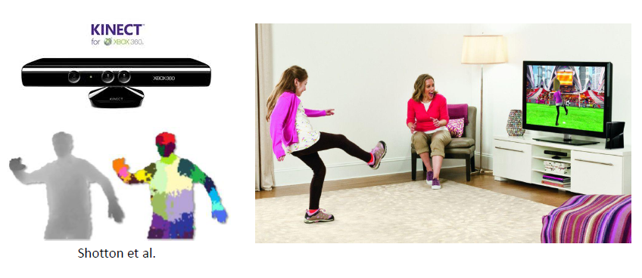
Motivation: Interactive Systems
Yong Jae Lee

Slide 27
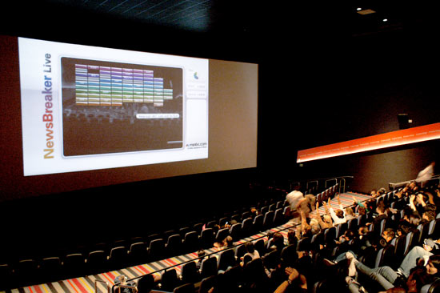
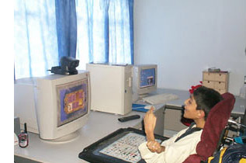
Motivation: Video-based interfaces
YouTube Link
Assistive technology systems
Camera Mouse
Boston College
Human joystick
NewsBreaker Live
Kristen Grauman
Notes:
http://www.youtube.com/watch?v=y6izXII54Qc

Slide 28
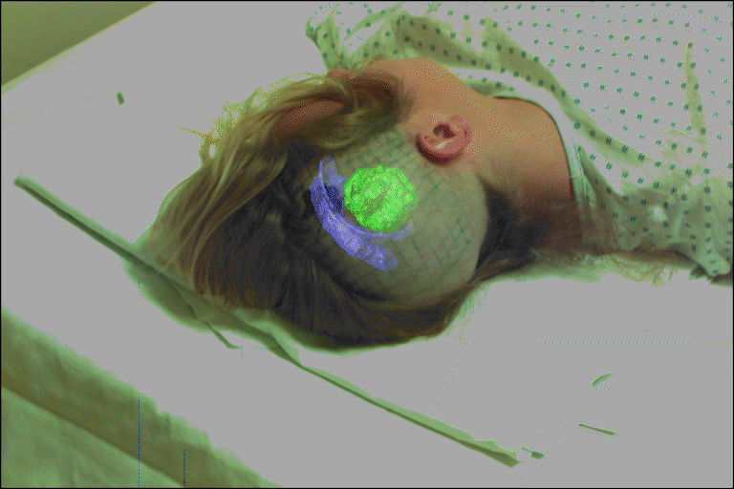
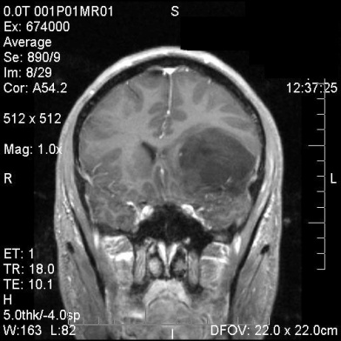
Motivation: Computer Vision for Medicine
fMRI data
Golland et al.
Image guided surgery
MIT AI Vision Group
Kristen Grauman

Slide 29
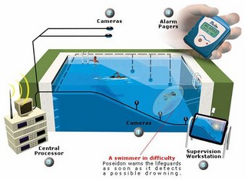
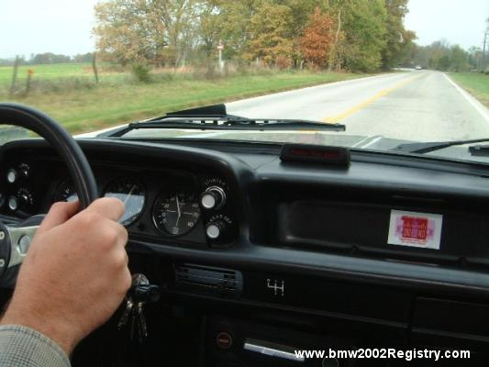
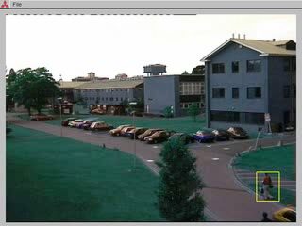
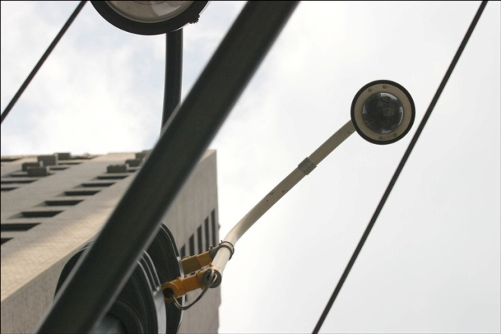
Motivation: Safety and security
Navigation, driver safety
Monitoring pool (Poseidon)
Pedestrian detection
MERL, Viola et al.
Surveillance
Kristen Grauman

Slide 30
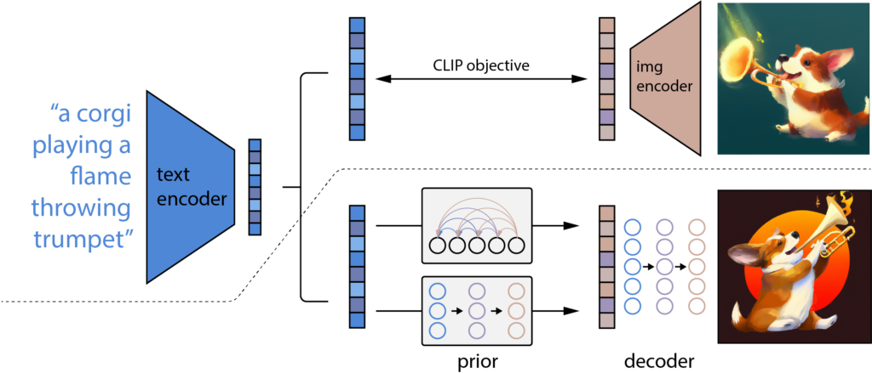
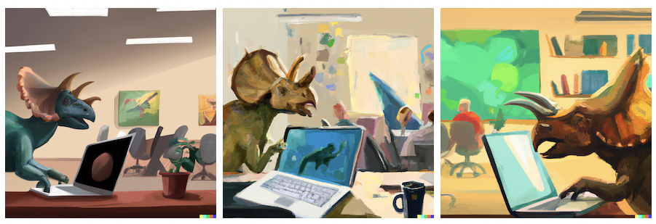
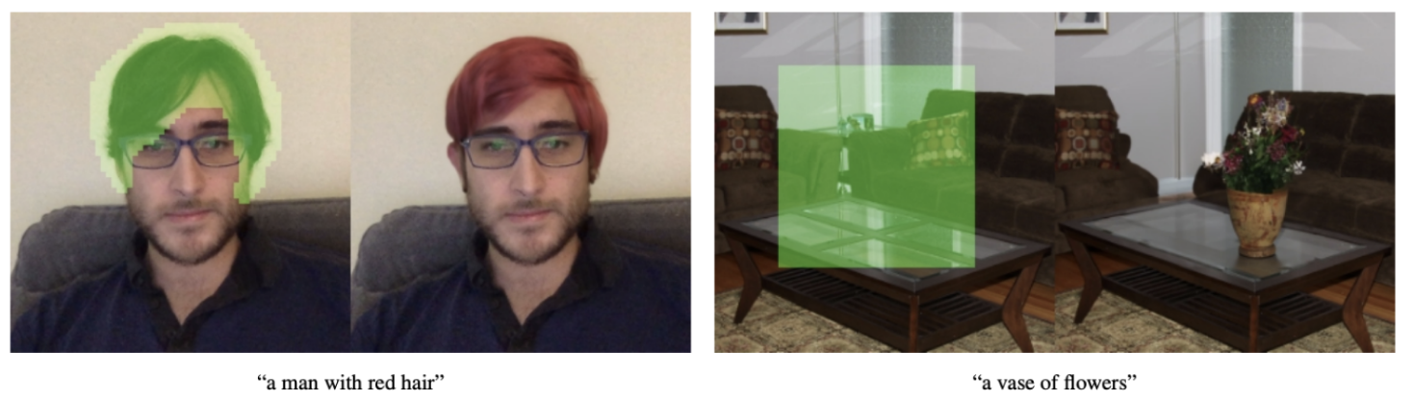
Motivation: Generative AI
Stable Diffusion: “Triceratops programming on a MacBook in a startup office”
Dall.e 2: https://learnopencv.com/mastering-dall-e-2/
Text-conditional image-inpainting [ref]
Notes:
https://www.assemblyai.com/blog/how-dall-e-2-actually-works/
https://www.edge-ai-vision.com/2023/01/from-dall%C2%B7e-to-stable-diffusion-how-do-text-to-image-generation-models-work/

Slide 31
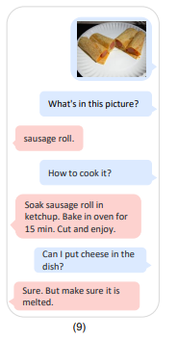
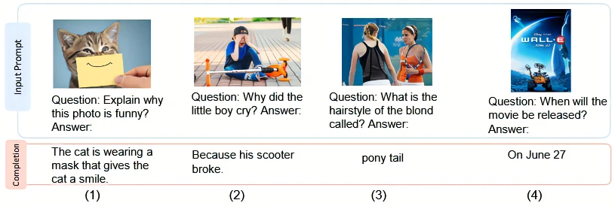
Motivation: Multimodal Large Language Models
Gpt-4: https://medium.com/@amol-wagh/whats-new-in-gpt-4-an-overview-of-the-gpt-4-architecture-and-capabilities-of-next-generation-ai-900c445d5ffe
Notes:
https://www.assemblyai.com/blog/how-dall-e-2-actually-works/
TODO: Ask Gemini question about Wall-e movie. It was released on 2008 (with image)

Slide 32
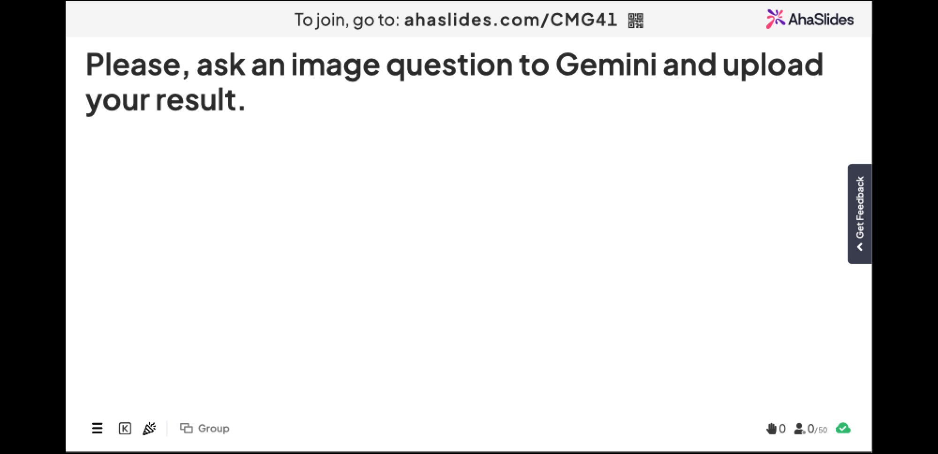
Ask an Image Question to https://gemini.google.com/

Slide 33
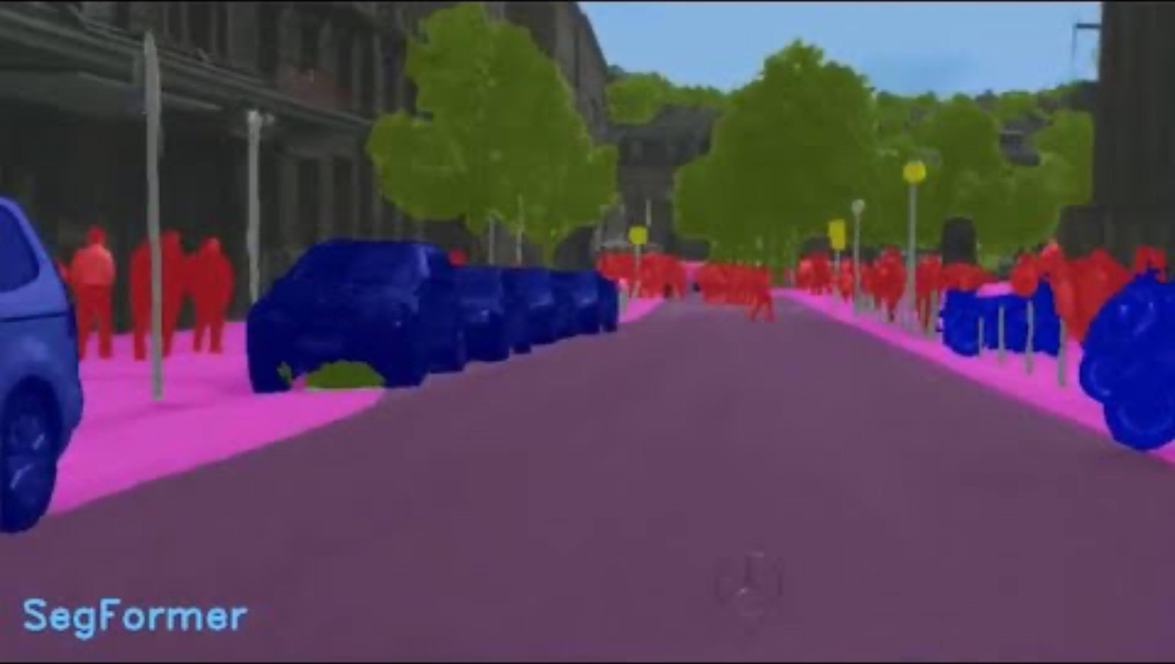
Motivation: NVIDIA Applications
https://www.youtube.com/watch?v=OnTgbN3uXvw&ab_channel=NVIDIA
Notes:
Until Min 1:38

Slide 34

Setup Environment
Create Github Account
Install Github Desktop
You may use any IDE for Python
  I use Pycharm: https://www.jetbrains.com/pycharm/
  Apply for your educational free license: https://www.jetbrains.com/community/education/#students

Slide 35
Setup Learning Environment
Installation and learning environment:
https://github.com/nineil-pitt/cs1674_2074_fall25

