Slide 1

CS 1674/2074: Linear Algebra
PhD. Nils Murrugarra-Llerena
nem177@pitt.edu

Slide 2
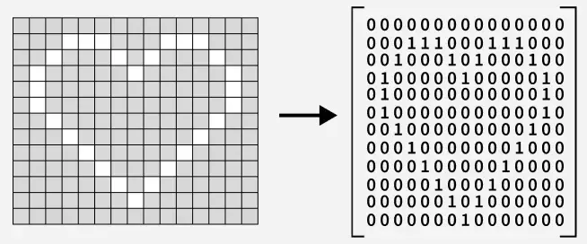
Motivation: How can we encode this image?
https://www.geeksforgeeks.org/engineering-mathematics/matrices/
Notes:
https://www.geeksforgeeks.org/engineering-mathematics/matrices/
https://www.asciiart.eu/cartoons/simpsons

Slide 3
Linear Algebra Review
See http://cs229.stanford.edu/section/cs229-linalg.pdf for more

Slide 4
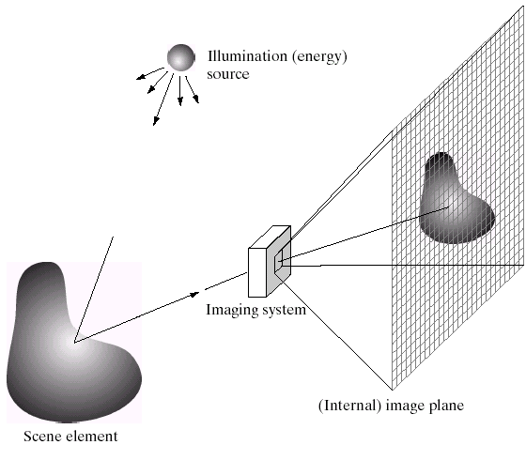
What are images? (in Python) – Image Formation
Python treats images as matrices of numbers
To proceed, let’s talk very briefly about how images are formed
Slide credit: Derek Hoiem

Slide 5
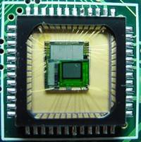
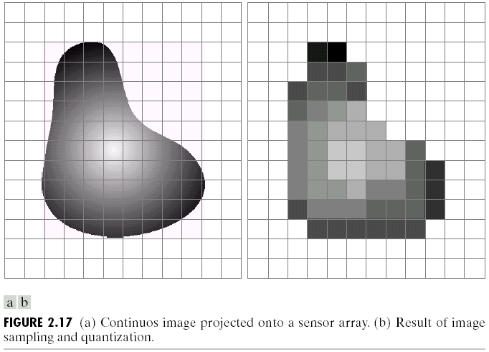
Digital Images
Sample the 2D space on a regular grid
Quantize each sample (round to nearest integer)
Slide credit: Derek Hoiem, Steve Seitz

Slide 6
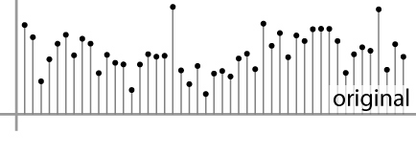

Digital Images
Sample the 2D space on a regular grid
Quantize each sample (round to nearest integer)
What does quantizing signal look like?
Image thus represented as a matrix of integer values.
6 5
5.9 4.6
1D
2D
Adapted from S. Seitz

Slide 7
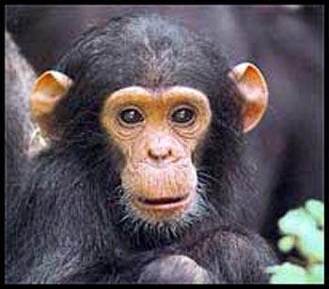
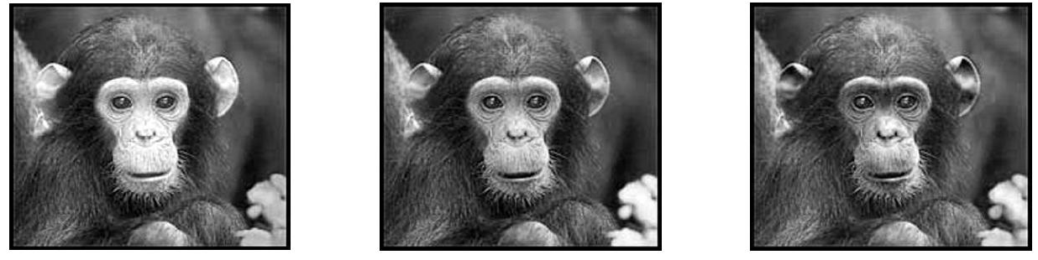
Digital Color Images
Color images, RGB color space:
Split image into three channels
R
G
B
Adapted from Kristen Grauman

Slide 8
Images in Python
Color images represented as a matrix with multiple channels (=1 if grayscale)
Suppose we have a NxM RGB image called “im”
  Im[0,0,0] = top-left pixel value in R-channel
  im(y, x, b) = y pixels down, x pixels to right in the b^{th} channel
  im(N, M, 3) = bottom-right pixel in B-channel
cv2.imread(filename) returns a uint8 image (values 0: Black to 255: White)
column
row
R
0.92 | 0.93 | 0.94 | 0.97 | 0.62 | 0.37 | 0.85 | 0.97 | 0.93 | 0.92 | 0.99
0.95 | 0.89 | 0.82 | 0.89 | 0.56 | 0.31 | 0.75 | 0.92 | 0.81 | 0.95 | 0.91
0.89 | 0.72 | 0.51 | 0.55 | 0.51 | 0.42 | 0.57 | 0.41 | 0.49 | 0.91 | 0.92
0.96 | 0.95 | 0.88 | 0.94 | 0.56 | 0.46 | 0.91 | 0.87 | 0.90 | 0.97 | 0.95
0.71 | 0.81 | 0.81 | 0.87 | 0.57 | 0.37 | 0.80 | 0.88 | 0.89 | 0.79 | 0.85
0.49 | 0.62 | 0.60 | 0.58 | 0.50 | 0.60 | 0.58 | 0.50 | 0.61 | 0.45 | 0.33
0.86 | 0.84 | 0.74 | 0.58 | 0.51 | 0.39 | 0.73 | 0.92 | 0.91 | 0.49 | 0.74
0.96 | 0.67 | 0.54 | 0.85 | 0.48 | 0.37 | 0.88 | 0.90 | 0.94 | 0.82 | 0.93
0.69 | 0.49 | 0.56 | 0.66 | 0.43 | 0.42 | 0.77 | 0.73 | 0.71 | 0.90 | 0.99
0.79 | 0.73 | 0.90 | 0.67 | 0.33 | 0.61 | 0.69 | 0.79 | 0.73 | 0.93 | 0.97
0.91 | 0.94 | 0.89 | 0.49 | 0.41 | 0.78 | 0.78 | 0.77 | 0.89 | 0.99 | 0.93
G
0.92 | 0.93 | 0.94 | 0.97 | 0.62 | 0.37 | 0.85 | 0.97 | 0.93 | 0.92 | 0.99
0.95 | 0.89 | 0.82 | 0.89 | 0.56 | 0.31 | 0.75 | 0.92 | 0.81 | 0.95 | 0.91
0.89 | 0.72 | 0.51 | 0.55 | 0.51 | 0.42 | 0.57 | 0.41 | 0.49 | 0.91 | 0.92
0.96 | 0.95 | 0.88 | 0.94 | 0.56 | 0.46 | 0.91 | 0.87 | 0.90 | 0.97 | 0.95
0.71 | 0.81 | 0.81 | 0.87 | 0.57 | 0.37 | 0.80 | 0.88 | 0.89 | 0.79 | 0.85
0.49 | 0.62 | 0.60 | 0.58 | 0.50 | 0.60 | 0.58 | 0.50 | 0.61 | 0.45 | 0.33
0.86 | 0.84 | 0.74 | 0.58 | 0.51 | 0.39 | 0.73 | 0.92 | 0.91 | 0.49 | 0.74
0.96 | 0.67 | 0.54 | 0.85 | 0.48 | 0.37 | 0.88 | 0.90 | 0.94 | 0.82 | 0.93
0.69 | 0.49 | 0.56 | 0.66 | 0.43 | 0.42 | 0.77 | 0.73 | 0.71 | 0.90 | 0.99
0.79 | 0.73 | 0.90 | 0.67 | 0.33 | 0.61 | 0.69 | 0.79 | 0.73 | 0.93 | 0.97
0.91 | 0.94 | 0.89 | 0.49 | 0.41 | 0.78 | 0.78 | 0.77 | 0.89 | 0.99 | 0.93
B
0.92 | 0.93 | 0.94 | 0.97 | 0.62 | 0.37 | 0.85 | 0.97 | 0.93 | 0.92 | 0.99
0.95 | 0.89 | 0.82 | 0.89 | 0.56 | 0.31 | 0.75 | 0.92 | 0.81 | 0.95 | 0.91
0.89 | 0.72 | 0.51 | 0.55 | 0.51 | 0.42 | 0.57 | 0.41 | 0.49 | 0.91 | 0.92
0.96 | 0.95 | 0.88 | 0.94 | 0.56 | 0.46 | 0.91 | 0.87 | 0.90 | 0.97 | 0.95
0.71 | 0.81 | 0.81 | 0.87 | 0.57 | 0.37 | 0.80 | 0.88 | 0.89 | 0.79 | 0.85
0.49 | 0.62 | 0.60 | 0.58 | 0.50 | 0.60 | 0.58 | 0.50 | 0.61 | 0.45 | 0.33
0.86 | 0.84 | 0.74 | 0.58 | 0.51 | 0.39 | 0.73 | 0.92 | 0.91 | 0.49 | 0.74
0.96 | 0.67 | 0.54 | 0.85 | 0.48 | 0.37 | 0.88 | 0.90 | 0.94 | 0.82 | 0.93
0.69 | 0.49 | 0.56 | 0.66 | 0.43 | 0.42 | 0.77 | 0.73 | 0.71 | 0.90 | 0.99
0.79 | 0.73 | 0.90 | 0.67 | 0.33 | 0.61 | 0.69 | 0.79 | 0.73 | 0.93 | 0.97
0.91 | 0.94 | 0.89 | 0.49 | 0.41 | 0.78 | 0.78 | 0.77 | 0.89 | 0.99 | 0.93
Adapted from Derek Hoiem

Slide 9


What is a Vector?
9
The Journey as a Vector
Imagine you're planning a trip. To describe your travel, you need two key pieces of information:
  Direction: The way you're going—north, south, east, or west. This tells you the path you're on.
  Magnitude: The distance you're traveling—50 miles, 100 kilometers, etc. This tells you how far you're going.
A vector combines both of these ideas. It's not enough to say you traveled 100 miles [Number/Scalar: Distance]; you also need to specify the direction, like "100 miles due north.” [Vector: Displacement] Without both, the information is incomplete.
Notes:
TODO: prereq ML?

Slide 10

Vectors and Matrices
10
Vectors and matrices are just collections of ordered numbers that represent something: movements in space, scaling factors, word counts, movie ratings, pixel brightness, etc.
We’ll define some common uses and standard operations on them.

Slide 11
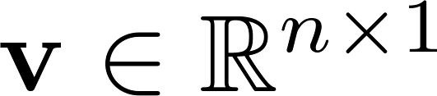
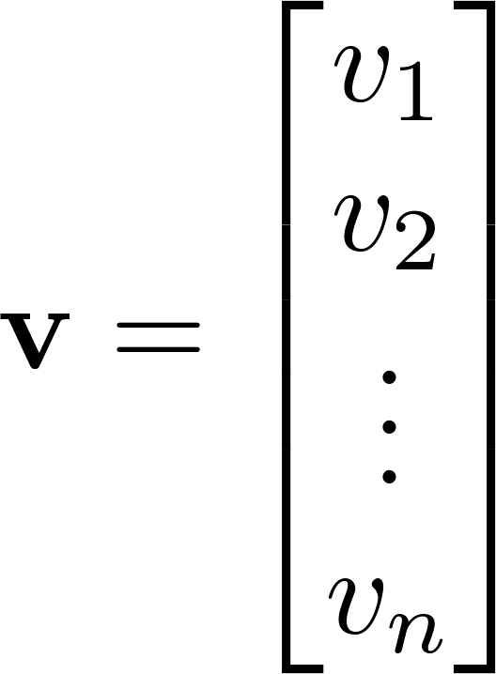
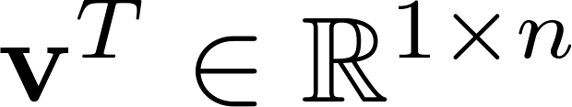
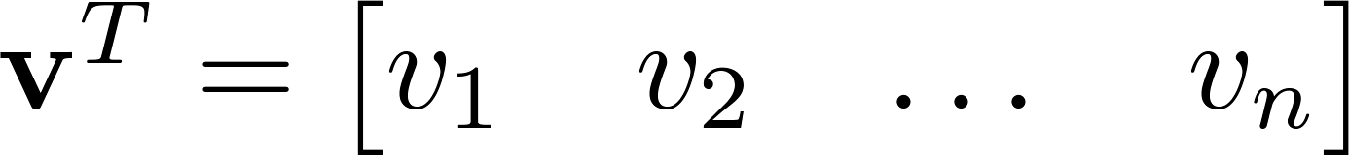

Vector
A column vector where
A row vector where
denotes the transpose operation

Slide 12
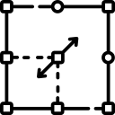
Vector
You’ll want to keep track of the orientation of your vectors when programming in Python.
You can transpose a vector V in Python by writing V.T.

Slide 13
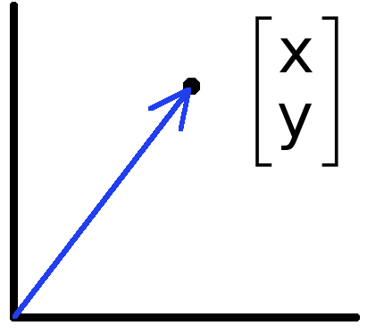
Vectors have two main uses
Data can also be treated as a vector
Such vectors don’t have a geometric interpretation, but calculations like “distance” still have value
Vectors can represent an offset in 2D or 3D space
Points are just vectors from the origin

Slide 14
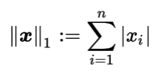
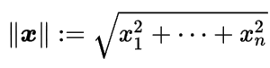
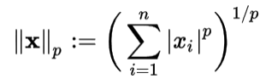
Norms
L1 norm
L2 norm
L^{p} norm (for real numbers p ≥ 1)

Slide 15
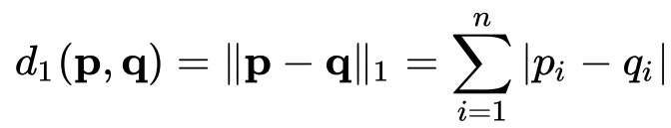

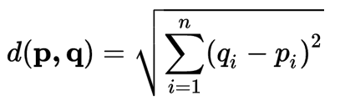
Distances
L1 (Manhattan) distance
L2 (Euclidean) distance

Slide 16
Example: feature representation
A vector representing measurable characteristics of a data sample we have.
E.g. a glass of juice can be represented via its color = {yellow=1, red=2, green=3, purple=4} and taste = {sweet=1, sour=2}
A given glass i can be represented as a vector: x_{i} = [3 2] represents green , sour juice
For D features, this defines a D-dimensional space where we can measure similarity between samples

Slide 17
Example: Feature representation
L2 distance:
d(x1, x2) = sqrt(4+0)
d(x1, x3) = sqrt(0+1)
d(x2, x3) = sqrt(4+1)
L1 distance:
d(x1, x2) = 2+0
d(x1, x3) = 0+1
d(x2, x3) = 2+1
E.g. a glass of juice can be represented via its color = {yellow=1, red=2, green=3, purple=4} and taste = {sweet=1, sour=2}
2
1
x1 = [1 2]
x2 = [3 2]
taste
x3 = [1 1]
0 1 2 3 4
color

Slide 18
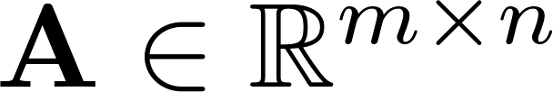
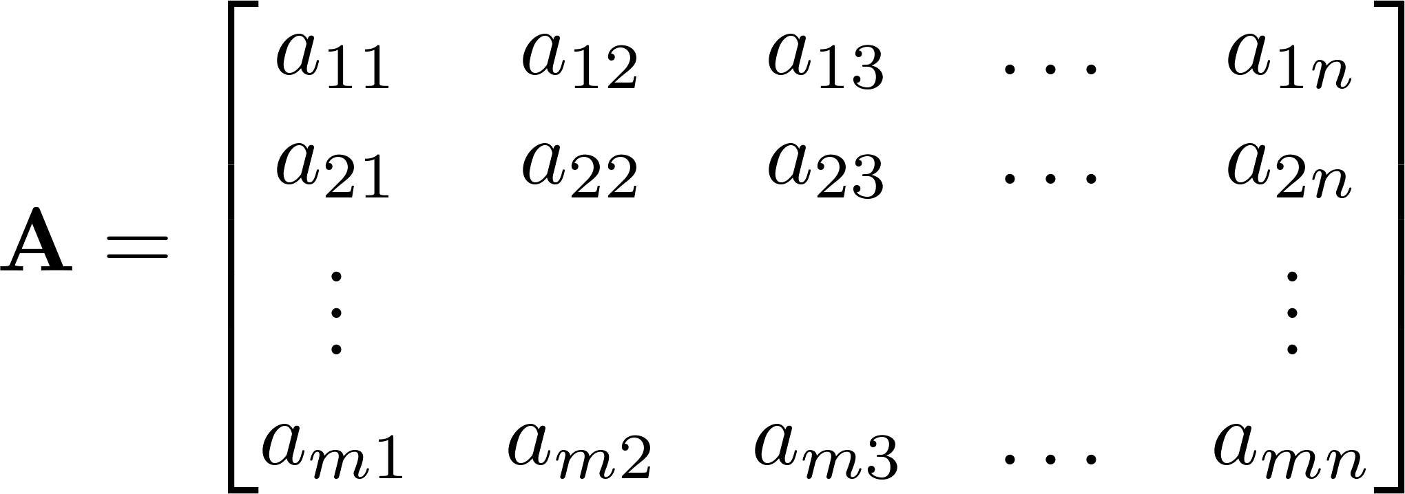



Matrix
A matrix is an array of numbers with size $m↓$ by $n→$, i.e. m rows and n columns.
If , we say that is square.

Slide 19
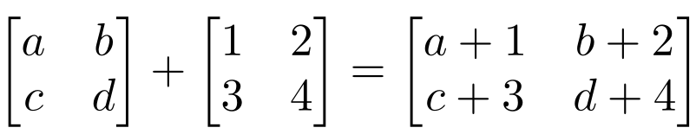
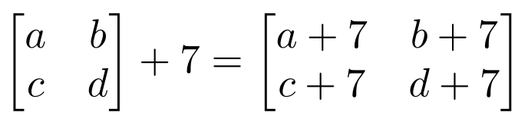
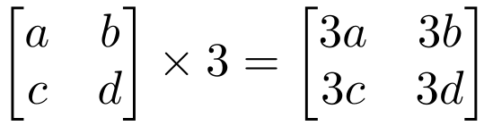
Matrix Operations
Addition
  Can only add a matrix with matching dimensions, or a scalar.
Scaling

Slide 20
Matrix Multiplication
Let X be an axb matrix, Y be an bxc matrix
Then Z = X*Y is an axc matrix
Second dimension of first matrix, and first dimension of second matrix have to be the same, for matrix multiplication to be possible

Slide 21
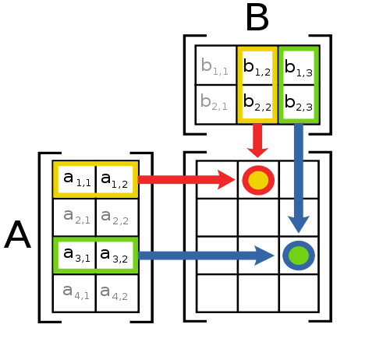
Matrix Multiplication
The product AB is:
Each entry in the result is (that row of A) dot product with (that column of B)

Slide 22
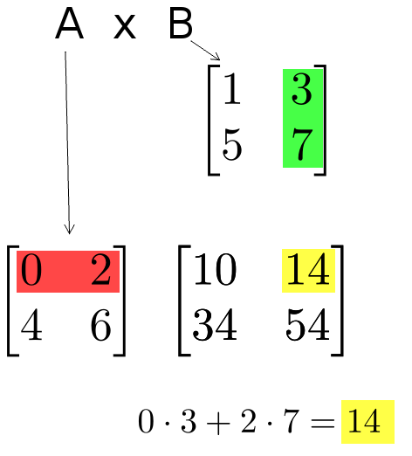
Matrix Multiplication
Example:
  Each entry of the matrix product is made by taking the dot product of the corresponding row in the left matrix, with the corresponding column in the right one.

Slide 23
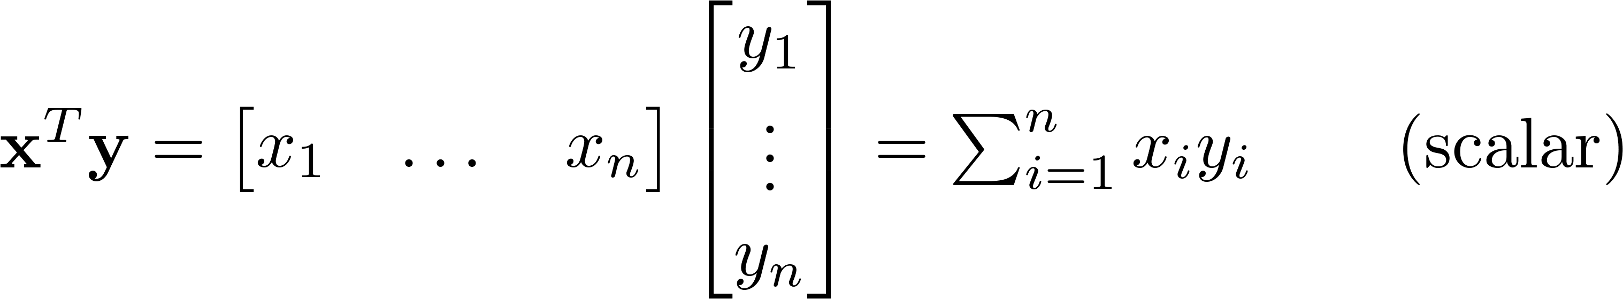
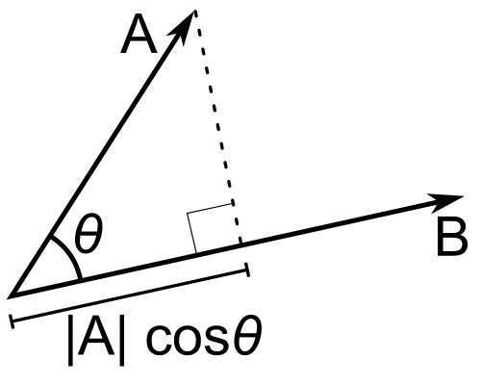
Inner Product
Multiply corresponding entries of two vectors and add up the result
x·y is also |x||y|Cos( angle between x and y )
If B is a unit vector, then A·B gives the length of A which lies in the direction of B (projection)
(if B is unit-length hence norm is 1)

Slide 24
Different Types of Product
x, y = column vectors (nx1)
X, Y = matrices (mxn)
x, y = scalars (1x1)
x^{T} y = x · y = inner product (1xn x nx1 = scalar)
x ⊗ y = x y^{T} = outer product (nx1 x 1xn = matrix)
X * Y = matrix product
X .* Y = element-wise product

Slide 25
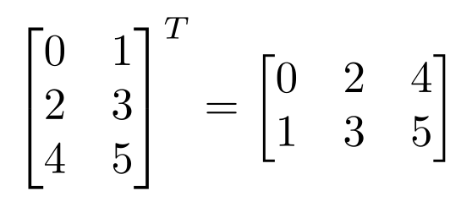
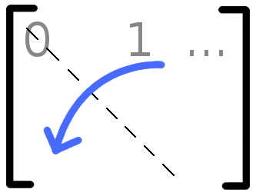

Matrix Operations
Transpose – flip matrix, so row 1 becomes column 1
A useful identity:

Slide 26
Matrix Operation Properties
Matrix addition is commutative and associative
  A + B = B + A
  A + (B + C) = (A + B) + C
Matrix multiplication is associative and distributive but not commutative
  A(B*C) = (A*B)C
  A(B + C) = A*B + A*C
  A*B != B*A

Slide 27
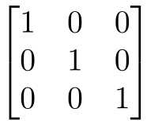
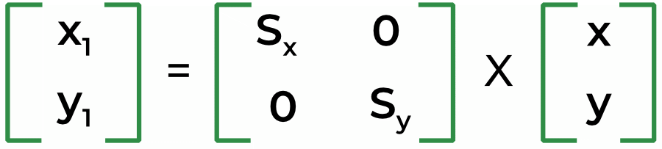
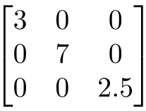
Special Matrices
Identity matrix I
  Square matrix, 1’s along diagonal, 0’s elsewhere
  I ∙ [another matrix] = [that matrix]
Diagonal matrix
  Square matrix with numbers along diagonal, 0’s elsewhere
  A diagonal ∙ [another matrix] scales the rows of that matrix
Diagonal Matrix → Scale Matrix
Notes:
Diagonal Matrix: Scale matrix

Slide 28
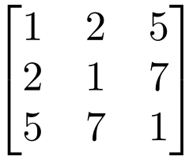

Special Matrices
Symmetric matrix
Fei-Fei Li

Slide 29
Python tutorial
Setup Conda Environment:
CS 1674
CS 2074

Slide 30

Python Tutorial
Duration: 60 min https://github.com/nineil-pitt/cs1674_2074_fall25/tree/main/lab_1_python

Slide 31


