Slide 1

CS 1674: Sequential Data: Language and Vision
PhD. Nils Murrugarra-Llerena
nem177@pitt.edu

Slide 2

Plan for this lecture
2
Language and vision
  Application: Image captioning
  Tool: Recurrent neural networks
  Tool: Transformers
  Application: Visual question answering

Slide 3
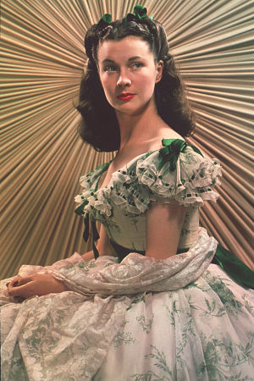
Motivation: Descriptive Text for Images
3
“It was an arresting face, pointed of chin, square of jaw. Her eyes were pale green without a touch of hazel, starred with bristly black lashes and slightly tilted at the ends. Above them, her thick black brows slanted upward, cutting a startling oblique line in her magnolia-white skin–that skin so prized by Southern women and so carefully guarded with bonnets, veils and mittens against hot Georgia suns”
Scarlett O’Hara described in Gone with the Wind
Tamara Berg
Notes:
People sometimes produce very vivid and richly informative descriptions about the visual world. For example, here the writer says “it was an arresting face, pointed of chin, …”

Slide 4
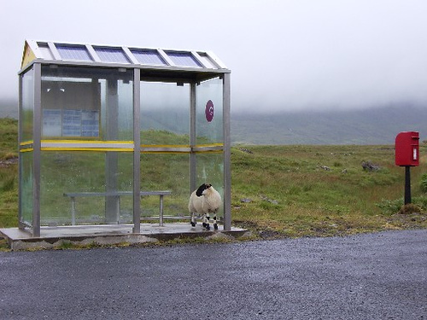
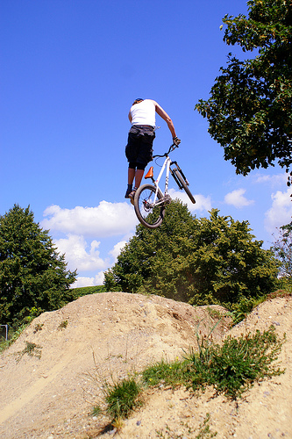
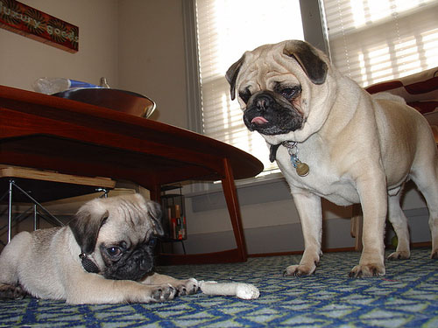
Some pre-RNN Good Results
4
This is a picture of one sky, one road and one sheep. The gray sky is over the gray road. The gray sheep is by the gray road.
Here we see one road, one sky and one bicycle. The road is near the blue sky, and near the colorful bicycle. The colorful bicycle is within the blue sky.
This is a picture of two dogs. The first dog is near the second furry dog.
Kulkarni et al., CVPR 2011
Notes:
This is a picture of one sky, one road…

Slide 5
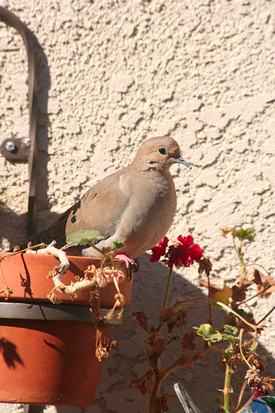
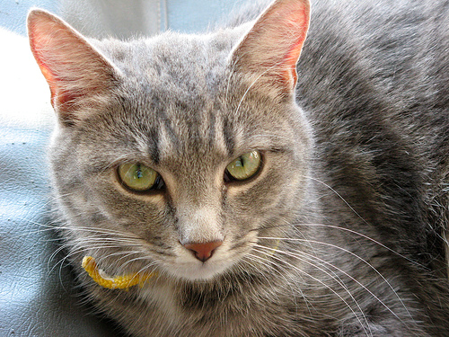
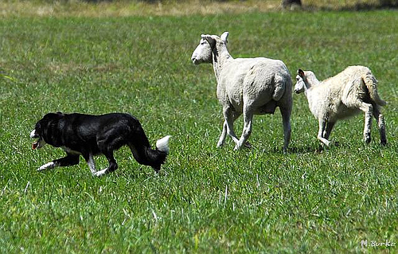
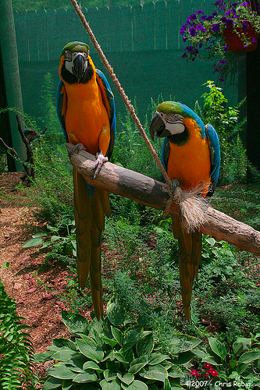
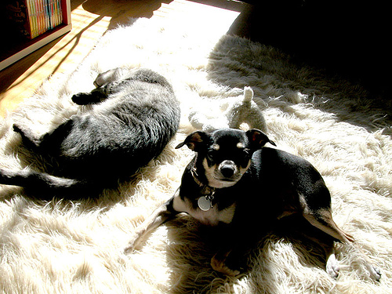
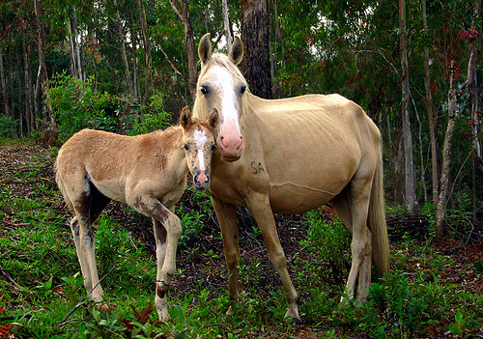
Some pre-RNN Good Results
5
Missed detections:
False detections:
Incorrect attributes:
There are one road and one cat. The furry road is in the furry cat.
This is a photograph of two sheeps and one grass. The first black sheep is by the green grass, and by the second black sheep. The second black sheep is by the green grass.
Here we see one potted plant.
This is a picture of one tree, one road and one person. The rusty tree is under the red road. The colorful person is near the rusty tree, and under the red road.
This is a photograph of two horses and one grass. The first feathered horse is within the green grass, and by the second feathered horse. The second feathered horse is within the green grass.
This is a picture of one dog.
Kulkarni et al., CVPR 2011
Notes:
Of course it doesn’t always work!
Some common mistakes are: missing detections, false detections,
Incorrectly predicted attributes.

Slide 6
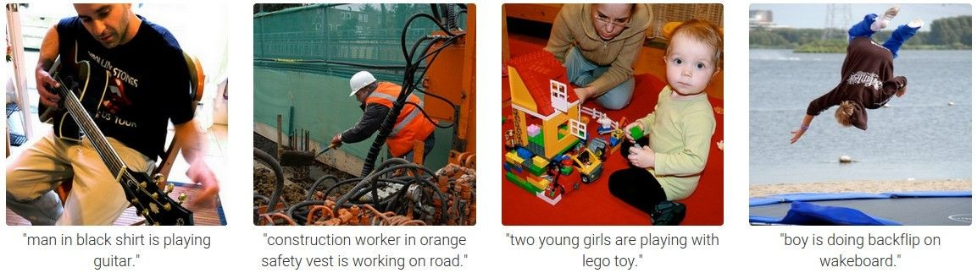
6
Results with Recurrent Neural Networks
Karpathy and Fei-Fei, CVPR 2015

Slide 7
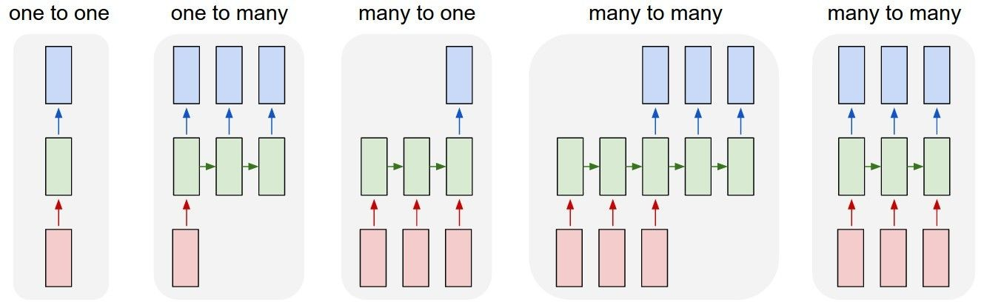
7
Recurrent Networks offer a lot of flexibility:
Output
Input
vanilla neural networks
Andrej Karpathy

Slide 8
8
Recurrent Networks offer a lot of flexibility:
Output
Input
e.g. image captioning
image -> sequence of words
Andrej Karpathy

Slide 9
9
Recurrent Networks offer a lot of flexibility:
Output
Input
e.g. sentiment classification
sequence of words -> sentiment
Andrej Karpathy

Slide 10
10
Recurrent Networks offer a lot of flexibility:
Output
Input
e.g. machine translation
seq of words -> seq of words
Andrej Karpathy

Slide 11
11
Recurrent Networks offer a lot of flexibility:
Output
Input
e.g. video classification on frame level
Andrej Karpathy

Slide 12
Recurrent Neural Network
12
RNN
RNN
x
Andrej Karpathy

Slide 13
Recurrent Neural Network
13
y
usually want to output a prediction at some time steps
RNN
x
Adapted from Andrej Karpathy

Slide 14

Recurrent Neural Network
14
We can process a sequence of vectors x by applying a recurrence formula at every time step:
y
RNN
new state
old state input vector at
some time step
some function
with parameters W
x
Andrej Karpathy

Slide 15
Recurrent Neural Network
15
We can process a sequence of vectors x by applying a recurrence formula at every time step:
y
RNN
Notice: the same function and the same set of parameters are used at every time step.
x
Andrej Karpathy

Slide 16

(Vanilla) Recurrent Neural Network
16
y
RNN
x
Andrej Karpathy

Slide 17
Character-level language model example
17
Example
RNN
x
y
Vocabulary: [h,e,l,o]
Example training sequence: “hello”
Andrej Karpathy

Slide 18
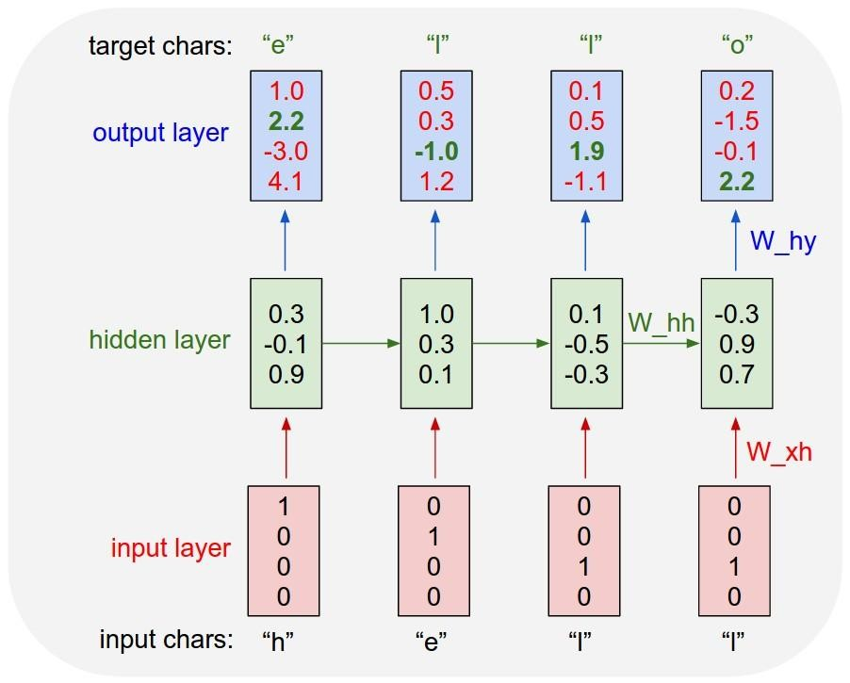
18
Example
Character-level language model example
Vocabulary: [h,e,l,o]
Example training sequence: “hello”
Andrej Karpathy

Slide 19
19
Example
Character-level language model example
Vocabulary: [h,e,l,o]
Example training sequence: “hello”
Andrej Karpathy

Slide 20
20
Example
Character-level language model example
Vocabulary: [h,e,l,o]
Example training sequence: “hello”
Andrej Karpathy

Slide 21
Extensions
21
Vanishing gradient problem makes it hard to model long sequences
  Multiplying together many values between 0 and 1 (range of gradient of sigmoid, tanh)
One solution: Use RELU
Another solution: Use RNNs with gates
  Adaptively decide how much of memory to keep
  Gated Recurrent Units (GRUs), Long Short Term Memories (LSTMs)

Slide 22
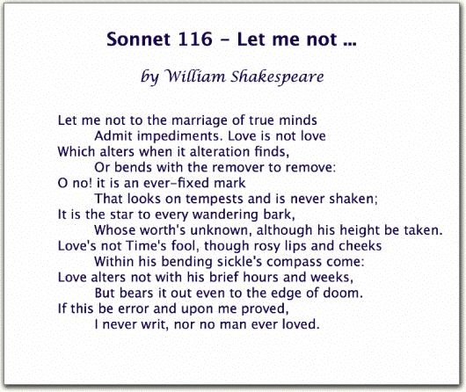
22
Generating poetry with RNNS
Fei-Fei Li & Andrej Karpathy & Justin Johnson Lecture 10 - 8 Feb 2016
Lecture 10 -
35
Andrej Karpathy

Slide 23
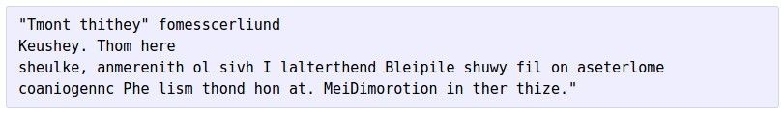


at first:
23
Generating poetry with RNNS
train more
train more
train more
Fei-Fei Li & Andrej Karpathy & Justin Johnson Lecture 10 - 8 Feb 2016
Lecture 10 -
36
More info: http://karpathy.github.io/2015/05/21/rnn-effectiveness/
Andrej Karpathy

Slide 24
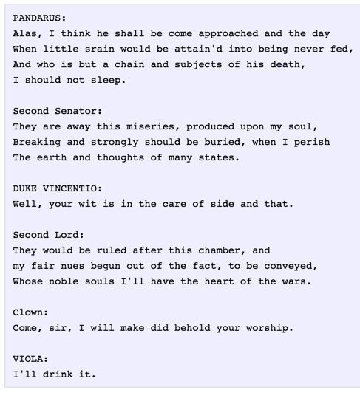
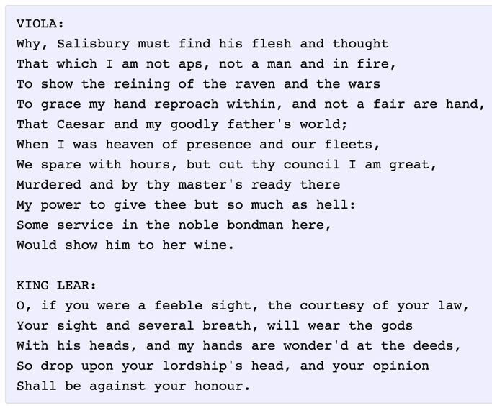
24
Generating poetry with RNNS
Fei-Fei Li & Andrej Karpathy & Justin Johnson Lecture 10 - 8 Feb 2016
Lecture 10 -
37
Andrej Karpathy
Notes:
https://huggingface.co/ashiqabdulkhader/GPT2-Poet
https://medium.com/@DenisKrivitski/generation-of-poems-with-a-recurrent-neural-network-128a5f62b483
https://github.com/AvoncourtPartners/poems
https://sballas8.github.io/2015/08/11/Poet-RNN.html

Slide 25
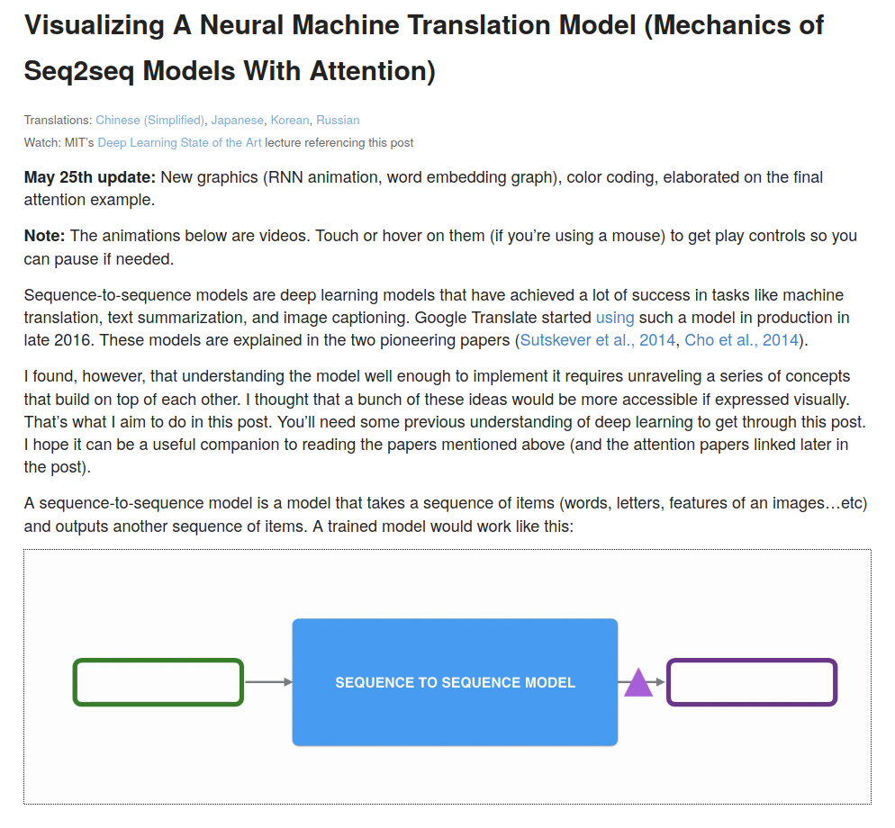
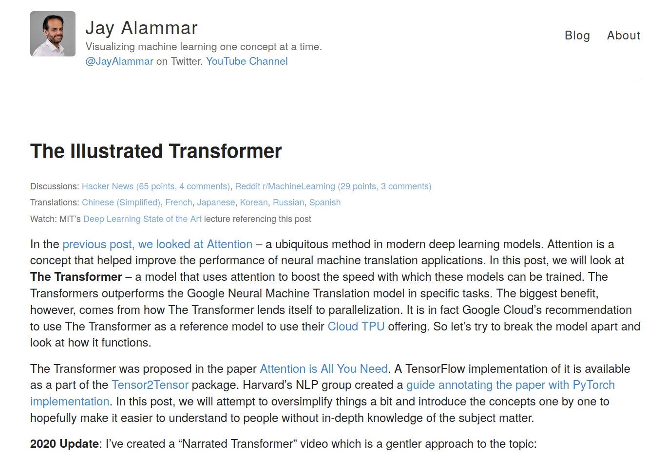
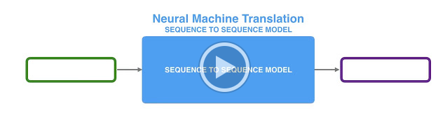
25
https://jalammar.github.io/visualizing-neural-machine-translation-mechanics-of-seq2seq-models-with-attention/
https://jalammar.github.io/visualizing-neural-machine-translation-mechanics-of-seq2seq-models-with-attention/
Slide Credit: Prof. Sandra Avila - UNICAMP

Slide 26
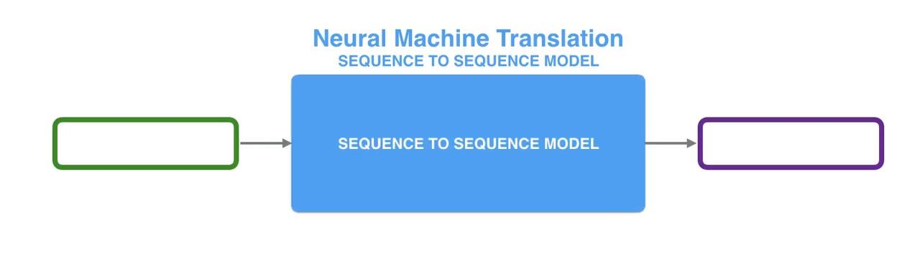
26
https://jalammar.github.io/visualizing-neural-machine-translation-mechanics-of-seq2seq-models-with-attention/
Slide Credit: Prof. Sandra Avila - UNICAMP
Notes:
Intro: 2 animations

Slide 27
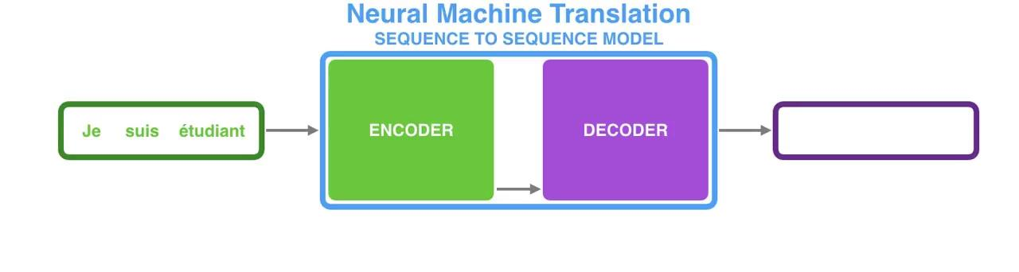
27
https://jalammar.github.io/visualizing-neural-machine-translation-mechanics-of-seq2seq-models-with-attention/
Slide Credit: Prof. Sandra Avila - UNICAMP
Notes:
Looking under the hood: Animations 1 and 2

Slide 28
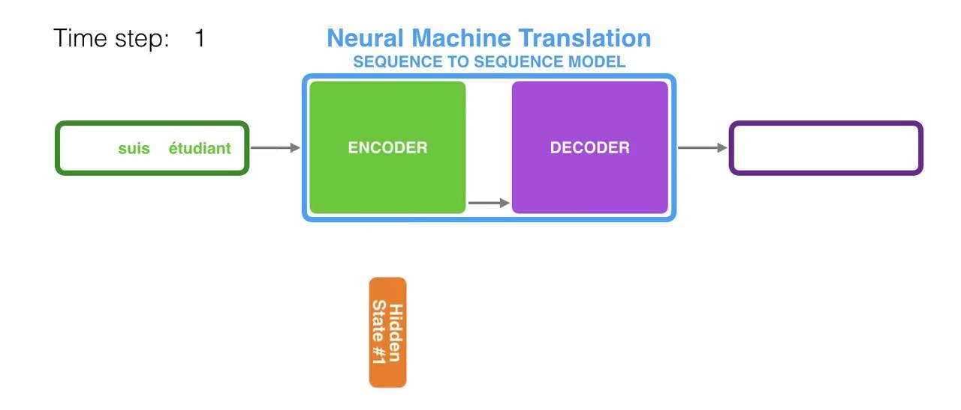
28
https://jalammar.github.io/visualizing-neural-machine-translation-mechanics-of-seq2seq-models-with-attention/
Slide Credit: Prof. Sandra Avila - UNICAMP
Notes:
Looking under the hood: Animation 4

Slide 29
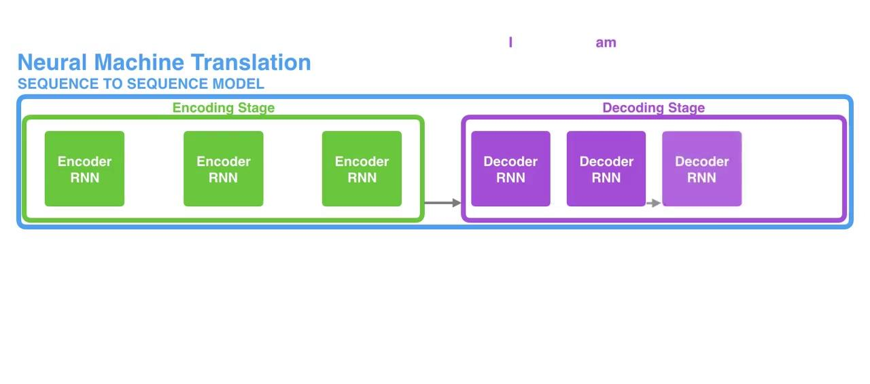
29
https://jalammar.github.io/visualizing-neural-machine-translation-mechanics-of-seq2seq-models-with-attention/
Slide Credit: Prof. Sandra Avila - UNICAMP
Notes:
Looking under the hood: Animation 5

Slide 30

30
https://gist.github.com/karpathy/d4dee566867f8291f086 (Andrej Karpathy)
RNN Vanilla: 112 lines of Python

Slide 31
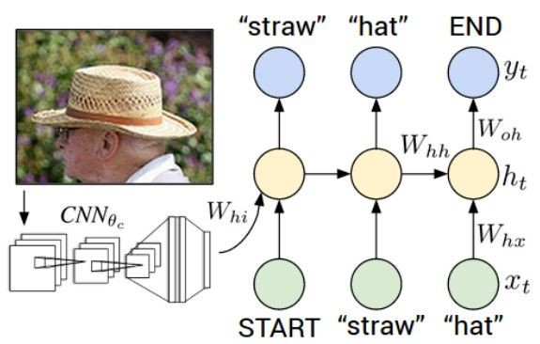
31
Image Captioning
CVPR 2015:
Deep Visual-Semantic Alignments for Generating Image Descriptions, Karpathy and Fei-Fei Show and Tell: A Neural Image Caption Generator, Vinyals et al.
Long-term Recurrent Convolutional Networks for Visual Recognition and Description, Donahue et al. Learning a Recurrent Visual Representation for Image Caption Generation, Chen and Zitnick
Adapted from Andrej Karpathy

Slide 32
Recurrent Neural Network
32
Image Captioning
Convolutional Neural Network
Andrej Karpathy

Slide 33

test image
33
Image Captioning
Andrej Karpathy

Slide 34
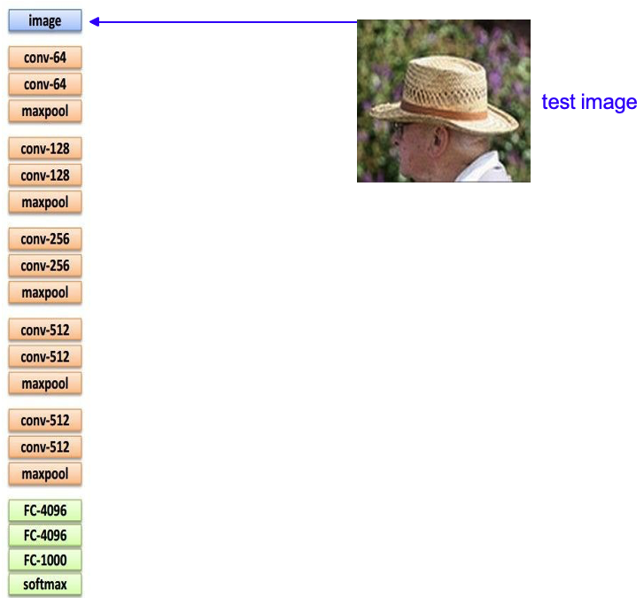
34
Image Captioning
Andrej Karpathy

Slide 35
35
Image Captioning
X
Andrej Karpathy

Slide 36
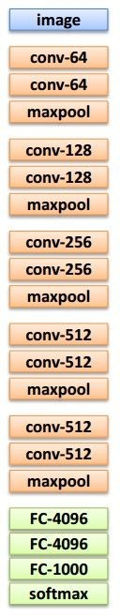
test image
36
Image Captioning
x0
<START>
<START>
Andrej Karpathy

Slide 37
37
Image Captioning
test image
y0
before:
h = tanh(W_{xh} * x + W_{hh} * h)
h0
Wih
now:
h = tanh(W_{xh} * x + W_{hh} * h + W_{ih} * im)
x0
<START>
im
<START>
Andrej Karpathy

Slide 38
test image
38
Image Captioning
y0
sample!
h0
x0
<START>
straw
<START>
Andrej Karpathy

Slide 39
test image
39
Image Captioning
y0
y1
h0
h1
x0
<START>
straw
<START>
Andrej Karpathy

Slide 40
test image
40
Image Captioning
y0
y1
sample!
h0
h1
x0
<START>
straw
hat
<START>
Andrej Karpathy

Slide 41
test image
41
Image Captioning
y0
y1
y2
h0
h1
h2
x0
<START>
straw
hat
<START>
Andrej Karpathy

Slide 42
test image
42
Image Captioning
Caption generated:
“straw hat”
y0
y1
y2
sample
<END> token
=> finish.
h0
h1
h2
x0
<START>
straw
hat
<START>
Adapted from Andrej Karpathy

Slide 43
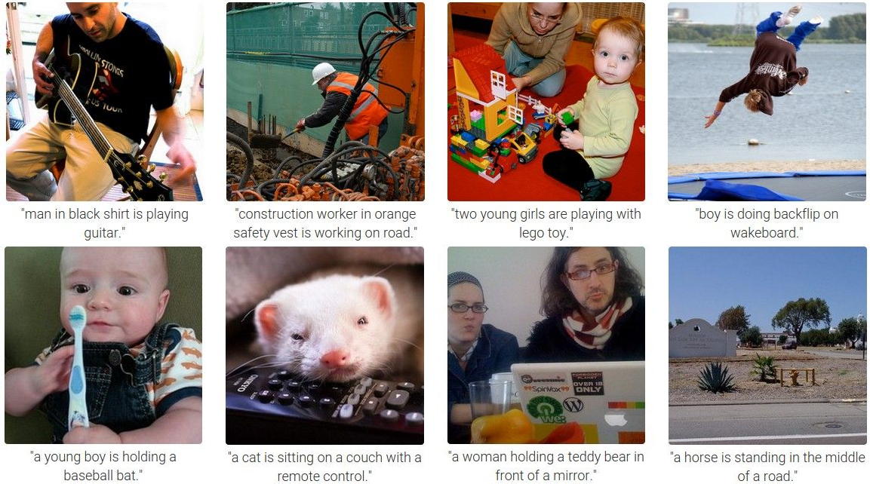
43
Image Captioning
Andrej Karpathy

Slide 44
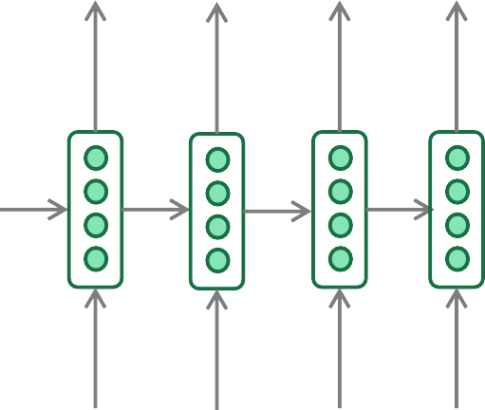
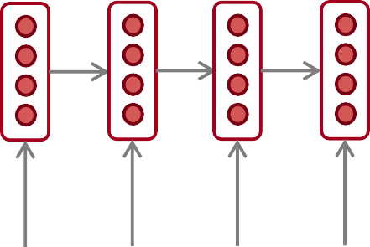
44
Neural Machine Translation (NMT)
The sequence-to-sequence model
Encoding of the source sentence.
Target sentence (output)
Provides initial hidden state
for Decoder RNN.
he
hit
me
with
a
pie <END>
argmax
argmax
argmax
argmax
argmax
argmax
argmax
Encoder RNN
Decoder RNN
il
a
m’ entarté
<START> he hit me with a pie
Source sentence (input)
Decoder RNN is a Language Model that generates target sentence, conditioned on encoding.
Encoder RNN produces an encoding of the source sentence.
Note: This diagram shows test time behavior:
decoder output is fed in as next step’s input
Abigail See

Slide 45
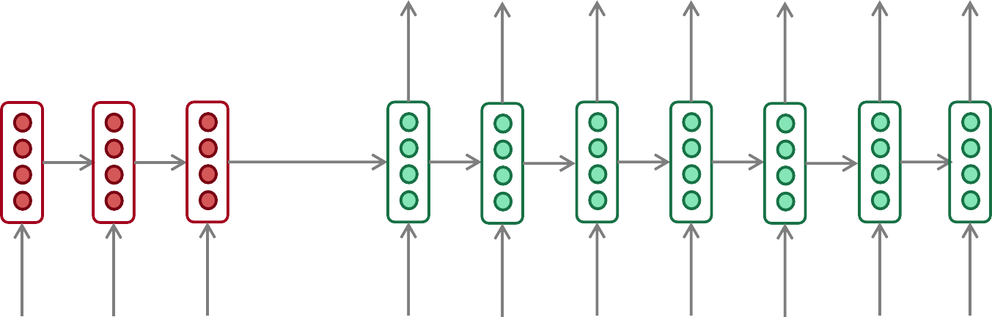
45
Sequence-to-sequence: the bottleneck problem
Encoding of the
source sentence.
This needs to capture all information about the source sentence.
Information bottleneck!
Target sentence (output)
he
hit
me with
a
pie <END>
Encoder RNN
Decoder RNN
il
a
m’ entarté
<START> he
hit
me with
a
pie
Source sentence (input)
Abigail See

Slide 46
46
Issues with recurrent models: Linear interaction distance
O(sequence length) steps for distant word pairs to interact means:
  Hard to learn long-distance dependencies (because gradient problems!)
  Linear order of words is “baked in”; not necessarily the right way to think about sentences…
The chef who …
was
Info of chef has gone through O(sequence length) many layers!
Adapted from John Hewitt

Slide 47
47
Issues with recurrent models: Lack of parallelization
Forward and backward passes have O(sequence length) unparallelizable operations
  GPUs can perform a bunch of independent computations at once!
  But future RNN hidden states can’t be computed in full before past RNN
hidden states have been computed
  Inhibits training on very large datasets!
1
2
3
T
0
1
2
T-1
h₁ h₂
h_{T}
Numbers indicate min # of steps before a state can be computed
John Hewitt

Slide 48

48
Attention
Attention provides a solution to the bottleneck problem.
Core idea: on each step of the decoder, use direct connection to the encoder to focus on a particular part of the source sequence
First, we will show via diagram (no equations), then we will show with equations
Abigail See

Slide 49
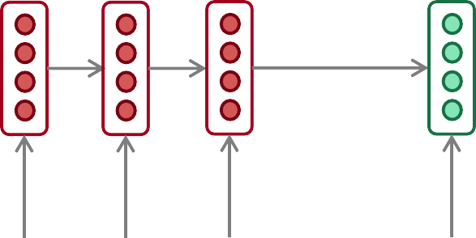
49
Sequence-to-sequence with attention
dot product
Attention
scores
Decoder RNN
Encoder
RNN
il
a
m’ entarté
<START>
Source sentence (input)
Abigail See

Slide 50
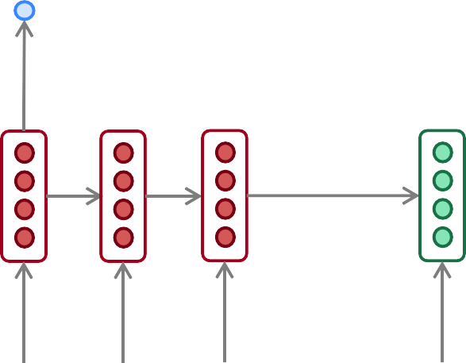
50
Sequence-to-sequence with attention
dot product
Attention
scores
Decoder RNN
Encoder
RNN
il
a
m’ entarté
<START>
Source sentence (input)
Abigail See

Slide 51
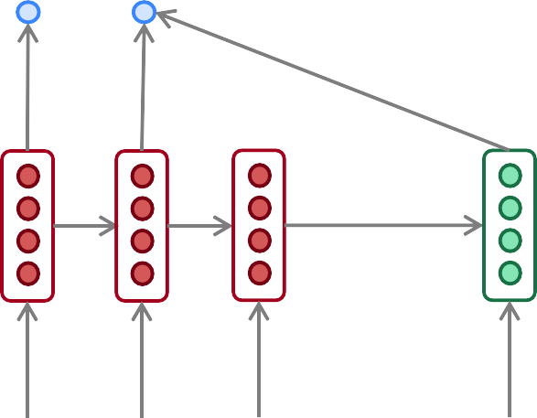
51
Sequence-to-sequence with attention
dot product
Attention
scores
Decoder RNN
Encoder
RNN
il
a
m’ entarté
<START>
Source sentence (input)
Abigail See

Slide 52
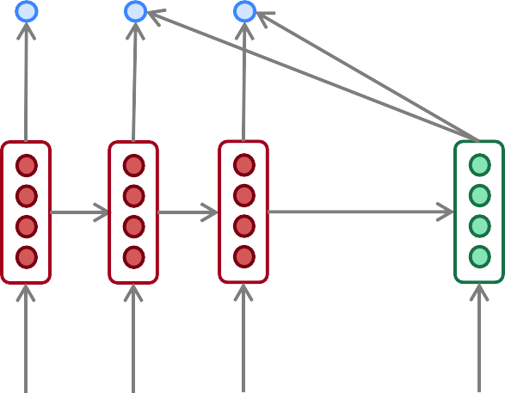
52
Sequence-to-sequence with attention
dot product
Attention
scores
Decoder RNN
Encoder
RNN
il
a
m’ entarté
<START>
Source sentence (input)
Abigail See

Slide 53
53
Sequence-to-sequence with attention
On this decoder timestep, we’re mostly focusing on the first encoder hidden state (”he”)
Attention
distribution
Take softmax to turn the scores into a probability distribution
Attention
scores
Decoder RNN
Encoder
RNN
il
a
m’ entarté
<START>
Source sentence (input)
Abigail See

Slide 54
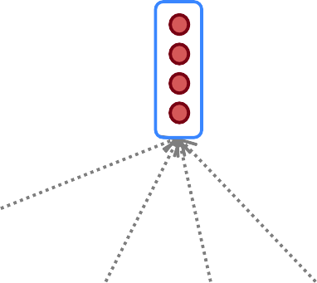
54
Sequence-to-sequence with attention
Attention output
Use the attention distribution to take a weighted sum of the encoder hidden states.
The attention output mostly contains information from the hidden states that received high attention.
Attention
distribution
Attention
scores
Decoder RNN
Encoder
RNN
il
a
m’ entarté
<START>
Source sentence (input)
Abigail See

Slide 55
55
Sequence-to-sequence with attention
Attention output
he
Concatenate attention output with decoder hidden state, then use to compute 𝑦₁ as before
Attention
distribution
𝑦₁
Attention
scores
Decoder RNN
Encoder
RNN
il
a
m’ entarté
<START>
Source sentence (input)
Abigail See

Slide 56
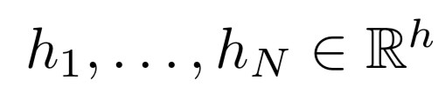






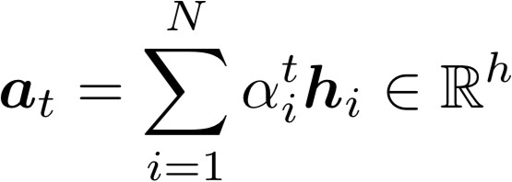



Attention in equations
56
We have encoder hidden states
On timestep t, we have decoder hidden state
We get the attention scores for this step:
We take softmax to get the attention distribution
distribution and sums to 1)
for this step (this is a probability
We use to take a weighted sum of the encoder hidden states to get the attention output
Finally, we concatenate the attention output with the decoder hidden state and proceed as in the non-attention seq2seq model
Abigail See

Slide 57
Attention is great!
57
Attention significantly improves Neural Machine Trans. (NMT) performance
  It’s very useful to allow decoder to focus on certain parts of the source
Attention solves the bottleneck problem
  Attention allows decoder to look directly at source; bypass bottleneck
Attention helps with vanishing gradient problem
  Provides shortcut to faraway states
Attention provides some interpretability
  By inspecting attention distribution, we can see what the decoder was focusing on
  We get (soft) alignment for free!
  This is cool because we never explicitly trained an alignment system
  The network just learned alignment by itself
he | hit | me | with | a | pie
il
a
m’
entarté
Abigail See
Notes:
NMT: Neural Machine Translation

Slide 58
Attention is a general deep-learning technique
58
We’ve seen that attention is a great way to improve the sequence-to-sequence model for Machine Translation.
However: You can use attention in many architectures (not just seq2seq) and many tasks (not just MT)
More general definition of attention:
  Given a set of vector values, and a vector query, attention is a technique to compute a weighted sum of the values, dependent on the query.
We sometimes say that the query attends to the values.
For example, in seq2seq + attention model, each decoder hidden state (query) attends to all encoder hidden states (values).
Abigail See

Slide 59
59
https://jalammar.github.io/visualizing-neural-machine-translation-mechanics-of-seq2seq-models-with-attention/
https://jalammar.github.io/visualizing-neural-machine-translation-mechanics-of-seq2seq-models-with-attention/
Slide Credit: Prof. Sandra Avila - UNICAMP

Slide 60
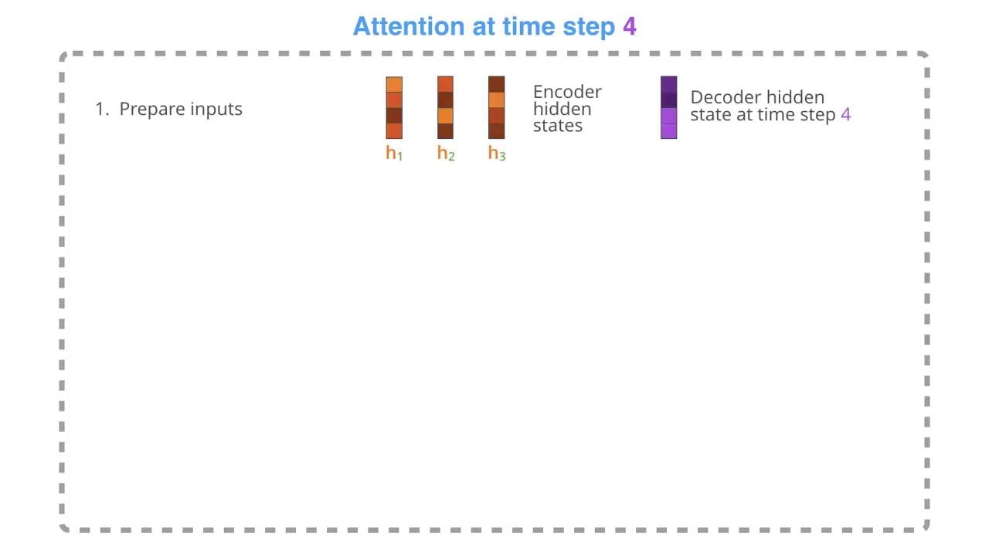
60
https://jalammar.github.io/visualizing-neural-machine-translation-mechanics-of-seq2seq-models-with-attention/
Slide Credit: Prof. Sandra Avila - UNICAMP
Notes:
https://jalammar.github.io/visualizing-neural-machine-translation-mechanics-of-seq2seq-models-with-attention/
Animation: Attention at time step 4

Slide 61
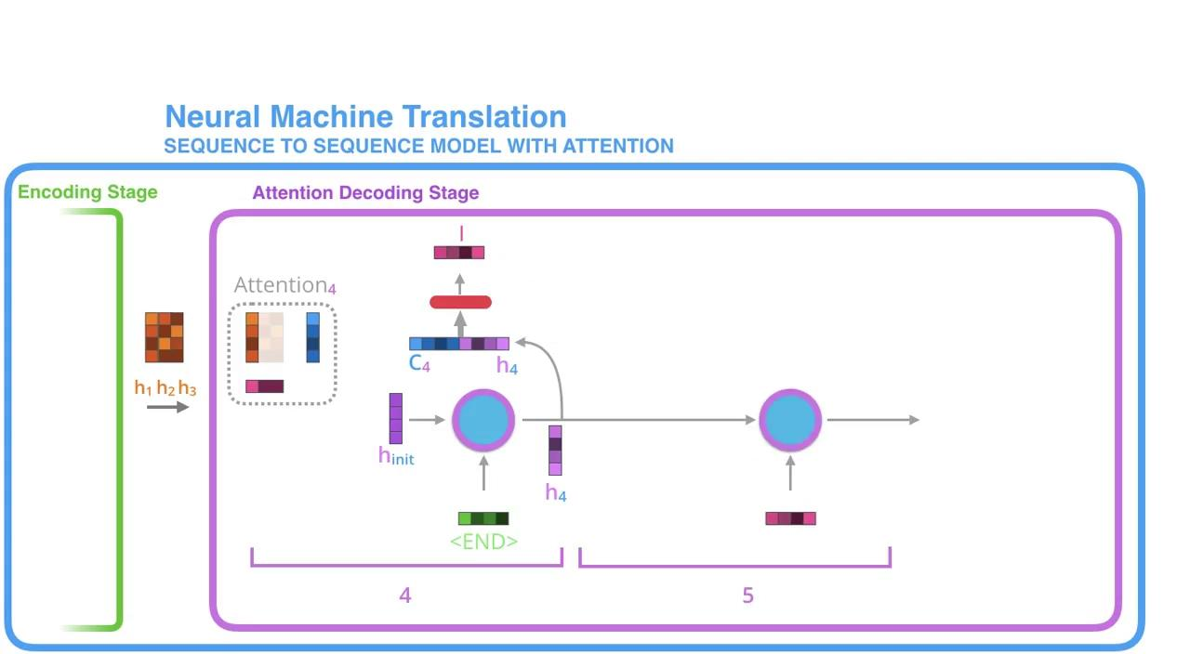
61
https://jalammar.github.io/visualizing-neural-machine-translation-mechanics-of-seq2seq-models-with-attention/
Slide Credit: Prof. Sandra Avila - UNICAMP
Notes:
https://jalammar.github.io/visualizing-neural-machine-translation-mechanics-of-seq2seq-models-with-attention/
Animation: from Figure on Slide

Slide 62
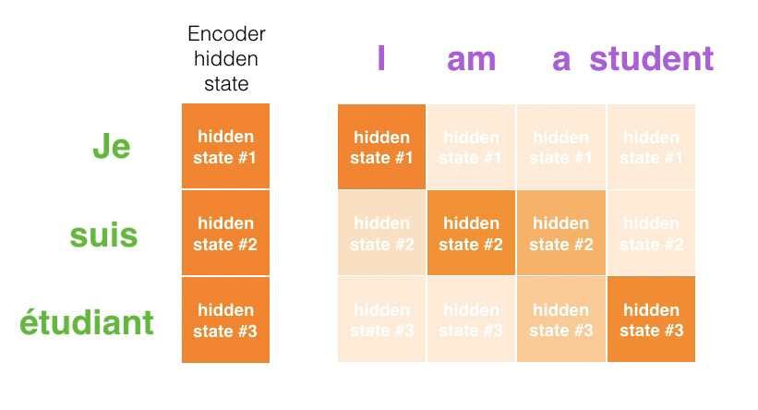
62
https://jalammar.github.io/visualizing-neural-machine-translation-mechanics-of-seq2seq-models-with-attention/
Slide Credit: Prof. Sandra Avila - UNICAMP
Notes:
https://jalammar.github.io/visualizing-neural-machine-translation-mechanics-of-seq2seq-models-with-attention/
Animation: from Figure on Slide

Slide 63
63
If not recurrence, then what? How about attention?
Attention treats each word’s representation as a query to access and incorporate information from a set of values.
  We saw attention from the decoder to the encoder; next we’ll think about
attention within a single sentence.
If attention gives us access to any state… maybe we can just use attention and don’t need the RNN?
Number of unparallelizable operations not tied to sequence length.
All words interact at every layer!
2 |  | 2 |  | 2 |  | 2 |  | 2 |  | 2 |  | 2 |  | 2
1 |  | 1 |  | 1 |  | 1 |  | 1 |  | 1 |  | 1 |  | 1
0 |  | 0 |  | 0 |  | 0 |  | 0 |  | 0 |  | 0 |  | 0
All words attend
to all words in previous layer; most arrows here are omitted
attention
attention embedding
h₁
h₂
h_{T}
Adapted from John Hewitt

Slide 64
64
Self-Attention
Attention operates on queries, keys, and values.
The number of queries can differ from the number of keys and
values in practice.
We have some queries 𝑞 , 𝑞 , … , 𝑞. Each query is 𝑞_{i} ∈ ℝ^{𝑑}
1 2 𝑇
We have some keys 𝑘₁, 𝑘₂, … , 𝑘_{𝑇}. Each key is 𝑘_{𝑖} ∈ ℝ^{𝑑}
We have some values 𝑣₁, 𝑣₂, … , 𝑣_{𝑇}. Each value is 𝑣_{𝑖} ∈ ℝ^{𝑑}
In self-attention, the queries, keys, and values are drawn from the same source.
  For example, if the output of the previous layer is 𝑥₁, … , 𝑥_{𝑇}, (one vec per word) we could let 𝑣_{𝑖} = 𝑘_{𝑖} = 𝑞_{𝑖} = 𝑥_{𝑖} (that is, use the same vectors for all of them!)
The (dot product) self-attention operation is as follows:
exp(𝑒_{𝑖𝑗})
𝑒 = 𝑞_{i}^{𝖳}𝑘 𝛼 =
output = Σ _{𝑗} 𝛼 𝑣
𝑖𝑗 𝑗
𝑖j
𝑖 𝑖𝑗 𝑗
𝑖
Σ
_{𝑗'}
exp(𝑒_{𝑖𝑗’} )
Compute outputs as weighted sum of values
Compute key- query affinities
Compute attention weights from affinities
(softmax)
John Hewitt

Slide 65
65
Barriers and solutions for Self-Attention as a building block
Barriers
Doesn’t have an inherent
notion of order!
Solutions
John Hewitt

Slide 66
66
Fixing the first self-attention problem: Sequence order
Since self-attention doesn’t build in order information, we need to encode the order of the
sentence in our keys, queries, and values.
Consider representing each sequence index as a vector
𝑝_{𝑖} ∈ ℝ^{𝑑}, for 𝑖 ∈ {1,2, … , 𝑇} are position vectors
Don’t worry about what the 𝑝_{𝑖} are made of yet!
Easy to incorporate this info into our self-attention block: just add the 𝑝_{𝑖} to our inputs!
Let 𝑣_{𝑖} ‘, 𝑘_{𝑖} ‘, 𝑞_{𝑖} ‘ be our old values, keys, and queries.
𝑣_{𝑖} = 𝑣_{𝑖} ‘ + 𝑝_{𝑖}
𝑞_{𝑖} = 𝑞_{𝑖} ‘ + 𝑝_{𝑖}
𝑘_{𝑖} = 𝑘_{𝑖} ‘ + 𝑝_{𝑖}
In deep self-attention networks, we do this at the first layer! You could concatenate them as well, but people mostly just add…
John Hewitt

Slide 67

67
Position representation vectors through sinusoids
Sinusoidal position representations: concatenate sinusoidal functions of varying periods:
sin(𝑖/10000^{2∗1/𝑑})
𝑝_{𝑖} = cos(𝑖/10000^{2∗1/𝑑})
𝑑
Dimension
sin(𝑖/10000^{2∗}2^{/𝑑})
𝑑
cos(𝑖/10000^{2∗}2^{/𝑑})
Index in the sequence
Periodicity indicates that maybe “absolute position” isn’t as important
Image: https://timodenk.com/blog/linear-relationships-in-the-transformers-positional-encoding/
John Hewitt

Slide 68
68
Barriers and solutions for Self-Attention as a building block
Barriers
Doesn’t have an inherent
notion of order!
Solutions
Add position representations to the inputs
No nonlinearities for deep
learning! It’s all just weighted
averages
John Hewitt

Slide 69
69
Adding nonlinearities in self-attention
Note that there are no elementwise nonlinearities in self-attention; stacking more self-attention layers just re-averages value vectors
Easy fix: add a feed-forward network
to post-process each output vector.
FF
FF
FF
self-attention
FF
…
FF
FF
FF
self-attention
FF
𝑚_{𝑖} = 𝑀𝐿𝑃 output_{𝑖}
= 𝑊₂ ∗ ReLU 𝑊₁ × output_{𝑖} + 𝑏₁
…
+ 𝑏₂
𝑤₁
The
𝑤₂
chef
𝑤₃
who
𝑤_{𝑇}
food
Intuition: the FF network processes the result of attention
John Hewitt

Slide 70
70
Barriers and solutions for Self-Attention as a building block
Barriers
Doesn’t have an inherent
notion of order!
No nonlinearities for deep learning magic! It’s all just weighted averages
Need to ensure we don’t “look at the future” when predicting a sequence
  Like in machine translation
  Or language modeling
Solutions
Add position representations to the inputs
Easy fix: apply the same feedforward network to each self- attention output.
John Hewitt

Slide 71
71
Masking the future in self-attention
We can look at these (not greyed out) words
To use self-attention in decoders, we need to ensure we can’t peek at the future.
0 | 0 | 0 | 0
 | 0 | 0 | 0
 |  | 0 | 0
 |  |  | 0
[START]
At every timestep, we could change the set of keys and queries to include only past words. (Inefficient!)
To enable parallelization, we mask out attention to future words by setting attention scores to 0.
𝑒_{𝑖𝑗} =
The
For encoding these words
chef
who
𝑞_{i}^{𝖳}𝑘_{𝑗}, 𝑗 < 𝑖
𝑖
0, 𝑗 ≥ 𝑖
John Hewitt

Slide 72
72
Barriers and solutions for Self-Attention as a building block
Barriers
Doesn’t have an inherent
notion of order!
No nonlinearities for deep learning magic! It’s all just weighted averages
Need to ensure we don’t “look at the future” when predicting a sequence
  Like in machine translation
  Or language modeling
Solutions
Add position representations to the inputs
Easy fix: apply the same feedforward network to each self- attention output.
Mask out the future by artificially setting attention weights to 0!
John Hewitt

Slide 73
73
Necessities for a self-attention building block:
Self-attention:
  the basis of the method.
Position representations:
  Specify the sequence order, since self-attention is an unordered function of its inputs.
Nonlinearities:
  At the output of the self-attention block
  Frequently implemented as a simple feed-forward network.
Masking:
  In order to parallelize operations while not looking at the future.
  Keeps information about the future from “leaking” to the past.
That’s it! But this is not the Transformer model we’ve been hearing about.
John Hewitt

Slide 74
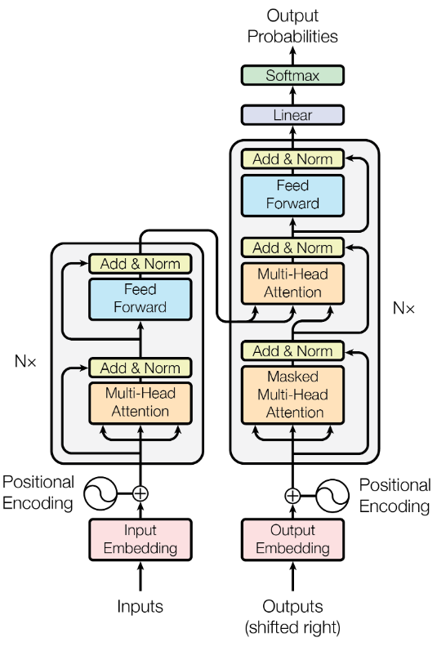
Transformer
74
Transformer Architecture
  Encoder & Decoder
  Input & output embedding
  Positional encoding
  Self-attention
  Multi-head attention
  Masked multi-head attention
  Residual connections
  Layer Normalization
  Feedforward
https://papers.nips.cc/paper/7181-attention-is-all-you-need.pdf
Slide Credit: Prof. Sandra Avila - UNICAMP

Slide 75
75
https://jalammar.github.io/illustrated-transformer/
Slide Credit: Prof. Sandra Avila - UNICAMP

Slide 76
Transformer
76
Decoder
Transformer Architecture
  Encoder & Decoder
  Input & output embedding
  Positional encoding
  Self-attention
  Multi-head attention
  Masked multi-head attention
  Residual connections
  Layer Normalization
  Feedforward
Encoder
https://papers.nips.cc/paper/7181-attention-is-all-you-need.pdf
Slide Credit: Prof. Sandra Avila - UNICAMP

Slide 77
Transformer: Encoder & Decoder
77
The model is primarily composed of two blocks:
  The encoder receives an input and builds a representation of it (its features). This means that the model is optimized to acquire understanding from the input.
  The decoder uses the encoder’s representation (features) along with other inputs to generate a target sequence. This means that the model is optimized for generating outputs.
Slide Credit: Prof. Sandra Avila - UNICAMP

Slide 78
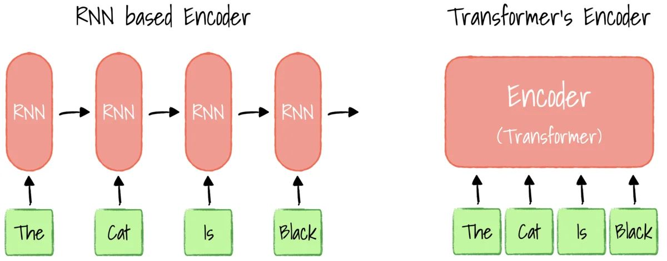
Transformers vs. RNNs
78
RNN
RNN
RNN
RNN
Encoder
(Transformer)
Slide Credit: Prof. Sandra Avila - UNICAMP

Slide 79
Transformer: Encoder & Decoder
79
Encoder-only models: ALBERT, BERT, DistilBERT, ELECTRA, RoBERTa
Decoder-only models: CTRL, GPT, GPT-2, GPT-3, GPT-4, Transformer XL.
Encoder-decoder models or sequence-to-sequence models: BART, mBART, Marian, T5.
Slide Credit: Prof. Sandra Avila - UNICAMP

Slide 80
Transformer
80
Transformer Architecture
  Encoder & Decoder
  Input & output embedding
  Positional encoding
  Self-attention
  Multi-head attention
  Masked multi-head attention
  Residual connections
  Layer Normalization
  Feedforward
https://papers.nips.cc/paper/7181-attention-is-all-you-need.pdf
Input Embedding
Output Embedding
Slide Credit: Prof. Sandra Avila - UNICAMP

Slide 81
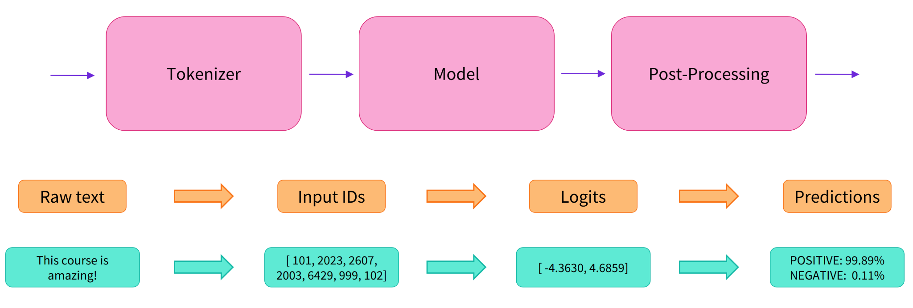
Transformer: Input & output embedding
81
Slide Credit: Prof. Sandra Avila - UNICAMP

Slide 82
Transformer
82
Transformer Architecture
  Encoder & Decoder
  Input & output embedding
  Positional encoding
  Self-attention
  Multi-head attention
  Masked multi-head attention
  Residual connections
  Layer Normalization
  Feedforward
https://papers.nips.cc/paper/7181-attention-is-all-you-need.pdf
Slide Credit: Prof. Sandra Avila - UNICAMP

Slide 83
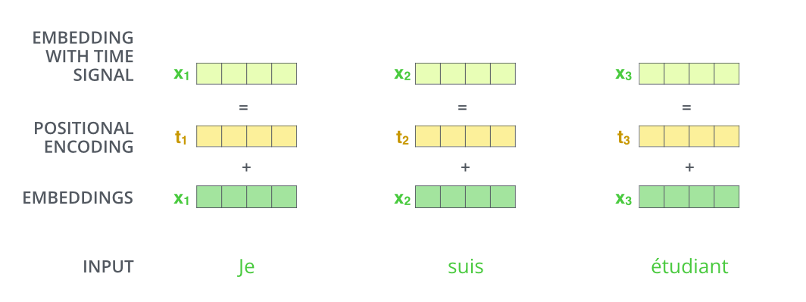
Transformer: Positional Encoding
83
https://huggingface.co/transformers/tokenizer_summary.html
Slide Credit: Prof. Sandra Avila - UNICAMP

Slide 84
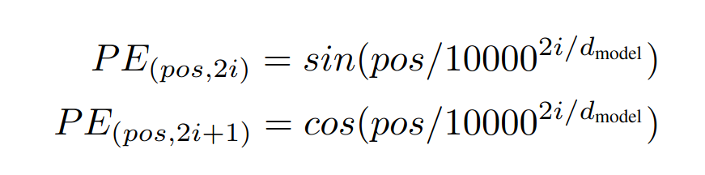
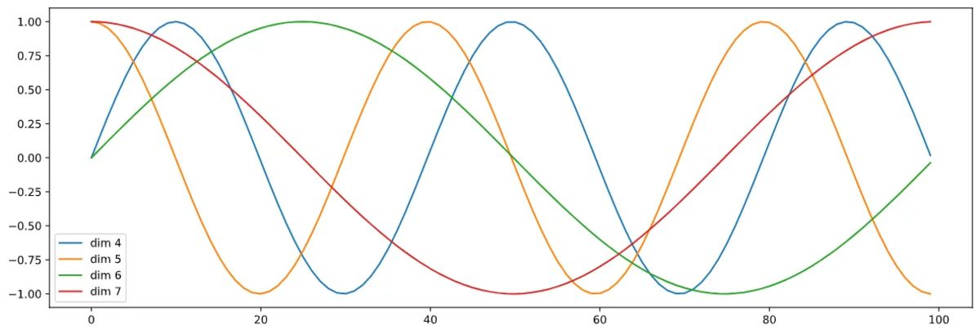
Transformer: Positional Encoding
84
https://huggingface.co/transformers/tokenizer_summary.html
Slide Credit: Prof. Sandra Avila - UNICAMP

Slide 85
Transformer
85
Transformer Architecture
  Encoder & Decoder
  Input & output embedding
  Positional encoding
  Self-attention
  Multi-head attention
  Masked multi-head attention
  Residual connections
  Layer Normalization
  Feedforward
Multi-head Self-Attention
https://papers.nips.cc/paper/7181-attention-is-all-you-need.pdf
Multi-head Self-Attention
Slide Credit: Prof. Sandra Avila - UNICAMP

Slide 86
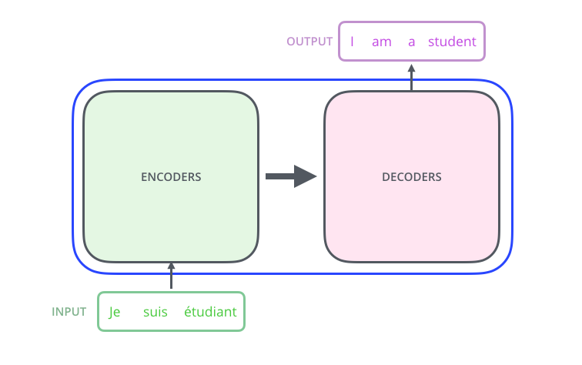
86
https://jalammar.github.io/illustrated-transformer
Slide Credit: Prof. Sandra Avila - UNICAMP

Slide 87
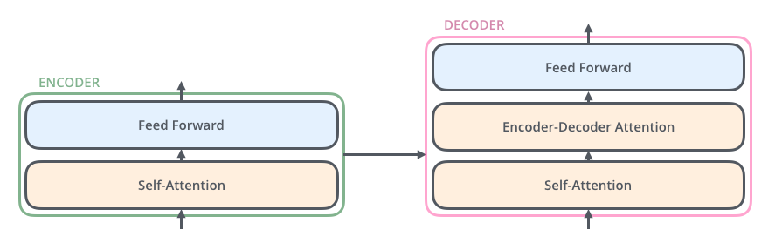
87
https://jalammar.github.io/illustrated-transformer
Slide Credit: Prof. Sandra Avila - UNICAMP

Slide 88
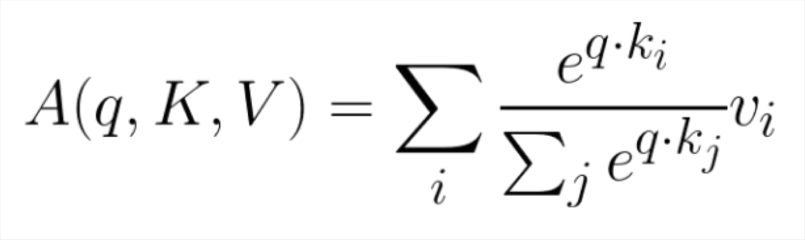
88
The Transformer Encoder: Dot-Product Attention
Inputs: a query q and a set of key-value (k-v) pairs to an output
Query, keys, values, and output are all vectors
Output is weighted sum of values, where
Weight of each value is computed by an inner product of query and corresponding key
Queries and keys have same dimensionality d_{k ,} value have d_{v}
Christopher Manning

Slide 89
89
The Transformer Encoder: Key-Query-Value Attention
We saw that self-attention is when keys, queries, and values come from the same
source. The Transformer does this in a particular way:
  Let 𝑥₁, … , 𝑥_{𝑇} be input vectors to the Transformer encoder; 𝑥_{𝑖} ∈ ℝ^{𝑑1}
Then keys, queries, values are:
  𝑘_{𝑖} = 𝑥_{𝑖}^{T} W^{K}, where W^{K} ∈ ℝ^{𝑑1×𝑑2} is the key matrix.
  𝑞_{𝑖} = 𝑥_{𝑖}^{T} W^{Q}, where W^{Q} ∈ ℝ^{𝑑1×𝑑2} is the query matrix.
  𝑣_{𝑖} = 𝑥_{𝑖}^{T} W^{V}, where W^{V} ∈ ℝ^{𝑑1×𝑑2} is the value matrix.
These matrices allow different aspects of the 𝑥 vectors to be used/emphasized in each of the three roles.
John Hewitt
Notes:
𝑥_{𝑖} ∈ ℝ^{𝑑1} → column vector (d1, 1)

Slide 90


90
https://jalammar.github.io/illustrated-transformer
Slide Credit: Prof. Sandra Avila - UNICAMP

Slide 91

91
https://jalammar.github.io/illustrated-transformer
Slide Credit: Prof. Sandra Avila - UNICAMP

Slide 92

92
https://jalammar.github.io/illustrated-transformer
Slide Credit: Prof. Sandra Avila - UNICAMP

Slide 93

93
https://jalammar.github.io/illustrated-transformer
Linear Layer
Slide Credit: Prof. Sandra Avila - UNICAMP

Slide 94
Transformer
94
Transformer Architecture
  Encoder & Decoder
  Input & output embedding
  Positional encoding
  Self-attention
  Multi-head attention
  Masked multi-head attention
  Residual connections
  Layer Normalization
  Feedforward
https://papers.nips.cc/paper/7181-attention-is-all-you-need.pdf
Masked multi-head self-attention
Slide Credit: Prof. Sandra Avila - UNICAMP

Slide 95
Transformer
95
Transformer Architecture
  Encoder & Decoder
  Input & output embedding
  Positional encoding
  Self-attention
  Multi-head attention
  Masked multi-head attention
  Residual connections
  Layer Normalization
  Feedforward
https://papers.nips.cc/paper/7181-attention-is-all-you-need.pdf
Slide Credit: Prof. Sandra Avila - UNICAMP

Slide 96
Transformer
96
Transformer Architecture
  Encoder & Decoder
  Input & output embedding
  Positional encoding
  Self-attention
  Multi-head attention
  Masked multi-head attention
  Residual connections
  Layer Normalization
  Feedforward
Normalization
Normalization
Normalization
https://papers.nips.cc/paper/7181-attention-is-all-you-need.pdf
Normalization
Normalization
Slide Credit: Prof. Sandra Avila - UNICAMP

Slide 97

97
https://jalammar.github.io/illustrated-transformer
Slide Credit: Prof. Sandra Avila - UNICAMP

Slide 98
Transformer
98
Transformer Architecture
  Encoder & Decoder
  Input & output embedding
  Positional encoding
  Self-attention
  Multi-head attention
  Masked multi-head attention
  Residual connections
  Layer Normalization
  Feedforward
FF
FF
https://papers.nips.cc/paper/7181-attention-is-all-you-need.pdf
Slide Credit: Prof. Sandra Avila - UNICAMP

Slide 99

Lab 12b: Transformers
Duration: 20 min
99
Notes:
[Content]
Section 1: Attention Overview [Extra]
Section 2: Queries, keys and values [For Class]
Section 3: Multihead Attention [For Class]
Section 4: Transformer Overview [For Class]
Section 5: Positional Encoding [Extra]
Section 6: Training Transformers [For Class]
Section 7: Transformers Beyond language Models [Extra]
[Exercises]
Coding Exercise 2: Dot Product Attention [For Class – Student Programming]
Coding Exercise 3: 𝑄, 𝐾, 𝑉 attention [For Class – Solution Provided]
Coding Exercise 4: Transformer Encoder [For Class – Solution Provided ]
Coding Exercise 6: Training Transformers [For Class – Solution Provided ]

Slide 100

100

Slide 101
101
Pretraining models
In modern NLP:
All (or almost all) parameters in NLP
networks are initialized via pretraining.
Pretraining methods hide parts of the input from the model and train the model to reconstruct those parts.
This has been exceptionally effective at building strong:
  representations of language
  parameter initializations for strong NLP
models.
𝒚
Pretrained jointly
… the movie was …
[This model has learned how to represent entire sentences through pretraining]
Adapted from John Hewitt

Slide 102

102
Pretraining through language modeling [Dai and Le, 2015]
Recall the language modeling task:
Model 𝑝_{𝜃}(𝑤_{𝑡 |} 𝑤_{1:𝑡−1}), the probability distribution over words given their past contexts.
There’s lots of data for this! (In English.)
Future
Lab 12a
goes
to
make
tasty
tea END
Decoder
(Transformer, LSTM, ++ )
Pretraining through language modeling:
Train a neural network to perform language modeling on a large amount of text.
Save the network parameters.
Iroh goes to
make
tasty tea
Past
John Hewitt

Slide 103

103
The Pretraining / Finetuning Paradigm
Pretraining can improve NLP applications by serving as parameter initialization.
Step 1: Pretrain (on language modeling)
Lots of text; learn general things!
Step 2: Finetune (on your task)
Not many labels; adapt to the task!
goes to
make tasty tea END
☺/☹
Decoder
Decoder
(Transformer, LSTM, ++ )
(Transformer, LSTM, ++ )
Iroh
goes
to
make
tasty
tea
… the movie was …
John Hewitt

Slide 104
104
Generative Pretrained Transformer (GPT) [Radford et al., 2018]
2018’s GPT was a big success in pretraining a decoder!
Transformer decoder with 12 layers.
768-dimensional hidden states, 3072-dimensional feed-forward hidden layers.
Byte-pair encoding with 40,000 merges
Trained on BooksCorpus: over 7000 unique books.
  Contains long spans of contiguous text, for learning long-distance dependencies.
The acronym “GPT” never showed up in the original paper; it could stand for
“Generative PreTraining” or “Generative Pretrained Transformer”
John Hewitt
[Devlin et al., 2018]

Slide 105
105
Generative Pretrained Transformer (GPT) [Radford et al., 2018]
How do we format inputs to our decoder for finetuning tasks?
Natural Language Inference: Label pairs of sentences as entailing/contradictory/neutral
Premise: The man is in the doorway
Hypothesis: The person is near the door
entailment
Radford et al., 2018 evaluate on natural language inference.
Here’s roughly how the input was formatted, as a sequence of tokens for the decoder.
[START] The man is in the doorway [DELIM] The person is near the door [EXTRACT]
The linear classifier is applied to the representation of the [EXTRACT] token.
John Hewitt

Slide 106
106
GPT-3, in-context learning, very large models
So far, we’ve interacted with pretrained models in two ways:
Sample from the distributions they define (maybe providing a prompt)
Fine-tune them on a task we care about, and take their predictions.
Very large language models seem to perform some kind of learning without gradient steps simply from examples you provide within their contexts.
GPT-3 is the canonical example of this.
GPT-3 has 175 billion parameters.
Adapted from John Hewitt

Slide 107
107
GPT-3, in-context learning, very large models
Very large language models seem to perform some kind of learning without gradient steps simply from examples you provide within their contexts.
The in-context examples seem to specify the task to be performed, and the conditional distribution mocks performing the task to a certain extent.
Input (prefix within a single Transformer decoder context):
“
thanks -> merci hello -> bonjour mint -> menthe otter -> ”
Output (conditional generations):
loutre…”
John Hewitt

Slide 108


108
GPT-3: Prompt Engineering
Translate English to French
﻿https://arxiv.org/abs/2005.14165
Vicente Ordoñez

Slide 109

109
Prompt Engineering
Vicente Ordoñez

Slide 110

110
How would you come with a solution for this problem?
Vicente Ordoñez

Slide 111
111
Prompt Engineering
﻿Input: The cat is throwing the ball into the ground
Output: The <subject>cat</subject> is throwing the <object>ball</object> into the <destination>ground</ground>
Input: The snake is being attacked by the wolf
Output: The <object>snake</object> is being attacked by the <actor>wolf</actor>
Input: The kid is throwing rocks at the window
Output:
Vicente Ordoñez

Slide 112


112
Prompt Engineering
﻿Any Large Language Model (LLM) such as GPT-3 can be turned into a general-purpose problem solver in this way.
Obviously, it is not going to work well for every use case.
Other Large Language Models trained at the scale of GPT-3 that are actually publicly available.
BLOOM-176B and OPT-175B:
https://huggingface.co/bigscience/bloom
https://huggingface.co/docs/transformers/model_doc/opt
Vicente Ordoñez

Slide 113
113
However, these are still limited
﻿Predicting the next word can lead to intelligent behavior such as the one exemplified earlier however this still limited
What makes some of the new LLMs special? ChatGPT (GPT-3.5, 3.5 Turbo, 4, 4-turbo), FLAN-T5, OPT-IML
Vicente Ordoñez

Slide 114

114
﻿Instruction Tuning (e.g. FLAN-T5 by Google)
Lab 12a
﻿https://arxiv.org/pdf/2210.11416.pdf
Vicente Ordoñez
Notes:
https://heidloff.net/article/running-llm-flan-t5-locally/
https://huggingface.co/docs/transformers/v4.26.1/en/model_doc/flan-t5
-------------------------------------------------------------
https://huggingface.co/google/flan-t5-small
https://github.com/google-research/t5x/blob/main/t5x/notebooks/README.md

Slide 115

115
﻿FLAN-T5
Vicente Ordoñez

Slide 116

116
﻿FLAN-T5
Vicente Ordoñez

Slide 117

117
﻿InstructGPT (ChatGPT)
﻿https://arxiv.org/abs/2203.02155
Vicente Ordoñez

Slide 118

118
Step by step: Train a reward model that learns from Human Ratings (e.g. from 1 to 5)
﻿https://gist.github.com/JoaoLages/c6f2dfd13d2484aa8bb0b2d567fbf093
Vicente Ordoñez

Slide 119

119
Step by step: Train the LM to generate text that get high reward but still produces stuff that makes sense
﻿https://gist.github.com/JoaoLages/c6f2dfd13d2484aa8bb0b2d567fbf093
Vicente Ordoñez

Slide 120
120
Pretraining encoders: What pretraining objective to use?
So far, we’ve looked at language model pretraining. But encoders get bidirectional context, so we can’t do language modeling!
Idea: replace some fraction of words in the input with a special [MASK] token; predict these words.
store
𝐴, 𝑏
ℎ₁, … , ℎ_{𝑇}
went
ℎ₁, … , ℎ_{𝑇} = Encoder 𝑤₁, … , 𝑤_{𝑇}
𝑦_{𝑖} ∼ 𝐴𝑤_{𝑖} + 𝑏
Only add loss terms from words that are “masked out.” If 𝑥 ’ is the masked version of 𝑥, we’re learning 𝑝_{𝜃}(𝑥|𝑥’ ). Called Masked LM.
Example: BERT: Bidirectional Encoder Representations from Transformers
I [M] to the [M]
[Devlin et al., 2018]
Adapted from John Hewitt

Slide 121

121
Case Study: Improving Embeddings Representations for Comparing Higher Education Curricula
Umap (MacInnes et al, JOSS 2018) visualizations for Bert and our approach.
Our approach separates computing programs more clearly.
Murrugarra-Llerena et al, EMNLP 2022

Slide 122

122
Case Study: Improving Embeddings Representations for Comparing Higher Education Curricula
Course-Based attention: Identifies the most and the least important courses following the intuition of core and elective courses.
Metric Learning: Learns boundaries to form well-defined groups.
Murrugarra-Llerena et al, EMNLP 2022

Slide 123
123
Capturing meaning via context: What kinds of things does pretraining learn?
There’s increasing evidence that pretrained models learn a wide variety of things about
the statistical properties of language:
Stanford University is located in , California. [Trivia]
I put fork down on the table. [syntax]
The woman walked across the street, checking for traffic over shoulder. [coreference]
I went to the ocean to see the fish, turtles, seals, and . [lexical semantics/topic]
Overall, the value I got from the two hours watching it was the sum total of the popcorn
and the drink. The movie was . [sentiment]
Iroh went into the kitchen to make some tea. Standing next to Iroh, Zuko pondered his destiny. Zuko left the . [some reasoning – this is harder]
I was thinking about the sequence that goes 1, 1, 2, 3, 5, 8, 13, 21, [some basic
arithmetic; they don’t learn the Fibonnaci sequence]
Models also learn – and can exacerbate racism, sexism, all manner of bad biases.
Adapted from John Hewitt

Slide 124

124
Transformers in vision
Dosovitskiy, ICLR 2021, https://github.com/google-research/vision_transformer
https://www.youtube.com/watch?v=TrdevFK_am4

Slide 125

125
Cross-modal transformers
Chen et al., “UNITER: Learning UNiversal Image-TExt Representations”, arxiv 2019

Slide 126


126
Visual Commonsense Reasoning leaderboard
https://visualcommonsense.com/leaderboard/

Slide 127

127
Visual Question Answering (VQA)
Task: Given an image and a natural language open-ended question, generate a natural language answer.
Agrawal et al., “VQA: Visual Question Answering”, ICCV 2015

Slide 128




128
Visual Question Answering (VQA)
Neural Network
Softmax
over top K answers
Image
Embedding
4096-dim
Convolution Layer
+ Non-Linearity
Pooling Layer
Convolution Layer
+ Non-Linearity
Pooling Layer
Fully-Connected
Embedding
Question
“How many horses are in this image?”
1024-dim
RNN
Agrawal et al., “VQA: Visual Question Answering”, ICCV 2015

Slide 129
Extra

Slide 130

Generate descriptions for events depicted in video clips
130
Video Captioning
A monkey pulls a dog’s tail and is chased by the dog.
Venugopalan et al., “Translating Videos to Natural Language using Deep Recurrent Neural Networks”, NAACL-HTL 2015

Slide 131


131
Video Captioning
English Sentence
RNN
encoder
RNN
decoder
French Sentence
[Sutskever et al. NIPS’14]
RNN
decoder
[Donahue et al. CVPR’15] [Vinyals et al. CVPR’15]
Encode
Sentence
RNN
decoder
Encode
Sentence
[Venugopalan et. al. NAACL’15] (this work)
Key Insight:
Generate feature representation of the video and “decode” it to a sentence
Venugopalan et al., “Translating Videos to Natural Language using Deep Recurrent Neural Networks”, NAACL-HTL 2015

Slide 132




132
Video Captioning
CNN
Input
Video
Forward propagate Output: “fc7” features
(activations before classification layer)
Sample frames
@1/10
fc7: 4096 dimension “feature vector”
Venugopalan et al., “Translating Videos to Natural Language using Deep Recurrent Neural Networks”, NAACL-HTL 2015

Slide 133



133
Video Captioning
Input Video
Convolutional Net Recurrent Net
LSTM LSTM
LSTM LSTM
LSTM LSTM
LSTM LSTM
LSTM LSTM
LSTM LSTM
Output
A
boy
. .
.
is
playing
golf
<EOS>
Mean across all frames
Venugopalan et al., “Translating Videos to Natural Language using Deep Recurrent Neural Networks”, NAACL-HTL 2015

Slide 134








134
Video Captioning
FGM: A person is dancing with the person on the stage. YT: A group of men are riding the forest.
I+V: A group of people are dancing.
GT: Many men and women are dancing in the street.
FGM: A person is cutting a potato in the kitchen. YT: A man is slicing a tomato.
I+V: A man is slicing a carrot.
GT: A man is slicing carrots.
FGM: A person is walking with a person in the forest. YT: A monkey is walking.
I+V: A bear is eating a tree.
GT: Two bear cubs are digging into dirt and plant matter at the base of a tree.
FGM: A person is riding a horse on the stage. YT: A group of playing are playing in the ball. I+V: A basketball player is playing.
GT: Dwayne wade does a fancy layup in an allstar game.
Venugopalan et al., “Translating Videos to Natural Language using Deep Recurrent Neural Networks”, NAACL-HTL 2015

Slide 135


135
Video Captioning
English Sentence
RNN
encoder
RNN
decoder
French Sentence
[Sutskever et al. NIPS’14]
RNN
decoder
[Donahue et al. CVPR’15] [Vinyals et al. CVPR’15]
Encode
Sentence
RNN
decoder
Encode
Sentence
[Venugopalan et. al. NAACL’15]
Encode
RNN
encoder
RNN
decoder
Sentence
[Venugopalan et. al. ICCV’ 15] (this work)
3
Venugopalan et al., “Sequence to Sequence - Video to Text”, ICCV 2015

Slide 136




S2VT Overview
136
Video Captioning
CNN
CNN
CNN
CNN
Now decode it to a sentence!
LSTM
LSTM
LSTM
LSTM
LSTM
LSTM
LSTM
LSTM
...
LSTM
LSTM
LSTM
LSTM
LSTM
LSTM
LSTM
LSTM
Encoding stage
A
man
is
talking ...
Decoding stage
Venugopalan et al., “Sequence to Sequence - Video to Text”, ICCV 2015

Slide 137
Plan for this lecture
137
Language and vision
  Application: Image and video captioning
  Tool: Recurrent neural networks
  Tool: Transformers
  Application: Visual question answering
Motion and video
  Video classification
  Measuring motion
  Tracking objects

Slide 138

Video Classification
138
﻿This image is CC0 public domain

Slide 139

Video Classification: Example
139
Swimming Running Jumping Eating Standing
Input video: T x 3 x H x W
Running video is in the public domain
Fei-Fei Li, Yunzhu Li, Ruohan Gao
Slide credit: Justin Johnson
May 4, 2023

Slide 140

Video Classification: Example
140
﻿Slide credit: Justin Johnson

Slide 141
141
Problem: Videos are big!
Videos are ~30 frames per second (fps)
Size of uncompressed video (3 bytes per pixel):
SD (640 x 480): ~1.5 GB per minute
HD (1920 x 1080): ~10 GB per minute
Solution: Train on short clips: low fps and low spatial resolution
e.g. T = 16, H=W=112
(3.2 seconds at 5 fps, 588 KB)
Input video: T x 3 x H x W
Slide credit: Justin Johnson023

Slide 142





Training on Clips
142
Raw video: Long, high FPS
Training: Train model to classify short clips with low FPS
Testing: Run model on different clips, average predictions
Slide credit: Justin Johnson
May 4, 2023

Slide 143
Video Classification: Single-Frame CNN
143
Simple idea: train normal 2D CNN to classify video frames independently! (Average predicted probs at test-time)
Often a very strong baseline for video classification
“Running” “Running” “Running” “Running” “Running” “Running”
CNN CNN CNN CNN CNN CNN
“Running”
CNN
Slide credit: Justin Johnson
May 4, 2023

Slide 144
Video Classification: Late Fusion (with FC layers)
144
Intuition: Get high-level appearance of each frame, and combine them
Class scores: C
Run 2D CNN on each frame, concatenate features and feed to MLP
Clip features: TDH’W’
MLP
Frame features
T x D x H’ x W’
2D CNN
on each frame
Flatten
CNN CNN CNN CNN CNN CNN
Input:
T x 3 x H x W
Karpathy et al, “Large-scale Video Classification with Convolutional Neural Networks”, CVPR 2014
Slide credit: Justin Johnson
May 4, 2023

Slide 145
Video Classification: Late Fusion (with pooling)
145
Intuition: Get high-level appearance of each frame, and combine them
Class scores: C
Run 2D CNN on each frame, pool features and feed to Linear
Linear
Clip features: D
Frame features
T x D x H’ x W’
Average Pool over space and time
2D CNN
on each frame
CNN CNN CNN CNN CNN CNN
Input:
T x 3 x H x W
Slide credit: Justin Johnson
May 4, 2023

Slide 146






Video Classification: Early Fusion
146
Intuition: Compare frames with very first conv layer,
after that normal 2D CNN
Class scores: C
Rest of the network is standard 2D CNN
First 2D convolution collapses all temporal information:
Input: 3T x H x W
Output: D x H x W
2D CNN
Reshape: 3T x H x W
Input:
T x 3 x H x W
Karpathy et al, “Large-scale Video Classification with Convolutional Neural Networks”, CVPR 2014
Slide credit: Justin Johnson
May 4, 2023

Slide 147




Video Classification: 3D CNN
147
Intuition: Use 3D versions of convolution and pooling to slowly fuse temporal
Class scores: C
information over the course of the network
Each layer in the network is a 4D tensor: D x T x H x W Use 3D conv and 3D pooling operations
3D CNN
Input:
3 x T x H x W
Ji et al, “3D Convolutional Neural Networks for Human Action Recognition”, TPAMI 2010 ; Karpathy et al, “Large-scale Video Classification with Convolutional Neural Networks”, CVPR 2014
Slide credit: Justin Johnson
May 4, 2023

Slide 148
3D Convolution
148
6x6x6 conv
5x5x5 conv
4x4x4 conv
Input:
C x T x H x W
FC
Layer
Class Scores
Slide credit: Fei-Fei Li, Yunzhu Li, Ruohan Gao
May 4, 2023

Slide 149
C3D: The VGG of 3D CNNs
149
Layer | Size
Input | 3 x 16 x 112 x 112
Conv1 (3x3x3) | 64 x 16 x 112 x 112
Pool1 (1x2x2) | 64 x 16 x 56 x 56
Conv2 (3x3x3) | 128 x 16 x 56 x 56
Pool2 (2x2x2) | 128 x 8 x 28 x 28
Conv3a (3x3x3) | 256 x 8 x 28 x 28
Conv3b (3x3x3) | 256 x 8 x 28 x 28
Pool3 (2x2x2) | 256 x 4 x 14 x 14
Conv4a (3x3x3) | 512 x 4 x 14 x 14
Conv4b (3x3x3) | 512 x 4 x 14 x 14
Pool4 (2x2x2) | 512 x 2 x 7 x 7
Conv5a (3x3x3) | 512 x 2 x 7 x 7
Conv5b (3x3x3) | 512 x 2 x 7 x 7
Pool5 | 512 x 1 x 3 x 3
FC6 | 4096
FC7 | 4096
FC8 | C
3D CNN that uses all 3x3x3 conv and 2x2x2 pooling
(except Pool1 which is 1x2x2)
Released model pretrained on Sports-1M: Many people used this as a video feature extractor
See on our
May 4, 2023
Slide credit: Fei-Fei Li, Yunzhu Li, Ruohan Gao
Tran et al, “Learning Spatiotemporal Features with 3D Convolutional Networks”, ICCV 2015

Slide 150

﻿Example Video Dataset: Sports-1M
150
﻿Karpathy et al, “Large-scale Video Classification with Convolutional Neural Networks”, CVPR 2014
Slide credit: Justin Johnson 2023

Slide 151

Early Fusion vs Late Fusion vs 3D CNN
151
Karpathy et al, “Large-scale Video Classification with Convolutional Neural Networks”, CVPR 2014
Slide credit: Justin Johnson 2023
Tran et al, “Learning Spatiotemporal Features with 3D Convolutional Networks”, ICCV 2015

Slide 152

Motion: Why is it useful?
152
Derek Hoiem

Slide 153
Motion: Why is it useful?
153
Even “impoverished” motion data can evoke a strong percept
G. Johansson, “Visual Perception of Biological Motion and a Model For Its Analysis", Perception and Psychophysics 14, 201-211, 1973.
Derek Hoiem

Slide 154





Optical Flow highlights
154
Measuring Motion: Optical Flow
Optical flow gives a
local motion
Horizontal flow dx
Image at frame t
displacement field F between images I_{t} and I_{t+1}
Tells where each pixel will move in the next frame:
F(x, y) = (dx, dy)
I_{t+1}(x+dx, y+dy) = I_{t}(x, y)
Image at frame t+1
Vertical Flow dy
Simonyan and Zisserman, “Two-stream convolutional networks for action recognition in videos”, NeurIPS 2014
Fei-Fei Li, Yunzhu Li, Ruohan Gao
Slide credit: Justin Johnson
May 4, 2023

Slide 155

Separating Motion and Appearance: Two-Stream Networks
155
Input: Single Image 3 x H x W
Input: Stack of optical flow: [2*(T-1)] x H x W
Early fusion: First 2D conv processes all flow images
Simonyan and Zisserman, “Two-stream convolutional networks for action recognition in videos”, NeurIPS 2014
Fei-Fei Li, Yunzhu Li, Ruohan Gao
Slide credit: Justin Johnson
May 4, 2023

Slide 156

Modeling Motion: Optical Flow
156
Walker et al., “Dense Optical Flow Prediction from a Static Scene”, ICCV 2015

Slide 157


Transferring Motion
157
Optical flow in generated video
Optical flow in source video
Key idea: Generate videos with similar flow patterns as source videos (+ many details).
Thomas, Song and Kovashka

Slide 158







Transferring Motion
158
Thomas, Song and Kovashka

Slide 159








Transferring Motion
159
Baking
Blooming
Thomas, Song and Kovashka

Slide 160

Modeling Long-term Temporal Structure
160
﻿So far all our temporal CNNs only model local
motion between frames in very short clips of ~2-5
seconds. What about long-term structure?
﻿We know how to handle
sequences! How about
recurrent networks?
﻿Slide credit: Justin Johnson

Slide 161


Modeling Long-term Temporal Structure
161
2
﻿Process local features using recurrent network (e.g. LSTM)
3
﻿Many to one: One output at end of video
1
﻿Slide credit: Justin Johnson

Slide 162

Modeling Long-term Temporal Structure
162
2
﻿Process local features using recurrent network (e.g. LSTM)
3
﻿Many to many: one output per video frame
1
﻿Slide credit: Justin Johnson

Slide 163

Modeling Long-term Temporal Structure
163
﻿Inside CNN: Each value is a function of a fixed temporal window (local temporal structure)
Inside RNN: Each vector is a function of all previous vectors (global temporal structure)
Can we merge both approaches?
Time
﻿Baccouche et al, "Sequential Deep Learning for Human Action Recognition”, 2011
Donahue et al, “Long-term recurrent convolutional networks for visual recognition and description”, CVPR 2015
﻿Slide credit: Justin Johnson

Slide 164

Intuition: Multi-layer RNN
164
﻿We can use a similar
structure to process
videos!
﻿Slide credit: Justin Johnson

Slide 165


Recurrent Convolutional Network
165

Slide 166

Recurrent Convolutional Network
166
﻿Slide credit: Justin Johnson

Slide 167


Recurrent Convolutional Network
167
﻿Ballas et al, “Delving Deeper into Convolutional Networks for Learning Video Representations”, ICLR 2016
﻿Slide credit: Justin Johnson

Slide 168

Recurrent Convolutional Network
168
﻿Recall: Vanilla RNN
ℎ_{t+1} = tanh(𝑊_{ℎ} h_{t} + 𝑊_{x}x)
﻿Ballas et al, “Delving Deeper into Convolutional Networks for Learning Video Representations”, ICLR 2016
﻿Slide credit: Justin Johnson

Slide 169


Modeling Long-term Temporal Structure
169
﻿Problem: RNNs are slow for long
sequences (can’t be parallelized)
﻿Baccouche et al, "Sequential Deep Learning for Human Action Recognition”, 2011
Donahue et al, “Long-term recurrent convolutional networks for visual recognition and description”, CVPR 2015
Time
﻿Ballas et al, “Delving Deeper into Convolutional Networks for
Learning Video Representations”, ICLR 2016
﻿Slide credit: Justin Johnson

Slide 170


﻿Recall: Self-Attention
170
﻿Slide credit: Fei-Fei Li

Slide 171

﻿Spatio-Temporal Self-Attention (Nonlocal Block)
171
﻿Wang et al, “Non-local neural networks”, CVPR 2018
﻿Slide credit: Justin Johnson

Slide 172

﻿Spatio-Temporal Self-Attention (Nonlocal Block)
172
﻿Wang et al, “Non-local neural networks”, CVPR 2018
﻿Slide credit: Justin Johnson

Slide 173

﻿Inflating 2D Networks to 3D (I3D)
173
﻿Carreira and Zisserman, “Quo Vadis, Action Recognition? A New Model and the Kinetics Dataset”, CVPR 2017
﻿Slide credit: Justin Johnson

Slide 174

﻿Inflating 2D Networks to 3D (I3D)
174
﻿Carreira and Zisserman, “Quo Vadis, Action Recognition? A New Model and the Kinetics Dataset”, CVPR 2017
﻿Slide credit: Justin Johnson

Slide 175

﻿Inflating 2D Networks to 3D (I3D)
175
﻿Carreira and Zisserman, “Quo Vadis, Action Recognition? A New Model and the Kinetics Dataset”, CVPR 2017
﻿Slide credit: Justin Johnson

Slide 176

﻿Inflating 2D Networks to 3D (I3D)
176
﻿Carreira and Zisserman, “Quo Vadis, Action Recognition? A New Model and the Kinetics Dataset”, CVPR 2017
﻿Slide credit: Fei-Fei Li

Slide 177

Vision Transformers for Video
177
﻿Slide credit: Fei-Fei Li

Slide 178

Vision Transformers for Video
178
﻿Li et al, “MViTv2: Improved Multiscale Vision Transformers for Classification and Detection”, CVPR 2022
﻿Slide credit: Justin Johnson

Slide 179

﻿Visualizing Video Models
179
﻿Slide credit: Justin Johnson

Slide 180

﻿Visualization: ﻿Can you guess the action?
180
﻿Feichtenhofer et al, “What have we learned from deep
representations for action recognition?”, CVPR 2018
Feichtenhofer et al, “Deep insights into convolutional
networks for video recognition?”, IJCV 2019.
Slide credit: Christoph Feichtenhofers
﻿Slide credit: Justin Johnson

Slide 181

﻿Visualization: ﻿Can you guess the action?
181
﻿Weightlifting
﻿Slide credit: Justin Johnson

Slide 182

﻿Visualization: ﻿Can you guess the action?
182
﻿Slide credit: Justin Johnson

Slide 183

﻿Visualization: ﻿Can you guess the action?
183
﻿Apply Eye Makeup
﻿Slide credit: Justin Johnson

Slide 184

﻿Frontiers: ﻿﻿Visually-guided audio source separation
184
﻿Slide credit: Fei-Fei Li

Slide 185

﻿Frontiers: ﻿﻿﻿Musical instruments source separation
185
﻿Slide credit: Fei-Fei Li

Slide 186

﻿Frontiers: ﻿﻿﻿﻿Audio as a preview mechanism for efficient action ﻿recognition in untrimmed videos
186
﻿Gao et al., Listen to Look: Action Recognition by Previewing Audio, CVPR 2020
﻿Slide credit: Fei-Fei Li

Slide 187

﻿Frontiers: ﻿﻿﻿﻿﻿Multimodal Video Understanding
187
﻿Slide credit: Fei-Fei Li

Slide 188





Tracking: some applications
188
Body pose tracking, activity recognition
Censusing a bat population
Video-based interfaces
Medical apps
Surveillance
Kristen Grauman

