Slide 1

CS 1674/2074: Filters
PhD. Nils Murrugarra-Llerena
nem177@pitt.edu

Slide 2
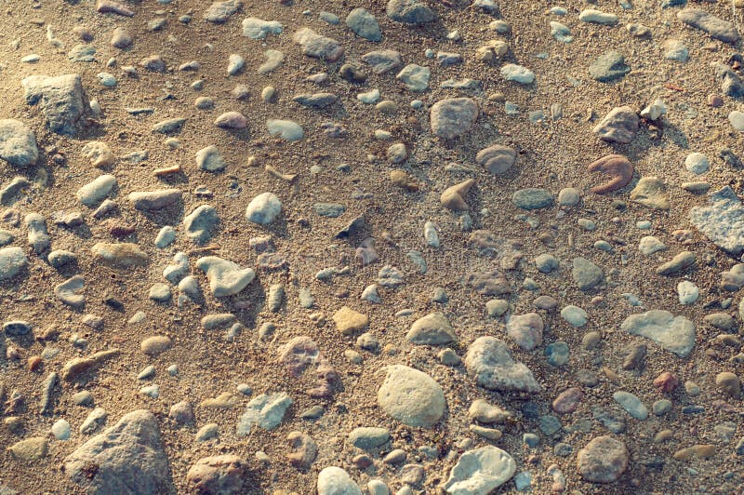
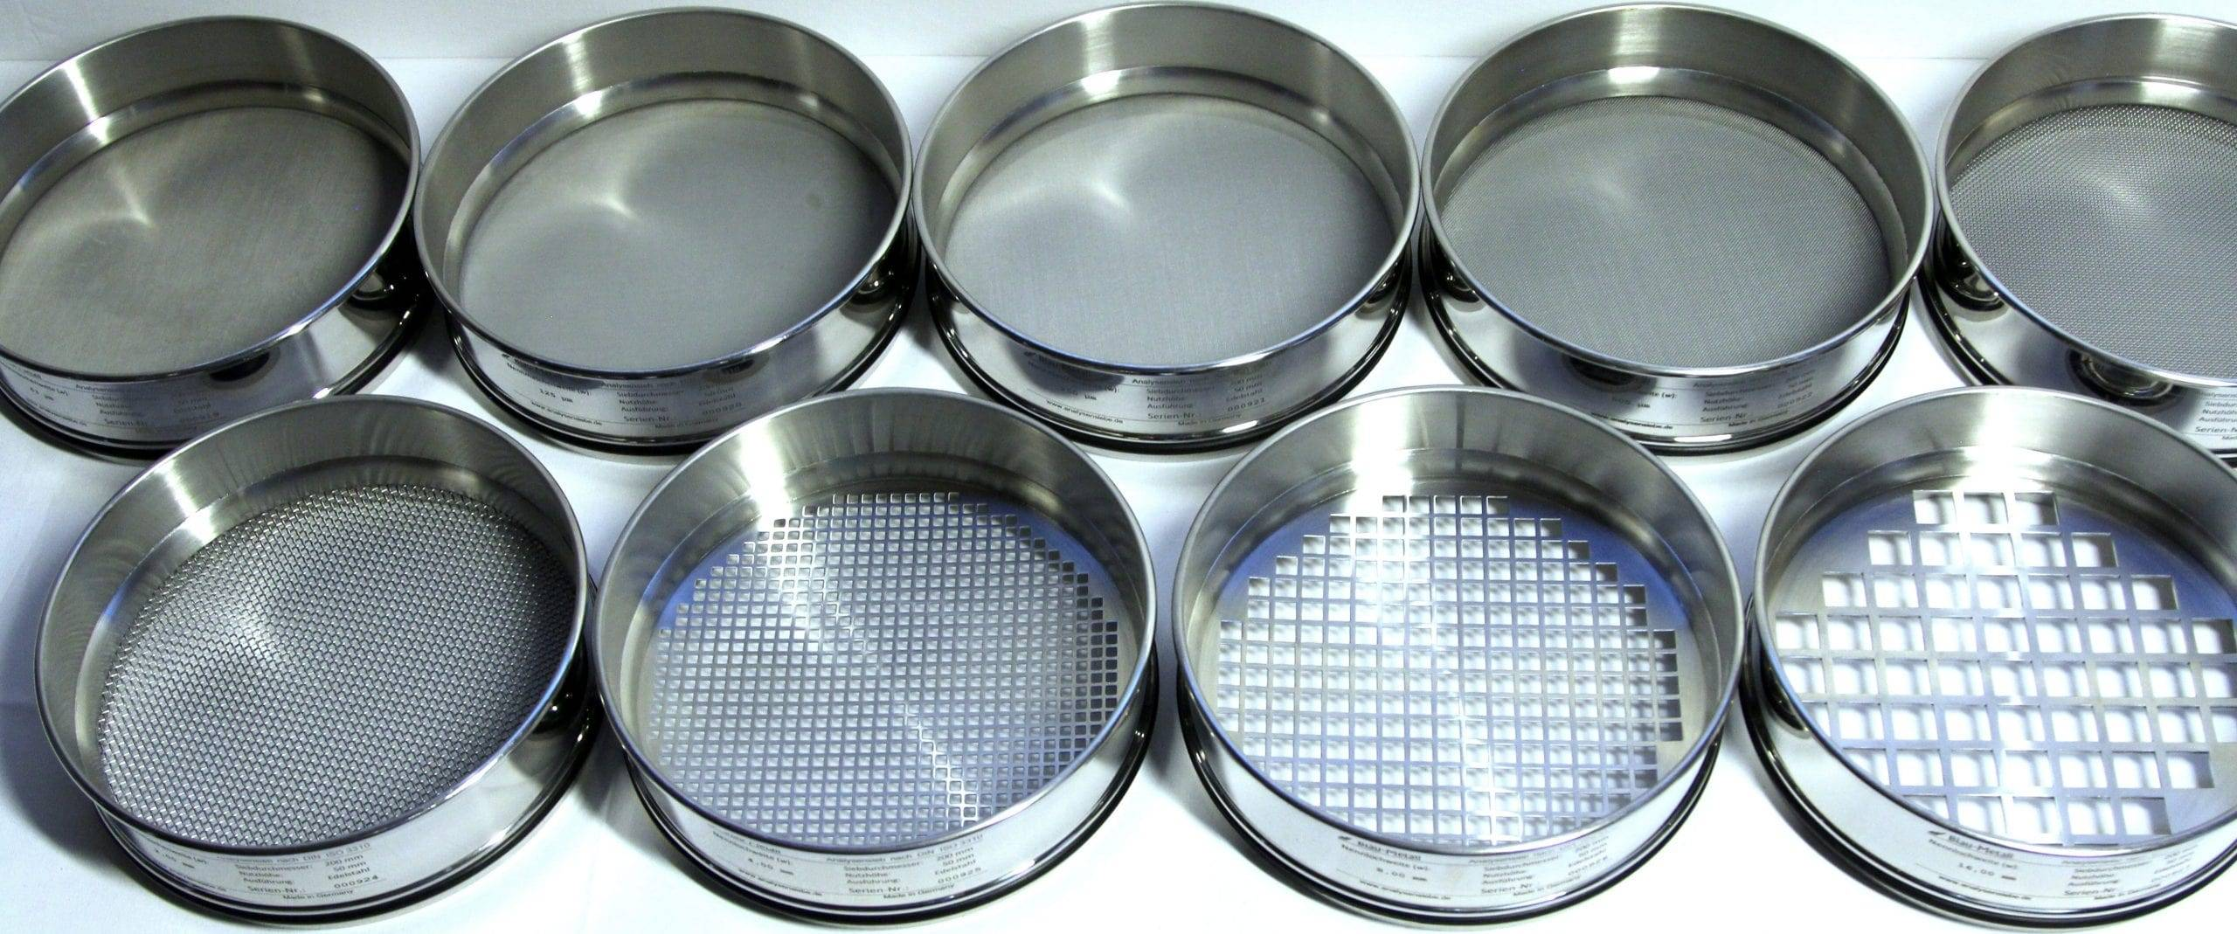
[Motivation] Filters
Sifting Sand
Imagine an image is a big pile of sand with different-sized pebbles mixed in. You want to separate the pebbles by size.
What would you do?
You wouldn't try to pick out each pebble by hand; instead, you'd use a series of sieves with different mesh sizes.
Filters
Notes:
Source: Gemini

Slide 3

Topics
Filters: motivation, math and properties
Types of filters
  Linear
    Smoothing
    Other
  Non-linear
    Median
Applications of filters
  Texture representation with filters
  Anti-aliasing for image subsampling
Notes:
Interactive Filters: https://setosa.io/ev/image-kernels/
Explained Visually: https://setosa.io/ev/

Slide 4
How images are represented
Color images represented as a matrix with multiple channels (=1 if grayscale)
Suppose we have a NxM RGB image called “im”
  im(0,0,0) = top-left pixel value in R-channel
  im(y, x, b) = y pixels down (rows), x pixels to right (cols) in b^{th} channel
  im(N-1, M-1, 2) = bottom-right pixel in B-channel
cv2.imread(filename) returns a uint8 image (values 0 to 255)
column
row
R
0.92 | 0.93 | 0.94 | 0.97 | 0.62 | 0.37 | 0.85 | 0.97 | 0.93 | 0.92 | 0.99
0.95 | 0.89 | 0.82 | 0.89 | 0.56 | 0.31 | 0.75 | 0.92 | 0.81 | 0.95 | 0.91
0.89 | 0.72 | 0.51 | 0.55 | 0.51 | 0.42 | 0.57 | 0.41 | 0.49 | 0.91 | 0.92
0.96 | 0.95 | 0.88 | 0.94 | 0.56 | 0.46 | 0.91 | 0.87 | 0.90 | 0.97 | 0.95
0.71 | 0.81 | 0.81 | 0.87 | 0.57 | 0.37 | 0.80 | 0.88 | 0.89 | 0.79 | 0.85
0.49 | 0.62 | 0.60 | 0.58 | 0.50 | 0.60 | 0.58 | 0.50 | 0.61 | 0.45 | 0.33
0.86 | 0.84 | 0.74 | 0.58 | 0.51 | 0.39 | 0.73 | 0.92 | 0.91 | 0.49 | 0.74
0.96 | 0.67 | 0.54 | 0.85 | 0.48 | 0.37 | 0.88 | 0.90 | 0.94 | 0.82 | 0.93
0.69 | 0.49 | 0.56 | 0.66 | 0.43 | 0.42 | 0.77 | 0.73 | 0.71 | 0.90 | 0.99
0.79 | 0.73 | 0.90 | 0.67 | 0.33 | 0.61 | 0.69 | 0.79 | 0.73 | 0.93 | 0.97
0.91 | 0.94 | 0.89 | 0.49 | 0.41 | 0.78 | 0.78 | 0.77 | 0.89 | 0.99 | 0.93
G
0.92 | 0.93 | 0.94 | 0.97 | 0.62 | 0.37 | 0.85 | 0.97 | 0.93 | 0.92 | 0.99
0.95 | 0.89 | 0.82 | 0.89 | 0.56 | 0.31 | 0.75 | 0.92 | 0.81 | 0.95 | 0.91
0.89 | 0.72 | 0.51 | 0.55 | 0.51 | 0.42 | 0.57 | 0.41 | 0.49 | 0.91 | 0.92
0.96 | 0.95 | 0.88 | 0.94 | 0.56 | 0.46 | 0.91 | 0.87 | 0.90 | 0.97 | 0.95
0.71 | 0.81 | 0.81 | 0.87 | 0.57 | 0.37 | 0.80 | 0.88 | 0.89 | 0.79 | 0.85
0.49 | 0.62 | 0.60 | 0.58 | 0.50 | 0.60 | 0.58 | 0.50 | 0.61 | 0.45 | 0.33
0.86 | 0.84 | 0.74 | 0.58 | 0.51 | 0.39 | 0.73 | 0.92 | 0.91 | 0.49 | 0.74
0.96 | 0.67 | 0.54 | 0.85 | 0.48 | 0.37 | 0.88 | 0.90 | 0.94 | 0.82 | 0.93
0.69 | 0.49 | 0.56 | 0.66 | 0.43 | 0.42 | 0.77 | 0.73 | 0.71 | 0.90 | 0.99
0.79 | 0.73 | 0.90 | 0.67 | 0.33 | 0.61 | 0.69 | 0.79 | 0.73 | 0.93 | 0.97
0.91 | 0.94 | 0.89 | 0.49 | 0.41 | 0.78 | 0.78 | 0.77 | 0.89 | 0.99 | 0.93
B
0.92 | 0.93 | 0.94 | 0.97 | 0.62 | 0.37 | 0.85 | 0.97 | 0.93 | 0.92 | 0.99
0.95 | 0.89 | 0.82 | 0.89 | 0.56 | 0.31 | 0.75 | 0.92 | 0.81 | 0.95 | 0.91
0.89 | 0.72 | 0.51 | 0.55 | 0.51 | 0.42 | 0.57 | 0.41 | 0.49 | 0.91 | 0.92
0.96 | 0.95 | 0.88 | 0.94 | 0.56 | 0.46 | 0.91 | 0.87 | 0.90 | 0.97 | 0.95
0.71 | 0.81 | 0.81 | 0.87 | 0.57 | 0.37 | 0.80 | 0.88 | 0.89 | 0.79 | 0.85
0.49 | 0.62 | 0.60 | 0.58 | 0.50 | 0.60 | 0.58 | 0.50 | 0.61 | 0.45 | 0.33
0.86 | 0.84 | 0.74 | 0.58 | 0.51 | 0.39 | 0.73 | 0.92 | 0.91 | 0.49 | 0.74
0.96 | 0.67 | 0.54 | 0.85 | 0.48 | 0.37 | 0.88 | 0.90 | 0.94 | 0.82 | 0.93
0.69 | 0.49 | 0.56 | 0.66 | 0.43 | 0.42 | 0.77 | 0.73 | 0.71 | 0.90 | 0.99
0.79 | 0.73 | 0.90 | 0.67 | 0.33 | 0.61 | 0.69 | 0.79 | 0.73 | 0.93 | 0.97
0.91 | 0.94 | 0.89 | 0.49 | 0.41 | 0.78 | 0.78 | 0.77 | 0.89 | 0.99 | 0.93
Adapted from Derek Hoiem

Slide 5
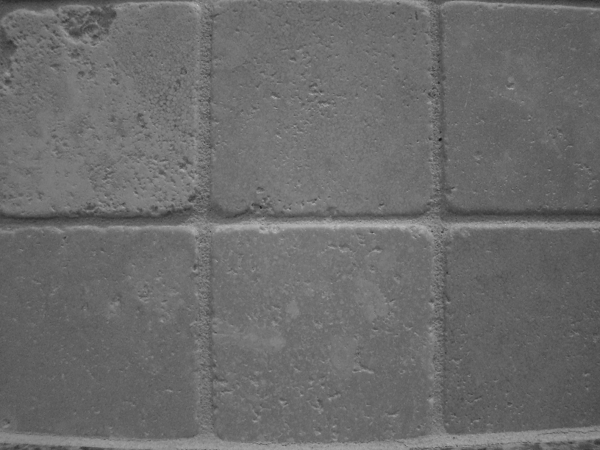
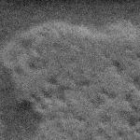
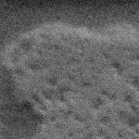

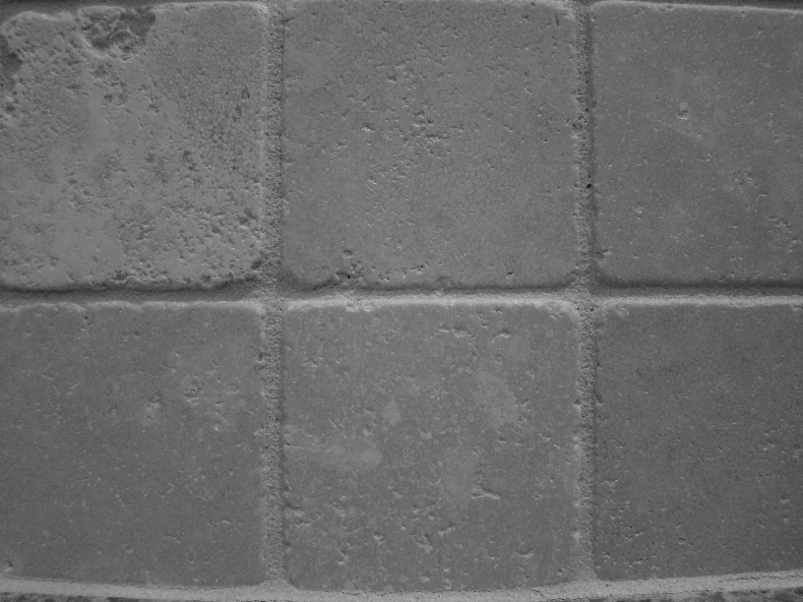
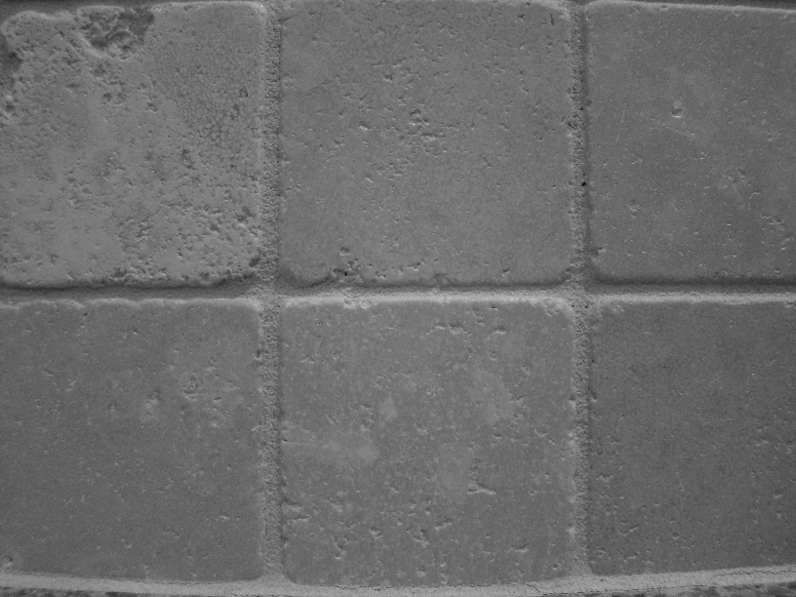


Enter Noise
The same object will look very different across images
Even multiple images of same static scene won’t be identical
How could we reduce the noise, i.e., give an estimate of the true intensities?
What if there’s only one image?
Kristen Grauman

Slide 6
Common types of noise
  Impulse noise: random occurrences of white pixels
  Salt and pepper noise: random occurrences of black and white pixels
  Gaussian noise: variations in intensity drawn from a Gaussian normal distribution
Source: S. Seitz

Slide 7
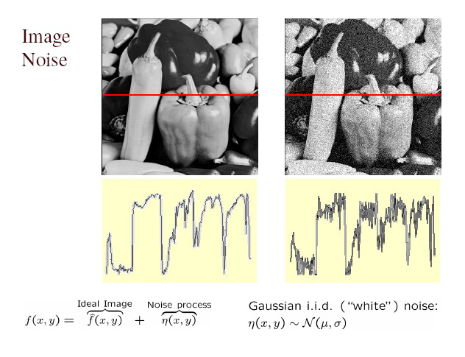

Gaussian noise
>> noise = np.random.rand( *im.shape ) * sigma
>> im_noise = im + noise
What is impact of the sigma?
[Github: Lab 2]
Fig: M. Hebert

Slide 8
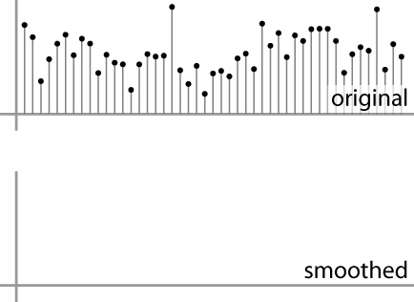
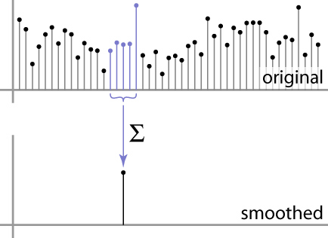
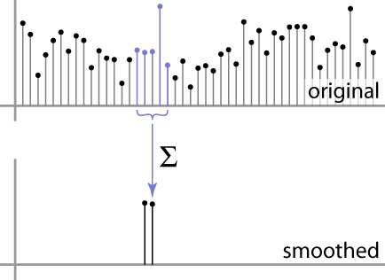
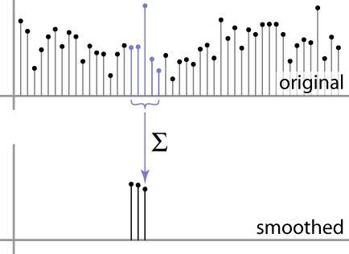
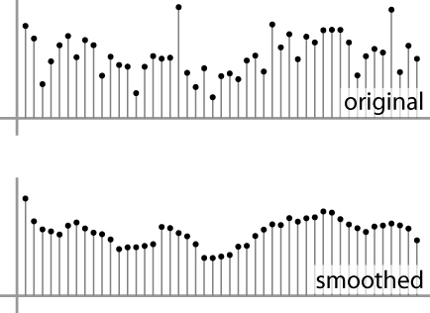
First attempt at a solution
Let’s replace each pixel with an average of all the values in its neighborhood
Moving average in 1D:
Source: S. Marschner

Slide 9
First attempt at a solution
Let’s replace each pixel with an average of all the values in its neighborhood
Why/when will this work?
Assumptions:
  Expect pixels to be like their neighbors
  Expect noise processes to be independent from pixel to pixel
Kristen Grauman

Slide 10
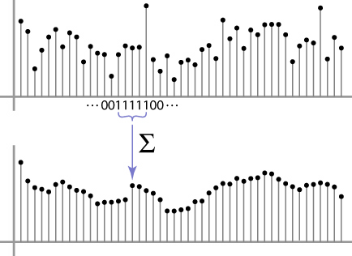
Weighted Moving Average
Can add weights to our moving average
Weights [1, 1, 1, 1, 1] / 5
Source: S. Marschner

Slide 11

Weighted Moving Average
Non-uniform weights [1, 4, 6, 4, 1] / 16
10 14 12 13 20
Central pixel =
(10*1 +
14*4 +
12*6 +
13*4 +
20*1) / 16
Adapted from S. Marschner

Slide 12


Moving Average In 2D
0 | 0 | 0 | 0 | 0 | 0 | 0 | 0 | 0 | 0
0 | 0 | 0 | 0 | 0 | 0 | 0 | 0 | 0 | 0
0 | 0 | 0 | 90 | 90 | 90 | 90 | 90 | 0 | 0
0 | 0 | 0 | 90 | 90 | 90 | 90 | 90 | 0 | 0
0 | 0 | 0 | 90 | 90 | 90 | 90 | 90 | 0 | 0
0 | 0 | 0 | 90 | 0 | 90 | 90 | 90 | 0 | 0
0 | 0 | 0 | 90 | 90 | 90 | 90 | 90 | 0 | 0
0 | 0 | 0 | 0 | 0 | 0 | 0 | 0 | 0 | 0
0 | 0 | 90 | 0 | 0 | 0 | 0 | 0 | 0 | 0
0 | 0 | 0 | 0 | 0 | 0 | 0 | 0 | 0 | 0
 | 0
0 | 0 | 0 | 0 | 0 | 0 | 0 | 0 | 0 | 0
0 | 0 | 0 | 0 | 0 | 0 | 0 | 0 | 0 | 0
0 | 0 | 0 | 90 | 90 | 90 | 90 | 90 | 0 | 0
0 | 0 | 0 | 90 | 90 | 90 | 90 | 90 | 0 | 0
0 | 0 | 0 | 90 | 90 | 90 | 90 | 90 | 0 | 0
0 | 0 | 0 | 90 | 0 | 90 | 90 | 90 | 0 | 0
0 | 0 | 0 | 90 | 90 | 90 | 90 | 90 | 0 | 0
0 | 0 | 0 | 0 | 0 | 0 | 0 | 0 | 0 | 0
0 | 0 | 90 | 0 | 0 | 0 | 0 | 0 | 0 | 0
0 | 0 | 0 | 0 | 0 | 0 | 0 | 0 | 0 | 0
Source: S. Seitz

Slide 13
Moving Average In 2D
0 | 0 | 0 | 0 | 0 | 0 | 0 | 0 | 0 | 0
0 | 0 | 0 | 0 | 0 | 0 | 0 | 0 | 0 | 0
0 | 0 | 0 | 90 | 90 | 90 | 90 | 90 | 0 | 0
0 | 0 | 0 | 90 | 90 | 90 | 90 | 90 | 0 | 0
0 | 0 | 0 | 90 | 90 | 90 | 90 | 90 | 0 | 0
0 | 0 | 0 | 90 | 0 | 90 | 90 | 90 | 0 | 0
0 | 0 | 0 | 90 | 90 | 90 | 90 | 90 | 0 | 0
0 | 0 | 0 | 0 | 0 | 0 | 0 | 0 | 0 | 0
0 | 0 | 90 | 0 | 0 | 0 | 0 | 0 | 0 | 0
0 | 0 | 0 | 0 | 0 | 0 | 0 | 0 | 0 | 0
 | 0 | 10
0 | 0 | 0 | 0 | 0 | 0 | 0 | 0 | 0 | 0
0 | 0 | 0 | 0 | 0 | 0 | 0 | 0 | 0 | 0
0 | 0 | 0 | 90 | 90 | 90 | 90 | 90 | 0 | 0
0 | 0 | 0 | 90 | 90 | 90 | 90 | 90 | 0 | 0
0 | 0 | 0 | 90 | 90 | 90 | 90 | 90 | 0 | 0
0 | 0 | 0 | 90 | 0 | 90 | 90 | 90 | 0 | 0
0 | 0 | 0 | 90 | 90 | 90 | 90 | 90 | 0 | 0
0 | 0 | 0 | 0 | 0 | 0 | 0 | 0 | 0 | 0
0 | 0 | 90 | 0 | 0 | 0 | 0 | 0 | 0 | 0
0 | 0 | 0 | 0 | 0 | 0 | 0 | 0 | 0 | 0
Source: S. Seitz

Slide 14
Moving Average In 2D
0 | 0 | 0 | 0 | 0 | 0 | 0 | 0 | 0 | 0
0 | 0 | 0 | 0 | 0 | 0 | 0 | 0 | 0 | 0
0 | 0 | 0 | 90 | 90 | 90 | 90 | 90 | 0 | 0
0 | 0 | 0 | 90 | 90 | 90 | 90 | 90 | 0 | 0
0 | 0 | 0 | 90 | 90 | 90 | 90 | 90 | 0 | 0
0 | 0 | 0 | 90 | 0 | 90 | 90 | 90 | 0 | 0
0 | 0 | 0 | 90 | 90 | 90 | 90 | 90 | 0 | 0
0 | 0 | 0 | 0 | 0 | 0 | 0 | 0 | 0 | 0
0 | 0 | 90 | 0 | 0 | 0 | 0 | 0 | 0 | 0
0 | 0 | 0 | 0 | 0 | 0 | 0 | 0 | 0 | 0
 | 0 | 10 | 20
0 | 0 | 0 | 0 | 0 | 0 | 0 | 0 | 0 | 0
0 | 0 | 0 | 0 | 0 | 0 | 0 | 0 | 0 | 0
0 | 0 | 0 | 90 | 90 | 90 | 90 | 90 | 0 | 0
0 | 0 | 0 | 90 | 90 | 90 | 90 | 90 | 0 | 0
0 | 0 | 0 | 90 | 90 | 90 | 90 | 90 | 0 | 0
0 | 0 | 0 | 90 | 0 | 90 | 90 | 90 | 0 | 0
0 | 0 | 0 | 90 | 90 | 90 | 90 | 90 | 0 | 0
0 | 0 | 0 | 0 | 0 | 0 | 0 | 0 | 0 | 0
0 | 0 | 90 | 0 | 0 | 0 | 0 | 0 | 0 | 0
0 | 0 | 0 | 0 | 0 | 0 | 0 | 0 | 0 | 0
Source: S. Seitz

Slide 15
Moving Average In 2D
0 | 0 | 0 | 0 | 0 | 0 | 0 | 0 | 0 | 0
0 | 0 | 0 | 0 | 0 | 0 | 0 | 0 | 0 | 0
0 | 0 | 0 | 90 | 90 | 90 | 90 | 90 | 0 | 0
0 | 0 | 0 | 90 | 90 | 90 | 90 | 90 | 0 | 0
0 | 0 | 0 | 90 | 90 | 90 | 90 | 90 | 0 | 0
0 | 0 | 0 | 90 | 0 | 90 | 90 | 90 | 0 | 0
0 | 0 | 0 | 90 | 90 | 90 | 90 | 90 | 0 | 0
0 | 0 | 0 | 0 | 0 | 0 | 0 | 0 | 0 | 0
0 | 0 | 90 | 0 | 0 | 0 | 0 | 0 | 0 | 0
0 | 0 | 0 | 0 | 0 | 0 | 0 | 0 | 0 | 0
 | 0 | 10 | 20 | 30
0 | 0 | 0 | 0 | 0 | 0 | 0 | 0 | 0 | 0
0 | 0 | 0 | 0 | 0 | 0 | 0 | 0 | 0 | 0
0 | 0 | 0 | 90 | 90 | 90 | 90 | 90 | 0 | 0
0 | 0 | 0 | 90 | 90 | 90 | 90 | 90 | 0 | 0
0 | 0 | 0 | 90 | 90 | 90 | 90 | 90 | 0 | 0
0 | 0 | 0 | 90 | 0 | 90 | 90 | 90 | 0 | 0
0 | 0 | 0 | 90 | 90 | 90 | 90 | 90 | 0 | 0
0 | 0 | 0 | 0 | 0 | 0 | 0 | 0 | 0 | 0
0 | 0 | 90 | 0 | 0 | 0 | 0 | 0 | 0 | 0
0 | 0 | 0 | 0 | 0 | 0 | 0 | 0 | 0 | 0
Source: S. Seitz

Slide 16
Moving Average In 2D
0 | 0 | 0 | 0 | 0 | 0 | 0 | 0 | 0 | 0
0 | 0 | 0 | 0 | 0 | 0 | 0 | 0 | 0 | 0
0 | 0 | 0 | 90 | 90 | 90 | 90 | 90 | 0 | 0
0 | 0 | 0 | 90 | 90 | 90 | 90 | 90 | 0 | 0
0 | 0 | 0 | 90 | 90 | 90 | 90 | 90 | 0 | 0
0 | 0 | 0 | 90 | 0 | 90 | 90 | 90 | 0 | 0
0 | 0 | 0 | 90 | 90 | 90 | 90 | 90 | 0 | 0
0 | 0 | 0 | 0 | 0 | 0 | 0 | 0 | 0 | 0
0 | 0 | 90 | 0 | 0 | 0 | 0 | 0 | 0 | 0
0 | 0 | 0 | 0 | 0 | 0 | 0 | 0 | 0 | 0
 | 0 | 10 | 20 | 30 | 30
Source: S. Seitz

Slide 17
Moving Average In 2D
0 | 0 | 0 | 0 | 0 | 0 | 0 | 0 | 0 | 0
0 | 0 | 0 | 0 | 0 | 0 | 0 | 0 | 0 | 0
0 | 0 | 0 | 90 | 90 | 90 | 90 | 90 | 0 | 0
0 | 0 | 0 | 90 | 90 | 90 | 90 | 90 | 0 | 0
0 | 0 | 0 | 90 | 90 | 90 | 90 | 90 | 0 | 0
0 | 0 | 0 | 90 | 0 | 90 | 90 | 90 | 0 | 0
0 | 0 | 0 | 90 | 90 | 90 | 90 | 90 | 0 | 0
0 | 0 | 0 | 0 | 0 | 0 | 0 | 0 | 0 | 0
0 | 0 | 90 | 0 | 0 | 0 | 0 | 0 | 0 | 0
0 | 0 | 0 | 0 | 0 | 0 | 0 | 0 | 0 | 0
 | 0 | 10 | 20 | 30 | 30 | 30 | 20 | 10
 | 0 | 20 | 40 | 60 | 60 | 60 | 40 | 20
 | 0 | 30 | 60 | 90 | 90 | 90 | 60 | 30
 | 0 | 30 | 50 | 80 | 80 | 90 | 60 | 30
 | 0 | 30 | 50 | 80 | 80 | 90 | 60 | 30
 | 0 | 20 | 30 | 50 | 50 | 60 | 40 | 20
 | 10 | 20 | 30 | 30 | 30 | 30 | 20 | 10
 | 10 | 10 | 10 | 0 | 0 | 0 | 0 | 0
In what ways is this output good/expected?
In what ways is it bad (what was lost)?
Source: S. Seitz
Notes:
ones, divide by 9

Slide 18


[Motivation] Interactive Filters
https://setosa.io/ev/image-kernels/
Explained Visually: https://setosa.io/ev/
Notes:
Interactive Filters: https://setosa.io/ev/image-kernels/
Explained Visually: https://setosa.io/ev/
https://www.youtube.com/watch?v=-Cusii3uPDU&ab_channel=QuantConcept

Slide 19
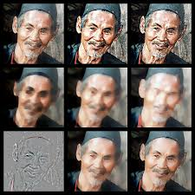
Image Filtering
Compute a function of the local neighborhood at each pixel in the image
  Function specified by a “filter” or mask saying how to combine values from neighbors
  Element-wise multiplication of filter and image patch
Uses of filtering:
  Enhance an image (denoise, resize, etc)
  Extract information (texture, edges, etc)
  Detect patterns (template matching)
Adapted from Derek Hoiem

Slide 20
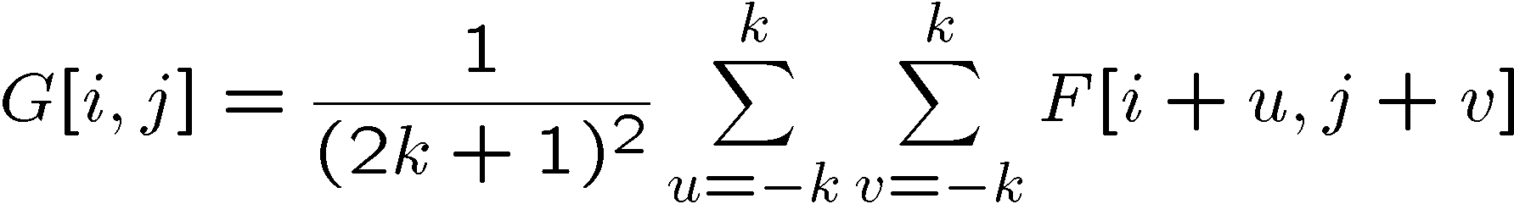
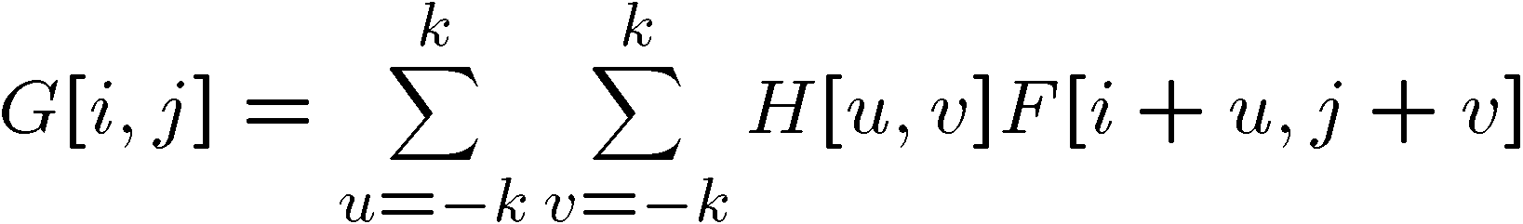
Correlation Filtering
Non-weighted, averaging window size is 2k+1 x 2k+1:
Attribute uniform weight to each pixel
Loop over all pixels in neighborhood around image pixel F[i,j]
Now generalize to allow different weights depending on neighboring pixel’s relative position:
Non-uniform weights
Kristen Grauman

Slide 21

Correlation Filtering
This is called cross-correlation, denoted
Filtering an image: replace each pixel with a linear combination of its neighbors.
The filter “kernel” or “mask” H[u,v] is the prescription for the weights in the linear combination.
Kristen Grauman

Slide 22


Averaging Filtering
What values belong in the kernel H for the moving average example?
0 | 0 | 0 | 0 | 0 | 0 | 0 | 0 | 0 | 0
0 | 0 | 0 | 0 | 0 | 0 | 0 | 0 | 0 | 0
0 | 0 | 0 | 90 | 90 | 90 | 90 | 90 | 0 | 0
0 | 0 | 0 | 90 | 90 | 90 | 90 | 90 | 0 | 0
0 | 0 | 0 | 90 | 90 | 90 | 90 | 90 | 0 | 0
0 | 0 | 0 | 90 | 0 | 90 | 90 | 90 | 0 | 0
0 | 0 | 0 | 90 | 90 | 90 | 90 | 90 | 0 | 0
0 | 0 | 0 | 0 | 0 | 0 | 0 | 0 | 0 | 0
0 | 0 | 90 | 0 | 0 | 0 | 0 | 0 | 0 | 0
0 | 0 | 0 | 0 | 0 | 0 | 0 | 0 | 0 | 0
 | 0 | 10 | 20 | 30 | 30
1
1
1
1
?
1
1
1
1
1
“box filter”
Kristen Grauman

Slide 23
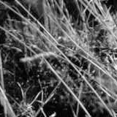
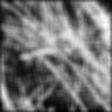
Smoothing by averaging
depicts box filter:
white = high value, black = low value
original
filtered
What if the filter size was 5 x 5 instead of 3 x 3?
Kristen Grauman

Slide 24
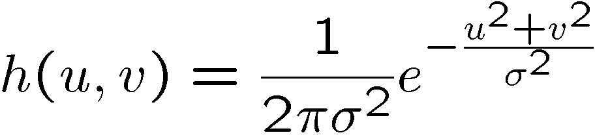
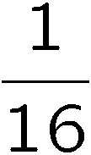
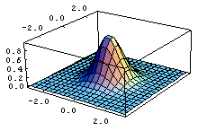
Gaussian Filter
What if we want nearest neighboring pixels to have the most influence on the output?
Removes high-frequency components from the image (“low-pass filter”).
This kernel is an approximation of a 2d Gaussian function:
0 | 0 | 0 | 0 | 0 | 0 | 0 | 0 | 0 | 0
0 | 0 | 0 | 0 | 0 | 0 | 0 | 0 | 0 | 0
0 | 0 | 0 | 90 | 90 | 90 | 90 | 90 | 0 | 0
0 | 0 | 0 | 90 | 90 | 90 | 90 | 90 | 0 | 0
0 | 0 | 0 | 90 | 90 | 90 | 90 | 90 | 0 | 0
0 | 0 | 0 | 90 | 0 | 90 | 90 | 90 | 0 | 0
0 | 0 | 0 | 90 | 90 | 90 | 90 | 90 | 0 | 0
0 | 0 | 0 | 0 | 0 | 0 | 0 | 0 | 0 | 0
0 | 0 | 90 | 0 | 0 | 0 | 0 | 0 | 0 | 0
0 | 0 | 0 | 0 | 0 | 0 | 0 | 0 | 0 | 0
1 | 2 | 1
2 | 4 | 2
1 | 2 | 1
Source: S. Seitz

Slide 25

Smoothing with a Gaussian
Vs box filter
Kristen Grauman

Slide 26
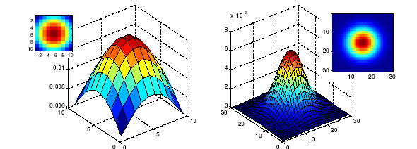
Gaussian Filters
What parameters matter here?
Size of kernel or mask
  Note, Gaussian function has infinite support, but discrete filters use finite kernels
σ = 5 with 10 x 10 kernel
σ = 5 with 30 x 30 kernel
Kristen Grauman

Slide 27
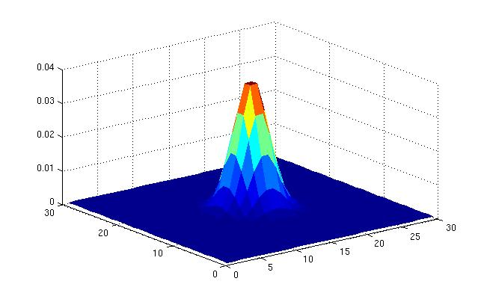
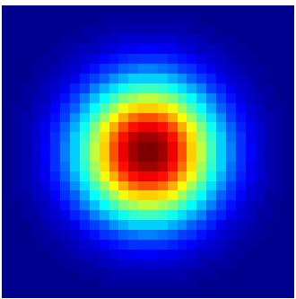
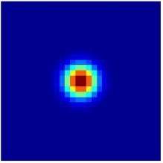
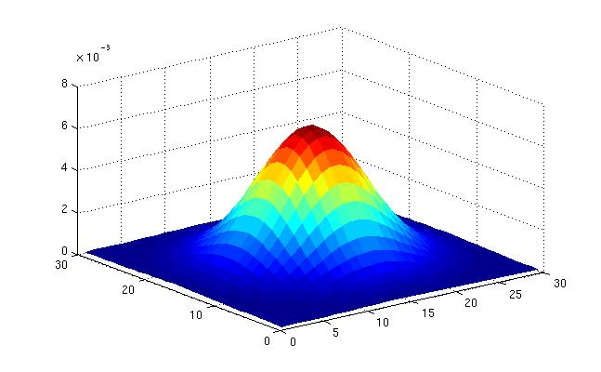
Gaussian Filters
What parameters matter here?
Variance of Gaussian: determines extent of smoothing
σ = 2 with 30 x 30 kernel
σ = 5 with 30 x 30 kernel
Kristen Grauman

Slide 28

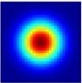
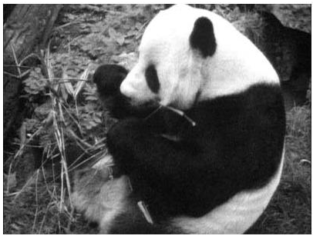
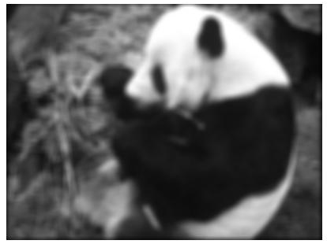
Gaussian Filters in Python
>> hsize = 10;
>> sigma = 5;
>> filter = fspecial_gauss(hsize, sigma)
>> plt.matshow(filter)
>> filt_im = ndimage.convolve(im, filter, mode='constant’)# correlation
>> cv2.imshow(outim);
[Github: Lab 2]
Kristen Grauman
outim
Notes:
In matlab, conv2 does convolution, filter2 does correlation. Imfilter does either if specified, correlation by default (‘conv’, ‘corr’ option)

Slide 29
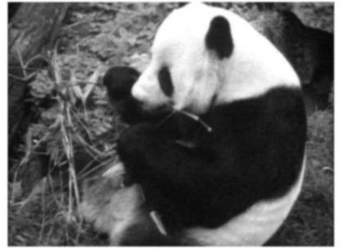
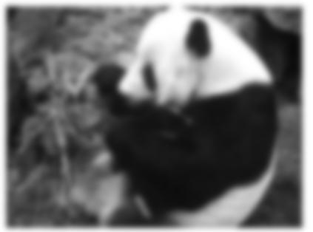
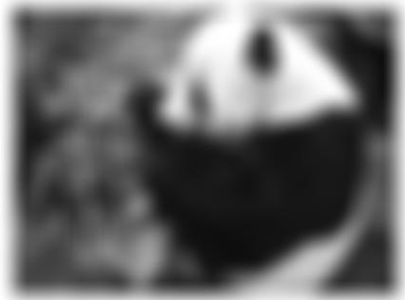
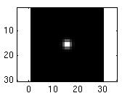
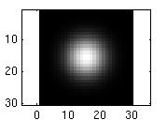
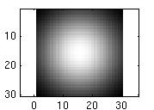
Smoothing with a Gaussian
Parameter σ is the “scale” / “width” / “spread” of the Gaussian kernel and controls the amount of smoothing.
…
for sigma=1:3:10
h = fspecial_gaus(hsize, sigma);
out = ndimage.convolve(im, h);
cv2.imshow(out);
end
Kristen Grauman

Slide 30
Gaussian Filters
How big should the filter be?
Values at edges should be near zero
Rule of thumb for Gaussian: set filter half-width (hsize) to 3 σ
Source: Derek Hoiem

Slide 31
Properties of smoothing filters
Smoothing
  Values positive
  Sum to 1 → overall intensity same as input
  Amount of smoothing proportional to mask size
  Remove “high-frequency” components; “low-pass” filter
Kristen Grauman

Slide 32
Lab 2: Filters
Duration: 10 min

Slide 33


Slide 34
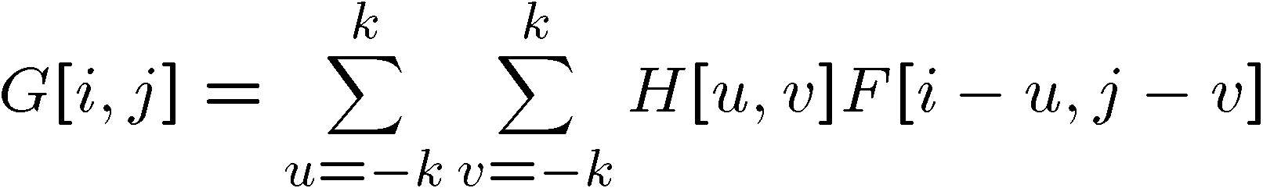
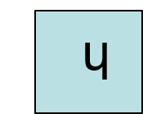

Convolution
Convolution:
  Flip the filter in both dimensions (bottom to top, right to left)
  Then apply cross-correlation
h
F
Notation for convolution operator
Kristen Grauman

Slide 35
Convolution vs correlation
Convolution
Cross-correlation
For a Gaussian or box filter, how will the outputs differ?
Kristen Grauman

Slide 36
Convolution vs correlation
Cross-correlation
F
5 | 2 | 5 | 4 | 4
5 | 200 | 3 | 200 | 4
1 | 5 | 5 | 4 | 4
5 | 5 | 1 | 1 | 2
200 | 1 | 3 | 5 | 200
1 | 200 | 200 | 200 | 1
(i, j)
u = -1,
v = -1
Convolution
H
.06 | .12 | .06
.12 | .25 | .12
.06 | .12 | .06
(0, 0)
Adriana Kovashka

Slide 37
Convolution vs correlation
Cross-correlation
F
5 | 2 | 5 | 4 | 4
5 | 200 | 3 | 200 | 4
1 | 5 | 5 | 4 | 4
5 | 5 | 1 | 1 | 2
200 | 1 | 3 | 5 | 200
1 | 200 | 200 | 200 | 1
(i, j)
u = -1,
v = -1
v = 0
Convolution
H
.06 | .12 | .06
.12 | .25 | .12
.06 | .12 | .06
(0, 0)
Adriana Kovashka

Slide 38
Convolution vs correlation
Cross-correlation
F
5 | 2 | 5 | 4 | 4
5 | 200 | 3 | 200 | 4
1 | 5 | 5 | 4 | 4
5 | 5 | 1 | 1 | 2
200 | 1 | 3 | 5 | 200
1 | 200 | 200 | 200 | 1
(i, j)
u = -1,
v = -1
v = 0
v = +1
Convolution
H
.06 | .12 | .06
.12 | .25 | .12
.06 | .12 | .06
(0, 0)
Adriana Kovashka

Slide 39
Convolution vs correlation
Cross-correlation
F
5 | 2 | 5 | 4 | 4
5 | 200 | 3 | 200 | 4
1 | 5 | 5 | 4 | 4
5 | 5 | 1 | 1 | 2
200 | 1 | 3 | 5 | 200
1 | 200 | 200 | 200 | 1
(i, j)
u = -1,
v = -1
v = 0
v = +1
u = 0,
v = -1
Convolution
H
.06 | .12 | .06
.12 | .25 | .12
.06 | .12 | .06
(0, 0)
Adriana Kovashka

Slide 40
Convolution vs correlation
Cross-correlation
F
5 | 2 | 5 | 4 | 4
5 | 200 | 3 | 200 | 4
1 | 5 | 5 | 4 | 4
5 | 5 | 1 | 1 | 2
200 | 1 | 3 | 5 | 200
1 | 200 | 200 | 200 | 1
(i, j)
u = -1,
v = -1
Convolution
H
.06 | .12 | .06
.12 | .25 | .12
.06 | .12 | .06
(0, 0)
Adriana Kovashka

Slide 41
Convolution vs correlation
Cross-correlation
F
5 | 2 | 5 | 4 | 4
5 | 200 | 3 | 200 | 4
1 | 5 | 5 | 4 | 4
5 | 5 | 1 | 1 | 2
200 | 1 | 3 | 5 | 200
1 | 200 | 200 | 200 | 1
(i, j)
u = -1,
v = -1
v = 0
Convolution
H
.06 | .12 | .06
.12 | .25 | .12
.06 | .12 | .06
(0, 0)
Adriana Kovashka

Slide 42
Convolution vs correlation
Cross-correlation
F
5 | 2 | 5 | 4 | 4
5 | 200 | 3 | 200 | 4
1 | 5 | 5 | 4 | 4
5 | 5 | 1 | 1 | 2
200 | 1 | 3 | 5 | 200
1 | 200 | 200 | 200 | 1
(i, j)
u = -1,
v = -1
v = 0
v = +1
Convolution
H
.06 | .12 | .06
.12 | .25 | .12
.06 | .12 | .06
(0, 0)
Adriana Kovashka

Slide 43
Convolution vs correlation
Cross-correlation
F
5 | 2 | 5 | 4 | 4
5 | 200 | 3 | 200 | 4
1 | 5 | 5 | 4 | 4
5 | 5 | 1 | 1 | 2
200 | 1 | 3 | 5 | 200
1 | 200 | 200 | 200 | 1
(i, j)
u = -1,
v = -1
v = 0
v = +1
u = 0,
v = -1
Convolution
H
.06 | .12 | .06
.12 | .25 | .12
.06 | .12 | .06
(0, 0)
Adriana Kovashka

Slide 44
Properties of Convolution
Commutative:
  f * g = g * f
Associative:
  (f * g) * h = f * (g * h)
Distributes over addition:
f * (g + h) = (f * g) + (f * h)
Scalars factor out:
kf * g = f * kg = k(f * g)
Identity:
  unit impulse e = […, 0, 0, 1, 0, 0, …]. f * e = f
Kristen Grauman

Slide 45
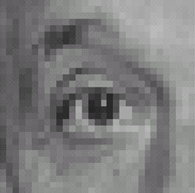
Predict the outputs using correlation filtering
0
0
0
0
0
0
*
= ?
*
= ?
0
1
0
0
0
1
0
0
0
0
0
0
0
0
0
-
1
1
1
*
= ?
0
2
0
1
1
1
0
0
0
1
1
1
Kristen Grauman

Slide 46
Practice with linear filters
0
0
0
?
0
1
0
0
0
0
Original
Source: D. Lowe

Slide 47
Practice with linear filters
0
0
0
0
1
0
0
0
0
Original
Filtered
(no change)
Source: D. Lowe

Slide 48
Practice with linear filters
0
0
0
?
0
0
1
0
0
0
Original
Source: D. Lowe

Slide 49
Practice with linear filters
0
0
0
0
0
1
0
0
0
Original
Shifted left
by 1 pixel with correlation
Source: D. Lowe

Slide 50
Practice with linear filters
1
1
1
?
1
1
1
1
1
1
Original
Source: D. Lowe

Slide 51
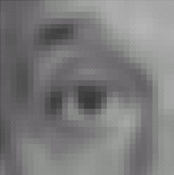
Practice with linear filters
1
1
1
1
1
1
1
1
1
Original
Blur (with a
box filter)
Source: D. Lowe

Slide 52
Practice with linear filters
0
0
0
-
1
1
1
?
0
2
0
1
1
1
0
0
0
1
1
1
Original
Source: D. Lowe

Slide 53
Practice with linear filters
0
0
0
-
1
1
1
0
2
0
1
1
1
=
0
0
0
1
1
1
0
0
0
-
1
1
1
0
0
0
+ ( )
0
1
0
0
1
0
1
1
1
0
0
0
0
0
0
1
1
1
Original image
Image minus blur = details
Adriana Kovashka

Slide 54
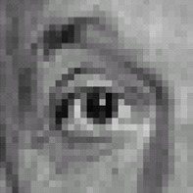
Practice with linear filters
0
0
0
-
1
1
1
0
2
0
1
1
1
0
0
0
1
1
1
Original
Sharpening filter:
  accentuates differences with local average
Source: D. Lowe

Slide 55
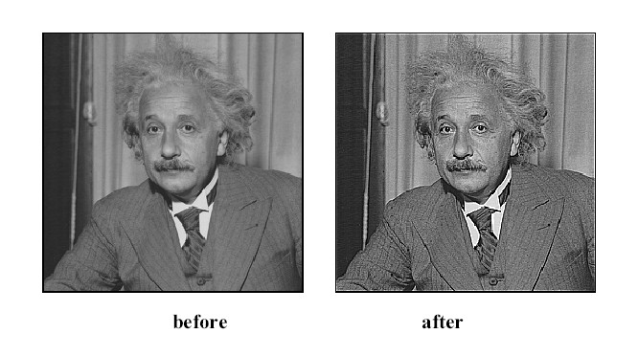
Sharpening
Kristen Grauman

Slide 56
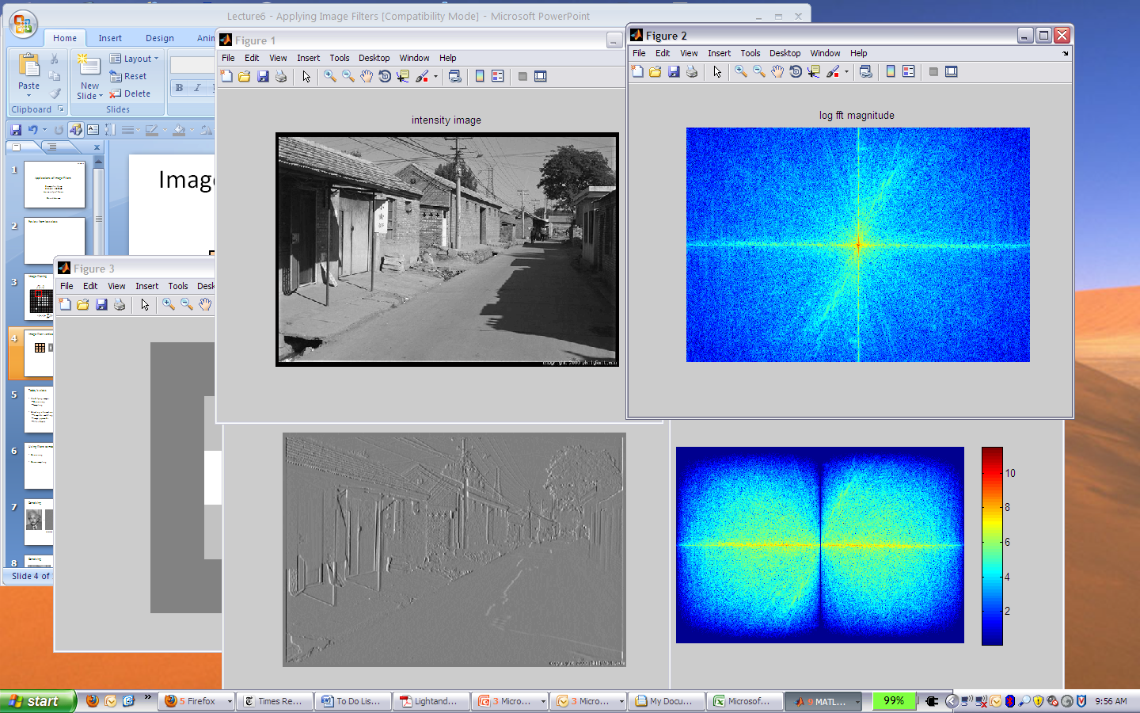
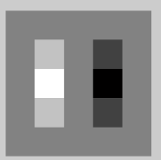
Filters for computing gradients
1
0
-1
2
0
-2
1
0
-1
*
=
Adapted from Derek Hoiem

Slide 57
Filters for computing gradients
+1*a + 0*b + (-1)*c = a - c
 |  |  |  |  |  |  |  |  |  |  | a | b | c
Input image
White = 1, black = 0
Filter: [+1 0 -1]
Output image

Slide 58
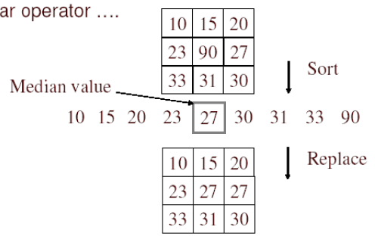
Median Filter
No new pixel values introduced
Removes spikes: good for impulse, salt & pepper noise
Non-linear filter
Kristen Grauman

Slide 59
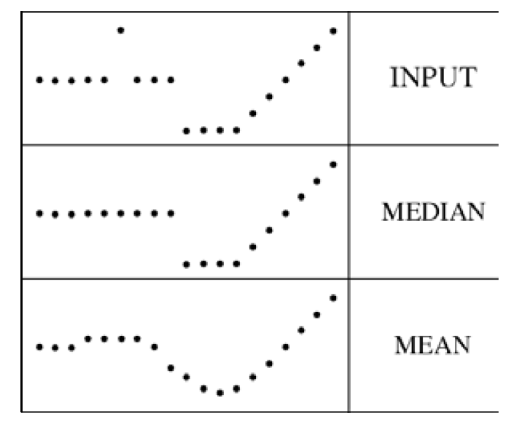
Median Filter
Median filter is edge preserving
Adapted from Kristen Grauman

Slide 60
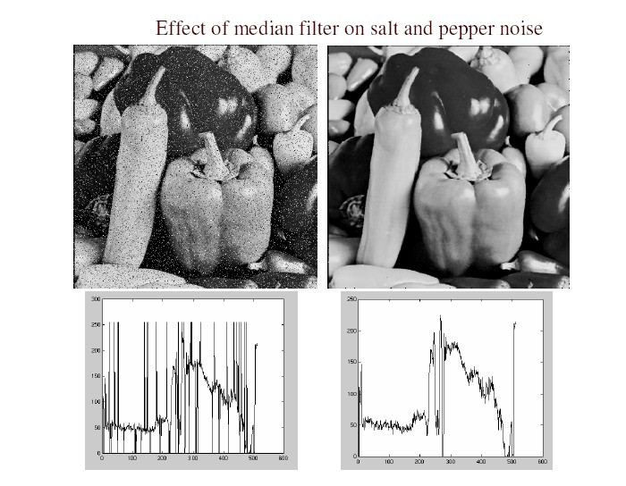
Median Filter
Salt and pepper noise
Median filtered
Plots of a row of the image
https://docs.scipy.org/doc/scipy/reference/generated/scipy.ndimage.median_filter.html#scipy.ndimage.median_filter
Source: M. Hebert

Slide 61
Boundary Issues
f = image
h = filter
What is the size of the output?
  ‘full’: output size is larger than the size of f
  ‘same’: output size is same as f (Default for Python)
 | 0 | 10 | 20 | 30 | 30 | 30 | 20 | 10
 | 0 | 20 | 40 | 60 | 60 | 60 | 40 | 20
 | 0 | 30 | 60 | 90 | 90 | 90 | 60 | 30
 | 0 | 30 | 50 | 80 | 80 | 90 | 60 | 30
 | 0 | 30 | 50 | 80 | 80 | 90 | 60 | 30
 | 0 | 20 | 30 | 50 | 50 | 60 | 40 | 20
 | 10 | 20 | 30 | 30 | 30 | 30 | 20 | 10
 | 10 | 10 | 10 | 0 | 0 | 0 | 0 | 0
full
same
h
h
h
h
f
f
h
h
h
h
Adapted from S. Lazebnik

Slide 62
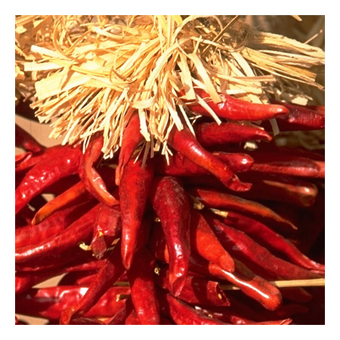
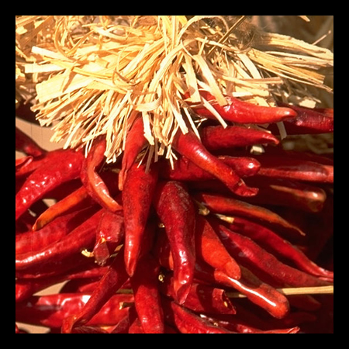

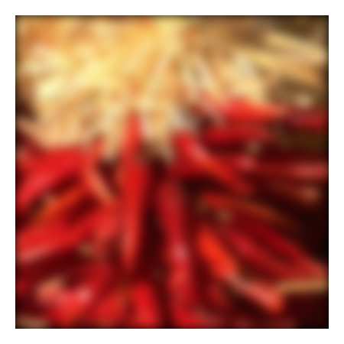









Boundary Issues
What about near the edge?
  the filter window might fall off the edge of the image (in ‘same’ or ‘full’)
  need to extrapolate
  methods:
    clip filter (black)
    wrap around
    copy edge
    reflect across edge
Source: S. Marschner

Slide 63
Separability
In some cases, filter is separable, and we can factor into two steps:
  Convolve all rows
  Convolve all columns
Kristen Grauman

Slide 64



Separability Example
2D filtering
(center location only)
filter
The filter factors
into an outer product
of 1D filters:
Perform filtering
along rows (horizontal pass):
*
=
Followed by filtering
along the remaining column (vertical pass):
*
=
Asymptotic cost for 2D vs 1D filtering? Let image be M x N, filter be k x k
Kristen Grauman
Notes:
No matrix multiplication

Slide 65



Separability Example
Convolution Cost Without Separability [Assume same size output]
Suppose you have a 2D image of size $M×N$and a $k×k$filter:
Naïve 2D convolution:
Each output pixel requires $k^{2}$multiplications and additions. So total cost:
Convolution Cost With Separability [Assume same size output]
A filter is separable if it can be expressed as the outer product of two 1D filters:
$$H=f⋅g^{T}$$
so instead of convolving with a full $k×k$kernel, you can convolve:
First with a $1×k$filter (horizontal pass).
Then with a $k×1$filter (vertical pass).
Cost per output pixel:
First pass: $k$ operations
Second pass: another $k$ operations
Total: $2k$ operations. So. Total cost is:
$$O\left(M⋅N⋅k^{2}\right)$$
$$O\left(M⋅N⋅2k\right)$$
Source: ChatGPT

Slide 66

Application: Hybrid Images
Kristen Grauman
Aude Oliva & Antonio Torralba & Philippe G Schyns, SIGGRAPH 2006
Notes:
\

Slide 67

Application: Hybrid Images
Kristen Grauman
Aude Oliva & Antonio Torralba & Philippe G Schyns, SIGGRAPH 2006
Notes:
\

Slide 68




Application: Hybrid Images
A. Oliva, A. Torralba, P.G. Schyns,
“Hybrid Images,” SIGGRAPH 2006
Gaussian Filter
Laplacian Filter
(sharpening)
Kristen Grauman
unit impulse
Gaussian
Laplacian of Gaussian

Slide 69

Application: Hybrid Images
Kristen Grauman
Aude Oliva & Antonio Torralba & Philippe G Schyns, SIGGRAPH 2006

Slide 70

Application: Hybrid Images
Kristen Grauman
Aude Oliva & Antonio Torralba & Philippe G Schyns, SIGGRAPH 2006

Slide 71
Plan for next lectures
Filters: math and properties
Types of filters
  Linear
    Smoothing
    Other
  Non-linear
    Median
Applications
  Texture representation with filters
  Anti-aliasing for image subsampling

Slide 72

Texture
Due to:
Patterns, marks, etches, blobs, holes, relief, etc.
Kristen Grauman

Slide 73



Regular (top), random (bottom) patterns
Kristen Grauman

Slide 74
Why analyze texture?
Important for how we perceive objects
Can be an important appearance cue that allows us to distinguish objects, especially if shape is similar across objects
Adapted from Kristen Grauman

Slide 75




Same shape, different texture/object
Kristen Grauman
http://animals.nationalgeographic.com/

Slide 76





Same object, different texture
Kristen Grauman

Slide 77

Texture Representation
Textures are made up of repeated local patterns, so:
  Find the patterns
    Use filters that look like patterns (spots, bars, raw patches…)
    Consider magnitude of response
  Describe their statistics within each local window
    E.g. mean, standard deviation, histogram
Kristen Grauman

Slide 78

Derivative of Gaussian filter
Figures from Noah Snavely

Slide 79


Texture representation: Example
 | mean d/dx value | mean d/dy value
Win. #1 | 4 | 10
original image
…
statistics to summarize patterns in small windows
Kristen Grauman
derivative filter responses, squared

Slide 80
Texture representation: Example
 | mean d/dx value | mean d/dy value
Win. #1 | 4 | 10
Win.#2 | 18 | 7
original image
…
statistics to summarize patterns in small windows
derivative filter responses, squared
Kristen Grauman

Slide 81
Texture representation: Example
 | mean d/dx value | mean d/dy value
Win. #1 | 4 | 10
Win.#2 | 18 | 7
Win.#9 | 20 | 20
original image
…
…
statistics to summarize patterns in small windows
Kristen Grauman
derivative filter responses, squared

Slide 82
Texture representation: Example
 | mean d/dx value | mean d/dy value
Win. #1 | 4 | 10
Win.#2 | 18 | 7
Win.#9 | 20 | 20
Dimension 2 (mean d/dy value)
Dimension 1 (mean d/dx value)
…
…
statistics to summarize patterns in small windows
Kristen Grauman

Slide 83
Texture representation: Example
Both
Windows with primarily horizontal edges
 | mean d/dx value | mean d/dy value
Win. #1 | 4 | 10
Win.#2 | 18 | 7
Win.#9 | 20 | 20
Dimension 2 (mean d/dy value)
Dimension 1 (mean d/dx value)
…
…
Windows with small gradient in both directions
Windows with primarily vertical edges
statistics to summarize patterns in small windows
Kristen Grauman

Slide 84

Texture representation: Example
original image
visualization of the assignment to texture “types”
derivative filter responses, squared
Kristen Grauman

Slide 85
Texture representation: Example
 | mean d/dx value | mean d/dy value
Win. #1 | 4 | 10
Win.#2 | 18 | 7
Win.#9 | 20 | 20
Dimension 2 (mean d/dy value)
Far: dissimilar textures
Close: similar textures
Dimension 1 (mean d/dx value)
…
…
statistics to summarize patterns in small windows
Kristen Grauman

Slide 86
Computing Distance using Texture
Dimension 2
Euclidean distance (L₂)
Dimension 1
Kristen Grauman
Notes:
86

Slide 87

Texture Representation: Example
Dimension 2
Dimension 1
Distance reveals how dissimilar texture from window a is from texture in window b.
Kristen Grauman
Notes:
87

Slide 88
Filter banks
Our previous example used two filters and resulted in a 2-dimensional feature vector to describe texture in a window.
  x and y derivatives revealed something about local structure.
We can generalize to apply a collection of multiple (d) filters: a “filter bank”.
Then our feature vectors will be d-dimensional.
Adapted from Kristen Grauman

Slide 89

Filter banks
orientations
scales
“Edges”
“Bars”
“Spots”
What filters to put in the bank?
  Typically we want a combination of scales and orientations, different types of patterns.
Which filters would you use to distinguish buildings from animals? Cheetahs from tigers? Ladybugs from dalmatians?
Adapted from Kristen Grauman, Matlab code: http://www.robots.ox.ac.uk/~vgg/research/texclass/filters.html

Slide 90

Filter bank
Kristen Grauman

Slide 91

Filter bank: Example
Image from http://www.texasexplorer.com/austincap2.jpg
Kristen Grauman

Slide 92


Filter bank: Example
Kristen Grauman

Slide 93


Filter bank: Example
Kristen Grauman
Notes:
2

Slide 94


Filter bank: Example
Kristen Grauman
Notes:
4

Slide 95


Filter bank: Example
Kristen Grauman
Notes:
16

Slide 96


Filter bank: Example
Kristen Grauman

Slide 97
Vectors of texture responses
38 filters
To represent pixel, form a “feature vector” from the responses at that pixel.
1x38 vector
representation
feature
[r1, r2, …, r38]
Response
Filter ID
Adapted from Kristen Grauman

Slide 98
Vectors of texture responses
To represent pixel, form a “feature vector” from the responses at that pixel.
To represent image, compute statistics over all pixel feature vectors, e.g. their mean.
[r_{(1,1)}¹, r_{(1,1)}², …, r_{(1,1)}³⁸]
[r_{(1,2)}¹, r_{(1,2)}², …, r_{(1,2)}³⁸]
Pixel location (row, column)
Filter ID
…
[r_{(W,H)}¹, r_{(W,H)}², …, r_{(W,H)}³⁸]
[mean(r_{(:)}¹), mean(r_{(:)}²), …, mean(r_{(:)}³⁸)]
Adriana Kovashka

Slide 99






You try: Can you match the texture to the response?
Filters
A
B
1
White color means higher response
2
C
3
Mean abs responses
Derek Hoiem

Slide 100

You try: Can you match the texture to the response?

Slide 101

Representing textures by mean absolute response
Filters
Mean abs responses
Derek Hoiem

Slide 102

Classifying materials, “stuff”
Figure by Varma & Zisserman
Kristen Grauman

Slide 103
Summary
Filters useful for
  Enhancing images (smoothing, removing noise), e.g.
    Box filter (linear)
    Gaussian filter (linear)
    Median filter
  Detecting patterns (e.g. gradients)
Texture is a useful property that is often indicative of materials, appearance cues
  Texture representations summarize repeating patterns of local structure

