Slide 1

CS 1674/2074: Local features: detection, description and matching
PhD. Nils Murrugarra-Llerena
nem177@pitt.edu

Slide 2

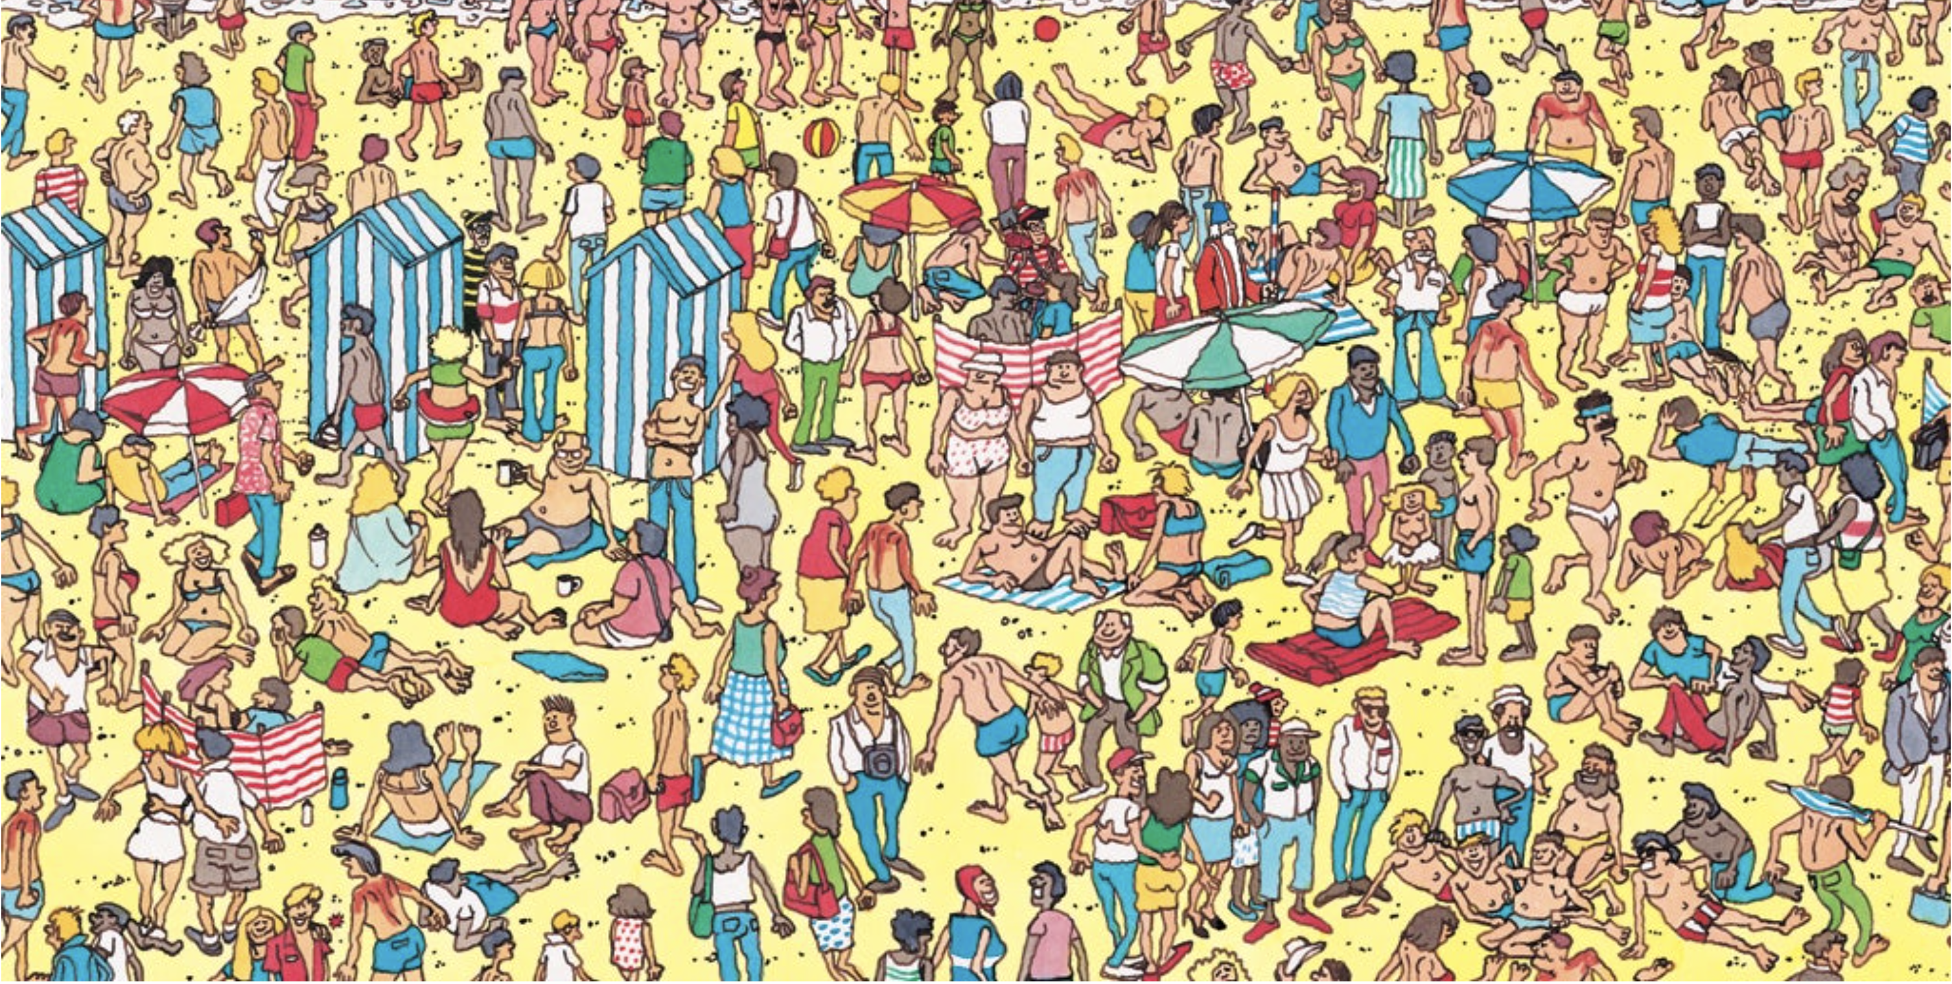
[Motivation] Local Features
The "Where's Waldo?" [Game]
The goal is to find Waldo in a crowded, complex scene.
How do you search for Waldo?
What are Waldo’s distinctive features?
Notes:
Source: Gemini
Play where is Waldo? - https://where-s-waldo-top.web.app/
A great way to understand local features is to think of the popular children's book series, "Where's Waldo?". The goal is to find Waldo in a crowded, complex scene. You don't try to find Waldo by looking for a picture of the entire scene—that would be impossible. Instead, you look for Waldo's distinctive local features: his striped red-and-white shirt, his beanie, and his glasses. Even if he's partially obscured or in a different pose, these key features help you pinpoint his location.

Slide 3
Plan for this lecture
Feature detection / keypoint extraction
  Corner detection
Feature description (of detected features)
Matching features across images

Slide 4
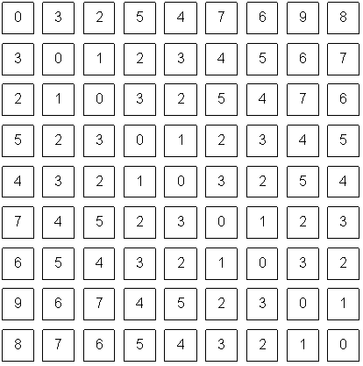
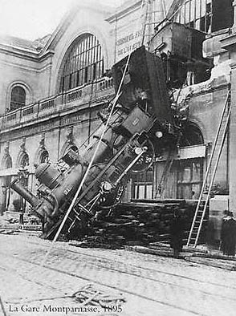

An image is a set of pixels
What we see
What a computer sees
Adapted from S. Narasimhan
Source: S. Narasimhan

Slide 5
Problems with pixel representation
Not invariant to small changes
  Translation
  Illumination
  etc.
Some parts of an image are more important than others
What do we want to represent?
Adriana Kovashka

Slide 6
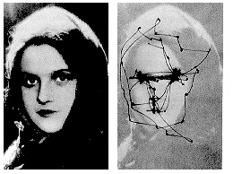
Human eye movements
Yarbus eye tracking
D. Hoiem
Notes:
Your eyes don’t see everything at once, but they jump around. You see only about 2 degrees with high resolution

Slide 7
Local features
Local means that they only cover a small part of the image
There will be many local features detected in an image; later we’ll use those to compute a representation of the whole image
Local features usually exploit image gradients, ignore color
Feature ~= vector of gradient statistics for a window with particular location and size
Adriana Kovashka

Slide 8
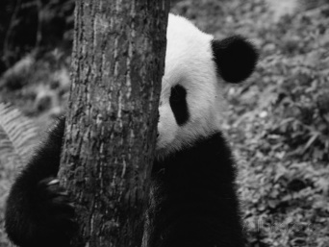

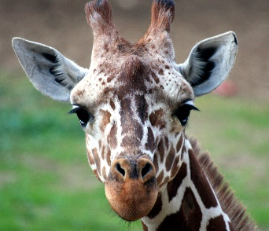
Local features: desired properties
Locality
  A feature occupies a relatively small area of the image; robust to clutter and occlusion
Repeatability and flexibility
  Robustness to expected variations: the same feature can be found in several images despite geometric/photometric transformations
  Maximize correct matches (panda to panda)
Distinctiveness
  Each feature has a distinctive description
  Minimize wrong matches (panda to giraffe)
Compactness and efficiency
  Many fewer features than image pixels
Adapted from K. Grauman and D. Hoiem

Slide 9
Interest(ing) points
Note: “interest points” = “keypoints”, also sometimes called “features”
Many applications
  Recognition: which patches are likely to tell us something about the object category?
  Image search: which points would allow us to match images between query and database?
  3D reconstruction: how to find correspondences across different views?
  Tracking: which points are good to track?
Adapted from D. Hoiem

Slide 10
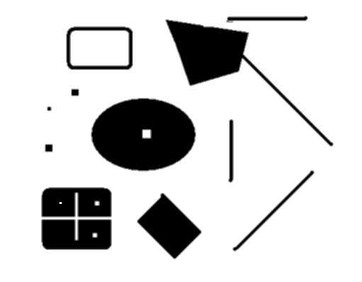
Interest points
original
Suppose you have to click on some point, go away and come back after I deform the image, and click on the same points again.
  Which points would you choose?
deformed
D. Hoiem

Slide 11
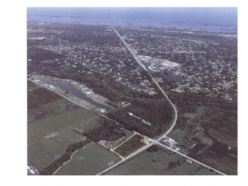
Choosing interest points
Where would you tell your friend to meet you?
→ Corner detection
D. Hoiem
Notes:
Corners!

Slide 12
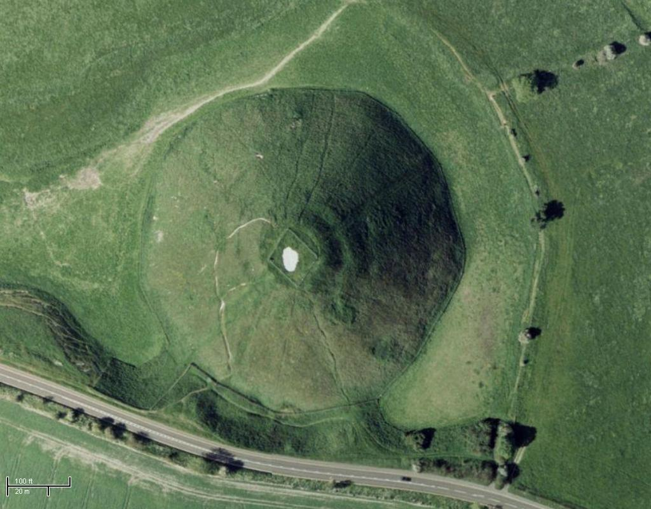
Choosing interest points
Where would you tell your friend to meet you?
→ Blob detection
D. Hoiem
Notes:
Blobs!

Slide 13
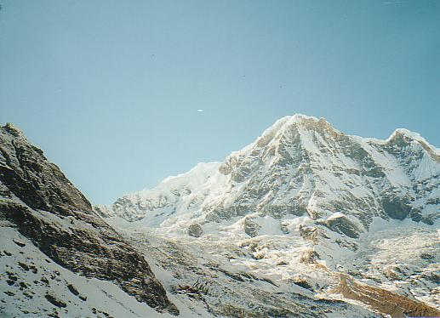
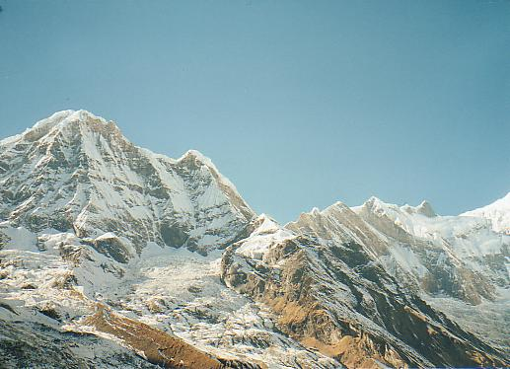
Application: Panorama stitching
We have two images – how do we combine them?
L. Lazebnik

Slide 14
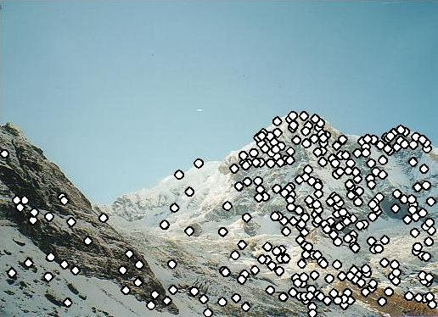
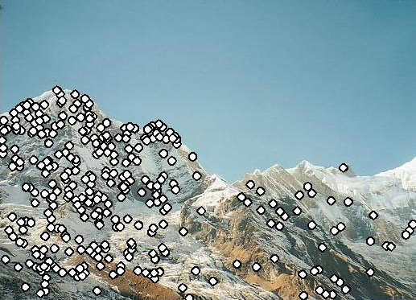
Application: Panorama stitching
We have two images – how do we combine them?
Step 1: extract features
Step 2: match features
L. Lazebnik

Slide 15
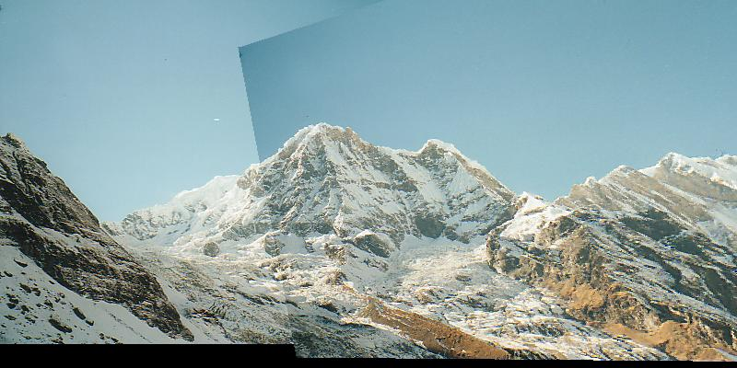
Application: Panorama stitching
We have two images – how do we combine them?
Step 1: extract features
Step 2: match features
Step 3: align images
L. Lazebnik

Slide 16

Corners are distinctive interest points
We should easily recognize the keypoint by looking through a small window
Shifting a window in any direction should give a large change in intensity
Candidate keypoint
“flat” region:
no change in all directions
“edge”:
no change along the edge direction
“corner”:
significant change in all directions
Adapted from A. Efros, D. Frolova, D. Simakov

Slide 17
Corners are distinctive interest points
We should easily recognize the keypoint by looking through a small window
Shifting a window in any direction should give a large change in intensity
“flat” region:
no change in all directions
“edge”:
no change along the edge direction
“corner”:
significant change in all directions
Adapted from A. Efros, D. Frolova, D. Simakov

Slide 18
Corners are distinctive interest points
We should easily recognize the keypoint by looking through a small window
Shifting a window in any direction should give a large change in intensity
“flat” region:
no change in all directions
“edge”:
no change along the edge direction
“corner”:
significant change in all directions
Adapted from A. Efros, D. Frolova, D. Simakov

Slide 19
Corners are distinctive interest points
We should easily recognize the keypoint by looking through a small window
Shifting a window in any direction should give a large change in intensity
“flat” region:
no change in all directions
“edge”:
no change along the edge direction
“corner”:
significant change in all directions
Adapted from A. Efros, D. Frolova, D. Simakov

Slide 20
Corners are distinctive interest points
We should easily recognize the keypoint by looking through a small window
Shifting a window in any direction should give a large change in intensity
“flat” region:
no change in all directions
“edge”:
no change along the edge direction
“corner”:
significant change in all directions
Adapted from A. Efros, D. Frolova, D. Simakov

Slide 21
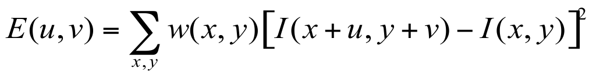
Harris Detector: Mathematics
Window-averaged squared change of intensity induced by shifting the patch for a fixed candidate keypoint by [u,v]:
Shifted intensity
Intensity
Adapted from D. Frolova, D. Simakov

Slide 22
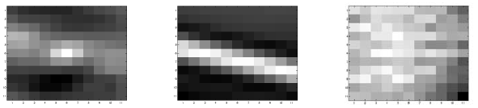
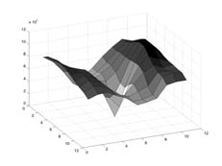
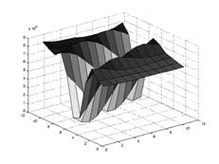
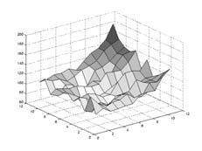
Harris Detector: Mathematics
Window-averaged squared change of intensity induced by shifting the patch for a fixed candidate keypoint by [u,v]:
Shifted intensity
Intensity
large
large
small
E(u, v)
0
0
0
v
0
v
0
v
0
u
u
u
Adapted from D. Frolova, D. Simakov

Slide 23
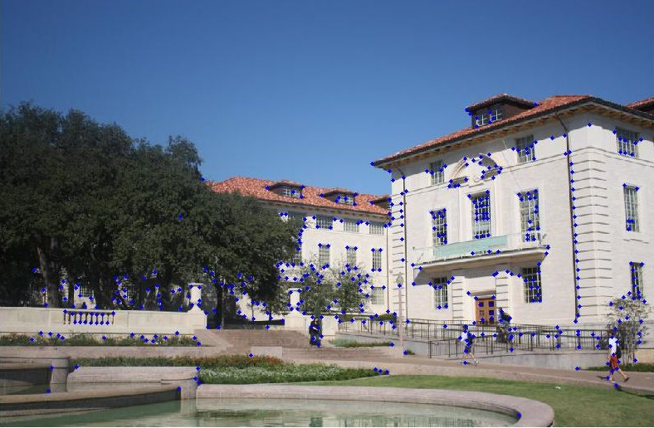
Example of Harris Application
K. Grauman
Notes:
24 min

Slide 24
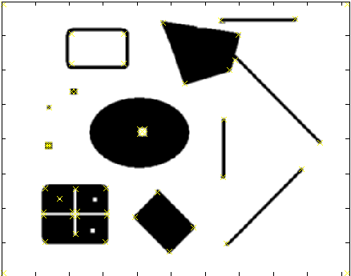
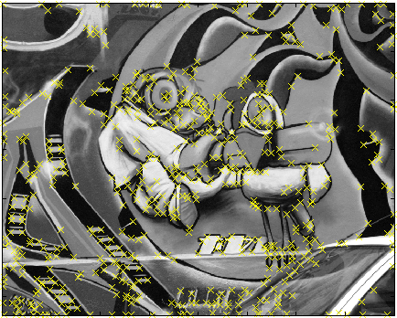
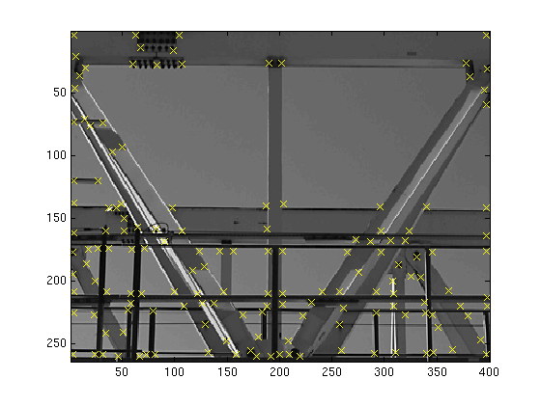
More Harris Responses
Effect: A very precise corner detector.
D. Hoiem

Slide 25
Plan for this lecture
Feature detection / keypoint extraction
  Corner detection
Feature description (of detected features)
Matching features across images

Slide 26
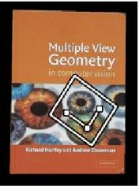



Geometric transformations
e.g. scale, translation, rotation
K. Grauman

Slide 27
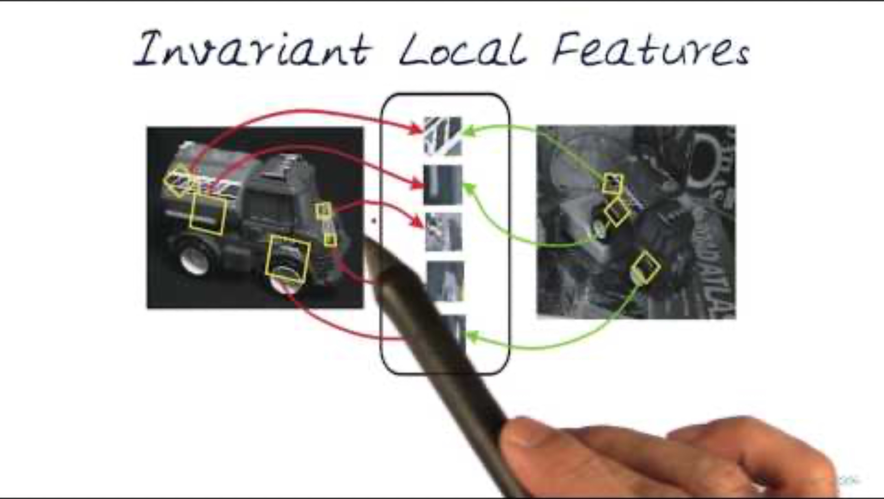
Short Video SIFT Descriptor
https://www.youtube.com/watch?v=oKAnOzIu66c&ab_channel=Udacity
Notes:
https://www.youtube.com/watch?v=oKAnOzIu66c&ab_channel=Udacity

Slide 28
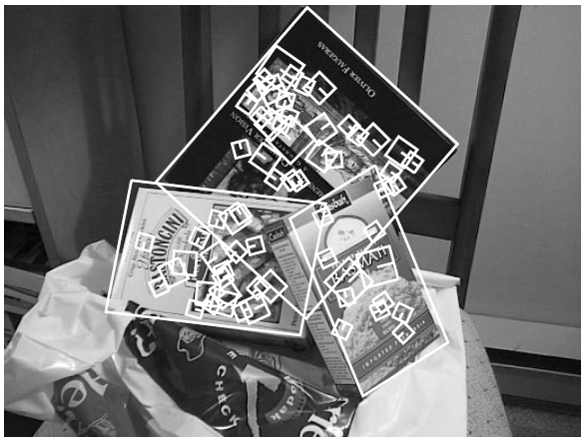
Scale-Invariant Feature Transform (SIFT) descriptor
Journal + conference versions: 87,527 citations (AlexNet paper has 93,821)
Histogram of oriented gradients
Captures important texture
information
Robust to small translations /
affine deformations
[Lowe, ICCV 1999]
K. Grauman, B. Leibe
Notes:
https://www.youtube.com/watch?v=4AvTMVD9ig0&ab_channel=CyrillStachniss

Slide 29

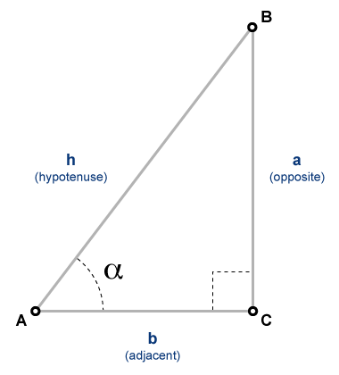

Computing gradients
L = the image intensity
gradient in x direction
gradient in y direction
Vertical Edges
Horizontal Edges
gradient in y direction
gradient in x direction
tan(α)= $\frac{opposite side}{adjacent side}$
Adriana Kovashka

Slide 30
Gradients
y
m(x, y) = sqrt(1 + 0) = 1
Θ(x, y) = atan(0/-1) = 0
0: Black
1: White
(0, 0)
x
Adriana Kovashka
Notes:
0: black
255: white (1)

Slide 31
Gradients
y
m(x, y) = sqrt(0 + 1) = 1
Θ(x, y) = atan(1/0) = 90
0: Black
1: White
Adriana Kovashka
(0, 0)
x

Slide 32
Gradients
y
(note length / magnitude)
m(x, y) = sqrt(1 + 1) = 1.41
Θ(x, y) = atan(-1/-1) = 45
0: Black
1: White
Adriana Kovashka
(0, 0)
x
Notes:
0: black
255: white (1)

Slide 33
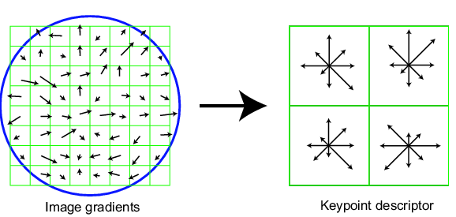
Scale Invariant Feature Transform
Basic idea:
  Take 16x16 square window around detected feature
  Compute gradient orientation for each pixel
  Create histogram over edge orientations weighted by magnitude
  That’s your feature descriptor!
0
2π
angle histogram
Adapted from L. Zitnick, D. Lowe

Slide 34
Scale Invariant Feature Transform
Full version
  Divide the 16x16 window into a 4x4 grid of cells (2x2 case shown below)
  Quantize the gradient orientations i.e. snap each gradient to one of 8 angles
  Each gradient contributes not just 1, but magnitude(gradient) to the histogram, i.e. stronger gradients contribute more
  16 cells * 8 orientations = 128 dimensional descriptor for each detected feature
Adapted from L. Zitnick, D. Lowe

Slide 35
Scale Invariant Feature Transform
1
3
1
Uniform weight (ignore magnitude)
2
3
2
4
2
4
Count
2
3
2
2
Type =
1
2
3
4
Gradients
Histogram of gradients
Adriana Kovashka

Slide 36
Scale Invariant Feature Transform
1
3
1
Weight contribution by magnitude
(e.g. long = 1, short = 0.5)
2
3
2
4
2
4
Count
2
2.5
1.5
1
Type =
1
2
3
4
Gradients
Histogram of gradients
Adriana Kovashka

Slide 37
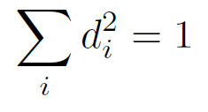

Scale Invariant Feature Transform
Full version
  Divide the 16x16 window into a 4x4 grid of cells (2x2 case shown below)
  Quantize the gradient orientations i.e. snap each gradient to one of 8 angles
  Each gradient contributes not just 1, but magnitude(gradient) to the histogram, i.e. stronger gradients contribute more
  16 cells * 8 orientations = 128 dimensional descriptor for each detected feature
  Normalize + clip (threshold normalize to 0.2) + normalize the descriptor
  We want:
such that:
0.2
Adapted from L. Zitnick, D. Lowe

Slide 38
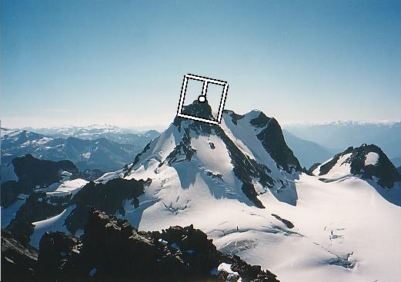
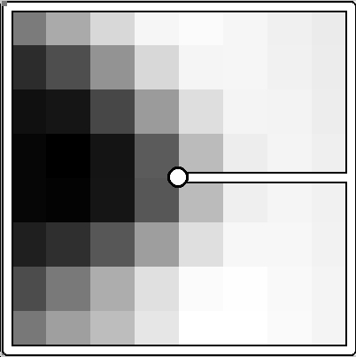
Making descriptor rotation invariant
Rotate patch according to its dominant gradient orientation
This puts the patches into a canonical orientation
Adapted from K. Grauman, image from Matthew Brown

Slide 39
SIFT is robust
Can handle changes in viewpoint
  Up to about 60 degree out of plane rotation
Can handle significant changes in illumination
  Sometimes even day vs. night
Fast and efficient—can run in real time
Can be made to work without feature detection, resulting in “dense SIFT” (more points means robustness to occlusion)
One commonly used implementation
  http://www.vlfeat.org/overview/sift.html
Adapted from S. Seitz

Slide 40
Examples of using SIFT
Adriana Kovashka

Slide 41
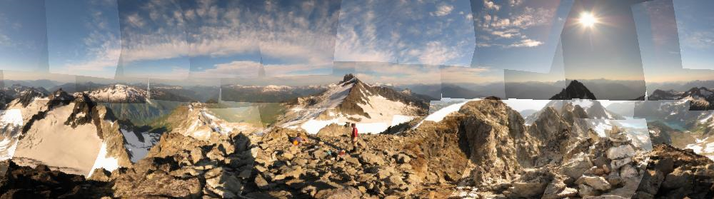
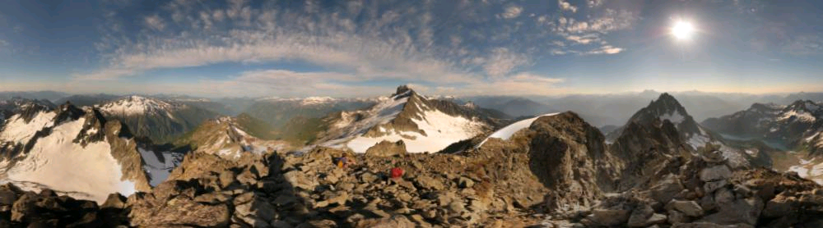
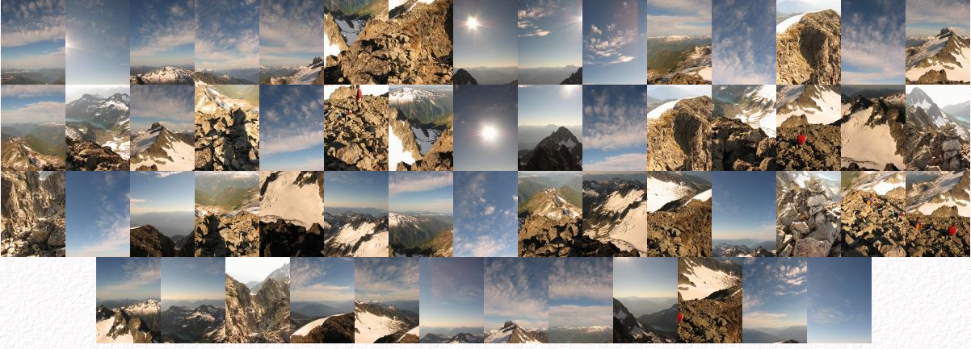
Applications of local invariant features
Object recognition
Indexing and retrieval
Robot navigation
3D reconstruction
Motion tracking
Image alignment
Panoramas and mosaics
…
http://www.cs.ubc.ca/~mbrown/autostitch/autostitch.html
Adapted from K. Grauman and L. Lazebnik

Slide 42

Lab 3: SIFT
Duration: 10 min

Slide 43
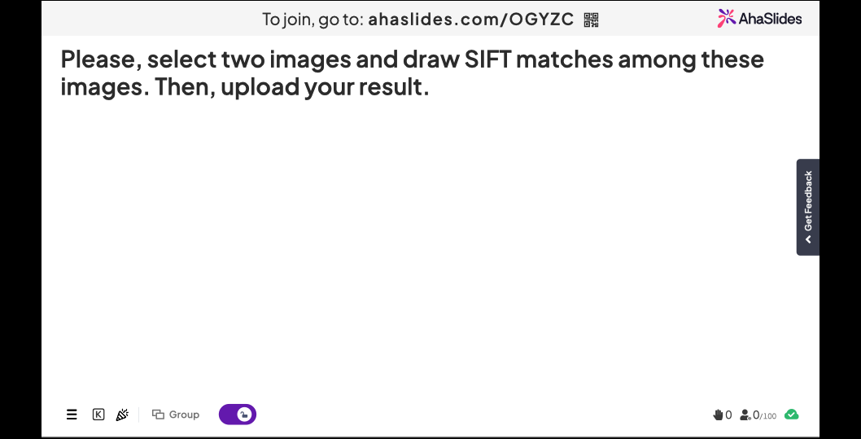

Slide 44
Plan for this lecture
Feature detection / keypoint extraction
  Corner detection
  Blob detection
Feature description (of detected features)
Matching features across images

Slide 45
Matching Local Features Setup
Each patch / region has a descriptor, which is a point in some high-dimensional feature space (e.g., SIFT)
Descriptor’s feature space
Database images
K. Grauman
Notes:
45

Slide 46
Matching Local Features Setup
When we see close points in feature space, we have similar descriptors, which indicates similar local content
Query image
Descriptor’s feature space
Database images
K. Grauman

Slide 47
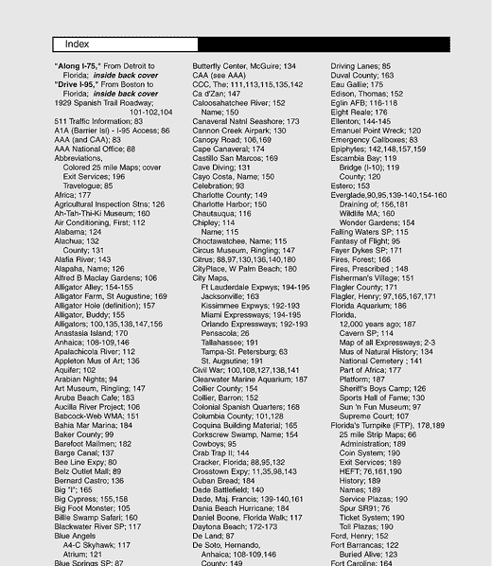
Indexing local features
For text documents, an efficient way to find all pages on which a word occurs is to use an index…
We want to find all images in which a feature occurs.
To use this idea, we’ll need to map our features to “visual words”.
K. Grauman

Slide 48
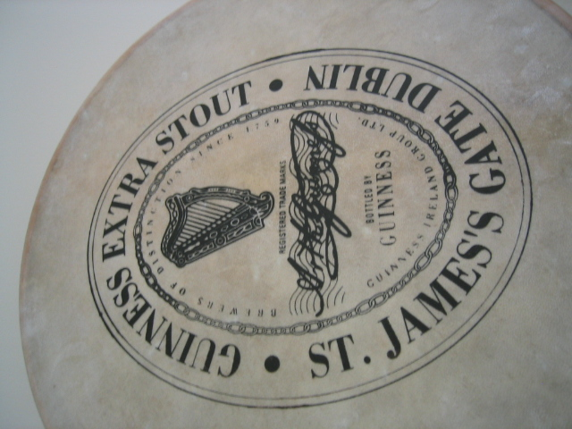
Visual Words: main idea
Extract some local features from a number of images …
e.g., SIFT descriptor space: each point is 128-dimensional
D. Nister, CVPR 2006

Slide 49
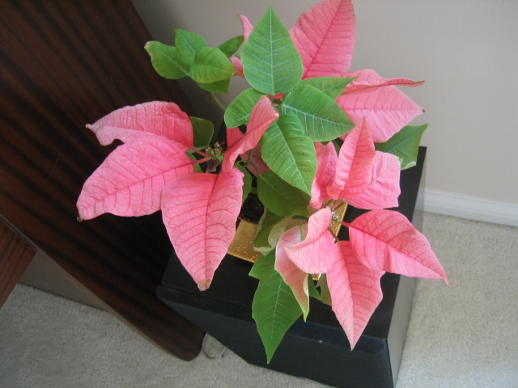
Visual Words: main idea
D. Nister, CVPR 2006

Slide 50
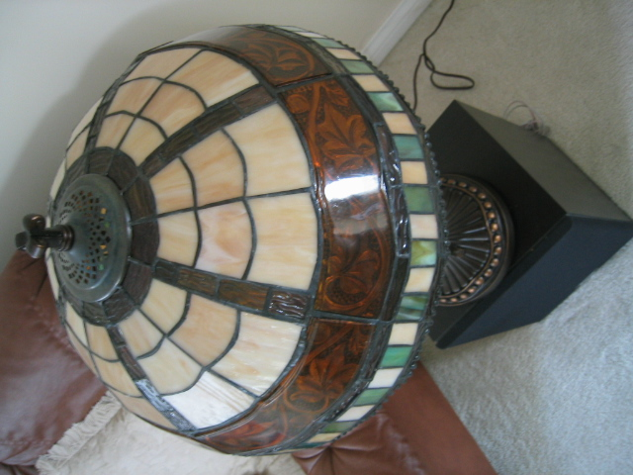
Visual Words: main idea
D. Nister, CVPR 2006

Slide 51

Visual Words: main idea
D. Nister, CVPR 2006

Slide 52
Each point is a local descriptor, e.g. SIFT feature vector.
D. Nister, CVPR 2006

Slide 53
“Quantize” the space by grouping (clustering) the features.
Note: For now, we’ll treat clustering as a black box.
D. Nister, CVPR 2006

Slide 54
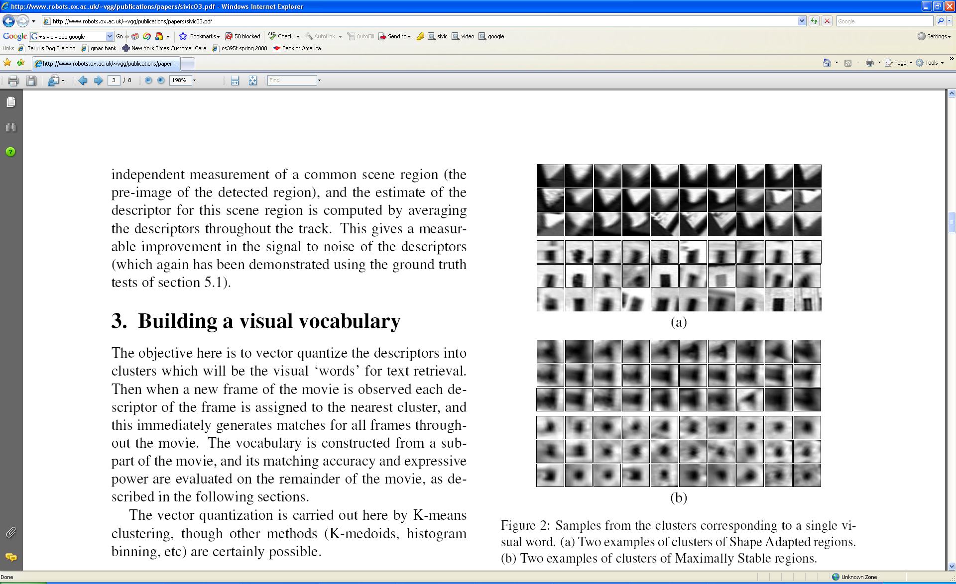
Visual Words
Patches on the right = regions used to compute SIFT
Each group of patches belongs to the same “visual word”
Figure from Sivic & Zisserman, ICCV 2003
Adapted from K. Grauman

Slide 55
Visual Words for Indexing
Map high-dimensional descriptors to tokens/words by quantizing the feature space
Each cluster has a center
1
2
To determine which word to assign to new image region (e.q. query), find closest cluster center
Word #3
3
To compare features: Only compare query to others in same cluster, or just compare word IDs
Descriptor’s feature space
Query
To compare images: see next few slides
Adapted from K. Grauman

Slide 56

How to describe documents with words
Of all the sensory impressions proceeding to the brain, the visual experiences are the dominant ones. Our perception of the world around us is based essentially on the messages that reach the brain from our eyes. For a long time it was thought that the retinal image was transmitted point by point to visual centers in the brain; the cerebral cortex was a movie screen, so to speak, upon which the image in the eye was projected. Through the discoveries of Hubel and Wiesel we now know that behind the origin of the visual perception in the brain there is a considerably more complicated course of events. By following the visual impulses along their path to the various cell layers of the optical cortex, Hubel and Wiesel have been able to demonstrate that the message about the image falling on the retina undergoes a step-wise analysis in a system of nerve cells stored in columns. In this system each cell has its specific function and is responsible for a specific detail in the pattern of the retinal image.
China is forecasting a trade surplus of $90bn (£51bn) to $100bn this year, a threefold increase on 2004's $32bn. The Commerce Ministry said the surplus would be created by a predicted 30% jump in exports to $750bn, compared with a 18% rise in imports to $660bn. The figures are likely to further annoy the US, which has long argued that China's exports are unfairly helped by a deliberately undervalued yuan. Beijing agrees the surplus is too high, but says the yuan is only one factor. Bank of China governor Zhou Xiaochuan said the country also needed to do more to boost domestic demand so more goods stayed within the country. China increased the value of the yuan against the dollar by 2.1% in July and permitted it to trade within a narrow band, but the US wants the yuan to be allowed to trade freely. However, Beijing has made it clear that it will take its time and tread carefully before allowing the yuan to rise further in value.
sensory, brain,
visual, perception,
retinal, cerebral cortex,
eye, cell, optical
nerve, image
Hubel, Wiesel
China, trade,
surplus, commerce,
exports, imports, US,
yuan, bank, domestic,
foreign, increase,
trade, value
ICCV 2005 short course, L. Fei-Fei

Slide 57
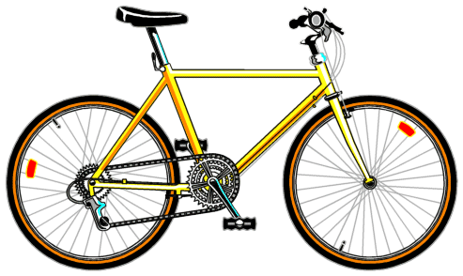
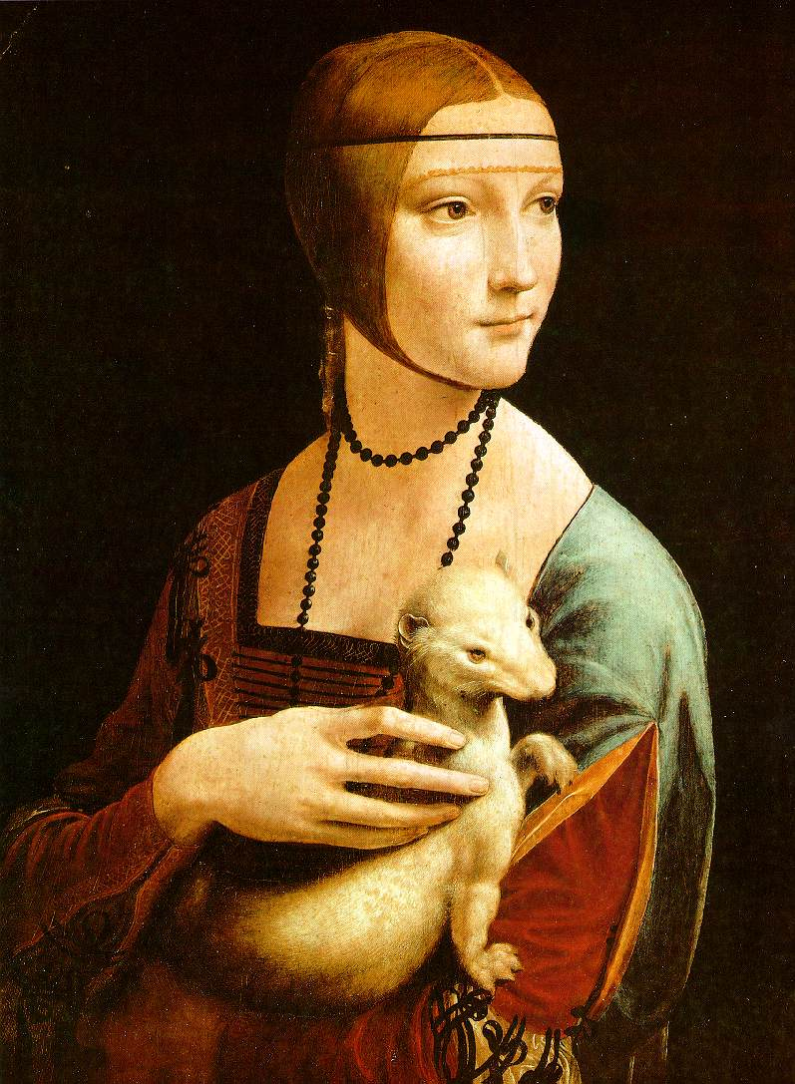


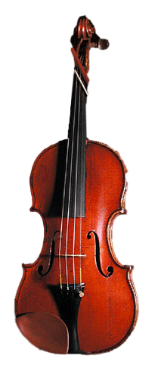


Describing images with visual words
Cluster 1
Summarize entire image based on its distribution (histogram) of word occurrences
Analogous to bag of words representation commonly used for documents
Cluster 2
Cluster 3
Feature patches:
Cluster 4
Adapted from K. Grauman
Notes:
57

Slide 58
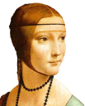


Describing images with visual words
Summarize entire image based on its distribution (histogram) of word occurrences
Analogous to bag of words representation commonly used for documents
times appearing
times appearing
Feature patches:
times appearing
Visual words
K. Grauman
Notes:
58

Slide 59





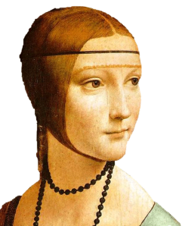
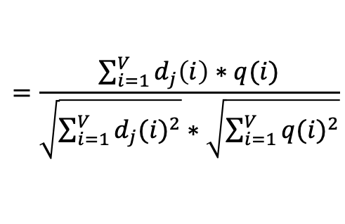

Comparing bags of words
Similarity of images measured as normalized scalar product between their word occurrence counts
Can be used to rank results (nearest neighbors of query)
[1 8 1 4]
[5 1 1 0]
$$sim\left(d_{j},q\right)=\frac{\left\langle d_{j},q\right\rangle }{\left\|d_{j}\right\|\left\|q\right\|}$$
$$=\frac{\sum_{i=1}^{V}{d_{j}\left(i\right)∗q(i)}}{\sqrt{\sum_{i=1}^{V}{{d_{j}(i)}^{2}}}∗\sqrt{\sum_{i=1}^{V}{{q(i)}^{2}}}}$$
for vocabulary of V words
Adapted from K. Grauman
Notes:
sim(d_j, q) = dot(d_j, q) / (norm(d_j, 2) * norm(q, 2))
Cosine Similarity
https://towardsdatascience.com/understanding-cosine-similarity-and-its-application-fd42f585296a

Slide 60
Bags of words: pros and cons
+ Flexible to geometry / deformations / viewpoint
+ Compact summary of image content
Basic model ignores geometry – verify afterwards
What is the optimal vocabulary size?
Background and foreground mixed when bag covers whole image
Adapted from K. Grauman
Notes:
60

Slide 61
Summary: Inverted file index and bags of words similarity
Offline:
Extract features in database images, cluster them to find words = cluster centers, make index
Online (during search):
Extract words in query (extract features and map each to closest cluster center)
Use inverted file index to find database images relevant to query
Rank database images by comparing word counts of query and database image
Adapted from K. Grauman

Slide 62
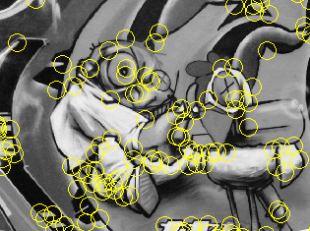
Summary
Keypoint detection: repeatable and distinctive
  Corners, blobs, stable regions
  Laplacian of Gaussian, automatic scale selection
Descriptors: robust and selective
  Histograms for robustness to small shifts and translations (SIFT descriptor)
Matching: cluster and index
  Compare images through their feature distribution
Adapted from D. Hoiem, K. Grauman

