Slide 1

CS 1674/2074: Grouping: segmentation
PhD. Nils Murrugarra-Llerena
nem177@pitt.edu

Slide 2

[Motivation] Grouping
Finding a Crowd at a Concert
Imagine you’re at a large outdoor music festival and you need to find your friends.
What would you do?
Your eyes don't process the scene one person at a time. Instead, you automatically group people together. You might spot a cluster of people wearing the same band t-shirt, or a tight-knit group all dancing together in a circle. You instantly recognize these as distinct groups, not just random individuals.
Notes:
Source: Gemini

Slide 3
Plan for today
Segments
  Find which pixels form a consistent region
  Clustering (e.g. K-means)

Slide 4
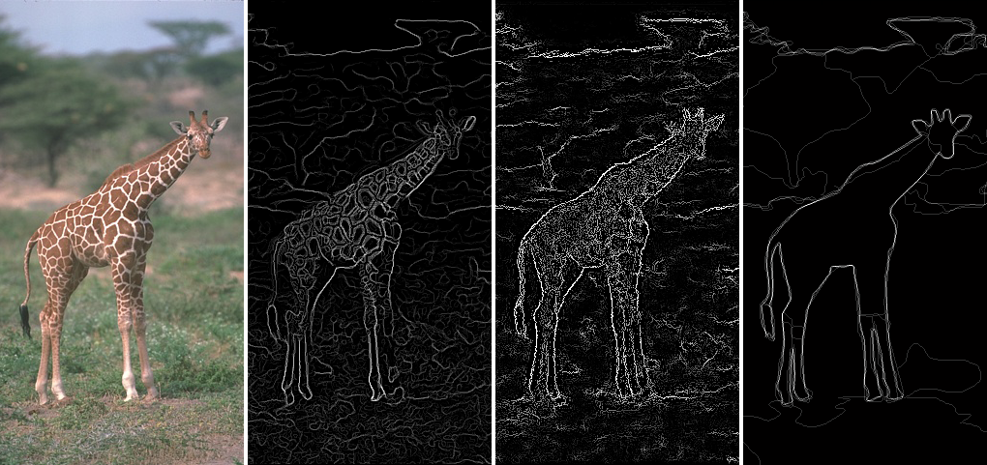
Edges vs Segments
Edges: More low-level; don’t need to be closed
Segments: Ideally one segment for each semantic group/object; should include closed contours
Figure adapted from J. Hays

Slide 5
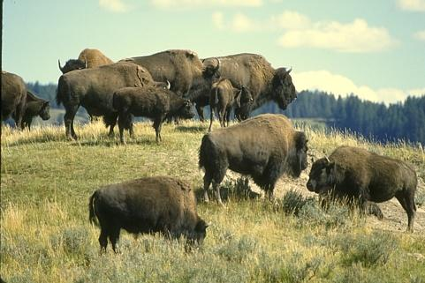
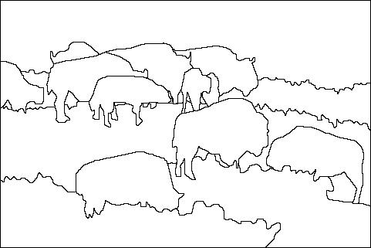
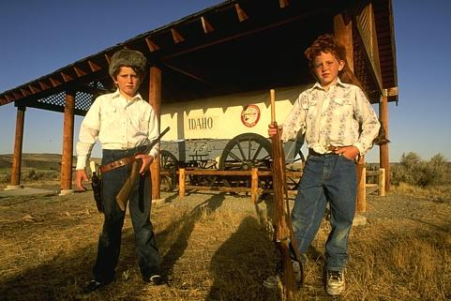
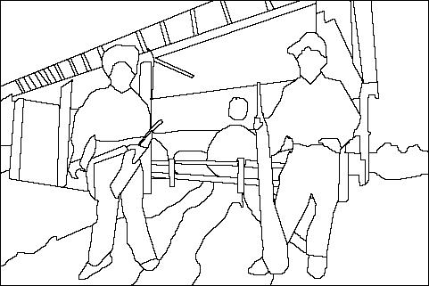
The goals of segmentation
Separate image into coherent “objects”
image
human segmentation
Source: L. Lazebnik

Slide 6
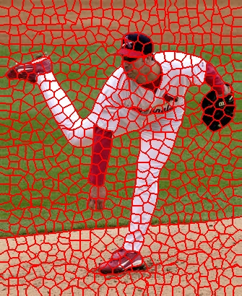
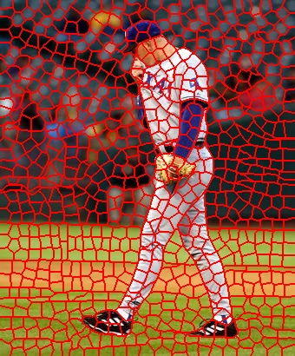
The goals of segmentation
Separate image into coherent “objects”
Group together similar-looking pixels for efficiency of further processing
“superpixels”
X. Ren and J. Malik. Learning a classification model for segmentation. ICCV 2003.
Source: L. Lazebnik

Slide 7
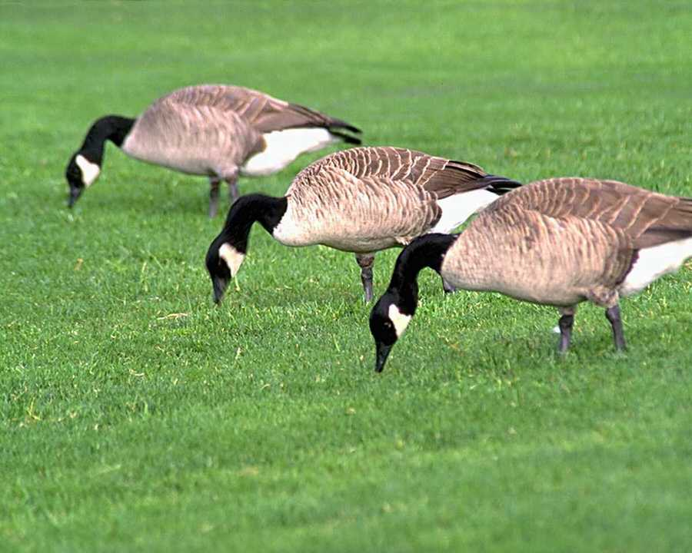
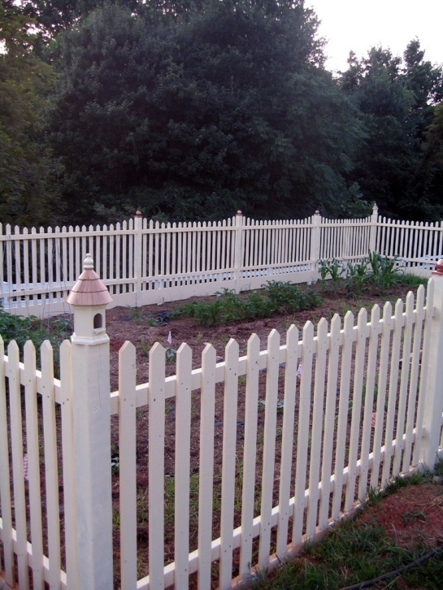
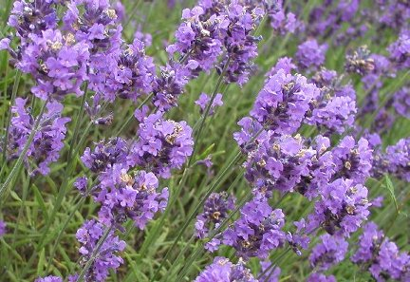
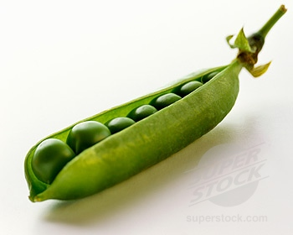
Similarity
Slide: K. Grauman

Slide 8
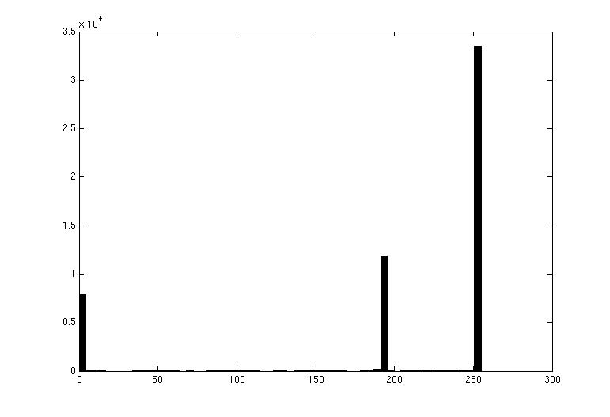

Image Segmentation: Toy Example
white pixels
pixel count
3
black pixels
gray pixels
1
2
input image
intensity
These intensities define the three groups.
We could label every pixel in the image according to which of these primary intensities it is.
  i.e., segment the image based on the intensity feature.
What if the image isn’t quite so simple?
Source: K. Grauman

Slide 9
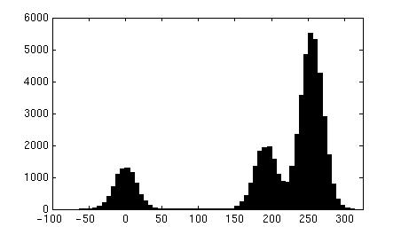
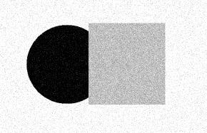
Image Segmentation: Toy Example
pixel count
input image
intensity
Now how to determine the three main intensities that define our groups?
We need to cluster.
Source: K. Grauman

Slide 10
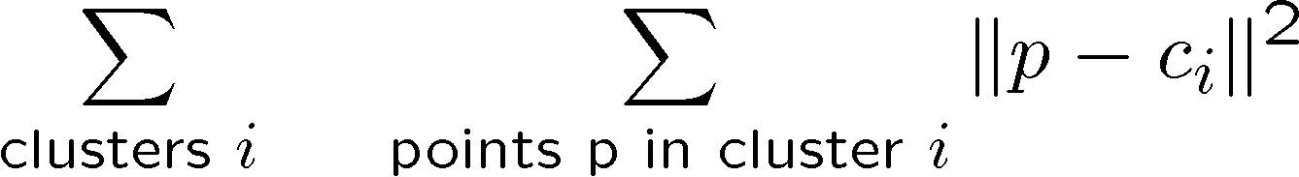
Image Segmentation: Toy Example
0
190
255
intensity
3
1
2
Goal: choose three “centers” as the representative intensities, and label every pixel according to which of these centers it is nearest to.
Best cluster centers are those that minimize sum of squared differences (SSD) between all points and their nearest cluster center ci:
Source: K. Grauman

Slide 11
Clustering
With this objective, it is a “chicken and egg” problem:
  If we knew the cluster centers, we could allocate points to groups by assigning each to its closest center.
  If we knew the group memberships, we could get the centers by computing the mean per group.
Source: K. Grauman

Slide 12
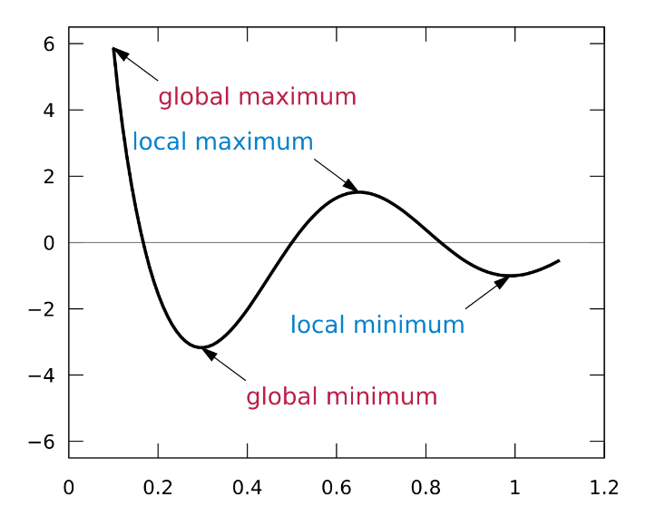
K-means clustering
Basic idea: randomly initialize the k cluster centers, and iterate between the two steps we just saw.
  Randomly initialize the cluster centers, c₁, ..., c_{K}
  Given cluster centers, determine points in each cluster
    For each point p, find the closest c_{i}. Put p into cluster i
  Given points in each cluster, solve for c_{i}
    Set c_{i} to be the mean of points in cluster i
  If c_{i} have changed, repeat Step 2
Properties
  Will always converge to some solution
  Can be a “local minimum” of objective:
Slide: Steve Seitz, image: Wikipedia

Slide 13
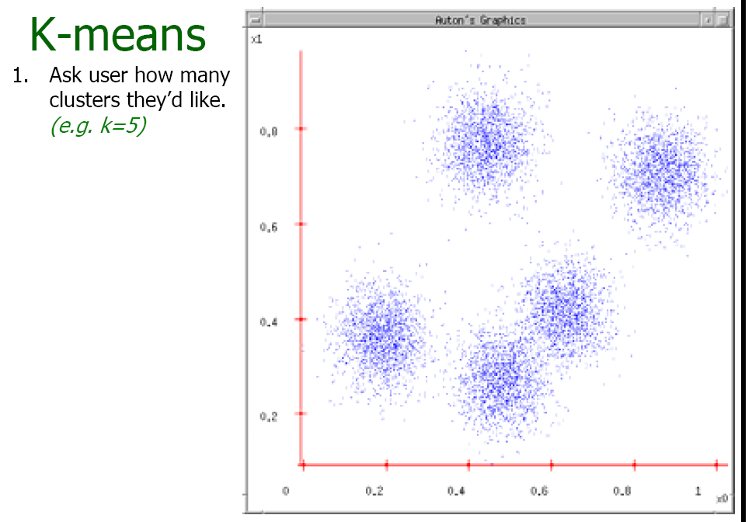
Source: A. Moore

Slide 14
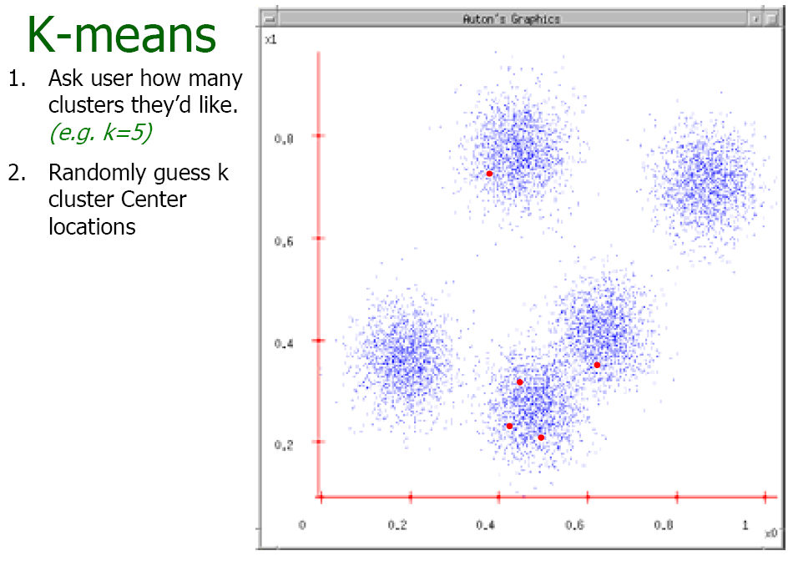
Source: A. Moore

Slide 15
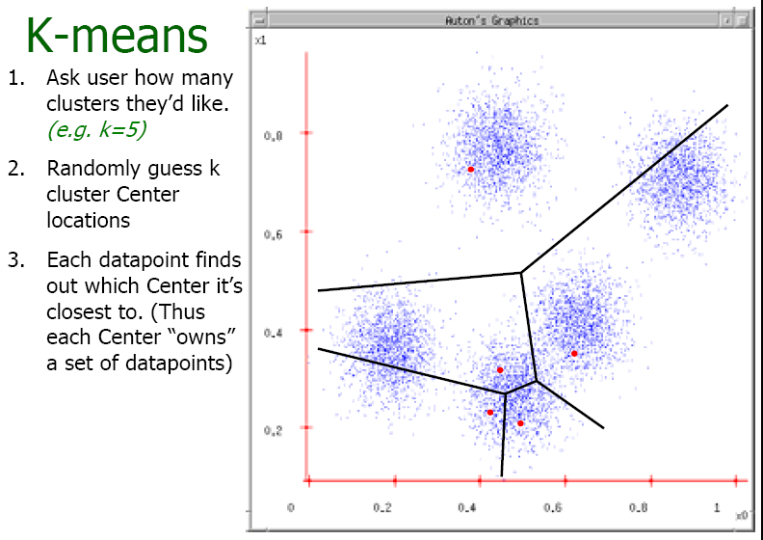
Source: A. Moore

Slide 16
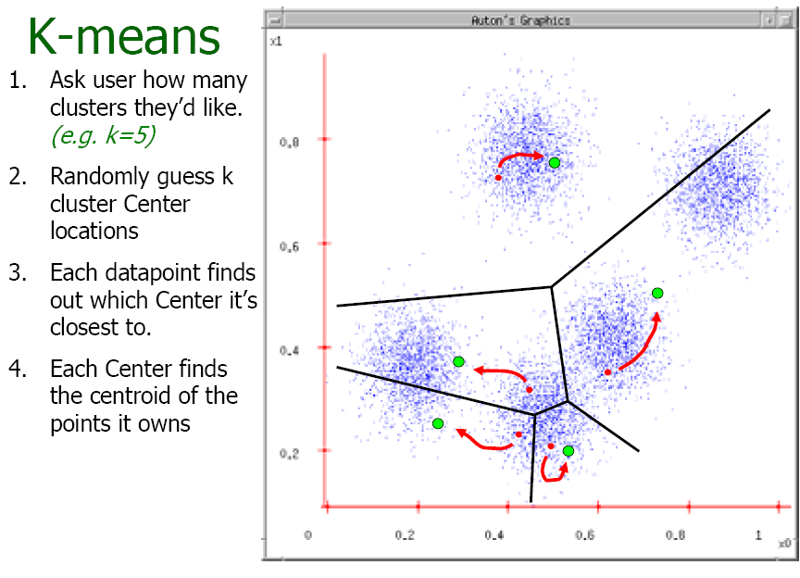
Source: A. Moore

Slide 17
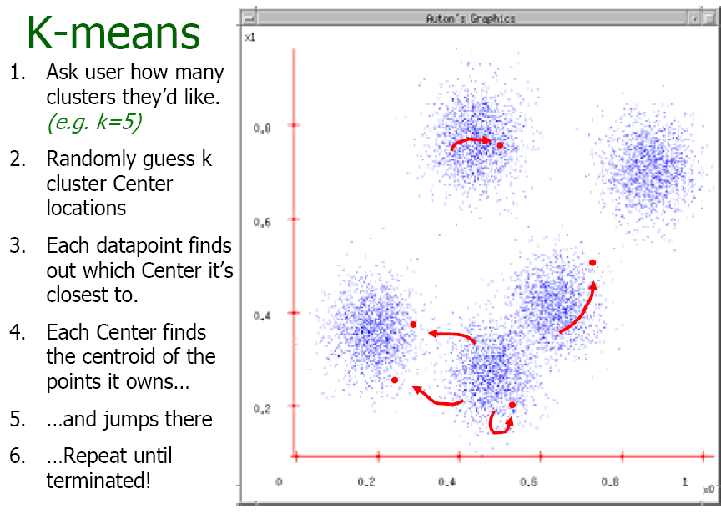
Source: A. Moore

Slide 18


Motivation: Interactive Clustering
https://www.naftaliharris.com/blog/visualizing-k-means-clustering/
Explained Visually: https://setosa.io/ev/
Notes:
https://www.naftaliharris.com/blog/visualizing-k-means-clustering/

Slide 19
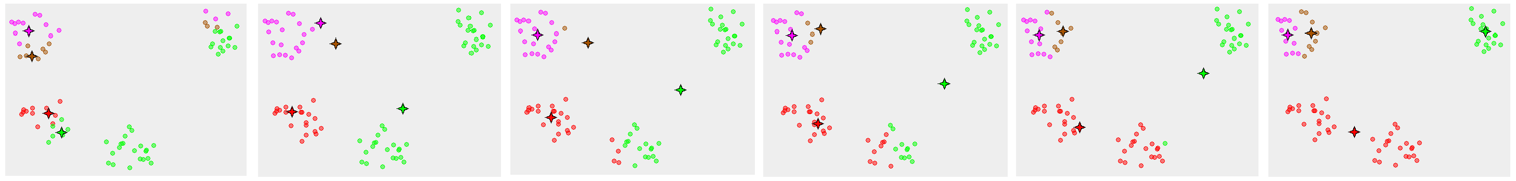
K-means converges to a local minimum
How can I try to fix this problem?
Adapted from James Hays
Notes:
Many random initializations

Slide 20
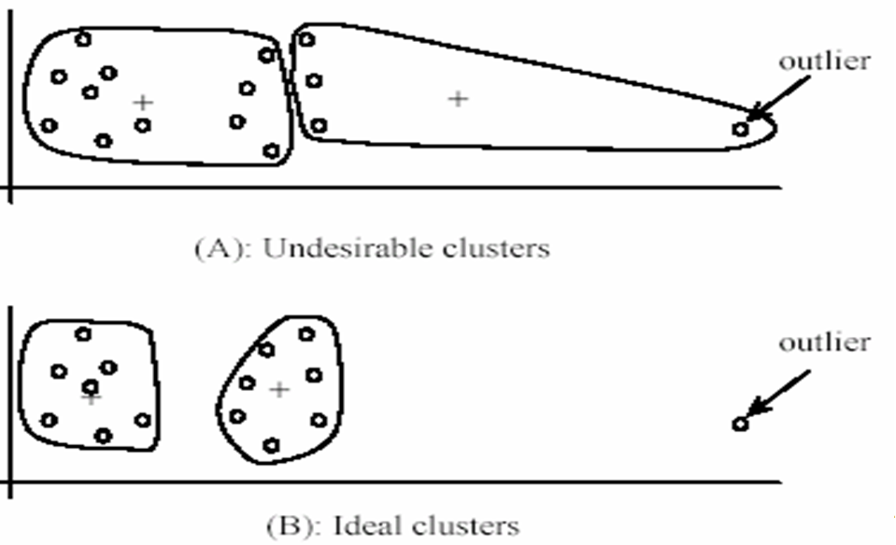
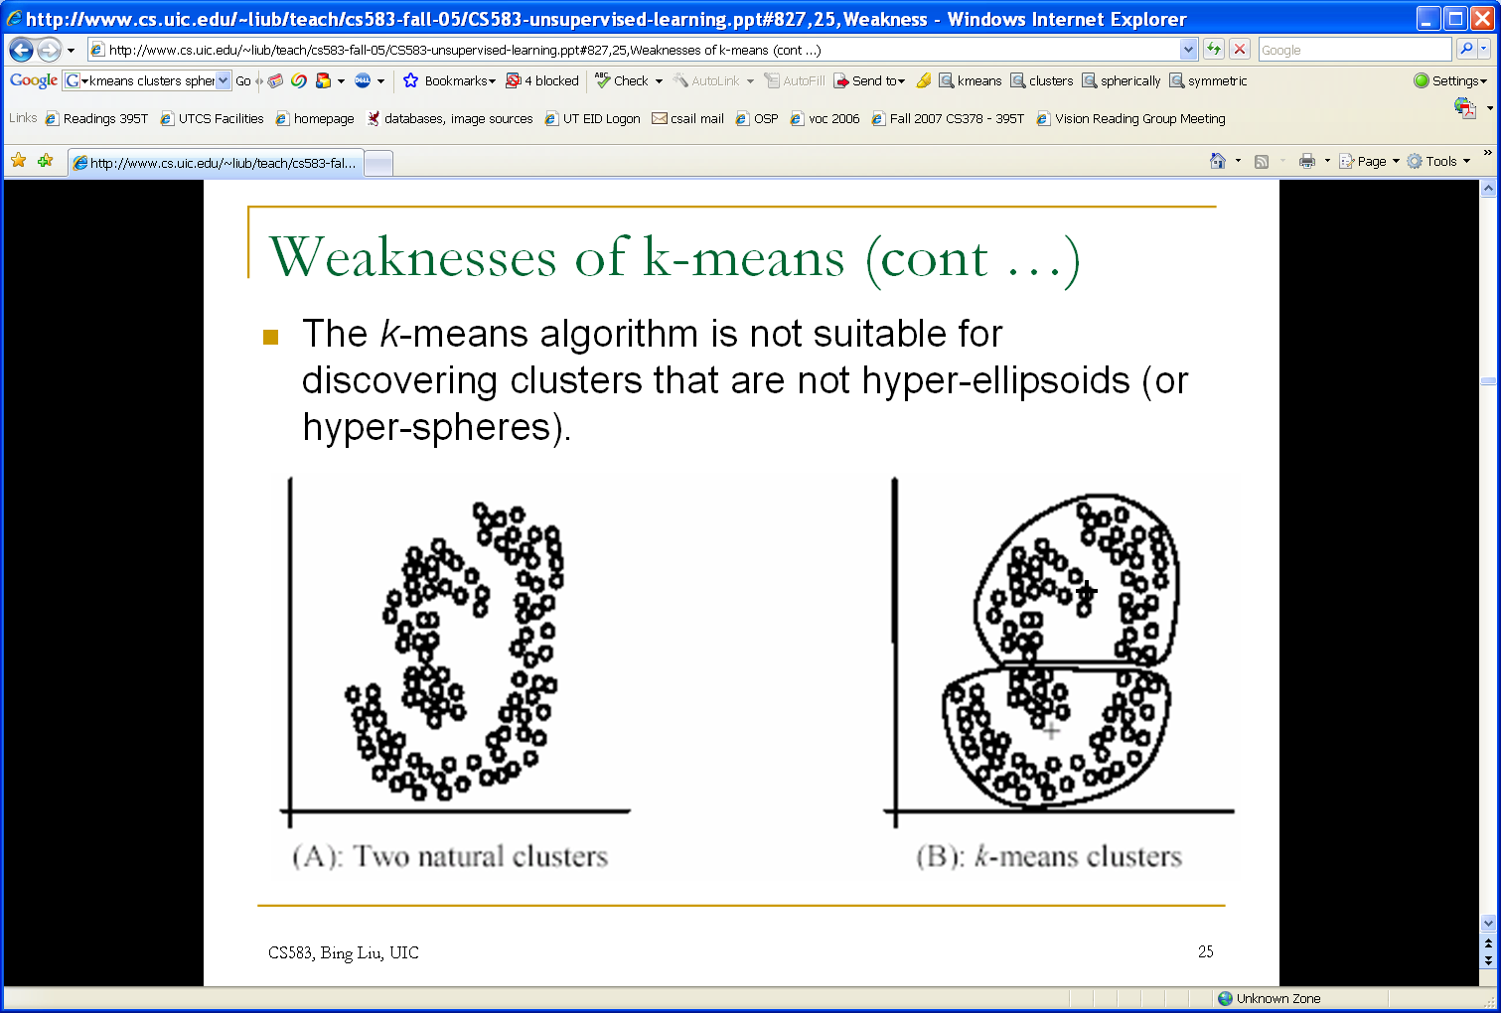
K-means: pros and cons
Pros
Simple, fast to compute
Converges to local minimum of within-cluster squared error
Cons/issues
Setting k?
  One way: silhouette coefficient
Sensitive to initial centers
  Use heuristics or output of another method
Sensitive to outliers
Detects spherical clusters
Adapted from K. Grauman
Notes:
20

Slide 21
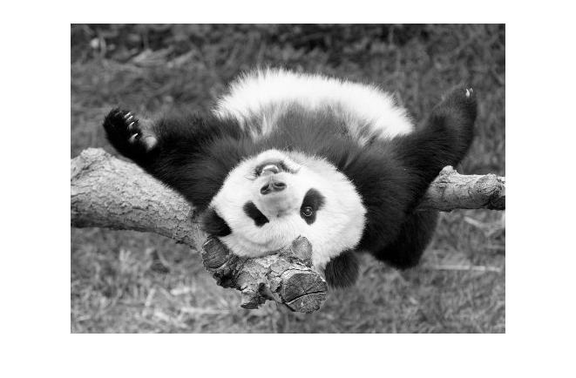
Segmentation as Clustering
Depending on what we choose as the feature space, we can group pixels in different ways.
Grouping pixels based on intensity similarity
Feature space: intensity value (1-d)
Source: K. Grauman
Notes:
21

Slide 22
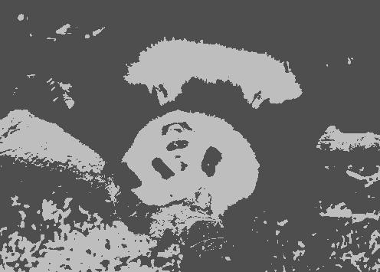
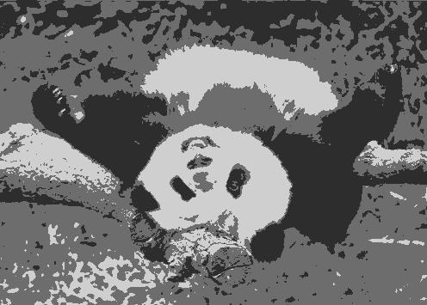
K=2
K=3
Adapted from K. Grauman

Slide 23
Segmentation as Clustering
Depending on what we choose as the feature space, we can group pixels in different ways.
Grouping pixels based on intensity similarity
Clusters based on intensity similarity don’t have to be spatially coherent.
Source: K. Grauman
Notes:
23

Slide 24
Segmentation as Clustering
Depending on what we choose as the feature space, we can group pixels in different ways.
Grouping pixels based
on intensity+position similarity
Intensity
Y
X
Both regions are black, but if we also include position (x,y), then we could group the two into distinct segments; way to encode both similarity & proximity.
Source: K. Grauman
Notes:
24

Slide 25
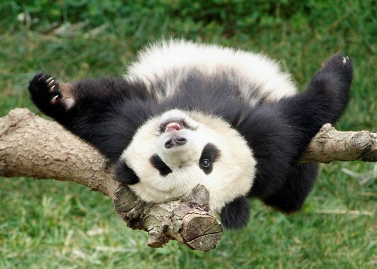
Segmentation as Clustering
Depending on what we choose as the feature space, we can group pixels in different ways.
R=255
G=200
B=250
Grouping pixels based on color similarity
B
R=245
G=220
B=248
G
R=15
G=189
B=2
R=3
G=12
B=2
R
Feature space: color value (3-d)
Adapted from K. Grauman
Notes:
25

Slide 26
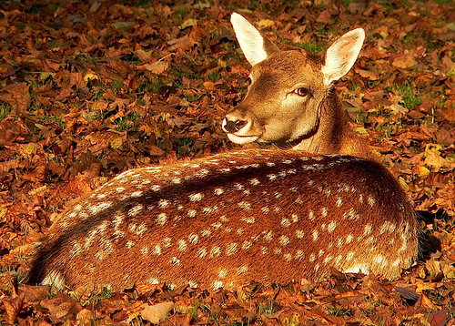
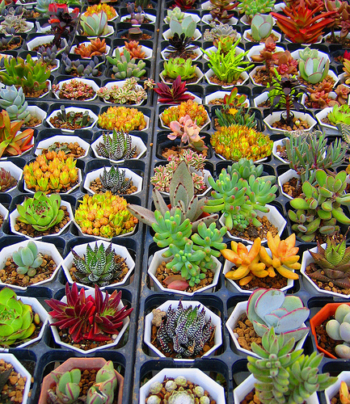
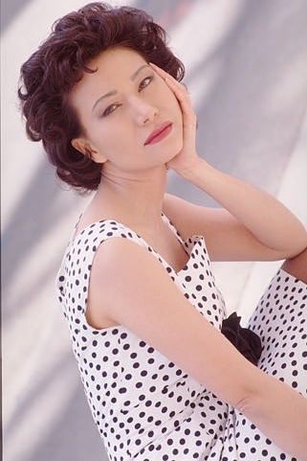
Segmentation as Clustering
Color, brightness, position alone are not enough to distinguish all regions…
Source: L. Lazebnik

Slide 27
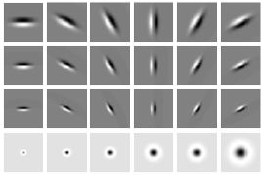
Segmentation as Clustering
Depending on what we choose as the feature space, we can group pixels in different ways.
Grouping pixels based on texture similarity
F₁
F₂
Filter bank of 24 filters
…
F₂₄
Feature space: filter bank responses (e.g., 24-d)
Source: K. Grauman
Notes:
27

Slide 28
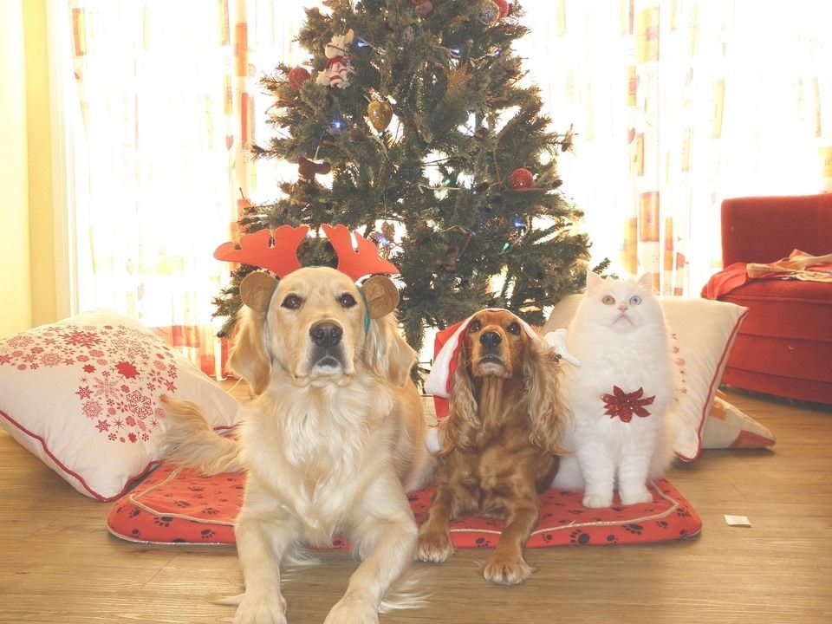
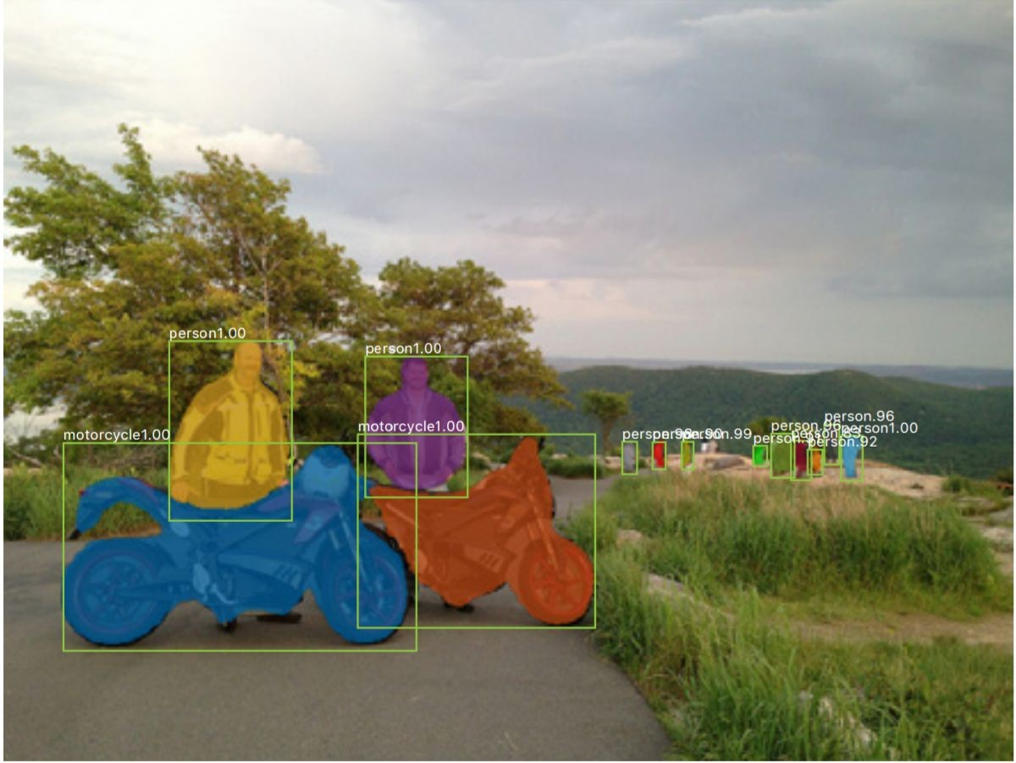
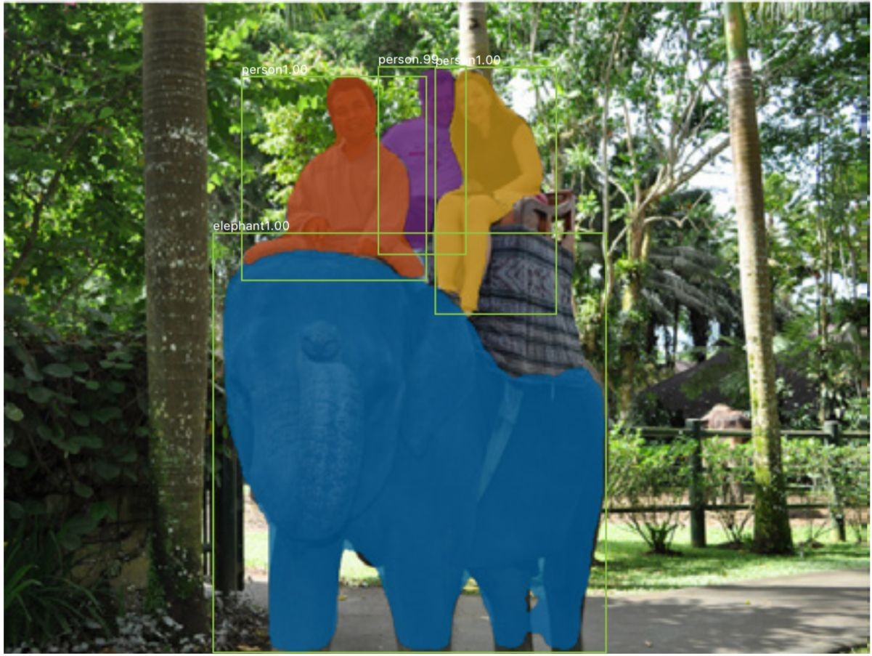
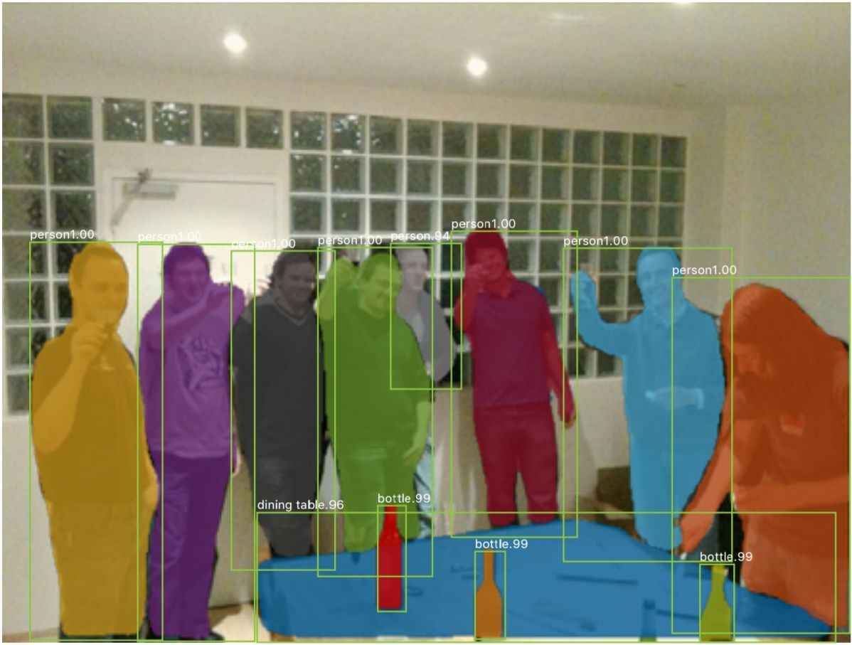
State-of-the-art (instance) segmentation: Mask R-CNN
28
Classification Scores: C
Box coordinates (per class): 4 * C
CNN
Conv
Conv
RoI Align
Predict a mask for each of C classes
May 10, 2017
He et al, “Mask R-CNN”, ICCV 2017; slide adapted from Justin Johnson

Slide 29

Lab 4: k-Means
Duration: 40 min
Use JPEG, PNG and GIF files less than 15 MB [ahaslides]

Slide 30
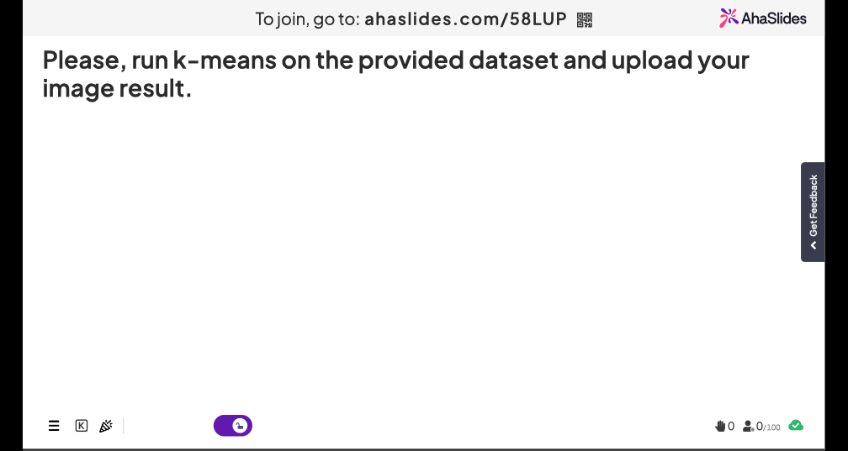
30

Slide 31
Summary
Segments: use clustering (e.g. K-means) to group pixels by intensity, texture, etc.

