Slide 1

CS 1674: Visual Recognition
PhD. Nils Murrugarra-Llerena
nem177@pitt.edu
Notes:
[Stanford]
kNN / DataSet splits : https://cs231n.stanford.edu/slides/2025/lecture_2.pdf
Regularization: https://cs231n.stanford.edu/slides/2025/lecture_3.pdf
##
[UNICAMP]
Regularization: https://docs.google.com/presentation/d/1KrEQJ-rh8-Kw1xnaIrahMacyopQKEaQ2-JnABEk93uQ/edit?slide=id.ged757e27a4_0_0#slide=id.ged757e27a4_0_0
Metrics: https://docs.google.com/presentation/d/13F0a3oqHcZq2nk9czTYq2aioMDachgTcVxfmA08s5QY/edit?slide=id.g2380c47321_0_20#slide=id.g2380c47321_0_20
Datasets: https://docs.google.com/presentation/d/1-1hiRatP-mdrf7qalEu9sCX4L0n68grP2wprxpFJdeM/edit

Slide 2


[Motivation] Visual Recognition
Medical Diagnostics: Aiding Pathologists
Imagine a pathologist examining a biopsy slide to detect cancer. This is a highly skilled, time-consuming, and mentally taxing task. They have to scan the entire slide under a microscope, looking for subtle cellular abnormalities that might indicate a malignant tumor. A single misdiagnosis can have devastating consequences.
Can we use CV to help pathologists in this task? How?
Notes:
Source: Gemini
This is where visual recognition steps in. We can train a computer vision model on thousands of biopsy images, each labeled as either "cancerous" or "non-cancerous." The model learns to identify intricate patterns and features that are indicative of cancer, often spotting things that a human eye might miss or that are too subtle to be easily noticed.

Slide 3

Plan for this lecture
What is recognition?
  a.k.a. classification, categorization
Support vector machines
  Separable case / non-separable case
  Linear / non-linear (kernels)
Example approach for scene classification
Evaluation Metrics

Slide 4
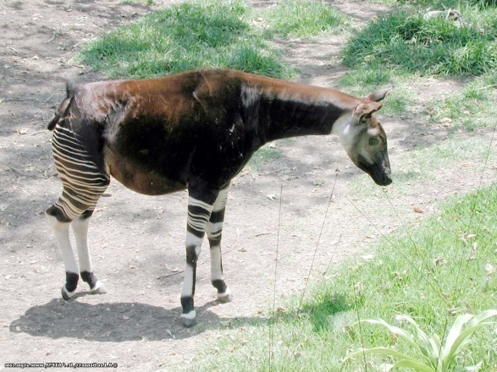
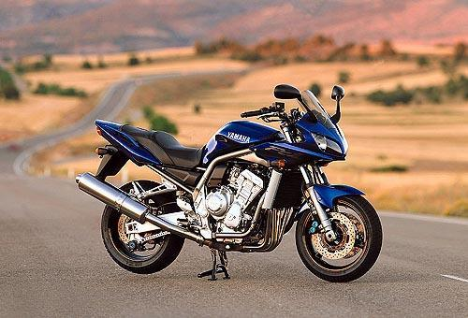
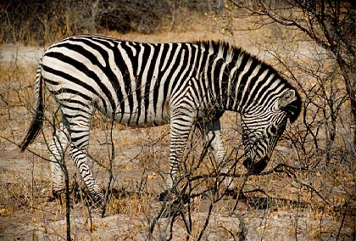
Classification
Given a feature representation for images, how do we learn a model for distinguishing features from different classes?
Decision
boundary
Zebra
Non-zebra
Slide credit: L. Lazebnik

Slide 5
Classification
Assign input vector to one of two or more classes
Input space divided into decision regions separated by decision boundaries
Slide credit: L. Lazebnik

Slide 6
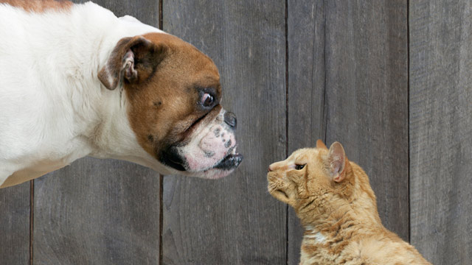
Examples of image classification
Two-class (binary): Cat vs Dog
Adapted from D. Hoiem

Slide 7
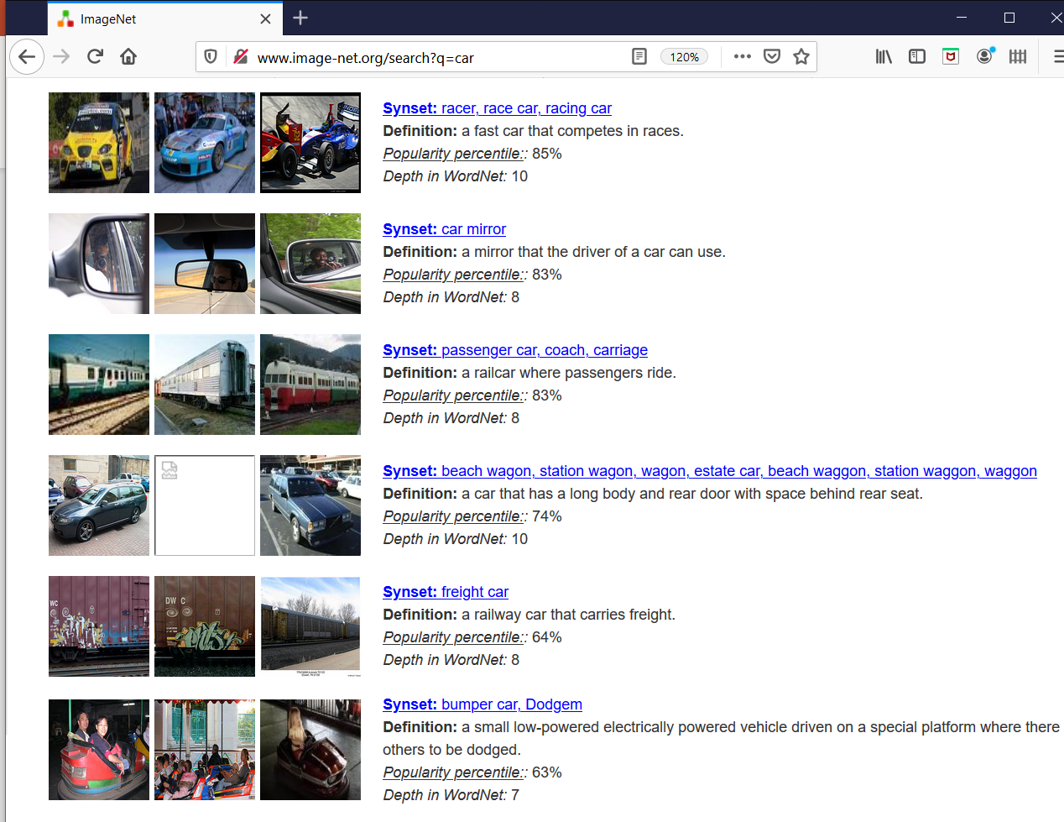
Examples of image classification
Multi-class (often): Object recognition

Slide 8
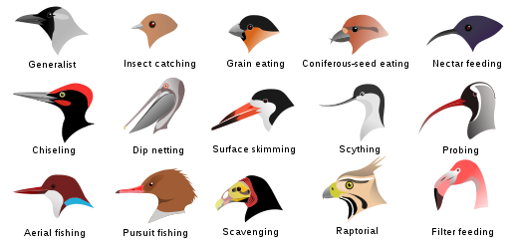
Examples of image classification
Fine-grained recognition
Visipedia Project
Slide credit: D. Hoiem

Slide 9
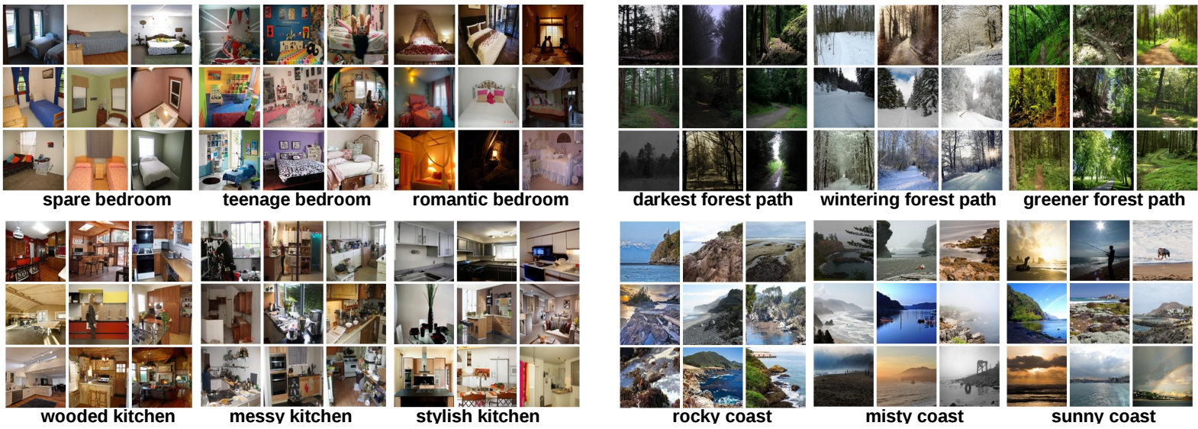
Examples of image classification
Place recognition
Places Database [Zhou et al. NIPS 2014]
Slide credit: D. Hoiem

Slide 10
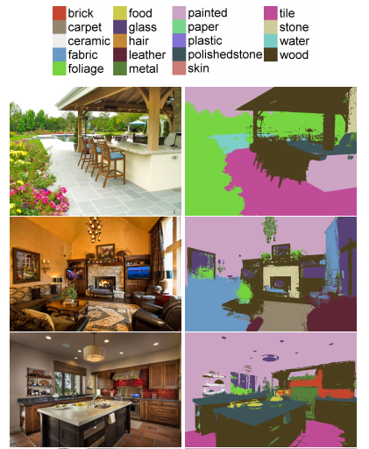
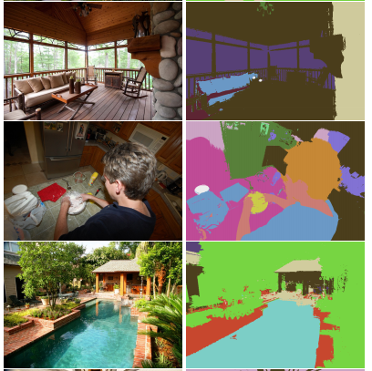
Examples of image classification
Material recognition
[Bell et al. CVPR 2015]
Slide credit: D. Hoiem

Slide 11
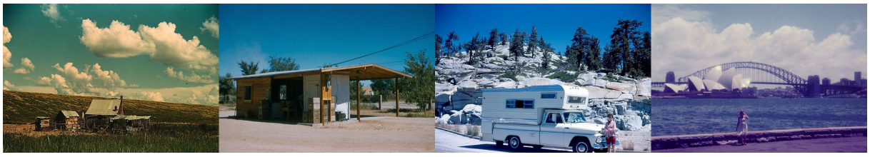
Examples of image classification
Dating historical photos
1940
1953
1966
1977
[Palermo et al. ECCV 2012]
Slide credit: D. Hoiem

Slide 12
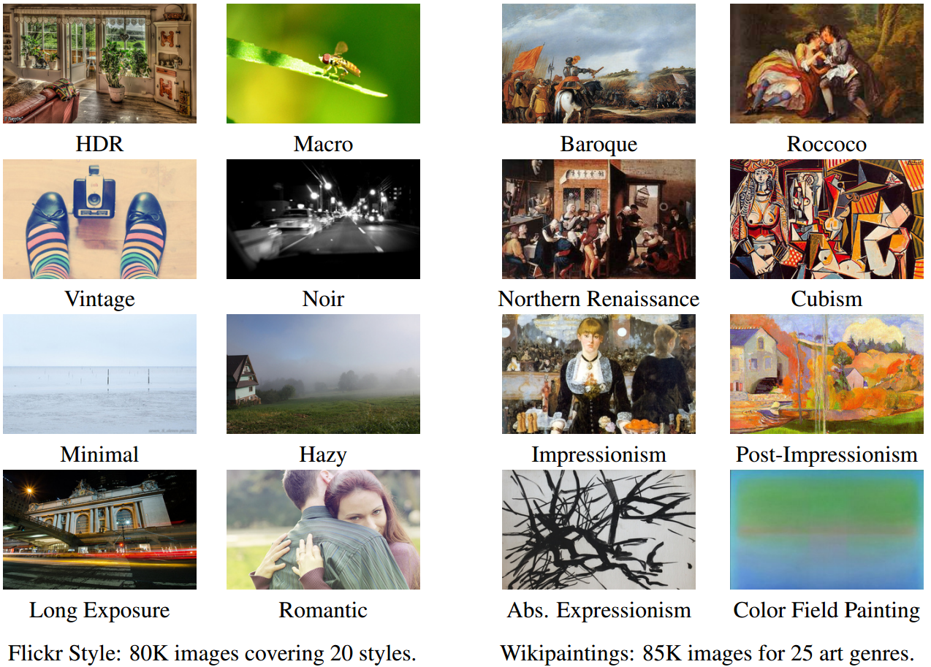
Examples of image classification
Image style recognition
[Karayev et al. BMVC 2014]
Slide credit: D. Hoiem

Slide 13
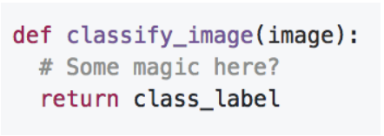

Recognition: An Image Classifier
Unlike e.g. sorting a list of numbers,
no obvious way to hard-code the algorithm for recognizing a cat, or other classes.
Slide Credit: https://cs231n.stanford.edu/

Slide 14
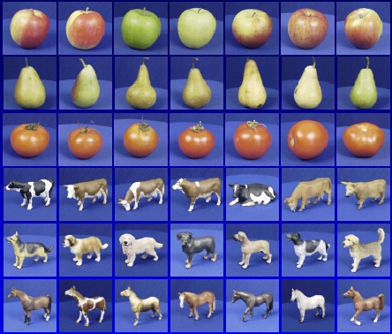
Recognition: A machine learning approach

Slide 15
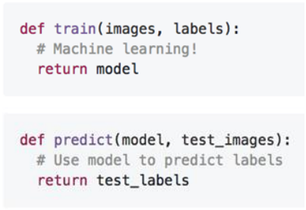
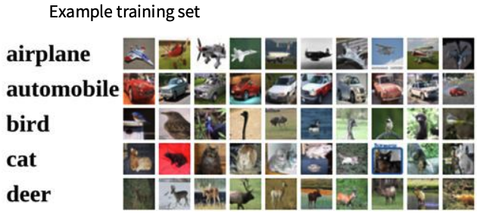
Recognition: A machine learning approach
Collect a dataset of images and labels
Use Machine Learning algorithms to train a classifier
Evaluate the classifier on new images
Slide Credit: https://cs231n.stanford.edu/

Slide 16



The machine learning framework
Apply a prediction function to a feature representation of the image to get the desired output:
f( ) = “apple”
f( ) = “tomato”
f( ) = “cow”
Slide credit: L. Lazebnik

Slide 17
The machine learning framework
y* = f(x)
Training: given a training set of labeled examples {(x₁,y₁), …, (x_{N},y_{N})}, estimate the prediction function f by minimizing the prediction error on the training set, e.g. |f(x_{i}) – y_{i}|
  Evaluate multiple hypotheses f₁, f₂, f_{H} … and pick the best one as f
Testing: apply f to a never-before-seen test example x and output the predicted value y* = f(x)
output (may differ from ground-truth label y)
prediction function
image / image features
Slide credit: L. Lazebnik

Slide 18

The old-school way
Training Labels
Training Images
Image Features
Training
Learned model
Training
Image Features
Learned model
Prediction
Testing
Test Image
Slide credit: D. Hoiem and L. Lazebnik

Slide 19
The simplest classifier: Nearest Neighbor Classifier
Training examples from class 2
Training examples from class 1
Test example
f(x) = label of the training example nearest to x
All we need is a distance function for our inputs
No training required!
Slide credit: L. Lazebnik

Slide 20
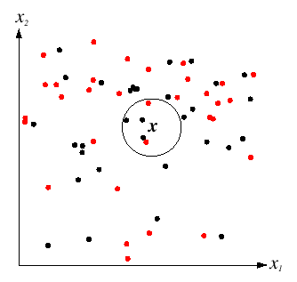
K-Nearest Neighbors classification
For a new point, find the k closest points from training data
Labels of the k points “vote” to classify
k = 5
Black = positive
Red = negative
If query lands here, the 5 NN consist of 3 positives and 2 negatives, so we classify it as positive.
Slide credit: D. Lowe

Slide 21
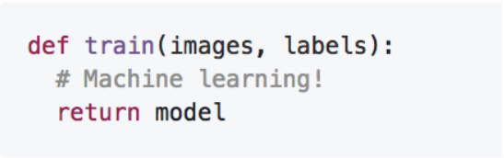
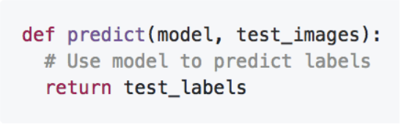
K-Nearest Neighbor - Summary
Memorize all data and labels
Predict the label of the most similar training image
Slide Credit: https://cs231n.stanford.edu/

Slide 22
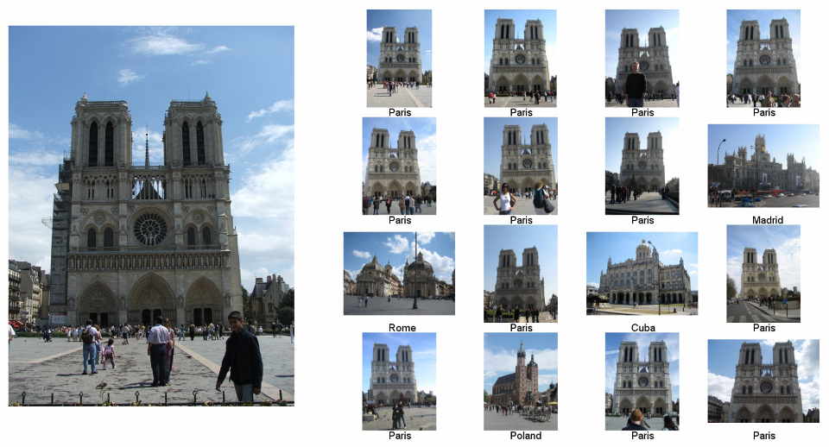
[Application ]Im2gps: Estimating Geographic Information from a Single Image [James Hays and Alexei Efros, CVPR 2008]
Where was this image taken?
Nearest Neighbors according to BOW-SIFT + color histogram + a few others
Slide credit: James Hays

Slide 23
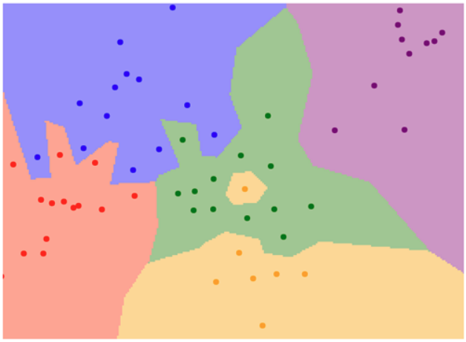
K-Nearest Neighbor - Visualization
1-nearest Neighbor
Slide Credit: https://cs231n.stanford.edu/

Slide 24
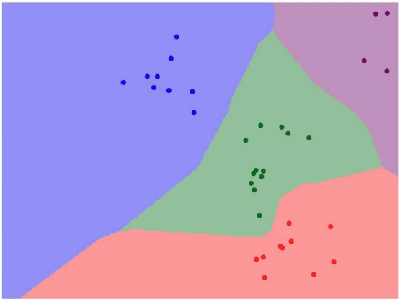
K-Nearest Neighbor – Interact – Try it yourself
http://vision.stanford.edu/teaching/cs231n-demos/knn/
Slide Credit: https://cs231n.stanford.edu/

Slide 25
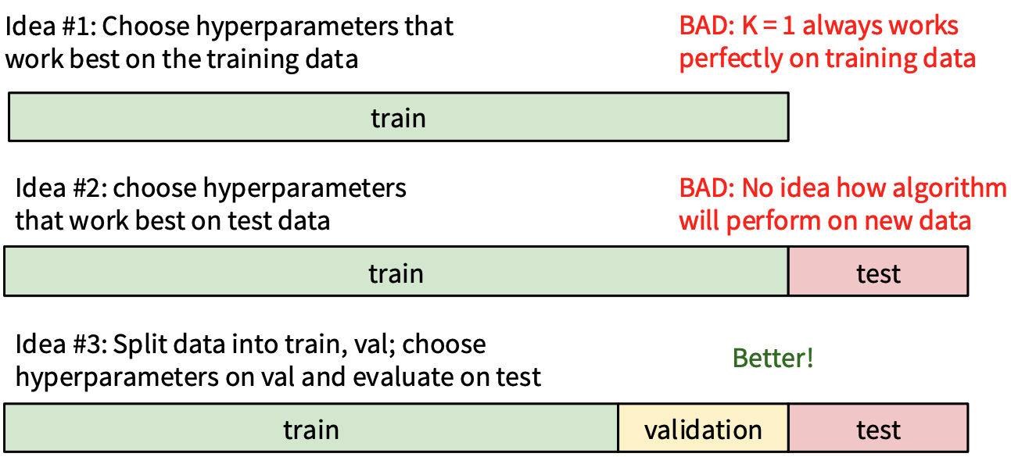
Setting Hyperparameters: Best value of k?
60%
20%
20%
Slide Credit: https://cs231n.stanford.edu/

Slide 26
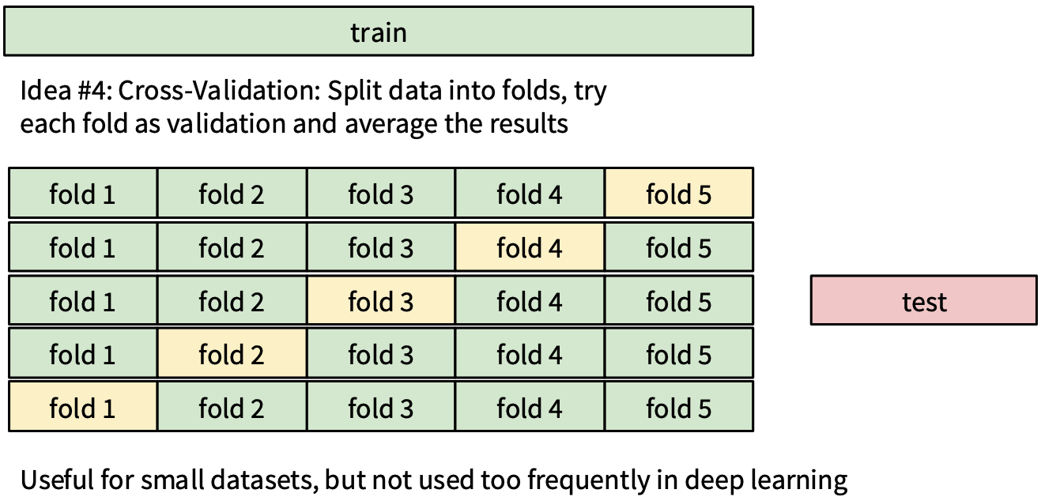
Setting Hyperparameters: Best value of k?
Slide Credit: https://cs231n.stanford.edu/

Slide 27
Which model is better? Why validating?
Slide Credit: Prof. Sandra Avila - UNICAMP

Slide 28
Why validating?
Slide Credit: Prof. Sandra Avila - UNICAMP

Slide 29
Why validating?
Training
Validation
Slide Credit: Prof. Sandra Avila - UNICAMP

Slide 30
Why validating?
Training
Validation
Slide Credit: Prof. Sandra Avila - UNICAMP

Slide 31


Why validating?
Training
Validation
Slide Credit: Prof. Sandra Avila - UNICAMP

Slide 32
Linear classifier
Find a linear function to separate the classes
f(x) = sgn(w₁x₁ + w₂x₂ + … + w_{D}x_{D}) = sgn(w ⋅ x)
Slide credit: L. Lazebnik

Slide 33
Linear Classifier
Decision = sign(w^{T}x) = sign(w1*x1 + w2*x2)
x2
x1
(0, 0)
What should the weights be?

Slide 34
Lines in R²
Let
Compare to:
slope*x + y-intercept = y
ax + b = -cy
(-a/c) x + (-b/c) = y
Slope: -a/c
Y-intercept: -b/c
Kristen Grauman

Slide 35
Lines in R²
Slope: -a/c
Y-intercept: -b/c
Let
Kristen Grauman
Notes:
TODO: update w transpose

Slide 36
Lines in R²
Slope: -a/c
Y-intercept: -b/c
Let
Kristen Grauman

Slide 37
Lines in R²
Slope: -a/c
Y-intercept: -b/c
Let
distance from point to line
Kristen Grauman
Notes:
https://brilliant.org/wiki/distance-between-point-and-line/

Slide 38
Lines in R²
Slope: -a/c
Y-intercept: -b/c
Let
distance from point to line
Adapted from Kristen Grauman

Slide 39
Linear classifiers
Find linear function to separate positive and negative examples
B
C
A
D
Which line
is best?
C. Burges, A Tutorial on Support Vector Machines for Pattern Recognition, Data Mining and Knowledge Discovery, 1998

Slide 40
Linear classifiers
Find linear function to separate positive and negative examples
B
C
A
D
Not seen until test time,
of class blue
Which line
is best?
C. Burges, A Tutorial on Support Vector Machines for Pattern Recognition, Data Mining and Knowledge Discovery, 1998

Slide 41
Support vector machines
Discriminative classifier based on optimal separating line (for 2d case)
Maximize the margin between the positive and negative training examples
C. Burges, A Tutorial on Support Vector Machines for Pattern Recognition, Data Mining and Knowledge Discovery, 1998

Slide 42
Support vector machines
Want line that maximizes the margin.
wx+b=1
wx+b=0
wx+b=-1
For support, vectors,
Support vectors
Margin
C. Burges, A Tutorial on Support Vector Machines for Pattern Recognition, Data Mining and Knowledge Discovery, 1998

Slide 43
Support vector machines
Want line that maximizes the margin.
wx+b=1
wx+b=0
wx+b=-1
For support, vectors,
Distance between point and line:
For support vectors:
Support vectors
Margin
C. Burges, A Tutorial on Support Vector Machines for Pattern Recognition, Data Mining and Knowledge Discovery, 1998

Slide 44
Support vector machines
Want line that maximizes the margin.
wx+b=1
wx+b=0
wx+b=-1
For support, vectors,
Distance between point and line:
Therefore, the margin is 2 / ||w||
Support vectors
Margin
C. Burges, A Tutorial on Support Vector Machines for Pattern Recognition, Data Mining and Knowledge Discovery, 1998

Slide 45
Finding the maximum margin line
Maximize margin 2/||w||
Correctly classify all training data points:
Quadratic optimization problem:
Minimize
Subject to y_{i}(w·x_{i}+b) ≥ 1
One constraint per training point.
Note sign trick:
w·x_{i} + b >= 1 (if y_{i} = 1)
w·x_{i} + b <= -1 (if y_{i} = -1)
(-1) w·x_{i} - b >= 1
Adapted from C. Burges, A Tutorial on Support Vector Machines for Pattern Recognition

Slide 46
Finding the maximum margin line
Solution:
Learned
weight
Support
vector
C. Burges, A Tutorial on Support Vector Machines for Pattern Recognition, Data Mining and Knowledge Discovery, 1998

Slide 47
Finding the maximum margin line
Solution:
b = y_{i} – w·x_{i} (for any support vector)
Classification function:
Notice that it relies on an inner product between the test point x and the support vectors x_{i}
(Solving the optimization problem also involves computing the inner products x_{i} · x_{j} between all pairs of training points)
If f(x) < 0, classify as negative, otherwise classify as positive.
C. Burges, A Tutorial on Support Vector Machines for Pattern Recognition, Data Mining and Knowledge Discovery, 1998

Slide 48
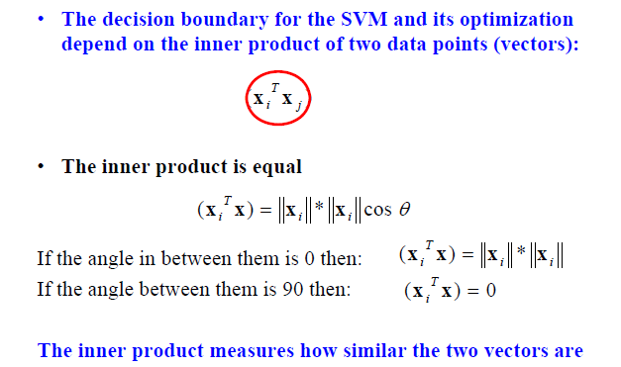
Inner product
Adapted from Milos Hauskrecht

Slide 49
Nonlinear SVMs
Datasets that are linearly separable work out great:
But what if the dataset is just too hard?
We can map it to a higher-dimensional space:
0
x
0
x
x²
Andrew Moore
0
x

Slide 50
Nonlinear SVMs
General idea: the original input space can always be mapped to some higher-dimensional feature space where the training set is separable:
Φ: x → φ(x)
Andrew Moore

Slide 51
Nonlinear kernel: Example
Consider the mapping
x²
Svetlana Lazebnik

Slide 52
The “Kernel Trick”
The linear classifier relies on dot product between vectors K(x_{i} , x_{j}) = x_{i} · x_{j}
If every data point is mapped into high-dimensional space via some transformation Φ: x_{i} → φ(x_{i} ), the dot product becomes: K(x_{i} , x_{j}) = φ(x_{i} ) · φ(x_{j})
A kernel function is similarity function that corresponds to an inner product in some expanded feature space
The kernel trick: instead of explicitly computing the lifting transformation φ(x), define a kernel function K such that: K(x_{i} , x_{j}) = φ(x_{i} ) · φ(x_{j})
Andrew Moore

Slide 53
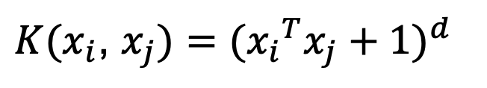
Examples of kernel functions
Linear:
Polynomials of degree up to d:
Gaussian RBF:
Histogram intersection:
$K(x_{i}$, $x_{j})={({x_{i}}^{T}x_{j}+1)}^{d}$
Andrew Moore / Carlos Guestrin

Slide 54
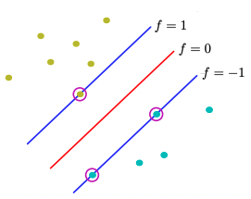
Hard-margin SVMs
The w that minimizes…
Maximize margin

Slide 55
Soft-margin SVMs
# data samples
Misclassification
cost
Slack variable
The w that minimizes…
Maximize margin
Minimize misclassification
Figure from Chris Bishop

Slide 56
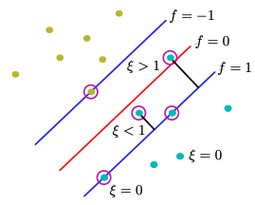
Soft-margin SVMs
ε>1
[Miss-classified points]
ε=0
[Easy to classify]
ε<1
[Points close to decision boundary]
Ideal Case
Figure from Chris Bishop
Notes:
http://www.cs.toronto.edu/~mbrubake/teaching/C11/Handouts/SupportVectorMachines.pdf

Slide 57
Soft-margin SVMs
ε>1
[Miss-classified points]
Slack variables allow:
Certain training points can be within the margin.
We want these number of points as small as possible.
How do we minimize the second term in the optimization?
A lot of examples with ε=0 (easy correctly classified)
Medium quantity of examples with 0<ε<1 (correct classified inside margin)
Few examples with ε>1 (misclassified examples)
ε<1
[Points close to decision boundary]
Figure from Chris Bishop
Notes:
http://www.cs.toronto.edu/~mbrubake/teaching/C11/Handouts/SupportVectorMachines.pdf
We minimize the second term having a lot of e=0, middle portion on 0<e<1, and less in e>1 (misclassified points)

Slide 58
What about multi-class SVMs?
Unfortunately, there is no “definitive” multi-class SVM formulation
In practice, we have to obtain a multi-class SVM by combining multiple two-class SVMs
One vs. others/all
  Training: learn an SVM for each class vs. the others
  Testing: apply each SVM to the test example, and assign it to the class of the SVM that returns the highest decision value
One vs. one
  Training: learn an SVM for each pair of classes
  Testing: each learned SVM “votes” for a class to assign to the test example
Svetlana Lazebnik

Slide 59
Multi-class problems
One-vs-all (a.k.a. one-vs-others)
  Train K classifiers
  In each, pos = data from class i, neg = data from classes other than i
  The class with the most confident prediction wins
  Example:
    You have 4 classes, train 4 classifiers
    1 vs others: score 3.5
    2 vs others: score 6.2
    3 vs others: score 1.4
    4 vs other: score 5.5
    Final prediction: class 2

Slide 60
Multi-class problems
One-vs-one (a.k.a. all-vs-all)
  Train K(K-1)/2 binary classifiers (all pairs of classes)
  They all vote for the label
  Example:
    You have 4 classes, then train 6 classifiers
    1 vs 2, 1 vs 3, 1 vs 4, 2 vs 3, 2 vs 4, 3 vs 4
    Votes: 1, 1, 4, 2, 4, 4
    Final prediction is class 4

Slide 61
Using SVMs
Select a kernel function.
Compute pairwise kernel values between labeled examples.
Use this “kernel matrix” to solve for SVM support vectors & alpha weights.
To classify a new example: compute kernel values between new input and support vectors, apply alpha weights, check sign of output.
Adapted from Kristen Grauman

Slide 62
Some SVM packages
LIBSVM http://www.csie.ntu.edu.tw/~cjlin/libsvm/
LIBLINEAR https://www.csie.ntu.edu.tw/~cjlin/liblinear/
SVM Light http://svmlight.joachims.org/
Scikit Learn https://scikit-learn.org/stable/modules/svm.html

Slide 63
Linear classifiers vs nearest neighbors
Linear pros:
  Low-dimensional parametric representation
  Very fast at test time
Linear cons:
  Can be tricky to select best kernel function for a problem
  Learning can take a very long time for large-scale problem
NN pros:
  Works for any number of classes
  Decision boundaries not necessarily linear
  Nonparametric method
  Simple to implement
NN cons:
  Slow at test time (large search problem to find neighbors)
  Storage of data
  Especially need good distance function (but true for all classifiers)
Adapted from L. Lazebnik

Slide 64

Lab 5: SVM
Duration: 30 min
Use JPEG, PNG and GIF files less than 15 MB [ahaslides]

Slide 65
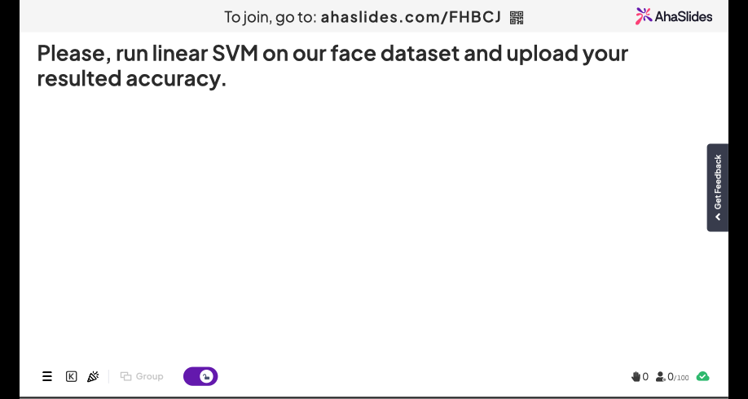
65

Slide 66
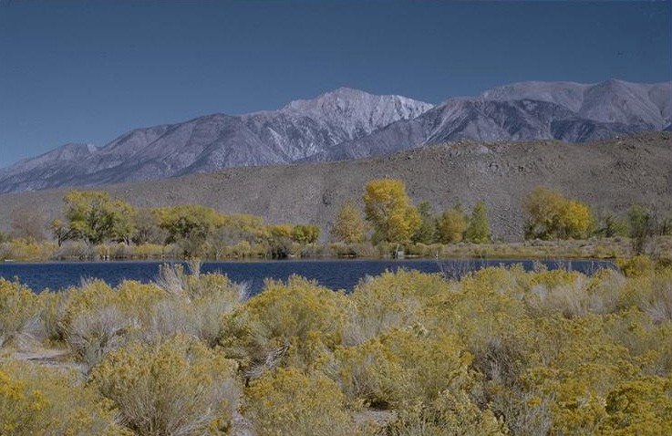
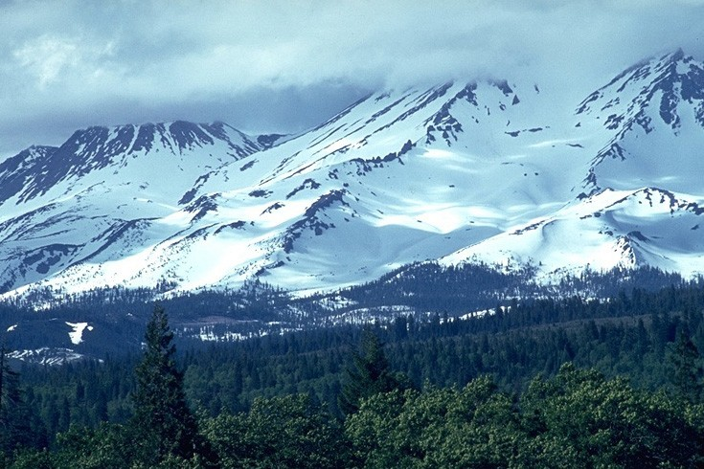
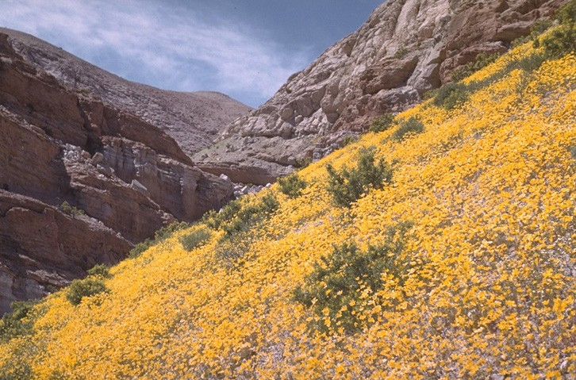
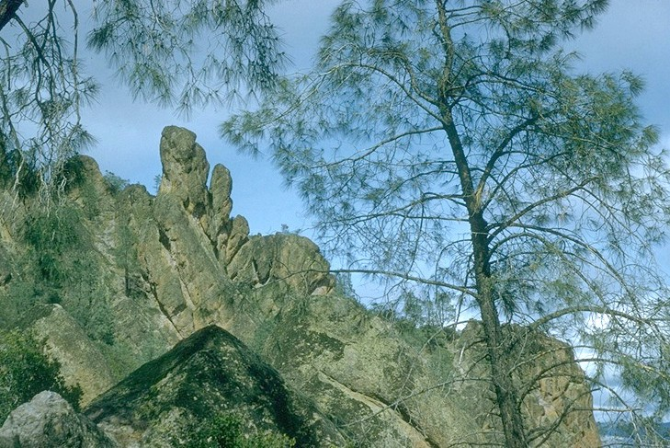
Beyond Bags of Features: Spatial Pyramid Matching for Recognizing Natural Scene Categories
CVPR 2006
Svetlana Lazebnik (slazebni@uiuc.edu)
Beckman Institute, University of Illinois at Urbana-Champaign
Cordelia Schmid (cordelia.schmid@inrialpes.fr)
INRIA Rhône-Alpes, France
Jean Ponce (ponce@di.ens.fr)
Ecole Normale Supérieure, France
Winner of 2016 Longuet-Higgins Prize

Slide 67
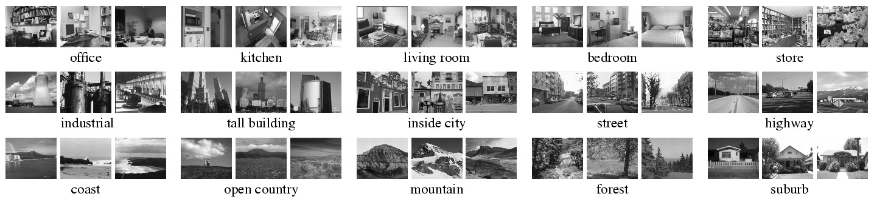
Scene category dataset
Fei-Fei & Perona (2005), Oliva & Torralba (2001)
http://www-cvr.ai.uiuc.edu/ponce_grp/data
Slide credit: L. Lazebnik

Slide 68
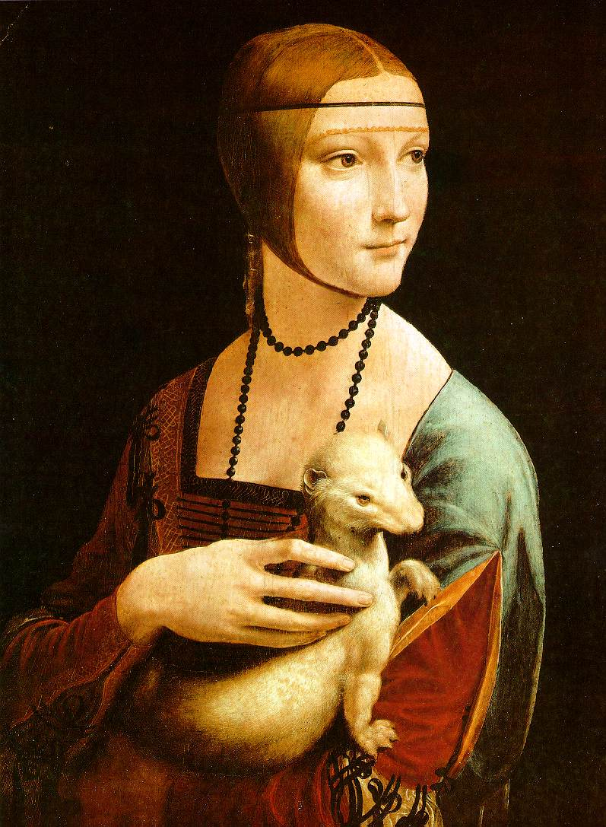
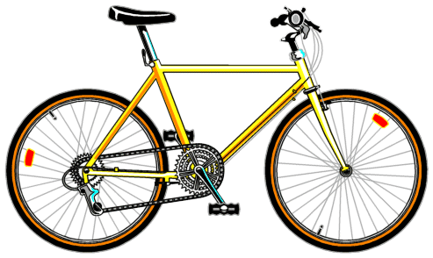
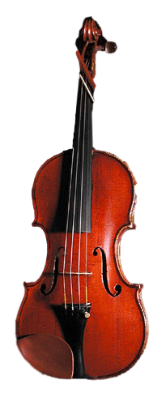
Bag-of-words representation
Extract local features
Learn “visual vocabulary” using clustering
Quantize local features using visual vocabulary
Represent images by frequencies of “visual words”
Slide credit: L. Lazebnik

Slide 69
Image categorization with bag of words
Training
Compute bag-of-words representation for training images
Train classifier on labeled examples using histogram values as features
Labels are the scene types (e.g. mountain vs field)
Testing
Extract keypoints / descriptors for test images
Quantize into visual words using the clusters computed at training time
Compute visual word histogram for test images
Compute labels on test images using classifier obtained at training time
Evaluation only, do only once: Measure accuracy of test predictions by comparing them to ground-truth test labels (obtained from humans)
Adapted from D. Hoiem

Slide 70

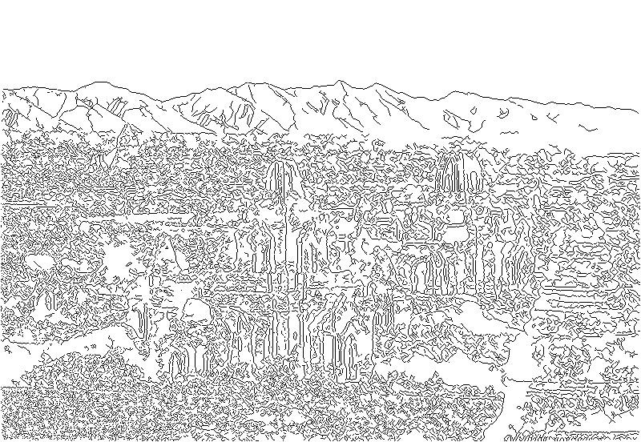
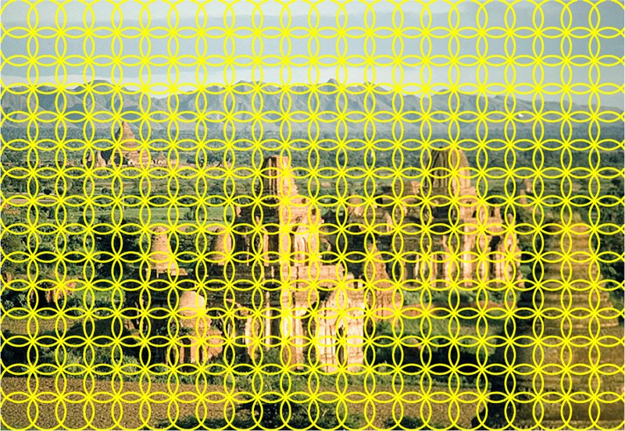
Feature extraction (on which BOW is based)
Weak features
Strong features
Edge points at 2 scales and 8 orientations (vocabulary size 16)
SIFT descriptors of 16x16 patches sampled on a regular grid, quantized to form visual vocabulary (size 200, 400)
Slide credit: L. Lazebnik

Slide 71
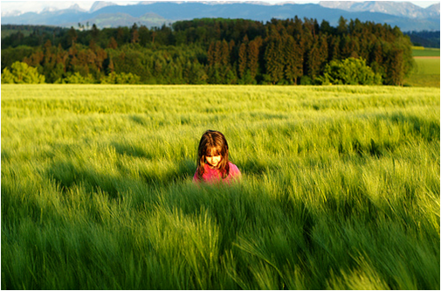
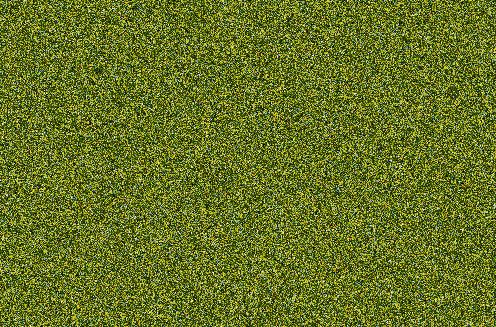
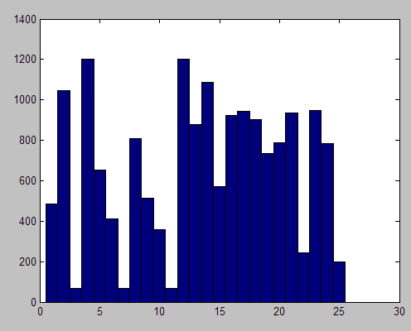
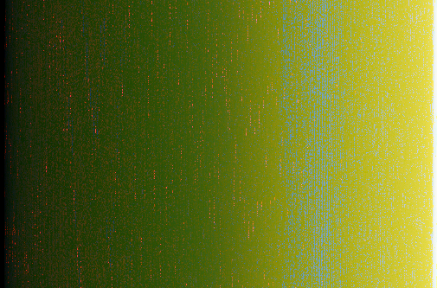
What about spatial layout?
All of these images have the same color histogram
Slide credit: D. Hoiem
Notes:
So far, global histogram over the whole image discard spatial information
Images contain structures and looking at a scene spatial distribution of feature we want to capture but we throw them away
Result in the fact that I can construct a very different image and still get the same histogram
This image is obvious a scene on grassland but with the noisy and gradient image on the bottom, color histogram

Slide 72
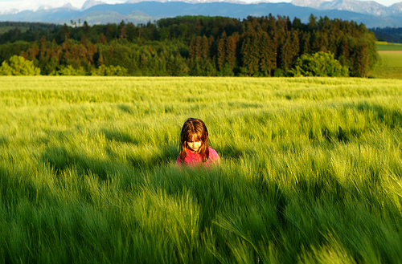
Spatial pyramid
Compute histogram in each spatial bin
Slide credit: D. Hoiem
Notes:
Overcome this, global, pyramid of histogram
Split into spatial bins at several levels and compute the histogram in each of them

Slide 73
Spatial pyramid
[Lazebnik et al. CVPR 2006]
Slide credit: D. Hoiem
Notes:
In more details, we still have the global histogram, but then I also have histograms computed in this 2x2 grid and histogram computed in 4x4 grid
Each of the histograms are individual normalized. They are weighted because you want each level to have equal weights, and combined together.
This spatial pyramid bag of bow is often considered as the goto feature to image categorization, works best for scenes, also works for most object.
One critism high dimensionality and you can deal with by doing PCA dimension reduction

Slide 74
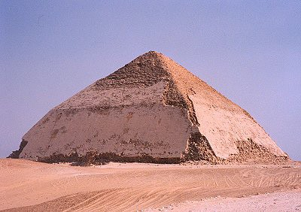
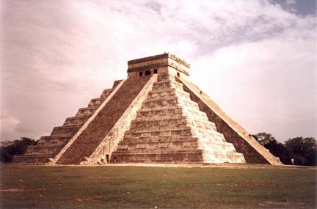
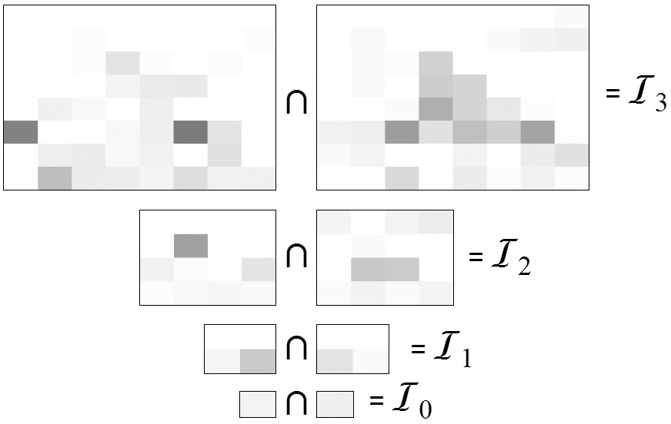
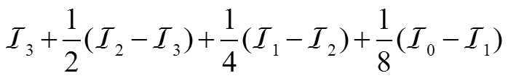
Pyramid Matching
[Indyk & Thaper (2003), Grauman & Darrell (2005)]
x_{i}
x_{j}
Matching using pyramid and histogram intersection for some particular visual word:
Original images
Feature histograms: Level 3
Level 2
Level 1
Level 0
Total weight (value of pyramid match kernel):
K( x_{i} , x_{j} )
Adapted from L. Lazebnik

Slide 75
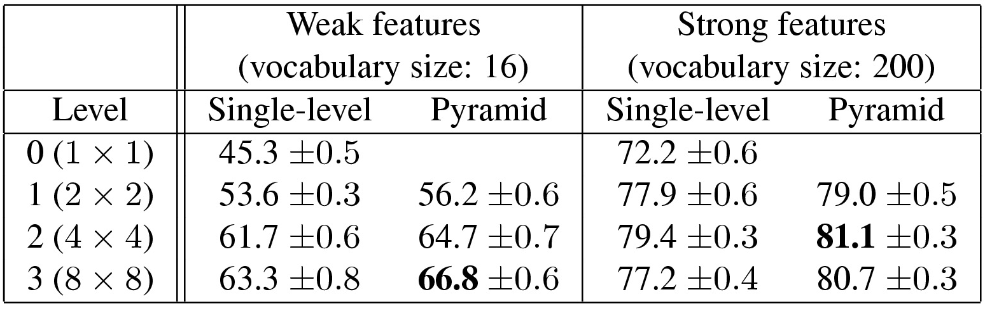
Scene category dataset
Fei-Fei & Perona (2005), Oliva & Torralba (2001)
http://www-cvr.ai.uiuc.edu/ponce_grp/data
Multi-class classification results (100 training images per class)
Fei-Fei & Perona: 65.2%
Slide credit: L. Lazebnik

Slide 76
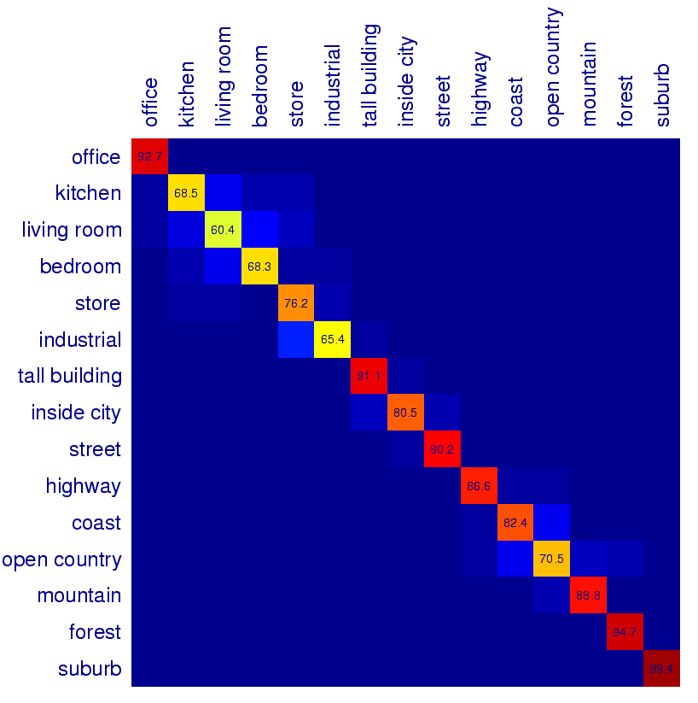
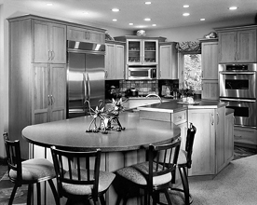


Scene Category Confusion Matrix
Predictions
Ground Truth
Difficult indoor images
kitchen
living room
bedroom
Slide credit: L. Lazebnik

Slide 77















Caltech101 dataset
Fei-Fei et al. (2004)
http://www.vision.caltech.edu/Image_Datasets/Caltech101/Caltech101.html
Multi-class classification results (30 training images per class)
Slide credit: L. Lazebnik

Slide 78
Evaluation Metrics: Credit Card Fraud
!
!
!
284,335
472
Model: All transactions are good.
284,335
Correct = = 99.83%
284,807
Slide Credit: Prof. Sandra Avila - UNICAMP

Slide 79
Evaluation Metrics: Credit Card Fraud
!
!
!
284,335
472
Model: All transactions are good.
Problem: I’m not catching any of the bad ones!
Slide Credit: Prof. Sandra Avila - UNICAMP

Slide 80
Evaluation Metrics: Credit Card Fraud
!
!
!
284,335
472
Model: All transactions are fraudulent.
Problem: I’m accidently catching all the good ones!
Slide Credit: Prof. Sandra Avila - UNICAMP

Slide 81



Evaluation Metrics: Spam Classifier Model
Not Spam
Spam
Slide Credit: Prof. Sandra Avila - UNICAMP

Slide 82
Evaluation Metrics: Confusion Matrix Table
Predictions
Sent to Spam Folder
Sent to Inbox
Annotations
Spam
True Positive
False Negative
Not Spam
False Positive
True Negative
Slide Credit: Prof. Sandra Avila - UNICAMP

Slide 83

Type I Error (False Positive)
Type II Error (False Negative)
You’re not pregnant.
You’re pregnant.
Slide Credit: Prof. Sandra Avila - UNICAMP

Slide 84
Evaluation Metrics: Confusion Matrix Table
Folder
 | Spam Folder | Inbox
Spam | 100 | 170
Not Spam | 30 | 700
1,000 emails
Email
Slide Credit: Prof. Sandra Avila - UNICAMP

Slide 85
Evaluation Metrics: Confusion Matrix Table
Prediction
 | Guessed Positive | Guessed Negative
Positive
Negative
Data
Slide Credit: Prof. Sandra Avila - UNICAMP

Slide 86
Evaluation Metrics: Confusion Matrix Table
Prediction
 | Guessed Positive | Guessed Negative
Positive | 6 True positives
Negative
Data
Slide Credit: Prof. Sandra Avila - UNICAMP

Slide 87
Evaluation Metrics: Confusion Matrix Table
Prediction
 | Guessed Positive | Guessed Negative
Positive | 6 True positives
Negative |  | 5 True negatives
Data
Slide Credit: Prof. Sandra Avila - UNICAMP

Slide 88
Evaluation Metrics: Confusion Matrix Table
Prediction
 | Guessed Positive | Guessed Negative
Positive | 6 True positives | 1 False negative
Negative |  | 5 True negatives
Data
Slide Credit: Prof. Sandra Avila - UNICAMP

Slide 89
Evaluation Metrics: Confusion Matrix Table
Prediction
 | Guessed Positive | Guessed Negative
Positive | 6 True positives | 1 False negative
Negative | 2 False positives | 5 True negatives
Data
Slide Credit: Prof. Sandra Avila - UNICAMP

Slide 90
Evaluation Metrics: Confusion Matrix Table (n classes)
Class 1:
Class 2:
Class 3:
Slide Credit: Prof. Sandra Avila - UNICAMP

Slide 91
Evaluation Metrics: Confusion Matrix Table (n classes)
Class 1:
Class 2:
Class 3:
Predicted Class
 | Guessed Class 1 | Guessed Class 2 | Guessed Class 3
Class 1
Class 2
Class 3
True Class
Slide Credit: Prof. Sandra Avila - UNICAMP

Slide 92
Evaluation Metrics: Confusion Matrix Table (n classes)
Class 1:
Class 2:
Class 3:
Predicted Class
 | Guessed Class 1 | Guessed Class 2 | Guessed Class 3
Class 1 | 5 | 2 | 1
Class 2 | 3 | 6 | 0
Class 3 | 0 | 1 | 7
True Class
Slide Credit: Prof. Sandra Avila - UNICAMP

Slide 93

Evaluation Metrics: Accuracy
Diagnosis
 | Diagnosed Sick | Diagnosed Healthy
Sick | 1,000 | 200
Healthy | 800 | 8,000
Patients
Slide Credit: Prof. Sandra Avila - UNICAMP

Slide 94
Evaluation Metrics: Accuracy
Diagnosis
Accuracy:
Out of all the patients, how many did we classify correctly?
 | Diagnosed Sick | Diagnosed Healthy
Sick | 1,000 | 200
Healthy | 800 | 8,000
Patients
Slide Credit: Prof. Sandra Avila - UNICAMP

Slide 95
Evaluation Metrics: Accuracy
Diagnosis
Accuracy:
Out of all the patients, how many did we classify correctly?
 | Diagnosed Sick | Diagnosed Healthy
Sick | 1,000 | 200
Healthy | 800 | 8,000
Accuracy =
1,000 + 8,000
Patients
Slide Credit: Prof. Sandra Avila - UNICAMP

Slide 96
Evaluation Metrics: Accuracy
Diagnosis
Accuracy:
Out of all the patients, how many did we classify correctly?
 | Diagnosed Sick | Diagnosed Healthy
Sick | 1,000 | 200
Healthy | 800 | 8,000
Accuracy =
1,000 + 8,000
10,000
Patients
= 90%
Slide Credit: Prof. Sandra Avila - UNICAMP

Slide 97
Evaluation Metrics: Accuracy
Folder
Accuracy:
Out of all the emails, how many did we classify correctly?
 | Spam Folder | Inbox
Spam | 100 | 170
Not Spam | 30 | 700
Email
Slide Credit: Prof. Sandra Avila - UNICAMP

Slide 98
Evaluation Metrics: Accuracy
Folder
Accuracy:
Out of all the emails, how many did we classify correctly?
 | Spam Folder | Inbox
Spam | 100 | 170
Not Spam | 30 | 700
Accuracy =
100 + 700
1,000
Email
= 80%
Slide Credit: Prof. Sandra Avila - UNICAMP

Slide 99

Summary
Visual Classification
Models
  K-Nearest Neighbor
  Suppor Vector Machines (SVM)
Spatial Pyramid Feature Extractor
Evaluation Metrics

